Slide 1
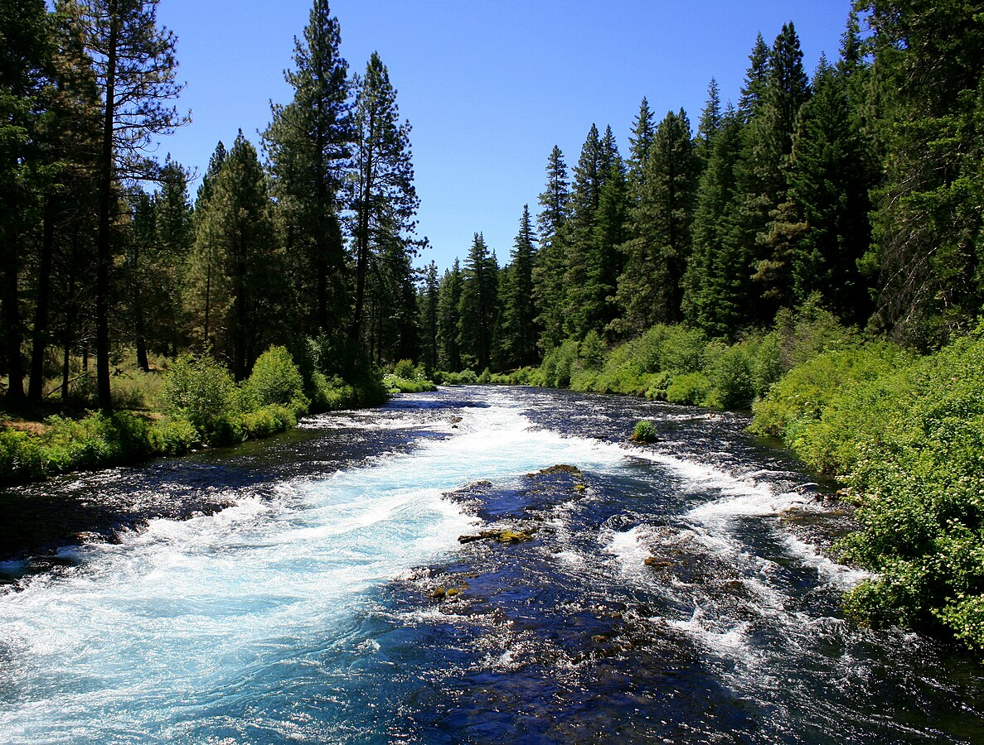
Adaptation to Natural Flow Regimes
David A. Lytle and N. LeRoy Poff
TRENDS in Ecology and Evolution Vol.19 No.2 February 2004
DROP Clarisse
VAES Daïna
BONNER Evie
Notes:
EVIE
Hello everybody

Slide 2
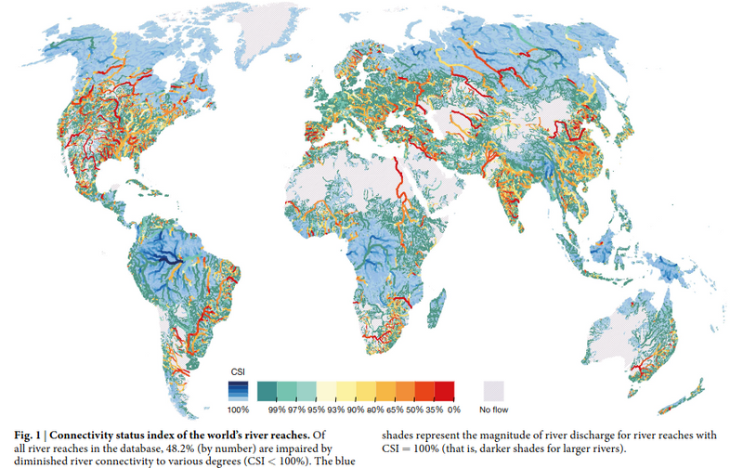

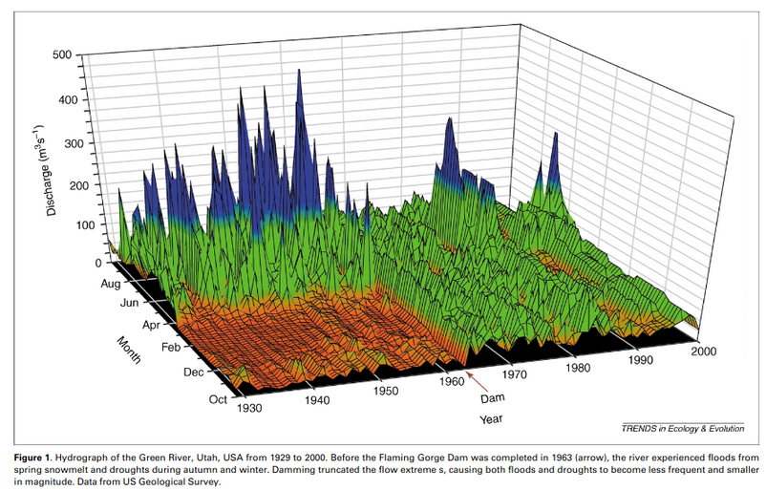
Flood and drought cycles in running water ecosystems are an essential component of the ecosystems.
Organisms have evolved to adapt to the natural flow regime.
Natural flow regime is being altered dramatically by human acitivities (dams, flood control).
how will these drought/flood adapted organisms be affected by these altered flow regimes ?
Top figure : Grill, G., Lehner, B., Thieme, M. et al. Mapping the world’s free-flowing rivers. Nature 569, 215–221 (2019). https://doi.org/10.1038/s41586-019-1111-9
Bottom figure : Lytle, D. & Poff, N. Adaptation to Natural Flow Regimes. Trends in ecology & evolution. 19. 94-100 (2004). 10.1016/j.tree.2003.10.002.
Notes:
EVIE
Natural disturbances are integral components of ecosystems
In running water ecosystems, part of these natural disturbances are historic flood/drought cycles (natural flow regime paradigm)
Organisms evolve to adapt to these changes in the flow regime
However, this natural flow regime is being altered dramatically by human acitivities (dams, flood control).
Raises the question :
how will these drought/flood adapted organisms be affected by these altered flow regimes ?
What are their specific adaptations allow them to survive the natural flow regime ?
How rapidly can they evolve to adapt to the new altered flow regime?
The paper explores the implications that the different modes of adaptation could have on conservation efforts in flow altered rivers

Slide 3

C
CROSS-SPECIES COMPARAISONS
Examine traits across multiple species to understand their link to specific environments.
G
E
GRADIENTS
METHODS
EXPERIMENTS
Evaluate species performance across varying flow regimes to understand their tolerance to flow variability.
Use controlled experiments to directly measure how species respond to specific flow conditions.

Slide 4
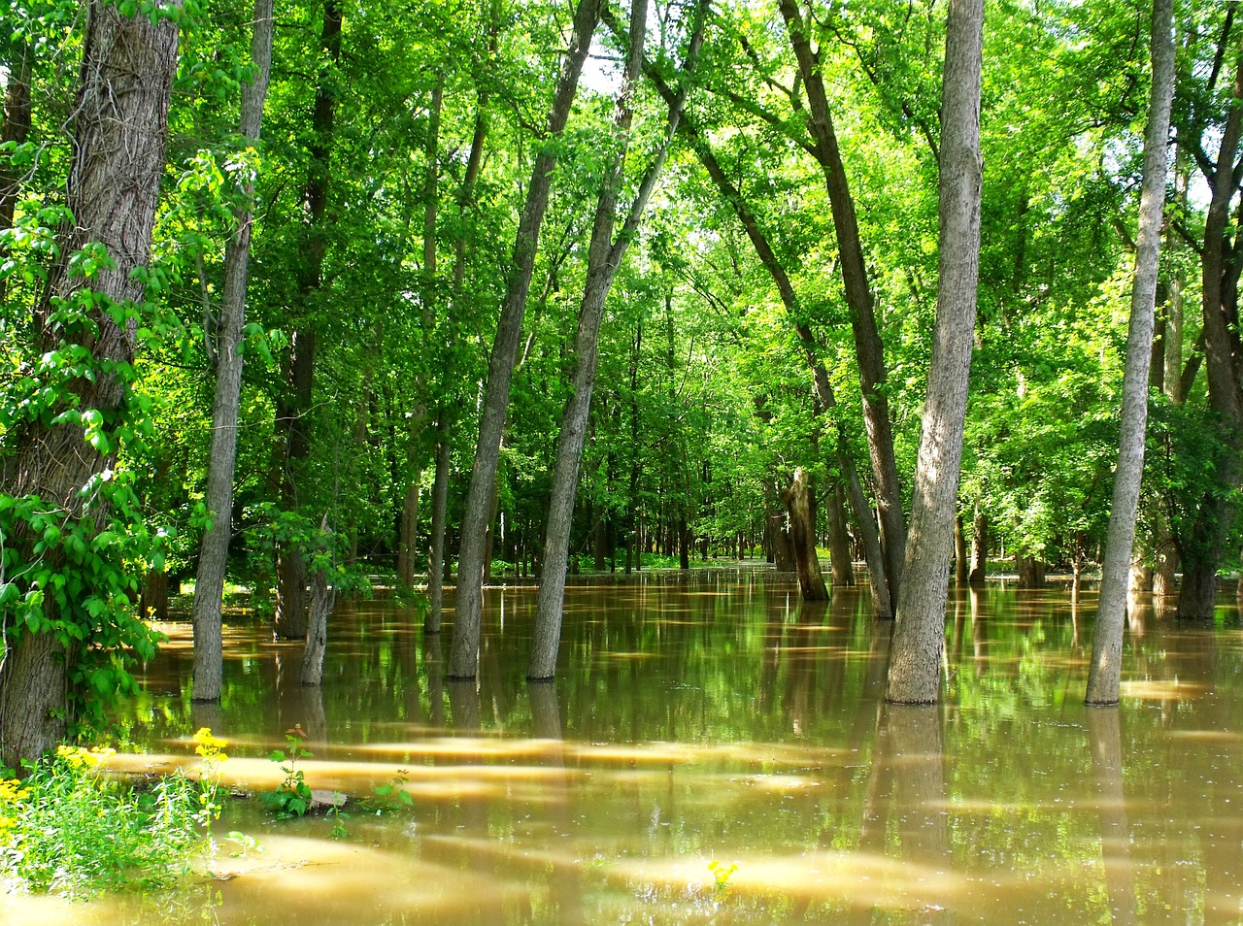
Different modes of adaptation
1) Life history
2) Behavioral
3) Morphological

Slide 5

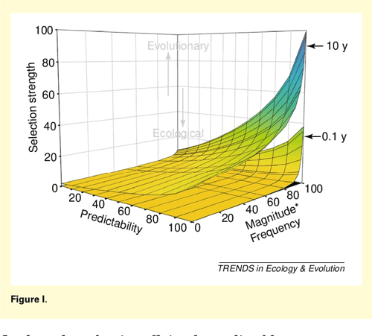
Life-history adaptations
Ideal germination conditions
Optimal egg-laying timing
Bet-hedging strategy
Examples
Synchronization of life-cycle events with the occurence of flow regime events

Slide 6

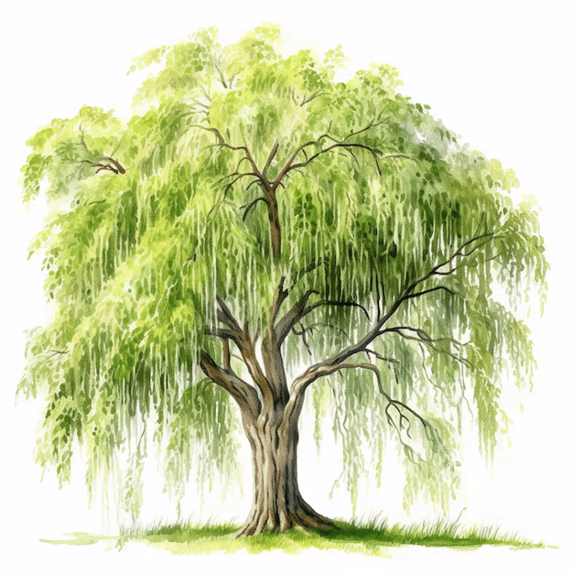
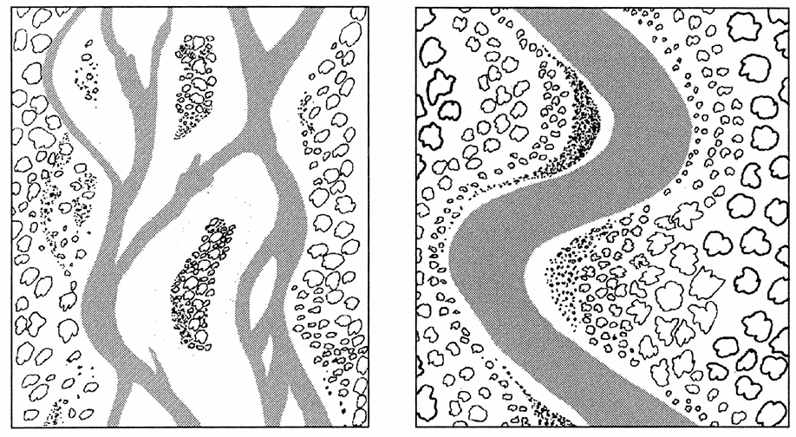

Ideal germination conditions
Life-history adaptations
Salicaceae
Optimal egg-laying timing
Seed release synchronised with timing of spring-flood recession moisture
Bet-hedging strategy
Late floods can remove seedlings
Braided
Meandering

Slide 7
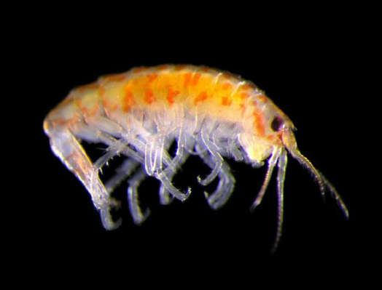
Ideal germination conditions
Life-history adaptations
Optimal egg-laying timing
Bet-hedging strategy
Egg-laying synchronised with seasonal low flows
Protected eggs from disturbance
Access to food + oxygen by larvae
Gammarid amphipod
Increased survivorship of young

Slide 8
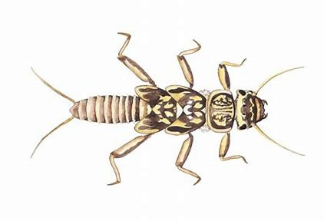
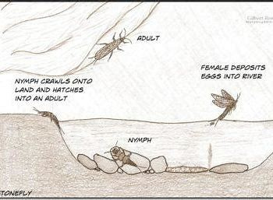


Stoneflies
Life-history adaptations
Ideal germination conditions
Optimal egg-laying timing
Bet-hedging = parent produces different offspring types corresponding to diverse environmental states
Bet-hedging strategy
Temperature threshold for egg hatching varies among indivduals
Variable flood regimes influence asynchronous hatching
Adaptation to an unstable environment

Slide 9
Different modes of adaptation
1) Life history
2) Behavioral
3) Morphological

Slide 10
Behavioural adaptations
Enable animals to respond directly to individual floods/droughts
Organisms respond to external cues
Reduced flood mortality of eggs
Optimal hatch timing
Flash flood
avoidance
Examples
Notes:
Evie
Enable animals to respond directly to individual floods/droughts
Organisms respond to external cues
->might be able to respond to flow event outside of usual timing, frequency or magnitude
these are examples of the benefits they can have

Slide 11
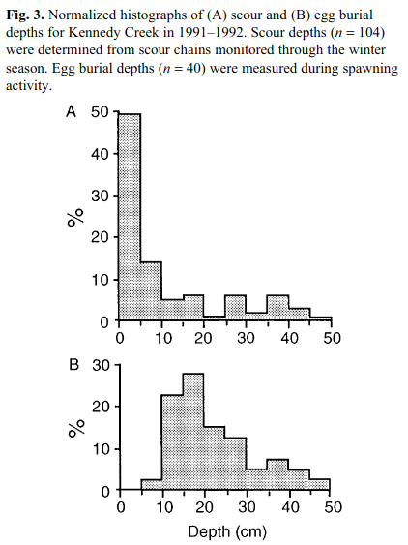
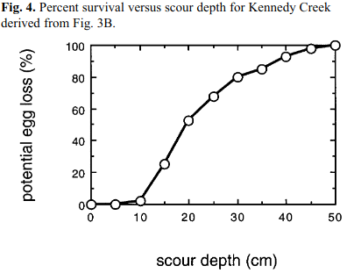
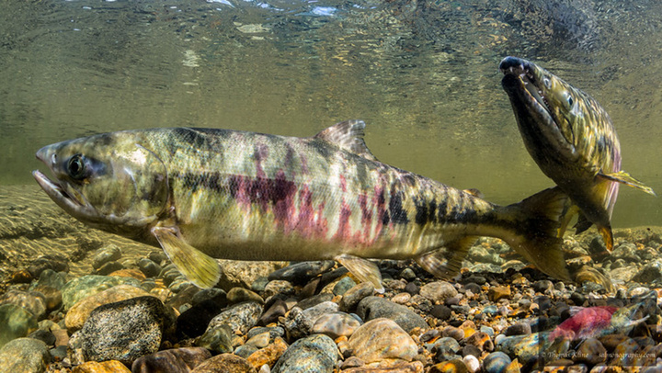
Behavioural adaptations
Reduced flood mortality of eggs
Chum Salmon
Egg burial depth in function of scour depth in stream
Optimal hatch timing
Flash flood
avoidance
Examples
D R Montgomery, J M Buffington et al. 1996. Stream-bed scour, egg burial depths, and the influence of salmonid spawning on bed surface mobility and embryo survival. Canadian Journal of Fisheries and Aquatic Sciences. 53(5): 1061-1070.
Notes:
Evie
The correlation between the scour depth and egg burial depth
Benefit : reduced risk of the eggs being swept away/crushed with the scour
however a cost : energetic, risk of not burying deep enough/too deep
sedimaent load also increases scour depth !
positive feedback loop -> ecosystem engineers

Slide 12
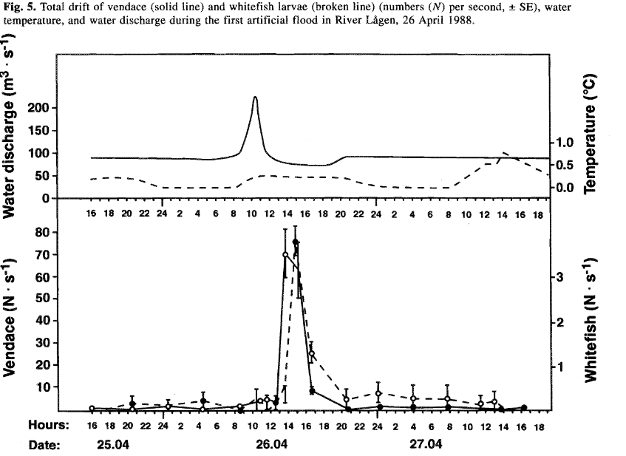
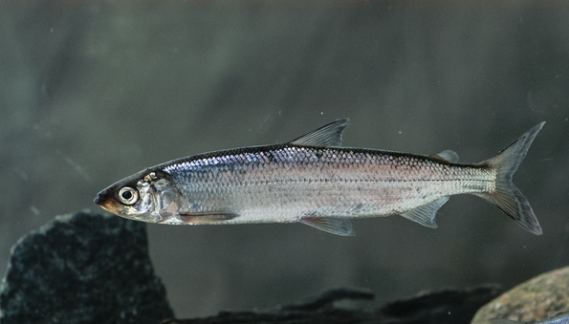
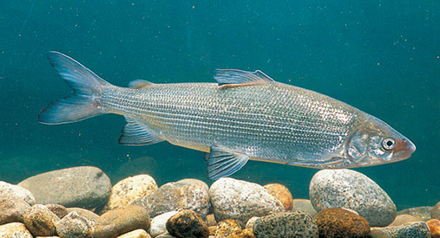
Behavioural adaptations
Reduced flood mortality of eggs
Coregonninae fish subfamily
Egg hatching is cued by spring floods
Optimal hatch timing
Flash flood
avoidance
Examples
The eggs hatch when an abundance of prey is expected !
Næsje, Tor & Jonsson, Bror & Skurdal, Jostein. (1995). Spring flood: A primary cue for hatching of river spawning Coregoninae. Canadian Journal of Fisheries and Aquatic Sciences. 52. 2190-2196. 10.1139/f95-811.
Notes:
Evie
length of hatching period is negatively correlated w increase in water discharge ->
higher discharge, shorter hatching time
larvae have to start feeeding quickly after hatching -> after the ice melt!!! more prey, bettter hunting conditions
early or delyed hatching due to alteration of flow regime ! hatching during period with less available prey

Slide 13
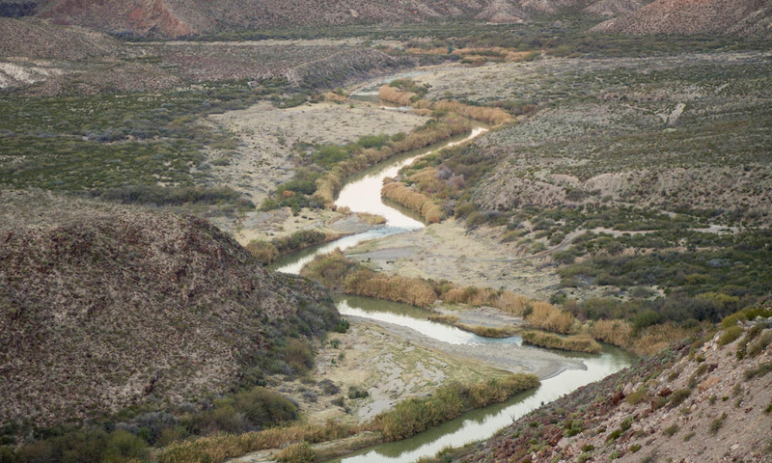
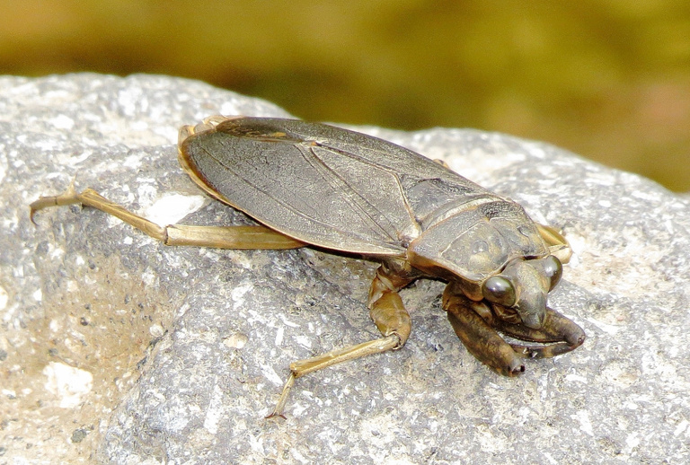
Behavioural adaptations
Reduced flood mortality of eggs
Giant waterbugs
Use periods of torrential rainfall that preceed floods as a cue to leave the stream.
Optimal hatch timing
Flash flood
avoidance
Examples
low mortality from flash floods!
Notes:
Evie
Giant waterbugs
Use periods of torrential rainfall that preceed floods as a cue to leave the stream.
low mortality in flash floods compared to other aquatic inverbrates !
risk : could fail to react if flood is caused by distant storm, predation in terrestrial environnment
or could react to rain fall that doesnt create big flash flood bc of res/ dam upstream eg

Slide 14
Different modes of adaptation to flow regime events
1) Life history
2) Behavioral
3) Morphological

Slide 15

Body shapes that reduce drag during floods
Morphological adaptations
Mechanical Devices for Shedding Vegetative Growth
Physical features or structural changes in an organism's body that enhance its ability to survive and thrive in its environment.
Adaptations evolve over time through natural selection and are suited to specific environmental challenges.
Allocation of biomass to different organs

Slide 16

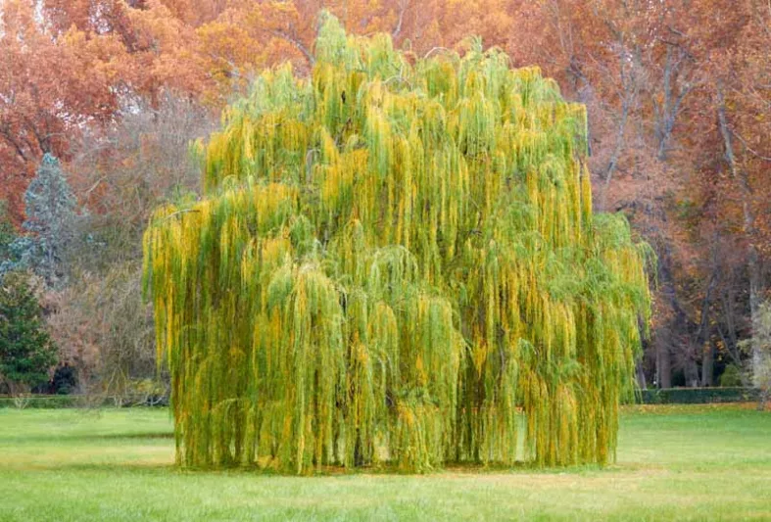
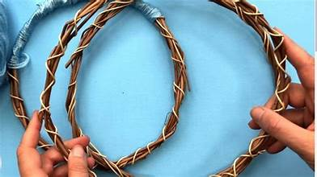
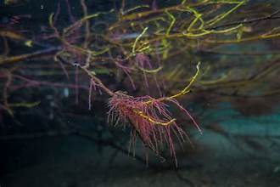
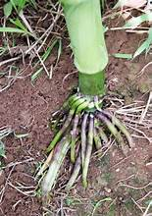
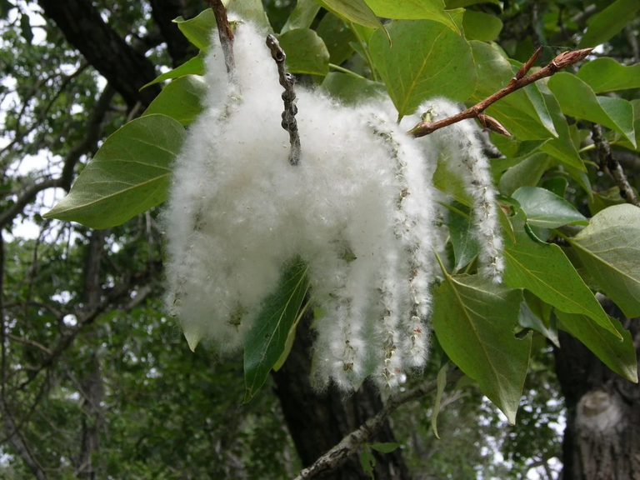
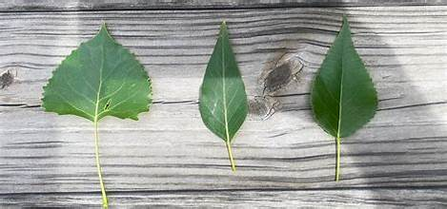

Body shapes that reduce drag during floods
Willows and Cottenwoods
Mechanical Devices for Shedding Vegetative Growth
Allocation of biomass to different organs
Ability to withstand floods.

Slide 17
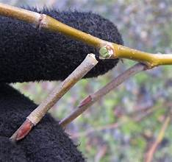
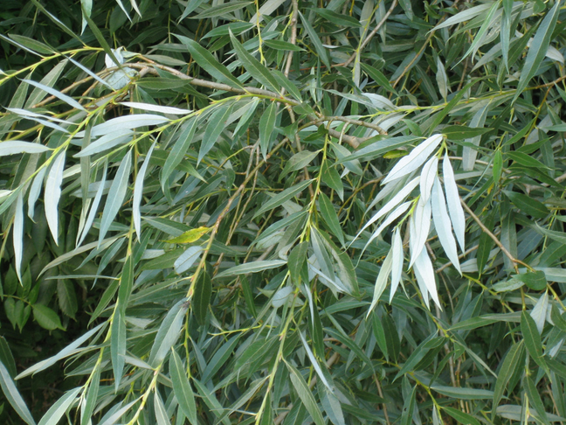
Body shapes that reduce drag during floods
Crack willow and other Salix spp., aquatic buttercup
Mechanical Devices for Shedding Vegetative Growth
Allocation of biomass to different organs
Protection of root and trunk biomass
Dispersal by floodborne fragments
Loss of biomass
Notes:
Brittle twig bases : Bases de brindilles fragiles qui permettent aux tiges vivantes de se libérer

Slide 18
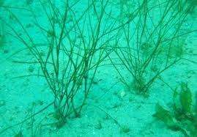
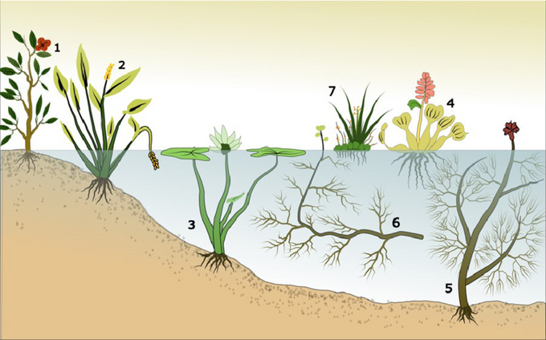
Body shapes that reduce drag during floods
Aquatic macrophytes
Mechanical Devices for Shedding Vegetative Growth
Allocation of biomass to different organs
Anchorage during flooding
Ability to resprout from roots
Possible reduction in
aboveground biomass, reduced dispersal by flood-borne fragments

Slide 19
Discussion
Crucial flooding/drought events for organisms
Critical survival with alterations
Can populations keep evolutionary pace with the current rates of changes ?

Slide 20
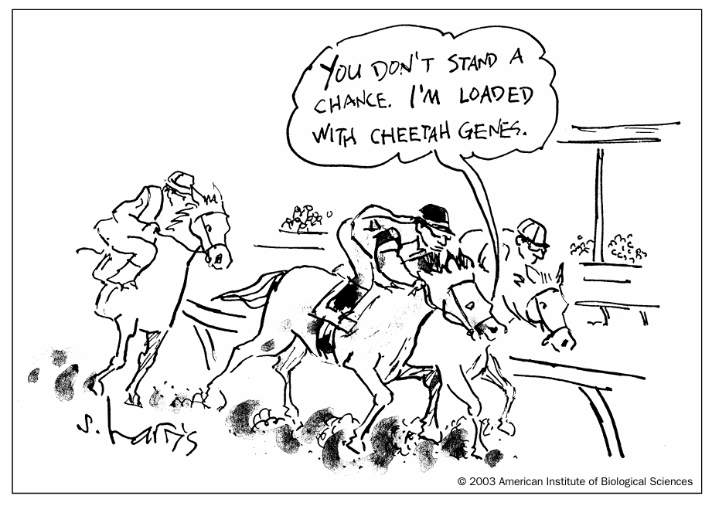
Questions ?
Notes:
CONCLUSION/DISCUSSION
CLARISSE

