Slide 1
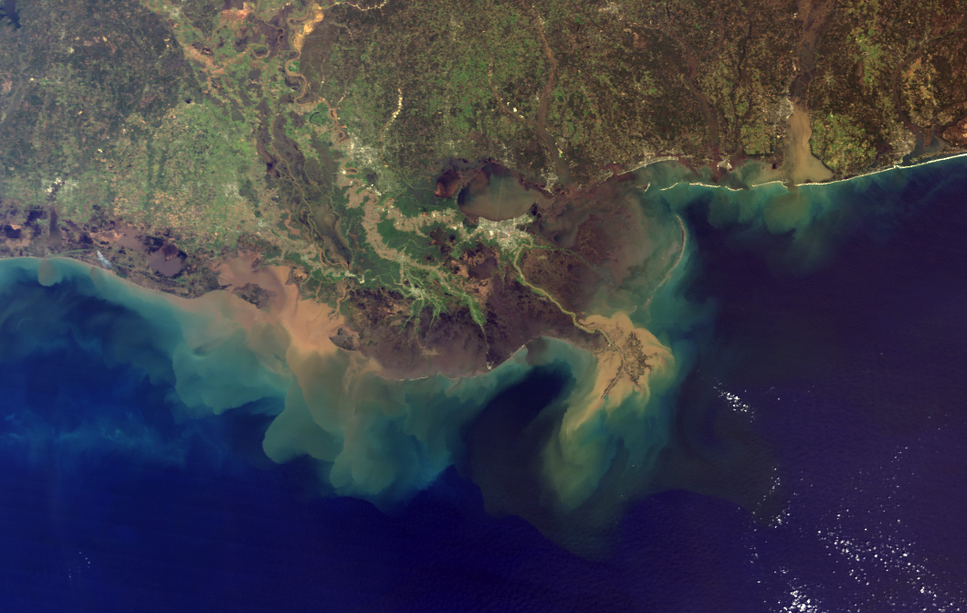
Rapid changes to global river suspended sediment flux by humans
Inès Laury
Quentin Poindextre
Lorenzo Prato
Marzhan Zhailau
09/10/2024
ENV - 512

Slide 2




Agenda
INTRODUCTION
METHODS
RESULTS
DISCUSSION

Slide 3
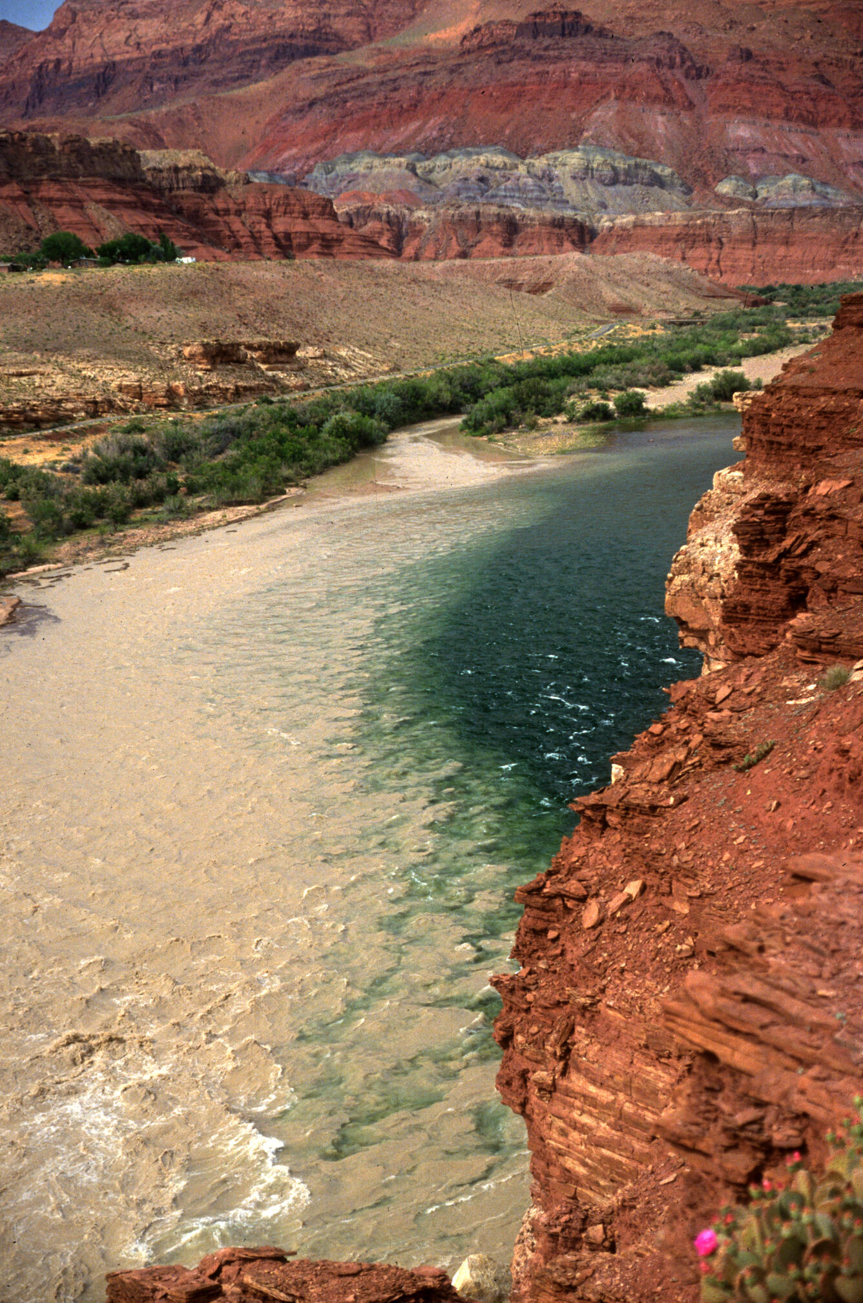
Introduction
River basins are under threat from land-use changes, dam construction, and climate change effects.
Lack of monitoring makes it difficult to assess and predict sediment flux impacts in river basins globally.
The study examines sediment flux changes in 414 rivers using satellite data and 130,000+ ground measurements.

Slide 4
Hypothesis
Human activities, such as dam construction and land-use changes, alter sediment flux in major rivers, disrupting sediment delivery patterns and impacting riparian habitats, wetland stability, nutrient flow to oceans, and coastal resilience to sea-level rise.
​

Slide 5
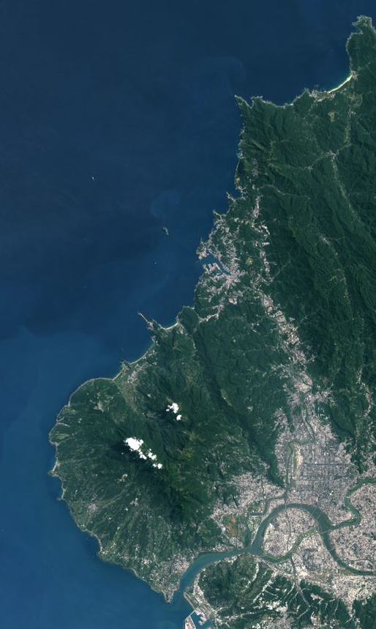

Methods
Data collection approach
414 majors rivers all over the world
Datas from 1984 to 2022
Algorithms trained with 130'000 ground truth measurements
Used Landsat 5 and 7 archive

Slide 6
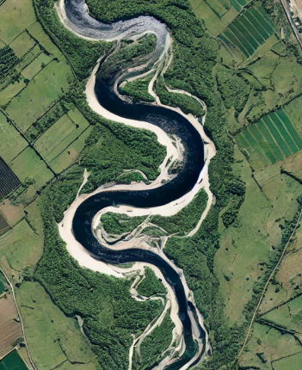

Methods
Algorithm and tools
Estimation of suspended sediment concentration (SSC) for each water river pixel
Monthly record of SSC for each river
SSC estimates combined with river discharge data ot compute the sediment flux

Slide 7
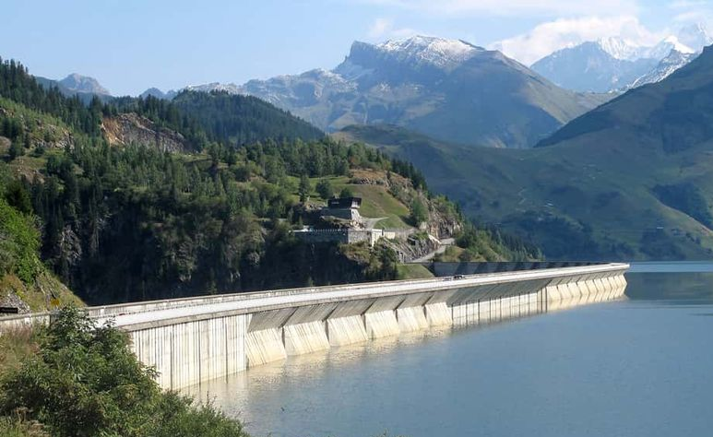
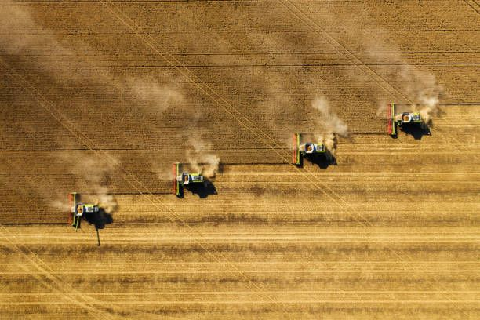
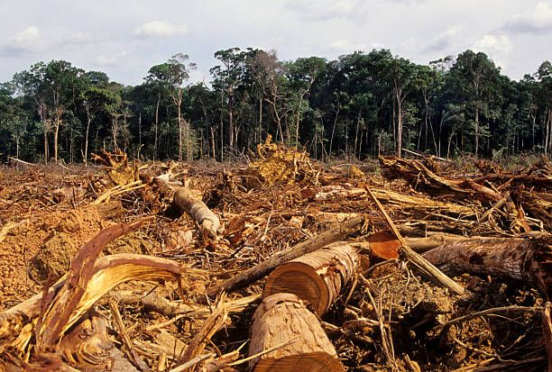
Methods
Key focus areas
Analyzed spacial and temporal variability : global pattern
Assessed the effect of damming (North)
Focus on intensive land-use changes (South)

Slide 8
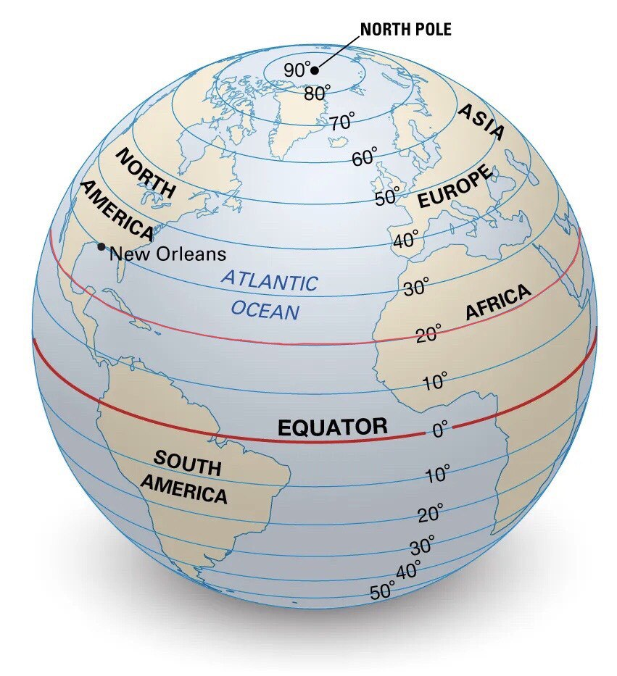
Results
Signficant trends in suspended sediment flux over the pas 40 years:
53% of the rivers involved in the study showed notable change in sediment transport
Overall decrease in the global hydrological North (north of 20°N)
Overall increase in the global hydrological South (south of 20°N)
Notes:
So, what did these measurements find?
Global river sediment flux is rapidly changing, and it found some pretty significant trends over the past 40 years. To give you an idea of the scope, about 53% of the rivers involved showed notable changes in sediment transport. While many rivers still maintain some of their natural variability, especially in terms of how sediment flux increases with discharge, human activities have caused major disruptions.
The study points out two contrasting effects on sediment transport due to human influence:
- Overall decrease in the global hydrological North (north of 20°N)
Overall increase in the global hydrological South (south of 20°N)

Slide 9
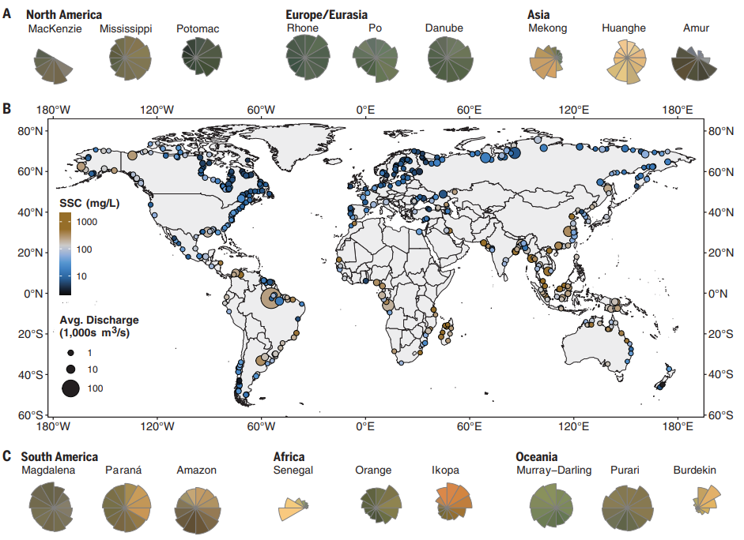
Results
(A and C) Variation in suspended sediment is shown with color wheels for select rivers from each primary landmass. Each wheel displays the monthly patterns in average river true color in Landsat imagery, by using the average red-green-blue (RGB) reflectance at the river outlet (supplementary materials, materials, and methods).
1 January is at the top of each wheel, and each section of the wheel is scaled by monthly average discharge normalized by average peak monthly discharge for that river.
Missing sections indicate ice-in season for high-latitude rivers.
(B) Global map of average discharge-weighted SSC for 414 major rivers shows global patterns in SSC.
Symbols are scaled by average annual discharge.
Notes:
Here we can see how suspended sediments concentration varies in global hydrologic north and south. The size of each dot is proprtional to the average annual discharge of the river. The wheels shows variation in suspended sediments concentration with river true color given by Landsat imagery, by using reflectance at the river outlet. Each section of the wheel is scaled by monthly average discharge of the river normalized by the peak monthly discharge.
From the map, we can therefore notice how in the global hydrologic south suspended sediment discharge is higher than in the north, because of the brownish colors in the wheels combined with a higher discharge.

Slide 10
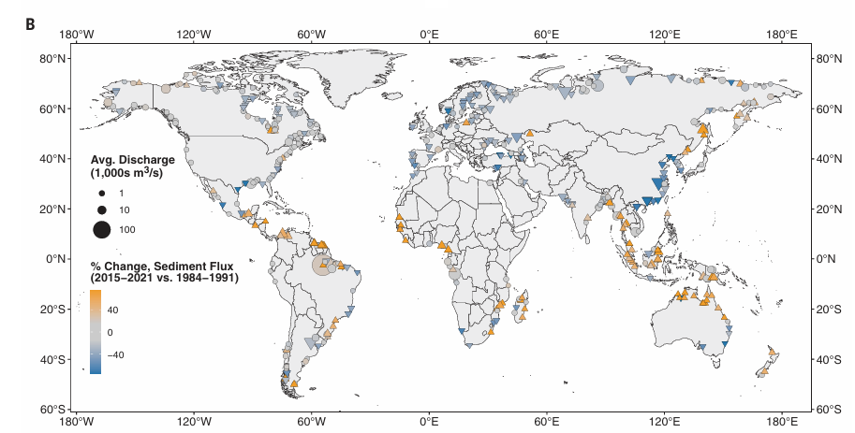
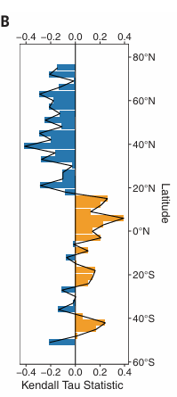
Results
(1B) Rivers with: Increasing suspended sediment flux (upward-pointing triangles),Declining suspended sediment flux (downward-pointing triangles) ;Rivers with no statistically significant change (circles).
(2B) Latitudinal variation in sediment flux trends, with the Mann-Kendall Tau statistic averaged for every river within 3° latitude bins, shows a global divergence, with:major increases south of 20°N, decreases north of 20°N.
Notes:
This map is different from the one showed earlier because it shows the trend of suspended sediment flux in the global hydrologic south and north. Upward triangles means increasing flux while downward triangles means decreasing flux. Circles indicates rivers with no drastic changes.
The graph on the right shows a statistic trend in sediment flux, with an overall decrease at the north of 20°N and an overall increase at the south of the same latitude.

Slide 11
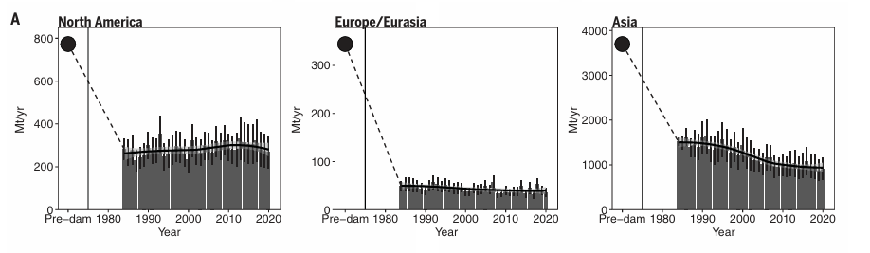
Results – Global hydrologic north
Systematic declines in suspended sediment flux from rivers :
58% of the rivers in the study have at least one dam; 78% of those shows this trend
Overall reduction of about 49% in sediment flux at a continental scale
(A)Changes for northern rivers relative to pre-dam fluxes estimated for those rivers(11).Annual estimates of suspended sediment flux show decrease or no change north of 20°N latitude, which is likely the result of continued dam building.
Notes:
First, in the global north (north of 20°N latitude), a sharp decline in sediment flux from rivers can be observed. Here’s a staggering fact: 58% of the rivers studied have at least one dam, and of those, 78% are transporting significantly less sediment than before the dams were built. On a continental scale, this has led to an overall reduction of about 49% in sediment flux.

Slide 12
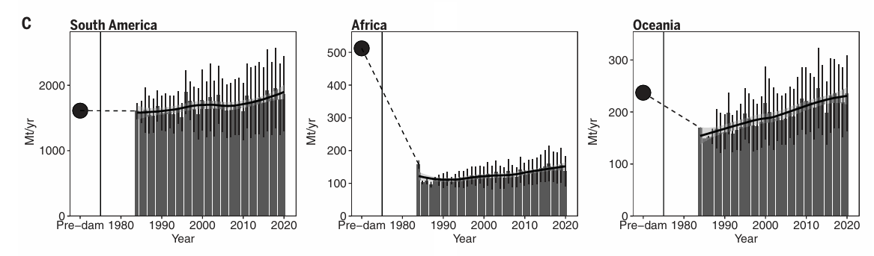
Results – Global hydrologic south
Overall trends in global hydrologic south:
Rapid increase in sediment flux
36% of the 146 rivers in the global hydrologic south are affected
41% increase on average
The increase depends in terms of timing and scale
(C)Suspended sediment flux has increased south of 20°N over the same period owing to ongoing land-use change and intensification of the hydrological cycle.
Notes:
But it’s a different story in the global south (south of 20°N latitude); here a rapid increase in sediment flux can be observed. In fact, about one-third of the southern rivers in the study are now transporting significantly more sediment than they did in 1984. On average, the sediment concentration in these rivers has gone up by 41%. What’s interesting is that this increase isn’t uniform; it varies a lot in terms of timing and scale depending on the river and region.
The takeaway from the study is that there’s a really striking north-south divide in how sediment is delivered to the world’s oceans. Until the 1990s, Asia was responsible for nearly 50% of the global suspended sediment that reached the oceans. Today, that’s dropped to just 27%,. Meanwhile, the south’s sediment flux is on the rise, which is shifting the overall balance of sediment delivery to the oceans.

Slide 13
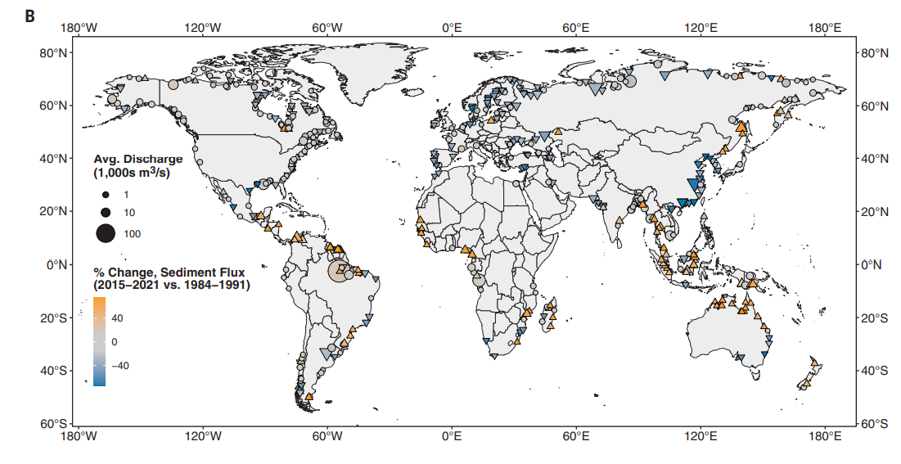
Discussion - Difference South-North
(B) Rivers with: Increasing suspended sediment flux (upward-pointing triangles),Declining suspended sediment flux (downward-pointing triangles) ;Rivers with no statistically significant change (circles).

Slide 14
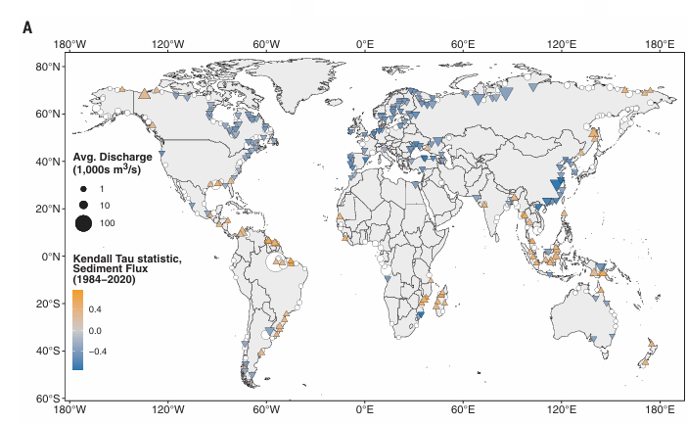
Discussion - Global hydrologic North
Trends in the north (above 20° N) for sediments recently is to decline or stagnate.
  Dams are important regulator of sediment. Image of direct human activity in altering suspended sediment transport.
  Dammed river are majorly in the North. Widespread dam building in the 20th and 21st centuries has led to systematic declines in suspended sediment flux from rivers
The exemple case of Asia :
  Represents~50% of all sediment exported to global oceans until 1990
  Now, export only 27% of the global total.
Stagnation or less decrease for river with dam pre-1984 in flux sediment
  52% of rivers with new dams have no impact in flux sediment due to previously constructed dams
(A) Changes in river suspended sediment flux for each river, as determined with the Mann-Kendall nonparametric trend test.

Slide 15
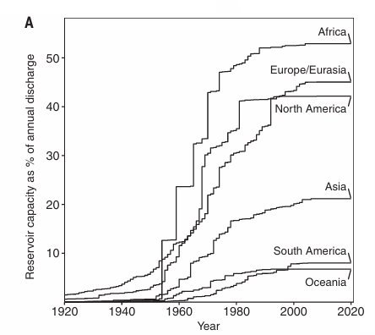
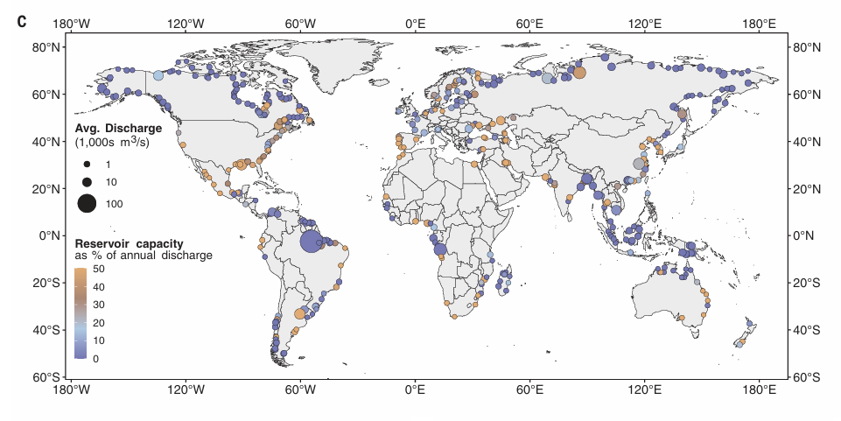
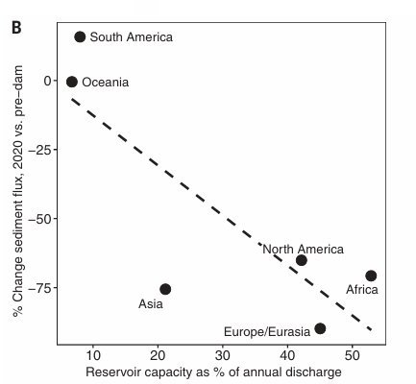
Discussion - Global Hydrologic North
Reservoirs in dams can retain on average 102% of the total annual river discharge, Sediment transport drops of 1.8% for each 1% increase in reservoir capacity
(A) Dam building in Africa, North America, and Europe/Eurasia has a capacity for ~40 to 50% of annual river flow, which is far greater than the capacity in Asia (~20%), South America (~8%), and Oceania (~6%).
(B) RCI is significantly negatively correlated with the change in suspended sediment flux relative to pre-dam (P = 0.043). The departure below the best-fit line in Asia is likely partially the consequence of a national soil conservation project and recent major dams missing from global dam inventories.
(C) Map of RCI indicates the remaining undammed or minimally dammed rivers in dark blue, which are concentrated in the arctic and near the equator.

Slide 16
Discussion – Global hydrologic South
Human Influence on Sediment Flux in South : land-use change
  58 of 70 total rivers with significant increasing trends, with most activities associated with deforestation
  alluvial mining, sand mining, and palm oil plantations appear to be primary drivers of increased erosion of watersheds with increasing suspended sediment flux.
  There are dams in the south but they are more sporadic and there reservoirs capacity are largely less important
Forecast the future of Sediment Flux in South :
  Construction of dams in the South and increase in reservoirs capacity may lead to a stop of increase and maybe a decrease in sediment fluxes.
(A) Dam building in Africa, North America, and Europe/Eurasia has a capacity for ~40 to 50% of annual river flow, which is far greater than the capacity in Asia (~20%), South America (~8%), and Oceania (~6%).​
(B) RCI is significantly negatively correlated with the change in suspended sediment flux relative to pre-dam (P = 0.043). The departure below the best-fit line in Asia is likely partially the consequence of a national soil conservation project and recent major dams missing from global dam inventories.
Notes:
Human Influence on Sediment Flux in South : land-use change
58 of 70 total rivers with significant increasing trends, with most activities associated with deforestation
alluvial mining, sand mining, and palm oil plantations appear to be primary drivers of increased erosion of watersheds with increasing suspended sediment flux.
There are dams in the south but they are more sporadic and there reservoirs capacity are largely less important with respect to the discharge of their rivers compare to their northern conterparts.
Forecast the future of Sediment Flux in South :
Construction of dams in the South and increase in reservoirs capacity may lead to a stop of increase and maybe a decrease in sediment fluxes.

Slide 17
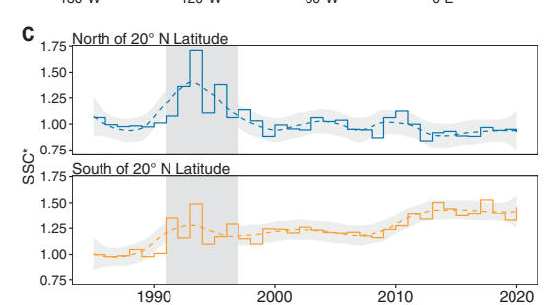
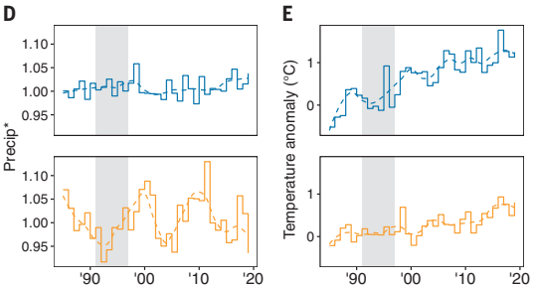
Discussion
Research of other factors :
  Cannot detect the effects of Climate Change on the hydrological cycle : precipitation have no significant relationship with sediment flux
  Temperature factor and potential explanatory variable because of its connection to rates of weathering and soil erosion cannot be compare to direct influence on sediment flux.
(C) Changes in SSC normalized by the 1984–1990 period (SSC*), with the Pinatubo eruption period removed, show a 7.5 ± 3.5% decline for northern rivers and a 41 ± 7% increase for southern rivers, which are likely driven by accelerating intensive land-use changes. (D) Changes in precipitation normalized by the 1984–1990 period (Precip*) do not show a significant relationship with trends in SSC*. (E) Changes in temperature relative to the 1984–1990 baseline show faster warming in northern watersheds, countering the hypothesis that increasing SSC for southern watersheds is the result of increased temperature.

Slide 18
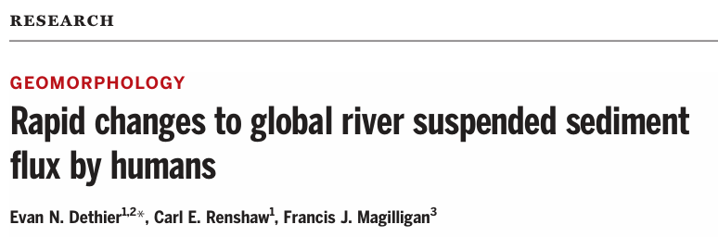
Conclusion
Two patterns :
      North : decrease of sediment flux due to dam
      South : increase of sediment flux due to land-use change
Importance of datas for futur planning
Algorithm can help inform policy decision...
… and evaluate their success

Slide 19
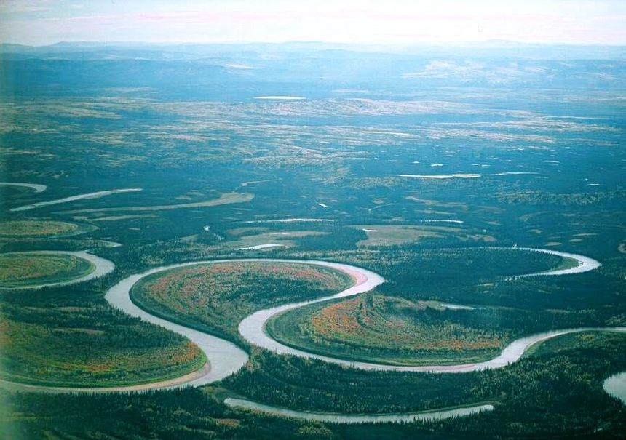
Thanks you for your attention
Questions?

