Slide 1
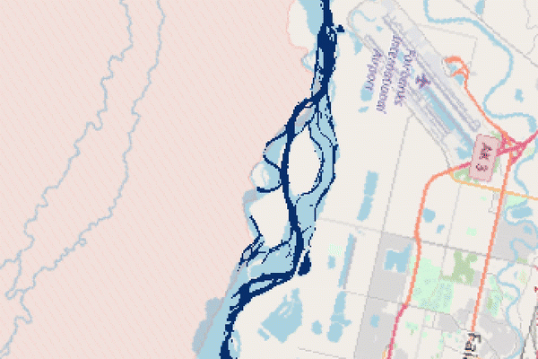
"Can machine learning accelerate process understanding and decision-relevant predictions of river water quality and river ecology?"
Group 4
Arianna Bertolo, Margaux Magali Cochard, Luca Raviglione
Global change ecology and fluvial ecosystem
A.Y. 2024/2025
[1]

Slide 2

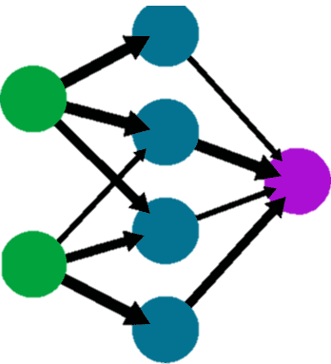

What is machine learning? (ML)
ML is a subset of Artificial Intelligence that focuses on learning patterns from complex data
It uses a model to compute results in a supervised/unsupervised way.
A model is defined by:
A structure
Hyperparameters
Steps:
Train
Validate
Predict
Using a given dataset
Model
$$β_{i,j}$$
Notes:
ML methods include supervised learning, wherein known observations are used to train a model to learn patterns or make predictions on a target variable; unsupervised learning, wherein the algorithm learns patterns or structures in the data heuristically without apriori knowledge of the target; and reinforcement learning, wherein the model learns to make decisions under uncertainty through trial and error interactions with its environment to maximize a reward.

Slide 3
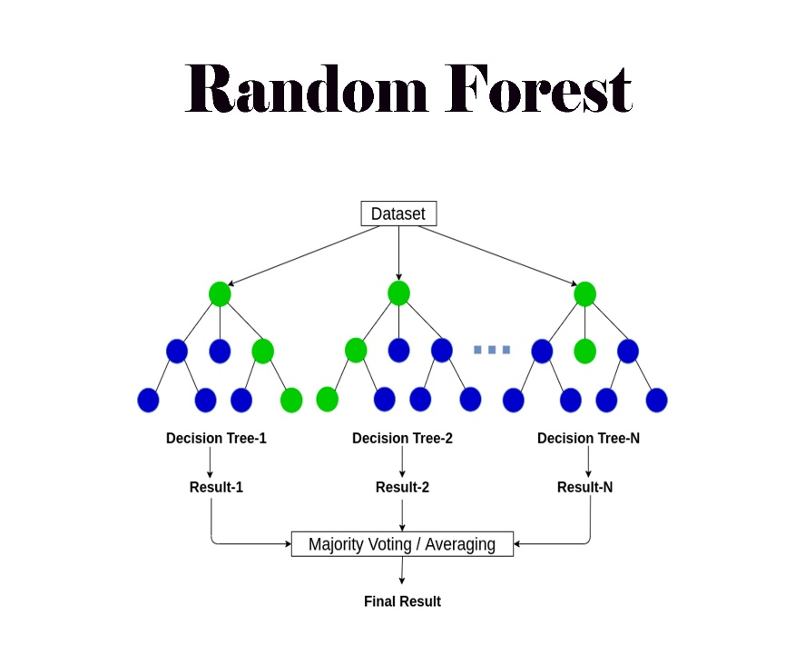
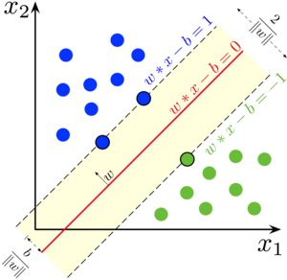
(Some) types of ML models
Neural networks
Deep Learning (DL)
Support vector
[3]
[4]
[2]
Convolutional NN (CNN), Recurrent NN (RNN), Progressively deep NN, LSTM, Multilayer perceptron (MLP),
Deep Belief Networks (DBN),
Restricted Boltzmann Machines (RBM)
Support vector
Machine (SVM), SVC
Tree based models (RF, XGBoost…)
Notes:
Use of hyperparameters (Number of tree, tree length – weights of NN – error tolerance in SVM...)
Pros and cons of different models:
Tree based and SVM: easy but time expensive
NN: complex but can handle a large dataset, can take into account time changes, LSTM (short and long timescales)
Questions :
What are the situations where ML can add value and what are its limitations? What are the primary considerations for model and feature selection? How do we compare performance and evaluate whether models have been constructed and parameterized appropriately? How can ML approaches complement process-based models to improve our prediction capabilities? And most importantly, how can we trust and use models that make predictions based on machine-derived information that is beyond human comprehension?

Slide 4
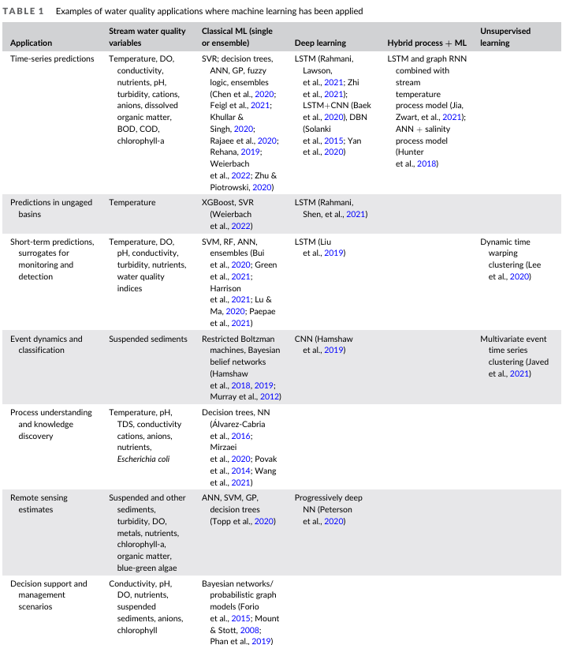
State of the art:
Use of many classical machine learning for many topics
In deep learning the use of LSTM is common
Some hybrid processes and unsupervised ML

Slide 5
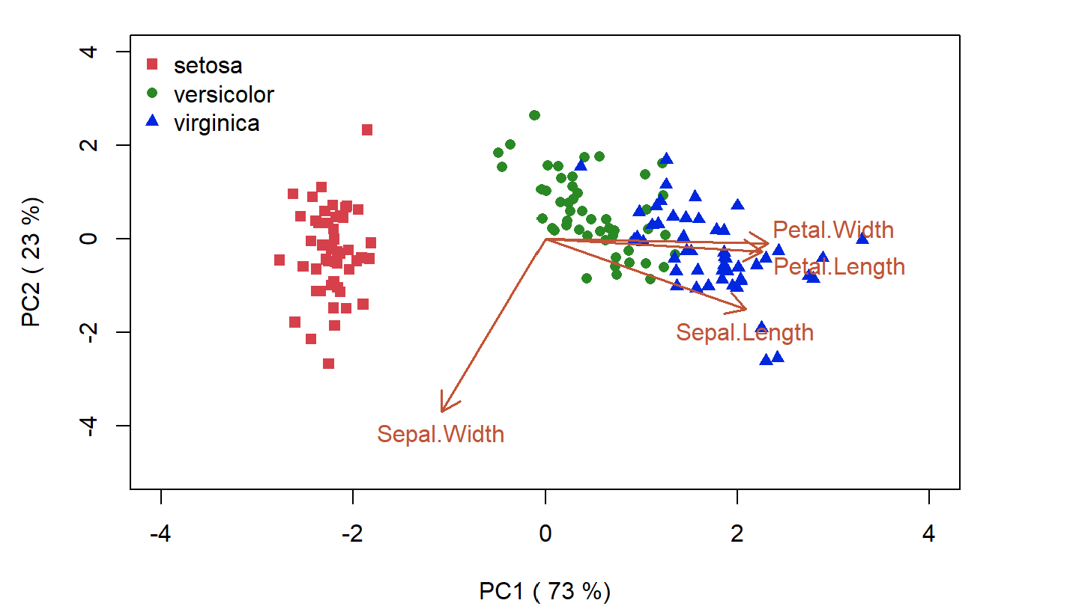
How to select and design ML models?
Model Selection
Model Design
Train different models to select the one with the greatest predictive skill.
Model ensembles combine multiple models to improve overall performance and robustness.
Hyperparameter optimization (HPO)
Bayesian optimization methods ​
Neural architecture search algorithms automatically design optimal models
Simple algorithms may be a more optimal solution for interpretability of river ecology and biological processes
[5]
Notes:
https://besjournals.onlinelibrary.wiley.com/doi/epdf/10.1111/2041-210X.13992
selection and optimisation of its hyperparameters are the next important step because these parameters can strongly affect model complexity, efficiency and results

Slide 6
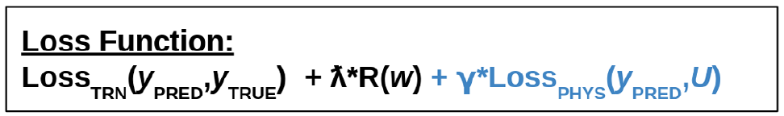
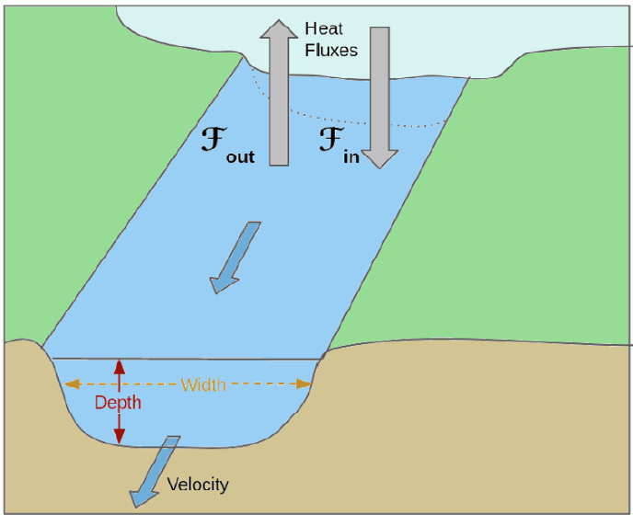
How to incorporate scientific knowledge?
Knowledge-guided ML​
Modification of loss function ​
Training on process-based model output​
Advanced modelling --> LSTM and RGCN ​
​ Not only statistically correct but also respecting natural laws.
Incorporation of river ecology and water quality knowledge
Prediction of pollutants and E.Coli in urban systems
Temperature prediction
Varadharajan et Al. (2022)
[6]
Notes:
https://www.sciencedirect.com/science/article/pii/S1470160X24012561

Slide 7
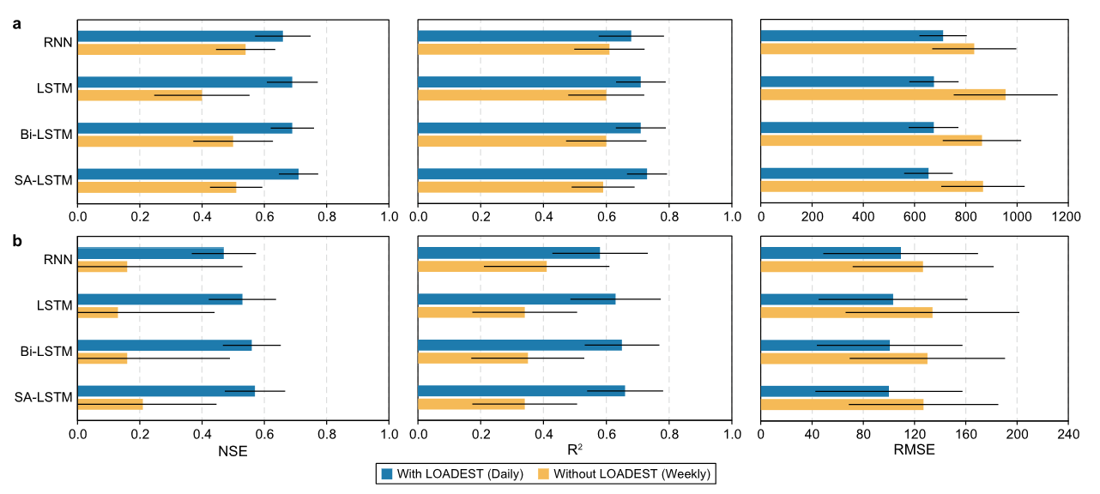



How to handle sparse data or extreme events?
COD
Sparse Data of water quality and ecological regime
LSTM with a load estimator LOADEST, KGML, Transfer Learning
NH₃
[7]
Integration of datasets
Remote sensing (RS) technologies to estimate riverine ecological flow regimes, such as turbidity, nutrients, blue-green algae
Extreme events
Loss function design to improve prediction accuracy for extreme values for floods, Specialised training on extreme events, Hybrid models
Notes:
https://www.sciencedirect.com/science/article/pii/S0301479722016942
Accuracy of the CODMn (a) and NH3N (b) pollution loads at the river-lake confluence using various machine learning models (i.e., RNN, LSTM, Bi-LSTM, and SA-LSTM) with and without LOADEST.
Developed by the United States Geological Survey, the Load
Estimator (LOADEST) is a FORTRAN program for estimating constituent loads in streams and rivers. Given a time series of streamflow, additional data variables, and constituent concentration, LOADEST assists the user in developing a regression model for the estimation of constituent load (calibration). Explanatory variables within the regression model include various functions of streamflow, decimal time, and additional user-specified data variables
OADEST was used to expand
the sparse water quality data into the dense to serve the LSTM
models in our research.

Slide 8





Explainability and Uncertainty in ML
Explainable AI (XAI) enhance the interpretability of machine learning models.
Explainable AI (XAI)
Commonly used to link environmental predictors with ecological outcomes for conservation planning.​
Causal Inference
Causal Inference helps uncover relationships between variables
Managing Uncertainty
Bayesian approaches, ensemble models, and Monte Carlo are utilized to quantify and manage uncertainty.
Model Reliability
Explainable and reliable models increase confidence in predictions and facilitate regulatory compliance.
Notes:
These AI models can transform into XAI models when they are coupled with the explanatory methods.
allowing users to understand model decisions and the factors influencing predictions.

Slide 9




Limitations
MODELS COMPLEXITY
ACCURACY
Model structure which involved many
non-linear and non-stationary processes
feedbacks
parameters
Interpretability
Computational costs
Catchment heterogeneity
Spatiotemporal scales
Distubance factors
Missing of computationally tractable models
Limited measurements in-situ
Integration between various sources
Data Quality: bias, different formats and lack of metadata
Data Processing: gap-filling
Trust in ML Models
Ethical considerations about ML usage for decision-making
Lacking involvement
AVAILABLE DATA
STAKEHOLDERS INVOLVMENT
Notes:
The use of models have to face many limitations. First is the model complexity, we have to manage non-linear and non-stationary processes, feedbacks, sometime they require a high computational costs, making interpretation challenging. Second is the accuracy which is impacted by catchment heterogeneity, different spatial and temporal scale, and natural or human disturbance factors (which can persist over long time). In terms of data, we face limited measurements, integration challenges, and data gaps that require preprocessing. Finally, stakeholder involvement requires building trust in machine learning models, through more trasparency and opening a discussion about its ethical usage for decision-making.
The question is: How can someone assess this connectivity?
In this sense, it is paramount the Dahmkohler number, described by the ratio between.....
Low Da
In fact, long residence times in transient storage zones actually necessitate a level of hydrologic disconnection from main channel flow (τ=1/α; where τ is residence time),
Researchers use techniques like tracer injections, geophysical imaging, and temperature monitoring to trace water flow between streams and groundwater.

Slide 10

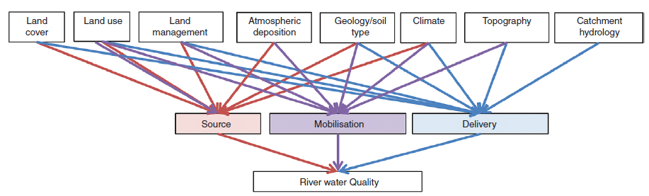


Limitations (2)
Main limitations are:
Spatial Variability​
Different impact of the landscape characteristics and eco-morphological features
Water bodies with strong human influence are more difficult to model and upscale
[8]
Available Data
Necessary to develop a FAIR dataset ​
Interpretability ​
Complex models do not always improve performance, but are less interpretable and increase computational costs
Notes:
Consulting other articles, the main limitations are 3.
Regarding spatial variability, as we know, landscape characteristics and features vary a lot temporally and spatially. The same is the source, mobilization, and delivery of sediments/nutrients which is given as a result of all these contribution. Water bodies heavily influenced by human activity are more difficult to model. For the available data it is suggested to create a FAIR dataset, which means Findable, Accessible, Interoperable, and Reusable. Interpretability reminds us that complex models are potentially more accurate but harder to understand.
The question is: How can someone assess this connectivity?
In this sense, it is paramount the Dahmkohler number, described by the ratio between.....
Low Da
In fact, long residence times in transient storage zones actually necessitate a level of hydrologic disconnection from main channel flow (τ=1/α; where τ is residence time),
Researchers use techniques like tracer injections, geophysical imaging, and temperature monitoring to trace water flow between streams and groundwater.

Slide 11
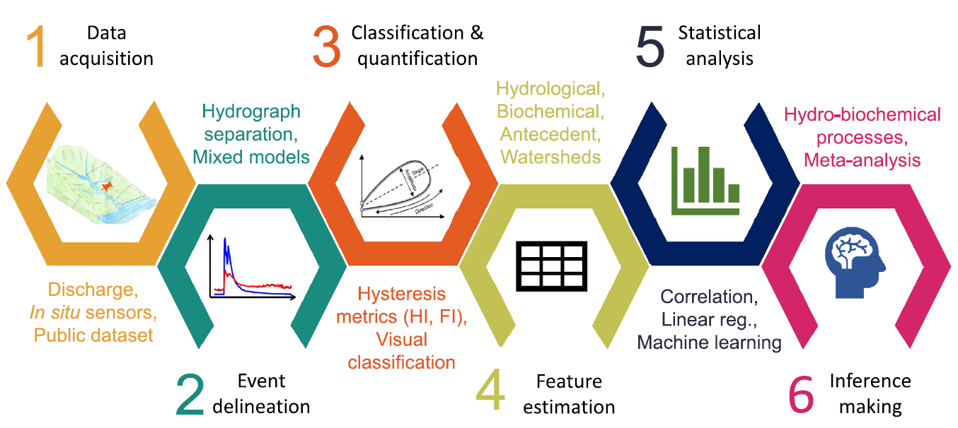
Limitations (3), C-Q patterns
Workflow for event-basis C-Q relationships
[9]
Structural limitations
Difficulties in representing rapidly changing of hysteresis patterns and in interpreting
Limited studies
Many challenges regarding hysteresis metrics
Notes:
Now high-frequency measurements of stream chemistry, provided by in situ sensors, are increased and this allows to investigate the relationship between stream discharge and concentrations at event-scales.
ML could be used to find concentration-discharge pattern and understand which processes control hysteresis loop. Its application is very promising, but the state of art results problematic due to structural limitation, representation and interpretation issues and, above all, limited studies. Some technical problems derives since the first steps. This is the entire flowchart for CQ relationship. After data acquisition we have to delineate storm events through those are called "hysteresis metrics", which are sensitive to the choice of the event starting point. Addressing these gaps in step 2 or 3, we can improve, as a cascade effect, the reliability of hydro-biochemical analyses

Slide 12
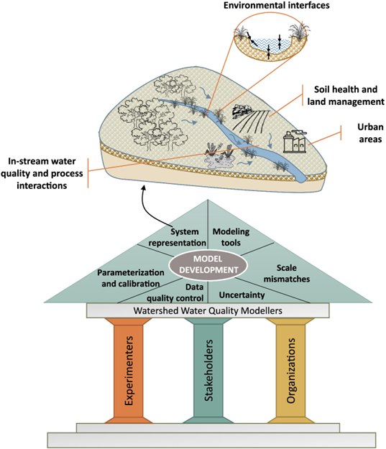
Potential improvements
Progress in practice of water quality modeling has stalled
6 key potential areas for water quality modeling
3 main environmental interfaces for system representation
3 pillars
Model standardization​
[10]
Notes:
Progress in water quality models are slowing down due to different reasons. Between these we have: 1) sometimes limited government funding and 2) the fragmentation of this subject in subdisciplines.
Experts have identified opportunities to further advance. There are six key elements as for example, system representation, parameterization and calibration. Since the system representation is the core of the water quality model development, four key potential areas are being recognized, that are those you can see upside in the figure.
To sustain this advancement three pillars must be experts, stakeholder and organization. Their collaboration and work should be very useful in order to achieve a model standardization, which is another lack in the entire system.
The question is: How can someone assess this connectivity?
In this sense, it is paramount the Dahmkohler number, described by the ratio between.....
Low Da
In fact, long residence times in transient storage zones actually necessitate a level of hydrologic disconnection from main channel flow (τ=1/α; where τ is residence time),
Researchers use techniques like tracer injections, geophysical imaging, and temperature monitoring to trace water flow between streams and groundwater.

Slide 13
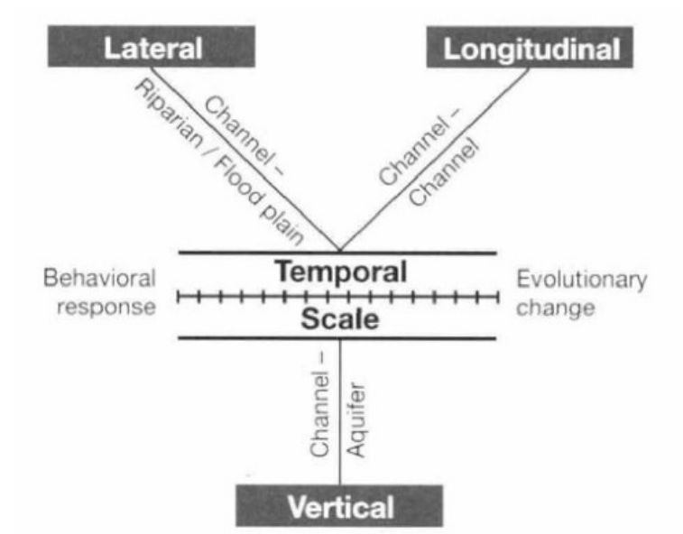
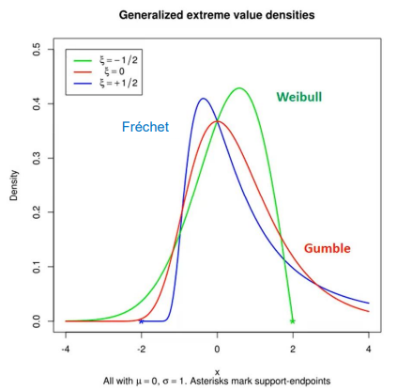
Conclusion
PROS
CONS
Can model complex systems (i.e. dimensions, dynamisms or non-linearities of rivers)​
​
Can be used to compute future extreme events (RCP scenarios)​
​
Complex models​​
The dataset size and configuration is highly relevant​​
Limited adaptability​​
Difficult interpretability of final and intermediary results​​
[11]
Necessity to made a trade-off between accuracy, complexity and computational cost
[12]
Notes:
In conclusion, complex models have significant advantages. They allow us to analyze intricate systems, like river dynamics, and predict future extreme events, such as those under RCP scenarios. However, these models come with challenges. Their complexity requires large, well-configured datasets and limits adaptability. Moreover, interpreting their results—both final and intermediate—can be difficult. This highlights the crucial need to balance accuracy, complexity, and computational cost when working with such models. Ultimately, these trade-offs shape their practical applications and effectiveness.
The question is: How can someone assess this connectivity?
In this sense, it is paramount the Dahmkohler number, described by the ratio between.....
Low Da
In fact, long residence times in transient storage zones actually necessitate a level of hydrologic disconnection from main channel flow (τ=1/α; where τ is residence time),
Researchers use techniques like tracer injections, geophysical imaging, and temperature monitoring to trace water flow between streams and groundwater.

Slide 14
THANK YOU!​

Slide 15
References
Chicco, D. (2017). Ten quick tips for machine learning in computational biology. BioData mining, 10(1), 35.
Fu, B., Horsburgh, J. S., Jakeman, A. J., Gualtieri, C., Arnold, T., Marshall, L., Green, T. R., Quinn, N. W. T., Volk, M., Hunt, R. J., Vezzaro, L., Croke, B. F. W., Jakeman, J. D., Snow, V., & Rashleigh, B. (2020). Modeling Water Quality in Watersheds: From Here to the Next Generation. Water resources research, 56(11), 10.1029/2020wr027721.
Ho, L., & Goethals, P. (2022). Machine learning applications in river research: Trends, opportunities and challenges. Methods in Ecology and Evolution, 13(11), 2603-2621.
Huang, S., Xia, J., Wang, Y., Lei, J., & Wang, G. (2024). Water quality prediction based on sparse dataset using enhanced machine learning. Environmental Science and Ecotechnology, 20, 100402.
Lintern, A., Webb, J. A., Ryu, D., Liu, S., Bende‐Michl, U., Waters, D., ... & Western, A. W. (2018). Key factors influencing differences in stream water quality across space. Wiley Interdisciplinary Reviews: Water, 5(1), e1260.
Liu, H., Xia, R., Chen, Y., Jia, R., Wei, Y., Yan, C., ... & Li, X. (2024). Spatial patterns of hydroecological health in the semi-arid yellow river basin: Revelations from machine learning models. Ecological Indicators, 168, 112799.
Liu, W., Birgand, F., Tian, S., & Chen, C. (2021). Event-scale hysteresis metrics to reveal processes and mechanisms controlling constituent export from watersheds: A review✰. Water Research, 200, 117254.
Sahoo, D. P., Sahoo, B., Tiwari, M. K., & Behera, G. K. (2022). Integrated remote sensing and machine learning tools for estimating ecological flow regimes in tropical river reaches. Journal of Environmental Management, 322, 116121.
Varadharajan, C., Appling, A. P., Arora, B., Christianson, D. S., Hendrix, V. C., Kumar, V., Lima, A. R., Müller, J., Oliver, S., Ombadi, M., Perciano, T., Sadler, J. M., Weierbach, H., Willard, J. D., Xu, Z., & Zwart, J. (2022). Can machine learning accelerate process understanding and decision-relevant predictions of river water quality? Hydrological Processes, 36(4), e14565. https://doi.org/10. 1002/hyp.14565.
Wang, R., Kim, J. H., & Li, M. H. (2021). Predicting stream water quality under different urban development pattern scenarios with an interpretable machine learning approach. Science of the Total Environment, 761, 144057.

Slide 16
Image sources
[1] https://earthsciences.osu.edu/news/deep-learning-models-track-river-extents-sub-meter-resolutions
[2] https://anasbrital98.github.io/blog/2021/Random-Forest/
[3] https://victorzhou.com/series/neural-networks-from-scratch/
[4] https://en.wikipedia.org/wiki/Support_vector_machine
[5] https://www.quantitative-biology.ca/multi.html
[6] Varadharajan, C., Appling, A. P., Arora, B., Christianson, D. S., Hendrix, V. C., Kumar, V., ... & Zwart, J. (2022). Can machine learning accelerate process understanding and decision‐relevant predictions of river water quality?. Hydrological Processes, 36(4), e14565.
[7] Huang, S., Xia, J., Wang, Y., Lei, J., & Wang, G. (2024). Water quality prediction based on sparse dataset using enhanced machine learning. Environmental Science and Ecotechnology, 20, 100402.
[8] Lintern, A., Webb, J. A., Ryu, D., Liu, S., Bende‐Michl, U., Waters, D., ... & Western, A. W. (2018). Key factors influencing differences in stream water quality across space. Wiley Interdisciplinary Reviews: Water, 5(1), e1260.
[9] Liu, W., Birgand, F., Tian, S., & Chen, C. (2021). Event-scale hysteresis metrics to reveal processes and mechanisms controlling constituent export from watersheds: A review✰. Water Research, 200, 117254.
[10] Fu, B., Horsburgh, J. S., Jakeman, A. J., Gualtieri, C., Arnold, T., Marshall, L., ... & Rashleigh, B. (2020). Modeling water quality in watersheds: From here to the next generation. Water Resources Research, 56(11), e2020WR027721.
[11] From GEFE course, from "An expansive Perspective of Riverine Landscapes: Pattern and Process Across Scales" (James v Ward)
[12] From Science of Climate change, based on Hansen A (2020) The Three Extreme Value Distributions: An Introductory Review. Front. Phys. 8:604053. doi: 10.3389/fphy.2020.604053

