Slide 1
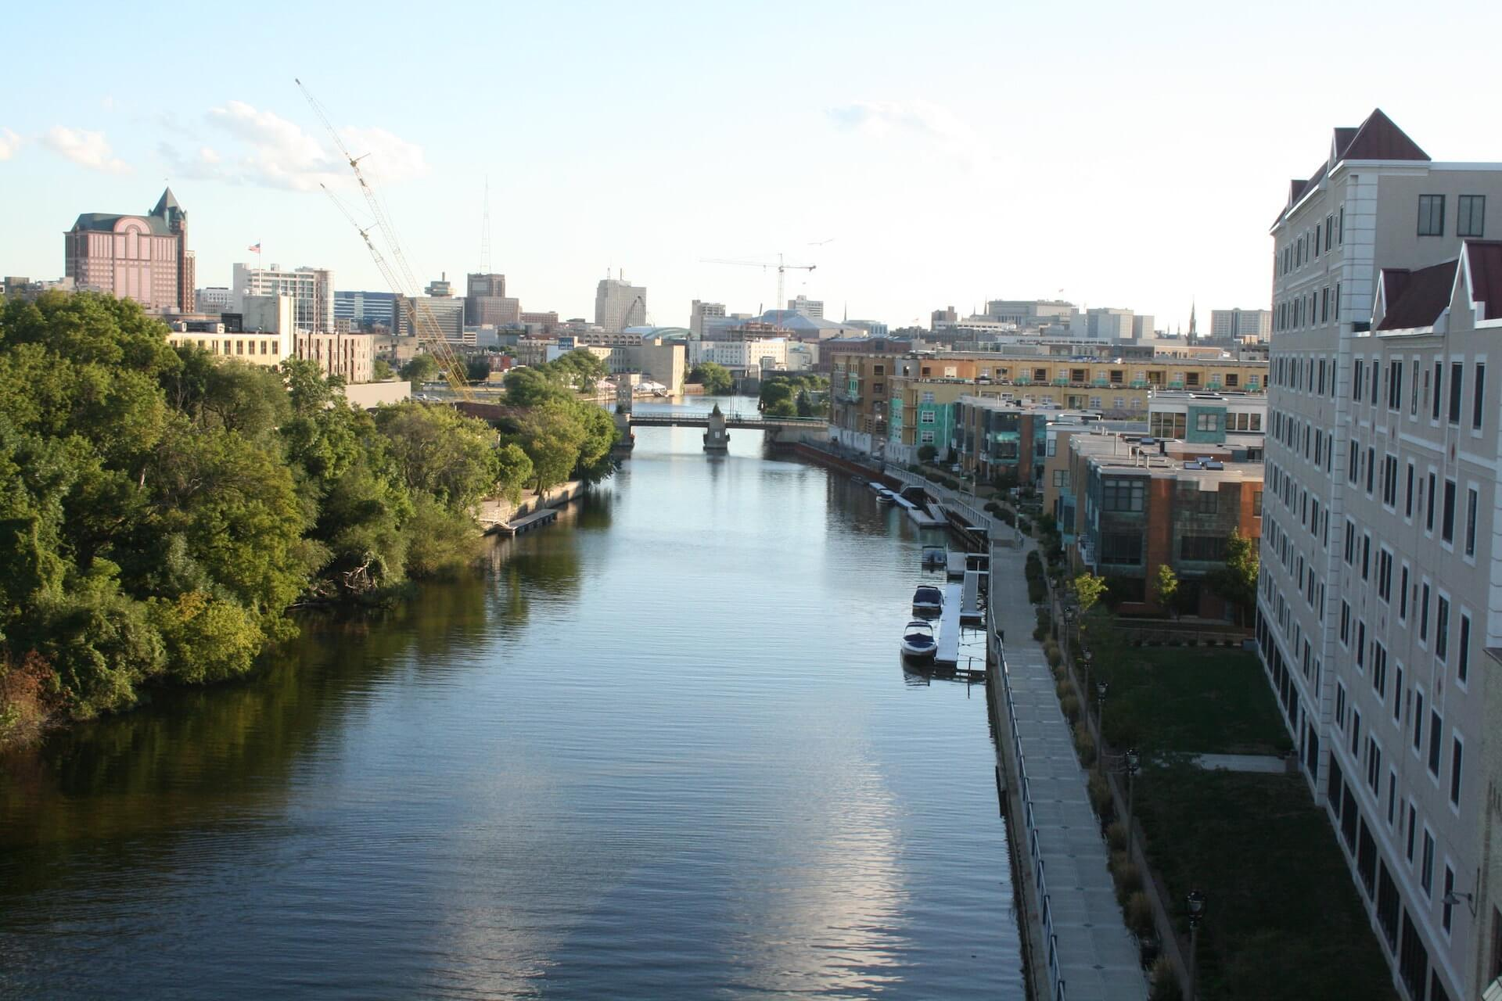
Ecosystem responses to channel restoration decline with stream size in urban river networks
Maëlle Regnier
Quitterie Legrand
Julie Varupenne
Global change ecology and fluvial ecosystems
Group H : Peter S. LEVI and Peter B. McINTYRE
Milwaukee

Slide 2
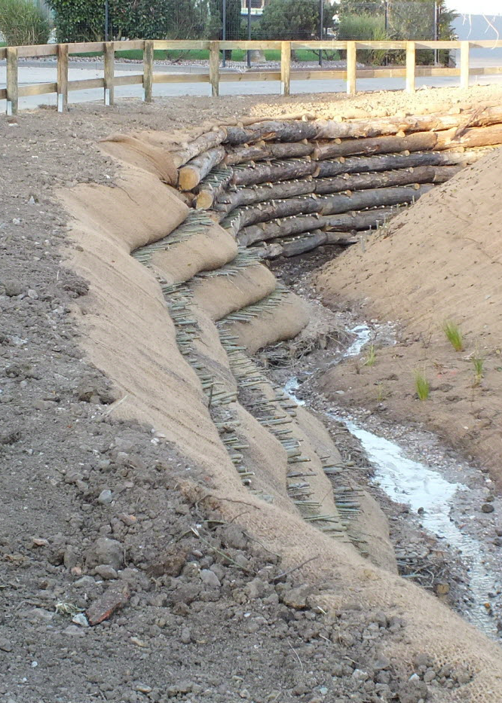
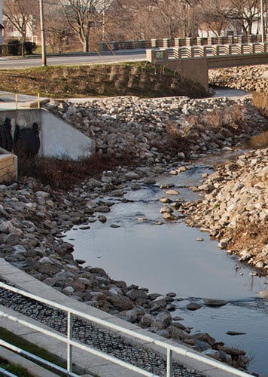
Introduction
Kinnickinnic

Slide 3
Introduction
Urban areas
Modification of the watershed
Riparian zone modification
Physical modification of the stream
Ecological impairment
=
Urban stream syndrome
Notes:
Urban areas affect ecosystem for example the watershed, the riparian zone etc. Which is why urban stream suffer from ecological impairment
This urban effect is so consistent that scientist have renamed it the urban stream syndrome

Slide 4
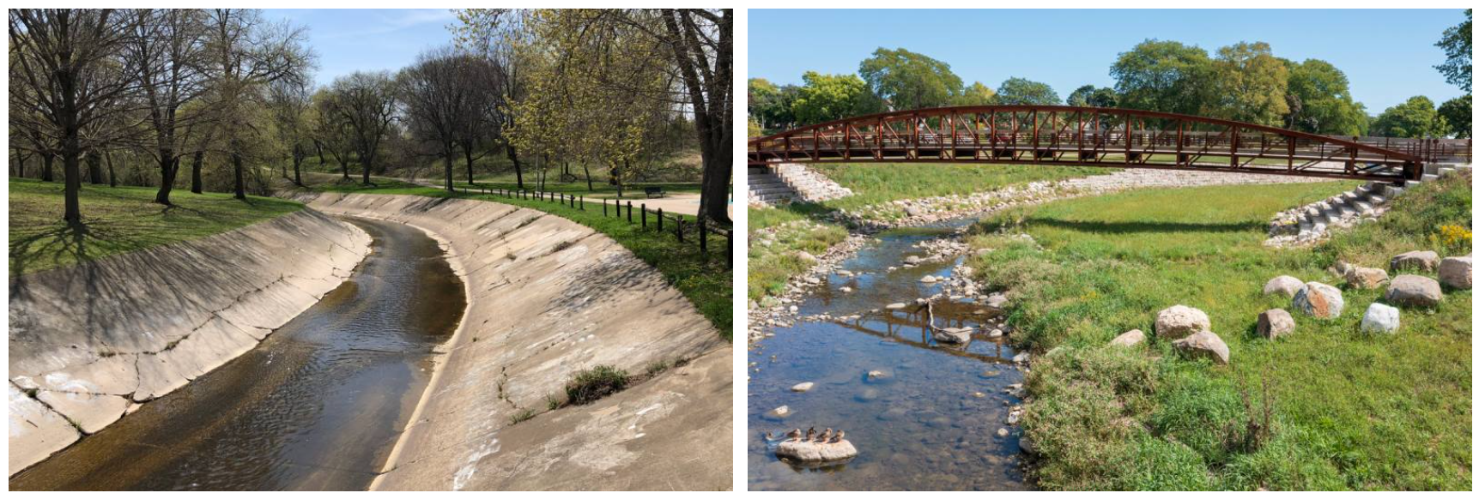
Introduction
Excpected physical-chemical-biological cascade response
Physical restoration
Kinnickinnic River
Returns hydrological processes?
Returns ecological processes?
Notes:
Usually there is the expectation that improving the geomorphology improves chemical and biological processes
But it is not that obvious
does it rly returns hydrological and ecological processes?
Actually only a few project are monitored and evidence inconsistent

Slide 5
Introduction
Difficult to predict the ecosystem shifts and measure responses
Restoration improves ecosystems?
Benefits vary depending on the stream size?
Depending on the stream location?
Restoration planning
Cost-efficient restoration
Notes:
difficult to predict the ecological benefits and measure responses bcause lack of metrics (integrative or whole metabolism) and spatial disparity response
The real questions are
Does restoration improves ecosystems and their services?
Does benefits vary dependin on stream size? Or depeding on their location – especially important in urban areas as there is a high dicontinuityy due to nifrastructures
Need all theses answers in order to plan correctly and efficiently restoration projects

Slide 6
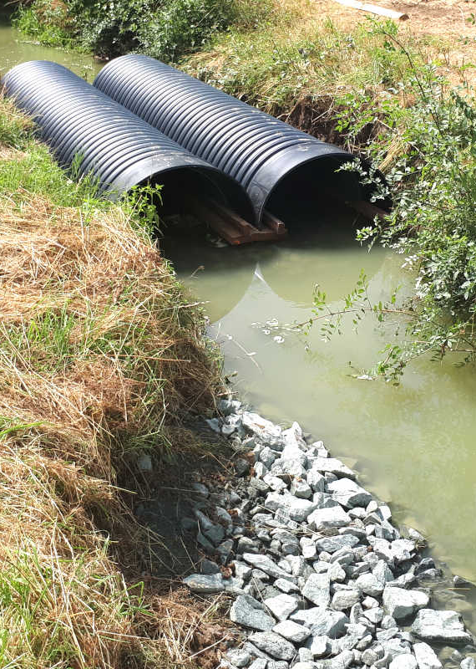
Methodology

Slide 7
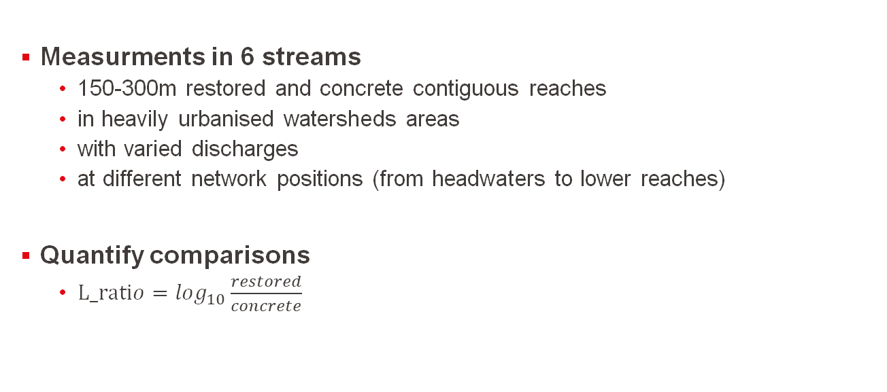
Data collection
Measurments in 6 streams
150-300m restored and concrete contiguous reaches
in heavily urbanised watersheds areas
with varied discharges
at different network positions (from headwaters to lower reaches)
Quantify comparisons
$L_ratio=\log_{10}\frac{restored}{concrete}$
Notes:
«Ecosystem responses to channel restoration decline with stream size in urban river networks»

Slide 8
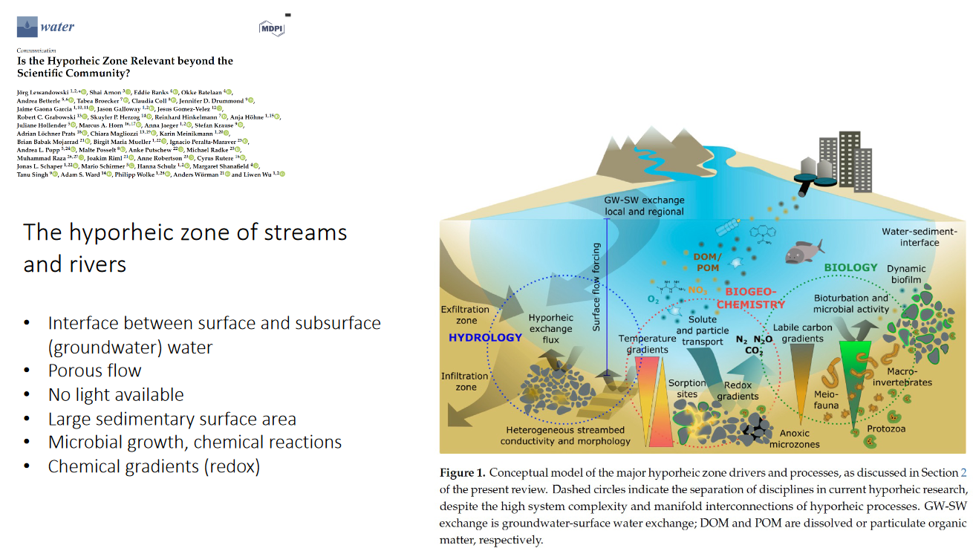
Data collection
Metrics to assess impacts of the restoration :
Physicochemical metrics
NH₄⁺, N0₃⁻, SRP : spiraling lenght, uptake velocity, uptake rate
Benthic biological metrics
chlorophyll-a, organic matter
Hydrological and transient storage metrics
velocity, dispersion, A/As, WRT
Whole-stream metabolism metrics
GPP, ER, NEP
Notes:
SRP : Soluble reactive phosphorus
N,P uptakes = major process of hyporheic zone → nutrient cycling = very important services
N, P limitants factors to GPP → impact metabolism

Slide 9
Data collection
Metrics to assess impacts of the restoration :
Physicochemical metrics
NH₄⁺, N0₃⁻, SRP : spiraling lenght, uptake velocity, uptake rate
Benthic biological metrics
chlorophyll-a, organic matter
Hydrological and transient storage metrics
velocity, dispersion, A/As, WRT
Whole-stream metabolism metrics
GPP, ER, NEP
Notes:
Driver of hyporheic zone

Slide 10
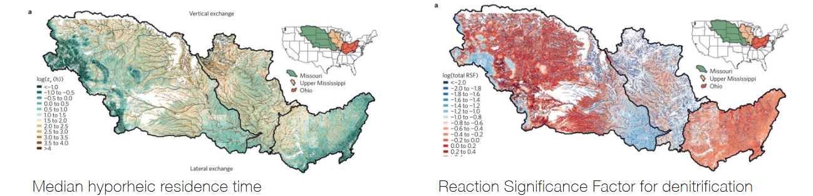
Data collection
Metrics to assess impacts of the restoration :
Physicochemical metrics
NH₄⁺, N0₃⁻, SRP : spiraling lenght, uptake velocity, uptake rate
Benthic biological metrics
chlorophyll-a, organic matter
Hydrological and transient storage metrics
velocity, dispersion, A/As, WRT
Whole-stream metabolism metrics
GPP, ER, NEP
Notes:
WRT : water retention time
A/As relative storage area
Drivers of hyporheic zone
Heterogen habitats→ ^ biodiv, ^oxygenation

Slide 11
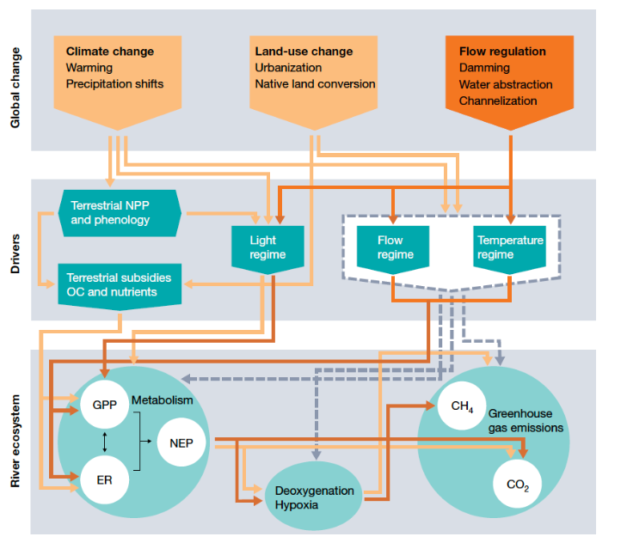
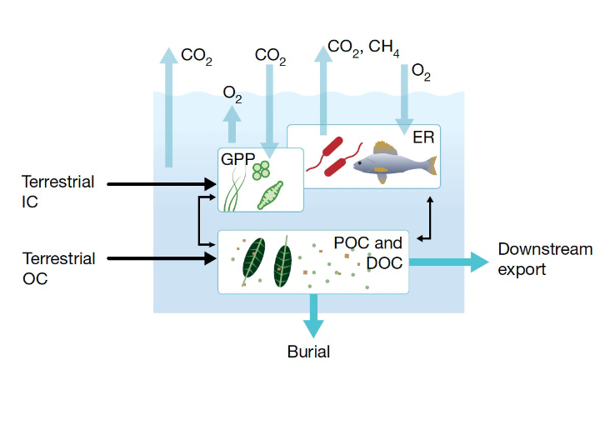
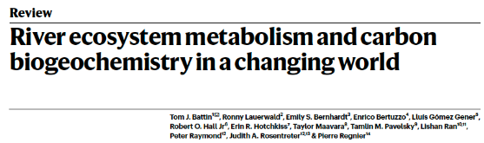
Data collection
Metrics to assess impacts of the restoration :
Physicochemical metrics
NH₄⁺, N0₃⁻, SRP : spiraling lenght, uptake velocity, uptake rate
Benthic biological metrics
chlorophyll-a, organic matter
Hydrological and transient storage metrics
velocity, dispersion, A/As, WRT
Whole-stream metabolism metrics
GPP, ER, NEP
Notes:
gross primary productivity, ecosyst respiration, net ecosyst productivity
Autotrophes-heterotrophes
Gaz exchanges (hypoxia)

Slide 12
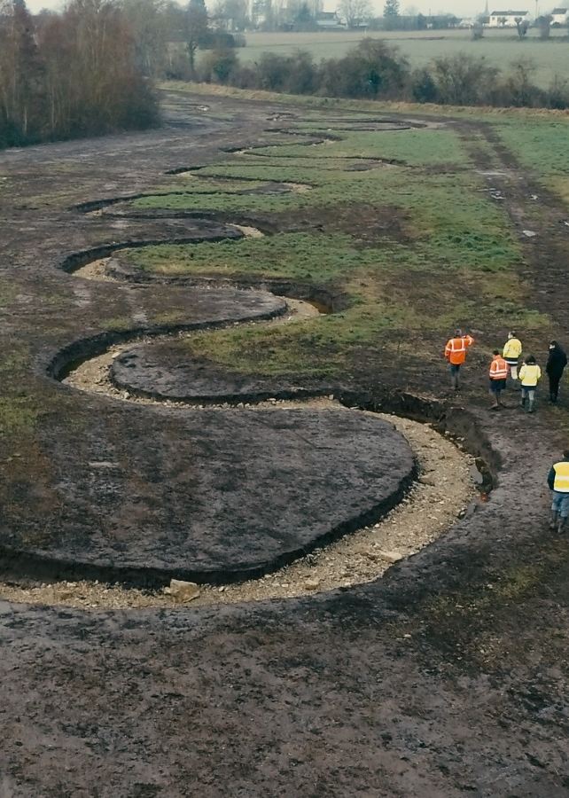
Results

Slide 13
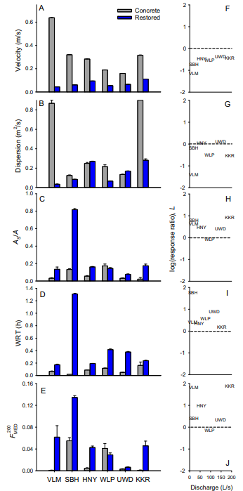
Hydrological response of urban streams to restoration
Velocity and dispersion:
Higher in concrete reaches
Don’t vary with stream size
Higher L velocity ratio in headwater
Dispersion: spreading and mixing of pollutant mass
Notes:
L ratios: difference between type reaches (i.e concrete and restored)
Dispersion: spreading and mixing of pollutant mass (effects of shear and molecular diffusion)

Slide 14
Hydrological response of urban streams to restoration
Transient storage metrics:
Higher in restored reaches
Don’t vary with stream size
As/A: relative area of the storage zone (Storage zone/Active channel area)
WRT: mean residence time
Notes:
Pool riffle to Water temporarly slowed

Slide 15
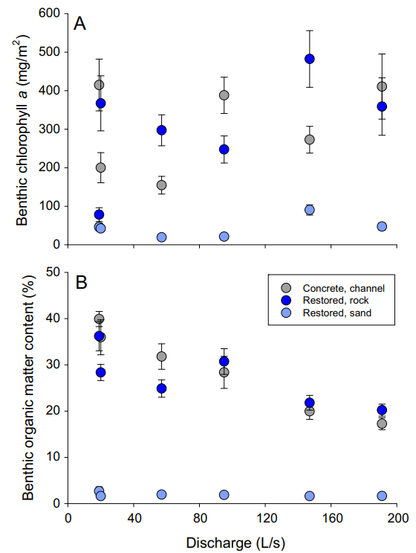
Benthic composition response of urban streams to restoration
Benthic chlorophyll-α and OM content:
Depends on type of materials and not restoration
Increase with stream size for chlorphyll-α
Decrease with stream size for OM
Benthic chlorophyll-α: concentration algal biomass
Increasing metabolic rates in restored reaches: more naturalistic substrates: allow accumulation of algae and benthic OM
Notes:
Higher in concrete reaches and rocks in restored reaches (relative to sand)
No conclusion because it depends on the stream bed material and not on the success of the restoration. Rocks et concrete similar

Slide 16
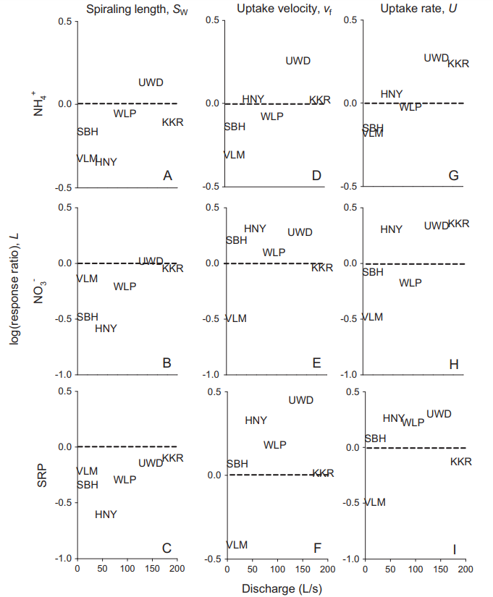
Nutrient composition response of urban streams to restoration
Spiraling lenght Sw: distance nutrients travel before removal from the water column
Shorter in restored reaches among all nutrients but NO3-
Longer in large streams than headwater
Uptake rate U: quantity of nutrients removed from water column
Higher in headwaters and middle-sized streams
High variation of nutrient concentration: no pattern
Decreasing velocity and increasing residence time leads to shorter distance traveled by nutrients
Notes:
SRP: phosphate
Formule générale
vf= U/C​
U=Uptake velocity,
U : Taux d'assimilation ou de consommation de nutriments par unité de surface (mg/m2/s\text{mg/m}^2/\text{s}mg/m2/s),
C : Concentration moyenne des nutriments dans la colonne d'eau (mg/m3\text{mg/m}^3mg/m3).
Interprétation
Une valeur élevée de vf​ indique une efficacité élevée dans l'assimilation des nutriments par le lit de la rivière ou par les biofilms.
Une valeur faible de vf​ reflète une assimilation lente ou inefficace, potentiellement due à une faible activité biologique ou à des conditions environnementales peu favorables.
Uptake velocity vf: vertical velocity from water column to surface for assimilation (efficacity of assimilation)
Nothing correlated
Uptake rate nothing correlaated

Slide 17
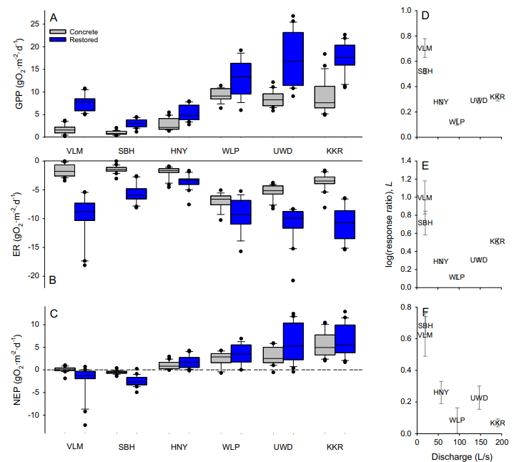
Whole-stream metabolism response of urban streams to restoration
Gross Primary Production GPP and Ecosystem respiration ER :
Higher in restored and larger reaches
Difference restored/concrete decrease with stream size
Net ecosystem production NEP:
NEP<0 in all reaches (autotrophic)
Higher in larger streams
Headwaters: higher in concrete
Large streams: higher in restored
Autotrophy: continued impairment despite restoration
Notes:
Difference restored/concrete decrease with stream size for NEP

Slide 18
Interrelationship among metrics
Other correlations for predictions with different metrics:
Following slope, As/A, WRT, dispersion
Examples:
ER predicted by reach type and habitat-weighted OM, and increased with benthic OM content

Slide 19
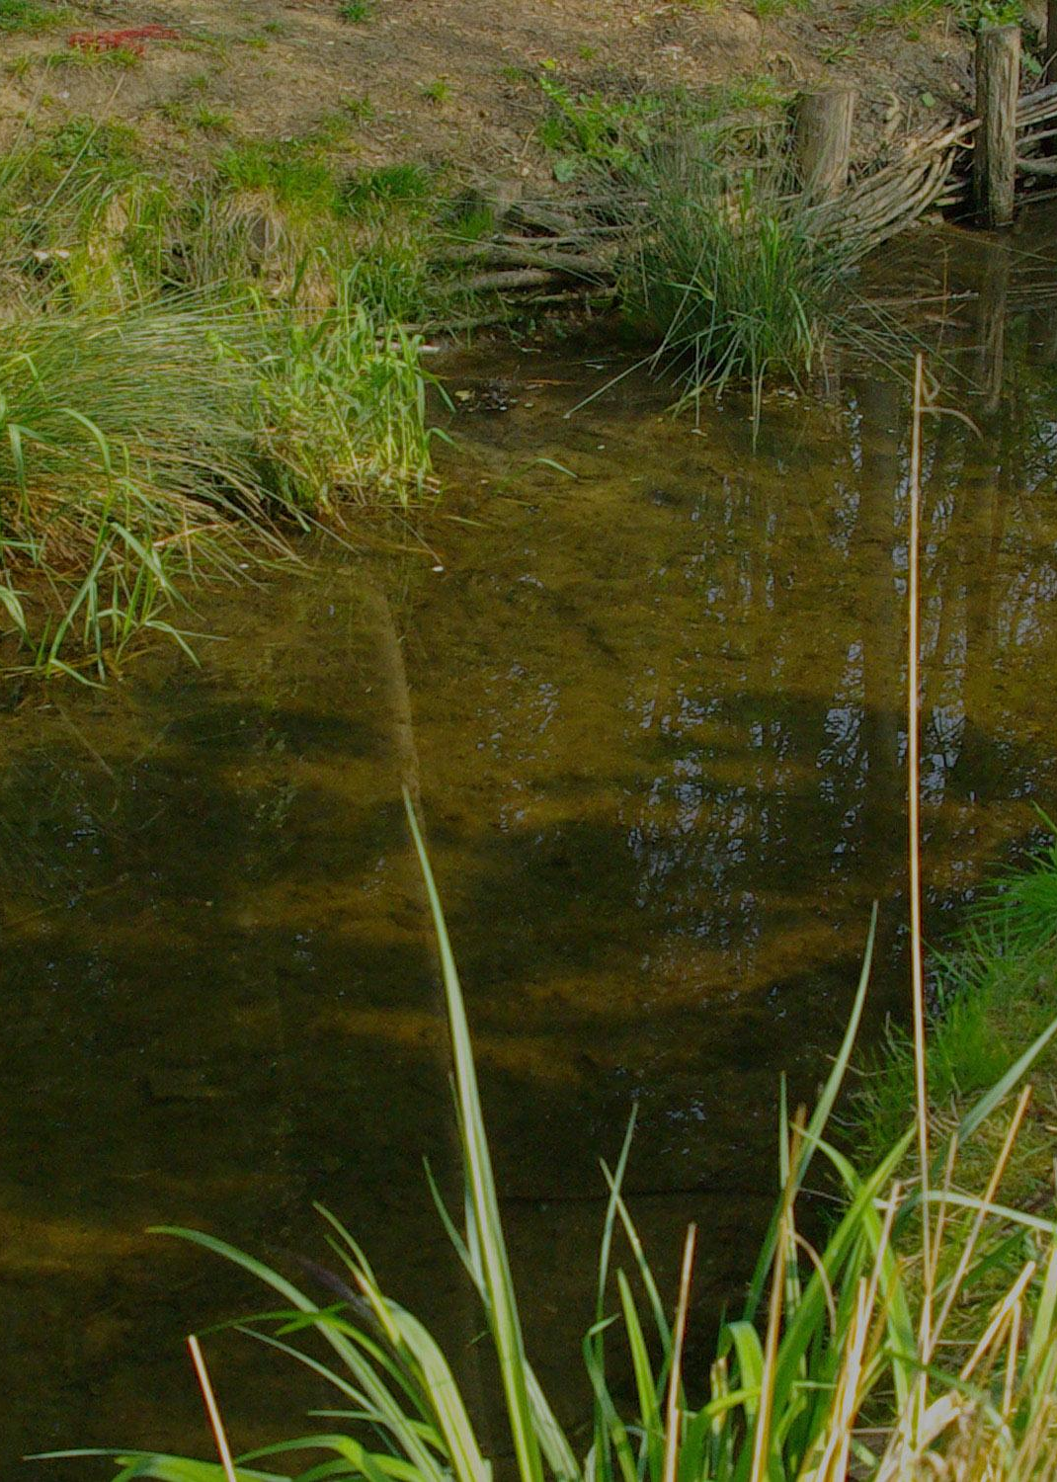
Discussion

Slide 20
Main conclusions
Strongest response: stream hydrology, pool-riffle big impact on decreasing velocity and increasing transient storage and dispersion
Defining restoration benefits: challenge
Restoration in small streams more efficient than mainstem, because:
• Increased width is relatively more important in headwaters
• Restored reach greater proportion in watershed of headwater
Magnitude of ecological response don’t scale with stream size

Slide 21
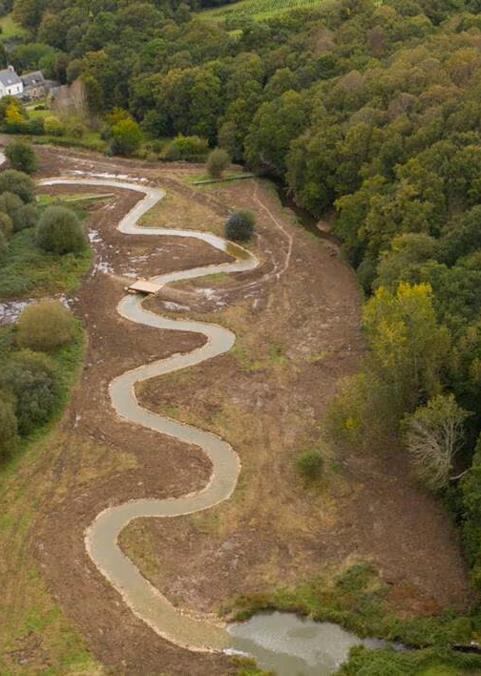
Limitations

Slide 22
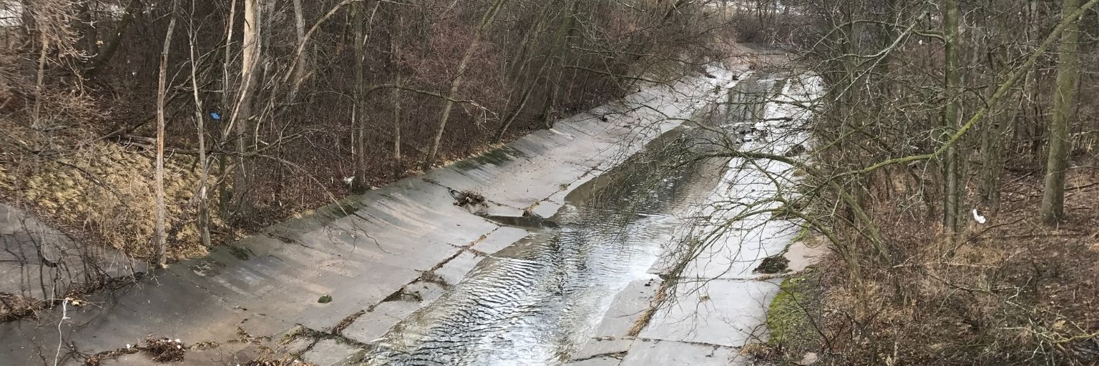
Main limits
Pre-condition of streams severly impaired (not the same results as prior work)
Honey River
Kinnickinnic River
Notes:
Dire qu’on a pris des ecological functions qui répondent strongly au conditions du stream pour éviter l’influence des conditions du stream mais still
Pas sure d avoir compris

Slide 23
Main limits
Urban continuum concept (common stressors and impairments), landscape heterogeneity and high connection of urban watershed not taken into account.
Low-flow conditions events, high precipitations can change everything.
No quantification of the influence of time since restoration (disturbance), improbable it has an impact but riparian zone and fish communities differents
Notes:
Dire qu’on a pris des ecological functions qui répondent strongly au conditions du stream pour éviter l’influence des conditions du stream mais still
Pas sure d avoir compris

Slide 24
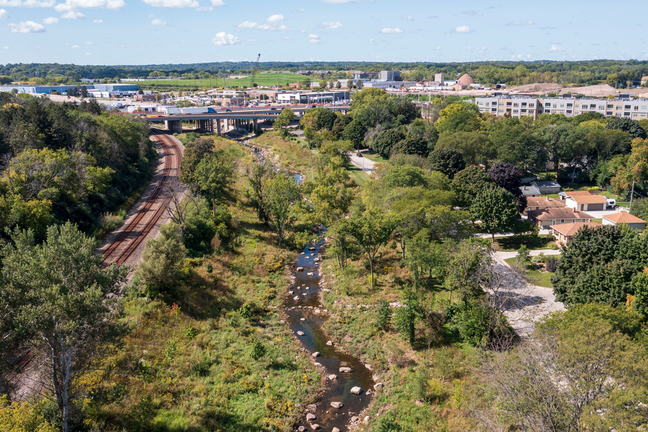

Take home messages
Restore headwaters
Focus on sensitive metrics
Create guidelines
Extend beyond reach boundaries
Combine interventions
Take into account societal benefits
RESTORATION IS WORTHWHILE !
Underwood
Notes:
Ponds?
SENSITIVE METRICS: ater residency
Functional metrics summarize dynamics through time
Using theses metrics creat guideline
Socital benefits: minimizing floods, aesthetic

Slide 25
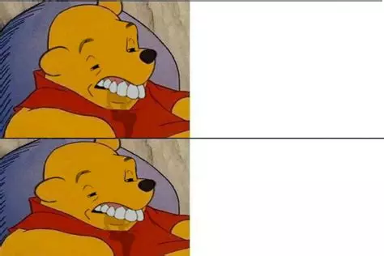
Thank you for your attention
BEFORE RESTORATION
AFTER RESTORATION

Slide 27
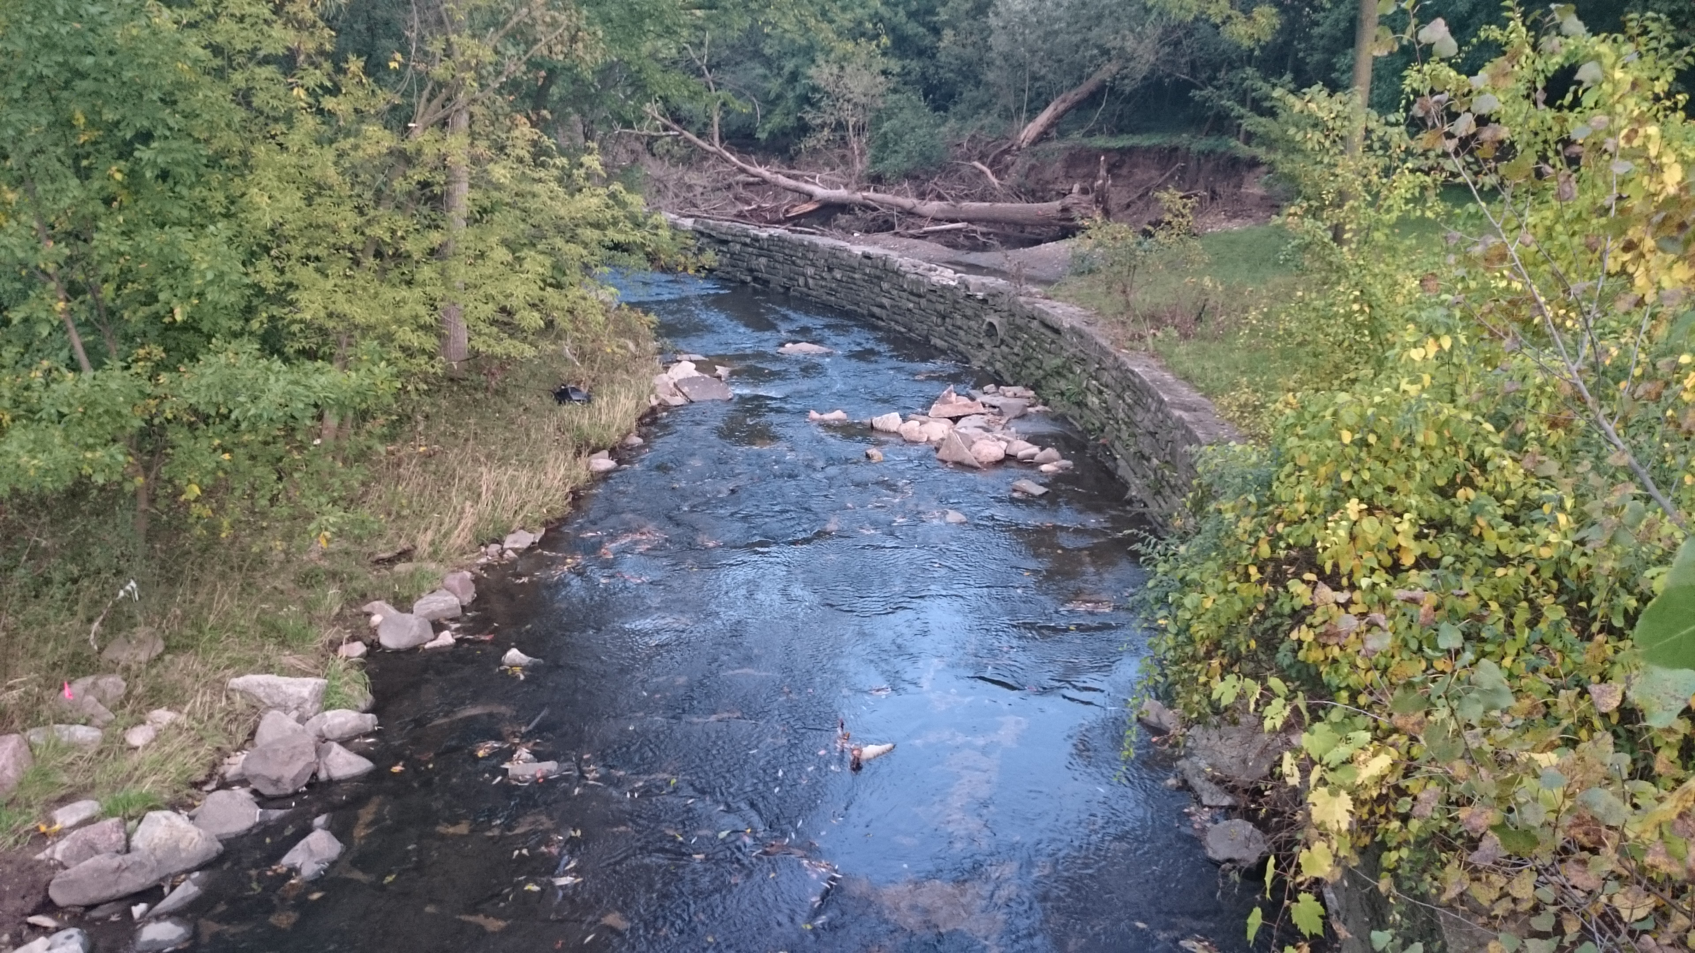
honey

Slide 28
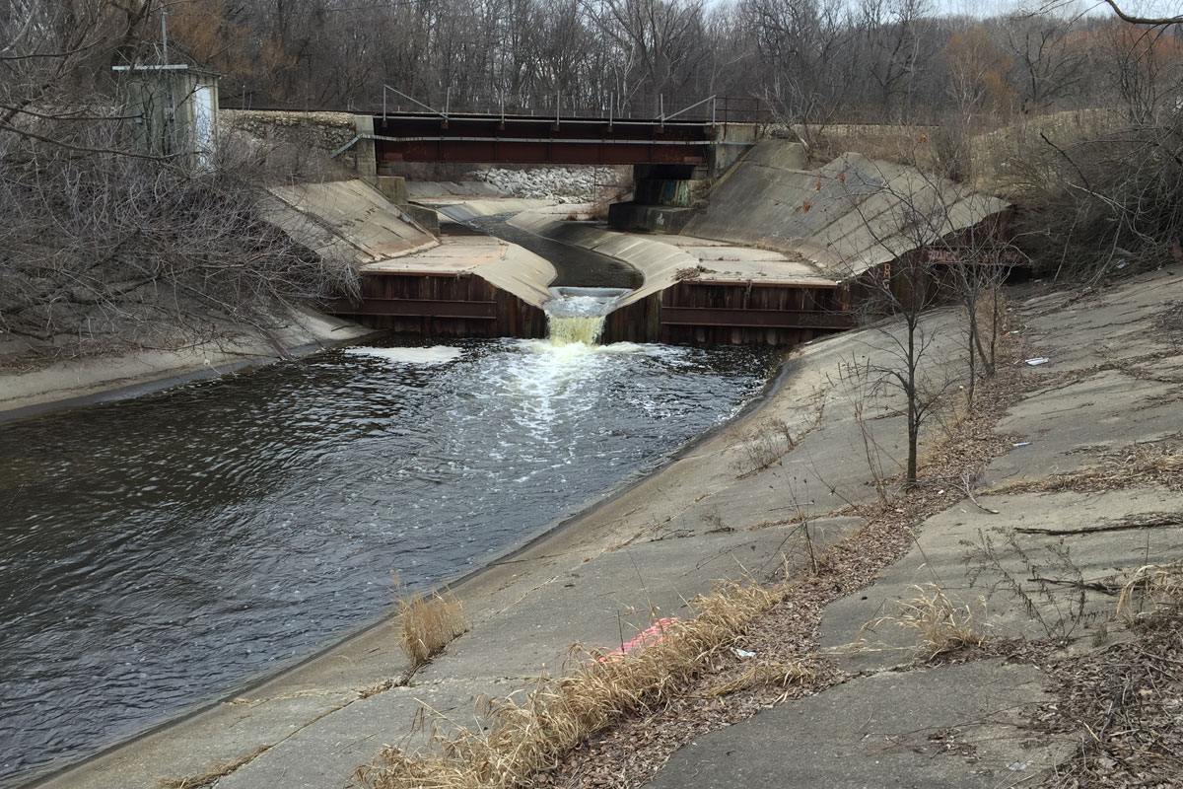
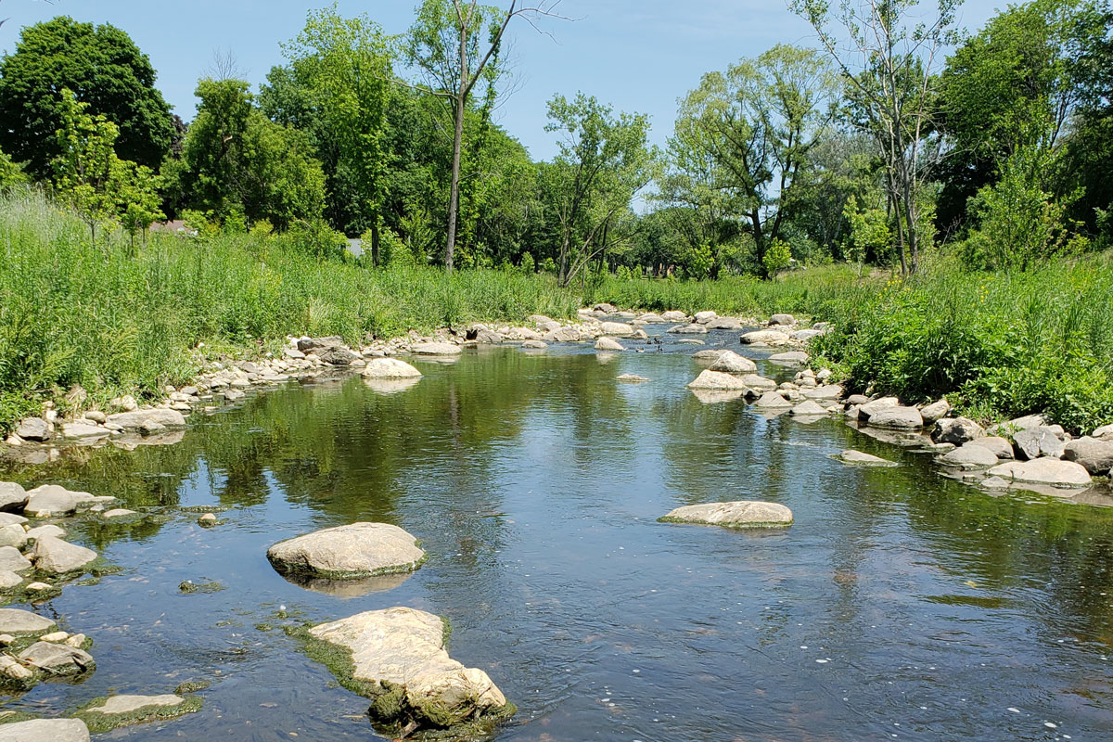
underwood

Slide 29
kinnickinnic

