Slide 1
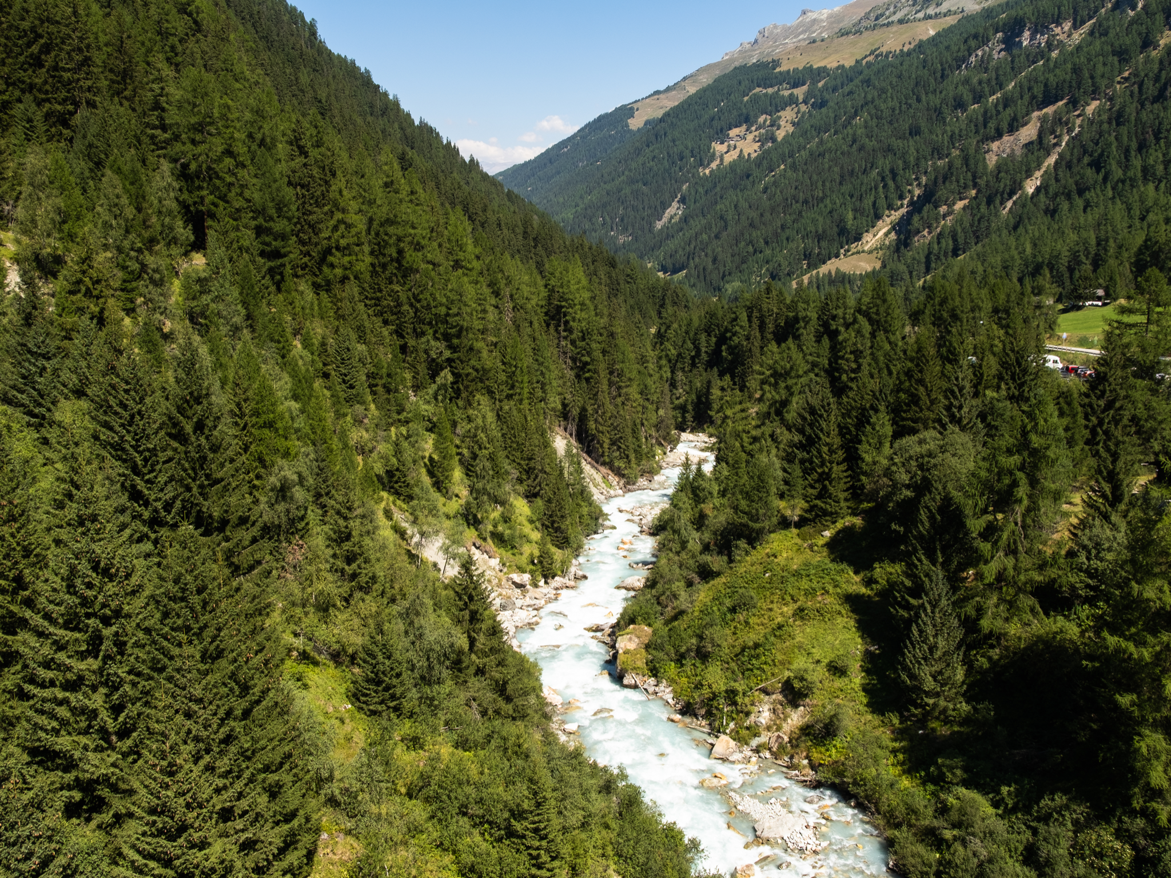

Biomic river restoration:
A new focus
for river management ​
Johnson et al.​
Camille Masanet​
Flavie Cordier​
Matteo Thomé​

Slide 2
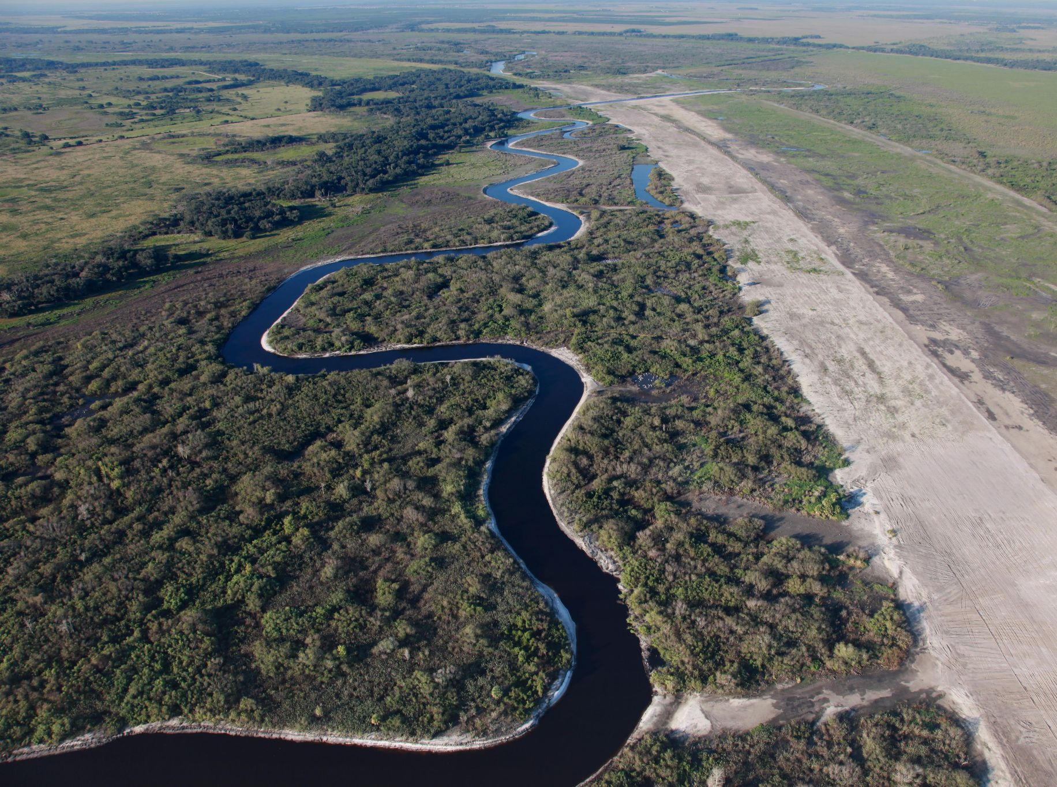
Introduction
Physical management
Biology
Biogeomorphology
Partnerships
Goals and challenges of biomic river restoration
flickriver.com
Notes:
mentionner que la présentation reprend deux grands titres du cours: physics & biology

Slide 3
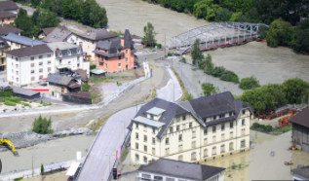
Introduction
Climate instability and river management problems
Floods (e.g., Rhône in Valais, Vénéon in Écrins) → massive damages
The stable channel design
Main technique used between 17th and 20th century restoration projects → engineering measures
Issues
Rhone flood in Valais ⁽¹⁾
Biomic River Restoration (BRR)
Novel framework prioritizing biological and ecological processes
Goals: improve river resilience support human activities
Key applications → ecotones, periodic floods, natural sediment flow

Slide 4
Physical management
Historical:
River management → manipulating hydrology and sediment dynamics
Dominance of physics-based models → stable channel design
Stable channel design ⁽²⁾
Goal: predict adjustments of river to water and sediment discharges
Steady flow
Sediment concentration → balanced average in space and time
General theory: resolution of relations between hydraulic variables
Q | D | C | S | P | R
Water discharge | Diameter of bed material | Sediment concentration | Energy slope | Wetted perimeter | Hydraulic radius

Slide 5
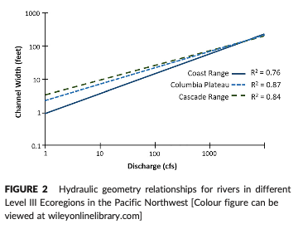
Physical management
Limitations:
Issues: habitat destruction, disruption of species, poor resolution of initial problems
Why?
Influence of non-physical factors (biotic)
Regional specificity: the example of Pacific Northwest in the US → differences in hydraulic geometry: climate, geology, soils…
→ single-thread channels for restoration is challenged
Castro & Jackson, 2001 ⁽³⁾

Slide 6
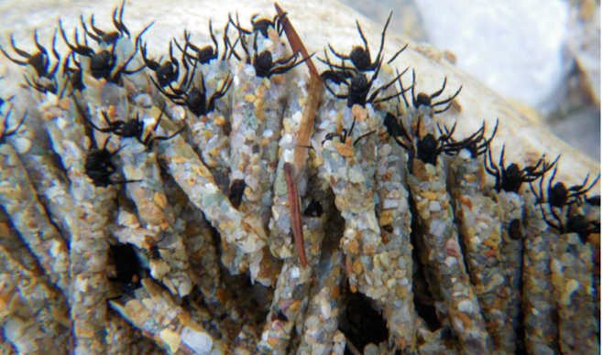
Biology - Small creatures
Small organisms have a surprisingly large influence on river processes and show us that biological processes play a critical role in sediment stability and river morphology.
Trichopteran Larvae (Caddisflies):
Stabilize fine sediments with silk nets → increase shear stress threshold by 33-45%.
Aquatic Invertebrates:
Crayfish and insect larvae move sediment through bioturbation.
Example: Signal crayfish significantly increase sediment transport.
Fish (Salmonid Species):
Move gravel while building nests (redds), redistributing up to 50% of annual sediment load in rivers.
Notes:
Despite their size, small organisms like insects, crayfish, and fish have a surprisingly large influence on river processes.
- For example, caddisfly larvae, a common aquatic insect, spin silk nets that bind sediments together. This increases the threshold needed for sediment to move by 33-45%, helping stabilize riverbeds.
- Aquatic invertebrates like shrimp or crayfish disturb sediments as they forage, a process known as bioturbation. In cases like the invasive signal crayfish, this disturbance can significantly increase sediment transport, creating challenges in sediment management.
- Fish, such as salmon, reshape riverbeds during reproduction. In British Columbia, salmon can move half of the annual sediment load in mountain streams as they dig nests, or redds, to lay their eggs. These actions contribute to longitudinal biodiversity gradients, where nutrient cycling and ecosystem functioning vary from headwaters to downstream reaches​
These small organisms show us that biological processes play a critical role in sediment stability and river morphology."

Slide 7
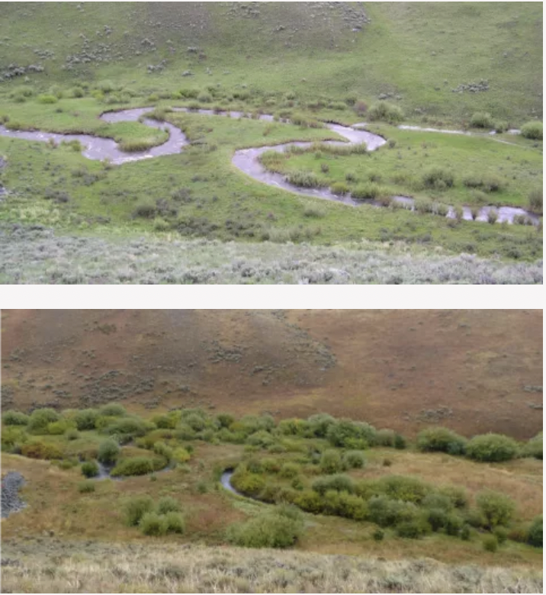
Biology - Bigger creatures
Beavers:
Build dams → create wetlands, slow water flow, and trap sediments.
Historically, their near extinction led to river incision and habitat loss.
Large Herbivores (Wolves and Elk Example):
Yellowstone: Elk overgrazing destabilized riverbanks.
Reintroduction of wolves → riparian vegetation recovery, river stabilization.
Animals actively shape river landscapes, whether through engineering, sediment stabilization, or grazing influences
https://news.oregonstate.edu/news/yellowstone-streams-recovering-thanks-wolf-reintroduction
Notes:
Bigger creatures also have substantial impacts on river systems.
Beavers are perhaps the most well-known river engineers. They build dams that create wetlands, slow water flow, and promote sediment deposition. In North America, the near extinction of beavers in the 19th century caused rivers to incise, losing floodplain connectivity and habitats. Modern restoration efforts now focus on reintroducing beavers to aid natural recovery.
Large herbivores like elk can negatively impact rivers when predators are absent. In Yellowstone, the absence of wolves allowed elk populations to overgraze riparian vegetation, destabilizing riverbanks. The reintroduction of wolves restored the ecosystem, reducing elk numbers and allowing vegetation and rivers to recover.
These examples show that animals actively shape river landscapes, whether through engineering, sediment stabilization, or grazing influences."

Slide 8
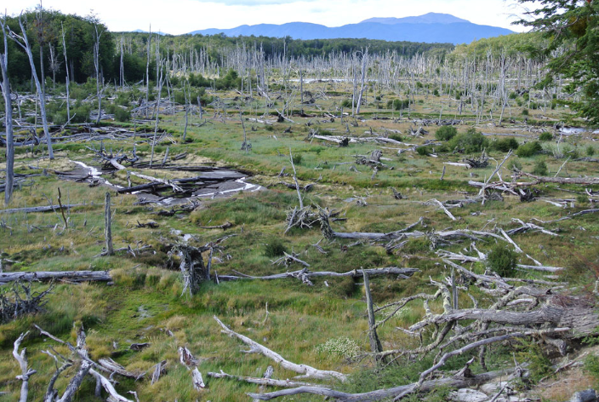
Biology - Invasive species
Ecological Context Matters:
Native species support ecosystem resilience.
Invasive species disrupt natural processes.
Invasive Species:
Signal crayfish → bioturbation increases sediment transport by 32%.
Beaver in Patagonia → flooding of peatlands, destruction of forests, and invasive plant growth.
Johnson et al.
Notes:
Biological processes can have negative effects, particularly when species act outside their native ranges.
Invasive species can cause unexpected disturbances. For example, signal crayfish in the UK increase sediment transport by up to 32% due to their intense burrowing activity. This destabilizes riverbeds and complicates restoration efforts.
Similarly, North American beavers introduced to Patagonia have caused significant damage. Their dams flood peatlands, drown native forests, and allow invasive plants to colonize the region.
These examples highlight the importance of understanding the ecological context. Native species often support resilience, while invasive species can destabilize ecosystems. Restoration must carefully manage biology to avoid unintended consequences.

Slide 9
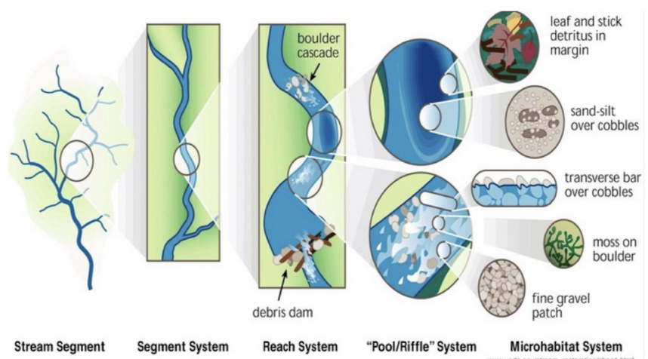
Biogeomorphology - Natural power
Co-Evolution of Rivers and Life:
Rivers evolved alongside terrestrial plants → stabilization of meandering channels.
Example: Vegetation and log jams formed ancient anastomosed channels.
Maximum Power:
Multi-threaded channels with floodplain connectivity.
Minimum Power:
Single-thread, high-flow channels.
Self-Healing Capacity:
Natural disturbances promote recovery through recolonization and succession.
Notes:
Over millions of years, rivers have co-evolved with life. The stabilization of meandering rivers is closely tied to the development of terrestrial vegetation and root systems.
For example, vegetation and log jams in ancient rivers created multi-threaded, anastomosed channels, which were more stable and resilient.
Rivers also have a self-healing capacity. Natural disturbances trigger recolonization and ecological succession, allowing systems to recover.
The maximum biogeomorphic power occurs in rivers with multi-threaded channels and connected floodplains, where biological influence is strong. In contrast, single-thread, high-flow channels minimize biological processes due to powerful water flows.
This balance between biology and physics is key to understanding natural river evolution. Streams co-evolve with biological systems, where vegetation and woody debris promote stability. These processes are akin to the adaptive traits of benthic organisms, which thrive in diverse hydraulic niches, sustaining functional diversity and ecosystem metabolism​

Slide 10
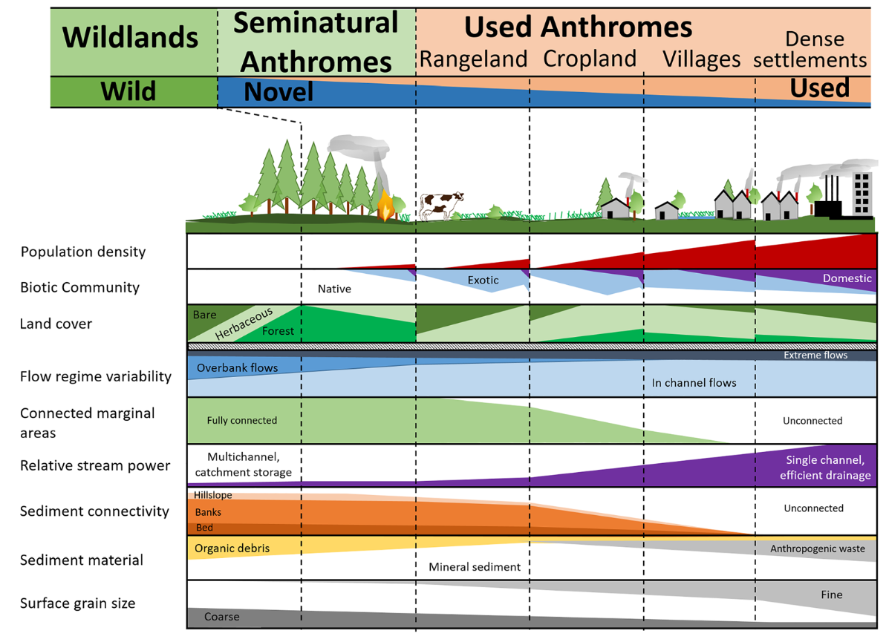
Biogeomorphology & Biomes
Biomes:
Natural systems defined by climate, geology, and vegetation.
Rivers are keystone components of biomes.
Anthromes (Anthropogenic Biomes):
Human-transformed landscapes → urban, agricultural, and industrial areas.
Rivers reflect these changes (altered flow, sediment dynamics).
Johnson et al.
Challenges in Restoration: Constrained by infrastructure, poor water quality, and limited space.
Notes:
Finally,
Biomes are natural systems defined by climate, geology, and vegetation. Rivers play a crucial role in maintaining these ecosystems.
However, human activity has transformed natural landscapes into anthromes—urban, agricultural, or industrial environments. Rivers integrate these changes, leading to altered flows, sediment transport, and ecosystem function.
Restoring rivers in anthromes is challenging due to infrastructure constraints, poor water quality, and limited space. For example, urban rivers are often confined and disconnected from their floodplains.
Despite these challenges, restoration efforts can still focus on improving connectivity and supporting natural processes wherever possible.

Slide 11
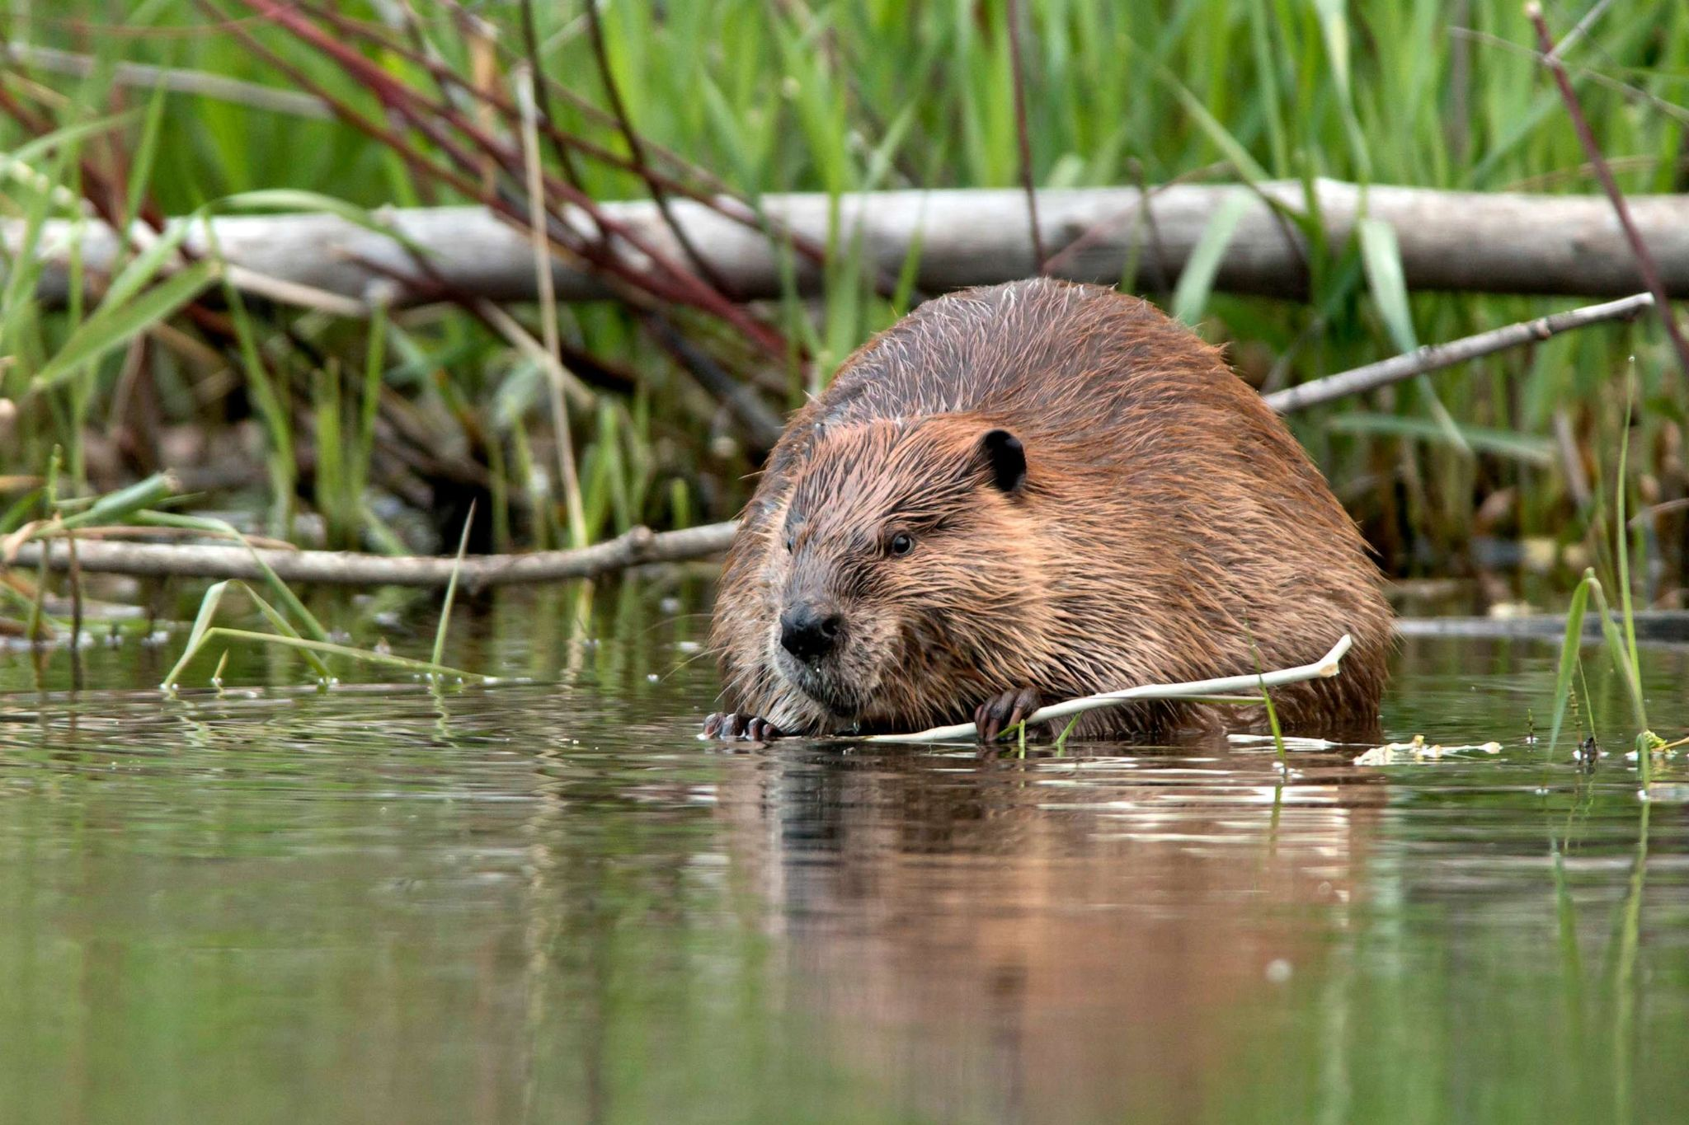
Partnerships
The idea of partnerships with river’s restorers
“We cannot replicate physically what biogeomorphology does organically”
STOCK IMAGE/Getty Images
The example of beavers:
we could never replicate the infrastructures and maintenance of beavers
physical processes build landforms not habitats
goal = not replace them but empower them to maintain their habitat
only animals are able to adaptively manage their habitat
So how should restoration be done?
Notes:
Beavers are our partners in river restoration and we should try to work with them
beavers = very obvious example of big creatures but small animals are as essential to the structural, chemical, biological balance
adaptively manage to changing flow regimes whereas human built infrastructures are steady and indefinite

Slide 12
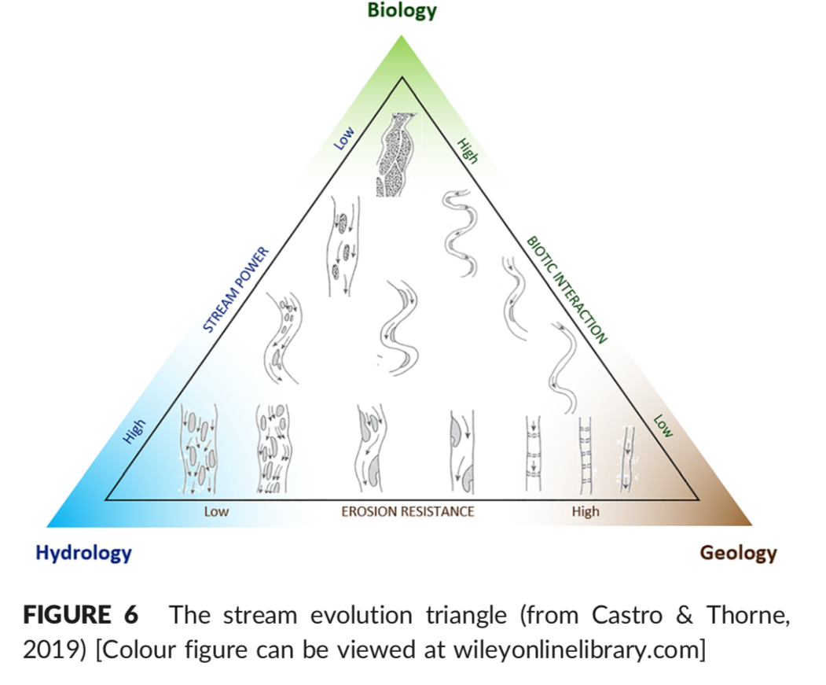
Varying biogeomorphic power
Minimal biogeomorphic power
Maximal biogeomorphic power
Channel configuration determines
stream flow
Biological power is inversely proportional to the stream flow
High flow = low biotic interactions
Low flow = high biotic interactions

Slide 13
2. The importance of seasonal patterns
Should we exactly reproduce previous flow regimes?
=> practically impossible, Climate Change = uncertainties for the future
But thankfully, species adapt and evolve to new conditions.
Goal in river restoration
range and seasonal patterns of instream and overbank events need to meet the life stage requirements of important species
A river’s capacity to recover from extreme events
depends on its river width => A wide river bed is needed !
the river needs room to flood but also to erode and deposit sediment, for trees to fall in from eroding banks and for riparian vegetation to reestablish on new surfaces
Problem= expanding the river bed is sometimes too costly or not possible with surrounding infrastructures

Slide 14
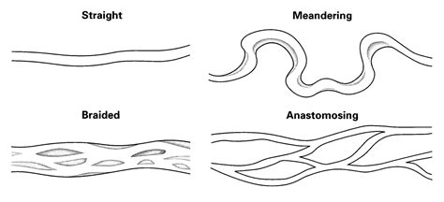
Goals and challenges of biomic restoration
Goals
Ecological assessment
= understanding the natural capital available, and its potential utility in restoration
Methods to maximize the significance of biology relative to purely physical processes
= moving away from single-thread channel designs towards anastomosed channels
Allow biological processes to “take over channel maintenance”
= goal for the restored area to fully reintegrate within its fluvial and catchment contexts, without the need for continued human intervention

Slide 15
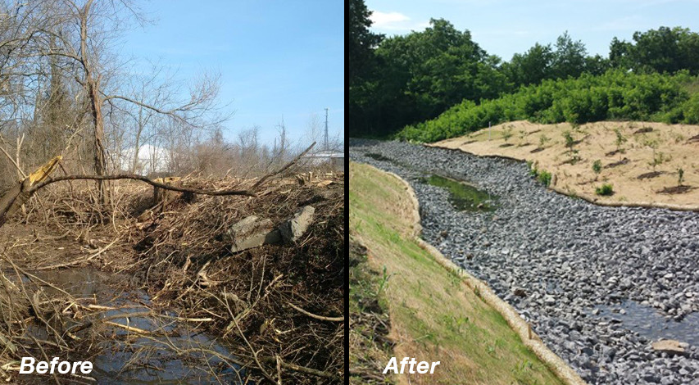
Goals and challenges of biomic restoration
Challenges
Looking at the entire ecosystem instead of one species
Considering the surrounding landscape
Not all catchments can be restored with this approach
Impossible if
no marginal room to accommodate a channel migration zone
irrecoverably poor water quality
channel in densely built and populated area
Possible if
dynamic flow and sediment regimes
enough space to accommodate a dynamic, erodible “stream evolution corridor” (Kondolf, 2011).
“Biogeomorphology is powerful, but hazardous if mishandled”
http://kilgoreintl.com/project-sediment-removal-and-wetland-stream-restoration/
Notes:
e.g. adding sediments to mimic the sediment loading but actually removing the proper environment for the microbial ecosystem = whole food chain disturbed

Slide 16
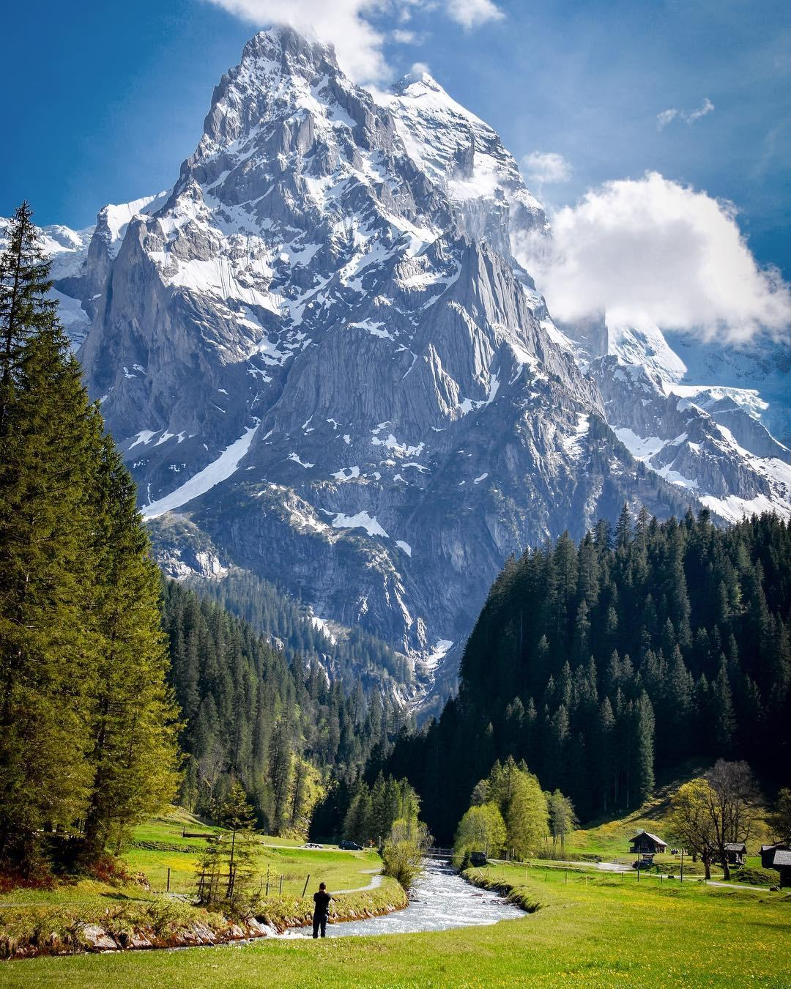
Thank you for your attention!

Slide 17
References
[1]
Radio Télévision Suisse, “Les crues en Valais font enfler le débat sur la révision de la troisième correction du Rhône,” rts.ch, Jul. 2024. https://www.rts.ch/info/suisse/2024/article/les-crues-en-valais-font-enfler-le-debat-sur-la-revision-de-la-troisieme-correction-du-rhone-28556058.html
[2]
G. A. Griffiths, “Stable-channel design in alluvial rivers,” Journal of Hydrology, vol. 65, no. 4, pp. 259–270, Sep. 1983, doi: https://doi.org/10.1016/0022-1694(83)90080-x.
[3]
J. M. Castro and P. L. Jackson, “BANKFULL DISCHARGE RECURRENCE INTERVALS AND REGIONAL HYDRAULIC GEOMETRY RELATIONSHIPS: PATTERNS IN THE PACIFIC NORTHWEST, USA,” Journal of the American Water Resources Association, vol. 37, no. 5, pp. 1249–1262, Oct. 2001, doi: https://doi.org/10.1111/j.1752-1688.2001.tb03636.x.

