Slide 1
Exercise session #1
Science of
Climate Change
Sept. 21, 2023

Slide 2
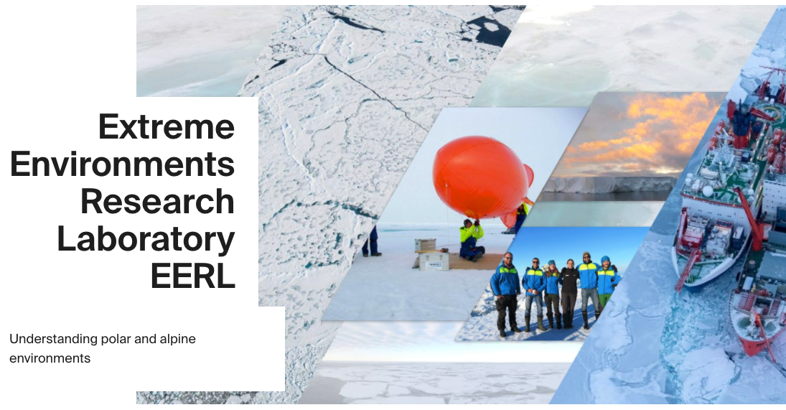
Joanna Dyson
Teaching Assistant
PhD in Atmospheric (tropospheric oxidation) Chemistry, University of Leeds, UK
Postdoc on Shipping Emissions in the Arctic and North Atlantic, British Antarctic Survey, Cambridge UK. (Ship campaign, Labrador Sea, Greenland)
Postdoc on Tropical Meteorology in South East Asia, University of Leeds, UK
Scientific Collaborator at EPFL’s Extreme Environments Research Lab (Sion, Valais) since Julia 2023
  Greenfjord project : Effect of the changing climate on Greenfjordic Fjord ecosystems (Atmosphere Cluster)
Also TA for lecture 11 (28th Nov) and lecture 12 (5th Dec)
https://www.epfl.ch/labs/eerl/

Slide 3

Assignment and poster groups
Groups of 4 students
Same group for both assignment and poster
We would like a mixture of backgrounds in each group (i.e. economics, maths, politics etc... )
  Rules:
    Minimum 3 sections represented
    Maximum 2 students from the same section
Please organise yourselves
Deadline: 5 October
Enter your groups in the
spreadsheet on moodle
Notes:
Create google spread sheet, enter the info on moodle

Slide 4

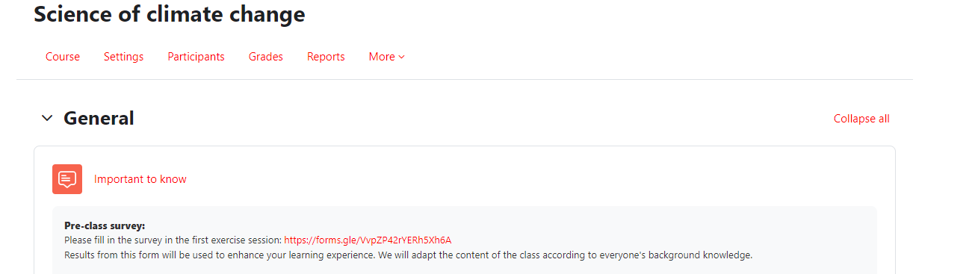
Questionnaire
15 minutes
Please take 15 minutes now to fill this in
100% anonymous
For us to evaluate what you already know (or don’t) on the topic
To help us identify topics to address in class
Same questionnaire at the end of the semester for you to assess your progress
One correct choice per question
If you don’t know the answer, don’t guess, choose “I don’t know”

Slide 5
Today’s goal:
Basic concepts of the Earth System

Slide 6
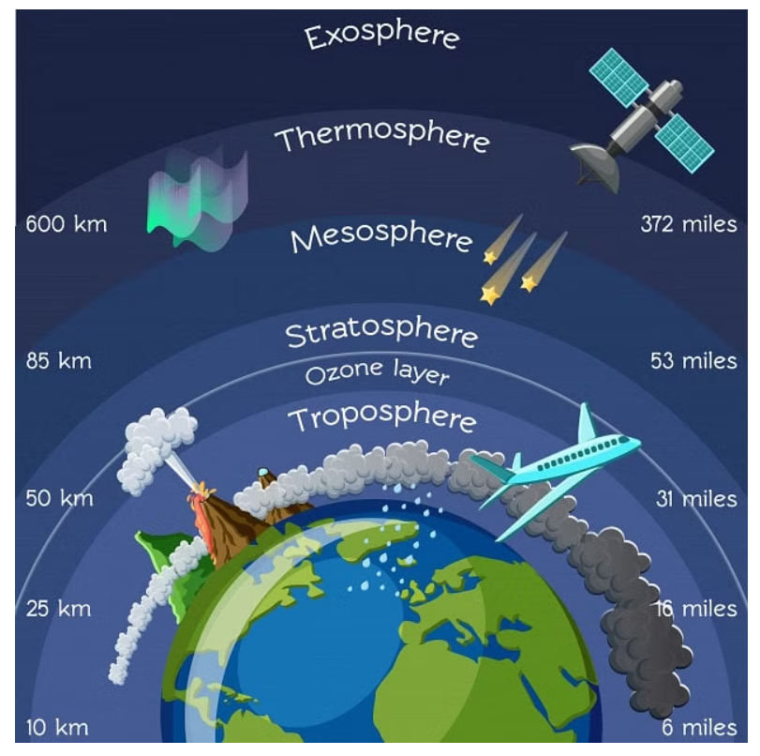
Structure of the Atmosphere
Thermosphere
Layer at the top of the atmosphere which absorbs high-energy x-rays and UV radiation from the sun
This means it is 100s or 1000s °C in T
Many satellites orbit within Thermosphere
Karmin line is found in the Thermosphere
  Approx. boundary between our atmosphere and space
Mesosphere
Extends up to ~ 85 km
Temperatures are colder that in the mesosphere compared to the stratosphere and the thermosphere
Coldest temps of ~ -90 °C in our atmosphere are found at the top of the Mesophere
https://edurev.in/t/180319/Earth-s-Atmosphere-Composition-Structure

Slide 7
Structure of the Atmosphere
Stratosphere
Extending from the top of the troposphere to ~50 km.
Ozone layer is found here
  Ozone absorbs high energy UV light converting it to heat which means the higher up the stratosphere you go the warmer it is.
Rising temp with altitude means that air lacks turbulence and mixing compared to the troposphere. Planes are found here for this reason
Troposphere
Lowest layer of the atmosphere containing the turbulent atmospheric boundary layer
Further away from surface heat, the air gets cooler which means the troposphere is warmest at the surface.
Nearly all weather occurs in this layer and most clouds appear here also
  This is because 99 % of H2O(v) in atmosphere is here
https://edurev.in/t/180319/Earth-s-Atmosphere-Composition-Structure

Slide 8
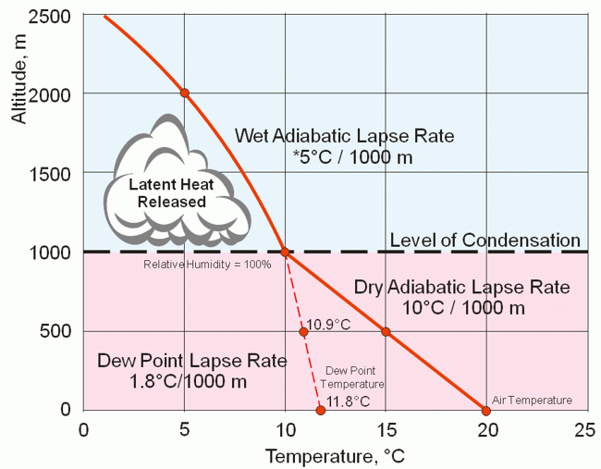
Lapse Rate
Environmental Lapse Rate: Rate at which temperature decreases with height
Dew point temperature: saturation temperature for water vapor in air
Dry Adiabatic Lapse Rate: Lapse rate without condensation
Wet Adiabatic Lapse Rate: Lapse rate with condensation
Dew Point Lapse Rate: Rate at which the dew point temperature decreases with height
Level of Condensation: The altitude of the intersection of the dew point lapse rate and dry adiabatic lapse rate given their surface temperature.
https://weatherworkedout.weebly.com/air-masses-and-weather-systems.html

Slide 9
Lapse Rate rate at which temperature changes with altitude
Lapse rates depends on T, pressure and degree of saturation in air parcel → all affected by altitude
Adiabatic Lapse Rate
Environmental Lapse Rate
Rate at which temperature of atmosphere decreases with height, or the lapse rate of non-rising air
Rate at which temperature of an air parcel decreases with height
Adiabatic – no heat is exchanged with the surroundings

Slide 10
Adiabatic Lapse Rate
Rate at which temperature of an air parcel decreases with altitude
Dry Adiabatic Lapse Rate
Does not consider condensation
Depends only on specific heat capacity of air at constant pressure and the acceleration due to gravity.
Wet Adiabatic Lapse Rate
Considers condensation
When an air parcel that is saturated with water vapour rises, some of the vapour will condense and release latent heat. This process causes the parcel to cool more slowly than it would if it were not saturated.
Therefore, this rate would be lesser than the dry adiabatic lapse rate.

Slide 11
Unstable vs Stable atmospheres
Lapse rates help determine atmospheric stability – dependant on the wet or dry adiabatic lapse rate vs the environmental lapse rate
i.e. rate of change in T of air parcel vs the surrounding air
In an unstable atmosphere:
Environmental lapse rate > Moist Adiabatic lapse rate
A rising parcel will therefore change temperature, i.e. cool down, more slowly than the environmental lapse rate.
The air parcel will stay warmer and less dense than the surrounding air. – This means that the parcel will rise as it is less dense.
Unstable environments lead to quick changes in weather such as sudden storms.

Slide 12
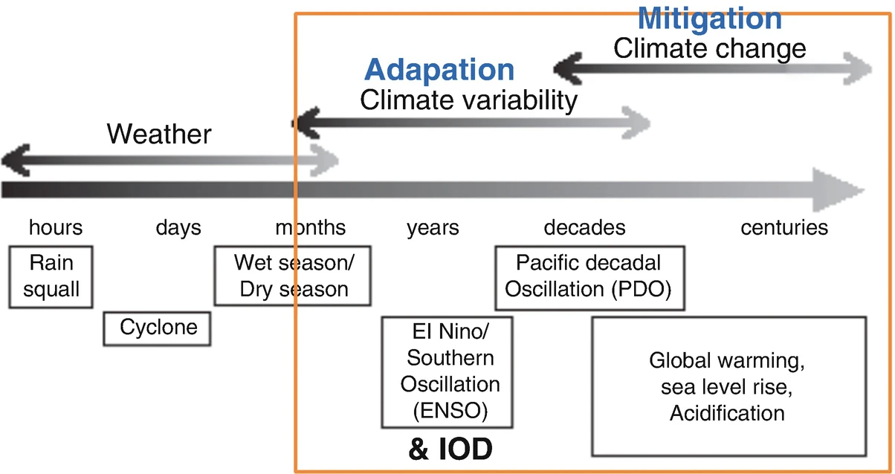
Climate Timescales
Climate is how the atmosphere behaves over relatively long periods of time, therefore, we need to understand these timescales
https://www.pacificclimatefutures.net/en/help/climate-projections/understanding-climate-variability-and-change/

Slide 13
Exercises

Slide 14
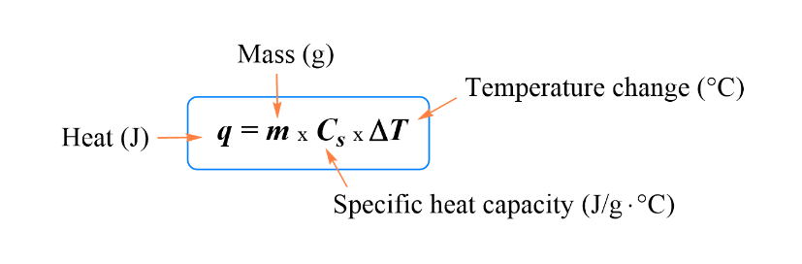
Exercise – Ocean Warming
The specific heat capacity (C_{s}) is the amount of energy (q) required to change a substance, with mass (m), by a certain temperature (ΔT)

Slide 15
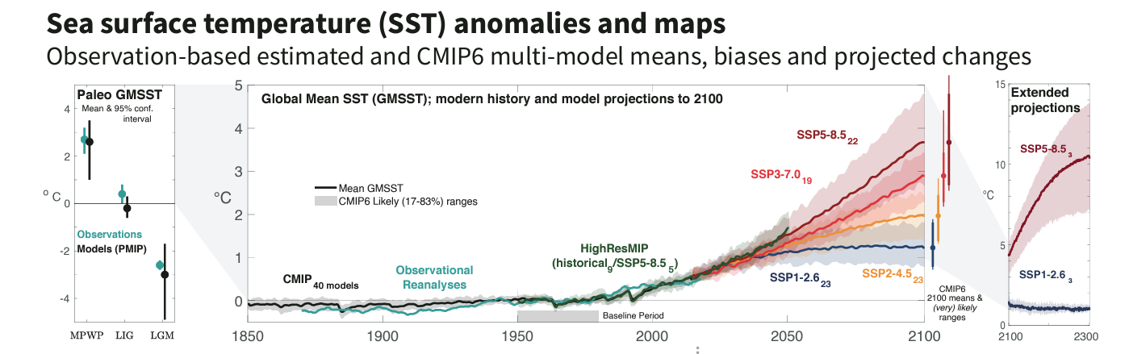
IPCC report – Ocean Warming
This is a time series of global mean SST anomaly relative to 1950-1980 climatological mean.
Added to this are paleoclimate reconstructions and observational reanalysis to take us back before 1950.
Projecting us forwards are the SSP1 to 5
These are Shared Socioeconomic Pathways which describe different pathways for continued global development based on varying degrees of climate action, mitigation efforts and socioeconomic growth and decline.

Slide 16
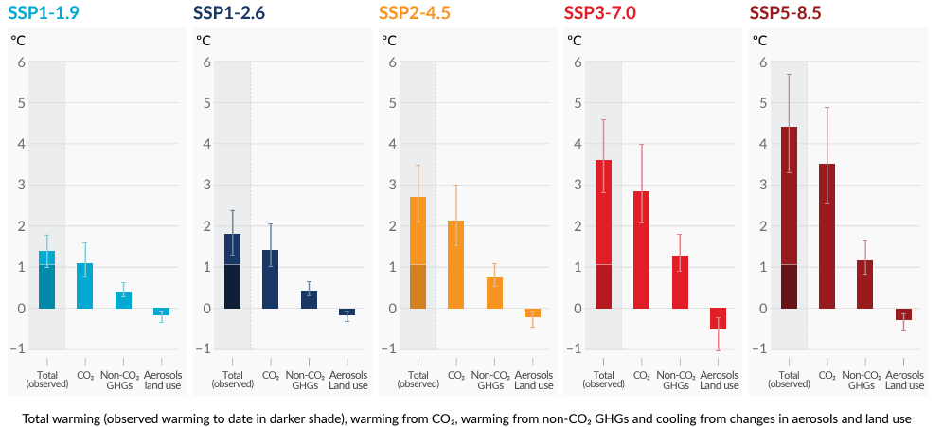
IPCC report – Ocean Warming

Slide 17
Exercise – Ocean Warming
Lets consider ocean warming in the context of SSP5 – the pathway with the least mitigation.
The ocean surface temperature is projected to increase on average by 2.89 °C in SSP5-8.5 between 1995 to 2014 and 2081 to 2100. ^{[1]}
1. Calculate the amount of energy required to heat the top 1 km of the ocean from this temperature ….. increase.
Assume the total surface area of the ocean is 361 million km^{2 [2]}
Density of seawater is about 1025 kg /m³ and the specific heat is about 3850 J/(kg °C) ^{[2]}
How does this compare to the maximum output of large-scale hydropower in Switzerland over roughly the same period (100 years)?
What are the potential effects of this energy absorption on marine ecosystems and sea level rise?
Hint: 1 W = J/sec
[1] https://www.ipcc.ch/report/ar6/wg1/chapter/chapter-9/ [2] https://rwu.pressbooks.pub/webboceanography/chapter/1-1-overview-of-the-oceans/#:~:text=Oceans%20cover%20an%20area%20of,the%20surface%20area%20(Figure%201.1 [3]http://sam.ucsd.edu/sio210/lect_2/lecture_2.html#:~:text=The%20density%20of%20seawater%20is,3850%20J%2F(kg%20C)

Slide 18
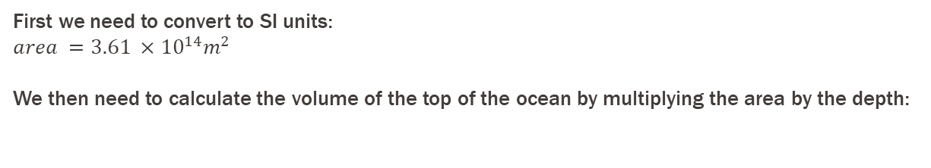
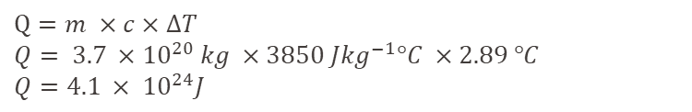
Exercise – Ocean Warming (Solution)
The ocean surface temperature is projected to increase on average by 2.89 °C in SSP5-8.5 between 1995 to 2014 and 2081 to 2100. ^{[1]}
1. Calculate the amount of energy required to heat the top 1 km of the ocean from this temperature increase.
Assume the total surface area of the ocean is 361 million km^{2 [2]}
Density of seawater is about 1025 kg /m³ and the specific heat is about 3850 J/(kg °C) ^{[2]}
First we need to convert to SI units:
$area =3.61 ×{10}^{14}m^{2}$
We then need to calculate the volume of the top of the ocean by multiplying the area by the depth:
$Volume=area ×depth=3.61 ×{10}^{14}m^{2} ×1000= 3.61 ×{10}^{17}m^{3}$
To calculate the energy required, Q, we need the mass:
$$m=v ×p=3.61 ×{10}^{17}m^{3} ×1025 kg m^{−3}=3.7 ×{10}^{20} kg$$
Therefore Q is:
$Q=m ×c×∆T$
$Q= 3.7 ×{10}^{20} kg ×3850 J{kg}^{−1}°C ×2.89 °C$
$Q=4.1 × {10}^{24}J$

Slide 19
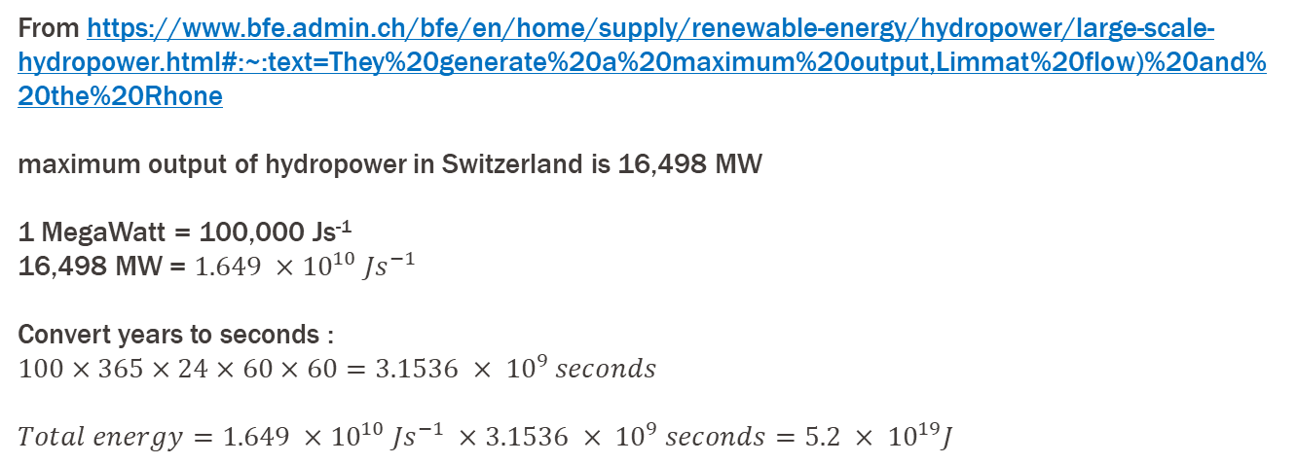
Exercise – Ocean Warming (Solution)
$Q=4.1 × {10}^{24}J$
How does this compare to the maximum output of large-scale hydropower in Switzerland over roughly the same period (100 years)?
From https://www.bfe.admin.ch/bfe/en/home/supply/renewable-energy/hydropower/large-scale-hydropower.html#:~:text=They%20generate%20a%20maximum%20output,Limmat%20flow)%20and%20the%20Rhone
maximum output of hydropower in Switzerland is 16,498 MW
1 MegaWatt = 100,000 Js⁻¹
16,498 MW = $1.649 ×10^{10} {Js}^{−1}$
Convert years to seconds :
$100×365×24×60×60=3.1536 × {10}^{9} seconds$
$Total energy=1.649 ×10^{10} {Js}^{−1} ×3.1536 × {10}^{9} seconds=5.2 × {10}^{19}J$

Slide 20
Exercise – Ocean Warming (Solution)
How does this compare to the maximum output of large-scale hydropower in Switzerland over roughly the same period (100 years)?
$Total energy=1.649 ×10^{10} {Js}^{−1} ×3.1536 × {10}^{9} seconds=5.2 × {10}^{19}J$
$$\frac{Energy required to heat ocean}{Energy required from Swiss hydropower}= \frac{4.1 × {10}^{24}J}{5.2 × {10}^{19}J}=7.9 × {10}^{4}$$
Energy required to heat the top 1km of ocean by 2.89 degrees is ~80,000 times that of the total energy output from large scale hydropower in Switzerland over 100 years.

Slide 21
Exercise – Ocean Warming (Solution)
What are the potential effects of this energy absorption on a) marine ecosystems
Ocean warming
Coral bleaching
Disrupted migration patterns
Algal bloom frequency increases
Ocean stratification and deoxygenation
Surface waters become less dense causing stratification of stable warmer ocean layers on top of cooler layers
Limits mixing reducing vertical transport of nutrients, oxygen levels in deeper waters reduce and marine organisms dependant on this upwelling for food will die
Decrease in biodiversity and disruption of food chain
Ocean acidification
and b) sea level rise?
Melting of ice caps and glaciers
Melting of ice caps and glaciers adds freshwater to the ocean accelerating sea level rise
Thermal expansion
Absorption of increased energy expands upper layers of the ocean directly contributing to sea level rise
Saltwater intrusions
Rising sea levels cause saltwater to intrude into freshwater aquifers
Threatens drinking water and agriculture in coastal regions
Coastal erosions and flooding

