Slide 1
Exercise session #11 28th November
Science of Climate Change
CO2 equivalent metrics
23.11.2023

Slide 2
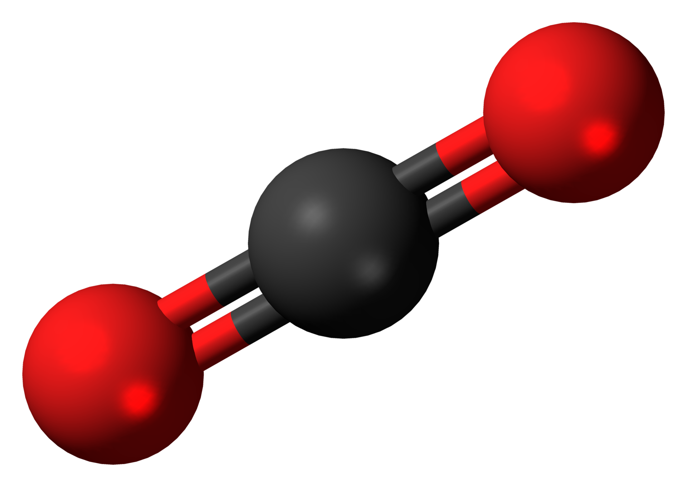
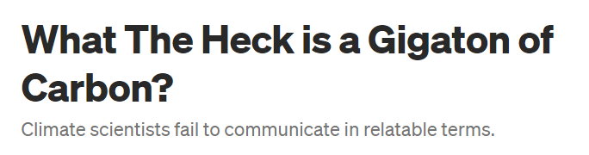
Today’s goal
Understand the concepts of CO₂ equivalent metrics and what they imply for decision making!
Plan:
Recap Metrics and carbon offsets lecture
Moles, concentration and volume calculations recap
CO₂ equivalent metrics
Global Warming Potential (GWP, GWP*, GTP)
Limitations and advantages
Calculating and using GWP and GWP*
Quiz questions for Carbon Offset and CSRD
12
C
O
Molar mass = 12g/mol
16
12
16
O
C
O
Found at: https://dannypilkenton.medium.com/what-the-heck-is-a-gigaton-of-carbon-62a1d211a15b
Molar mass = 44g/mol

Slide 3

Mole, conc, volume calculations
Calculate the number of moles in 1Gt of C and 1 Gt of CO₂
Calculate the volume at standard temperature and pressure of 1 Gt of CO₂ and the total yearly emissions in 2021.
Give your answer in cubic meters (m³) and convert it to number of
Léman lakes.
HINT:
At STP: 1 mol of gas = 22.41 L
2021 CO₂ emissions: 37.9 Gt
Volume of Lake Léman: 89 km³
Time : 5 mins

Slide 4
Mole, conc, volume calculations
Calculate the number of moles in 1Gt of C and 1 Gt of CO₂
1 gigatonne = 10⁹ tonnes = 10¹² kg
Molar mass of C = 12.01 gmol⁻¹
Molar mass of CO₂ = 44.01 gmol⁻¹
$$moles= \frac{mass}{molar mass}=\frac{10^{12} kg}{0.012 kg {mol}^{−1}}=8.33 ×1013 mol of C$$
$$moles= \frac{mass}{molar mass}=\frac{10^{12} kg}{0.044 kg {mol}^{−1}}=2.27 ×1013 mol of CO_{2}$$

Slide 5
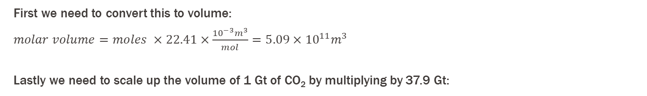
Mole, conc, volume calculations
HINT:
At STP: 1 mol of gas = 22.41 L
2021 CO₂ emissions: 37.9 Gt
b) Calculate the volume at standard temperature and pressure of 1 Gt of CO₂ and the total yearly emissions in 2021.
We know that:
From part a) we calculated that there are 2.27 x 10¹³ mol of CO₂ in 1 Gt
At STP, 1 mol of gas occupies 22.41 L or 22.41 x 10⁻³ m³
Remember that we know the mol of CO2 in 1 Gigatonne
First we need to convert this to volume:
$molar volume=moles ×22.41×\frac{10^{−3}m^{3}}{mol}=5.09×{10}^{11}m^{3}$
Lastly we need to scale up the volume of 1 Gt of CO₂ by multiplying by 37.9 Gt:
$yearly volumefor 2021=emissions of CO2 \left(37.9 Gt\right)×5.09×{10}^{11}m^{3}=1.93×{10}^{13}m^{3}$
Number of Lake Léman volumes = $\frac{1.93×10^{13}}{89×{10}^{9}}=$ 217 lakes

Slide 6
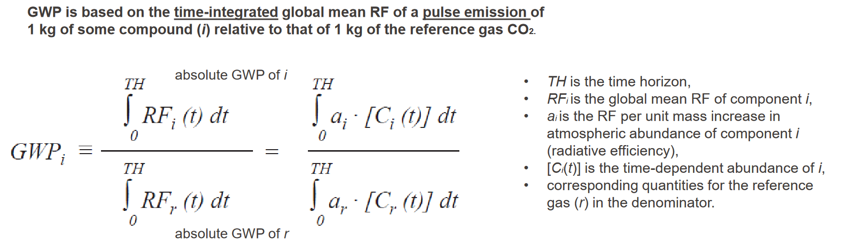
Global warming potential is calculated relative to CO₂. So… How do we convert other species to CO₂ equivalent?
*Slide 20/60 in Lecture 11

Slide 7
Or more simply...
GWP is a component of carbon accounting and provides a way to quantify and intercompare the effect of GHG emissions.
GWP is a calculation which requires us to take into consideration several components:
Time horizon i.e. the time over which you are calculating the metric
Usually 20,100 or 500 years
This is dependant on the residence time of gases in the atmosphere. i.e. how long they stick around and can impact our atmosphere
Radiative efficiency – how effectively a gas absorbs energy in the form of heat and re-emits it back towards earth
Atmospheric lifetime – the average time a gas phase molecule will remain in the atmosphere without being removed by chemical reaction or other processes.
If a gas has a longer lifetime, it can exert more of a warming effect on the atmosphere but this also depends on its radiative efficiency
Simply put … we are interested in the total energy absorbed by a specific quantity of GHG over a chosen period….we can then compare this to CO₂

Slide 8
If we look at the most known GHGs we can see that:
Greenhouse gas | Role | GWP over 100 years
CO₂ | Primary GHG Responsible for most of Earths warming Remains in the atmosphere longer than other GHG | 1
CH₄ | More effective than CO₂ at trapping heat in the atmosphere Breaks down much faster than CO₂ | 28 - 36
N₂O | Over 100 year period N₂O has a much greater impact than CO₂ Also depletes stratospheric O₃ | 298
Fluorinated gases (HFCs,PFCs,SF₆) | Synthetic gases that have a higher GWB than CO₂ Used in various industrial applications such as refridgeration | Varies a lot, but can be up to and over 23,000
https://www.minimum.com/resources/global-warming-potential

Slide 9
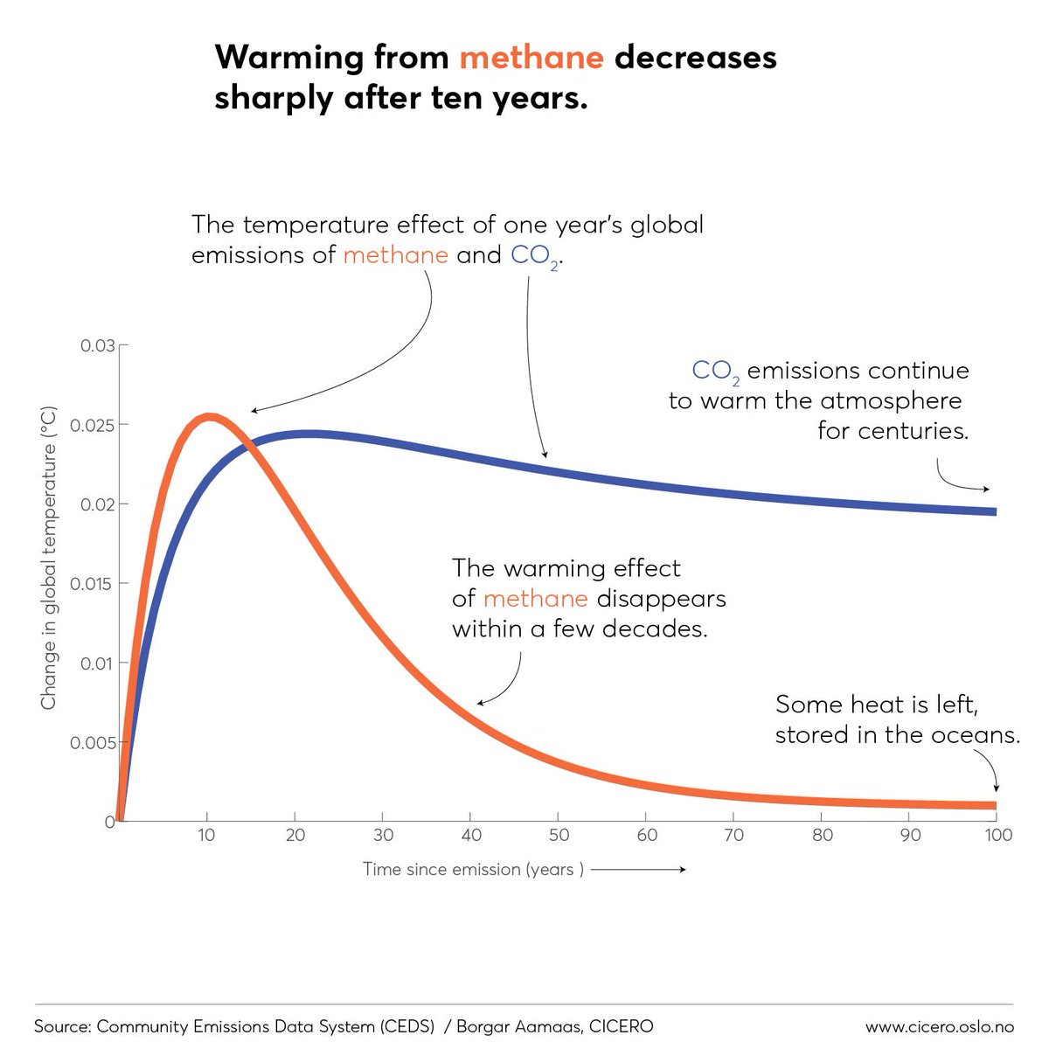
Different greenhouse gases have different effects
*Slide 16/60 in Lecture 11
Difference depends on:
Efficacy of the greenhouse gas (how powerful is the gas?)
Lifetime of the gas in the atmosphere
CH₄: ~12 years
CO₂: ~100 years
Notes:
https://twitter.com/hausfath/status/1183813162795032577

Slide 10
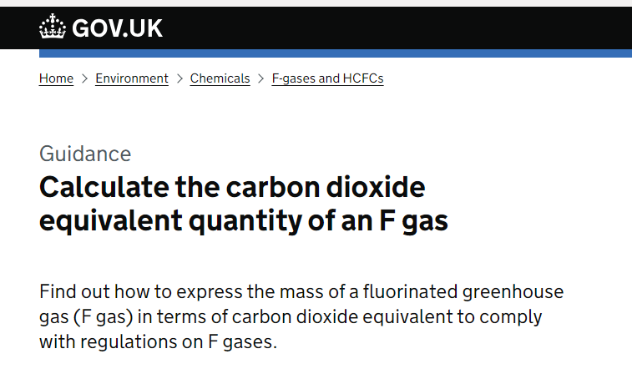
Calculate GWP
The UK government requires that you calculate the CO₂ equivalent mass if you, import or produce F gas into the UK
You work for a refridgerant company and have produced 15 kg of hydrofluorocrabon 404a and 10kg of HFC-407a.
If the GWP of HFC-404A is 3922 and the GWP of HFC-407a is 2107, calculate the equivalent tonnes of CO₂.
Hint:
First we want the mass of the HFCs in tonnes
Then we want to take into account the GWP of each
https://www.gov.uk/guidance/fluorinated-gases-f-gases

Slide 11
Calculate GWP
You work for a refridgerant company and have produced 15 kg of hydrofluorocrabon 404a and 10kg of HFC-407a.
If the GWP of HFC-404A is 3922 and the GWP of HFC-407a is 2107, calculate the equivalent tonnes of CO₂.
First we want the mass of the HFCs in tonnes
10/1000 = 0.01 tonnes
15/1000 = 0.015 tonnes
Then, we multiply this by the GWP of each gas:
0.015 x 3922 = 58.8 tonnes CO₂ equivalent for HFC-404A
0.01 x 2107 = 21.07 tonnes CO₂ equivalent for HFC-407A
https://www.gov.uk/guidance/fluorinated-gases-f-gases

Slide 12
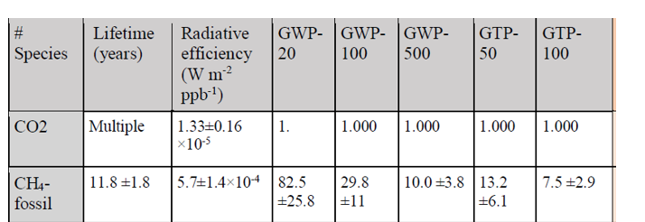
Limitations of GWP
The selected time horizon has a large impact on the value of
the metric and does not represent long or short term effects of specific GHGs.
GWP over-simplifies complex interactions of various gases in the atmosphere by converting them to the single metric relative to CO₂
Does not account for indirect effects of GHG such as their influence on cloud formation and the albedo effect.
There is a degree of uncertainty due to the uncertainty in the atmospheric models and assumptions used in the calculation of GWP values
Despite its name, it does not compare gases against their effect on global temperature.
Notes:
Show slide

Slide 13
GWP vs GTP
Global Temperature Change Potential (GTP)
… estimates the potential surface temperature reponse to emissions of different gases in a specific year in the future as opposed to spreading the impact over many years
This is useful for target-based climate policies like the Paris agreement.
Both GTP and GWP assume that there is a single time pulse of emissions into the atmosphere.
chrome-extension://efaidnbmnnnibpcajpcglclefindmkaj/https://transportproject.org/wp-content/uploads/2018/06/Understanding-Global-Warming-Potential.pdf

Slide 14
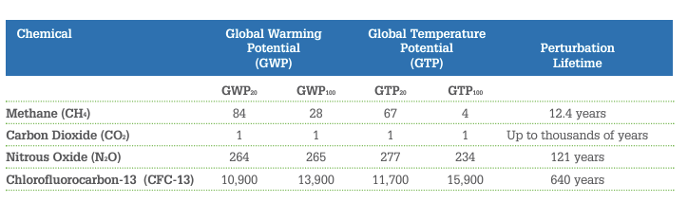
GWP vs GTP
Unlike GWP, GTP adds in knowledge of response times for the climate system, which is useful if the lifetime of X gas is not close to that of the reference gas.
Due to this, GTP values for pulse emissions of gases with shorter lifetimes than the reference gas will be lower than the corresponding GWP value.
For example, the lifetime of methane in the atmosphere is between 7 – 12 years, which is a relatively short lifetime compared to CO₂ which is thousands of years.

Slide 15

Calculating GWP*
*from slide 28/60 of lecture 11
Under the new GWP*, the CO₂ equivalent emission rate for short-lived species is calculated as the change in emission rates across the reference period multiplied by the warming potential over the time horizon:
$$E_{{CO}_{2}e∗}= \frac{∆E}{∆t}×{GWP}_{H}×H$$
Time horizon
CO₂ equivalents
Warming potential over time horizon
Change in emission rate

Slide 16
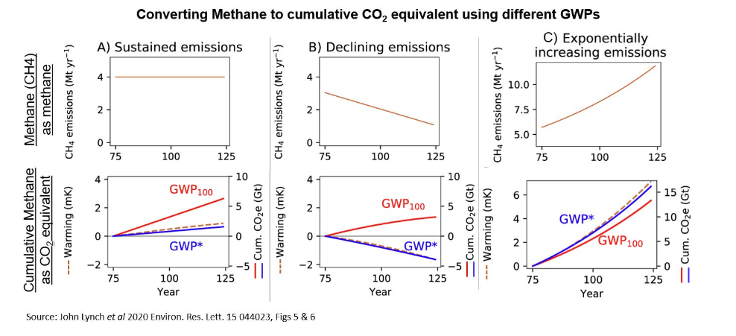
GWP*
https://ahdb.org.uk/knowledge-library/what-is-gwp#:~:text=GWP*%20aims%20to%20better%20model,well%20below%20that%20from%20GWP100.
GWP* aims to better model the impact of methane and compare the warming effect it has
Condition 1:
CH₄ emissions remain constant
Condition 2:
CH₄ emissions decline
Condition 3:
CH₄ emissions increase
GWP* - additional warming effects are negligible with older CH₄ breaking down balancing out the warming impact of newly emitted CH₄
GWP* - if CH₄ emissions noticeably decrease GWP* better takes into account this decrease in warming effect, unlike GWP100
GWP* - methane emissions have a stronger impact than under GWP100

Slide 17
GWP* vs GWP100
GWP100 | GWP*
Includes all GHGs | For CH₄ only, possibility to expand to short-lived GHGs
Average warming potential over 100 years | Warming effect over time, but accounts for the breakdown of CH₄
Focuses on fixed quantities of emissions | Focuses on the change in the rate of emissions over time
Can use emissions data over any timespan | Requires 20 years of emissions data
Less accurate representation of CH₄ impact | More accurate representation of the impact of CH₄ specifically
Formally adopted in international climate policy | Growing recognition as a metric, recognised by IPCC but so far no national or international level adoption
https://ahdb.org.uk/knowledge-library/what-is-gwp#:~:text=GWP*%20aims%20to%20better%20model,well%20below%20that%20from%20GWP100.

Slide 18
Carbon Offset
You are a cattle farmer, buying and growing your herd up from nothing over a 20 year period. The growing herd leads to a 20 tonnes CH₄ emission per year.
For the ensuing 20 years, you maintain the farm running at the same rate for another 20 years without growing your herd anymore.
Your friend however is the CEO of a small coal-driven power plant. While you have been growing your herd they have been running their small power plant for the last 20 years. At the 20 year mark however, solar power takes over and they decide to follow down the route of renewable energy and subsequently close the plant. Over the 20 running years, the plant emitted 40,000 tonnes CO₂ per year.
Question 1:
Compare the emitted CO2 eq for yourself and your CEO friend, with GWP and GWP*.
Question 2:
1 tonne of CO2_{eq} costs 100 CHF. What then is the cost of the 2 different careers if carbon emissions are taxed based on GWP and GWP*?

Slide 19
Carbon Offset
Question 1:
Compare the emitted CO_{2eq} for yourself and your CEO friend, with GWP and GWP*.
Herd emits 20 ton yr⁻¹ if the herd number is maintained and an additional 20 ton yr⁻¹ if it grows.
So if x is the original number of cows which emit 20t yr⁻¹, and the number of cows grows by y every year
If the original herd emits x in the first year, and then grows the next year releasing x again and an additional x, this means that in year 1 x is emitted and year 2, 2x is emitted, year 3 then 3x will be emitted etc… leading to 20x being released in year 20.
In total this leads to 4200 tonnes over 20 years while the herd is growing.
As the herd then remains the same size as it was at year 20 it will emit the same as this, i.e. 400 tonnes yr-1 for the next 20 years.
Total emission = 4200 + (400*20) = 12,200 tonnes over 40 years

Slide 20
Carbon Offset
Question 1:
Compare the emitted CO_{2eq} for yourself and your CEO friend, with GWP and GWP*, and discuss the result.
For the Farmer
Total emission = 4200 + (400*20) = 12,200 tonnes over 40 years
Using GWP:
12,200 * 81 (GWP20 of CH4) = 988200 tonnes CO_{2eq}
Using GWP*:
20 tonnes yr⁻¹ (change in emission rate) * 81 (GWP20 of CH4) * 20 (time horizon) = 32400 tonnes CO_{2eq}
For the power plant CEO:
Use GWP as there is no change in emission rates over the time:
40,000 tonnes yr⁻¹ were emitted by the power plant * 20 years = 800,000 tonnes CO_{2eq}
Question 2:
1 tonne of CO2_{eq} costs 100 CHF. What then is the cost of the 2 different careers if carbon emissions are taxed based on GWP and GWP*?
For the Farmer
Cost using GWP:
988200 tonnes CO2eq * 100CHF = 98,820,000 CHF
Cost using GWP*:
32400 tonnes CO2eq * 100 CHF = 3,240,000 CHF
For the power plant CEO:
Cost using GWP:
64,800,000 tonnes CO2eq * 100 CHF = 80,000,000 CHF

Slide 21

Corporate Sustainability Reporting Directive (CSRD)
The Corporate Sustainability Reporting Directive (CSRD) is a European Union (EU) regulation aimed at enhancing corporate transparency on environmental, social, and governance (ESG) issues. It builds upon the Non-Financial Reporting Directive (NFRD) and represents a significant step in integrating sustainability into corporate governance.
Companies must disclose how sustainability issues impact their business and their own impact on the environment and society
Introduces mandatory and standardised reporting
Key features
Wide scope of companies included
Data accessbility increased by digital format of mandatory sustainability reports.
Continuous auditing and assurance required – standards are maintained
GOALS
Promote accountability for ESG performance.
Encourage sustainable
business
practices.
Empower investors, consumers, and stakeholders with comprehensive ESG data.
Help achieve the EU's climate and sustainability objectives.

Slide 22
CSRD Quiz
Q1: What is the main purpose of the Corporate Sustainability Reporting Directive (CSRD)?
A. To regulate the financial statements of companies B. To enhance transparency on sustainability issues C. To simplify tax reporting requirements D. To create a new stock exchange for sustainable companies

Slide 23
Q1: What is the main purpose of the Corporate Sustainability Reporting Directive (CSRD)?
A. To regulate the financial statements of companies B. To enhance transparency on sustainability issues C. To simplify tax reporting requirements D. To create a new stock exchange for sustainable companies

Slide 24
Q2: How does the CSRD differ from the Non-Financial Reporting Directive (NFRD)?
A. It reduces the scope of companies required to report. B. It introduces mandatory assurance of sustainability information. C. It removes requirements for ESG disclosures. D. It eliminates materiality considerations.

Slide 25
Q2: How does the CSRD differ from the Non-Financial Reporting Directive (NFRD)?
A. It reduces the scope of companies required to report. B. It introduces mandatory assurance of sustainability information. C. It removes requirements for ESG disclosures. D. It eliminates materiality considerations.

Slide 26
Q3: An advantage of CSRD is the aspect of "double materiality“. What do you think this means?
A. Companies must report on both financial and tax matters. B. Companies must disclose both opportunities and risks. C. Companies must address the impact of sustainability on their business and their business's impact on sustainability. D. Companies must double their sustainability budgets annually.

Slide 27
Q3: What does "double materiality" mean under the CSRD?
A. Companies must report on both financial and tax matters. B. Companies must disclose both opportunities and risks. C. Companies must address the impact of sustainability on their business and their business's impact on sustainability. D. Companies must double their sustainability budgets annually.

Slide 28
Q4: When will listed small and medium-sized enterprises (SMEs) start reporting under the CSRD?
A. 2024 B. 2025 C. 2026 D. 2027

Slide 29
Q4: When will listed small and medium-sized enterprises (SMEs) start reporting under the CSRD?
A. 2024 B. 2025 C. 2026 D. 2027

Slide 30
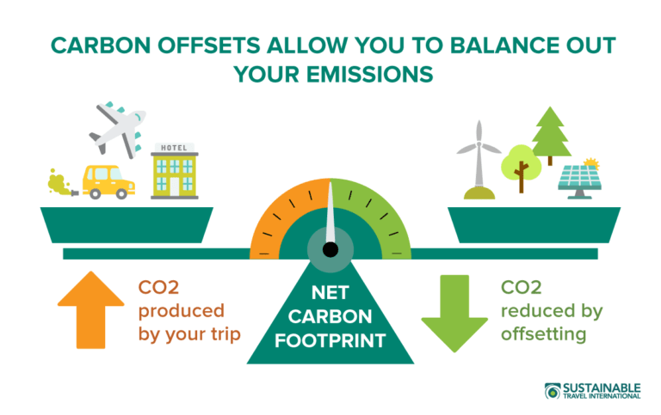
What is a carbon offset?
A carbon offset is the avoidance or sequestration of carbon dioxide or other greenhouse gases emissions to compensate for (offset) emissions produced elsewhere.
*slide 39/60 of lecture 11

Slide 31
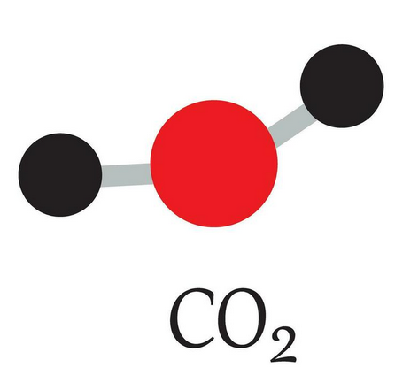
Offset strategies and sectors
There are two strategies that work with different sectors.
Avoidance
Removal
We avoid emitting CO2 all together
CO₂ is emitted but then removed from emissions
*slide 54/60 of lecture 11
Notes:
https://www.vecteezy.com/vector-art/27117761-model-of-carbon-dioxide-co2-molecule-and-chemical-formulas-geometric-structures-and-illustration-on-white-background-educational-and-study-content-of-chimestry-students-vector-illustration

Slide 32
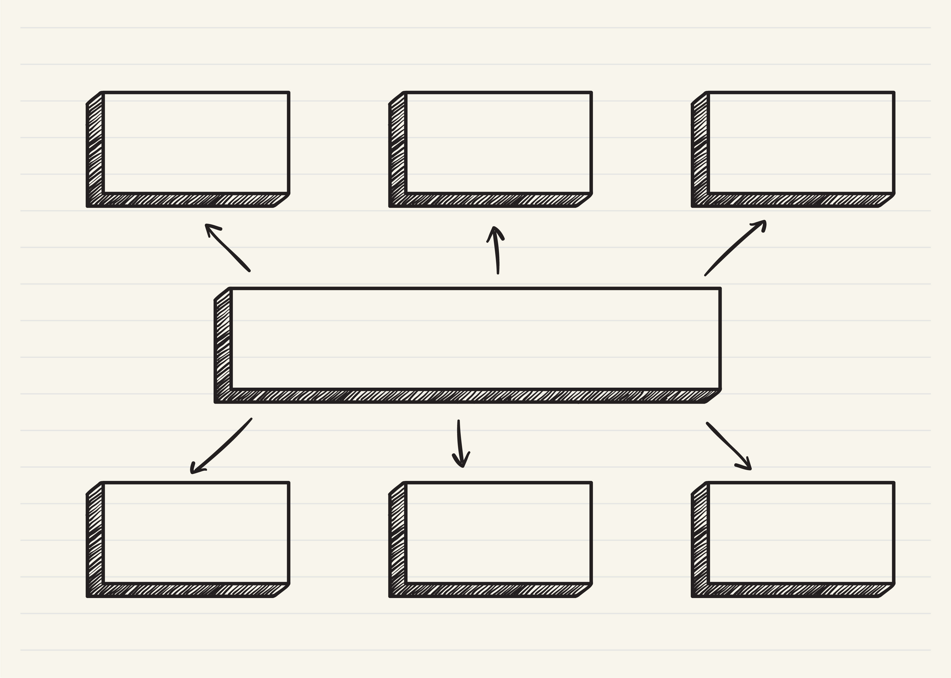
Avoidance Strategies
Energy saving measures to reduce CO2 emissions and replace fossil fuels
Energy efficiency and fuel switching
Renewable energy
Hydro, Solar, wind, nuclear
Increase energy efficiency of household devices, reduce fossil fuel burning in cookstoves for example
household devices
Water management
Invest in clean water supply and reduce need to boil water for sanitation
*based on slide 55/60 of lecture 11
Notes:
https://ecochain.com/blog/the-criteria-for-high-standard-carbon-offsetting-projects/

Slide 33
Removal Strategies
Agriculture
Forestry and Land use
Waste management
Increase agricultural practises that store carbon in soil
Improve biodiversity
Protect existing forested areas
Reforestation
Fight deforestation
Increase controls on landfill sites e.g.
Capture methane emissions released from waste
*based on slide 56/60 of lecture 11
Notes:
https://ecochain.com/blog/the-criteria-for-high-standard-carbon-offsetting-projects/

Slide 34
Carbon Offet Quiz Questions
Q1: What are carbon offsets?
A. Investments in renewable energy to reduce emissions globally B. Actions to compensate for emissions by reducing or removing CO₂ elsewhere C. Government-mandated reductions in carbon emissions D. Taxes imposed on high-emission industries

Slide 35
Carbon Offet Quiz Questions
Q1: What are carbon offsets?
A. Investments in renewable energy to reduce emissions globally B. Actions to compensate for emissions by reducing or removing CO₂ elsewhere C. Government-mandated reductions in carbon emissions D. Taxes imposed on high-emission industries

Slide 36
Carbon Offet Quiz Questions
Q2: Why are carbon offsets considered important in climate change mitigation?
A. They completely eliminate the need for reducing emissions at the source. B. They address emissions from activities that are hard to decarbonize. C. They replace the need for renewable energy sources. D. They reduce costs for fossil fuel industries.

Slide 37
Carbon Offet Quiz Questions
Q2: Why are carbon offsets considered important in climate change mitigation?
A. They completely eliminate the need for reducing emissions at the source. B. They address emissions from activities that are hard to decarbonize. C. They replace the need for renewable energy sources. D. They reduce costs for fossil fuel industries.

Slide 38
Carbon Offet Avoidance Strategies
Q3: Which of the following is an example of a carbon offset focused on avoidance?
A. Planting trees to absorb CO₂ B. Capturing CO₂ directly from the air and storing it underground
C. Investing in wind or solar energy projects D. Enhancing soil carbon sequestration

Slide 39
Carbon Offet Avoidance Strategies
Q3: Which of the following is an example of a carbon offset focused on avoidance?
A. Planting trees to absorb CO₂ B. Capturing CO₂ directly from the air and storing it underground
C. Investing in wind or solar energy projects D. Enhancing soil carbon sequestration

Slide 40
Carbon Offet Avoidance Strategies
Q4: How do avoidance offsets contribute to emissions reduction?
A. By capturing and storing existing atmospheric carbon B. By preventing the release of CO₂ through sustainable energy or efficiency projects C. By removing carbon from industrial processes D. By using chemical reactions to neutralize CO₂

Slide 41
Carbon Offet Avoidance Strategies
Q4: How do avoidance offsets contribute to emissions reduction?
A. By capturing and storing existing atmospheric carbon B. By preventing the release of CO₂ through sustainable energy or efficiency projects C. By removing carbon from industrial processes D. By using chemical reactions to neutralize CO₂

Slide 42
Carbon Offet Removal Strategies
Q5: What is the primary goal of carbon removal offsets?
A. To actively capture and store existing atmospheric CO₂
B. To prevent new emissions from being released C. To increase energy efficiency in factories D. To subsidize fossil fuel companies

Slide 43
Carbon Offet Removal Strategies
Q5: What is the primary goal of carbon removal offsets?
A. To actively capture and store existing atmospheric CO₂
B. To prevent new emissions from being released C. To increase energy efficiency in factories D. To subsidize fossil fuel companies

Slide 44
Carbon Offet Removal Strategies
Q6: Which of the following is an example of a carbon removal strategy?
A. Installing energy-efficient appliances B. Protecting forests from deforestation C. Direct air capture with underground storage D. Shifting to electric vehicles

Slide 45
Carbon Offet Removal Strategies
Q6: Which of the following is an example of a carbon removal strategy?
A. Installing energy-efficient appliances B. Protecting forests from deforestation C. Direct air capture with underground storage D. Shifting to electric vehicles

Slide 46
Comparing Avoidance and Removal Strategies
Q7: What is a key difference between carbon avoidance and removal strategies?
A. Avoidance focuses on energy efficiency, while removal focuses on renewable energy. B. Avoidance is always more effective than removal.
C. Avoidance reduces emissions intensity, while removal stops deforestation.
D. Avoidance prevents new emissions, while removal captures and stores existing CO₂.

Slide 47
Comparing Avoidance and Removal Strategies
Q7: What is a key difference between carbon avoidance and removal strategies?
A. Avoidance focuses on energy efficiency, while removal focuses on renewable energy. B. Avoidance is always more effective than removal.
C. Avoidance reduces emissions intensity, while removal stops deforestation.
D. Avoidance prevents new emissions, while removal captures and stores existing CO₂.

Slide 48
Comparing Avoidance and Removal Strategies
Q8: Why are removal strategies considered essential despite their higher cost compared to avoidance strategies?
A. They directly reduce the concentration of atmospheric CO₂. B. They are more profitable for businesses. C. They rely on fossil fuel consumption to work effectively. D. They completely replace the need for renewable energy.

Slide 49
Comparing Avoidance and Removal Strategies
Q8: Why are removal strategies considered essential despite their higher cost compared to avoidance strategies?
A. They directly reduce the concentration of atmospheric CO₂. B. They are more profitable for businesses. C. They rely on fossil fuel consumption to work effectively. D. They completely replace the need for renewable energy.

Slide 50
Q9: What is the primary challenge associated with carbon removal strategies like direct air capture?
A. Lack of demand for the technology B. High costs and energy requirements C. Limited public awareness D. Difficulty in measuring CO₂ removal

Slide 51
Q9: What is the primary challenge associated with carbon removal strategies like direct air capture?
A. Lack of demand for the technology B. High costs and energy requirements C. Limited public awareness D. Difficulty in measuring CO₂ removal

Slide 52
Q10: Which sector is most likely to benefit from avoidance offsets?
A. Heavy industry with high energy demand B. Forestry and agriculture C. Technology startups D. Aviation and transportation

Slide 53
Q10: Which sector is most likely to benefit from avoidance offsets?
A. Heavy industry with high energy demand B. Forestry and agriculture C. Technology startups D. Aviation and transportation

Slide 54
Q11: How can combining avoidance and removal strategies improve a company’s sustainability approach?
A. By achieving net-zero emissions more effectively B. By reducing costs associated with carbon taxes C. By eliminating the need for regulatory compliance D. By focusing solely on carbon avoidance

Slide 55
Q11: How can combining avoidance and removal strategies improve a company’s sustainability approach?
A. By achieving net-zero emissions more effectively B. By reducing costs associated with carbon taxes C. By eliminating the need for regulatory compliance D. By focusing solely on carbon avoidance

Slide 56
Q12: Why is it important to ensure the quality of carbon offsets, whether avoidance or removal?
A. To guarantee they are affordable for businesses B. To ensure they deliver real, measurable, and permanent climate benefits C. To comply with international trade laws D. To improve energy efficiency in factories

Slide 57
Q12: Why is it important to ensure the quality of carbon offsets, whether avoidance or removal?
A. To guarantee they are affordable for businesses B. To ensure they deliver real, measurable, and permanent climate benefits C. To comply with international trade laws D. To improve energy efficiency in factories

Slide 58
Take home message
There are several different metrics to compare gas emissions -> there’s no perfect one.
Mitigation strategies and political decisions depend on the metrics used -> the outcomes can be very different if we look at one or another metric.
Mitigation strategies on long-lived or short-lived species will not have the same effect on the temperature response.
These metrics can seem pretty straightforward during political debates but there’s often a misunderstanding of the underlying complexity and assumptions.

