Slide 1
Exercise session #10
Science of
Climate Change
Nov. 21, 2024

Slide 2
Today’s plan
Key points from this morning’s lecture and any questions
(RCPs/SSPs, Tipping Elements, Carbon Budget)
Exercises using Interactive IPCC atlas and Mentimeter
Simple calculation related to carbon budget

Slide 3
Reminder about posters
Poster submission deadline
Today!

Slide 4
Overview/Take-home from Lecture 10
RCPs vs SSPs
RCPS – Representative Concentration Pathways
Climate scenarios which focus on GHG emissions radiative forcing (RF) outcomes - no influence of any natural factors (e.g., volcanic activity, solar variability)
Used in CMIP5
SSPs – Shared Socioeconomic Pathways
Scenarios which focus on the projected socioeconomic changes globally up to 2100 – then we derive the GHG emission scenarios from these
Used in CMIP6

Slide 5
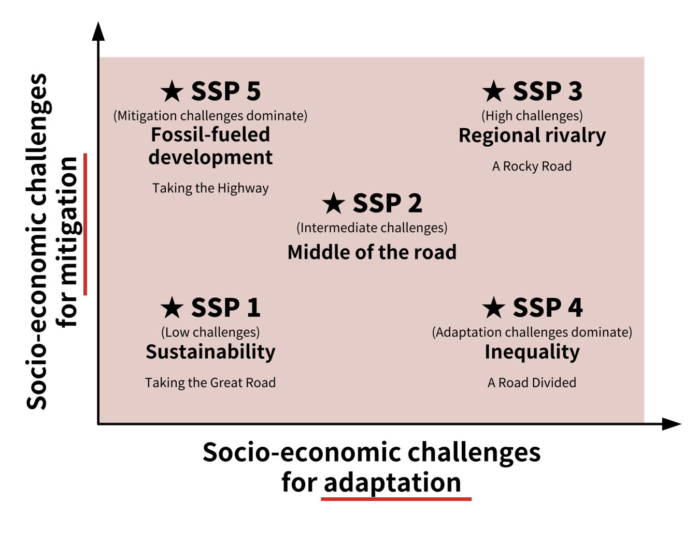
Overview/Take-home from Lecture 10
SSPs are scenarios of projected socioeconomic global changes up to 2100. They are used to derive greenhouse gas emissions scenarios with different climate policies.
Used since IPCC AR6
SSPs are:
narratives describing alternative socio-economic developments.
qualitative description of logic relating elements of the narratives to each other.
quantitative elements: they provide data accompanying the scenarios on national population, urbanization and GDP (per capita).

Slide 6
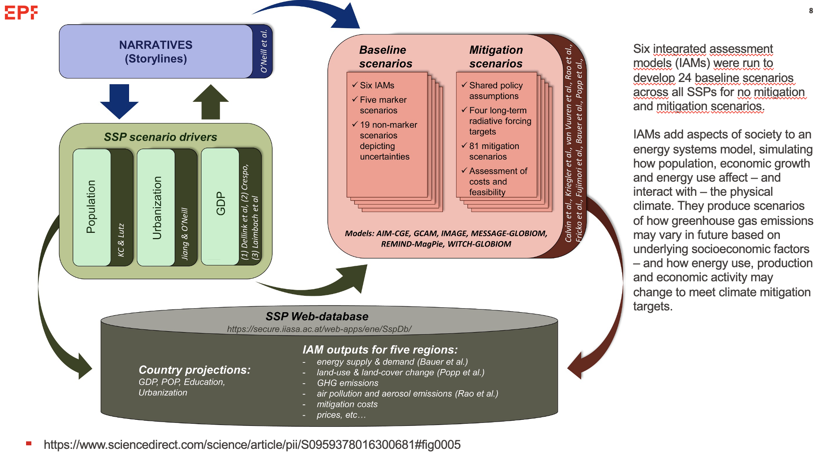

Slide 7
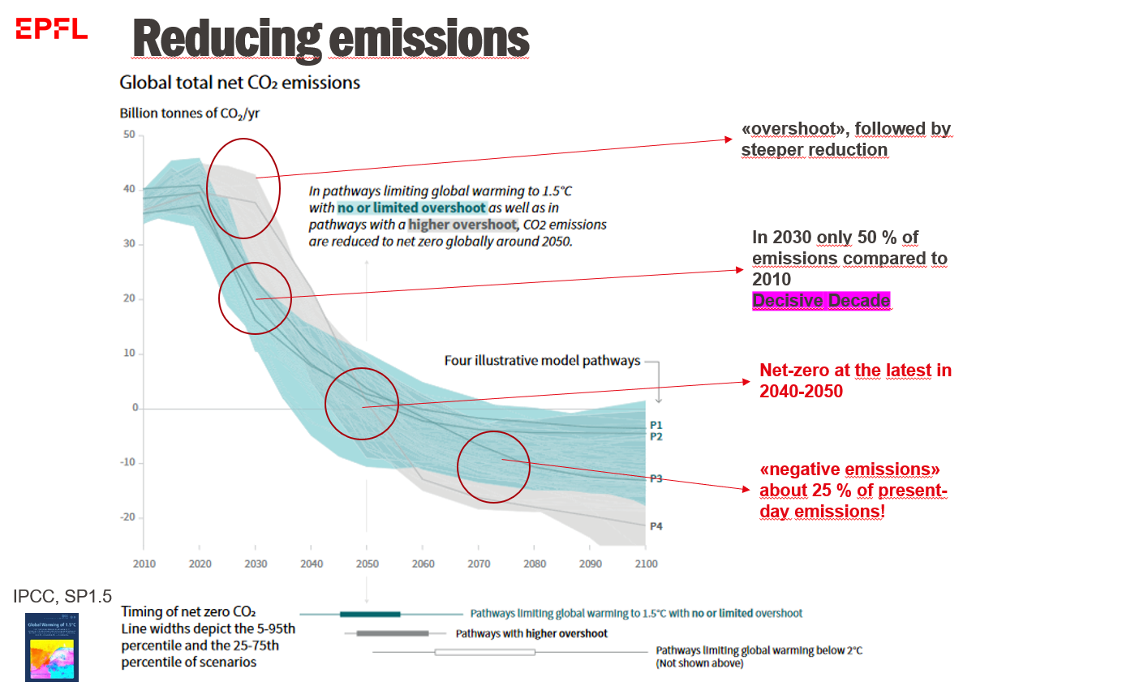

Slide 8
Exercise 1: 1.5°C vs 2°C warming
Go on the interactive IPCC map: https://interactive-atlas.ipcc.ch/ and click on advanced climate future
Which SSP scenario would allow to remain below the 1.5°C ?
How should anthropogenic emissions look like according to this/these scenario/scenarii?
What about the other scenarii? What is the temperature increase projected by 2100?
Now, check what are projections of sea level rise corresponding to 1.5 and 2 and 2.7°C (current path).

Slide 9
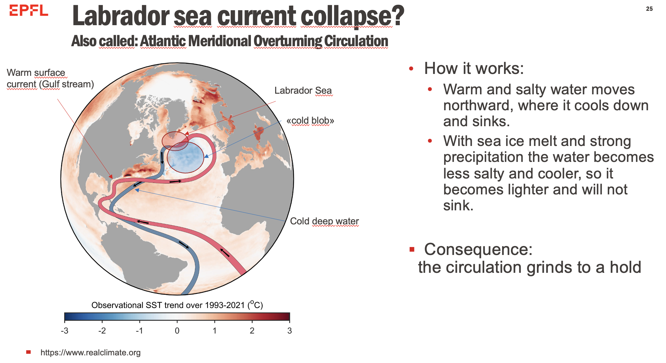
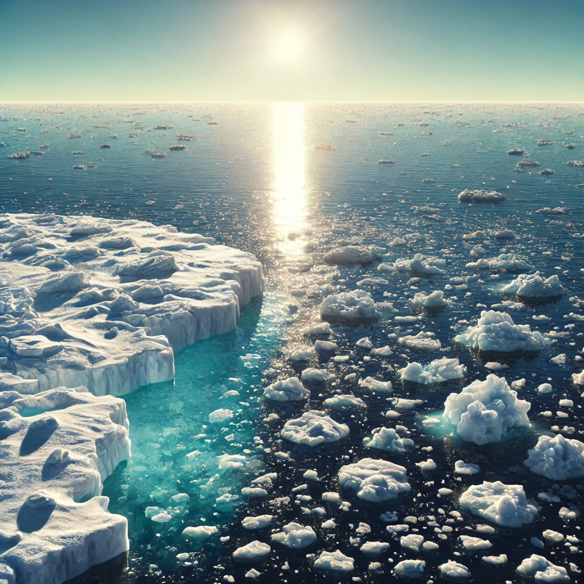


Exercise 2: Tipping elements
Within the following examples, which ones represent potential tipping elements and why? Take 5 minutes to identify them and explain why they represent tipping elements.
Atlantic meridional overturning circulation
Arctic summer ice
Sea level
Increased rainfall

Slide 10

Exercise 3 Connection
Connecting to Mentimeter
https://www.menti.com/alt8315xd3be

Slide 11
Exercise 3 Solutions
Tipping Points occur when change in large parts of the climate system—known as tipping elements—become self-perpetuating beyond a warming threshold. (True)
What are some examples of Positive Tipping Point? (Renewable Energy Expansion, Electric Vehicle (EV) Adoption, Reforestation and Ecosystem Restoration)
Paris agreement can prevent Greenland ice sheet collapse. (Verly likely/Unlikely)
Amazon rainforest dieback is an example of negative tipping point. (True)
Carbon budget tells us how much more carbon we can emit until we reach a certain level of warming. (True)
Both RCPs and SSPs incorporate projections of socioeconomic developments to model future climate scenarios. (False)
Which one of the following is not included in the SSP priority scenarios? (SSP4-8.5)
An SSP scenario can only be associated with a single radiative forcing outcome. (False)

Slide 12
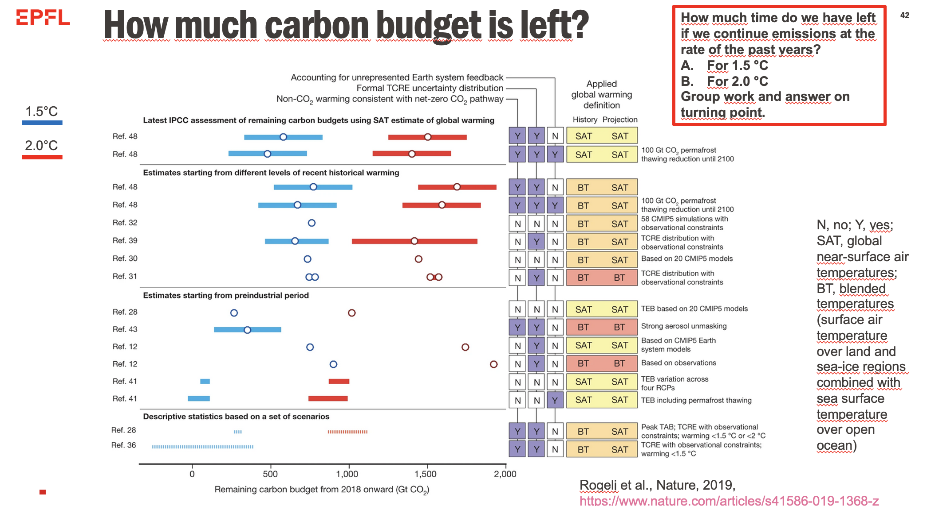
Notes:
First, ask how can we compute when we will reach 1.5 deg Celcius. Highlight we would need to consider the carbon budget left to reach each temperature level. Highlight studies can have different carbon budget estimation

Slide 13
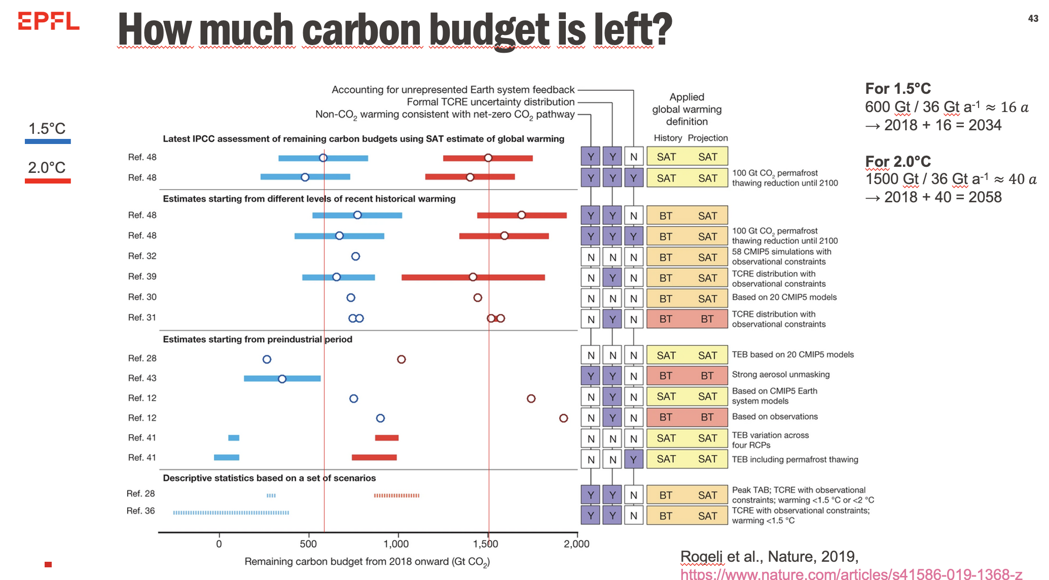
Notes:
Focus on the carbon budget estimation from IPCC

Slide 14
Time to work on the assignment/poster

Slide 15
