Slide 1
Exercise session #10
Science of
Climate Change
Nov. 3, 2022

Slide 2
Today’s plan
Key points from this morning’s lecture and any questions
(RCPs/SSPs, Tipping Elements, Carbon Budget)
Exercises using Interactive IPCC atlas and Mentimeter
Simple calculation related to carbon budget

Slide 3
Reminder about posters
Poster submission deadline
Today!

Slide 4
Overview/Take-home from Lecture 10
RCPS vs SSPs
RCPS – Representative Concentration Pathways
Climate scenarios which focus on GHG emissions - no influence of any natural factors (e.g., volcanic activity, solar variability)
Used in CMIP5
SSPs – Shared Socioeconomic Pathways
Scenarios which focus on the projected socioeconomic changes globally up to 2100 – then we derive the GHG emission scenarios from these
Used in CMIP6

Slide 5
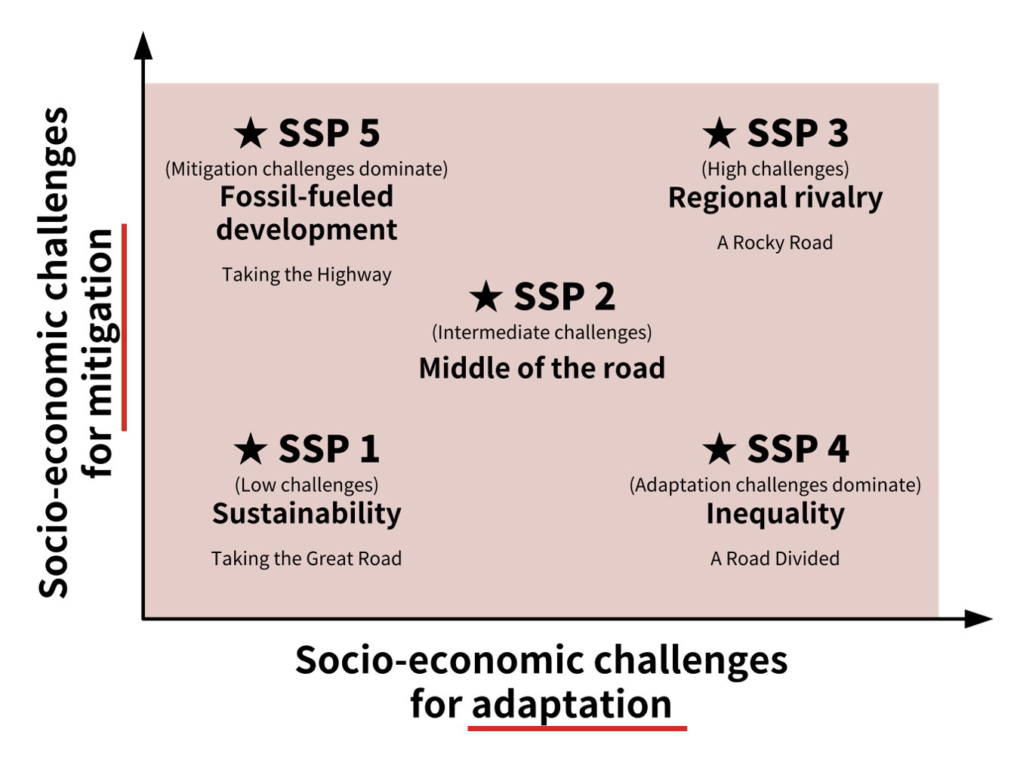
Overview/Take-home from Lecture 10
SSPs are scenarios of projected socioeconomic global changes up to 2100. They are used to derive greenhouse gas emissions scenarios with different climate policies.
Used since IPCC AR6
SSPs are:
  narratives describing alternative socio-economic developments.
  qualitative description of logic relating elements of the narratives to each other.
  quantitative elements: they provide data accompanying the scenarios on national population, urbanization and GDP (per capita).

Slide 6
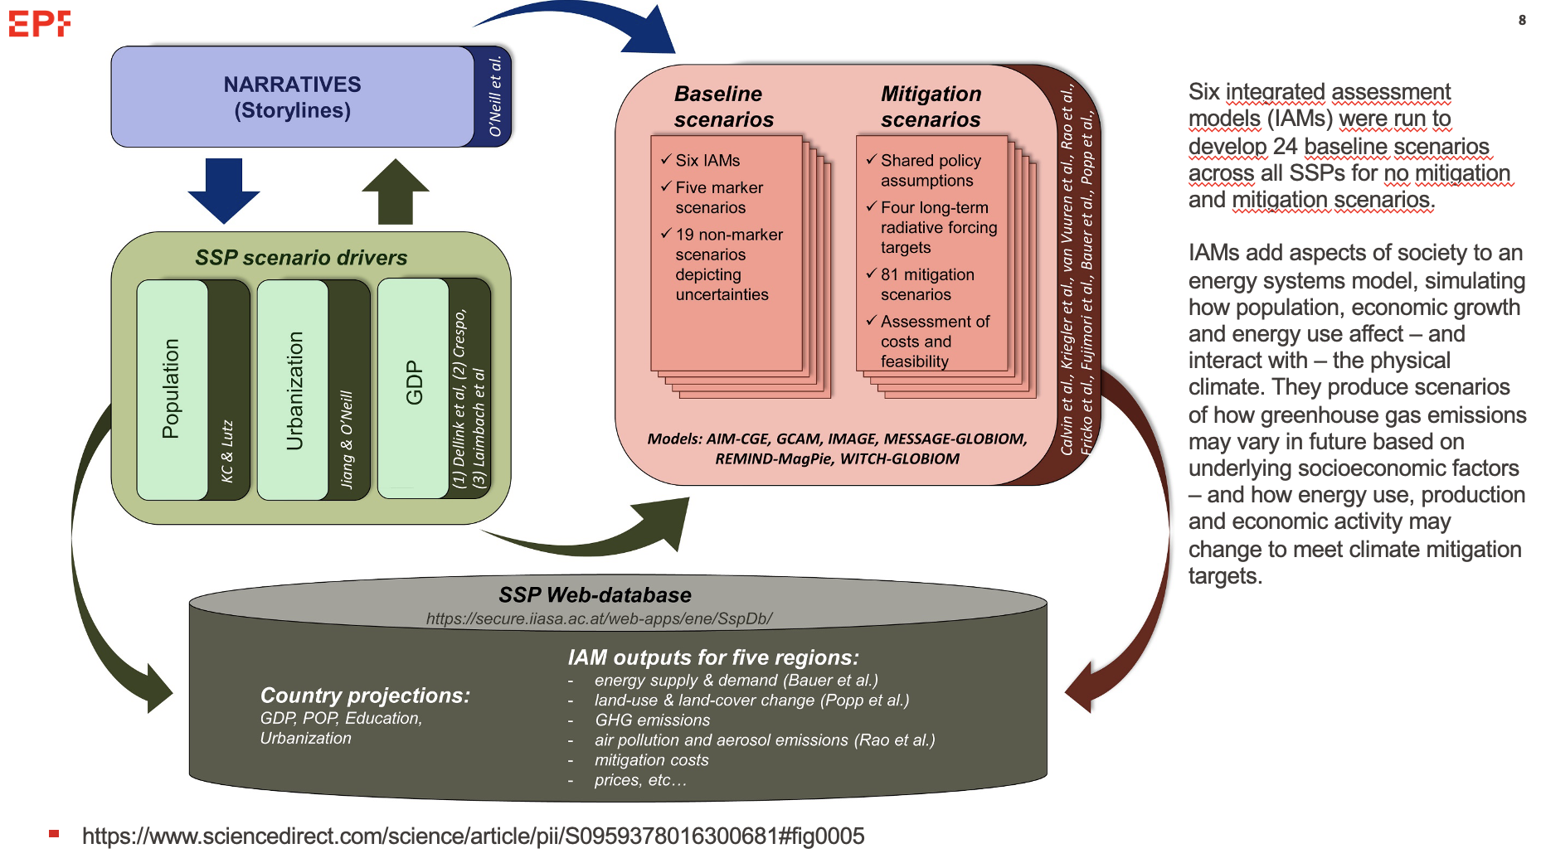

Slide 7
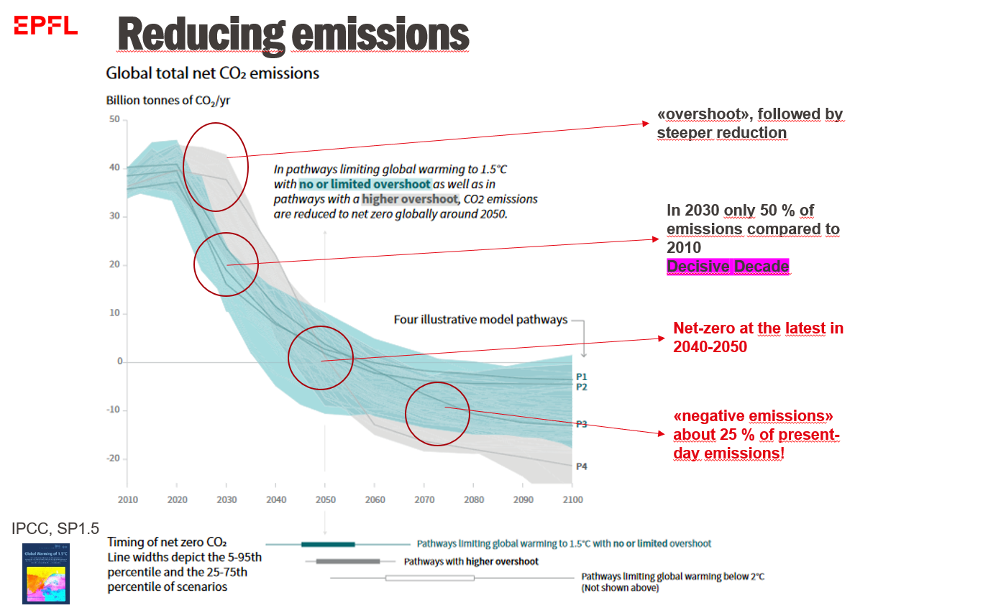

Slide 8
Exercise 1: 1.5°C vs 2°C warming
Go on the interactive IPCC map: https://interactive-atlas.ipcc.ch/ and click on advanced climate future
  Which SSP scenario would allow to remain below the 1.5°C ?
  How should anthropogenic emissions look like according to this/these scenario/scenarii?
  What about the other scenarii? What is the temperature increase projected by 2100?
  Now, check what are projections of sea level rise corresponding to 1.5 and 2 and 2.7°C (current path).

Slide 9
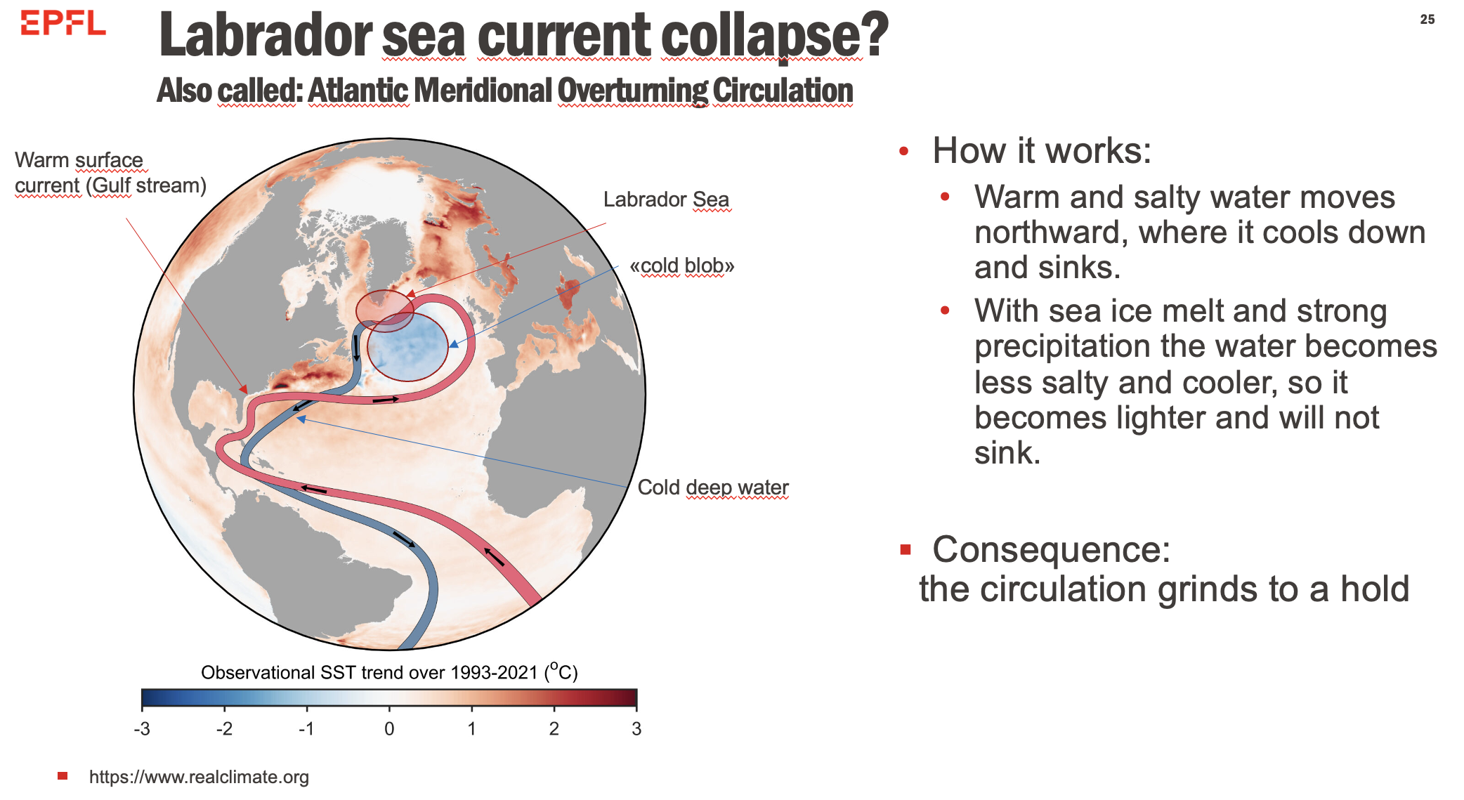
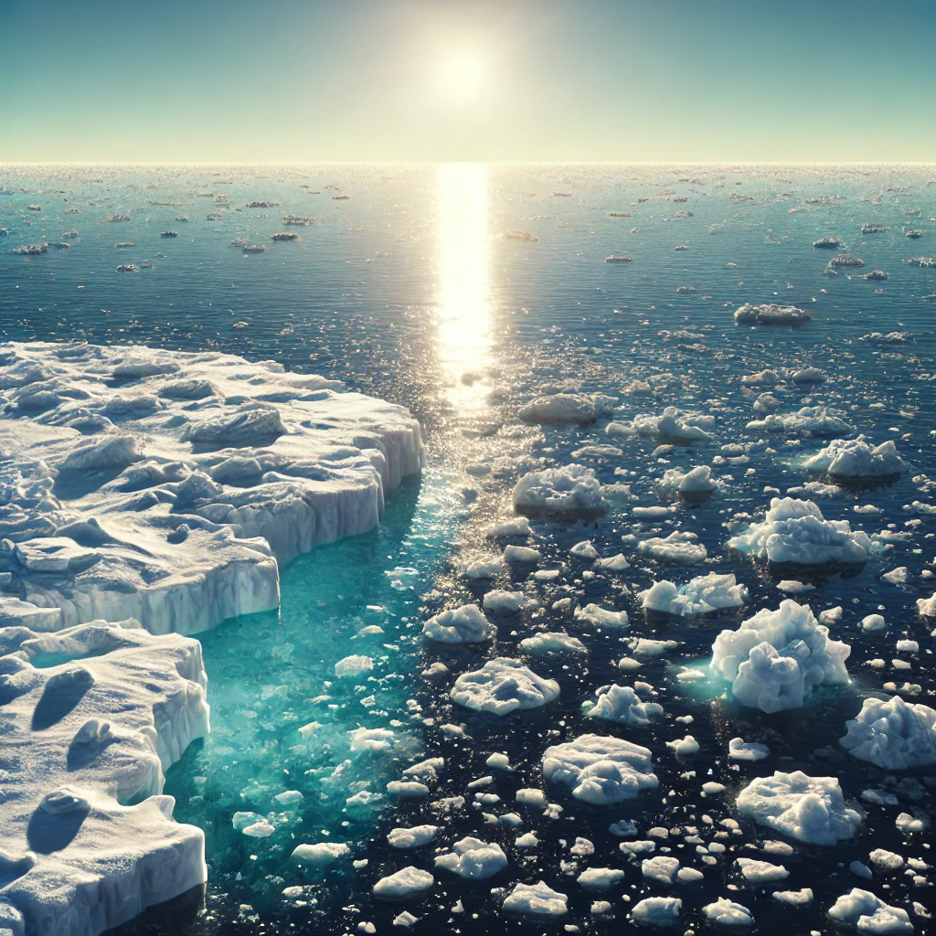
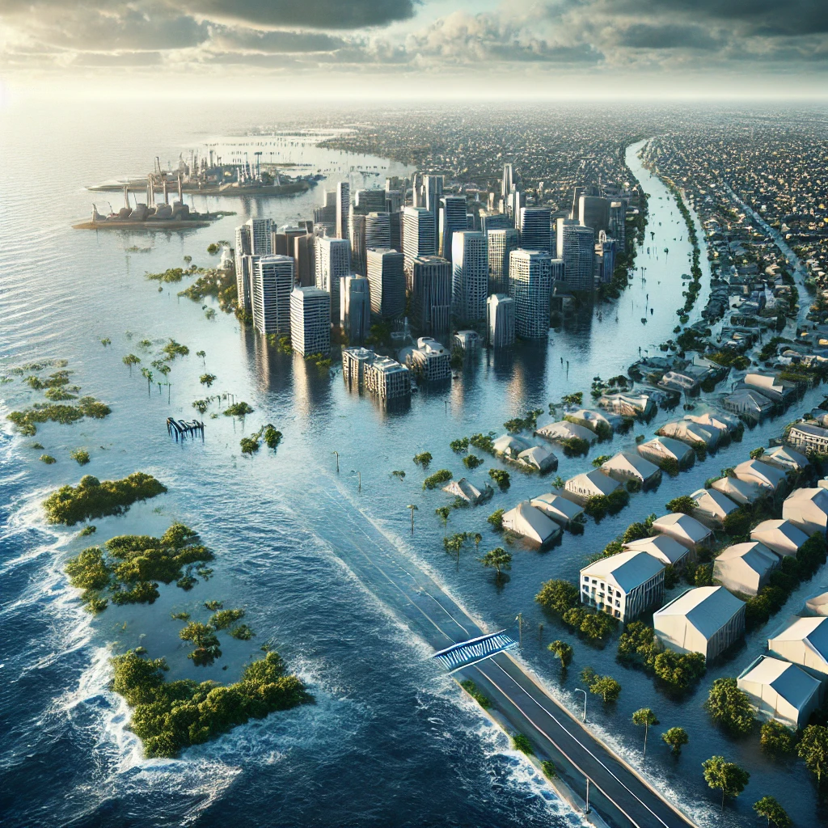
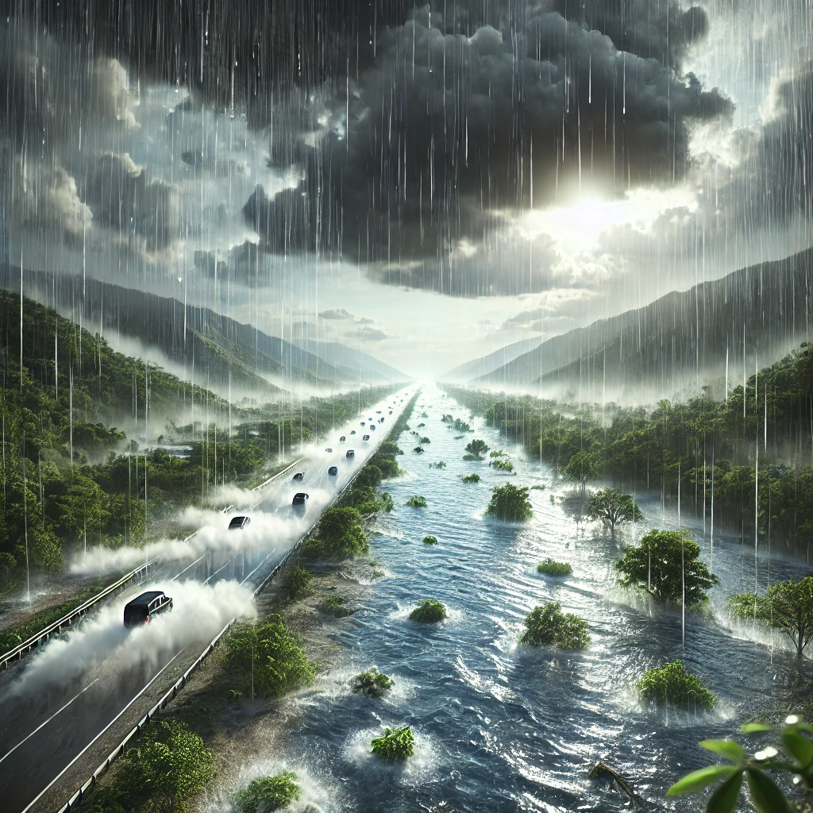
Exercise 2: Tipping elements
Within the following examples, which ones represent potential tipping elements and why? Take 5 minutes to identify them and explain why they represent tipping elements.
Atlantic meridional overturning circulation
Arctic summer ice
Sea level
Increased rainfall

Slide 10

Exercise 3 Connection
Connecting to Mentimeter
https://www.menti.com/alt8315xd3be

Slide 11
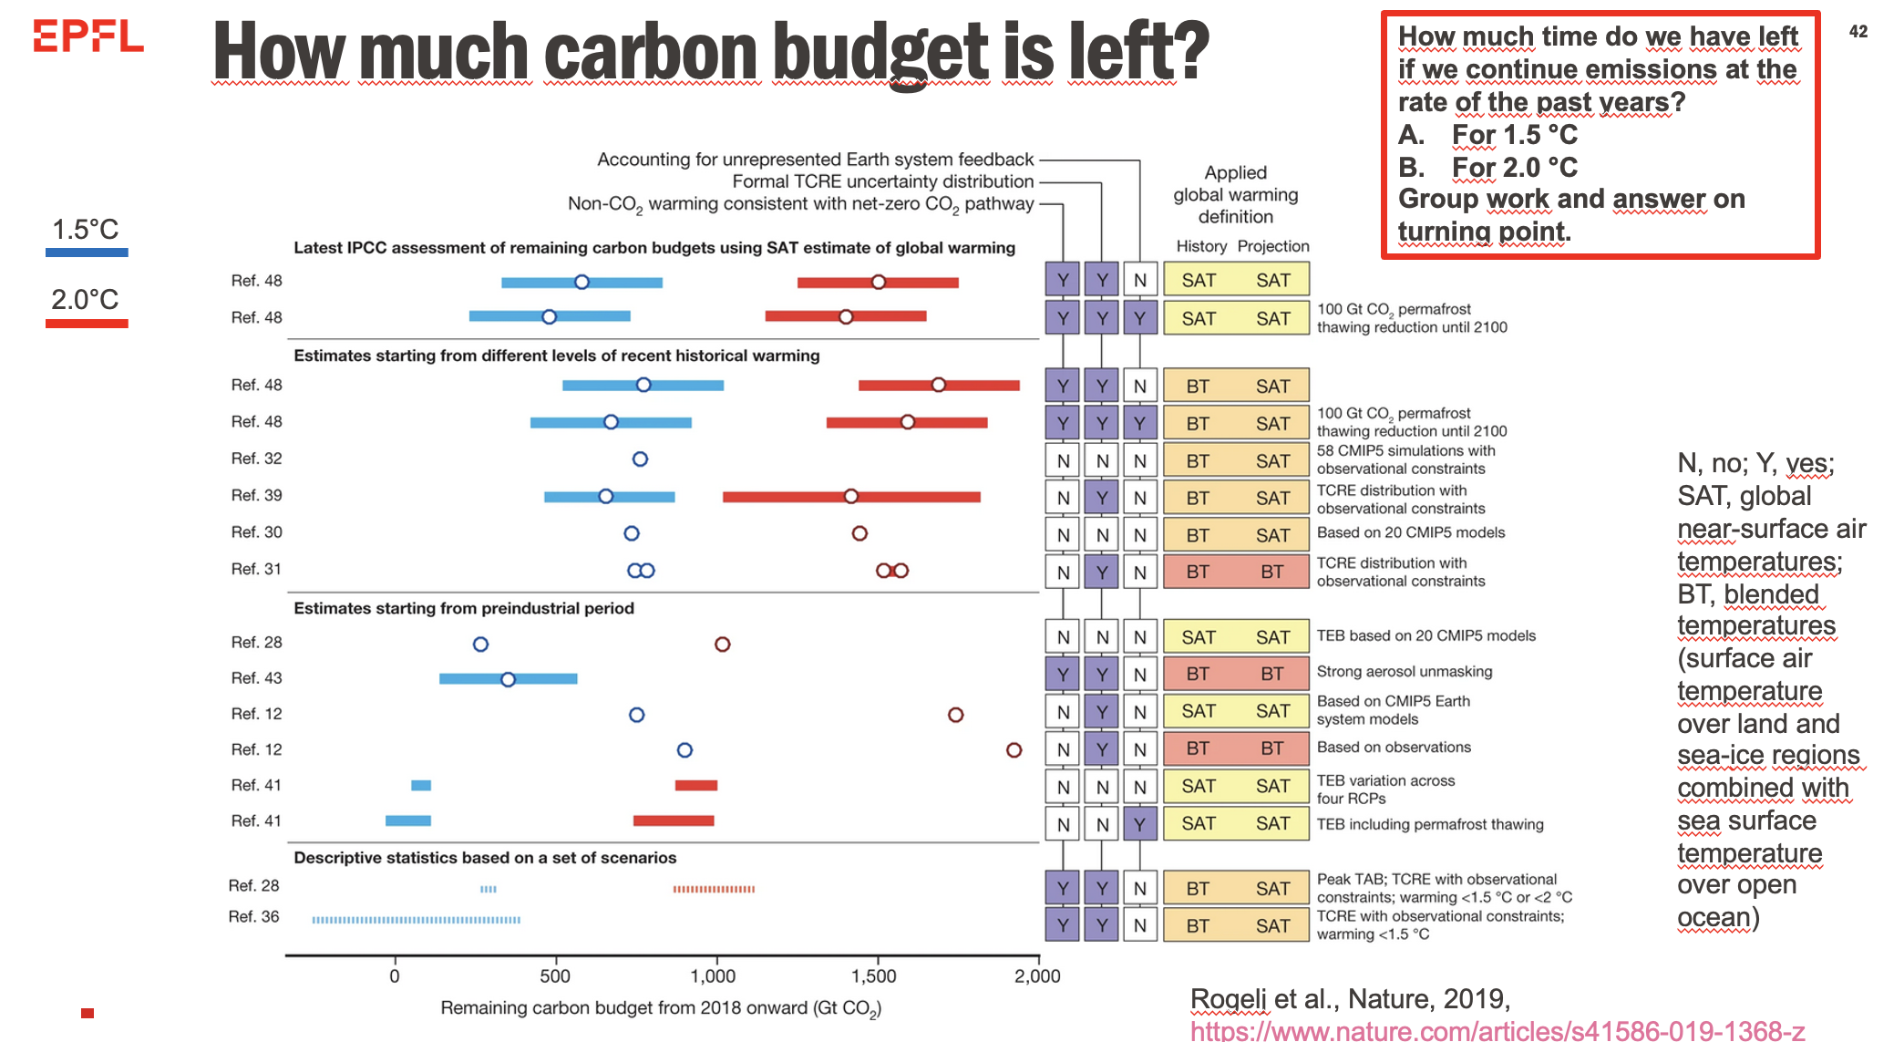
Notes:
First, ask how can we compute when we will reach 1.5 deg Celcius. Highlight we would need to consider the carbon budget left to reach each temperature level. Highlight studies can have different carbon budget estimation

Slide 12
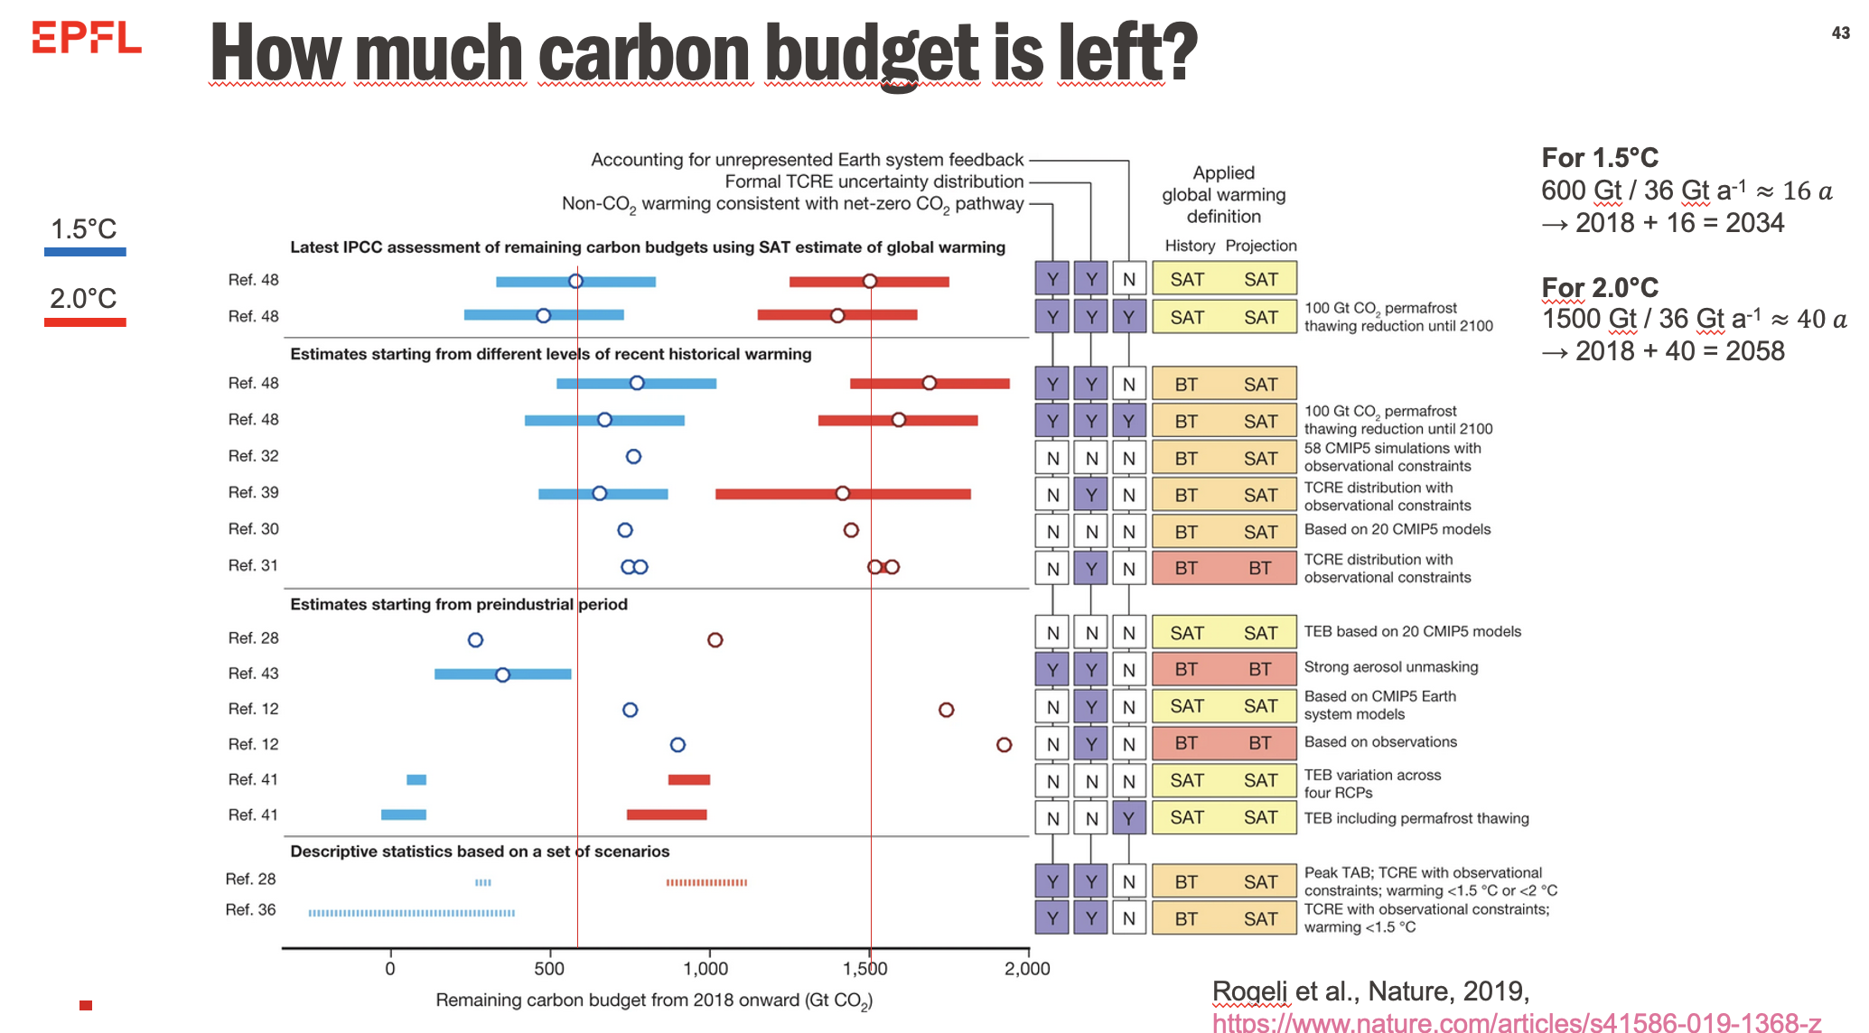
Notes:
Focus on the carbon budget estimation from IPCC

Slide 13
Time to work on the assignment/poster

