Slide 1
Tutorium 3:
Atmospheric Boundary Layer

Slide 2
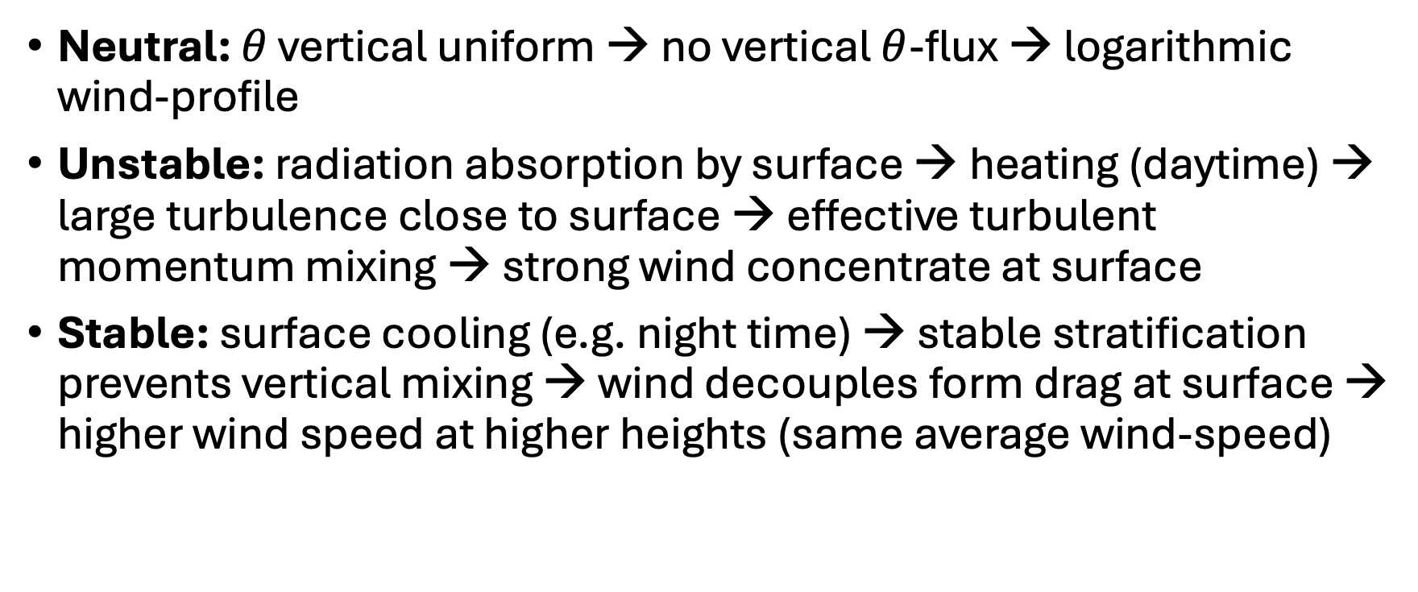
Recap: BL stability
Neutral: $θ$ vertical uniform → no vertical $θ$-flux → logarithmic wind-profile
Unstable: radiation absorption by surface → heating (daytime) → large turbulence close to surface → effective turbulent momentum mixing → strong wind concentrate at surface
Stable: surface cooling (e.g. night time) → stable stratification prevents vertical mixing → wind decouples form drag at surface → higher wind speed at higher heights (same average wind-speed)

Slide 3
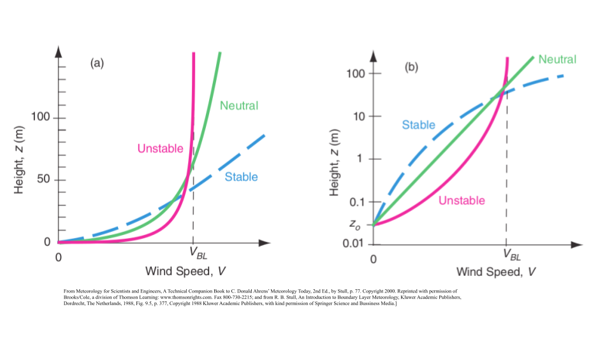
Recap: BL stability

Slide 4

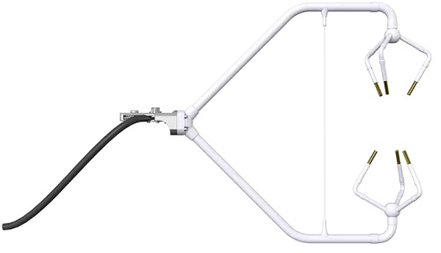
Assignment #2:
2 Exercises, cover Lectures #3, #4
  Ex.1: Atmospheric boundary layer dynamics
    Python assignment (Don’t forget to submit your Python script!)
    Turbulent fluxes (sensible/latent heat)
    Eddy covariance /Monin Obukhov
    Use measurement data in Alpine Valley (24.05.2021 8:00 – 14:00)
      High frequency data (windspeed (u,v,w), temperature, humidity) at 1m height
      10 min average data (temperature, humidity) at surface

Slide 5
Assignment #2:
2 Exercises, cover Lectures #3, #4
  Ex.2: Global circulation and weather systems
  → next week

Slide 6
Assignment #2:
2 Exercises, cover Lectures #3, #4
  Ex.2: Global circulation and weather systems
    Synoptic map (26.02.2025) with fronts
    Fronts cold –warmfront
    Air-masses

Slide 7
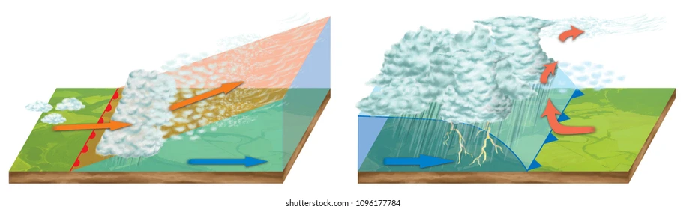
Recap: Fronts
Warmfornt: Coldfront:

Slide 8
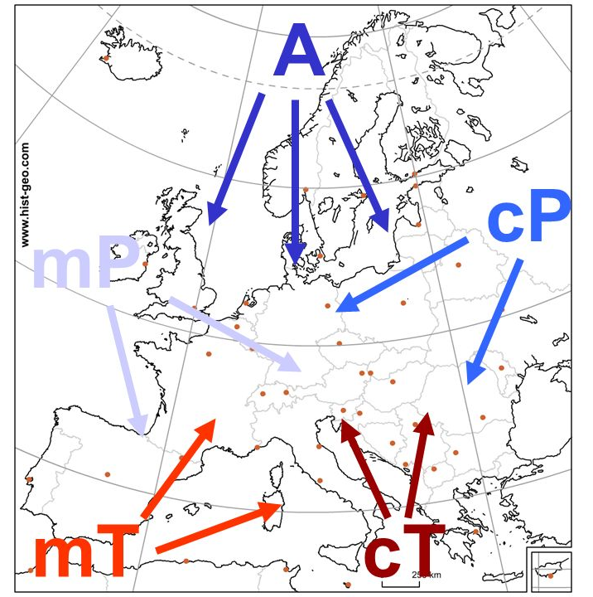
Airmasses
Uniform T and q (determined by their origin)
interact and modify → determine our weather (e.g. at fronts
Notes:
Maritime Air Masses:
• Polar Maritime: cool and moist air from the North Atlantic.
• Tropical Maritime: warm and moist air from the Azores.
Continental Air Masses:
• Polar Continental: cold and dry air from Siberia.
• Tropical Continental: hot and dry air from North Africa.
Arctic Air Mass:
• Brings very cold air from the Arctic region.

