Slide 1

Analysis of the paper by Sobral et al.
Farhad Rachidi

Slide 2
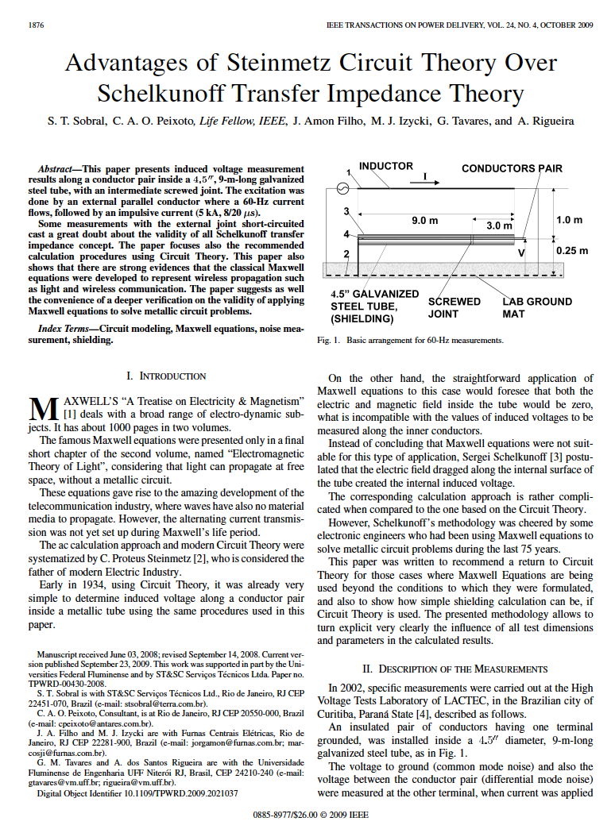

Slide 3
Background: Coupling to Shielded Cables

Slide 4
Transfer Impedance
The internal voltage source V´_{s} arises from the external current I_{external} acting on the conductive shield material
As such, it can be represented by a per-unit-length transfer impedance, Z´_{t} as

Slide 5
Diffusion Through a Solid Shield
The current flow in the cable sheath will create an axial electric field inside the sheath.
Due to the skin effect, the current distribution and the associated E-field distribution in the sheath cross section are not uniform
E_{i}

Slide 6
The Transfer Impedance
The transfer impedance of a thin tubular shield has been developed by Schelkunoff:
Equals R_{o}, the DC resistance of the shield
Note the exponential decrease of the transfer impedance with shield thickness Δ at high frequencies

Slide 7
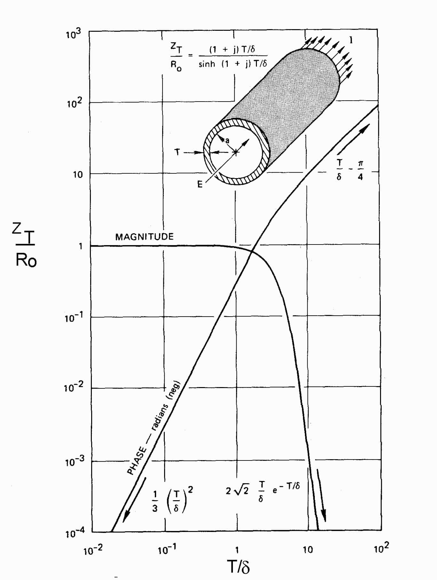
Illustration of the Transfer Impedance
Plot of the calculated Z´_{t}
At DC, the transfer impedance
is just the tube resistance
At higher frequencies, it
decreases, due to the skin
effect.
Magnitude
Phase

Slide 8
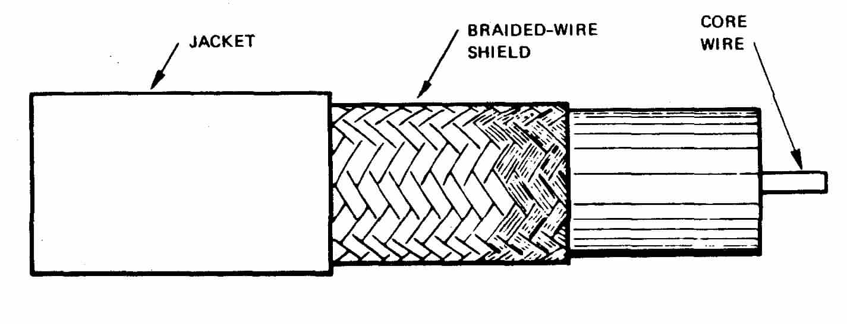
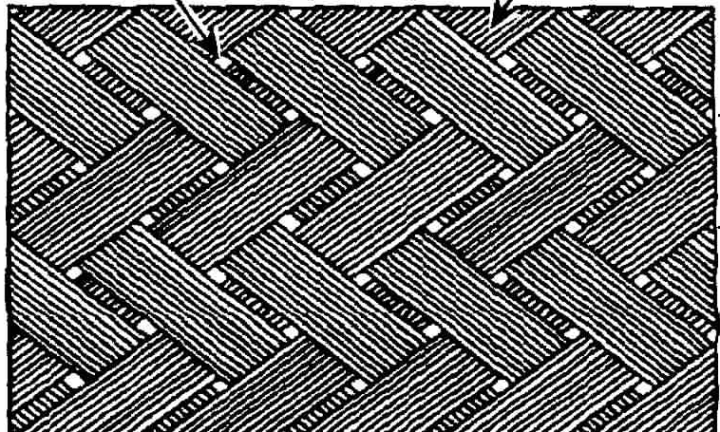
Braided Shields: H-Field Penetration
The braid is not really a
homogeneous shield
  It has small openings
  The external B-field is
  able to penetrate inside
  and the flux introduces an additional
  component to the transfer impedance
Thus, at high frequencies, the transfer
impedance for braided cables can be
written as

Slide 9
Braided Shields: E-Field Penetration
E-field penetration inside the shield of a coaxial cable
through a single aperture

Slide 10
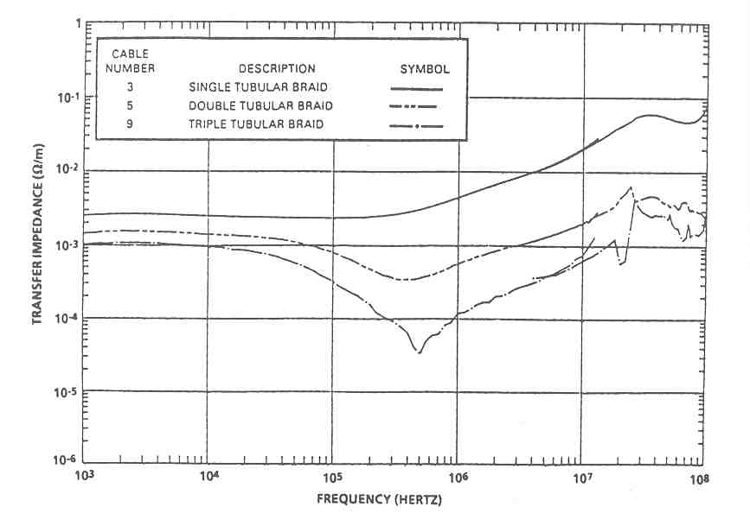
Examples of Measured Transfer Impedance

Slide 11
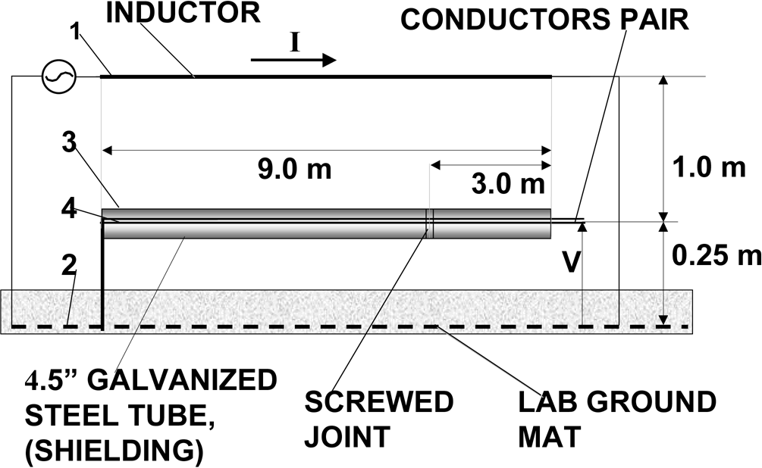
The paper
Authors present measurement results which are used to test the validity of Schelkunoff’s transfer impedance theory.
Notes:
The simple measurement setup (Fig. 1 of [1]) concerns common-mode and differential mode voltages on a pair of conductors inside a steel tube situated above the ground plane, induced by a parallel conductor excited by a source. The induced voltages are measured considering different arrangements for the grounding of the tube. The results are then compared with theoretical results obtained using circuit theory in which the coupling between the two circuits is represented by longitudinal self and mutual impedances. The obtained results are used in the paper as a basis to challenge the validity of Schelkunoff’s transfer impedance theory and, also, to question the applicability of Maxwell’s equations to wired structures.

Slide 12
The assertions
‘The famous Maxwell equations were presented only in a final short chapter of the second volume, named “Electromagnetic Theory of Light”, considering that light can propagate at free space, without a metallic circuit.’

Slide 13
The assertions
‘The famous Maxwell equations were presented only in a final short chapter of the second volume, named “Electromagnetic Theory of Light”, considering that light can propagate at free space, without a metallic circuit.’
Maxwell’s equations were presented to be solved in a general medium represented by its electric permittivity and magnetic permeability. The dyadic permittivity and permeability can be used to represent inhomogeneous, anisotropic media. Thus, any material can be considered for the solution of Maxwell’s equations, including highly conducting metallic surfaces, such as wires and other components in electric circuits.

Slide 14
The assertions
‘On the other hand, the straightforward application of Maxwell equations to this case would foresee that both the electric and magnetic field inside the tube would be zero, what is incompatible with the values of induced voltages to be measured along the inner conductors.’

Slide 15
The assertions
‘On the other hand, the straightforward application of Maxwell equations to this case would foresee that both the electric and magnetic field inside the tube would be zero, what is incompatible with the values of induced voltages to be measured along the inner conductors.’
Since the conductivity of the conductors is not infinite, the application of Maxwell’s equations would not result in both the E and H fields inside the tube being zero. The E and H fields can be calculated by considering the diffusion of the fields through the conducting sheet. Since the considered frequency is very low, the penetration of the magnetic field is very efficient (large skin depth), and internal currents and voltages must indeed be induced. This result is compatible with the reported experiment.

Slide 16
The assertions
‘Schelkunoff’s Transfer Impedance concept cannot explain why a modification introduced at the external surface of the tube can strongly reduce the induced voltage inside the tube’. ‘Schelkunoff transfer impedance methodology fails for some important conditions measured, what cast a great doubt about the validity of all the transfer impedance concept’.

Slide 17
The assertions
Schelkunoff solved Maxwell’s equations to obtain the transfer impedance of a lossy solid conducting tube by considering the diffusion of the fields, and obtained an analytical formula for this parameter.
On the other hand, circuit theory is a tool that also results from Maxwell’s equations using the assumption that the physical size of the circuit is much smaller than the wavelength of the disturbance. The transfer impedance and circuit theory are therefore not in antagonism.

Slide 18
The assertions
The fact that the circuit-theory results obtained by the authors are in good agreement with their measurements comes from the fact that the test circuit used is electrically small compared to the wavelengths involved.
The highest significant frequency f_{max} of the 8/20 μs test pulse used by the authors:
which is more than two orders of magnitude greater than the 10-m length of the tube and almost four orders of magnitude greater than its cross section.

Slide 19
The assertions
In addition, the fact that introducing a modification to the external surface of the tube affects the inner induced voltages is an expected observation that can be explained by the transfer impedance.
Indeed, the induced voltage in the inner conductor of a shielded cable not only depends on the transfer impedance but also on the current distribution along the cable shield.
Any modification to the external surface of the tube and/or its connection to the ground would change this current distribution and would therefore affect the inner induced voltage.

Slide 20
The assertions
‘The application of Maxwell equations to transformers is likewise problematic. Almost all the magnetic field is inside the metallic core, while only a small residual flux touches the coil conductors. However, the electric field is maximum in the region touching the coil while the magnetic field is nearly zero.’

Slide 21
The assertions
‘The application of Maxwell equations to transformers is likewise problematic. Almost all the magnetic field is inside the metallic core, while only a small residual flux touches the coil conductors. However, the electric field is maximum in the region touching the coil while the magnetic field is nearly zero.’
This does not contradict Maxwell’s equations, according to which the coupling between electric and magnetic fields is weak at low frequencies. In Maxwell’s equations, the limiting case of zero frequency implies a decoupling of the electric and magnetic fields. Electrostatic and magnetostatic regimes represent thus special cases of Maxwell’s equations.

Slide 22
The assertions
‘This paper emphasizes the need of a deeper verification on the validity of applying Maxwell equations to solve a metallic circuit, because there are strong evidence they were developed to represent propagation without a metallic circuit, as light and wireless telecommunication phenomena.’

Slide 23
The assertions
‘This paper emphasizes the need of a deeper verification on the validity of applying Maxwell equations to solve a metallic circuit, because there are strong evidence they were developed to represent propagation without a metallic circuit, as light and wireless telecommunication phenomena.’
As mentioned earlier, circuit theory can be derived starting from the Maxwell’s equations applying appropriate mathematical manipulations and taking into account the assumption of an electrically small system. This derivation can be found in several textbooks.

Slide 24
