Slide 1
Plane Wave Coupling to a Transmission Line
Assignement Due: April 3

Slide 2
Frequency Domain Solutions
where

Slide 3
Plane Wave Excitation: Reflection Coefficients
E_{x}

Slide 4
Plane Wave Excitation: Fresnel Reflection Coefficients
Vertical polarization
Horizontal polarization

Slide 5
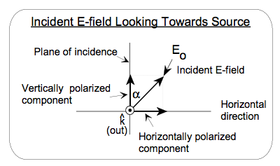
Plane Wave Excitation: Analytical solution for a perfectly-conducting ground
The excitation field (plane wave is described by angles of incidence ψ and Φ shown in the figure.

Slide 6
Plane Wave Excitation: Analytical solution for a perfectly-conducting ground
The polarization angle α defines the E-field vector direction relative to the vertical plane of incidence

Slide 7
Plane Wave Excitation: Analytical solution for a perfectly-conducting ground
For a vertically polarized incident field, the E-field vector lies in the plane of incidence with the angle α = 0º. A horizontally polarized incident field has the E-field perpendicular to the plane of incidence and α = 90º for this case.

Slide 8
Plane Wave Excitation: Analytical solution for a perfectly-conducting ground
The magnitude of the incident E-field is E_{o}.

Slide 9
Plane Wave Excitation: Analytical solution for a perfectly-conducting ground
For an incident plane wave and a perfectly conducting ground plane, the distributed source term in the Agrawal et al. model is given as
  where k = ω/c.
  Because of the requirement that the line height h << λ, a frequently made approximation is to consider the small argument expansion for the exponentials in the above equation, which gives

Slide 10
Plane Wave Excitation: Analytical solution for a perfectly-conducting ground
The total vertical excitation E-field at a location x and height z over the perfect ground involves only the vertically polarized field component, and is expressed as
  The lumped voltage source at the x = 0 end of the line is evaluated as
  Again, for h<< λ, this expression becomes

Slide 11
Plane Wave Excitation: Analytical solution for a perfectly-conducting ground
The lumped voltage source V₂ at the x = L end is simply V₁ multiplied by the phase shift factor accounting for the propagation of the excitation field along the line:
  With these obtained equations, the source integrals can be evaluated analytically as was done for the two-wire case, and the following result is obtained:

Slide 12
Assignment
Write a code for the computation of plane-wave coupling to a single-wire line above a perfectly conducting ground using the Agrawal et al. model:

Slide 13
Assignment (Cont’d)
Calculate the induced current for the following case:
L = 30 m, h = 0.1 m, a = 0.15 cm (radius of the conductor), ψ=60º, φ=0º, α=0º, Z₁=Z₂=Z_{c}/2=147 Ω, E_{o}=1 V/m. Represent the current magnitude as a function of kh from 0 to 0.2.
You should obtain the results (labeled Transmission Line) in the next slide.

Slide 14
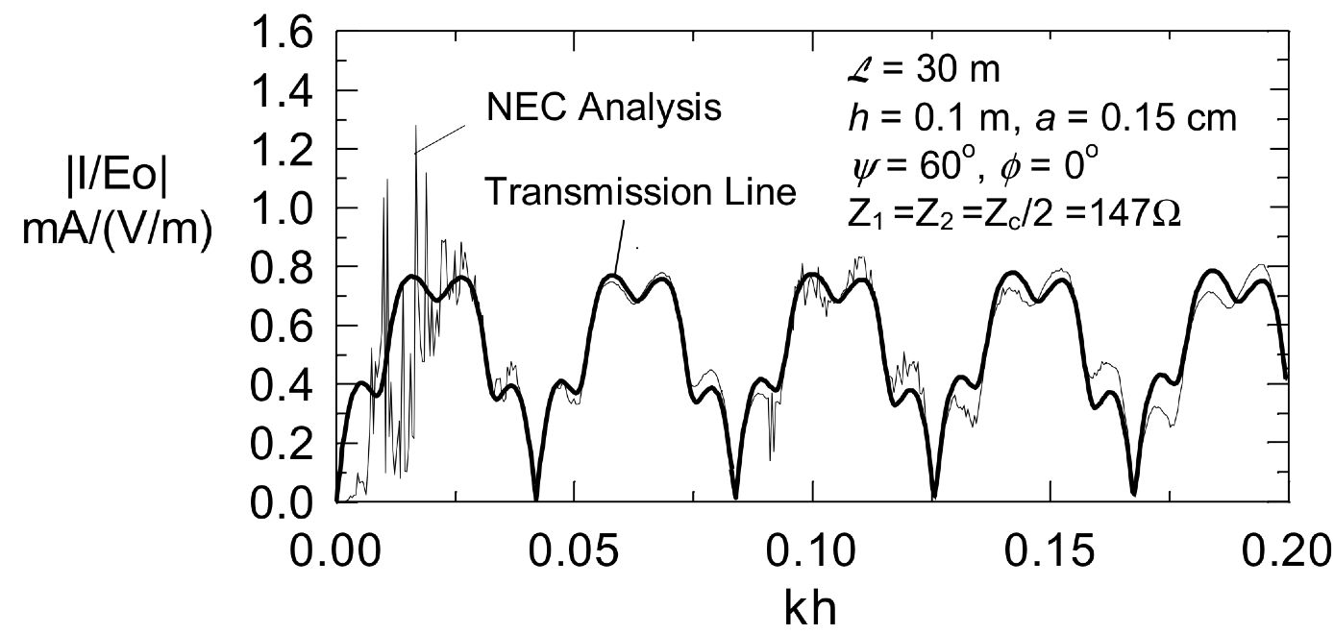
Assignment (Cont’d)

Slide 15
Assignment (Cont’d)
Once you have validated your code, you are requested to run the two following cases:
Case 1: Normal Incidence
L = 30 m, h = 0.1 m, a = 0.15 cm (radius of the conductor), ψ=90º, φ=0º, α=0º, Z₁=Z₂=293.4 Ω, E_{o}=1 V/m. Represent the current magnitude I(L) as a function of frequency from 10 Hz to 100 MHz.
Case 2: Grazing Incidence
L = 30 m, h = 0.1 m, a = 0.15 cm (radius of the conductor), ψ=0º, φ=0º, α=0º, Z₁=Z₂=293.4 Ω, E_{o}=1 V/m. Represent the current magnitude I(L) as a function of frequency from 10 Hz to 100 MHz.
The results for the two case (in log-log graph) should be included in your report.

Slide 16
Assignment (Cont’d)
Calculate analytically the current I(L) for Case 2. Compare with the simulated results and discuss.

