Slide 1
Geometrical Mean Distance/Radius
In this section we shall present an approach which can be applied to conductors with dimensions of the same order of magnitude as the distances between them, using the concept of the geometrical mean distance (GMD) and the geometrical mean radius (GMR), introduced by Maxwell*.
* Maxwell, J. C., A Treatise on Electricity and Magnetism, 3rd ed., Oxford University Press, London, 1959.

Slide 2
Mutual Inductance between Two Circuits
Conductor 3
Conductor 4
Area
Area
Area
Area
Current
Current
Conductor 1
Conductor 2
Transverse cross-section of a four-conductor system for two circuits..

Slide 3
Mutual Inductance between Two Circuits
The current I_{a} flows through circuit a formed by conductors 1 and 2 and the current I_{b} through circuit b formed by conductors 3 and 4.
These currents are assumed to vary slowly enough with the time so that the skin effect and other proximity effects are negligible.

Slide 4
Mutual Inductance between Two Circuits
In an elementary current filament of cross-section dS within the conductor, a current dI = J·dS flows. J is the current density in the conductor, which is assumed to be constant over the cross-section S, and is given by J = I / S.
Each filament of the circuit a couples its magnetic field to each element of the circuit b. Thus, for a filament area of dS1 of conductor 1, a current I_{a}dS1/S1 flows, and in an element dS2 of conductor 2, the current is - I_{a}dS2/S2.

Slide 5
Mutual Inductance between Two Circuits
The partial flux in a length Δx linking the filaments k and l of circuit b due to the current (I_{a}·dS1/S1) in the element i of conductor 1 is equal to
while the contribution of the current element j of conductor 2 to the elementary flux between k and l is

Slide 6
Mutual Inductance between Two Circuits
In order to calculate the total flux between the elementary filaments k and l due to the complete circuit a, it is necessary to integrate over the cross sections S₁ and S₂ in circuit a containing the current.

Slide 7
Mutual Inductance between Two Circuits
The total coupled flux Φ_{b,a} in circuit b arising from all of the current in circuit a is the algebraic mean (or average) and is given by the integral of the equation over the cross-sectional areas S₃ and S₄ as

Slide 8
Mutual Inductance between Two Circuits
The per-unit-length mutual inductance between circuits a and b due to the current I_{a} is then given as

Slide 9
Geometrical Mean Distance (GMD)
Starting from the analytical expressions of the flux linking two coupled circuits given in the last equation, it is possible to express the mutual inductances of the circuits in terms of the geometrical mean distance of the circuits.
The geometrical mean distance (GMD) of the cross-section S_{i} to the cross-section S_{j}, is denoted by g_{ij} and is defined as

Slide 10
Geometrical Mean Distance (GMD)
Using the geometrical mean distance as defined earlier, the analytical expression of the mutual inductance between two circuits a and b becomes

Slide 11
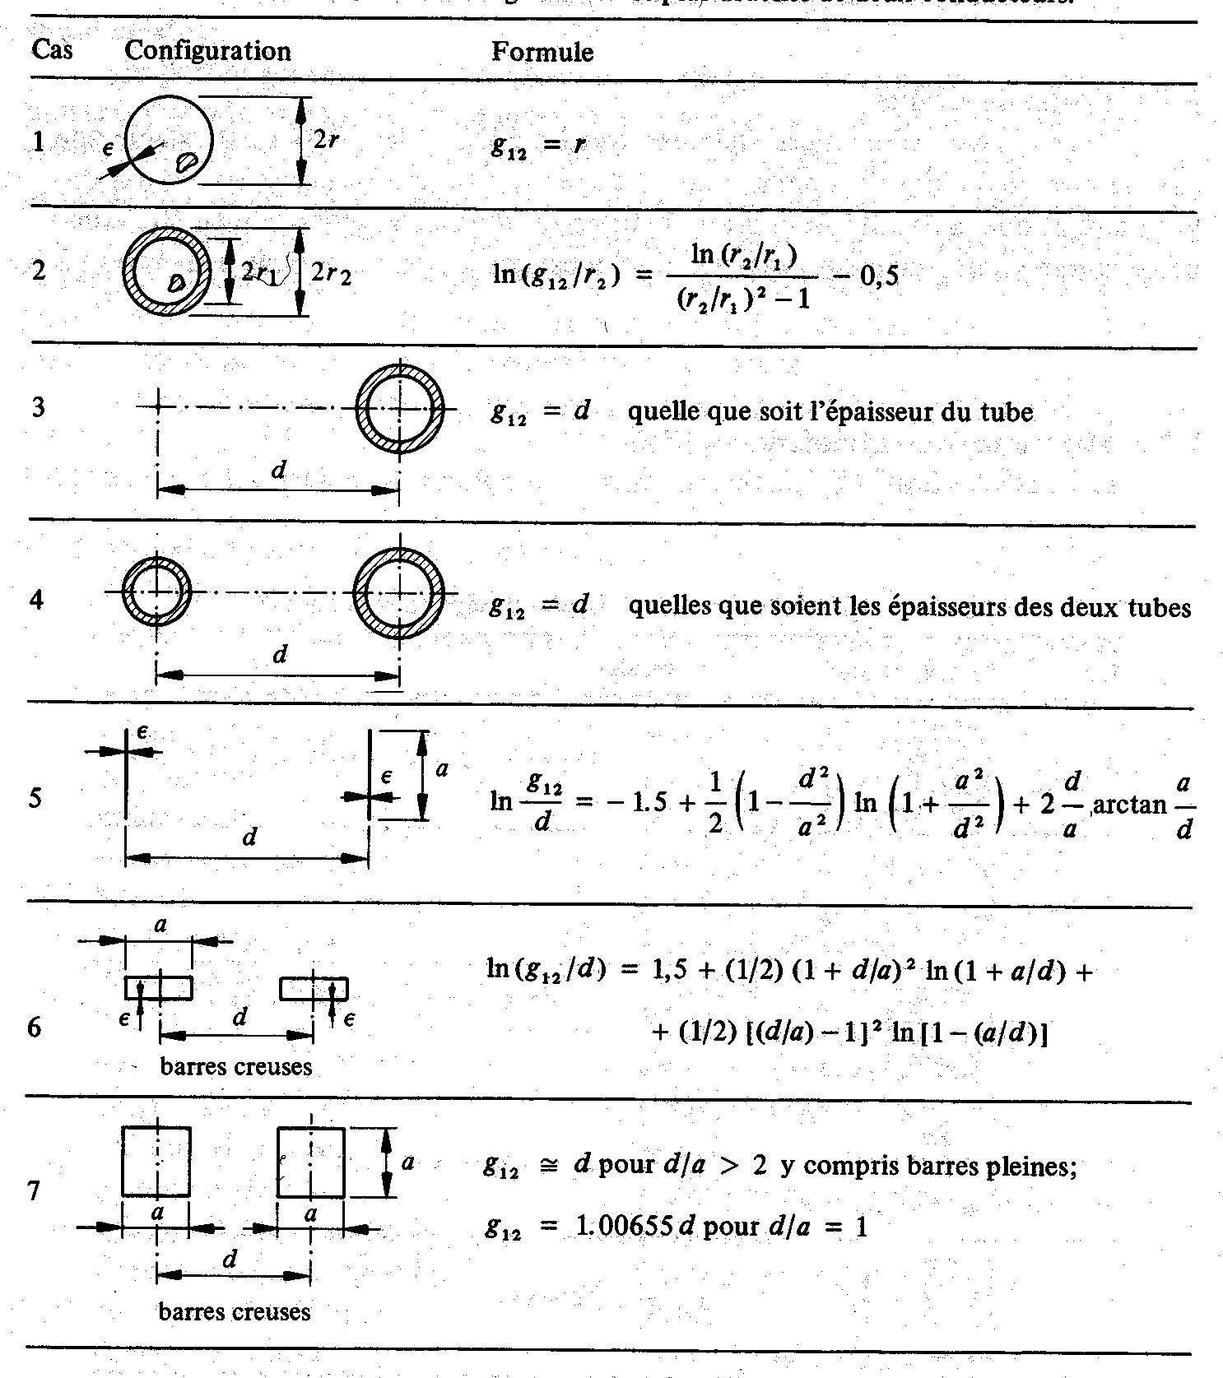
GMD for usual configurations

Slide 12
GMD: Example
If d_{a} and d_{b} << D, the GMDs have the following values:

Slide 13
GMD: Example
If the circuits are identical, d_{a} = d_{b} = d, we have

Slide 14
Geometric Mean Radius (GMR)
In order to determine the self-inductance of a circuit, we need to define the Geometric Mean Radius (GMR) of a conductor i, which is defined as the geometrical mean distance of a surface S_{i} to itself:

Slide 15
Self-Inductance: Geometric Mean Radius (GMR)
The self inductance is defined as the flux linking a circuit due to the current flowing in the circuit divided by the same current. Therefore, the expression of the self inductance can be found by superposing the circuits a and b
Conductors 1 & 3
Conductors 2 & 4
Area
Area
Current I
Current -I

Slide 16
Self-Inductance: Geometric Mean Radius (GMR)
Conductors 1 & 3
Conductors 2 & 4
Area
Area
Current I
Current -I

Slide 17
Self-Inductance: Geometric Mean Radius (GMR)
Conductors 1 & 3
Conductors 2 & 4
Area
Area
Current I
Current -I
or more generally, the per unit length self inductance of a loop comprised of conductors i and a neutral (return) conductor n is

Slide 18
GMR: Example
Two circuits with a common ground return conductor

Slide 19
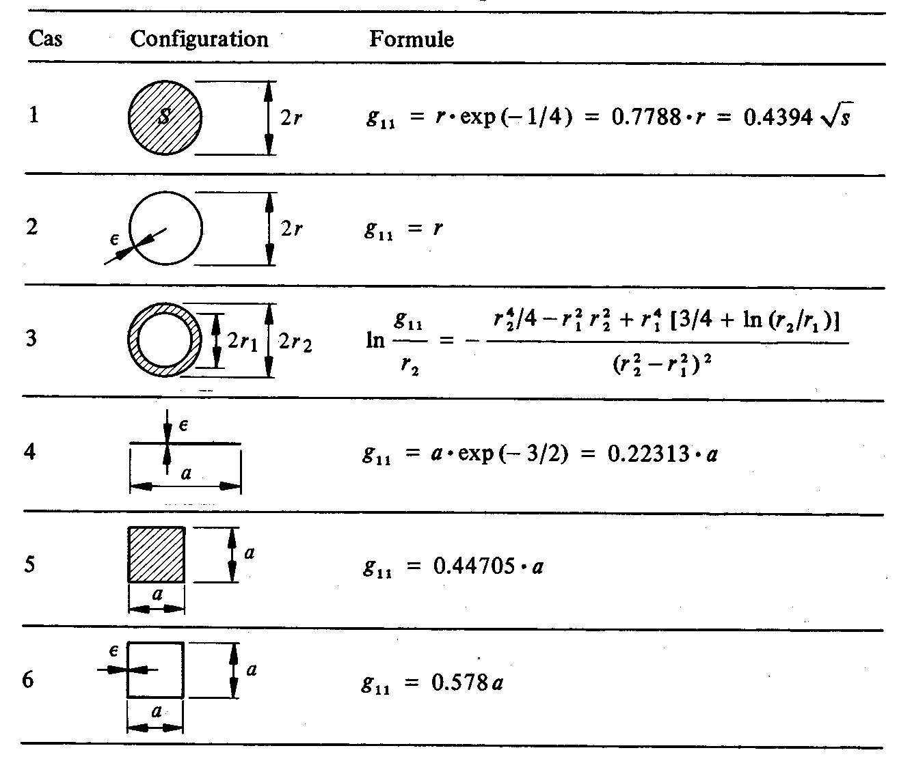
GMR for usual configurations

Slide 20
Mutual and Self Inductances of Lines with the Earth as a Return Conductor

Slide 21
Mutual Inductances of Lines with the Earth as a Return Conductor
where g_{ik*} = g_{ki*} = d* and g_{ki} = g_{k*i*} = d, respectively.
Note that the leading factor of (1/2) arises from the fact that we wish to consider only the component of mutual inductance arising only from the flux above the ground plane.
The final expression for the mutual inductance is

Slide 22
Self Inductances of Lines with the Earth as a Return Conductor
where g_{ii*} = 2h_{i} and g_{ii} = g_{i*i*} .
The final expression for the self inductance is

