Slide 1
FVLSI ALU8BIT Project
FIRSTNAME, LASTNAME
EDAlabs 2022-2023

Slide 2
Outline
Logic block
Adder block
Top ALU
Simulation benchmark
Results
Additional guidelines for grading

Slide 3
Logic block
Insert here a screenshot of the schematic of the logic block

Slide 4
Logic block
Insert here a screenshot of the layout of the logic block
Show us the size using the cadence ruler (k)

Slide 5
Adder block
Insert here a screenshot of the schematic and layout of a 1bit adder
Show us the size using the cadence ruler (k)

Slide 6
MUX 1bit
Insert here a screenshot of the schematic and layout of a 1bit MUX
Show us the size using the cadence ruler (k)

Slide 7
ALU 1bit
Insert here a screenshot of the layout of the 1 bit ALU
Show us the size using the cadence ruler (k)
Show us how does the carry signal propagate

Slide 8
Top ALU
Insert here a screenshot of the layout of the top ALU
Show us the size using the cadence ruler (k)
Show us how does the carry signal propagate
What is the area in um2?

Slide 9
Simulation benchmark – logic
ALU configured as logic (SEL = 0)
Post PEX, Show us the simulation of a NAND, NOR, NOT(A), NOT(B)
How much time does it take to go through the ALU ?

Slide 10
Simulation benchmark – adder
Post PEX, Show us a simulation of A+B where A=1111 1111, and B switches from 0000 0000 to 0000 0001 and back to 0000 0000 - call it case 1
Post PEX, Show us a simulation of A+B where B=1111 1111, and A switches from 0000 0000 to 0000 0001 and back to 0000 0000 - call it case 2
Pick the slowest and adapt case 3 and 4 accordingly with the slowest
Post PEX, Show us a simulation of A+B where A or B=0111 1111, and B or A switches from 0000 0000 to 0000 0001 and back to 0000 0000 – call it case 3
Post PEX, Show us a simulation of A+B where A or B=0011 1111, and B or A switches from 0000 0000 to 0000 0001 and back to 0000 0000 – call it case 4
Why could case 3 be interesting ? Give a few words about it in the next slide
Fill in the following table :
If for some reason your worst cases are different, go ahead and present them as well.
Rising | Time (pre-PEX) | Time (Post PEX) | Falling | Time (pre-PEX) | Time (Post PEX)
Case 1 |  |  | Case 1
Case 2 |  |  | Case 2
Case 3 |  |  | Case 3
Case 4 |  |  | Case 4

Slide 11
Additional material
Feel free to add material any justification that you believe will be useful
Any design choice you made
Anything for which you are not sure in your design
You can also add questions and suggestions which you believe would have helped you in the design.

Slide 12
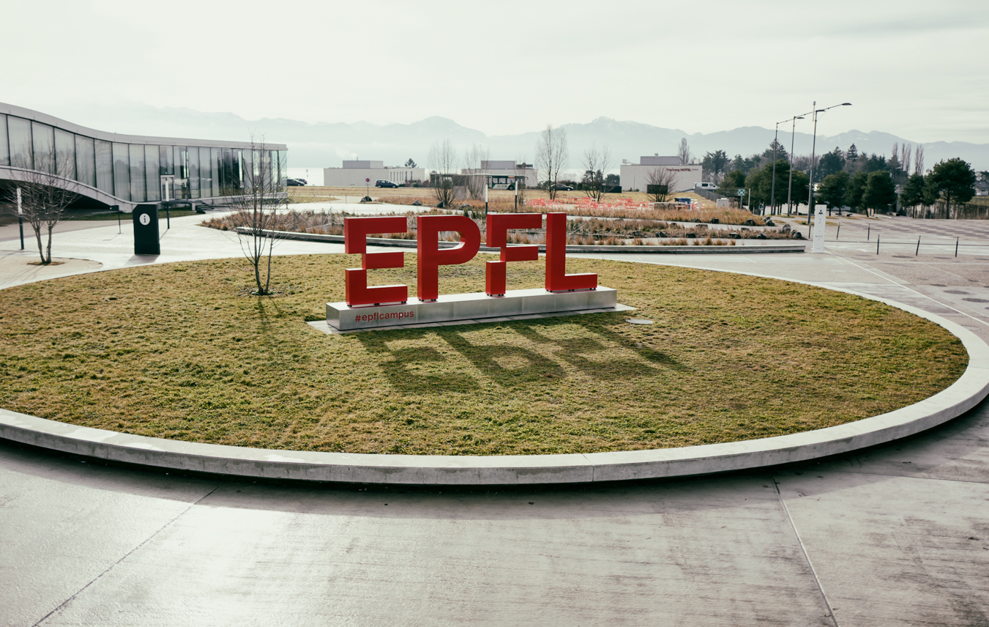
Merci

