Slide 1
DiStefano:
Decentralized Infrastructure for Sharing Trusted Encrypted Facts and Nothing
More Private and Efficient Commitments for TLS-encrypted Data
Published in IACR ePrint 2023
Sofía Celi Alex Davidson Hamed Haddadi Gonçalo Pestana Joe Rowell
Student seminar: security protocols and applications
EPFL Lausanne
Noah El Hassanie, Cristina Morad

Slide 2
Transport Layer Security - TLS
Definition: Transport Layer Security (TLS) is a cryptographic protocol designed to provide communications security over a computer network, such as the Internet¹.
Actors Involved
Client (C) → Initiates the connection and verifies the server’s identity.
Server (S) → Responds to the client and provides a digital certificate to prove its identity.
TLS Versions:
TLS 1.1 → Deprecated due to weak security measures.
TLS 1.2 → Introduced stronger encryption and support for modern cryptographic algorithms.
TLS 1.3 → Improved security and performance, reducing handshake time and removing weak algorithms.
PROBLEMS:
No Transparent Third-Party Verification
Lacks commitment mechanisms: it's impossible to prove what was communicated without revealing everything.
¹ https://en.wikipedia.org/wiki/Transport_Layer_Security

Slide 3
Designated-Commitment TLS - DCTLS
Definition: Designated-Commitment TLS (DCTLS) protocols (a.k.a. three-party handshake protocols) provide modified TLS handshakes that allow exporting certain claims on the TLS channel to a designated verifier.
Why Was It Introduced?
Due to the limitations of TLS 1.3:
Prevents third parties from verifying communications without decryption.
Lacks commitment mechanisms, making it impossible to prove what was communicated without revealing everything.
Actors Involved
Client (C) → Initiates the connection and verifies the server’s identity.
Server (S) → Responds to the client and provides a digital certificate to prove its identity.
Verifier (V) → Can verify a TLS session without accessing its content.
Example of DCTLS: DECO, TLSNotary/PageSigner, TownCrier, Garble-thenProve, and Janus.

Slide 4
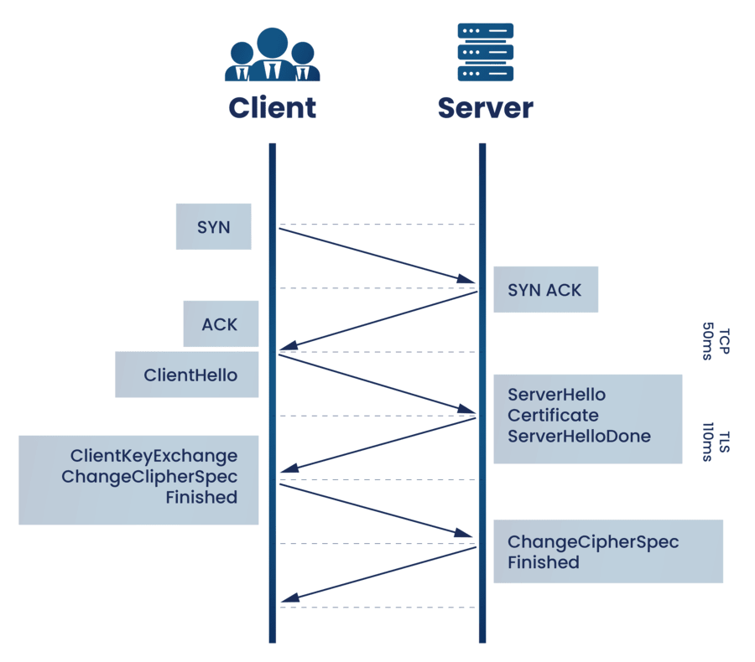
TLS 1.3 - Handshake Protocol (HSP)
ClientHello
ServerHello +
EncryptedExtensions +
Certificate +
CertificateVerify +
Finished
Finished
Data

Slide 5
DCTLS - Handshake Protocol (HSP)
V
Verifier
Generate ephemeral key share
Combine ephemeral key share
Generate ephemeral key share
ClientHello (CH)
Generate ephemeral key share
ServerHello (SH)
Ephemeral Shared Secret Computation
Derive other HS keys
Ephemeral shared secret
Derive other HS keys
Reveal part of HS keys
ServerCertificate (SCRT)
ServerCertificateVerify (SCV)
2PC
ServerFinished (SF)
Verify signature (SCV)
And MAC of SF
Derive Final Key
Derive Final Key
Generate MAC
ClientFinished (CF)

Slide 6
DCTLS - Query Execution (QP) & Commitment phase (CP)
V
Verifier
Encrypt Query 𝙦
𝙦
2PC
Decrypt 𝙦
Compute 𝐫
𝐫
QP
CP
Decrypt 𝐫
Commit (𝙦, 𝐫 )
Return verifier’s key shares
Verify integrity
Notes:
## **Assumptions (Invariants)**
1. **Parties:**
- **C (Client)**: Sends encrypted queries to **S**.
- **S (Server)**: Processes encrypted queries and sends encrypted responses.
- **V (Verifier)**: Holds part of the session key and helps with encryption.
2. **Key Notation:**
- **Session keys:** \( K_{\text{enc}}, K_{\text{mac}} \) for encryption and authentication.
- **Secret-sharing:**
- C and V hold shares \( K_{\text{enc}}^C, K_{\text{enc}}^V \) such that:
\[
K_{\text{enc}} = K_{\text{enc}}^C + K_{\text{enc}}^V
\]
- **Encryption:**
- Symmetric encryption uses **AES-GCM**, where:
\[
\hat{m} = \text{Enc}_{K_{\text{enc}}}(m)
\]
- **Message authentication:**
- Uses a MAC function:
\[
\text{MAC}_{K_{\text{mac}}}(m)
\]
- **Commitments:**
- C commits to a response \( r \) by sending:
\[
\text{Commit} = H(\hat{r} \parallel \text{nonce})
\]
—---------------QP—-------------------------------------
## **Step-by-Step Breakdown**
The **record layer** handles **encrypted queries and responses**, while the **commitment phase** ensures integrity.
### **Step 0: Initial State**
- The **session is established**, and **C, S, and V** share session keys:
- \( K_{\text{enc}}^C, K_{\text{enc}}^V \) are secret shares of \( K_{\text{enc}} \).
- \( K_{\text{mac}} \) is known to C and S.
---
### **Step 1: Encrypting and Sending Query \( q \)**
- **C wants to send a query \( q \) securely**.
- Since **C and V share \( K_{\text{enc}} \)**, they use **2PC** to compute encryption:
- Compute **partial encryptions**:
\[
\hat{q}_C = \text{Enc}_{K_{\text{enc}}^C}(q)
\]
\[
\hat{q}_V = \text{Enc}_{K_{\text{enc}}^V}(q)
\]
- Combine these to get the final **encrypted query**:
\[
\hat{q} = \hat{q}_C \oplus \hat{q}_V
\]
- **C sends \( \hat{q} \) to S**.
##### **DCTLS Modification:**
- Normally, C would **encrypt using a full key**.
- Here, C and V **jointly encrypt via 2PC**.
---
### **Step 2: Server Processes Query and Responds**
- **S receives \( \hat{q} \) and decrypts it:**
\[
q = \text{Dec}_{K_{\text{enc}}}(\hat{q})
\]
- **S computes response \( r \)** and encrypts it:
\[
\hat{r} = \text{Enc}_{K_{\text{enc}}}(r)
\]
- **S sends \( \hat{r} \) to C**.
##### **DCTLS Modification:**
- No change in how S handles encryption.
- Decryption at C happens **collaboratively** using **2PC**.
—----------CP—-----------------------
2. **(C & V) Joint decryption via 2PC**
- C and V **jointly decrypt \( \hat{r} \) in 2PC**:
- C computes **partial decryption** \( r_C = \text{Dec}_{K_{\text{enc}}^C}(\hat{r}) \).
- V computes **partial decryption** \( r_V = \text{Dec}_{K_{\text{enc}}^V}(\hat{r}) \).
- Combine: \( r = r_C \oplus r_V \).
3. **(C → V) Commitment: C sends \( q, \hat{r} \) to V**
- C **commits** to the query-response pair **before** receiving V’s key share:
- Computes **commitment hash**:
\[
\text{Commit} = H(q \parallel \hat{r} \parallel \text{nonce})
\]
- Sends **\( (q, \hat{r}) \) to V**.
4. **(V → C) V sends final key share**
- V **sends \( K_{\text{enc}}^V \) to C**.
- Now C **has the full session key**:
\[
K_{\text{enc}} = K_{\text{enc}}^C + K_{\text{enc}}^V
\]
5. **(C verifies \( r \))**
- With the full key, C **authenticates \( r \) and ensures integrity**.
### **Final State**
- **C has the full session key \( K_{\text{enc}} \)**.
- **C can now securely communicate with S like in normal TLS 1.3**.
- **V retains a commitment to \( q, r \) for later verification**.
This ensures **integrity, confidentiality, and verifiability** while transitioning into standard **TLS 1.3 behavior**. 🚀

Slide 7
Limitations of Existing DCTLS
Security Issues:
Many rely on outdated TLS versions (≤1.2) or trusted hardware, both of which have known vulnerabilities.
DECO's non-modular security makes updates difficult and lacks formal TLS 1.3 support.
Privacy Concerns:
Existing protocols expose the server’s identity to the verifier, compromising client privacy.
Unlike TLS 1.3, which encrypts server identity, older methods reveal browsing history.
Performance Challenges:
Some cryptographic tools used are outdated, leading to high computational costs.
Handling modern ciphersuites (e.g., AES-GCM) is inefficient in existing implementations.
Deployability Barriers:
Most protocols are theoretical, incomplete, or lack public implementations.
No widely deployed TLS 1.3 attestation mechanism exists.
Even optimized protocols struggle with high handshake times and excessive data exchange.

Slide 8
DiStefano - Goal
Objective: To create a practical DCTLS protocol overcoming the limitations of existing approaches.
Key Goals:
Support for TLS 1.3: Focus on modern protocols, ensuring broad compatibility.
Enhanced Privacy: Maintain client privacy without revealing browsing history.
No Hardware/Extensions Required: Avoid reliance on trusted hardware or TLS extensions.
Deployability: Provide a publicly available implementation integrated into existing TLS libraries with no specialized hardware.

Slide 9
Disclaimer - Simplified DiStefano
The real protocol is more complex with advanced cryptographic details.
We show only the key ideas of how DiStefano differs from “classical” DCTLS.
We skip deep math (e.g., how exactly each 2PC circuit is built).
We highlight the main problems and how DiStefano solves them.
Some details are oversimplified to keep it understandable.

Slide 10
Two-party secure computation (2PC)
Definition: Two-party secure computation (2PC) allows two parties to jointly compute a function over their private inputs, without revealing anything about their inputs to each other—except what can be learned from the output itself.
There are two common approaches:
Garbled Circuits Protocols: The function f is encoded as a boolean circuit, and an encrypted version of this circuit is evaluated between the two parties.
→ Well-suited for operations like AES and SHA-256
→ Cost mainly depends on the number of AND gates
Threshold Secret-Sharing Protocols: The computation is done by first generating random multiplicative triples¹, then sharing the inputs additively along with auxiliary data.
→ Efficient for arithmetic-heavy computations
→ Cost depends on the number of communication rounds and bandwidth
¹ referred to as Beaver triples
Notes:
Garbled: A prende
Secret: si spezzano gli input, si passa una parte all’altra parte (questo non rivela nulla sull’input in se). Si usano triples casuali che mascherano la moltiplicazione.

Slide 11
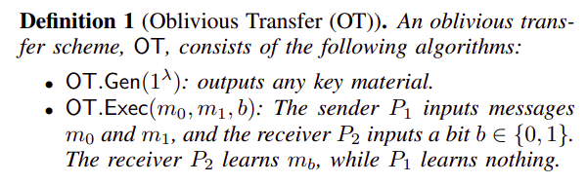
Definition 1 - Oblivious Transfer (OT)
How is it implemented in DiStefano?
IKNP Extension: A method of speeding up OT by making it more efficient.
Ferret OT Scheme: An advanced technique to perform OT more securely and faster.
Why it is important?
Protects privacy → V can get some of C's data without revealing which ones.
Prevents malicious attacks → Ensures that neither party can cheat in the key sharing process.
Notes:
OT is a protocol that allows one party (the receiver) to get a message between two possible options, without revealing which one he has chosen, and without the sender knowing.

Slide 12
Oblivious Transfer (OT) in Garbled Circuit - Example
Assume P1 and P2 wants to compute f(p1, p2) = p1 AND p2, with p1 = 1 and p2 = 0.
AND-function table of label ENC(Ai, Bi, Zi)
(0,0) → 0
(0,1) → 0
(1,0) → 0
(1,1) → 1
Bit | Lbl P1 | Lbl P2 | output
0 | A0 | B0 | Z0
1 | A1 | B1 | Z1
ENC1
ENC2
ENC3
ENC4
P1
OT
Decrypt(ENCi, A1, B0), for i = 1...4
SOLUTION:
Decrypt(ENC3, A1, B0) = Z0
A1
B0
0
ENCi
Notes:
OT is a protocol that allows one party (the receiver) to get a message between two possible options, without revealing which one he has chosen, and without the sender knowing.
How is it implemented in DiStefano?
IKNP Extension: A method of speeding up OT by making it more efficient.
Ferret OT Scheme: An advanced technique to perform OT more securely and faster.
Why it is important?
Protects privacy → V can get some of C's data without revealing which ones.
Prevents malicious attacks → Ensures that neither party can cheat in the key sharing process.
(magari elimina)
Mathematical assumptions on which it is based?
Learning Parity with Noise (LPN): A difficult problem to solve that guarantees security.
MACs and random hashes: Help protect the data exchanged.

Slide 13
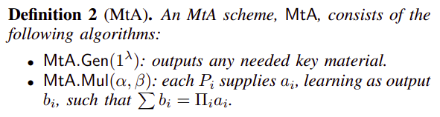
Definition 2 - Multiplicative-to-Additive (MtA)
MtA (Multiplicative-to-Additive Secret Sharing) makes it possible to safely calculate the product of secret values between two parties without revealing them.
Problem in standard protocols: a malicious participant could send manipulated data to compromise the final calculation.
Solution in DiStefano: add MtA.Check(a1, . . . , b1, . . .), a mechanism that checks whether secret shares are consistent and not altered.
The inclusion of MtA.Check provides DiStefano with malicious security, i.e., protection against active adversaries attempting to cheat during the protocol.

Slide 14
AES-GCM (Advanced Encryption Standard in Galois Counter Mode)
(Classic) Definition: encrypts data using AES in counter mode and produces an authentication tag to protect both the ciphertext and optional additional data.
DiStefano AES-GCM: Adapted it to work in 2PC.
V C
How?
Use a 2PC-friendly AES (DECO-style) inside a garbled circuit
Avoid Galois multiplications in GCM:
  Precompute additive/multiplicative shares of powers of h¹
  Use multiplicative sharing → reduces rounds from ~500 to 1, and enables parallel computation
Result:
~3× speedup vs additive sharing
18K AND gates (vs 23K with standard method)
Avoids full GCM circuit (~17M gates) → total 2PC cost ~1.3M gates
Keeps key and plaintext private
𝐊v
𝐊c, m
AES-GCM
in 2PC
c
¹ h = AES(k,0) – a value derived from the AES key, used in the computation of the authentication tag (GCM mode).
Notes:
GCM è la parte che autentica i messaggi (cioè controlla che non siano stati modificati).
Funziona facendo delle moltiplicazioni in (GF(2^128)).
Queste operazioni sono molto costose da fare in 2PC, quindi DiStefano le evita.
—-------
La chiave h è un valore derivato dalla chiave AES (h = AES(k, 0)) che viene usato nel calcolo del tag di autenticazione.
Il tag si ottiene facendo moltiplicazioni successive tra h, h², h³... fino a h^1024.
Per evitare di calcolare questi esponenti “in diretta” (che è lento), DiStefano li precalcola in anticipo, e li divide in due parti (shares), una per il Client, una per il Verifier.
—
Con la tecnica classica (additive sharing), ogni potenza di h richiede una comunicazione tra Client e Verifier.
Per h^1024, servivano circa 500 round di comunicazione.
Con multiplicative sharing, possono calcolare tutto in un solo round, in parallelo.
Questo riduce enormemente il tempo totale.
—-

Slide 15
DiStefano - Handshake Protocol (HSP)
V
Verifier
Generate ephemeral key share
Combine ephemeral key share
Generate ephemeral key share
ClientHello (CH)
MtA / ECtF
Generate ephemeral key share
Ephemeral Shared Secret Computation
Derive other HS keys
ServerHello (SH)
Garbled circuit
Reveal part of HS keys
Ephemeral shared secret
Derive other HS keys
ServerCertificate (SCRT)
ServerCertificateVerify (SCV)
Forward them + commit
ServerFinished (SF)
Reveal part of HS keys
Derive Final Key
Verify signature (SCV)
And MAC of SF
Garbled circuit
Derive Final Key
Generate MAC
Generate MAC
ClientFinished (CF)

Slide 16
DiStefano - Query Execution (QP) & Commitment phase (CP)
V
Verifier
AES-GCM
Encrypt Query 𝙦
_0
…
𝙦
Decrypt 𝙦
Compute 𝐫
AES-GCM
𝐫
Decrypt 𝐫
QP
CP
_0
…
Commit (𝙦, 𝐫 )
…
…
Return verifier’s key shares
ZKPVS scheme
Verify integrity
AES-GCM
Notes:
## **Assumptions (Invariants)**
1. **Parties:**
- **C (Client)**: Sends encrypted queries to **S**.
- **S (Server)**: Processes encrypted queries and sends encrypted responses.
- **V (Verifier)**: Holds part of the session key and helps with encryption.
2. **Key Notation:**
- **Session keys:** \( K_{\text{enc}}, K_{\text{mac}} \) for encryption and authentication.
- **Secret-sharing:**
- C and V hold shares \( K_{\text{enc}}^C, K_{\text{enc}}^V \) such that:
\[
K_{\text{enc}} = K_{\text{enc}}^C + K_{\text{enc}}^V
\]
- **Encryption:**
- Symmetric encryption uses **AES-GCM**, where:
\[
\hat{m} = \text{Enc}_{K_{\text{enc}}}(m)
\]
- **Message authentication:**
- Uses a MAC function:
\[
\text{MAC}_{K_{\text{mac}}}(m)
\]
- **Commitments:**
- C commits to a response \( r \) by sending:
\[
\text{Commit} = H(\hat{r} \parallel \text{nonce})
\]
—---------------QP—-------------------------------------
## **Step-by-Step Breakdown**
The **record layer** handles **encrypted queries and responses**, while the **commitment phase** ensures integrity.
### **Step 0: Initial State**
- The **session is established**, and **C, S, and V** share session keys:
- \( K_{\text{enc}}^C, K_{\text{enc}}^V \) are secret shares of \( K_{\text{enc}} \).
- \( K_{\text{mac}} \) is known to C and S.
---
### **Step 1: Encrypting and Sending Query \( q \)**
- **C wants to send a query \( q \) securely**.
- Since **C and V share \( K_{\text{enc}} \)**, they use **2PC** to compute encryption:
- Compute **partial encryptions**:
\[
\hat{q}_C = \text{Enc}_{K_{\text{enc}}^C}(q)
\]
\[
\hat{q}_V = \text{Enc}_{K_{\text{enc}}^V}(q)
\]
- Combine these to get the final **encrypted query**:
\[
\hat{q} = \hat{q}_C \oplus \hat{q}_V
\]
- **C sends \( \hat{q} \) to S**.
##### **DCTLS Modification:**
- Normally, C would **encrypt using a full key**.
- Here, C and V **jointly encrypt via 2PC**.
---
### **Step 2: Server Processes Query and Responds**
- **S receives \( \hat{q} \) and decrypts it:**
\[
q = \text{Dec}_{K_{\text{enc}}}(\hat{q})
\]
- **S computes response \( r \)** and encrypts it:
\[
\hat{r} = \text{Enc}_{K_{\text{enc}}}(r)
\]
- **S sends \( \hat{r} \) to C**.
##### **DCTLS Modification:**
- No change in how S handles encryption.
- Decryption at C happens **collaboratively** using **2PC**.
—----------CP—-----------------------
2. **(C & V) Joint decryption via 2PC**
- C and V **jointly decrypt \( \hat{r} \) in 2PC**:
- C computes **partial decryption** \( r_C = \text{Dec}_{K_{\text{enc}}^C}(\hat{r}) \).
- V computes **partial decryption** \( r_V = \text{Dec}_{K_{\text{enc}}^V}(\hat{r}) \).
- Combine: \( r = r_C \oplus r_V \).
3. **(C → V) Commitment: C sends \( q, \hat{r} \) to V**
- C **commits** to the query-response pair **before** receiving V’s key share:
- Computes **commitment hash**:
\[
\text{Commit} = H(q \parallel \hat{r} \parallel \text{nonce})
\]
- Sends **\( (q, \hat{r}) \) to V**.
4. **(V → C) V sends final key share**
- V **sends \( K_{\text{enc}}^V \) to C**.
- Now C **has the full session key**:
\[
K_{\text{enc}} = K_{\text{enc}}^C + K_{\text{enc}}^V
\]
5. **(C verifies \( r \))**
- With the full key, C **authenticates \( r \) and ensures integrity**.
### **Final State**
- **C has the full session key \( K_{\text{enc}} \)**.
- **C can now securely communicate with S like in normal TLS 1.3**.
- **V retains a commitment to \( q, r \) for later verification**.
This ensures **integrity, confidentiality, and verifiability** while transitioning into standard **TLS 1.3 behavior**. 🚀

Slide 17
DiStefano - Commitment phase (CP)
Client commits to a specific ciphertext block C_i (CTR mode) with a mask b_i
2PC checks the tag of the ciphertext to check that the Client didn’t modify it
2PC decryption outputs AES.Enc(k, IV + i) to the Client and
E_i = AES.Enc(k, IV + i) ⊕ b_i to the Verifier
If the Client wants to prove that a specific substring is present in the ciphertext the client can send b_i to the Verifier
The verifier check that b_i is the same the Client committed to via Zero Knowledge Proof and then the Verifier is able to decrypt the specific ciphertext block using
AES.Enc(k, IV + i) = E_i ⊕ b_i
Notes:
## **Assumptions (Invariants)**
1. **Parties:**
- **C (Client)**: Sends encrypted queries to **S**.
- **S (Server)**: Processes encrypted queries and sends encrypted responses.
- **V (Verifier)**: Holds part of the session key and helps with encryption.
2. **Key Notation:**
- **Session keys:** \( K_{\text{enc}}, K_{\text{mac}} \) for encryption and authentication.
- **Secret-sharing:**
- C and V hold shares \( K_{\text{enc}}^C, K_{\text{enc}}^V \) such that:
\[
K_{\text{enc}} = K_{\text{enc}}^C + K_{\text{enc}}^V
\]
- **Encryption:**
- Symmetric encryption uses **AES-GCM**, where:
\[
\hat{m} = \text{Enc}_{K_{\text{enc}}}(m)
\]
- **Message authentication:**
- Uses a MAC function:
\[
\text{MAC}_{K_{\text{mac}}}(m)
\]
- **Commitments:**
- C commits to a response \( r \) by sending:
\[
\text{Commit} = H(\hat{r} \parallel \text{nonce})
\]
—---------------QP—-------------------------------------
## **Step-by-Step Breakdown**
The **record layer** handles **encrypted queries and responses**, while the **commitment phase** ensures integrity.
### **Step 0: Initial State**
- The **session is established**, and **C, S, and V** share session keys:
- \( K_{\text{enc}}^C, K_{\text{enc}}^V \) are secret shares of \( K_{\text{enc}} \).
- \( K_{\text{mac}} \) is known to C and S.
---
### **Step 1: Encrypting and Sending Query \( q \)**
- **C wants to send a query \( q \) securely**.
- Since **C and V share \( K_{\text{enc}} \)**, they use **2PC** to compute encryption:
- Compute **partial encryptions**:
\[
\hat{q}_C = \text{Enc}_{K_{\text{enc}}^C}(q)
\]
\[
\hat{q}_V = \text{Enc}_{K_{\text{enc}}^V}(q)
\]
- Combine these to get the final **encrypted query**:
\[
\hat{q} = \hat{q}_C \oplus \hat{q}_V
\]
- **C sends \( \hat{q} \) to S**.
##### **DCTLS Modification:**
- Normally, C would **encrypt using a full key**.
- Here, C and V **jointly encrypt via 2PC**.
---
### **Step 2: Server Processes Query and Responds**
- **S receives \( \hat{q} \) and decrypts it:**
\[
q = \text{Dec}_{K_{\text{enc}}}(\hat{q})
\]
- **S computes response \( r \)** and encrypts it:
\[
\hat{r} = \text{Enc}_{K_{\text{enc}}}(r)
\]
- **S sends \( \hat{r} \) to C**.
##### **DCTLS Modification:**
- No change in how S handles encryption.
- Decryption at C happens **collaboratively** using **2PC**.
—----------CP—-----------------------
2. **(C & V) Joint decryption via 2PC**
- C and V **jointly decrypt \( \hat{r} \) in 2PC**:
- C computes **partial decryption** \( r_C = \text{Dec}_{K_{\text{enc}}^C}(\hat{r}) \).
- V computes **partial decryption** \( r_V = \text{Dec}_{K_{\text{enc}}^V}(\hat{r}) \).
- Combine: \( r = r_C \oplus r_V \).
3. **(C → V) Commitment: C sends \( q, \hat{r} \) to V**
- C **commits** to the query-response pair **before** receiving V’s key share:
- Computes **commitment hash**:
\[
\text{Commit} = H(q \parallel \hat{r} \parallel \text{nonce})
\]
- Sends **\( (q, \hat{r}) \) to V**.
4. **(V → C) V sends final key share**
- V **sends \( K_{\text{enc}}^V \) to C**.
- Now C **has the full session key**:
\[
K_{\text{enc}} = K_{\text{enc}}^C + K_{\text{enc}}^V
\]
5. **(C verifies \( r \))**
- With the full key, C **authenticates \( r \) and ensures integrity**.
### **Final State**
- **C has the full session key \( K_{\text{enc}} \)**.
- **C can now securely communicate with S like in normal TLS 1.3**.
- **V retains a commitment to \( q, r \) for later verification**.
This ensures **integrity, confidentiality, and verifiability** while transitioning into standard **TLS 1.3 behavior**. 🚀

Slide 18
Security Analysis
Handshake: Builds on proven TLS 1.3 security with an extra 2PC layer for client secrets.
Query: Uses 2PC AES-GCM, preventing forging or tampering.
Commitment: DiStefano’s approach is computationally binding (client cannot fake a different plaintext later) and perfectly hiding (the verifier cannot see the plaintext unless the client allows it).
Privacy: The verifier does not learn the exact server’s identity (if the client uses zero-knowledge proofs for the certificate).
Malicious Security: Checks ensure no party can cheat in the 2PC computations.

Slide 19
Experimental Analysis (I)
Implementation Setup
Libraries: BoringSSL (for TLS), emp (for secure 2PC).
DiStefano Code: ~14k lines of C++, integrated with real TLS 1.3 handshake logic.
Evaluation:
  LAN:
    Client (C): MacBook Air (M1, 8GB RAM)
    Verifier (V) & Server (S): Intel Xeon Gold 6138 with 32 GB of RAM
    Network: 1 Gbps, ~16 ms latency
  WAN(real-world, cross-continent)
    Client (C): AWS EC2 t2.2xlarge in Paris
    Verifier (V) & Server (S): Same instance type in: Ohio (~94 ms latency), London (~9 ms latency), Seoul (~248 ms latency)
(Check github repository: https://github.com/brave-experiments/DiStefano)

Slide 20
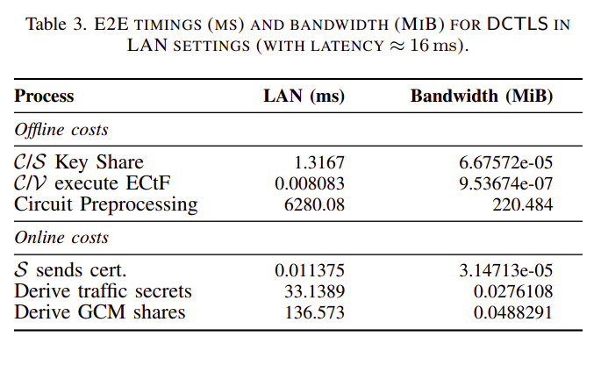
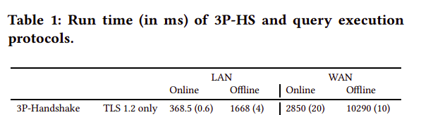
Experimental Analysis (II)
~6281
~169
Table 1 from DECO, arXiv:1909.00938
Notes:
🗣️ Note discorsive per la slide: Key Results
🔐 Handshake – LAN
"In una rete locale, quindi con bassa latenza, l'intera fase di handshake di DiStefano richiede circa 0.5–0.7 secondi di tempo online.
I 28 KiB extra si riferiscono ai dati aggiuntivi scambiati rispetto a una normale connessione TLS: ad esempio, i messaggi 2PC e i commitment.
È un overhead minimo, e il tutto avviene ben prima di un qualsiasi timeout TLS."
🔐 Handshake – WAN
"In un contesto più realistico, come una connessione da Parigi a Ohio con latenza di ~90–100 ms,
la fase di handshake arriva a circa 0.9–1.2 secondi, con ~40 KiB di dati extra.
Anche qui, siamo ben sotto i timeout standard di TLS, che di solito sono tra i 10 e i 20 secondi."
📦 Record / Query Phase – 2PC AES-GCM
"Durante la trasmissione dei dati applicativi (cioè il contenuto cifrato), DiStefano usa AES-GCM dentro una 2PC.
Per decriptare o cifrare 1 KiB di dati:
ci vogliono circa 50–70 ms in LAN
e 80–150 ms in WAN.
Questi tempi sono molto buoni, considerando che parliamo di cifratura a due parti."
📈 Scalabilità lineare
"La buona notizia è che i tempi crescono in modo lineare con la dimensione dei dati.
Quindi per 2 KiB servono ~300 ms, per 16 KiB circa 1.2 secondi, e così via.
Questo rende il protocollo prevedibile e gestibile anche con messaggi più lunghi."
✅ Considerazioni generali
"In sintesi, l’overhead rispetto a TLS standard è molto contenuto e non blocca l’uso pratico del protocollo.
Funziona anche in scenari di rete reali, senza hardware speciale o requisiti particolari.
In più, il protocollo offre sicurezza contro Client maliziosi, un vantaggio che TLS standard non copre."

Slide 21
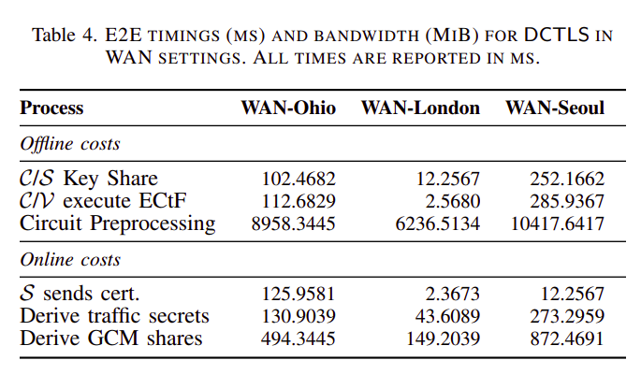
Experimental Analysis (III)
~10955
~1157
Table 1 from DECO, arXiv:1909.00938
Notes:
🗣️ Note discorsive per la slide: Key Results
🔐 Handshake – LAN
"In una rete locale, quindi con bassa latenza, l'intera fase di handshake di DiStefano richiede circa 0.5–0.7 secondi di tempo online.
I 28 KiB extra si riferiscono ai dati aggiuntivi scambiati rispetto a una normale connessione TLS: ad esempio, i messaggi 2PC e i commitment.
È un overhead minimo, e il tutto avviene ben prima di un qualsiasi timeout TLS."
🔐 Handshake – WAN
"In un contesto più realistico, come una connessione da Parigi a Ohio con latenza di ~90–100 ms,
la fase di handshake arriva a circa 0.9–1.2 secondi, con ~40 KiB di dati extra.
Anche qui, siamo ben sotto i timeout standard di TLS, che di solito sono tra i 10 e i 20 secondi."
📦 Record / Query Phase – 2PC AES-GCM
"Durante la trasmissione dei dati applicativi (cioè il contenuto cifrato), DiStefano usa AES-GCM dentro una 2PC.
Per decriptare o cifrare 1 KiB di dati:
ci vogliono circa 50–70 ms in LAN
e 80–150 ms in WAN.
Questi tempi sono molto buoni, considerando che parliamo di cifratura a due parti."
📈 Scalabilità lineare
"La buona notizia è che i tempi crescono in modo lineare con la dimensione dei dati.
Quindi per 2 KiB servono ~300 ms, per 16 KiB circa 1.2 secondi, e così via.
Questo rende il protocollo prevedibile e gestibile anche con messaggi più lunghi."
✅ Considerazioni generali
"In sintesi, l’overhead rispetto a TLS standard è molto contenuto e non blocca l’uso pratico del protocollo.
Funziona anche in scenari di rete reali, senza hardware speciale o requisiti particolari.
In più, il protocollo offre sicurezza contro Client maliziosi, un vantaggio che TLS standard non copre."

Slide 22
Conclusion
Main Achievement: A modular, efficient, and maliciously-secure protocol that commits to TLS 1.3 data with no hardware or server changes.
Benefits:
Preserves client privacy: hides which server the client connected to.
Produces verifiable commitments to real server data.
Practical and compatible with existing TLS libraries (e.g., BoringSSL).
Future Work:
Integrating zero-knowledge proofs for complex statements over committed data.
Deploying the system in real-world browsers for everyday use.
Critique: While technically solid, the paper is not beginner-friendly. It assumes significant background knowledge and may be difficult to follow for non-experts, due to dense notation and lack of intuitive explanations.

Slide 23
Thank You for Your Attention!
Any questions?

Slide 24
Questions to You Folks!
Why do I want to prove to a third party that I received specific data from a server?
Think of a possible real scenario.
  Example: A financial dispute—you claim that a bank sent you a balance statement at a certain time. Instead of showing your entire banking session, you commit to the data cryptographically, allowing a trusted party (V) to verify your claim.
So, do you always need DCTLS?
  No! If you don’t need third-party verification, standard TLS 1.3 is enough.
Why can't the Verifier just ask the Server to confirm what it sent to the Client?
  For privacy reasons.
  Because in DCTLS, the Server is passive and not aware of the protocol. This allows using any standard TLS server, without modifying it.
  It reduces complexity and works even with public or legacy servers.
What could go wrong if the Client could encrypt/decrypt everything alone?
  Example: Lie about what it received (e.g., forge data or fabricate responses).
  This would break the trust model, since the Verifier would have no cryptographic assurance that what the Client presents is authentic.

