Slide 1
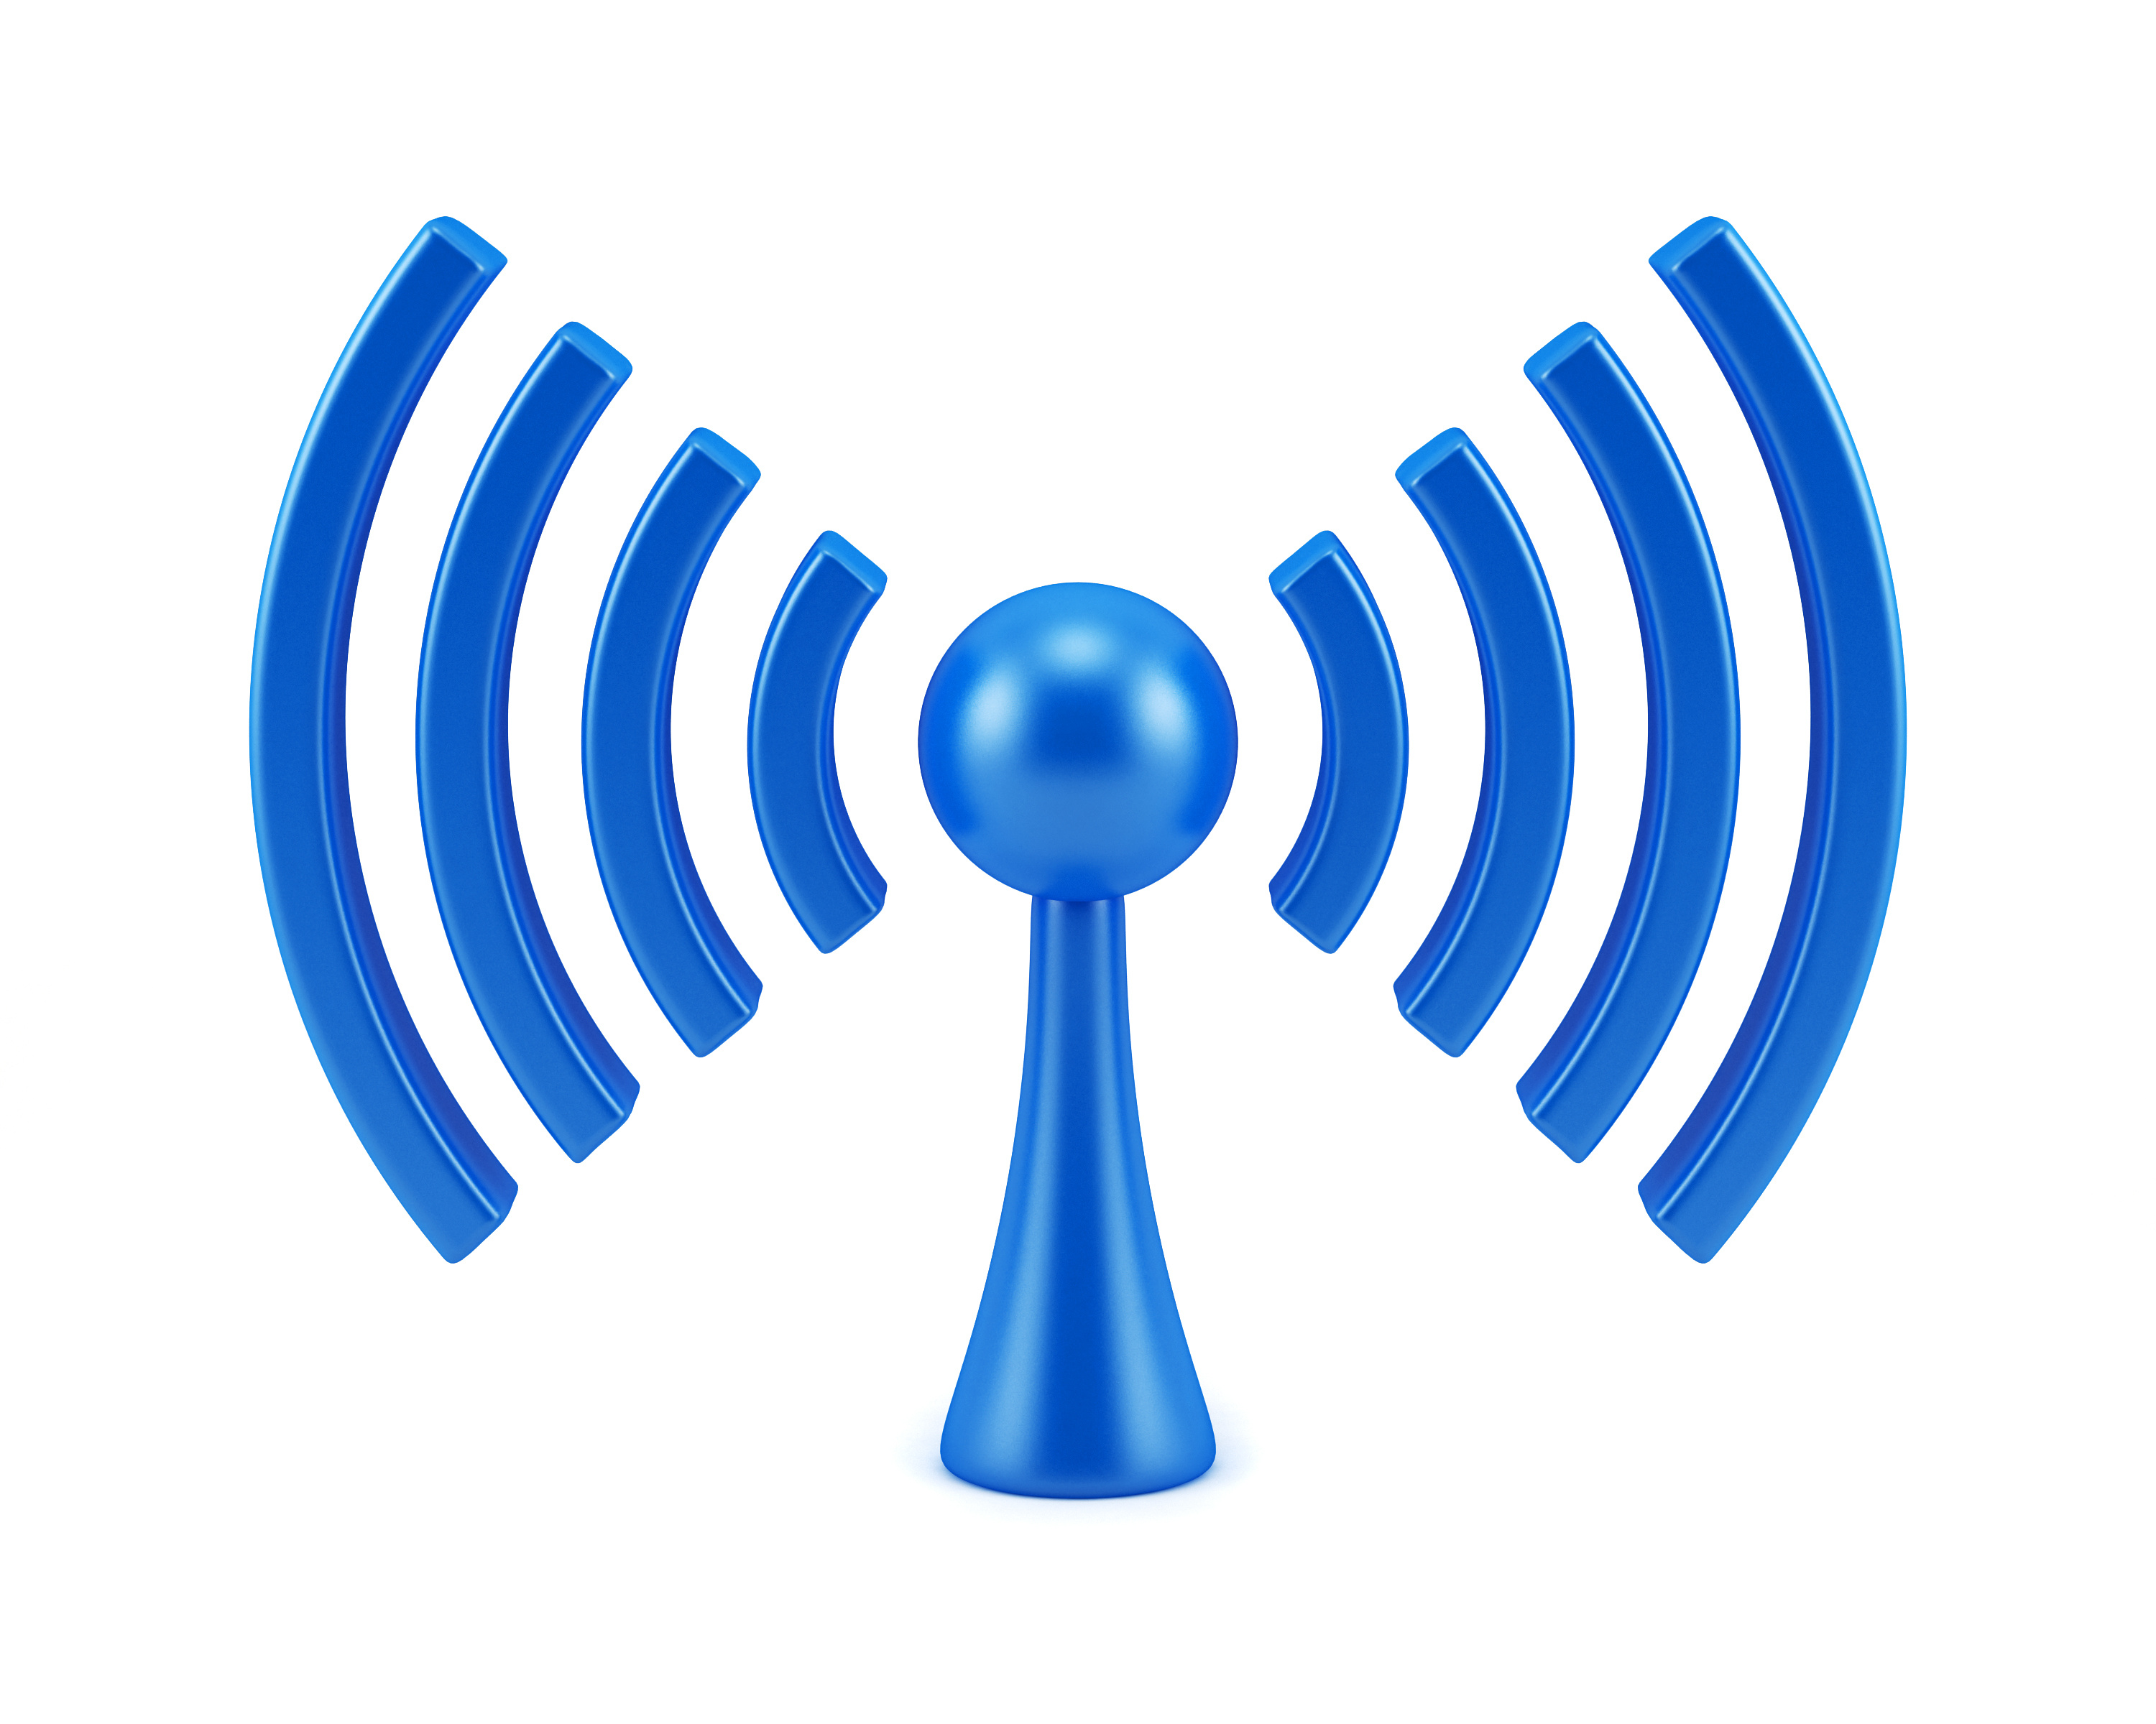
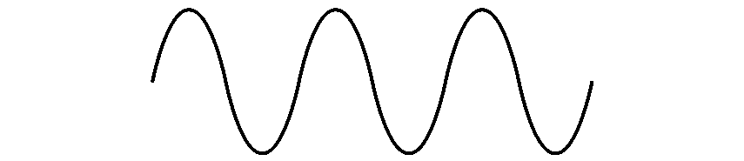

COM-405: Mobile Networks
Lecture 9.1: Wireless Localization
Haitham Hassanieh
Laboratory of SEnsing
& Networking Systems

Slide 2
Wireless Localization / Positioning
The process of obtaining a human or object’s location using wireless signals
Applications:
Navigation: outdoors (GPS) and indoors (e.g., museum)
Location based services: Tagging, Reminder, Ads
Virtual Reality and Motion Capture
Gestures, writing in the air
Behavioral Analytics (Health, activities, etc.)
Locating misplaced items (keys)
Location based security
Delivery drones

Slide 3
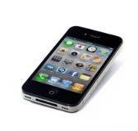
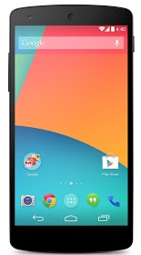
Wireless Localization Architecture.
Device based: A device uses incoming signal from one or more “anchors” to determine its own location
Network based: Anchors (or Access points) use the signal coming from device to determine its location

Slide 4
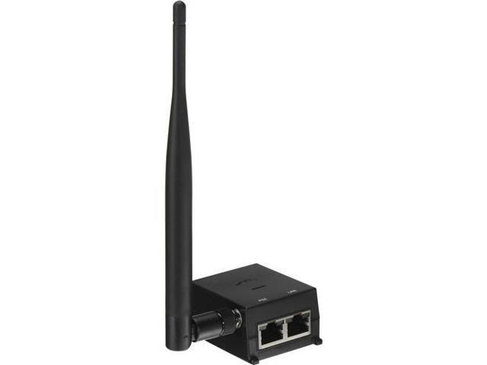
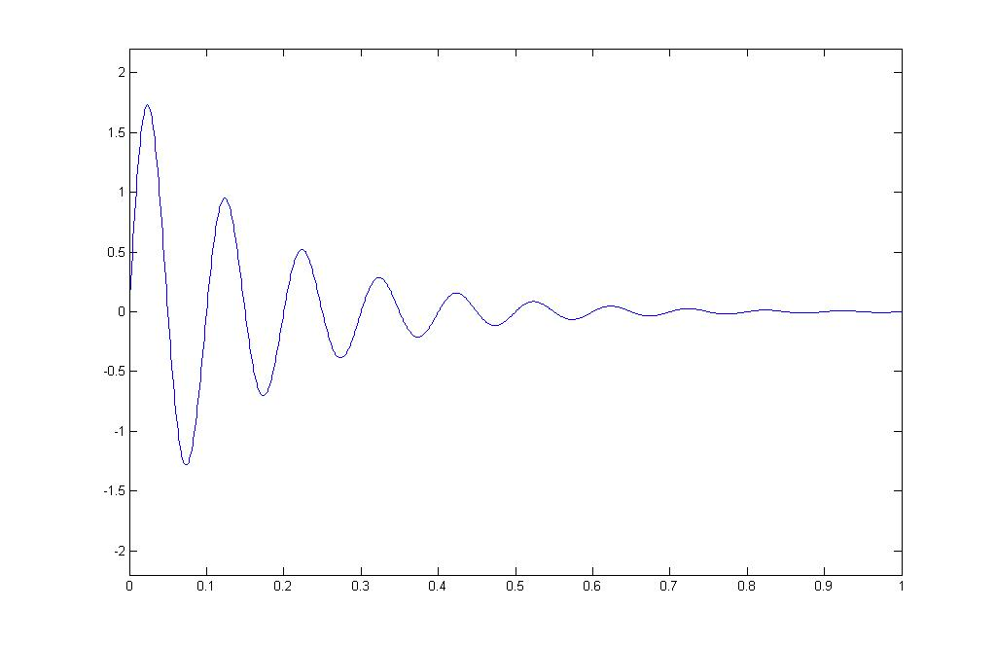
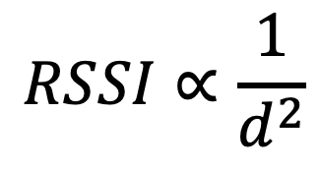
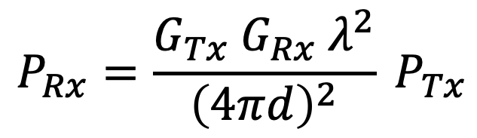

Method 1: RSSI Based Localization
Higher received power → Closer
Lower received power → Farther
Amplitude decays
$$d$$
Receiver
Transmitter
$$P_{Rx}=\frac{G_{Tx} G_{Rx}{ λ}^{2}}{{\left(4πd\right)}^{2}} P_{Tx}$$
$$RSSI∝\frac{1}{d^{2}}$$
Use RSSI to estimate distance from APs!

Slide 5
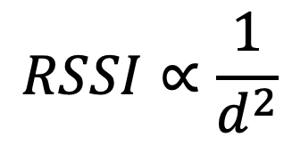
Method 1: RSSI Based Localization
$$RSSI∝\frac{1}{d^{2}}$$
RSSI
distance

Slide 6
Method 1: RSSI Based Localization
Trilateration

Slide 7
Method 1: RSSI Based Localization
Pros:
Cons:
Very simple, no hardware modifications
Highly inaccurate!
RSSI
For low RSSI, small error due to noise results in huge distance error!
Small Error at High RSSI
Small Error at Low RSSI
Small Error
Large Error
distance

Slide 8
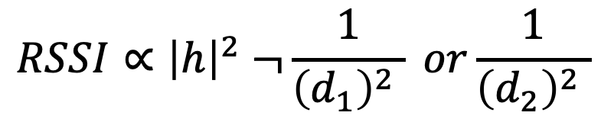
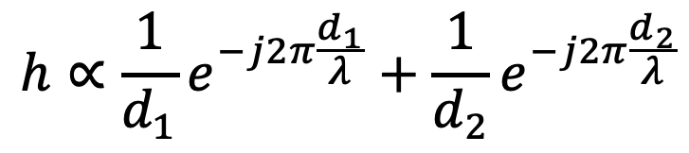
Method 1: RSSI Based Localization
Pros:
Cons:
Very simple, no hardware modifications!
Highly inaccurate!
Does not work with multipath!
RSSI
$$h∝\frac{1}{d_{1}}e^{−j2π\frac{d_{1}}{λ}}+\frac{1}{d_{2}}e^{−j2π\frac{d_{2}}{λ}}$$
$$RSSI∝{\left|h\right|}^{2} ¬\frac{1}{{\left(d_{1}\right)}^{2} } or\frac{1}{{\left(d_{2}\right)}^{2} }$$
distance

Slide 9
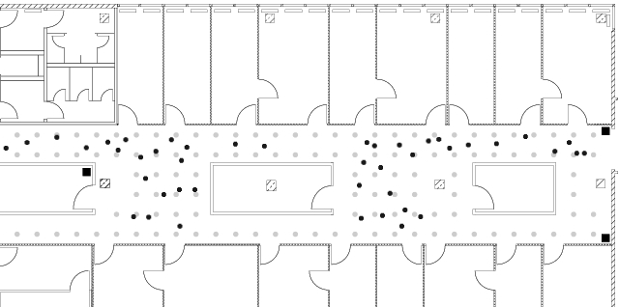
Method 1: RSSI Based Localization
Solution:
Fingerprinting
Measure and records RSSI fingerprints at each location (war-driving)
Pros:
Cons:
Works with multipath,
No need to know AP locations!
Changes in environment/movement ➔ change RSSI!
Continuous training is needed. Lots of effort!

Slide 10


Method 2: AoA Based Localization
Measure Angle of Arrival (AoA) from device to each AP
$$θ_{2}$$
$$θ_{1}$$
Triangulation

Slide 11
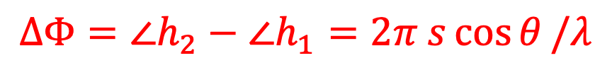

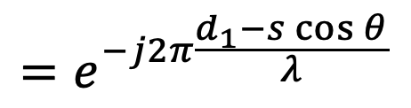


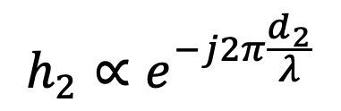
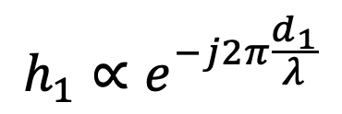
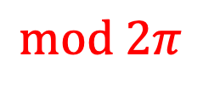
Method 2: AoA Based Localization
Measure Angle of Arrival (AoA) from device to each AP
$$d_{2}=d_{1}−s\cos{θ}$$
$$θ$$
$$θ$$
s
Rx1
Rx2
$$h_{1}∝e^{−j2π\frac{d_{1}}{λ}}$$
$$h_{2}∝e^{−j2π\frac{d_{2}}{λ}}$$
$$=e^{−j2π\frac{d_{1}−s\cos{θ}}{λ}}$$
$$ΔΦ=∠h_{2}−∠h_{1}=2π s\cos{θ}/λ$$
$$mod 2π$$

Slide 12
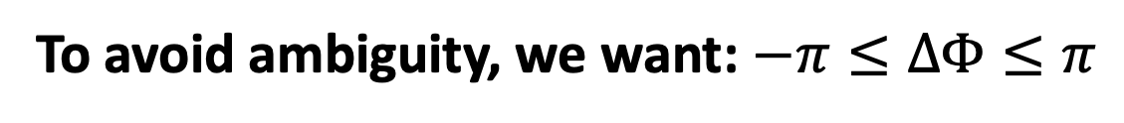
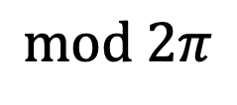
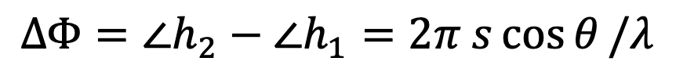
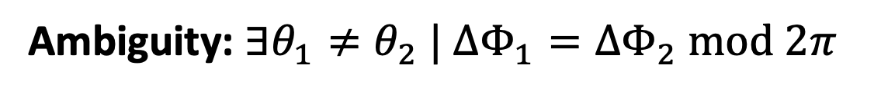
Method 2: AoA Based Localization
Measure Angle of Arrival (AoA) from device to each AP
$$d_{2}=d_{1}−s\cos{θ}$$
$$θ$$
$$θ$$
s
Rx1
Rx2
$$ΔΦ=∠h_{2}−∠h_{1}=2π s\cos{θ}/λ$$
$$mod 2π$$
Ambiguity: $∃θ_{1}≠θ_{2} | ΔΦ_{1}=ΔΦ_{2} mod 2π$
To avoid ambiguity, we want: $−π≤ΔΦ≤π$

Slide 13
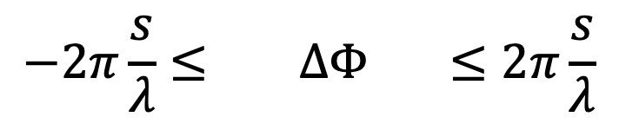
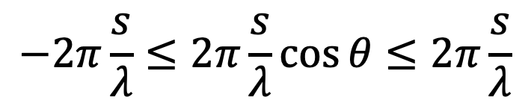
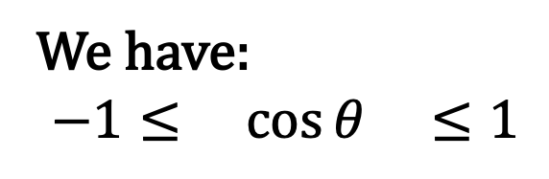
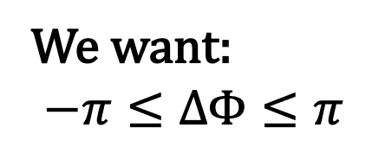
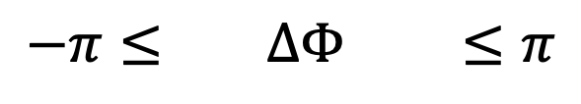

Method 2: AoA Based Localization
Measure Angle of Arrival (AoA) from device to each AP
We want:
$$−π≤ΔΦ≤π$$
$$d_{2}=d_{1}−s\cos{θ}$$
$$θ$$
$$θ$$
We have:
$$−1≤ \cos{θ} ≤1$$
s
Rx1
Rx2
$$−2π\frac{s}{λ}≤2π\frac{s}{λ}\cos{θ}≤2π\frac{s}{λ}$$
$$−2π\frac{s}{λ}≤ ΔΦ ≤2π\frac{s}{λ}$$
Set: $s=λ/2$
$$−π≤ ΔΦ ≤π$$

Slide 14

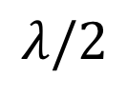

Method 2: AoA Based Localization
Measure Angle of Arrival (AoA) from device to each AP
$$d_{2}=d_{1}−s\cos{θ}$$
$$θ$$
$$θ$$
$$λ/2$$
Rx1
Rx2
Pros:
Cons:
Simple!
More accurate than RSSI,
Ambiguity: $\cos{θ}=\cos\left(−θ\right)$
Error not linear with $θ$ due to $\cos{θ}$
Requires 2 Antennas separated $λ/2$
Does not work with multipath!

Slide 15
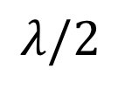



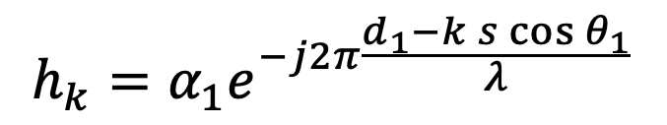


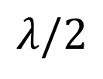
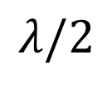


Method 3: Antenna Arrays
$$θ_{1}$$
$$θ_{1}$$
$$θ_{1}$$
$$θ_{1}$$
$$θ_{1}$$
$$θ_{1}$$
…
$$λ/2$$
$$λ/2$$
$$λ/2$$
$$λ/2$$
Rx1
Rx2
Rx3
Rx4
Rx5
RxN
$$h_{k}=α_{1}e^{−j2π\frac{d_{1}−k s\cos{θ_{1}}}{λ}}$$
$$=α_{1}e^{−jφ_{1}+kπ\cos{θ_{1}}}$$

Slide 16


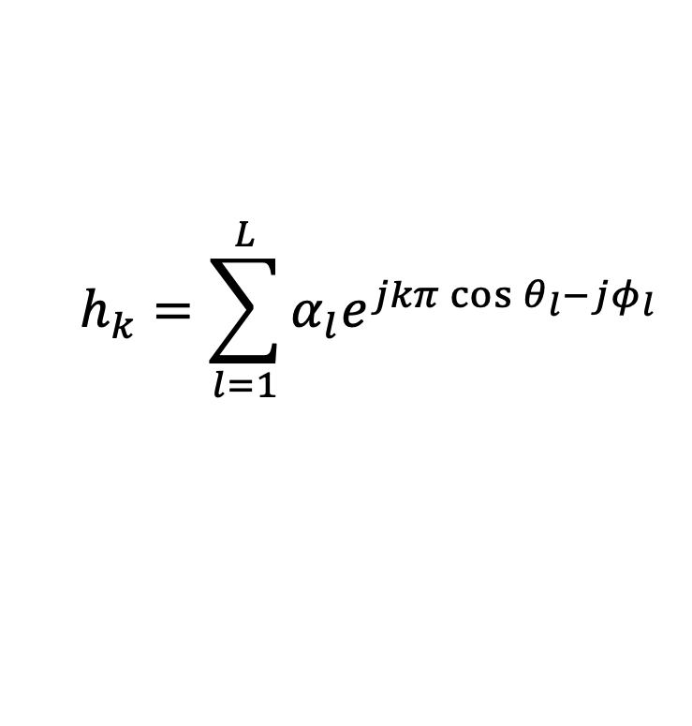


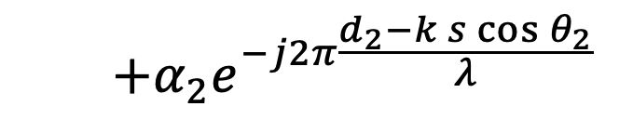




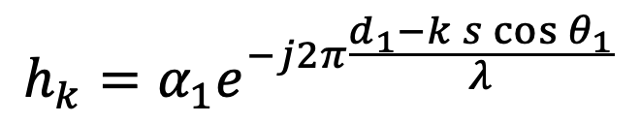

Method 3: Antenna Arrays
$$θ_{2}$$
$$θ_{2}$$
$$θ_{2}$$
$$θ_{2}$$
$$θ_{2}$$
$$θ_{2}$$
$$θ_{1}$$
$$θ_{1}$$
$$θ_{1}$$
$$θ_{1}$$
$$θ_{1}$$
$$θ_{1}$$
…
$$λ/2$$
$$λ/2$$
$$λ/2$$
$$λ/2$$
Rx1
Rx2
Rx3
Rx4
Rx5
RxN
$$h_{k}=α_{1}e^{−j2π\frac{d_{1}−k s\cos{θ_{1}}}{λ}}$$
$$=α_{1}e^{−jφ_{1}+kπ\cos{θ_{1}}}$$
$$+α_{2}e^{−j2π\frac{d_{2}−k s\cos{θ_{2}}}{λ}}$$
$$+α_{2}e^{−jφ_{2}+kπ\cos{θ_{2}}}$$
$$h_{k}=\sum_{l=1}^{L}{α_{l}e^{jkπ\cos{θ_{l}}−jφ_{l}}}$$
For L paths →

Slide 17
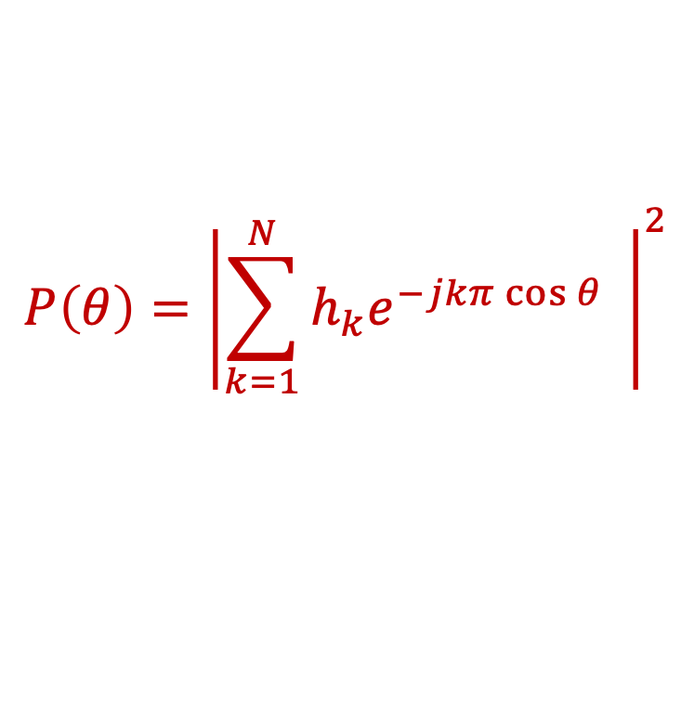
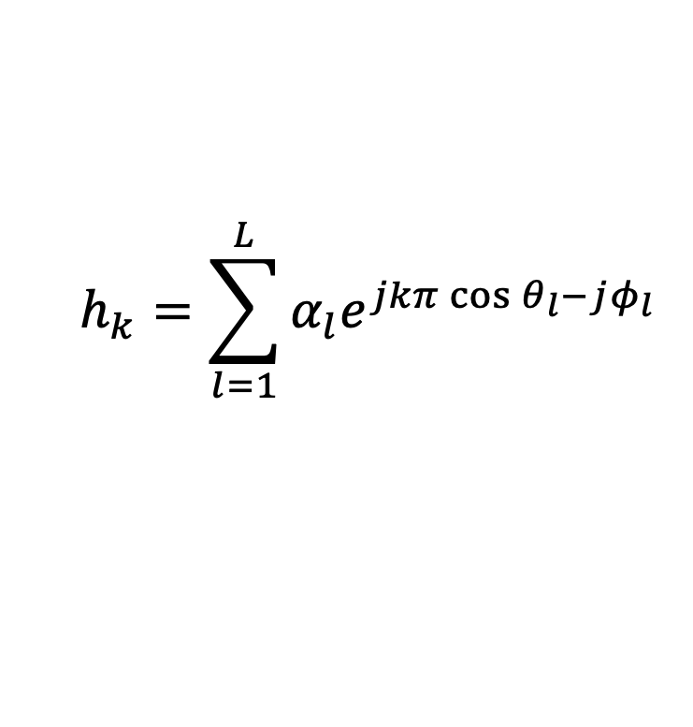
Method 3: Antenna Arrays
$$θ_{2}$$
$$θ_{2}$$
$$θ_{2}$$
$$θ_{2}$$
$$θ_{2}$$
$$θ_{2}$$
$$θ_{1}$$
$$θ_{1}$$
$$θ_{1}$$
$$θ_{1}$$
$$θ_{1}$$
$$θ_{1}$$
…
$$λ/2$$
$$λ/2$$
$$λ/2$$
$$λ/2$$
Rx1
Rx2
Rx3
Rx4
Rx5
RxN
$$h_{k}=\sum_{l=1}^{L}{α_{l}e^{jkπ\cos{θ_{l}}−jφ_{l}}}$$
$$P\left(θ\right)={\left|\sum_{k=1}^{N}{h_{k}e^{−jkπ\cos{θ}}} \right|}^{2}$$
Multipath Profile:

Slide 18

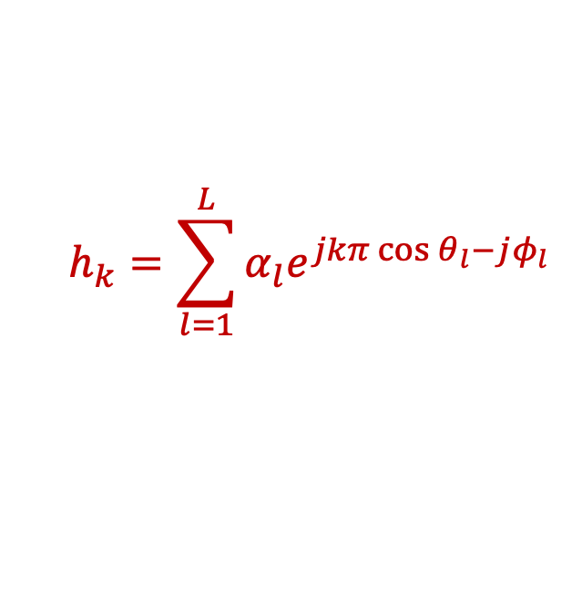
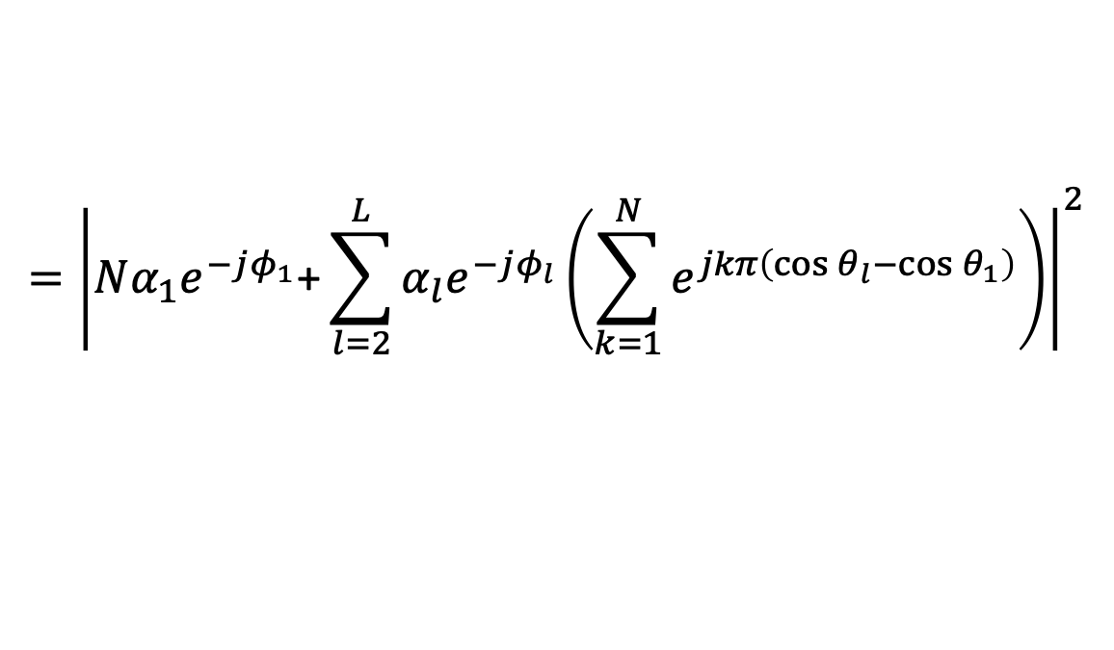
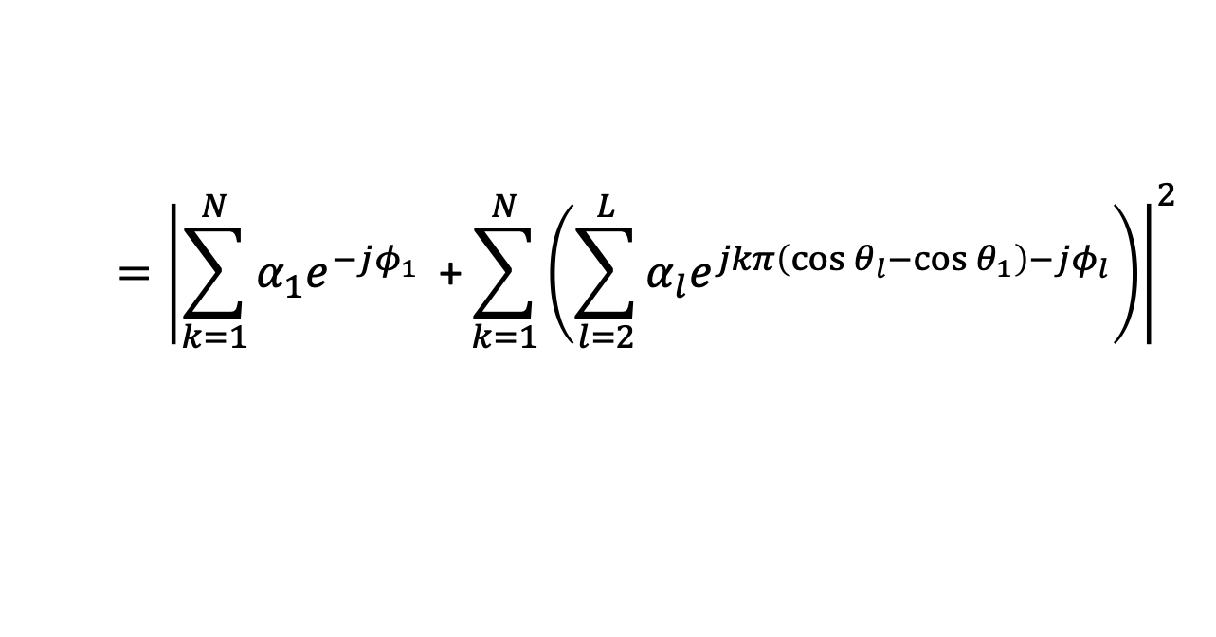
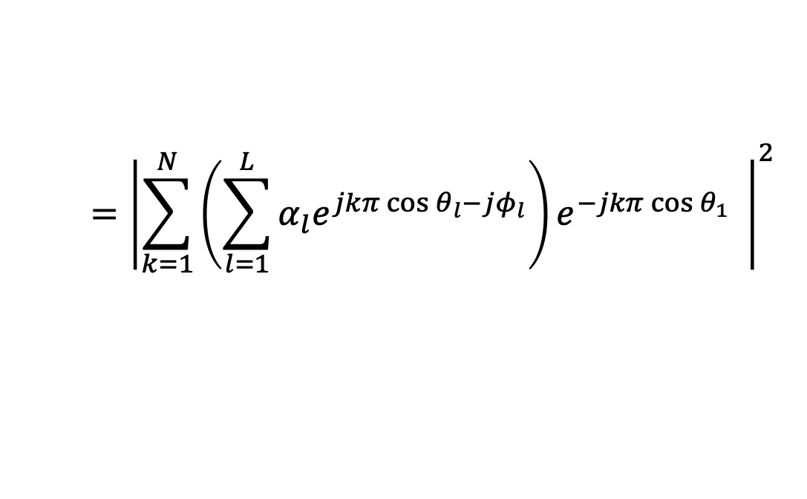
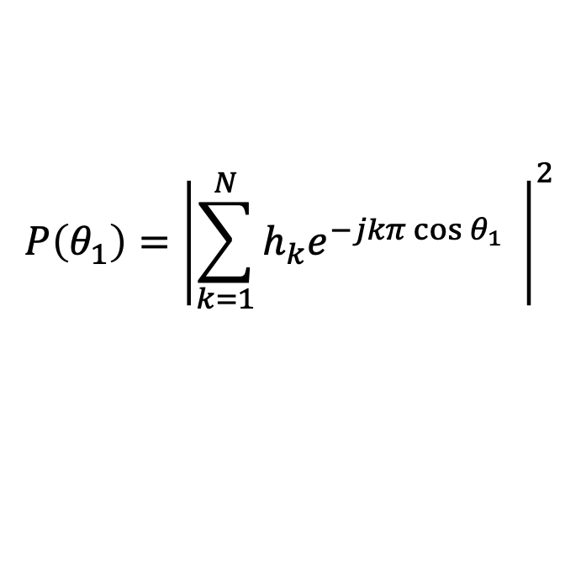
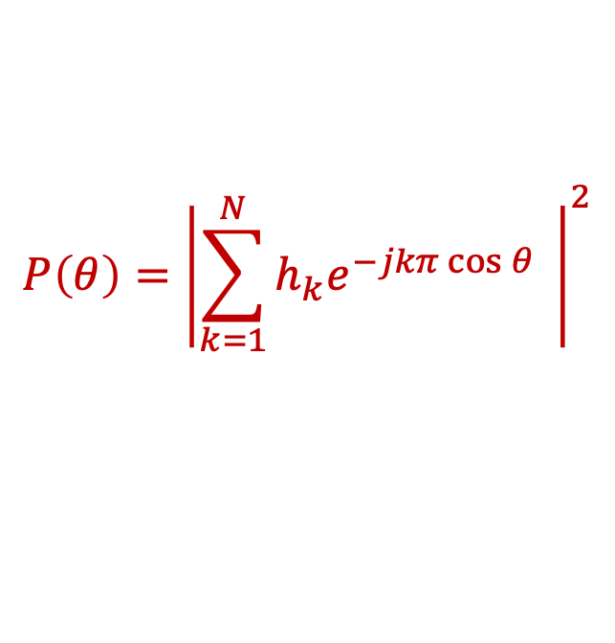
Method 3: Antenna Arrays
$$P\left(θ\right)={\left|\sum_{k=1}^{N}{h_{k}e^{−jkπ\cos{θ}}} \right|}^{2}$$
$$h_{k}=\sum_{l=1}^{L}{α_{l}e^{jkπ\cos{θ_{l}}−jφ_{l}}}$$
$$P\left(θ_{1}\right)={\left|\sum_{k=1}^{N}{h_{k}e^{−jkπ\cos{θ_{1}}}} \right|}^{2}$$
$$={\left|\sum_{k=1}^{N}{\left(\sum_{l=1}^{L}{α_{l}e^{jkπ\cos{θ_{l}}−jφ_{l}}}\right)e^{−jkπ\cos{θ_{1}}}} \right|}^{2}$$
$$={\left|\sum_{k=1}^{N}{α_{1}e^{−jφ_{1}}}\text{ +}\sum_{k=1}^{N}{\left(\sum_{l=2}^{L}{α_{l}e^{jkπ\left(\cos{θ_{l}}−\cos{θ_{1}}\right)−jφ_{l}}}\right)}\right|}^{2}$$
$$={\left|Nα_{1}e^{−jφ_{1}}\text{+}\sum_{l=2}^{L}{α_{l}e^{−jφ_{l}}\left(\sum_{k=1}^{N}{e^{jkπ\left(\cos{θ_{l}}−\cos{θ_{1}}\right)}}\right)}\right|}^{2}$$
$$≈N^{2}α_{1}^{2}$$

Slide 19
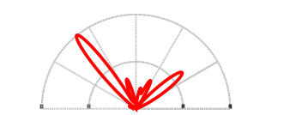
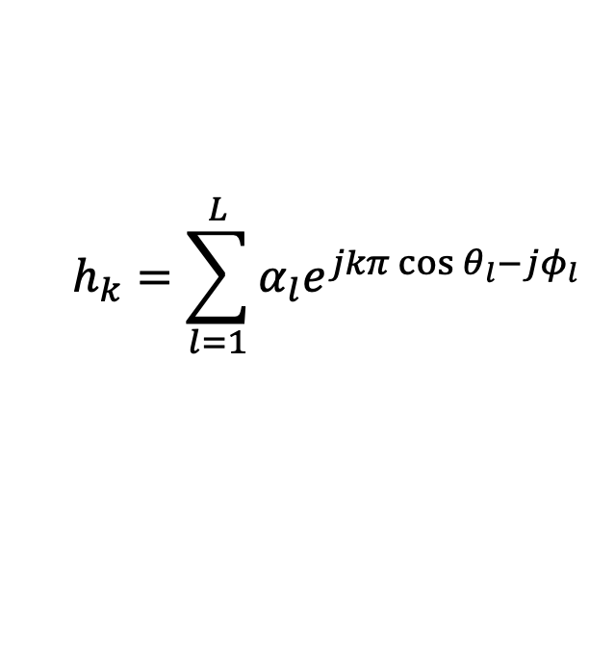
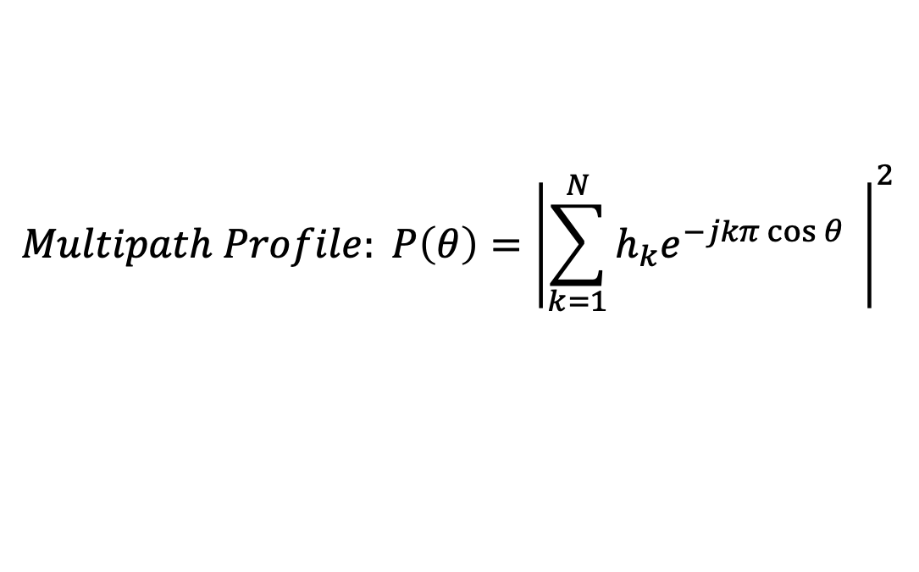
Method 3: Antenna Arrays
$$h_{k}=\sum_{l=1}^{L}{α_{l}e^{jkπ\cos{θ_{l}}−jφ_{l}}}$$
$$Multipath Profile: P\left(θ\right)={\left|\sum_{k=1}^{N}{h_{k}e^{−jkπ\cos{θ}}} \right|}^{2}$$
90º
60º
120º
30º
150º
180º
0

Slide 20
Method 3: Antenna Arrays
Which is the Line-of-Sight Path (Direct Path)?
Strongest Path!
90º
60º
120º
30º
150º
180º
0

Slide 21
Method 3: Antenna Arrays
Which is the Line-of-Sight Path (Direct Path)?
Strongest Path!
Not always due to blockage!
90º
60º
120º
30º
150º
180º
0

Slide 22
Method 3: Antenna Arrays
Which is the Line-of-Sight Path (Direct Path)?
Strongest Path!
Not always due to blockage!
90º
60º
120º
30º
150º
180º
0

Slide 23
Method 3: Antenna Arrays
Which is the Line-of-Sight Path (Direct Path)?
Shortest Path!
90º
60º
120º
30º
150º
180º
0

Slide 24
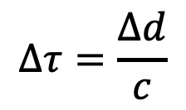
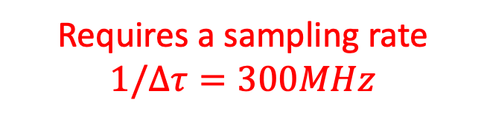


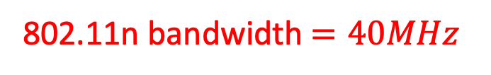

Method 3: Antenna Arrays
Which is the Shortest Path (Direct Path)?
Multipath Profile vs Time
$$Δτ=\frac{Δd}{c}$$
$$Δd=1m$$
Requires a sampling rate
$$1/Δτ=300MHz$$
$$Δτ=3.3ns$$
$$c=3×{10}^{8}m/s$$
802.11n bandwidth $=40MHz$

Slide 25
Method 3: Antenna Arrays
Which is the Shortest Path (Direct Path)?
90º
60º
120º
30º
150º
0
180º
Multipath Profile vs Time
Multipath Profile vs AoA
Use multipath profile as a filter to separate different paths
Estimate time of arrival of each path
Find the shortest path

Slide 26
Method 3: Antenna Arrays
$$θ_{1}$$
$$θ_{1}$$
$$θ_{1}$$
$$θ_{1}$$
$$θ_{1}$$
$$θ_{1}$$
…
$$λ/2$$
$$λ/2$$
$$λ/2$$
$$λ/2$$
Rx1
Rx2
Rx3
Rx4
Rx5
RxN
Pros:
Cons:
Works with multipath,
No need for fingerprinting
Requires more hardware!
Assumes device is sufficiently far such that wavefront is parallel

Slide 27
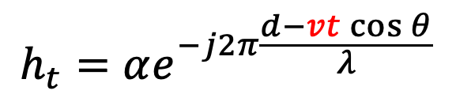
Method 4: SAR: Synthetic Aperture Radar
Move the antenna to emulate a very large array:
$$h_{t}=αe^{−j2π\frac{d−vt\cos{θ}}{λ}}$$

Slide 28
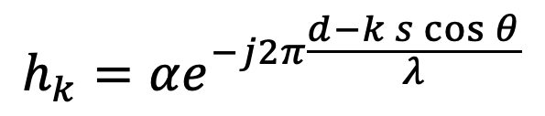



Method 4: SAR: Synthetic Aperture Radar
$$θ$$
$$h_{k}=αe^{−j2π\frac{d−k s\cos{θ}}{λ}}$$
$$=αe^{−j2π\frac{d−k s\cos{θ}}{λ}−jφ(t)}$$
$${}^{−j2πΔf_{c}t}$$
So far, we ignored CFO!
In antenna arrays: all antennas are synchronized!
All antennas see the same CFO relative to transmitter
Phase created by CFO is same on all antenna!
→ CFO is not a problem.

Slide 29

Method 4: SAR: Synthetic Aperture Radar
$$h_{t}=αe^{−j2π\frac{d−vt\cos{θ}}{λ}−j2πΔf_{c}t}$$
Channel at each location measured at different times
→Phase created by CFO is different for different antenna locations

Slide 30



Method 4: SAR: Synthetic Aperture Radar
How to use enable SAR for WiFi?
Use 2 antennas that are synched:
1 Moving antenna
1 Static antenna
$$h_{1t}=αe^{−j2π\frac{d_{1}−vt\cos{θ}}{λ}−j2πΔf_{c}t}$$
$$h_{2t}=αe^{−j2π\frac{d_{2}}{λ}−j2πΔf_{c}t}$$
$$\frac{h_{1t}}{h_{2t}}=e^{−j2π\frac{d_{1}+d_{2}−vt\cos{θ}}{λ}}$$
Taking ratio eliminates CFO:
Enable SAR with WiFi but … limited mobility
→ Emulate small arrays

Slide 31








Method 5: TDoA Based Localization
Measure Time Difference of Arrival (TDoA) from device to AP’s antennas
$$h_{1}∝e^{−j2π\frac{d_{1}}{λ}}$$
$$h_{2}∝e^{−j2π\frac{d_{2}}{λ}}$$
$$\left(x,y\right)$$
$$ΔΦ=∠h_{2}−∠h_{1}$$
$$d_{1}−d_{2}=λΔΦ/2π=d′$$
$$\left(x_{1},y_{1}\right)$$
Equation of Hyperbola
$$\left(x_{2},y_{2}\right)$$
$$\sqrt{{\left(x−x_{1}\right)}^{2}+{\left(y−y_{1}\right)}^{2}}−\sqrt{{\left(x−x_{2}\right)}^{2}+{\left(y−y_{2}\right)}^{2}}=d′$$

Slide 32
Method 5: TDoA Based Localization
Measure Time Difference of Arrival (TDoA) from device to AP’s antennas
$$h_{1}∝e^{−j2π\frac{d_{1}}{λ}}$$
$$h_{2}∝e^{−j2π\frac{d_{2}}{λ}}$$
$$\left(x,y\right)$$
$$ΔΦ=∠h_{2}−∠h_{1}$$
$$d_{1}−d_{2}=λΔΦ/2π=d′$$
$$\left(x_{1},y_{1}\right)$$
Equation of Hyperbola
$$\left(x_{2},y_{2}\right)$$
$$\sqrt{{\left(x−x_{1}\right)}^{2}+{\left(y−y_{1}\right)}^{2}}−\sqrt{{\left(x−x_{2}\right)}^{2}+{\left(y−y_{2}\right)}^{2}}=d′$$

Slide 33
Method 6: ToF Based Localization
Measure Time of Flight (ToF) from device to each AP
Distance = Time of flight $×$ speed of travel
Measure ToF → Get distance → Trilateration

Slide 34
Method 6: ToF Based Localization
Measure Time of Flight (ToF) from device to each AP
Challenges:
How do you know when signal was transmitted?
Measure Round Trip
How about packet detection delay & processing delay?
- Use OFDM to correct for packet detection delay
- Estimate and calibrate for processing delay
Not Practical!

Slide 35




Method 6: ToF Based Localization
Measure Time of Flight (ToF) from device to each AP
Challenges:
Accuracy limited by sampling rate (bandwidth)!
$$Δd=Δτ × c$$
802.11n bandwidth $=40MHz$
$$Δτ=25ns$$
$$Δd=12.5 m$$
Other systems than WiFi can get accurate ToF:
- UWB: Ultra-Wide Band (Apple Air Tag)
- FMCW: Frequency Modulated Carrier Wave (Google Solis, Nest Hub, Amazon Halo, Emerald Innovations)

