Slide 1



COM-405: Mobile Networks
Lecture 8.0: Cellular Networks II
Haitham Hassanieh
slides shamelessly stolen from Prof. JP Hubaux & others
Laboratory of SEnsing
& Networking Systems

Slide 2
Feedback Survey Results
homework
lab
MAC
Scheduling
OFDM phase tracking
Highlights of constructive critism from verbal feedback:
3 hour lectures are mentally tiring
Labs are not straightforward and require extra clarification by attending lab sessions
Consistency of terminology and equations between labs/homeworks/lectures
More background and extra material to look back at (eg. more detailed slides)
More concrete examples shown in class
Labs should be in Matlab 🤨
However, overall, it seems like most people enjoy the material presented in class! ☺
Notes:
Improving the quality of the slides maybe
Offer the two 15min breaks we are supposed to have during the lecture.
Avoid confusions in the labs such as:
the H matrix in the MIMO lab being defined as the transposed version of the one from the lectures.
Frequency-domain channel being called H in one function and then h in an another (causes confusion when not specified because lowercase h usually means time-domain in theory). note: this has been taken into account in the MIMO lab, thank you!
In general, the course is great, however, it is already hard enough to have 3 hours of consecutive class, having to focus for more then 45 minutes with no break is challenging, especially since we always have 45 minutes of class usually, the attention span just decreases after that. It would be okay if the break would last less than 15 minutes but it would be better to at least have it every 45 minutes. The labs could be made less challenging by respecting conventions. Most of the frustration comes from the fact that conventions between the lab and the course vary or are sometimes not specified, for example, it would be great to have it stated clearly if the return function and parameters are expected in the frequency or time domain, and stick to the convention of having capital letters represent frequency domain functions and lower case letters represent time-domain functions.
First of all, the course is globally very interesting and goes into very little details that enables a deep understanding of the material which I appreciate a lot.
Sometimes I find that the homework and more the labs have some lack of precision in the statement which leads to confusion and wasted time making wrong assumptions which could have been stated in the statement. Fortunately, the TA's are reactive and send us some updates on the homework and lab statement quite fast if we ask for them but it could also be made more exhaustive from the beginning.
No very hard labs/hw please :D
I'd appreciate it if the fact that someone is doing the homeworks/labs alone was taken into consideration when grading. I know that doing them alone is a choice in theory, but it turns out in my situation that I could not find someone to team with me..
For the labs, I think sometimes we can't really do it by ourself without asking many questions to the TAs. For example, For the MIMO labs, I don't think we have a lot of informations in the course regarding alamuti and how to use it in practice so it makes the lab more complex for nothing and very dependent on the help given by the TAs. And it is a little bit frustrating. ( same for the last part of the MIMO lab)
For the course, maybe sometimes for the physics part, it would be more comprehensive with some reality situation/example to understand better some notion as phase tracking, etc... maybe with some examples. Because I find it hard sometimes to see the impact of those things.
The lab sessions seem to me to be very complete, however I consider that they lack some explanations that lead to confusion, causing too much time to be spent on a priori simple concepts.
I believe there’s room for improvement in the way lab sessions are currently structured.
At the moment, the labs feel particularly challenging due to the minimal guidance provided—usually just a brief description of the methods and their intended functionality. This format often requires over 20 hours of effort per lab, which can become quite overwhelming.
Without more detailed instructions or theoretical insights, we sometimes find ourselves repeatedly iterating on code snippets without a clear understanding of the underlying principles. This trial-and-error approach may ultimately get the code working, but it doesn’t foster a deep comprehension of the concepts involved.
It would be incredibly helpful to have either more thorough explanations during the theory sessions to guide us through the lab requirements or additional details within the lab instructions themselves.
I think that the lab tasks could be a bit clearer and maybe give a few more theoretical hints and guidelines to help us, as the rest (i.e. programming and debugging) is already very time consuming. Perhaps have the quizzes at the start of the lecture and not at the end. Otherwise the rhythm of the course is good. I would give more theory information/advice to solve the labs. Additional work such as papers, presentations or videos about the topic would be useful to solve the labs. One example is the Heterogeneous MIMO in lab 2 were the available information was insufficient and more of the strategies to solve the lab were brute-force instead of having a deep understanding of the topic.
Fix the consistency between the labs, homeworks and course
The slides could be clearer. They are good enough as a presentation support during the lectures, but when doing labs or homeworks it is hard to find the required information. When found it is not very clear. Maybe having a PDF summarizing each lecture and its formulas could help.
Otherwise, the professor presents well, he goes through the material slowly enough as to make sure everything is understood, and it's great. The only issue is the massive amount of information we're exposed to during the lecture which makes it hard to digest. Which is why giving the 2 breaks of 15 minutes is necessary as well as maybe highlighting the key information we should remember.
For the most challenging are the labs. I understand most of the content of the lectures but it takes me a lot of time to apply it to the labs. I think more TAs to help for this would be good.
Answer in 3 applies for 4 too
Could maybe create a sort of prerequisite pdf document which contains some basic math remainder on complex numbers which are massively used in the first lectures and other things like fourrier discrete transforms.
I also did need a lot of time to have an abstract idea of what was OFDM "in real life physics" so either I didn't catch the key points at the beginning or maybe you could spend a bit more time on the "big picture" idea of what's OFDM. Also I find the OFDM phase tracking quite complex and require more details to perfectly understand it.
It can be challenging to leverage two concurrent deadlines (for lab and for homework), I think a more sequential distribution would make things a bit easier to manage. Sometimes figuring out small details/intricacies of the lab take some time, and you may spend quite a bit of it before corrections/crucial clarifications are announced. I suppose for the next year there will be less of this, based on experience with us.
The part about the physical layer is quite scary. It takes time to understand and I am not even sure I did. I feel like it could be made clearer. In the end, what we need to understand from the physical layer lectures is the effects of the channel on the signal. I feel that this part could be explained more intuitively than just with math.
- Give more clear information for the labs that would make us less dependent from the TAs. In general, I think the classes are very good. The syllabus is dense but the explanations are clear and easy to understand. The problem is that they hardly prepare for the lab. Whenever I finish the classes I always feel like I've understood everything and when I get to the lab I feel stupid ahhaha. That's why I would add demonstrations of the algebra behind it, mainly what we are going to use in the lab. Otherwise, the concepts seem understandable until you get to do the lab and it takes a while to self learn.
In fact, the theoretical work is awesome. I have strong background due to my home studies. And I have never been in such an amazing class. Everything is self-contained, well explained, beautiful explanations and schemas.
I think it is the best class about mobile networks I have ever been.
Basically, from zero to hero!
PD: You should improve the guiding in lab sesions.
It would be good if there was a signal processing crash course presentation for people who haven't dealt with this topic before and for others as a reminder. Fix the typos/errors in the slides and have the definitions be the consistent between the slides and the labs.
I would suggest using Matlab, even if it was explained that Python was the answer to the student's request, Matlab is the default programming language for telecom and matrix operations. The environment allows fast debugging, directly tracking the evolution of the variables and seeing vectors and matrices more clearly.
Another suggestion is to go deeper into MU-MIMO as it was slightly presented during the lectures but it was highly required for Lab2
The Labs are a big plus for understanding. However, sometimes, while the general idea of the task is clear, almost insignificant details (in the grand scheme of the lecture content) take up a lot of time in the lab work. I would have liked more hints like the one we got for the Interference Alignment task 5 where we got the hint about how we calculate the directions.
Keep/add step-by-step instructions about what the steps of the process of a task are. I though this was very well done in the same task mentioned above. Spend more time on last part of MIMO lecture
So far I enjoy the class so I would not change it maybe more infos at the end of the semester. No
Overall, the course is great and I am grateful that EPFL offers it. We learn a lot about the wireless technologies we use everyday and how to implement them which is awesome. I also really like the course material which covers the basics, which are already quite advanced, but spares us of going too deep into specifics such as all the existing coding methods for example. Paradoxically, the course gives us a general, but advanced knowledge of the field, which is something I hope will be maintained in the next years.
Not really. The teaching assistant Arman Maghsoudnia explains really well the concepts and is a really good teaching assistant, very helpful during lab and exercise sessions and very available! On the contrary, there was another assistant at the beginning of the semester who during the exercise sessions seemed to really be lacking motivation to answer and did not even know about the homework questions, she gave us wrong answers and directed us towards the wrong direction when our initial answer ended up being correct after verifying with another assistant, maybe this was a one-time thing but it was really frustrating and di not motivate to come to the exercise sessions. Other than that, the course is well explained and the lecturer is making a great job in trying to engage discussions over the topic, like said before, my main issue is thatthere aren't enough breaks to focus productively during the 3 hours.
Again, overall the course is very interesting and well taught.
I think overall the course is cool, so thanks! No more. Nice subject! As a telecommunications engineer I'm enjoying it! Congrats
I like the lectures and the matter of the course is also really interesting. I also like how lab 1 makes us build the entire chain from scratch basically (besides some boilerplate that is already provided) because I believe that building things from scratch is the best way to learn.
It really helps to have the recorded lectures. I am enjoying the course very much. No, we are good! :)
Make an effort on the labs/homework so that it is better explained. I feel like it is not possible to finish them without going to the exercise sessions.
Not yet. Everything is great. Thanks!
Lectures are clear, exercise sessions useful and labs are interesting
not really

Slide 3
Cellular Networks Modeling
Infrastructure
Base Station (BS)
Fixed network
The most common model used for wireless networks is uniform hexagonal shaped areas, called cells.
Uniform cells with radius R.
Omnidirectional antennas
radiate radio wave power uniformly in all directions in one plane
Base station with an omnidirectional antenna is positioned in the middle of each cell

Slide 4
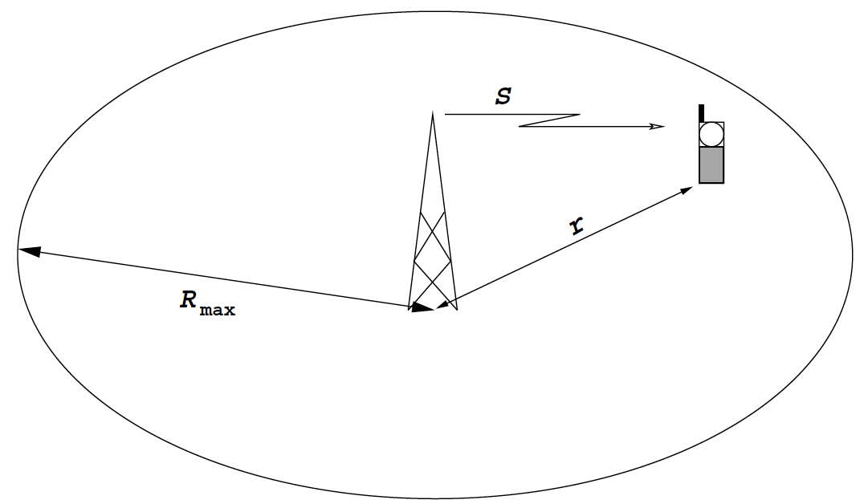
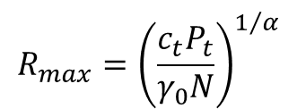



Area Coverage Planning
The received Signal-to-Noise (SNR) power by a receiver can be written as follows:
r – distance from receiver to base station
P_{t} – transmitted power
N – noise power
c_{t} – constant = $G_{TX}G_{RX}/{\left(4πλ\right)}^{2}$
$α$ – propagation constant
The minimum received SNR within the cell
is the SNR at the cell border
is given by
The radius of the coverage area (maximum range) is obtained as
$$Γ=\frac{c_{t}P_{t}}{r^{α}N}$$
$$γ_{0}=\frac{c_{t}P_{t}}{R^{α}N}$$
$$R_{max}={\left(\frac{c_{t}P_{t}}{γ_{0}N}\right)}^{1/α}$$

Slide 5
Cellular Networks Modeling
Infrastructure
Base Station (BS)
Fixed network
The most common model used for wireless networks is uniform hexagonal shaped areas, called cells.
Uniform cells with radius R.
Omnidirectional antennas
radiate radio wave power uniformly in all directions in one plane
Base station with an omnidirectional antenna is positioned in the middle of each cell

Slide 6

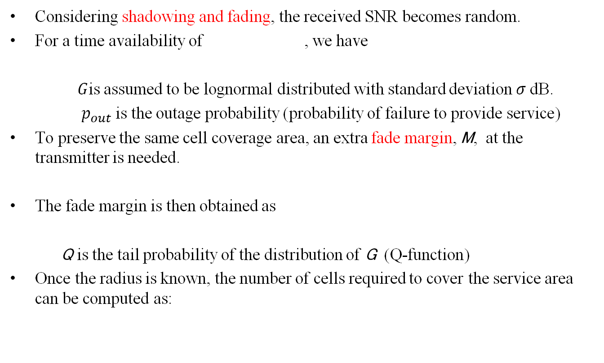
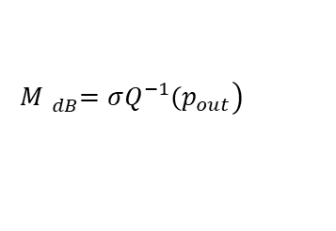



Area Coverage Planning – Effect of Fading
Considering shadowing and fading, the received SNR becomes random.
For a time availability of , we have
$G$is assumed to be lognormal distributed with standard deviation$σ$ dB.
$p_{out}$is the outage probability (probability of failure to provide service)
To preserve the same cell coverage area, an extra fade margin, M, at the transmitter is needed.
The fade margin is then obtained as
Q is the tail probability of the distribution of G (Q-function)
Once the radius is known, the number of cells required to cover the service area can be computed as:
$$p_{ta}=1−p_{out}$$
$$P(Γ≤γ_{0})=P\left(\frac{c_{t}GP_{t}}{r^{α}N}≤γ_{0}\right)≤p_{out}$$
$$P\left(\frac{c_{t}GP_{t}M}{r^{α}N}≤γ_{0}\right)≤p_{out}$$
$$\left.M{}_{dB}^{}=σQ^{−1}(p_{out}\right)$$
$$Number of cells= \frac{Total area}{Cell area}$$

Slide 7

Frequency Planning – Frequency Reuse
An efficient way of managing the radio spectrum is to reuse the same frequency, within the service area, as often as possible.
Frequency reuse is possible thanks to the propagation properties of radio waves.
By properly setting the distance D, the same frequency can be used at two cells simultaneously.
D is called the reuse distance
R₁
R₂
R
R
D

Slide 8


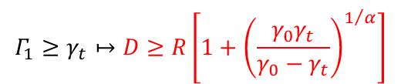
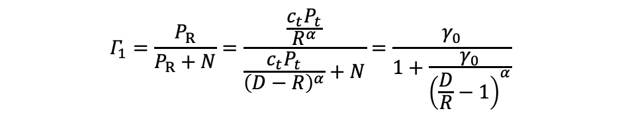
Frequency Planning – Frequency Reuse: 2 base stations
The worst SINR (Signal-to-Interference-Noise-Ratio) at the receiving mobile unit R₁ (placed at the border of the cell) can be written as:
P_{t} is the transmitted power for both base stations
With a required SINR minimum threshold of $γ_{t}$, we have
$R$ should be selected s.t.${ γ}_{0}>γ_{t}$
$$Γ_{1}=\frac{P_{R}}{P_{R}+N}=\frac{\frac{c_{t}P_{t}}{R^{α}}}{\frac{c_{t}P_{t}}{{\left(D−R\right)}^{α}}+N}=\frac{γ_{0}}{1+\frac{γ_{0}}{{\left(\frac{D}{R}−1\right)}^{α}}}$$
$$γ_{0}=\frac{c_{t}P_{t}}{R^{α}N}$$
$$Γ_{1}≥γ_{t}↦D≥R\left[1+{\left(\frac{γ_{0}γ_{t}}{γ_{0}−γ_{t}}\right)}^{1/α}\right]$$
R₁
R₂
R
R
D

Slide 9
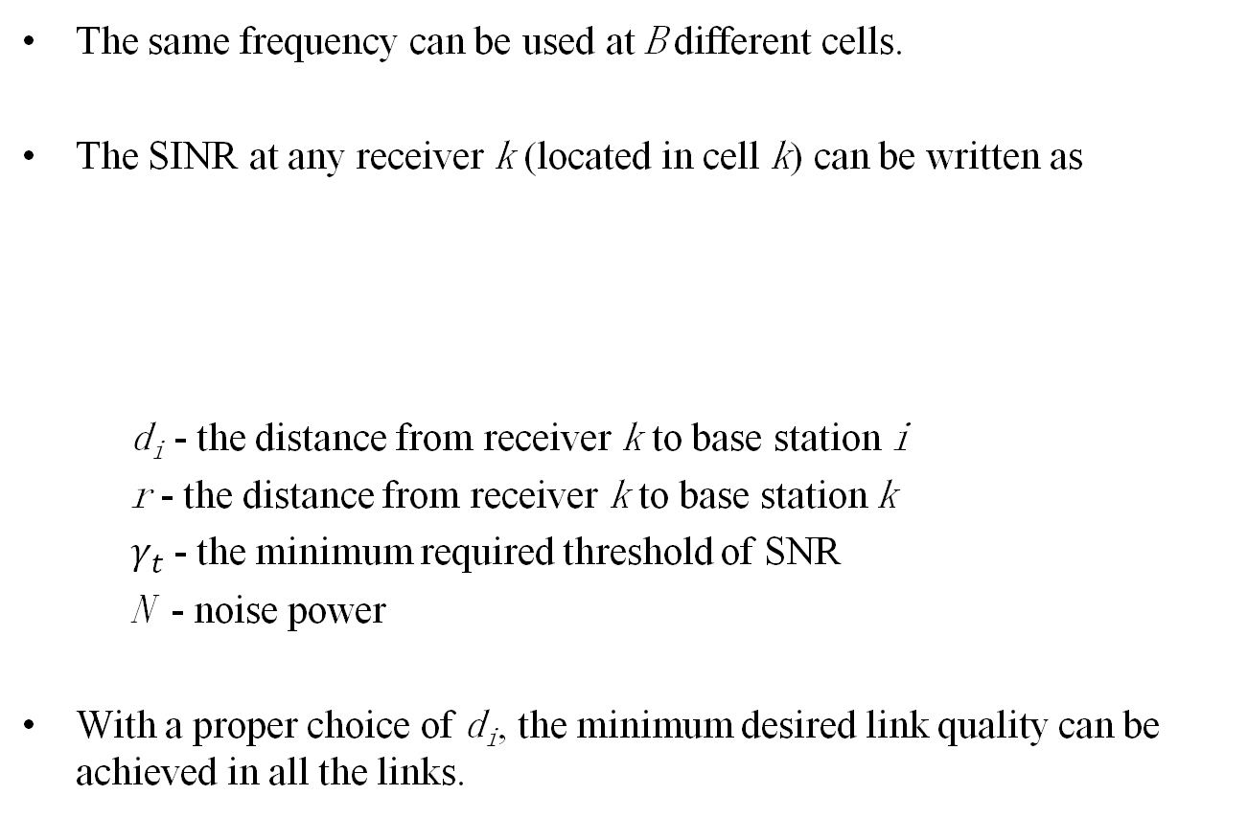

Frequency Planning – Frequency Reuse: B base stations
The same frequency can be used at B different cells.
The SINR at any receiver k (located in cell k) can be written as
d_{i} - the distance from receiver k to base station i
r - the distance from receiver k to base station k
$γ_{t}$- the minimum required threshold of SNR
N - noise power
With a proper choice of d_{i}, the minimum desired link quality can be achieved in all the links.
$$Γk=\frac{c{P_{t}}/{r^{α}}}{\sum_{\begin{aligned}i=1…B \\ i<>k\end{aligned}}{\frac{cP_{t}}{d_{i}^{α}}+}N}≥γ_{t}$$

Slide 10
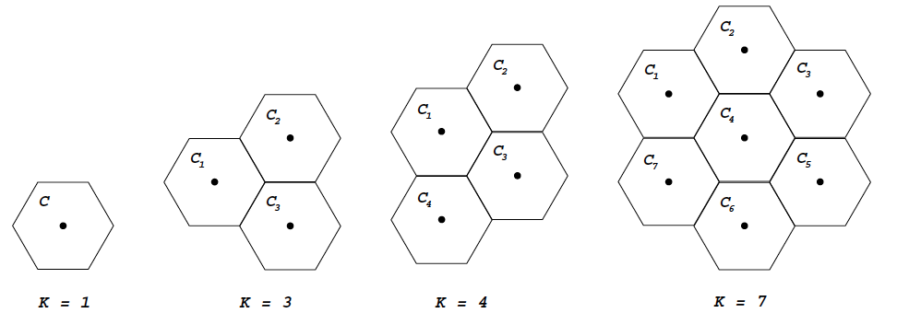


Design of Wireless Networks – Fixed Channel Allocation for Frequency Reuse
Goal: for a certain available bandwidth, design a system with the highest possible capacity
For a hexagonal cell structure, cells are grouped in clusters of K (called the reuse factor) cells. Let R be the radius of the cell and D the distance between 2 base stations using the same frequency band
Let$C$ be the total number of orthogonal channels available.
Divide$C$ into$K$ disjoint groups $\left\{C_{1},C_{2},...C_{K}\right\}$
Assign each group $C_{i}$ to a different cell of a cell cluster.
Repeat the same distribution of channels in the other clusters.
$$K=\frac{1}{3}{\left(\frac{D}{R}\right)}^{2}, or D=R\sqrt{3K}, K={\left(i+j\right)}^{2}−ij, i,j=0,1,2,3...$$
$$\left.C=\{f_{1},f_{2},...,f_{C}\right\}$$
i=2, j=0
i=2, j=1
i=1, j=1
i=1, j=0
Notes:
The geometry of hexagons is such that K can only have values which satisfy K =(i+j)ˆ2 - ij

Slide 11
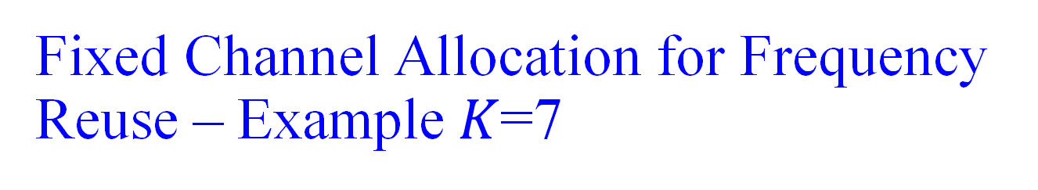

Fixed Channel Allocation for Frequency Reuse – Example$K$=7
$$D=R\sqrt{3K}=\sqrt{21}R$$
Cells with the same number use the same channel

Slide 12
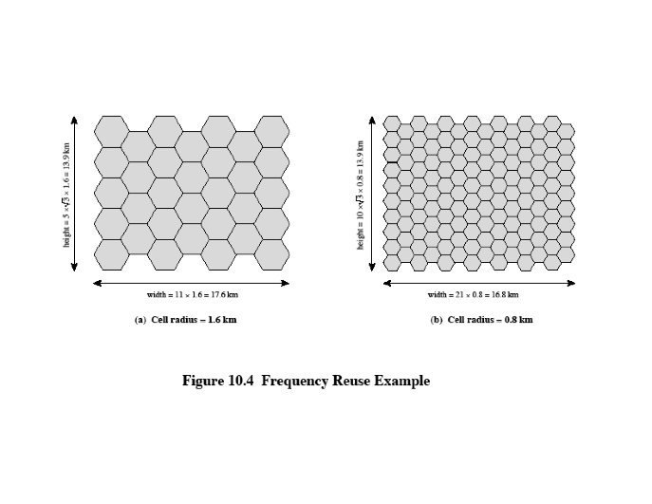
Example: system of 32 cells with cell radius of 1.6km
Total frequency bandwidth supporting 336 traffic channels
Reuse factor (or cluster size) = 7
What geographic area is covered?
Total number of supported channels?
Solution:
Cell area = 6.65 km²
Covered area: 32*6.65=213 km²
Channels/cell = 336/7=48
Total channel capacity: 32*48=1536 channels
Same question for a system of 128 cells with cell radius of 0.8km. As before:
- total frequency bandwidth supporting 336 traffic channels
reuse factor (or cluster size) = 7
Solution:
Cell area: 1.66 km²
Covered area: 128*1.66=213 km2
Total channel capacity: 128*48=6144
Area of the hexagon:

Slide 13
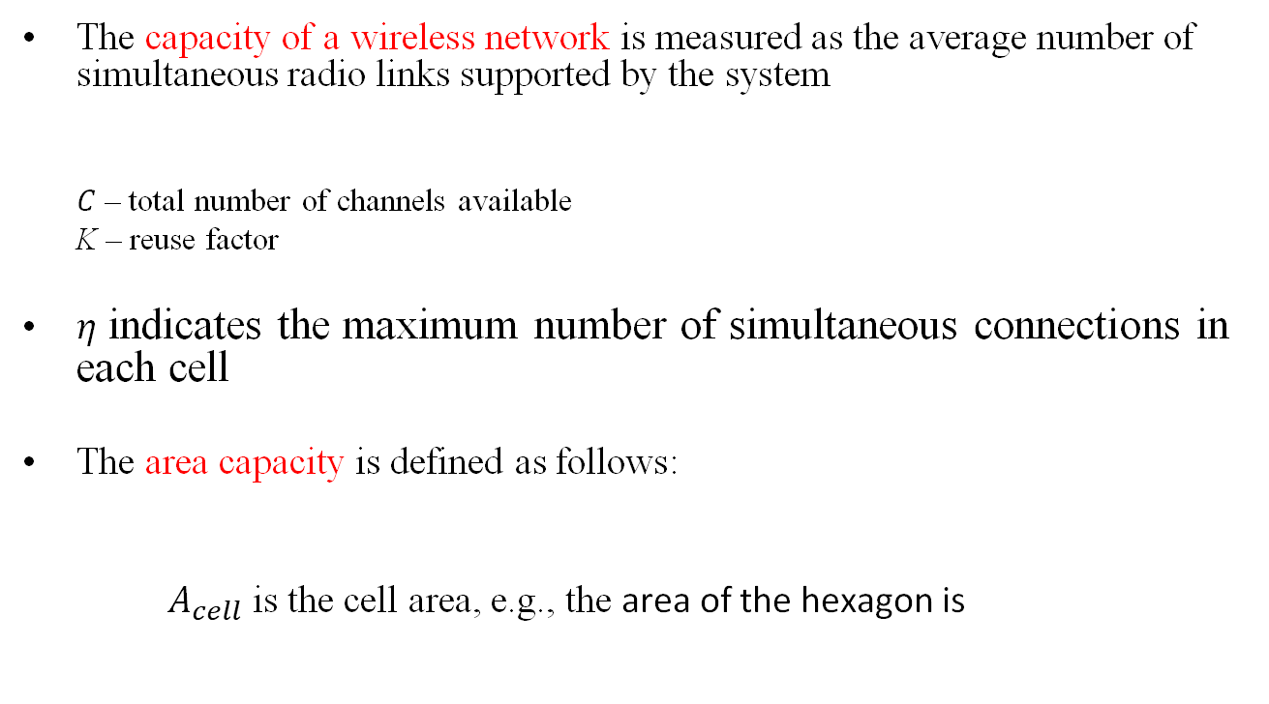


Capacity of Wireless Networks
The capacity of a wireless network is measured as the average number of simultaneous radio links supported by the system
$C$ – total number of channels available
K – reuse factor
$η$ indicates the maximum number of simultaneous connections in each cell
The area capacity is defined as follows:
$A_{cell}$ is the cell area, e.g., the area of the hexagon is
$η=\left\lfloor \frac{C}{K}\right\rfloor$ users/cell
$area capacity=\frac{C}{K A_{cell}}$ users/cell/unit area

Slide 14
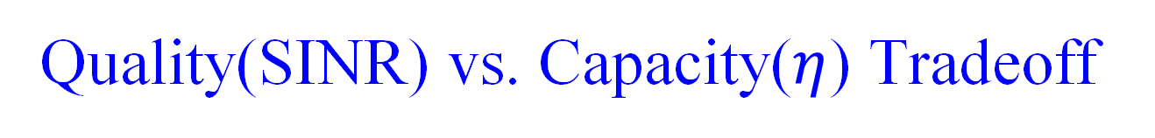
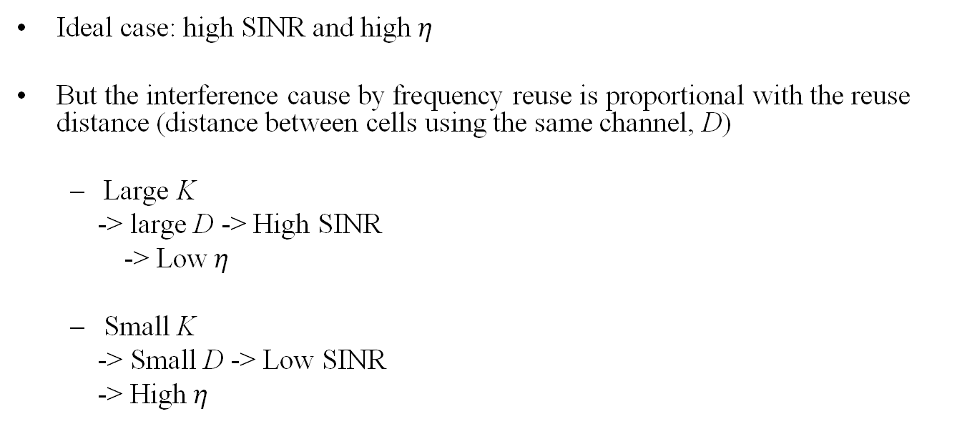
Quality(SINR) vs. Capacity($η$) Tradeoff
Ideal case: high SINR and high$η$
But the interference cause by frequency reuse is proportional with the reuse distance (distance between cells using the same channel, D)
Large K
-> large D -> High SINR
-> Low$η$
Small K
-> Small D -> Low SINR
-> High$η$
D

Slide 15
Co-channel Interference
D+R
D
R
D+R
D-R
A
D
D-R
First tier of co-channel cells for a cluster size of K=7
Note: the marked distances are approximations

Slide 16

Co-channel Interference (cont’d)
If the transmit power of each base station is equal and α is the same throughout the coverage area, in a corner of a cell (most remote place from the base station in the cell) we have:
i₀ - number of co-channel interfering cells
D_{i} - distance from corner A to the center
of the interfering co-channel cell i
R - radius of a cell
K - cluster size (or “reuse factor”)
$$ΓA\sim \frac{R^{−α}}{\sum_{i=1}^{i0}{{D_{i}}^{−α}}}$$
D+R
D
R
D+R
D-R
A
D
D-R

Slide 17
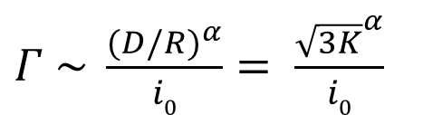
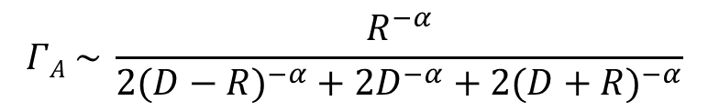
Co-channel Interference (cont’d)
Considering only the first layer of interfering cells and assuming that they are equidistant from the desired base station (all at distance D):
Approximation of the SINR at point A
$Γ \sim \frac{{(D/R)}^{α}}{i0}= \frac{{\sqrt{3K}}^{α}}{i0}$
D+R
D
R
D+R
$$ΓA \sim \frac{R^{−α}}{{2(D−R)}^{−α}+{2D}^{−α}+{2(D+R)}^{−α}}$$
D-R
A
D
D-R

Slide 18
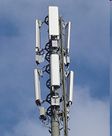
Directional Antennas in Wireless Networks
Directional antennas in wireless networks reduce the number of sites by allowing multiple BS to share the same site (120 degree site patterns for 1/3 reuse)

Slide 19
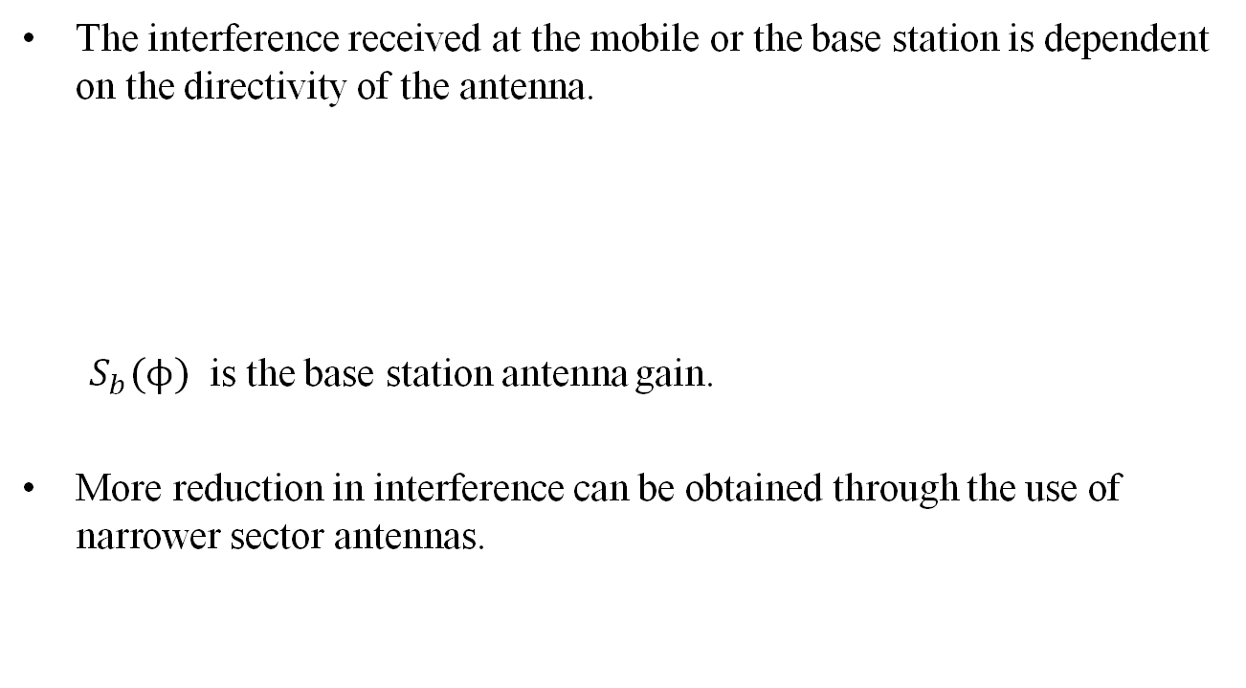

Directional Antennas
The interference received at the mobile or the base station is dependent on the directivity of the antenna.
${ S}_{b}(ϕ)$ is the base station antenna gain.
More reduction in interference can be obtained through the use of narrower sector antennas.
$$Γ=\frac{S_{b}(Φ_{0})\frac{cP_{t}}{r^{α}}}{\sum_{k}{S_{b}(Φ_{k})\frac{cP_{t}}{D_{k}^{α}}}+N}$$
Notes:
Add more info about Sb

Slide 20

Femtocells
Home base stations for mobile networks
Licensed spectrum
Low-power, low-range
At user’s premises
Cellular access through fixed broadband connection (ADSL,…)
Why femtocells?
Better throughput, coverage, lower prices for users
Unload wide area cellular networks, reduce op. costs
Examples in Switzerland:
Sunrise Indoor Box
Salt Booster Box

Slide 21
Femtocell Deployment

Slide 22
Frequency Management
In all countries of the world, the licensed spectrum is managed by the government and (usually) leased to private operators
Regulation authority
In Switzerland: Federal Commission for Communications, or ComCom; assisted by BAKOM
In the US: FCC
In the EU: each country still has its national regulation authority
Some political willingness (especially in the US) to reduce the role of the FCC → Dynamic Spectrum Allocation (cognitive radios) See the IEEE DySPAN conference (ieee-dyspan.org)

Slide 23
Procedure for Frequency Allocation
2 main options
Auction
“Beauty contest”
Usually fixed price
Based on very detailed dossiers
+ : price pre-determined
: temptation/suspicion of bribery; no price discovery

Slide 24
Auctioning of Frequencies
Goal of auction: best possible allocation of frequencies to operators
Auctions are not meant to maximize the revenue for the government
Splitting of the frequency bands in blocks (e.g., of 2*5Mhz)
Issue: how to combine the auctioned blocks
Caps in high-value bands to avoid unfair behavior
Typical duration of allocation: 10 to 20 years
Minimal (or starting) price: xxx CHFrs/MHz*Year (defined by law in the case of CH)

Slide 25
The case of Switzerland
3 main cellular operators (cellcos)
Swisscom (state-controlled) has 60% of the mobile market
Failed attempt of merger of Orange and Sunrise (in 2010)
Orange → Salt Mobile (2015)
Good quality of service, but high prices
Swiss peculiarities: topography, super-tight emission regulations, site acquisitions (to set up base stations) often problematic, expensive manpower, high-revenue and change-averse population
All licenses already available at that time (800, 900, 1800, 2100 and 2600MHz) (re-)allocated as of 2013 or 2016 until 2028

Slide 26
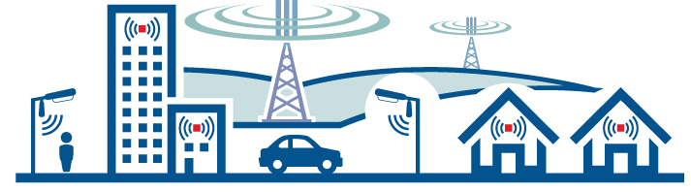
5G Requires Low and High Frequencies
Use of low frequencies (e.g., 700, 800 et 900 MHz) in macrocells for service across the territory
Source: amta.org.au
Use of high frequencies (e.g., 3.5 GHz and higher) in small cells located in streets and buildings. This allows very high bandwidths over short distances

Slide 27
Frequency Allocation for Operators In Switzerland (before 5G)
Note: This slide and some of the following adapted from a slide show kindly provided by Urs von Arx (BAKOM)

Slide 28
5G New Mobile Frequencies

Slide 29
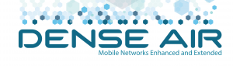



5G Frequencies Auction Results
700 MHz FDD | 0 | 20 MHz | 10 MHz | 30 MHz
700 MHz SDL | 0 | 0 | 10 MHz | 0
1400 MHz SDL | 0 | 10 MHz | 15 MHz | 50 MHz
2600 MHz TDD | 0 | 0 | 0 | 0
3500 - 3800 MHz TDD | 0 | 80 MHz | 100 MHz | 120 MHz
Surcharge in CHF | 0 | 94'500’625 | 89'238’101 | 195'554’002
 | Total Revenue: 379’292’728 CHF

Slide 30
New Frequency Allocation for Operators in Switzerland

Slide 31
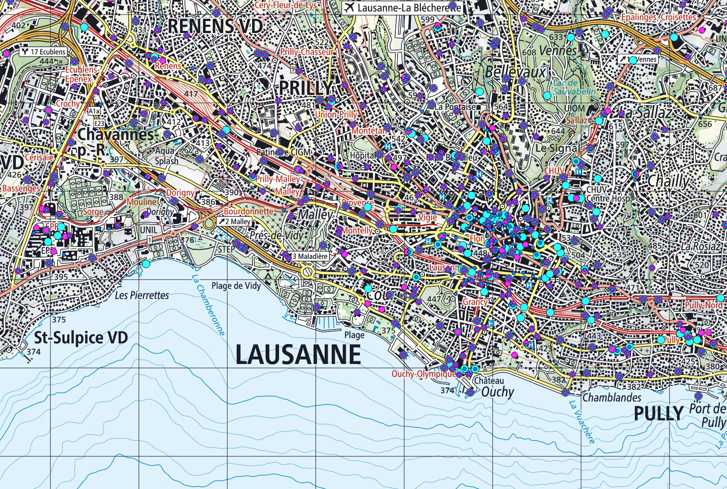
https://www.bakom.admin.ch/bakom/en/homepage/frequencies-and-antennas/location-of-radio-transmitters.html

Slide 32
Association: Radio Resource Management problem
To each active terminal, we need to assign:
Transmit power
Waveform
Base station(s)
in order to maximize system utility
Association on the move: handover
Notes:
RRM = Radio Resource Management

Slide 33
Mobility management
While inactive
Tracking location of terminal and waking it up when necessary
Location area updates
Paging
While connection in progress:
Handover (or “handoff”, US English): timely selection (transition) of base stations based on signal quality measurements

Slide 34
Handover types
Involved networks
Horizontal handover
Within a single network of homogeneous radio access technology (RAT)
Vertical handover (or network selection)
Between different networks, usually with heterogeneous RATs
2 families of handover
Hard handover
Only one base station serving at a time
Soft handover
Multiple base stations can simultaneously serve a mobile terminal

Slide 35
Handover phases
Handover measurement & decision
Decides when and where to handover
Handover resource management
Radio resources available in the target base station? → allocate them
Handover execution
Reliable handover signaling (handshaking) procedure

Slide 36
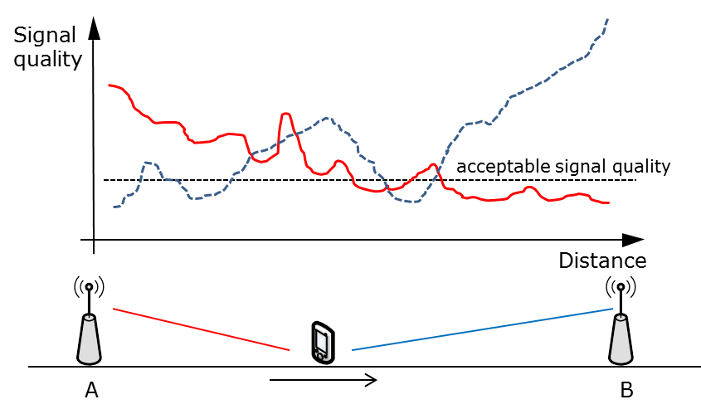
Handover decision

Slide 37
Performance metric
Two main metrics
Handover failure probability
Measures how often handover attempts fail
Probability that signal quality is below the required value for more than a given time interval
Handover frequency (or rate)
Measure of how frequently handover decisions are made
Tradeoff between handover frequency and failure probability

Slide 38
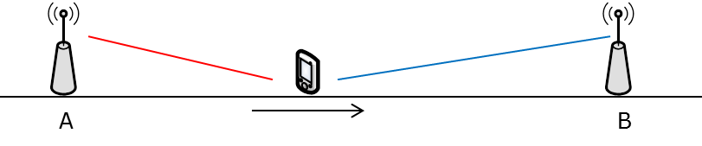
Handover Decisions
Handover decision algorithms:
Algorithm I: instantaneous decision
AP with the highest signal level is chosen at any sample point
Algorithm II: moving average
Average over the last 10 samples determines the serving AP
Algorithm III: expected value
AP is selected based on expected signal level rather than on measurements
1 km

Slide 39
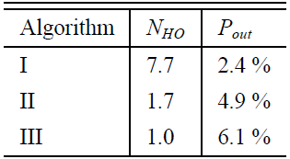
Handover Decisions
N_{HO}: number of handovers
P_{out}: probability of outage

Slide 40
Handover decision criteria
Received signal strength (RSS)
Detecting cell boundaries
Designed for (low capacity) macro-cellular systems (noise-limited)
Signal to interference ratio (SIR)
Efficient in micro-cellular environments (interference-limited)

Slide 41
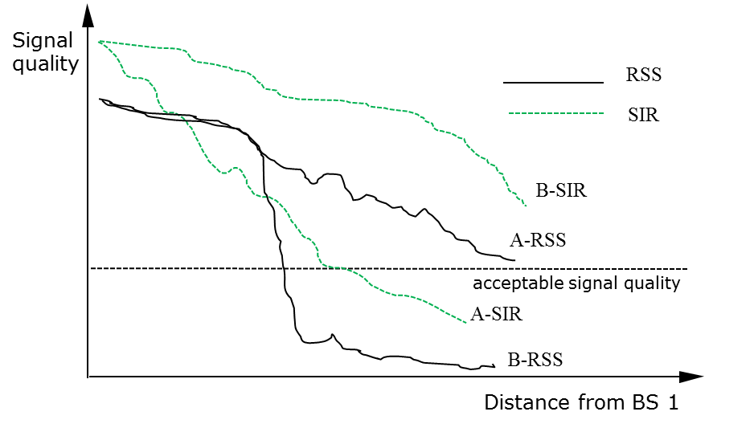
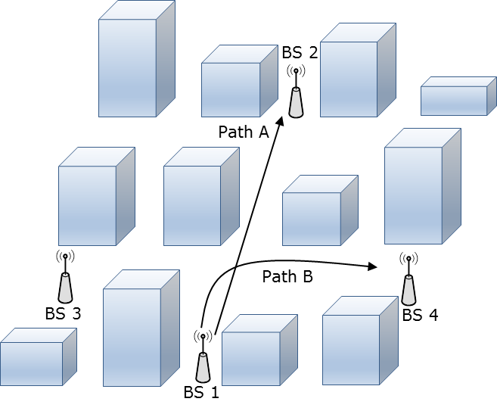
Example
Limitation of RSS-based handover in microcells
Rapid RSS level changes at street corners
RSS is not a good indicator of connection quality in microcells
BS1 and BS2 use the same frequency channel, while BS3 and BS4 utilize another one.

Slide 42
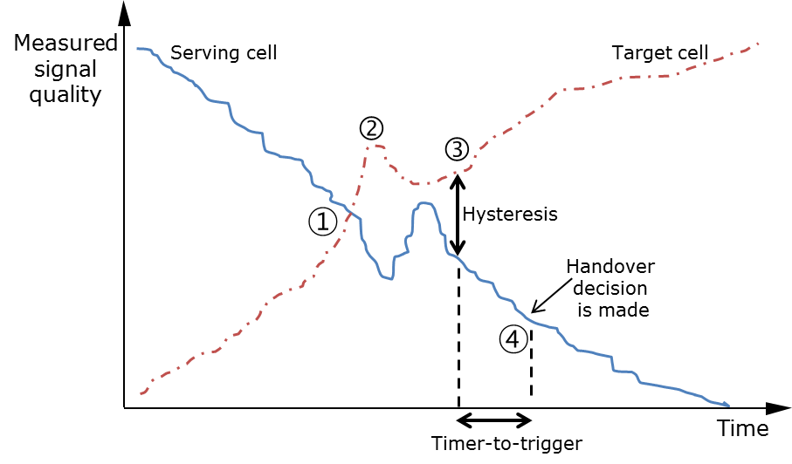
Practical handover algorithm
Typical hard handover decision in LTE system
Hysteresis & time-to-trigger
This is the very basic handover mode in LTE

Slide 43
Handover execution
It is mostly about signaling procedure
The system and mobile should reach agreement on
Which Base station?
Which waveform? (frequency, timeslot, code, etc.)
Authentication
The signaling should be fast & reliable
Handover is performed under difficult SIR conditions
Notes:
SIR = Signal to Interference Ratio

Slide 44




5G Deployment Strategies
Non-Standalone (NSA)
Standalone (SA)
LTE CORE
Data plane
LTE CORE
5G CORE
Control plane
LTE-RAN
5G-RAN
LTE-RAN
5G-RAN
UE
UE
UE
No dependency on LTE
Fully exploit features provided by 5GC
Requires heavy infrastructure investments
Supplement existing infrastructure investments
Control plane over LTE network
https://networking.umn.edu/research-projects/5g-measurements
Notes:
We now take a look at how carriers can deploy 5G. Two deployment models have been standardized to meet initial market requirement.
[click]
The first one is called as “Non-Standalone 5G or NSA”.
In NSA, [click] the user equipment is able to simultaneously connect to both the LTE and 5G base stations.
[click] Such dual connectivity allows carriers to roll out 5G faster with minimal infrastructure investment.
[click] However, all the control plane signaling -- including that of 5G -- is now performed over LTE.
[click] The second deployment model is called the Standalone 5G or SA. In this model, at any given time, the user equipment can connect to either LTE or 5G base station.
[click] Thus there is no dependency of 5G on LTE.
[click] Standalone 5G will allow carriers to fully exploit 5G core architecture’s features such as network slicing, etc.
[click] This model however requires heavy investment.
[next]

Slide 45
5G Deployment Strategies
Non-Standalone (NSA)
Standalone Mode (SA)
LTE CORE
Data plane
LTE CORE
5G CORE
Control plane
All current 5G deployments follow this model
LTE-RAN
5G-RAN
LTE-RAN
5G-RAN
UE
UE
UE
No dependency on LTE
Fully exploit features provided by 5GC
Requires heavy infrastructure investments
“Main drop”
Supplement existing infrastructure investments
Control plane over LTE network
https://networking.umn.edu/research-projects/5g-measurements
Notes:
All current commercial 5G deployments worldwide follow the NSA model.
Next, let’s take a look at the commercial 5G landscape in the US.
[next]

Slide 46
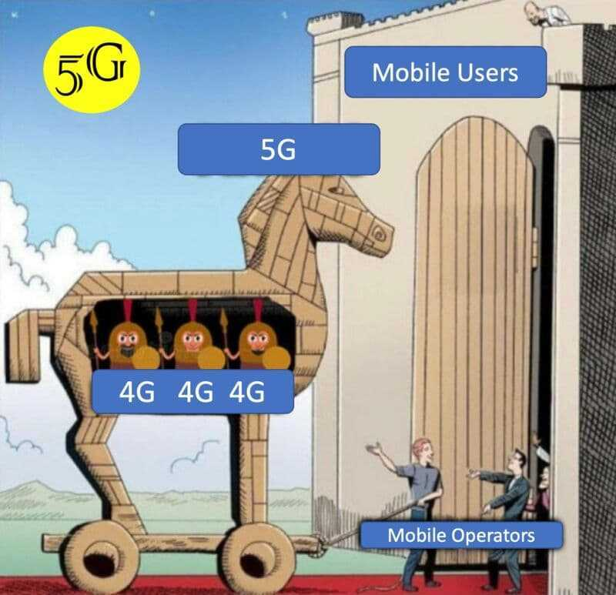
5G Deployment Strategies
Non-Standalone (NSA)
LTE CORE
LTE-RAN
5G-RAN
UE
Supplement existing infrastructure investments
Control plane over LTE network
https://networking.umn.edu/research-projects/5g-measurements
Notes:
All current commercial 5G deployments worldwide follow the NSA model.
Next, let’s take a look at the commercial 5G landscape in the US.
[next]

Slide 47

Handoffs in NSA 5G
Tower
Tower
A
B
left
right
left
Alice
Tower/Panel
A
left
A
A
right
A
right
B
B
left
Active Radio Type
5G
4G
5G
5G
4G
5G
Primitive
vertical
vertical
horizontal
vertical
vertical
Handoff
Type
Combinational
5G to 5G
(same tower)
5G to 5G
(diff. tower)
https://networking.umn.edu/research-projects/5g-measurements
Notes:
Consider Tower A is a 5G base station having two panels –
[click] one on the left side and
[click] another on the right.
[click]
Assume, Alice is connected to the left panel of tower A with 5G connectivity.
[click]
As she walks along the path, there is a handoff from the left-5G panel to the right-5G panel.
But since all the control signaling is happening over LTE, we observed such a 5G to 5G handoff associated with the same tower happens in two stages.
[click]
In the first stage, Alice experiences a handoff from 5G to 4G. Such a change in wireless technology is referred to as a vertical handoff.
[click]
in the second stage, another vertical handoff takes place but this time the radio type changes from 4G to 5G. Note, in this whole process, we were connected to the same tower A, but moved between panels.
[click]
The combination of the two primitive vertical handoffs resulted into a 5G to 5G handoff associated with the same tower.
In general, we define a combinational handoff as a type of handoff that corresponds to a high-level event that cannot be realized by a single primitive handoff type.
[click]
Now as Alice continues to walk towards another Tower, say B which again has two panels - left and right.
[click]
This time we see that she experienced a different type of combinational handoff – a 5G to 5G handoff involving two different towers A to B.
[click]
We observed this handoff event also consisted of two stages, the first one is when Alice having 5G connectivity moved from tower A to Tower B but with 4G active, resulting in a horizontal and vertical handoff occurring together as a single primitive handoff.
[click]
In the second stage, Alice -- who is now connected to tower B experiences a vertical handoff making her 5G connection active with tower B.
While these two scenarios illustrate two combinational handoffs, we observe that often times the primitive handoffs form more complex sequences and other 5G carriers also exhibit similar behavior. More details about handoffs observed in NSA 5G is explained in the paper.

Slide 48

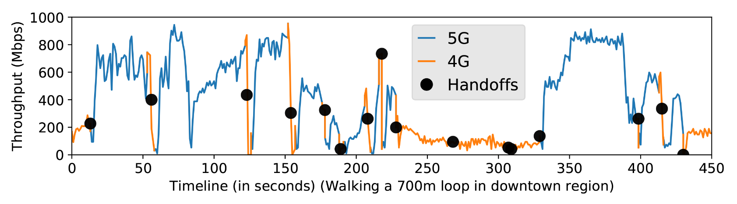
Handoff Analysis
Setup:
mmWave
Walking a 700m loop @ MPLS
US East
UE experiences a total of 31 primitive handoffs (16 combinational) within 8 minutes!
Frequent handoffs causes frequent throughput fluctuations
https://networking.umn.edu/research-projects/5g-measurements
Notes:
Given the knowledge about the primitive and combinational handoffs in non-standalone 5G, we conduct an experiment with low mobility in Minneapolis area using Verizon’s 5G service. Holding the phone in our hand, we walk a loop of 700 meters spanning for roughly 8 minutes. While walking, we keep a downloading session active on the phone, and [click] log the perceived throughput and handoff activity events over time.
[click]
We find that the phone experiences a total of 31 primitive handoffs and bounces between 4G and 5G for 13 times.
While this may seem to be a side effect of non-standalone 5G, we still find a total of 16 combinational handoffs during this short walk. Such high number of handoffs especially while using millimeter wave is inevitable due to the small footprints of the 5G base stations.
[click]
Frequent handoffs results the throughput to highly fluctuate between 0 to 1Gbps.

Slide 49
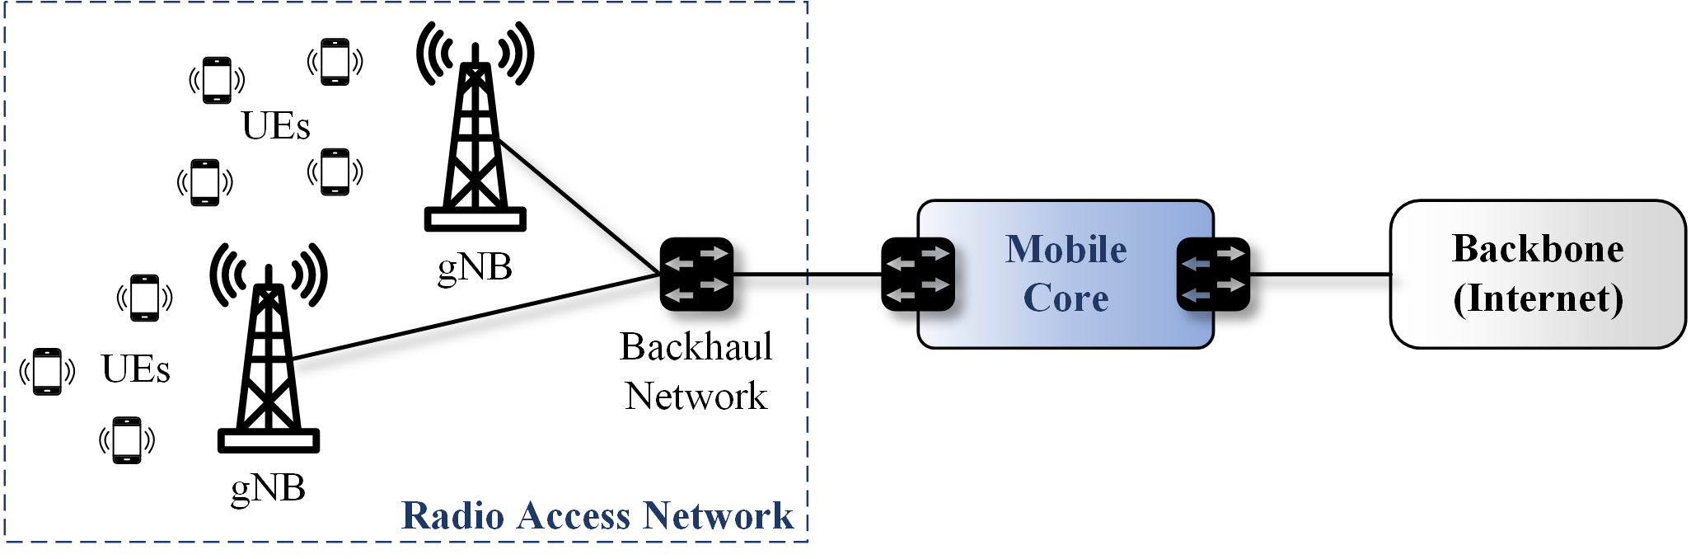
5G Network
The 5G network consists of two subsystems.
The Mobile Core and the Radio Access Network (RAN)
The Mobile Core provides and ensures Internet connectivity.
The RAN corresponds to a distributed set of base stations, named gNodeB (or gNB).

Slide 50
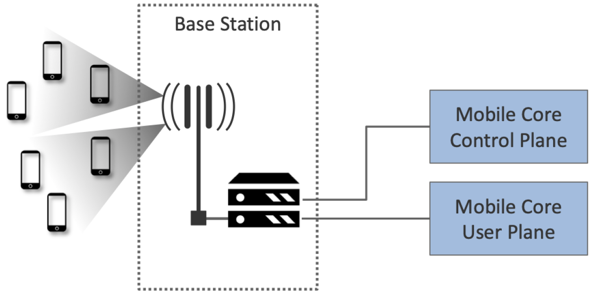
Mobile Core
The Mobile Core is divided into a Control Plane and a User Plane.
An architectural feature known as control and user plane separation

Slide 51
Mobile Core: User Plane
Uplink
Traffic
Downlink
Traffic
Internet
The User Plane forwards traffic between the RAN and the Internet (i.e., IP packet forwarding)
It is also responsible for policy enforcement, lawful intercept, traffic usage measurement, and QoS policing

Slide 52
Mobile Core: Control Plane
Uplink
Traffic
Downlink
Traffic
Internet
The Control Plane contains the Access and Mobility Management Function (AMF) and the Session Management Function (SMF)
The AMF is responsible for connection and reachability management, mobility management, access authorization, and location services.
The SMF manages each UE session, such as IP address allocation.

Slide 53
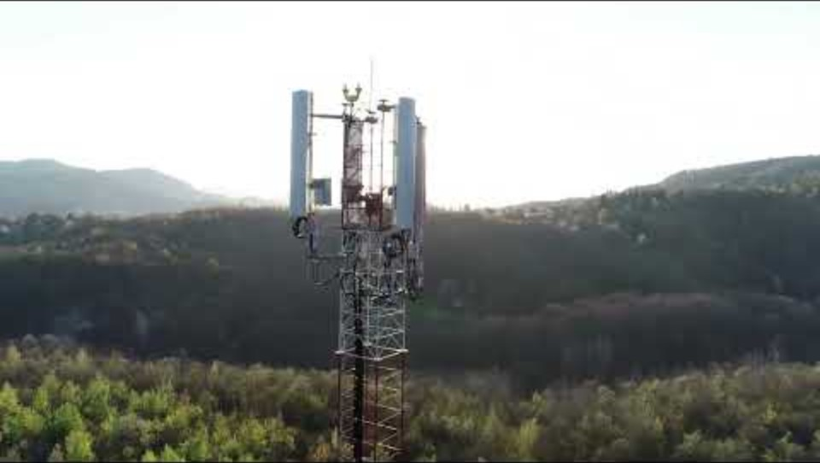
Radio Access Network (RAN)
The main function of the RAN is to transfer packets between the Mobile Core and a set of UEs.
Deeply involved in the management and scheduling of radio spectrum

Slide 54
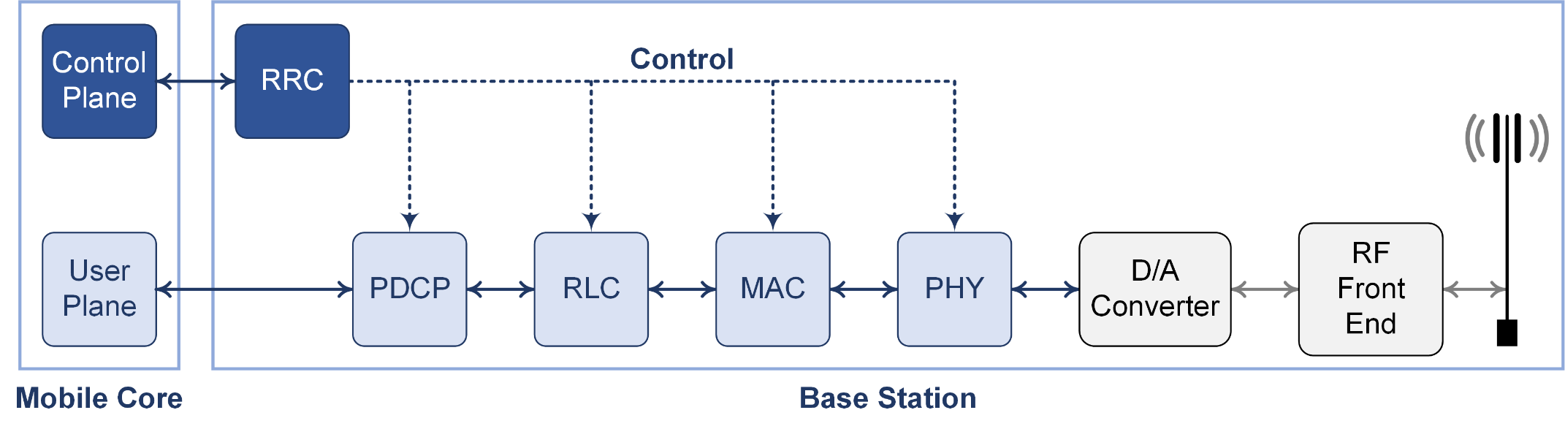
RAN Processing Pipeline (Protocol Stack)
The packet processing pipeline integrated in 5G base stations
Specified by the 3GPP standard
Including both user and control plane components
It can also be viewed as the 5G protocol stack

Slide 55

RAN Processing Pipeline: RRC
Radio Resource Control (RRC) layer
This layer is responsible for the establishment, configuration, maintenance, and release of radio bearers (logical channels between the base station and the UE).

Slide 56
RAN Processing Pipeline: PDCP
Packet Data Convergence Protocol (PDCP) layer
This layer handles tasks such as header compression and decompression, ciphering and deciphering, and integrity protection and verification.

Slide 57
RAN Processing Pipeline: RLC
Radio Link Control (RLC) layer
This layer is responsible for segmentation and reassembly, as well as reliably transmitting or receiving segments using error correction through automatic repeat request (ARQ).

Slide 58
RAN Processing Pipeline: MAC
Media Access Control (MAC) layer
This layer addresses all real-time scheduling regarding physical resource allocation.

Slide 59
RAN Processing Pipeline: PHY
Physical (PHY) layer
This layer, including the upper and lower PHY layers, manages (de)coding and (de)modulation.

Slide 60
RAN Processing Pipeline: Radio Head
Radio head (RH)
The RH converts Radio Frequency (RF) signals into digital data and vice versa.

Slide 61
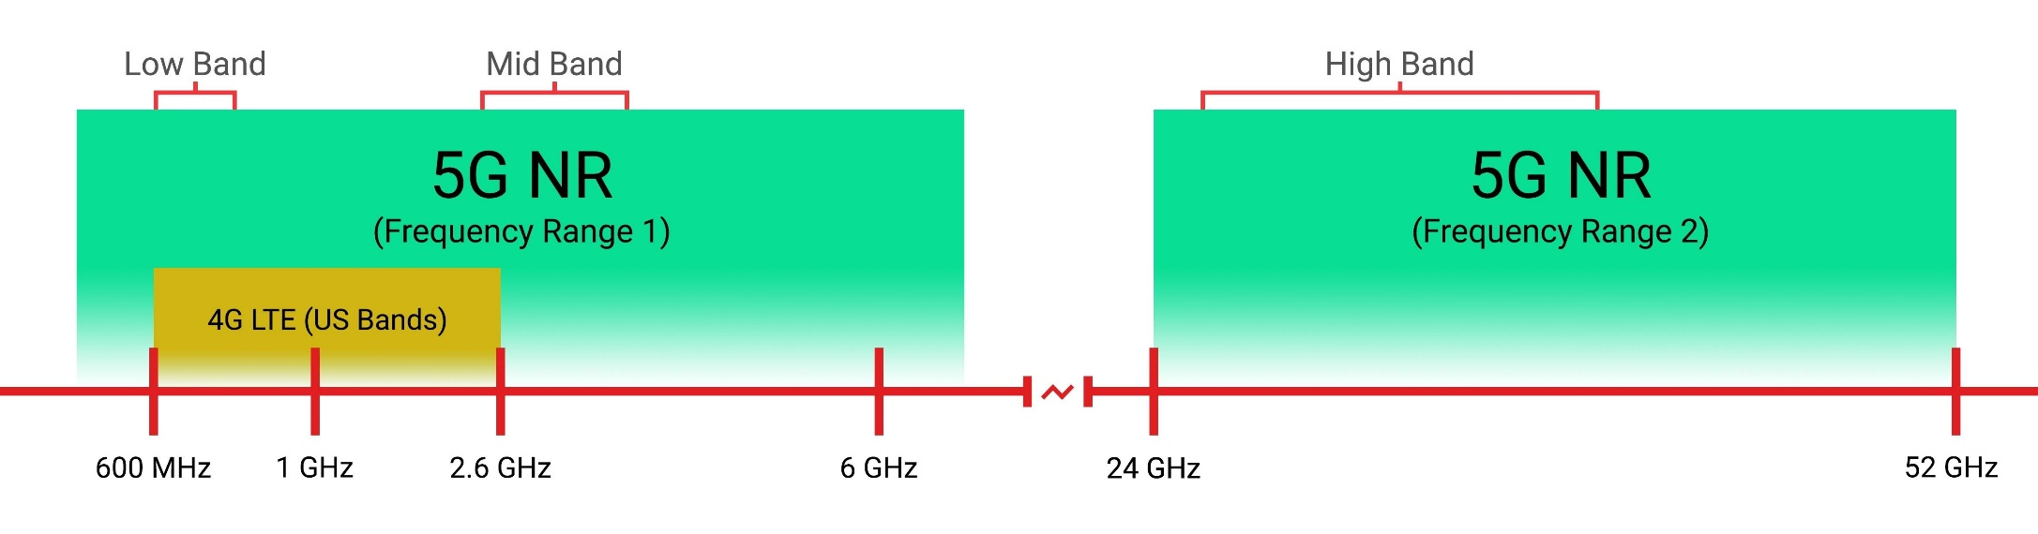
Frequency Bands
Credit: Dallas Thomas/Gadget Hacks

Slide 62
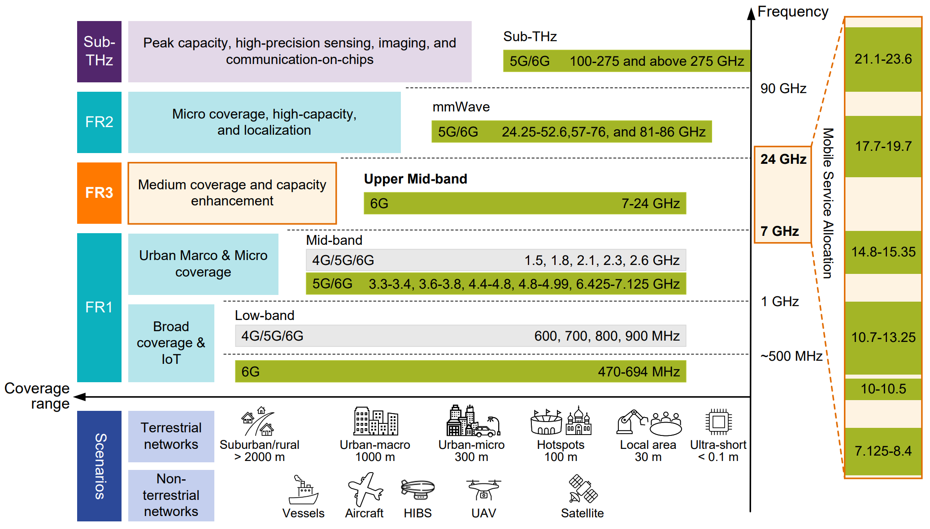
Frequency Bands
Credit: 6G Wireless Communications in 7-24 GHz Band: Opportunities, Techniques, and Challenges

Slide 63
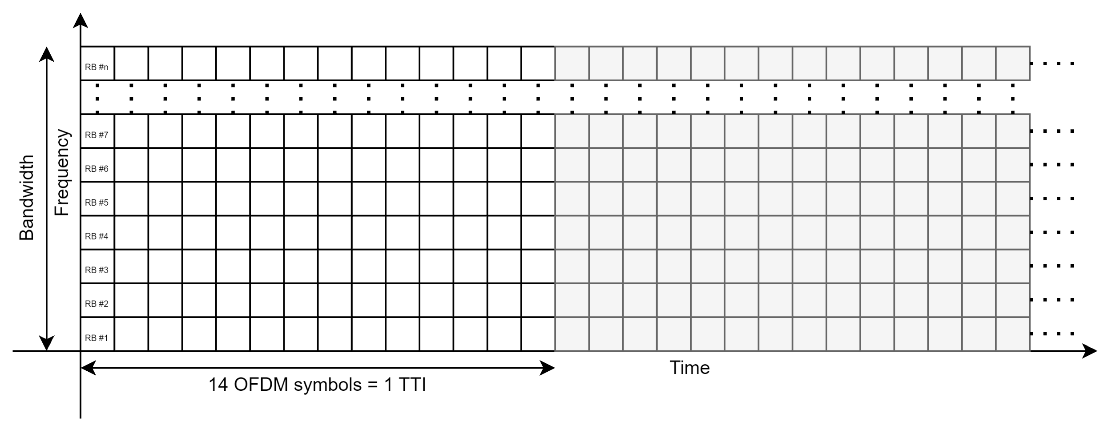
Scheduling
Centralized scheduling
The base station manages physical resource allocation to UEs
OFDM modulation
14 OFDM symbols = Time transmission interval (TTI) (or time slot)

Slide 64
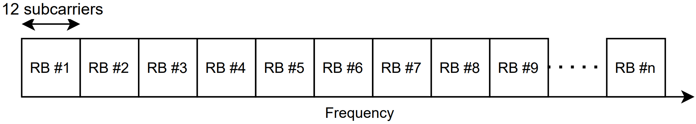
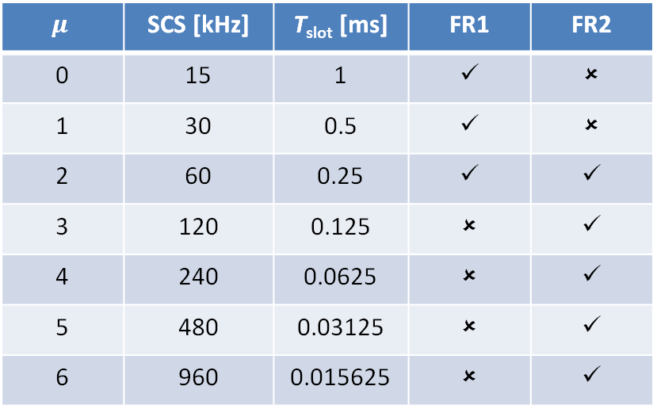
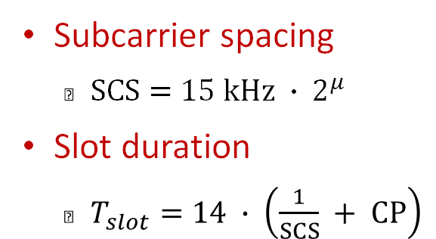
Scheduling
Numerology (𝜇) table
$$μ$$ | SCS [kHz] | T_{slot} [ms] | FR1 | FR2
0 | 15 | 1 | ✓ | ✗
1 | 30 | 0.5 | ✓ | ✗
2 | 60 | 0.25 | ✓ | ✓
3 | 120 | 0.125 | ✗ | ✓
4 | 240 | 0.0625 | ✗ | ✓
5 | 480 | 0.03125 | ✗ | ✓
6 | 960 | 0.015625 | ✗ | ✓
Subcarrier spacing
$SCS=15 kHz ∙ 2^{μ}$
Slot duration
$T_{slot}=14 ∙ \left(\frac{1}{SCS} + CP\right)$

Slide 65
Scheduling
MCS Index I_{MCS} | Modulation Order Q_{m} | Target code Rate x [1024] R | Spectral efficiency
0 | 2 | 120 | 0.2344
1 | 2 | 193 | 0.377
2 | 2 | 308 | 0.6016
3 | 2 | 449 | 0.877
4 | 2 | 602 | 1.1758
5 | 4 | 378 | 1.4766
6 | 4 | 434 | 1.6953
7 | 4 | 490 | 1.9141
8 | 4 | 553 | 2.1602
9 | 4 | 616 | 2.4063
10 | 4 | 658 | 2.5703
11 | 6 | 466 | 2.7305
12 | 6 | 517 | 3.0293
13 | 6 | 567 | 3.3223
MCS Index I_{MCS} | Modulation Order Q_{m} | Target code Rate x [1024] R | Spectral efficiency
14 | 6 | 616 | 3.6094
15 | 6 | 666 | 3.9023
16 | 6 | 719 | 4.2129
17 | 6 | 772 | 4.5234
18 | 6 | 822 | 4.8164
19 | 6 | 873 | 5.1152
20 | 8 | 682.5 | 5.332
21 | 8 | 711 | 5.5547
22 | 8 | 754 | 5.8906
23 | 8 | 797 | 6.2266
24 | 8 | 841 | 6.5703
25 | 8 | 885 | 6.9141
26 | 8 | 916.5 | 7.1602
27 | 8 | 948 | 7.4063
Modulation and Coding Scheme (MCS) Table 2

Slide 66
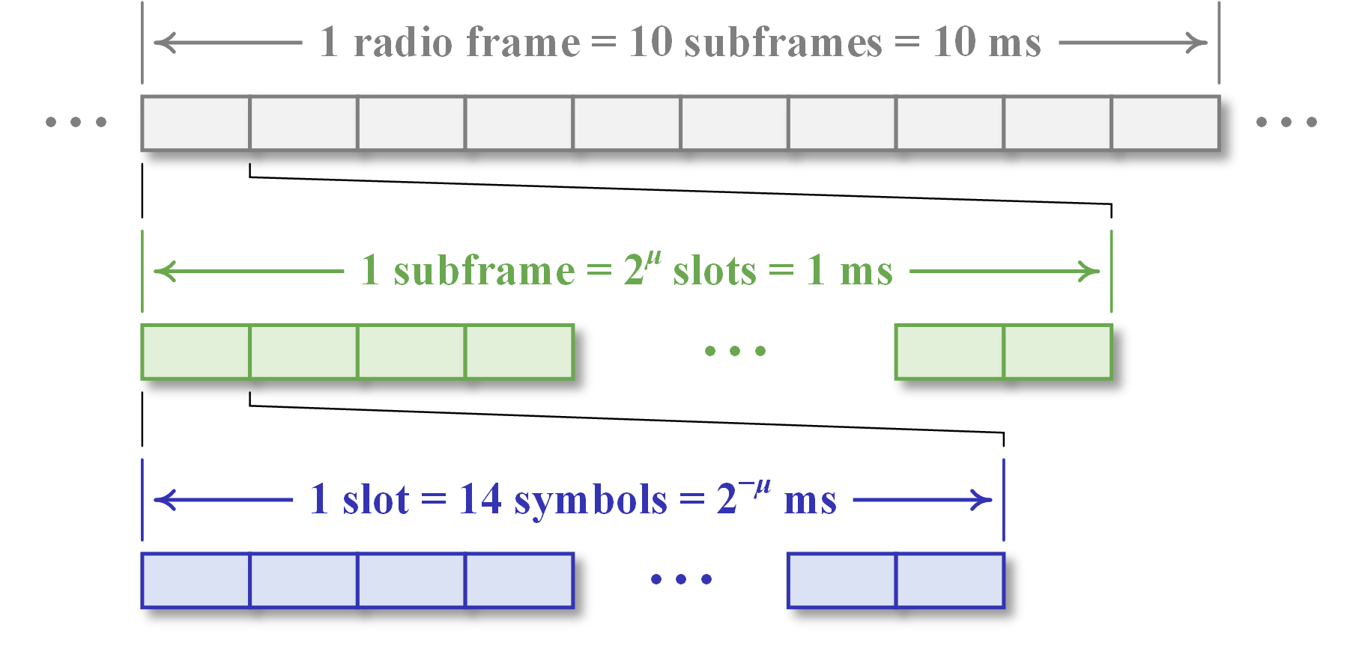
5G Frame Structure
5G introduces a novel frame structure, which is designed to be more flexible than its predecessors.
At the heart of this flexibility is the concept of numerology, labelled by μ.

Slide 67
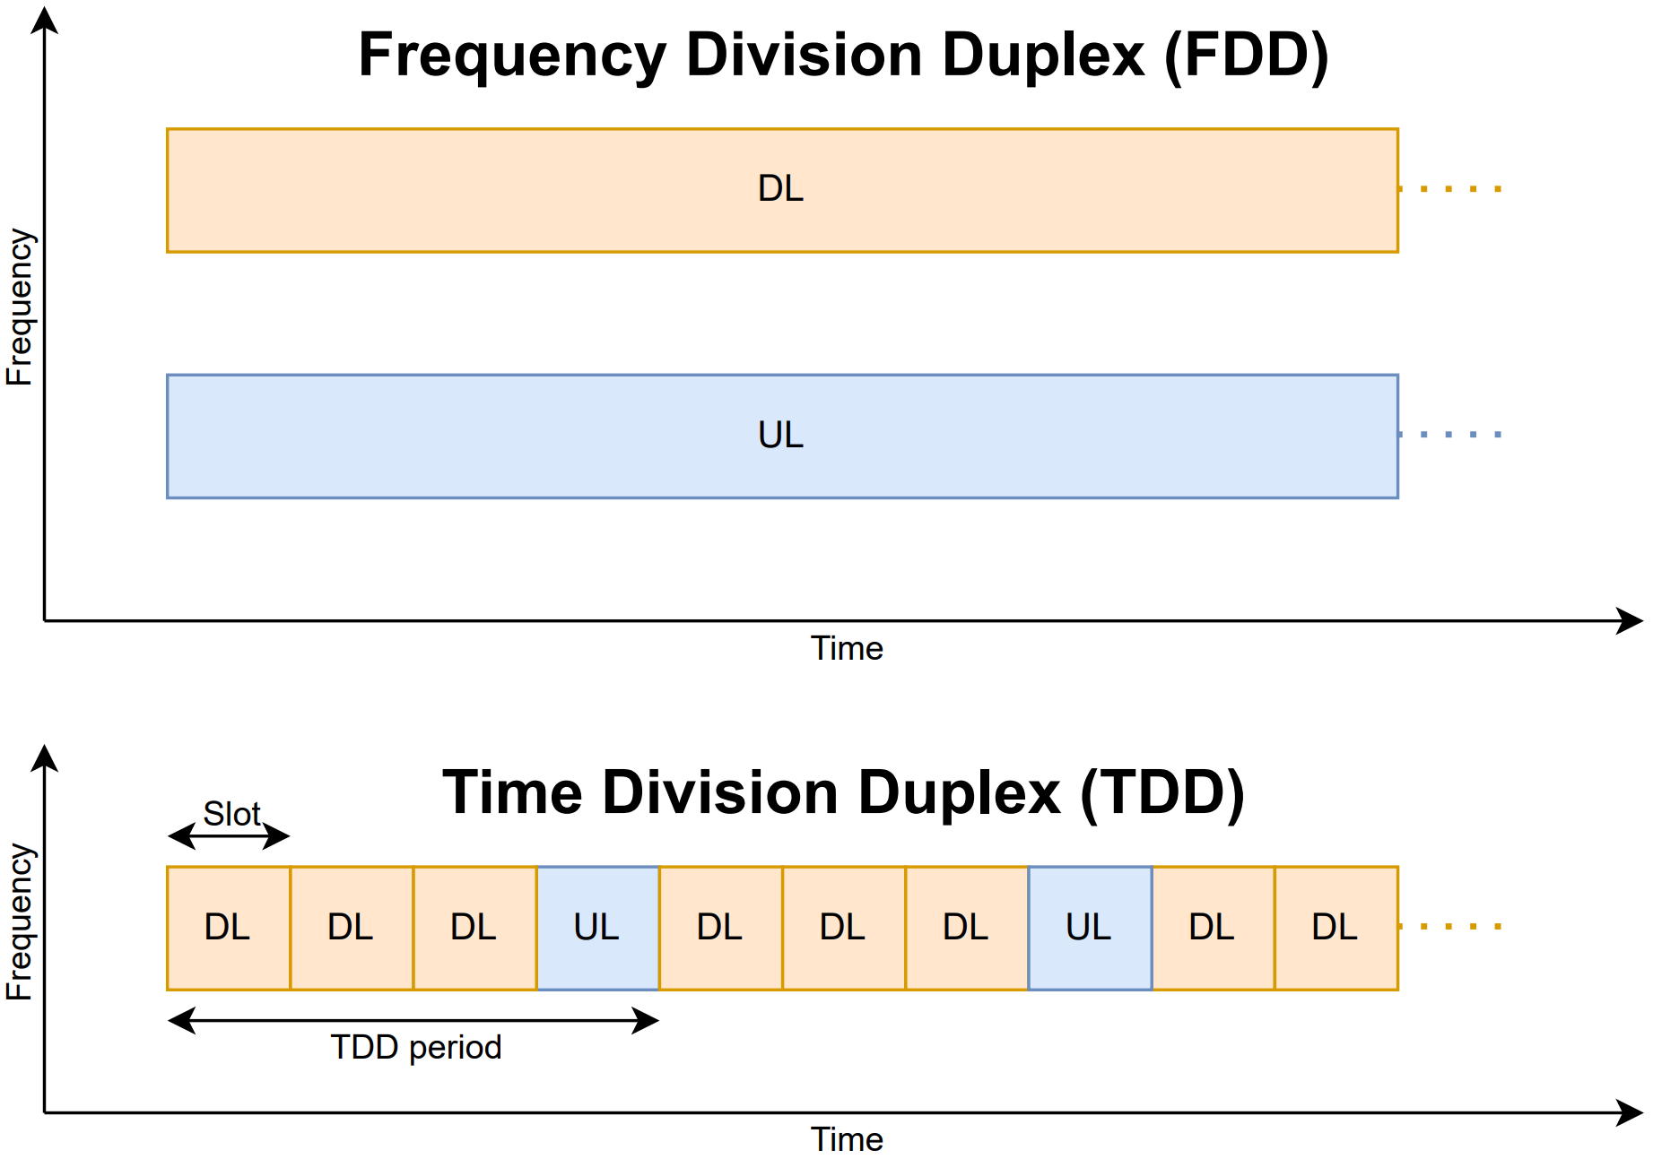
Duplex Modes

Slide 68
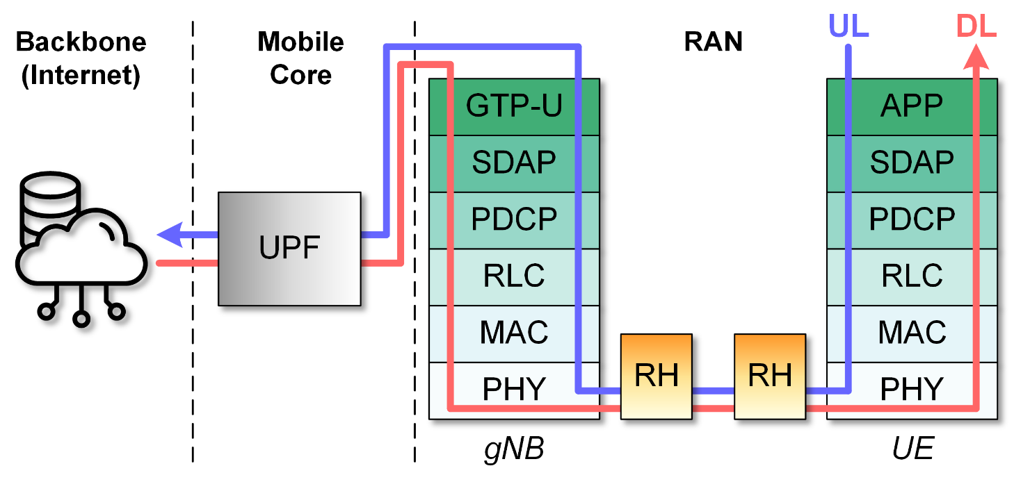
Downlink Scheduling & Uplink Scheduling
Downlink scheduling
The gNB has full knowledge on its queue and buffer
The gNB needs Channel Quality Indicators (CQI) from UEs
Uplink scheduling
The gNB has no knowledge on UEs’ queues and buffers
The gNB knows the SNR of UEs

Slide 69
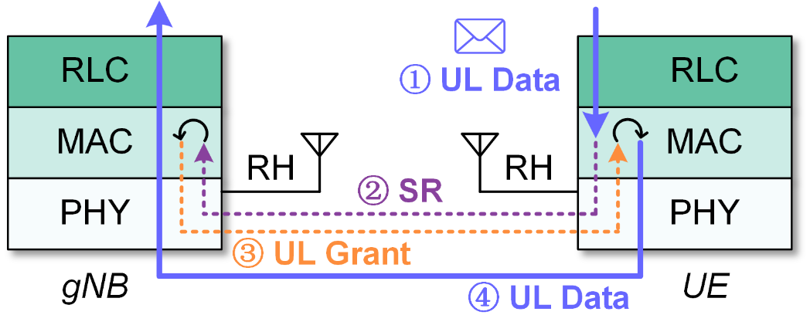
Grant-Based Access & Grant-Free Access
Grant-based access
A UE first sends a scheduling request to the gNB
The gNB schedules and sends an uplink grant to the UE
The UE transmits uplink data to the gNB
Grant-based access

Slide 70

Grant-Based Access & Grant-Free Access
Grant-based access
A UE first sends a scheduling request to the gNB
The gNB schedules and sends an uplink grant to the UE
The UE transmits uplink data to the gNB
Grant-free access
The gNB always allocates a fixed number of resources to the UE
The UE can directly transmit uplink data to the gNB
Grant-based access
Grant-free access

Slide 71

5G Network Slicing
With its high capacity and low latency, 5G paves the way for new business models across various vertical markets
Credit: https://brunch.co.kr/@b047a588c11b462/90

Slide 72
5G Network Slicing
Traffic Class | SST | Slice Type | Acronym
eMBB | 1 | eMBB | Enhanced Mobile Broadband
URLLC | 2 | URLLC | Ultra-Reliable Low-Latency Communication
mMTC | 3 | mIoT | Massive Internet of Things
 | 4 | V2X | Vehicle-to-Everything
 | 5 | HMTC | High-Performance Machine-Type Communication
With its high capacity and low latency, 5G paves the way for new business models across various vertical markets
A 5G network is usually shared among many users and may not always be able to guarantee different requirements

Slide 73


5G Network Slicing
5G network slicing is a technique that divides a single physical network into several virtualized slices
Credit: What is network slicing? | https://www.youtube.com/watch?v=kqpo9LCspiI

Slide 74

5G Network Slicing
5G network slicing is a technique that divides a single physical network into several virtualized slices
Each slice can be designed to guarantee diverse service level agreements (SLA) as for throughput, latency, and reliability

Slide 75

5G Network Slicing
Network slices can be specialized to meet eMBB, URLLC, and mMTC and dedicated for specific services.
eMBB: Live broadcasting, VR/AR
URLLC: Automotive, health & wellness
mMTC: Utilities & logistics

Slide 76

Traditional RAN vs Open RAN
Traditional RANs focused on providing end-to-end service from a geographical perspective to millions of customers.
These networks follow the 3GPP standard.
Credit: 5G Challenge - Traditional RAN vs. O-RAN | https://www.youtube.com/watch?v=RtYwkDYSBFU

Slide 77

Traditional RAN vs Open RAN
Each operator tends to buy equipment for large markets from a single vendor (e.g., Ericsson and Nokia).
It is unlikely to be interoperable with other vendors’ equipment.
Credit: 5G Challenge - Traditional RAN vs. O-RAN | https://www.youtube.com/watch?v=RtYwkDYSBFU

Slide 78

Traditional RAN vs Open RAN
This end-to-end focus and single vendor solution raised significant barriers to new entrants.
Traditional RAN typically relied on specialized hardware.
Credit: 5G Challenge - Traditional RAN vs. O-RAN | https://www.youtube.com/watch?v=RtYwkDYSBFU

Slide 79

Traditional RAN vs Open RAN
Open RAN (O-RAN) represents an ongoing shift from closed, proprietary solutions towards open, modular, interoperable, multi-vendor solutions.
Credit: 5G Challenge - Traditional RAN vs. O-RAN | https://www.youtube.com/watch?v=RtYwkDYSBFU

Slide 80

Traditional RAN vs Open RAN
O-RAN seeks to separate the hardware and software within the RAN segment of the network and to create open interfaces between these segments.

Slide 81

Traditional RAN vs Open RAN
Allow more competition in building the hardware and software
Allow multiple vendor components to interoperate
Like how keyboards, monitors, and mice can connect to any computer

Slide 82


O-RAN Alliance
The O-RAN Alliance defines the specifications for Open RAN.
It disaggregates the RAN’s functionalities into central units (CUs), distributed units (DUs), and radio units (RUs), many of which can be virtualized or containerized.

Slide 83

O-RAN Splitting
The RAN’s functionalities is split across centralized and distributed locations.
The CU can be located near the Mobile Core.
The DU is physically located at or near the RU.

Slide 84

Cloud RAN (C-RAN)
Cloud RAN operates by centralizing the baseband processing functions of mobile networks into cloud-based environments
Baseband processing functions, such as (de)coding and (de)modulation of radio signals, are centralized in a data center.
The remote radio heads are distributed across various cell sites.
Credit: What Is Cloud RAN & How Does It Work? | https://nybsys.com/what-is-cloud-ran/

Slide 85

C-RAN vs Traditional RAN
C-RAN centralizes baseband processing in a data center.
Enable efficient resource utilization and easier management
Traditional RAN keeps baseband processing distributed across individual cell sites.

Slide 86

C-RAN vs O-RAN
C-RAN centralizes baseband processing in a data center.
Enable efficient resource utilization and easier management
O-RAN disaggregates the RAN components.
Allow standardized, open interfaces between various network functions

Slide 87

O-RAN & V-RAN & C-RAN

Slide 88

RAN Intelligent Controller (RIC)
The RIC is a key component in the O-RAN framework
It enables intelligent and dynamic control of RAN resources
Near-real-time (near-RT) RIC and non-real-time (non-RT) RIC
The near-RT RIC manages RAN functions within milliseconds
The non-RT RIC handles them with a longer time horizon

Slide 89

RAN Intelligent Controller (RIC)
Intelligent Control
Artificial intelligence
Machine learning
Optimize network performance
Credit: O-RAN ALLIANCE e.V | https://www.o-ran.org/

Slide 90

RAN Intelligent Controller (RIC)
Intelligent Control
Artificial intelligence
Machine learning
Optimize network performance
Open Interfaces (e.g., E2, A1)
Open, standardized interfaces
Interoperability between vendors
Seamless integration

Slide 91

RAN Intelligent Controller (RIC)
Intelligent Control
Artificial intelligence
Machine learning
Optimize network performance
Open Interfaces (e.g., E2, A1)
Open, standardized interfaces
Interoperability between vendors
Seamless integration
Dynamic Orchestration
Adaptive resource allocation
Adaptive Load balancing
Automated configuration adjustments

Slide 92


Open-Source 5G RAN Software
srsRAN: https://www.srslte.com/
Written in C and C++
GNU Affero General Public License v3.0
3GPP Release 17
Open Air Interface: https://openairinterface.org/
Written in C
OAI Public License V1.1
3GPP Release 17
Both offers software-based implementation of 5G RANs

Slide 93


Open-Source 5G Mobile Core Software
Open5GS: https://open5gs.org/
Written in C
GNU Affero General Public License v3.0
3GPP Release 17
free5GC: https://free5gc.org/
Written in Golang
Apache License 2.0
3GPP Release 15
Both offers software-based implementation of 5G Mobile Cores

Slide 94


A Real-World 5G System

Slide 95
Open Projects
Build Real-World 5G Testbed
Simplify complex 5G deployment tasks through an intuitive framework with minimal overhead, making it easier to scale, monitor, and troubleshoot
Comprehensive API for Private 5G Network Control
Develop comprehensive API for private 5G networks to provide seamless control over user management, network slicing, and infrastructure optimization.
Offloading 5G Lower PHY Processing onto Digital Signal Processors (DSPs)
Offload lower PHY processing onto dedicated DSPs to maximize efficiency and reduce latency
Customized RF Amplifier Circuit with Digital Predistortion
Create a high-power amplifier with digital predistortion to boost software-defined radio integrated circuits for reliable 5G communication
Developing Interference-Resilient RAN for Robust 5G Connectivity
Build a RAN that resists both self and external interference by exploring adaptive interference mitigation techniques for enhanced network stability

