Slide 1


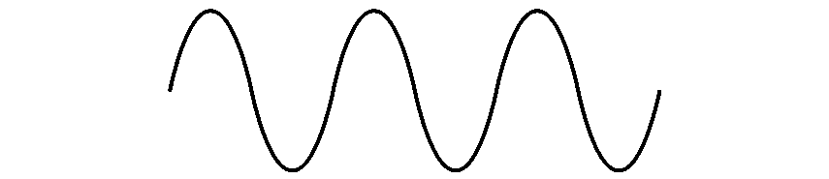
COM-405: Mobile Networks
Lecture 7.0: Scheduling II
Haitham Hassanieh
slides shamelessly stolen from Prof. JP Hubaux with minor modifications
Laboratory of SEnsing
& Networking Systems

Slide 2
Round-Robin (RR) Scheduling
Users are scheduled in a round robin, i.e. cyclic order
i[t]: user scheduled at time t. RR scheduler:
i[t+1]=i[t]+1 (mod M -1)
The algorithm is fair: all users are given the same amount of time resources

Slide 3
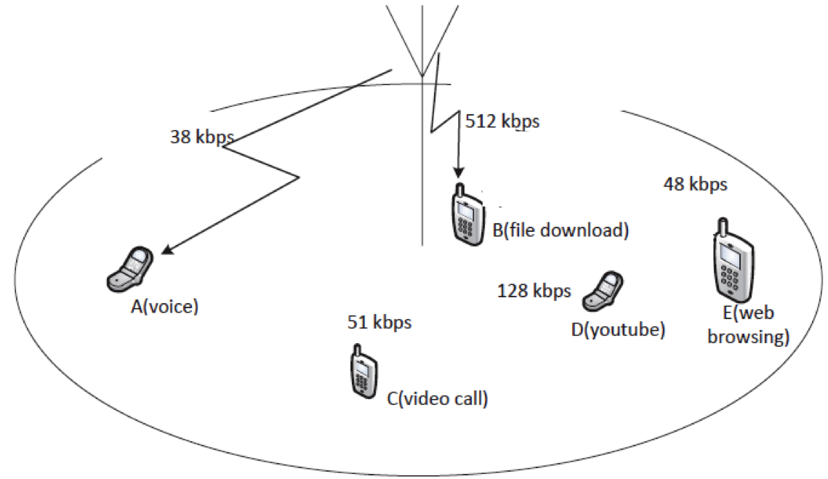
Round-Robin Scheduling
Performance
  All users are allocated the same amount of network resources
  What is the throughput of all users in the following network?

Slide 4
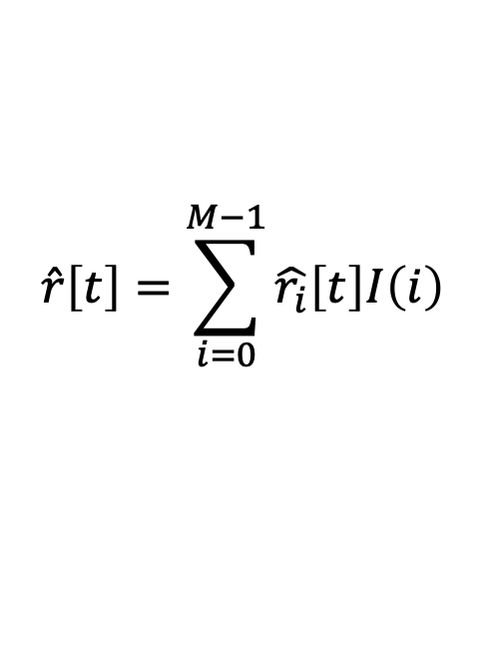
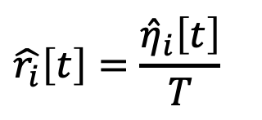
Max Throughput Scheduling
Objective: maximize total network throughput
If user i is scheduled, the expected data rate is:
The total expected network throughput is
$$\hat{r_{i}}\left[t\right]=\frac{{\hat{η}}_{i}\left[t\right]}{T}$$
Expected number of bits that can be successfully delivered
Slot length
$$\hat{r}\left[t\right]=\sum_{i=0}^{M−1}{\hat{r_{i}}\left[t\right]I\left(i\right)}$$
I(i): Scheduling indicator:
1 scheduled, 0 otherwise.

Slide 5
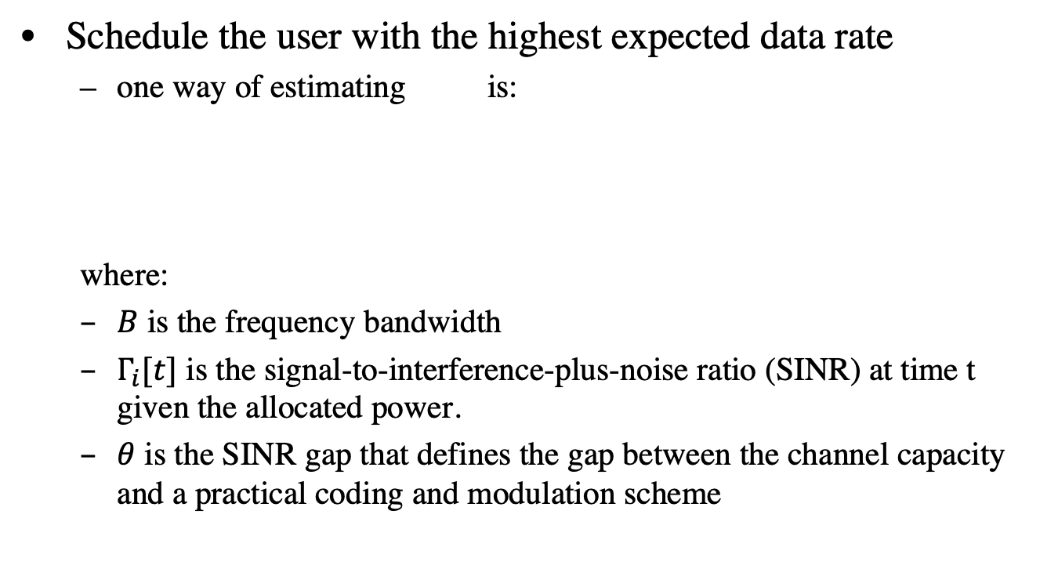
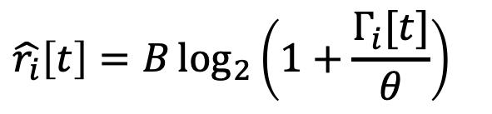

Max Throughput Scheduling
Schedule the user with the highest expected data rate
  one way of estimating is:
  where:
  $B$ is the frequency bandwidth
  $Γ_{i}[t]$ is the signal-to-interference-plus-noise ratio (SINR) at time t given the allocated power.
  $θ$ is the SINR gap that defines the gap between the channel capacity and a practical coding and modulation scheme
$$\hat{r_{i}}\left[t\right]$$
$$\hat{r_{i}}\left[t\right]=B\log_{2}\left(1+\frac{Γ_{i}[t]}{θ}\right)$$
Notes:
Bigger SINR → smaller the gap theta → bigger r_i[t]. This means the terminal with the highest estimated throughput r_i[t] is also the terminal with the highest SINR.

Slide 6
Max Throughput Scheduling
Main drawbacks
  Unfairness
  Coverage limitation
  Most users may never be served

Slide 7
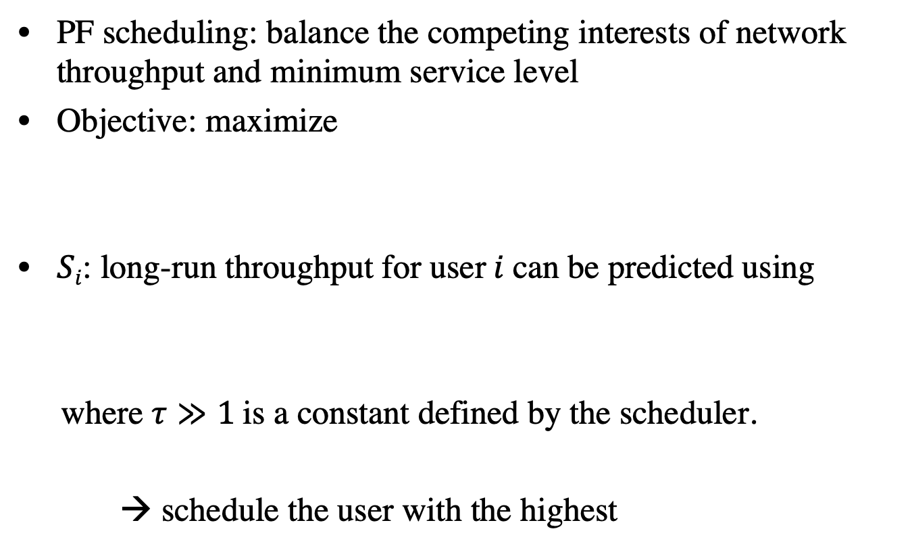
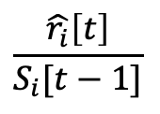
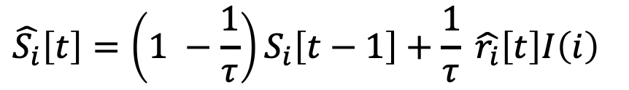
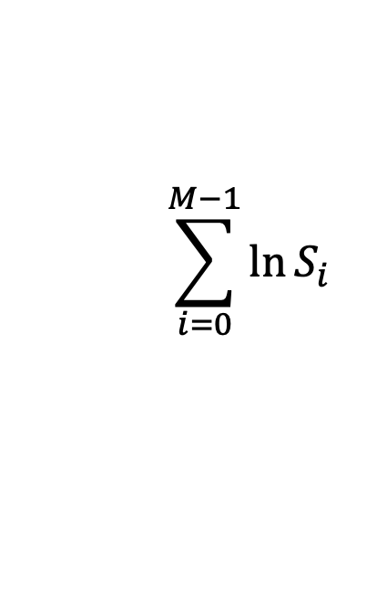
Proportional Fair Scheduling
PF scheduling: balance the competing interests of network throughput and minimum service level
Objective: maximize
$Si$: long-run throughput for user$i$can be predicted using
where $τ≫1$is a constant defined by the scheduler.
→ schedule the user with the highest
$$\sum_{i=0}^{M−1}{\ln{S_{i}}}$$
$$\hat{S_{i}}\left[t\right]=\left(1 −\frac{1}{τ}\right)S_{i}\left[t−1\right]+\frac{1}{τ} \hat{r_{i}}\left[t\right]I\left(i\right)$$
$$\frac{\hat{r_{i}}\left[t\right]}{S_{i}[t−1]}$$
Notes:
Intuitively: if a user does not have much throughput in the previous rounds, then he should be scheduled in this round.

Slide 8
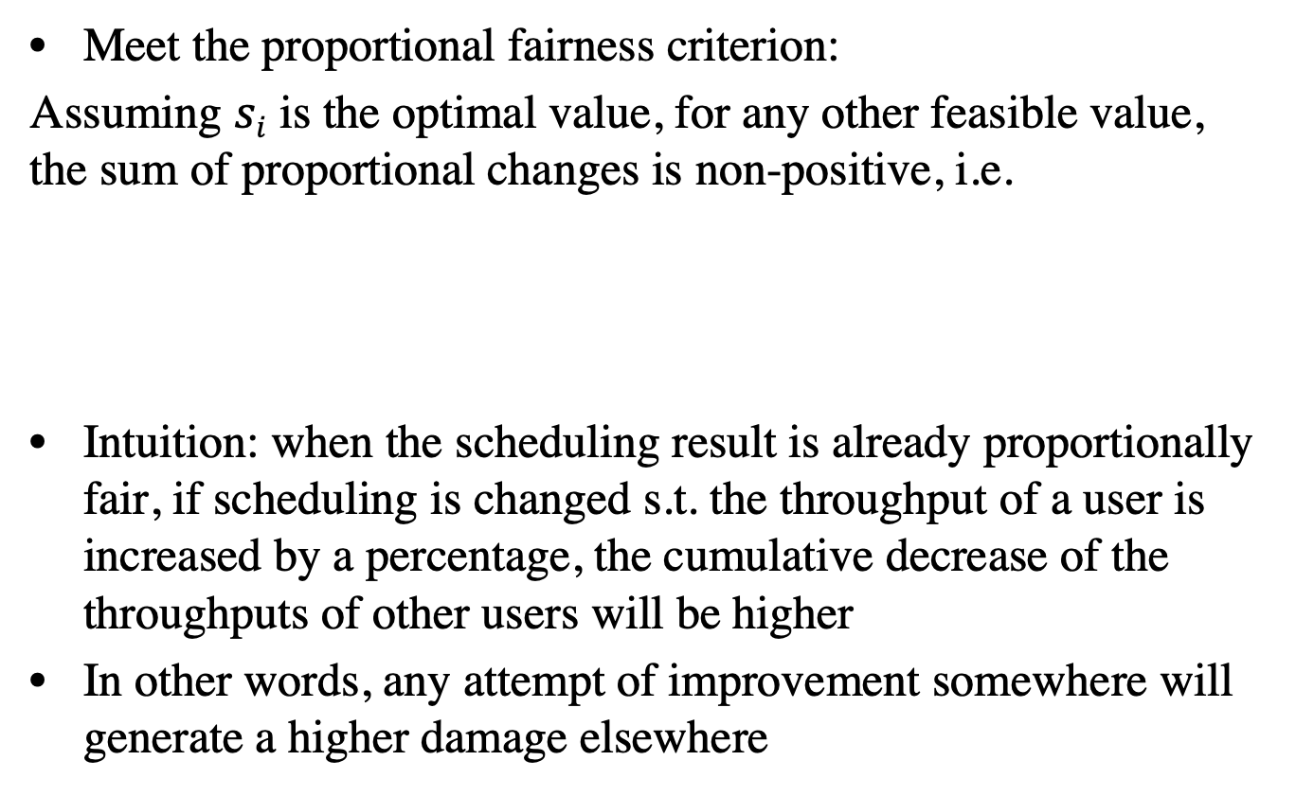
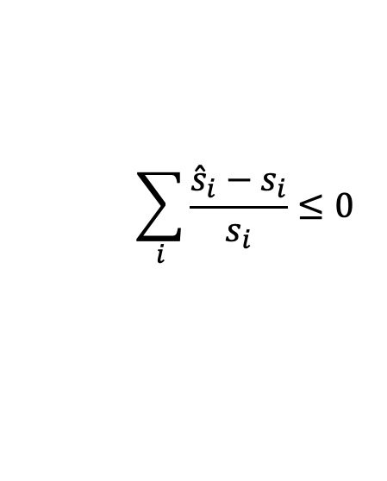
Proportional Fair Scheduling
Meet the proportional fairness criterion:
Assuming $si$ is the optimal value, for any other feasible value, the sum of proportional changes is non-positive, i.e.
Intuition: when the scheduling result is already proportionally fair, if scheduling is changed s.t. the throughput of a user is increased by a percentage, the cumulative decrease of the throughputs of other users will be higher
In other words, any attempt of improvement somewhere will generate a higher damage elsewhere
$$\sum_{i}{\frac{{\hat{s}}_{i}−s_{i}}{s_{i}}}≤0$$

Slide 9
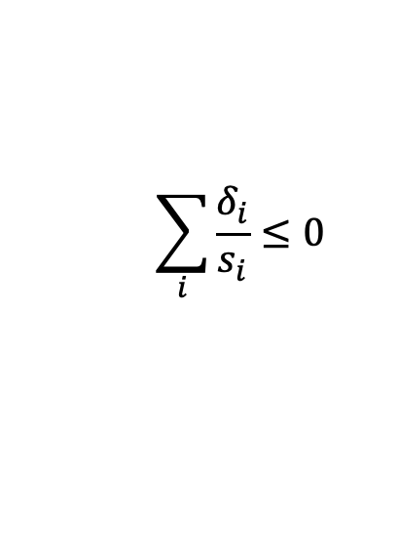
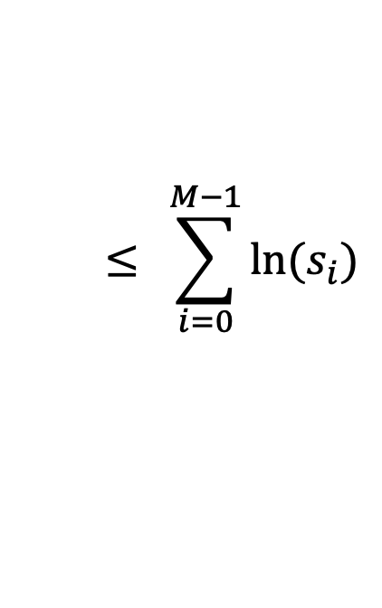
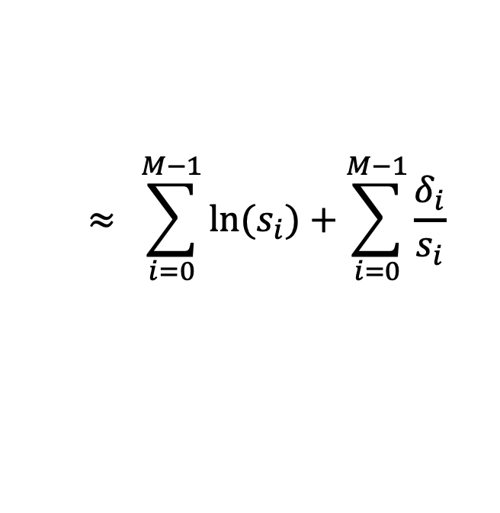


Proportional Fair Scheduling
Why proportional fair
Assume $δ_{i}≪s_{i}$
$$\sum_{i=0}^{M−1}{\ln{{(s}_{i}+δ_{i})}}= \sum_{i=0}^{M−1}{\ln{{(s}_{i})}}+\sum_{i=0}^{M−1}{\ln\left(1+\frac{δ_{i}}{s_{i}}\right)}$$
$$≈ \sum_{i=0}^{M−1}{\ln{{(s}_{i})}}+\sum_{i=0}^{M−1}{\frac{δ_{i}}{s_{i}}}$$
$$\sum_{i}{\frac{δ_{i}}{s_{i}}}≤0$$
but
$$≤ \sum_{i=0}^{M−1}{\ln{{(s}_{i})}}$$
Notes:
Because the sum of ln(x_i) is already the maximum, it cannot be higher than the maximum.

Slide 10


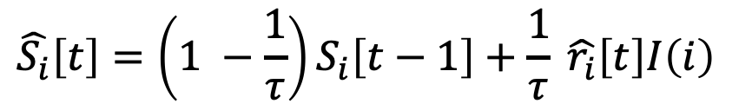
Max-Min Scheduling
Objective: maximize the minimum user throughput
A scheduling result is max-min fair if and only if a further increase of throughput of one user will result in the decrease of a user with a smaller throughput
Schedule the user with the minimum , i.e. the one with the smallest throughput at time t-1.
$$\hat{S_{i}}\left[t\right]=\left(1 −\frac{1}{τ}\right)S_{i}\left[t−1\right]+\frac{1}{τ} \hat{r_{i}}\left[t\right]I\left(i\right)$$

Slide 11
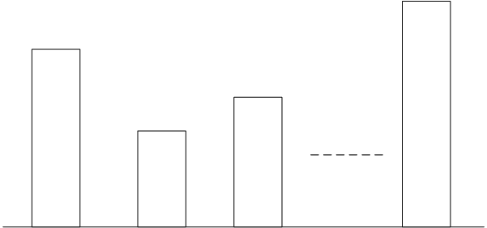
Max-Min Scheduling
M empty cylindrical buckets (users), all with the same radius but different heights.
Allocate water

Slide 12
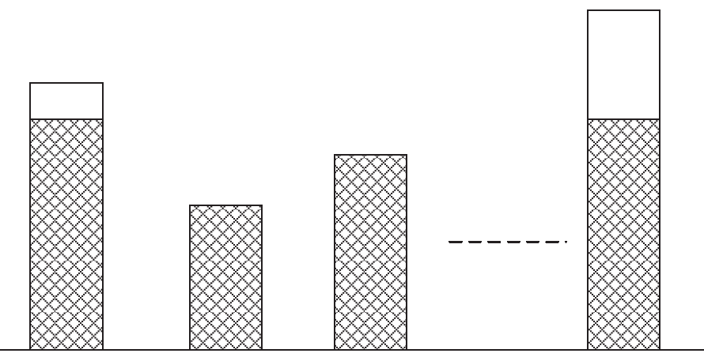
Max-Min Scheduling
M empty cylindrical buckets (users), all with the same radius but different heights.
Allocate water

Slide 13
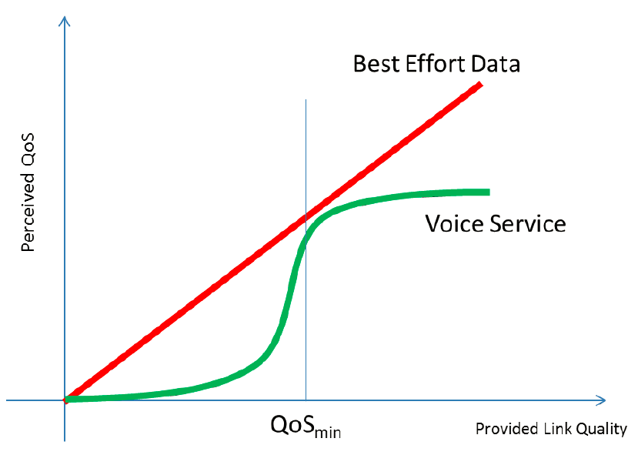
Can these schedulers deal with QoS?

Slide 14
Max Utility Scheduling
Previous schedulers do not consider QoS
Utility-based scheduling
  Utility quantifies the satisfaction of each user given the allocated resources
  Model the QoS perception of users
  Objective: maximize the sum utility of all users, i.e. total network satisfaction
Utility functions: model how user perceives services

Slide 15



Max Utility Scheduling
Different utility functions can be designed.
In addition to QoS modeling, different utility functions can be designed to reflect fairness and efficiency.
Max-throughput (highest efficiency):
Proportional fair:

Slide 16


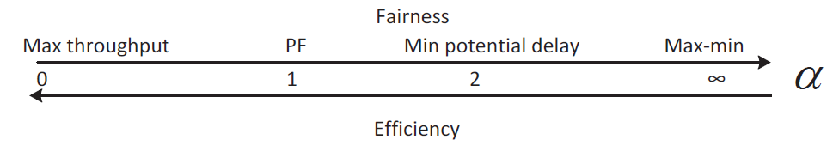
Max Utility Scheduling - Alpha Fair Utility
More generic definition: fair scheduling
measures how fair the scheduling result is
  0: Max throughput;
  1: Proportional fair;
  2: equivalent to minimizing
    Minimize the total potential delay
  Infinity: Most fair, max-min scheduler.

Slide 17
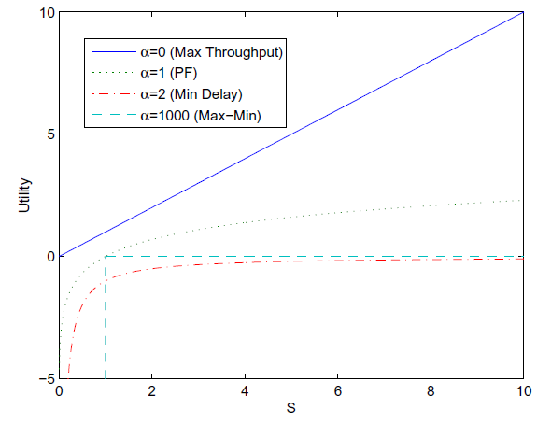
Alpha Fair Utility
PF: proportional fairness
Resource

Slide 18
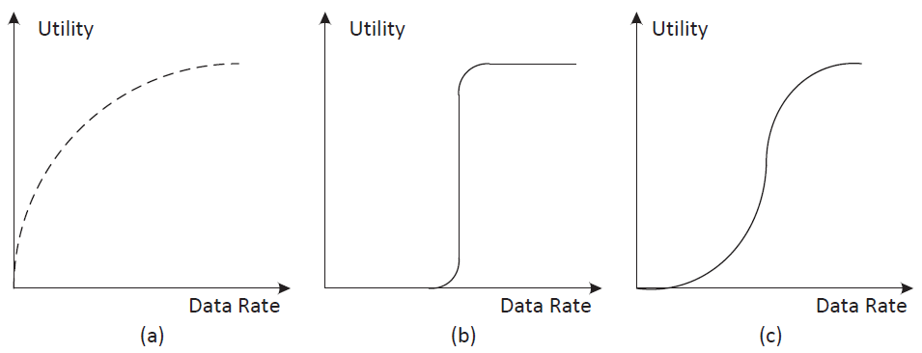
Utility Functions with QoS Consideration
Determined based on traffic characteristics
(a) best effort; (b) real time with tight delay requirement;
(c) real time with loose delay requirement.

Slide 19
Scheduling in OFDMA Systems
OFDMA: Orthogonal Frequency-Division Multiple Access
One more dimension of resources
  Subcarrier allocation
Different users experience, independent wireless channels and their subcarriers may experience substantially different channel gains because of the frequency selectivity in the channels.
Theoretically it is possible to set the data rate for each sub-carrier based on its channel quality and power allocated.

Slide 20
Scheduling in OFDMA Systems
Subcarriers in deep fading for one user might not be used by this user as sending bits on these subcarriers costs too much power
  They might be in good conditions on channels of other users → can be used by them instead
Scheduling of subcarriers in an adaptive way based on the instantaneous channel qualities
OFDMA systems typically use adaptive subcarrier assignment, power allocation, modulation and coding to exploit the diversity in multiple users and frequency to improve the network performance

Slide 21
Scheduling in OFDMA Systems

Slide 22
Scheduling in OFDMA Systems
Frequency Selective Fading

