Slide 1



COM-405: Mobile Networks
Lecture 6.1: Scheduling I
Haitham Hassanieh
slides shamelessly stolen from Prof. JP Hubaux with minor modifications
Laboratory of SEnsing
& Networking Systems

Slide 2
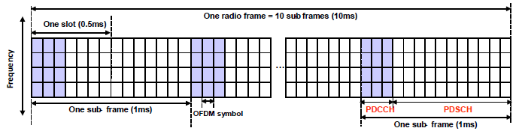
A Reservation-based Protocol
Physical Downlink Control Channel (PDCCH): conveys control information for each user.
Physical Downlink Shared Channel (PDSCH): multiplex the data of all terminals:
Each user will transmit on a unique set of Orthogonal Frequency Division Multiplexing (OFDM) symbols and frequency blocks.
Reservation phase: PDCCH. Data phase: PDSCH.

Slide 3
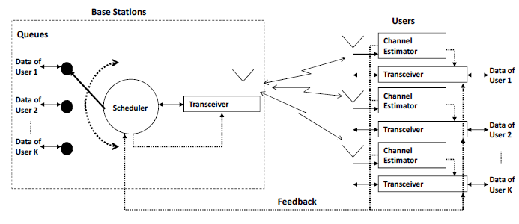
Role of Scheduling
Reservation phase:
Estimate channel Feedback Scheduling

Slide 4
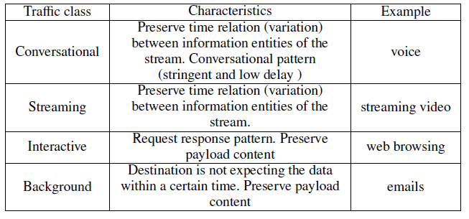
Issues in Wireless Scheduling
Need to support mixed classes of traffic with different characteristics:

Slide 5
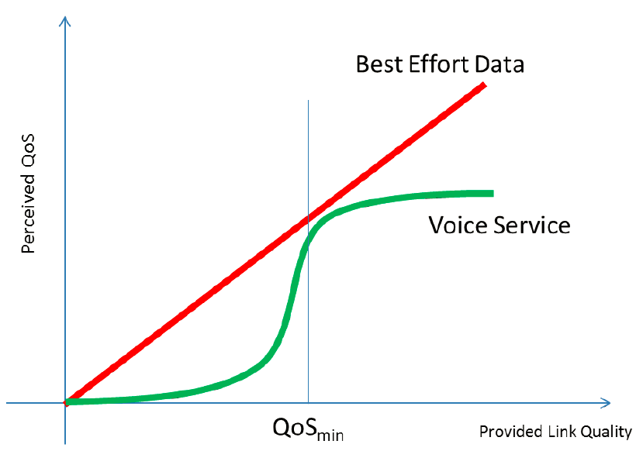
Perceived QoS

Slide 6
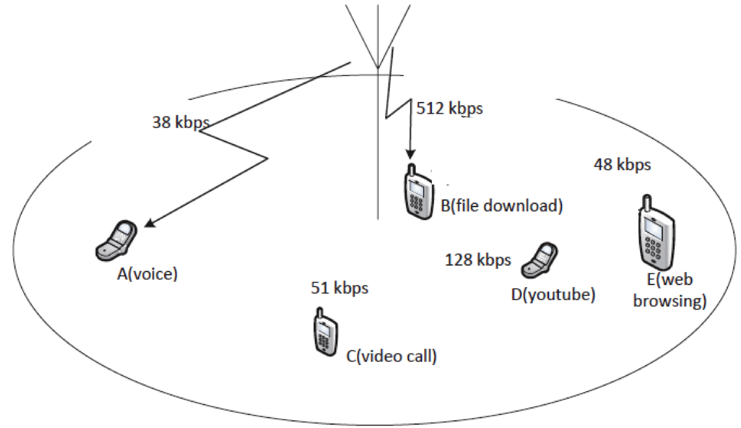
Issues in Wireless Scheduling
Need to be flexible in allocating network resources
Achieved using scheduling algorithms
Note: In modern cellular networks, bitrates can be much higher than those in the picture

Slide 7
Issues in Wireless Scheduling
Channel variation
Shadowing, fading, noise, interference, and user mobility
Unstable, error-prone, and hard to predict
Capacity of each link varies significantly in different time periods and locations
Even if the scheduler knows QoS requirements
Difficult to estimate the amount of resources needed
An adaptive procedure is needed to assure QoS, taking into account the requirements and channel variations

Slide 8
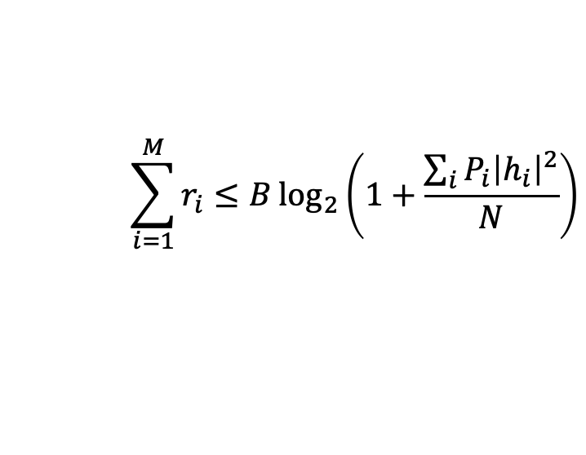
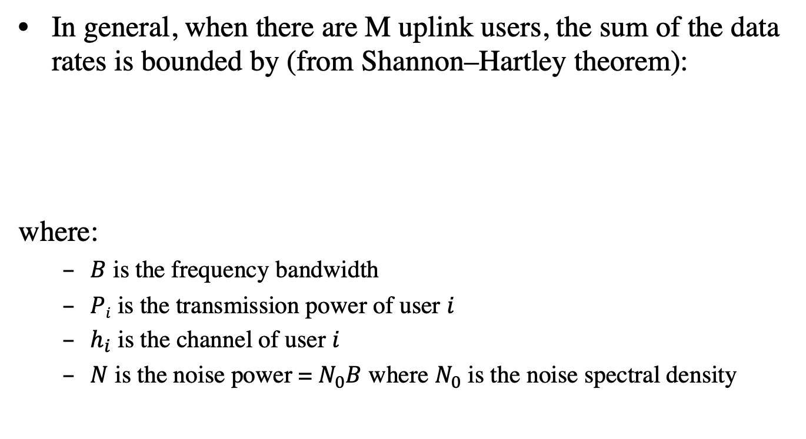
Uplink capacity with M users
In general, when there are M uplink users, the sum of the data rates is bounded by (from Shannon–Hartley theorem):
where:
$B$ is the frequency bandwidth
$Pi$ is the transmission power of user $i$
$h_{i}$ is the channel of user $i$
$N$ is the noise power = $N_{0}B$ where $N_{0}$ is the noise spectral density
$$\sum_{i=1}^{M}{r_{i}}≤B\log_{2}\left(1+\frac{\sum_{i}{P_{i}{\left|h_{i}\right|}^{2}}}{N}\right)$$

Slide 9
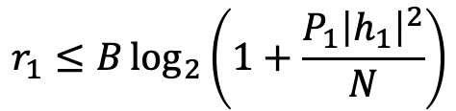

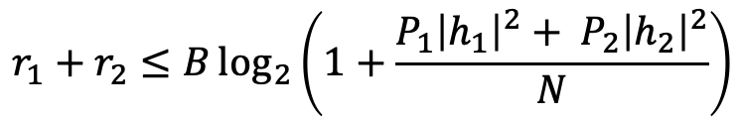
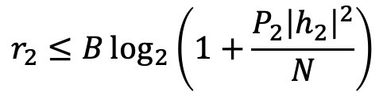
Uplink capacity with two users
Consider the uplink transmission with two users whose channels are static. The capacity region is the set of all rates $(r1, r2)$ that satisfy the following three constraints:
$$r_{1}≤B\log_{2}\left(1+\frac{P_{1}{\left|h_{1}\right|}^{2}}{N}\right)$$
$$r_{2}≤B\log_{2}\left(1+\frac{P_{2}{\left|h_{2}\right|}^{2}}{N}\right)$$
$$r_{1}+r_{2}≤B\log_{2}\left(1+\frac{P_{1}{\left|h_{1}\right|}^{2}+ P_{2}{\left|h_{2}\right|}^{2}}{N}\right)$$

Slide 10
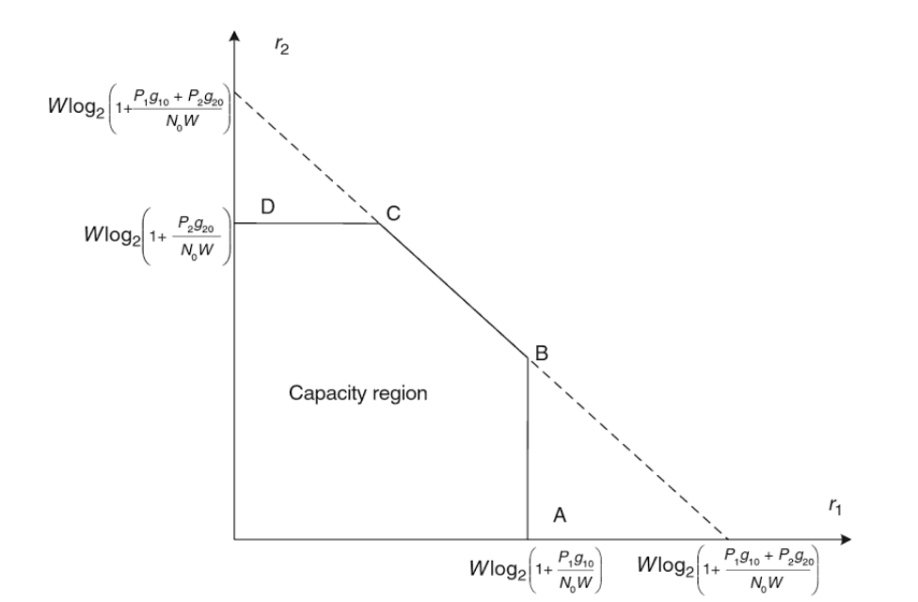




Uplink capacity with two users
$$B\log_{2}\left(1+\frac{P_{1}{\left|h_{1}\right|}^{2}+ P_{2}{\left|h_{2}\right|}^{2}}{N}\right)$$
$$B\log_{2}\left(1+\frac{P_{2}{\left|h_{2}\right|}^{2}}{N}\right)$$
$$B\log_{2}\left(1+\frac{P_{1}{\left|h_{1}\right|}^{2}}{N}\right)$$
$$B\log_{2}\left(1+\frac{P_{1}{\left|h_{1}\right|}^{2}+ P_{2}{\left|h_{2}\right|}^{2}}{N}\right)$$

Slide 11








Uplink capacity with three users
With three users, the capacity region is the set of all rates $(r1, r2, r3)$ that satisfy the following constraints:
$$r_{1}≤B\log_{2}\left(1+\frac{P_{1}{\left|h_{1}\right|}^{2}}{N}\right)$$
$$r_{2}≤B\log_{2}\left(1+\frac{P_{2}{\left|h_{2}\right|}^{2}}{N}\right)$$
$$r_{3}≤B\log_{2}\left(1+\frac{P_{3}{\left|h_{3}\right|}^{2}}{N}\right)$$
$$r_{1}+r_{2}≤B\log_{2}\left(1+\frac{P_{1}{\left|h_{1}\right|}^{2}+ P_{2}{\left|h_{2}\right|}^{2}}{N}\right)$$
$$r_{1}+r_{3}≤B\log_{2}\left(1+\frac{P_{1}{\left|h_{1}\right|}^{2}+ P_{3}{\left|h_{3}\right|}^{2}}{N}\right)$$
$$r_{2}+r_{3}≤B\log_{2}\left(1+\frac{P_{2}{\left|h_{2}\right|}^{2}+ P_{3}{\left|h_{3}\right|}^{2}}{N}\right)$$
$$r_{1}+r_{2}+r_{3}≤B\log_{2}\left(1+\frac{P_{1}{\left|h_{1}\right|}^{2}+P_{2}{\left|h_{2}\right|}^{2}+ P_{3}{\left|h_{3}\right|}^{2}}{N}\right)$$

Slide 12
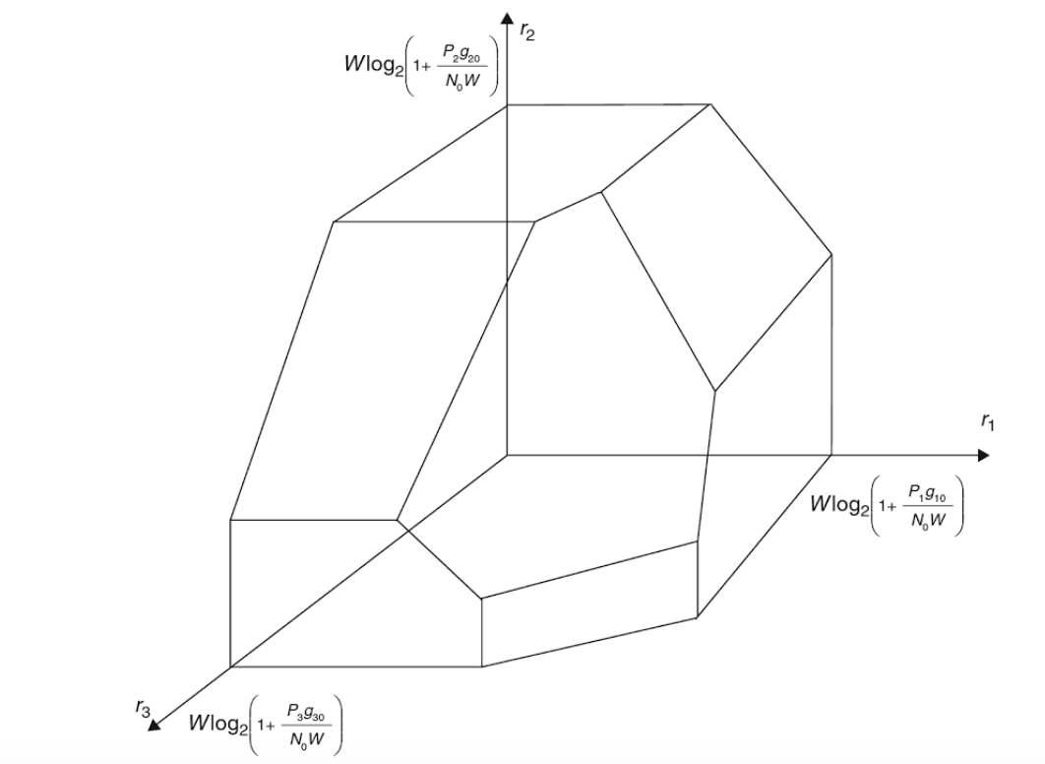



Uplink capacity with three users
$$B\log_{2}\left(1+\frac{P_{2}{\left|h_{2}\right|}^{2}}{N}\right)$$
$$B\log_{2}\left(1+\frac{P_{1}{\left|h_{1}\right|}^{2}}{N}\right)$$
$$B\log_{2}\left(1+\frac{P_{3}{\left|h_{3}\right|}^{2}}{N}\right)$$

Slide 13

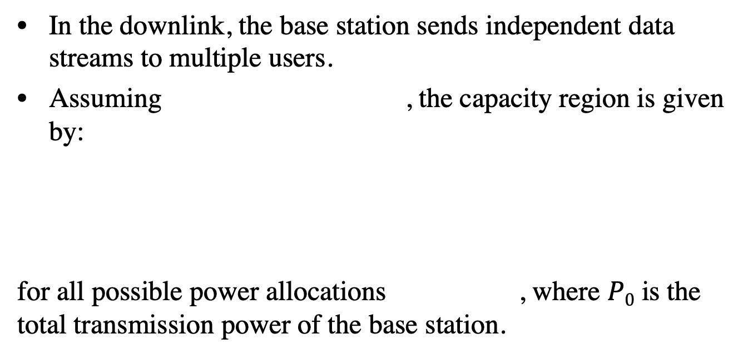

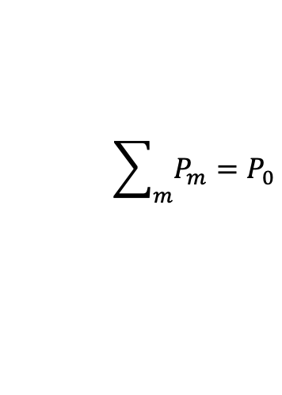
Downlink capacity with M users
In the downlink, the base station sends independent data streams to multiple users.
Assuming , the capacity region is given by:
for all possible power allocations , where $P0$ is the total transmission power of the base station.
$${\left|h_{1}\right|}^{2}≤{\left|h_{2}\right|}^{2}≤⋯≤{\left|h_{M}\right|}^{2}$$
$$r_{m}≤B\log_{2}\left(1+\frac{P_{m}{\left|h_{m}\right|}^{2}}{\sum_{i=m+1}^{M}{P_{i}{\left|h_{i}\right|}^{2}}+ N}\right)$$
$$\sum_{m}{P_{m}}=P_{0}$$

Slide 14
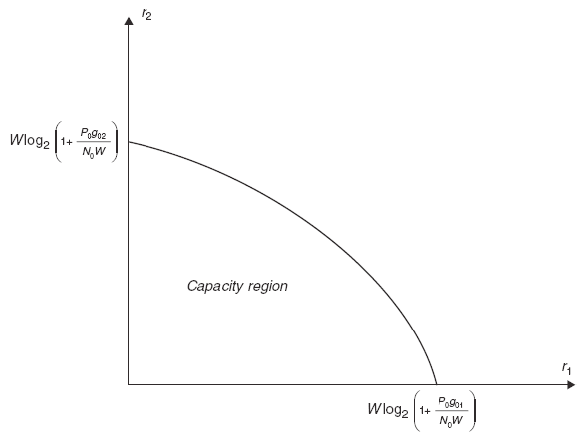


Downlink capacity with two users
$$B\log_{2}\left(1+\frac{P_{2}{\left|h_{2}\right|}^{2}}{N}\right)$$
$$B\log_{2}\left(1+\frac{P_{1}{\left|h_{1}\right|}^{2}}{N}\right)$$

Slide 15
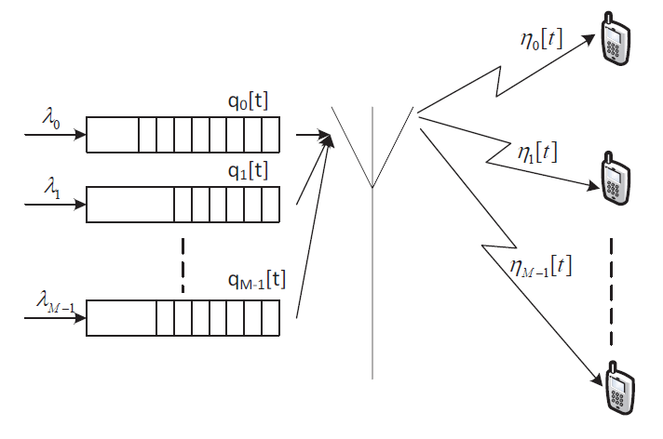
Downlink Scheduling

Slide 16
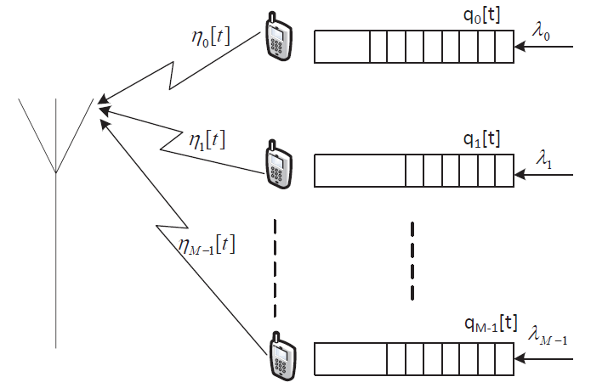
Uplink Scheduling

Slide 17

Queue Modeling
At timeslot t, the queue of user i changes as follows:
$$q_{i}\left[t+1\right]=q_{i}\left[t\right]+δ_{i}\left[t\right]−η_{i}[t]$$
Number of new bits arriving
Number of bits scheduled to transmit, determined by the scheduling algorithm
Number of bits in the queue

Slide 18
Round-Robin (RR) Scheduling
Users are scheduled in a round robin, i.e. cyclic order
i[t]: user scheduled at time t. RR scheduler:
i[t+1]=i[t]+1 (mod M -1)
The algorithm is fair: all users are given the same amount of time resources

Slide 19
Round-Robin Scheduling
Performance
All users are allocated the same amount of network resources
What is the throughput of all users in the following network?

Slide 20
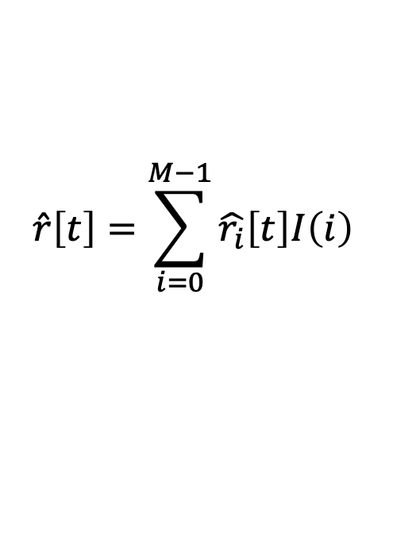
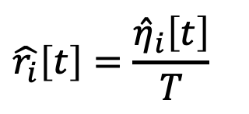
Max Throughput Scheduling
Objective: maximize total network throughput
If user i is scheduled, the expected data rate is:
The total expected network throughput is
$$\hat{r_{i}}\left[t\right]=\frac{{\hat{η}}_{i}\left[t\right]}{T}$$
Expected number of bits that can be successfully delivered
Slot length
$$\hat{r}\left[t\right]=\sum_{i=0}^{M−1}{\hat{r_{i}}\left[t\right]I\left(i\right)}$$
I(i): Scheduling indicator:
1 scheduled, 0 otherwise.

Slide 21
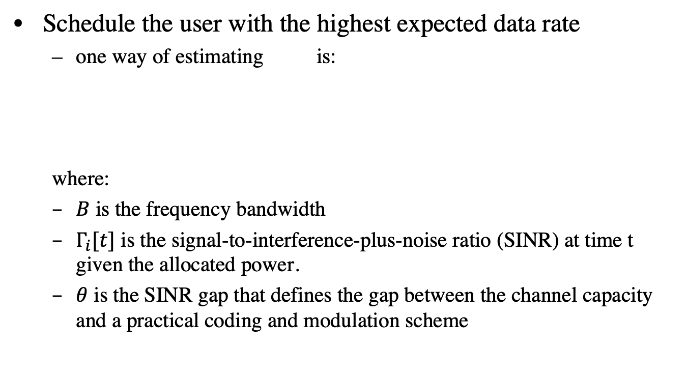
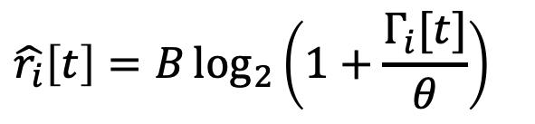

Max Throughput Scheduling
Schedule the user with the highest expected data rate
one way of estimating is:
where:
$B$ is the frequency bandwidth
$Γ_{i}[t]$ is the signal-to-interference-plus-noise ratio (SINR) at time t given the allocated power.
$θ$ is the SINR gap that defines the gap between the channel capacity and a practical coding and modulation scheme
$$\hat{r_{i}}\left[t\right]$$
$$\hat{r_{i}}\left[t\right]=B\log_{2}\left(1+\frac{Γ_{i}[t]}{θ}\right)$$
Notes:
Bigger SINR → smaller the gap theta → bigger r_i[t]. This means the terminal with the highest estimated throughput r_i[t] is also the terminal with the highest SINR.

Slide 22
Max Throughput Scheduling
Main drawbacks
Unfairness
Coverage limitation
Most users may never be served

