Slide 1
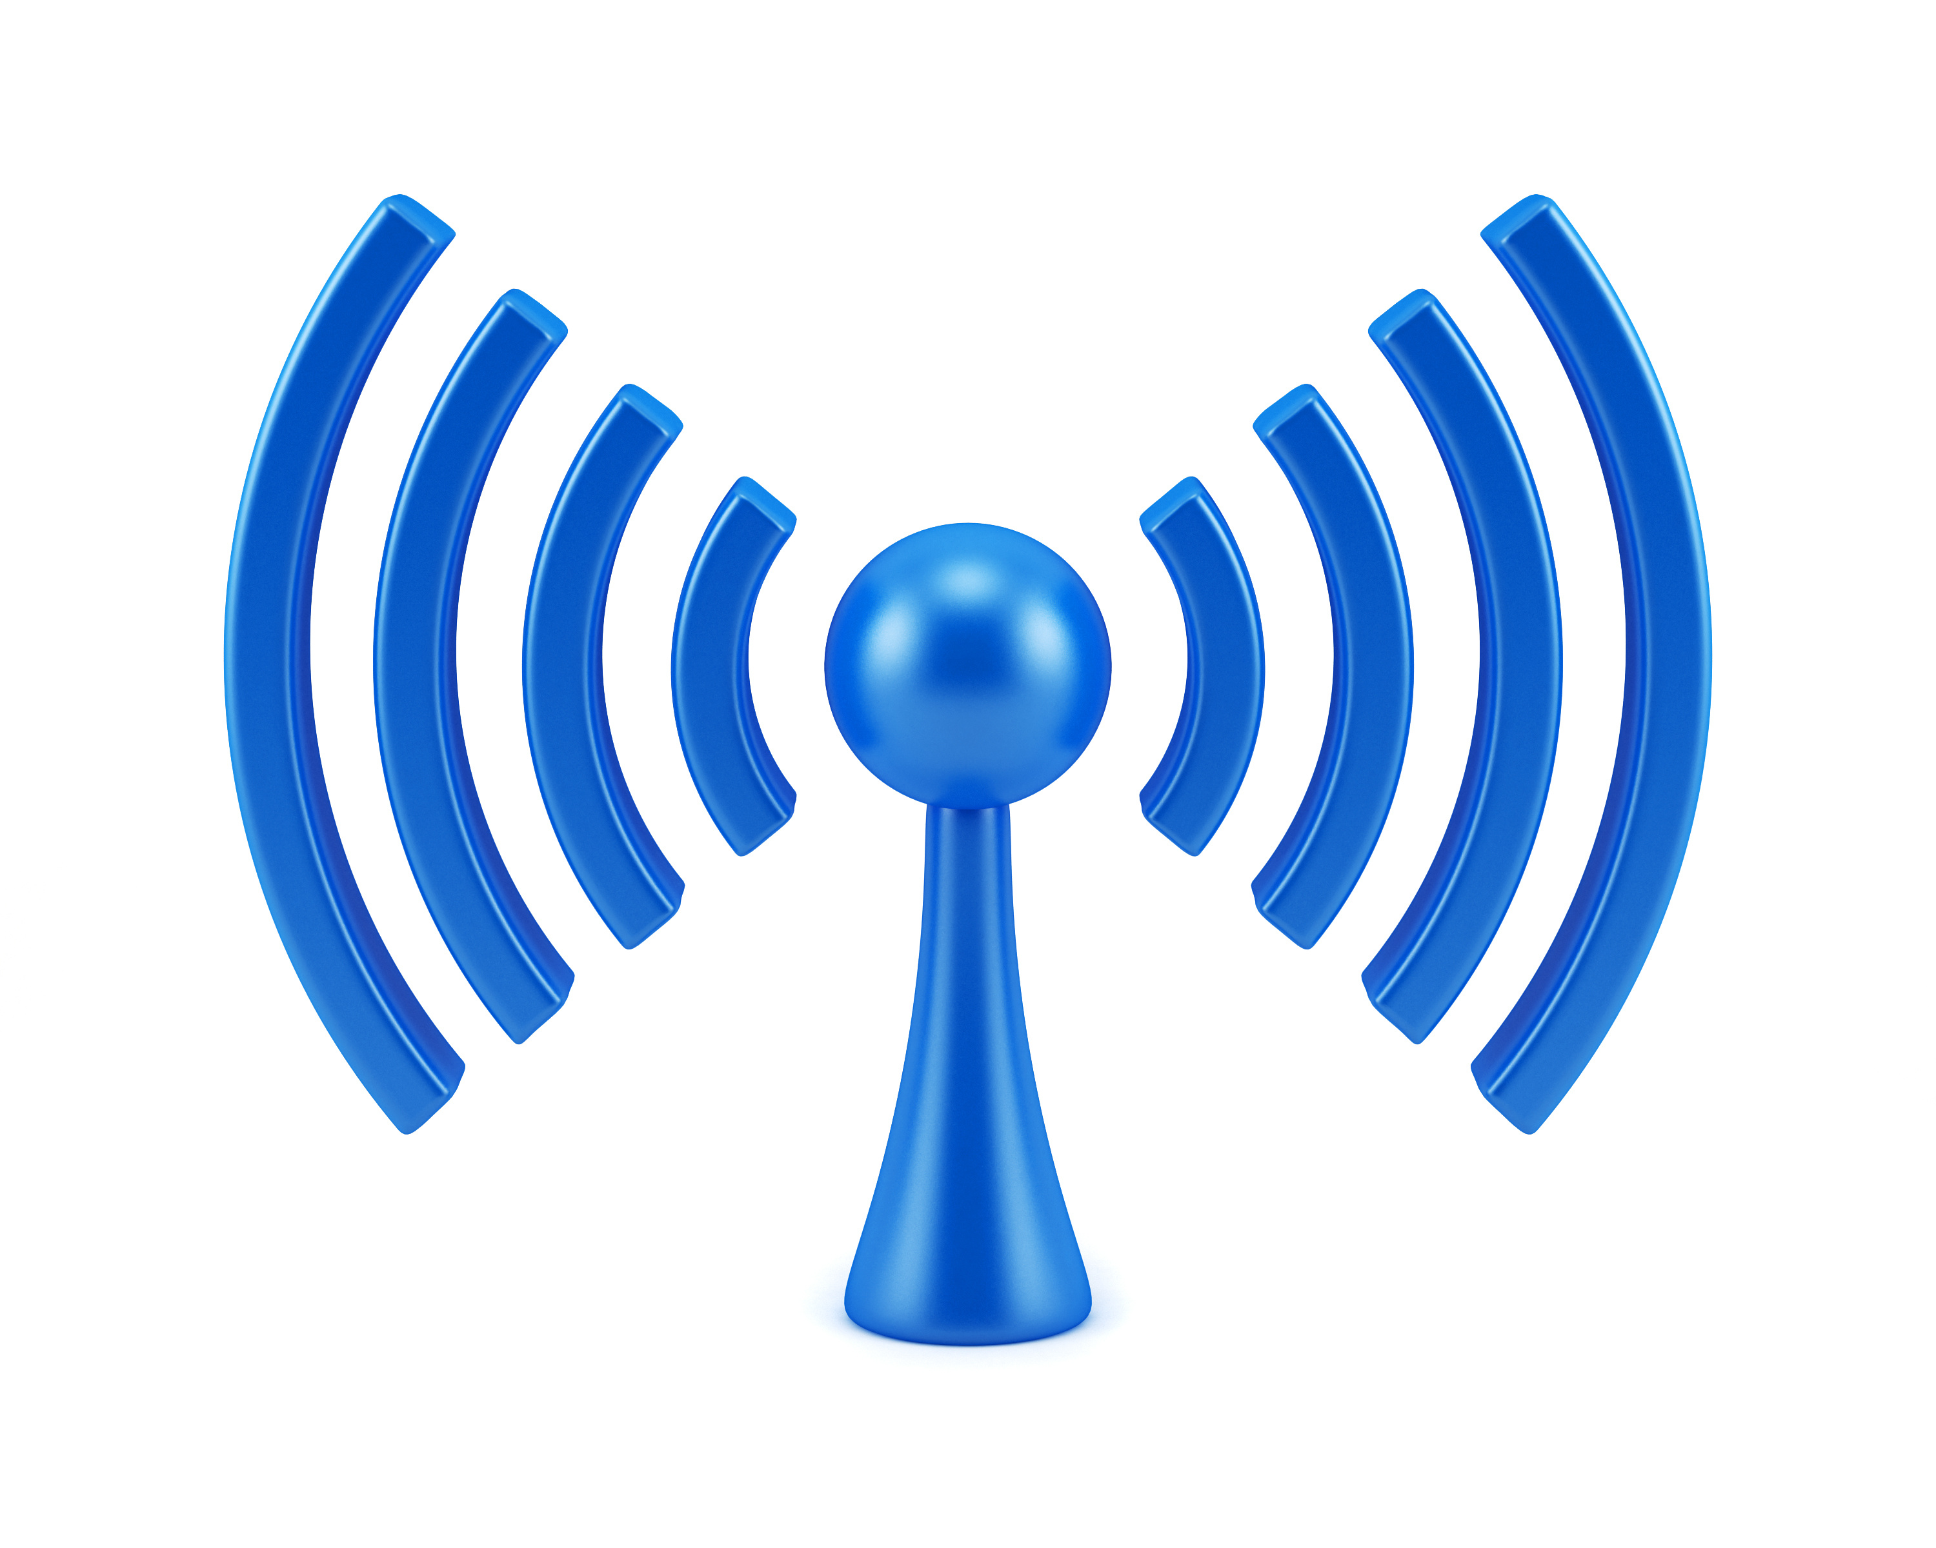
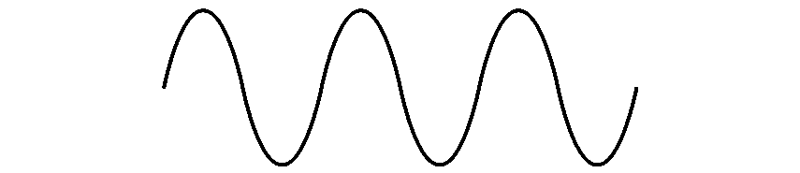

COM-405: Mobile Networks
Lecture 4.0: Modulation II
Haitham Hassanieh
Laboratory of SEnsing
& Networking Systems

Slide 2
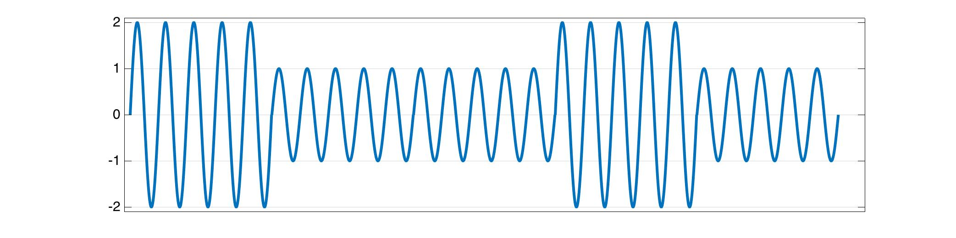
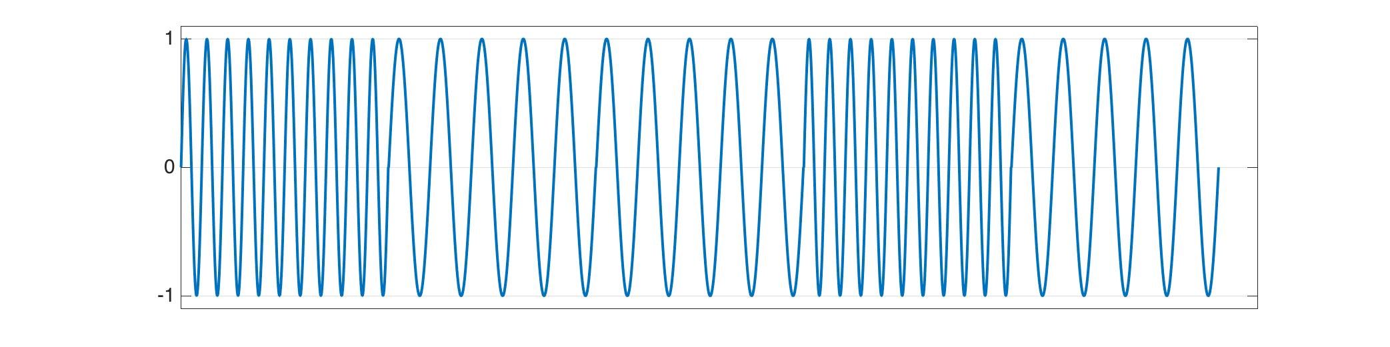
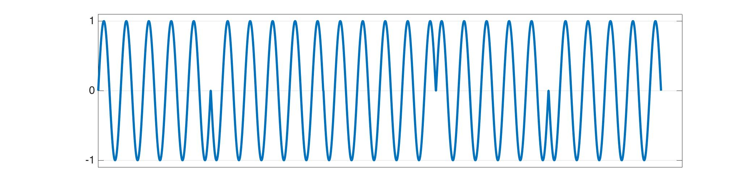








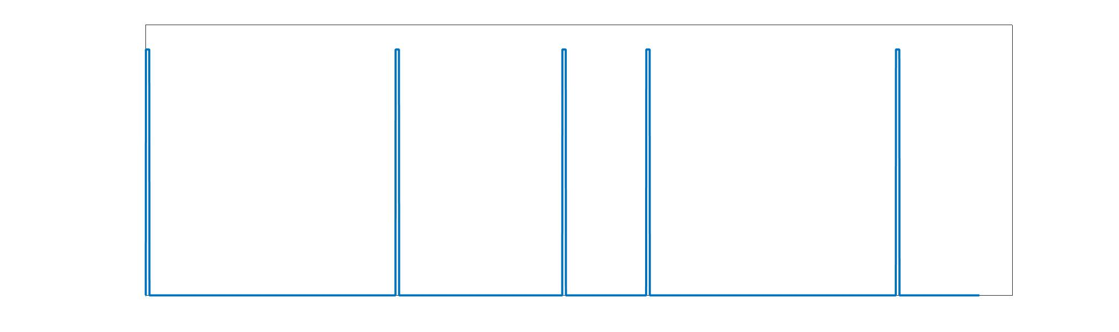
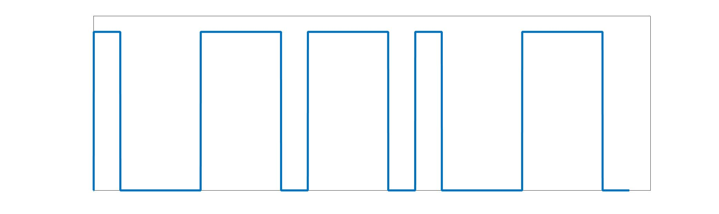
Modulation
Based on how the bits are encoded
ASK
FSK
PSK
QAM
Amplitude
Shift Keying
Frequency
Shift Keying
Phase
Shift Keying
Phase & Amplitude
Modulation
(APSK)
OOK, ASK
CFSK, MSK, GMSK
BPSK, QPSK, CPM
PAM, M-QAM
PPM
PWM
DQPSK
DQAM
Pulse Position
Modulation
Pulse Width
Modulation
Differential QPSK
Differential QAM
DBPSK, DQPSK,
DQAM

Slide 3
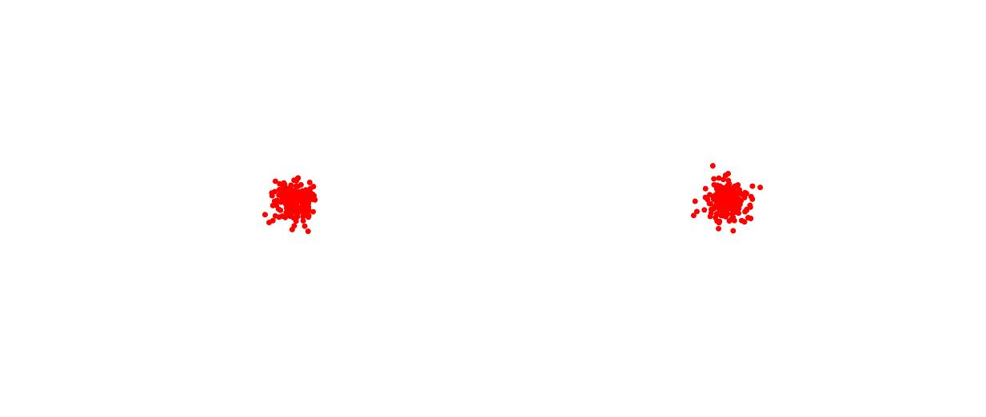


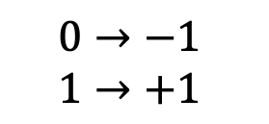

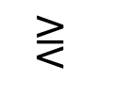












Maximum Likelihood Decoder
$$x=±1$$
$$y=x+v$$
$$1$$
$$P\left(y|x=+1\right)$$
$$⋛$$
$$P\left(y|x=−1\right)$$
$$0$$
$$1$$
$$Re\left\{y\right\}$$
$$⋛$$
$$0$$
$$0$$
$$Q$$
$$0→−1$$
$$1→+1$$
$$−1$$
$$+1$$
$$I$$

Slide 4
















16-QAM
4-QAM
BPSK
$$Q$$
$$Q$$
$$Q$$
$$−1/\sqrt{2}$$
$$+1/\sqrt{2}$$
$$−3$$
$$−1$$
$$+1$$
$$+3$$
$$I$$
$$I$$
$$−3$$
$$−1$$
$$+1$$
$$+3$$
$$I$$
4 bits/symbol
2 bits/symbol
1 bit/symbol
Higher Order Modulation:
Needs higher SNR to decode correctly.
Achieves higher Bit Rate
Given an SNR, choose highest order modulation that guarantees minimal Bit Error Rate (BER)

Slide 5
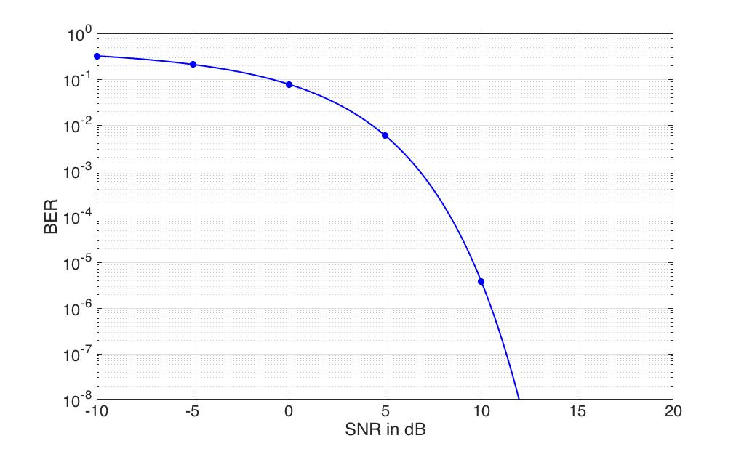






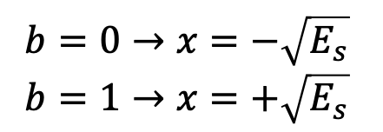




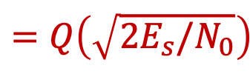





Bit Error Rate (BER) of BPSK
Encoding:
Decoding:
$$1$$
$$b=0→x=−\sqrt{E_{s}}$$
$$b=1→x=+\sqrt{E_{s}}$$
$$⋛$$
$$y=x+v$$
$$P\left(y|x=+\sqrt{E_{s}}\right)$$
$$P\left(y|x=−\sqrt{E_{s}}\right)$$
$$0$$
$$1$$
$$⋛$$
$$Re\left\{y\right\}$$
$$0$$
$$=Q\left(\sqrt{2SNR}\right)$$
$$=Q\left(\sqrt{{2E}_{s}/N_{0}}\right)$$
$$BER$$
$$0$$
$$Q$$
$$−1$$
$$+1$$
$$I$$

Slide 6
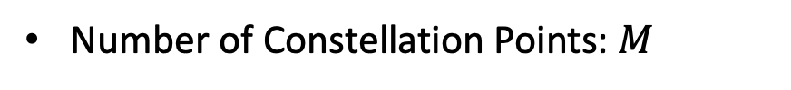
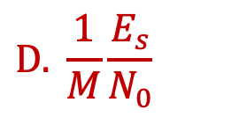
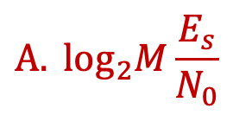
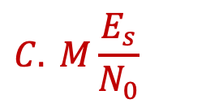

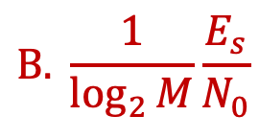




Bit Error Rate (BER)
Number of Constellation Points: $M$
$$\log_{2}M$$
Bits per symbol:
Signal-to-Noise Ratio:
$$SNR$$
$$\frac{E_{s}}{N_{0}}$$
SNR per symbol:
$$\frac{E_{b}}{N_{0}}$$
SNR per bit:
$$=??$$
$$A. \log_{2}M\frac{E_{s}}{N_{0}}$$
$$B. \frac{1}{\log_{2}{M}}\frac{E_{s}}{N_{0}}$$
$$C. M\frac{E_{s}}{N_{0}}$$
$$D. \frac{1}{M}\frac{E_{s}}{N_{0}}$$

Slide 7

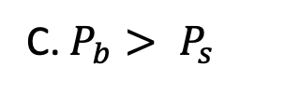
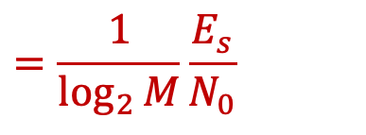
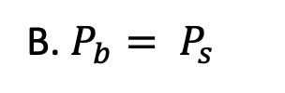
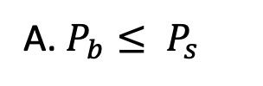

Bit Error Rate (BER)
Number of Constellation Points: $M$
$$\log_{2}M$$
Bits per symbol:
Signal-to-Noise Ratio:
$$SNR$$
$$\frac{E_{s}}{N_{0}}$$
SNR per symbol:
Symbol Error Rate:
${SER=P}_{s}$
$$\frac{E_{b}}{N_{0}}$$
$$=\frac{1}{\log_{2}{M}}\frac{E_{s}}{N_{0}}$$
SNR per bit:
Bit Error Rate:
$$BER=P_{b}$$
Relation between $P_{s}$ and $P_{b}$?
A. $P_{b}≤ P_{s}$
B. $P_{b}= P_{s}$
C. $P_{b}> P_{s}$
D. Depends on Modulation Used

Slide 8

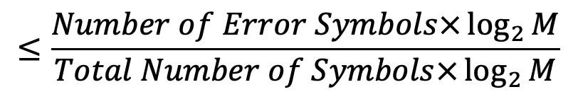
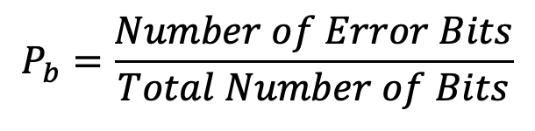
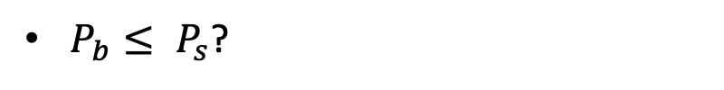
Bit Error Rate (BER)
Number of Constellation Points: $M$
$$\log_{2}M$$
Bits per symbol:
$P_{b}≤ P_{s}$?
1 symbol error can at most generate $\log_{2}M$ bit errors.
$$P_{b}=\frac{Number of Error Bits}{Total Number of Bits}$$
$$≤\frac{Number of Error Symbols×\log_{2}{M}}{Total Number of Symbols×\log_{2}{M}}$$
$$=P_{s}$$
How much is $P_{b}$ less than $P_{s}$?
Depends on the code used: How we assign bits to symbol

Slide 9








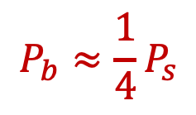






















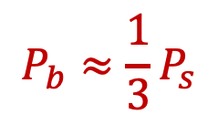














How much is $P_{b}$ less than $P_{s}$?
Depends on the code used: How we assign bits to symbol
$$P_{b}≈\frac{1}{3}P_{s}$$
16-QAM
$$P_{b}≈\frac{1}{4}P_{s}$$
$$1 bit$$
$$2 bits$$
$$1 bits$$
$$1 bit$$
$$1 bit$$
$$1 bit$$
$$0000$$
$$0001$$
$$0010$$
$$0011$$
$$0000$$
$$0100$$
$$1100$$
$$1000$$
$$1 bit$$
$$1 bit$$
$$0100$$
$$0101$$
$$0110$$
$$0111$$
$$0001$$
$$0101$$
$$1101$$
$$1001$$
$$2 bits$$
$$1 bit$$
$$1000$$
$$1001$$
$$1010$$
$$1011$$
$$0011$$
$$0111$$
$$1111$$
$$1011$$
$$1 bit$$
$$1 bit$$
$$1100$$
$$1101$$
$$1110$$
$$1111$$
$$0010$$
$$0110$$
$$1110$$
$$1010$$
Most likely error occurs between nearest neighbor constellation points!
Minimize bit flips between nearest neighbors.

Slide 10

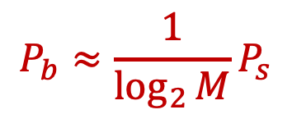

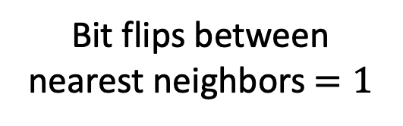

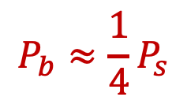
How much is $P_{b}$ less than $P_{s}$?
Depends on the code used: How we assign bits to symbol
16-QAM
$$P_{b}≈\frac{1}{4}P_{s}$$
$$1 bit$$
$$1 bits$$
$$1 bits$$
Gray Codes
$$0000$$
$$0100$$
$$1100$$
$$1000$$
$$1 bit$$
Bit flips between nearest neighbors$=1$
$$0001$$
$$0101$$
$$1101$$
$$1001$$
$$1 bits$$
$$P_{b}≈\frac{1}{\log_{2}{M}}P_{s}$$
$$0011$$
$$0111$$
$$1111$$
$$1011$$
$$1 bit$$
$$0010$$
$$0110$$
$$1110$$
$$1010$$

Slide 11
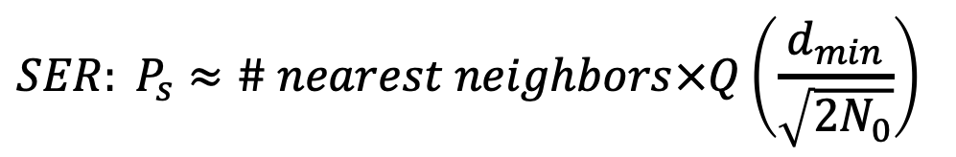
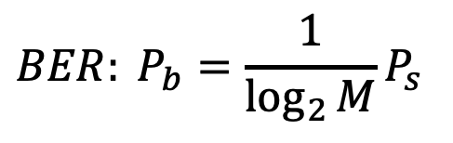
Bit Error Rate (BER)
Number of Constellation Points: $M$
$$\log_{2}M$$
Bits per symbol:
Assuming Gray Code is used:
$$BER: P_{b}=\frac{1}{\log_{2}{M}}P_{s}$$
Nearest Neighbor Approximation:
$$SER: P_{s}≈\# nearest neighbors×Q\left(\frac{d_{min}}{\sqrt{2N_{0}}}\right)$$

Slide 12


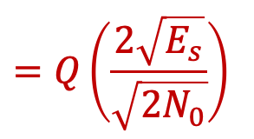

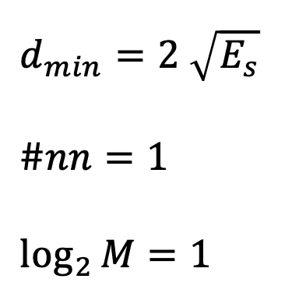
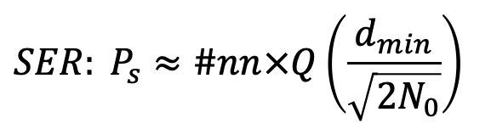

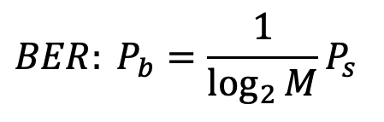


Bit Error Rate (BER)
$$SER: P_{s}≈\#nn×Q\left(\frac{d_{min}}{\sqrt{2N_{0}}}\right)$$
$$=Q\left(\frac{2\sqrt{E_{s}}}{\sqrt{2N_{0}}}\right)$$
$$=Q\left(\sqrt{{2E}_{s}/N_{0}}\right)$$
$$BER: P_{b}=\frac{1}{\log_{2}{M}}P_{s}$$
$$=Q\left(\sqrt{{2E}_{b}/N_{0}}\right)$$
BPSK:
$d_{min}=2$ $\sqrt{E_{s}}$
$$\#nn=1$$
$$\log_{2}{M}=1$$
$$Q$$
$$−1$$
$$+1$$
$$I$$

Slide 13



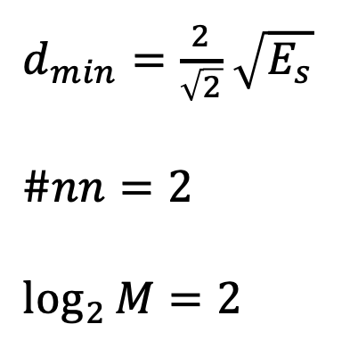




Bit Error Rate (BER)
$$SER: P_{s}≈\#nn×Q\left(\frac{d_{min}}{\sqrt{2N_{0}}}\right)$$
$$=2Q\left(\sqrt{E_{s}/N_{0}}\right)$$
$$BER: P_{b}=\frac{1}{\log_{2}{M}}P_{s}$$
$$=Q\left(\sqrt{{2E}_{b}/N_{0}}\right)$$
4-QAM/QPSK
$$Q$$
$d_{min}=\frac{2}{\sqrt{2}}$ $\sqrt{E_{s}}$
$$\#nn=2$$
$$\log_{2}{M}=2$$
$$−1/\sqrt{2}$$
$$+1/\sqrt{2}$$
$$−1/\sqrt{2}$$
$$+1/\sqrt{2}$$
$$I$$

Slide 14
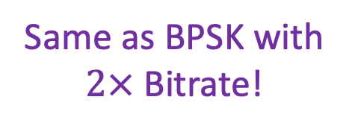
Bit Error Rate (BER)
$$SER: P_{s}≈\#nn×Q\left(\frac{d_{min}}{\sqrt{2N_{0}}}\right)$$
$$=2Q\left(\sqrt{E_{s}/N_{0}}\right)$$
$$BER: P_{b}=\frac{1}{\log_{2}{M}}P_{s}$$
Same as BPSK with $2×$Bitrate!
$$=Q\left(\sqrt{{2E}_{b}/N_{0}}\right)$$
4-QAM/QPSK
$$Q$$
$d_{min}=\frac{2}{\sqrt{2}}$ $\sqrt{E_{s}}$
$$\#nn=2$$
$$\log_{2}{M}=2$$
$$−1/\sqrt{2}$$
$$+1/\sqrt{2}$$
$$−1/\sqrt{2}$$
$$+1/\sqrt{2}$$
$$I$$

Slide 15







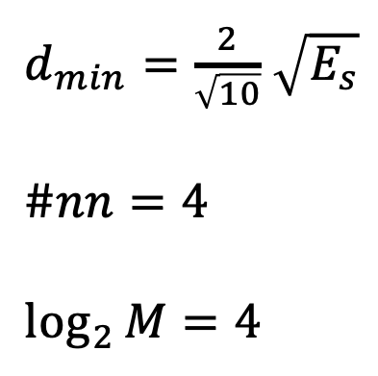





Bit Error Rate (BER)
$$SER: P_{s}≈\#nn×Q\left(\frac{d_{min}}{\sqrt{2N_{0}}}\right)$$
$$=4Q\left(\sqrt{E_{s}/5N_{0}}\right)$$
$$BER: P_{b}=\frac{1}{\log_{2}{M}}P_{s}$$
$$=Q\left(\sqrt{{4E}_{b}/5N_{0}}\right)$$
16-QAM
$$Q$$
$d_{min}=\frac{2}{\sqrt{10}}$ $\sqrt{E_{s}}$
$$\#nn=4$$
$$\log_{2}{M}=4$$
$−3$ $/\sqrt{10}$
$−1$ $/\sqrt{10}$
$$+1/\sqrt{10}$$
$$+3/\sqrt{10}$$
$−3$ $/\sqrt{10}$
$$−1/\sqrt{10}$$
$+1$ $/\sqrt{10}$
$+3$ $/\sqrt{10}$
$$I$$

Slide 16
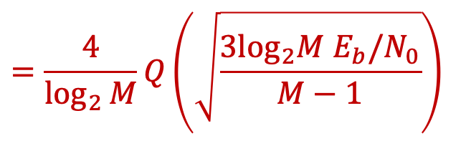
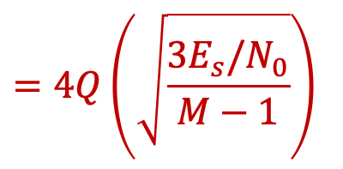
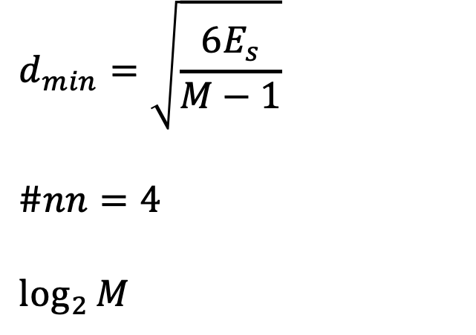
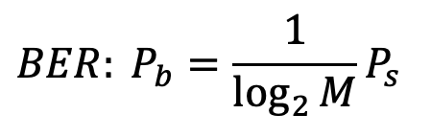
Bit Error Rate (BER)
$$=4Q\left(\sqrt{\frac{3E_{s}/N_{0}}{M−1}}\right)$$
$$SER: P_{s}≈\#nn×Q\left(\frac{d_{min}}{\sqrt{2N_{0}}}\right)$$
$$=\frac{4}{\log_{2}{M}}Q\left(\sqrt{\frac{{3\log_{2}M E}_{b}/N_{0}}{M−1}}\right)$$
$$BER: P_{b}=\frac{1}{\log_{2}{M}}P_{s}$$
M-QAM
$$Q$$
$$d_{min}=\sqrt{\frac{6E_{s}}{M−1}}$$
$$\#nn=4$$
$$\log_{2}{M}$$
$−3$ $/\sqrt{10}$
$−1$ $/\sqrt{10}$
$$+1/\sqrt{10}$$
$$+3/\sqrt{10}$$
$−3$ $/\sqrt{10}$
$$−1/\sqrt{10}$$
$+1$ $/\sqrt{10}$
$+3$ $/\sqrt{10}$
$$I$$

Slide 17
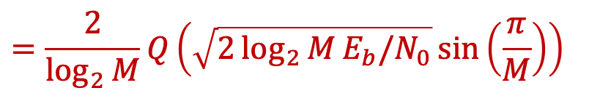
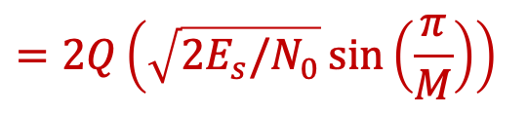

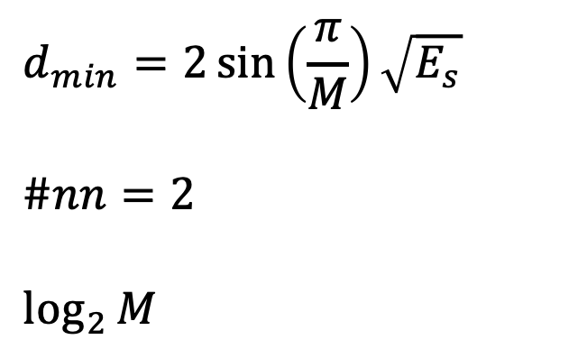

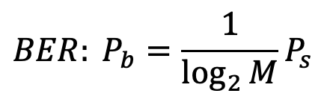
Bit Error Rate (BER)
$$SER: P_{s}≈\#nn×Q\left(\frac{d_{min}}{\sqrt{2N_{0}}}\right)$$
$$=2Q\left(\sqrt{2E_{s}/N_{0}}\sin\left(\frac{π}{M}\right)\right)$$
$$BER: P_{b}=\frac{1}{\log_{2}{M}}P_{s}$$
$$=\frac{2}{\log_{2}{M}}Q\left(\sqrt{2\log_{2}{M}E_{b}/N_{0}}\sin\left(\frac{π}{M}\right)\right)$$
M-PSK
$$Q$$
$$d_{min}=2\sin\left(\frac{π}{M}\right)\sqrt{E_{s}}$$
$$\#nn=2$$
$$\log_{2}{M}$$
$$d_{min}$$
$$2π/M$$
$$I$$

Slide 18
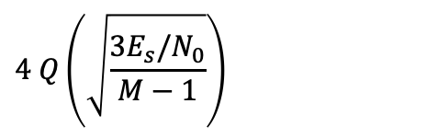














Bit Error Rate (BER)
$$SER: P_{s}≈\#nn×Q\left(\frac{d_{min}}{\sqrt{2N_{0}}}\right)$$
$$BER: P_{b}=\frac{1}{\log_{2}{M}}P_{s}$$
BPSK
$$Q\left(\sqrt{2E_{s}/N_{0}}\right)$$
$$Q\left(\sqrt{2E_{b}/N_{0}}\right)$$
QPSK/4-QAM
$$2 Q\left(\sqrt{E_{s}/N_{0}}\right)$$
$$Q\left(\sqrt{{2E}_{b}/N_{0}}\right)$$
$$\frac{2\left(M−1\right)}{M} Q\left(\sqrt{\frac{6E_{s}/N_{0}}{M^{2}−1}}\right)$$
$$\frac{2\left(M−1\right)}{M\log_{2}{M}} Q\left(\sqrt{\frac{6\log_{2}{M}E_{b}/N_{0}}{M^{2}−1}}\right)$$
MPAM
MPSK
$$2 Q\left(\sqrt{2E_{s}/N_{0}}\sin\left(\frac{π}{M}\right)\right)$$
$$\frac{2}{\log_{2}{M}}Q\left(\sqrt{2\log_{2}{M}E_{b}/N_{0}}\sin\left(\frac{π}{M}\right)\right)$$
$$4 Q\left(\sqrt{\frac{3E_{s}/N_{0}}{M−1}}\right)$$
$$\frac{4}{\log_{2}{M}}Q\left(\sqrt{\frac{3\log_{2}{M}E_{b}/N_{0}}{M−1}}\right)$$
MQAM
$$α_{M}Q\left(\sqrt{β_{M}E_{s}/N_{0}}\right)$$
$${\hat{α}}_{M}Q\left(\sqrt{{\hat{β}}_{M}E_{b}/N_{0}}\right)$$
$${\hat{α}}_{M}=\frac{α_{M}}{\log_{2}{M}}, {\hat{β}}_{M}=β_{M}\log_{2}{M}, \frac{E_{b}}{N_{0}}=\frac{1}{\log_{2}{M}}\frac{E_{s}}{N_{0}}$$

Slide 19
Bit Error Rate (BER)
BPSK/4QAM
16 QAM
64 QAM

Slide 20


Bit Error Rate (BER)
BPSK/4QAM
16 QAM
64 QAM
$$≈7 dB$$
$$≈15 dB$$

Slide 21









Shape of the Constellation (e.g. $M=16$)
16-QAM:
$4×4$ Grid
$$Q$$
$2×8$ Grid
$$Q$$
$$I$$
$$I$$
16-PSK:
Circular
$$Q$$
$$Q$$
Random
$$I$$
$$I$$

Slide 22

























Shape of the Constellation (e.g. $M=16$)
$$SER: P_{s}≈\#nn×Q\left(\frac{d_{min}}{\sqrt{2N_{0}}}\right)$$
Goal: Maximize $d_{min}$ for the same overall power
$4×4$ Grid
$$Q$$
$$Q$$
$2×8$ Grid
$$+3/\sqrt{10}$$
$$+1/\sqrt{10}$$
$−3$ $/\sqrt{10}$
$$−1/\sqrt{10}$$
$+1$ $/\sqrt{10}$
$+3$ $/\sqrt{10}$
$$I$$
$−7$ $/\sqrt{22}$
$$−5/\sqrt{22}$$
$−3$ $/\sqrt{22}$
$$−1/\sqrt{22}$$
$+1$ $/\sqrt{22}$
$+3$ $/\sqrt{22}$
$+5$ $/\sqrt{22}$
$+7$ $/\sqrt{22}$
$$I$$
$−1$ $/\sqrt{10}$
$−3$ $/\sqrt{10}$
$$d_{min}=\frac{2}{\sqrt{10}}\sqrt{E_{s}}$$
$$≫$$
$$d_{min}=\frac{2}{\sqrt{22}}\sqrt{E_{s}}$$

Slide 23















Shape of the Constellation (e.g. $M=16$)
$$SER: P_{s}≈\#nn×Q\left(\frac{d_{min}}{\sqrt{2N_{0}}}\right)$$
Goal: Maximize $d_{min}$ for the same overall power
Average of constellation should be zero.
$$Q$$
$$Q$$
$$+3/\sqrt{10}$$
$$+1/\sqrt{10}$$
$−3$ $/\sqrt{10}$
$$−1/\sqrt{10}$$
$+1$ $/\sqrt{10}$
$+3$ $/\sqrt{10}$
$$I$$
$−1$ $/\sqrt{10}$
$$I$$
$−3$ $/\sqrt{10}$
$$E\left[{\left|x\left(t\right)\right|}^{2}\right]=1$$
$E\left[{\left|x\left(t\right)\right|}^{2}\right]=1+{\left|E\left[x\left(t\right)\right]\right|}^{2}$
If Average is not zero, we have higher TX Power for the same $d_{min}$ or smaller $d_{min}$ for same TX power.

Slide 24





Shape of the Constellation (e.g. $M=16$)
$$SER: P_{s}≈\#nn×Q\left(\frac{d_{min}}{\sqrt{2N_{0}}}\right)$$
Goal: Maximize $d_{min}$ for the same overall power
Average of constellation should be zero.
Geometric packing problem.
$$Q$$
$$Q$$
$$I$$
$$I$$

Slide 25



Shape of the Constellation (e.g. $M=16$)
$$SER: P_{s}≈\#nn×Q\left(\frac{d_{min}}{\sqrt{2N_{0}}}\right)$$
Goal: Maximize $d_{min}$ for the same overall power
Average of constellation should be zero.
Geometric packing problem.
$$Q$$
Rotating the constellation maintains same $d_{min}$ for same overall power
$$Q$$
$$I$$
$$I$$

Slide 26
Shape of the Constellation (e.g. $M=16$)
$$SER: P_{s}≈\#nn×Q\left(\frac{d_{min}}{\sqrt{2N_{0}}}\right)$$
Goal: Maximize $d_{min}$ for the same overall power
Average of constellation should be zero.
Geometric packing problem.
$$Q$$
Rotating the constellation maintains same $d_{min}$ for same overall power
$$Q$$
$$I$$
$$I$$

Slide 27
Shape of the Constellation (e.g. $M=16$)
$$SER: P_{s}≈\#nn×Q\left(\frac{d_{min}}{\sqrt{2N_{0}}}\right)$$
Goal: Maximize $d_{min}$ for the same overall power
Average of constellation should be zero.
Geometric packing problem.
$$Q$$
Rotating the constellation maintains same $d_{min}$ for same overall power
$$Q$$
$$I$$
$$I$$

Slide 28
Shape of the Constellation (e.g. $M=16$)
$$SER: P_{s}≈\#nn×Q\left(\frac{d_{min}}{\sqrt{2N_{0}}}\right)$$
Goal: Maximize $d_{min}$ for the same overall power
Average of constellation should be zero.
Geometric packing problem.
$$Q$$
Rotating the constellation maintains same $d_{min}$ for same overall power
$$Q$$
$$I$$
$$I$$

Slide 29
QAM Is Popular!
WiFi
802.11n: BPSK, QPSK, 16-QAM, 64-QAM
802.11ac: BPSK, QPSK, 16-QAM, 64-QAM, 256-QAM
802.11ax (2019): BPSK, QPSK, 16-QAM, 64-QAM, 256-QAM, 1024-QAM
LTE, 4G, 5G: QPSK, 16-QAM, 64-QAM, 256 QAM
Digital TV:
DVB-C: 16-QAM, 64-QAM, 256-QAM
DVB-C2: 16-QAM, 64-QAM, 256-QAM, 1024-QAM, 4096-QAM
Next Gen. to include 16364-QAM & 65536-QAM
Ethernet, Phone lines, Power lines…: 1024-QAM, 4096-QAM
ADSL: 32768-QAM

Slide 30


65536-QAM
Number of Constellation Points: $M=65536$
Bits per symbol: $\log_{2}M=16$
QAM Grid: $256×256$
Need 8 bits to represent $I$ and 8 bits to represent $Q$
What is the problem?
ADCs need to have a large dynamic range!
Quantization noise kicks in!

Slide 31

65536-QAM
Number of Constellation Points: $M=65536$
Bits per symbol: $\log_{2}M=16$
QAM Grid: $256×256$
Need 8 bits to represent $I$ and 8 bits to represent $Q$
ADC with$K$bits typically supports $N<K$ bit samples
ENOB: Effective Number of Bits $N<K$

Slide 32














Quantization Noise
Consider N bit quantization
$$2^{N−1}$$
$$SNR_{quant.}=\frac{{\left(Signal Amplitude\right)}^{2}}{{\left(Quantization Noise\right)}^{2}}$$
$$⋮$$
$$+2$$
Maximum Error = 0.5
$$=\frac{{\left(2^{N−1}\right)}^{2}}{{\left(0.5\right)}^{2}}$$
$$=\frac{2^{2N−2}}{2^{−2}}$$
$$=2^{2N}$$
$$+1$$
$$0$$
$$−1$$
$$SNR_{quant.}\left(dB\right)=10\log_{10}{2^{2N}}=20N\log_{10}{2}$$
$$=6.02N$$
$$−2$$
$$⋮$$
$≈6 dB$ per bit

Slide 33




Quantization Noise
Consider N bit quantization
$$2^{N−1}$$
$$SNR_{quant.}=\frac{{\left(Signal Amplitude\right)}^{2}}{{\left(Quantization Noise\right)}^{2}}$$
$$⋮$$
$$+2$$
Maximum Error = 0.5
$$=\frac{{\left(2^{N−1}\right)}^{2}}{{\left(0.5\right)}^{2}}$$
$$=\frac{2^{2N−2}}{2^{−2}}$$
$$=2^{2N}$$
$$+1$$
$$0$$
$$−1$$
$$SNR_{quant.}\left(dB\right)=10\log_{10}{2^{2N}}=20N\log_{10}{2}$$
$$=6.02N$$
$$−2$$
$$⋮$$
$≈6 dB$ per bit
Need: ${SNR}_{quant.}>SNR_{thermal}$
65536-QAM: $BER=\frac{1}{4}Q\left(\sqrt{\frac{3 SNR}{65535}}\right)$
Need: $SNR>52 dB$ to achieve $BER < {10}^{−3}$
Need: $N>9$ bits

Slide 34

65536-QAM
Number of Constellation Points: $M=65536$
Bits per symbol: $\log_{2}M=16$
QAM Grid: $256×256$
Need 8 bits to represent $I$ and 8 bits to represent $Q$
ADC with$K$bits typically supports $N<K$ bit samples
ENOB: Effective Number of Bits $N<K$
Need very high SNR to achieve reasonable BER.
Need to minimize quantization noise: $N≥12$
Need at least a 14 bit or 16 bit ADC

Slide 35





Quantization Noise
Consider N bit quantization
$$2^{N−1}$$
$$SNR_{quant.}=\frac{{\left(Signal Amplitude\right)}^{2}}{{\left(Quantization Noise\right)}^{2}}$$
$$⋮$$
$$+2$$
Maximum Error = 0.5
$$+1$$
$$=\frac{{\left(2^{N−1}\right)}^{2}}{{\left(0.5\right)}^{2}}$$
$$=\frac{2^{2N−2}}{2^{−2}}$$
$$=2^{2N}$$
$$0$$
$$−1$$
$$−2$$
$$SNR_{quant.}\left(dB\right)=10\log_{10}{2^{2N}}=20N\log_{10}{2}$$
$$=6.02N$$
$$⋮$$
$≈6 dB$ per bit
Assumes signal amplitude fills maximum quantization level.
Signals arrives too attenuated → fill smaller quantization levels → Low $SNR_{quant.}$

Slide 36
Quantization Noise
Consider N bit quantization
$$2^{N−1}$$
$$SNR_{quant.}=\frac{{\left(Signal Amplitude\right)}^{2}}{{\left(Quantization Noise\right)}^{2}}$$
$$⋮$$
$$+2$$
Maximum Error = 0.5
$$+1$$
$$=\frac{{\left(2^{N−1}\right)}^{2}}{{\left(0.5\right)}^{2}}$$
$$=\frac{2^{2N−2}}{2^{−2}}$$
$$=2^{2N}$$
$$0$$
$$−1$$
$$−2$$
$$SNR_{quant.}\left(dB\right)=10\log_{10}{2^{2N}}=20N\log_{10}{2}$$
$$=6.02N$$
$$⋮$$
$≈6 dB$ per bit
Assumes signal amplitude fills maximum quantization level.
Signals arrives too attenuated → fill smaller quantization levels → Low $SNR_{quant.}$
Signals arrives too amplified → Clipping

Slide 37


AGC: Automatic Gain Control
Consists of Variable Gain Amplifier and Control Circuit
Adjust the gain to minimize quantization noise & avoid clipping.
Receiver Circuit:
Mixer
Demodulation
1011010110
LNA
BPF
LPF
AGC
ADC
Matched
Filter
PLL
AGC
Mixer
Demodulation
1011010110
LNA
BPF
LPF
IF
Amplifier
ADC
Matched
Filter
PLL

