Slide 1
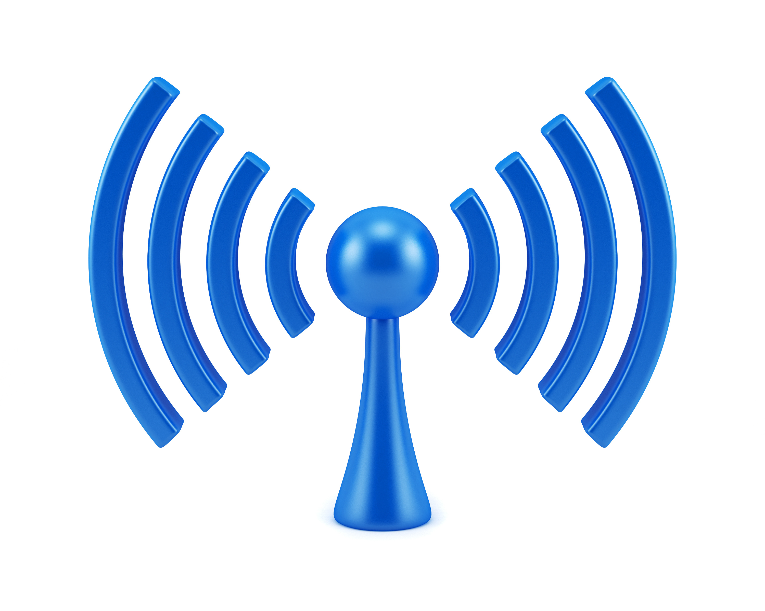
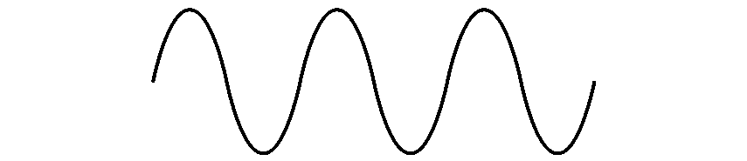

COM-405: Mobile Networks
Lecture 3.0: OFDM II
Haitham Hassanieh
Laboratory of SEnsing
& Networking Systems

Slide 2
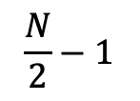
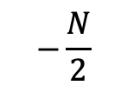

OFDM Symbol
Bits:
$$1 0 1 0 1 0 0 0 1 1 0 1 1 0 0$$
$$…,+1,−1,+1,−1,+1,−1,−1,−1,+1,+1,−1, +1,+1,−1,−1,…$$
Guard
Bins
DC
Guard
Bins
$$−\frac{N}{2}$$
$$0$$
$$\frac{N}{2}−1$$
IFFT
Symbol in Time

Slide 3
OFDM Cyclic Prefix
$$⋯$$
S1
S2
S3
S4
$$⋯$$

Slide 4
OFDM Cyclic Prefix
S1
S1
S2
S2
S3
S3

Slide 5
OFDM Cyclic Prefix
S1
CP1
S2
CP2
S3
CP3

Slide 6






Carrier Frequency Offset
101101011
101101011
TX
RX
$$x\left(t\right)$$
$$x\left(t\right)×e^{−j2πf_{c}t}$$
$$h\left(t\right)∗ x\left(t\right)e^{−j2πf_{c}t}$$
$$h\left(t\right)∗ x\left(t\right)e^{−j2πf_{c}t}×e^{j2πf_{c}t}$$
$$h\left(t\right)∗ x\left(t\right)$$
$$y\left(t\right)=h\left(t\right)∗ x\left(t\right)+v\left(t\right)$$
Assumes TX & RX perfectly synched

Slide 7







Carrier Frequency Offset
101101011
101101011
TX
RX
$$x\left(t\right)$$
$$x\left(t\right)×e^{−j2πf_{c}t}$$
$$h\left(t\right)∗ x\left(t\right)e^{−j2πf_{c}t}$$
$$h\left(t\right)∗ x\left(t\right)e^{−j2πf_{c}t}×e^{j2πf_{c}^{′}t}$$
TX & RX are not synched
$h\left(t\right)∗ x\left(t\right)$ $e^{−j2π{Δf}_{c}t}$
CFO: ${Δf}_{c}=f_{c}−f_{c}^{′}$
$$y\left(t\right)=h\left(t\right)∗ x\left(t\right)e^{−j2π{Δf}_{c}t}+v\left(t\right)$$
Phase changes with time!

Slide 8











Carrier Frequency Offset
Consider BPSK Modulation.
$$0→−1$$
$$1→+1$$
$$Q$$
$$Q$$
$$−1$$
$$+1$$
$$I$$
$$−1$$
$$+1$$
$$I$$
$$x\left(t\right)$$
$$h x\left(t−τ\right)e^{−j2π{Δf}_{c}t}+v\left(t\right)$$

Slide 9
Carrier Frequency Offset
Consider BPSK Modulation.
$$0→−1$$
$$1→+1$$
$$Q$$
$$Q$$
$$−1$$
$$+1$$
$$I$$
$$−1$$
$$+1$$
$$I$$
$$x\left(t\right)$$
$$h x\left(t−τ\right)e^{−j2π{Δf}_{c}t}+v\left(t\right)$$
Impossible to Decode!

Slide 10


Carrier Frequency Offset
Consider 16 QAM Modulation
$$Q$$
$$I$$
Need to estimate and correct CFO to decode!

Slide 11
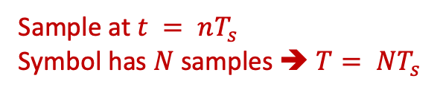




OFDM CFO Estimation & Correction
Preamble
Preamble
$$⋯$$
Preamble
S1
CP1
S2
CP2
$$⋯$$
Use Preamble to estimate CFO
$$y_{1}\left(t\right)=x\left(t\right)e^{−j2πΔf_{c}t}$$
Sample at $t = nT_{s}$
Symbol has $N$ samples ➔ $T= NT_{s}$
$$y_{2}\left(t\right)=x\left(t\right)e^{−j2πΔf_{c}\left(t+T\right)}$$

Slide 12
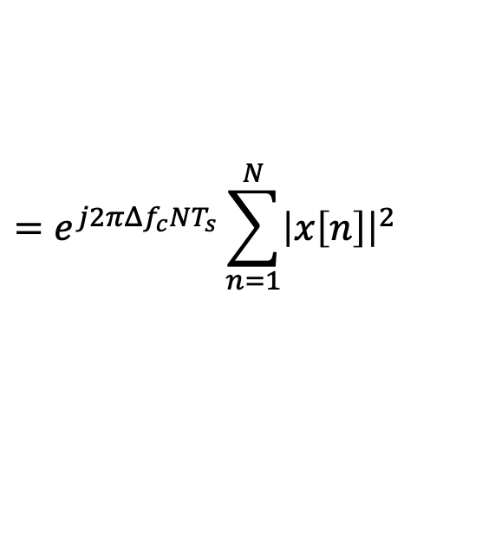
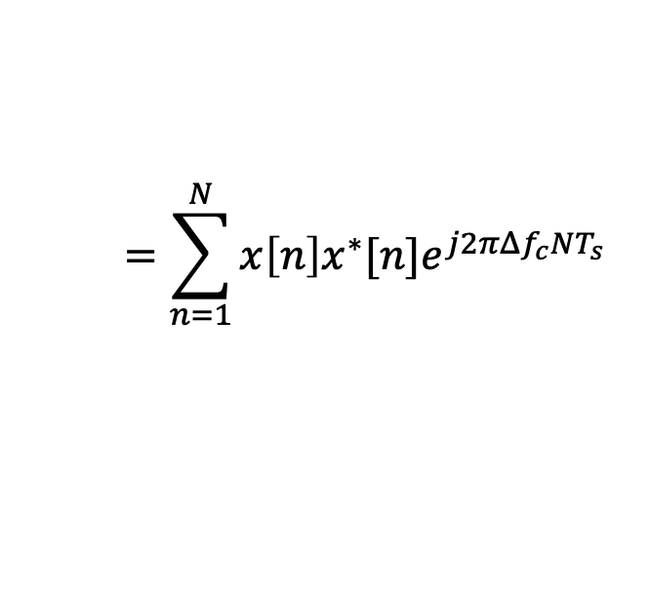
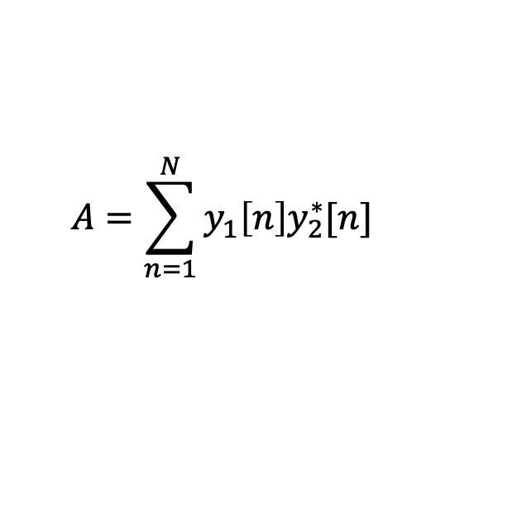


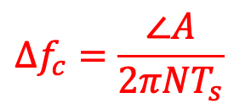
OFDM CFO Estimation & Correction
Preamble
Preamble
$$⋯$$
Preamble
S1
CP1
S2
CP2
$$⋯$$
Use Preamble to estimate CFO
Sample at $t = nT_{s}$
Symbol has $N$ samples ➔ $T= NT_{s}$
$$y_{1}[n]=x[n]e^{−j2πΔf_{c}nT_{s}}$$
$$y_{2}[n]=x[n]e^{−j2πΔf_{c}\left(nT_{s}+NT_{s}\right)}$$
$$A=\sum_{n=1}^{N}{y_{1}\left[n\right]y_{2}^{∗}[n]}$$
$$=\sum_{n=1}^{N}{x\left[n\right]x^{∗}[n]e^{j2πΔf_{c}NT_{s}}}$$
Compute:
$$=e^{j2πΔf_{c}NT_{s}}\sum_{n=1}^{N}{{\left|x\left[n\right]\right|}^{2}}$$
$$Δf_{c}=\frac{∠A}{2πNT_{s}}$$

Slide 13

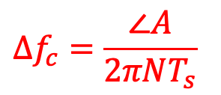
OFDM CFO Estimation & Correction
Preamble
Preamble
$$⋯$$
Preamble
S1
CP1
S2
CP2
$$⋯$$
Use Preamble to estimate CFO
$$y_{1}[n]=x[n]e^{−j2πΔf_{c}nT_{s}}$$
$$y_{2}[n]=x[n]e^{−j2πΔf_{c}\left(nT_{s}+NT_{s}\right)}$$
$$A=\sum_{n=1}^{N}{y_{1}\left[n\right]y_{2}^{∗}[n]}$$
$$Δf_{c}=\frac{∠A}{2πNT_{s}}$$
Compute:
Correct CFO:
$$y\left[n\right]×e^{j2πΔf_{c}nT_{s}}$$

Slide 14
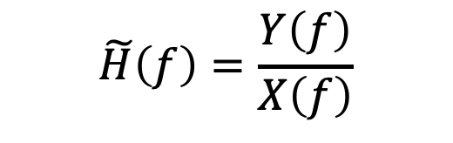

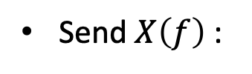

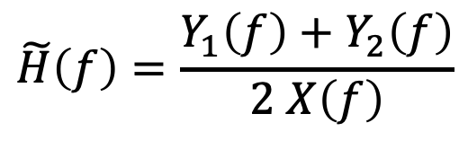
OFDM Channel Estimation
Preamble
Preamble
$$⋯$$
Preamble
S1
CP1
S2
CP2
$$⋯$$
Use Preamble to estimate the channel
$$y\left(t\right)=h\left(t\right)∗x\left(t\right)↔Y\left(f\right)=H\left(f\right) X\left(f\right)$$
Send $X\left(f\right)$:
$$−1,+1,−1,−1,−1,+1,…$$
Receive:
$$−H(1),H(2),−H(3),−H(4),−H(5),H(6),…$$
$$\tilde{H}\left(f\right)=\frac{Y\left(f\right)}{X\left(f\right)}$$
Estimate:
$$\tilde{H}\left(f\right)=\frac{Y_{1}\left(f\right)+Y_{2}\left(f\right)}{2 X\left(f\right)}$$
Use two preambles to average noise:

Slide 15
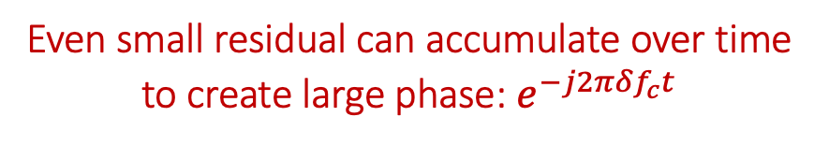


Phase Tracking
So Far: Estimated and Corrected For Coarse Value of CFO
Residual CFO:
$$y\left(t\right)=h\left(t\right) x\left(t\right)e^{−j2π{Δf}_{c}t}+v\left(t\right)$$
$$Δf_{c}=df_{c}+δf_{c}$$
Coarse CFO
Residual CFO
We estimated and corrected for coarse CFO!
Even small residual can accumulate over time to create large phase: $e^{−j2π{δf}_{c}t}$
Need to track the phase

Slide 16










Phase Tracking
$$Q$$
$$Q$$
$$−1$$
$$+1$$
$$I$$
$$−1$$
$$+1$$
$$I$$
$$h x\left(t−τ\right)e^{−j2π{Δf}_{c}t}+v\left(t\right)$$
$$h x\left(t−τ\right)e^{−j2π{δf}_{c}t}+v\left(t\right)$$
Without Course CFO Correction
Without Residual CFO Correction

Slide 17
Phase Tracking
Residual CFO (Carrier Frequency Offset)
Residual SFO (Sampling Frequency Offset)

Slide 18
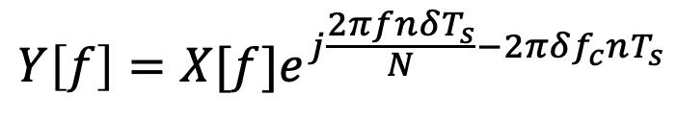
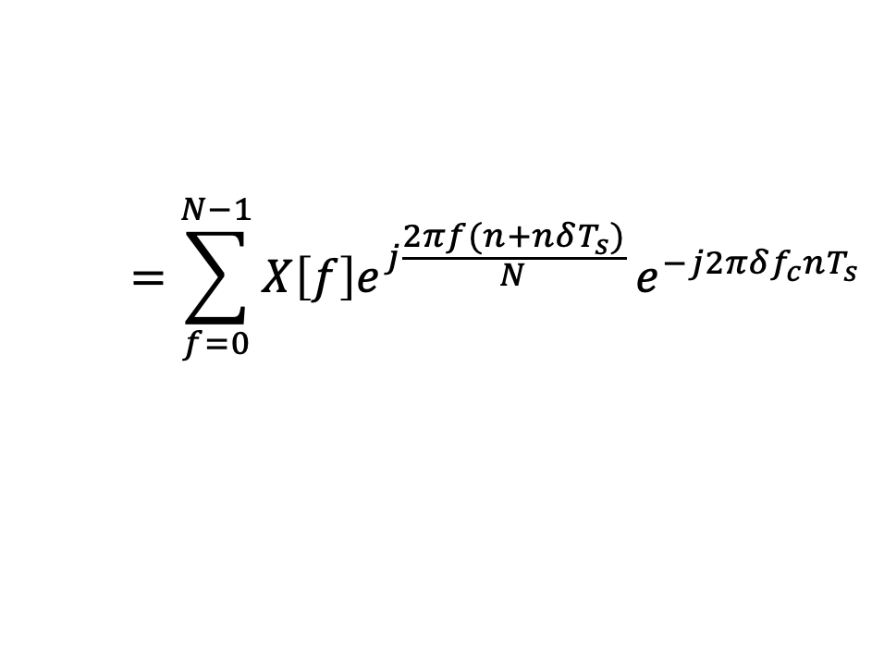

Phase Tracking
Residual CFO (Carrier Frequency Offset)
Residual SFO (Sampling Frequency Offset)
When we sample the signal there is a residual sampling offset: $nδT_{s}$
$$y[n]=x[n+nδT_{s}]e^{−j2πδf_{c}nT_{s}}$$
$$=\sum_{f=0}^{N−1}{X\left[f\right]e^{j\frac{2πf(n+nδT_{s})}{N}}}e^{−j2πδf_{c}nT_{s}}$$
$$Y\left[f\right]=X[f]e^{j\frac{2πfnδT_{s}}{N}−2πδf_{c}nT_{s}}$$

Slide 19
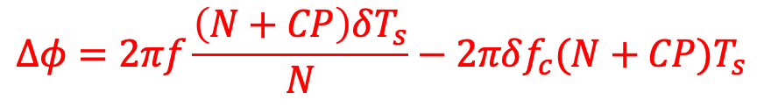
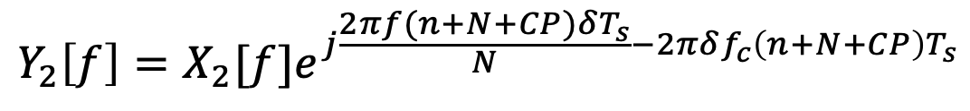
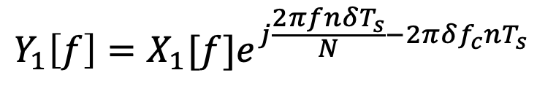
Phase Tracking
Residual CFO (Carrier Frequency Offset)
Residual SFO (Sampling Frequency Offset)
$$Y_{1}\left[f\right]=X_{1}[f]e^{j\frac{2πfnδT_{s}}{N}−2πδf_{c}nT_{s}}$$
$$Y_{2}\left[f\right]=X_{2}[f]e^{j\frac{2πf(n+N+CP)δT_{s}}{N}−2πδf_{c}\left(n+N+CP\right)T_{s}}$$
$$Δφ=2πf\frac{\left(N+CP\right)δT_{s}}{N}−2πδf_{c}(N+CP)T_{s}$$
Phase accumulation:

Slide 20
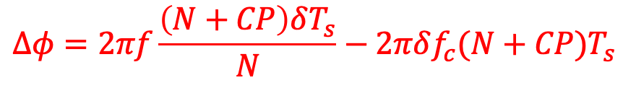


Phase Tracking
Residual CFO (Carrier Frequency Offset)
Residual SFO (Sampling Frequency Offset)
$$Δφ=2πf\frac{\left(N+CP\right)δT_{s}}{N}−2πδf_{c}(N+CP)T_{s}$$
Phase accumulation:
Slope: SFO
y-intercept: CFO
$$−N/2$$
Frequency Bins
$$N/2$$

Slide 21



OFDM Phase Tracking
$$Δφ=2πf\frac{\left(N+CP\right)δT_{s}}{N}−2πδf_{c}(N+CP)T_{s}$$
Phase accumulation:
Slope: SFO
y-intercept: CFO
$$−N/2$$
Frequency Bins
$$N/2$$
Sufficient to estimate slope & y-intercept to know the phase accumulated for all subcarriers.
Use only few subcarriers as pilots & send known bits in them.

Slide 22

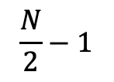
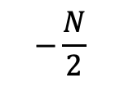

OFDM Phase Tracking
Guard
Bins
Pilots
DC
Pilots
Guard
Bins
$$−\frac{N}{2}$$
$$0$$
$$\frac{N}{2}−1$$
$$Δφ$$
Use Linear Regression to estimate phase accumulated
$$−N/2$$
$$N/2$$

Slide 23
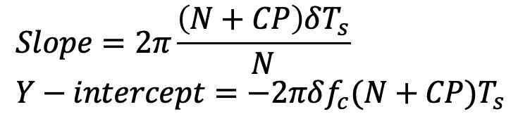


OFDM Phase Tracking
$$Δφ$$
Use Linear Regression to estimate phase accumulated
Slope: SFO
y-intercept: CFO
$$−N/2$$
$$N/2$$
$$Slope=2π\frac{\left(N+CP\right)δT_{s}}{N}$$
$$Y−intercept=−2πδf_{c}(N+CP)T_{s}$$
$$Δφ=2πf\frac{\left(N+CP\right)δT_{s}}{N}−2πδf_{c}(N+CP)T_{s}$$
$${\tilde{H}}_{new}\left(f\right)={\tilde{H}}_{old}\left(f\right)×e^{jΔφ}$$

Slide 24
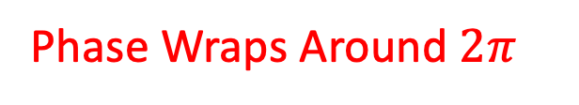
Be Careful!
$$Δφ$$
Phase Wraps Around $2π$
$$−N/2$$
$$N/2$$

Slide 25
Be Careful!
$$Δφ$$
Phase Wraps Around $2π$
$$−N/2$$
$$N/2$$

Slide 26
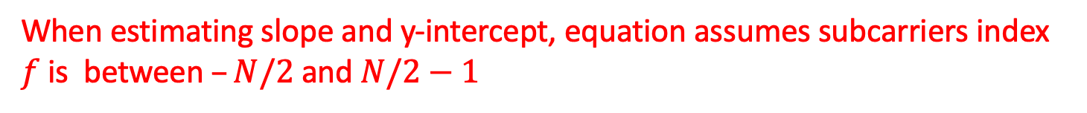
Be Careful!
$$Δφ$$
Phase Wraps Around $2π$
Wrong Estimates
$$−N/2$$
$$N/2$$
Need to unwrap phase mod $2π$ first!
When estimating slope and y-intercept, equation assumes subcarriers index $f$ is between$–N/2$and $N/2−1$

Slide 27




Be Careful!
When estimating slope and y-intercept, equation assumes subcarriers index $f$ is between$–N/2$and $N/2−1$
Guard
Bins
Guard
Bins
Guard
Bins
Pilots
DC
Pilots
Guard
Bins
Pilots
DC
Pilots
$$0$$
$$−\frac{N}{2}$$
$$0$$
$$\frac{N}{2}−1$$

Slide 28


Be Careful!
When estimating slope and y-intercept, equation assumes subcarriers index $f$ is between$–N/2$and $N/2−1$
Guard
Bins
Guard
Bins
Guard
Bins
Pilots
DC
Pilots
Guard
Bins
Pilots
DC
Pilots
$$0$$
$$−\frac{N}{2}$$
$$0$$
$$\frac{N}{2}−1$$
$$0$$
$$N−1$$

Slide 29

Be Careful!
When estimating slope and y-intercept, equation assumes subcarriers index $f$ is between$–N/2$and $N/2−1$
Guard
Bins
Pilots
DC
Pilots
Guard
Bins
$$−\frac{N}{2}$$
$$0$$
$$\frac{N}{2}−1$$
DC
Pilots
Guard
Bins
Guard
Bins
Pilots
$$0$$
$$N−1$$

Slide 30
Be Careful!
When estimating slope and y-intercept, equation assumes subcarriers index $f$ is between$–N/2$and $N/2−1$
Guard
Bins
Pilots
DC
Pilots
Guard
Bins
$$−\frac{N}{2}$$
$$0$$
$$\frac{N}{2}−1$$
DC
Pilots
Guard
Bins
Guard
Bins
Pilots
$$0$$
$$N−1$$

Slide 31
OFDM: Putting it Together
At TX:
Create preamble symbol from training sequence (Uses BPSK)
Repeat preamble symbol:
4 times for packet detection
2 times for CFO estimation
2 times for channel estimation
Add CP for the last preamble
Create data symbol from:
  Data bits (Uses BPSK, QPSK, M-QAM)
  Pilot bits (Uses BPSK)
Add cyclic prefix to data symbols.

Slide 32
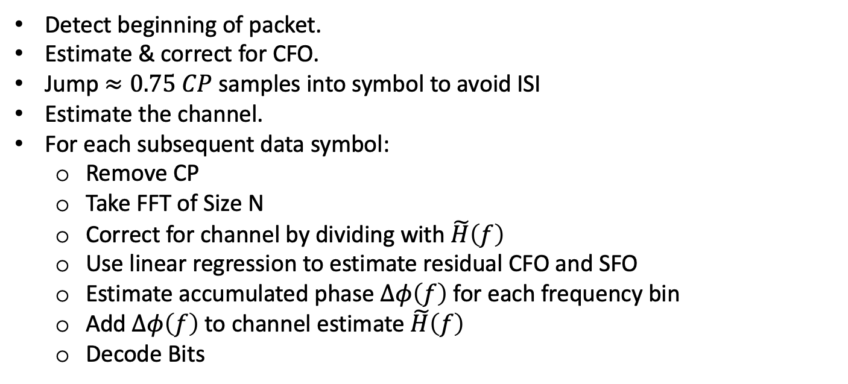
OFDM: Putting it Together
At RX:
Detect beginning of packet.
Estimate & correct for CFO.
Jump $≈0.75 CP$ samples into symbol to avoid ISI
Estimate the channel.
For each subsequent data symbol:
  Remove CP
  Take FFT of Size N
  Correct for channel by dividing with $\tilde{H}\left(f\right)$
  Use linear regression to estimate residual CFO and SFO
  Estimate accumulated phase $Δφ\left(f\right)$for each frequency bin
  Add $Δφ\left(f\right)$to channel estimate $\tilde{H}\left(f\right)$
  Decode Bits

