Slide 1
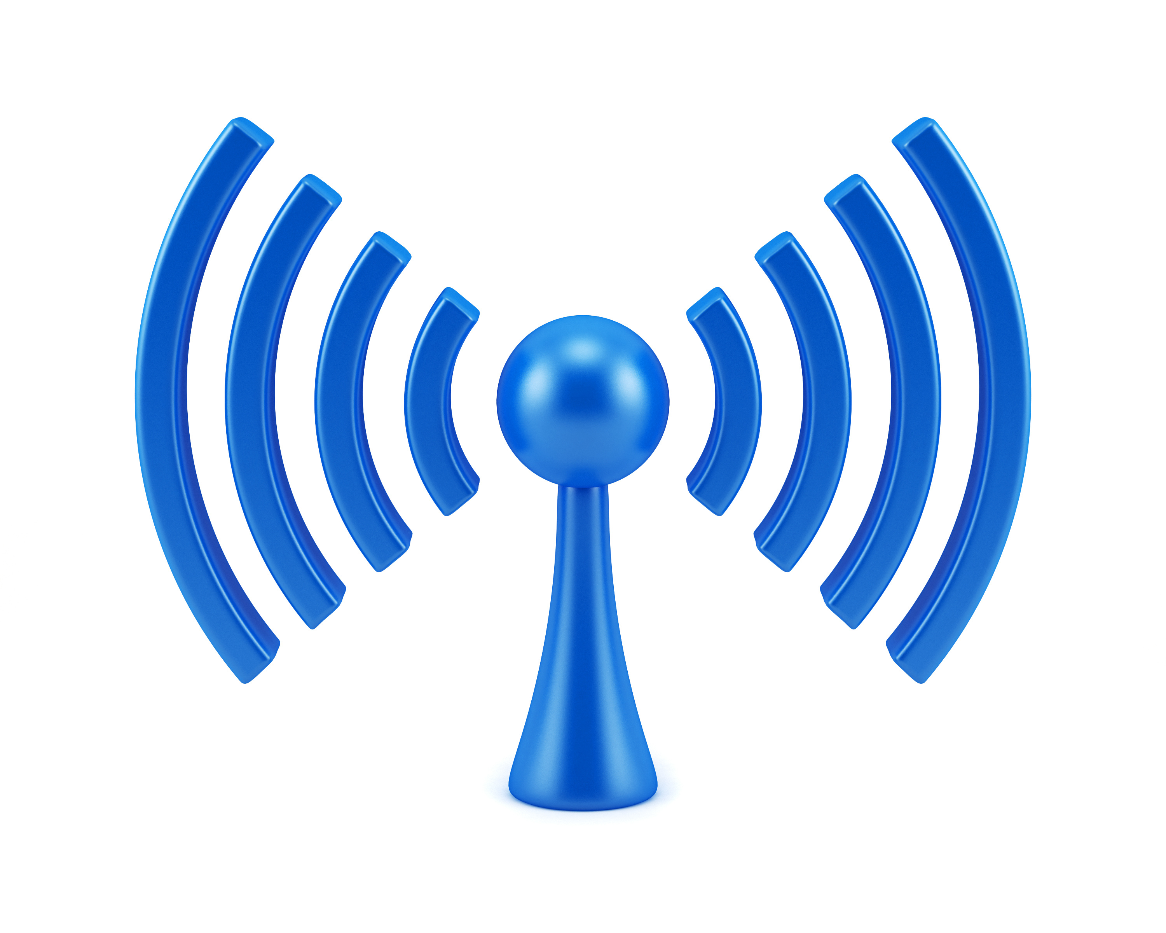
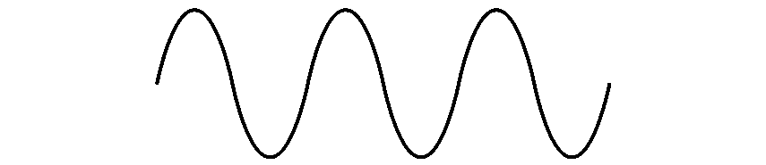

COM-405: Mobile Networks
Lecture 2.1: OFDM I
Haitham Hassanieh
Laboratory of SEnsing
& Networking Systems

Slide 2
Why OFDM?
Makes life easy → channel estimation and correction is straightforward
Used in most high throughput mobile networks:
  WiFi 4, 5, 6
  4G, 5G, … 6G
Higher layer resource allocation schemes use OFDMA (WiFi 6, 4G, 5G)

Slide 3









Wireless Communication
1011010110011001
1011010110011001
Digital Input
Digital Output
TX
RX
Channel
1011010110
1011010110
Mixer
Mixer
Modulation
PA
Demodulation
DAC
LPF
BPF
LNA
BPF
LPF
ADC
PLL
PLL
1011010110
$$s\left[n\right]$$
$$s(t)$$
$$s\left(t\right)\cos{2πf_{c}t}$$
$$h\left(t\right)∗s\left(t\right)\cos{2πf_{c}t}$$
$$×\cos{2πf_{c}t}$$
$$h\left(t\right)∗s\left(t\right)$$
$$h[n]∗s[n]$$
$$s\left[n\right]$$
1011010110

Slide 4



Wireless Communication
1011010110011001
1011010110011001
Digital Input
Digital Output
TX
RX
Channel
1011010110
1011010110
Mixer
Mixer
Modulation
PA
Demodulation
DAC
LPF
BPF
LNA
BPF
LPF
ADC
PLL
PLL
1011010110
$$s\left[n\right]$$
$$s(t)$$
$$s\left(t\right)e^{−j2πf_{c}t}$$
$$h\left(t\right)∗s\left(t\right)e^{−j2πf_{c}t}$$
$$×e^{+j2πf_{c}t}$$
$$h\left(t\right)∗s\left(t\right)$$
$$h[n]∗s[n]$$
$$s\left[n\right]$$
1011010110

Slide 5


Wireless Communication
1011010110011001
1011010110011001
Digital Input
Digital Output
TX
RX
Channel
1011010110
1011010110
Mixer
Mixer
Modulation
PA
Demodulation
DAC
LPF
BPF
LNA
BPF
LPF
ADC
PLL
PLL
1011010110
$$s\left[n\right]$$
$$s[n]e^{−j2πf_{c}t}$$
$$h[n]∗s[n]e^{−j2πf_{c}t}$$
$$×e^{+j2πf_{c}t}$$
$$h[n]∗s[n]$$
$$s\left[n\right]$$
1011010110

Slide 6






Wireless Communication
1011010110011001
1011010110011001
Digital Input
Digital Output
TX
RX
Channel
1011010110
1011010110
Mixer
Mixer
Modulation
PA
Demodulation
DAC
LPF
BPF
LNA
BPF
LPF
ADC
PLL
PLL
1011010110
$$s\left[n\right]$$
$$s[n]e^{−j2πf_{c}t}$$
$$h[n]∗s[n]e^{−j2πf_{c}t}$$
$$×e^{+j2πf_{c}t}$$
$$h[n]∗s[n]$$
$$s\left[n\right]$$
1011010110
Single Carrier Modulation
Symbols modulated on a single carrier frequency: $s\left[n\right]e^{−j2πf_{c}t}$

Slide 7
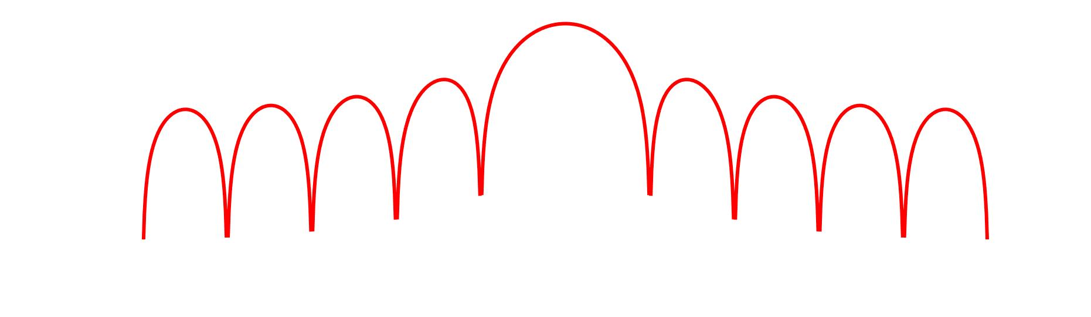



Single Carrier Modulation
Symbols modulated on a single carrier frequency
Low Spectral Efficiency: leakage
ISI: Inter-Symbol-Interference limits performance
$$f$$
$$−B$$
$$B$$

Slide 8
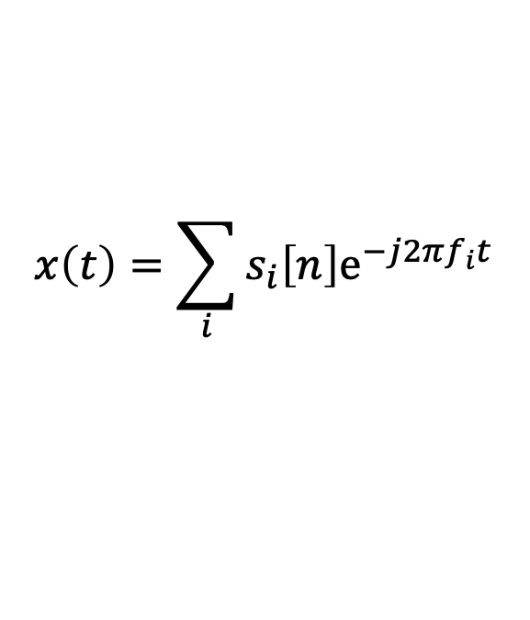
Multi-Carrier Modulation
Symbols modulated on multiple Sub-carrier frequencies
Divide spectrum into many narrow bands
$$x\left(t\right)=\sum_{i}{s_{i}\left[n\right]e^{−j2πf_{i}t} }$$
Transmit symbols on different carriers in narrow bands
Channel is Flat → No need to worry about ISI

Slide 9
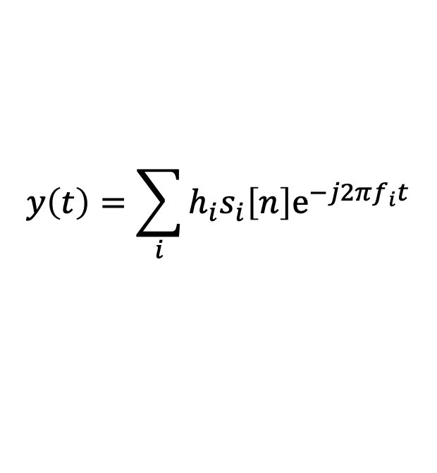
Multi-Carrier Modulation
Symbols modulated on multiple Sub-carrier frequencies
Divide spectrum into many narrow bands
$$x\left(t\right)=\sum_{i}{s_{i}\left[n\right]e^{−j2πf_{i}t} }$$
$$y\left(t\right)=\sum_{i}{h_{i}s_{i}\left[n\right]e^{−j2πf_{i}t} }$$
Transmit symbols on different carriers in narrow bands
Channel is Flat → No need to worry about ISI

Slide 10
Multi-Carrier Modulation
Symbols modulated on multiple Sub-carrier frequencies
Divide spectrum into many narrow bands
$$x\left(t\right)=\sum_{i}{s_{i}\left[n\right]e^{−j2πf_{i}t} }$$
$$y\left(t\right)=\sum_{i}{h_{i}s_{i}\left[n\right]e^{−j2πf_{i}t} }$$
Transmit symbols on different carriers in narrow bands
Channel is Flat → No need to worry about ISI
Not That Simple!

Slide 11

Multi-Carrier Modulation
Symbols modulated on multiple Sub-carrier frequencies
Guard Bands
Divide spectrum into many narrow bands
$$f$$
$$f$$
Significant Leakage between adjacent subcarriers
Need Guard Bands → Very inefficient!
Solution: Make the Sub-Carriers Orthogonal

Slide 12
Multi-Carrier Modulation
Symbols modulated on multiple Sub-carrier frequencies
Make the Sub-Carriers Orthogonal

Slide 13
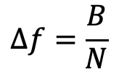
OFDM: Orthogonal Frequency Division Multiplexing
Subcarriers are orthogonal: At the sub-carrier frequency, the sampled value has zero leakage from other subcarriers.
Subcarrier separation can be very small, for N subcarriers and bandwidth B:
$$Δf=\frac{B}{N}$$

Slide 14
OFDM: Orthogonal Frequency Division Multiplexing
Subcarriers are orthogonal: At the sub-carrier frequency, the sampled value has zero leakage from other subcarriers.
Subcarrier separation can be very small, for N subcarriers and bandwidth B:
$$Δf=\frac{B}{N}$$
How to Achieve This?

Slide 15
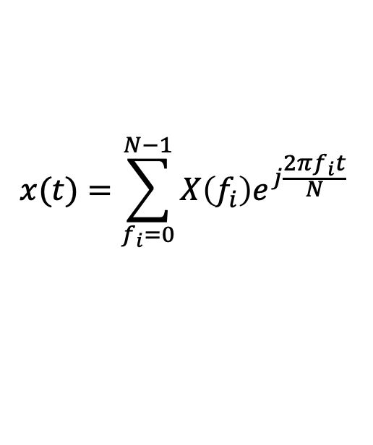
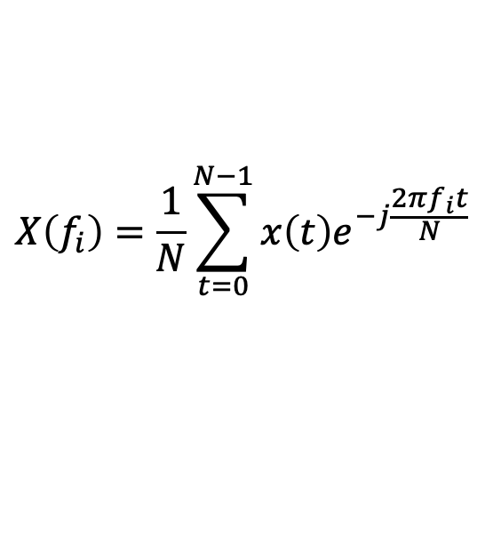
OFDM: Orthogonal Frequency Division Multiplexing
Use DFT: Discrete Fourier Transform
$$X\left(f_{i}\right)=\frac{1}{N}\sum_{t=0}^{N−1}{x\left(t\right)e^{−j\frac{2πf_{i}t}{N}} }$$
N-Point DFT:
$$x(t)=\sum_{f_{i}=0}^{N−1}{X\left(f_{i}\right)e^{j\frac{2πf_{i}t}{N}} }$$
N-Point IDFT:
Send symbols in Frequency Domain
$X\left(f_{i}\right)=s\left[n\right]→$ Compute and transmit $x\left(t\right)$ using IDFT

Slide 16
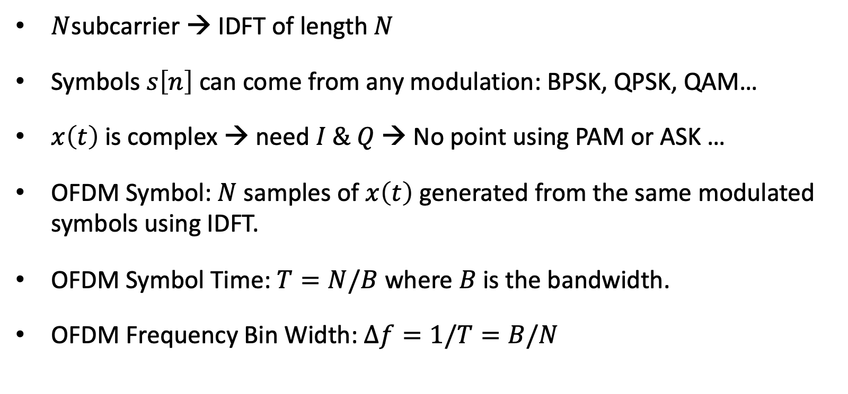
OFDM: Orthogonal Frequency Division Multiplexing
Send symbols in Frequency Domain
$X\left(f_{i}\right)=s\left[n\right]→$ Compute and transmit $x\left(t\right)$ using IDFT
$N$subcarrier → IDFT of length $N$
Symbols $s\left[n\right]$ can come from any modulation: BPSK, QPSK, QAM…
$x\left(t\right)$ is complex → need $I \& Q$ → No point using PAM or ASK …
OFDM Symbol: $N$ samples of $x\left(t\right)$ generated from the same modulated symbols using IDFT.
OFDM Symbol Time: $T=N/B$ where $B$ is the bandwidth.
OFDM Frequency Bin Width: $Δf=1/T=B/N$

Slide 17
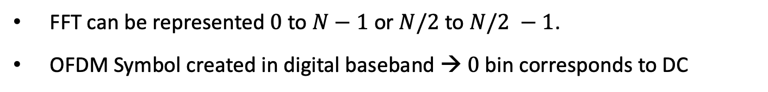



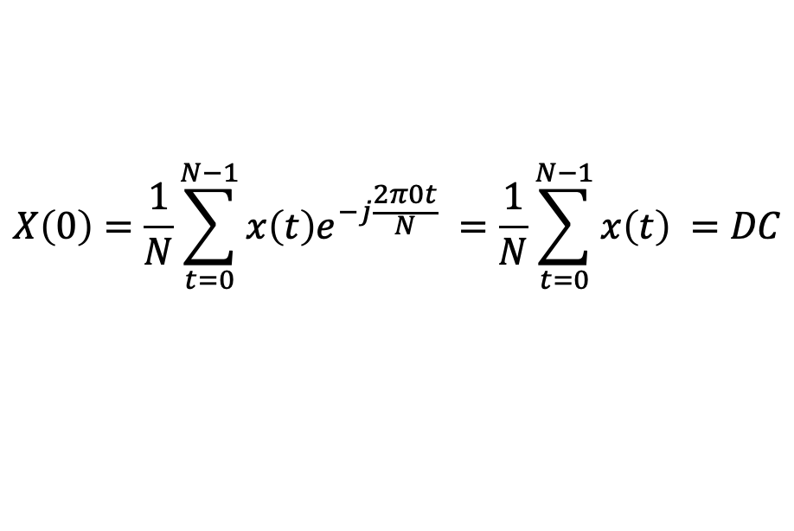
OFDM Symbol in Frequency Domain
$$−\frac{N}{2}$$
$$0$$
$$\frac{N}{2}−1$$
FFT can be represented $0$ to $N−1$ or $N/2$ to $N/2 −1$.
OFDM Symbol created in digital baseband → $0$ bin corresponds to DC
$$X\left(0\right)=\frac{1}{N}\sum_{t=0}^{N−1}{x\left(t\right)e^{−j\frac{2π0t}{N}} }=\frac{1}{N}\sum_{t=0}^{N−1}{x\left(t\right) }=DC$$

Slide 18
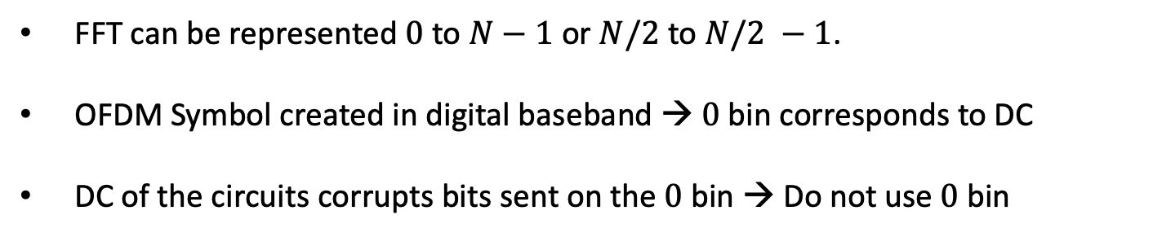
OFDM Symbol in Frequency Domain
$$−\frac{N}{2}$$
$$0$$
$$\frac{N}{2}−1$$
FFT can be represented $0$ to $N−1$ or $N/2$ to $N/2 −1$.
OFDM Symbol created in digital baseband → $0$ bin corresponds to DC
DC of the circuits corrupts bits sent on the $0$ bin → Do not use $0$ bin

Slide 19
OFDM Symbol in Frequency Domain
DC Bin
$$−\frac{N}{2}$$
$$0$$
$$\frac{N}{2}−1$$
FFT can be represented $0$ to $N−1$ or $N/2$ to $N/2 −1$.
OFDM Symbol created in digital baseband → $0$ bin corresponds to DC
DC of the circuits corrupts bits sent on the $0$ bin → Do not use $0$ bin

Slide 20
OFDM Symbol in Frequency Domain
DC Bin
$$−\frac{N}{2}$$
$$0$$
$$\frac{N}{2}−1$$
Subcarriers orthogonal to each other but not to near by channels.
Need Guard Bins at sides of the channel → Transmit nothing there

Slide 21
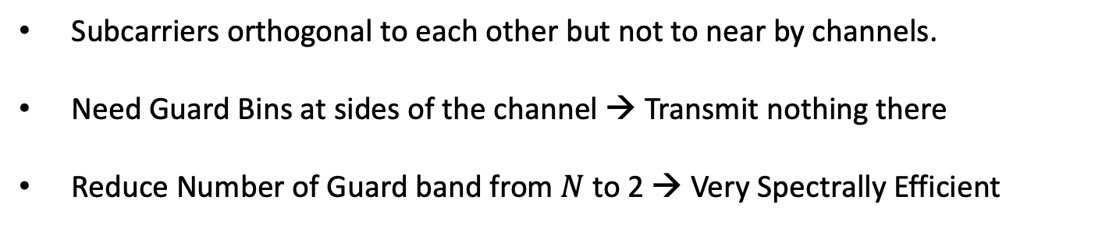
OFDM Symbol in Frequency Domain
Guard Bins
DC Bin
Guard Bins
$$−\frac{N}{2}$$
$$0$$
$$\frac{N}{2}−1$$
Subcarriers orthogonal to each other but not to near by channels.
Need Guard Bins at sides of the channel → Transmit nothing there
Reduce Number of Guard band from $N$ to 2 → Very Spectrally Efficient

Slide 22
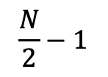
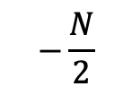

OFDM Symbol
Bits:
$$1 0 1 0 1 0 0 0 1 1 0 1 1 0 0$$
$$…,+1,−1,+1,−1,+1,−1,−1,−1,+1,+1,−1, +1,+1,−1,−1,…$$
Guard
Bins
DC
Guard
Bins
$$−\frac{N}{2}$$
$$0$$
$$\frac{N}{2}−1$$
IFFT
Symbol in Time

Slide 23










OFDM Symbol
$$⋯$$
Symbol in Time
Symbol in Time
Symbol in Time
Symbol in Time
$$⋯$$
FFT
FFT
FFT
FFT
$$…,+1,−1,+1,…$$
$$…,+1,+1,+1,…$$
$$…,−1,−1,+1,…$$
$$…,+1,−1,−1,…$$
$$…101…$$
$$…111…$$
$$…001…$$
$$…100…$$
Not That Simple

Slide 24

OFDM Symbol
$$⋯$$
S1
S2
S3
S4
$$⋯$$
FFT Window
FFT
$$…,+1,−1,+1,…$$
$$…101…$$

Slide 25

OFDM Symbol
$$⋯$$
S1
S2
S3
S4
$$⋯$$
FFT Window
FFT
FFT
$$…,+1,−1,+1,…$$
$$…,+1,+1,+1,…$$
$$…101…$$
$$…111…$$

Slide 26


OFDM Symbol
$$⋯$$
S1
S2
S3
S4
$$⋯$$
FFT Window
FFT
FFT
FFT
$$…,+1,−1,+1,…$$
$$…,+1,+1,+1,…$$
$$…,−1,−1,+1,…$$
$$…101…$$
$$…111…$$
$$…001…$$

Slide 27

OFDM Symbol
$$⋯$$
S1
S2
S3
S4
$$⋯$$
FFT Window
FFT
FFT
FFT
FFT
$$…,+1,−1,+1,…$$
$$…,+1,+1,+1,…$$
$$…,−1,−1,+1,…$$
$$…,+1,−1,−1,…$$
$$…101…$$
$$…111…$$
$$…001…$$
$$…100…$$
Assumes FFT window is perfectly aligned with symbol boundaries

Slide 28

OFDM Symbol
$$⋯$$
S1
S2
S3
S4
$$⋯$$
FFT Window
FFT
$$…,+0.5+1i,−0.7+0.3i, …$$
Cannot decode!
FFT window is misaligned with symbol
Subcarriers are no longer orthogonal.

Slide 29
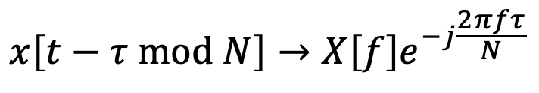

OFDM Cyclic Prefix
$$⋯$$
S1
S2
S3
S4
$$⋯$$
FFT Window
DFT (FFT) assumes time samples are periodic of period $N$
Circular Shift before taking FFT:
$$x[t]→X[f]$$
$$x\left[t−τ mod N\right]→X\left[f\right]e^{−j\frac{2πfτ}{N}}$$

Slide 30
OFDM Cyclic Prefix
S1
S1
S2
S2
S3
S3
FFT Window
DFT (FFT) assumes time samples are periodic of period $N$
Circular Shift before taking FFT:
$$x[t]→X[f]$$
$$x\left[t−τ mod N\right]→X\left[f\right]e^{−j\frac{2πfτ}{N}}$$

Slide 31
OFDM Cyclic Prefix
S1
S1
S2
S2
S3
S3
FFT Window
Even if FFT window is misaligned, CP ensures that all samples come from the same symbol → Orthogonality is preserved!
Cyclic Prefix can be created by:
  Take first few samples and append them to end of symbol.
  Take last few samples and prefix them to beginning of symbol.
Simple Phase Shift → Can be corrected by lumping with channel $H[f]$

Slide 32
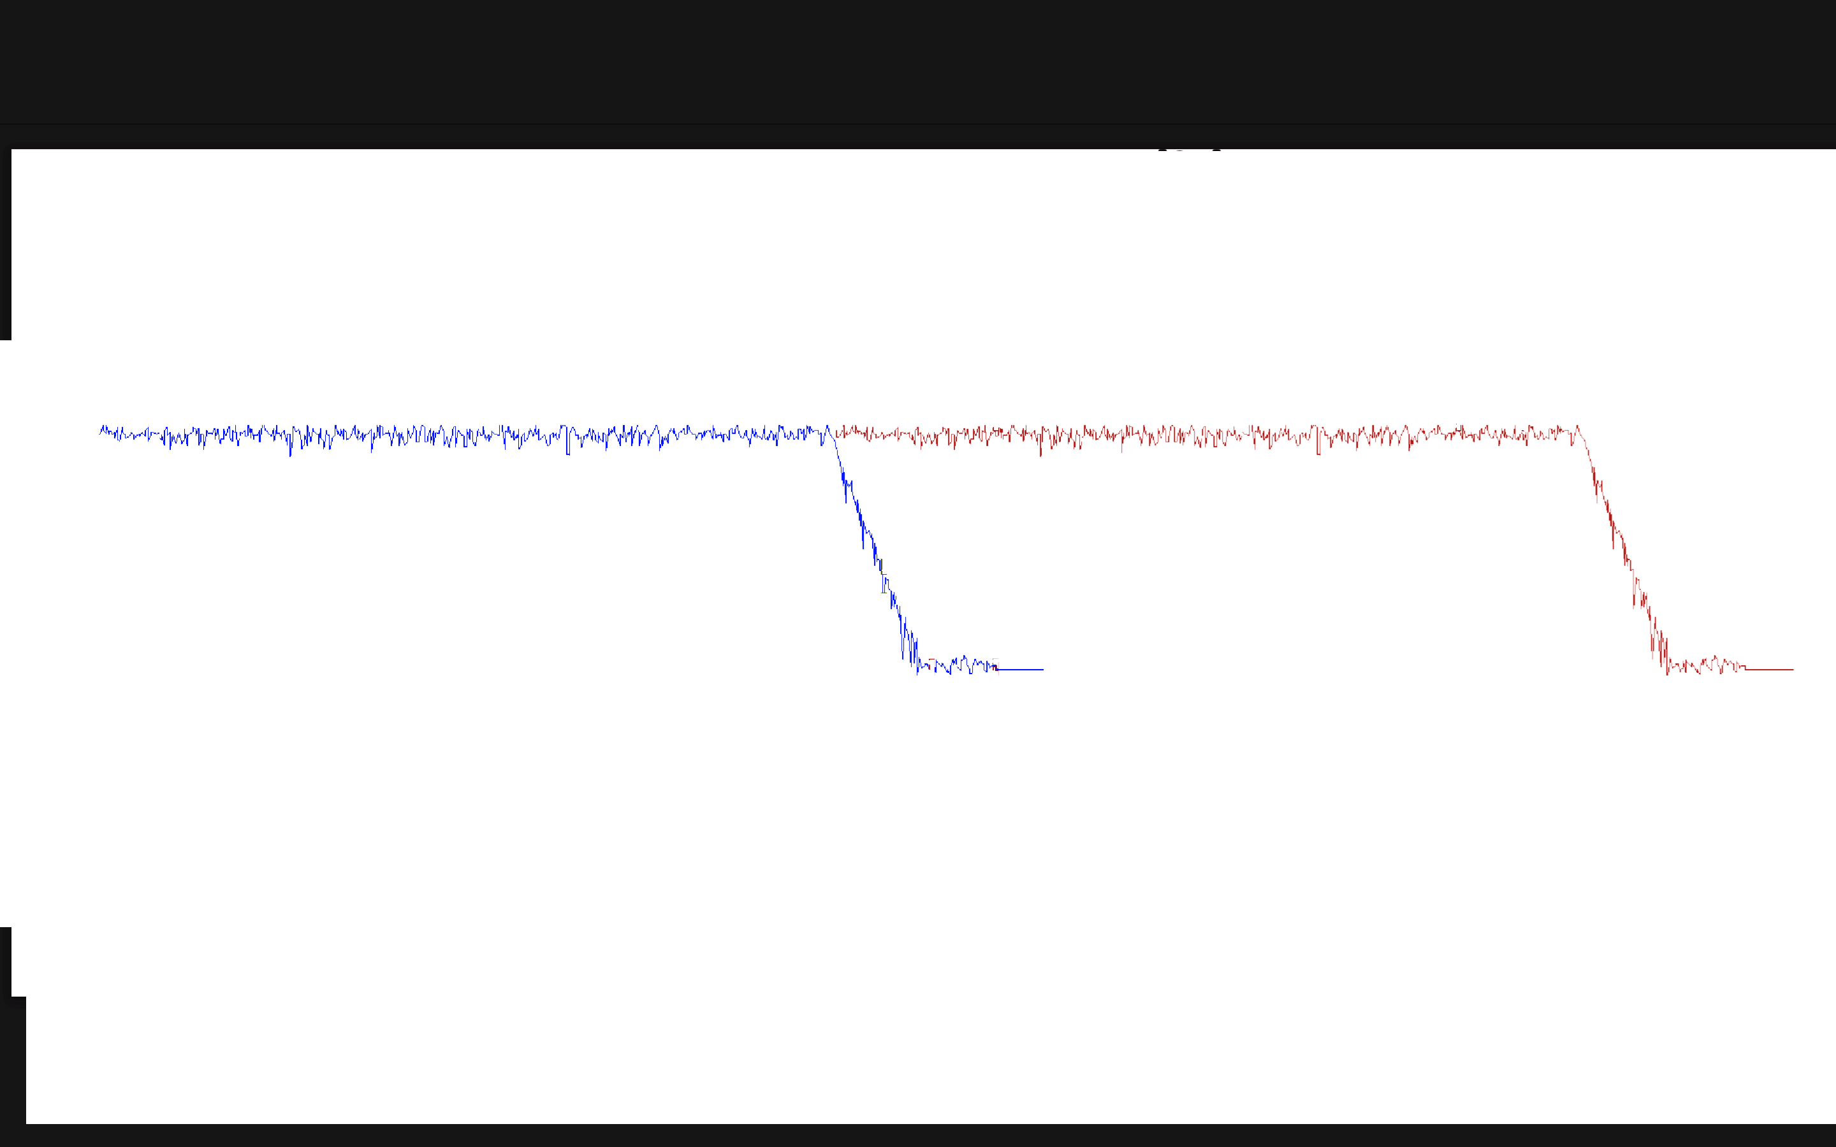
OFDM Cyclic Prefix
Cyclic Prefix:
Preserves orthogonality by allowing some misalignment in FFT Window
Deals with Inter-Symbol-Interference
S1
S1
S2
S2
S3
S3
FFT Window
ISI
ISI
ISI

Slide 33
OFDM Cyclic Prefix
Cyclic Prefix:
Preserves orthogonality by allowing some misalignment in FFT Window
Deals with Inter-Symbol-Interference
S1
S1
S2
S2
S3
S3
FFT Window
ISI
ISI
ISI
NO ISI in
FFT Window

Slide 34
OFDM Cyclic Prefix
Cyclic Prefix:
Preserves orthogonality by allowing some misalignment in FFT Window
Deals with Inter-Symbol-Interference
S1
S1
S2
S2
S3
S3
FFT Window
FFT Window
FFT Window
ISI
ISI
ISI
NO ISI in
FFT Window
NO ISI in
FFT Window
NO ISI in
FFT Window

Slide 35
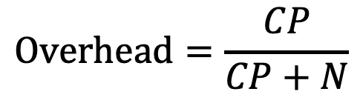
OFDM Cyclic Prefix
Cyclic Prefix:
Preserves orthogonality by allowing some misalignment in FFT Window
Deals with Inter-Symbol-Interference
Overhead: Send $CP + N$samples for every $N$ samples
$$Overhead=\frac{CP}{CP+N}$$
$$e.g. WiFi 802.11n:N=64, CP=16→Overhead=20\%$$
$$e.g. LTE:N=1024, CP=72→Overhead=6.5\%$$

Slide 36
OFDM Cyclic Prefix
S1
S1
S2
S2
S3
S3
FFT Window
Cyclic prefix is a not a bullet proof solution.
Can still end up misaligned!
Need a way to ensure we detect the beginning of the packet correctly.
If we do, CP will ensure that even if we are not accurate, we can still decode.

Slide 37


OFDM Packet Detection
Detect Beginning of packet to make sure we are within the CP
Send Training Sequence: Preamble Symbols
Preamble Symbols: Known Symbol Repeated at the beginning of packet
Preamble
Preamble
$$⋯$$
Preamble
S1
CP1
S2
CP2
$$⋯$$
No need for CP with preamble symbols

Slide 38
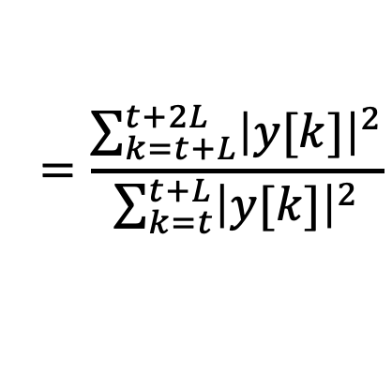

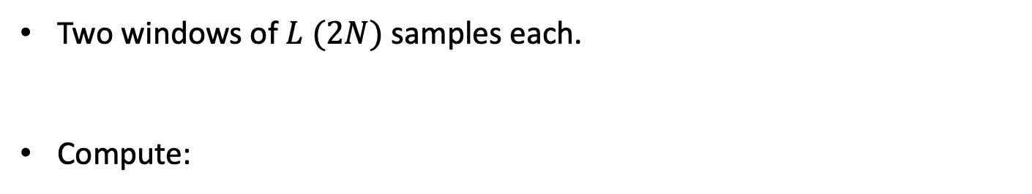




OFDM Packet Detection: Sliding Window
Preamble
Preamble
$$⋯$$
Preamble
S1
CP1
S2
CP2
$$⋯$$
A
B
$$\frac{P_{B}}{P_{A}}$$
$$1$$
Two windows of $L (2N)$ samples each.
Compute:
$$\frac{P_{B}}{P_{A}}$$
$$=\frac{\sum_{k=t+L}^{t+2L}{{\left|y[k]\right|}^{2}}}{\sum_{k=t}^{t+L}{{\left|y[k]\right|}^{2}}}$$

Slide 39
OFDM Packet Detection: Sliding Window
Preamble
Preamble
$$⋯$$
Preamble
S1
CP1
S2
CP2
$$⋯$$
A
B
$$\frac{P_{B}}{P_{A}}$$
$$1$$
Two windows of $L (2N)$ samples each.
Compute:
$$\frac{P_{B}}{P_{A}}$$
$$=\frac{\sum_{k=t+L}^{t+2L}{{\left|y[k]\right|}^{2}}}{\sum_{k=t}^{t+L}{{\left|y[k]\right|}^{2}}}$$

Slide 40
OFDM Packet Detection: Sliding Window
Preamble
Preamble
$$⋯$$
Preamble
S1
CP1
S2
CP2
$$⋯$$
A
B
$$\frac{P_{B}}{P_{A}}$$
$$1$$
Two windows of $L (2N)$ samples each.
Compute:
$$\frac{P_{B}}{P_{A}}$$
$$=\frac{\sum_{k=t+L}^{t+2L}{{\left|y[k]\right|}^{2}}}{\sum_{k=t}^{t+L}{{\left|y[k]\right|}^{2}}}$$

Slide 41
OFDM Packet Detection: Sliding Window
Preamble
Preamble
$$⋯$$
Preamble
S1
CP1
S2
CP2
$$⋯$$
A
B
$$\frac{P_{B}}{P_{A}}$$
$$1$$
Two windows of $L (2N)$ samples each.
Compute:
$$\frac{P_{B}}{P_{A}}$$
$$=\frac{\sum_{k=t+L}^{t+2L}{{\left|y[k]\right|}^{2}}}{\sum_{k=t}^{t+L}{{\left|y[k]\right|}^{2}}}$$

Slide 42
OFDM Packet Detection: Sliding Window
Preamble
Preamble
$$⋯$$
Preamble
S1
CP1
S2
CP2
$$⋯$$
A
B
$$\frac{P_{B}}{P_{A}}$$
$$1$$
Two windows of $L (2N)$ samples each.
Compute:
$$\frac{P_{B}}{P_{A}}$$
$$=\frac{\sum_{k=t+L}^{t+2L}{{\left|y[k]\right|}^{2}}}{\sum_{k=t}^{t+L}{{\left|y[k]\right|}^{2}}}$$

Slide 43
OFDM Packet Detection: Sliding Window
Preamble
Preamble
$$⋯$$
Preamble
S1
CP1
S2
CP2
$$⋯$$
A
B
$$\frac{P_{B}}{P_{A}}$$
$$1$$
Packet Start +L
Two windows of $L (2N)$ samples each.
Compute:
$$\frac{P_{B}}{P_{A}}$$
$$=\frac{\sum_{k=t+L}^{t+2L}{{\left|y[k]\right|}^{2}}}{\sum_{k=t}^{t+L}{{\left|y[k]\right|}^{2}}}$$

Slide 44






Carrier Frequency Offset
101101011
101101011
TX
RX
$$x\left(t\right)$$
$$x\left(t\right)×e^{−j2πf_{c}t}$$
$$h\left(t\right)∗ x\left(t\right)e^{−j2πf_{c}t}$$
$$h\left(t\right)∗ x\left(t\right)e^{−j2πf_{c}t}×e^{j2πf_{c}t}$$
$$h\left(t\right)∗ x\left(t\right)$$
$$y\left(t\right)=h\left(t\right)∗ x\left(t\right)+v\left(t\right)$$
Assumes TX & RX perfectly synched

Slide 45







Carrier Frequency Offset
101101011
101101011
TX
RX
$$x\left(t\right)$$
$$x\left(t\right)×e^{−j2πf_{c}t}$$
$$h\left(t\right)∗ x\left(t\right)e^{−j2πf_{c}t}$$
$$h\left(t\right)∗ x\left(t\right)e^{−j2πf_{c}t}×e^{j2πf_{c}^{′}t}$$
TX & RX are not synched
$h\left(t\right)∗ x\left(t\right)$ $e^{−j2π{Δf}_{c}t}$
CFO: ${Δf}_{c}=f_{c}−f_{c}^{′}$
$$y\left(t\right)=h\left(t\right)∗ x\left(t\right)e^{−j2π{Δf}_{c}t}+v\left(t\right)$$
Phase changes with time!

Slide 46











Carrier Frequency Offset
Consider BPSK Modulation.
$$0→−1$$
$$1→+1$$
$$Q$$
$$Q$$
$$−1$$
$$+1$$
$$I$$
$$−1$$
$$+1$$
$$I$$
$$x\left(t\right)$$
$$h x\left(t−τ\right)e^{−j2π{Δf}_{c}t}+v\left(t\right)$$

Slide 47
Carrier Frequency Offset
Consider BPSK Modulation.
$$0→−1$$
$$1→+1$$
$$Q$$
$$Q$$
$$−1$$
$$+1$$
$$I$$
$$−1$$
$$+1$$
$$I$$
$$x\left(t\right)$$
$$h x\left(t−τ\right)e^{−j2π{Δf}_{c}t}+v\left(t\right)$$
Impossible to Decode!

Slide 48


Carrier Frequency Offset
Consider 16 QAM Modulation
$$Q$$
$$I$$
Need to estimate and correct CFO to decode!

Slide 49
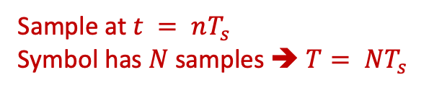




OFDM CFO Estimation & Correction
Preamble
Preamble
$$⋯$$
Preamble
S1
CP1
S2
CP2
$$⋯$$
Use Preamble to estimate CFO
$$y_{1}\left(t\right)=x\left(t\right)e^{−j2πΔf_{c}t}$$
Sample at $t = nT_{s}$
Symbol has $N$ samples ➔ $T= NT_{s}$
$$y_{2}\left(t\right)=x\left(t\right)e^{−j2πΔf_{c}\left(t+T\right)}$$

Slide 50
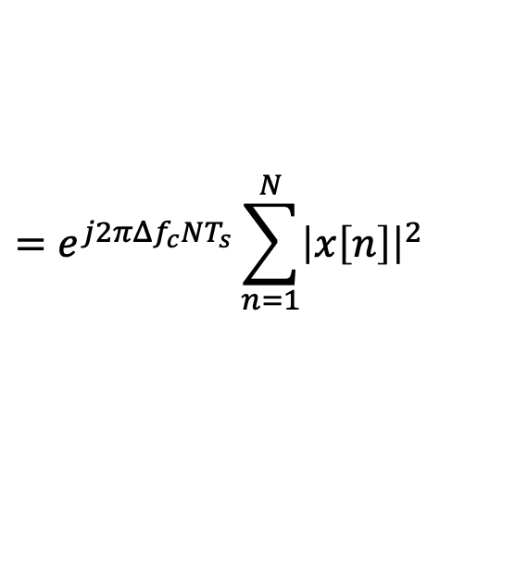
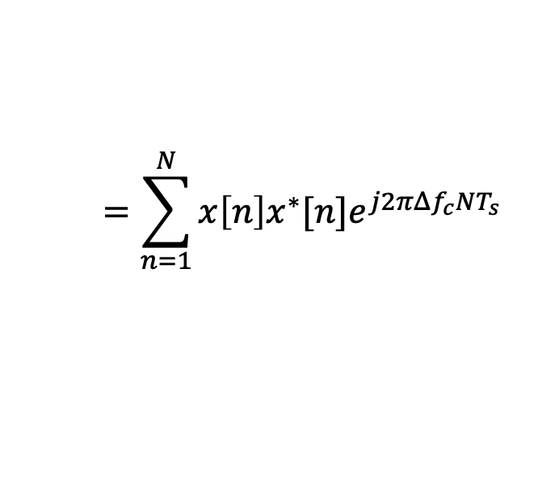
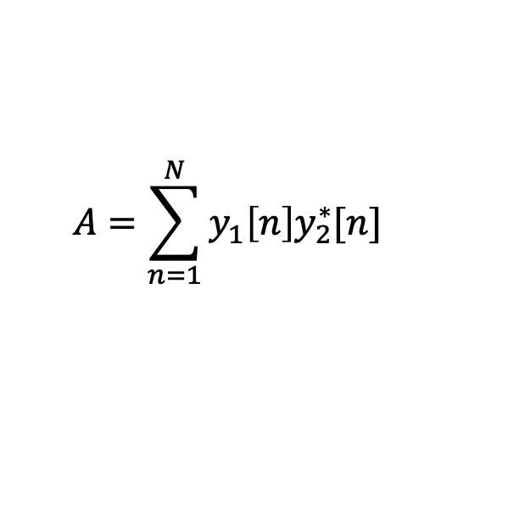


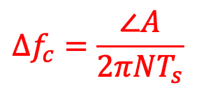
OFDM CFO Estimation & Correction
Preamble
Preamble
$$⋯$$
Preamble
S1
CP1
S2
CP2
$$⋯$$
Use Preamble to estimate CFO
Sample at $t = nT_{s}$
Symbol has $N$ samples ➔ $T= NT_{s}$
$$y_{1}[n]=x[n]e^{−j2πΔf_{c}nT_{s}}$$
$$y_{2}[n]=x[n]e^{−j2πΔf_{c}\left(nT_{s}+NT_{s}\right)}$$
$$A=\sum_{n=1}^{N}{y_{1}\left[n\right]y_{2}^{∗}[n]}$$
$$=\sum_{n=1}^{N}{x\left[n\right]x^{∗}[n]e^{j2πΔf_{c}NT_{s}}}$$
Compute:
$$=e^{j2πΔf_{c}NT_{s}}\sum_{n=1}^{N}{{\left|x\left[n\right]\right|}^{2}}$$
$$Δf_{c}=\frac{∠A}{2πNT_{s}}$$

Slide 51

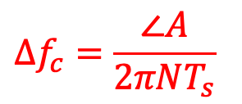
OFDM CFO Estimation & Correction
Preamble
Preamble
$$⋯$$
Preamble
S1
CP1
S2
CP2
$$⋯$$
Use Preamble to estimate CFO
$$y_{1}[n]=x[n]e^{−j2πΔf_{c}nT_{s}}$$
$$y_{2}[n]=x[n]e^{−j2πΔf_{c}\left(nT_{s}+NT_{s}\right)}$$
$$A=\sum_{n=1}^{N}{y_{1}\left[n\right]y_{2}^{∗}[n]}$$
$$Δf_{c}=\frac{∠A}{2πNT_{s}}$$
Compute:
Correct CFO:
$$y\left[n\right]×e^{j2πΔf_{c}nT_{s}}$$

