Slide 1
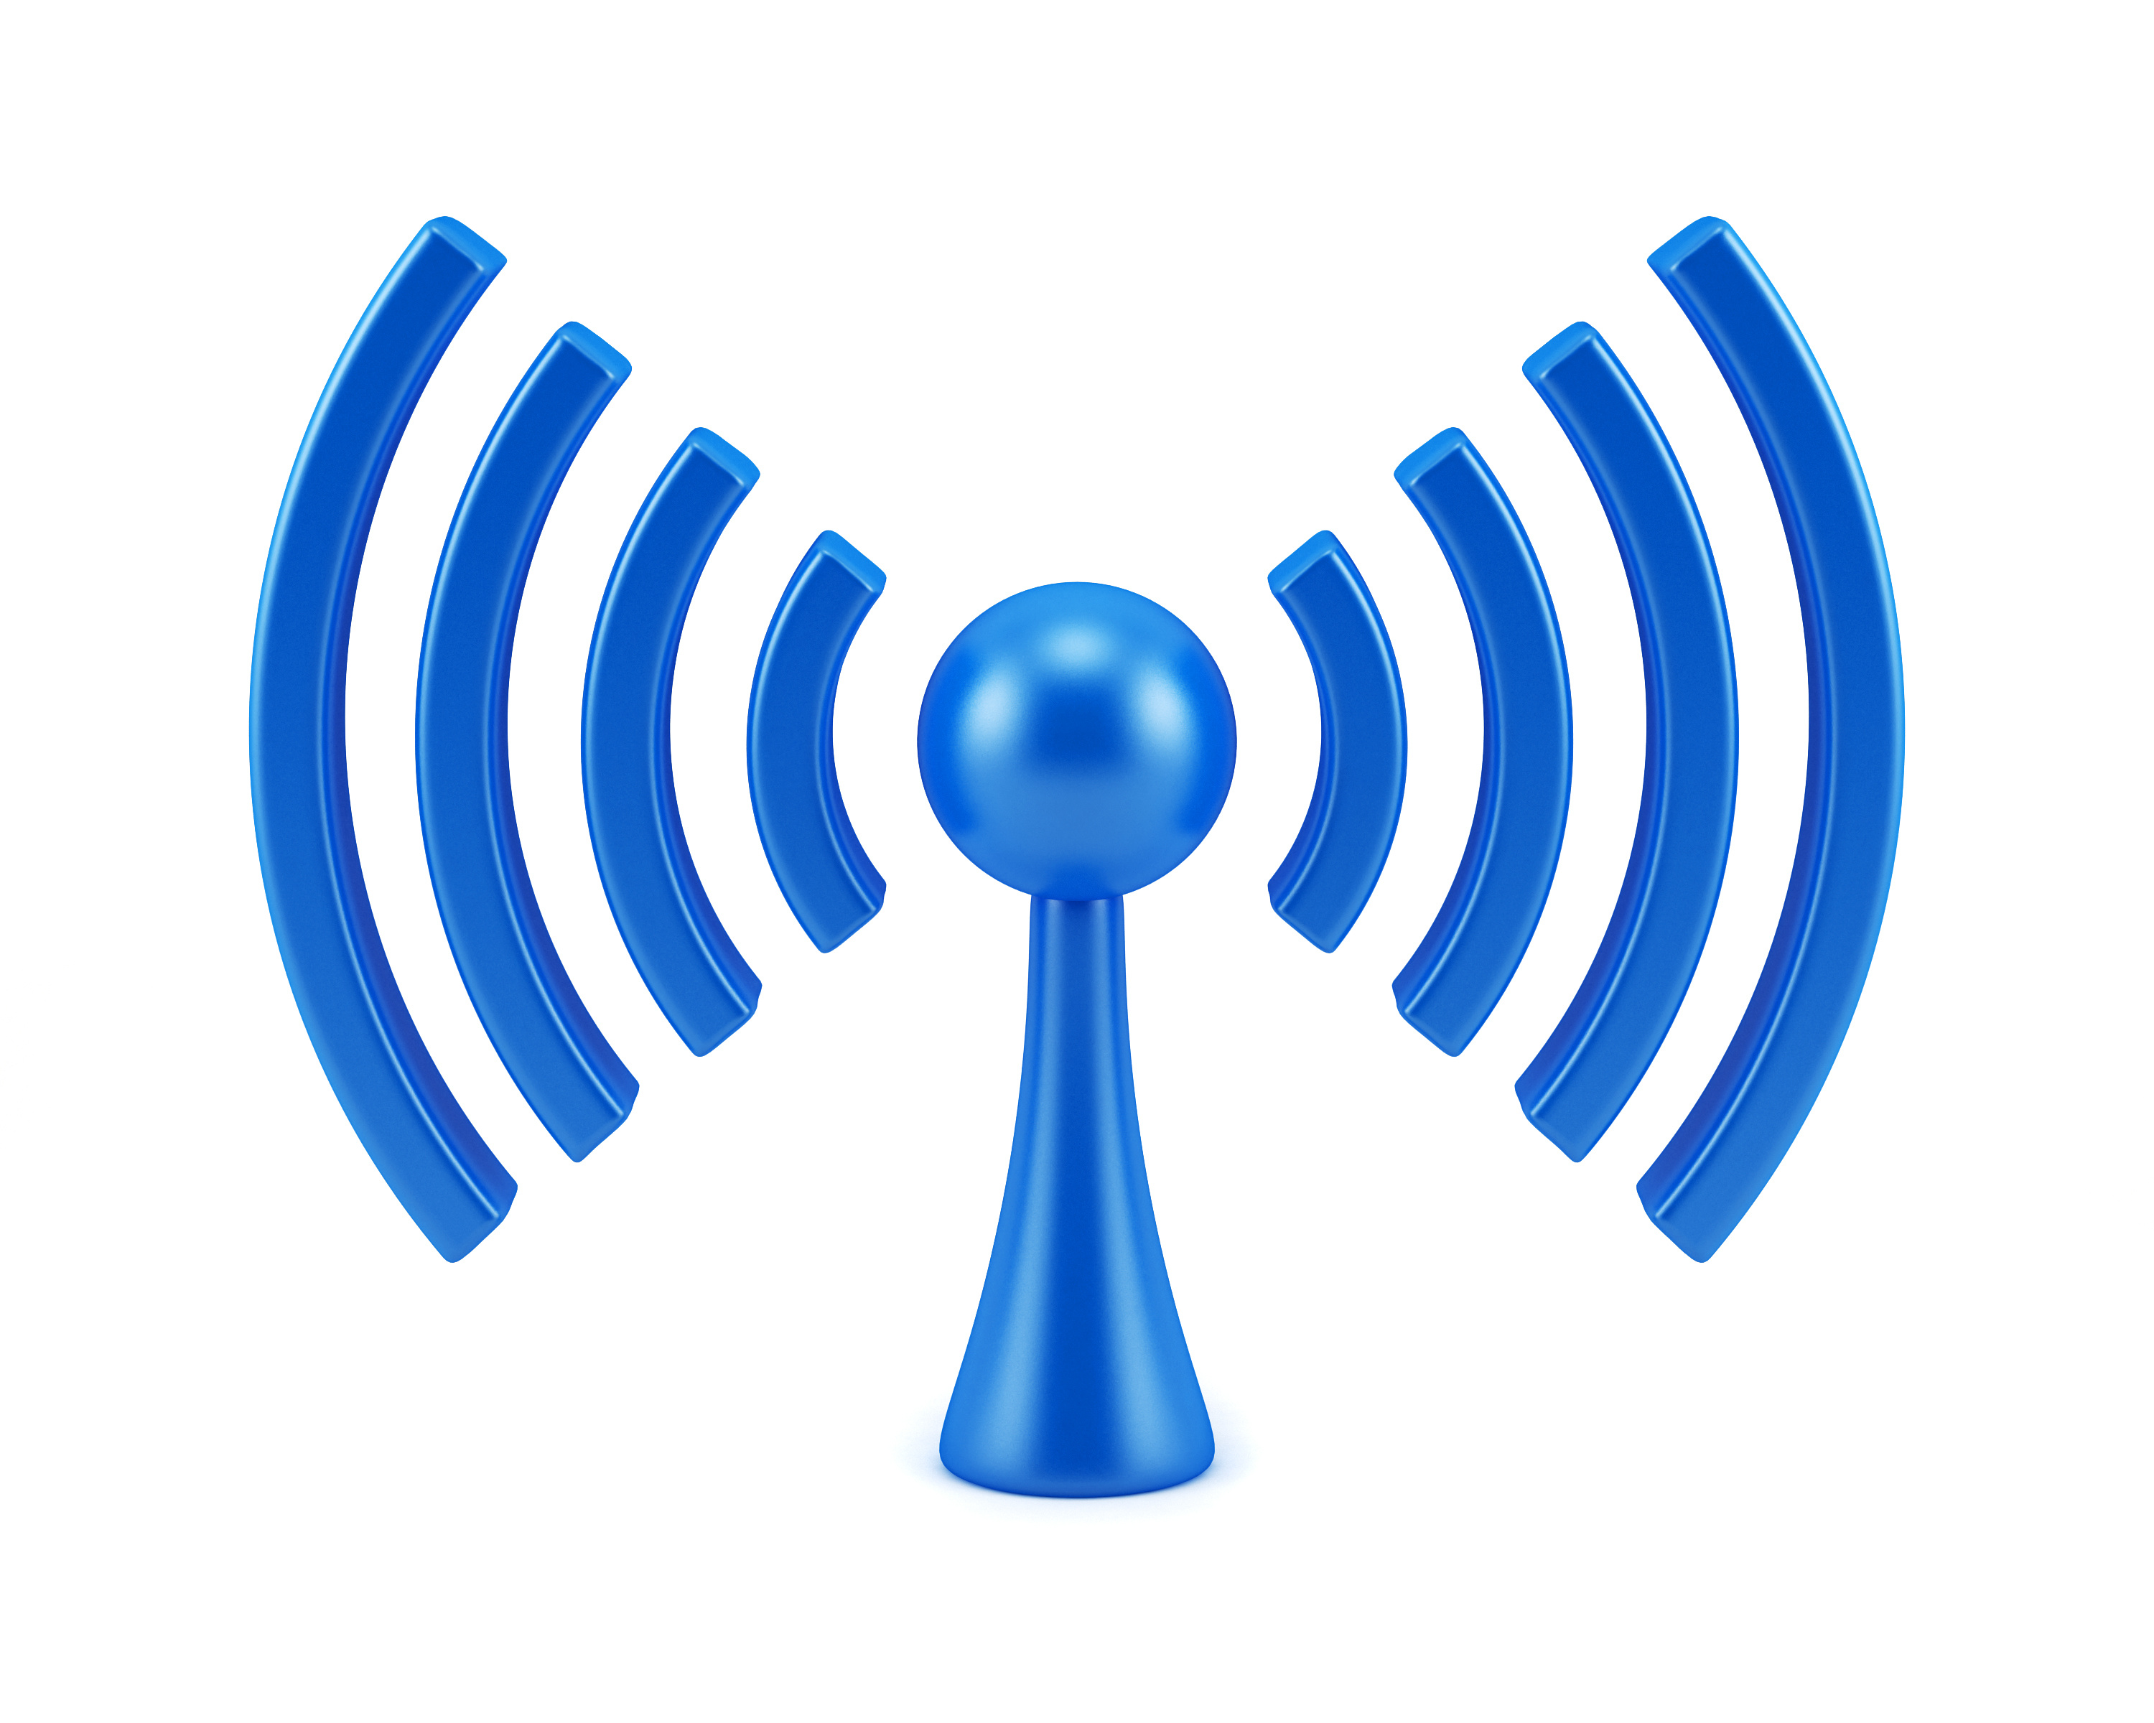
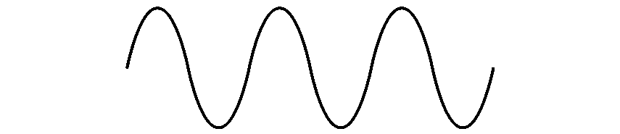

COM-405: Mobile Networks
Lecture 2.0: Wireless Channel
Haitham Hassanieh
Laboratory of SEnsing
& Networking Systems

Slide 2

Wireless Radio Frontend
1011010110011001
1011010110011001
Digital Input
Digital Output
TX
RX
Mixer
Mixer
PA
DAC
LPF
BPF
LNA
BPF
LPF
ADC
PLL
PLL

Slide 3
Wireless Communication
1011010110011001
1011010110011001
Digital Input
Digital Output
TX
RX
1011010110
1011010110
Mixer
Mixer
Modulation
PA
Demodulation
DAC
LPF
BPF
LNA
BPF
LPF
ADC
PLL
PLL
BPSK: 1 bits/symbol
Modulation:
Mapping of Bits to Symbols
$$1$$
$$0$$
$$−1$$
$$+1$$

Slide 4
Wireless Communication
1011010110011001
1011010110011001
Digital Input
Digital Output
TX
RX
1011010110
1011010110
Mixer
Mixer
Modulation
PA
Demodulation
DAC
LPF
BPF
LNA
BPF
LPF
ADC
PLL
PLL
PAM: 2 bits/symbol
Modulation:
Mapping of Bits to Symbols
$$11$$
$$10$$
$$00$$
$$01$$
$$−3$$
$$−1$$
$$+1$$
$$+3$$

Slide 5
























Wireless Communication
1011010110011001
1011010110011001
Digital Input
Digital Output
TX
RX
1011010110
1011010110
Mixer
Mixer
Modulation
PA
Demodulation
DAC
LPF
BPF
LNA
BPF
LPF
ADC
$$0000$$
$$0100$$
$$1100$$
$$1000$$
PLL
PLL
$$0001$$
$$0101$$
$$1101$$
$$1001$$
16-QAM:
4 bits/symbol
Modulation:
Mapping of Bits to Symbols
$$−3$$
$$−1$$
$$+1$$
$$+3$$
$$−3$$
$$−1$$
$$+1$$
$$+3$$
$$0011$$
$$0111$$
$$1111$$
$$1011$$
Complex Symbols!
$$0010$$
$$0110$$
$$1110$$
$$1010$$

Slide 6
Wireless Channel
1011010110011001
1011010110011001
Digital Input
Digital Output
TX
RX
Channel
1011010110
1011010110
Mixer
Mixer
Modulation
PA
Demodulation
DAC
LPF
BPF
LNA
BPF
LPF
ADC
PLL
PLL

Slide 7


Wireless Channel
1011010110011001
1011010110011001
Digital Input
Digital Output
TX
RX
1011010110
1011010110
Channel
Modulation
$$x\left(t\right)$$
$$y\left(t\right)$$
Demodulation

Slide 8


Wireless Channel
1011010110011001
1011010110011001
Digital Input
Digital Output
TX
RX
1011010110
1011010110
Channel
Modulation
$$x\left(t\right)$$
$$y\left(t\right)$$
Demodulation
$$y\left(t\right)=x\left(t\right)+v(t)$$
Channel adds noise (AWGN)!
$$v\left(t\right)\sim N\left(0,σ\right)$$

Slide 9

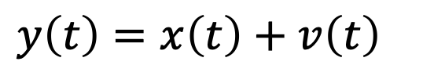



Noise
Circuit Components and wireless channel add noise to the wireless signal.
Transmit
Receive
$$x\left(t\right)$$
$$y\left(t\right)=x\left(t\right)+v\left(t\right)$$
$v\left(t\right)$ is Additive White Gaussian Noise (AWGN)
Low noise is good
→ Can decode Bits correctly
High noise is bad
→ Cannot decode Bits correctly
$$+$$
$$=$$
Bits:
0
1
0
0
$$+$$
$$=$$
Bits:
0
1
0
0

Slide 10
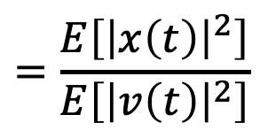
Noise
Circuit Components and wireless channel add noise to the wireless signal.
Transmit
Receive
$$x\left(t\right)$$
$$y\left(t\right)=x\left(t\right)+v\left(t\right)$$
$v\left(t\right)$ is Additive White Gaussian Noise (AWGN)
Low noise is good → Can decode Bits correctly
High noise is bad → Cannot decode Bits correctly
Signal-to-Noise Ratio (SNR)
$$SNR=\frac{Signal Power}{Noise Power}$$
$$=\frac{E\left[{\left|x\left(t\right)\right|}^{2}\right]}{E\left[{\left|v\left(t\right)\right|}^{2}\right]}$$
$$=\frac{E_{s}}{N_{0}}$$

Slide 11
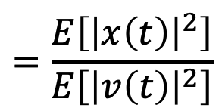
Noise
Circuit Components and wireless channel add noise to the wireless signal.
Transmit
Receive
$$x\left(t\right)$$
$$y\left(t\right)=x\left(t\right)+v\left(t\right)$$
$v\left(t\right)$ is Additive White Gaussian Noise (AWGN)
Signal-to-Noise Ratio (SNR)
$$SNR=\frac{Signal Power}{Noise Power}$$
$$=\frac{E\left[{\left|x\left(t\right)\right|}^{2}\right]}{E\left[{\left|v\left(t\right)\right|}^{2}\right]}$$
$$=\frac{E_{s}}{N_{0}}$$
We typically measure and report SNR in dB scale: $SNR_{dB}=10\log_{10}{SNR}$
e.g., if $SNR = 100$, then $SNR_{dB} = 20 dB$,
if $SNR = 2$, then $SNR_{dB}≈ 3dB$.

Slide 12


Wireless Channel
1011010110011001
1011010110011001
Digital Input
Digital Output
TX
RX
1011010110
1011010110
Channel
Modulation
$$x\left(t\right)$$
$$y\left(t\right)$$
Demodulation
$$y\left(t\right)=x\left(t−τ\right)+v(t)$$
Channel delays the signal!
$$τ=\frac{d}{c}$$

Slide 13

Wireless Channel
1011010110011001
1011010110011001
Digital Input
Digital Output
TX
RX
1011010110
1011010110
Channel
Modulation
$$x\left(t\right)$$
$$y\left(t\right)$$
Demodulation
$$y\left(t\right)=h x\left(t−τ\right)+v(t)$$
Channel attenuates the signal (Pathloss)

Slide 14
Given a distance $d$ and frequency of operation $f,$the received signal power is proportional to:
A. $∝d ,∝f$
B. $∝1/d,∝1/f$
C. $∝1/d^{2},∝1/f^{2}$
D. $∝1/d^{2},∝f^{2}$

Slide 15
Given a distance $d$ and frequency of operation $f,$the received signal power is proportional to:
A. $∝d ,∝f$
B. $∝1/d,∝1/f$
C. $∝1/d^{2},∝1/f^{2}$
D. $∝1/d^{2},∝f^{2}$

Slide 16
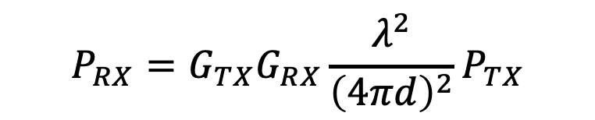

Wireless Channel
1011010110011001
1011010110011001
Digital Input
Digital Output
TX
RX
1011010110
1011010110
Channel
Modulation
$$x\left(t\right)$$
$$y\left(t\right)$$
Demodulation
$$y\left(t\right)=h x\left(t−τ\right)+v(t)$$
Channel attenuates the signal (Pathloss)
$$P_{RX}=G_{TX}G_{RX}\frac{λ^{2}}{{\left(4πd\right)}^{2}}P_{TX}$$
$$\left|h\right|∝\frac{λ}{d}$$

Slide 17

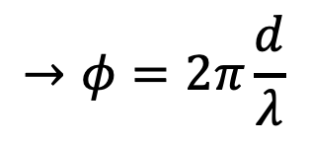

Wireless Channel
1011010110011001
1011010110011001
Digital Input
Digital Output
TX
RX
1011010110
1011010110
Channel
Modulation
$$x\left(t\right)$$
$$y\left(t\right)$$
Demodulation
$$y\left(t\right)=h x\left(t−τ\right)+v(t)$$
Channel rotates the signal (Adds Phase)
$$h∝\frac{λ}{d}e^{jφ}$$
$$→φ=2π\frac{d}{λ}$$

Slide 18
Wireless Channel
1011010110011001
1011010110011001
Digital Input
Digital Output
TX
RX
1011010110
1011010110
Channel
Modulation
$$x\left(t\right)$$
$$y\left(t\right)$$
Demodulation
$$y\left(t\right)=h x\left(t−τ\right)+v(t)$$
$$x\left(t\right)$$
$$×e^{−j2πf_{c}t}$$
$$\left|h\right|x\left(t−τ\right)e^{−j2πf_{c}\left(t−τ\right)}$$
$$×e^{j2πf_{c}t}$$
$$\left|h\right|x\left(t−τ\right)e^{j2πf_{c}τ}$$
$$h∝\frac{λ}{d}e^{jφ}$$
$$=2π\frac{c}{λ}\frac{d}{c}$$
$$=2π\frac{d}{λ}$$
$$→h∝\frac{λ}{d}e^{j2πd/λ}$$
$$→φ=2πf_{c}τ$$

Slide 19
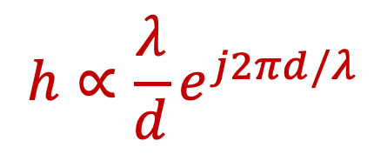

Wireless Channel
1011010110011001
1011010110011001
Digital Input
Digital Output
TX
RX
1011010110
1011010110
Channel
Modulation
$$x\left(t\right)$$
$$y\left(t\right)$$
Demodulation
$$y\left(t\right)=h x\left(t−τ\right)+v(t)$$
Channel:
Adds Noise
Delays the Signal
Attenuates the Signal
Rotates the Phase of the Signal
$$h∝\frac{λ}{d}e^{j2πd/λ}$$

Slide 20












The Channel
Consider BPSK Modulation.
$$0→−1$$
$$1→+1$$
$$Q$$
$$Q$$
$$−1$$
$$+1$$
$$I$$
$$−1$$
$$+1$$
$$I$$
$$x\left(t\right)$$
$$h×x\left(t\right)$$
$$+v\left(t\right)$$

Slide 21
The Channel
Consider BPSK Modulation.
$$0→−1$$
$$1→+1$$
$$Q$$
$$Q$$
$$−1$$
$$+1$$
$$I$$
$$−1$$
$$+1$$
$$I$$
$$x\left(t\right)$$
$$h×x\left(t\right)$$
$$+v\left(t\right)$$

Slide 22









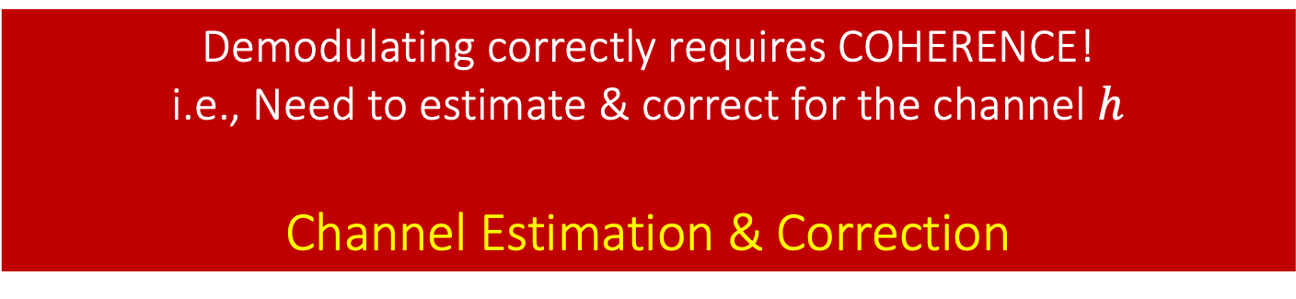
The Channel
Consider QAM Modulation
$$Q$$
$$−3$$
$$−3$$
$$−1$$
$$−1$$
$$+1$$
$$+1$$
$$+3$$
$$+3$$
$$I$$
Demodulating correctly requires COHERENCE!
i.e., Need to estimate & correct for the channel $h$
Channel Estimation & Correction

Slide 23












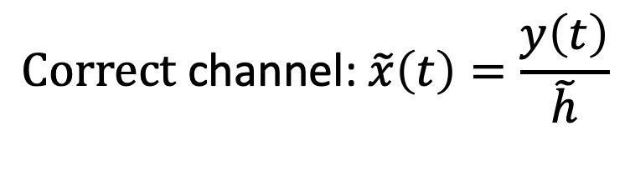





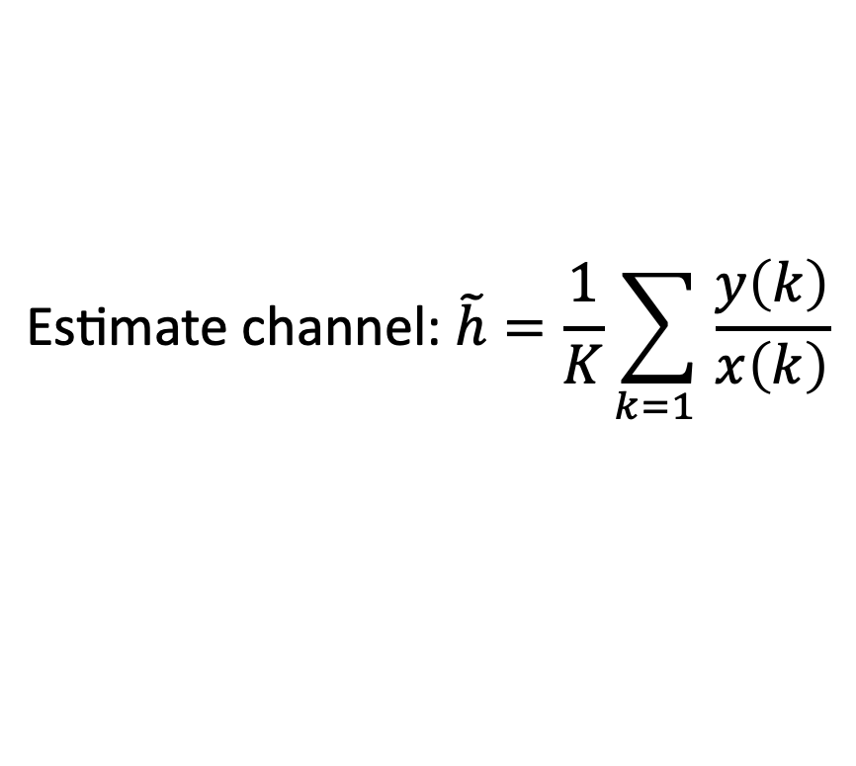
Channel Estimation & Correction
Consider BPSK Modulation.
$$0→−1$$
$$1→+1$$
$$Q$$
$$Q$$
$$−1$$
$$+1$$
$$I$$
$$−1$$
$$+1$$
$$I$$
$$x\left(t\right)$$
$$h×x\left(t\right)$$
$$+v\left(t\right)$$
Send Training Sequence (Preamble Bits): Known Bits
$$x\left(0\right)=1$$
$$y\left(0\right)=h+v\left(0\right)$$
$$\text{Estimate} \text{channel}\text{:} \tilde{h}=\frac{1}{K}\sum_{k=1 }{\frac{y\left(k\right)}{x\left(k\right)}}$$
$$x\left(1\right)=1$$
$$y\left(1\right)=h+v\left(1\right)$$
$$x\left(2\right)=−1$$
$$y\left(2\right)=−h+v\left(2\right)$$
$$\text{Correct} \text{channel}\text{:} \tilde{x}\left(t\right)=\frac{y\left(t\right)}{\tilde{h}}$$

Slide 24
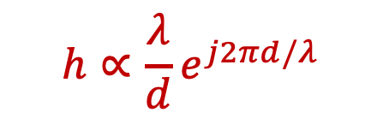


Single Path Channel
1011010110011001
1011010110011001
Digital Input
Digital Output
TX
RX
Channel
$$x\left(t\right)$$
$$y\left(t\right)=h x\left(t−τ\right)+v(t)$$
$$h∝\frac{λ}{d}e^{j2πd/λ}$$
Assumes single path!

Slide 25




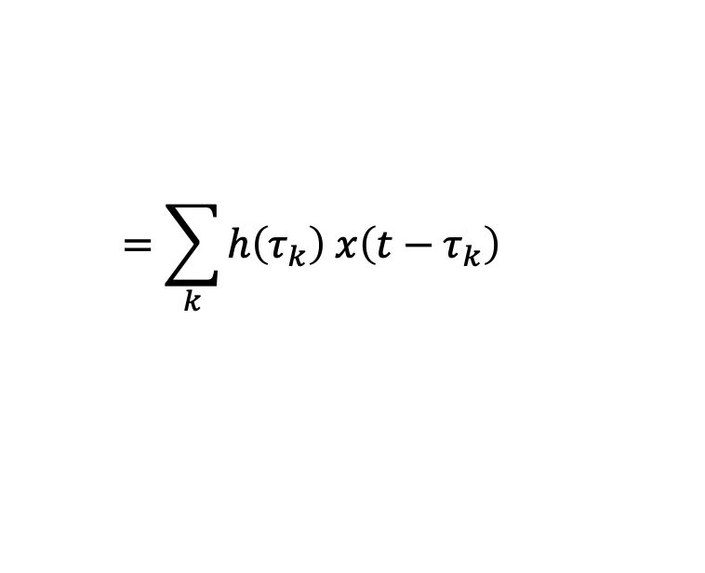
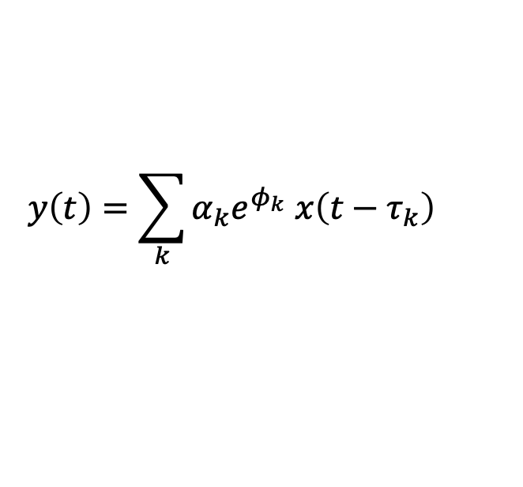
Multipath Channel
1011010110011001
1011010110011001
Digital Input
Digital Output
TX
RX
Multipath Propagation: radio signal reflects off objects ground, arriving at destination at slightly different times
$$y\left(t\right)=α_{1}e^{φ_{1}} x\left(t−τ_{1}\right)$$
$$+ α_{2}e^{φ_{2}} x\left(t−τ_{2}\right)$$
$$+ α_{3}e^{φ_{3}} x\left(t−τ_{3}\right)⋯$$
$$y\left(t\right)=\sum_{k}{α_{k}e^{φ_{k}} x\left(t−τ_{k}\right) }$$
$$=\sum_{k}{h\left(τ_{k}\right) x\left(t−τ_{k}\right) }$$
$$=h\left(t\right)∗x\left(t\right)$$
$h\left(t\right)$ is channel impulse response.

Slide 26




Multipath Channel
$h\left(t\right)$ is channel impulse response.
$$y\left(t\right)=\sum_{k}{h\left(τ_{k}\right) x\left(t−τ_{k}\right) }=h\left(t\right)∗x\left(t\right)$$
First Path
$$+1$$
Second Path
$$t$$
nth Path
$$−1$$
Multi-tap Channel
ISI: Inter-Symbol-Interference
Symbols arriving along late paths interfere with following symbols.

Slide 27
Multipath Channel
Paths sum with
different phases:
Constructive/Destructive
$h\left(t\right)$ is channel impulse response.
$$y\left(t\right)=\sum_{k}{h\left(τ_{k}\right) x\left(t−τ_{k}\right) }=h\left(t\right)∗x\left(t\right)$$
ISI
First Path
$$+1$$
Second Path
$$t$$
nth Path
$$−1$$
Multi-tap Channel
ISI: Inter-Symbol-Interference
Symbols arriving along late paths interfere with following symbols.
Channel Fading
Symbols arriving along different paths sum up destructively

Slide 28
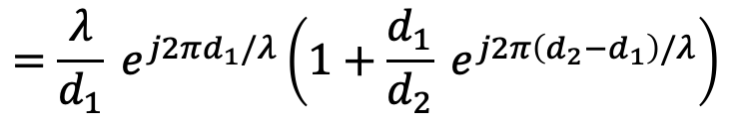
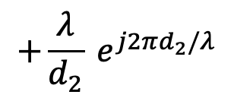

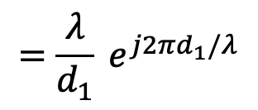


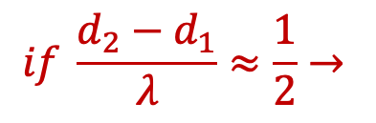
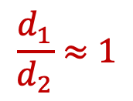
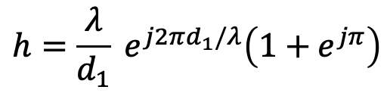
Multipath Channel
$h\left(t\right)$ is channel impulse response.
$$y\left(t\right)=\sum_{k}{h\left(τ_{k}\right) x\left(t−τ_{k}\right) }=h\left(t\right)∗x\left(t\right)$$
Channel Fading:
Symbols arriving along different paths sum up destructively
Example 2 paths with distance $d_{1} and d_{2}$
$$=\frac{λ}{d_{1}} e^{j2πd_{1}/λ}$$
$$+\frac{λ}{d_{2}} e^{j2πd_{2}/λ}$$
$$h=$$
$$h_{1}+h_{2}$$
$$=\frac{λ}{d_{1}} e^{j2πd_{1}/λ}\left(1+\frac{d_{1}}{d_{2}} e^{j2π\left(d_{2}−d_{1}\right)/λ}\right)$$
$$\frac{d_{1}}{d_{2}}≈1$$
$$if \frac{d_{2}−d_{1}}{λ}≈\frac{1}{2}→$$
$$h=\frac{λ}{d_{1}} e^{j2πd_{1}/λ}\left(1+e^{jπ}\right)$$
$$=0$$
Destructive Interference!

Slide 29
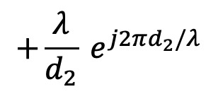
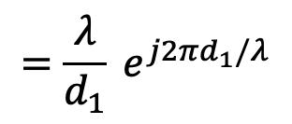

Multipath Channel
Channel Fading:
Symbols arriving along different paths sum up destructively
Suppose the 2 paths have distance $d_{1}=1m, d_{2}=1.06m$:
$$=\frac{λ}{d_{1}} e^{j2πd_{1}/λ}$$
$$+\frac{λ}{d_{2}} e^{j2πd_{2}/λ}$$
$$h=$$
$$h_{1}+h_{2}$$
Compute h if the signal is transmitted at 2.5 GHz and 5 GHz. How much will power of the receiver signal differ if it is transmitted at 5 GHz instead of 2.5 GHz?
A. – 6 dB
B. 0 dB
C. 12.3 dB
D. 24.6 dB

Slide 30

Multipath Channel
Channel Fading:
Symbols arriving along different paths sum up destructively
Suppose the 2 paths have distance $d_{1}=1m, d_{2}=1.06m$:
$$=\frac{λ}{d_{1}} e^{j2πd_{1}/λ}$$
$$+\frac{λ}{d_{2}} e^{j2πd_{2}/λ}$$
$$h=$$
$$h_{1}+h_{2}$$
Compute h if the signal is transmitted at 2.5 GHz and 5 GHz. How much will power of the receiver signal differ if it is transmitted at 5 GHz instead of 2.5 GHz?
A. – 6 dB
B. 0 dB
C. 12.3 dB
D. 24.6 dB

Slide 31
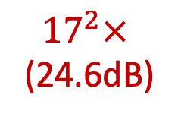
Multipath Channel
Channel Fading:
Symbols arriving along different paths sum up destructively
Suppose the 2 paths have distance $d_{1}=1m, d_{2}=1.06m$:
$$=\frac{λ}{d_{1}} e^{j2πd_{1}/λ}$$
$$+\frac{λ}{d_{2}} e^{j2πd_{2}/λ}$$
$$h=$$
$$h_{1}+h_{2}$$
Compute h if the signal is transmitted at 2.5 GHz and 5 GHz. How much will power of the receiver signal differ if it is transmitted at 5 GHz instead of 2.5 GHz?
$@f_{1}=2.5GHz \left(λ=12 cm\right):|h|=|0.12 e^{j\frac{2π}{3}}+0.113 e^{j\frac{5π}{3}}|≈0.006$8
$${17}^{2}×$$
(24.6dB)
$$@f_{2}=5GHz \left(λ=6 cm\right): |h|=|0.06 e^{j\frac{4π}{3}}+0.056 e^{j\frac{4π}{3}}|≈0.116$$
Frequency Selective Fading

Slide 32

Multipath Channel
$h\left(t\right)$ is channel impulse response.
$$y\left(t\right)=\sum_{k}{h\left(τ_{k}\right) x\left(t−τ_{k}\right) }=h\left(t\right)∗x\left(t\right)$$
$$⟺ H\left(f\right)X\left(f\right)$$
First Path
Second Path
nth Path
Multi-tap Channel

Slide 33
Multipath Channel
$h\left(t\right)$ is channel impulse response.
$$y\left(t\right)=\sum_{k}{h\left(τ_{k}\right) x\left(t−τ_{k}\right) }=h\left(t\right)∗x\left(t\right)$$
$$⟺ H\left(f\right)X\left(f\right)$$
Fading
First Path
Second Path
nth Path
100 MHz
Multi-tap Channel
Frequency Selective Fading
Symbols arriving along different paths sum up destructively
ISI: Inter-Symbol-Interference
Problematic in
Wideband Channel!
Symbols arriving along late paths interfere with following symbols.

Slide 34
Narrowband Channel
$h\left(t\right)$ is channel impulse response.
$$y\left(t\right)=\sum_{k}{h\left(τ_{k}\right) x\left(t−τ_{k}\right) }=h\left(t\right)∗x\left(t\right)$$
$$⟺ H\left(f\right)X\left(f\right)$$
100 MHz

Slide 35
Narrowband Channel
$h\left(t\right)$ is channel impulse response.
$$y\left(t\right)=\sum_{k}{h\left(τ_{k}\right) x\left(t−τ_{k}\right) }=h\left(t\right)∗x\left(t\right)$$
$$⟺ H\left(f\right)X\left(f\right)$$
2MHz

Slide 36
Narrowband Channel
$h\left(t\right)$ is channel impulse response.
$$y\left(t\right)=\sum_{k}{h\left(τ_{k}\right) x\left(t−τ_{k}\right) }=h\left(t\right)∗x\left(t\right)$$
$$⟺ H\left(f\right)X\left(f\right)$$
2MHz

Slide 37


Narrowband Channel
$h\left(t\right)$ is channel impulse response.
$$y\left(t\right)=\sum_{k}{h\left(τ_{k}\right) x\left(t−τ_{k}\right) }=h\left(t\right)∗x\left(t\right)$$
$$⟺ H\left(f\right)X\left(f\right)$$
Narrowband
Symbol time: $T∝\frac{1}{Bandwidth}$
$$≫τ_{k}$$
Flat Channel

Slide 38
Narrowband Channel
$h\left(t\right)$ is channel impulse response.
$$y\left(t\right)=\sum_{k}{h\left(τ_{k}\right) x\left(t−τ_{k}\right) }=h\left(t\right)∗x\left(t\right)$$
$$⟺ H\left(f\right)X\left(f\right)$$
Narrowband
Symbol time: $T∝\frac{1}{Bandwidth}$
$$≫τ_{k}$$
Flat Channel

Slide 39
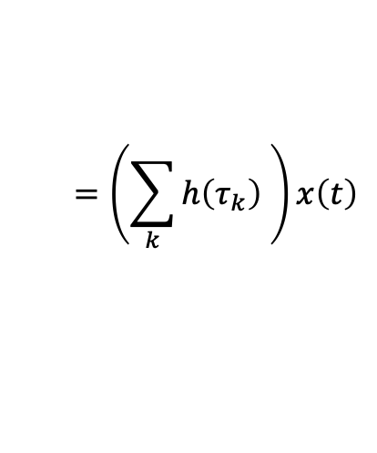
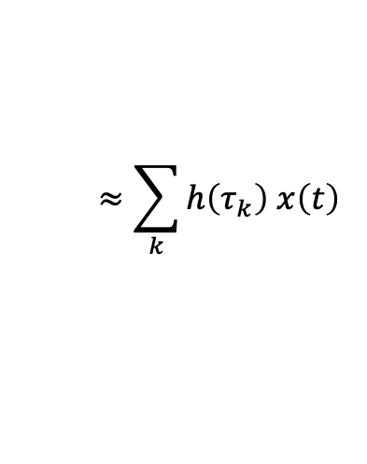
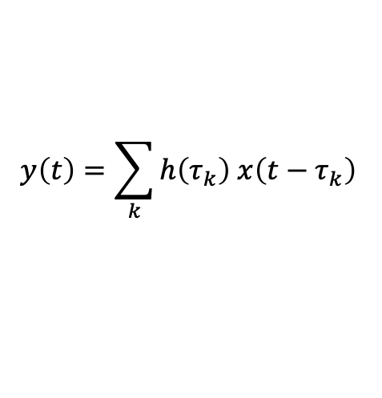

Narrowband Channel
$h\left(t\right)$ is channel impulse response.
$$y\left(t\right)=\sum_{k}{h\left(τ_{k}\right) x\left(t−τ_{k}\right) }=h\left(t\right)∗x\left(t\right)$$
$$⟺ H\left(f\right)X\left(f\right)$$
Narrowband
Symbol time: $T∝\frac{1}{Bandwidth}$
$$≫τ_{k}$$
Flat Channel
$$y\left(t\right)=\sum_{k}{h\left(τ_{k}\right) x\left(t−τ_{k}\right) }$$
$$≈\sum_{k}{h\left(τ_{k}\right) x\left(t\right) }$$
$$=\left(\sum_{k}{h\left(τ_{k}\right) }\right)x\left(t\right)$$
$$=hx\left(t\right)$$
Narrowband Channel is Approximated by a Single Tap Channel

Slide 40

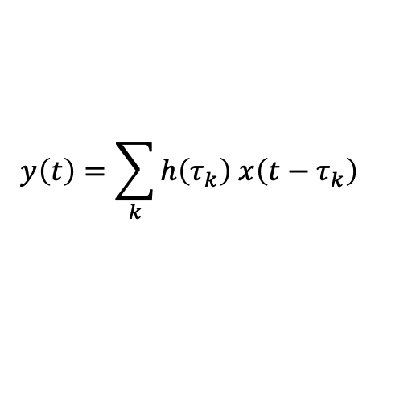
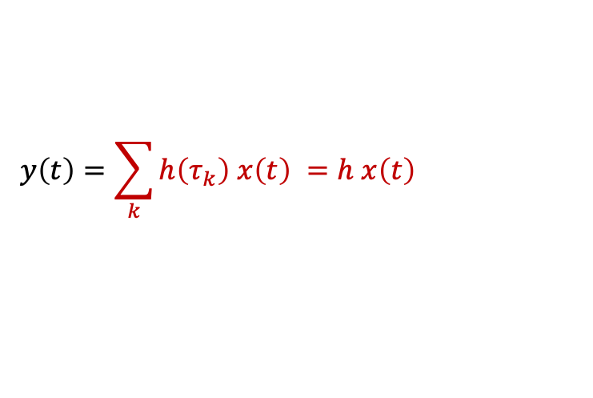
Narrowband Channel
$h\left(t\right)$ is channel impulse response.
$$y\left(t\right)=\sum_{k}{h\left(τ_{k}\right) x\left(t\right) }=h x\left(t\right)$$
$$⟺ h X\left(f\right)$$
Narrowband
Symbol time: $T∝\frac{1}{Bandwidth}$
$$≫τ_{k}$$
Flat Channel
$$y\left(t\right)=\sum_{k}{h\left(τ_{k}\right) x\left(t−τ_{k}\right) }$$
$$≈\sum_{k}{h\left(τ_{k}\right) x\left(t\right) }$$
$$=\left(\sum_{k}{h\left(τ_{k}\right) }\right)x\left(t\right)$$
$$=hx\left(t\right)$$
Narrowband Channel is Approximated by a Single Tap Channel

Slide 41








Narrowband vs. Wideband Channel
Narrowband Channel
Wideband Channel
$$h x\left(t\right)$$
$$h\left(t\right)∗ x\left(t\right)$$
$$+1$$
$$+1$$
$$t$$
$$t$$
$$−1$$
$$−1$$
Symbol Time
Symbol Time
ISI
ISI

Slide 42




Narrowband vs. Wideband Channel
Narrowband Channel
Wideband Channel
$h x\left(t\right)$ $⟺ h X\left(f\right)$
$h\left(t\right)∗ x\left(t\right)$ $⟺ H(f) X\left(f\right)$
$≈$ Single Tap
$≈$ Flat Channel
Multi-tap
Channel
(ISI)
Frequency
Selective Channel
Need to correct for ISI to be able to decode correctly!
Estimating and Correcting for multi-tap channel is hard

Slide 43
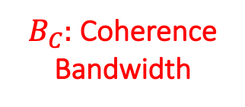

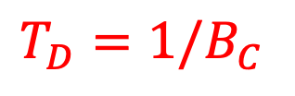
Multipath Wideband Channel
$h\left(t\right)∗ x\left(t\right)$ $⟺ H(f) X\left(f\right)$
Multi-tap Channel (ISI)
Frequency Selective Channel
$T_{D}:$ Delay Spread
$B_{C}:$ Coherence
Bandwidth
$T_{D}=1/B_{C}$
Delay Spread: Spread of the channel in time i.e. time delay between first and last path received above noise floor
Coherence Bandwidth: region where the channel frequency response is flat (coherent).

Slide 44

Time Varying Channel
So far, considered only static channels, i.e. the channel does not change.
But the channel $h(t)$ cannot be the same forever
Reasons why $h(t)$ changes:
Environment changes:
Reflectors move
People moving around
Doppler
Spread/Shift
Transmitter or Receiver Moves:
Reflectors move
People moving around

Slide 45
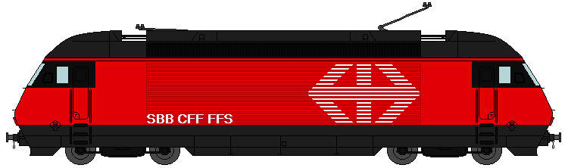
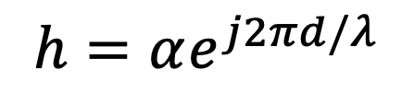
Doppler Shift
TX
$$h=αe^{j2πd/λ}$$
RX
RX

Slide 46
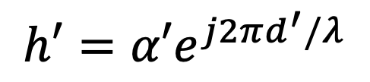
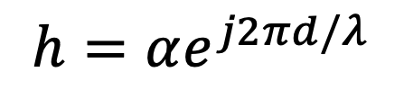
Doppler Shift
TX
$$h′=α′e^{j2πd^{′}/λ}$$
$$h=αe^{j2πd/λ}$$
RX
RX

Slide 47
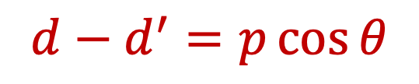


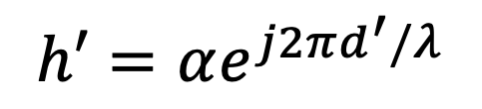

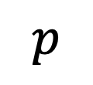
Doppler Shift
TX
$$d−d^{′}=p\cos{θ}$$
$$h′=αe^{j2π\left(d−p\cos{θ}\right)/λ}$$
$$p$$
$$h′=αe^{j2πd^{′}/λ}$$
$$h=αe^{j2πd/λ}$$
$$θ$$
$$θ$$
RX
RX

Slide 48


Doppler Shift
TX
$$d−d^{′}=p\cos{θ}$$
$$h′=αe^{j2π\left(d−p\cos{θ}\right)/λ}$$
$$p$$
$$h=αe^{j2πd/λ}$$
$$θ$$
$$θ$$
$$θ$$
$$θ$$
RX
RX
RX
RX
RX

Slide 49
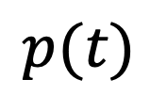

Doppler Shift
TX
$$d−d^{′}=p\cos{θ}$$
$$h′=αe^{j2π\left(d−p\cos{θ}\right)/λ}$$
$$h=αe^{j2πd/λ}$$
$$θ$$
$$θ$$
$$θ$$
$$θ$$
RX
RX
RX
RX
RX
$$p(t)$$
$$=vt$$

Slide 50
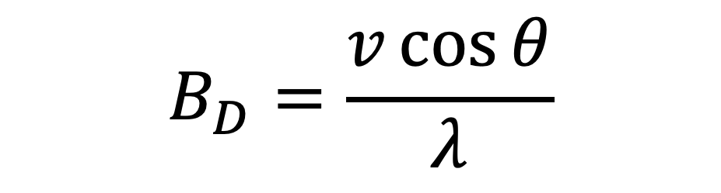

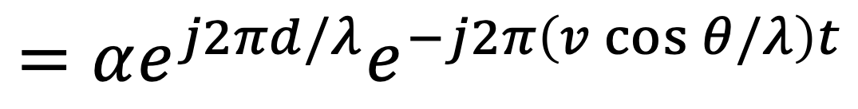
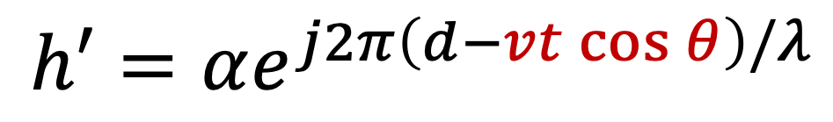
Doppler Shift
$$h′=αe^{j2π\left(d−vt\cos{θ}\right)/λ}$$
$$={αe^{j2πd/λ}e}^{−j2π\left(v\cos{θ}/λ\right)t}$$
$$=he^{−j2πΔft}$$
Doppler Shift: Frequency shift caused by the movement in TX/RX or reflectors
$$B_{D}=\frac{v\cos{θ}}{λ}$$

Slide 51
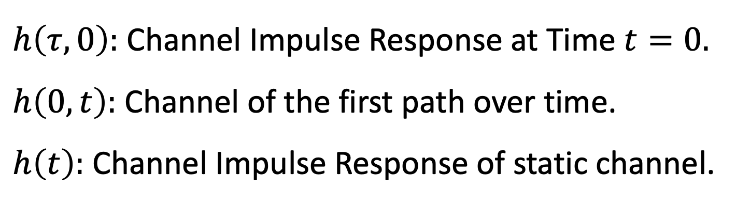
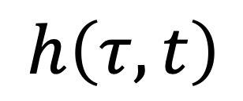
Time Varying Channel
$$h\left(τ, t\right)$$
Delay of different paths
Time Changing
$h\left(τ, 0\right):$ Channel Impulse Response at Time $t=0.$
$h\left(0, t\right):$ Channel of the first path over time.
$h\left(t\right):$ Channel Impulse Response of static channel.

Slide 52
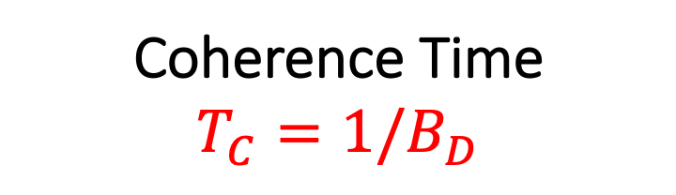

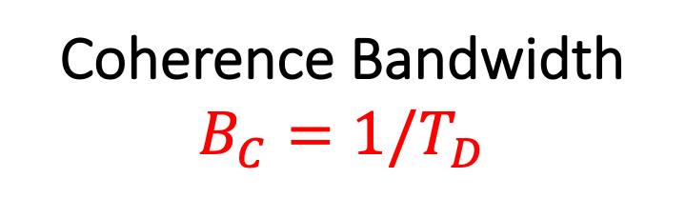

Time Varying Channel
$$h\left(τ, t\right)$$
Delay of different paths
Time Changing
Delay Spread
$T_{D}=Δτ$
Doppler Spread
$$B_{D}=Δf$$
Coherence Bandwidth
$$B_{C}=1/T_{D}$$
Coherence Time
$$T_{C}=1/B_{D}$$

Slide 53
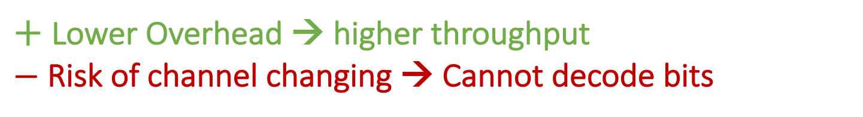
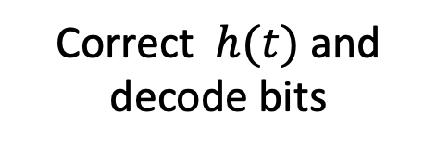
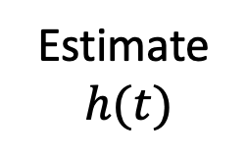
Time Varying Channel
Channel Coherence Time : Time period over which we can assume the channel is static.
Packet
Preamble Bits
Data Bits
Estimate$h(t)$
Correct $h(t)$ and decode bits
Assumption: Channel Coherence Time >> Time to transmit packet
Preamble Bits
Data Bits
$+$ Lower Overhead → higher throughput
$−$Risk of channel changing → Cannot decode bits

