Slide 1



COM-405: Mobile Networks
Lecture 12.0: Multi-Hop Networks
Haitham Hassanieh
Laboratory of SEnsing
& Networking Systems

Slide 2



















Elements of a wireless network
infrastructure mode
base station connects mobiles into wired network
handoff: mobile changes base station providing connection into wired network
network
infrastructure

Slide 3
Elements of a wireless network
ad hoc mode
no base stations
nodes can only transmit to other nodes within link coverage
nodes organize themselves into a network: route among themselves

Slide 4
Wireless network taxonomy
single hop
multiple hops
host connects to
base station (WiFi,
WiMAX, cellular)
which connects to
larger Internet
host may have to
relay through several
wireless nodes to
connect to larger
Internet: mesh net
infrastructure
(e.g., APs)
no base station, no
connection to larger
Internet. May have to
relay to reach other
a given wireless node
MANET, VANET
no
infrastructure
no base station, no
connection to larger
Internet (Bluetooth,
ad hoc nets)

Slide 5


Wireless network characteristics
Problem: A wants to transmit a packet to C
A
d
B
d
C
Option 1: A increases its power such that its packet reaches C
A
B
C
Option 2: A sends that packet to B which intern send it to C
A
B
C

Slide 6
Wireless network characteristics
Problem: A wants to transmit a packet to C
A
d
B
d
C
Option 1: A increases its power such that its packet reaches C
To double transmission range, we need: 4x more overall power!
A
B
C
To transmit over two hops, we need: 2x more overall power!
Option 2: A sends that packet to B which intern send it to C
A
B
C

Slide 7
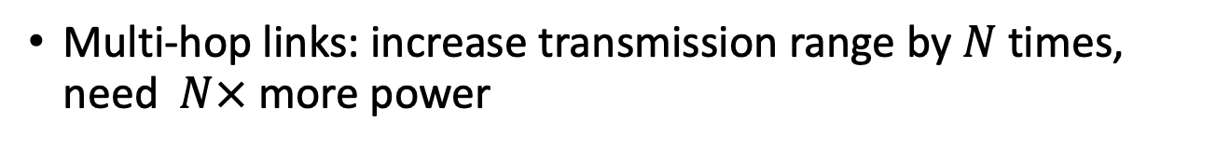
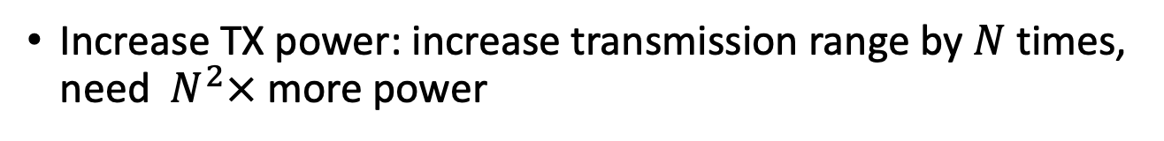
Wireless network characteristics
Multi-hop wireless networks:
A
d
B
d
C
Increase TX power: increase transmission range by $N$ times, need $N^{2}×$ more power
Multi-hop links: increase transmission range by $N$ times, need $N×$ more power
Multi-hop wireless networks!

Slide 8
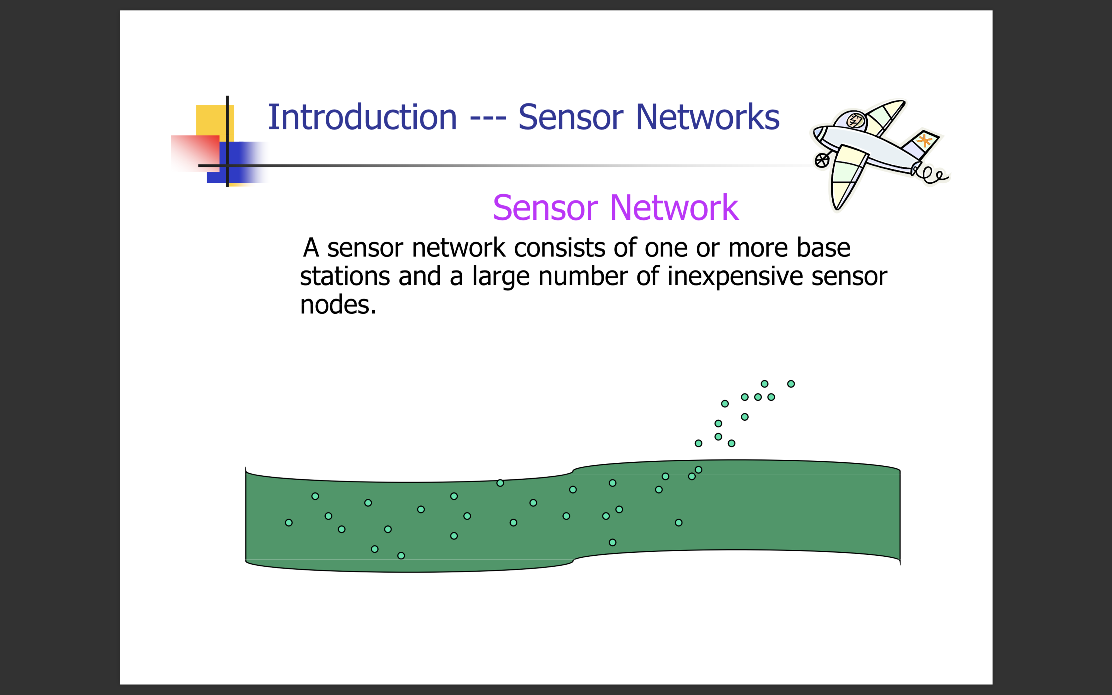
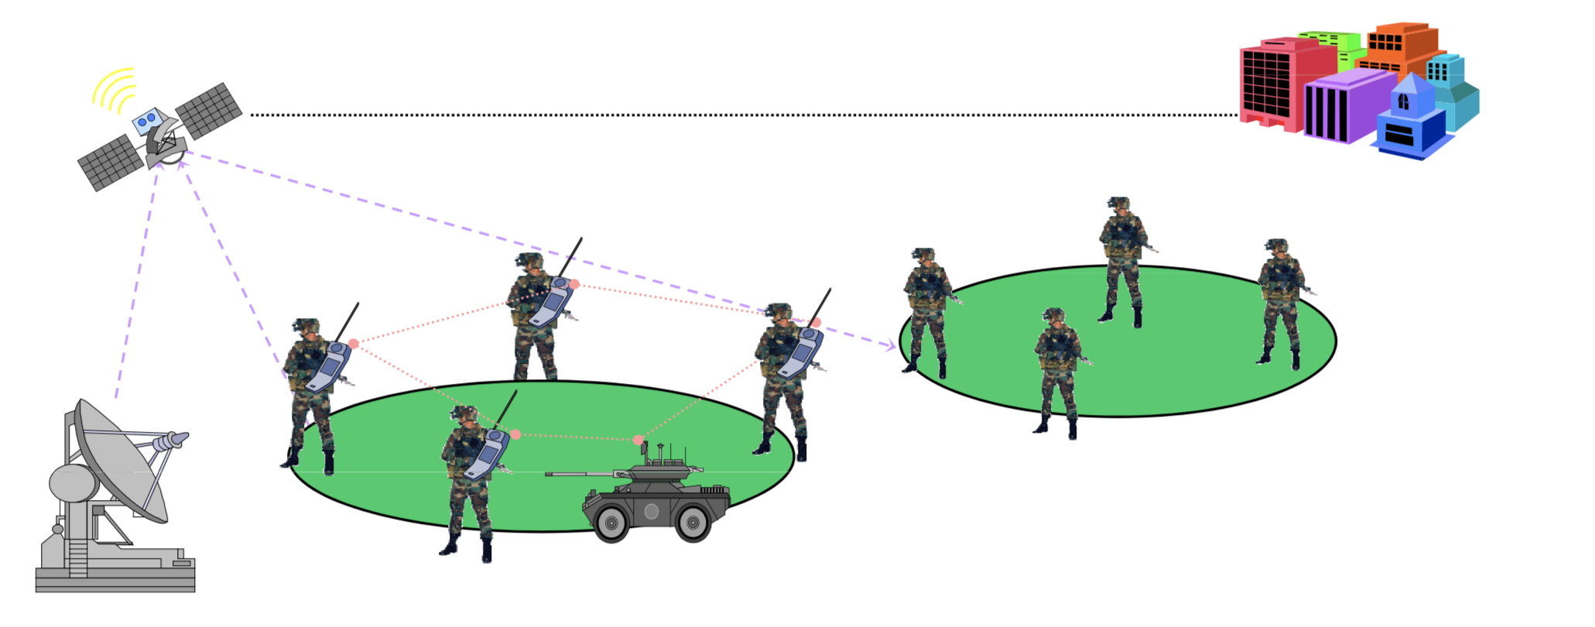
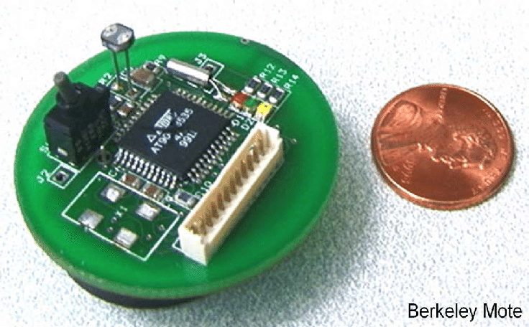
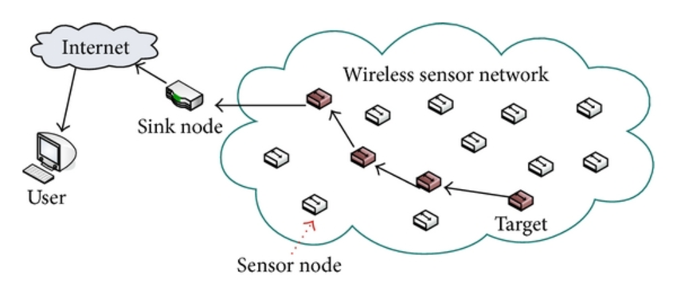
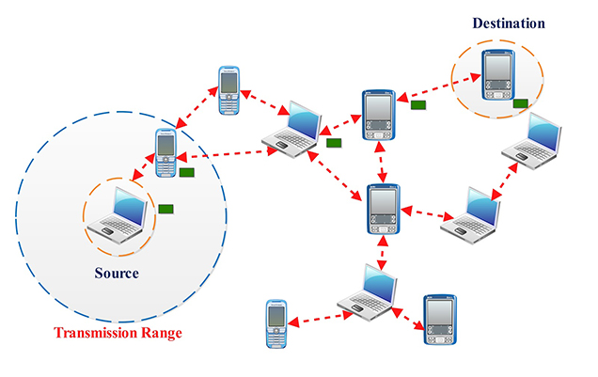
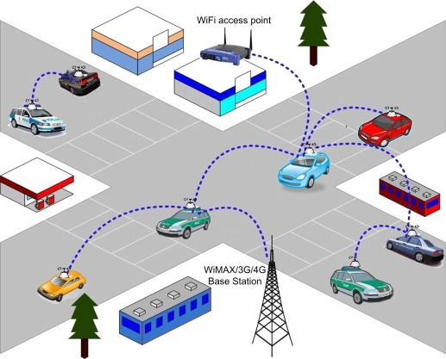
Multi-hop Wireless Networks
Wireless Ad Hoc Networks (WANETs)
Wireless Sensor Networks (WSN)
A wireless Ad hoc network consists of a collection of mobile hosts dynamically forming a temporary network without the use of an existing network infrastructure.
A sensor network consists of one or more base stations and a large number of inexpensive sensors.
Mobile Ad Hoc Networks
(MANETs)
Vehicular Ad Hoc Networks (VANETs)

Slide 9
Wireless Mesh Networks
Very low installation and maintenance cost
Easy to provide coverage outdoors
Ubiquitous access.
Rapid deployment.

Slide 10
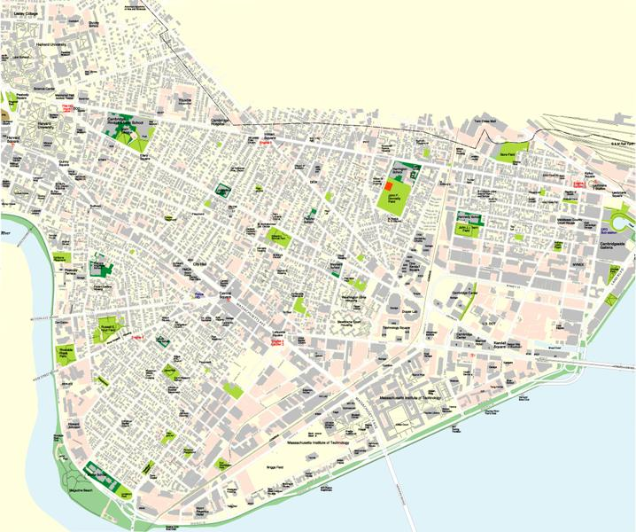

Wireless Mesh Networks
Roofnet
Wireless Philly
1 kilometer
Dense 802.11-based multi-hop network
Goal is high-throughput in the presence of lossy links

Slide 11
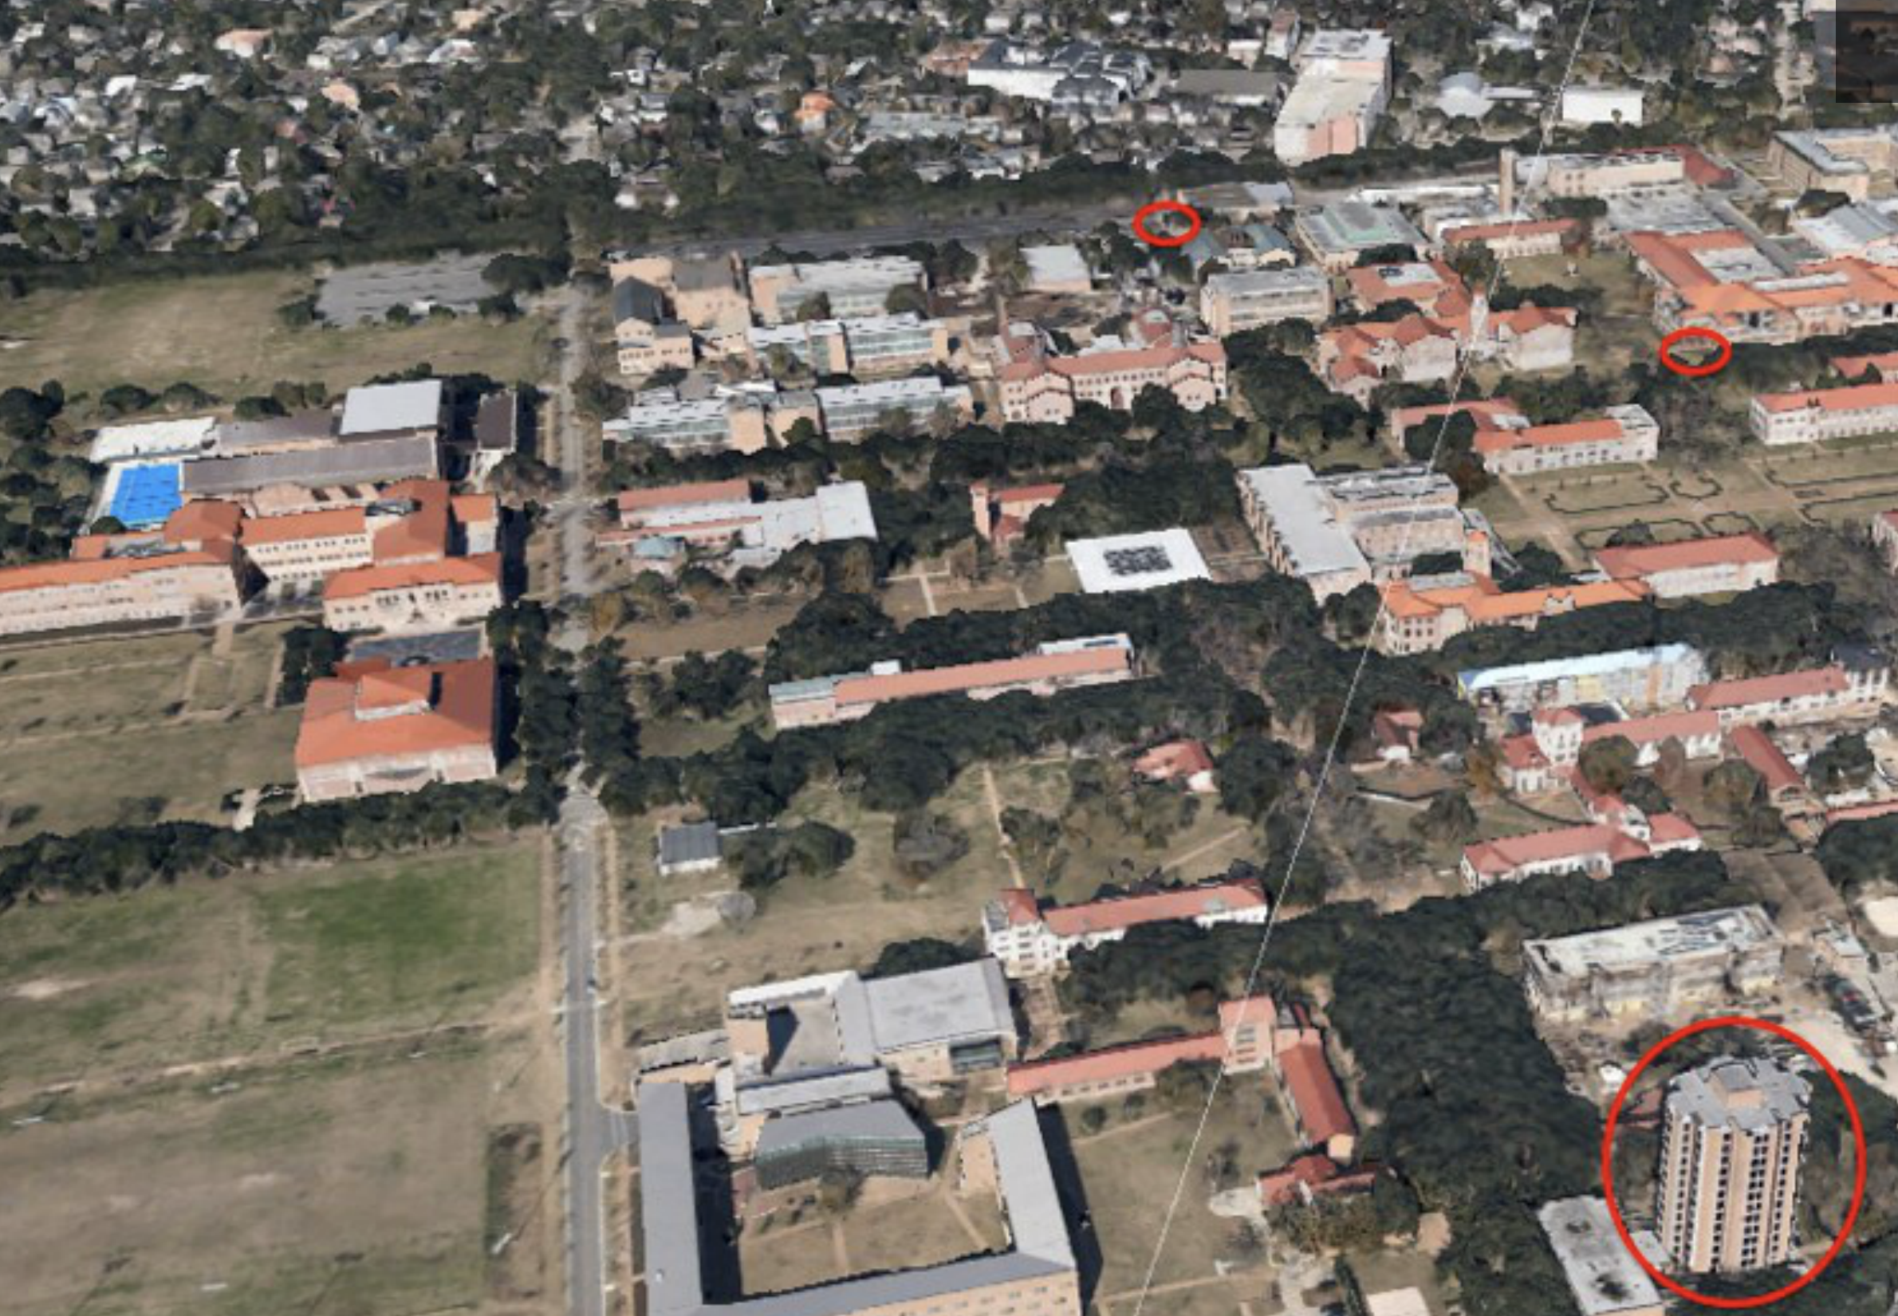
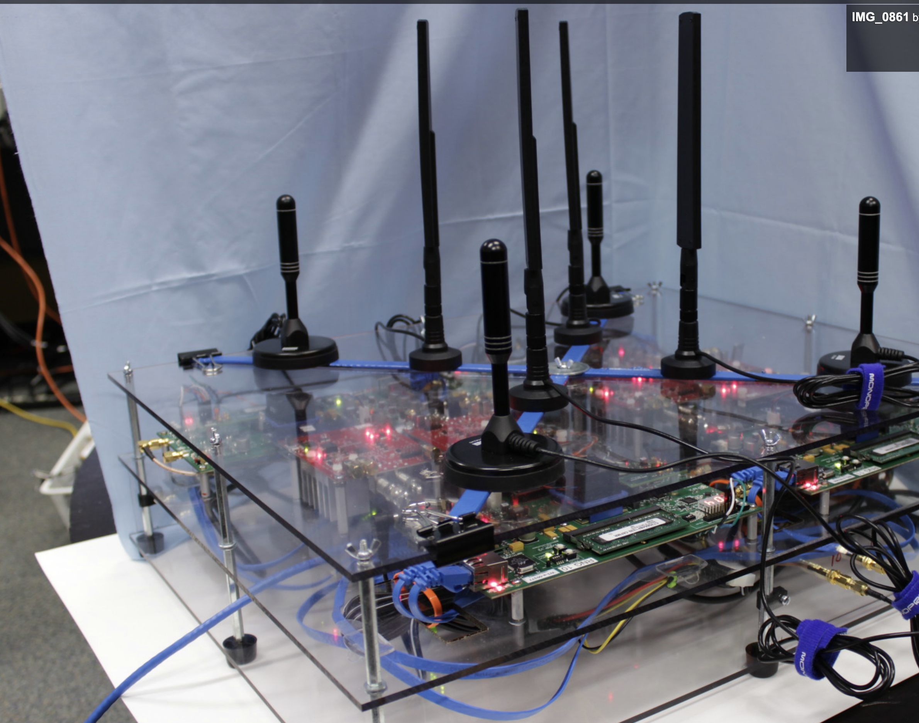
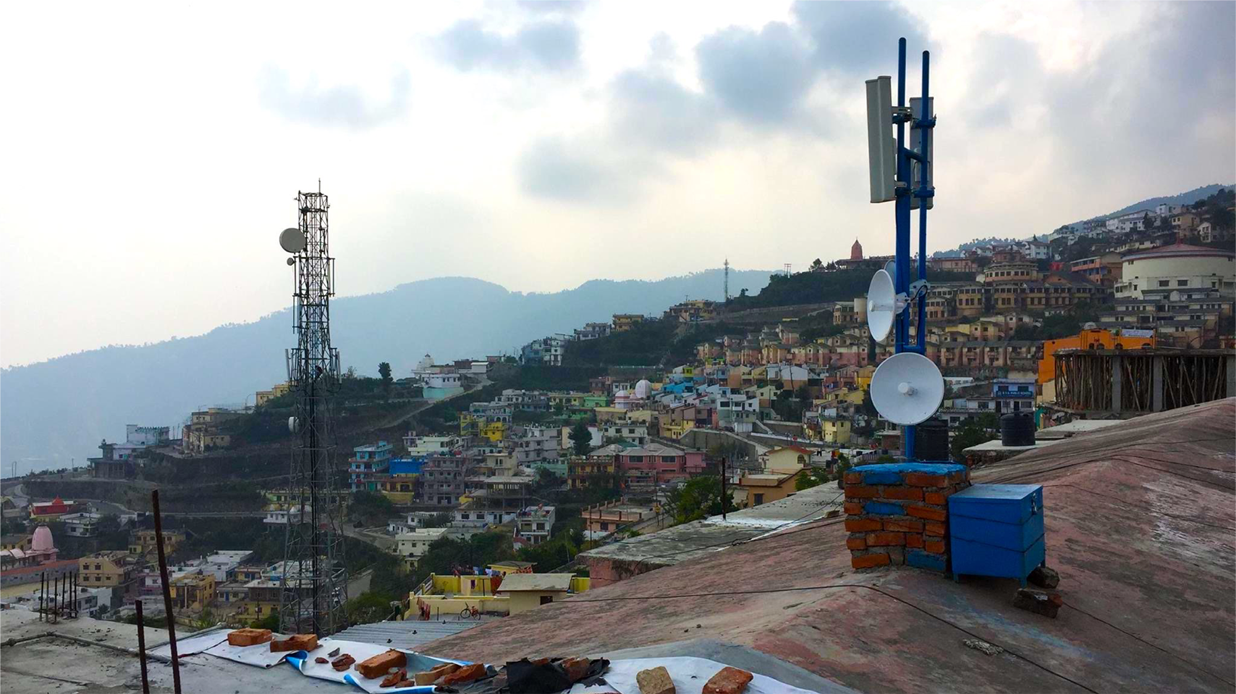
Facebook WiFi Mesh Network
TARF Rice Mesh Network

Slide 12
Traditional Single Path Routing
Represent the wireless network as a graph
Two nodes have an edge if they can communicate (i.e., are within radio range)
Each edge is labeled with a weight (where a smaller weight indicates a preferred edge)
Run shortest path algorithm on the graph (e.g., Dijkstra, Bellman Ford)
Produce the minimum weight path between every pair of nodes
How do you pick the edge weights?
i.e., what metric should shortest path minimize?

Slide 13
Graph abstraction of the network
5
graph: G = (N,E)
N = set of routers = { u, v, w, x, y, z }
E = set of links ={ (u,v), (u,x), (v,x), (v,w), (x,w), (x,y), (w,y), (w,z), (y,z) }
v
3
w
2
5
u
2
1
z
3
1
2
x
y
1
c(x,x’) = cost of link (x,x’) e.g., c(w,z) = 5
cost could always be 1, or inversely related to bandwidth, or related to congestion
cost of path (x₁, x₂, x₃,…, x_{p}) = c(x₁,x₂) + c(x₂,x₃) + … + c(x_{p-1},x_{p})
key question: what is the least-cost path between u and z ?
routing algorithm: algorithm that finds that least cost path

Slide 14
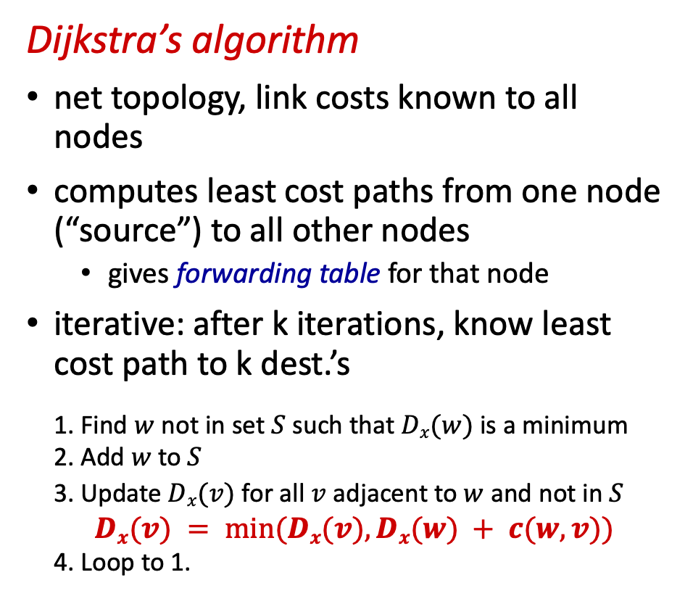



Link-state Routing
Distance Vector Routing
Dijkstra’s algorithm
net topology, link costs known to all nodes
computes least cost paths from one node (“source”) to all other nodes
gives forwarding table for that node
iterative: after k iterations, know least cost path to k dest.’s
1. Find $w$ not in set $S$ such that $Dx(w)$ is a minimum
2. Add $w$ to $S$
3. Update $Dx(v)$ for all $v$ adjacent to $w$ and not in $S$
$Dx(v) = min⁡(Dx(v), Dx(w) + c(w,v))$
4. Loop to 1.
Bellman-Ford (Dynamic Programming)
let $Dx(y)$:= cost of least-cost path from $x$ to $y$
then
$Dx(y) = min⁡\{c(x,v) +Dv(y) \}$
$$v$$
$x$ maintains distance vector $Dx = [Dx(y): y∈N ]$
$x$knows cost to each neighbor v: $c(x,v)$
$x$maintains its neighbors’ distance vectors
1. From time-to-time, each node sends its own distance vector estimate to neighbors
2. When $x$receives new DV estimate from neighbor, it updates its own DV using B-F equation:

Slide 15
Cannot use classical wired routing in wireless!
Channel is Broadcast
Interference: Cannot transmit on all links in parallel.
Opportunity!
Unreliable
Packet loss due to collision
Packet loss due to bit errors
Overhead
Nodes not as powerful (e.g. Sensor networks).
Link bandwidth is typically lower than wired.

Slide 16
Dynamic Source Routing (DSR)
Routing in Wireless Ad-Hoc Networks
Ad hoc On-demand distance vector (AODV )
On demand routing
→ No periodic updates
When a source wants to route packets, routes generated
Consists of two parts
Route discovery
Route maintenance
Best of both worlds of DSR and DV
Like DV it is next hop based routing, full route path not included in packet
Like DSR, does not need periodic route maintenance messages

Slide 17
Challenge: How to select the link cost?

Slide 18
A straw-man route metric (1):
Assign all edges the same weight → Minimize number of hops
Reasoning:
Links in route share radio spectrum
Extra hops reduce throughput
Throughput = 1
Throughput = 1/2
Throughput = 1/3
But is not good enough because different edges many have very different packet loss rates

Slide 19
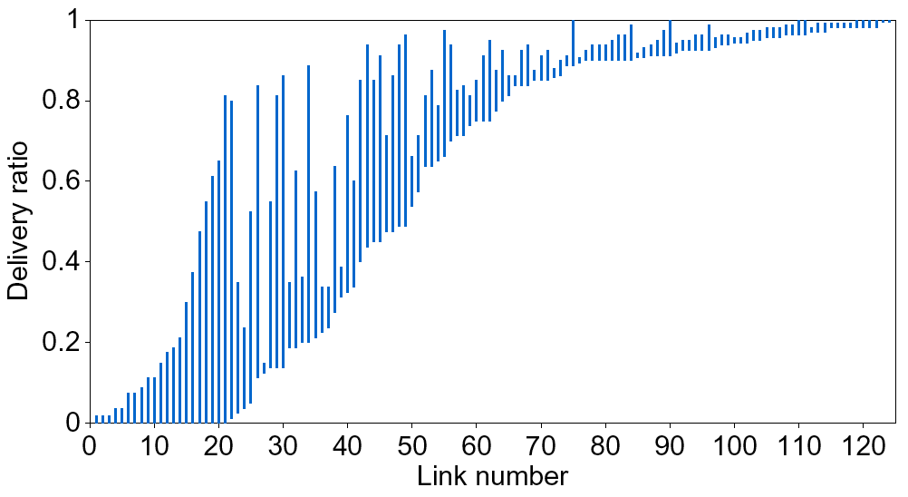
Challenge: links are lossy and asymmetric
Very asymmetric links.
Different links have different loss rates
Further, the loss rate may be different in each direction

Slide 20
A straw-man route metric (2):
Maximize bottleneck throughput
B
Delivery ratio = 100%
50%
A
C
51%
51%
D
A-B-C = 50%
A-D-C = 51%
Bottleneck throughput:
A-B-C : ABBABBABB = 33%
A-D-C : AADDAADD = 25%
Actual throughput:
Key Idea: In a shared medium links are not independent

Slide 21
A straw-man metric (3):
Maximize end-to-end delivery ratio
B
100%
51%
A
C
50%
A-B-C = 51%
A-C = 50%
End-to-end delivery ratio:
A-B-C : ABBABBABB = 33%
A-C : AAAAAAAA = 50%
Actual throughput:
Key Idea: Again, links are not independent

Slide 22
Wireless routing metric: ETX
Minimize total transmissions per packet
(ETX, ‘Expected Transmission Count’)
Link throughput ≈ 1/ Link ETX
Delivery Ratio
Link ETX
Throughput
100%
1
100%
50%
2
50%
33%
3
33%

Slide 23
Route ETX
Route ETX = Sum of link ETXs
Route ETX
Throughput
1
100%
2
50%
2
50%
3
33%
5
20%

Slide 24
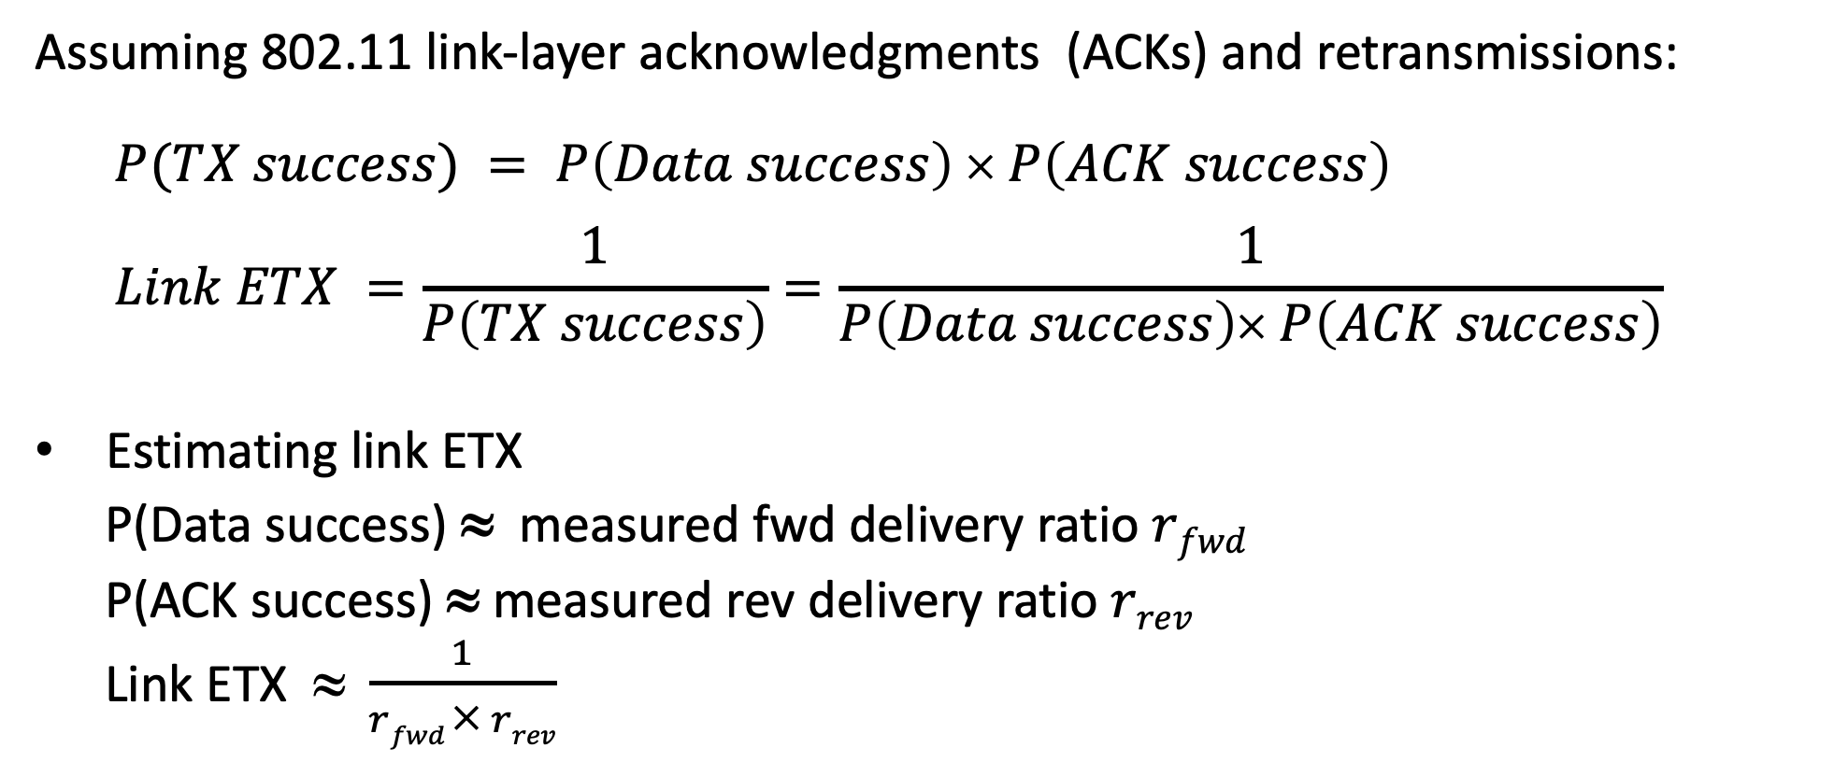
Calculating Link ETX
Assuming 802.11 link-layer acknowledgments (ACKs) and retransmissions:
$$P(TX success) = P\left(Data success\right) × P\left(ACK success\right)$$
$$Link ETX =\frac{1}{P\left(TX success\right)}=\frac{1}{P\left(Data success\right)× P\left(ACK success\right)}$$
Estimating link ETX
P(Data success) ≈ measured fwd delivery ratio $rfwd$
P(ACK success) ≈ measured rev delivery ratio $rrev$
Link ETX $ \frac{1}{rfwd × rrev}$

Slide 25
Measuring delivery ratios
Each node broadcasts small link probes once per second
Nodes remember probes received over past 10 seconds
Reverse delivery ratios estimated as
r_{rev} ≈ pkts received / pkts sent
Forward delivery ratios obtained from neighbors (piggybacked on probes)

Slide 26
ETX Caveats
It is really hard to measure link quality/loss
Changes as a function of load
Changes with time
ETX ignores differences in bit-rate and packet size
ETT = ETX *(pkt_size/link-bit-rate)
ETX ignores spatial re-use (i.e., assumes all links interfere)

Slide 27
Traditional routing
packet
packet
A
B
packet
src
dst
C
Identify a route, forward over links
Abstract radio to look like a wired link

Slide 28
Radios aren’t wires
A
B
1
2
src
dst
2
2
3
3
3
4
4
4
5
5
5
6
6
1
6
1
2
3
4
5
6
1
C
Every packet is broadcast
Receptions are probabilistic and independent (Spatial diversity)

Slide 29
ExOR Idea: exploit probabilistic broadcast
packet
packet
packet
packet
A
B
src
dst
packet
packet
packet
packet
packet
C
Decide who forwards after reception
Goal: for each packet, receiver closest to the destination should forward
Challenge: agree efficiently on which node should forward, and avoid duplicate transmissions

Slide 30
Why ExOR might increase throughput (1)
Delivery Prob.
33%
src
100%
R
100%
dst
Delivery Prob.
Delivery Prob.
Traditional routing picks the path via R → on average 2 tx per packet
Throughput ≅ ¹/_{# transmissions}
Traditional routing ignores that 33% of the packets make it to the destination in one transmission
ExOR exploits these opportunistic receptions → 1.67 tx per packet

Slide 31
Why ExOR might increase throughput (2)
N1
Delivery Prob.
Delivery Prob.
25%
100%
N2
25%
100%
src
dst
25%
N3
100%
25%
100%
N4
Traditional routing: ¹/_{0.25} + 1 = 5 tx
ExOR: ¹/(1 – (1 – 0.25)⁴) + 1 = 2.5 transmissions

Slide 32
Challenge
Overlap in received packets → Routers forward duplicates

Slide 33
Challenge
Overlap in received packets → Routers forward duplicates
P₁
R1
P₂
P₁
src
dst
P₂
P₁₀
R2
P₁
P₂
ExOR imposes a global scheduler:
Nodes have to agree on who transmits what
Only one node transmits at a time, others listen

Slide 34
Limitations of ExOR
Dst
Src
Learning who received what → too much overhead
Forcing only one transmitter at a time → prevents spatial reuse of the medium

Slide 35
Limitations of ExOR
Dst
Src
Learning who received what → too much overhead
Forcing only one transmitter at a time → prevents spatial reuse of the medium
Can we eliminate these problems?

Slide 36
Solution: Random Network Coding
Each router forwards random combinations of packets

Slide 37
Solution: Random Network Coding
Each router forwards random combinations of packets
P₁
R1
3 P₁+ 7 P₂
P₂
src
dst
P₁
R2
2 P₁+ 4 P₂
P₂
Randomness prevents duplicates
No need to know who received what
Can exploit spatial reuse

Slide 38
Network Coding Also Benefits Multicast
P₁
P₂
src
8 P₁+ 6 P₂+ P₃+ P₄
P₃
7 P₁+2 P₂+3 P₃+4 P₄
P₄
dst1
dst2
dst3
P₁
P1
P1
P₂
P₂
P2
P3
P₃
P₃
P4
P4
P₄
Without coding → source has to retransmit all 4 packets
With network coding → 2 packets are sufficient

Slide 39
MORE
MAC-independent Opportunistic Routing & Encoding.
An opportunistic routing protocol that reduces overhead and enables spatial reuse
It is based on network coding, where routers code packets together before forwarding them

Slide 40
How Does MORE Work?
Source sends packets in batches
Forwarders keep all heard (innovative) packets in a buffer
Nodes transmit linear combinations of buffered packets
a
P1
+ b
P2
+ c
P3
=
a,b,c
src
A
B
dst
P1
4,1,3
4,1,3
P2
0,2,1
P3
4
P1
+ 1
P2
+ 3
P3
=
4,1,3
0
P1
+ 2
P2
+ 1
P3
=
0,2,1

Slide 41
How Does MORE Work?
Source sends packets in batches
Forwarders keep all heard (innovative) packets in a buffer
Nodes transmit linear combinations of buffered packets
a
P1
+ b
P2
+ c
P3
=
a,b,c
src
A
B
dst
P1
4,1,3
4,1,3
8,4,7
P2
0,2,1
8,4,7
P3
2
4,1,3
+ 1
0,2,1
=
8,4,7

Slide 42
How Does MORE Work?
Source sends packets in batches
Forwarders keep all heard (innovative) packets in a buffer
Nodes transmit linear combinations of buffered packets
Destination decodes once it receives enough combinations
Say batch is 3 packets
1
P1
+ 3
P2
+ 2
P3
=
1,3,2
5
P1
+ 4
P2
+ 5
P3
=
5,4,5
4
P1
+ 5
P2
+ 5
P3
=
4,5,5
Decoding is solving linear equations
Once it decoded a batch, the destination acks the batch and the source moves to next batch

Slide 43
Network Coding
Requires less coordination
No scheduler
More flexibility
One framework for unicast and multicast
More throughput
22% more than ExOR and 95% more than current shortest path routing

Slide 46


Traditional Approach
Alice
Router
Bob
Requires 4 transmissions
Alice to router; Router to Bob; Bob to router; Router to Alice
Can we exploit broadcast to do better?

Slide 47
COPE
XOR
=
Alice
Router
Bob
=
XOR
=
XOR
Requires 3 transmissions instead of 4
Alice to router; Bob to router; and router to both Alice and Bob
Network Coding → 3 Transmissions instead of 4
→ Increases Throughput

Slide 48
Beyond Duplex Communications
S1
S2
Router
D2
D1
Two communication flows that intersect at a router

Slide 49
Beyond Duplex Communications
S1
S2
Router
D2
D1
D2 overhears S1’s packet
D1 overhears S2’s packet

Slide 50
Beyond Duplex Communications
S1
S2
XOR
=
Router
D2
D1
=
XOR
=
XOR
3 transmissions instead of 4 → Higher Throughput

Slide 53
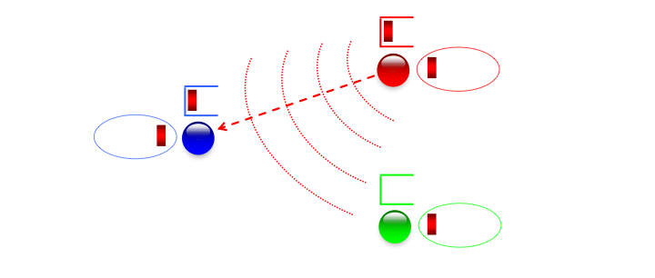

Slide 56
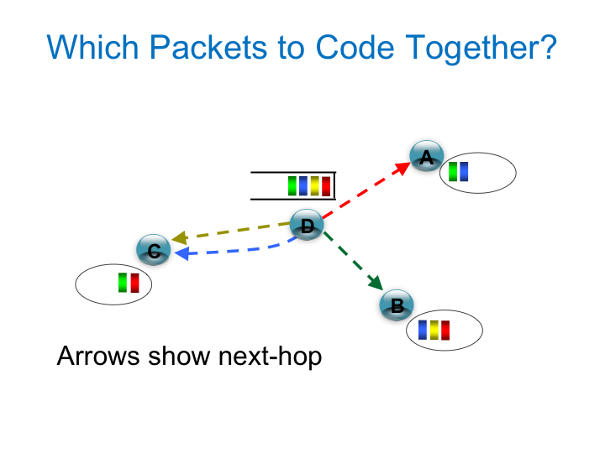
çç

Slide 58
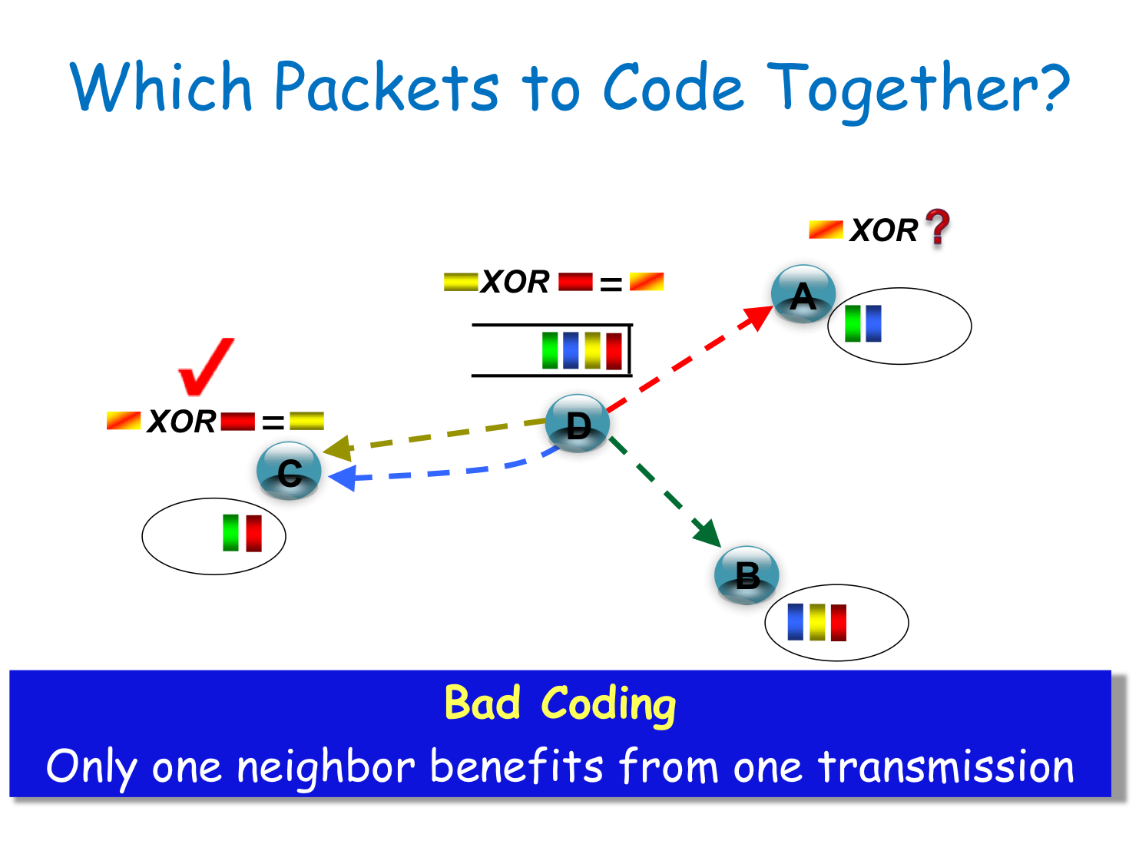
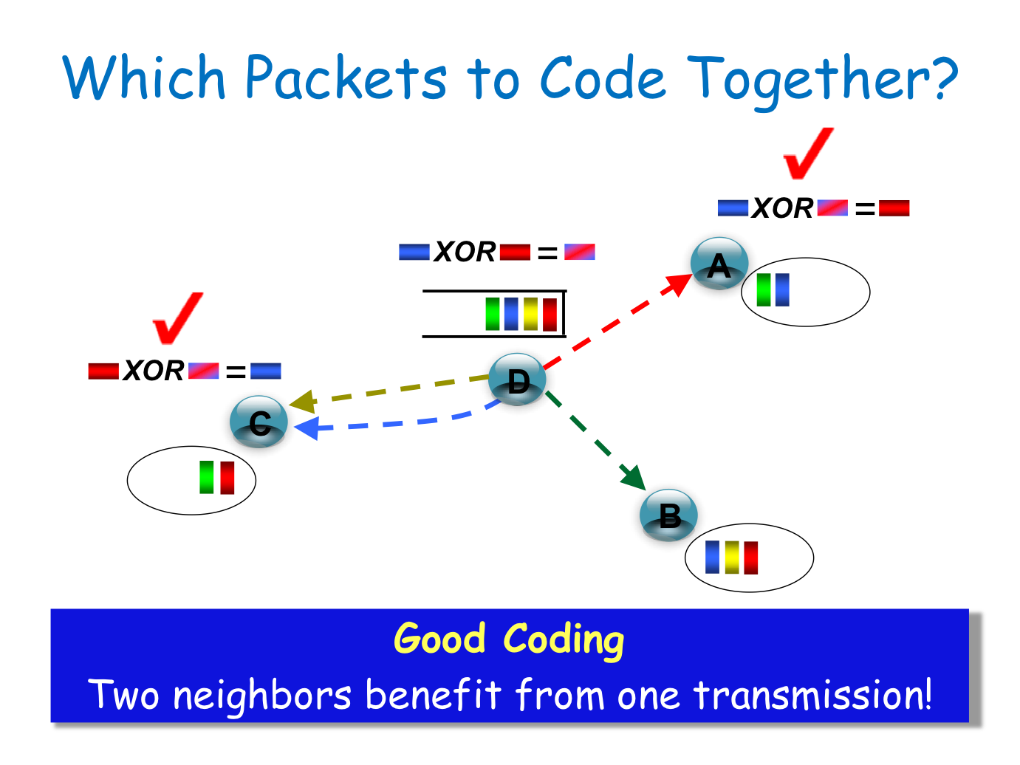
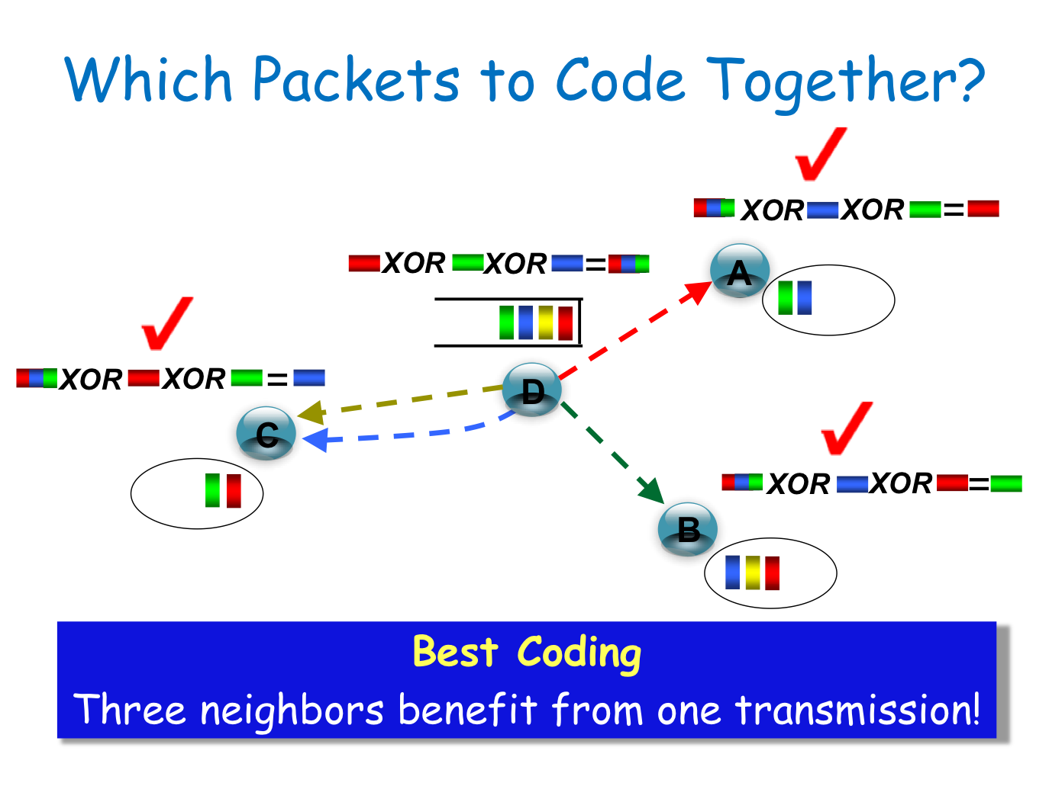
A.
B.
C.
D.

Slide 64
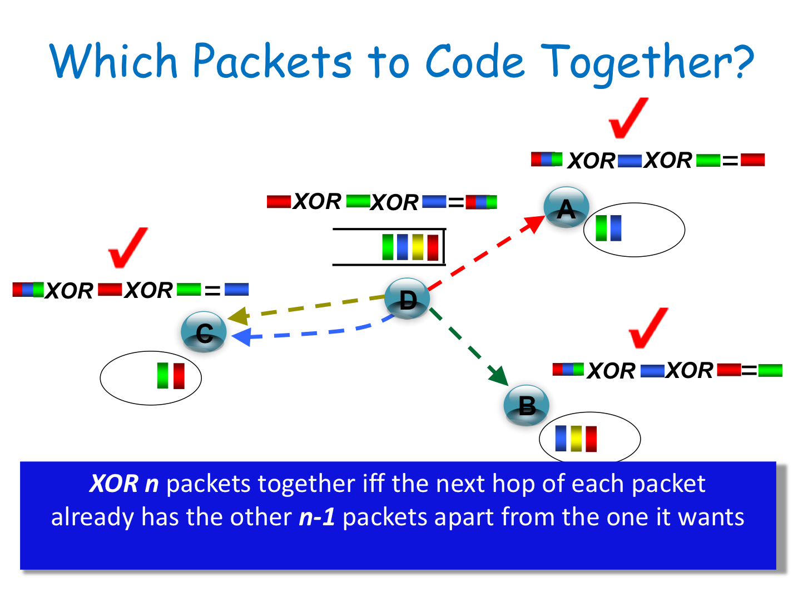

Slide 68
Alice and Bob Experiment
Alice
Router
Bob
3 transmissions instead of 4
→ Throughput Gain = 4/3 = 1.3333

Slide 70
Why the Gain is more than 1.33 ?
Alice
Router
Bob
802.11 is fair → Each node transmits 1/3
Without COPE: Router needs to transmit twice as much
With COPE: All nodes need equal rate.

Slide 73
Alice
Router
Bob
Traditional Approach: requires 4 transmissions
COPE: requires 3 transmissions
Can we do it in 2 transmissions?

Slide 74
Analog Network Coding (ANC)
Instead of router mixing packets…
Exploit that the wireless channel naturally mixes signals

Slide 75
Analog Network Coding
Router
Alice
Bob

Slide 76
Analog Network Coding
Router
Alice
Bob
Interference
Alice and Bob transmit simultaneously

Slide 77
Analog Network Coding
Router
Alice
Bob
Alice and Bob transmit simultaneously
Router amplifies and broadcasts interfered signal

Slide 78
Analog Network Coding
Router
Alice
Bob
Alice and Bob transmit simultaneously
Router amplifies and broadcasts interfered signal
Alice subtracts known signal from interfered signal

Slide 79
Analog Network Coding
Router
Alice
Bob
Dina and Robert transmit simultaneously
Router amplifies and broadcasts interfered signal
Dina subtracts known signal from interfered signal
Analog Network Coding requires 2 time slots
Higher throughput

Slide 80
X topology
S1
S2
Router
Interference
D2
D1
Capture!
Capture!

Slide 81
X topology
S1
S2
Router
Interference
D2
D1
Capture!
Capture!

Slide 82
X topology
S1
S2
Router
D2
D1
ANC decodes interference using overheard signals

Slide 83
It Is More Than Going From 3 To 2!
Philosophical shift in dealing with interference
Strategically exploit interference instead of avoiding it
Promises new ways of dealing with hidden terminals

Slide 84
Hidden Terminal Scenario
C
C
C
C
Src
R1
R2
Dst

Slide 85
Hidden Terminal Scenario
C
C
C
C
Src
R1
R2
Dst
P1

Slide 86
Hidden Terminal Scenario
C
C
C
C
Src
R1
R2
Dst
P2
P1
Src and R2 transmit simultaneously

Slide 87
Hidden Terminal Scenario
C
C
C
C
Src
R1
R2
Dst
P1
P2
Src and R2 transmit simultaneously
R1 subtracts P1, which he relayed earlier to recover P2 that he wants

Slide 88
Hidden Terminal Scenario
C
C
C
C
Src
R1
R2
Dst
P1
P2
R2 and Src are hidden terminals
Today : Simultaneous transmission → Collision
ANC : Simultaneous transmission → Success!

