Slide 1
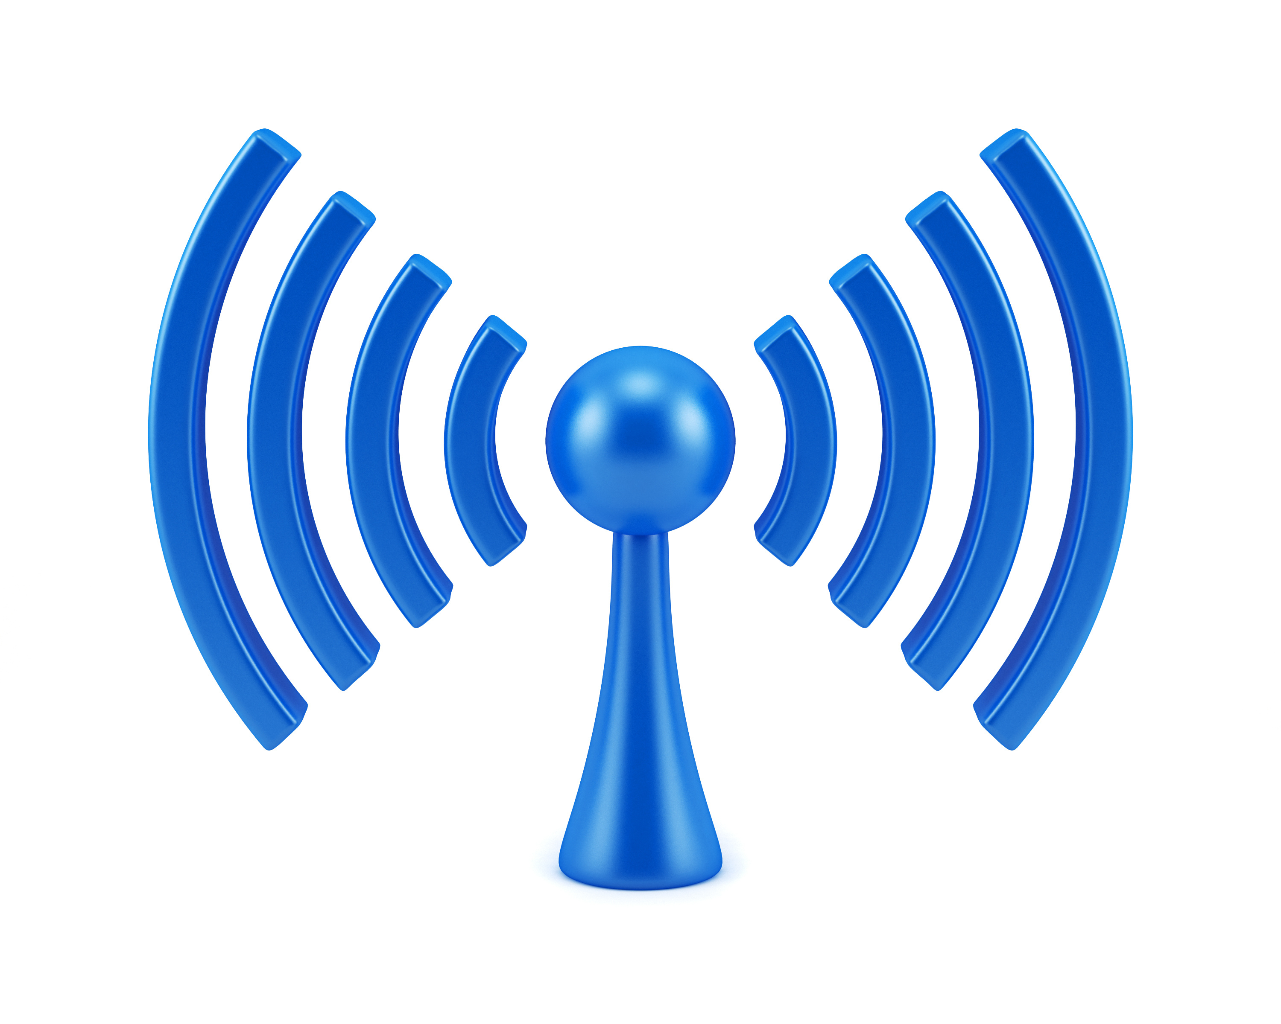
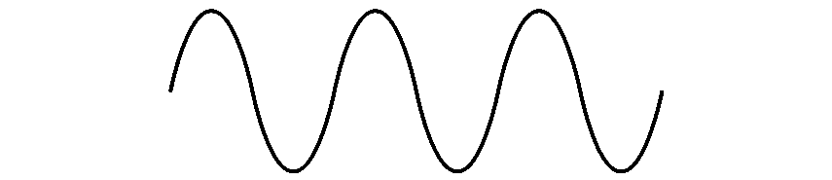

COM-405: Mobile Networks
Lecture 1.1: Wireless Radio
Haitham Hassanieh
Laboratory of SEnsing
& Networking Systems

Slide 2
Wireless Radio Frontend
1011010110011001
1011010110011001
Digital Input
Digital Output
TX
RX

Slide 3
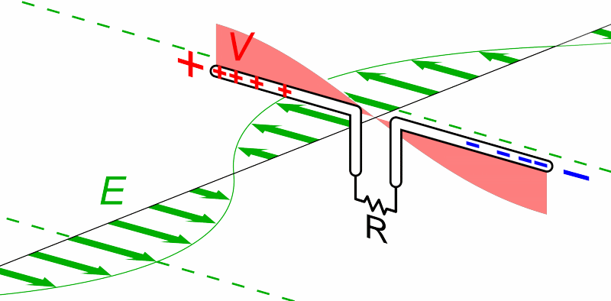
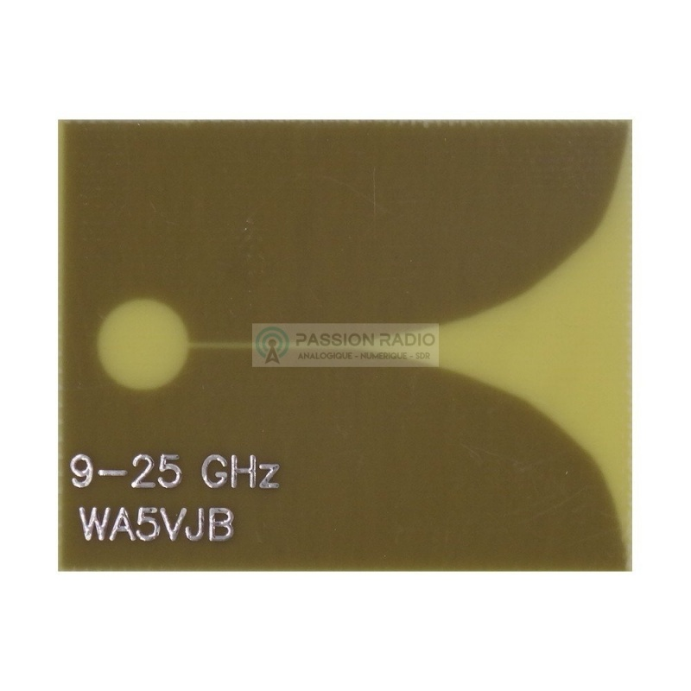
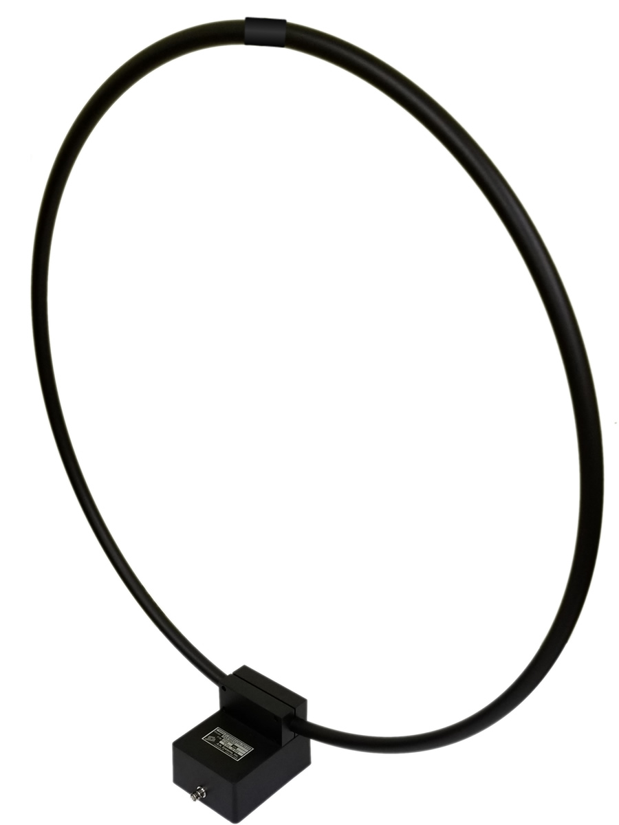
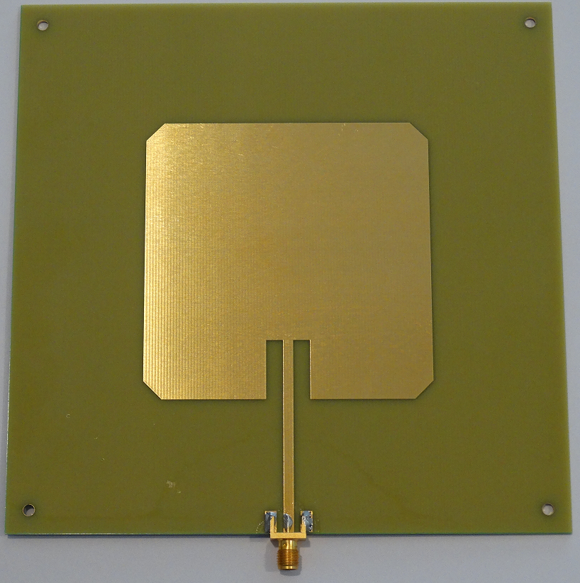
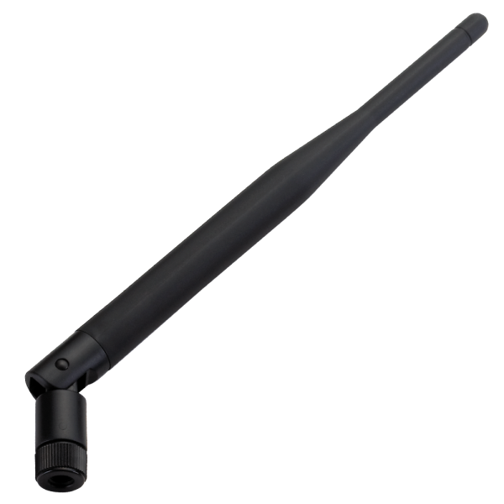
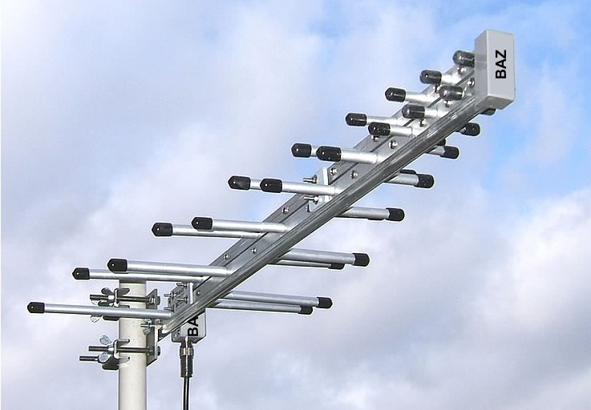
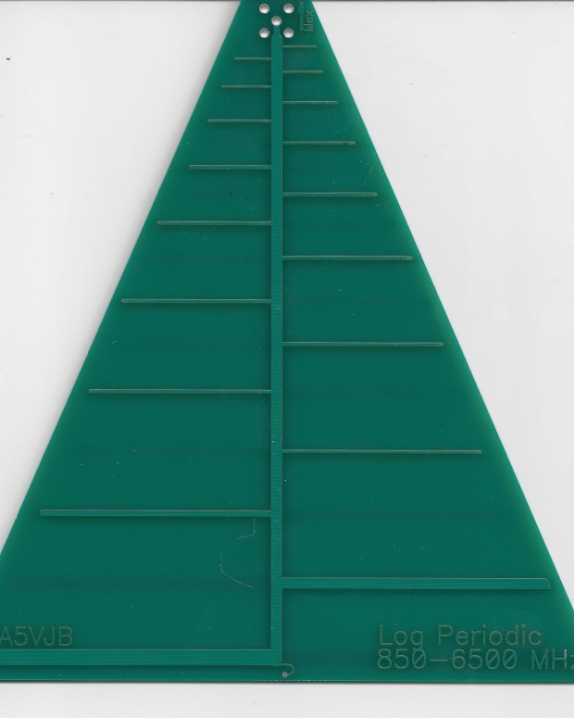
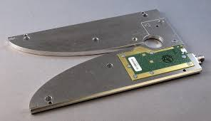
Wireless Radio Frontend
1011010110011001
1011010110011001
Digital Input
Digital Output
TX
RX
Antenna
Vivaldi
Dipole
Log Periodic Antennas
Loop
Antenna

Slide 4
The size of the antenna increases with the frequency of operation i.e., the higher the frequency the larger the size.
$True$
$False$

Slide 5
The size of the antenna increases with the frequency of operation i.e., the higher the frequency the larger the size.
$True$
$False$

Slide 6
Wireless Radio Frontend
1011010110011001
1011010110011001
Digital Input
Digital Output
TX
RX
Power Amplifier:
Amplify signal power
Low Noise Amplifier:
Amplify signal power with minimal noise
PA
Amplifiers
LNA
Gain
Efficiency
Saturation
dB scale $=10\log_{10}{Gain}$
dBm $=10\log_{10}{\frac{Power}{1mW}}$

Slide 7
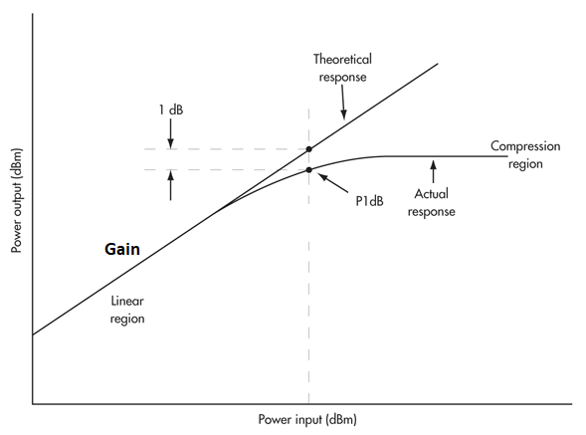
Amplifier Gain

Slide 8
Wireless Radio Frontend
1011010110011001
1011010110011001
Digital Input
Digital Output
TX
RX
PA
BPF
Band Pass Filters
LNA
BPF
Removes Frequency Signals outside desired frequency of operation

Slide 9

Wireless Radio Frontend
1011010110011001
1011010110011001
Digital Input
Digital Output
TX
RX
Mixer
Mixer
PA
BPF
LNA
BPF
Mixer + PLL:
Move signal to desired frequency of operation
PLL
PLL
Up Conversion
Down Conversion

Slide 10
Up/Down Conversion
Receiver
Down-conversion
Transmitter
Up-conversion
Mixer
Mixer
PLL
PLL
Baseband
Passband
$$0$$
$$B$$
$$0$$
$$f_{c}$$

Slide 11
Up/Down Conversion
Receiver
Down-conversion
Transmitter
Up-conversion
Mixer
Mixer
PLL
PLL
Baseband
Passband
Baseband
$$0$$
$$B$$
$$0$$
$$f_{c}$$
$$0$$
$$B$$
Why do we need to up/down conversion?

Slide 12
Up/Down Conversion
Baseband
Passband
Baseband
$$0$$
$$B$$
$$0$$
$$f_{c}$$
$$0$$
$$B$$
Why do we need to up/down conversion?

Slide 13
Up/Down Conversion
Baseband
Passband
Baseband
$$0$$
$$B$$
$$0$$
$$f_{c}$$
$$0$$
$$B$$
Why do we need to up/down conversion?
Why not transmit everything at lower frequencies?
Data rate ∝ bandwidth
Not enough bandwidth:
Different Technologies
Antenna size ∝ wavelength

Slide 15
Up/Down Conversion
Baseband
Passband
Baseband
$$0$$
$$B$$
$$0$$
$$f_{c}$$
$$0$$
$$B$$
Why do we need to up/down conversion?
Why not transmit everything at lower frequencies?
Data rate ∝ bandwidth
Not enough bandwidth:
Different Technologies
Antenna size ∝ wavelength
Why not transmit & receive directly at high frequency?
Nyquist!

Slide 16
Nyquist Theorem
To recover the signal properly, we need to sample at twice the highest frequency, i.e. $2f_{max}$
Baseband
Sample at $2B$
$$0$$
$$B$$
e.g. WiFi 802.11b $≈$ 40 MS/s
Passband
Sample at $2f_{c}+B$
$$0$$
$$f_{c}$$
e.g. WiFi 802.11b $≈$ 5 GS/s

Slide 17
Up/Down Conversion
Receiver
Down-conversion
Transmitter
Up-conversion
Mixer
Mixer
PLL
PLL
How to we do up/down conversion?
$$s\left(t\right)$$
$$×$$
$$s\left(t\right)\cos\left(2πf_{c}t\right)$$
$$×$$
$$s\left(t\right)\cos^{2}\left(2πf_{c}t\right)$$
$$\cos\left(2πf_{c}t\right)$$
$$\cos\left(2πf_{c}t\right)$$
$$s\left(t\right)\left(\frac{1}{2}+\frac{1}{2}\cos\left(2π 2f_{c} t\right)\right)$$
$$s\left(t\right)\cos^{2}\left(2πf_{c}t\right)=$$

Slide 18
Up/Down Conversion
Receiver
Down-conversion
Transmitter
Up-conversion
Mixer
Mixer
LPF
PLL
PLL
How to we do up/down conversion?
$$s\left(t\right)$$
$$×$$
$$s\left(t\right)\cos\left(2πf_{c}t\right)$$
$$×$$
$$s\left(t\right)\cos^{2}\left(2πf_{c}t\right)$$
$$\cos\left(2πf_{c}t\right)$$
$$\cos\left(2πf_{c}t\right)$$
Low Pass Filter
$$=\frac{1}{2}s\left(t\right)$$
$$s\left(t\right)\left(\frac{1}{2}+\frac{1}{2}\cos\left(2π 2f_{c} t\right)\right)$$
$$s\left(t\right)\cos^{2}\left(2πf_{c}t\right)=$$

Slide 19
Up/Down Conversion
$$s\left(t\right)$$
$$×$$
$$s\left(t\right)\cos\left(2πf_{c}t\right)$$
$$×$$
$$s\left(t\right)\cos^{2}\left(2πf_{c}t\right)$$
$$\cos\left(2πf_{c}t\right)$$
$$\cos\left(2πf_{c}t\right)$$

Slide 20
Up/Down Conversion
$$s\left(t\right)$$
$$×$$
$$s\left(t\right)\cos\left(2πf_{c}t\right)$$
$$×$$
$$s\left(t\right)\cos^{2}\left(2πf_{c}t\right)$$
$$\cos\left(2πf_{c}t\right)$$
$$\cos\left(2πf_{c}t\right)$$
$s\left(t\right)$ is real
$➔S\left(f\right)$ is symmetric around $0$
$$−B$$
$$0$$
$$B$$

Slide 21
Up/Down Conversion
$$s\left(t\right)$$
$$×$$
$$s\left(t\right)\cos\left(2πf_{c}t\right)$$
$$×$$
$$s\left(t\right)\cos^{2}\left(2πf_{c}t\right)$$
$$\cos\left(2πf_{c}t\right)$$
$$\cos\left(2πf_{c}t\right)$$
$$S\left(f\right)$$
$$−B$$
$$0$$
$$B$$
$$⊛$$
$$\frac{1}{2}δ\left(f−f_{c}\right)+\frac{1}{2}δ\left(f+f_{c}\right)$$
$$−f_{c}$$
$$0$$
$$f_{c}$$

Slide 22
Up/Down Conversion
$$s\left(t\right)$$
$$×$$
$$s\left(t\right)\cos\left(2πf_{c}t\right)$$
$$×$$
$$s\left(t\right)\cos^{2}\left(2πf_{c}t\right)$$
$$\cos\left(2πf_{c}t\right)$$
$$\cos\left(2πf_{c}t\right)$$
$$S\left(f\right)$$
$$−B$$
$$0$$
$$B$$
$$⊛$$
$$\frac{1}{2}S\left(f−f_{c}\right)+\frac{1}{2}S\left(f+f_{c}\right)$$
$$\frac{1}{2}δ\left(f−f_{c}\right)+\frac{1}{2}δ\left(f+f_{c}\right)$$
$$−f_{c}$$
$$0$$
$$f_{c}$$
$$−f_{c}$$
$$0$$
$$f_{c}$$

Slide 23
Up/Down Conversion
$$s\left(t\right)$$
$$×$$
$$s\left(t\right)\cos\left(2πf_{c}t\right)$$
$$×$$
$$s\left(t\right)\cos^{2}\left(2πf_{c}t\right)$$
$$\cos\left(2πf_{c}t\right)$$
$$\cos\left(2πf_{c}t\right)$$
$$\frac{1}{2}S\left(f−f_{c}\right)+\frac{1}{2}S\left(f+f_{c}\right)$$
$$−f_{c}$$
$$0$$
$$f_{c}$$
$$\frac{1}{4}S\left(f−2f_{c}\right)+\frac{1}{4}S\left(f\right)$$
$$⊛$$
$$\frac{1}{2}δ\left(f−f_{c}\right)+\frac{1}{2}δ\left(f+f_{c}\right)$$
$$+\frac{1}{4}S\left(f\right)+\frac{1}{4}S\left(f+2f_{c}\right)$$
$$−f_{c}$$
$$0$$
$$f_{c}$$

Slide 24
Up/Down Conversion
$$s\left(t\right)$$
$$×$$
$$s\left(t\right)\cos\left(2πf_{c}t\right)$$
$$×$$
$$s\left(t\right)\cos^{2}\left(2πf_{c}t\right)$$
$$\cos\left(2πf_{c}t\right)$$
$$\cos\left(2πf_{c}t\right)$$
$$\frac{1}{2}S\left(f−f_{c}\right)+\frac{1}{2}S\left(f+f_{c}\right)$$
$$−f_{c}$$
$$0$$
$$f_{c}$$
$$\frac{1}{4}S\left(f−2f_{c}\right)+\frac{1}{4}S\left(f+2f_{c}\right)+\frac{1}{2}S\left(f\right)$$
$$⊛$$
$$\frac{1}{2}δ\left(f−f_{c}\right)+\frac{1}{2}δ\left(f+f_{c}\right)$$
$$−f_{c}$$
$$0$$
$$f_{c}$$
$$−{2f}_{c}$$
$$−f_{c}$$
$$0$$
$$f_{c}$$
$$2f_{c}$$

Slide 25
Up/Down Conversion
$$s\left(t\right)$$
$$×$$
$$s\left(t\right)\cos\left(2πf_{c}t\right)$$
$$×$$
$$s\left(t\right)\cos^{2}\left(2πf_{c}t\right)$$
$$\cos\left(2πf_{c}t\right)$$
$$\cos\left(2πf_{c}t\right)$$
$$\frac{1}{2}S\left(f−f_{c}\right)+\frac{1}{2}S\left(f+f_{c}\right)$$
Low Pass Filter
$$−f_{c}$$
$$0$$
$$f_{c}$$
$$\frac{1}{4}S\left(f−2f_{c}\right)+\frac{1}{4}S\left(f+2f_{c}\right)+\frac{1}{2}S\left(f\right)$$
$$⊛$$
$$\frac{1}{2}δ\left(f−f_{c}\right)+\frac{1}{2}δ\left(f+f_{c}\right)$$
$$−f_{c}$$
$$0$$
$$f_{c}$$
$$−{2f}_{c}$$
$$−f_{c}$$
$$0$$
$$f_{c}$$
$$2f_{c}$$

Slide 26
Up/Down Conversion
$$s\left(t\right)$$
$$×$$
$$s\left(t\right)\cos\left(2πf_{c}t\right)$$
$$×$$
$$s\left(t\right)\cos^{2}\left(2πf_{c}t\right)$$
$$\cos\left(2πf_{c}t\right)$$
$$\cos\left(2πf_{c}t\right)$$
$s\left(t\right)$ is complex: $s\left(t\right)=I+jQ$

Slide 27
Up Conversion
$$s\left(t\right)$$
$$×$$
$$s\left(t\right)\cos\left(2πf_{c}t\right)$$
$$\cos\left(2πf_{c}t\right)$$
$s\left(t\right)$ is complex: $s\left(t\right)=I+jQ$

Slide 28
Up Conversion
$$ℜ𝔢\left\{s\left(t\right)\right\}$$
$$×$$
$$I\cos\left(2πf_{c}t\right)$$
$$\cos\left(2πf_{c}t\right)$$
$$+$$
$$I\cos\left(2πf_{c}t\right)$$
$$+Q\sin\left(2πf_{c}t\right)$$
$$ℑ𝔪\left\{s\left(t\right)\right\}$$
$$×$$
$$Q\sin\left(2πf_{c}t\right)$$
$$\sin\left(2πf_{c}t\right)$$

Slide 29
Down Conversion
$$×$$
$$I\cos^{2}\left(2πf_{c}t\right)+Q\cos\left(2πf_{c}t\right)\sin\left(2πf_{c}t\right)$$
$$=\frac{1}{2}I\left(1+\cos\left(2π 2f_{c} t\right)\right)+\frac{1}{2}Q\sin\left(2π {2f}_{c}t\right)$$
$$I\cos\left(2πf_{c}t\right)$$
$$+Q\sin\left(2πf_{c}t\right)$$
$$\cos\left(2πf_{c}t\right)$$
$$×$$
$$Q\sin^{2}\left(2πf_{c}t\right)+I\cos\left(2πf_{c}t\right)\sin\left(2πf_{c}t\right)$$
$$=\frac{1}{2}Q\left(1−\cos\left(2π 2f_{c} t\right)\right)+\frac{1}{2}I\sin\left(2π{ 2f}_{c}t\right)$$
$$\sin\left(2πf_{c}t\right)$$

Slide 30
Down Conversion
$$×$$
$$I\cos^{2}\left(2πf_{c}t\right)+Q\cos\left(2πf_{c}t\right)\sin\left(2πf_{c}t\right)$$
Low Pass Filter
Low Pass Filter
$$=\frac{1}{2}I\left(1+\cos\left(2π 2f_{c} t\right)\right)+\frac{1}{2}Q\sin\left(2π {2f}_{c}t\right)$$
$$I\cos\left(2πf_{c}t\right)$$
$$+Q\sin\left(2πf_{c}t\right)$$
$$\cos\left(2πf_{c}t\right)$$
$$=\frac{1}{2}I$$
$$×$$
$$Q\sin^{2}\left(2πf_{c}t\right)+I\cos\left(2πf_{c}t\right)\sin\left(2πf_{c}t\right)$$
Low Pass Filter
Low Pass Filter
$$=\frac{1}{2}Q\left(1−\cos\left(2π 2f_{c} t\right)\right)+\frac{1}{2}I\sin\left(2π{ 2f}_{c}t\right)$$
$$\sin\left(2πf_{c}t\right)$$
$$=\frac{1}{2}Q$$

Slide 31
Up/Down Conversion
Transmitter
Receiver
$$ℜ𝔢\left\{s\left(t\right)\right\}=I$$
$$×$$
$$×$$
$$I$$
LPF
$$\cos\left(2πf_{c}t\right)$$
$$\cos\left(2πf_{c}t\right)$$
$$+$$
$$I\cos\left(2πf_{c}t\right)$$
$$+Q\sin\left(2πf_{c}t\right)$$
$$\sin\left(2πf_{c}t\right)$$
$$\sin\left(2πf_{c}t\right)$$
$$ℑ𝔪\left\{s\left(t\right)\right\}=Q$$
$$×$$
$$×$$
$$Q$$
LPF
$$s\left(t\right)$$
$$×$$
$$e^{−j2πf_{c}t}$$
$$ℜ𝔢\left\{s\left(t\right)e^{−j2πf_{c}t}\right\}$$
$$×$$
$$e^{j2πf_{c}t}$$
$$s\left(t\right)$$
Low Pass Filter
$$=\frac{1}{2}s\left(t\right)e^{−j2πf_{c}t}+\frac{1}{2}s^{∗}\left(t\right)e^{j2πf_{c}t}$$
$$=\frac{1}{2}s\left(t\right)+\frac{1}{2}s^{∗}\left(t\right)e^{j2π{2f}_{c}t}$$

Slide 32
Up/Down Conversion
Transmitter
Receiver
$$s\left(t\right)$$
$$×$$
$$e^{−j2πf_{c}t}$$
$$ℜ𝔢\left\{s\left(t\right)e^{−j2πf_{c}t}\right\}$$
$$×$$
$$e^{j2πf_{c}t}$$
$$s\left(t\right)$$
Low Pass Filter
$$=\frac{1}{2}s\left(t\right)e^{−j2πf_{c}t}+\frac{1}{2}s^{∗}\left(t\right)e^{j2πf_{c}t}$$
$$=\frac{1}{2}s\left(t\right)+\frac{1}{2}s^{∗}\left(t\right)e^{j2π{2f}_{c}t}$$

Slide 33
Up/Down Conversion
Transmitter
Receiver
$$s\left(t\right)$$
$$×$$
$$e^{−j2πf_{c}t}$$
$$ℜ𝔢\left\{s\left(t\right)e^{−j2πf_{c}t}\right\}$$
$$×$$
$$e^{j2πf_{c}t}$$
$$s\left(t\right)$$
Low Pass Filter
$$=\frac{1}{2}s\left(t\right)e^{−j2πf_{c}t}+\frac{1}{2}s^{∗}\left(t\right)e^{j2πf_{c}t}$$
$$=\frac{1}{2}s\left(t\right)+\frac{1}{2}s^{∗}\left(t\right)e^{j2π{2f}_{c}t}$$
$$\frac{1}{2}δ\left(f+f_{c}\right)$$
$$\frac{1}{2}S\left(f+f_{c}\right)$$
$$S\left(f\right)$$
$$⊛$$
$$=$$
$$−B$$
$$0$$
$$B$$
$$−f_{c}$$
$$0$$
$$f_{c}$$
$$−f_{c}$$
$$0$$
$$f_{c}$$
$$\frac{1}{2}δ\left(f−f_{c}\right)$$
$$\frac{1}{2}S^{∗}\left(−f+f_{c}\right)$$
$$S^{∗}\left(−f\right)$$
$$⊛$$
$$=$$
$$−B$$
$$0$$
$$B$$
$$−f_{c}$$
$$0$$
$$f_{c}$$
$$−f_{c}$$
$$0$$
$$f_{c}$$

Slide 34
Up/Down Conversion
Transmitter
Receiver
$$s\left(t\right)$$
$$×$$
$$e^{−j2πf_{c}t}$$
$$ℜ𝔢\left\{s\left(t\right)e^{−j2πf_{c}t}\right\}$$
$$×$$
$$e^{j2πf_{c}t}$$
$$s\left(t\right)$$
Low Pass Filter
$$=\frac{1}{2}s\left(t\right)e^{−j2πf_{c}t}+\frac{1}{2}s^{∗}\left(t\right)e^{j2πf_{c}t}$$
$$=\frac{1}{2}s\left(t\right)+\frac{1}{2}s^{∗}\left(t\right)e^{j2π{2f}_{c}t}$$
$$\frac{1}{2}S\left(f+f_{c}\right)+\frac{1}{2}S^{∗}\left(−f+f_{c}\right)$$
$$δ\left(f−f_{c}\right)$$
$$\frac{1}{2}S\left(f\right)+\frac{1}{2}S^{∗}\left(−f+2f_{c}\right)$$
$$⊛$$
$$=$$
$$−f_{c}$$
$$0$$
$$f_{c}$$
$$−f_{c}$$
$$0$$
$$f_{c}$$
$$−f_{c}$$
$$0$$
$$f_{c}$$
$$2f_{c}$$

Slide 35
Up/Down Conversion
Transmitter
Receiver
$$s\left(t\right)$$
$$×$$
$$e^{−j2πf_{c}t}$$
$$ℜ𝔢\left\{s\left(t\right)e^{−j2πf_{c}t}\right\}$$
$$×$$
$$e^{j2πf_{c}t}$$
$$s\left(t\right)$$
Low Pass Filter
$$=\frac{1}{2}s\left(t\right)e^{−j2πf_{c}t}+\frac{1}{2}s^{∗}\left(t\right)e^{j2πf_{c}t}$$
$$=\frac{1}{2}s\left(t\right)+\frac{1}{2}s^{∗}\left(t\right)e^{j2π{2f}_{c}t}$$
Low Pass Filter
$$\frac{1}{2}S\left(f+f_{c}\right)+\frac{1}{2}S^{∗}\left(−f+f_{c}\right)$$
$$δ\left(f−f_{c}\right)$$
$$\frac{1}{2}S\left(f\right)+\frac{1}{2}S^{∗}\left(−f+2f_{c}\right)$$
$$⊛$$
$$=$$
$$−f_{c}$$
$$0$$
$$f_{c}$$
$$−f_{c}$$
$$0$$
$$f_{c}$$
$$−f_{c}$$
$$0$$
$$f_{c}$$
$$2f_{c}$$

Slide 36
Up/Down Conversion
Sends $B$ real symbols/sec with $k$ bits/symbol
Baseband
Passband
$$11$$
$$10$$
$$00$$
$$01$$
$$−3$$
$$−1$$
$$+1$$
$$+3$$
$$−B$$
$$0$$
$$B$$
$$−f_{c}$$
$$0$$
$$f_{c}$$
Sends $B$ complex symbols/sec with $2k$ bit/symbol
$$Q$$
Baseband
$$0000$$
$$0100$$
$$1100$$
$$0100$$
Passband
$$0001$$
$$0101$$
$$1101$$
$$1001$$
$$−3$$
$$−1$$
$$+1$$
$$+3$$
$$−3$$
$$−1$$
$$+1$$
$$+3$$
$$I$$
$$0011$$
$$0111$$
$$1111$$
$$1011$$
$$−B$$
$$0$$
$$B$$
$$−f_{c}$$
$$0$$
$$f_{c}$$
$$0010$$
$$0110$$
$$1110$$
$$1010$$

Slide 37
Up/Down Conversion
PAM:
Sends $B$ real symbols/sec with $k$ bits/symbol
Baseband
Passband
$$11$$
$$10$$
$$00$$
$$01$$
$$−3$$
$$−1$$
$$+1$$
$$+3$$
$$−B$$
$$0$$
$$B$$
$$−f_{c}$$
$$0$$
$$f_{c}$$
QAM:
Sends $B$ complex symbols/sec with $2k$ bit/symbol
$$Q$$
Baseband
$$0000$$
$$0100$$
$$1100$$
$$0100$$
Passband
$$0001$$
$$0101$$
$$1101$$
$$1001$$
$$−3$$
$$−1$$
$$+1$$
$$+3$$
$$−3$$
$$−1$$
$$+1$$
$$+3$$
$$I$$
$$0011$$
$$0111$$
$$1111$$
$$1011$$
$$−B$$
$$0$$
$$B$$
$$−f_{c}$$
$$0$$
$$f_{c}$$
$$0010$$
$$0110$$
$$1110$$
$$1010$$
$$2B$$

Slide 38
Up/Down Conversion
PAM:
Sends $B$ real symbols/sec with $k$ bits/symbol
Baseband
Passband
Spectral Efficiency:
$$\frac{B×k bits/sec}{2B Hz}=\frac{k}{2} bits/Hz$$
$$11$$
$$10$$
$$00$$
$$01$$
$$−3$$
$$−1$$
$$+1$$
$$+3$$
$$−B$$
$$0$$
$$B$$
$$−f_{c}$$
$$0$$
$$f_{c}$$
QAM:
Sends $B$ complex symbols/sec with $2k$ bit/symbol
$$Q$$
Baseband
Spectral Efficiency:
$$\frac{B×2k bits/sec}{2B Hz}=k bits/Hz$$
Passband
$$0000$$
$$0100$$
$$1100$$
$$0100$$
$$0001$$
$$0101$$
$$1101$$
$$1001$$
$$−3$$
$$−1$$
$$+1$$
$$+3$$
$$−3$$
$$−1$$
$$+1$$
$$+3$$
$$I$$
$$0011$$
$$0111$$
$$1111$$
$$1011$$
$$−B$$
$$0$$
$$B$$
$$−f_{c}$$
$$0$$
$$f_{c}$$
$$0010$$
$$0110$$
$$1110$$
$$1010$$
$$2B$$

Slide 39
Up/Down Conversion
Sends $B$ real symbols/sec with $k$ bits/symbol
Baseband
Passband
Spectral Efficiency:
$$\frac{B×k bits/sec}{2B Hz}=\frac{k}{2} bits/Hz$$
$$11$$
$$10$$
$$00$$
$$01$$
$$−3$$
$$−1$$
$$+1$$
$$+3$$
$$−B$$
$$0$$
$$B$$
$$−f_{c}$$
$$0$$
$$f_{c}$$
Sends $B$ complex symbols/sec with $2k$ bit/symbol
$$Q$$
Baseband
Spectral Efficiency:
$$\frac{B×2k bits/sec}{2B Hz}=k bits/Hz$$
Passband
$$0000$$
$$0100$$
$$1100$$
$$0100$$
$$0001$$
$$0101$$
$$1101$$
$$1001$$
$$−3$$
$$−1$$
$$+1$$
$$+3$$
$$−3$$
$$−1$$
$$+1$$
$$+3$$
$$I$$
$$0011$$
$$0111$$
$$1111$$
$$1011$$
$$−B$$
$$0$$
$$B$$
$$−f_{c}$$
$$0$$
$$f_{c}$$
Complex Modulation ➔ More efficient use of the same bandwidth
$$0010$$
$$0110$$
$$1110$$
$$1010$$
$$2B$$

Slide 40
Up/Down Conversion
Transmitter
Up-conversion
Receiver
Down-conversion
Mixer
Mixer
LPF
PLL
PLL

Slide 41
Up/Down Conversion
Transmitter
Up-conversion
Receiver
Down-conversion
Mixer
Mixer
LPF
PLL
PLL
$$+$$
$${90}^{o}$$
$${90}^{o}$$
Mixer
Mixer
LPF

Slide 42
Up/Down Conversion
Transmitter
Up-conversion
Receiver
Down-conversion
Mixer
Mixer
LPF
PLL
PLL
$$+$$
PA
$${90}^{o}$$
BPF
$${90}^{o}$$
LNA
BPF
Mixer
Mixer
LPF

Slide 43
Wireless Radio Frontend
1011010110011001
1011010110011001
Digital Input
Digital Output
TX
RX
Mixer
Mixer
PA
BPF
LNA
BPF
LPF
PLL
PLL

Slide 44
Wireless Radio Frontend
1011010110011001
1011010110011001
Digital Input
Digital Output
TX
RX
Mixer
Mixer
PA
DAC
LPF
BPF
LNA
BPF
LPF
ADC
PLL
PLL
DAC: Digital-to-Analog Converter:
Takes digital signal values and outputs analog signal i.e. current/voltage on the circuit.
ADC: Analog-to-Digital Converter:
Takes analog signal and digitizes it, i.e. samples and quantizes the signal values.

Slide 45
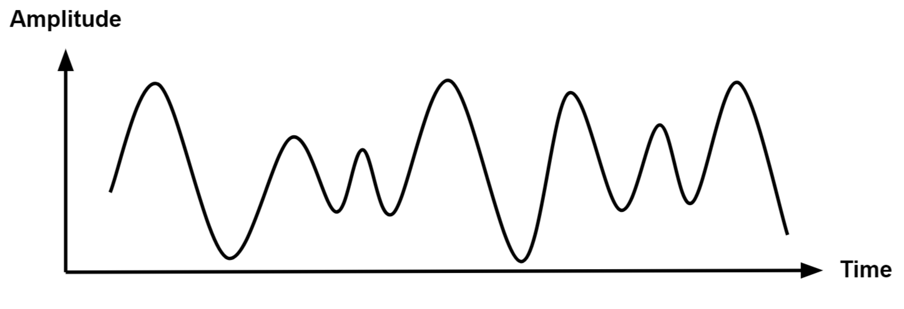
Sampling
$$t$$
$$−B$$
$$0$$
$$B$$
$$f$$
$$t$$
$$f$$
$$t$$
$$f$$

Slide 46
Sampling
$$t$$
$$−B$$
$$0$$
$$B$$
$$f$$
$$t$$
$$t$$
$$f$$
$$f$$

Slide 47
Sampling
$$t$$
$$−B$$
$$0$$
$$B$$
$$f$$
$$t$$
$$f$$
$$t$$
$$f$$

Slide 48
Sampling
$$t$$
$$−B$$
$$0$$
$$B$$
$$f$$
$$t$$
$$f$$
$$t$$
Low Pass Filter
$$f$$

Slide 49
Sampling
$$t$$
$$−B$$
$$0$$
$$B$$
$$f$$
$$t$$
Low Pass Filter
$$f$$

Slide 50
Sampling
$$t$$
$$−B$$
$$0$$
$$B$$
$$f$$
$$t$$
$$t$$
Low Pass Filter
$$f$$

Slide 51
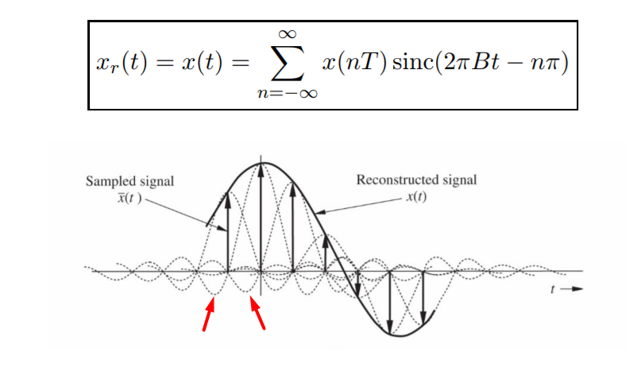
Nyquist Reconstruction

Slide 52
Nyquist Theorem
To recover the signal properly, we need to sample at twice the highest frequency
$$t$$
$$−B$$
$$0$$
$$B$$
$$f$$
$$t$$
$$f$$
$$t$$
$$f$$

Slide 53
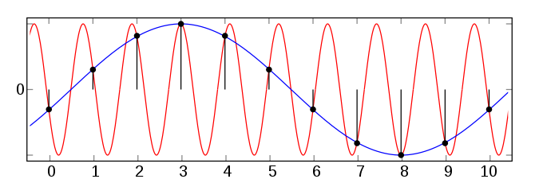
Aliasing

Slide 54
Wireless Radio Frontend
1011010110011001
1011010110011001
Digital Input
Digital Output
TX
RX
Mixer
Mixer
PA
DAC
LPF
BPF
LNA
BPF
LPF
ADC
PLL
PLL

