Slide 1



COM-405: Mobile Networks
Lecture 10.0: Wireless Localization
Haitham Hassanieh
Laboratory of SEnsing
& Networking Systems

Slide 2
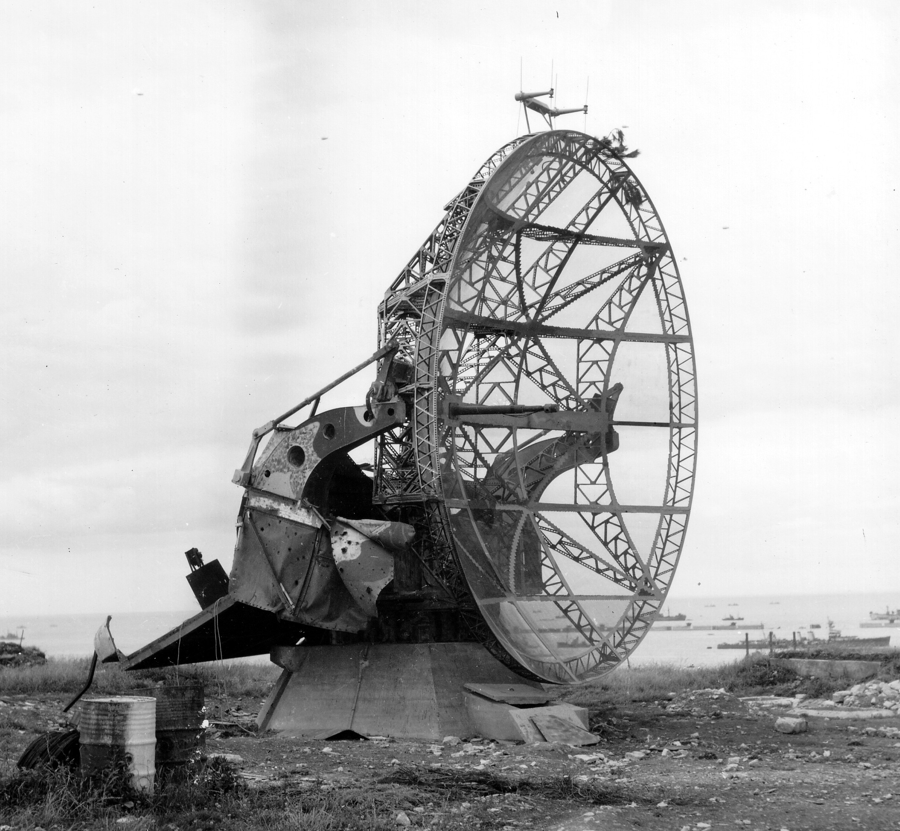
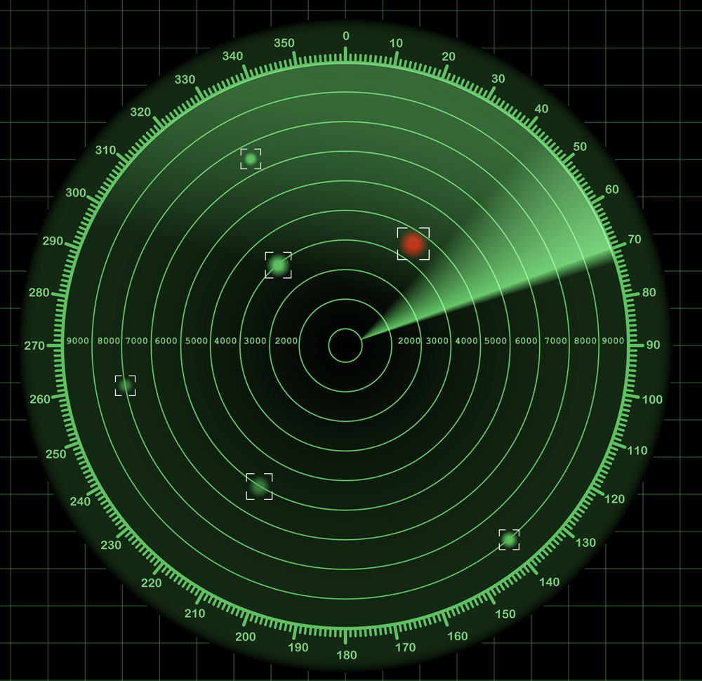
RADAR: RAdio Detection And Ranging
Invented during world war 2 to detect planes
Changed the course of the war
Transmit wireless signals, detect the reflections

Slide 3
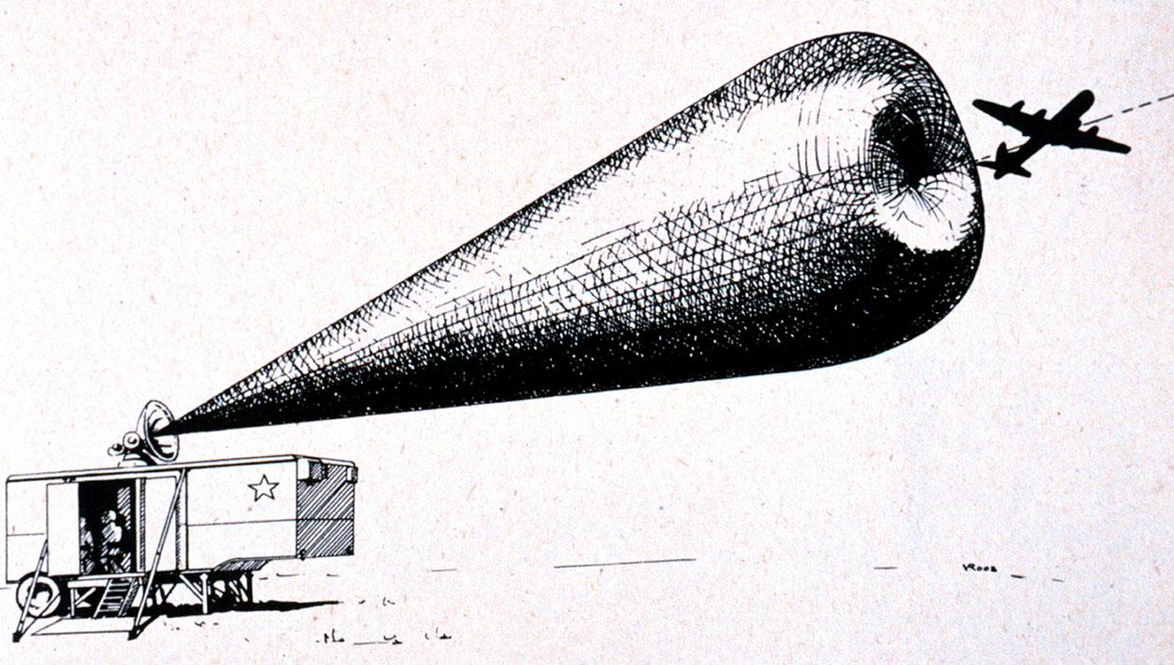

Slide 4
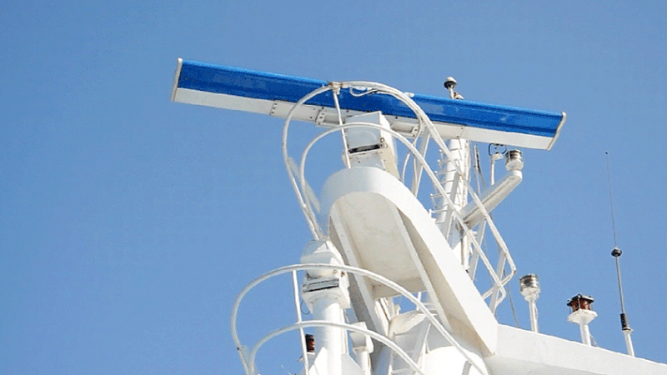
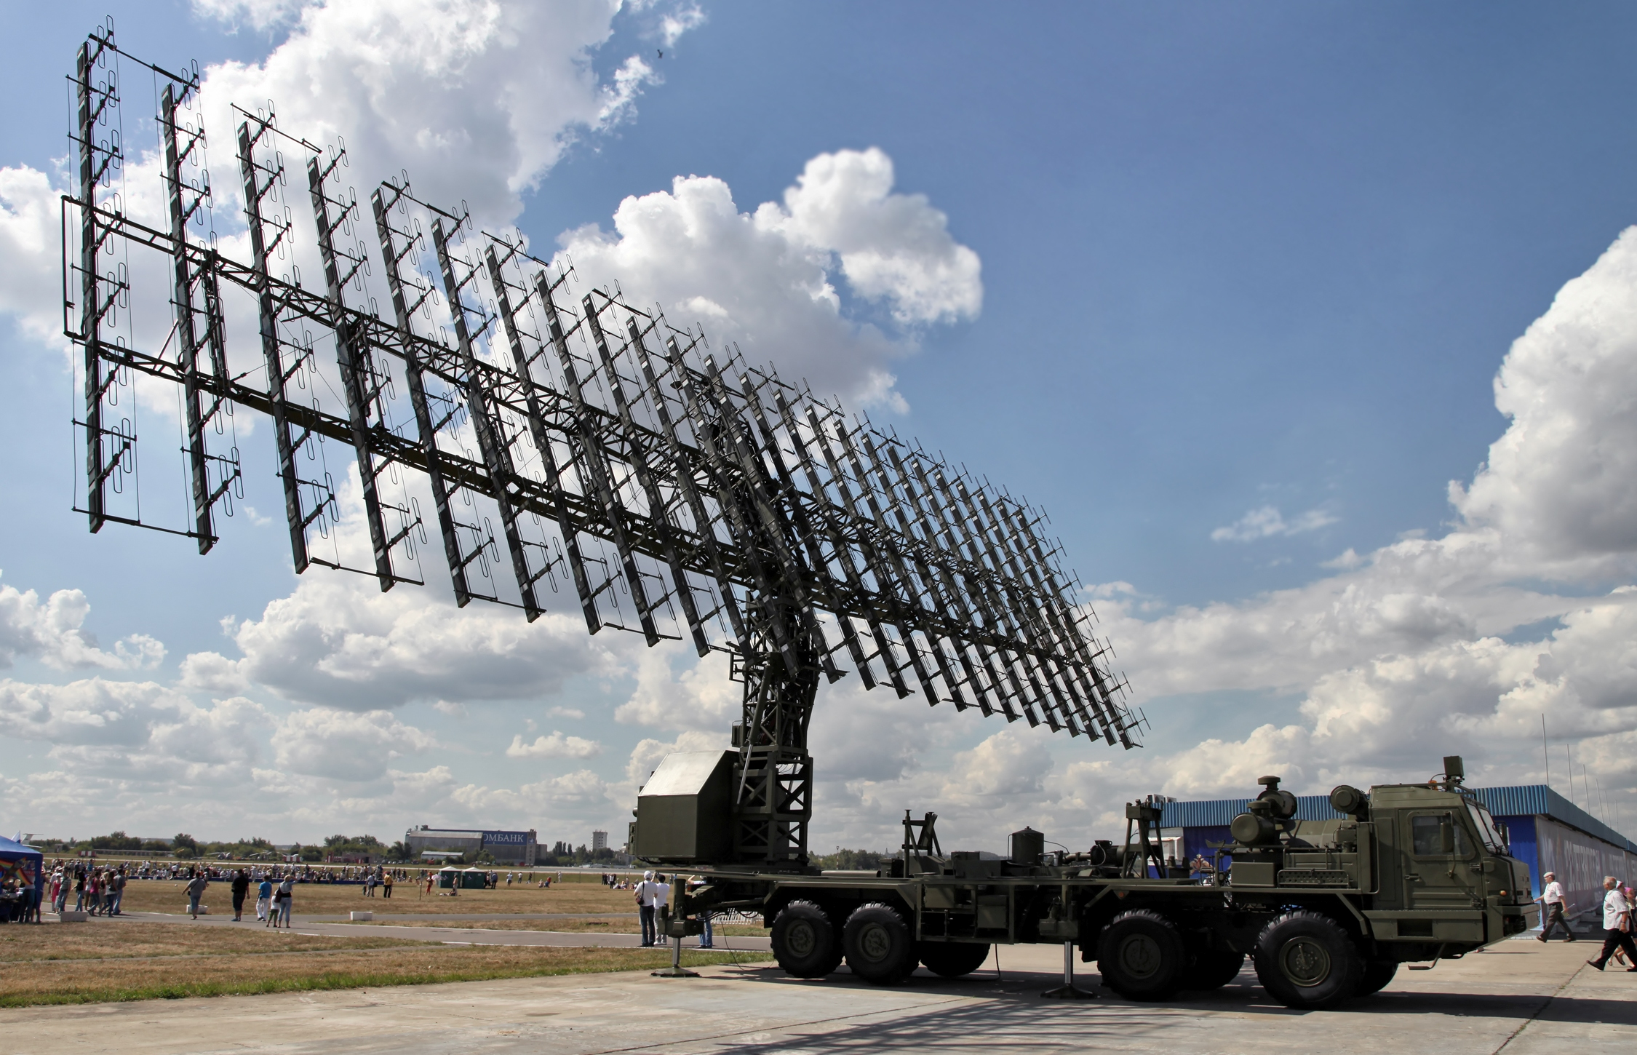
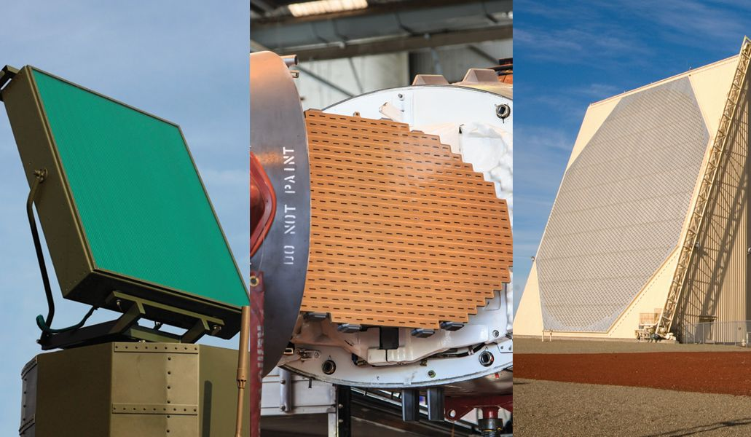
Radar: Interested in Detecting
Range: Distance from the radar
UWB: Ultra Wide Band
FMCW: Frequency Modulated Carrier Wave
Direction: Angle from which the object is coming
Directional antenna that is rotating.
Phased Antenna Array that is always Scanning.

Slide 5

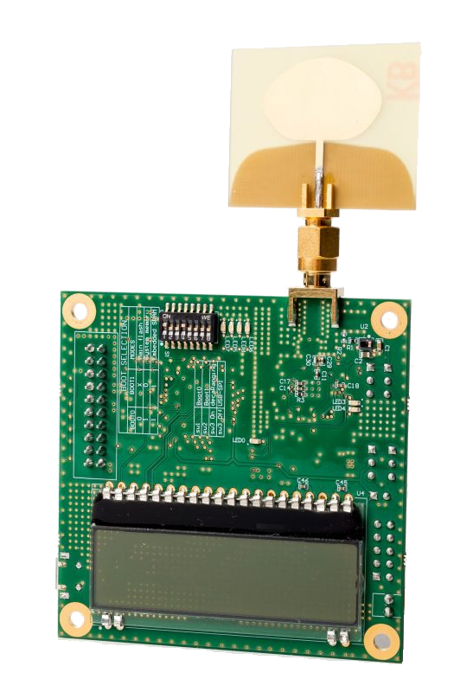
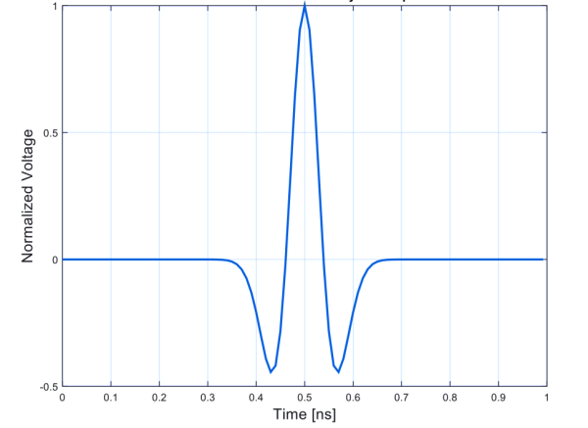
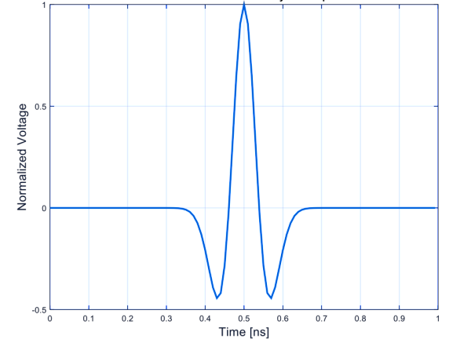
UWB: Ultra Wide Band
Transmit a Narrow Pulse in Time (1 ns)
x
x
Reflection Time
time
1ns
1ns

Slide 6
UWB: Ultra Wide Band
Transmit a Narrow Pulse in Time (1 ns)
x
x
Distance =$($Reflection Time $/2) ×$Speed of Light
Reflection Time
time
1ns
1ns

Slide 7
UWB: Ultra Wide Band
Transmit a Narrow Pulse in Time (1 ns)
Bandwidth = 1/pulse time = 1 GHz → UWB
To detect pulse need to sample at Multi-GigaSample/sec
Distance =$($Reflection Time $/2) ×$Speed of Light
Reflection Time
time
1ns
1ns

Slide 8
UWB: Ultra Wide Band
Pros:
High resolution
Simple idea
Used also for communication (UWB 802.15.3a, 3 - 10 GHz)
Cons:
Very High Speed Sampling Rate!

Slide 9
FMCW: Frequency Modulated Carrier Wave
Use chirps: signals where the frequency changes with time
Measure time using a frequency change
Transmitted
Received
ΔF
Frequency
=
ΔF
slope
Reflection Time
Time
t
t+ΔT

Slide 10
How do we measure ΔF ?
Subtracting frequencies is easy (e.g., removing carrier in WiFi)
Done using a mixer (low-power; cheap)
Power
Transmitted
Mixer
FFT
Received
ΔF
Signal whose frequency is ΔF
ΔF ➔Reflection Time ➔ Distance

Slide 11
FMCW: Frequency Modulated Carrier Wave
Slope
$$x\left(t\right)=e^{j2π\left( \frac{α}{2} t^{2}+f_{0}t+φ_{0}\right)}$$
FMCW Transmitted Signal:
Reflection Time
FMCW Received Signal: (Single reflector)
$$y\left(t\right)=Ae^{j2π\left( \frac{α}{2} {(t−τ)}^{2}+f_{0}\left(t−τ\right)+φ_{0}\right)}$$
$$=Ae^{j2π\left( \frac{α}{2} t^{2}−ατt+\frac{α}{2}τ^{2}+f_{0}t−f_{0}τ+φ_{0}\right)}$$
Phase
Mix TX and RX Signal:
$$y_{b}\left(t\right)=y\left(t\right)× x^{∗}(t)=$$
$$Ae^{−j2π\left(ατt +f_{0}τ\right)}$$
Frequency at $f=ατ$

Slide 12
FMCW: Frequency Modulated Carrier Wave
Slope
$$x\left(t\right)=e^{j2π\left( \frac{α}{2} t^{2}+f_{0}t+φ_{0}\right)}$$
FMCW Transmitted Signal:
Reflection Time
FMCW Received Signal: (Multiple reflectors)
$$y\left(t\right)=\sum_{i}{A_{i}e^{j2π\left( \frac{α}{2} {(t−τ_{i})}^{2}+f_{0}\left(t−τ_{i}\right)+φ_{0}\right)} }$$
Phase
$$\sum_{i}{A_{i}e^{−j2π\left(ατ_{i}t +f_{0}τ_{i}\right)}}$$
Mix TX and RX Signal:
$$y_{b}\left(t\right)=y\left(t\right)× x^{∗}(t)=$$
Frequencies at $f=ατ_{i}$

Slide 13
FMCW: Frequency Modulated Carrier Wave
$$x\left(t\right)=e^{j2π\left( \frac{α}{2} t^{2}+f_{0}t+φ_{0}\right)}$$
FMCW Transmitted Signal:
$$\sum_{i}{A_{i}e^{−j2π\left(ατ_{i}t +f_{0}τ_{i}\right)}}$$
Mix TX and RX Signal:
$$y_{b}\left(t\right)=y\left(t\right)× x^{∗}(t)=$$
Sweep Time $T_{s}$
$$Slope:α=\frac{B_{s}}{T_{s}}$$
B
ΔF
Sweep Bandwidth $B_{s}$
$$ΔF=αΔT=ατ_{i}$$
Frequency
ΔT
$$Sampling Rate:B≪B_{s}$$
Time
t
t+ΔT
$$FFT Window:T=T_{s}$$

Slide 14
FMCW: Frequency Modulated Carrier Wave
Sweep Time $T_{s}$
$$Slope:α=\frac{B_{s}}{T_{s}}$$
B
ΔF
$$ΔF=αΔT=ατ_{i}$$
Sweep Bandwidth $B_{s}$
Frequency
ΔT
$$Sampling Rate:B≪B_{s}$$
Time
$$FFT Window:T=T_{s}$$
t
t+ΔT
Max Range:
$$ΔF<B$$
$$⇒τ_{max}<B/α$$
$$=B T_{s}/B_{s}$$
$$⇒d_{max}<c B T_{s}/{2B}_{s}$$
Resolution:
$$δF=1/T$$
$$=1/T_{s}$$
$$⇒τ_{min}=1/αT_{s}$$
$$=1/B_{s}$$
$$⇒d_{min}=c/2B_{s}$$

Slide 15
Radar: Interested in Detecting
Range: Distance from the radar
UWB: Ultra Wide Band
FMCW: Frequency Modulated Carrier Wave
Direction: Angle from which the object is coming
Directional antenna that is rotating.
Phased Antenna Array that is always Scanning.

Slide 16
Phased Arrays Primer
$$θ$$
$$h_{k}=α_{1}e^{−j2π\frac{d_{1}−k s\cos{θ_{1}}}{λ}}$$

Slide 17
Phased Arrays Primer
Digital Phased Arrays
$$θ$$

Slide 18
Phased Arrays Primer
Digital Phased Arrays
$$θ$$

Slide 19

Phased Arrays Primer
Digital Phased Arrays
$$θ$$
RX
RX
RX
RX
RX
RX
RX
RX
RX
RX
RX
RX
RX
RX
Mixer
BPF
LPF
ADC
$$I$$
PLL
$$+$$
Digital Processing
LNA
$${90}^{o}$$
$$jQ$$
BPF
Mixer
LPF
ADC
Every antenna connected to full fledged RX
Sample & Process Signals in Digital

Slide 20

Phased Arrays Primer
Digital Phased Arrays
Analog Phased Arrays
$$θ$$
$$θ$$
RX
RX
RX
RX
RX
RX
RX
RX
RX
RX
RX
RX
RX
RX
RX
Mixer
All antennas connected to a single receiver
BPF
LPF
ADC
$$I$$
PLL
Each antenna connected to a phase shifter.
Phase shifter changes the phase of the signal on each antenna by multiplying with $e^{jφ}$.
Steer the beam electronically by changing the phases of the signals.
Get the sum along a certain direction.
$$+$$
Digital Processing
LNA
$${90}^{o}$$
$$jQ$$
BPF
Mixer
LPF
ADC
Every antenna connected to full fledged RX
Sample & Process Signals in Digital
Very expensive and high power for large arrays & mmWave
Cheap & low power but requires scanning

Slide 21
Analog Phased Arrays
$$θ$$
$$h_{k}=αe^{−j2π\frac{d−k s\cos{θ}}{λ}}$$
RX
$$y\left(t\right)=\sum_{1}^{N}{y_{k}\left(t\right)e^{jφ_{k}}}$$
$$=\sum_{1}^{N}{h_{k}x\left(t\right)e^{jφ_{k}}}$$
$$=\sum_{1}^{N}{αe^{−j2π\frac{d−k s\cos{θ}}{λ}}x\left(t\right)e^{jφ_{k}}}$$
$$=x\left(t\right)αe^{−j2π\frac{d}{λ}}\sum_{1}^{N}{e^{jπk \cos{θ}}e^{jφ_{k}}}$$
To get signal along direction $θ_{1}$, set the phases on the phase shifters to $φ_{k}=−πk cos θ$

Slide 22
Analog Phased Arrays
$$θ$$
$$h_{k}=αe^{−j2π\frac{d−k s\cos{θ}}{λ}}$$
RX

Slide 23
Analog Phased Arrays
$$θ$$
$$h_{k}=αe^{−j2π\frac{d−k s\cos{θ}}{λ}}$$
RX
Set the phase shifters to receive signals from a given direction.
Send FMCW signals.
Receiver FMCW reflections, down convert, sample and compute range FFT.
Repeat until you get 2D range image: AoA + Range

Slide 24
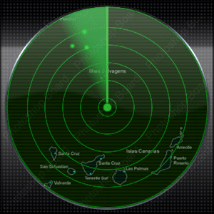
Analog Phased Arrays
$$θ$$
$$h_{k}=αe^{−j2π\frac{d−k s\cos{θ}}{λ}}$$
RX

Slide 25
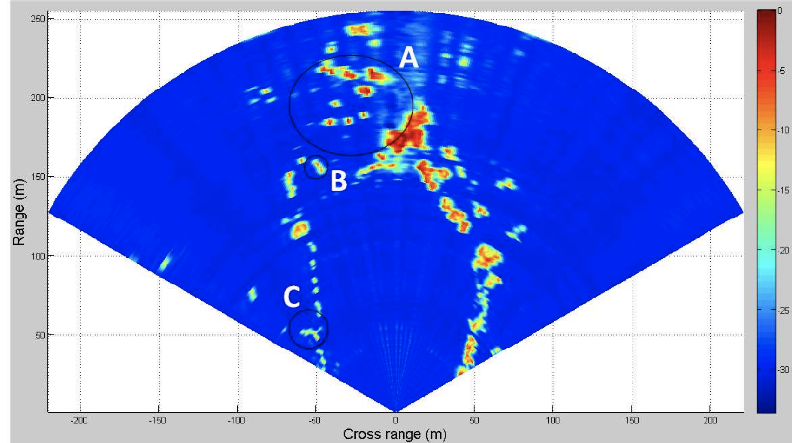
Analog Phased Arrays
$$θ$$
$$h_{k}=αe^{−j2π\frac{d−k s\cos{θ}}{λ}}$$
RX

Slide 26
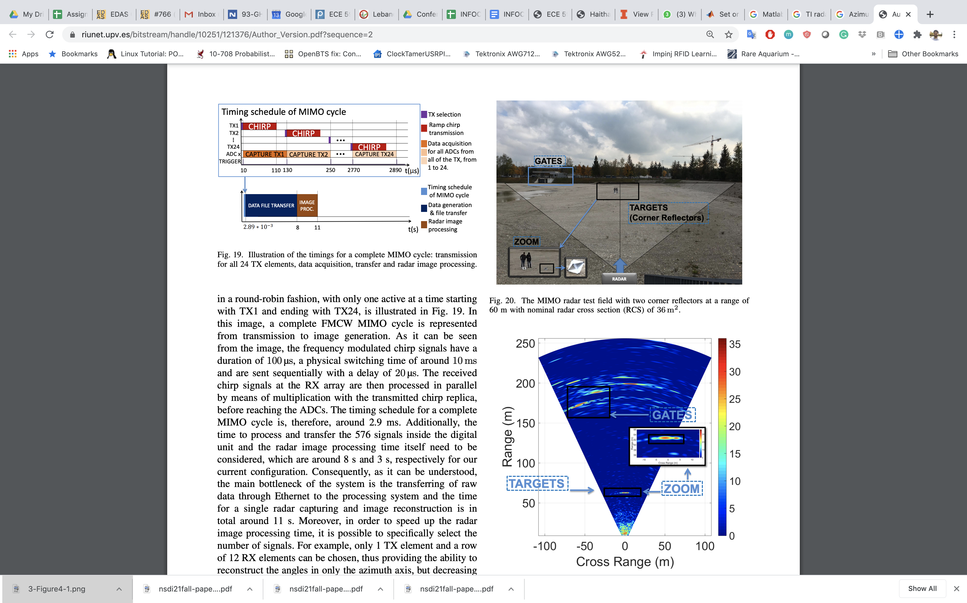
Analog Phased Arrays
Ganis, A.; Miralles-Navarro, E.; Schoenlinner, B.; Prechtel, U.; Meusling, A.; Heller, C.; Spreng, T.... (2018). A portable 3D Imaging FMCW MIMO Radar Demonstrator with a 24x24 Antenna Array for Medium Range Applications. IEEE Transactions on Geoscience and Remote Sensing. 56(1):298-312. https://doi.org/10.1109/TGRS.2017.2746739

Slide 27
Analog Phased Arrays
$$θ$$
$$h_{k}=αe^{−j2π\frac{d−k s\cos{θ}}{λ}}$$
RX
8 Antenna
16 Antenna
32 Antenna
Larger Array → Narrower Beams → Higher Resolution

Slide 28
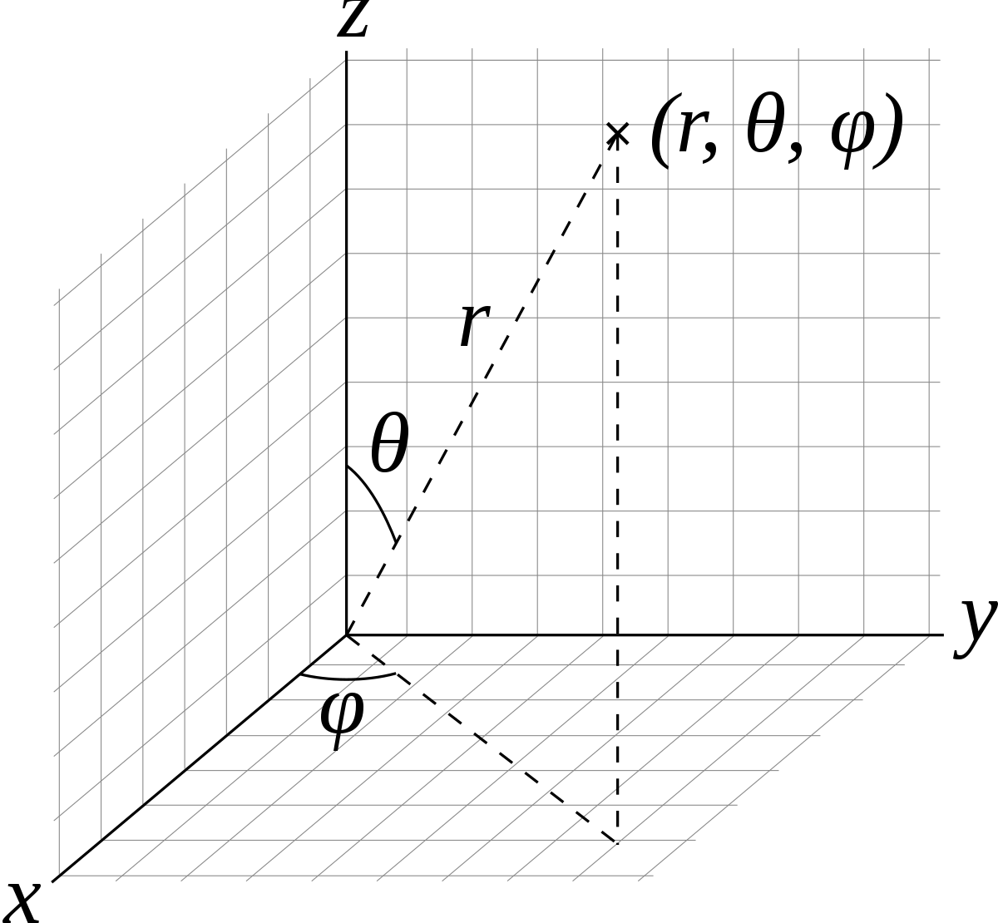


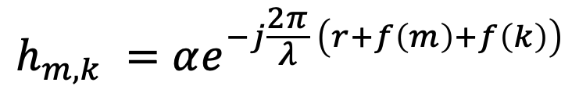

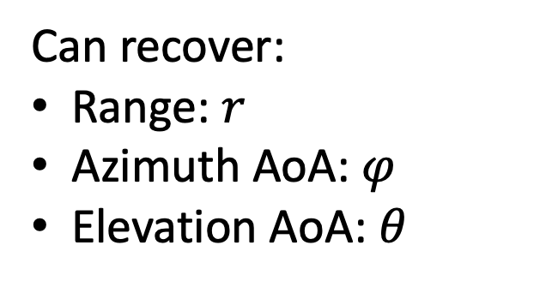


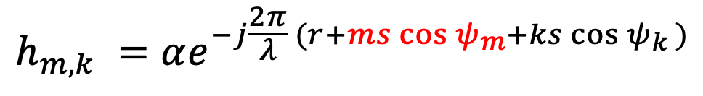

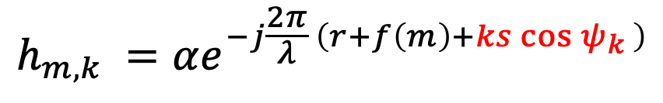
2D Phased Arrays
$$ψ_{k}$$
$$k$$
$$ψ_{m}$$
$$m$$
$$h_{m,k} =αe^{−j\frac{2π}{λ} \left(r+f\left(m\right)+f\left(k\right)\right)}$$
Can recover:
Range: $r$
Azimuth AoA: $φ$
Elevation AoA: $θ$
$$h_{m,k} =αe^{−j\frac{2π}{λ} \left(r+f\left(m\right)+ks\cos{ψ_{k}} \right)}$$
Fix $m$:
$$h_{m,k} =αe^{−j\frac{2π}{λ} (r+ms\cos{ψ_{m}}+ks\cos{ψ_{k}} )}$$
Fix $k$:

Slide 29
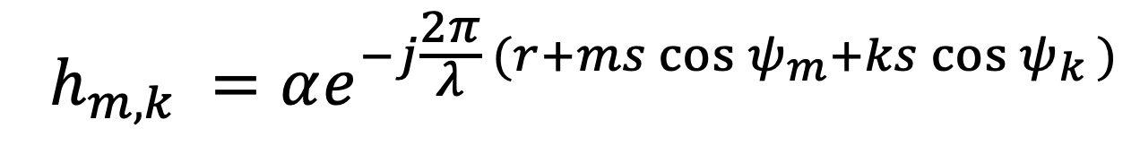
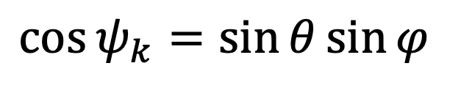
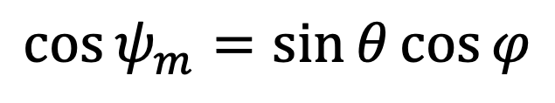
2D Phased Arrays
$$ψ_{k}$$
$$k$$
$$ψ_{m}$$
$$m$$
$$h_{m,k} =αe^{−j\frac{2π}{λ} (r+ms\cos{ψ_{m}}+ks\cos{ψ_{k}} )}$$
Can recover:
Range: $r$
Azimuth AoA: $φ$
Elevation AoA: $θ$
$$\cos{ψ_{m}}=\sin{θ}\cos{φ}$$
$$\cos{ψ_{k}}=\sin{θ}\sin{φ}$$

Slide 30
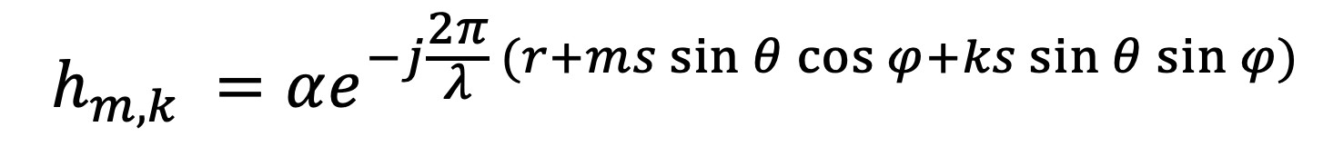
2D Phased Arrays
$$ψ_{k}$$
$$k$$
$$ψ_{m}$$
$$m$$
Can recover:
Range: $r$
Azimuth AoA: $φ$
Elevation AoA: $θ$
$$h_{m,k} =αe^{−j\frac{2π}{λ} (r+ms\sin{θ}\cos{φ}+ks\sin{θ}\sin{φ})}$$

Slide 31
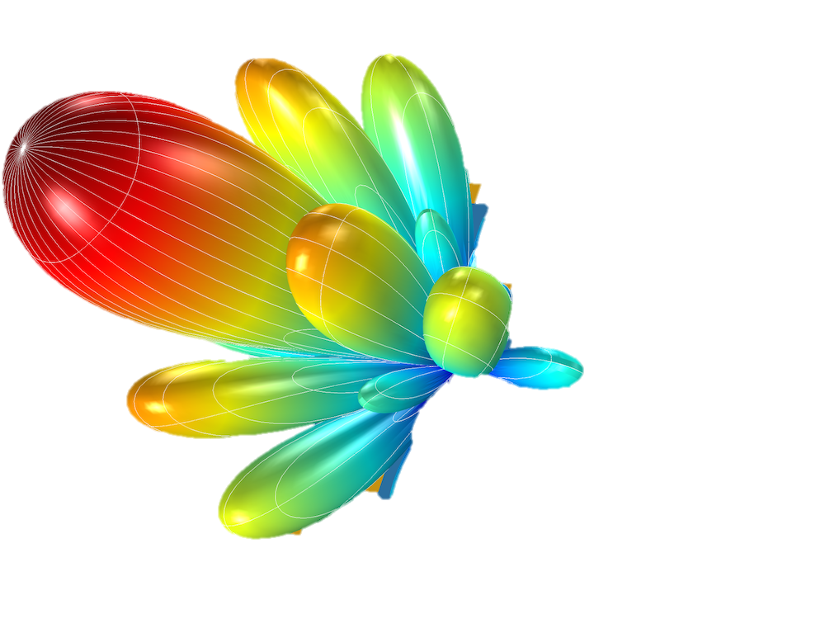
2D Phased Arrays
$$ψ_{k}$$
$$k$$
$$ψ_{m}$$
$$m$$
Can recover:
Range: $r$
Azimuth AoA: $φ$
Elevation AoA: $θ$
$$h_{m,k} =αe^{−j\frac{2π}{λ} (r+ms\sin{θ}\cos{φ}+ks\sin{θ}\sin{φ})}$$

Slide 32
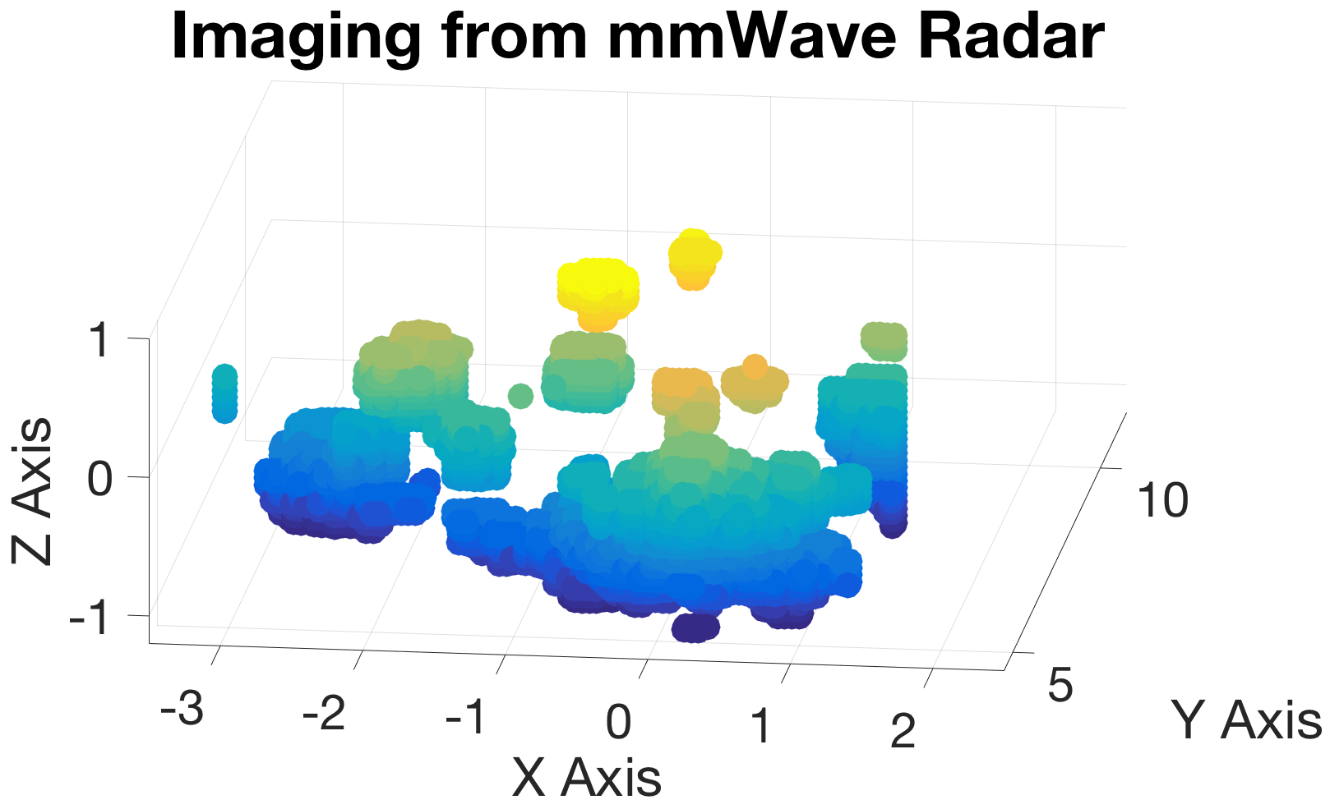
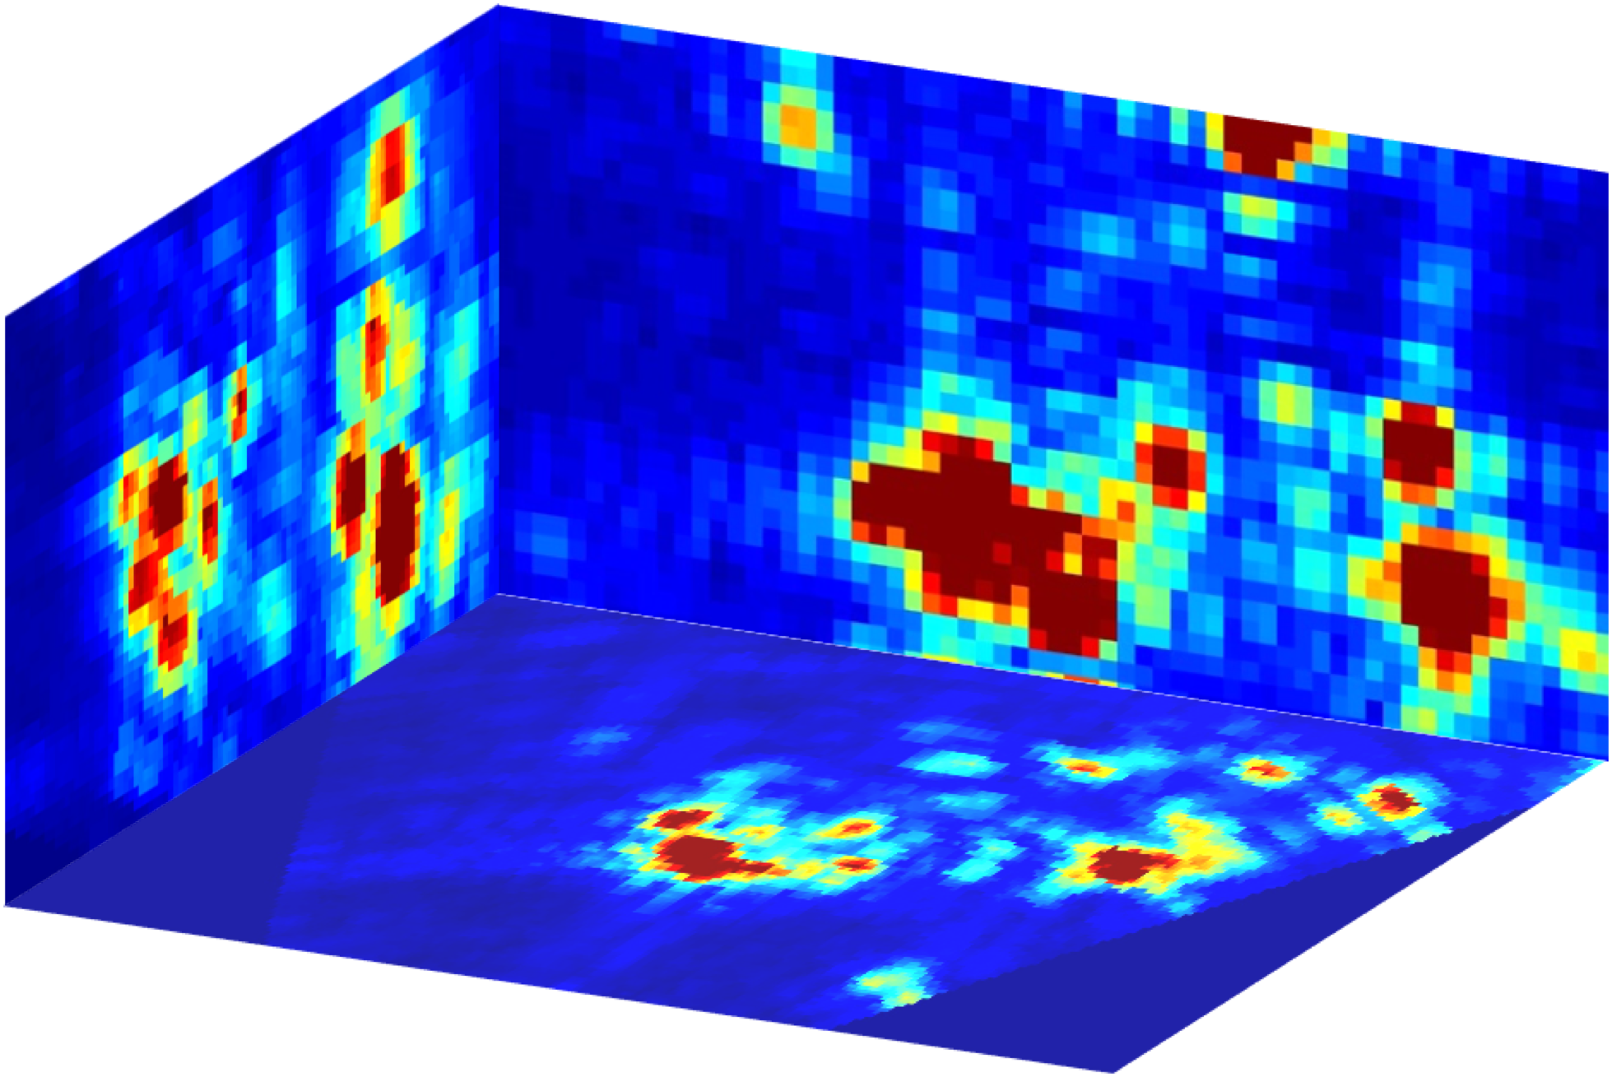

2D Phased Arrays
Pick the phase shift on each antenna to create a beam in each 3D direction.
Transmit FMCW signals and receive reflections.
Mix RX signal with TX and take range FFT .
Repeat in every direction.
$$ψ_{k}$$
$$k$$
$$ψ_{m}$$
$$m$$
3D Heatmap Image
3D Point Cloud

Slide 33


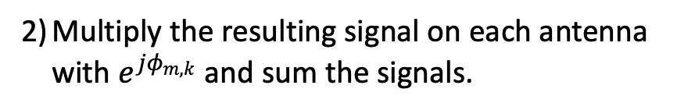





Phased Arrays Primer
Digital Phased Arrays
Analog Phased Arrays
Single RX Chain
$N×N$ RX Chains
Could Potentially Do the Same thing:
Pick the phase shift on each antenna to create a beam in each 3D direction.
Transmit FMCW signals and receive reflections.
Mix RX signal with TX and take range FFT .
Repeat in every direction.
Mix the RX signal with TX.
Multiply the resulting signal on each antenna with $e^{jφ_{m,k}}$ and sum the signals.
Compute Range FFT.
Repeat in every direction.
3D Heatmap Image
$$($$
$$N×N×T$$
$$+T\log{T}$$
$$)$$
$$×N×N$$
$$=O\left(N^{4}T+N^{2}T\log{T}\right)$$

Slide 34

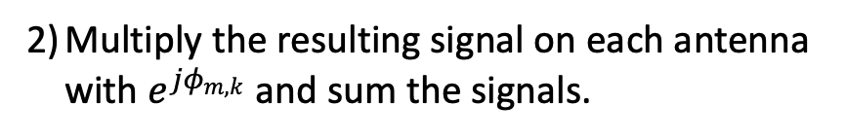




Phased Arrays Primer
Digital Phased Arrays
Analog Phased Arrays
Single RX Chain
$N×N$ RX Chains
Could Potentially Do the Same thing:
Pick the phase shift on each antenna to create a beam in each 3D direction.
Transmit FMCW signals and receive reflections.
Mix RX signal with TX and take range FFT .
Repeat in every direction.
Mix the RX signal with TX.
Compute Range FFT.
Multiply the resulting signal on each antenna with $e^{jφ_{m,k}}$ and sum the signals.
Repeat in every direction.
3D Heatmap Image
$$N×N×T\log{T}$$
$$+N×N×T$$
$$×N×N$$
$$=$$
$$O\left(N^{4}T+N^{2}T\log{T}\right)$$

Slide 35
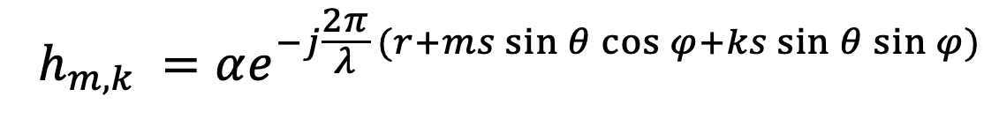

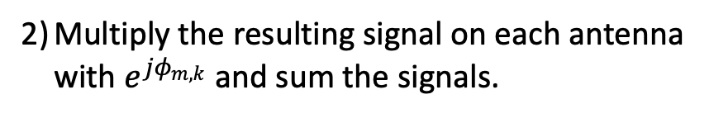
Phased Arrays Primer
Digital Phased Arrays
Algorithm 1:
$$O\left(N^{4}T+N^{2}T\log{T}\right)$$
Mix the RX signal with TX.
Compute Range FFT.
Multiply the resulting signal on each antenna with $e^{jφ_{m,k}}$ and sum the signals.
Repeat in every direction.
$N×N$ RX Chains
Algorithm 2: (Faster)
IDEA: antenna arrays are Fourier Transforms
$$h_{m,k} =αe^{−j\frac{2π}{λ} (r+ms\sin{θ}\cos{φ}+ks\sin{θ}\sin{φ})}$$

Slide 36
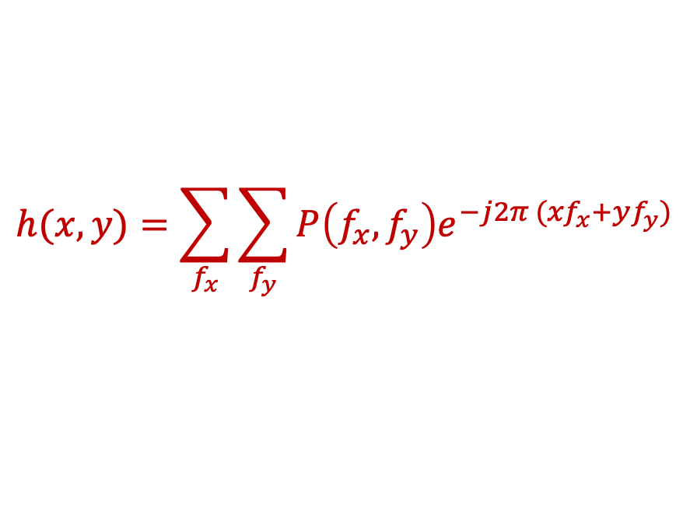
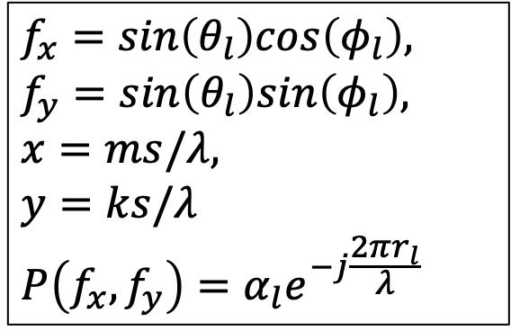
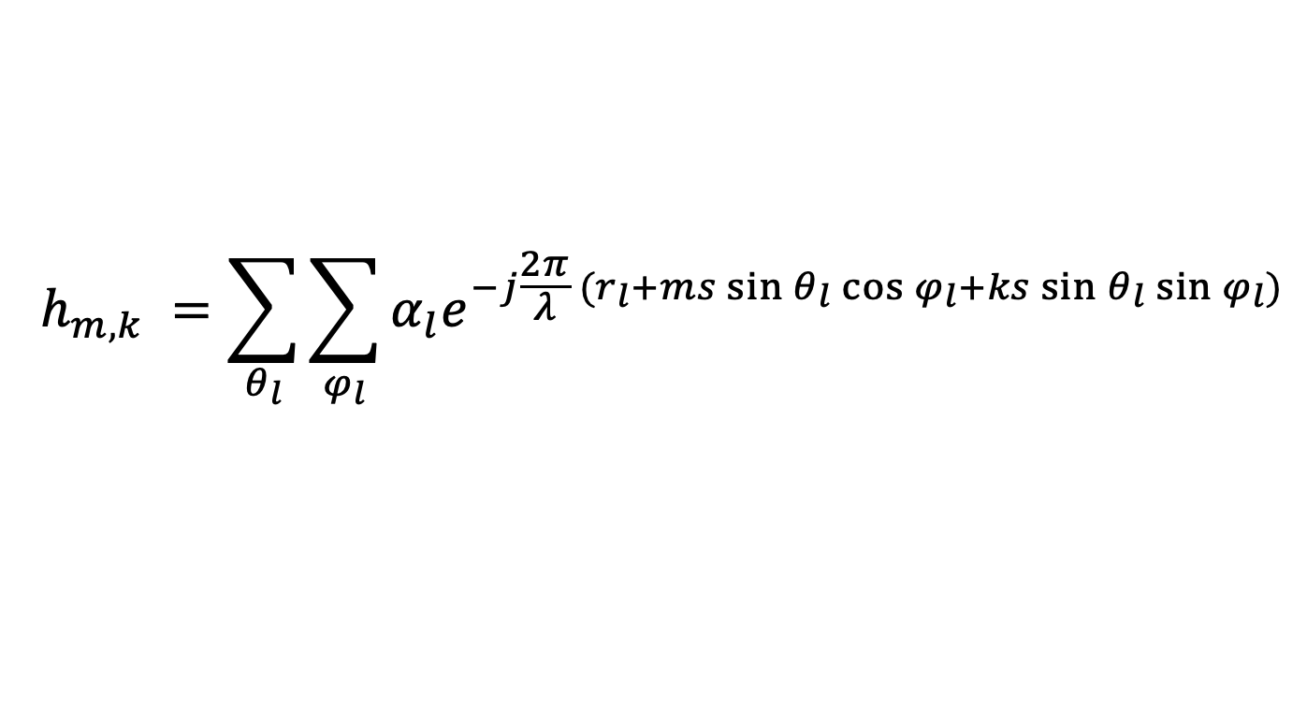
Phased Arrays Primer
Digital Phased Arrays
Algorithm 1:
$$O\left(N^{4}T+N^{2}T\log{T}\right)$$
Mix the RX signal with TX.
Compute Range FFT.
Multiply the resulting signal on each antenna with $e^{jφ_{m,k}}$ and sum the signals.
Repeat in every direction.
$N×N$ RX Chains
Algorithm 2: (Faster)
IDEA: antenna arrays are Fourier Transforms
$$h_{m,k} =\sum_{θ_{l}}{\sum_{φ_{l}}{α_{l}e^{−j\frac{2π}{λ} (r_{l}+ms\sin{θ_{l}}\cos{φ_{l}}+ks\sin{θ_{l}}\sin{φ_{l}})}}}$$
$$f_{x}=sin\left(θ_{l}\right)cos\left(φ_{l}\right),$$
$$f_{y}=sin\left(θ_{l}\right)sin\left(φ_{l}\right),$$
$$x=ms/λ,$$
$$y=ks/λ$$
$$P\left(f_{x}, f_{y}\right)=α_{l}e^{−j\frac{2πr_{l}}{λ} }$$
$$h(x,y)=\sum_{f_{x}}{\sum_{f_{y}}{P\left(f_{x}, f_{y}\right)e^{−j2π ({xf}_{x}+yf_{y})}}}$$
Use 2D FFT

Slide 37




Phased Arrays Primer
Digital Phased Arrays
Algorithm 1:
$$O\left(N^{4}T+N^{2}T\log{T}\right)$$
Mix the RX signal with TX.
Compute Range FFT.
Multiply the resulting signal on each antenna with $e^{jφ_{m,k}}$ and sum the signals.
Repeat in every direction.
$N×N$ RX Chains
Algorithm 2: (Faster)
IDEA: antenna arrays are Fourier Transforms
Mix the RX signal with TX.
Compute 2D FFT across antennas
3D FFT
Compute Range FFT.
$$N^{2}\log{N^{2}}× T$$
$$+N×N× T log T$$
$$=$$
$$O\left(N^{2}T\log{N^{2}T}\right)$$

Slide 38

Phased Arrays Primer
Digital Phased Arrays
Algorithm 1:
$$O\left(N^{4}T+N^{2}T\log{T}\right)$$
Mix the RX signal with TX.
Compute Range FFT.
Multiply the resulting signal on each antenna with $e^{jφ_{m,k}}$ and sum the signals.
Repeat in every direction.
$N×N$ RX Chains
Algorithm 2: (Faster)
$$O\left(N^{2}T\log{NT}\right)$$
3D FFT
Algorithm 3: (More Accurate)
Mix the RX signal with TX.
Compute 2D FFT across antennas
Compute Range FFT.

Slide 39
Phased Arrays Primer
Assumes parallel waves
Reflector is far away
$N×N$ RX Chains
Algorithm 3: (More Accurate)

Slide 40

Phased Arrays Primer
Assumes parallel waves
Reflector is far away
$N×N$ RX Chains
$N×N$ RX Chains
Algorithm 3: (More Accurate)

Slide 41





Phased Arrays Primer
Assumes parallel waves
Reflector is far away
Reflector is not far
$N×N$ RX Chains
$N×N$ RX Chains
Algorithm 3: (More Accurate)
IDEA: use the exact equation
$p$: FMCW Slope
$$s_{m,k}\left(t\right)$$
$$=α_{l}e^{−j2π(pτ_{l}t+f_{0}τ_{l}) }$$
$$=α_{l}e^{−j2π(p{2d}_{l}t/c+{2d}_{l}/λ) }$$
Received FMCW signal from reflector $l$after mixing with TX

Slide 42
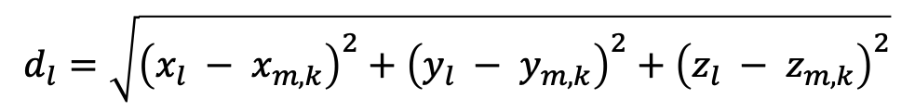
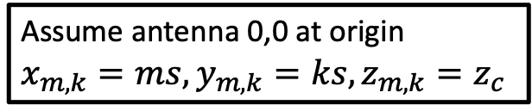


Phased Arrays Primer
Assumes parallel waves
Reflector is far away
Reflector is not far
$N×N$ RX Chains
$N×N$ RX Chains
Algorithm 3: (More Accurate)
Assume antenna 0,0 at origin
$$x_{m,k}=ms,y_{m,k}=ks, z_{m,k}=z_{c}$$
IDEA: use the exact equation
$$s_{m,k}\left(t\right)$$
$$=α_{l}e^{−j2π(pτ_{l}t+f_{0}τ_{l}) }$$
$$=α_{l}e^{−j2π(p{2d}_{l}t/c+2d_{l}/λ) }$$
$$d_{l}=\sqrt{{\left(x_{l} − x_{m,k}\right)}^{2}+{\left(y_{l} − y_{m,k}\right)}^{2}+{\left(z_{l} − z_{m,k}\right)}^{2}}$$
$$=\sqrt{{\left(x_{l} −ms\right)}^{2}+{\left(y_{l} −ks\right)}^{2}+{\left(z_{l} −z_{c}\right)}^{2}}$$

Slide 43
Phased Arrays Primer
Assumes parallel waves
Reflector is far away
Reflector is not far
$N×N$ RX Chains
$N×N$ RX Chains
Algorithm 3: (More Accurate)
Assume antenna 0,0 at origin
$$x_{m,k}=ms,y_{m,k}=ks, z_{m,k}=z_{c}$$
IDEA: use the exact equation
$$s_{m,k}\left(t\right)$$
$$=α_{l}e^{−j2π(pτ_{l}t+f_{0}τ_{l}) }$$
$$=α_{l}e^{−j2π(p{2d}_{l}t/c+2d_{l}/λ) }$$
$$=α_{l}e^{−j4π(pt/c+1/λ)\sqrt{{\left(x_{l} −ms\right)}^{2}+{\left(y_{l} −ks\right)}^{2}+{\left(z_{l} −z_{c}\right)}^{2}}}$$

Slide 44
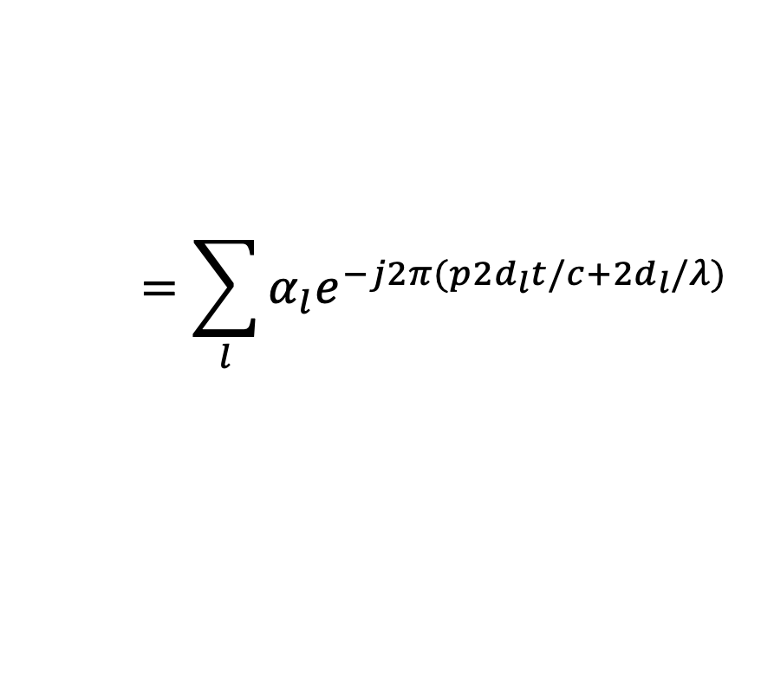
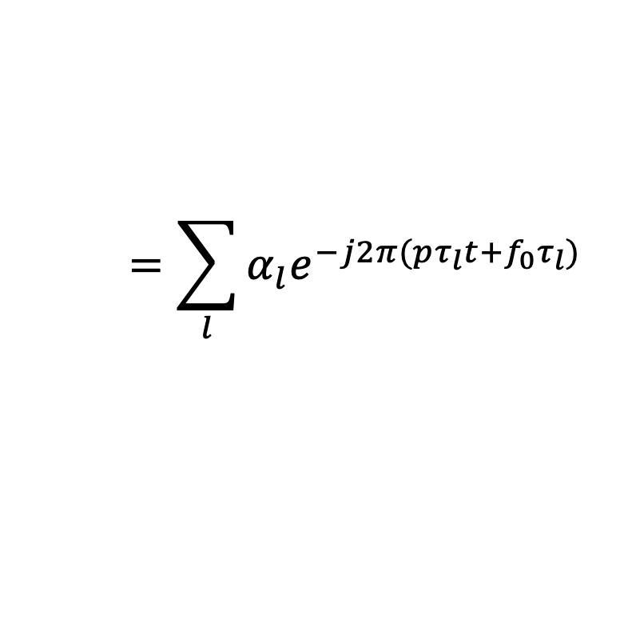
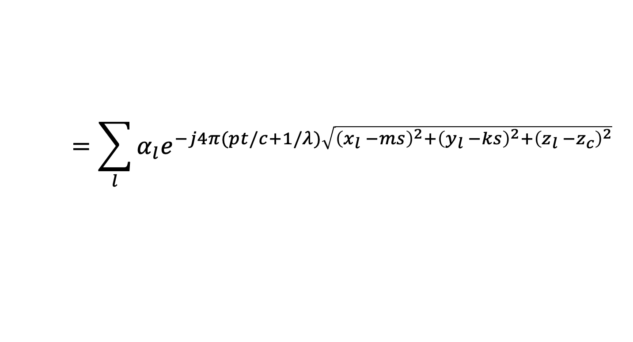
Phased Arrays Primer
Assumes parallel waves
Reflector is far away
Reflector is not far
$N×N$ RX Chains
$N×N$ RX Chains
Algorithm 3: (More Accurate)
Assume antenna 0,0 at origin
$$x_{m,k}=ms,y_{m,k}=ks, z_{m,k}=z_{c}$$
IDEA: use the exact equation
$$=\sum_{l}{α_{l}e^{−j2π(pτ_{l}t+f_{0}τ_{l}) } }$$
$$=\sum_{l}{α_{l}e^{−j2π(p{2d}_{l}t/c+{2d}_{l}/λ) } }$$
$$s_{m,k}\left(t\right)$$
$$=\sum_{l}{α_{l}e^{−j4π(pt/c+1/λ)\sqrt{{\left(x_{l} −ms\right)}^{2}+{\left(y_{l} −ks\right)}^{2}+{\left(z_{l} −z_{c}\right)}^{2}}} }$$

Slide 45
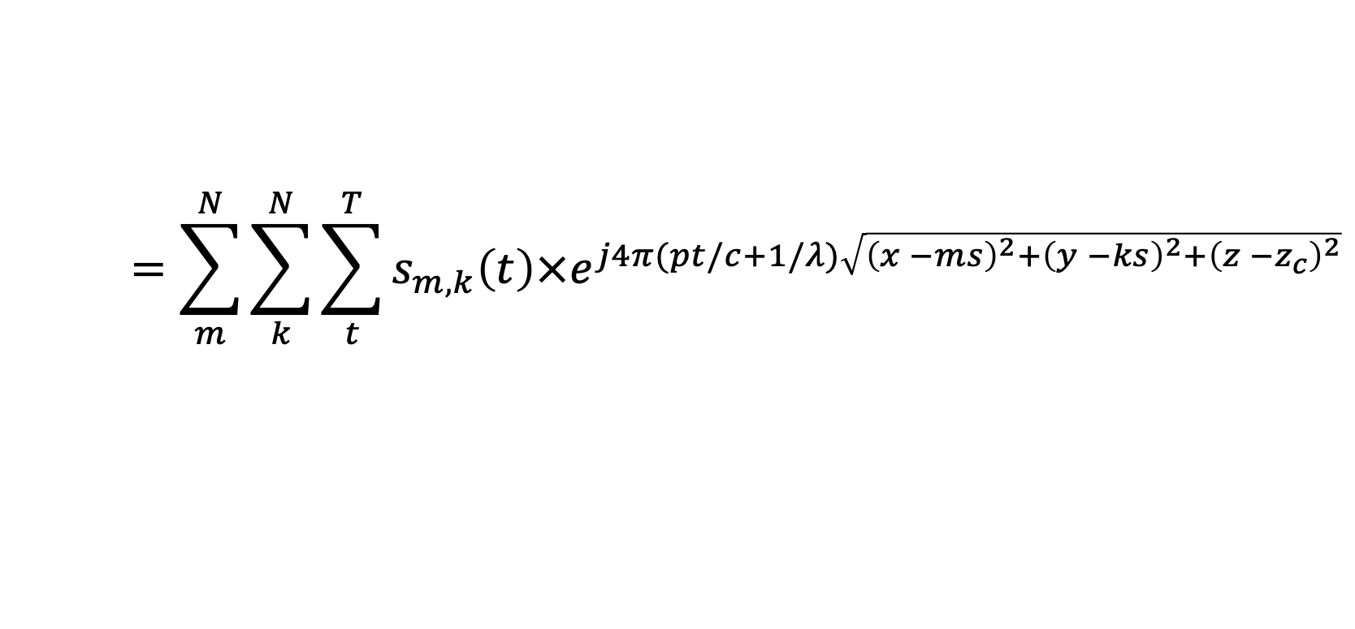

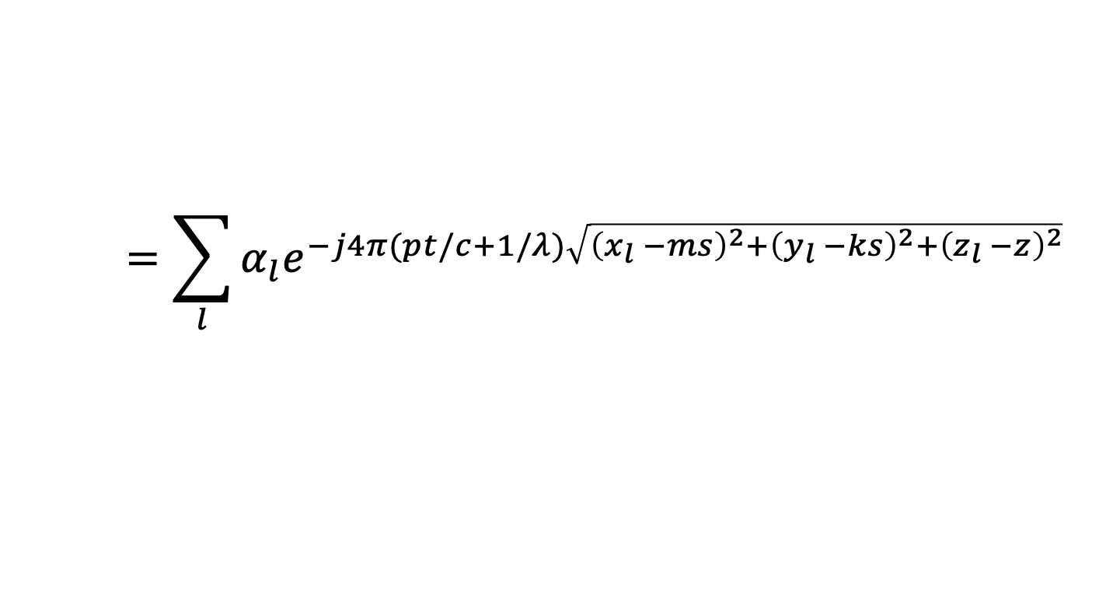

Phased Arrays Primer
Assumes parallel waves
Reflector is far away
Reflector is not far
$N×N$ RX Chains
$N×N$ RX Chains
Algorithm 3: (More Accurate)
Assume antenna 0,0 at origin
$$x_{m,k}=ms,y_{m,k}=ks, z_{m,k}=z_{c}$$
IDEA: use the exact equation
$$=\sum_{l}{α_{l}e^{−j4π(pt/c+1/λ)\sqrt{{\left(x_{l} −ms\right)}^{2}+{\left(y_{l} −ks\right)}^{2}+{\left(z_{l} −z\right)}^{2}}} }$$
$$s_{m,k}\left(t\right)$$
$$=\sum_{m}^{N}{\sum_{k}^{N}{\sum_{t}^{T}{s_{m,k}\left(t\right)×e^{j4π(pt/c+1/λ)\sqrt{{\left(x −ms\right)}^{2}+{\left(y −ks\right)}^{2}+{\left(z −z_{c}\right)}^{2}}}}}}$$
$$P\left(x,y,z\right)$$
$$=N^{2}Tα_{l}$$

Slide 46
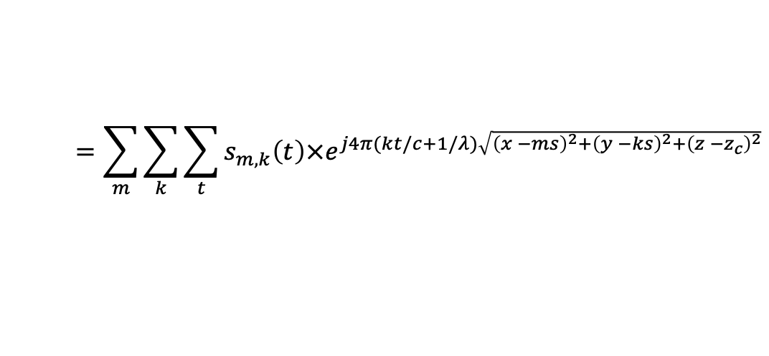



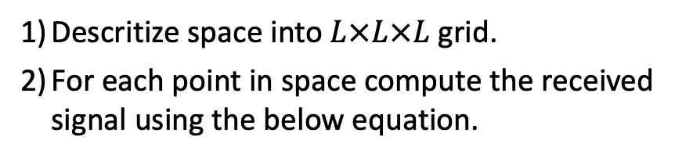
Phased Arrays Primer
Digital Phased Arrays
Algorithm 1:
$$O\left(N^{4}T+N^{2}T\log{T}\right)$$
Mix the RX signal with TX.
Compute Range FFT.
Multiply the resulting signal on each antenna with $e^{jφ_{m,k}}$ and sum the signals.
Repeat in every direction.
$N×N$ RX Chains
Algorithm 2: (Faster)
$$O\left(N^{2}T\log{NT}\right)$$
3D FFT
Algorithm 3: (More Accurate)
$$O\left(L^{3}N^{2}T\right)$$
$$=o\left(N^{5}T\right)$$
Mix the RX signal with TX.
Descritize space into $L×L×L$ grid.
For each point in space compute the received signal using the below equation.
Compute 2D FFT across antennas
Compute Range FFT.
$$P\left(x,y,z\right)$$
$$=\sum_{m}{\sum_{k}{\sum_{t}{s_{m,k}\left(t\right)×e^{j4π(kt/c+1/λ)\sqrt{{\left(x −ms\right)}^{2}+{\left(y −ks\right)}^{2}+{\left(z −z_{c}\right)}^{2}}}}}}$$

Slide 47




Phased Arrays Primer
Digital Phased Arrays
Analog Phased Arrays
Single RX Chain
$N×N$ RX Chains
Algorithm 1:
Pick the phase shift on each antenna to create a beam in each 3D direction.
Transmit FMCW signals and receive reflections.
Mix RX signal with TX and take range FFT .
Repeat in every direction.
$$O\left(N^{4}T+N^{2}T\log{T}\right)$$
Similar to Analog
Algorithm 2: (Faster)
$$O\left(N^{2}T\log{NT}\right)$$
3D FFT
Algorithm 3: (More Accurate)
$$O\left(L^{3}N^{2}T\right)$$
$$=o\left(N^{5}T\right)$$
3D Heatmap Image

