Slide 1
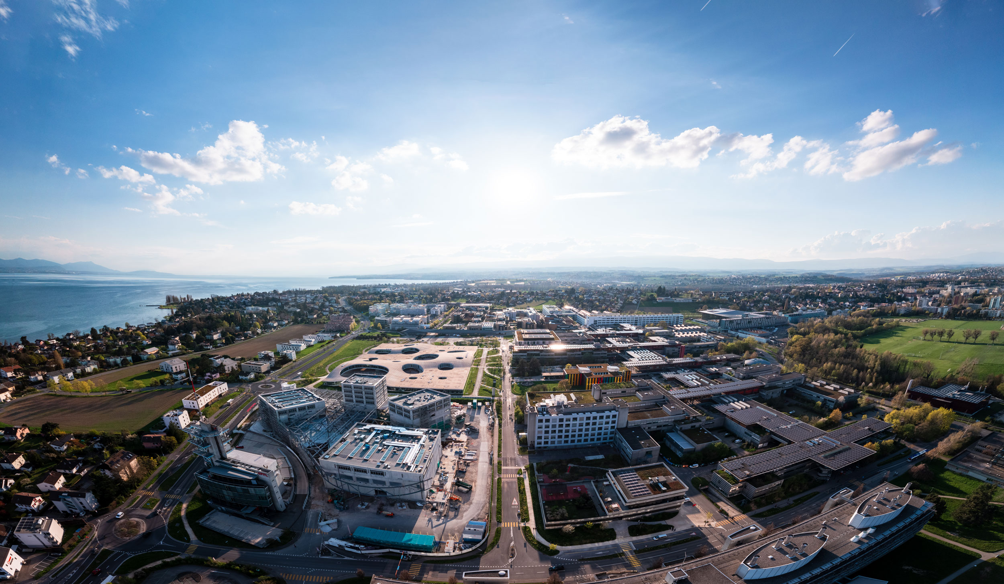
Advanced simulations of solar cell devices
V. Carnevali,
V. Slama,
A. Vezzosi
École Polytechnique fédérale
de Lausanne
April 30, 2025

Slide 2
Why classical molecular dynamics?
Simulation of large systems - ab-initio hundreds of atoms, classical MD millions of atoms
Interfaces
Systems in solution
Disordered systems
Better ensemble averages
Longer propagation times - ab-initio few picoseconds, classical MD microseconds (with enhanced sampling even more)
“Full" conformational sampling
Diffusion processes
Absorption processes
Possible to obtain equilibrium properties
Much lower hardware requirements
Very well parallelized on GPUs
Usually, single workstation is enough for fairly large systems
Good for obtaining initial structures for ab-initio modelling or for studying mechanistic properties

Slide 3
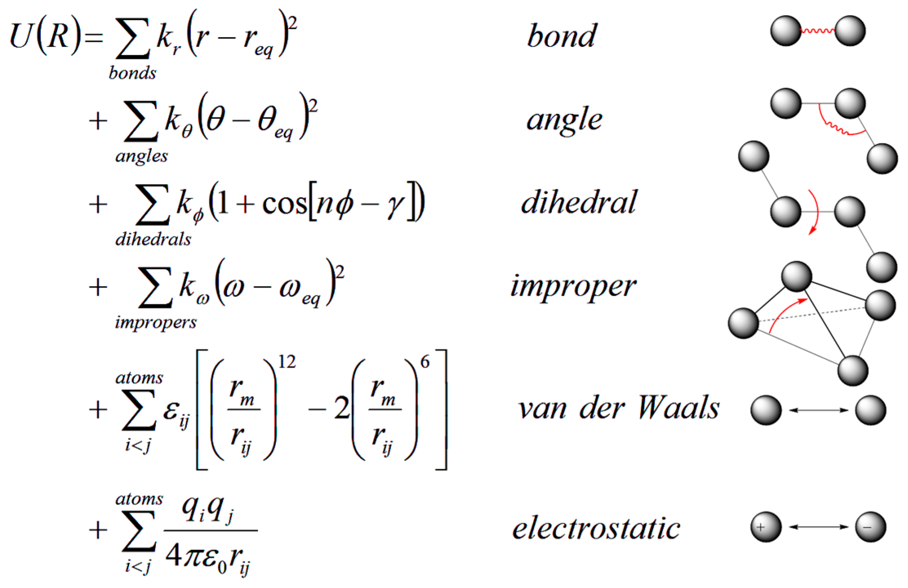






Classical molecular dynamics
Ab-initio molecular dynamics :
$H_{el}$=electronic Hamiltonian
$ψ_{R}(r)$=electronic wavefunction
$$V(R)=\left\langle ψ_{R}(r) | H_{el}(R,r) | ψ_{R}(r)\right\rangle$$
$R$= nuclear positions
$r$= electronic positions
Classical molecular dynamics :
$$V(r)=$$
Simpler nuclear potential description
Set of formulas for each interaction together with the parameters = Force-Field
For evolution in time, the same equations of motion have to be solved
One of the possible forms

Slide 4
Forcefield types
Simple description of the potential
  fast
  force-field tuned to specific properties and systems – we cannot have general description for all the systems as in ab-initio approaches
  Selection of forcefield usually requires some information about the system or the processes we would like to study => It can lead to biased results depending on the quality of the forcefield
Classical forcefields:
Fixed charges (atomic charges, multipoles)
No chemical reactions
Examples: AMBER (DNA and proteins), CFF (organic compounds and metals), CHARMM (small molecules and macromolecules), OPLS, IFF (Interface Force Field), …
Polarizable forcefields:
Fixed charges + mutual polarization of atoms or molecules
No chemical reactions
Usually atomic polarizabilities or Drude model (charges on a spring)
Examples: AMBER(atomic polarizabilities), AMOEBA (atomic polarizabilities and multipoles), CHARMM (Drude), …
Reactive forcefields:
Bond breaking and chemical reactions (change of the parameters during the reaction
Slower than classical forcefield and parameters sometimes not interpretable
Examples: ReaxFF, EVB, …
Machine learning force-fields

Slide 5
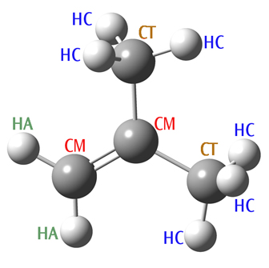
Forcefield - parameters
Atom types (force-field atom types)
Contrary to ab-initio approaches atomic or interatomic parameters are dependent on the chemical environment
Instead of atom elements we have atom types – define atoms with the same chemical properties and same parameters
  Usually, the first letter is element and then some unique identifier
Atom names
Usually, all atoms within a molecule have unique names
Important for example for the assigning atomic charges/multipoles – Even the atoms belonging to same force-field type can have different charges
Obtaining the force-field parameters
Available force-field databases – if your system is well parametrized within some force-field it is strongly recommended to use it
Scientific papers – new and refined parameters can be often found in literature
Own parametrization
  Online tools with generalized FF parameters (LibParGen, CGenFF), within MD software (antechamber for AMBER)
  Refining parameters based on ab-initio results
  Force matching (efficient way how to obtain FF parameters from the ab-initio MD, machine learning
  Charge fitting (RESP, semiempirical methods e.g. AM1, CM1A, …)
  When parametrizing only part of the system it is important to follow the parametrization procedure

Slide 6

Forcefield parameters example
(FAPbI3/01_parametrize/in.FAPbI3)
VdW interaction
pair_coeff 1 1 lj/cut/coul/long 0.076 3.55 #C C
pair_coeff 2 2 lj/cut/coul/long 0.0157 1.06910 # H-H
pair_coeff 8 8 buck/coul/long 72791130.3845458 0.126795228 0.0 # Pb-Pb
Pair of atom-type indexes
Buckingham potential
Bonding interaction
bond_coeff 1 340.4000 1.0800 # C-Ha
bond_coeff 2 448.0000 1.3650 # C-N
bond_coeff 3 434.0000 1.0100 # H-N
Bond type index
Strength of the harmonic potential k_{r}
Optimal distance r_{eq}
Optimal angle O_{eq}
Angular motion
angle_coeff 1 35.000 120.000 # C-N-H
angle_coeff 2 35.000 113.000 # H-N-H
angle_coeff 3 63.000 104.520 # HW-OW-HW

Slide 7
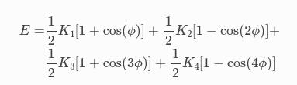

Forcefield parameters example
(FAPbI3/01_parametrize/in.FAPbI3)
Dihedral torsion
dihedral_coeff 1 opls 3.900 0.000 0.000 0.000 # Ha-C-N-H dihedral_coeff 2 opls 3.900 0.000 0.000 0.000 # N-C-N-H
Improper interaction (energy penatly for out-of-plane distortion)
improper_coeff 1 2.500 -1 2 # C-H-N-H
improper_coeff 2 2.500 -1 2 # Ha-N-C-N

Slide 8
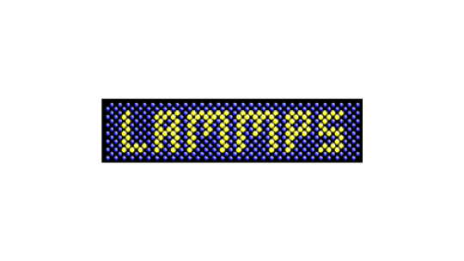

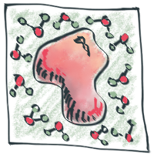
Software
As for the force-field - different packages for different properties
LAMMPS (Large-scale Atomic/Molecular Massively Parallel Simulator)
Open source
Possible to combine different force-field types for different parts of system
Large variability of approaches and methods
Good for simulation of periodic systems (crystals, surfaces, …)
Not very user friendly – Preparation of simulation takes some time
AMBER
Commercial
Good molecular systems in solution (mostly for bio-systems or molecular crystals)
Many tools to help with simulation setup and parametrization – pretty quick and easy
GROMACS
Open-source (possible to implement new features)
Easy to use
Mainly for the biological systems
Packmol
Open source (python)
Good for initial system structure preparation (no MD)
…

Slide 9
LAMMPS input
Link with files for today's lecture
10Lect_shared

Slide 10
Application
Prepare perovskite surface
Rename hydrogens on C to Ha and hydrogens on N closer to the C to Hb in your initial cell (00_FAPbI3_2x2x2.pdb or 00_FAPbI3_1x1x1.pdb)
Create larger super cell: "./create_supercell.py -I 01_FAPbI3_2x2x2_renamed.pdb -o 02_FAPbI3_10x10x6_renamed.pdb -s 5 5 3
Create LAMMPS data file with system structural information:
  Open larger system in vmd
  Open tk console
  Write: "source data_file_FAPbI_CHA.tcl" script sould create system.data file
  source data_file_FAPbI_CHA.tcl contain information about the charges and atomic masses for all atoms in the system
Prepare perovskite FF parameter file
Force-field types, bond types, angle types, ... indexes have to correspond to the generated data file
For the perovskite parameter file is provided "in.FF_style". Take a look if you understand how it is structured

Slide 11
Application
Generate parameter file for your system
Run "./Parametrize_lammps_Mattoni.py -d FAPbI3.data -o in.FAPbI3"
In case of additives or water it is possible to specify the structure and parameter files and produce FF for the full system as: "./Parametrize_lammps_Mattoni.py -d FAPbI3.data -I WAT.lmp WAT.pdb -o in.FAPbI3"
The perovskite is described by both Buckingham and LJ potential. For interaction with additives only LJ is used => code in current version compute all the pair interactions with LJ. It is important to replace the parameters for the FAPbI3 with the parameters specified in FF_vdW_perovskite.dat:
# vdW perovskite
pair_coeff 6 6 buck/coul/long 72791130.3845458 0.126795228 0.0 # Pb-Pb
pair_coeff 4 6 buck/coul/long 172493.555016667 0.3109909842 0.0 # Pb-I
pair_coeff 4 4 buck/coul/long 18994.4488183333 0.44363964 641.1935584 # I-I
pair_coeff 5 6 buck/coul/long 32690390.937995 0.150947 0.000000 # Pb-N
pair_coeff 2 6 lj/cut/coul/long 0.0140 2.26454 # Pb-H
pair_coeff 1 6 buck/coul/long 32690390.937995 0.150947 0.000000 # Pb-C
pair_coeff 3 6 lj/cut/coul/long 0.0140 2.70999 # Pb-Ha
pair_coeff 4 5 buck/coul/long 112936.714213 0.342426 0.000000 # I-N
pair_coeff 2 4 lj/cut/coul/long 0.0574 2.75000 # I-H
pair_coeff 1 4 buck/coul/long 112936.714213 0.342426 0.000000 # I-C
pair_coeff 3 4 lj/cut/coul/long 0.0574 3.10000 # I-Ha
pair_coeff 5 5 lj/cut/coul/long 0.1700 3.25000 # N-N
pair_coeff 2 2 lj/cut/coul/long 0.0157 1.06910 # H-H
pair_coeff 1 1 lj/cut/coul/long 0.076 3.55 #C C
pair_coeff 3 3 lj/cut/coul/long 0.030 2.50 #Ha Ha

Slide 12
Application
Run initial FA orientation equilibration
Surfaces are in general more prone to defects compared to the bulk due to the cut and exposure to vacuum (in the simulation)
It is important to slowly equilibrate the surface to have reasonable starting structure
First, we run NPT simulation to equilibrate the box dimension together with atomic coordinates. For NPT run we need 3D periodic boundary condition =>
  Comment line: "# kspace_modify slab 3.0" in FF parameter file (in.FAPbI3)
  Submit LAMMPS job

Slide 13
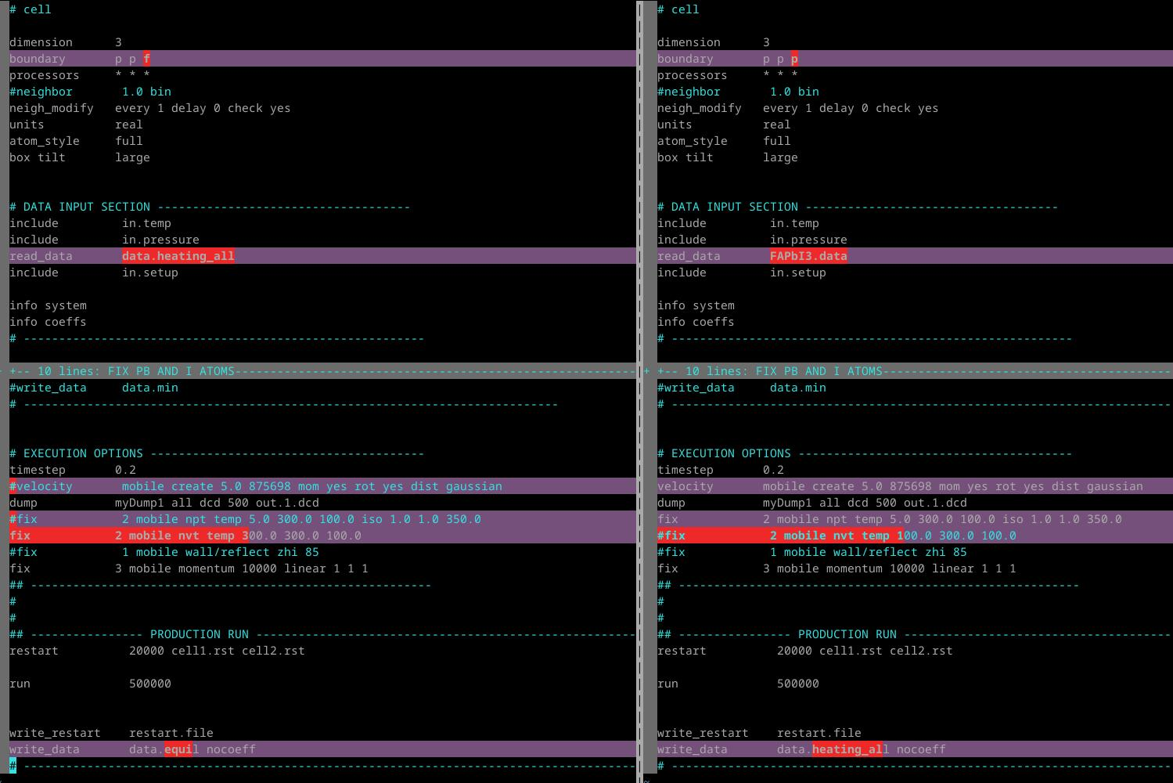
Application
Equilibration at NVT
  Uncomment line: "kspace_modify slab 3.0" in FF parameter file (in.FAPbI3)​
  Change LAMMPS input file
  NEW
  OLD
  Not periodic in z
  Read .data file from previous simulation
  Do not reassign velocities (use the ones from previous simulation)
  Use NVT instead of NPT
  Rename the output .data file

Slide 14
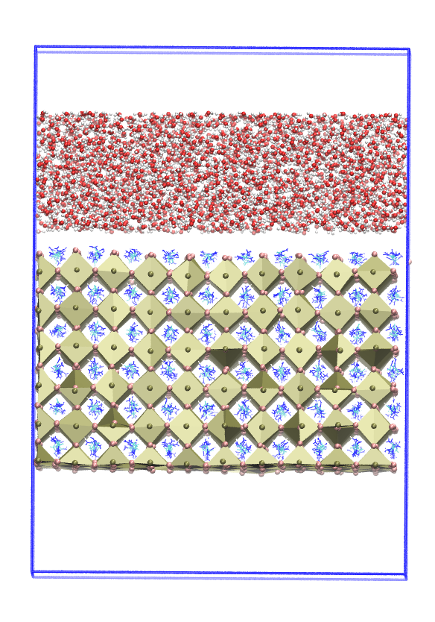
Application
Setting up the system with water (FAPbI3_WAT/00_prepare folder)
Solvate the system with water
  Useful tool is packmol. (optional you can try to download "https://m3g.github.io/packmol/", install and use it with the provided input script: " packmol < packmol.inp"
  You should obtain solvated system with water layer – files provided: "FAPbI_WAT_10x10x6.pdb"
  After generating the fille add box definition from the initial perovskite structure (line starting with CRYST1)
Generate data file with VMD
  Open pdb file with water layer (vmd FAPbI_WAT_10x10x6.pdb)
  Open tk console
  Execute "source data_file_FAPbI_CHA.tcl"
  Rename the system.data to FAPbI_WAT_10x10x6.data
Parametrization (FAPbI3_WAT/01_prepare folder)
Run parametrization with "./Parametrize_lammps_Mattoni.py -d FAPbI_WAT_10x10x6.data -i WAT_tip3p.lmp WAT_tip3p.pdb -o in.FAPbI3_WAT"
Correct vdW potential parameters in in.FAPbI3_WAT parameter file (copy the ones in FF_vdW_perovskite.dat and remove the existing ones in in.FAPbI3_WAT)

Slide 15
Application
Initial minimization and short equilibration (FAPbI3_WAT/02_equilibrate_NVT)
After building the system we need to minimize the geometry to avoid close contacts:
  Uncomment line "minimize 1.0e-5 1.0e-6 5000 50000" in lammps.inp file
  Because we don't have periodic system in z we need to make sure that the water is not going toward the boundary of the box => adding reflection wall in lammps.in file:
    "fix 1 mobile wall/reflect zhi 90"
Running simulation with SHAKE (FAPbI3_WAT/03_equilibrate_shake_NVT)
SHAKE algorithm fixes the bond length and angle of the water molecules => rigit body
  Allow longer propagation timesteps 1-2 fs (without 0.5 fs or lower)
  Turned on by adding line in lammps.in file: "fix 8 all shake 0.001 20 10 b 4 a 3"
    0.001 = tolerance for the SHAKE algorithm
    20 maximum iteration of SHAKE
    10 frequency of printing SHAKE info (in steps)
    b 4 = fix bond type with index 4 (OW-HW)
    a 3 = fix angle type with index 3 (HW-OW-HW)

