Slide 1
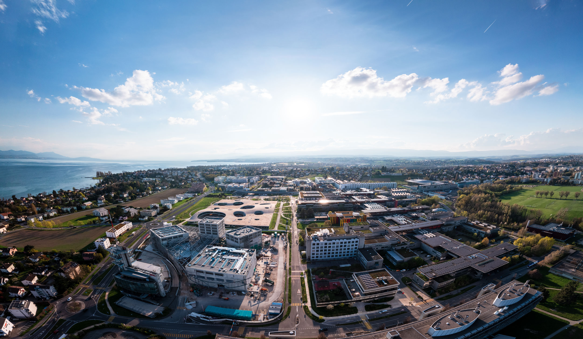
Advanced simulations of solar cell devices
V. Carnevali, V. Slama, A. Vezzosi
École Polytechnique fédérale de Lausanne
April 16, 2025

Slide 2

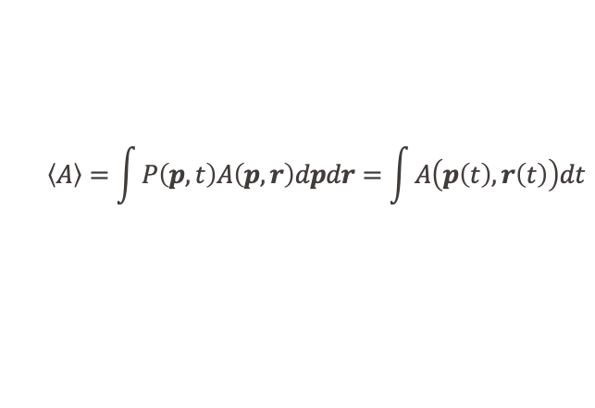


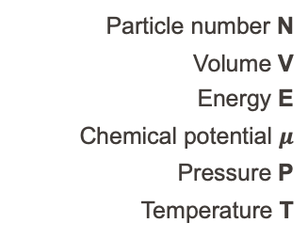

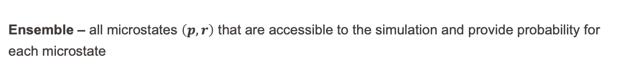


MD simulations
Obtain ensemble average from trajectory:
$$\left\langle A\right\rangle =\int{P\left(p,t\right)A\left(p,r\right)dpdr}=\int{A\left(p\left(t\right),r\left(t\right)\right)dt}$$
$A$=property
$p$=momenta
$P$=probability
$r$=position
$$H\left(r,p\right)=\frac{p^{2}}{2m}+U(r)$$
Solve equation of motion:
$$F_{i}=m_{i}{\ddot{r}}_{i}$$
Ensemble – all microstates $\left(p,r\right)$ that are accessible to the simulation and provide probability for each microstate
Particle number N
Volume V
Energy E
Chemical potential $μ$
Pressure P
Temperature T
NVE microcanonical
NVT canonical
NPT isothermal-isobaric

Slide 3
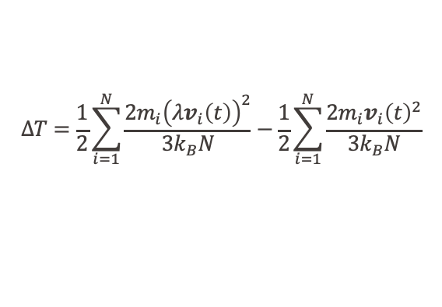

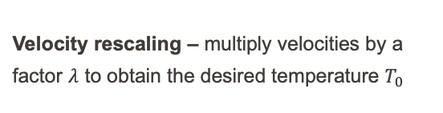

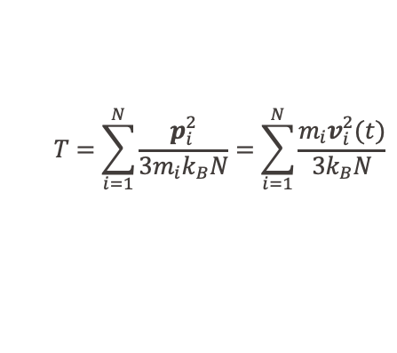

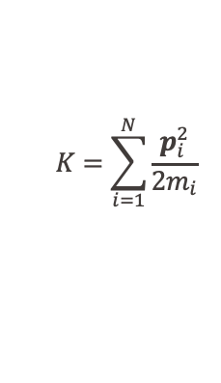


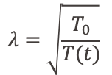
Temperature calculation
$$K=\sum_{i=1}^{N}{\frac{p_{i}^{2}}{2m_{i}}}$$
Kinetic energy ($K$) of gas particles:
$$T=\sum_{i=1}^{N}{\frac{p_{i}^{2}}{3m_{i}k_{B}N}}=\sum_{i=1}^{N}{\frac{m_{i}v_{i}^{2}(t)}{{3k}_{B}N}}$$
Average kinetic energy of gas particles:
$$\left\langle K\right\rangle =\frac{3N}{2}k_{B}T$$
Velocity rescaling – multiply velocities by a factor $λ$ to obtain the desired temperature $T_{0}$
$$p$$
Does not correspond to an ensemble!
$$ΔT=\frac{1}{2}\sum_{i=1}^{N}{\frac{{2m}_{i}{\left(λv_{i}\left(t\right)\right)}^{2}}{{3k}_{B}N}}−\frac{1}{2}\sum_{i=1}^{N}{\frac{{2m}_{i}{v_{i}\left(t\right)}^{2}}{{3k}_{B}N}}$$
$$r$$
$$=\left(λ^{2}−1\right)T(t)$$
$$λ=\sqrt{\frac{T_{0}}{T(t)}}$$

Slide 4



Berendsen thermostats
System weakly coupled to heat bath with temperature $T_{bath}$:
$$\frac{dT(t)}{dt}=\frac{1}{τ}(T_{bath}−T(t))$$
coupling parameter
System
Rescaling at each step, with temperature change:
$$ΔT=\frac{1}{τ}\left(T_{bath}−T\left(t\right)\right)dt$$
Heat bath
Scaling factor:
$$(λ^{2}−1)T(t)=\frac{1}{τ}\left(T_{bath}−T\left(t\right)\right)dt$$
Berendsen, JCP (1984)

Slide 5



Berendsen thermostats
System weakly coupled to heat bath with temperature $T_{bath}$:
$$\frac{dT(t)}{dt}=\frac{1}{τ}(T_{bath}−T(t))$$
→ smoother than velocity rescaling → suppresses fluctuations in K no ensemble → global thermostat → good approximation for large systems
coupling parameter
Rescaling at each step, with temperature change:
$$ΔT=\frac{1}{τ}\left(T_{bath}−T\left(t\right)\right)dt$$
Scaling factor:
$$(λ^{2}−1)T(t)=\frac{1}{τ}\left(T_{bath}−T\left(t\right)\right)dt$$
Berendsen, JCP (1984)

Slide 6



NVT thermostats
Andersen
Andersen, JCP (1980)
Random collisions of molecules with an imaginary heat bath (randomize velocities)
$P\left(p_{1},p_{2},…\right)∝e^{−\frac{p_{1}^{2}}{2{m_{1}k}_{B}T}} × e^{−\frac{p_{2}^{2}}{2{m_{2}k}_{B}T}}$ $×…$
System
$$p_{new}=R\sqrt{mk_{B}T}$$
random Gaussian number
Heat bath
Lengevin
Schneider and Stoll, PRB (1978)
Velocity corrected by random force and constant friction
$$m\ddot{r_{i}}=−\frac{∂U\left(t\right)}{∂r_{i}}−mΓ\dot{r_{i}}+W_{i}(t)$$
friction coefficient
random force

Slide 7
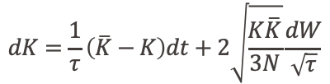
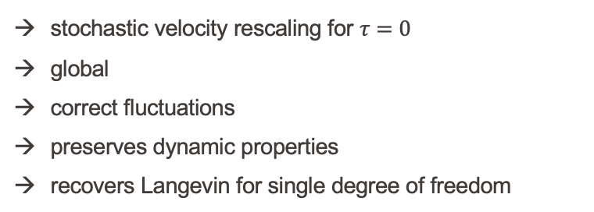
CSVR thermostats
$$dK=\frac{1}{τ}\left(\overline{K}−K\right)dt+2\sqrt{\frac{K\overline{K}}{3N}}\frac{dW}{\sqrt{τ}}$$
Berendsen thermostat
Stochastic term: correct fluctuations
System
stochastic velocity rescaling for $τ=0$
global
correct fluctuations
preserves dynamic properties
recovers Langevin for single degree of freedom
Heat bath
Bussi, Donadio and Parrinello, JCP (2007)

Slide 8
Ab initio molecular dynamics (AIMD)
Change to MD to run AIMD
&GLOBAL
PRINT_LEVEL LOW
PROJECT_NAME FAPbI3
RUN_TYPE MD
WALLTIME 23:30:00
&END GLOBAL
&MOTION
&MD
ENSEMBLE NVT
STEPS 10000
TIMESTEP 0.5
TEMPERATURE 300
&END MD
…
&END MOTION
microcanonical: NVE
canonical: NVT
canonical using Langevin: LANGEVIN
isobaric-isothermic: NPT_F
isobaric-isothermic in isotropic cell: NPT_I
constant pressure: NPE_F
constant pressure in isotropic cell: NPE_I
constant kinetic energy: ISOKIN
HYDROSTATICSHOCK, MSST, MSST_DAMPED, NVT_ADIABATIC,...
Tuned by the lighter atom

Slide 9
NVT & NPT AIMD inputs
&MOTION
&MD
ENSEMBLE NPT_F
STEPS 10000
TIMESTEP 0.5
TEMPERATURE 300
&THERMOSTAT
TYPE CSVR
REGION GLOBAL
&CSVR
TIMECON 100
&END CSVR
&END THERMOSTAT
&BAROSTAT
PRESSURE 1.0
TIMECON 100
&END BAROSTAT
&END MD
…
&END MOTION
&MOTION
&MD
ENSEMBLE NVT
STEPS 10000
TIMESTEP 0.5
TEMPERATURE 300
&THERMOSTAT
TYPE CSVR
REGION GLOBAL
&CSVR
TIMECON 100
&END CSVR
&END THERMOSTAT
&END MD
…
&END MOTION

Slide 10
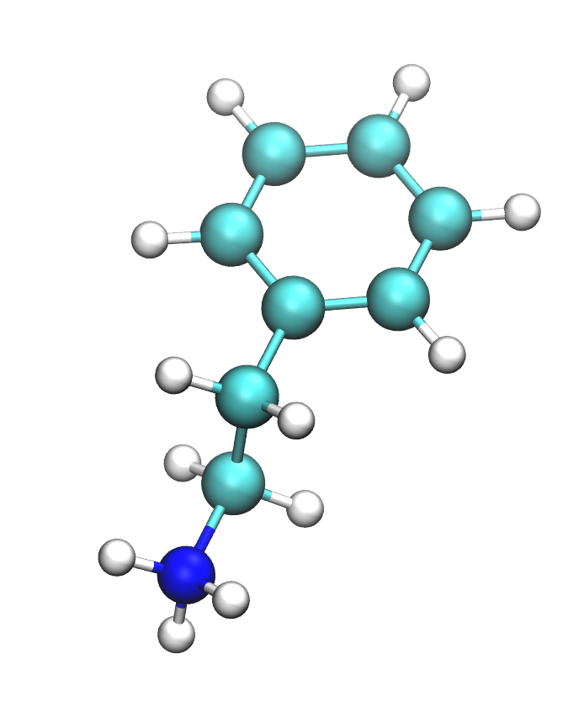
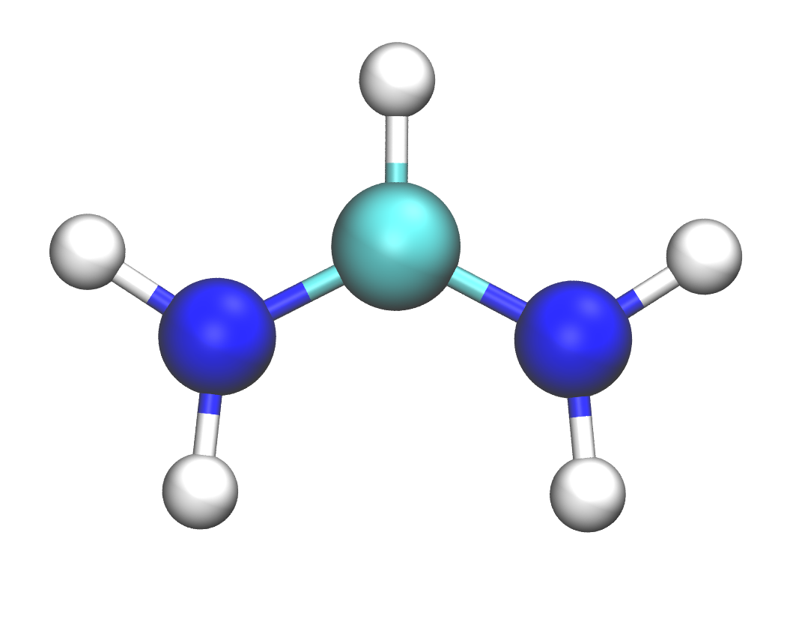
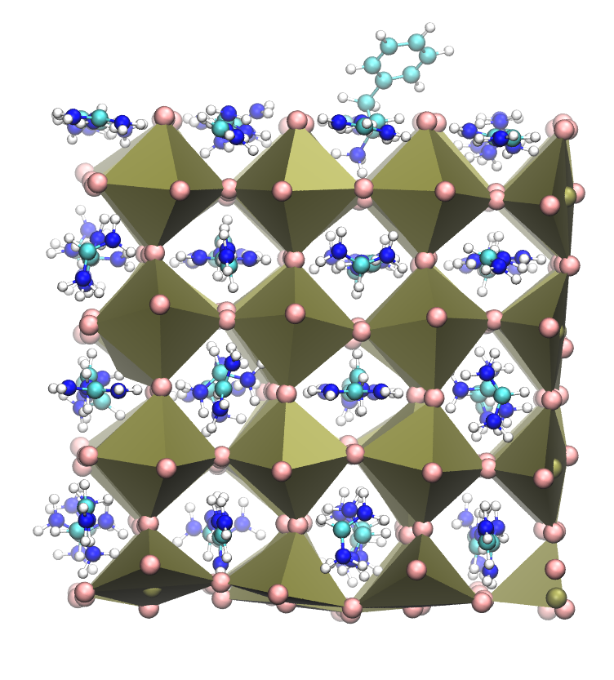
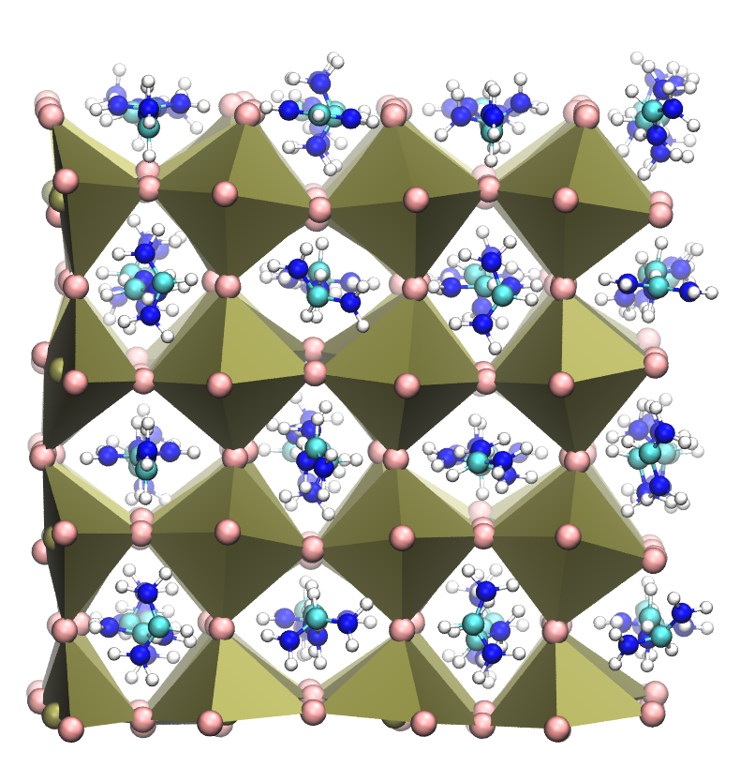
Binding energies
Energy difference?

Slide 11




Binding energies
$${\left(FAPbI_{3}+mol\right)}^{\left(0\right)}$$
$$mol^{(+1)}$$
Two different optimized systems
$${\left(FAPbI_{3}+vacancy\right)}^{\left(−1\right)}$$
Absolute binding energy
$$E_{mol}^{(bind)}=E_{opt}{\left(FAPbI_{3}+mol\right)}^{(0)}−E{\left(FAPbI_{3}+vacancy\right)}^{\left(−1\right)}−E_{opt}^{(vac)}{\left(mol\right)}^{\left(+1\right)}$$
Relative binding energy to formamidinium (FA) binding energy
$$ΔE_{mol}^{(bind)}=E_{mol}^{(bind)}−E_{FA}^{(bind)}$$
Problematic especially for GGA functionals (overdelocalization of charge)
$$=E_{opt}{\left(FAPbI_{3}+mol\right)}^{(0)}−E{\left(FAPbI_{3}+vacancy\right)}^{\left(−1\right)}−E_{opt}^{\left(vac\right)}{\left(mol\right)}^{\left(+1\right)}−E_{opt}{\left(FAPbI_{3}\right)}^{\left(0\right)}+E{\left(FAPbI_{3}+vacancy\right)}^{\left(−1\right)}+E_{opt}^{(vac)}{\left(FA\right)}^{\left(+1\right)}$$
Same optimized perovskite surface
$ΔE_{mol}^{(bind)}=E_{opt}{\left(FAPbI_{3}+mol\right)}^{(0)}−E_{opt}{\left(FAPbI_{3}\right)}^{(0)}−E_{opt}^{\left(vac\right)}{\left(mol\right)}^{\left(+1\right)}$ $+E_{opt}^{\left(vac\right)}{\left(FA\right)}^{\left(+1\right)}$
From NVT simulation
Dependent on the initial configuration of the surface with molecule
$ΔE_{mol}^{(bind)}={\left\langle E_{NVT}{\left(FAPbI_{3}+mol\right)}^{\left(0\right)}\right\rangle }_{t}−{\left\langle E_{NVT}{\left(FAPbI_{3}\right)}^{\left(0\right)}\right\rangle }_{t}−E_{opt}^{\left(vac\right)}{\left(mol\right)}^{\left(+1\right)}$ $+E_{opt}^{\left(vac\right)}{\left(FA\right)}^{\left(+1\right)}$
Long time averaging needed. Subtracting close large numbers => large error of the result
Very sensitive to system equilibration

Slide 12
Binding energies – CP2K input
Link to the folder with the material:
9Lect_shared

Slide 13
Binding energies – CP2K input
Surface
Molecule in gas-phase
&DFT
CHARGE 0
…
&POISSON
PSOLVER ANALYTIC
PERIODIC XY
&END POISSON
…
&END DFT
&SUBSYS
&CELL
ABC 25.391 25.512 80.000
PERIODIC XY
&END CELL
&TOPOLOGY
COORD_FILE_FORMAT PDB
COORD_FILE_NAME ./FAPbI3_SURF_BULKSIZE.pdb
CONN_FILE_FORMAT OFF
&END TOPOLOGY
…
&DFT
CHARGE +1
LSD
…
&POISSON
PSOLVER ANALYTIC
PERIODIC NONE
&END POISSON
…
&END DFT
&SUBSYS
&CELL
ABC 45.0 45.0 45.0
PERIODIC NONE
&END CELL
&TOPOLOGY
COORD_FILE_FORMAT PDB
COORD_FILE_NAME ./FA.pdb
&CENTER_COORDINATES
&END
CONN_FILE_FORMAT OFF
&END TOPOLOGY
…
Non-periodic calculation (to avoid interaction of molecule with its own periodic image)
Important to keep same Poisson solver and other parameters for both calculations
Larger box leads to more precise energies
Center molecule in the box

