Slide 1

Advanced simulations of solar cell devices
V. Carnevali,
V. Slama,
A. Vezzosi
École Polytechnique fédérale
de Lausanne
April 9, 2025

Slide 2
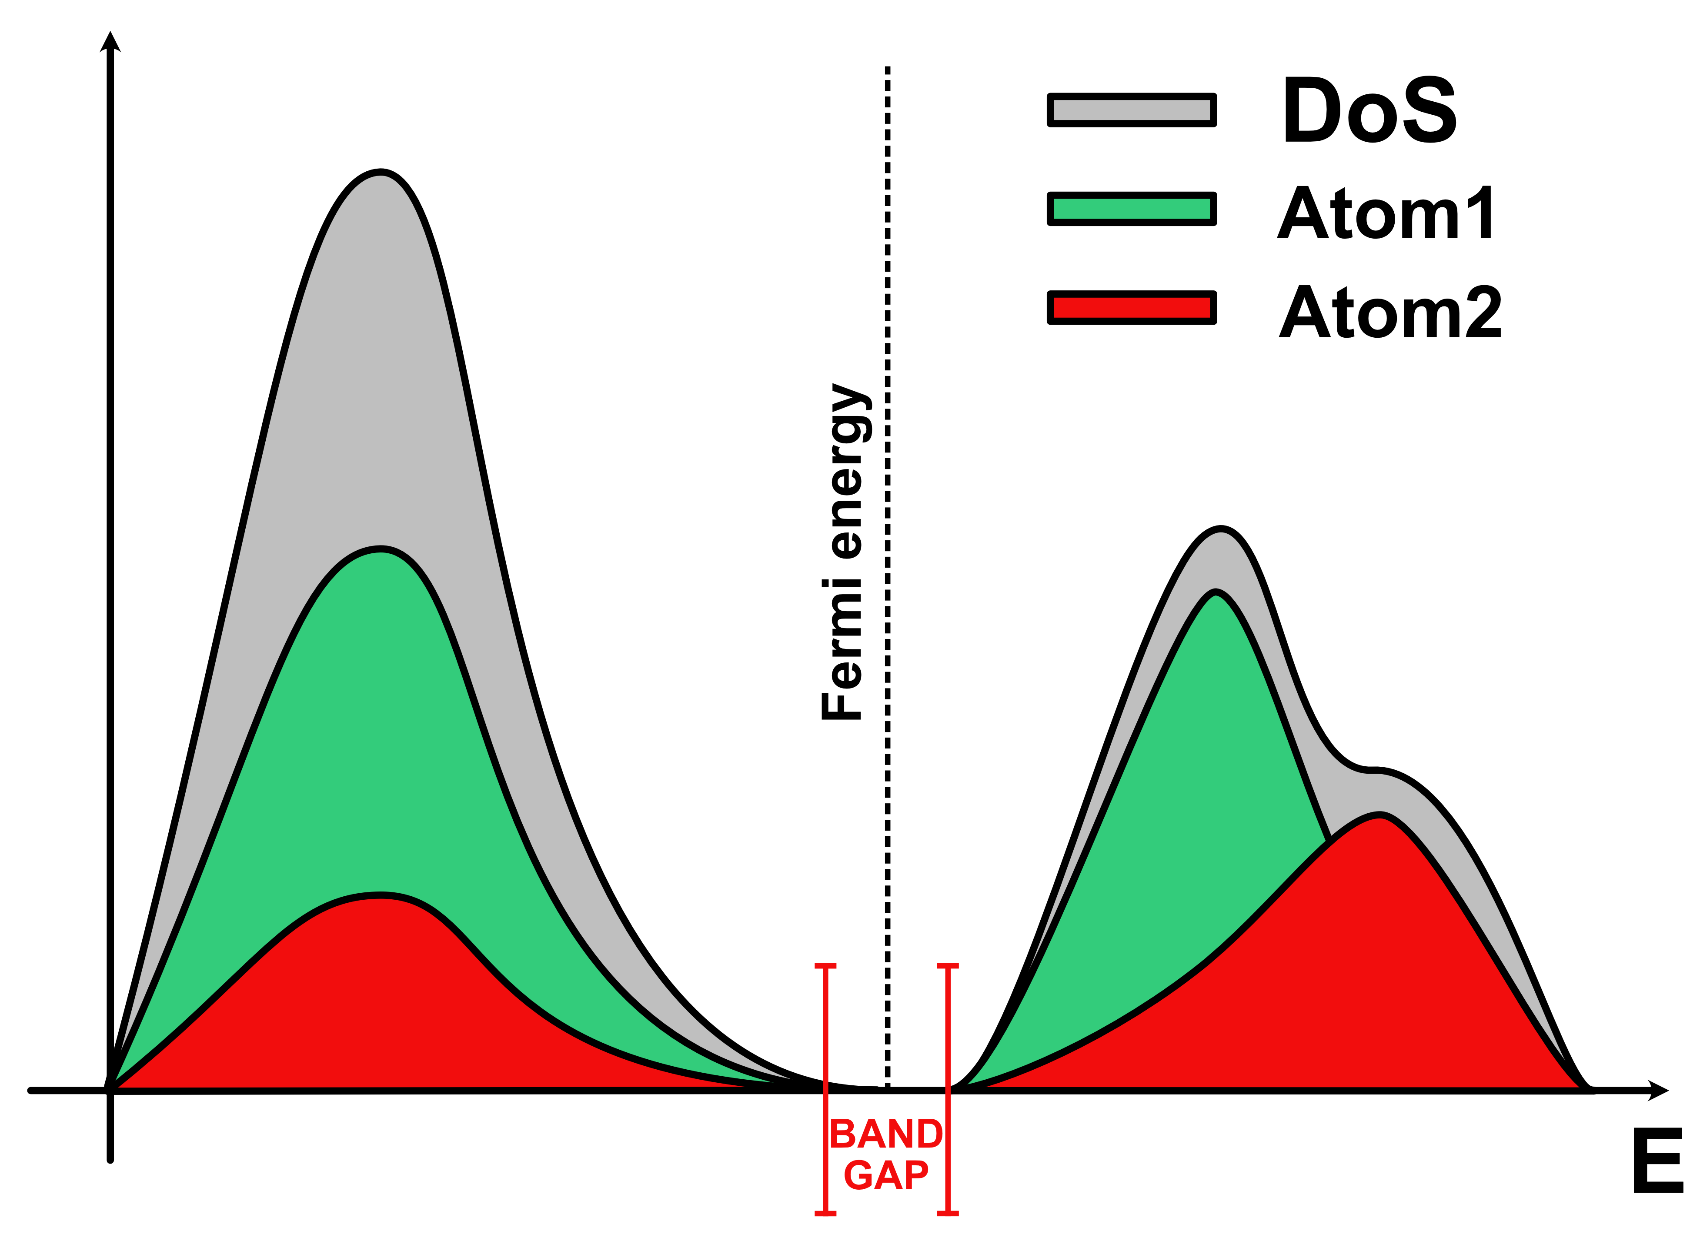

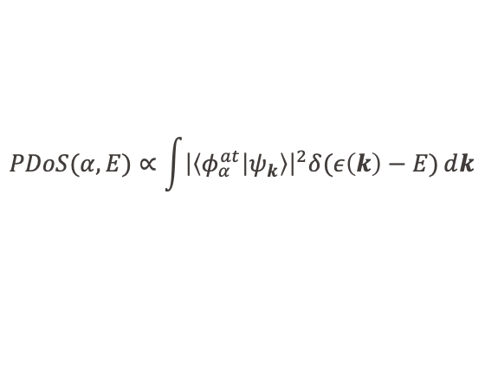

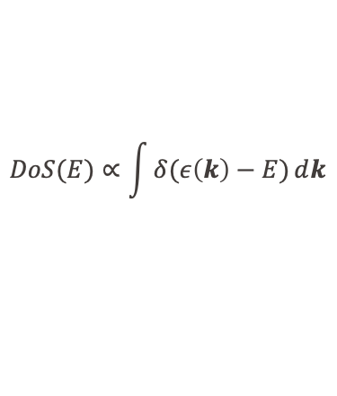
Projected Density of States (PDOS)
PDOS – information about the occupied and unoccupied electronic states of the system and nature of the system (conductor, semiconductor, insulator).
Post-processing of the electronic wave functions of the systems.
$$DoS(E)∝\int{δ(ε\left(k\right)−E)ⅆk}$$
$$BZ$$
$$PDoS(α,E)∝\int{{\left|\left\langle φ_{α}^{at} | ψ_{k}\right\rangle \right|}^{2}δ(ε\left(k\right)−E)ⅆk}$$
$$BZ$$

Slide 3
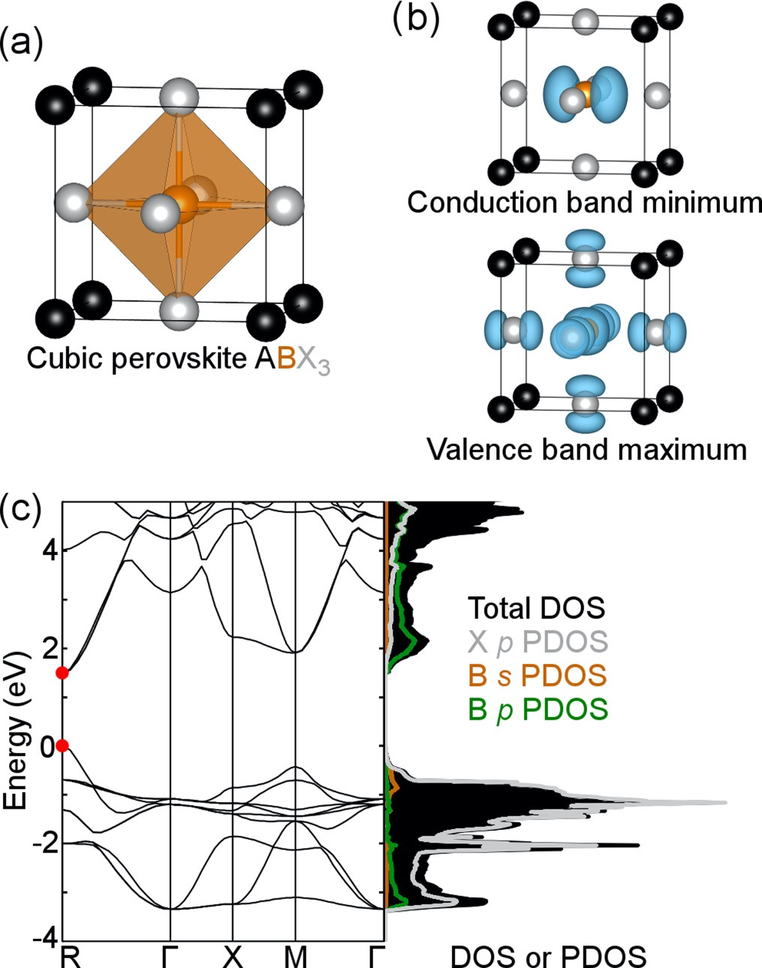


Perovskite PDOS
A-site –
does not affect band gap and states close to the band gap
ex. CH₃NH₃PbI₃
C-N cubic unit cell axis 1.53 eV
C-N face diagonal 1.51 eV
C-N body diagonal 1.52 eV
Larger band gap –
more electronegative X (TVB)
$$χ\left(I\right)<χ\left(Br\right)<χ(Cl)$$
least electronegative B (BCB)
$$χ\left(Sn\right)<χ\left(Pb\right)$$
larger cations A (lattice size)
PHYSICAL REVIEW B 90, 205202 (2014)
https://doi.org/10.1103/PhysRevB.90.205202

Slide 4
PDOS
&DFT
&PRINT
&PDOS
NLUMO –1
COMPONENTS
&LDOS
# Atom list
COMPONENTS
LIST 1 .. 768
&END LDOS
&END PDOS
&END PRINT
&END DFT
…
Compute all unoccupied states
Atom list definition
…
Make your lists according to what you want to see in the PDOS and compare PBE with PBE0

Slide 5
PDOS
PDOS FILES:
https://moodle.epfl.ch/mod/folder/view.php?id=1330724
$ python get-smearing-pdos_lists.py FAPbI3-PDOS-list5-1.pdos
$ mv FAPbI3-PDOS-list5-1.pdos smeared-Pb-PBE.dat

Slide 6
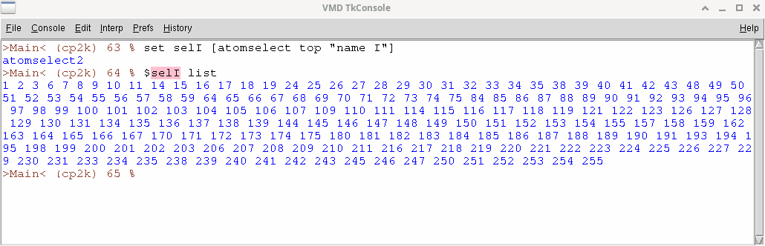
Getting atoms list from VMD
Open a TCL console in VMD
Create a selection: set sel [atomselect top "name atom_name"]
Use $sel list to get the indices of the atoms of the selection you just defined
In CP2K input files list of atoms are defined with the syntax:
        LIST {integer} {integer} .. {integer}
But list in CP2K starts from 1 while in VMD it start from 0, so you must add 1 to the lists obtained from VMD !

