Slide 1

Advanced simulations of solar cell devices
V. Carnevali,
V. Slama,
A. Vezzosi
École Polytechnique fédérale
de Lausanne
March 26, 2025

Slide 2

Ab-initio software input (CP2K)
Calculation type definition
&GLOBAL
RUN_TYPE ENERGY ! (MD, GEO_OPT, ENERGY... )
PROJECT FAPbI3-alpha-2x2x2
PRINT_LEVEL LOW
&END GLOBAL
Calculation type
Name of the job
Verbosity of the output
Calculation settings
&FORCE_EVAL
METHOD Quickstep
&DFT
CHARGE 0
BASIS_SET_FILE_NAME BASIS_MOLOPT
POTENTIAL_FILE_NAME GTH_POTENTIALS
Modules which perform the calculation (energy, MD, geometry optimization, PDOS,…)
Total charge of the system
Database with the basis set and pseudopotential definitions
…

Slide 3
Ab-initio software input (CP2K)
…
&MGRID
CUTOFF 370
REL_CUTOFF 70
&END MGRID
&SCF
EPS_SCF 5.0E-6
SCF_GUESS RESTART
MAX_SCF 2000
&OT
MINIMIZER CG
PRECONDITIONER FULL_SINGLE_INVERSE
&END
&END SCF
Energy cutoff for the plane waves (higer value => more plane waves)
At which energy gaussian basis functions are mapped onto plane waves
Setting parameters for the electron density convergence
Electron density optimization algorithm (Orbital transformation good for big systems)
…

Slide 4
Ab-initio software input (CP2K)
…
&XC
&XC_FUNCTIONAL PBE
&END XC_FUNCTIONAL
&VDW_POTENTIAL
POTENTIAL_TYPE PAIR_POTENTIAL
&PAIR_POTENTIAL
TYPE DFTD3
CALCULATE_C9_TERM .TRUE.
REFERENCE_C9_TERM .TRUE.
LONG_RANGE_CORRECTION .TRUE.
PARAMETER_FILE_NAME dftd3.dat
REFERENCE_FUNCTIONAL PBE
R_CUTOFF 10.0
&END PAIR_POTENTIAL
&END VDW_POTENTIAL
&END XC
&END DFT
DFT functional for the calculation
Definition of the vdW corrections
Type of the vdW corrections
Range of the interaction (usually around half of the box)
…

Slide 5
Ab-initio software input (CP2K)
Topology and basis set definition
…
&SUBSYS
&CELL
ABC 16.134 17.070 29.317
ALPHA_BETA_GAMMA 62.98 100.02 81.61
PERIODIC XYZ
&END CELL
&TOPOLOGY
COORD_FILE_FORMAT PDB
COORD_FILE_NAME ./FAPbI3-alpha-2x2x2.pdb
&CENTER_COORDINATES
&END
&END TOPOLOGY
Definition of the periodic box for the system
Periodicity of the system
Input structure file type
File with the atomic coordinates
…

Slide 6
Ab-initio software input (CP2K)
Topology and basis set definition
…
Specify basis function for each element
&KIND I
BASIS_SET DZVP-MOLOPT-SR-GTH
POTENTIAL GTH-PBE-q7
&END KIND
&KIND O
BASIS_SET TZVP-MOLOPT-GTH
POTENTIAL GTH-PBE-q6
&END KIND
&KIND Pb
BASIS_SET DZVP-MOLOPT-SR-GTH
POTENTIAL GTH-PBE-q4
&END KIND
&KIND H
BASIS_SET DZVP-MOLOPT-GTH
POTENTIAL GTH-PBE-q1
&END KIND
&END SUBSYS
&END FORCE_EVAL
Basis set
Pseudopotential (Goedecker-Teter-Hutter norm conserving pseudopotential)
Core charge (positive)

Slide 7
FAPbI3 2x2x2 ENERGY CALCULATION
Generate a 2x2x2 FAPbI3 supercell – use FAPbI3.pdb and create_supercell.py
File located in “CP2K hands on: energy” topic in moodle.
Run 2x2x2 FAPbI3 supercell energy calculation – use FAPbI3_2x2x2.in and run.cp2k-ENERGY
File located in “CP2K hands on: energy” topic in moodle.
Compare the output file with the one on moodle – FAPbI3_2x2x2.out
File located in “CP2K hands on: energy” topic in moodle.

Slide 8
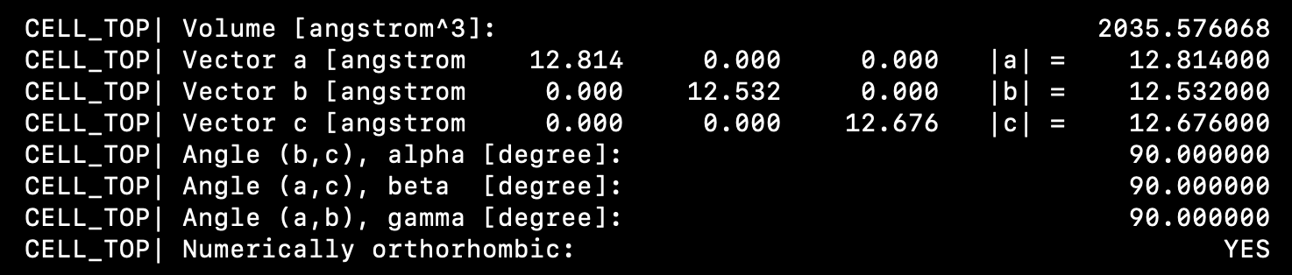
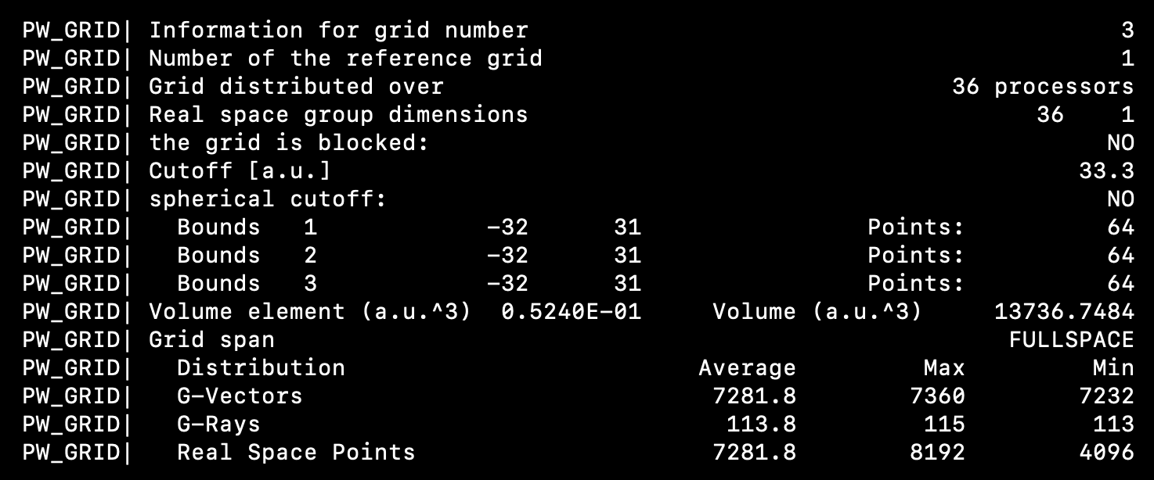
FAPbI3 2x2x2 ENERGY CALCULATION
Simulation box info
Parallelization info

Slide 9
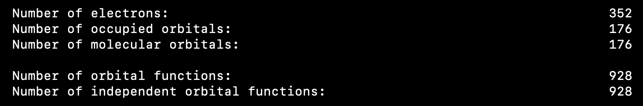
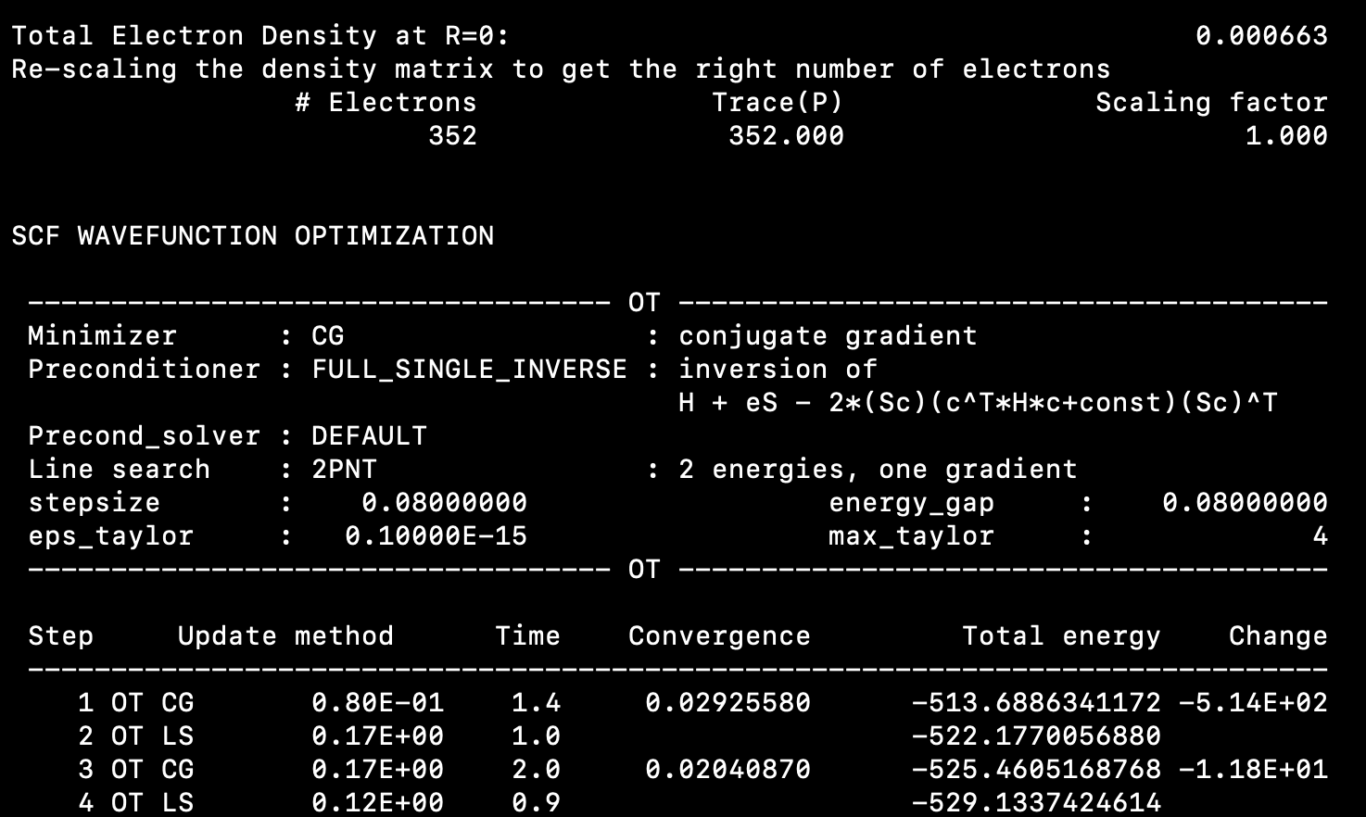
FAPbI3 2x2x2 ENERGY CALCULATION
Electrons and orbitals
Beginning of the calculation

Slide 10
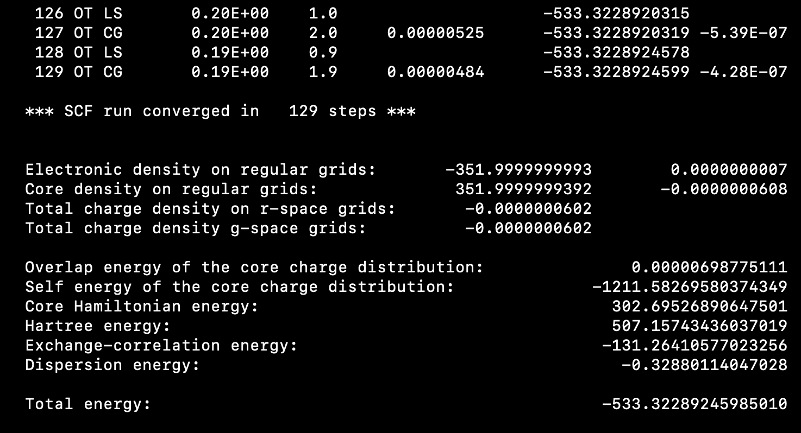
FAPbI3 2x2x2 ENERGY CALCULATION
End of the calculation

Slide 11
PBE0 hybrid functional
&XC
&XC_FUNCTIONAL PBE
&END XC_FUNCTIONAL
&END DFT
Input for the GGA functional
&DFT
POTENTIAL_FILE_NAME GTH_PBE0_POTENTIALS
BASIS_SET_FILE_NAME BASIS_PBE0_MOLOPT
BASIS_SET_FILE_NAME BASIS_ADMM_MOLOPT
BASIS_SET_FILE_NAME BASIS_ADMM
&QS
METHOD GPW
MIN_PAIR_LIST_RADIUS -1
&END QS
Basis set for PBE0
Basis set for Auxiliary Density Matrix Method – approximative approach for reducing cost of hybrid functional calculation
Pseudopotential calculation
Do not use any cutoff for exchange integrals (include all the pairs)
…
&AUXILIARY_DENSITY_MATRIX_METHOD
METHOD BASIS_PROJECTION
ADMM_PURIFICATION_METHOD NONE
&END AUXILIARY_DENSITY_MATRIX_METHOD
Settings for basis set for Auxiliary Density Matrix Method
…

Slide 12
PBE0 hybrid functional
…
&XC
&XC_FUNCTIONAL PBE0
&END XC_FUNCTIONAL
&XC_GRID
XC_DERIV SPLINE2_SMOOTH
&END XC_GRID
&HF
FRACTION 0.25
&SCREENING
EPS_SCHWARZ 1.0E-11
SCREEN_ON_INITIAL_P FALSE
&END
&INTERACTION_POTENTIAL
POTENTIAL_TYPE TRUNCATED
CUTOFF_RADIUS 8.0
T_C_G_DATA t_c_g.dat
&END INTERACTION_POTENTIAL
&MEMORY
MAX_MEMORY 3000
EPS_STORAGE_SCALING 0.1
&END
&END
Set PBE0 hybrid functional (GGA part)
Pseudopotential close to the core is almost zero – this may make density convergence difficult – use larger energy cutoff or smoothing (computationally cheaper)
Set PBE0 hybrid functional (GGA part)
important parameter to get stable HFX calcs (contributions to hfx smaller than EPS_SCHWARZ are not considered)
Required for hybrid periodic calculations. Radius should be smaller than the half of the periodic box
Defines the maximum amount of memory [MiB] to be consumed by the full HFX module per MPI process
Notes:
EPS_SCHWARZ comes from the Schwartz inequality. The SCHWARZ inequality sets an upper bound on the scalar product between two vector in terms of the product of the vector norms. Basically it tells you that the scalar product of two vectors is always less thane the product of the norm of the two vectors. This inequality is very useful when it comes to evaluate the four-center electron repulsion integrals contained in the exact exchange term. If the square root of the product between the norm of the codensities (so two center integrals) is less than EPS_SCHWARTZ, the integral is not considered. This can be interpreted as a short-range screening. This gives scaling as N square
If the interaction potential is a TRUNCATED Coulomb operator (TC), product of codensities that have spatial separation larger than the CUTOFF_RADIUS are disregarded.
In reality, in CP2K the two center integrals that are needed for the estimate of the ERIs are not evaluated directly. Instead, a screening function for each gaussian basis function is parametrized that is an upper bound for the integral. In this way one can simply evaluate a functions of Rmu,nu and get the Schwarz estimate for the ERI in a aprticularly efficient way.
In CP2K far-field screening betwenn product gaussian is implemented in a rather crude approach, by simply flagging integrals that will be smaller than a given threshold. For TC operator, if the sum of the radii of the product densities and the the cutoff radius is smaller than the distance between the centers of the product gaussians, the ERI is set to zero.
One can also screen on the density matrix. Usually, the elements of the density matrix become smaller as the distance increase. For example in insulators the elements of the density matrix go down exponentially with distance, and the exponential factor is proportional to the energy gap of the system.
All these features can reduce the cost of an HFX calculation. Also, they increse stability of the SCF cycle. Infact screening can reduce the coordination number of the overlap matrix.
NOTE: The exchange energy for periodic systems is difficult to calculate as it requires as sum over k points in the first bruillen zone which is only conditionally converging. One way to converge the sum is to replace the Coulomb operator with a TC operator. It can be shown that with TC the sum converges to the exact value for Rc going to infinity and that the number of k-points needed to converge scales as 1/V where V is the supercell volume. So for very large supercells Gamma sampling is enough. But in this case the CUTOFF_RADIUS has to be smaller than half of the periodic box! In fact, imagine a system where the electron density is localized. You then expect the HFX energy to be smalle between electrons localized in different unit cells. However if we do not set Rc<L/2 we get a large contribution from and electron and its periodic image. This "self-exchange" should not be present, thus Rc should be chosen accordingly.
XC_GRID section.

Slide 13
PBE0 hybrid functional
Topology and basis set definition
…
Specify basis function for each element
&KIND I
BASIS_SET DZVP-MOLOPT-SR-PBE0-GTH
BASIS_SET AUX_FIT FIT6
POTENTIAL GTH-PBE0-q7
&END KIND
&KIND O
BASIS_SET TZVP-MOLOPT-PBE0-GTH
BASIS_SET AUX_FIT cFIT3
POTENTIAL GTH-PBE0-q6
&END KIND
&KIND Pb
BASIS_SET DZVP-MOLOPT-SR-PBE0-GTH
BASIS_SET AUX_FIT FIT6
POTENTIAL GTH-PBE0-q4
&END KIND
&KIND H
BASIS_SET DZVP-MOLOPT-PBE0-GTH
BASIS_SET AUX_FIT FIT3
POTENTIAL GTH-PBE0-q1
&END KIND
&END SUBSYS
&END FORCE_EVAL
Basis set for Auxiliary Density Matrix Method
Basis set and potentials for PBE0

Slide 14
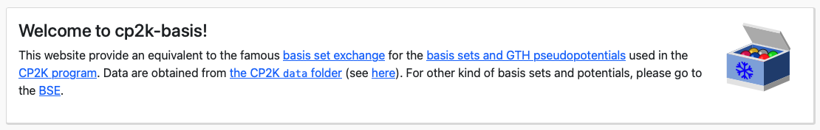
PBE0 hybrid functional
GTH_PBE0_POTENTIALS: https://moodle.epfl.ch/pluginfile.php/3432368/mod_folder/content/0/GTH_PBE0_POTENTIALS?forcedownload=1
BASIS_PBE0_MOLOPT:
https://moodle.epfl.ch/pluginfile.php/3432368/mod_folder/content/0/BASIS_PBE0_MOLOPT?forcedownload=1
CP2K-basis website: https://cp2k-basis.pierrebeaujean.net
Add PBE0 potential and basis set for I in the files

Slide 15
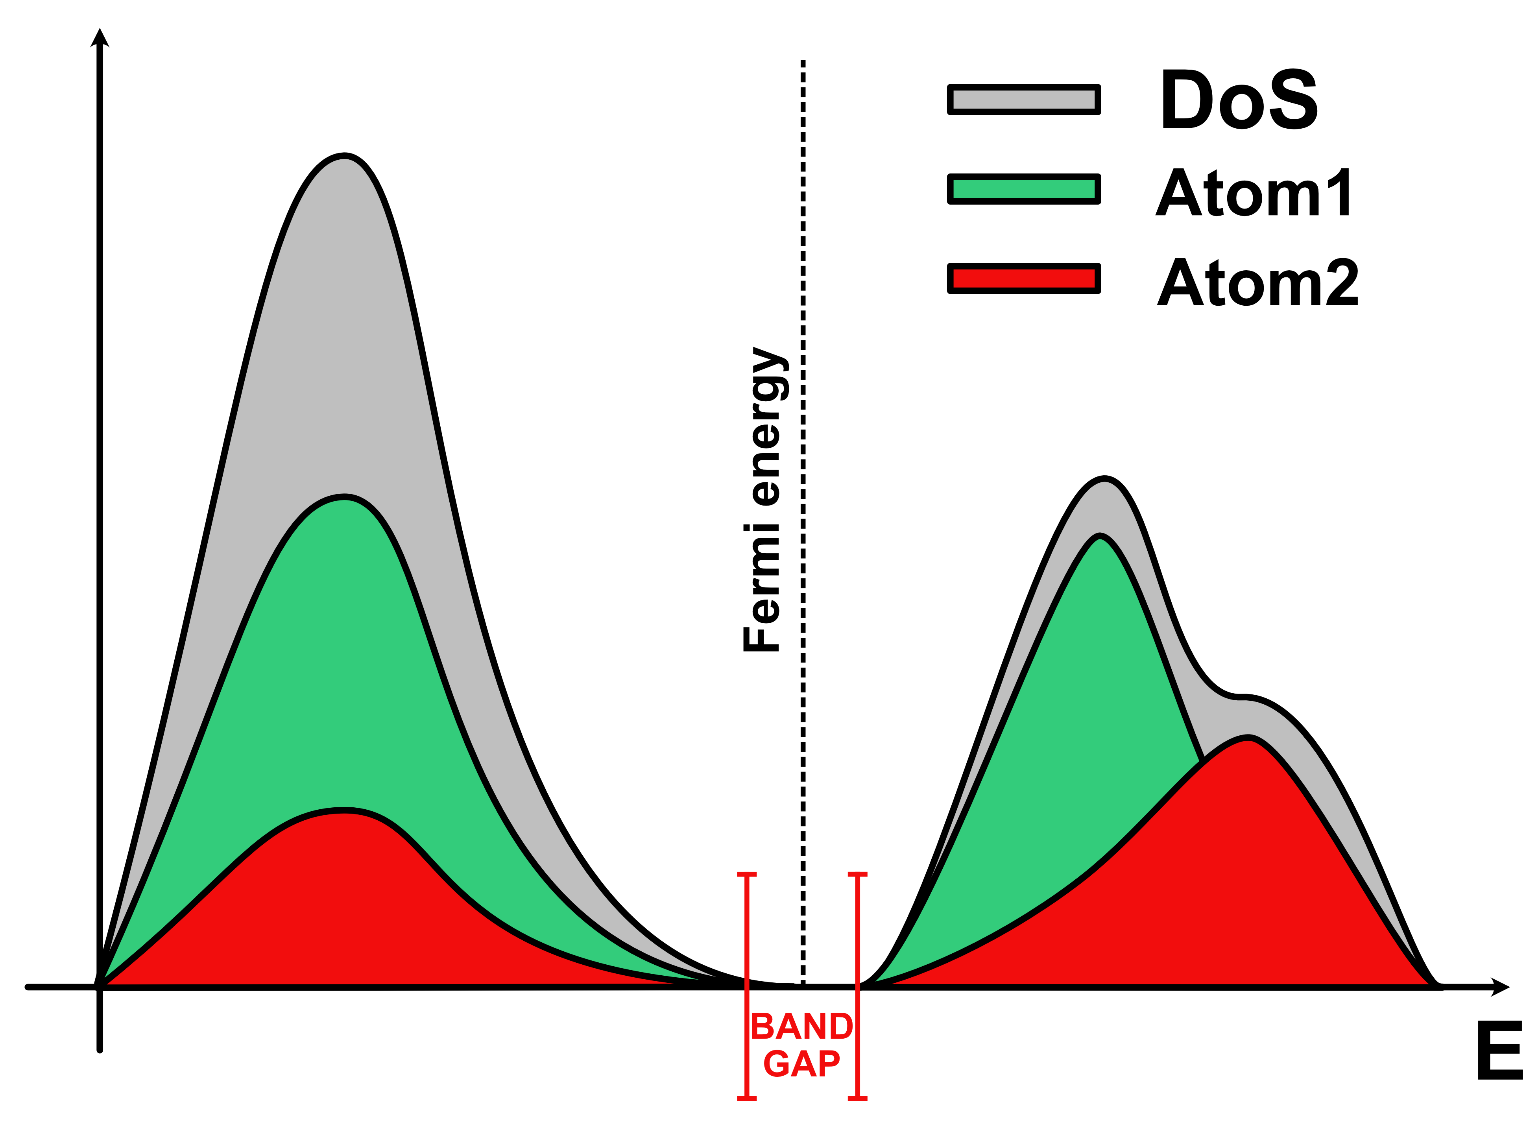

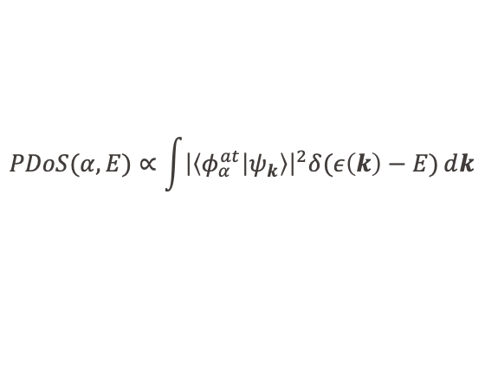

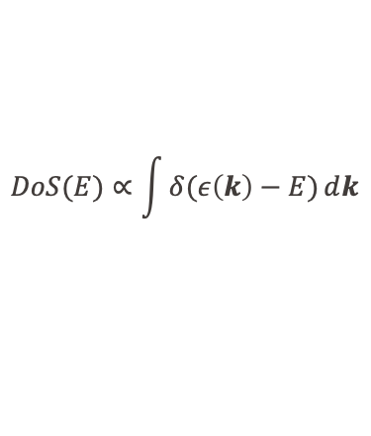
Projected Density of States (PDOS)
PDOS – information about the occupied and unoccupied electronic states of the system and nature of the system (conductor, semiconductor, insulator).
Post-processing of the electronic wave functions of the systems.
$$DoS(E)∝\int{δ(ε\left(k\right)−E)ⅆk}$$
$$BZ$$
$$PDoS(α,E)∝\int{{\left|\left\langle φ_{α}^{at} | ψ_{k}\right\rangle \right|}^{2}δ(ε\left(k\right)−E)ⅆk}$$
$$BZ$$

Slide 16
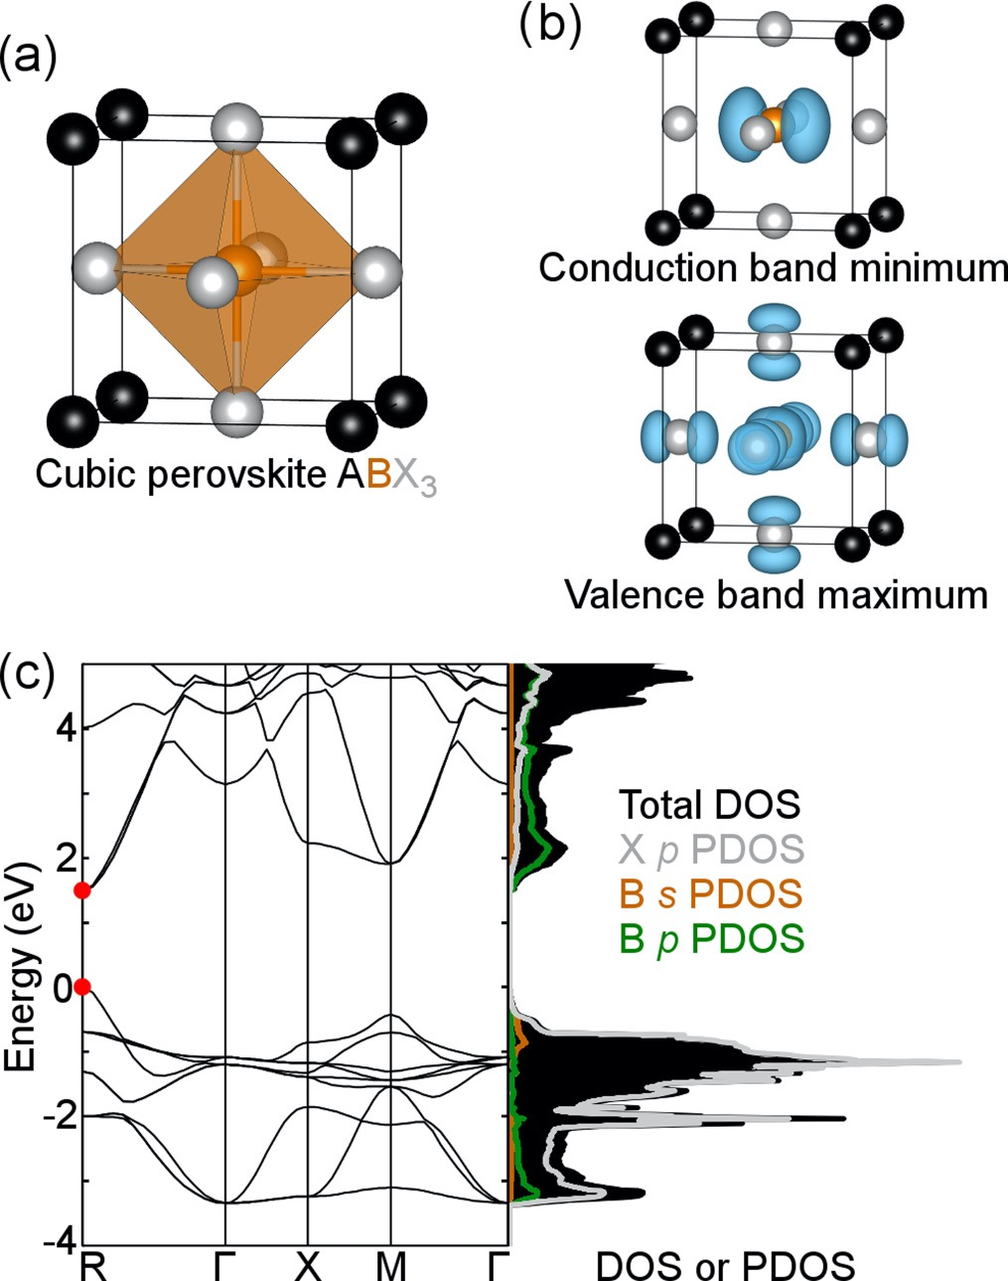


Perovskite PDOS
A-site –
does not affect band gap and states close to the band gap
ex. CH₃NH₃PbI₃
C-N cubic unit cell axis 1.53 eV
C-N face diagonal 1.51 eV
C-N body diagonal 1.52 eV
Larger band gap –
more electronegative X (TVB)
$$χ\left(I\right)<χ\left(Br\right)<χ(Cl)$$
least electronegative B (BCB)
$$χ\left(Sn\right)<χ\left(Pb\right)$$
larger cations A (lattice size)
PHYSICAL REVIEW B 90, 205202 (2014)
https://doi.org/10.1103/PhysRevB.90.205202

Slide 17
PDOS
&DFT
&PRINT
&PDOS
NLUMO –1
COMPONENTS
&LDOS
# Atom list
COMPONENTS
LIST 1 .. 768
&END LDOS
&END PDOS
&END PRINT
&END DFT
…
Compute all unoccupied states
Atom list definition
…
Make your lists according to what you want to see in the PDOS

Slide 18
PDOS
PDOS FILES:
https://moodle.epfl.ch/mod/folder/view.php?id=1330724
$ python get-smearing-pdos_lists.py FAPbI3-PDOS-list5-1.pdos
$ mv FAPbI3-PDOS-list5-1.pdos smeared-Pb-PBE.dat

Slide 19
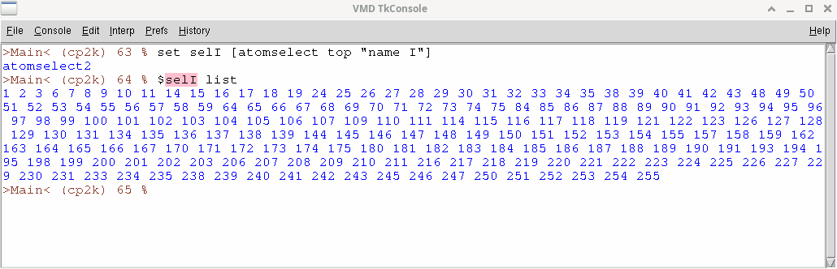
Getting atoms list from VMD
Open a TCL console in VMD
Create a selection: set sel [atomselect top "name atom_name"]
Use $sel list to get the indices of the atoms of the selection you just defined
In CP2K input files list of atoms are defined with the syntax:
        LIST {integer} {integer} .. {integer}
But list in CP2K start from 1 while in VMD it start from 0, so you have to add 1 to the lists obtained from VMD !

