Slide 1
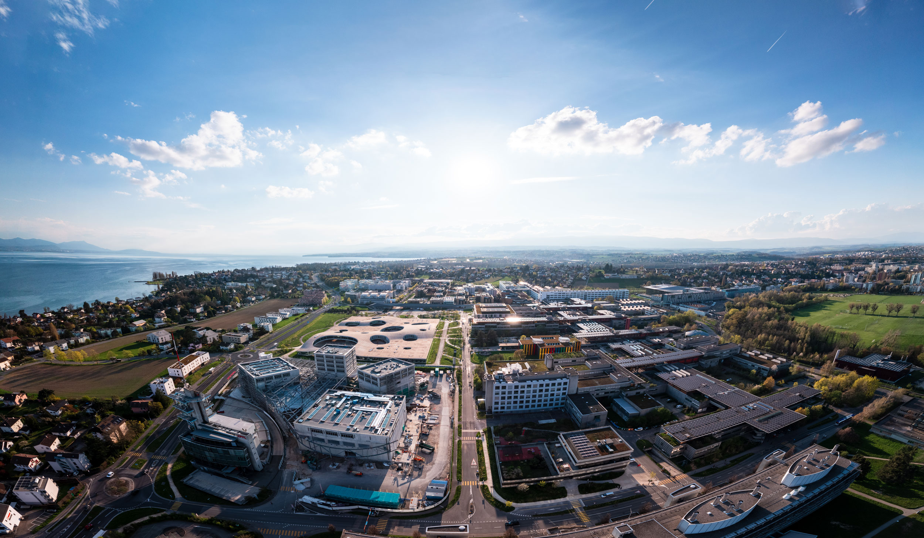
Advanced simulations of solar cell devices
V. Carnevali,
V. Slama,
A. Vezzosi
École Polytechnique fédérale
de Lausanne
March 19, 2025

Slide 2
Getting structure files
Structure databases:
https://next-gen.materialsproject.org
https://www.crystallography.net
Crystal structure (for this exercise):
https://github.com/WMD-group/hybrid-perovskites/blob/master/2014_cubic_halides_PBEsol/FAPbI3.cif
FIle format converter
https://www.cheminfo.org/Chemistry/Cheminformatics/FormatConverter/index.html
User online manual
https://www.ks.uiuc.edu/Research/vmd/current/ug/

Slide 3
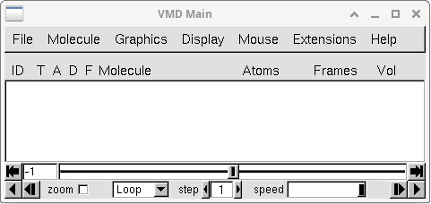
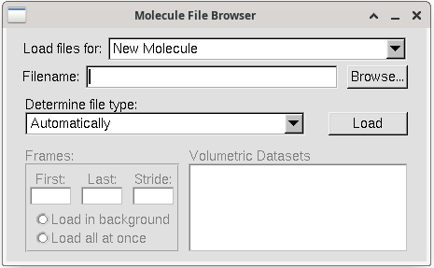
Quick intro to VMD
Load new "molecule"
Browse .xyz or .pdb file
User online manual
https://www.ks.uiuc.edu/Research/vmd/current/ug/

Slide 4
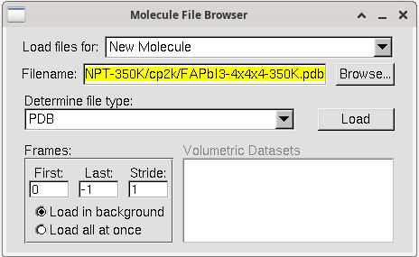
Quick intro to VMD
Load new "molecule"
Browse .xyz or .pdb file
file format is automatically determined
Load the selected file as a "molecule"
User online manual
https://www.ks.uiuc.edu/Research/vmd/current/ug/

Slide 5
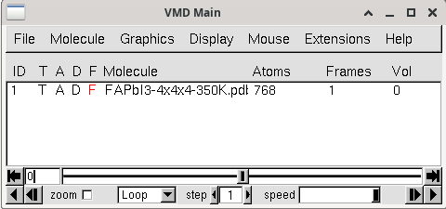
Quick intro to VMD
Open "graphical representation" sections
# of atoms
# of frames
Molecule ID
Molecule name (double click to rename it)
User online manual
https://www.ks.uiuc.edu/Research/vmd/current/ug/

Slide 6
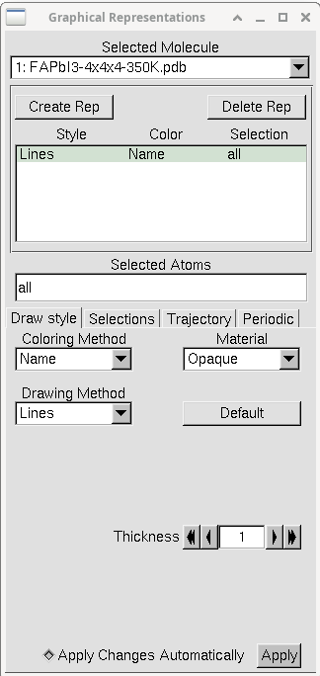
Quick intro to VMD
Select molecule to which apply representation method
Delete representation
Create a new representation
Atom selection interface
("all" -> all atoms are affected by this representation)
Selected representation
Color method
(Color is assigned based on the atom name)
Change drowing style
User online manual
https://www.ks.uiuc.edu/Research/vmd/current/ug/

Slide 7
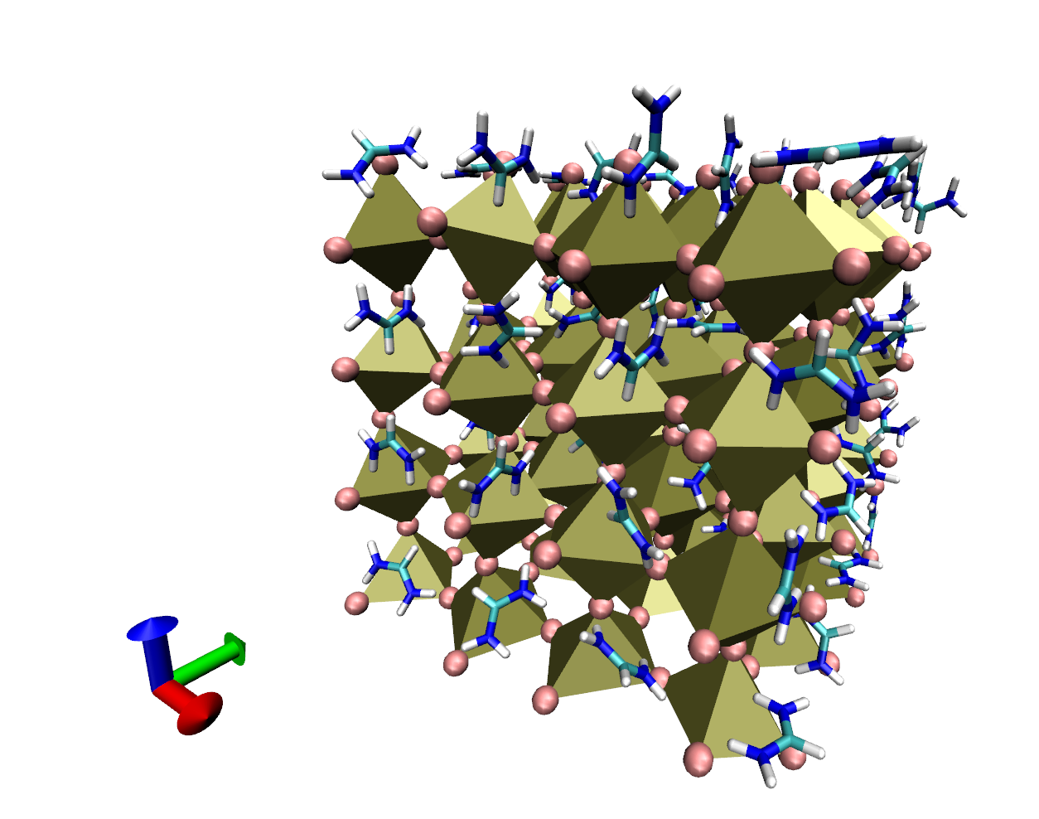
Typical VMD state for FAPbI₃

Slide 8
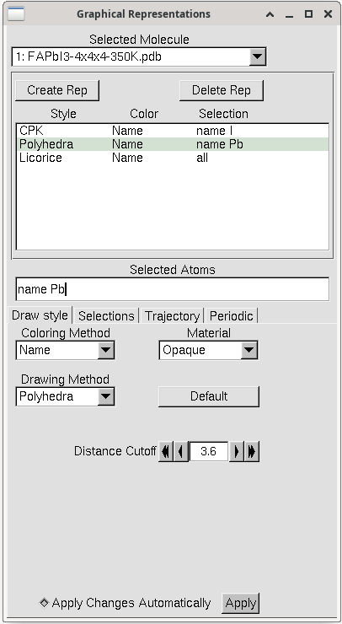
Typical VMD state for FAPbI₃
To represent the octahedra framework
Atoms with name "I" represented with CPK method
All atoms within 3.6 A distance to the selected atoms (Pb) are connected through polyhedra.

Slide 9
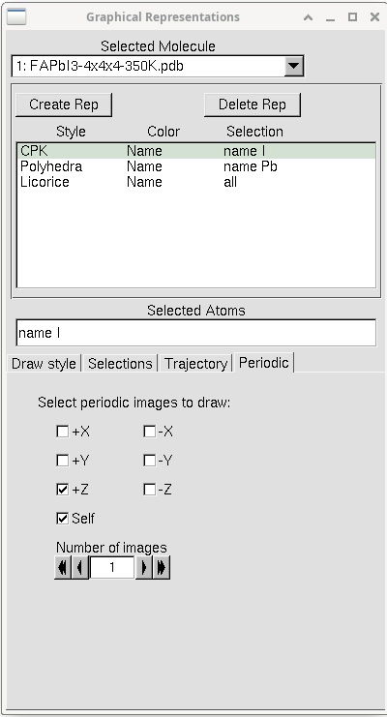
Typical VMD state for FAPbI₃
This section allows to show the periodic images of the supercell for the selected representation.
This requires the cell vectors to be defined first !
Show periodic images on z-direction
Show the supercell too
# of periodic images

Slide 10
Setting the PBC with VMD
Open TCL shell by clicking on "Extensions" and then "TK Console"

Slide 11
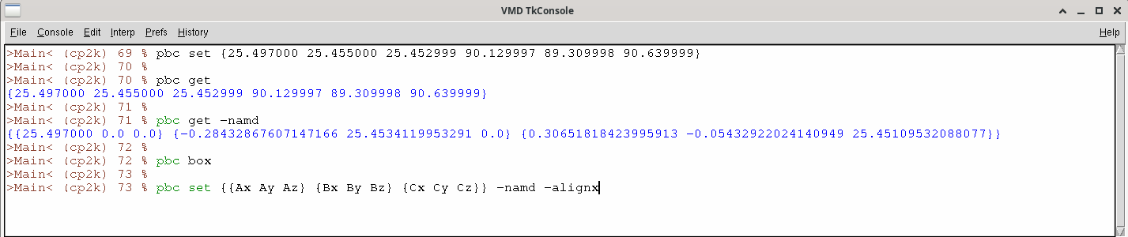
Setting the PBC with VMD
Set the box {|a| |b| |c| α β γ}
Get the cell vector component {{Ax Ay Az} {Bx By Bz} {Cx Cy Cz}}
Visualize the box
Set the box replacing {{Ax Ay Az} {Bx By Bz} {Cx Cy Cz}} with actual cell vector components and align A vector to x-axis and B vector contained in xy-plane
Note that the convention: "A vector aligned with the x-axis and B contained in the xy-plane is the one consistent with the &CELL input subsection of CP2K when cell parameters are given throw the definition of |a|, |b|, |c|, α, β and γ.
See https://manual.cp2k.org/trunk/CP2K_INPUT/FORCE_EVAL/SUBSYS/CELL.html
Reference manual for pbctools plugin
https://www.ks.uiuc.edu/Research/vmd/plugins/pbctools/

Slide 12
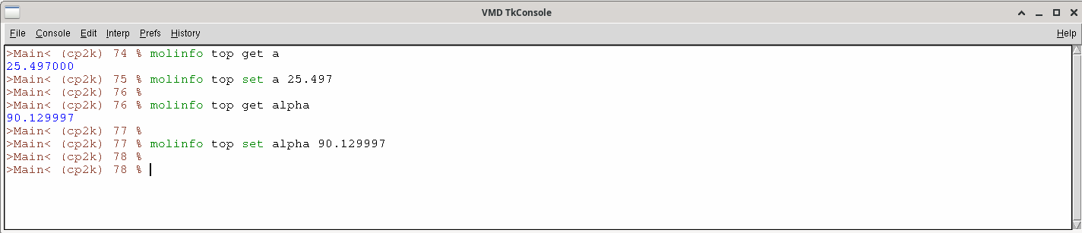
Setting the PBC with VMD
You can set the cell parameters individually using these commands.
Here "top" refers to the last added molecule. If you need to set pbc parameters for a different molecule just use its molecule id. For instance "% molinfo 2 set alpha 90.000"

Slide 13
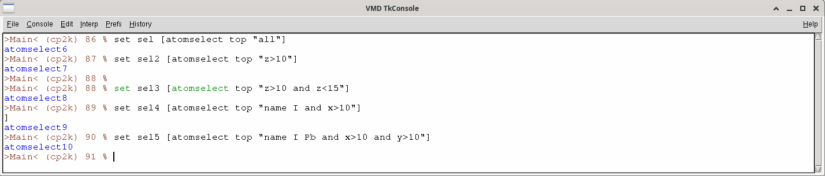
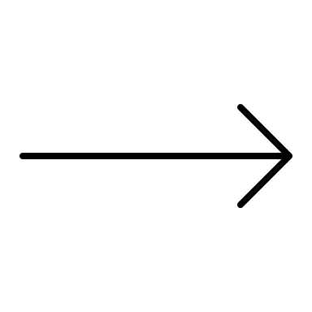
Selections with tcl scripting
Here you see a set of example that use the command "set" to create selections from the tcl command line
% Set selection_name [atomselect molecule_id "selection command"]
Replace "selection command" with the actual selection rule you want to apply. For example in the last command shown in the example I am selecting all the atoms named "I" or "Pb" that have x as well as y coordinate larger than 10 Angstrom.
Note that these selection rules can be use in the same way in the graphical representations window !

Slide 14
Selections with tcl scripting
Then you can act on selections:
Move the atoms of the selection of 1 A in the z-direction
Rotate the selected atoms of 90 degrees about the x-axis
Or save the selection as a new .pdb file:
All these commands are really helpful to split the .pdb file of a composite system in separate fragments !
This is needed, for example, to compute charge density differences, and can be helpful when calculating projected density of states.

Slide 15
Mouse actions
Some useful shortcuts for mouse actions in VMD:
"R": rotation mode
"T": translation mode (this does not affect atom coordinates, it just moves the view)
"=": center the view on top molecule
"0" : Atom info (mol_id, fragment_id, atom_name, xyz position ...)
"2" : Bond label to show distance between two atoms
"5": Move atom (Left to move)
"6": Move residue (Left to move, Right to rotate)
"8": Move molecule (Left to move, Right to rotate)

Slide 16

Ab-initio software input (CP2K)
Calculation type definition
&GLOBAL
RUN_TYPE ENERGY ! (MD, GEO_OPT, ENERGY... )
PROJECT FAPbI3-alpha-2x2x2
PRINT_LEVEL LOW
&END GLOBAL
Calculation type
Name of the job
Verbosity of the output
Calculation settings
&FORCE_EVAL
METHOD Quickstep
&DFT
CHARGE 0
BASIS_SET_FILE_NAME BASIS_MOLOPT
POTENTIAL_FILE_NAME GTH_POTENTIALS
Modules which perform the calculation (energy, MD, geometry optimization, PDOS,…)
Total charge of the system
Database with the basis set and pseudopotential definitions
…

Slide 17
Ab-initio software input (CP2K)
…
&MGRID
CUTOFF 370
REL_CUTOFF 70
&END MGRID
&SCF
EPS_SCF 5.0E-6
SCF_GUESS RESTART
MAX_SCF 2000
&OT
MINIMIZER CG
PRECONDITIONER FULL_SINGLE_INVERSE
&END
&END SCF
Energy cutoff for the plane waves (higer value => more plane waves)
At which energy gaussian basis functions are mapped onto plane waves
Setting parameters for the electron density convergence
Electron density optimization algorithm (Orbital transformation good for big systems)
…

Slide 18
Ab-initio software input (CP2K)
…
&XC
&XC_FUNCTIONAL PBE
&END XC_FUNCTIONAL
&VDW_POTENTIAL
POTENTIAL_TYPE PAIR_POTENTIAL
&PAIR_POTENTIAL
TYPE DFTD3
CALCULATE_C9_TERM .TRUE.
REFERENCE_C9_TERM .TRUE.
LONG_RANGE_CORRECTION .TRUE.
PARAMETER_FILE_NAME dftd3.dat
REFERENCE_FUNCTIONAL PBE
R_CUTOFF 10.0
&END PAIR_POTENTIAL
&END VDW_POTENTIAL
&END XC
&END DFT
DFT functional for the calculation
Definition of the vdW corrections
Type of the vdW corrections
Range of the interaction (usually around half of the box)
…

Slide 19
Ab-initio software input (CP2K)
Topology and basis set definition
…
&SUBSYS
&CELL
ABC 16.134 17.070 29.317
ALPHA_BETA_GAMMA 62.98 100.02 81.61
PERIODIC XYZ
&END CELL
&TOPOLOGY
COORD_FILE_FORMAT PDB
COORD_FILE_NAME ./FAPbI3-alpha-2x2x2.pdb
&CENTER_COORDINATES
&END
&END TOPOLOGY
Definition of the periodic box for the system
Periodicity of the system
Input structure file type
File with the atomic coordinates
…

Slide 20
Ab-initio software input (CP2K)
Topology and basis set definition
…
Specify basis function for each element
&KIND I
BASIS_SET DZVP-MOLOPT-SR-GTH
POTENTIAL GTH-PBE-q7
&END KIND
&KIND O
BASIS_SET TZVP-MOLOPT-GTH
POTENTIAL GTH-PBE-q6
&END KIND
&KIND Pb
BASIS_SET DZVP-MOLOPT-SR-GTH
POTENTIAL GTH-PBE-q4
&END KIND
&KIND H
BASIS_SET DZVP-MOLOPT-GTH
POTENTIAL GTH-PBE-q1
&END KIND
&END SUBSYS
&END FORCE_EVAL
Basis set
Pseudopotential (Goedecker-Teter-Hutter norm conserving pseudopotential)
Core charge (positive)

Slide 21
Basic linux commands
Useful commands
$ mkdir DirName (create a directory)
$ cd DirName (enter a directory)
$ ls DirName (display content of the directory)
$ ls . (display content of the directory you are in)
$ chmod +x FileName (make the file executable)
$ chmod 777 FileName (give all the rights to the file)
$ cat file1.txt file2.txt > compo.txt (concatenate file)
$ grep ENERGY output.out > energy.txt (write all lines that contain "ENERGY" in output.out to energy.txt)
$ grep scp | history (show previous commands that contain "scp")
$ cp source_file dest_file (copy files)
$ mv source_file dest_file (mv or rename files)
$ rm filename (remove file)

Slide 22
File editing
More at...
https://cs.stanford.edu/people/miles/vi.html
Basic VIM commands
$ . (repeat the last action)
$ : (enter command line)
$ v (enter visual mode)
$ :w (save file)
$ ctrl+v (enter visual block mode)
$ :wq (save file and exit VIM)
$ shift+v (enter visual line mode)
$ / > text_search > Enter (search mode)
Once in visual mode
$ 1234 > Enter (go to line number 1234)
$ y (copy selection)
$ dd (delete line)
$ d (delete selection)
$ yy (copy line)
$ shift+i > type text > Esc (insert text in sel. block)
$ p (paste selection)
$ 1234 > d (delete 1234 lines below cursor)
$ u (undo)
$ ctrl+a (increse number under cursor by one)
$ gg (go to top of the file)
$ ctrl+x (decrease number under cursor by one)
$ shift+g (go to bottom of the file)
$ :split /path/to/file/ (open new file in split window)
$ i (enter insert mode)
$ ctrl+ww (move between split windows)
$ o (new line and enter insert mode)
$ :%s/text_search/text_replace/g (search and replace)

Slide 23
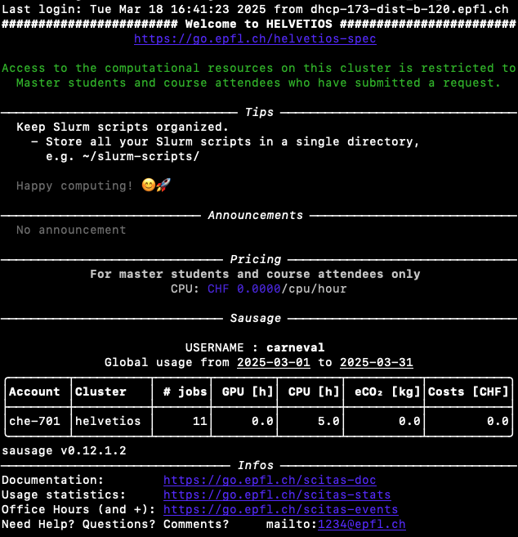
How access Helvetios
Connecting to Helvetios SCITAS cluster
$ ssh -X GasparUsername@helvetios.hpc.epfl.ch
$ … (Gaspar password)
Generate SSH key for easy access to Helvetios
$ ssh-keygen
Append the contents of the file ~/.ssh/id_rsa.pub
to ~/.ssh/authorized_keys on Helvetios.
Config file
Create the file in ~/.ssh/config
Host helvetios
User GasparUsername
HostName helvetios.hpc.epfl.ch
IdentityFile ~/.ssh/id_rsa
Connecting to Helvetios with Config:
$ ssh -X helvetios (No password is needed)

Slide 24
How access Helvetios
Home directory – storing permanent files (few memory)
/home/GasparUsername
Scratch directory – running actual simulations (inactive files will be removed after 40 days)
/scratch/GasparUsername
Copy a file from local computer to Helvetios
$ scp FilePath/file helvetios:PathOnHelvetios
Copy a file from Helvetios to local computer
$ scp helvetios:PathOnHelvetios FilePath/file
To copy a folder
$ scp –r …

Slide 25
How run on Helvetios
#!/bin/bash
#SBATCH --export=ALL
#SBATCH --account=che-701
#SBATCH --nodes 1
#SBATCH --ntasks-per-node 36
#SBATCH --cpus-per-task 1
#SBATCH --mem 190000
#SBATCH --time 01:00:00
#SBATCH --job-name 2x2x2_FAPbI3_ENERGY
#SBATCH --qos che-701
module purge
module load gcc/11.3.0 openmpi/4.1.3
module load cp2k/9.1-mpi-openmp-plumed
export OMP_NUM_THREADS=1
export PATH=$LAMMPS_ROOT/bin:$PATH
export LD_LIBRARY_PATH=$LAMMPS_ROOT/lib64:$LD_LIBRARY_PATH
srun cp2k.psmp -i FAPbI3_ENERGY.in -o FAPbI3_ENERGY-16.out
Class group account
Number of nodes (up to 4 max)
you can play with this number to improve the performance
Helvetios has 36 cpu per node
cpu per task
Memory request (bytes)
(hours/sec/minutes)
Job name in queue
Class group queue
Upload and set CP2K module properly
Run the job
squeue –u GasparUsername
Check job status
squeue –a che-701

Slide 26
FAPbI3 2x2x2 ENERGY CALCULATION
Generate a 2x2x2 FAPbI3 supercell – use FAPbI3.pdb and create_supercell.py
File located in “CP2K hands on: energy” topic in moodle.
Run 2x2x2 FAPbI3 supercell energy calculation – use FAPbI3_2x2x2.in and run.cp2k-ENERGY
File located in “CP2K hands on: energy” topic in moodle.
Compare the output file with the one on moodle – FAPbI3_2x2x2.out
File located in “CP2K hands on: energy” topic in moodle.

Slide 27
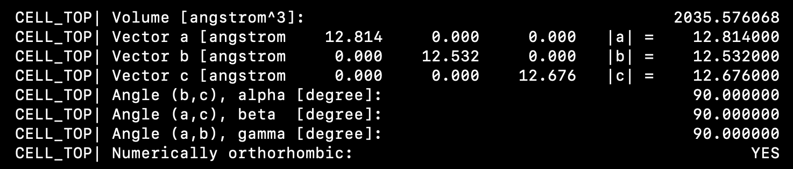
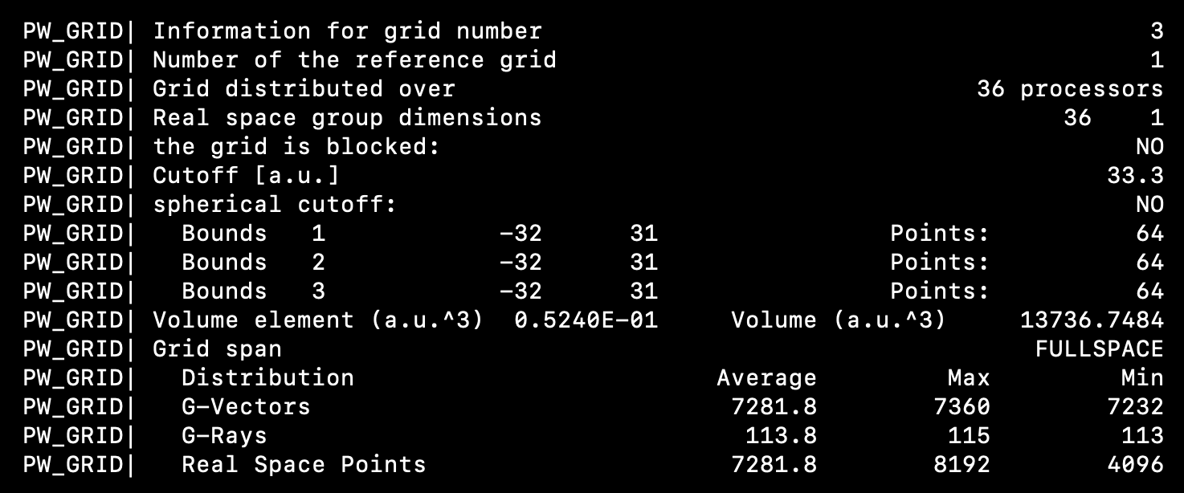
FAPbI3 2x2x2 ENERGY CALCULATION
Simulation box info
Parallelization info

Slide 28
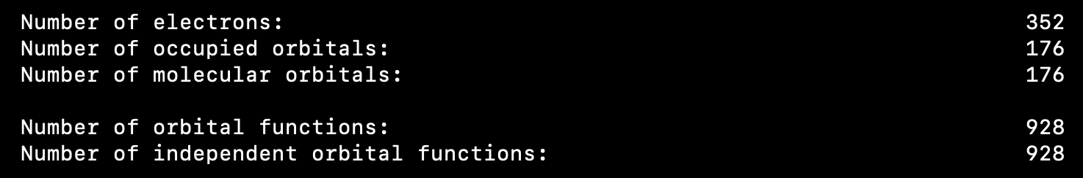
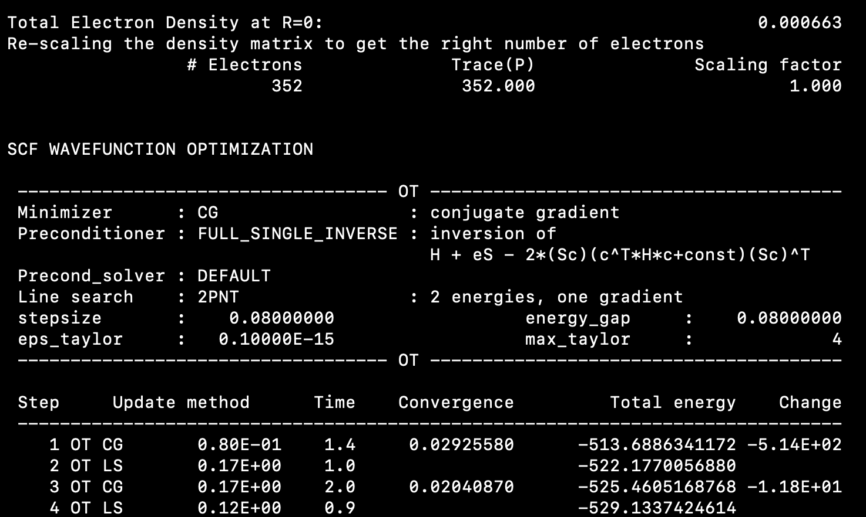
FAPbI3 2x2x2 ENERGY CALCULATION
Electrons and orbitals
Beginning of the calculation

Slide 29
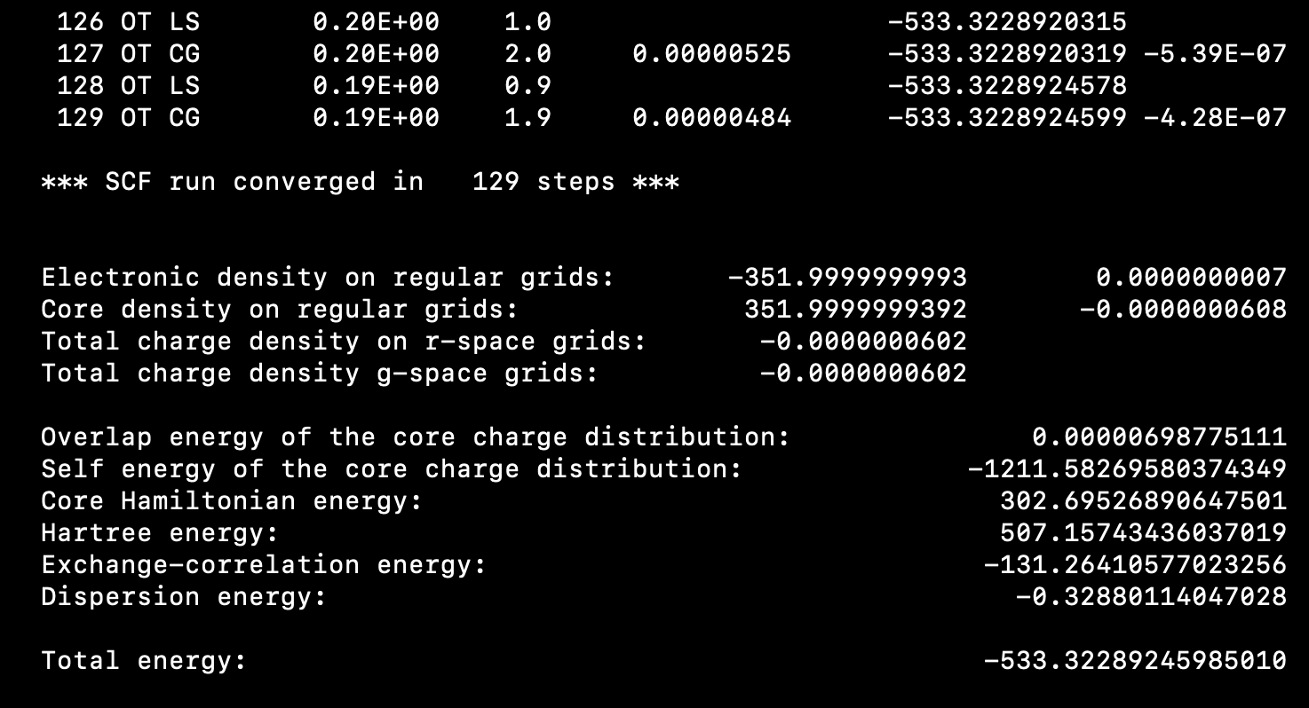
FAPbI3 2x2x2 ENERGY CALCULATION
End of the calculation

Slide 30
PBE0 hybrid functional
&XC
&XC_FUNCTIONAL PBE
&END XC_FUNCTIONAL
&END DFT
Input for the GGA functional
&DFT
BASIS_SET_FILE_NAME BASIS_ADMM_MOLOPT
BASIS_SET_FILE_NAME BASIS_ADMM
&QS
METHOD GPW
MIN_PAIR_LIST_RADIUS -1
&END QS
Basis set for Auxiliary Density Matrix Method – approximative approach for reducing cost of hybrid functional calculation
Pseudopotential calculation
Do not use any cutoff for exchange integrals (include all the pairs)
…
&AUXILIARY_DENSITY_MATRIX_METHOD
METHOD BASIS_PROJECTION
ADMM_PURIFICATION_METHOD NONE
&END AUXILIARY_DENSITY_MATRIX_METHOD
Settings for basis set for Auxiliary Density Matrix Method
…

Slide 31
PBE0 hybrid functional
…
&XC
&XC_FUNCTIONAL PBE0
&END XC_FUNCTIONAL
&XC_GRID
XC_DERIV SPLINE2_SMOOTH
&END XC_GRID
&HF
FRACTION 0.25
&SCREENING
EPS_SCHWARZ 1.0E-11
SCREEN_ON_INITIAL_P FALSE
&END
&INTERACTION_POTENTIAL
POTENTIAL_TYPE TRUNCATED
CUTOFF_RADIUS 8.0
T_C_G_DATA t_c_g.dat
&END INTERACTION_POTENTIAL
&MEMORY
MAX_MEMORY 3000
EPS_STORAGE_SCALING 0.1
&END
&END
Set PBE0 hybrid functional (GGA part)
Pseudopotential close to the core is almost zero – this may make density convergence difficult – use larger energy cutoff of smoothing (computationally cheaper)
Set PBE0 hybrid functional (GGA part)
important parameter to get stable HFX calcs (contributions to hfx smaller than EPS_SCHWARZ are not considered)
Required for hybrid periodic calculations. Radius should be smaller than the half of the periodic box
Defines the maximum amount of memory [MiB] to be consumed by the full HFX module per MPI process

