Slide 1

Advanced simulations of solar cell devices
V. Carnevali,
V. Slama,
A. Vezzosi
École Polytechnique fédérale
de Lausanne
March 12, 2025

Slide 2
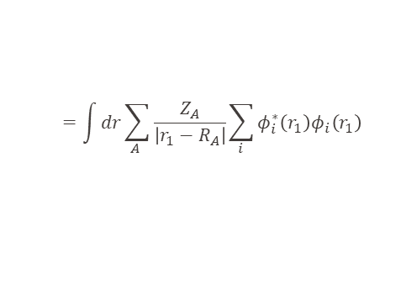

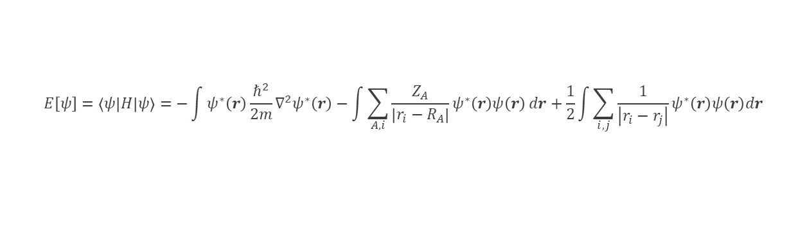
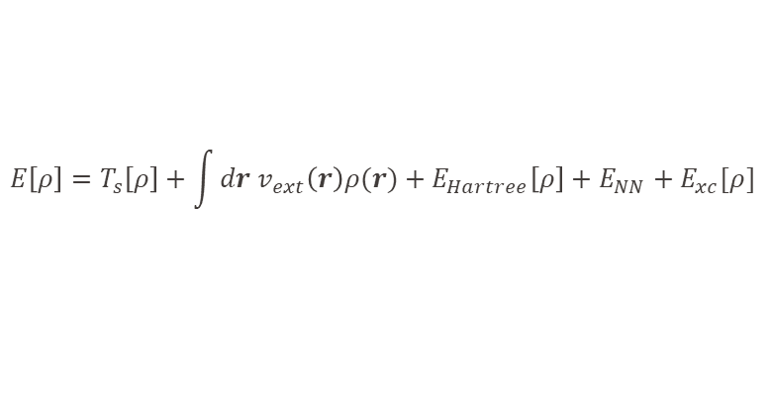
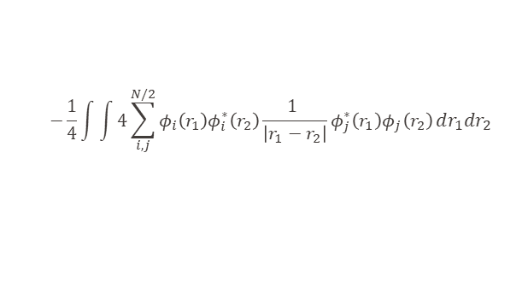

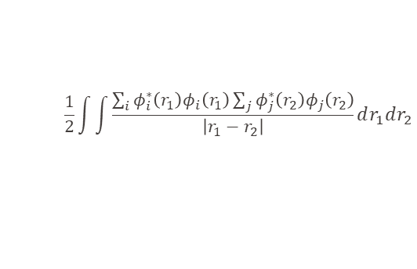

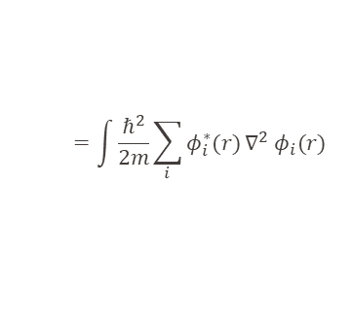




Last lecture repetition
Wavefunction approaches (Hartree-Fock)
$$E\left[ψ\right]=\left\langle ψ | H | ψ\right\rangle =−\int{ψ^{∗}\left(r\right)\frac{ℏ^{2}}{2m}∇^{2}ψ^{∗}\left(r\right)}−\int{\sum_{A,i}{\frac{Z_{A}}{\left|r_{i}−R_{A}\right|}ψ^{∗}\left(r\right)ψ\left(r\right)}}dr+\frac{1}{2}\int{\sum_{i,j}{\frac{1}{\left|r_{i}−r_{j}\right|}}}ψ^{∗}\left(r\right)ψ\left(r\right)dr$$
Wavefunction 3N dimensional function => computationally demanding
Most of the observables (what we can measure) are dependent on single electron only (electron density)
$$Q=∫ρ\left(r\right)dr$$
$$μ=−e∫rρ\left(r\right)dr$$
$$<A>=∫A(r)ρ\left(r\right)dr$$
Total charge
Dipole
Expectation value of operator A
Coulomb interaction
$$=\int{\frac{ℏ^{2}}{2m}\sum_{i}{φ_{i}^{∗}(r)}∇^{2} φ_{i}(r)}$$
$$\frac{1}{2}\int{\int{\frac{\sum_{i}{φ_{i}^{∗}\left(r_{1}\right)φ_{i}\left(r_{1}\right)}\sum_{j}{φ_{j}^{∗}\left(r_{2}\right)φ_{j}\left(r_{2}\right)}}{\left|r_{1}−r_{2}\right|}}}dr_{1}dr_{2}$$
$$=\int{dr\sum_{A }{\frac{Z_{A}}{\left|r_{1}−R_{A}\right|}\sum_{i}{φ_{i}^{∗}\left(r_{1}\right)φ_{i}\left(r_{1}\right)}}}$$
$$ρ(r_{1})$$
$$ρ(r_{2})$$
Need to keep identity of bra and ket
$$−\frac{1}{4}\int{\int{4\sum_{i,j}^{N/2}{φ_{i}\left(r_{1}\right)φ_{i}^{∗}\left(r_{2}\right)}\frac{1 }{\left|r_{1}−r_{2}\right|}φ_{j}^{∗}\left(r_{1}\right)φ_{j}\left(r_{2}\right)}}dr_{1}dr_{2}$$
?
$$v_{ext}(r)$$
$$ρ(r)$$
Exchange interaction
?
Kohn-Sham DFT
Electron density – only 3-dimensional function of single electron => computationally much cheaper and efficient
All the observables can be obtained from the electron density
$$E\left[ρ\right]=T_{s}\left[ρ\right]+\int{dr v_{ext}\left(r\right)ρ(r)}+{E_{Hartree}\left[ρ\right]+E}_{NN}+E_{xc}[ρ]$$

Slide 3

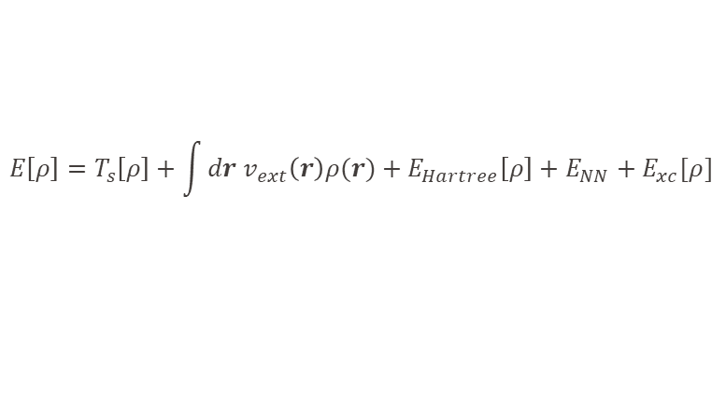



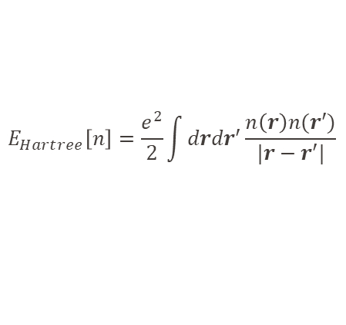


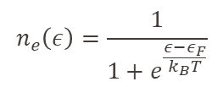
Last lecture repetition
Free electron model – free e⁻ confined into a cubic box of side L
$$n_{e}\left(ε\right)=\frac{1}{1+e^{\frac{ε−ε_{F}}{k_{B}T}}}$$
$$\hat{H}=−\frac{ℏ^{2}}{2m}∇^{2}$$
$$k=\left(\frac{2πn_{x}}{L},\frac{2πn_{y}}{L},\frac{2πn_{z}}{L}\right)$$
$$ψ_{k}\left(r\right)=Ae^{ik⋅r}$$
Hamiltonian
Solution
Boundary conditions
Fermi-Dirac distribution
$$g\left(ε\right)=\frac{dN\left(ε\right)}{dε}=\frac{V}{4π^{2}}{\left(\frac{2m}{ℏ^{2}}\right)}^{\frac{3}{2}}\sqrt{ε}=2π{\left(\frac{2mL^{2}}{h^{2}}\right)}^{\frac{3}{2}}\sqrt{ε}$$
$$ε_{k}=\frac{ℏ^{2}k^{2}}{2m}$$
Energy eigenvalues
# spin orbitals / $ε_{k}$ (Density of states)
Kohn-Sham DFT
$$E\left[ρ\right]=T_{s}\left[ρ\right]+\int{dr v_{ext}\left(r\right)ρ(r)}+{E_{Hartree}\left[ρ\right]+E}_{NN}+E_{xc}[ρ]$$
$$E_{Hartree}\left[n\right]=\frac{e^{2}}{2}\int{drdr′\frac{n\left(r\right)n(r′)}{|r−r′|}}$$
$E_{xc}\left[n\right]=T\left[n\right]−T_{s}\left[n\right]+V_{ee}\left[n\right]−$ $E_{Hartree}\left[n\right]$
How to get these functionals?

Slide 4



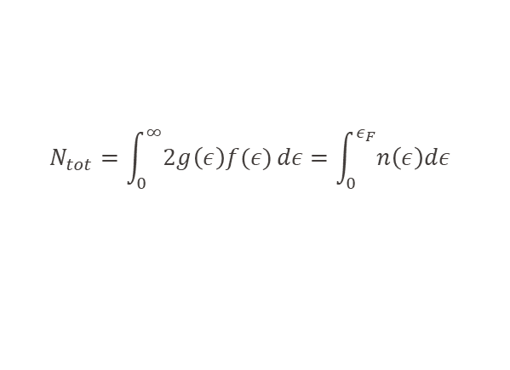
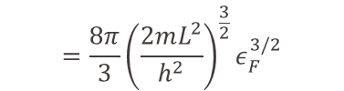






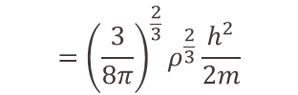

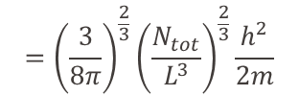

Kinetic energy of free electron gas at 0K
Total number of electrons in the box
Number of electrons at energy $ε$
$$=\int_{0}^{ε_{F}}{2⋅2π{\left(\frac{2mL^{2}}{h^{2}}\right)}^{\frac{3}{2}}\sqrt{ε}}dε$$
$$=\frac{8π}{3}{\left(\frac{2mL^{2}}{h^{2}}\right)}^{\frac{3}{2}}ε_{F}^{3/2}$$
$$N_{tot}=\int_{0}^{∞}{2g\left(ε\right)f(ε)}dε=\int_{0}^{ε_{F}}{n\left(ε\right)dε}$$
Spin up/down
Density of states at energy $ε$
$$ε_{F}={\left(\frac{3N_{tot}}{8π}\right)}^{\frac{2}{3}}\frac{h^{2}}{2mL^{2}}$$
$$={\left(\frac{3}{8π}\right)}^{\frac{2}{3}}{\left(\frac{N_{tot}}{L^{3}}\right)}^{\frac{2}{3}}\frac{h^{2}}{2m}$$
$$={\left(\frac{3}{8π}\right)}^{\frac{2}{3}}ρ^{\frac{2}{3}}\frac{h^{2}}{2m}$$
Momentum at fermi level
$$ε_{F}=E_{F}^{(kin)}=\frac{p_{F}^{2}}{2m}$$
$$⇒p_{F}={\left(\frac{3}{8π}\right)}^{\frac{1}{3}}ρ^{\frac{1}{3}}h$$
$$n\left(ε\right)dε→n\left(p\right)dp$$
$$⇒ n\left(p\right)dp=\frac{8πL^{3}}{h^{3}}p^{2}dp$$
Density of kinetic energy
Electron density at momentum p
Thomas-Fermi kinetic energy functional
$$=\frac{3h^{2}}{10m}{\left(\frac{3}{8π}\right)}^{\frac{2}{3}}ρ^{5/3}$$
$$t[ρ(r)]=\frac{3h^{2}}{10m}{\left(\frac{3}{8π}\right)}^{\frac{2}{3}}{ρ(r)}^{5/3}$$
$$t=\frac{E^{(kin)}}{L^{3}}=\frac{1}{L^{3}}\int_{0}^{p_{F}}{\frac{p^{2}}{2m}}n(p)dp$$

Slide 5

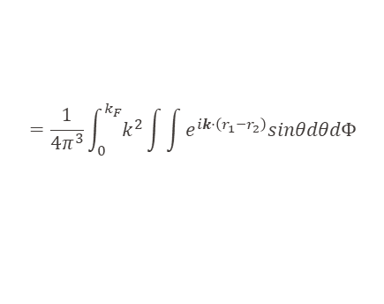

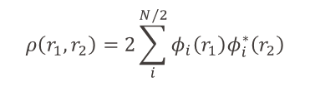
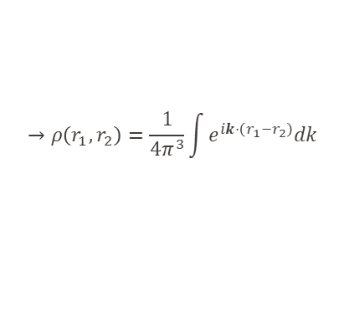

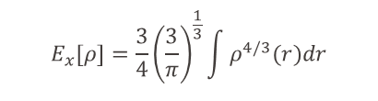
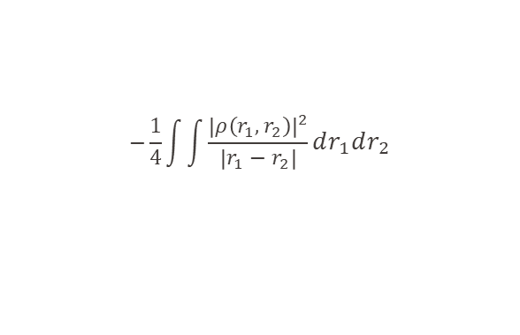
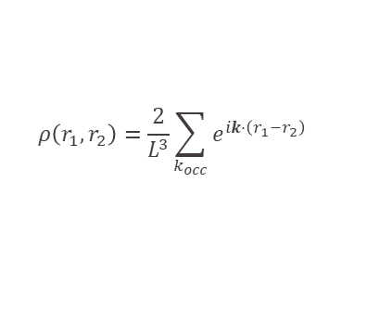
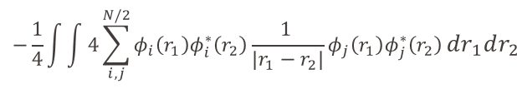


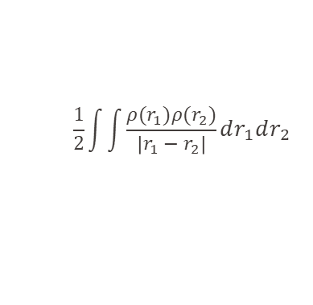


Electron-electron interaction
Wavefunction approaches
$$E\left[ψ\right]=T\left[ψ\right]−\int{\sum_{A,i}{\frac{Z_{A}}{\left|r_{i}−R_{A}\right|}ψ^{∗}\left(r\right)ψ\left(r\right)}}dr+\frac{1}{2}\int{\sum_{i,j}{\frac{1}{\left|r_{i}−r_{j}\right|}}}ψ^{∗}\left(r\right)ψ\left(r\right)dr$$
Electron density approaches
$$\frac{1}{2}\int{\int{\frac{ρ(r_{1})ρ(r_{2})}{\left|r_{1}−r_{2}\right|}}}dr_{1}dr_{2}$$
$$−\frac{1}{4}\int{\int{4\sum_{i,j}^{N/2}{φ_{i}\left(r_{1}\right)φ_{i}^{∗}\left(r_{2}\right)}\frac{1 }{\left|r_{1}−r_{2}\right|}φ_{j}\left(r_{1}\right)φ_{j}^{∗}\left(r_{2}\right)}}dr_{1}dr_{2}$$
Easy to describe by single electron density $ρ(r)$
$$ρ\left(r_{1},r_{2}\right)=2\sum_{i}^{N/2}{φ_{i}\left(r_{1}\right)φ_{i}^{∗}\left(r_{2}\right)}$$
$$−\frac{1}{4}\int{\int{\frac{{\left|ρ\left(r_{1},r_{2}\right)\right|}^{2}}{\left|r_{1}−r_{2}\right|}}}dr_{1}dr_{2}$$
Exchange energy for free electron gas
Exchange energy = two electron property => hard to describe by single electron density $ρ(r)$
$$ψ_{k}\left(r\right)=\frac{1}{L^{3/2}}e^{ik⋅r}$$
$$ρ\left(r_{1},r_{2}\right)=\frac{2}{L^{3}}\sum_{k_{occ}}{e^{ik⋅\left(r_{1}−r_{2}\right)}}$$
$$→ρ\left(r_{1},r_{2}\right)=\frac{1}{4π^{3}}\int{e^{ik⋅\left(r_{1}−r_{2}\right)}dk}$$
$$=\frac{1}{4π^{3}}\int_{0}^{k_{F}}{k^{2}}\int{\int{e^{ik⋅\left(r_{1}−r_{2}\right)}sinθdθdΦ}}$$
Dirac exchange functional
$$E_{x}[ρ]=\frac{3}{4}{\left(\frac{3}{π}\right)}^{\frac{1}{3}}\int{ρ^{4/3}(r)dr}$$
$$k_{F}={\left(3π^{2}ρ\left(r\right)\right)}^{\frac{1}{3}}$$
(Combination $ε_{F}$ and expression for $k(ε)$)
$$ε_{F}={\left(\frac{3}{8π}\right)}^{\frac{2}{3}}ρ^{\frac{2}{3}}\frac{h^{2}}{2m}$$
$$ε_{k}=\frac{ℏ^{2}k^{2}}{2m}$$

Slide 6
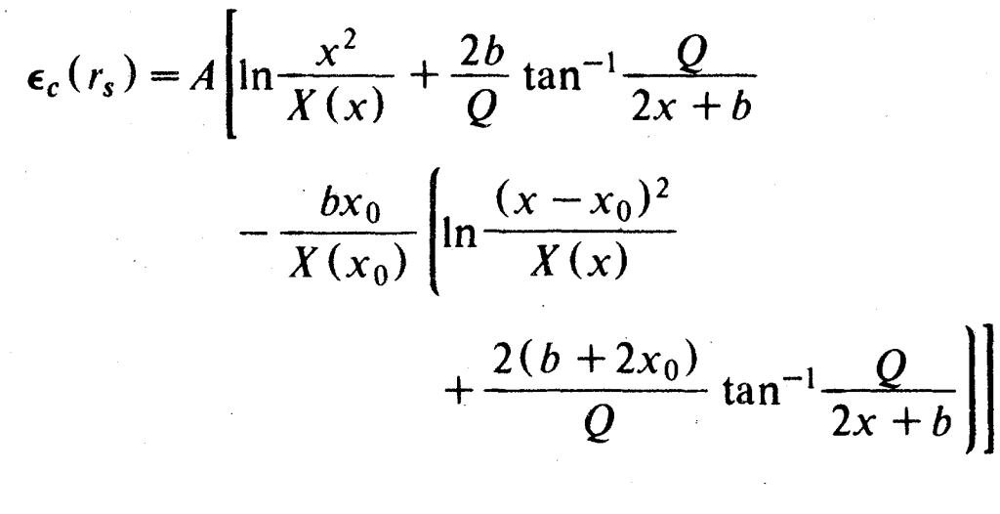



What is still missing?
Electron correlation
Exchange energy – Pauli’s principle (antisymmetric wavefunctions)
Correlation energy – Electrons are interaction => repulsion (try to avoid each other) – not independent
Free electron model
$$r_{s}={\left(\frac{4}{3}πa_{0}^{3}ρ\left(r\right)\right)}^{−\frac{1}{3}}$$
$$E_{c}[ρ]=∫ρε_{c}\left(ρ\right)$$
$$ε_{c}\left(ρ\right)=0.0311\ln\left(r_{s}\right)−0.048+r_{s}(A\ln\left(r_{s}\right)+C)$$
$$x=√r_{s}$$
$$X\left(x\right)=x^{2}+bx+c$$
…
For more realistic systems even more complex
Vosko, Wilk, Phys. Rev. B 22, 3812

Slide 7







Types of functionals
$$ε_{t}[ρ(r)]=\frac{3h^{2}}{10m}{\left(\frac{3}{8π}\right)}^{\frac{2}{3}}{ρ(r)}^{2/3}$$
Local density approximation (LDA) – with spin (LSDA)
Energy functional depends only on the electron density $ρ\left(r\right)$ at each point in space
$$ε_{x}[ρ]=\frac{3}{4}{\left(\frac{3}{π}\right)}^{\frac{1}{3}}ρ^{1/3}(r)$$
$$E\left[ρ\right]=∫ρ(r)ε\left(ρ(r)\right)dr$$
$$ε_{c}\left(ρ\right)=0.0311\ln\left(r_{s}\right)−0.048+r_{s}(A\ln\left(r_{s}\right)+C)$$
Works well for homogeneous systems with slowly varying electron density
  Perfect periodic systems at low temperatures
  Wrong predictions of impurity effects (localized)
$$r_{s}={\left(\frac{4}{3}πa_{0}^{3}ρ\left(r\right)\right)}^{−\frac{1}{3}}$$
Not used anymore (maybe for very large systems with large number of electrons)
Generalized gradient approximation (GGA)
Improvement of the LDA by including dependence of the energy on electron density gradients $∇ρ(r)$
$$ε(ρ\left(r\right),∇ρ\left(r\right))$$
Large improvement in accuracy
Good for geometries
Tendency to underestimate the band gap (mostly due to the self-interaction error)
Representatives: PBE, BLYP, PW92…
Some functionals fitted for specific systems or properties

Slide 8

Types of functionals
How to improve even more?
GGA functionals approximative exchange and correlation
Hartree-Fock (HF) exact exchange but no correlation (to include correlation post HF methods: MP2, CI, CC,…)
GGA functionals tend to underestimate band gap x Hartree-Fock tends to overestimate
=> Combination of GGA and HF for error cancelation
Hybrid functionals
Part of the exact exchange computed with approximate functional and part using exact HF exchange
Correct portion of the exact exchange is not known (usually around 20-30%)
PBE0
$$E_{XC}^{PBE0}=\frac{1}{4}E_{X}^{HF}+\frac{3}{4}E_{x}^{PBE}+E_{C}^{PBE}$$
B3LYP
$$E_{XC}^{B3LYP}=0.8E_{X}^{LSDA}+0.2E_{X}^{HF}+0.72ΔE_{X}^{B}+0.19E_{C}^{LSDA}+0.81E_{C}^{LYP}$$
Some derived analytically (PBE0) and some fitted to specific properties on set of systems
Very good for the structural properties
Good for band gaps
Wrong asymptotic dependence of the electron density (exponential decay of potential compared to the correct ~1/r )
  For periodic systems usually not a problem
  Problems with excited states especially with charge transfer (CT) character

Slide 9
Types of functionals
How to improve even more?
GGA functionals approximative exchange and correlation
Hartree-Fock (HF) exact exchange but no correlation (to include correlation post HF methods: MP2, CI, CC,…)
GGA functionals tend to underestimate band gap x Hartree-Fock tends to overestimate
=> Combination of GGA and HF for error cancelation
Hybrid functionals
Part of the exact exchange computed with approximate functional and part using exact HF exchange
Correct portion of the exact exchange is not known (usually around 20-30%)
PBE0
$$E_{XC}^{PBE0}=\frac{1}{4}E_{X}^{HF}+\frac{3}{4}E_{x}^{PBE}+E_{C}^{PBE}$$
B3LYP
$$E_{XC}^{B3LYP}=0.8E_{X}^{LSDA}+0.2E_{X}^{HF}+0.72ΔE_{X}^{B}+0.19E_{C}^{LSDA}+0.81E_{C}^{LYP}$$
Some derived analytically (PBE0) and some fitted to specific properties on set of systems
Very good for the structural properties
Good for band gaps
Wrong asymptotic dependence of the electron density (exponential decay of potential compared to the correct ~1/r )
  For periodic systems usually not a problem
  Problems with excited states especially with charge transfer (CT) character

Slide 10

Types of functionals
Range separated (long-range corrected) functionals
Different portion of the exact exchange for the short and long distances
Improved (sometimes corrected) asymptotic dependence of the electron density
$$\frac{1}{\left|r_{1}−r_{2}\right|}=\frac{1−erf⁡(ω\left|r_{1}−r_{2}\right|)}{\left|r_{1}−r_{2}\right|}+\frac{erf⁡(ω\left|r_{1}−r_{2}\right|)}{\left|r_{1}−r_{2}\right|}$$
Range separation parameter
Short range
Long range
Good for thermochemistry, barrier heights and chemical reactions
Very good for excited states and reasonable for the CT states
Examples: $ωB97XD$ with 100% exact exchange in long range, $cam−B3LYP$ with 65% of exact exchange in long range, $LC−ωPBE$, …

Slide 11


Types of functionals
meta-GGA / meta-hybrid functionals
Improvement of the GGA/hybrid functionals by including dependence of the energy on kinetic energy density $∇^{2}ρ(r)$
$$ε(ρ\left(r\right),∇ρ\left(r\right),∇^{2}ρ\left(r\right))$$
Possible to separate single-orbital and overlap regions => good for description of molecular and solid-state properties
  Semiconducting oxides formation enthalpies, equilibrium lattice constants and transition pressures.
  First principles description medium-ranged Van der Waals interactions
Problems with numerical stability
Examples: SCAN, M06L, VSXC, …

Slide 12
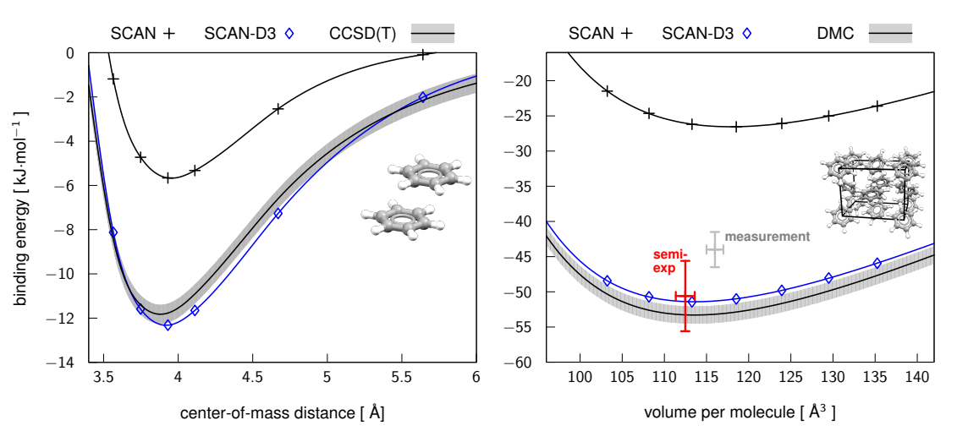

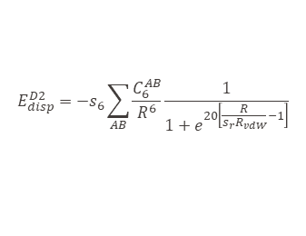

Additional corrections of DFT functionals
Both DFT and HF have problems with non-local interactions like dispersion
  One atom/molecule/system induces charge redistribution of the other and that trigger changes in electron density back on the first = van der Waals (dispersion interaction)
Large gradients of the electron density in the regions, where the density is small
Problem of mean the field description (electron moving in potential generated by all other electrons) – for dispersion we need correlated movement of two electrons
In wavefunction approaches – post HF approaches: MP2, CI, CC… can recover dispersion energy
In DFT we usually use empirical corrections
Essential for interaction of non-covalently linked subsystems
van der Waals corrections
Classical description
$$V(r)=4ε\left({\left(\frac{σ}{r}\right)}^{12}−{\left(\frac{σ}{r}\right)}^{6}\right)$$
Short range repulsive part of the vdW interaction is described correctly – need to correct the attractive part of the potential
scaling
Sum of vdW radii
Grimme’s D2 correction
$$E_{disp}^{D2}=−s_{6}\sum_{AB}{\frac{C_{6}^{AB}}{R^{6}}\frac{1}{1+e^{20\left[\frac{R}{s_{r}R_{vdW}}−1\right]}}}$$
$$C_{6}^{AB}=\sqrt{C_{6}^{AA}C_{6}^{BB}}$$
Atomic vdW coefficients
No dependence on the molecular environment
Grimme’s D3 correction – fractional coordination number (different parameters for different hybridization)

Slide 13
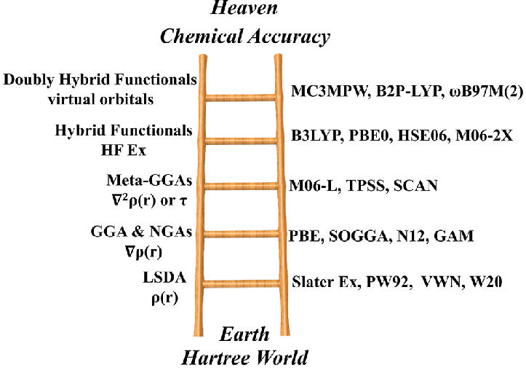
Functionals comparison
GGA functionals
Computationally cheap
Reasonable geometries
Tendency to delocalize electron density (slower variations) => e.g. overestimate the covalency of bonds, overstabilization of the separated charges
Sometimes fortunate error cancelations (fitted on the correct properties)
Hybrid functionals
10-100 more computationally expensive
Very good structures
Good for band gaps
With more than 30% of exact exchange tendency to overestimate ionic character of the bonds
Reasonable for localized properties, e.g. defects, molecules incorporated in periodic systems, interfaces…
Range separated functionals
Good for thermochemistry, barrier heights and chemical reactions
Very good for excited states and reasonable for the CT states
Double hybrid functionals
Including effect of virtual orbital => better description of the electron correlation
Jacob's ladder of density functional

Slide 14


Basis set
Atom-centred basis sets
System “molecular orbitals” are constructed as linear combination of slater atomic orbitals localized on each atom
  Each slater orbital represented by set of gaussian molecular orbitals – numerical reasons
Minimal basis set (e.g. STO-3G)
  Each electron is described by single slater orbital (usually constructed from three gaussian functions)
  For example, for C the minimal basis set consist of 1s, 2s and 2p orbitals (per atom).
  Do not use for production!
Split valence basis sets
  Different description of the core and valence electrons
    Core electrons are not affected by the environment and they are “atom-like”
      Single slater orbital is enough
    Valence electrons are involved in formation of the chemical bonds delocalized states
      Usually described by more slater orbitals to have higher chemical flexibility
Pople basis set (e.g. 6-31G)
  6 gaussian functions representing single slater orbital for core electrons
  Two slater orbitals per valence electron (double-zeta basis)
    First described by 3 gaussian orbitals
    Second described by 1 gaussian orbital
  For example, for C basis set consist of 1s, 2s, 2p, 3s and 3p orbitals (per atom)
$$E_{SCF}\left(∞\right)= \frac{E_{SCF}\left(n\right)e^{−z√m}−E_{SCF}\left(m\right)e^{−z√n}}{e^{−z√m}−e^{−z√n}}$$
Correlation consistent basis sets = Dunning basis set (e.g. cc-pVDZ, cc-pVnZ)
  Designed to converging systematically post HF methods to complete basis set limit
  For example, for C basis set consist of 1s, 2s, 2p, 3s, 3p and 3d orbitals (per atom)
$$E_{corr}\left(∞\right)= \frac{E_{corr}\left(n\right)n^{y}−E_{SCF}\left(m\right)m^{y}}{n^{y}−m^{y}}$$
Karsruhe basis set (e.g. def2-SVP, def2-TZVP)
  Larger variability which orbitals included ( for C: 1s, 2s, 2p, 3s, 3p and 3d orbitals, but different n. of gaussian orbitals)

Slide 15



Basis set
Atom-centred basis sets
Possible to add additional polarization or diffuse functions to the basis sets
Polarization functions
  Adding basis functions with higher angular momentum
  Extend basis set to properly describe orbital changes from the atomic ones to the molecular ones (e.g. sp3 hybridization)
  Important also for excited states
  Less important for larger basis sets (for quadruple-zeta basis sets and larger only small effect)
  Less added basis functions than increasing the “zeta” number
  For Pople basis sets denoted by * (6-31G**), for Karlsruhe def2-TZVPP
Diffuse functions
  Adding special basis functions with longer tail (slower decay to 0 with the distance from the atom)
  Important for the systems with long range interactions e.g. hydrogen bonds, ligands interaction, Rydberg states,…
  Important for the charged systems especially anions, charge-transfer or highly excited states
  For Pople basis set denoted by + (6-31+G), for correlation consistent basis by aug- (aug-cc-pVDZ) and for the Karsruhe basis sets by D (def2-TZVPD)
Plane wave basis set
$$ψ_{k}\left(r\right)=Ae^{ik⋅r}$$
Used for periodic calculations (defined by the box dimensions)
Filling the space by the plane waves
Number of plane waves usually defined by the cutoff energy (largest energy of the plane wave)
Good and cheap description of the delocalized electrons but poor description of localized properties like core electrons
$$k=\left(\frac{2πn_{x}}{L},\frac{2πn_{y}}{L},\frac{2πn_{z}}{L}\right)$$
$$ε_{k}=\frac{ℏ^{2}k^{2}}{2m}$$

Slide 16
Basis set
Basis set selection strongly depends on the system and properties of interest
  No rule how to select basis set (should be smallest which provide desired accuracy)
  Usually good to check convergence with the basis set size (sometimes could be computationally expensive)
Plane wave basis set
  good for delocalized properties – pure crystals, homogeneous periodic systems
  Basis is static (not moving with atoms) and independent on number of atoms in the system (for the same box we get the same accuracy)
Atom centered basis sets
  describe well localized properties – e.g. molecules, impurities, chemical bonds, heterogeneity
  When atoms removed from the system basis set is decreased => Basis set superposition error (BSSE)
Some software allows to use combined plane-wave and atom-centered basis sets – “best of both worlds approach”
Possible to correct problem of the plane wave basis with the core electrons by removing them from explicit treatment => pseudopotentials
Notes:
Example of check of the basis set size effects – chemical challenge of photoexcited reaction furane

Slide 17
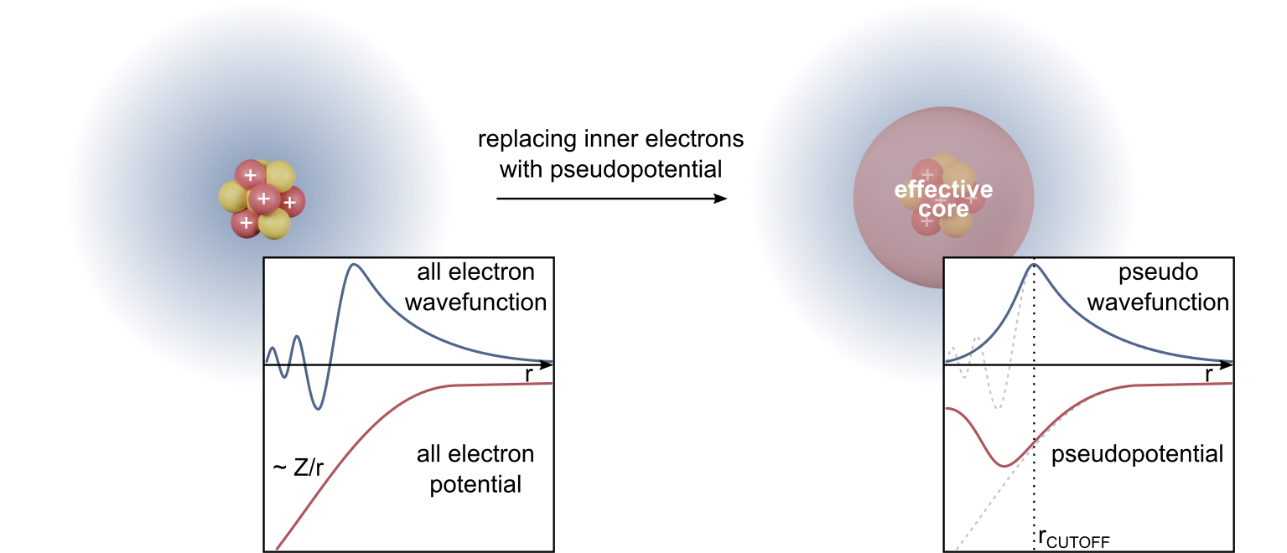
Pseudopotentials
Core electrons do not influence chemical properties of the system => we don’t need to treat them explicitly
  Shielding of the nuclei potential -> valence electrons see only effective screened nuclear charge
Replacing correct ~1/r nuclear potential by shallower one representing potential of nuclei+core electrons
Basic types:
  Norm conserving pseudopotentials
    Inside the radius the norm of the wavefunction the same as full electron one
    Outside the radius the wavefunction identical with the full electron one
  Ultrasoft pseudopotentials
    Replacing the norm condition by minimizing the norm difference
  Projector augmented wave method (PAW)
    Projection of the “trial” wavefunction on the full electron one in region outside the core
Important for the plane wave basis – removing the localized electrons => lower basis functions needed
Useful also for the atom-centered basis sets – reducing computational cost with (hopefully) negligible effect on accuracy
Relativistic effects of the core electrons in heavy atoms could be included into the pseudopotential

Slide 18

Ab-initio software input (CP2K)
Calculation type definition
&GLOBAL
RUN_TYPE ENERGY ! (MD, GEO_OPT, ...)
PROJECT NDI_PbI3_1D
PRINT_LEVEL LOW
&END GLOBAL
Calculation type
Name of the job
Verbosity of the output
Calculation settings
&FORCE_EVAL
METHOD Quickstep
&DFT
CHARGE 0
BASIS_SET_FILE_NAME BASIS_MOLOPT
POTENTIAL_FILE_NAME GTH_POTENTIALS
Modules which perform the calculation (energy, MD, geometry optimization, PDOS,…)
Total charge of the system
Database with the basis set and pseudopotential definitions
…

Slide 19
Ab-initio software input (CP2K)
…
&MGRID
CUTOFF 370
REL_CUTOFF 70
&END MGRID
&SCF
EPS_SCF 5.0E-6
SCF_GUESS RESTART
MAX_SCF 2000
&OT
MINIMIZER CG
PRECONDITIONER FULL_SINGLE_INVERSE
&END
&END SCF
Energy cutoff for the plane waves (higer value => more plane waves)
At which energy gaussian basis functions are mapped onto plane waves
Setting parameters for the electron density convergence
Electron density optimization algorithm (Orbital transformation good for big systems)
…

Slide 20
Ab-initio software input (CP2K)
…
&XC
&XC_FUNCTIONAL PBE
&END XC_FUNCTIONAL
&VDW_POTENTIAL
POTENTIAL_TYPE PAIR_POTENTIAL
&PAIR_POTENTIAL
TYPE DFTD3
CALCULATE_C9_TERM .TRUE.
REFERENCE_C9_TERM .TRUE.
LONG_RANGE_CORRECTION .TRUE.
PARAMETER_FILE_NAME dftd3.dat
REFERENCE_FUNCTIONAL PBE
R_CUTOFF 10.0
&END PAIR_POTENTIAL
&END VDW_POTENTIAL
&END XC
&END DFT
DFT functional for the calculation
Definition of the vdW corrections
Type of the vdW corrections
Range of the interaction (usually around half of the box)
…

Slide 21
Ab-initio software input (CP2K)
Topology and basis set definition
…
&SUBSYS
&CELL
ABC 16.134 17.070 29.317
ALPHA_BETA_GAMMA 62.98 100.02 81.61
PERIODIC XYZ
&END CELL
&TOPOLOGY
COORD_FILE_FORMAT PDB
COORD_FILE_NAME ./NDI-PbI3_1D_FAPbI3-delta_2x2x2_opt.pdb
&CENTER_COORDINATES
&END
&END TOPOLOGY
Definition of the periodic box for the system
Periodicity of the system
Input structure file type
File with the atomic coordinates
…

Slide 22
Ab-initio software input (CP2K)
Topology and basis set definition
…
Specify basis function for each element
&KIND I
BASIS_SET DZVP-MOLOPT-SR-GTH
POTENTIAL GTH-PBE-q7
&END KIND
&KIND O
BASIS_SET TZVP-MOLOPT-GTH
POTENTIAL GTH-PBE-q6
&END KIND
&KIND Pb
BASIS_SET DZVP-MOLOPT-SR-GTH
POTENTIAL GTH-PBE-q4
&END KIND
&KIND H
BASIS_SET DZVP-MOLOPT-GTH
POTENTIAL GTH-PBE-q1
&END KIND
&END SUBSYS
&END FORCE_EVAL
Basis set
Pseudopotential (Goedecker-Teter-Hutter norm conserving pseudopotential)

