Slide 1

Advanced simulations of solar cell devices
V. Carnevali, V. Slama, A. Vezzosi
École Polytechnique fédérale de Lausanne
February 26, 2025

Slide 2
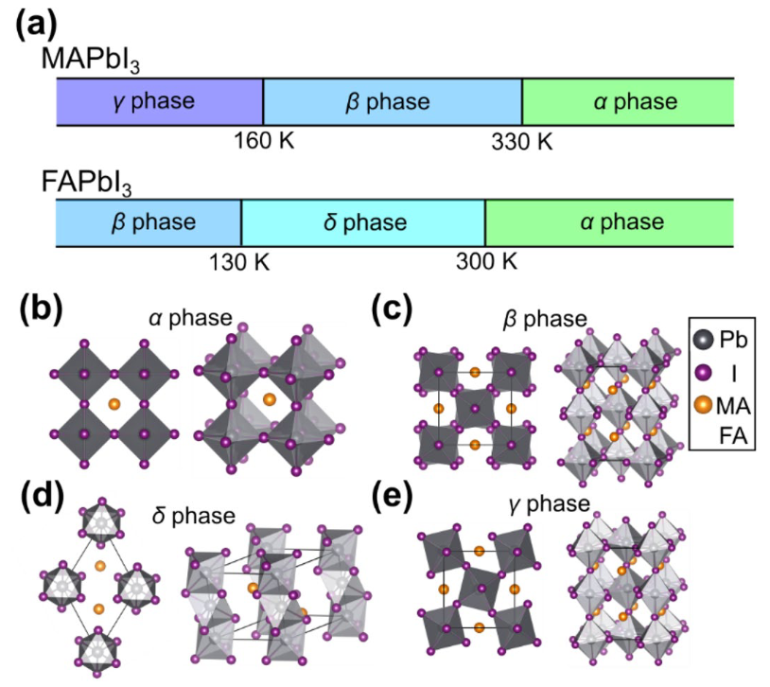
Structural phase transitions
https://doi.org/10.1038/s41598-020-76742-7
Organic-ionrganic hybrid metal halide perovskite with general formula AMI₃ show structural phase transitions as a function of temperature.
In particular, for FAPbI₃ the most stable structure at room temperature is the trigonal δ-FAPbI₃ phase, and exhibit a large band gap (2.43 eV) leading to very low photoactivity.
Different structural phases corresponds to different optoelectronic properties and impact on the efficiency of the solar cell device.

Slide 3
Grain size and grain orientation
Control of perovskite thin-film microstructure is a key factor enabling high PCE
The term "microstructure" refers to surface coverage, phase purity, grain size, grain orientation and structural defects.
Larger grain size in the active layer reduces grain boundaries which act as recombination sites for the charge carriers, leading to improved mobility and carrier lifetimes.
Properties such as photocurrent generation and open-circuit voltage are influenced by the microscopic structure and orientation of the perovskite crystals, as surface trap density varies as a function of facets orientation
Wanyi Nie et al.,High-efficiency solution-processed perovskite solar cells with millimeter-scale grains. Science347,522-525(2015)
Leblebici, S., Leppert, L., Li, Y. et al. Facet-dependent photovoltaic efficiency variations in single grains of hybrid halide perovskite. Nat Energy 1, 16093 (2016).

Slide 4
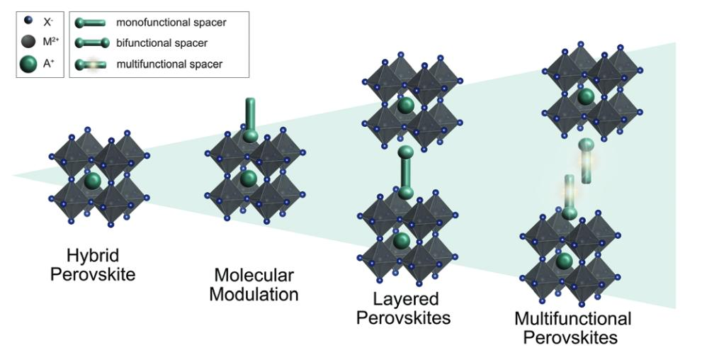
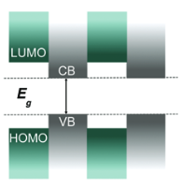
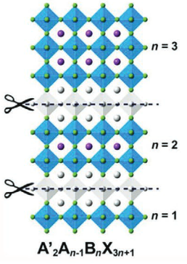
2D layered perovskites
https://doi.org/10.1039/D1TC01533H
Organic cation
3D phase
Dion-Jacobson
(DJ)
Ruddlesden-Popper
(RP)
2D perovskites are made of single/multiple corner-sharing layers of 3D perovskites seprated by organic mono- or divalent cations.
Improved moisture stability, thermal stability, and lower ion migration occurrence in comparison to 3D perovskite
Multiple quantum wells are formed due to the insulating nature of the spacer cations, which hinders charge transport along the layer stacking direction leading to reduced efficiency as compared to 3D absorbers
Charge transport becomes highly anisotropic !
Need to control and characterize the slab thickness and orientation

Slide 5
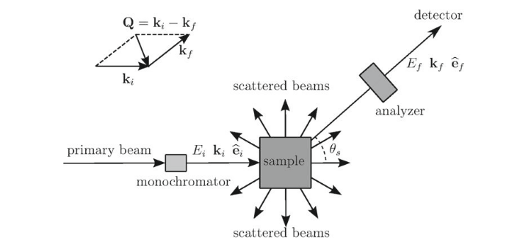
Scattering of particles by crystals
Schematic experimental set-up for scattering measurement
E_{i} : initial energy
E = E_{i}-E_{f} : energy transfer
Q = k_{i}-k_{f} : momentum transfer
e_{i} : initial polarization state
e_{f} : initial polarization state
Assumptions:
Beam source is made of photons with energy of 10-50 keV (X-rays) --> wavelength is of the order of interatomic spacing
Elastic scattering --> energy and momentum are conserved
Atoms are fixed at the equilibrium position
Both the incident radiation and the sample crystal are treated classically
We only consider the coupling of the free electronic charge with the electric field of the radiation
G. Grosso and G. P. Parravicini. Solid state physics. Academic press, 2013.

Slide 6
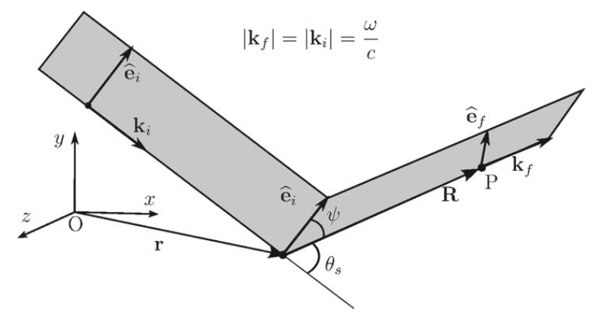


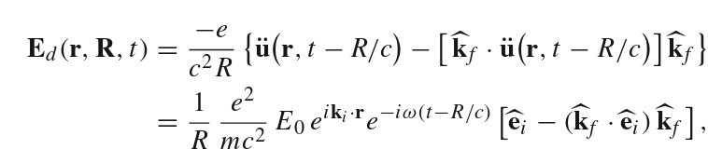
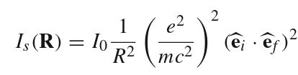
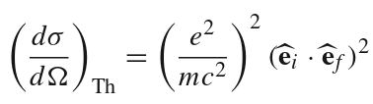

Elastic scattering of X-rays
Incident radiation beam
The free electron in r starts oscillating at the same frequency of the incident radiation
Electric fied at point P of an oscillating electric dipole centered at r for R>>λ
If the analyzer accepts photons with a fixed polarization e_{f}
Thomson cross-section
Polarization vector of the scattered field
G. Grosso and G. P. Parravicini. Solid state physics. Academic press, 2013.

Slide 7
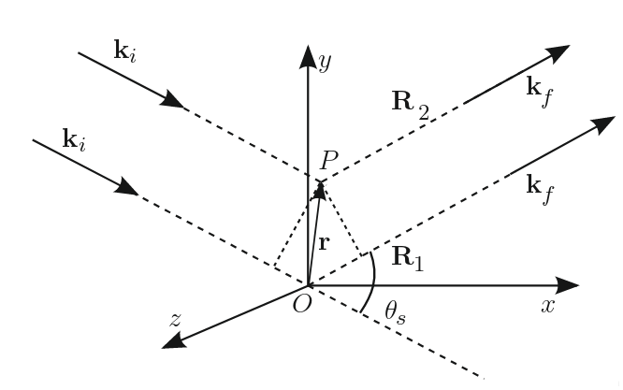


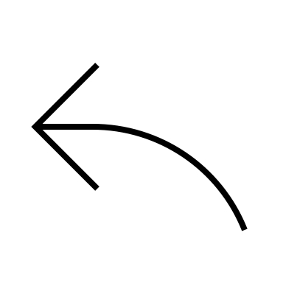


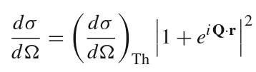
Elastic scattering of X-rays
For elastic scattering ω/c = |k_{f}|
Consider now scattering from two electrons, one located in O and the other in P.
Both are accelerated by th electric field of the same incoming radiation, and both radiate.
The two scattered field differ only in the phase factors:
Two electron diff. cross-section
The phase factors differ by a quantity exp(i Q • r)
G. Grosso and G. P. Parravicini. Solid state physics. Academic press, 2013.

Slide 8

The form factor F(Q)
The last result can be easily genralized to a quantum system with total electron density n_{el}(r)
Form factor: F(Q)
The form factor corresponds to the Fourier transform of the electronic density.
The modulus square of the form factor is also called structure factor.
The intensity of X-ray scattering is controlled by the modulus squared of the Fourier transform of the electron density of the system.
G. Grosso and G. P. Parravicini. Solid state physics. Academic press, 2013.

Slide 9



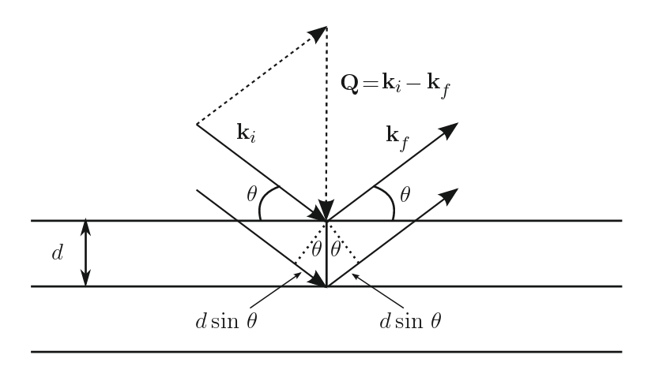
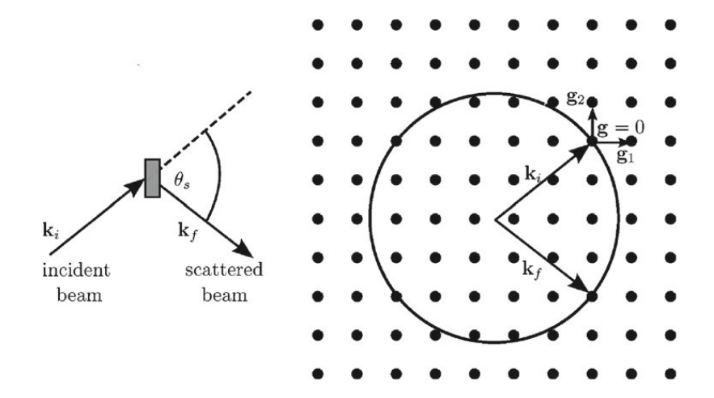

Bragg law and Von Laue condition
In crystalline systems the electron density n_{el}(r) is a periodic function, with the same periodicity of the underlaying Bravais lattice of the crystal.
As a result, the crystal form factors are different from zero only at the reciprocal lattice vectors G.
This means that diffraction peaks exist only if the momentum transfer Q vector coincides with a reciprocal lattice vector G (Laue diffraction condition):
Ewald construction
Bragg law

Slide 10
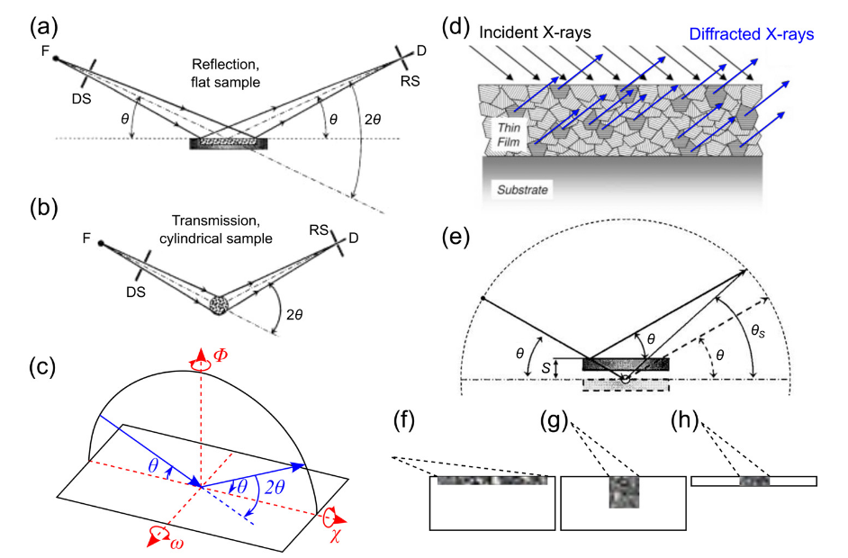
Laboratory based XRD
https://doi.org/10.1063/5.0076665
Bragg method (rotating crystal method): Incident radiation is monochromatic, but the crystal is rotated around a given axis (2θ scan) and "reflected" radiation is detected. Ewald sphere is fixed but the reciprocal lattice rotates: when points of the reciprocal lattice intercepts the Ewald sphere we have elastic diffraction.
Debye-Scherrer method (powder method): Incident radiation is monochromatic, sample is polycrystalline system, or powder, with random orientation of the crystallites. The detector is rotated in order to detect the transmitted radiation.
Note that in the Bragg method X-ray diffraction can be observed only fo crystal planes that are parallel to the sample stage:
orientation of the crystallites strongly affects the diffraction pattern
If the sample contains crystallites with all possible orientations of the crystal planes, the diffraction pattern will contain all possible peaks
If not, we can use XRD to ass the preferential alignement of the crystallites in the sample

Slide 11
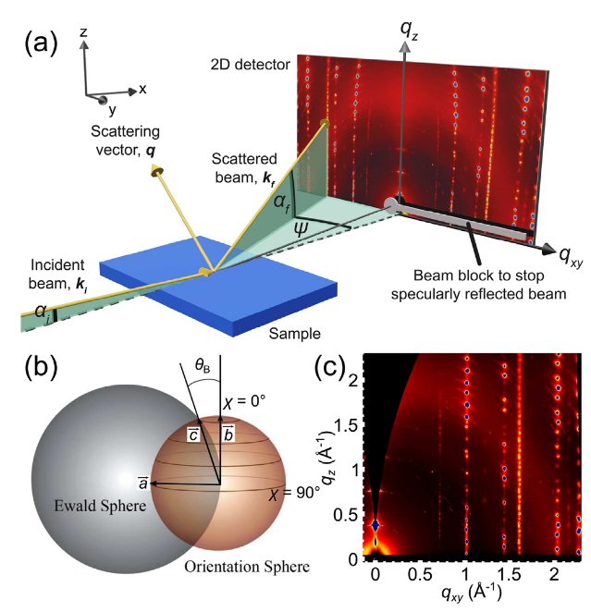
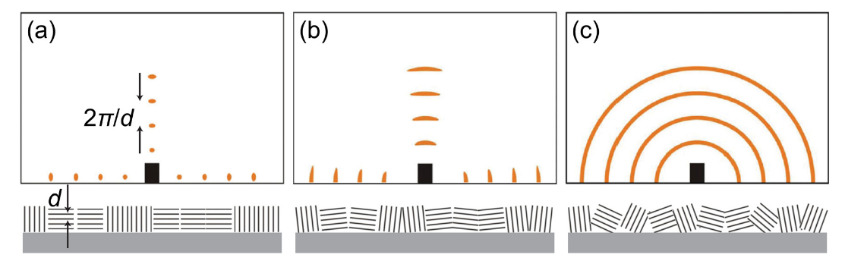
GIWAXS
https://doi.org/10.1063/5.0076665
X-ray diffraction exp. can be also performed using synchrotron-based techniques. Highly relevant for the sudy of the microstructure of thin-film samples is grazing-incidence wide-angle x-ray scattering (GIWAXS) technique.
Grazing incidence (α<1°) allows to increase the surface sensitivity w.r.t. the bulk.
Wide-angle x-ray scatering allows to probe ordered structures with sizes down to the atomic level
However, since scattering from the surface is very weak, the use of syncrotron radiation is necessary to obtain reliable data. Syncrotron radiation has also many othed advantages apart from the high brillance, such as X-ray energy tunability.
Use of a 2D detector at short distance from the sample (wide-angle setup)
2D scattering data come from the projection of the reciprocal lattice intersected with the Ewald sphere onto the detector plane. Curvature of the Ewald spaces causes distortion of the reciprocal space and the so called "missing wedge" in the vertical direction.
Map of the r.s. in 2D allowsto probe crystal planes with any orientation w.r.t. the substrate + info on preferred crystallite orientation
q_{z} axis scattering (parallel to substrate, same as Bragg method)
q_{xy} axis scattering (perpendicular to substrate)
45° off-axis (45° to substrate)

Slide 12
GIWAXS
https://doi.org/10.1063/5.0076665
X-ray diffraction exp. can be also performed using synchrotron-based techniques. Highly relevant for the sudy of the microstructure of thin-film samples is grazing-incidence wide-angle x-ray scattering (GIWAXS) technique.
Grazing incidence (α<1°) allows to increase the surface sensitivity w.r.t. the bulk.
Wide-angle x-ray scatering allows to probe ordered structures with sizes down to the atomic level
However, since scattering from the surface is very weak, the use of syncrotron radiation is necessary to obtain reliable data. Syncrotron radiation has also many othed advantages apart from the high brillance, such as X-ray energy tunability.
Use of a 2D detector at short distance from the sample (wide-angle setup)
2D scattering data come from the projection of the reciprocal lattice intersected with the Ewald sphere onto the detector plane. Curvature of the Ewald spaces causes distortion of the reciprocal space and the so called "missing wedge" in the vertical direction.
Map of the r.s. in 2D allowsto probe crystal planes with any orientation w.r.t. the substrate + info on preferred crystallite orientation
q_{z} axis scattering (parallel to substrate, same as Bragg method)
q_{xy} axis scattering (perpendicular to substrate)
45° off-axis (45° to substrate)
Hybrid perovskite material are highly crystalline and
GIWAXS pattern indexation is not trivial due to the large number of diffraction spots

Slide 13
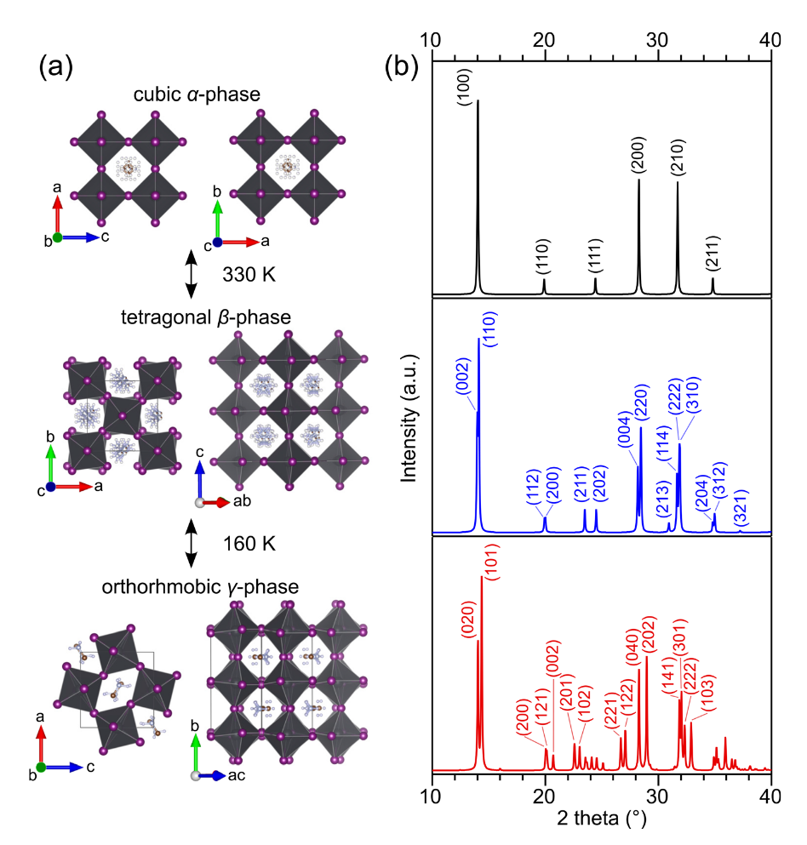
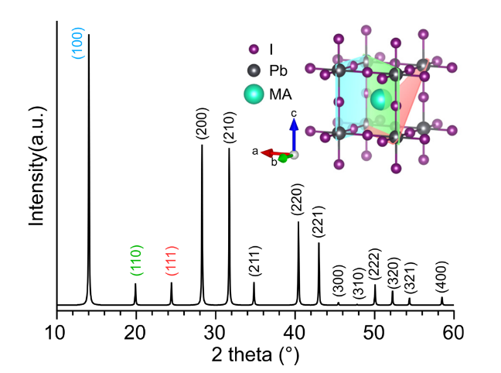
Structural phase identification
https://doi.org/10.1063/5.0076665
A typical XRD pattern is a 1D plot with diffraction angle (2θ) or q vector on the x-axis and diffraction intensity on the y-a​xis.
Each Bragg peak is indexed to a miller index (hkl).
The miller index (hkl) represents the crystal plane that intersects the three principal crystallographic axes at a distance 1/h 1/k and 1/l along the lattice vectors.
Reduced symmetry
Increaasing complexity
Simulated and indexed XRD pattern of MAPbI3 in its cubc phase. Inset contains representation of the crystal planes.
MA is indicated as a sphere for simplicity.

Slide 14
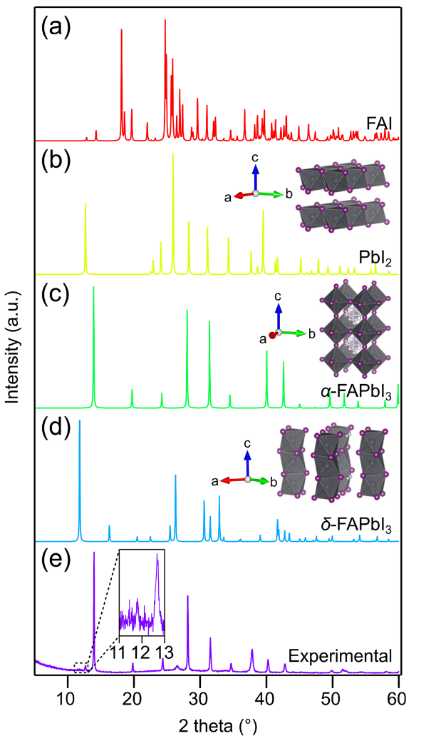
Structural phase identification
https://doi.org/10.1063/5.0076665
The position of the peaks provides information on the geometry of the unit cell. The relative intensities of the peaks provide information on the atoms/molecules within the unit cell, or the associated basis (phase identification)
XRD can also identify different materials in multi-component sample. For example, fabricated thin films with FAPbI₃ composition typically show coexistence of multiple and different crystal phases
As different phases exhibit different XRD patterns, we can use XRD to determine the phase-purity of the thin film.
However, the identification of different phases is not a trivial task. A valid phase identification usually requires comparison between experimental and simulated patterns in terms of position and relative intensities of the Bragg peaks.
Question: To which phase does the very weak peak at 2θ~11.8 correspond?
Notes:
Answer to the question for the students: the peak at 11.8 can be attributed either to a delta phase or to an excess PbI2, from the crystal plane (001)at 12.6 which is very nearby. However the strongest peak of PbI2 at 25 deg coming from (011) reflection is absent in the experimental XRD. So we answer that the peak corresponds to a weak delta-FAPbI3.
Note that the absence of peak at 25 for PbI2 could be due to preferred orientation effect, in principle. However, this is not a strong argument as GIWAX experiments show that exess PbI2 in perovskites mostly adopt the peferential out-of-plane orientation [001], resulting in a stronger (001) peak at 12.6.

Slide 15
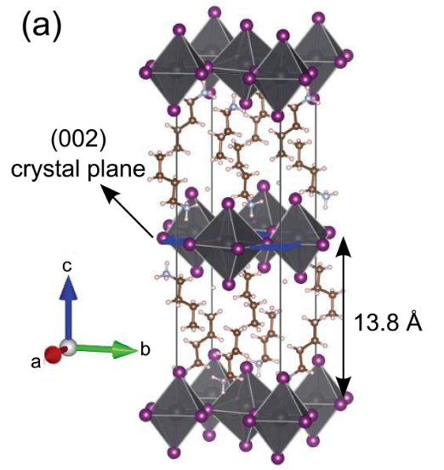
XRD of Layered perovskites
https://doi.org/10.1063/5.0076665
BA₂PbI₄ crystal structure
Notes:
Answer to the question for the students: the peak at 11.8 can be attributed either to a delta phase or to an excess PbI2, from the crystal plane (001)at 12.6 which is very nearby. However the strongest peak of PbI2 at 25 deg coming from (011) reflection is absent in the experimental XRD. So we answer that the peak corresponds to a weak delta-FAPbI3.
Note that the absence of peak at 25 for PbI2 could be due to preferred orientation effect, in principle. However, this is not a strong argument as GIWAX experiments show that exess PbI2 in perovskites mostly adopt the peferential out-of-plane orientation [001], resulting in a stronger (001) peak at 12.6.

Slide 16
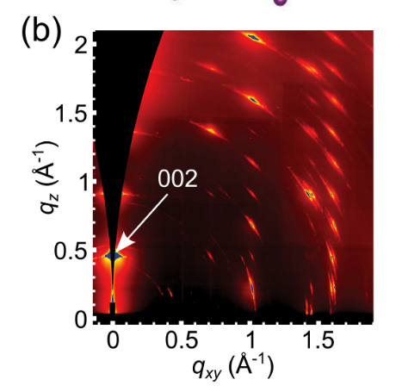
XRD of Layered perovskites
https://doi.org/10.1063/5.0076665
BA₂PbI₄ crystal structure
Typical XRD patterns of 2D perovskite show the appearance of "low-theta" or, equivalently, "low-q" peaks, corresponding to first order reflections from the inorganic layer seprated by a distance d ~ 2π/q
Notes:
Answer to the question for the students: the peak at 11.8 can be attributed either to a delta phase or to an excess PbI2, from the crystal plane (001)at 12.6 which is very nearby. However the strongest peak of PbI2 at 25 deg coming from (011) reflection is absent in the experimental XRD. So we answer that the peak corresponds to a weak delta-FAPbI3.
Note that the absence of peak at 25 for PbI2 could be due to preferred orientation effect, in principle. However, this is not a strong argument as GIWAX experiments show that exess PbI2 in perovskites mostly adopt the peferential out-of-plane orientation [001], resulting in a stronger (001) peak at 12.6.

Slide 17
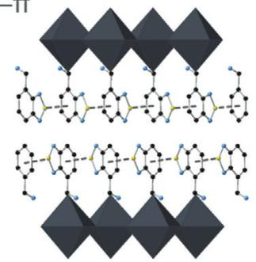
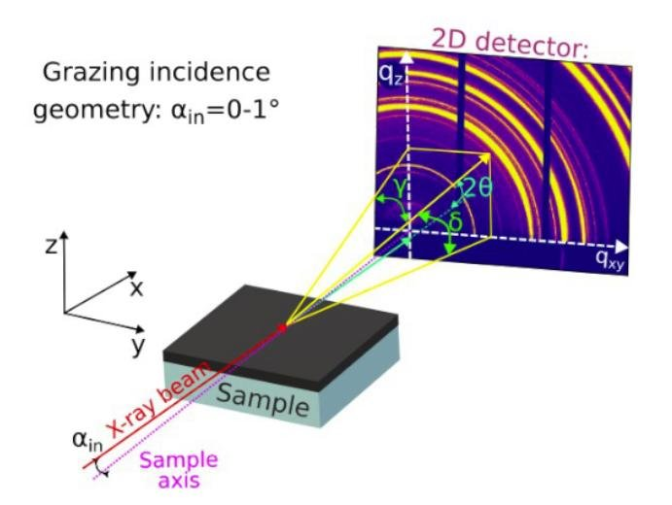
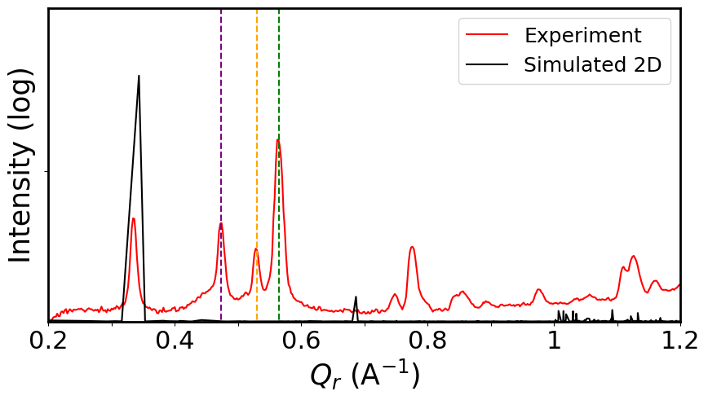
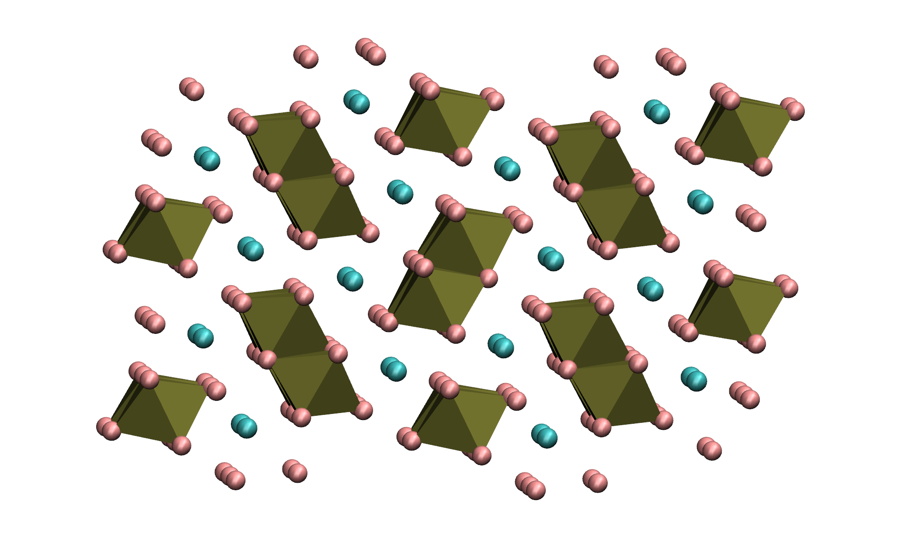
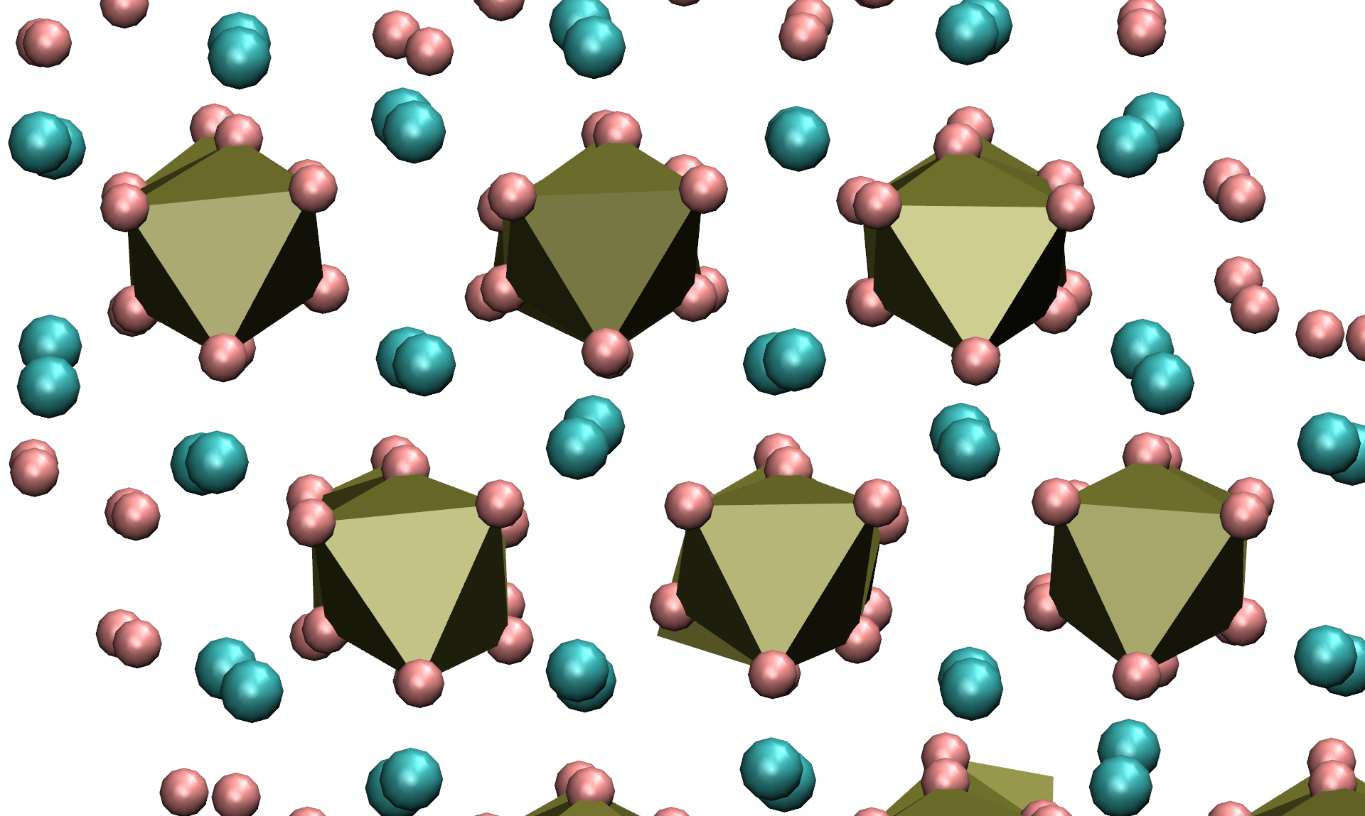
XRD of layered perovskites
https://doi.org/10.1002/advs.202405622
2D n=1
Layered perovskite thin films are rarely phase pure, especially for n>1. Multiple phases coexist that are to be indexed through the comparison of simulated and experimental XRD patterns.
Inter-layer
distance
2D
(a),(b) - LD 1D
1D
(c)
(a)
(b)
(c) - (BTDZ)PbI3 1D

Slide 18
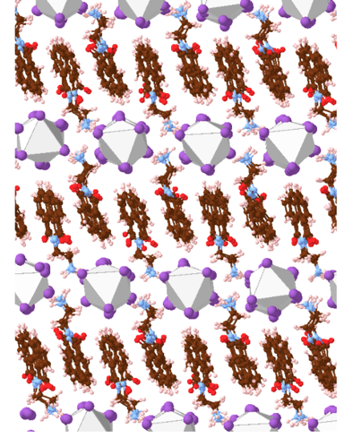
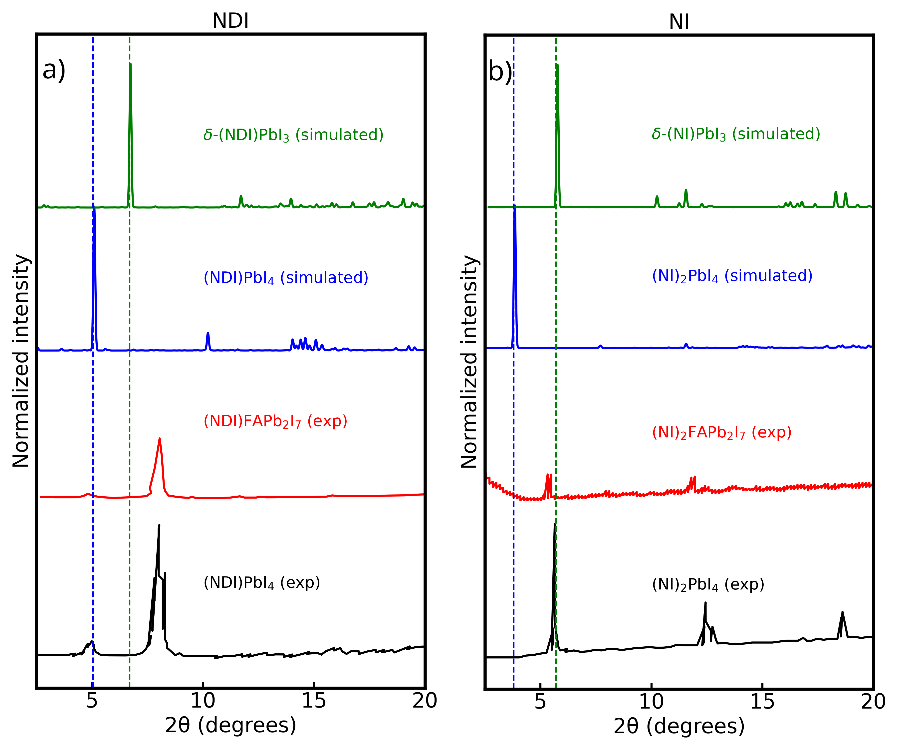
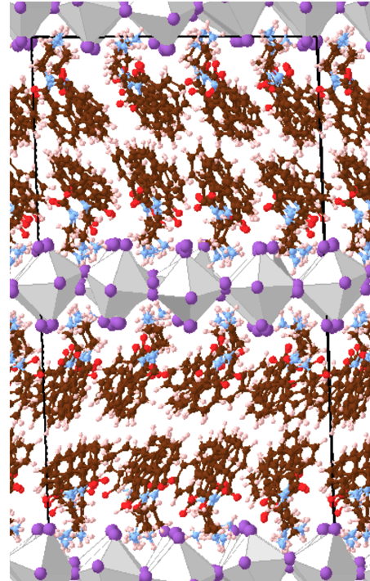
XRD of layered perovskites
1D delta-phase
2D-RP phase

Slide 19



NMR
Atkins, P. W., De Paula, J., & Keeler, J. (2023). Atkins' physical chemistry. Oxford university press.
How the energies of the nuclei depend on an external magnetic field?
According to QM nuclei have spin angular momentum I with spin quantum number I:
Magnitude
Component along a chosen quantization axis
Spin multiplicity is given by 2I+1 (example: ¹⁴N has I=1 and three possible values for the magnetic quantum number m. ¹⁶O has I=0 and zero magnetic moment).
Energy of interaction with a magnetic field
The interaction energies of the nuclear spin with magnetic fields is 2000 times smaller as compared to electrons!

Slide 20
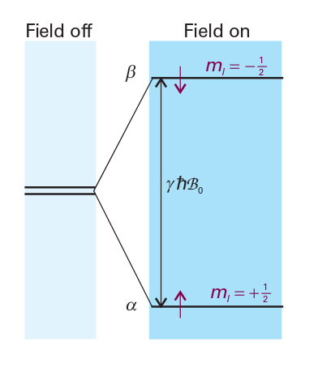
NMR
Atkins, P. W., De Paula, J., & Keeler, J. (2023). Atkins' physical chemistry. Oxford university press.
How does NMR work?
Nuclear magnetic resonance
Study of materials containing magnetic nuclei by applying a magnetic field and observing the frequency of the resonant electromagnetic field
Resonance condition
Typical larmor frequency at B=12 T ~ 500 MHz => NMR is a radiofrequency technique
NMR transition intensity ∝ (N_{α} - N_{β}) B₀
(N_{α} - N_{β}) ~ (N γ ℏ B₀) / (2 k T)
N = N_{α} + N_{β}
Decreasing T increases the intensity by increasing the population difference
Intensity grows with the square of the applied magnetic field
Absorption from nuclei with large magnetogyric ratios are more intense

Slide 21
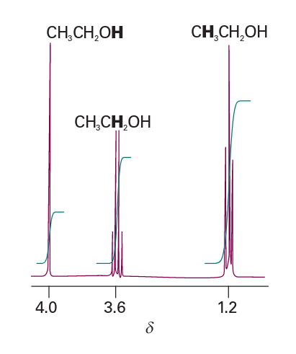
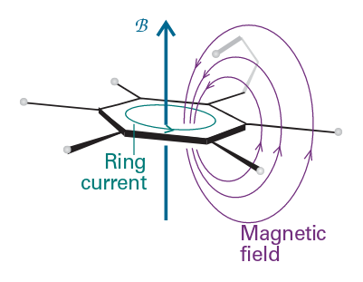
NMR
Atkins, P. W., De Paula, J., & Keeler, J. (2023). Atkins' physical chemistry. Oxford university press.
Nuclear magnetic moments interacts with local magnetic fields
The local field is different from the applied field as the external field induces circulation of electronic currents which generate additional magnetic field δB at the nuclei
The (dimensionless) quantity σ is called shielding constant.
We expect different chemical groups to have different σ because their electronic structure near the nucleus is different
If we refer the shielding constant σ with respect to a reference standard σ₀, we can define the chemical shift as
Nuclei with large chemical shift are said to be strongly deshielded
Example CH₃CH₂OH: the O atom reduces the electron density of the closest OH proton. As a result, this proton exhibit a larger δ (more deshielding) as compared to the methyl protons that are further away from the oxygen (less deshielding).
Example benzene ring: protons attached to the ring are deshielded, the hydrogen above the ring is shielded.
ΔB = - σ B₀
δ = (σ₀ - σ) x 10⁶

Slide 22
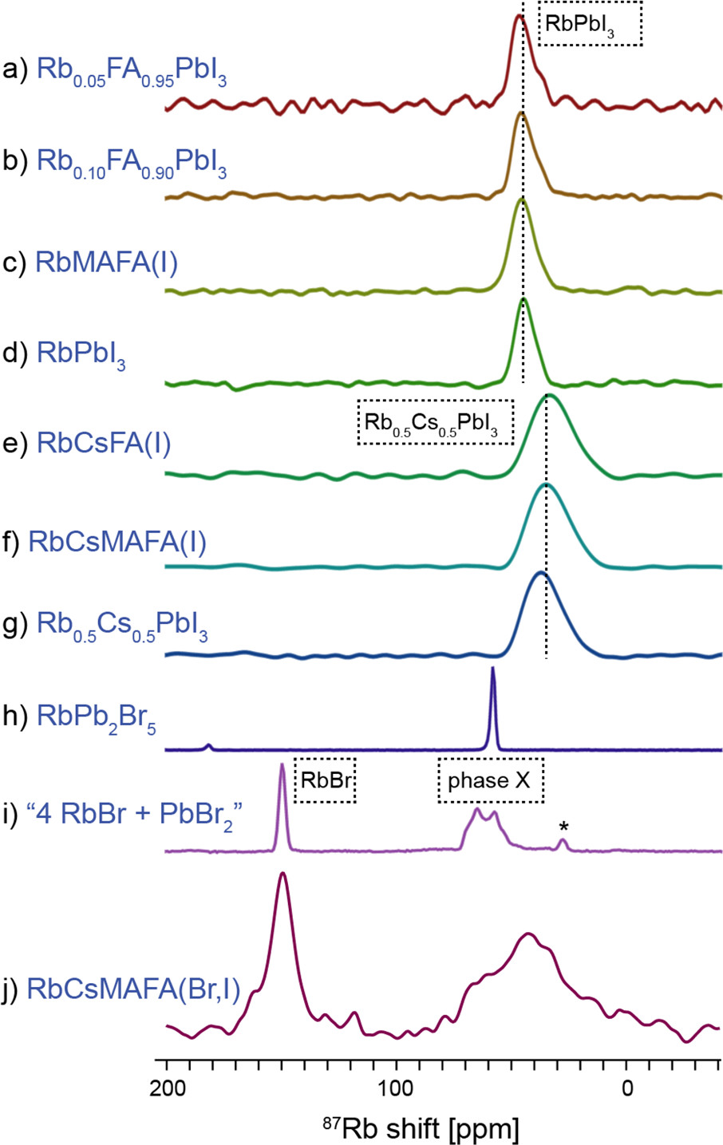
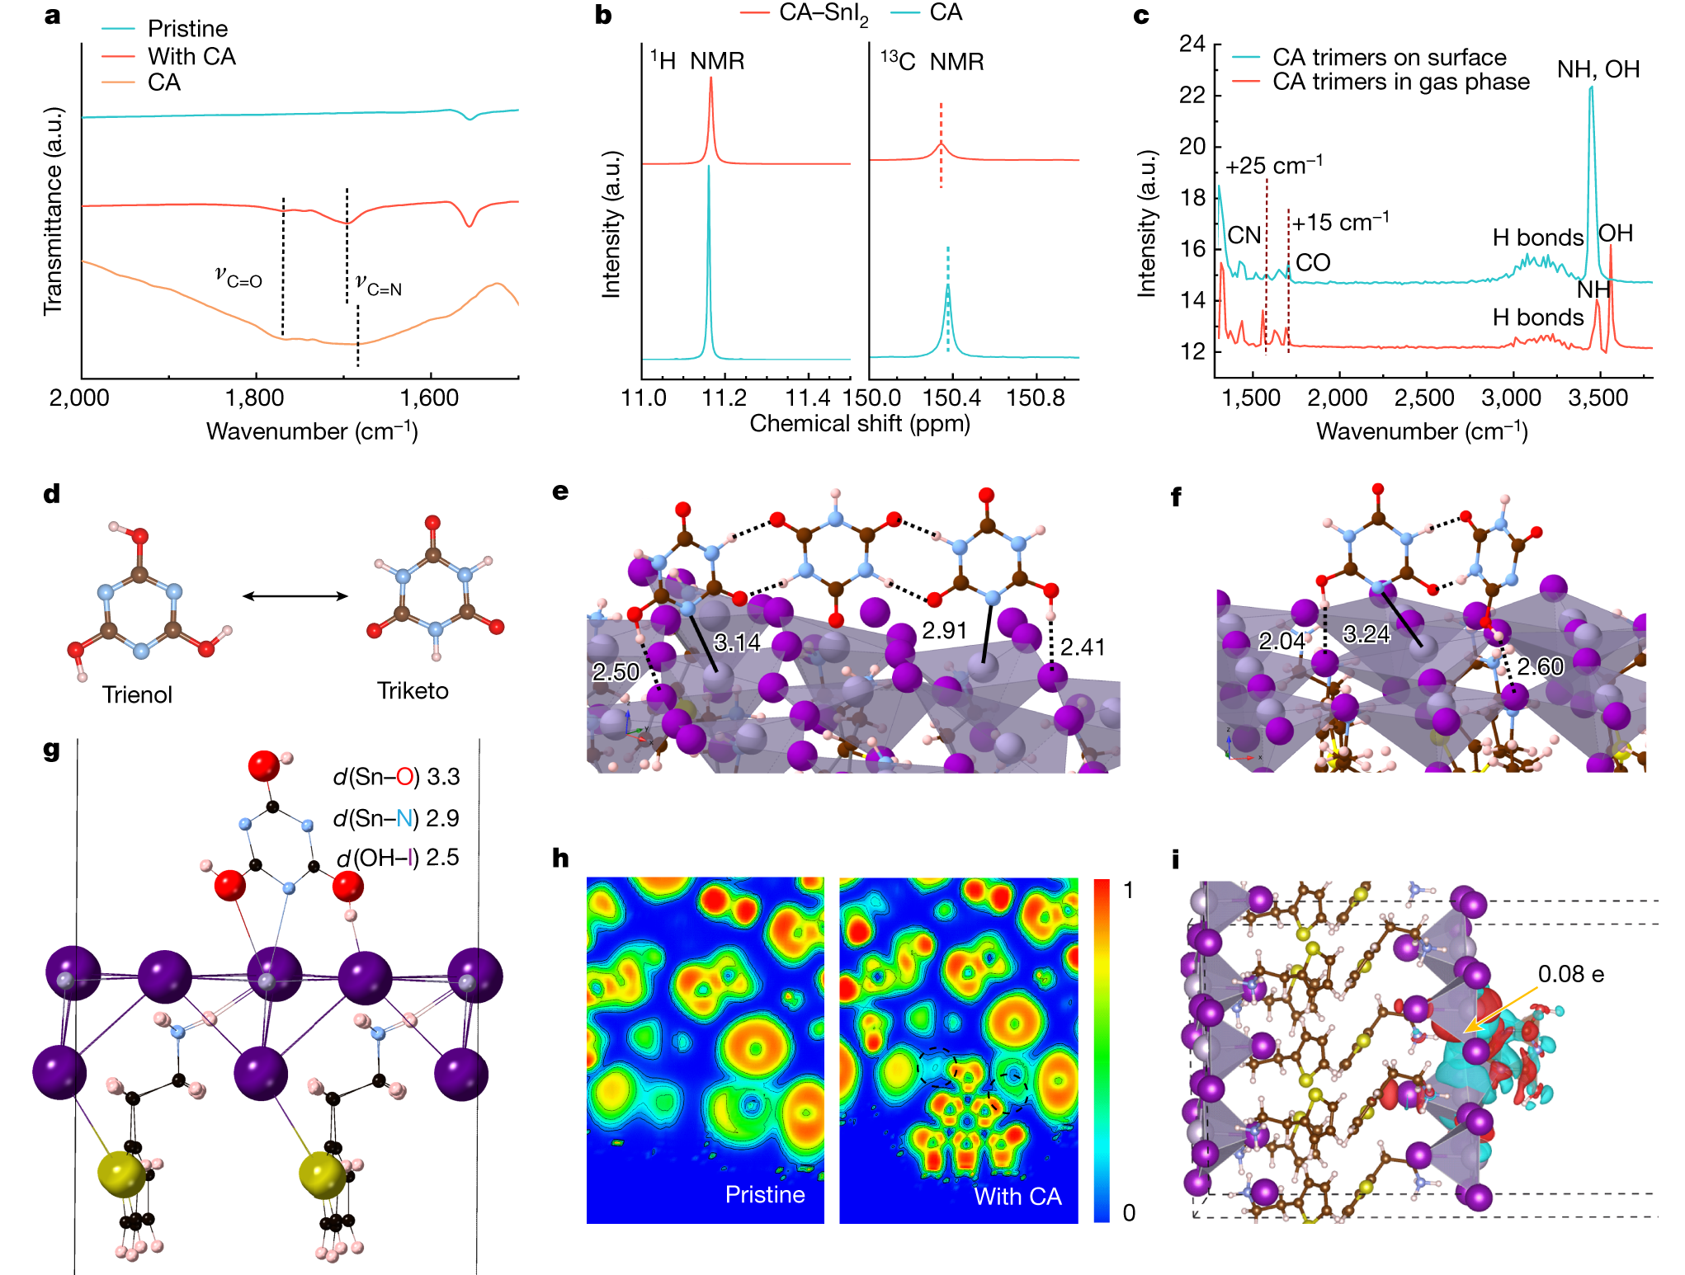
NMR
https://doi.org/10.1038/s41586-023-06514-6 https://doi.org/10.1021/jacs.7b07223
Chemical shift of the resonance signal of CA Hydrogen bond formation N=C–OH⋯I⁻
The broad resonance signal of SnI₂-CA CA is immobilized by the N=C–OH⋯I⁻
Element incorporation/phase identification of perovskite crystalline structures

Slide 23
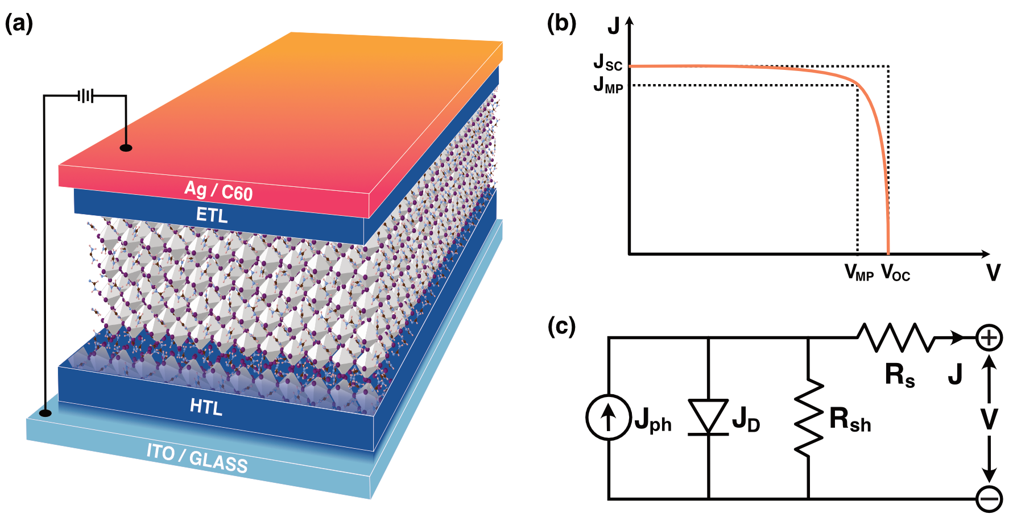


Power Conversion Efficiency (PCE)
Short-circuit current density
$$PCE=\frac{P_{out}}{P_{in}}=\frac{J_{sc}V_{oc}FF}{P_{in}}$$
Maximum power current density
$$FF=\frac{J_{MP}V_{MP}}{J_{sc}V_{oc}}$$
J_{sc}
Maximum power voltage
Open circuit voltage
– absorption characteristics of the photoactive layer
– charge generation and charge transport
– charge extraction efficiency
V_{oc}
FF
– energy levels of the photoactive materials
– resistance due energetic barriers at ETL/AL/HTL interfaces
– work functions of the electrode materials
– bulk resistance within the layers
– charge carrier recombination rate
– exciton recombination

Slide 24

Solar cell equivalent circuit
https://doi.org/10.1038/s41558-020-00939-x https://doi.org/10.1038/s41586-018-0173-4
EQUIVALENT CIRCUIT
J_{D} – diode current
Solar cell can be model as a diode.
$$FF=\frac{J_{MP}V_{MP}}{J_{sc}V_{oc}}$$
R_{s} – series resistances
Energetic barriers at interfaces and bulk resistances within layers. It must be minimized to avoid efficiency losses due to increased exciton recombination.
Ideally ~ 1
R_{sh} – shunt resistance
Existence of alternate current paths through a solar cell It should be as high as possible to prevent current leakage through these alternate paths.
R_{s} ~ 0
R_{sh} ~ ∞

Slide 25
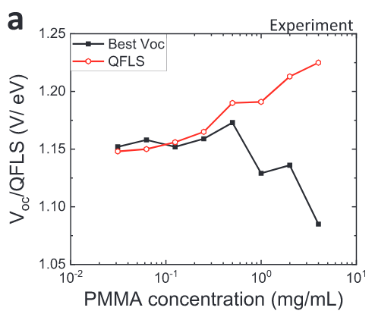

Quasi-Fermi Level Splitting (QFLS)
https://doi.org/10.1002/aenm.202303135
QFLS – excited e⁻ in the CB and corresponding h⁺ in the VB have different chemical potential.
Related to the internal potential of semiconductor.
Depends on the population of the exited e⁻ and h⁺.
Increasing the excited carrier population in the bands increases the difference in chemical potential between e⁻ and h⁺, which generates an internal voltage.
Generation current
$$QFLS=k_{B}T \ln\left(PLQY ×\frac{J_{G}}{J_{0,rad}}\right)$$
Radiative current in the dark
QFLS & V_{oc} are related – ideally QFLS ≈ V_{oc}
Bottlenecks are non-radiative recombination losses, non-selective charge collecting layers, resistances at the ETL/AL/HTL interfaces.

Slide 26
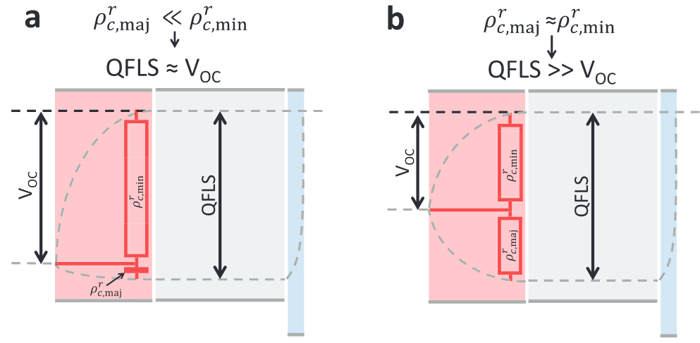





Quasi-Fermi Level Splitting (QFLS)
Metallic electrodes / degenerated doped semiconductors – QFL has to collapse
https://doi.org/10.1002/aenm.202303135
$$\frac{V_{oc}}{QFLS}=\frac{ρ_{c,min}^{r}}{ρ_{c,min}^{r}+ρ_{c,maj}^{r}}=S_{e,maj}$$
$$ρ_{c,min}^{r} /ρ_{c,maj}^{r}$$
Device contact resistances for majority and minority carries
$$S_{e,maj} ∈\{0,1\}$$
HTL
AL
ETL
HTL
AL
ETL
Selectivity for majority carries
AL
ETL
e⁻/h⁺ electrical current density at each point in the devices
$$J_{e/h}=J_{e/h, drift}+J_{e/h, diff}=−/+\frac{σ_{e/h}∇E_{f,e/h}}{e}$$
V_{oc} steady state
$$J=J_{e}+J_{h}=0 →J_{h}=−J_{e}=J_{R}$$
Recombination current
$$\frac{σ_{h}}{σ_{e}}=−\frac{∇E_{f,e}}{∇E_{f,h}}$$
At V_{oc}, e- and h+ QFL gradients are inversely proportional to the ratio of the carriers’ conductivities.

Slide 27
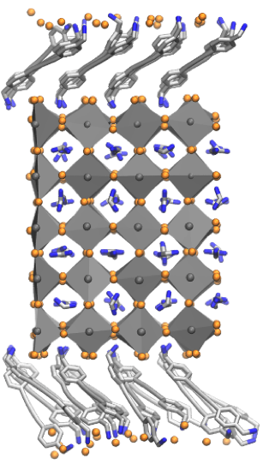
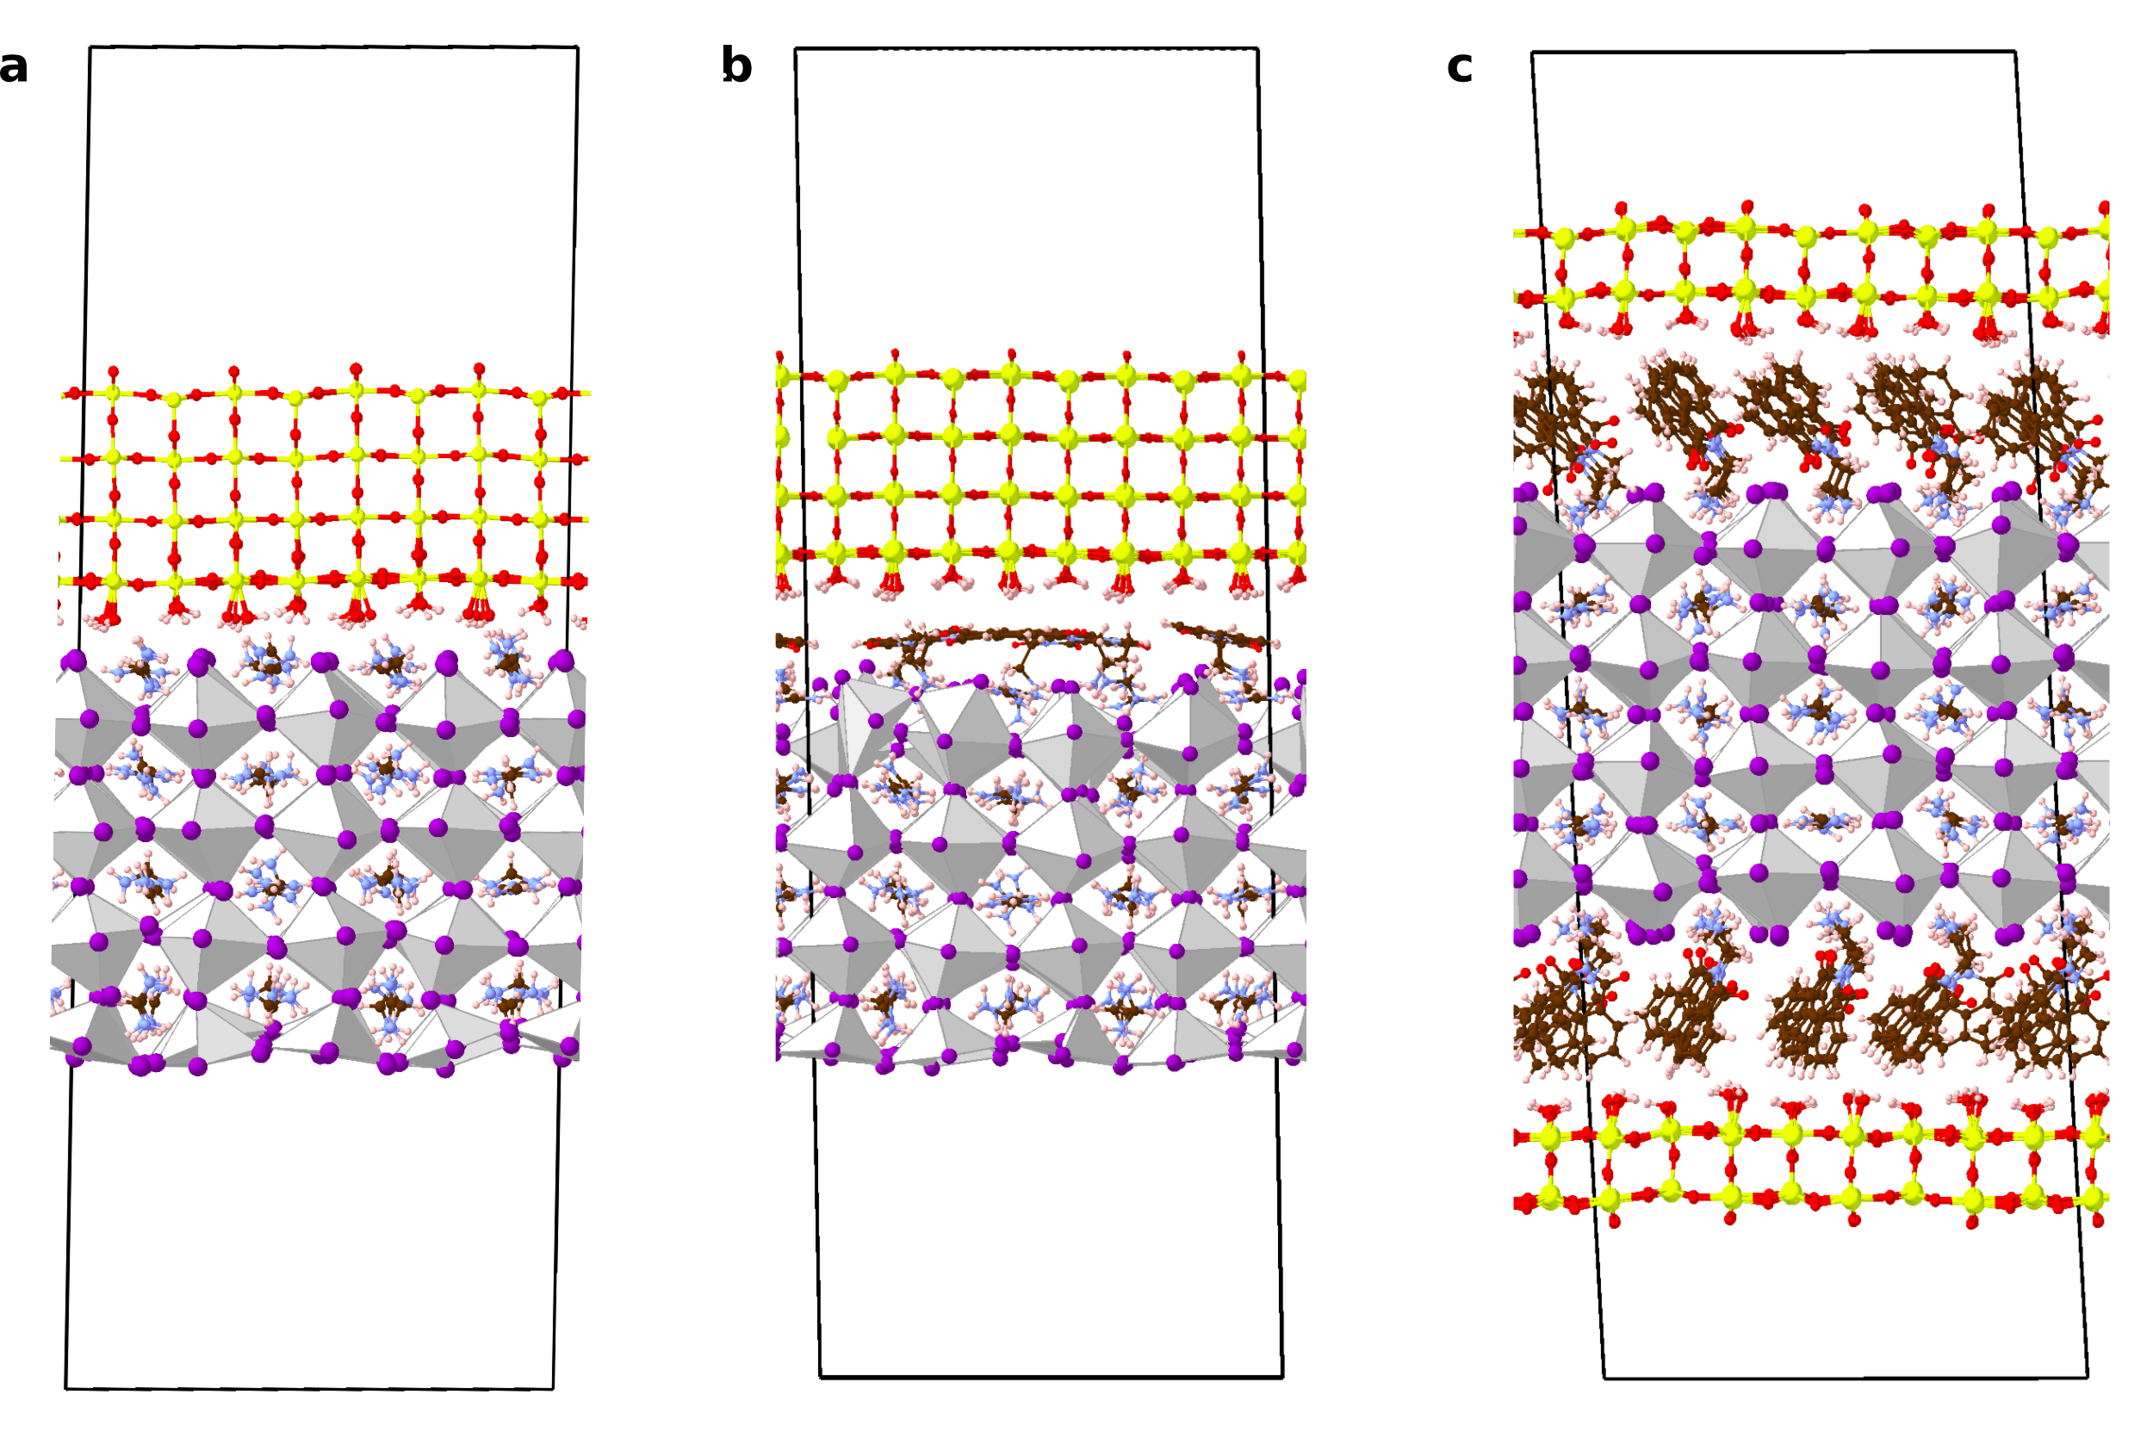
V_{oc}-QFLS mismatch in PSC
https://doi.org/10.1002/aenm.202303135
https://doi.org/10.1002/ange.202417432
BNMA
3D perovskite mobility ~1 cm²V⁻¹s⁻²
2D/3D perovskites Very low out-of-plane mobility: carriers do not diffuse fast enough to the interface, and rapid non-radiative recombination
FAPbI₃
HTL
AL
ETL
Large offset for the majority carriers Contact region without energetic selectivity
Passivator layer with strong dipole Reducing of QFLS-V_{oc} mismatch
Energy injection barrier formation
The majority carriers go back into perovskites
Built-in field reduction across the device
SnO₂
FAPbI₃
HTL
AL
ETL

Slide 28
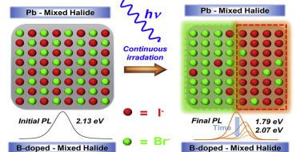
V_{oc}-QFLS mismatch in PSC
https://doi.org/10.1002/aenm.202303135
https://doi.org/10.1016/j.isci.2020.101415
Passivator layer thickness Carriers’ density at the interface become more similar, increasing the interface recombination
HTL
AL
ETL
Light soaking and ion migrations Charge accumulation that is detrimental for the internal functioning of the device; charges’ resistivities become more similar
HTL
AL
ETL

Slide 29
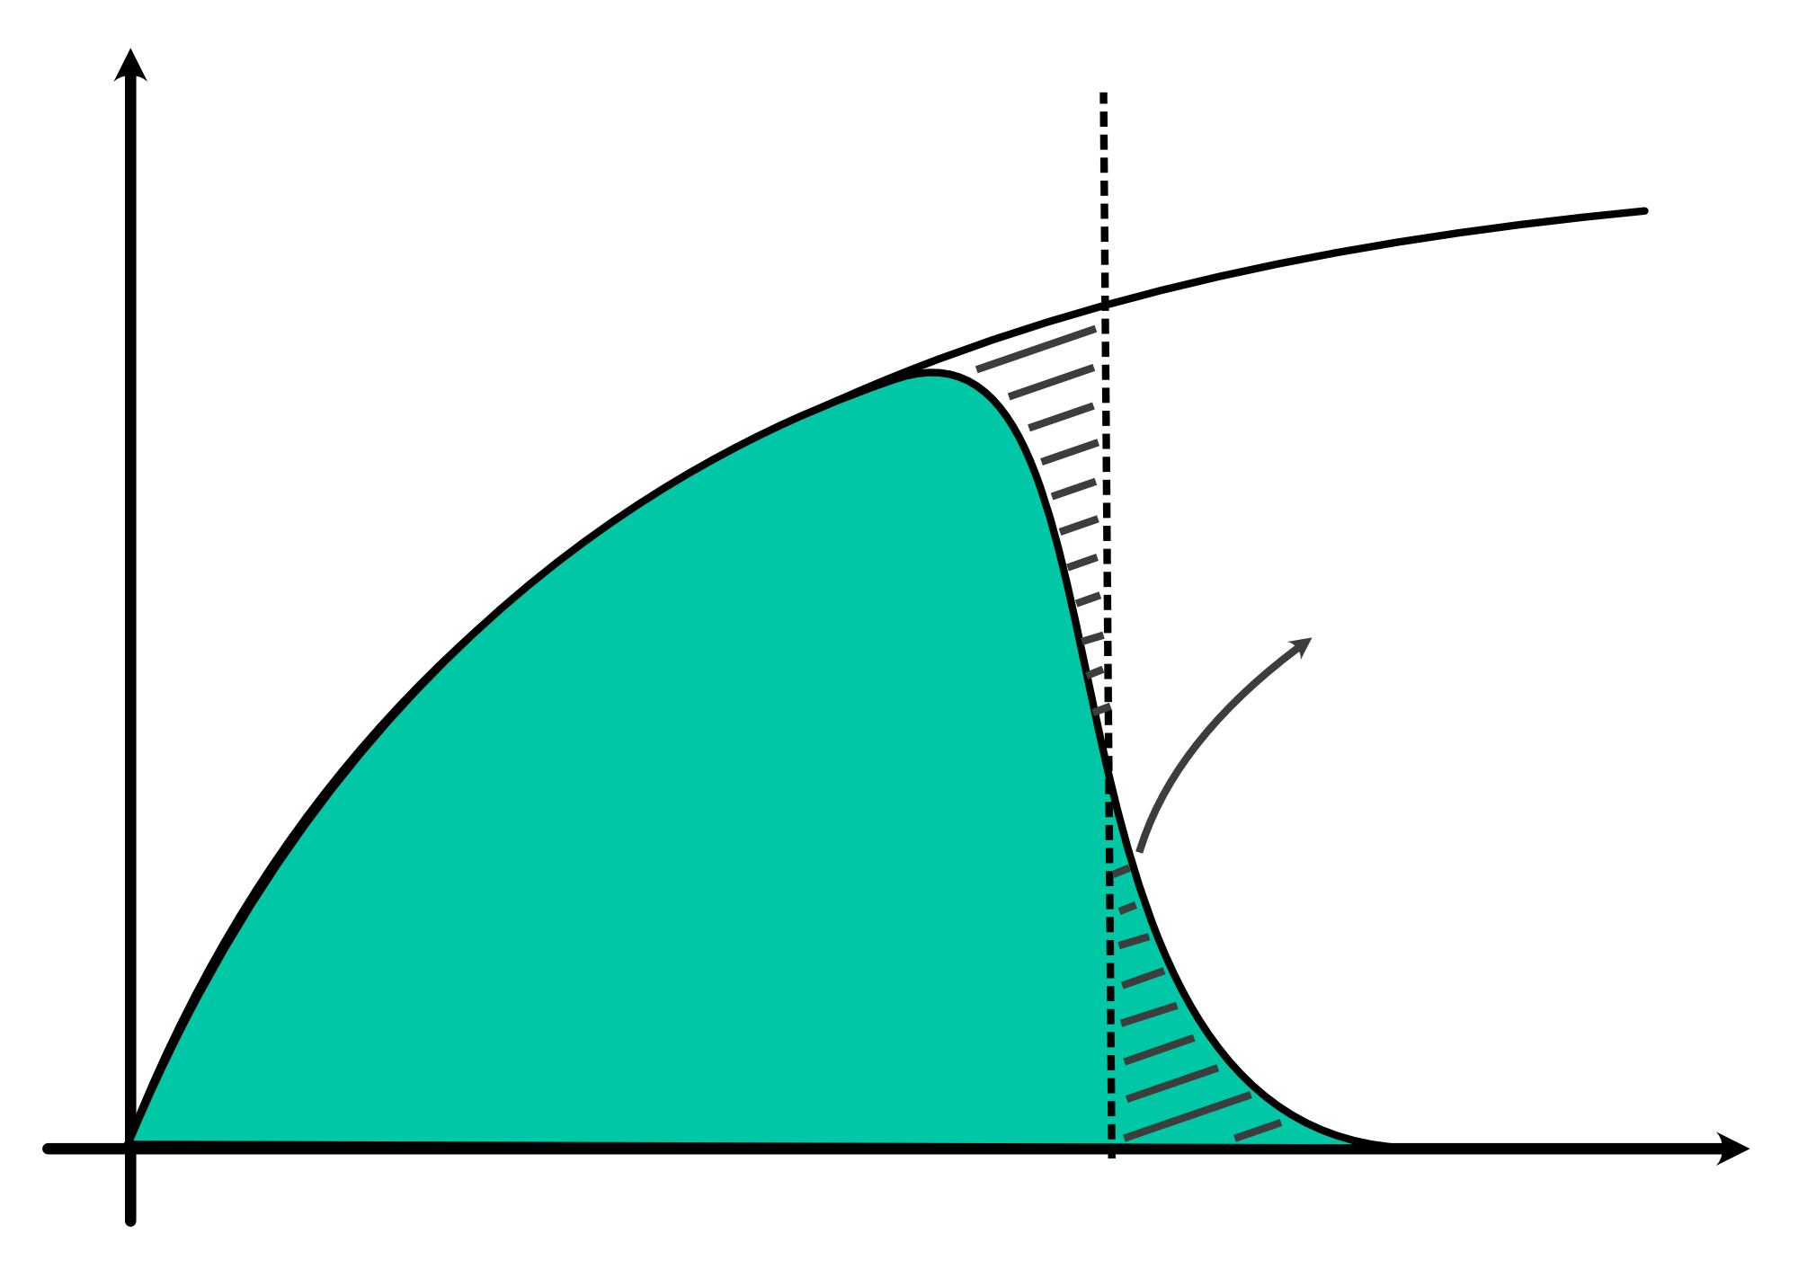




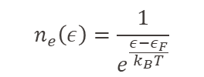









Charge carriers
Free electron model – free e⁻ confined into a cubic box of side L
$$\hat{H}=−\frac{ℏ^{2}}{2m}∇^{2}$$
$$k=\left(\frac{2πn_{x}}{L},\frac{2πn_{y}}{L},\frac{2πn_{z}}{L}\right)$$
$$ψ_{k}\left(r\right)=Ae^{ik⋅r}$$
Hamiltonian
Solution
Boundary conditions
$$ε_{k}=\frac{ℏ^{2}k^{2}}{2m}$$
$$N\left(ε\right)=\frac{V}{2π^{2}}{\left(\frac{2mε}{ℏ^{2}}\right)}^{\frac{3}{2}}$$
$$g\left(ε\right)=\frac{dN\left(ε\right)}{dε}=\frac{V}{2π^{2}}{\left(\frac{2m}{ℏ^{2}}\right)}^{\frac{3}{2}}\sqrt{ε}$$
$$→$$
Energy eigenvalues
# orbitals up to $ε_{k}$
# orbitals / $ε_{k}$ (Density of states)
$$\tilde{g}\left(ε_{k}\right)$$
$$n_{e}\left(ε\right)=\frac{1}{e^{\frac{ε−ε_{F}}{k_{B}T}}}$$
$$n_{e}(ε)g\left(ε\right)=n$$
Fermi-Dirac distribution
$$ε_{F}$$
$$ε_{k}$$

Slide 30
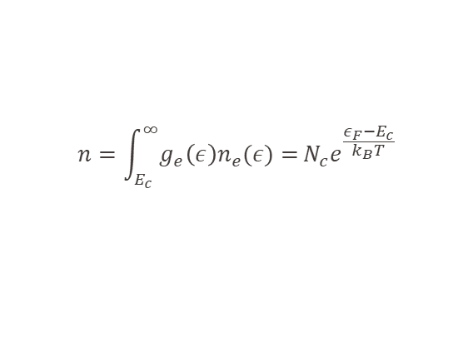











Charge carriers
-
$$g_{e}\left(ε\right)=\frac{V}{2π^{2}}{\left(\frac{2m_{e}}{ℏ^{2}}\right)}^{\frac{3}{2}}\sqrt{ε−E_{c}}$$
$$g_{h}\left(ε\right)=\frac{V}{2π^{2}}{\left(\frac{2m_{h}}{ℏ^{2}}\right)}^{\frac{3}{2}}\sqrt{E_{v}−ε}$$
CB
Carriers’ density at equilibrium:
$$n=\int_{E_{c}}^{∞}{g_{e}\left(ε\right)n_{e}(ε)=}N_{c}e^{\frac{ε_{F}−E_{c}}{k_{B}T}}$$
$$p=\int_{−∞}^{E_{v}}{g_{h}\left(ε\right)n_{h}(ε)=}N_{h}e^{\frac{E_{v}−ε_{F}}{k_{B}T}}$$
+
VB
$$ε_{F}=\frac{E_{g}}{2}+\frac{3}{4}k_{B}T\ln\left(\frac{m_{h}}{m_{e}}\right)$$
$n⋅p=N_{c}N_{v}$ $e^{\frac{−E_{g}}{k_{B}T}}=n_{i}^{2}$
Low-temperature regime
$$ε−ε_{F}≫k_{B}T$$
Carriers’ density at out-of-equilibrium:
$$ε_{c}=E_{c}+\frac{ℏ^{2}k^{2}}{2m_{e}}$$
$$n=N_{c}e^{\frac{E_{Fc}−E_{c}}{k_{B}T}}$$
$$p=N_{h}e^{\frac{E_{v}−E_{Fv}}{k_{B}T}}$$
$$ε_{v}=E_{v}−\frac{ℏ^{2}k^{2}}{2m_{h}}$$
$n⋅p=N_{c}N_{v}$ $e^{\frac{E_{FC}−E_{c}}{k_{B}T}}e^{\frac{E_{v}−E_{Fv}}{k_{B}T}}$
Related to V_{oc}
Notes:
See Grosso ch.10

