Slide 1

Advanced simulations of solar cell devices
V. Carnevali,
V. Slama,
A. Vezzosi
École Polytechnique fédérale
de Lausanne
February 19, 2025

Slide 2
Objectives & exam format
Objectives
– functioning principles of a solar cell
– basic understanding of the experimental methods and results
– understanding of how to simulate a periodic system at the quantum mechanical and classical level
– designing computational strategies to break down the complexity of a real solar cell device into realistic and affordable simulations
Exam format
– assigned project + final presentation (10 min) followed by discussion (~10 min: 5 min about the presentation, 5 min about the course)
The project can be decided together. We will have some proposals according to our ongoing/completed research, but we can find something related to your interests.

Slide 3
Tentative program
Introduction
– solar cell design
– charge evolution in the device
– main experiments for solar cell characterization (TRPL,PYQL, XRD, NMR)
Quantum
– introduction on electronic structure calculations with the focus on solar cells and periodic systems
– introduction on perovskites and influence of the most common defects on the electronic properties and stability
– surface stability & finite temperature simulations
– band alignment, transport properties, molecular orbitals
– ETL/AL/HTL interfaces
Classical
– force field parametrization/adjustment
– conformational sampling and system equilibration as good QM starting point for the system
– mechanistic properties (young modulus etc.)
ML
– how to efficiently parametrize a ML force field
– application to solar cells

Slide 4
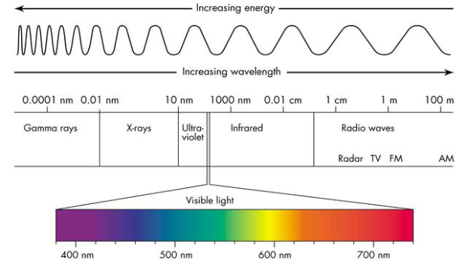
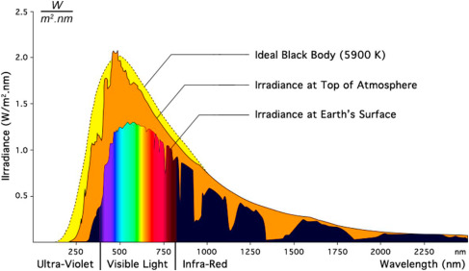
Renewable energy
Challenge of the 21st century is the production of enough clean energy.
< 0.1% energy generated from solar radiation.
1.54 - 1.31 eV
PV limitations
– high cost / low efficiency
solar cells
https://www.nrel.gov/pv/cell-efficiency.html
U.S. Energy Information Administration
https://doi.org/10.1016/B978-0-443-18786-5.00002-0

Slide 5
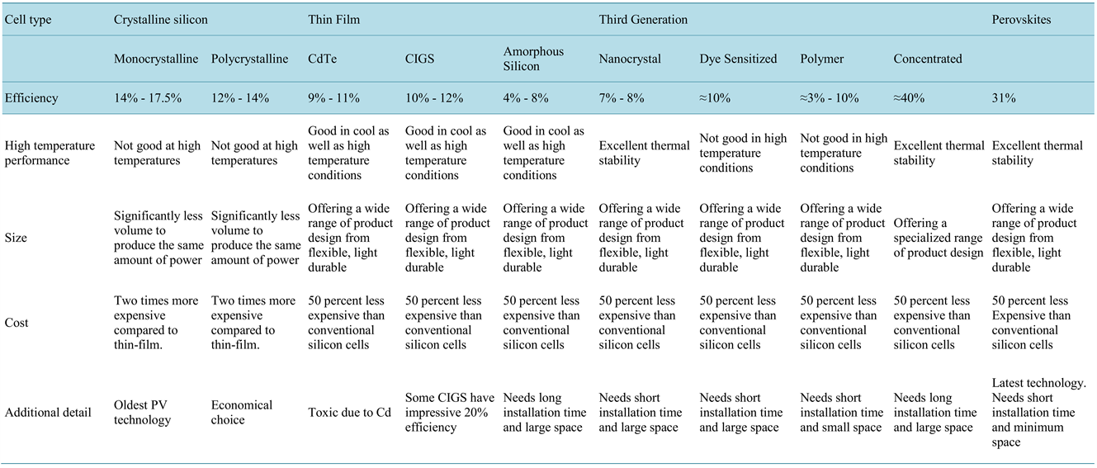
Solar cell generations
10.4236/msa.2015.612113

Slide 6
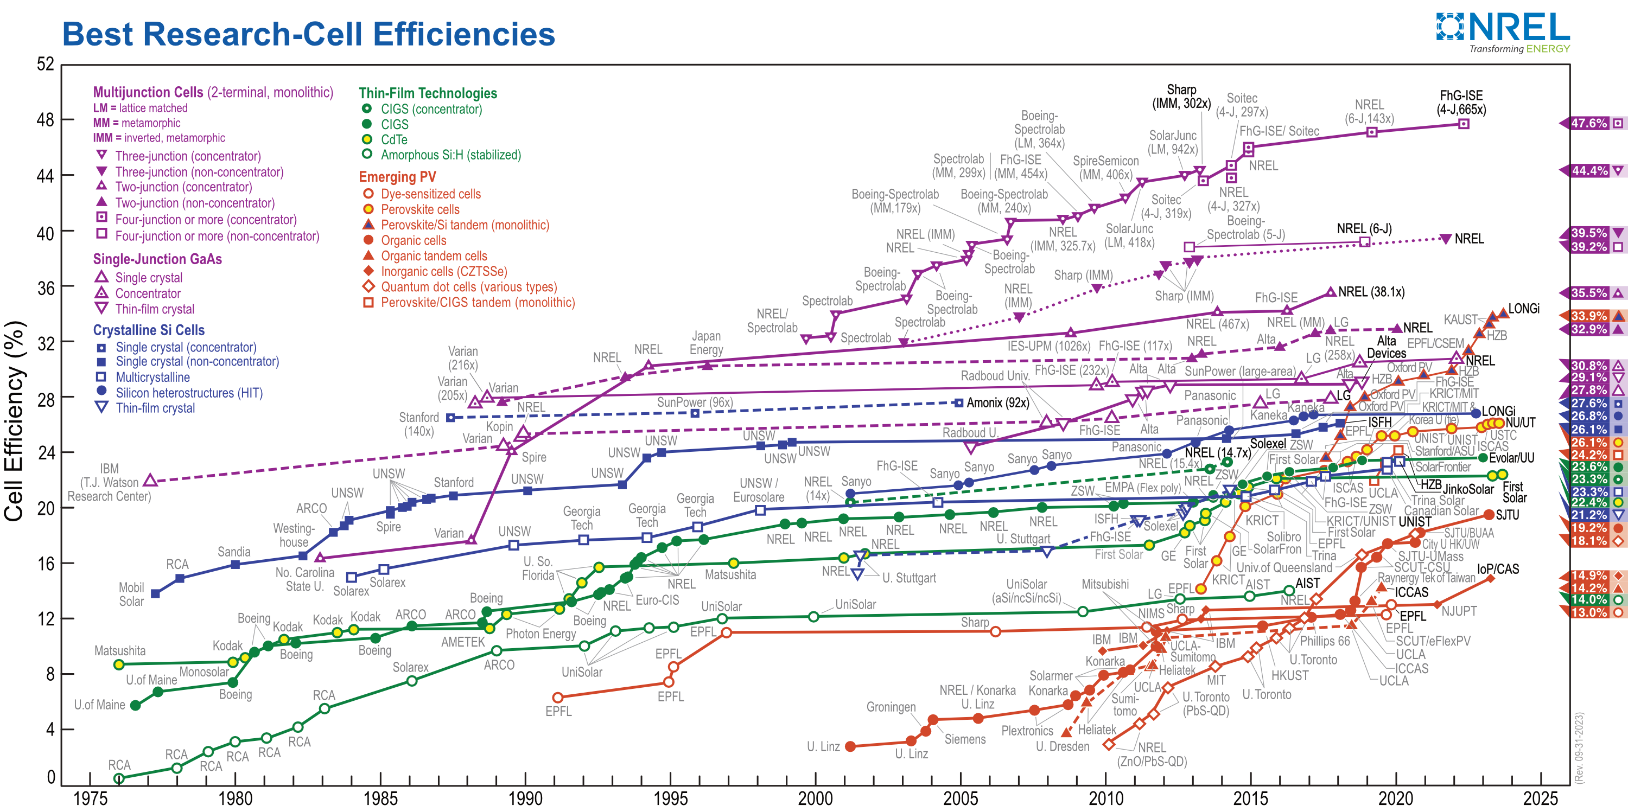
Solar cell generations
https://www.nrel.gov/pv/cell-efficiency.html

Slide 7
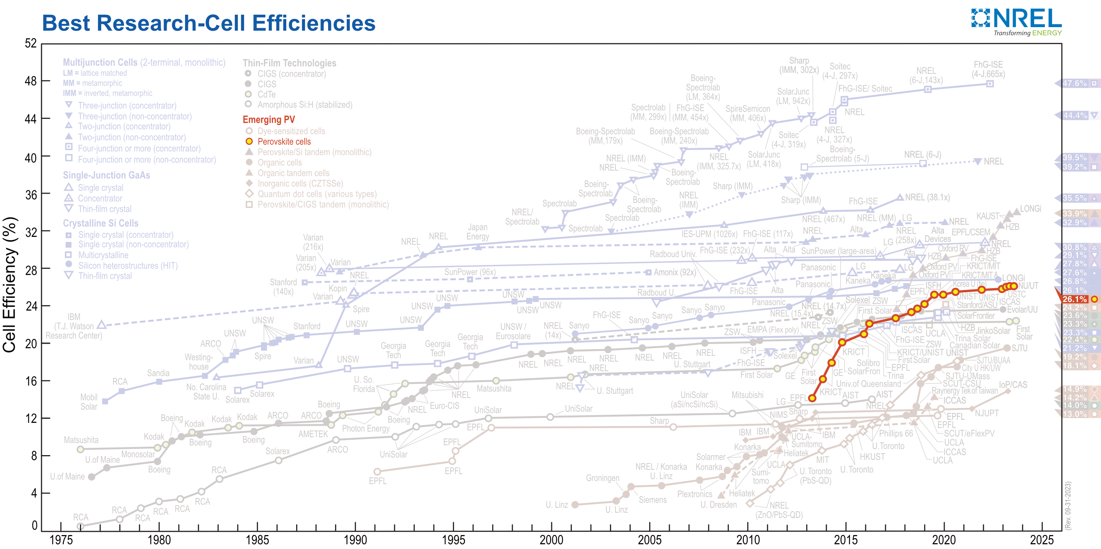
Solar cell generations
https://www.nrel.gov/pv/cell-efficiency.html

Slide 8
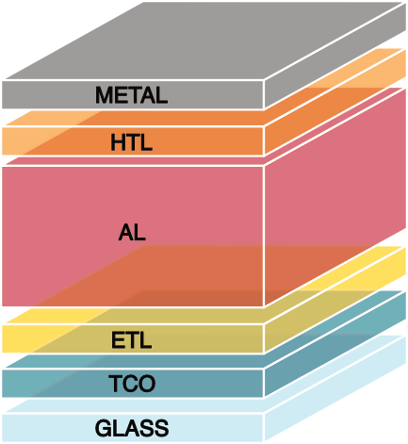
Perovskite solar cell
Active layer
(perovskite, AL)
Core of the solar cell, where the light is absorbed, and the free charges are generated.
Electron transport layer
(ETL)
Collects electrons generated by AL.
PCBM, SnO₂, TiO₂, ZnO …
Hole transport layer
(HTL)
Collects holes generated by AL.
SPIRO, NiOx, FTO, graphene …
Electrodes
Terminals that connect the cell to the external circuit (top & bottom). At least one electrode must be transparent

Slide 9
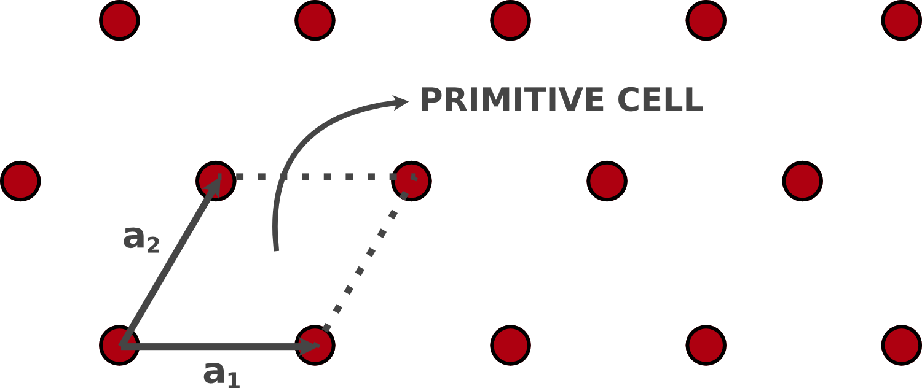
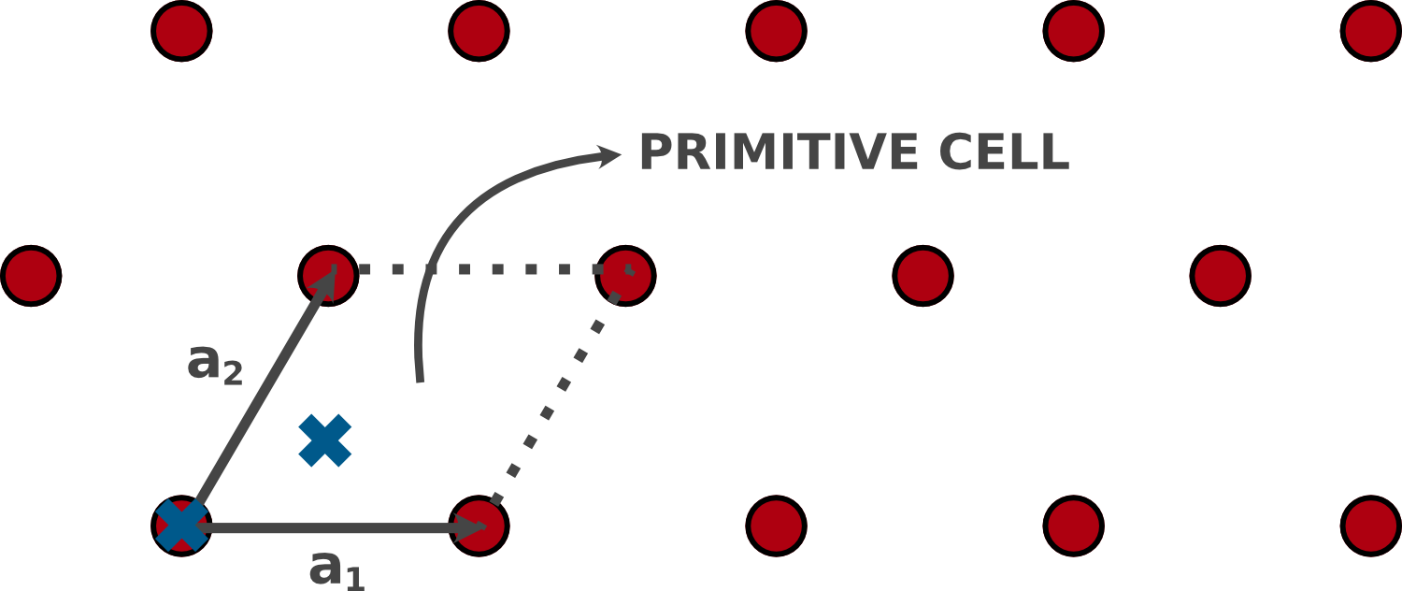


What is a material?
Material – collection of interacting atoms
Nucleus: neutrons, protons (+)
Electrons (-)
MATERIALS
ORDERED
DISORDERED
QUASI
CRYSTALS
CRYSTALS
AMORPHOUS
Crystals – atoms arranged through the symmetries of the Bravais lattice + basis
Primitive cell – cell with the minimum volume that accommodates all the symmetry of the crystal
$R=n_{1}a_{1}+n_{2}a_{2}+n_{3}a_{3} , n_{i}∈ℤ$
$${\hat{T}}_{R}$$
– Traslational symmetry
$$C_{6}$$
– Point Group
Rotational symmetry
3D – 14 Bravais lattices
2D – 5 Bravais lattices

Slide 10




What is a material?
Material – collection of interacting atoms
Nucleus: neutrons, protons (+)
Electrons (-)
MATERIALS
ORDERED
DISORDERED
QUASI
CRYSTALS
CRYSTALS
AMORPHOUS
Crystals – atoms arranged through the symmetries of the Bravais lattice + basis
Reciprocal space – Fourier transform of the real space (dual space)
$$b_{1}=\frac{2π}{V}a_{2}×a_{3}$$
$$b_{2}=\frac{2π}{V}a_{3}×a_{1}$$
$${a_{i}∙b}_{j}=2πδ_{ij}$$
$$b_{3}=\frac{2π}{V}a_{1}×a_{2}$$
3D – 14 Bravais lattices
2D – 5 Bravais lattices

Slide 11
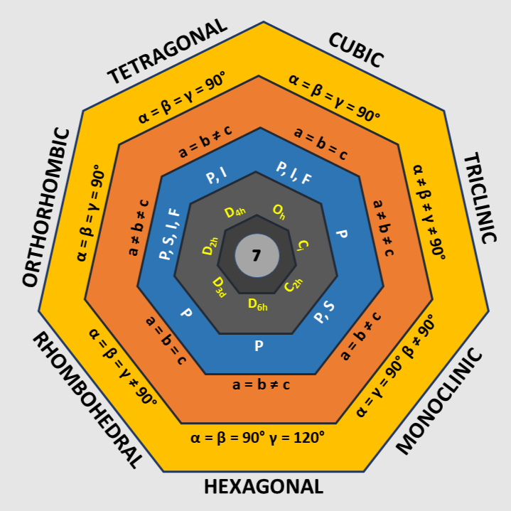
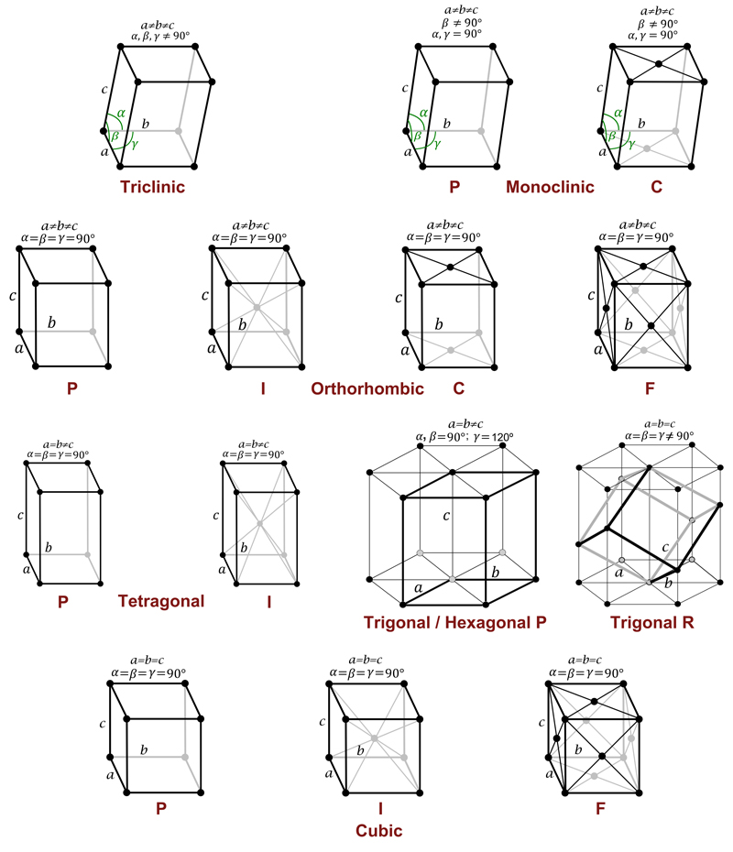
What is a material?
Material – collection of interacting atoms
Nucleus: neutrons, protons (+)
Electrons (-)
MATERIALS
ORDERED
DISORDERED
QUASI
CRYSTALS
CRYSTALS
AMORPHOUS
https://en.wikipedia.org/wiki/Bravais_lattice
https://www.xtal.iqf.csic.es/Cristalografia

Slide 12
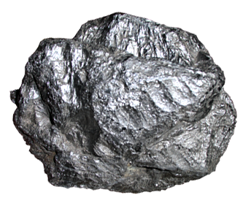
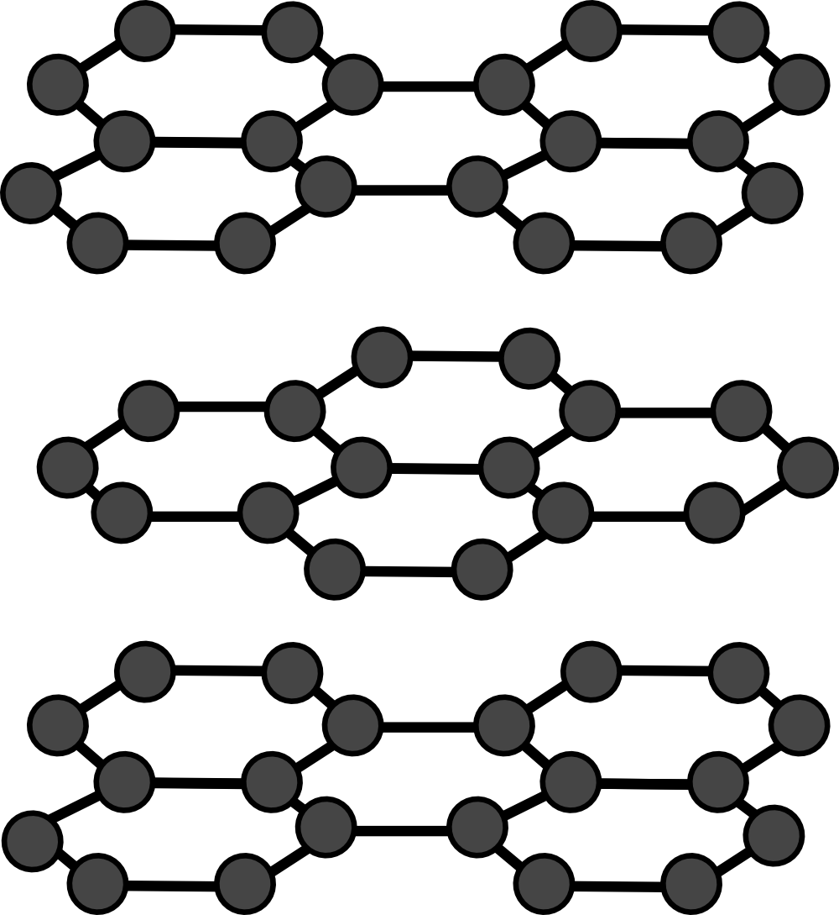
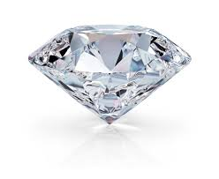
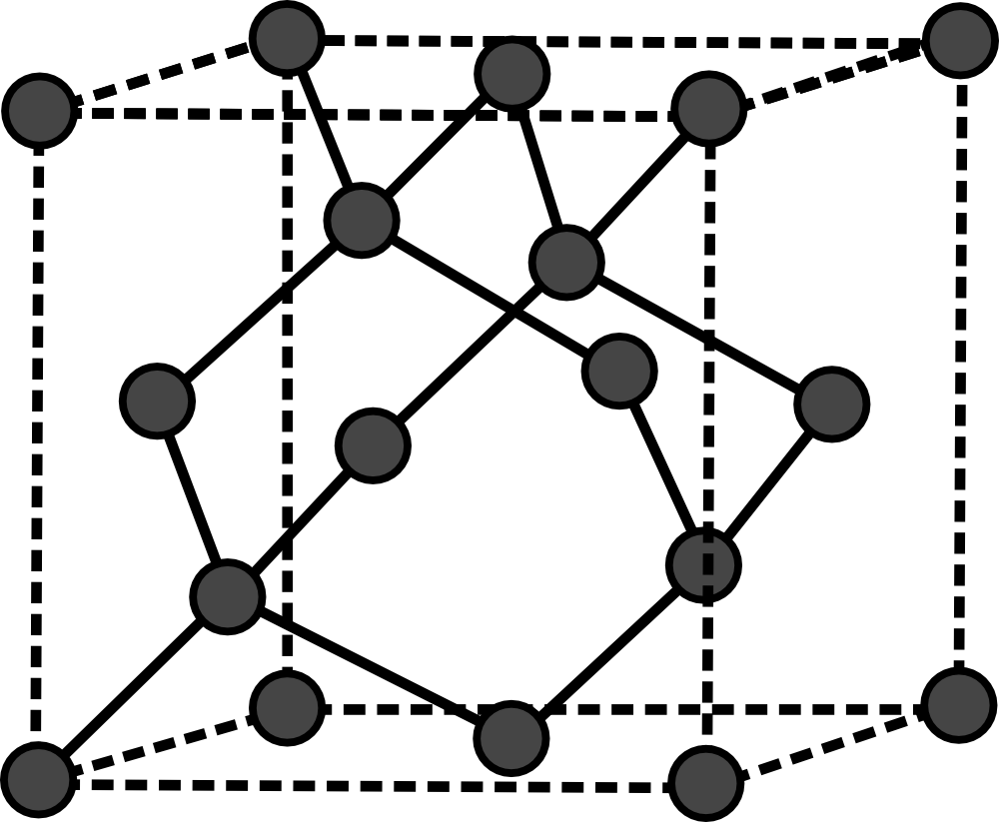
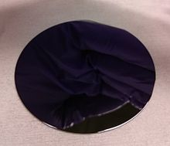
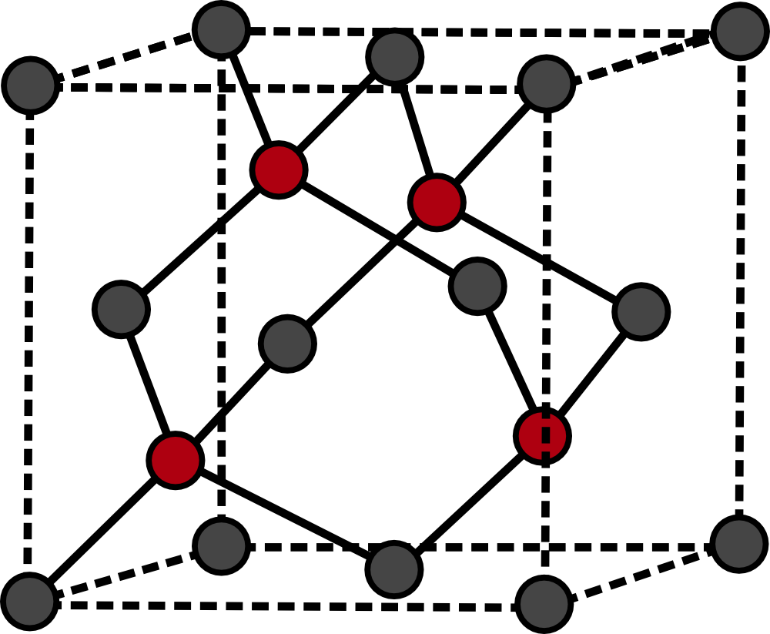
What is a material?
Material – collection of interacting atoms
Nucleus: neutrons, protons (+)
Electrons (-)
MATERIALS
ORDERED
DISORDERED
QUASI
CRYSTALS
CRYSTALS
AMORPHOUS
Graphite
Conductor
Same atom type (C)
Different Bravais lattice
Different material properties
Diamond
Insulator
Same Bravais lattice
Different atom types
GaAs
Semiconductor

Slide 13
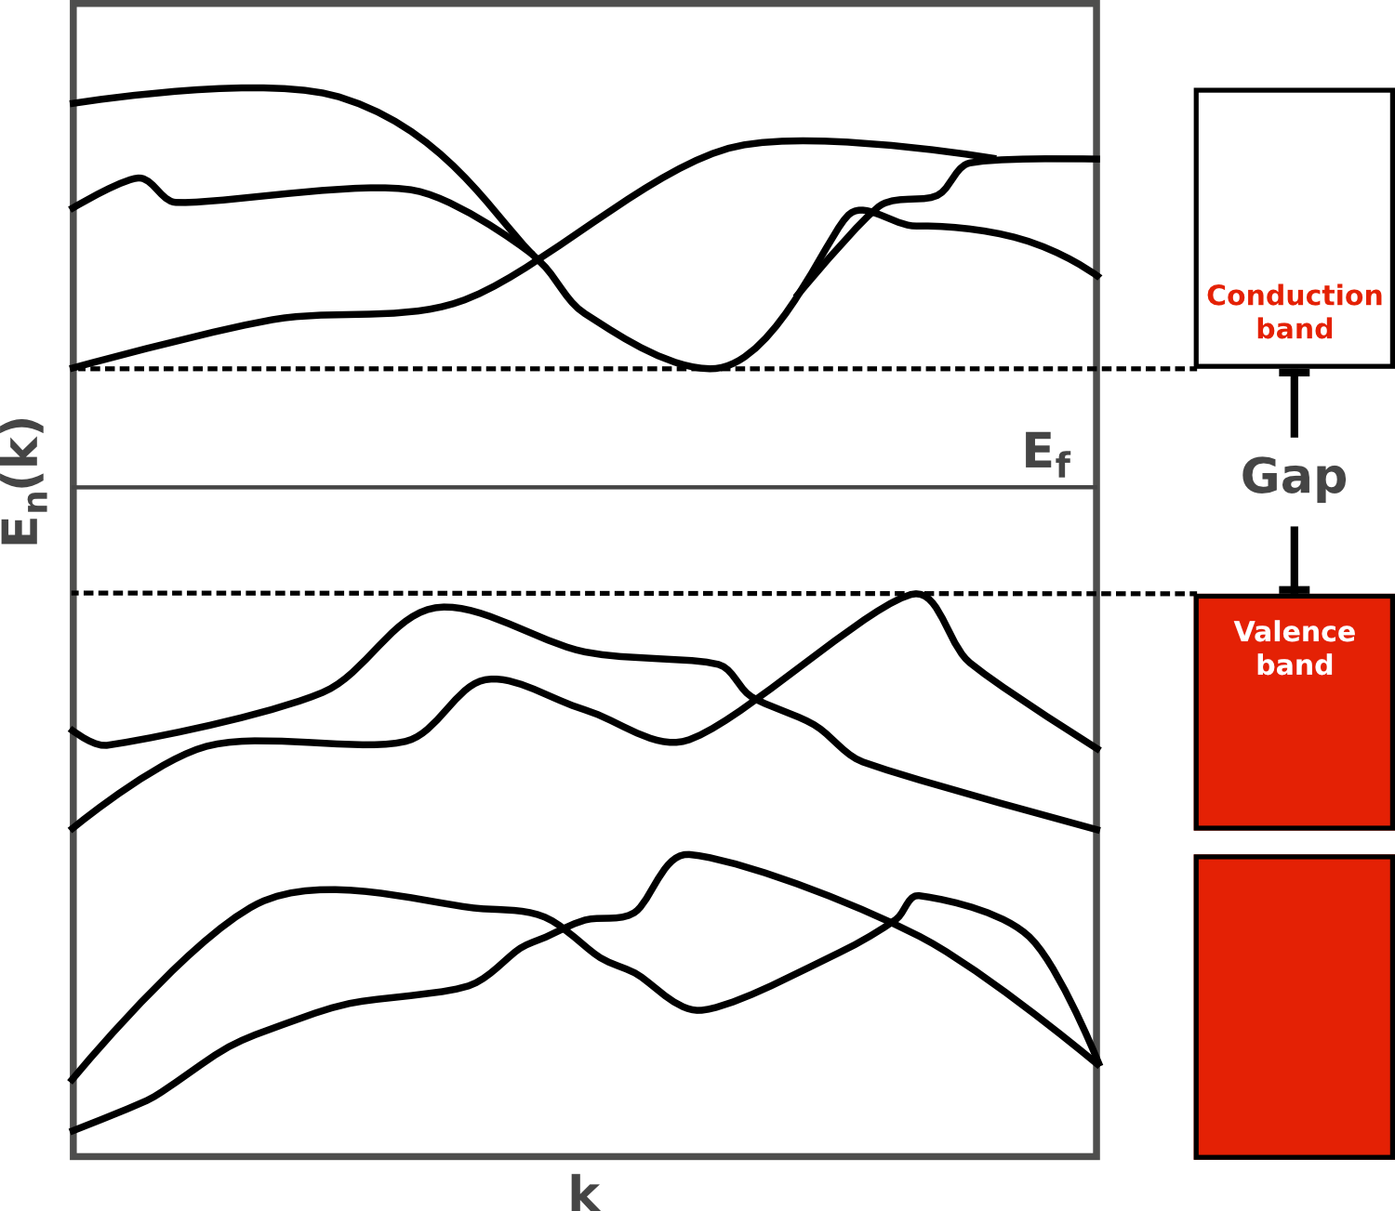
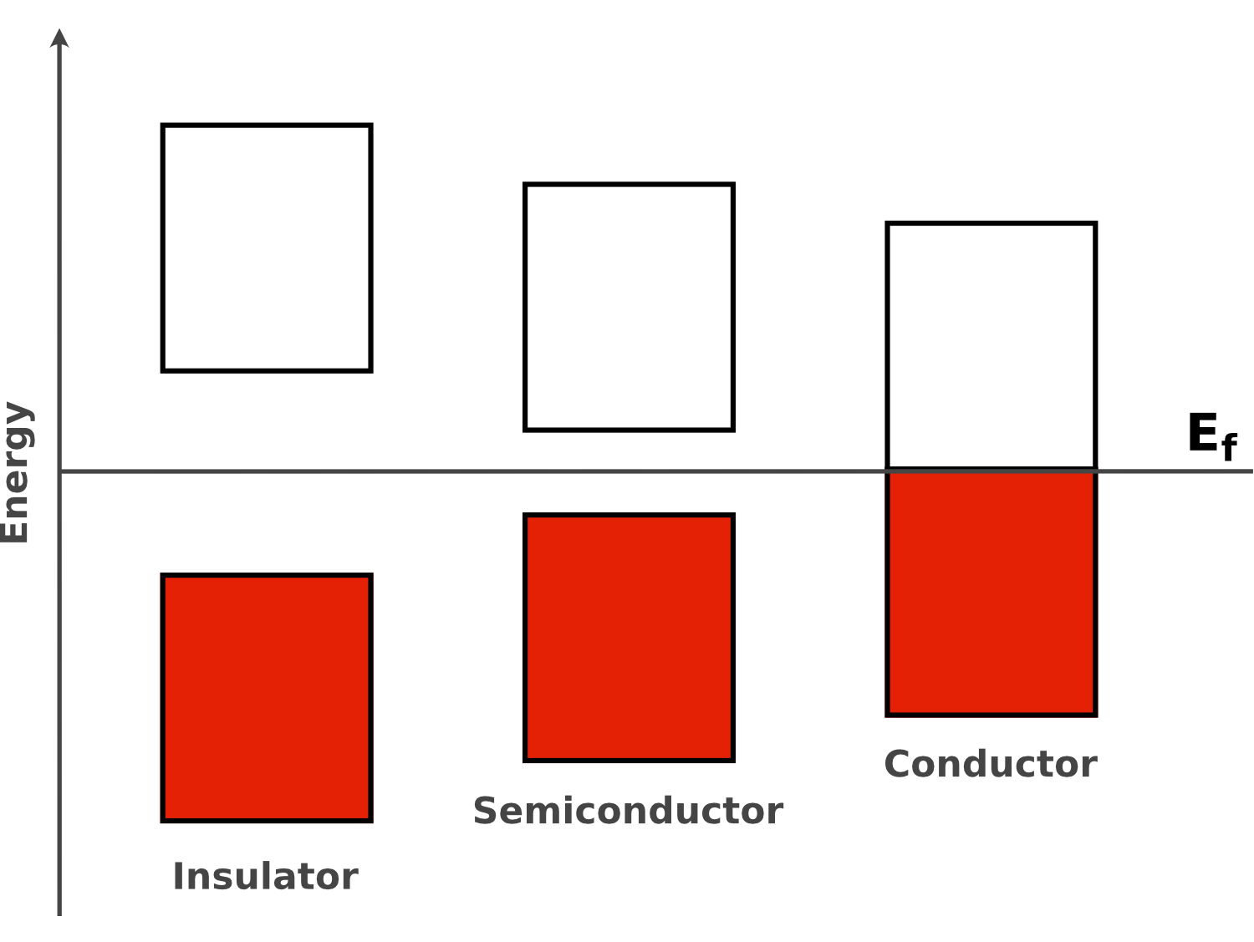




Electronic properties
Material – collection of interacting atoms
Nucleus: neutrons, protons (+)
Electrons (-)
$$H=\frac{p^{2}}{2m}+V(r)$$
Schrödinger equation
$$H ψ\left(r,k\right)=E_{n}(k)ψ(r,k)$$
Band structure
$$E_{n}(k)$$
$$k$$
vs

Slide 14
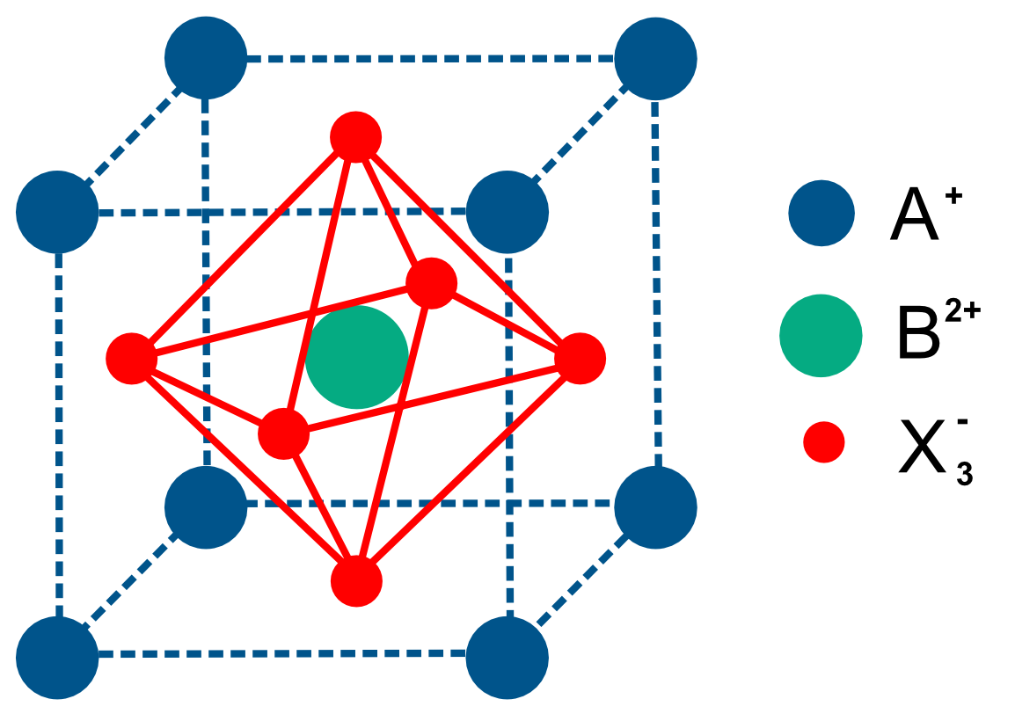
Perovskite solar cell
A ⁺ : Atoms/molecules
Inorganic: Cs⁺, Rb⁺
Organic: MA⁺, FA⁺
B²⁺ : Metal ion
Pb^{2+,} Sn²⁺
X ⁻ : Halide
I ^{- ,} Br ^{- ,} Cl ⁻
Opportunities – Favorable optoelectronic properties
High α_{Abs}, tunable E_{gap}, high μ_{Q} , low E_{Exc,bind}
Challenges – Limited long-term stability
Degradation (moisture, O₂), defects, halide segregation, competing Phases
Challenges – Toxicity

Slide 15
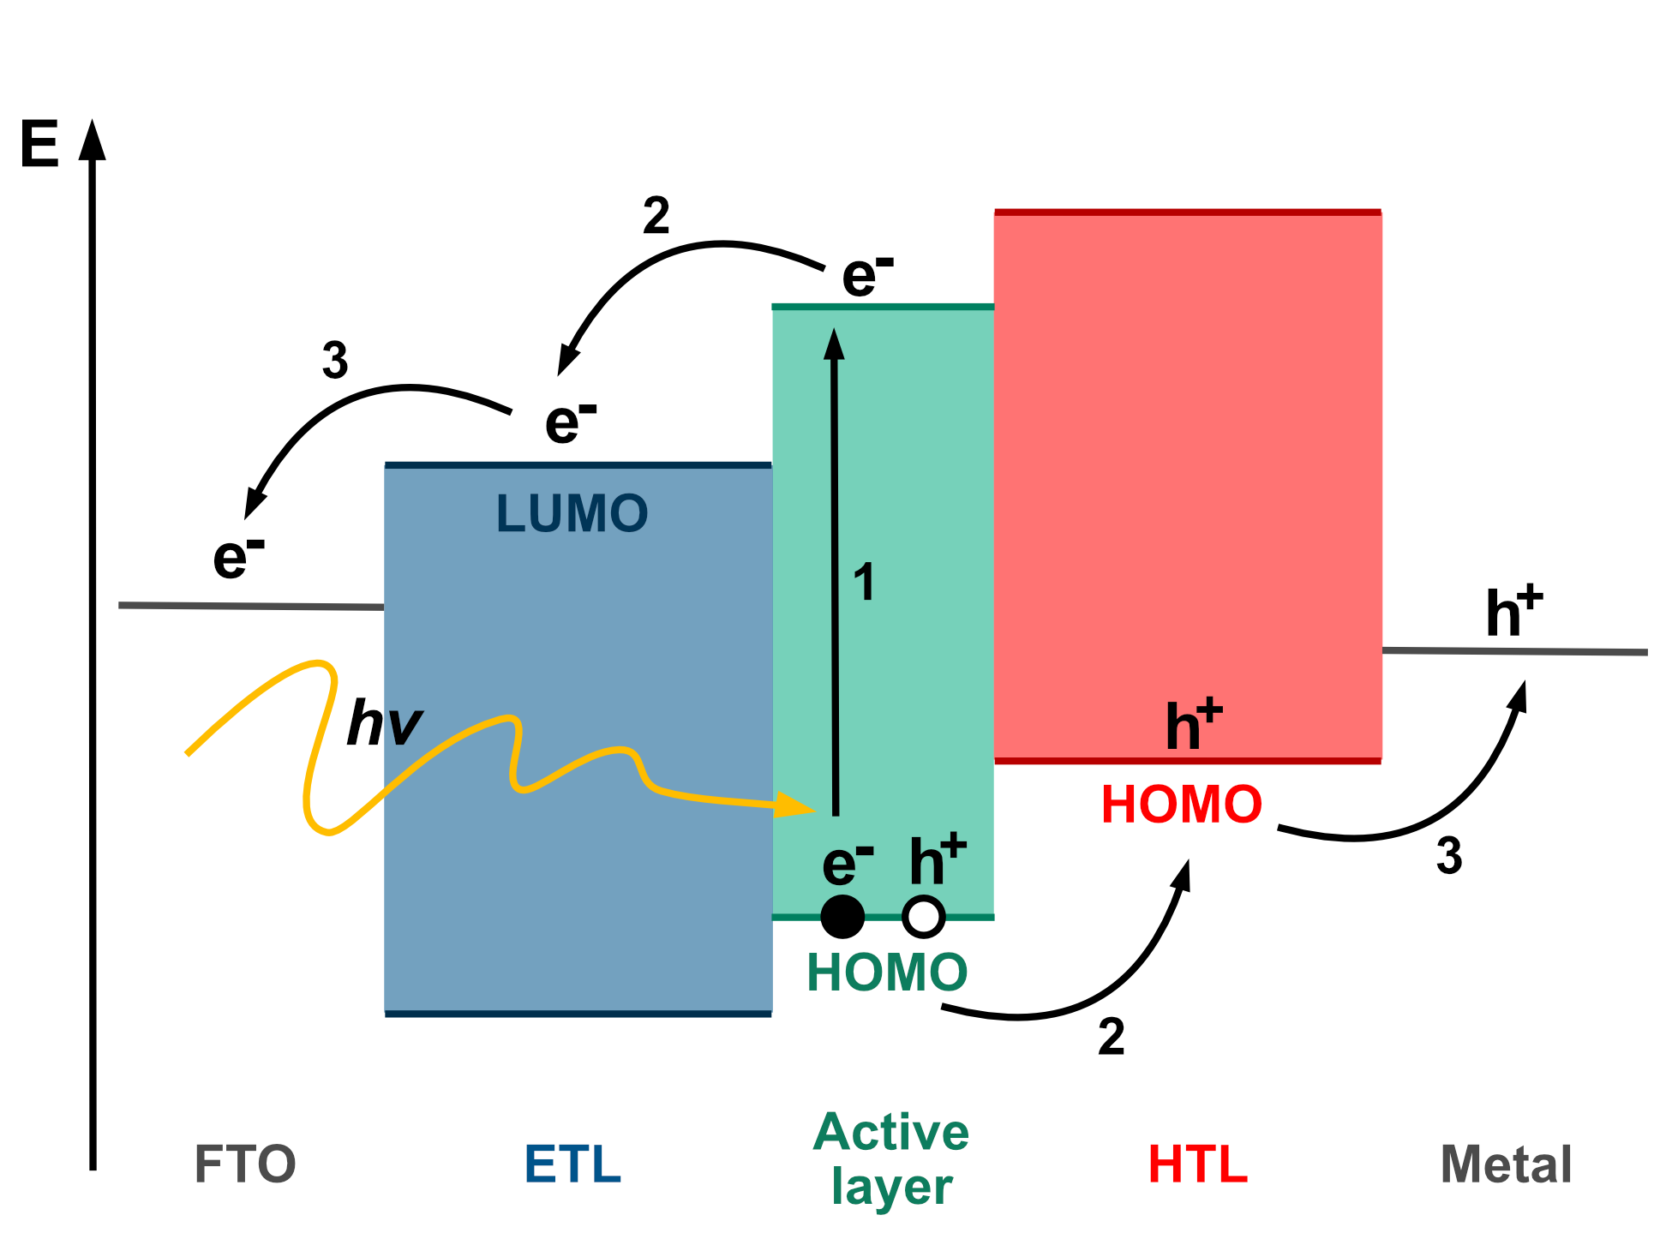
Perovskite solar cell
If a photon hits the AL with an energy (h𝜈) greater than the band gap (𝐸_{g}) can be absorbed.
An electron is excited from the valence band (VB) into the conduction band (CB).
The unoccupied state left in the VB is known as a hole and behaves like a particle analogous to an electron in the CB, albeit positively charged.
The electron-hole pair is coulombically bound in a state known as an exciton.
Once an exciton is created in the AL, it dissociates into electron on the ETL and HTL.

Slide 16
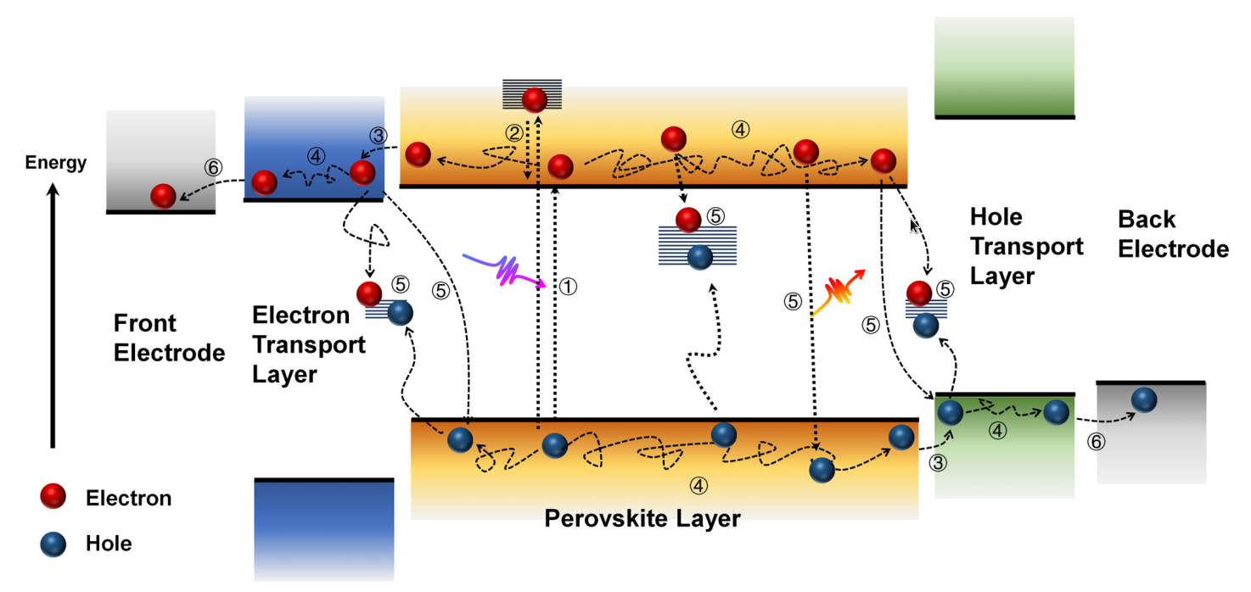
Charge Dynamics in Solar Cells
EcoMat. 2023;5:e12268.
1. Charge generation
  Excitation
  Electron-Hole separation
4. Charge transport/diffusion
5. Charge trapping and recombination
2. Charge relaxation
6. Charge collection
3. Charge extraction

Slide 17
Charge generation
Conduction band
Excitation
Very fast ~fs
Bound electron-hole pair is created
(Exciton binding energy)
  Due to the binding energy electron and hole confined to the same space
  For lead-halide perovskites exciton binding energy very low ~8-60meV (thermal fluctuation k_{B}T ~ 26meV)
  FAPbI3 binding energy ~ 8meV
-
Exciton binding energy
Exciton binding energy
Excitation
Electron-hole pair stabilized by coulomb interaction
+
Valence band
Independent non-interacting hole and electron
Conduction band
Charge separation
Electron (or hole) needs to overcome binding energy barrier to create separate independent electron and hole (charge-separated state).
Binding energy is small in perovskites – thermal fluctuation is enough to create charge-separated state
Typical times <ps
-
Exciton binding energy
Exciton binding energy
-
+
Valence band

Slide 18
Charge relaxation
-
Energy relaxation by interaction with phonons
CB
-
Charge cooling
Solar light can excite the electron to higher levels in the conduction band (CB) or from lower levels in the valence band (VB)
High energy electron/hole is interacting with the lattice and losing its energy to phonons (excess energy is deposited into lattice vibrational motion)
+
VB

Slide 19
Charge diffusion, trapping and recombination
Charge diffusion
Free charges in the perovskite active layer are subject of random (diffusive) motion. During this motion, several processes can occur:
Trapping of the charge
  Due to the imperfections in the material there can be states within the perovskite band gap
  Depends on the electron/hole capture probability and electron/hole excitation probability (detrapping)
  Linear dependence with charge density (until the holes are filled)
  - more charges higher probability to be close to the trap state
CB
-
-
Electron excitation ~ s_{n}
Electron trapping ~ r_{n}
-
-
Hole trapping ~ r_{p}
+
Hole excitation ~ s_{p}
VB

Slide 20
Charge diffusion, trapping and recombination
Charge diffusion
Free charges in the perovskite active layer are subject of random (diffusive) motion. During this motion, several processes can occur:
Trapping of the charge
  Due to the imperfections in the material there can be states within the perovskite band gap or interface states
  Depends on the electron/hole capture probability and electron/hole excitation probability (detrapping)
  Linear dependence with charge density (until the holes are filled)
  - more charges higher probability to be close to the trap state
Radiative recombination (exciton annihilation)
  When hole and electron meats -> create bound exciton -> possible to decay radiatively to the ground state or detach again
  Quadratic dependence with charge density
CB
-
Exciton
Radiative deexcitation
+
VB

Slide 21
Charge diffusion, trapping and recombination
Relaxation by interaction with phonons
Charge diffusion
Free charges in the perovskite active layer are subject of random (diffusive) motion. During this motion, several processes can occur:
Trapping of the charge
  Due to the imperfections in the material there can be states within the perovskite band gap or interface states
  Depends on the electron/hole capture probability and electron/hole excitation probability (detrapping)
  Linear dependence with charge density (until the holes are filled)
  - more charges higher probability to be close to the trap state
Radiative recombination (exciton annihilation)
  When hole and electron meats -> create bound exciton -> possible to decay radiatively to the ground state or detach again
  Quadratic dependence with charge density
Auger recombination
  Three particle process – only at high charge density
-
CB
-
-
Energy is used to excite another electron
Non-radiative recombination
+
VB

Slide 22
Charge diffusion, trapping and recombination
Charge diffusion
Free charges in the perovskite active layer are subject of random (diffusive) motion. During this motion, several processes can occur:
Trapping of the charge
  Due to the imperfections in the material there can be states within the perovskite band gap or interface states
  Depends on the electron/hole capture probability and electron/hole excitation probability (detrapping)
  Linear dependence with charge density (until the holes are filled)
  - more charges higher probability to be close to the trap state
Radiative recombination (exciton annihilation)
  When hole and electron meats -> create bound exciton -> possible to decay radiatively to the ground state or detach again
  Quadratic dependence with charge density
Auger recombination
  Three particle process – only at high charge density
Charge extraction at the interface
  Charge can be extracted after diffusion to the interface
  Charge hopping x tunneling through interface
HTL
AL
ETL
VB
CB
CB
-
energy
+
VB
VB
VB

Slide 23
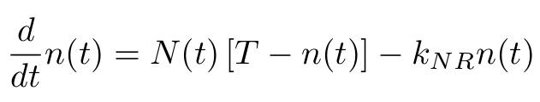
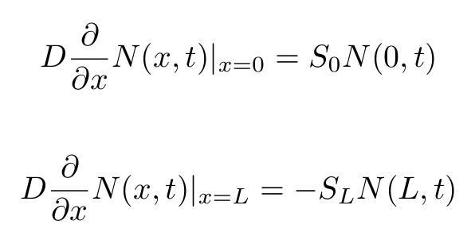
Charge density evolution
Charge density
Charge diffusion constant
Charge trapping rate
Detrapping rate
Rate of Auger recombination
Charge generation
Dependent on exciton binding energy k_{ex} and light intensity I
Trap density
Charge density in the traps
Rate of radiative recombination
We should separate dynamics of electrons and holes, e.g. for electrons:
  Radiative recombination k_{R}N_{h}(x,t)N_{e}(x,t)
  Auger recombination k_{A}N_{h}(x,t)N_{e}²(x,t)
Trap filling
Very complex evolution of the charge density. How to investigate individual processes?
Charge extraction
Additional flux at the AL and ETL/HTL interface

Slide 24
Charge density evolution
Charge density
Charge diffusion constant
Charge trapping rate
Detrapping rate
Rate of Auger recombination
Charge generation
Dependent on exciton binding energy k_{ex} and light intensity I
Trap density
Charge density in the traps
Rate of radiative recombination
Separating individual contributions of charge dynamics
Order of the charge density (excitation light intensity)
  At low intensity (i.e. low charge density) linear orders dominant (1 sun is low intensity)
  At higher intensities (100-1000 suns) radiative recombination becomes dominant
  At large intensities (>1000 suns) Auger recombination dominant decay channel
Characteristic time
  Rates of the different processes can have different order of magnitude
Composition of the measured sample
  For example, removing charge extraction by removing ETL or HTL layer or studying single component separately

Slide 25
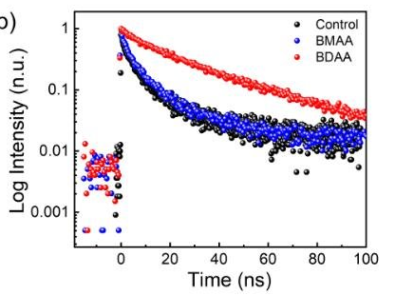
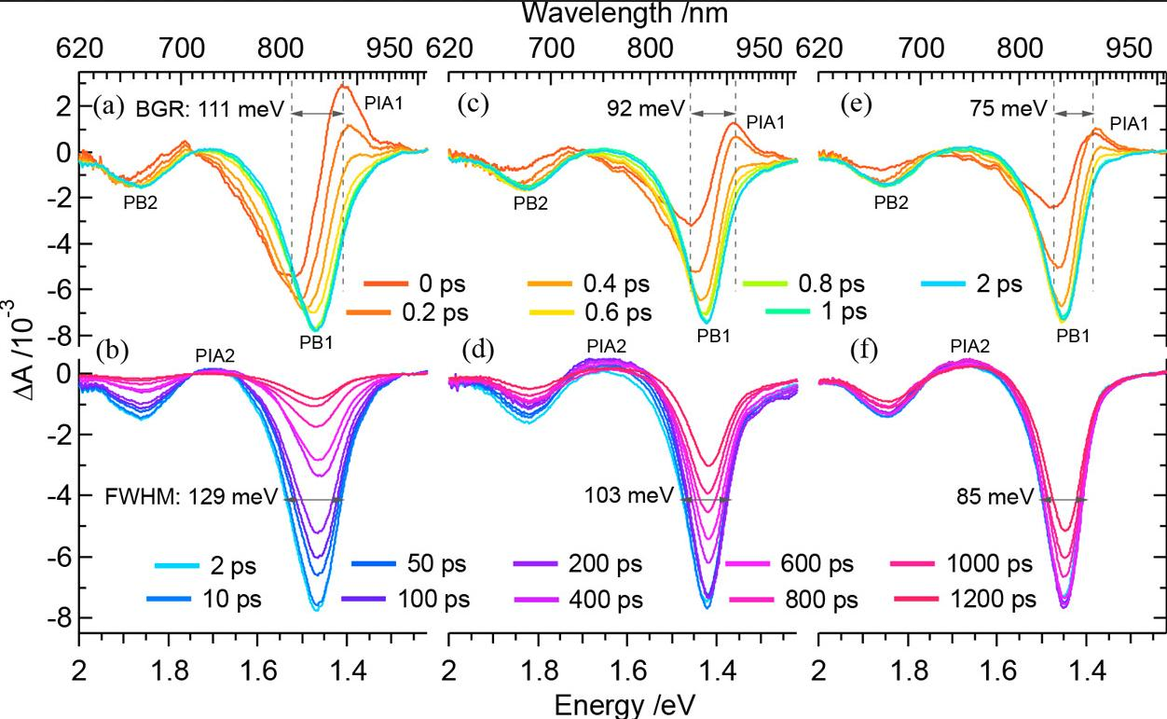
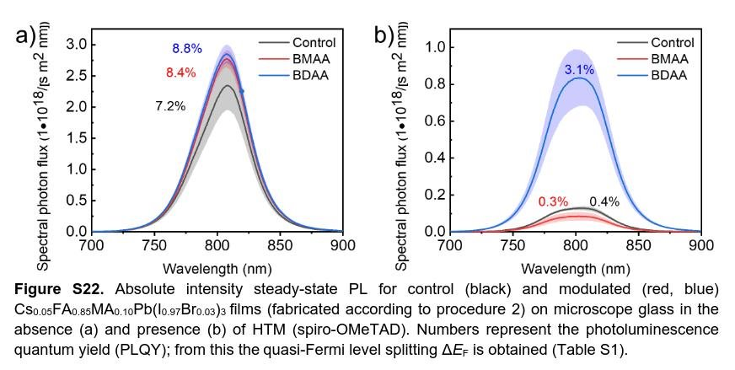
Optical measurements
Charge and exciton dynamics mostly probed by optical experiments
Initial excitation by visible light => create excitons and free charges
Observe time evolution of the spectra => information about individual processes
Types of experiments:
Time resolved photoluminiscence (TRPL)
  Measuring fluorescence intensity decay times after initial excitation
Transient absorption spectroscopy
  Exciting the system with initial pulse
  Measure absorption at specific delay times after the excitation
  Theoretically very hard to simulate (not used very often)
Photoluminiscence quantum yield (PLQY)
  Fraction of the emitted photons and the absorbed ones
  Information about non-radiative decay channels

Slide 26
Optical measurements
Charge density
Charge diffusion constant
Charge trapping rate
Detrapping rate
Rate of Auger recombination
Charge generation
Dependent on exciton binding energy k_{ex} and light intensity I
Trap density
Charge density in the traps
Rate of radiative recombination
Trap filling
Charge extraction
Low intensity electric field => Auger recombination is negligible
Start with active layer only => No charge extraction
Time scale separation
  Low binding energy -> charge carrier generation very fast 1fs-1ps
  Radiative recombination very slow (source of the luminiscence)
  Charge trapping quite fast -> traps filled usually within 100ps-10ns

Slide 27
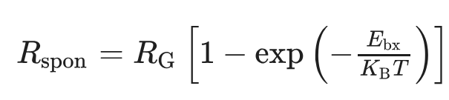
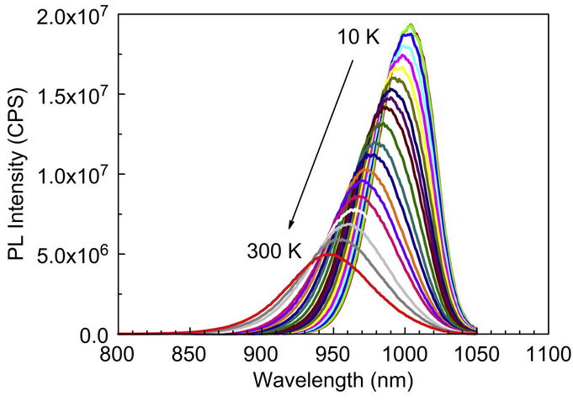
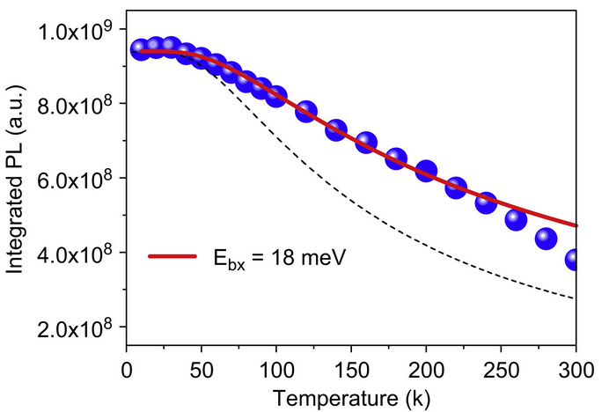
Exciton binding energy
Conduction band
-
Forming charge separated state from initial exciton is very fast
Requires overcoming energy barrier => temperature dependent
Temperature dependent photoluminiscence (PL) measuremets
+
Spontaneous emission
(only from excitons)
Exciton generation rate
(excitation intensity)
Probability of overcoming barrier (lower binding energy => more free charges => lower PL signal)
Valence band

Slide 28
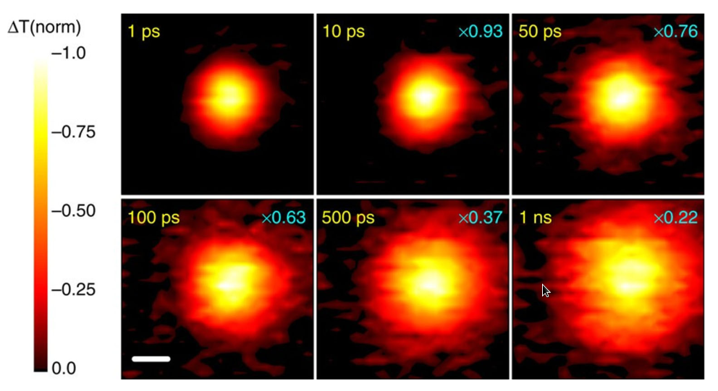

Diffusion constant
CB
-
After initial charge separation electrons and holes start to diffuse in the active layer until they reach
Possible to measure by transient absorption microscopy (spatially resolved transient absorption)
  Initial excitation by laser pulse (pump) => create charge carriers (different absorption)
  Initial charges diffuse in the AL
  With different time delay absorption measurements => from difference with and without pump possible to determine where the charge carriers are.
  Fitting of the spread of the signal provides diffusion constant
+
VB
Variance of the density distribution
Diffusion dimensionality parameter

Slide 29
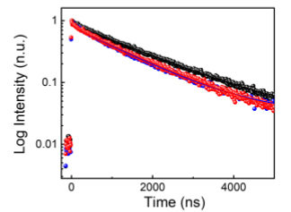
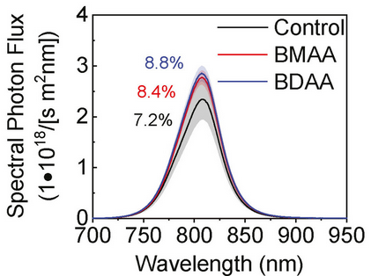
Bulk charge trapping
CB
In lead-halide perovskites most of the traps in the bulk are shallow (they are located close to the edge of the VB or CB => easy detrapping and small effect on the charge dynamics.
Possible to measure by Time Resolved Lhotoluminiscence (TRPL) or by Photoluminiscence Quantum Yield (PLQY)
  After excitation charge carriers are created -> some of the carriers get trapped => reduction of the photoluminiscence signal because only free carriers can radiatively recombine (less free charges lower photoluminiscence signal)
  Recombination from the traps usually on different timescale (~100nm-1ms) => when traps are filled "trap-free" dynamics
  Trapping of the charge ~100ps-10ns
  PLQY => ratio between radiative recombination (good for performance) and all processes
-
+
VB
TRPL
PLQY
Increasing the quantum yield with additive => passivating the defects (traps)
Radiative recombination
Trapping

Slide 30
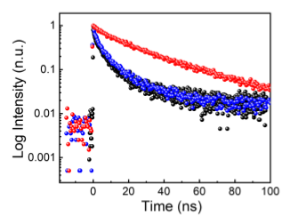
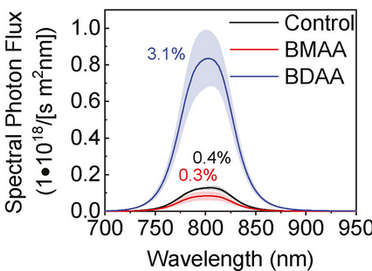
Charge extraction, interface traps and recombination
Charge extraction rates and quality of the interface is measured from change of the properties when electron or hole extraction layer is added.
Timescale separation
  Thermalization < 100ps
  Trap filling 100ps-10ns
  Charge extraction 10-1000ns
  Charge recombination at the interface 100ns-10µs
  Radiative recombination > µs
TRPL
PLQY
Active layer only
Active layer + HTL
Active layer only
Active layer +HTL
Decay time ~ µs
Decay time ~ 10-40ns
=> information about charge extraction
Interface between two materials introduce new trap states and possibility for the surface charge recombination => Smaller reduction of QY better for the performance (less traps and charge recombination)

Slide 31

Thank you

