Slide 1

Advanced simulations of solar cell devices
V. Carnevali,
V. Slama,
A. Vezzosi
École Polytechnique fédérale
de Lausanne
May 7, 2025

Slide 2
Hands on: Install DeepMD-kit
12Lect_shared
Access the first virtual machine
Download and extract folder CH4-solution.tar from 12Lect_shared
$ python -m venv deepmd_env
$ source deepmd/bin/activate
$ pip install deepmd-kit[gpu,cu12,lmp,ipi]

Slide 3
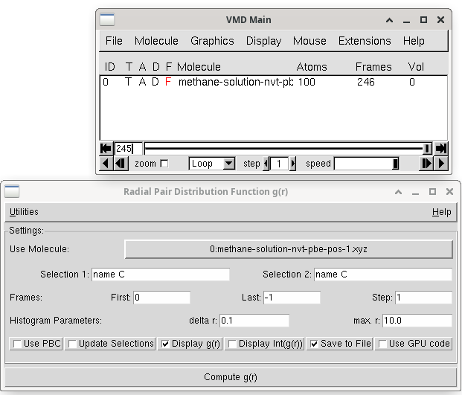
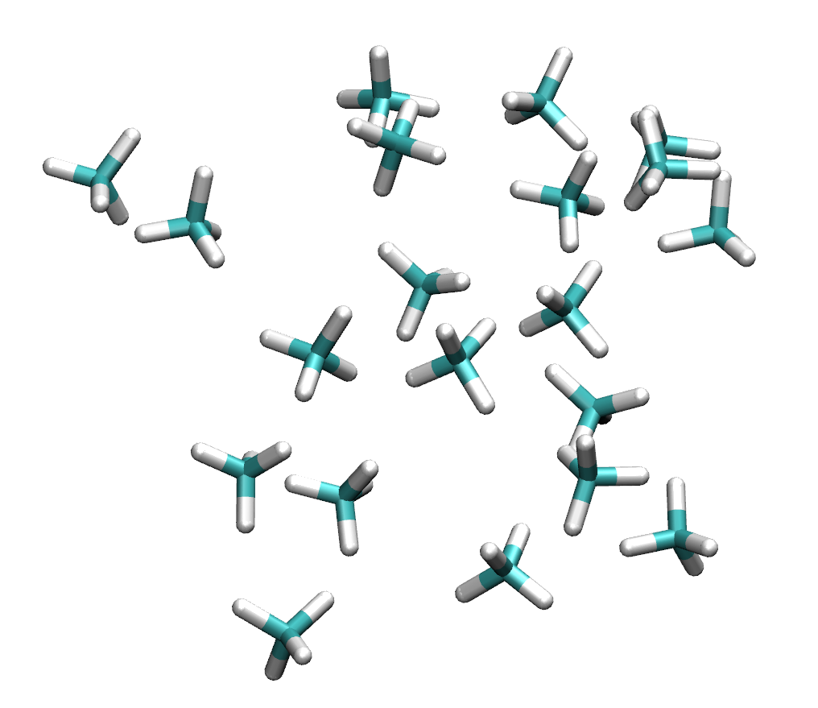
Hands on: MLP for CH₄
12Lect_shared
Set the cutoff and smooth cutoff radii (you can compute the pair C-C pair correlation function to get a lower bound)
r_{c}

Slide 4
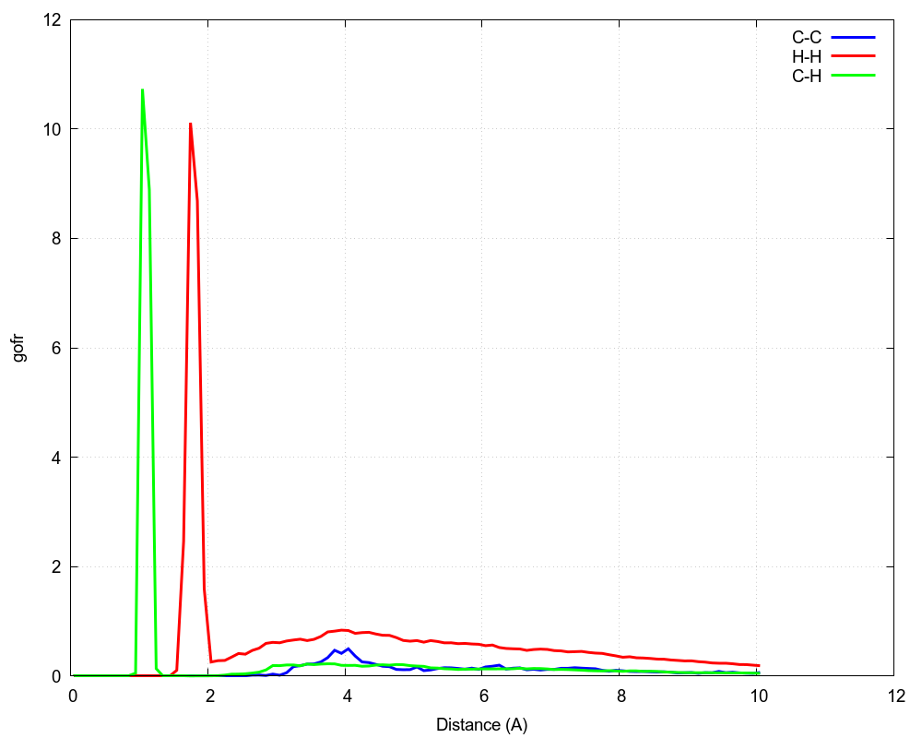
Hands on: MLP CH₄
12Lect_shared
Set the cutoff and smooth cutoff radii (you can compute the pair C-C pair correlation function to get a lower bound)
r_{c}

Slide 5
Hands on: MLP for CH₄
12Lect_shared
Set the cutoff and smooth cutoff radii
(you can compute the pair C-C pair correlation function to get a lower bound)
Set the parameter "sel" = maximum number of atom corresponding to a given atom type that are considered with r_{c}
Example:
to include all the atoms within rc for the carbon atom in the center I need sel = [2,13]
dp neighbor-stat -s training_data -r 6.0 -t C H​
r_{c}
r_{c}

Slide 6
Hands on: MLP for CH₄
12Lect_shared
Set the cutoff and smooth cutoff radii
(you can compute the pair C-C pair correlation function to get a lower bound)
Set the parameter "sel" = maximum number of atom corresponding to a given atom type that are considered with r_{c}
Start the training process
Example:
to include all the atoms within rc for the carbon atom in the center I need sel = [2,13]
dp neighbor-stat -s training_data -r 6.0 -t C H​
r_{c}
r_{c}

Slide 7
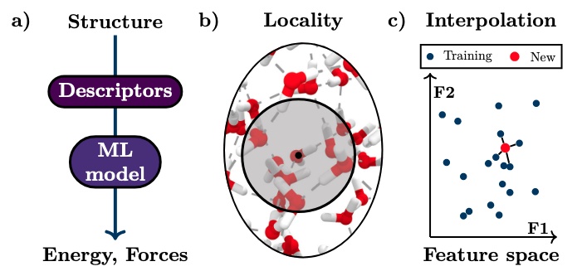
Machine learning potentials
https://arxiv.org/pdf/2410.00626
Main principles of machine learning potentials.
Structure is mapped to chemical descriptors as input for the machine learning regression model to predict energy and forces
Most descriptors in the field are limited to a certain cutoff around each atom --> locality approximation
Task of MLP --> after training to interpolate between the training data for unseen configurations.

Slide 8

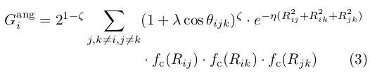
Examples of chemical descriptors
Chemical descriptors rely on a set of radial and angular functions that probe different regions in the vicinity of each atom up to a predefined cutoff (local environment)
Atom centered symmetry functions (ACSFs)¹
Radial probe
Angular probe
Cutoff function
Adapt width and shift of the gaussian to probe different regions
Different angular regions are probed by adjusting the exponent ζ
¹J. Behler and M. Parrinello, “Generalized Neural-Network Representation of High-Dimensional Potential-Energy Surfaces,” Phys. Rev. Lett. 98, 146401 (2007)

Slide 9
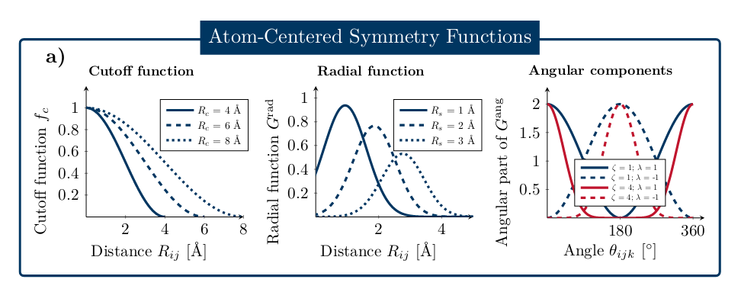
Examples of chemical descriptors
Chemical descriptors rely on a set of radial and angular functions that probe different regions in the vicinity of each atom up to a predefined cutoff (local environment)
Rc, η, Rs, ζ, λ are hyperparameters of the model and need to be chosen by the user!
¹J. Behler and M. Parrinello, “Generalized Neural-Network Representation of High-Dimensional Potential-Energy Surfaces,” Phys. Rev. Lett. 98, 146401 (2007)

Slide 10
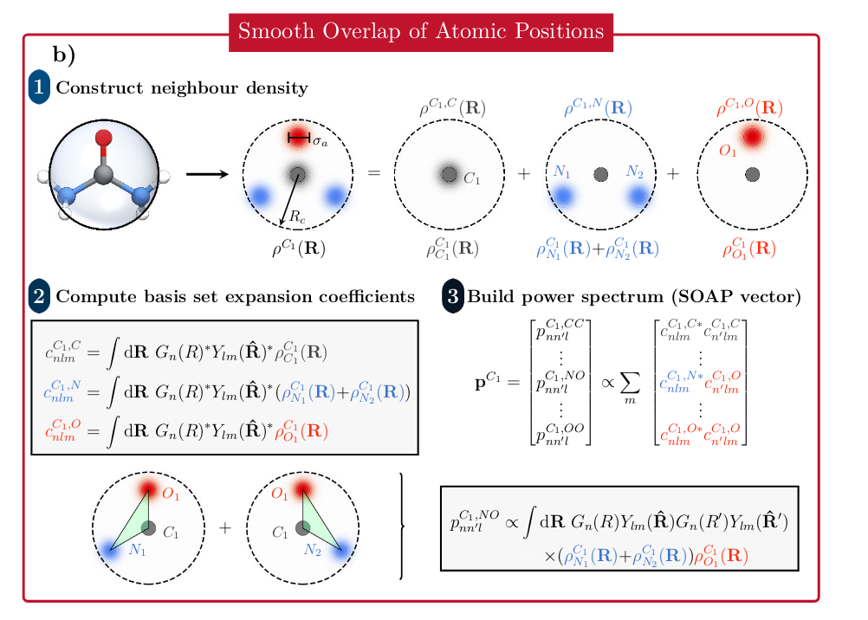

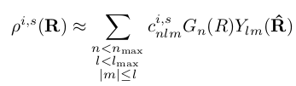

Examples of chemical descriptors
Neighbor density
Rotational invariance
SOAP descriptor
Rely only on two hyperparameters n_{max} and l_{max}

Slide 11
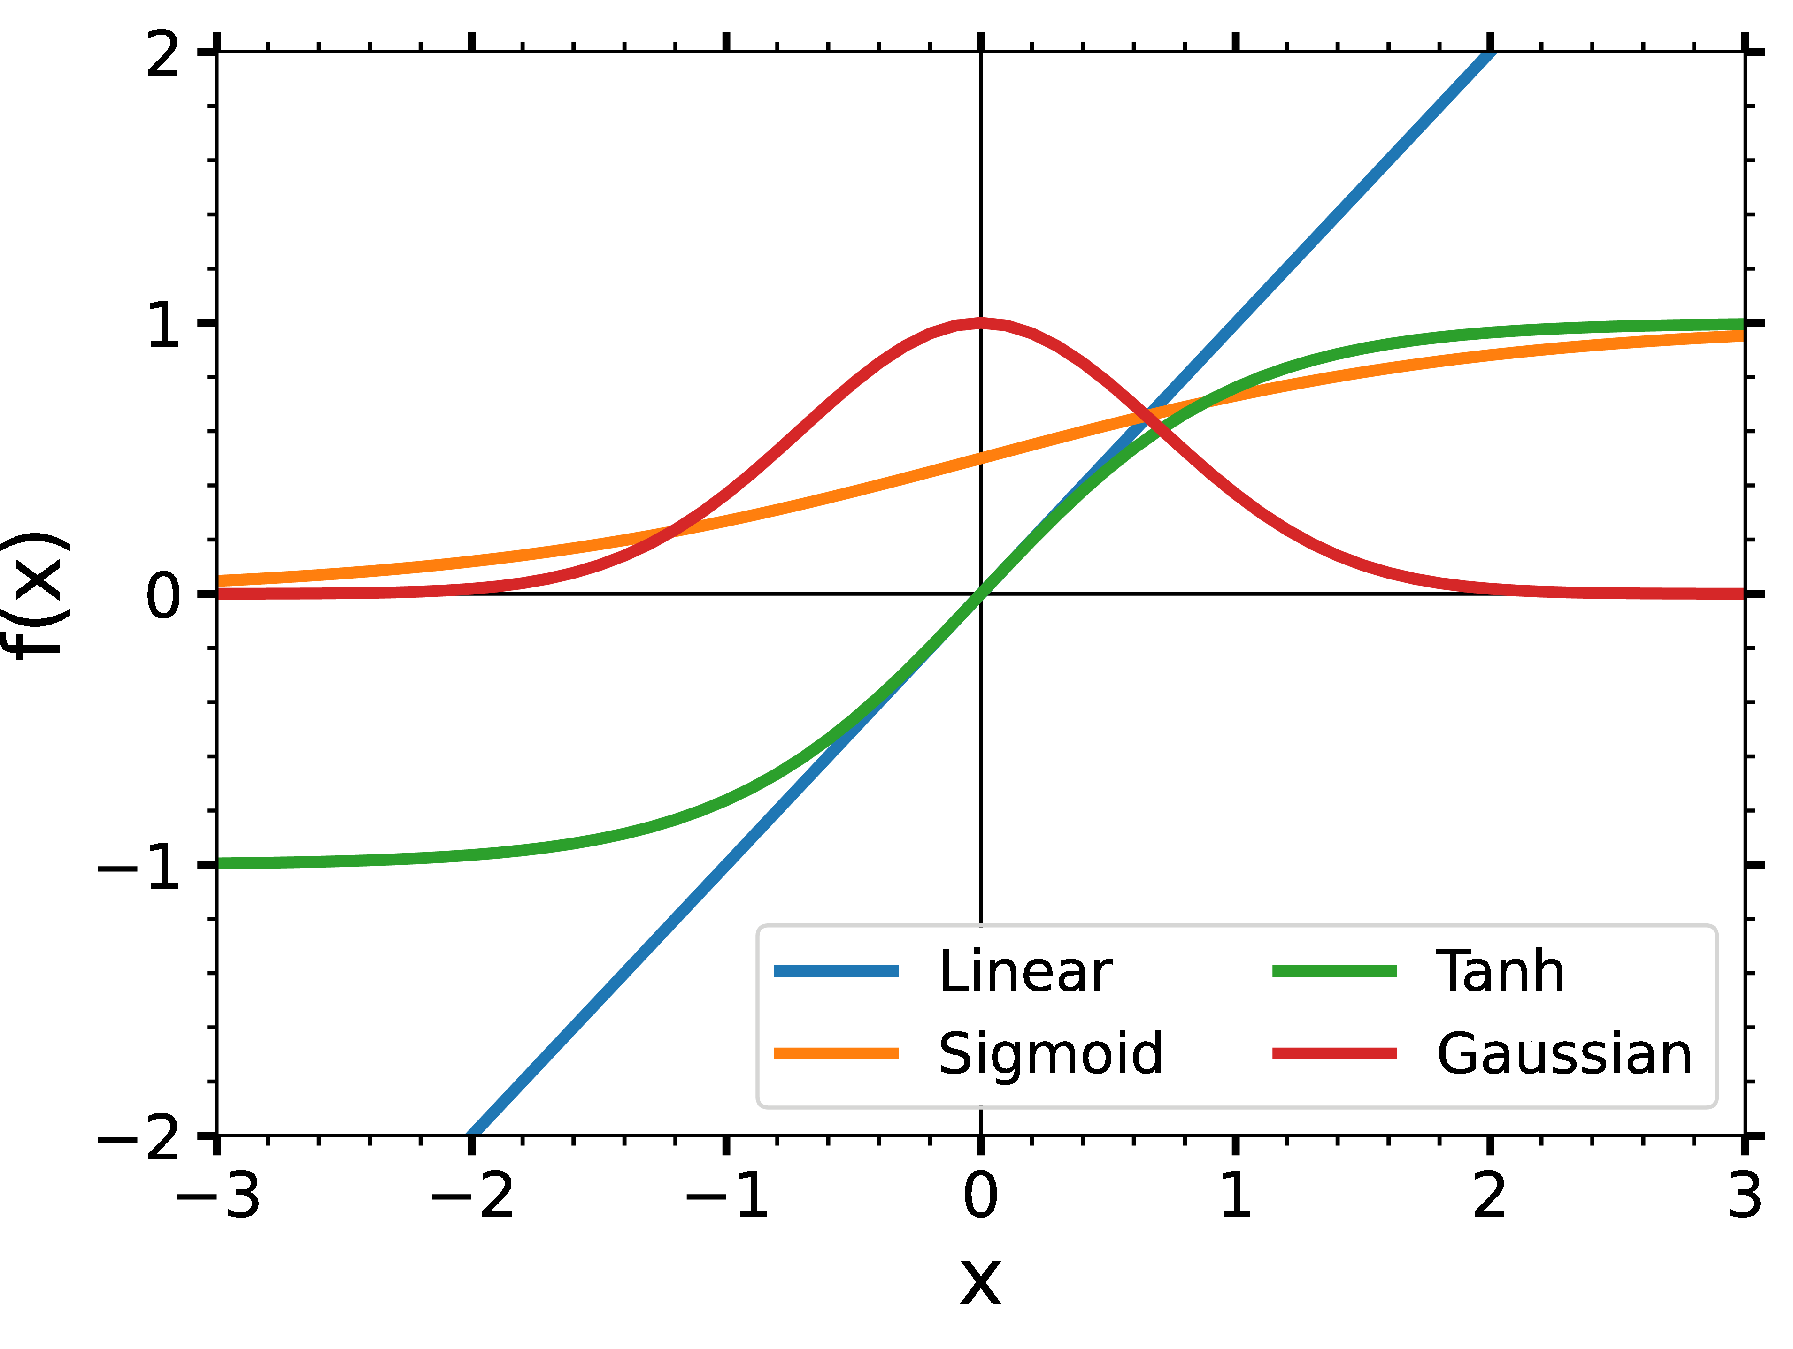
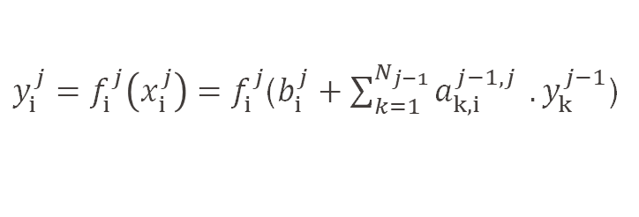
Feed forward neural network
Hidden Layers
Input Layer
Output Layer
y¹₁
a^{1,2}_{1,1}
y²₁
a^{0,1}_{1,1}
a^{2,3}_{1,1}
E
G
a^{2,3}_{2,1}
a^{0,1}_{1,2}
y¹₂
y²₂
b¹₁
b²₁
b³₁
Bias Node = 1
$y_{i}^{j}=f_{i}^{j}\left(x_{i}^{j}\right)=f_{i}^{j}$($b_{i}^{j}+\sum_{k=1}^{N_{j−1}}{a_{k,i}^{j−1,j} }.y_{k}^{j−1}$)

Slide 12
Feed forward neural network
Hidden Layers
Input Layer
Output Layer
y¹₁
0.2
y²₁
1.1
3.12
1.22
+
1.9
0.1
2
E
10.57
G
0.3
7.24
+
3.33
1
3
1.1
0.3
1
2
y¹₂
y²₂
3
1.33
+
1
2.33
0
1
1
1
Bias Node = 1
$y_{i}^{j}=f_{i}^{j}\left(x_{i}^{j}\right)=f_{i}^{j}$($b_{i}^{j}+\sum_{k=1}^{N_{j−1}}{a_{k,i}^{j−1,j} }.y_{k}^{j−1}$)

Slide 13
Stages of the construction of MLIP
Training of MLIP
(e.g. Supervised learning, Reinforced learning, loss function, optimizer)
Validation
(e.g. RMSE, parity plot, MD,)
Sampling
(MD, Enhance sampling (umbrella, metadynamics) , screen with less expensive method)
Architecture of MLIP
(e.g. Feed forward, Graph)
Descriptors
(e.g., EAM, SOAP, ACSF, ACE, etc...)
Production
(e.g. Exploration of chemical space)
Analysis
(e.g. SOAP, DeepL)

Slide 14
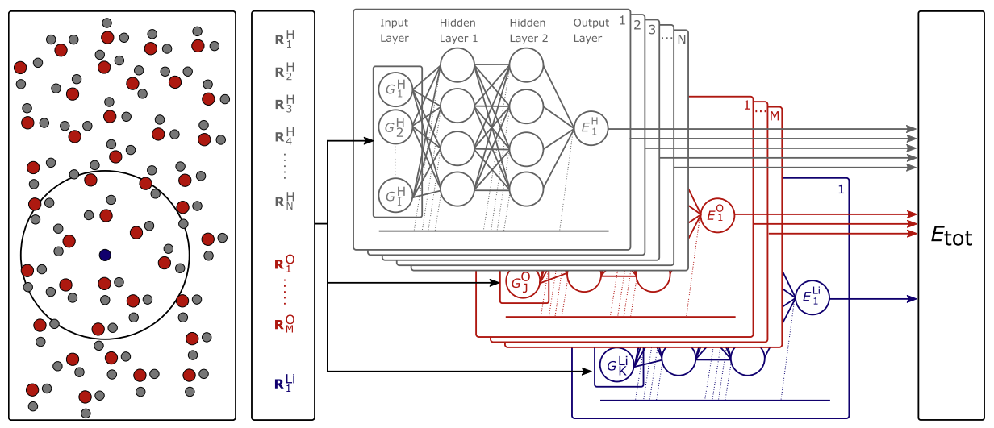
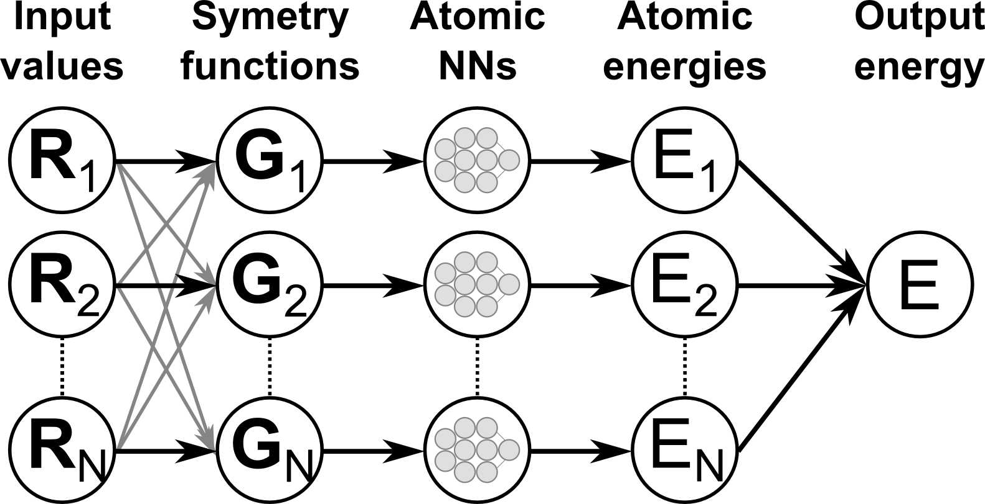
Machine Learning Interatomic Potential: Architecture

Slide 15
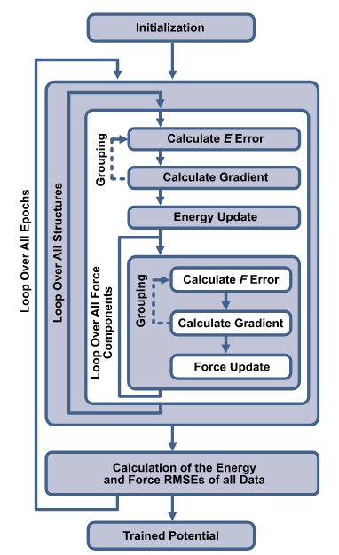
The training process
Each epoch loops over all structures in the dataset
Numerous updates increase computational cost
Weights can be updated batch-wise, for a group of energy and forces (good for parallelization)
Once the loop over all structures is completed and the new RMSE values of the energies and forces in the training as well as in the test set are computed and stored to assess the improvement of the potential.
Too small networks prevent an accurate representation of the PES.
Too many parameters can give rise to overfitting, reduce transferability of the potential --> early stopping method

Slide 16
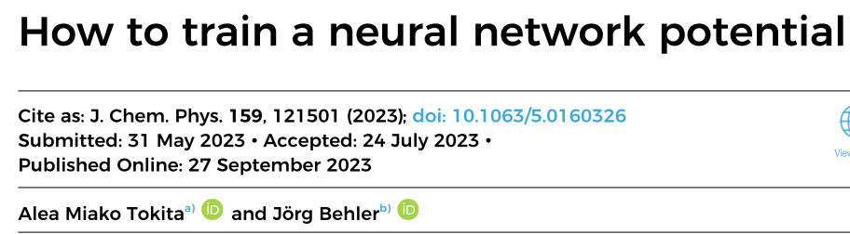
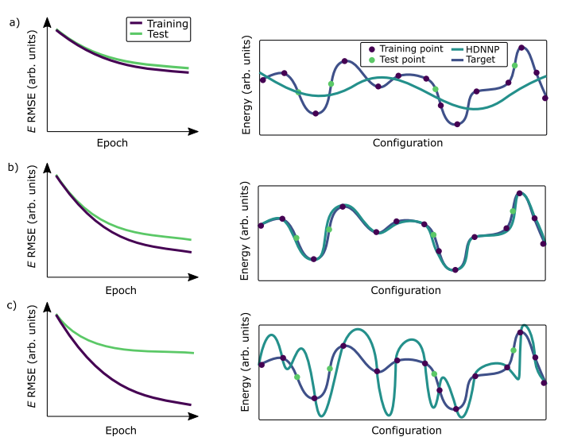
Machine Learning Interatomic Potential: Training
Under fitting
Target fitting
Over fitting

Slide 17
Active learning
The quality of the potential depend critically on the reference dataset covering the relevant configurational space.
Classical FF ensure a safe degree of transferability because they rely on physically inspired functional forms. This is not the case for MLIPs! --> very limited extrapolation capability
Cover the full topology of the PES before the training process is usually impossible. Solution: Active learning

Slide 18
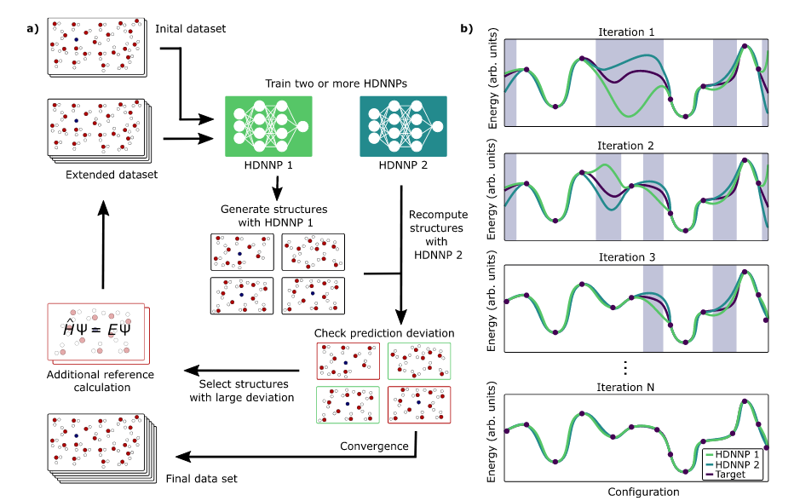
Active learning

Slide 19
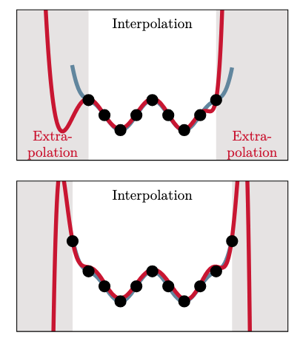
Machine Learning Interatomic Potential: Training
Reinforced learning
Use a minimal amount of configuration to produce a MLIP
Evaluate configuration of the predict set
Take the worst prediction and include them in the training set
Retrain the MLIP
Go to step 2 until you reach the required accuracy

Slide 20
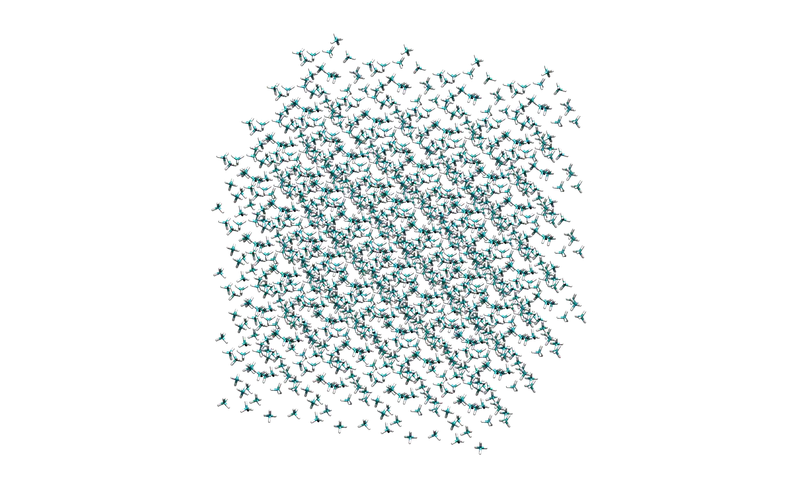
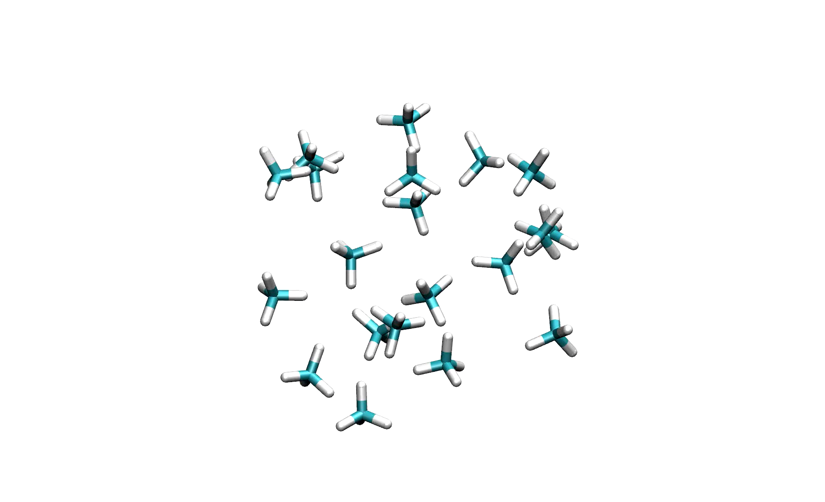
Hands on: MLIP for CH₄
12Lect_shared
Training CP2K = 100 atoms.
AIMD @ 300K, 500K, 700K
0.25 ps trajectories
--> 735 frames
DeepMD = 6400 atoms
NVT @ 50K
r_{c}=6 A

