Slide 1

Advanced simulations of solar cell devices
V. Carnevali, V. Slama, A. Vezzosi
École Polytechnique fédérale de Lausanne
May 7, 2025

Slide 2

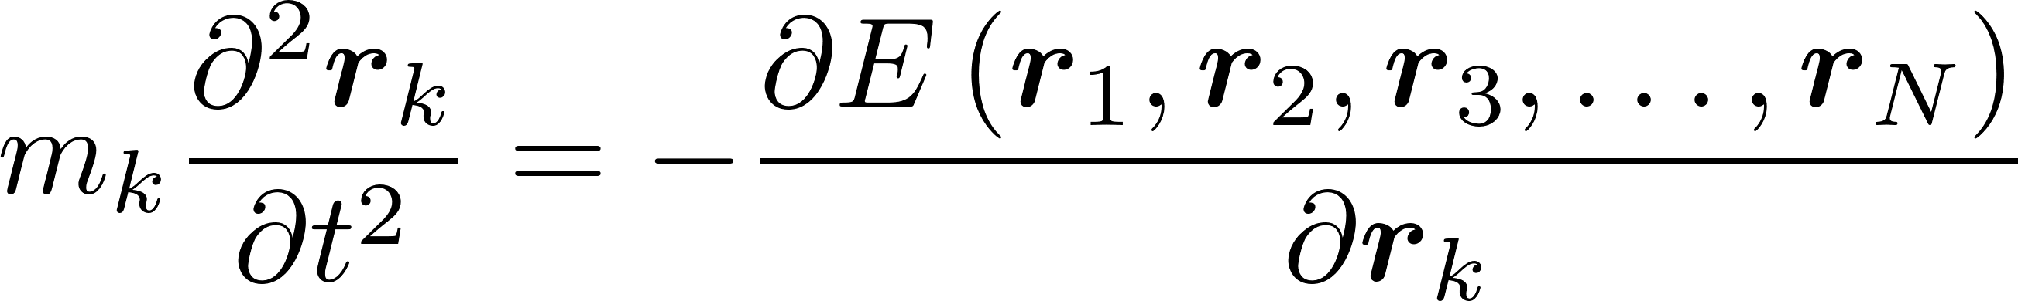
Deep Potential (DP) method assumptions and features
Extensivity: the many body PES can be expressed as a sum of many body atomic potentials of finite range
Continuity: continuous and differentiable function of the atomic coordinates
Symmetry: has the translation, rotational and permutational symmetry of the environment
Deep Neural Network (DNN): is represented by a DNN traind on ab-initio DFT data
Much more accurate that classical FFs. Efficiency-wise, still inferior to classical FFs, because of complex and thus more expensive functional form to evaluate --> One to three orders of magnitude slower than classical FF.
https://www.youtube.com/watch?v=7JuIC37dx3E

Slide 3


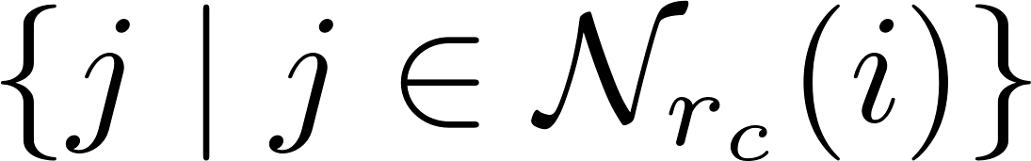
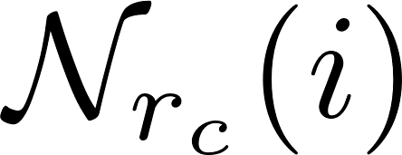

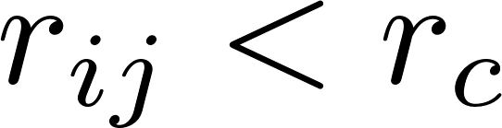
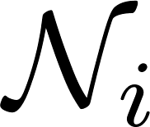


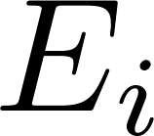
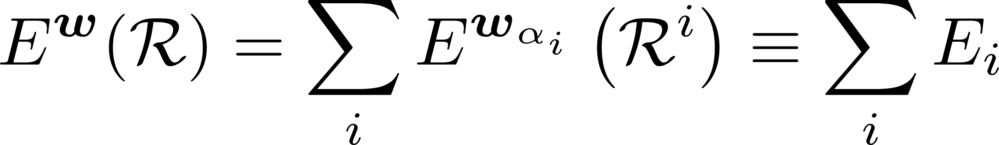
Deep Potential (DP) method assumptions and features
A system of N atoms in a 3D Euclidean space with coordinate matrix
Define a cut-off radius and consider, for each atom , its neighbors where is the set of atom such that , having cardinality .
Local environment of atom in terms of the relative coordinates
The PES is a function that maps the atomic coordinates and their chemical characters to real numbers through so-called subnetworks
Each subnetwork consist of an encoding and a fitting neural network
Zhang, Linfeng, et al. "Deep potential molecular dynamics: a scalable model with the accuracy of quantum mechanics.“
Physical review letters 120.14 (2018): 143001.

Slide 4
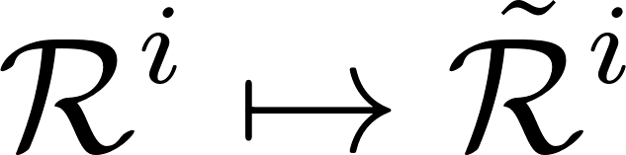
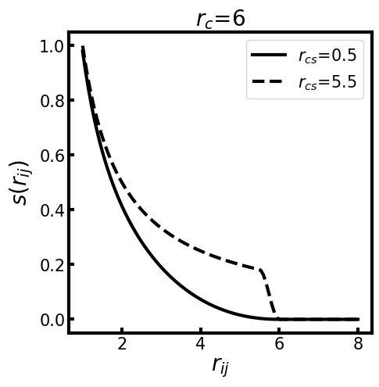
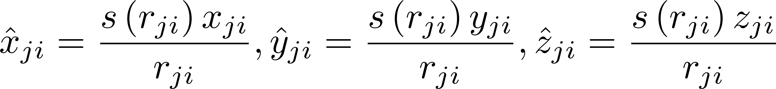
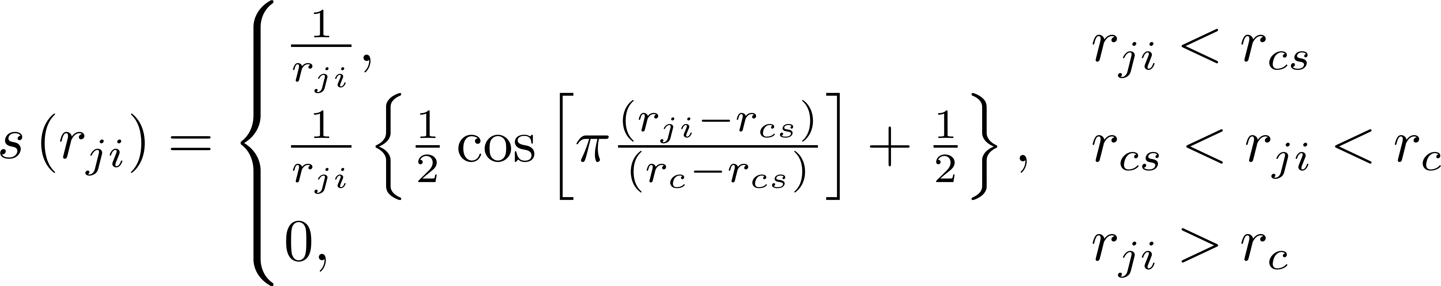
Deep Potential (DP) method assumptions and features
Mapping to a generalized local environment matrix

Slide 5
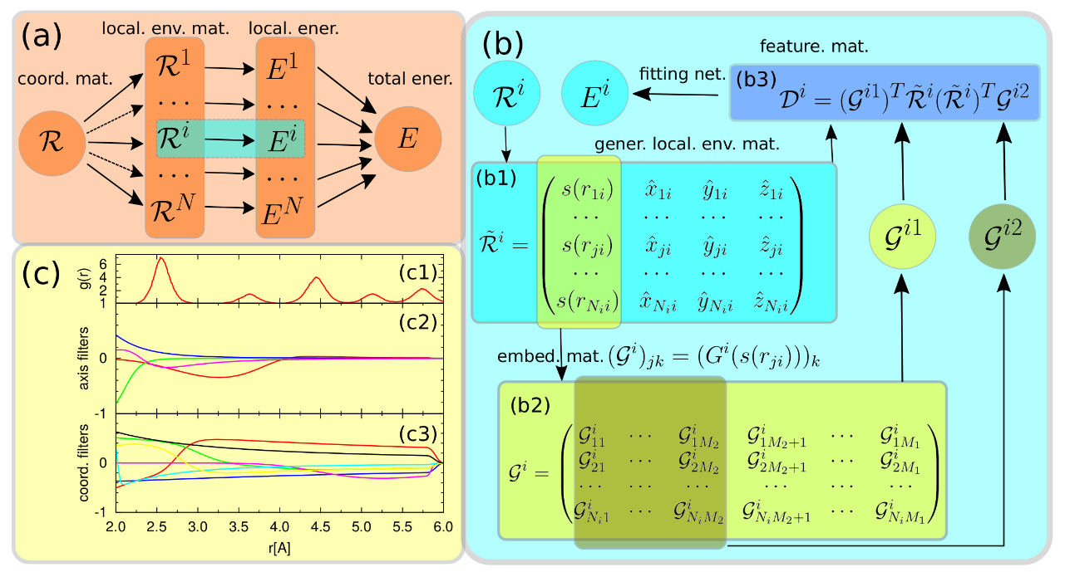
Deep Potential (DP) method assumptions and features
Local embedding network and fitting network (2-body embedding)
axis_neuron
Zhang, Linfeng, et al. "End-to-end symmetry preserving inter-atomic potential energy model for finite and extended systems." Advances in neural information processing systems 31 (2018).

Slide 6
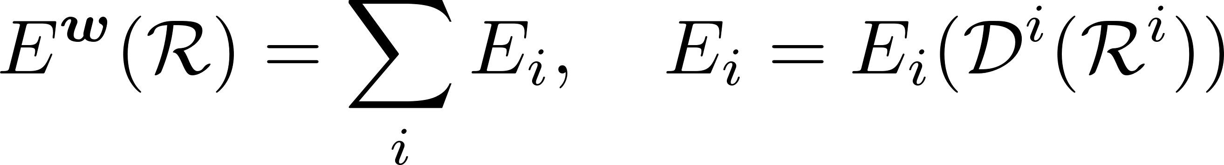
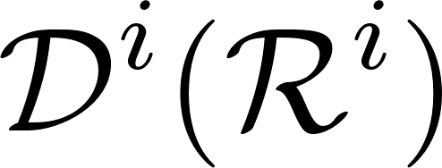
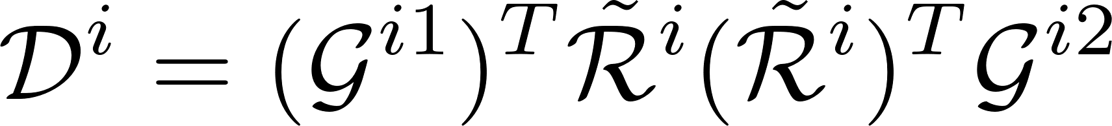
Deep Potential (DP) method Does the model preserves the symmetry invarances?
The DeePot model can be summarized as
I show that is invariant under translational, rotational, and permutational operations.
The loc. env. matrices contain relative distances only, hence translational invariance.
The coordinate and and axis filters are functions of scalars only (s(r_{ij})), while the product of gen. loc. env. only contains scalars and dot products between relative coordinate vectors, hence rotational invariance.
The matrix product between coordinate (axis) fileters and the gen. loc. env. matrices involve a summation on the atom indices within the cut-off radius, hence permutational invariance.
Zhang, Linfeng, et al. "End-to-end symmetry preserving inter-atomic potential energy model for finite and extended systems." Advances in neural information processing systems 31 (2018).

Slide 7
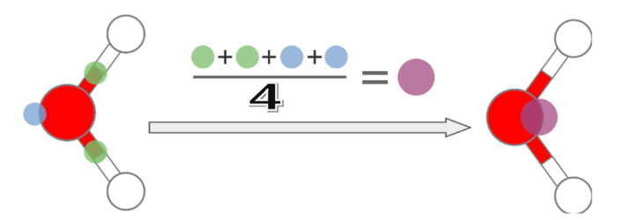

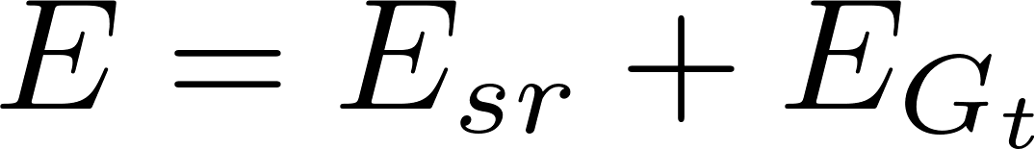
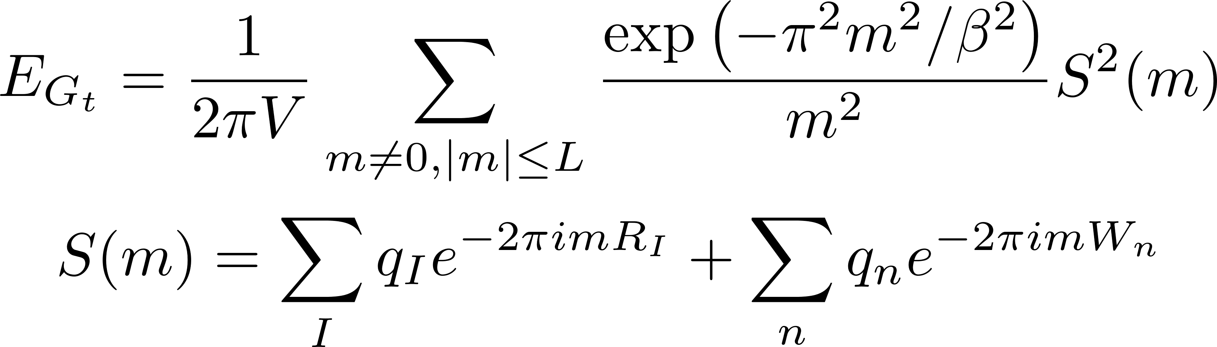
Deep Potential Long Range (DPLR)
Long range electrostatic interaction is approximated by distributions of spherical gaussian charges located at ionic and electronic sites (WC)
Spread
Ewald sumation for gaussian charges under periodic boundary conditions
The short-range contribution is constructed as in the standard DP model. However, E_{sr} is not equal to the standard DP energy because the Gaussian electrostatic energy E_{Gt} is subtracted from the DFT training data to avoid double counting
Zhang, Linfeng, et al. "A deep potential model with long-range electrostatic interactions." The Journal of Chemical Physics 156.12 (2022).

Slide 8

Training process
The parameters w contained in the encoding and fitting networks are obtained by a training process with the stochastic gradient descent method (fast and scalable optimization technique that updates model parameters using mini-batches of data points, good for large-scale machine learning tasks.
The aim is to minimize the Loss Function
Tunable prefactors
Batch size
l is index of training data (coordinates, energy, forces etc.)
The use of forces reduces the number of snapshots required to obtain a good model (N_{atoms} x 3 per snapshot)
Zhang, Linfeng, et al. "A deep potential model with long-range electrostatic interactions." The Journal of Chemical Physics 156.12 (2022).

Slide 9
Data collection: garbage in, garbage out”
AIMD sampling:
Good starting point and straightforward
Temperature defines what PES regions are explored.
Sampling at higher temperatures ensures that the model does not enter the extrapolation regime during production runs (guaranteed to happen when a lower temperature is used for sampling !)
Good for MD simulations at equilibrium, e.g. vibrational spectra, minima population, or thermodynamic properties.
Can be computationally expansive...
Sampling by proxy: Sample the PES at a lower level of theory--> long trajectory--> subsampled to generate representative set of geometries + single-point calculations at a higher level of theory
Highly accurate and representative reference data
Adaptive sampling: Preliminary ML-FF --> MD simulation --> collect new data if predictions become unreliable according to an uncertainty criterion
For NNP train ensemble of models (different parameter initialization). Discrepancy between their predictions = uncertainty estimate.
Metadynamics sampling: similar to adaptive smapling but dynamics is biased towards unexplored regions of the PES
Data consistency: Data has to be generated with the same level of theory!

Slide 10
DeepMD: Installation
$ python -m venv deepmd_env
$ source deepmd_env/bin/activate
$ pip install deepmd-kit
$ pip install deepmd-kit[cpu,lmp]
$ dp train –-help
$ lmp --help
$ pip install dpdata (for data conversion)
$ pip install cp2kdata (for data conversion)

Slide 11
Hands on: MLP for gas-phase CH₄
12Lect_shared
Generate a training using CP2K (AIMD @ 300K on Jed)
Convert CP2K data with dpdata
Training the Deep potential model (learning curve)
Freezing and testing the model
Running LAMMPS with DeepMD

