Slide 1
One week to answer the questions
Lecture 1
Lecture 2
Release of excercise 1
Answer of excercise 1
Release of excercise 2
Contact:
lise.boitard-crepeau@epfl.ch;
yameng.hao@epfl.ch

Slide 2
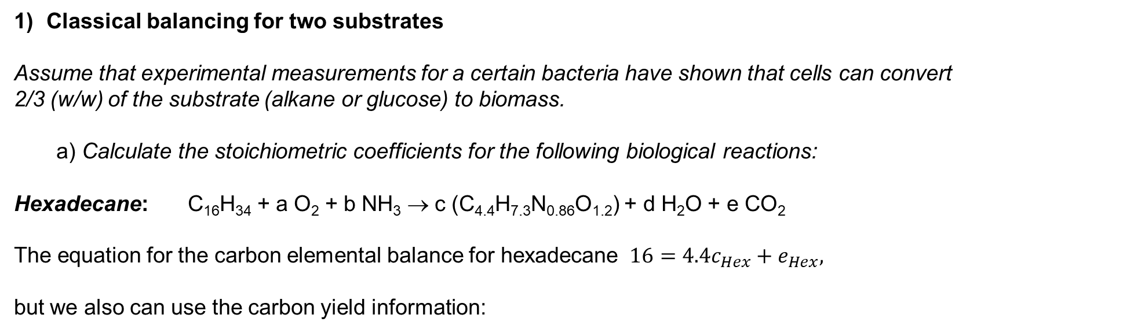
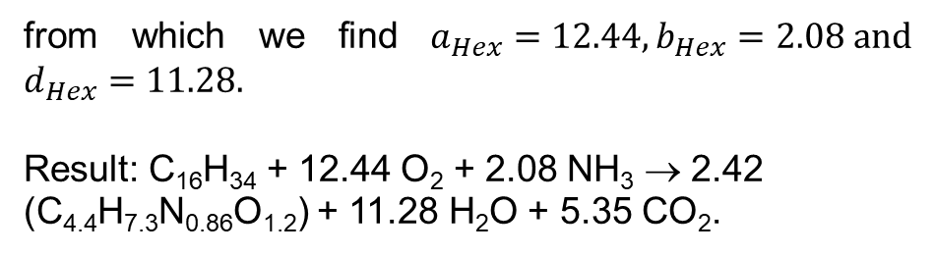
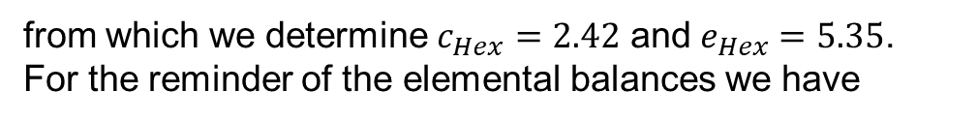
Classical balancing for two substrates
Assume that experimental measurements for a certain bacteria have shown that cells can convert
2/3 (w/w) of the substrate (alkane or glucose) to biomass.
a) Calculate the stoichiometric coefficients for the following biological reactions:
Hexadecane: C₁₆H₃₄ + a O₂ + b NH₃ → c (C_{4.4}H_{7.3}N_{0.86}O_{1.2}) + d H₂O + e CO₂
The equation for the carbon elemental balance for hexadecane $16=4.4c_{Hex}+e_{Hex},$
but we also can use the carbon yield information:
from which we find $a_{Hex}=12.44,b_{Hex}=2.08 \text{and} d_{Hex}=11.28.$
Result: C₁₆H₃₄ + 12.44 O₂ + 2.08 NH₃ → 2.42 (C_{4.4}H_{7.3}N_{0.86}O_{1.2}) + 11.28 H₂O + 5.35 CO₂.
from which we determine $c_{Hex}=2.42$ and $e_{Hex}=5.35$.
For the reminder of the elemental balances we have

Slide 3
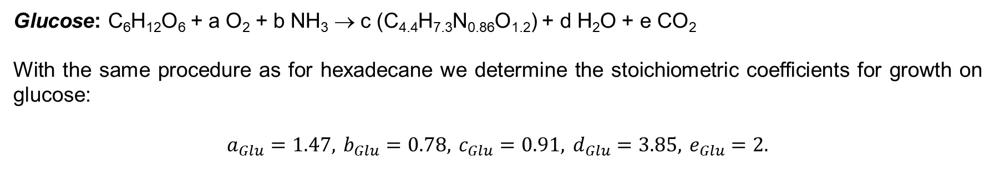
Glucose: C₆H₁₂O₆ + a O₂ + b NH₃ → c (C_{4.4}H_{7.3}N_{0.86}O_{1.2}) + d H₂O + e CO₂
With the same procedure as for hexadecane we determine the stoichiometric coefficients for growth on glucose:
$$a_{Glu}=1.47, b_{Glu}=0.78, c_{Glu}=0.91, d_{Glu}=3.85, e_{Glu}=2.$$

Slide 4
Calculate the yield coefficients Y_{X/S} (g dw cells /g substrate) and Y_{X/O2} (g dw cell /g O₂) for both
reactions. Comment on differences.
Molecular weights:
$${MW}_{Bio}=91.34, {MW}_{Hex}=226, {MW}_{Glu}=180 \text{and} {MW}_{O_{2}}=32.$$
For growth on Hexadecane: C₁₆H₃₄ + 12.44 O₂ + 2.08 NH₃ → 2.42 (C_{4.4}H_{7.3}N_{0.86}O_{1.2}) + 11.28 H₂O + 5.35 CO₂.
For growth on Glucose: C₆H₁₂O₆ + 1.47 O₂ + 0.78 NH₃ → 0.91 (C_{4.4}H_{7.3}N_{0.86}O_{1.2}) + 3.85 H₂O + 2 CO₂.
This means that the specific organism grows much better in Hexadecane than in Glucose but in order to achieve this it needs roughly three times the amount of oxygen per carbon biomass.

Slide 5
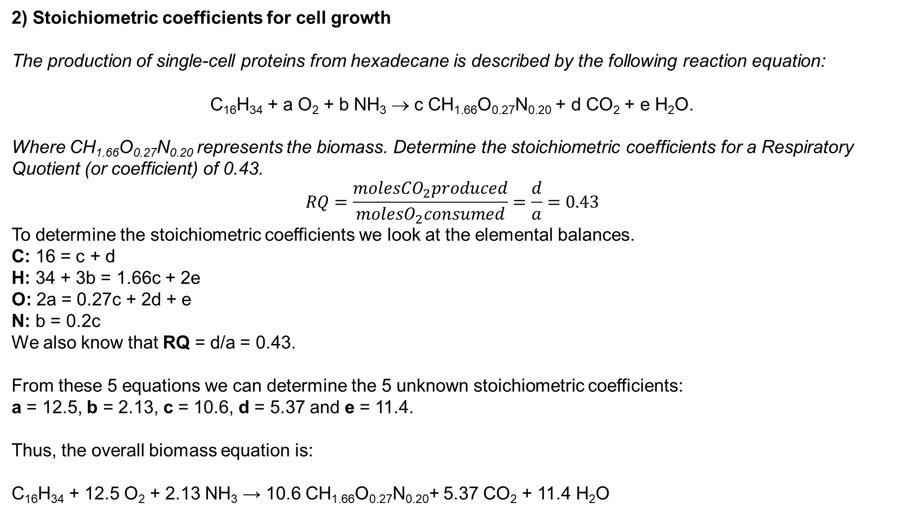
2) Stoichiometric coefficients for cell growth
The production of single-cell proteins from hexadecane is described by the following reaction equation:
C₁₆H₃₄ + a O₂ + b NH₃ → c CH_{1.66}O_{0.27}N_{0.20} + d CO₂ + e H₂O.
Where CH_{1.66}O_{0.27}N_{0.20} represents the biomass. Determine the stoichiometric coefficients for a Respiratory Quotient (or coefficient) of 0.43.
$$RQ=\frac{moles{CO}_{2}produced}{molesO_{2}consumed}=\frac{d}{a}=0.43$$
To determine the stoichiometric coefficients we look at the elemental balances.
C: 16 = c + d
H: 34 + 3b = 1.66c + 2e
O: 2a = 0.27c + 2d + e
N: b = 0.2c
We also know that RQ = d/a = 0.43.
From these 5 equations we can determine the 5 unknown stoichiometric coefficients:
a = 12.5, b = 2.13, c = 10.6, d = 5.37 and e = 11.4.
Thus, the overall biomass equation is:
C₁₆H₃₄ + 12.5 O₂ + 2.13 NH₃ → 10.6 CH_{1.66}O_{0.27}N_{0.20}+ 5.37 CO₂ + 11.4 H₂O

Slide 6
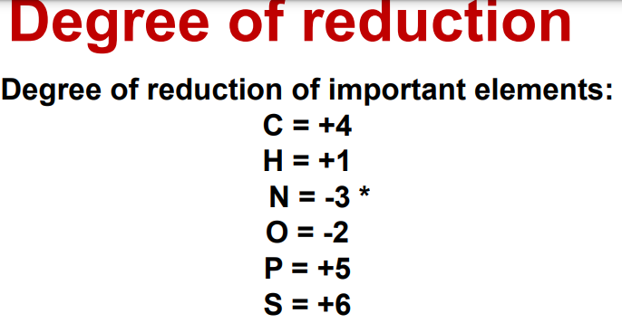
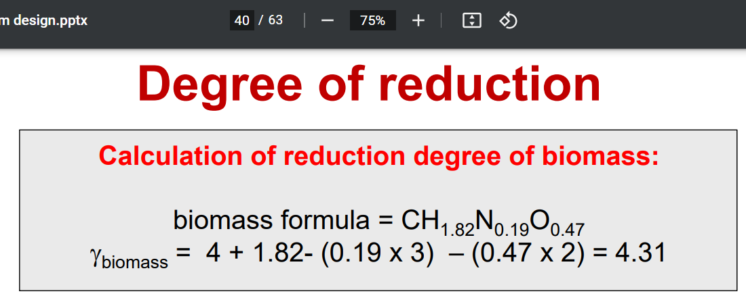
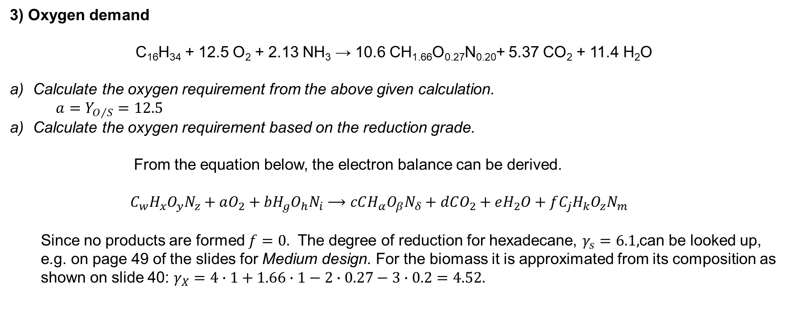
3) Oxygen demand
C₁₆H₃₄ + 12.5 O₂ + 2.13 NH₃ → 10.6 CH_{1.66}O_{0.27}N_{0.20}+ 5.37 CO₂ + 11.4 H₂O
Calculate the oxygen requirement from the above given calculation.
$a=Y_{O/S}=12.5$
Calculate the oxygen requirement based on the reduction grade.
From the equation below, the electron balance can be derived.
$$C_{w}H_{x}O_{y}N_{z}+aO_{2}+bH_{g}O_{h}N_{i}⟶cCH_{α}O_{β}N_{δ}+dCO_{2}+eH_{2}O+fC_{j}H_{k}O_{z}N_{m}$$
Since no products are formed $f=0.$ The degree of reduction for hexadecane, $γ_{s}=6.1,$can be looked up, e.g. on page 49 of the slides for Medium design. For the biomass it is approximated from its composition as shown on slide 40: $γ_{X}=4∙1+1.66∙1−2∙0.27−3∙0.2=4.52.$

Slide 7
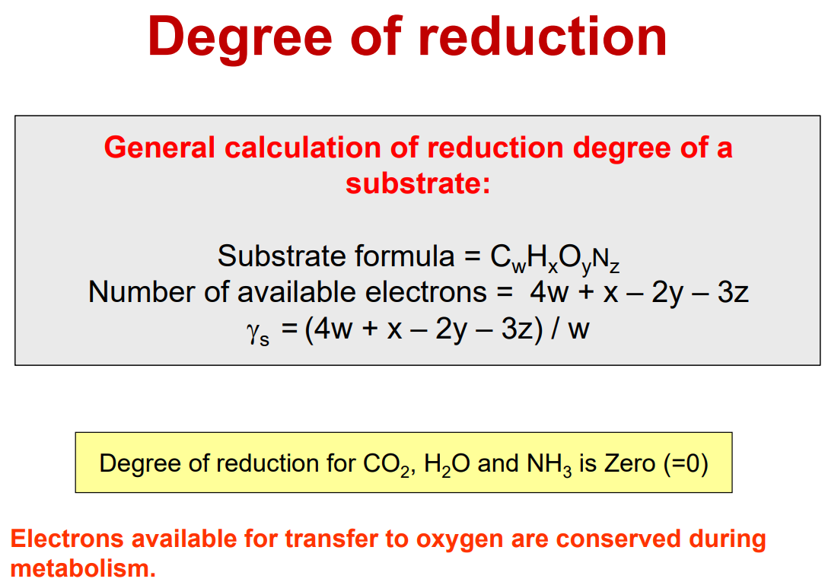
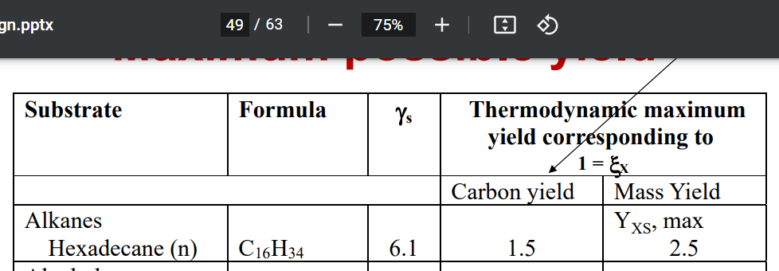
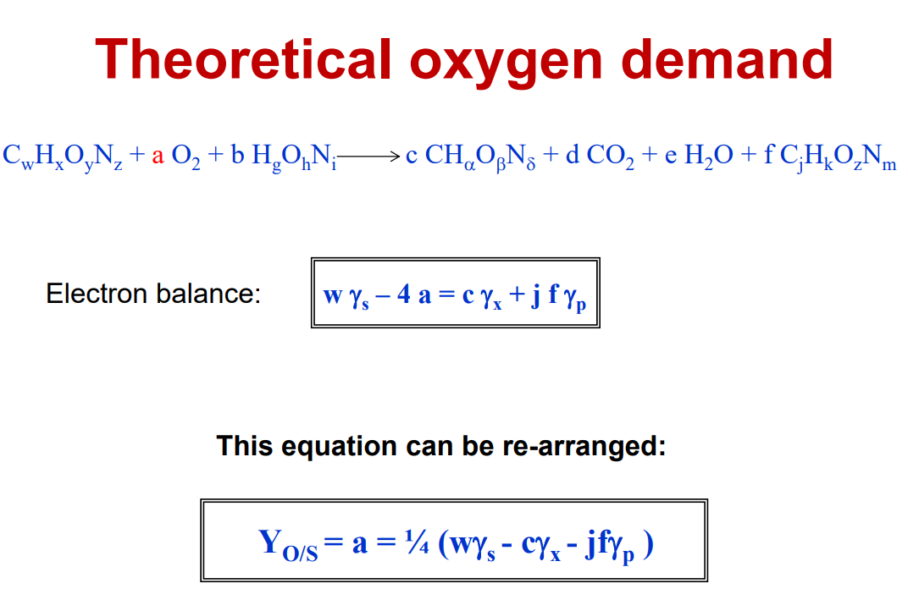
$$Y_{\frac{O}{S}}=\frac{1}{4}\left({wγ}_{s}−cγ_{X}−fjγ_{p}\right)=\frac{1}{4}\left(16∙6.1−10.6∙4.52\right)≅12.5$$

Slide 8
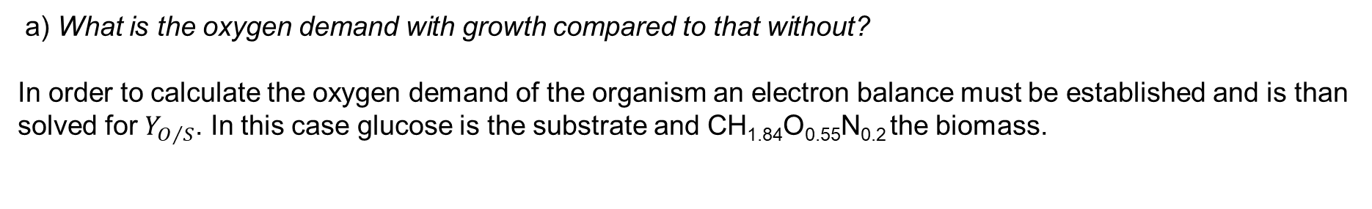
4) Product yield and oxygen demand
The chemical reaction equation for respiration of glucose is:
C₆H₁₂O₆ + 6 O₂ → 6 CO₂ + 6 H₂O
Candida utilis converts glucose to CO₂ and H₂O during growth. The cell composition is CH_{1.84}O_{0.55}N_{0.2} plus 5% ash. Yield of biomass from substrate is 0.5 g g⁻¹. Ammonia is used as nitrogen source.
a) What is the oxygen demand with growth compared to that without?
In order to calculate the oxygen demand of the organism an electron balance must be established and is than solved for $Y_{O/S}$. In this case glucose is the substrate and CH_{1.84}O_{0.55}N_{0.2} the biomass.

Slide 9
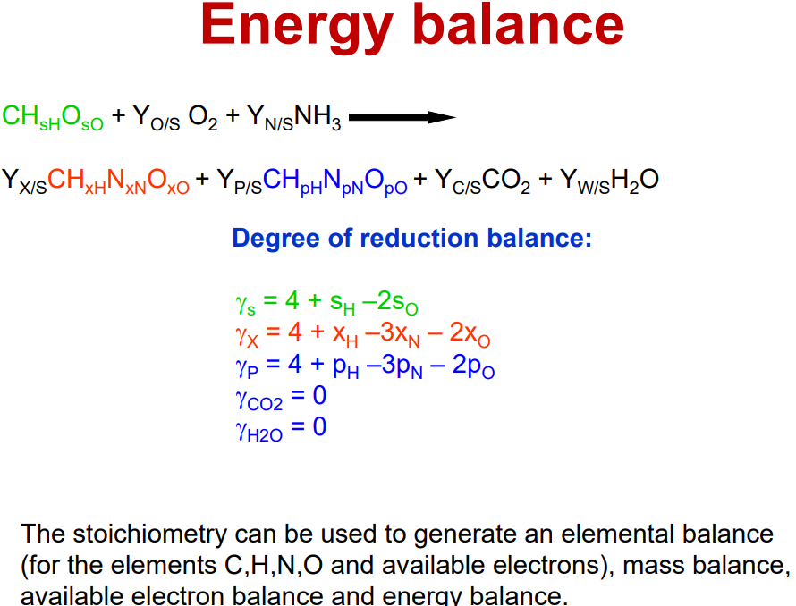
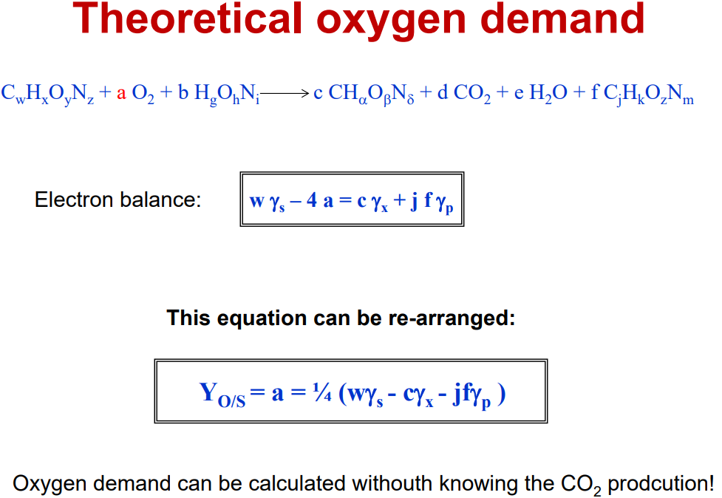
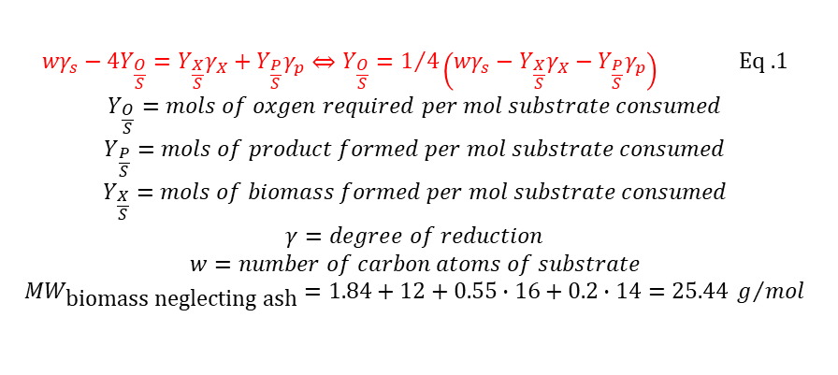
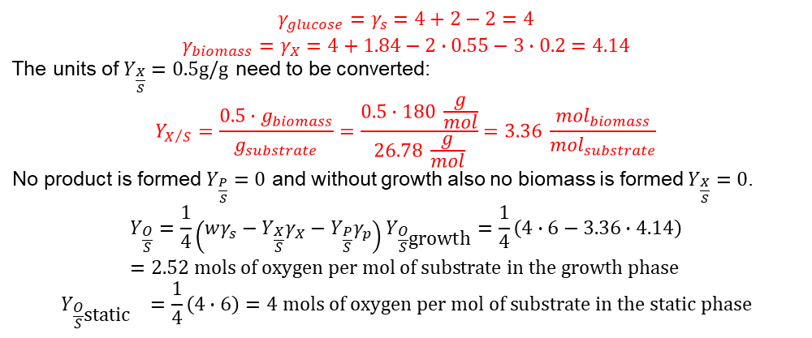
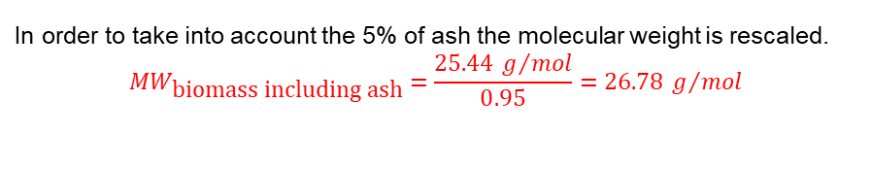
$${wγ}_{s}−4Y_{\frac{O}{S}}=Y_{\frac{X}{S}}γ_{X}+Y_{\frac{P}{S}}γ_{p}⇔Y_{\frac{O}{S}}=1/4\left({wγ}_{s}−Y_{\frac{X}{S}}γ_{X}−Y_{\frac{P}{S}}γ_{p}\right) \text{Eq}\text{ .1}$$
$$Y_{\frac{O}{S}}=mols of oxgen required per mol substrate consumed$$
$$Y_{\frac{P}{S}}=mols of product formed per mol substrate consumed$$
$$Y_{\frac{X}{S}}=mols of biomass formed per mol substrate consumed$$
$$γ=degree of reduction$$
$$w=number of carbon atoms of substrate$$
$${MW}_{\text{biomass} \text{neglecting} \text{ash}}=1.84+12+0.55∙16+0.2∙14=25.44 g/{mol}$$
In order to take into account the 5% of ash the molecular weight is rescaled.
$${MW}_{\text{biomass} \text{including} \text{ash}}=\frac{25.44 g/{mol}}{0.95}=26.78 g/{mol}$$
$$γ_{glucose}=γ_{s}=4+2−2=4$$
$$γ_{biomass}=γ_{X}=4+1.84−2∙0.55−3∙0.2=4.14$$
The units of $Y_{\frac{X}{S}}=0.5\text{g}\text{/}\text{g}$ need to be converted:
$$Y_{X/S}=\frac{0.5∙g_{biomass}}{g_{substrate}}=\frac{0.5∙180 \frac{g}{mol}}{26.78 \frac{g}{mol}}=3.3\text{6} \frac{{mol}_{biomass}}{{mol}_{substrate}}$$
No product is formed $Y_{\frac{P}{S}}=0$ and without growth also no biomass is formed $Y_{\frac{X}{S}}=0$.
$$Y_{\frac{O}{S}}=\frac{1}{4}\left(wγ_{s}−Y_{\frac{X}{S}}γ_{X}−Y_{\frac{P}{S}}γ_{p}\right)Y_{\frac{O}{S}\text{growth}}=\frac{1}{4}\left(4∙6−3.36∙4.14\right)=2.\text{52} \text{mols} \text{of} \text{oxygen} \text{per} \text{mol} \text{of} \text{substrate} \text{in} \text{the} \text{growth} \text{phase}$$
$$Y_{\frac{O}{S}\text{static} }=\frac{1}{4}\left(4∙6\right)=4 \text{mols} \text{of} \text{oxygen} \text{per} \text{mol} \text{of} \text{substrate} \text{in} \text{the} \text{static} \text{phase}$$

Slide 10
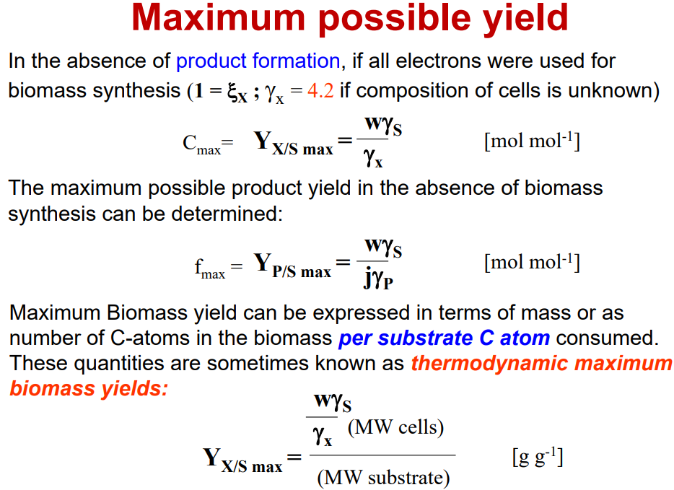
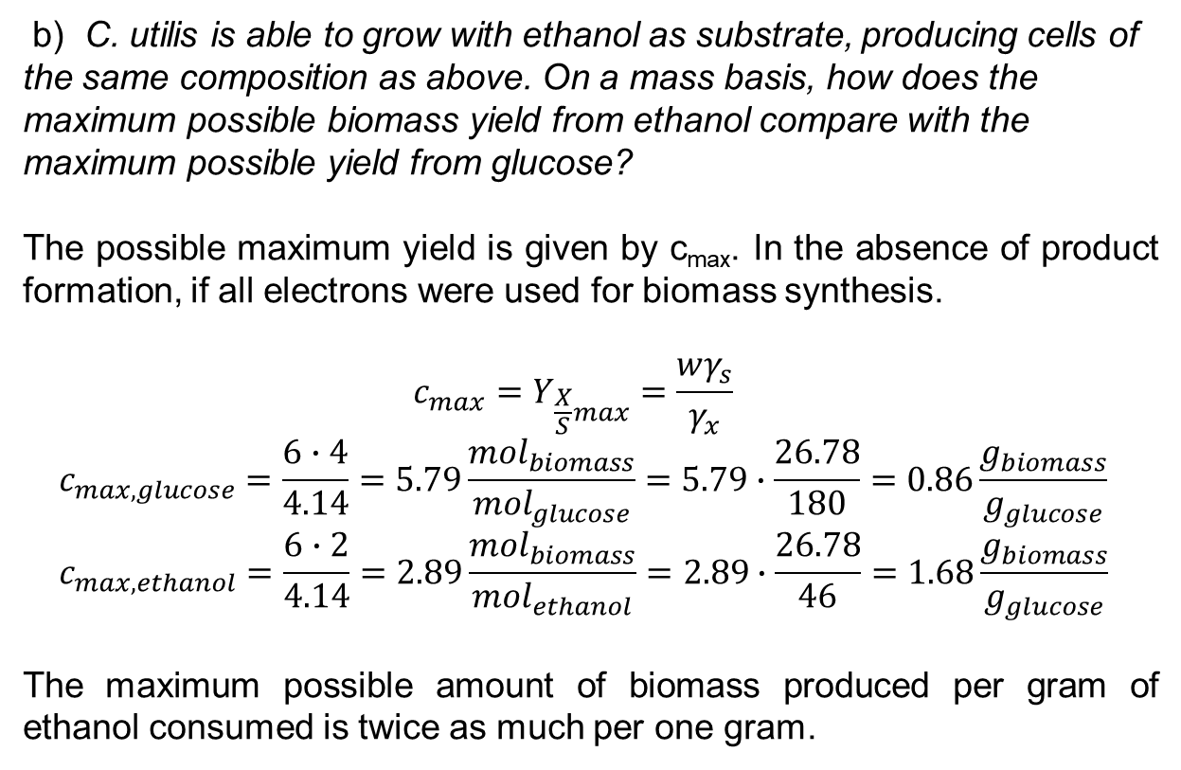
b) C. utilis is able to grow with ethanol as substrate, producing cells of the same composition as above. On a mass basis, how does the maximum possible biomass yield from ethanol compare with the maximum possible yield from glucose?
The possible maximum yield is given by c_{max}. In the absence of product formation, if all electrons were used for biomass synthesis.
$$c_{max}=Y_{\frac{X}{S}max}=\frac{wγ_{s}}{γ_{x}}$$
$$c_{max,glucose}=\frac{6∙4}{4.14}=5.79\frac{{mol}_{biomass}}{{mol}_{glucose}}=5.79∙\frac{26.78}{180}=0.86\frac{g_{biomass}}{g_{glucose}}$$
$$c_{max,ethanol}=\frac{6∙2}{4.14}=2.89\frac{{mol}_{biomass}}{{mol}_{ethanol}}=2.89∙\frac{26.78}{46}=1.68\frac{g_{biomass}}{g_{glucose}}$$
The maximum possible amount of biomass produced per gram of ethanol consumed is twice as much per one gram.

