Slide 1
Solid state chemistry and energy application
Paul
EPFL LFIM
Ecole Polytechnique Fédérale de Lausanne
March 2025

Slide 2
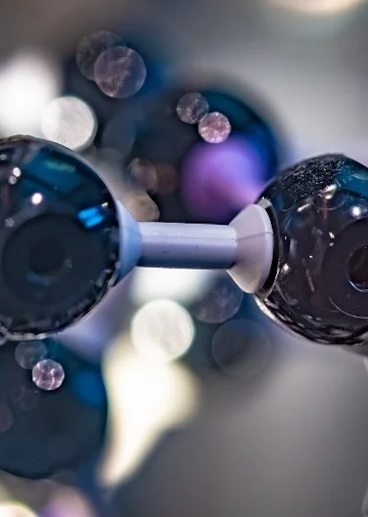
Solid State Chemistry
Closed-packed structure
3D modelling

Slide 3
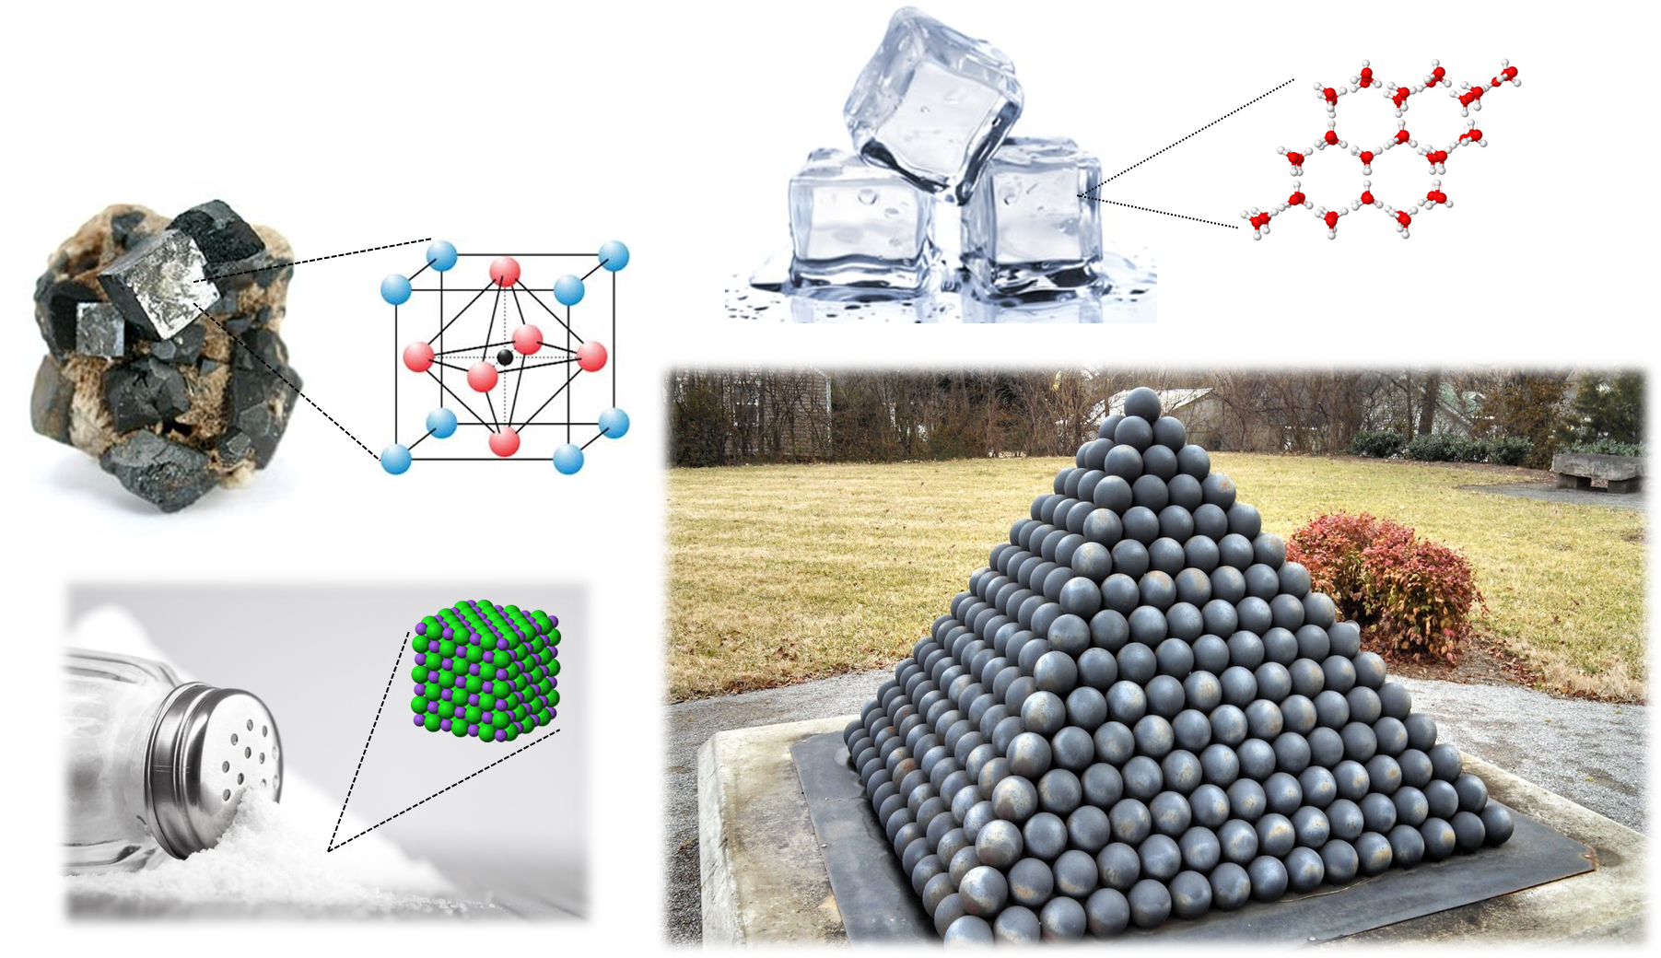
Closed-packed structure

Slide 4
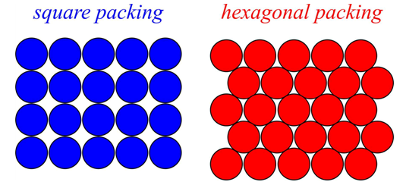
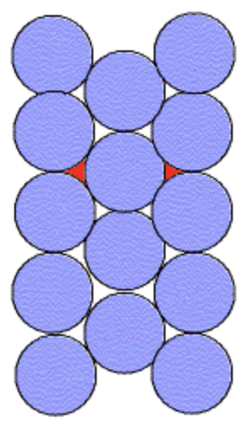
Closed packing in 2D
Minimize empty space
Maximizing numbers of neighboring spheres
→ how to stack the layers in the 3rd dimension to minimize empty space?

Slide 5
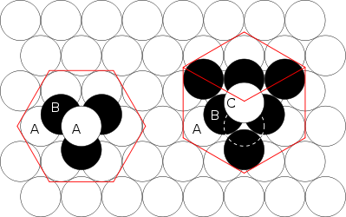
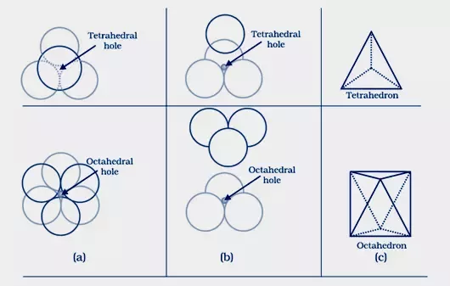
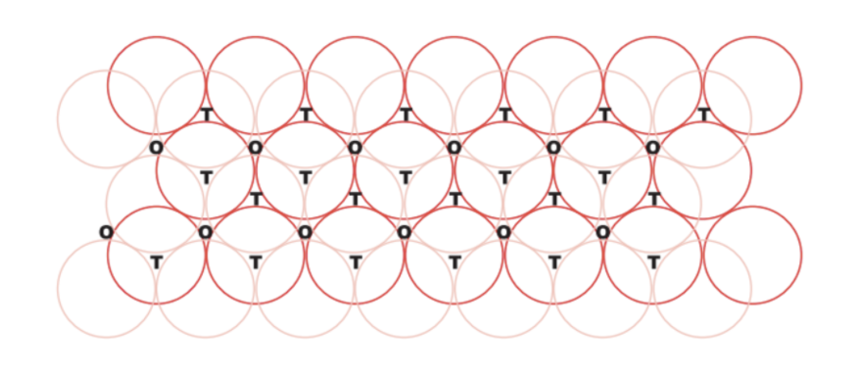
Stacking in 3D
*The two types of closed packing systems!
hcp*
ccp/fcc*
hcp*
ccp/fcc*
Number of Td holes/voids = 2x number of atoms Number of Oh holes/voids = number of atoms

Slide 6
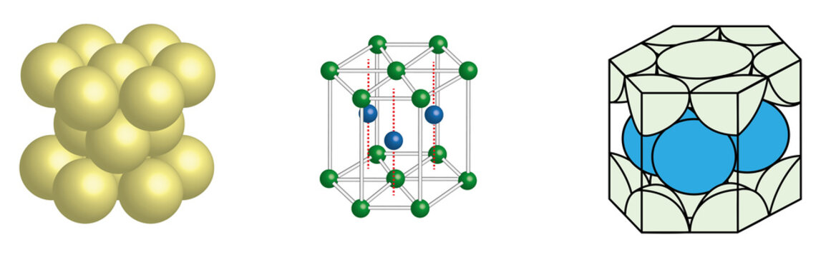
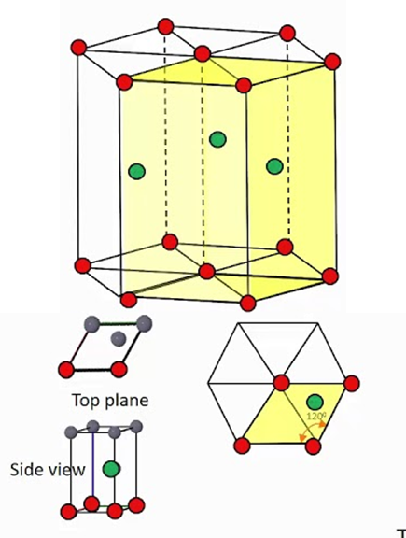
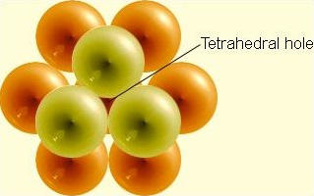
Hexagoal closest packing (HCP)
Hexagonal close packing

Slide 7
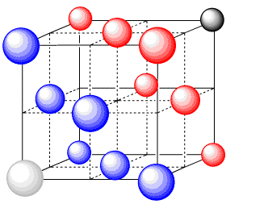
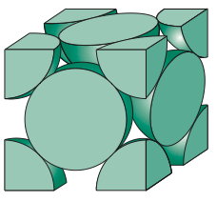
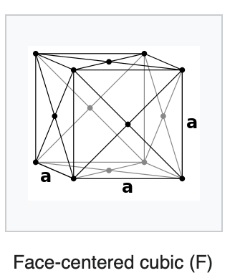
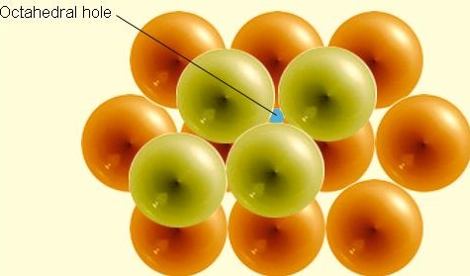
Cubic close packed/ Face-centered cubic (FCC)

Slide 8
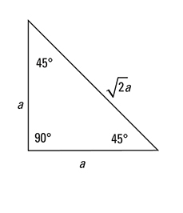
FCC exercise: How to determine the packing efficiency/volume taken up by the spheres in FCC structure?
Express the volume of the unit cell (cube) in terms of r
Determine the volume of spheres in the cube
Calculate the packing efficiency/percentage of the unit cells volume that they take up
x
4r
x

Slide 9
Exercise: How can you determine the packing efficiency/percent volume taken up by the spheres in a CCP structure?
1). Lets first determine the volume of the box in terms of r, the radius of the close packed spheres.
Due to the close packed structure the face diagonal in the cell is = 4r.
The Pythagorean theorem says x² + x² = z²
As such, 2x² = 16r²
Then x = 2*sqr(2)*r or sqr(8)*r
And the cell volume (V_{cell}) = 16*sqr(2)*r³
2) Now we must determine the volume of the spheres.
In general the volume of a sphere is 4/3πr³
How many spheres are there in a FCC array? 4
So the volume of atom (V_{atoms}) is 16/3πr³
3) Now we can calculate packing efficiency/volume taken up by atoms in FCC
Packing efficiency = V_{atoms}/V_{cell} =​ (16/3)*πr³/16*sqr(2)*r³
Packing efficiency = 0.74 or 74% of the unit cell was filled by atoms
x
4r
x

Slide 10
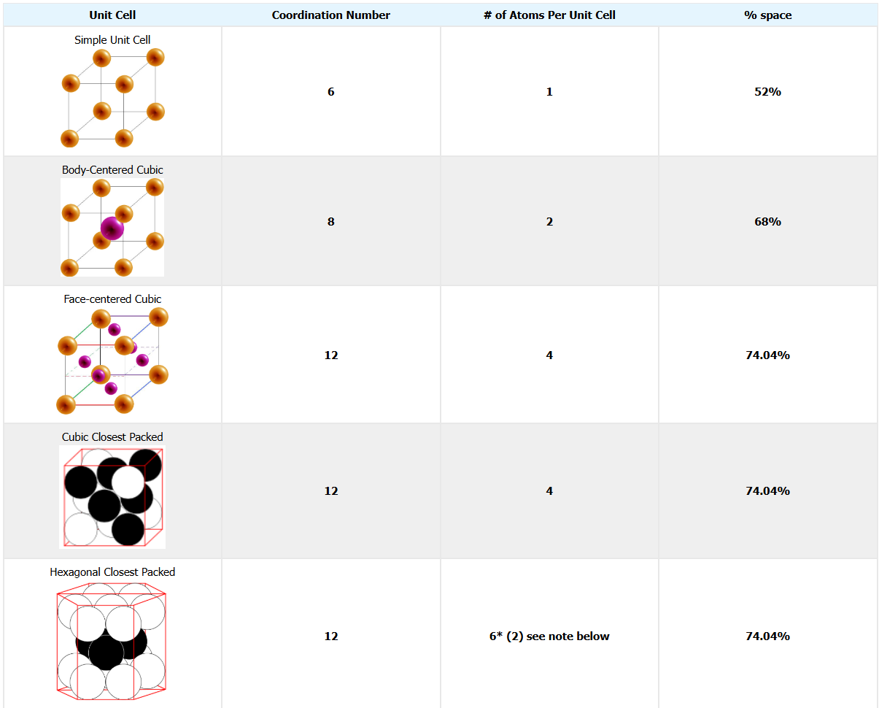
Unit Cell | Packing Efficiency / %
Simple Cubic | 52%
Body-Centered Cubic | 68%
Face-Centered Cubic | 74.04%
Hexagonal Closest Packed | 74.04%

Slide 11
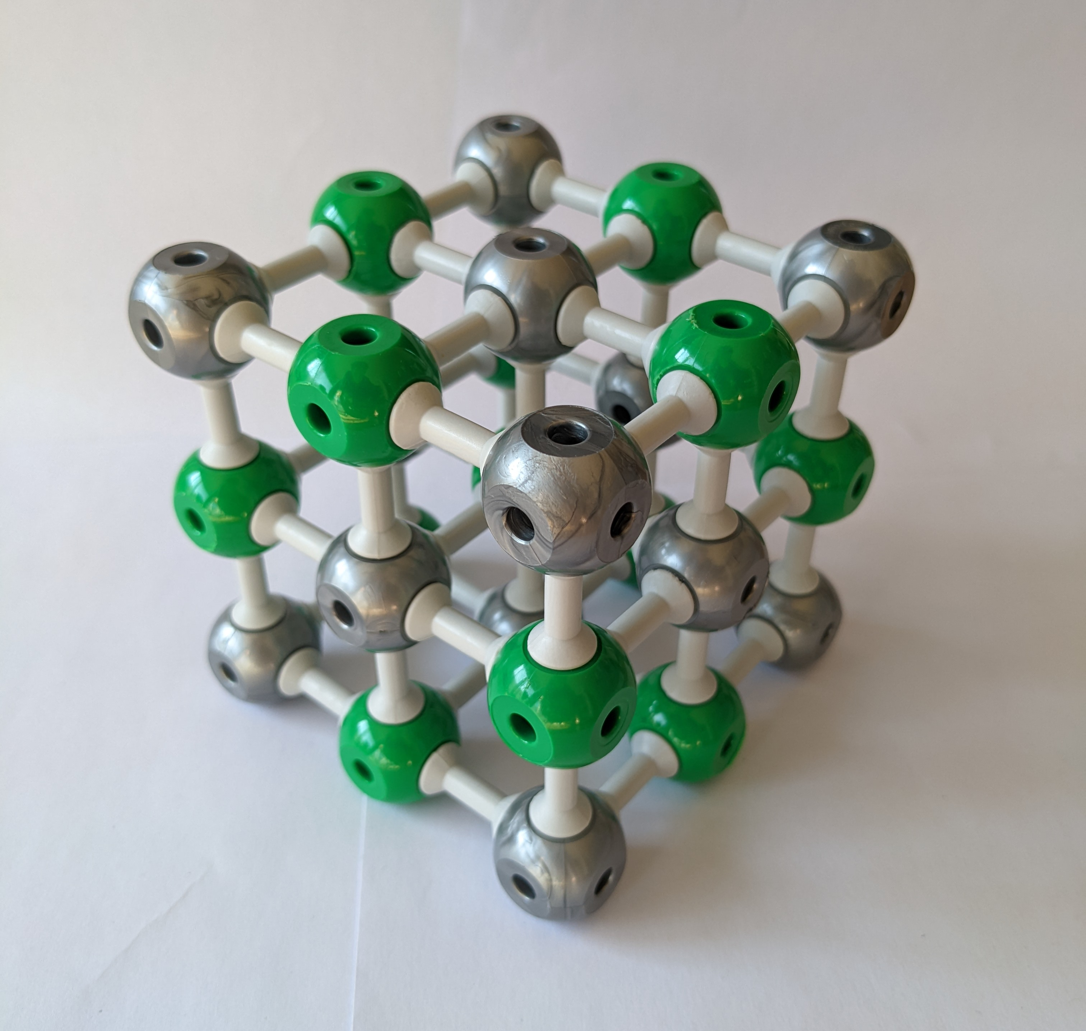
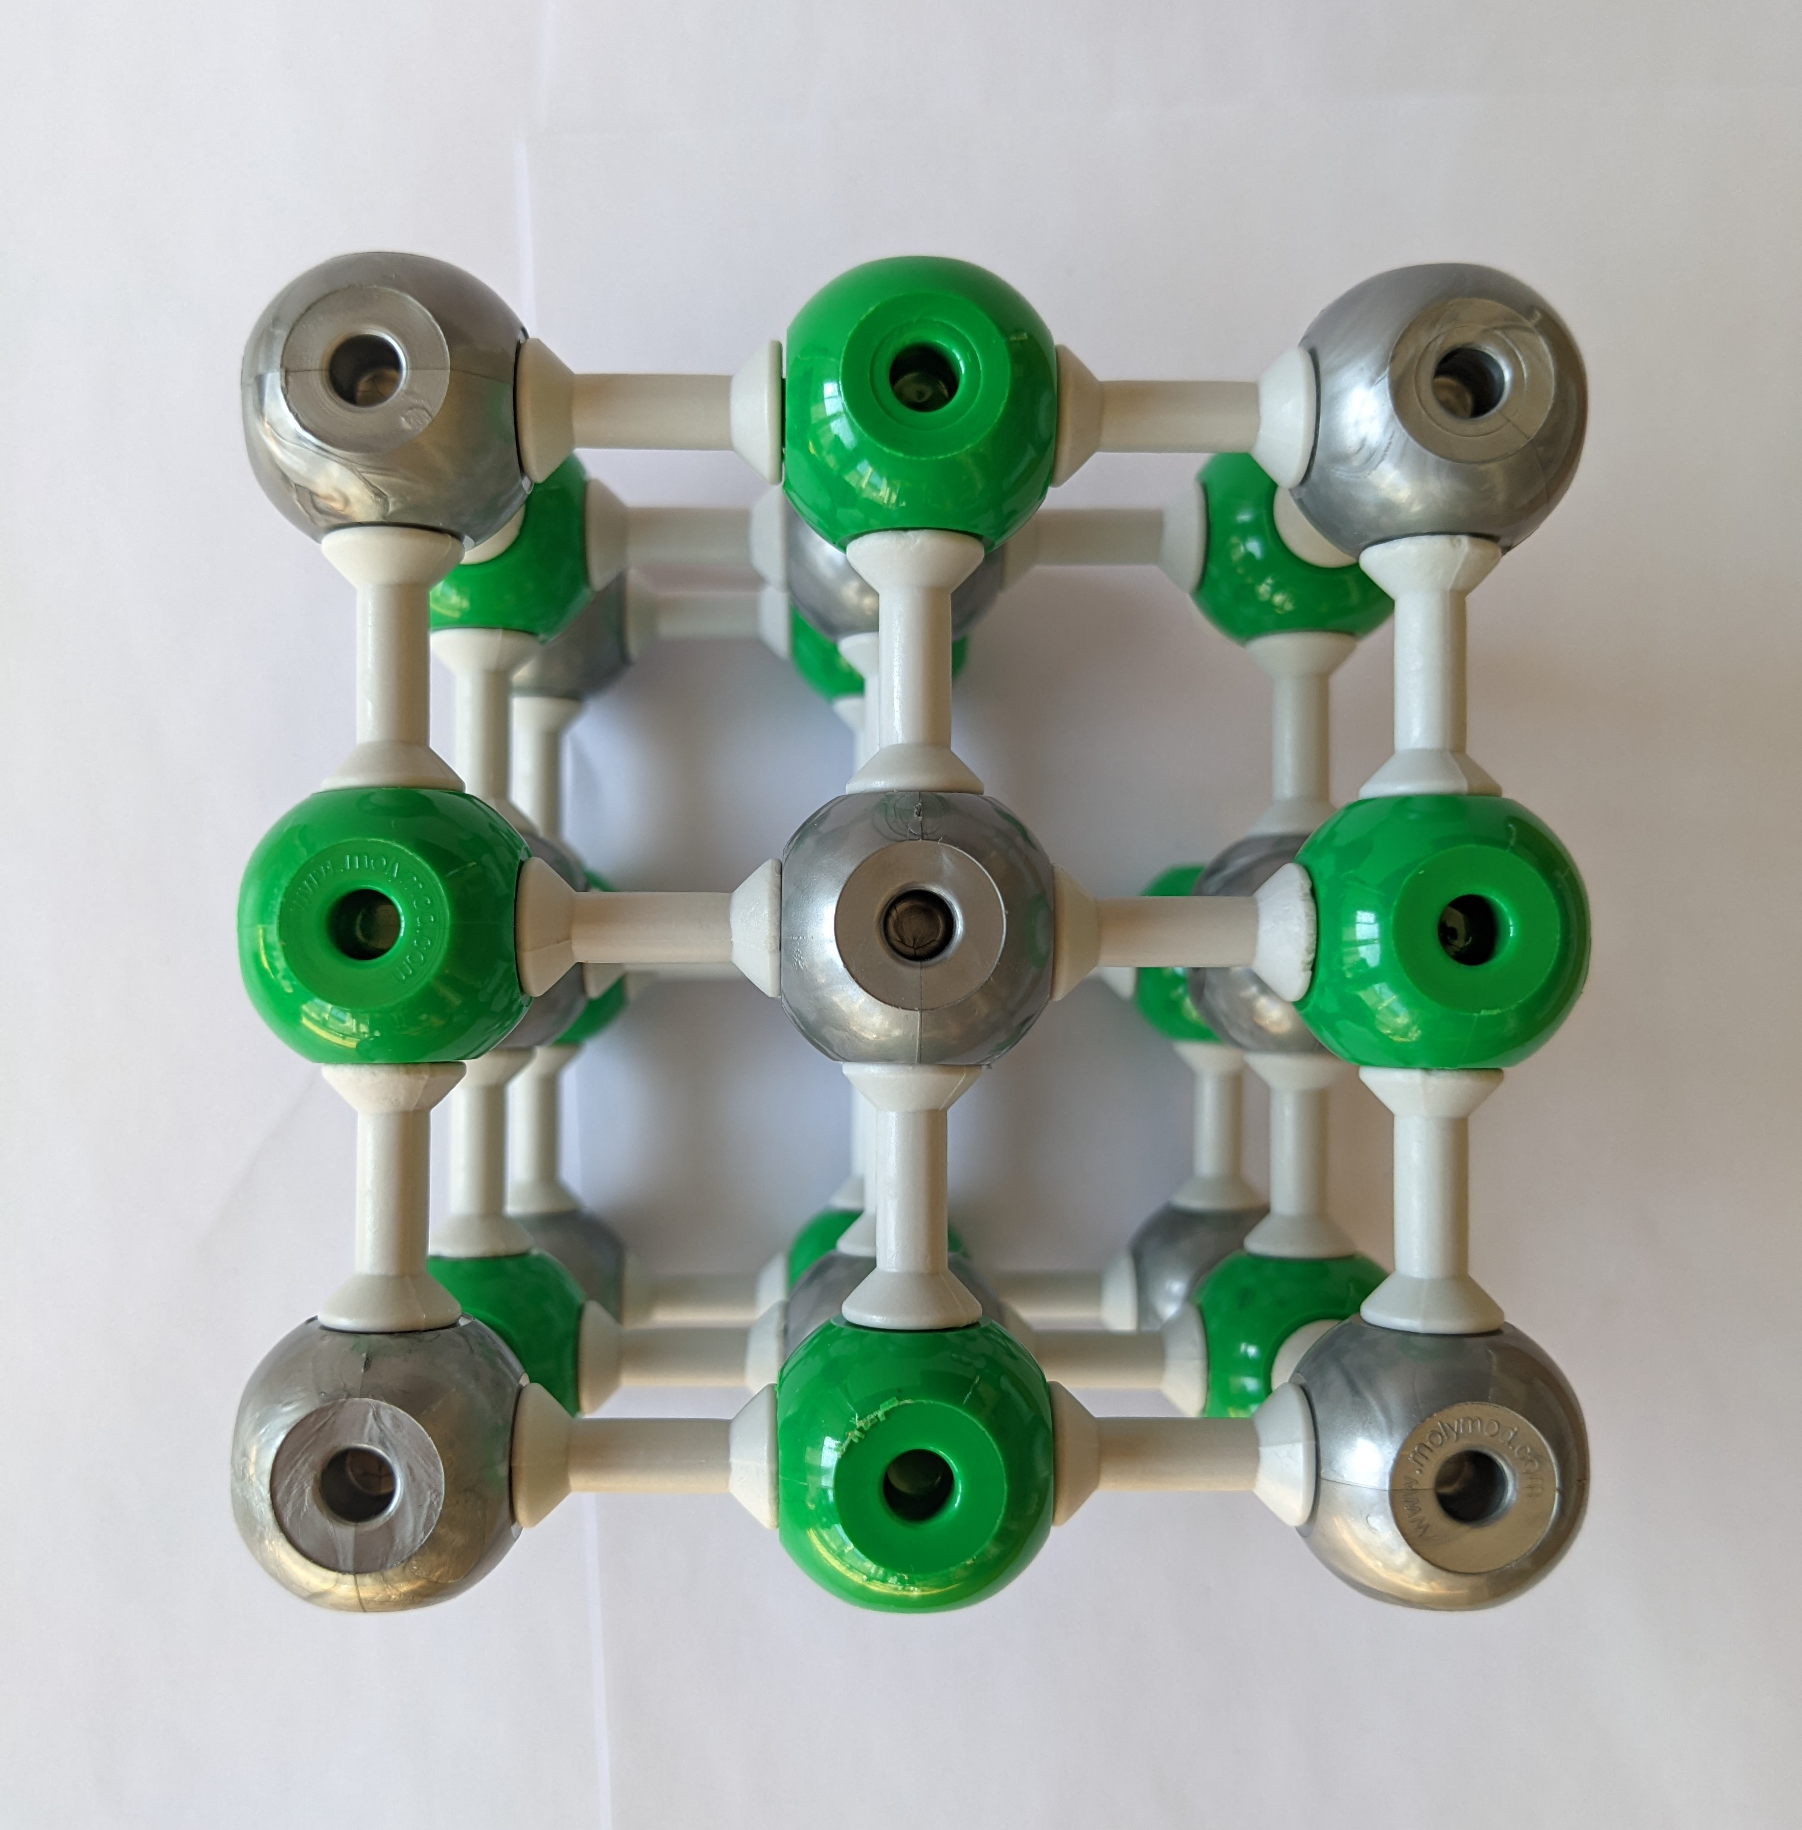
Rocksalt structure Example: NaCl
grey = Na⁺
green = Cl⁻
Coordination number of Na:
Coordination number of Cl:
Packing of crystal system (only consider the grey spheres):
Number of Na atoms (grey) per unit cell:
Number of Cl atoms (green) per unit cell:
Which voids are filled with green speheres?
6
6
Face-centered cubic
8 corners / 8 6 faces / 2
= 4
12 edges / 4 1 in the center
= 4
All of the octahedral voids are filled

Slide 12
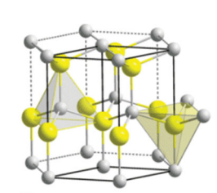
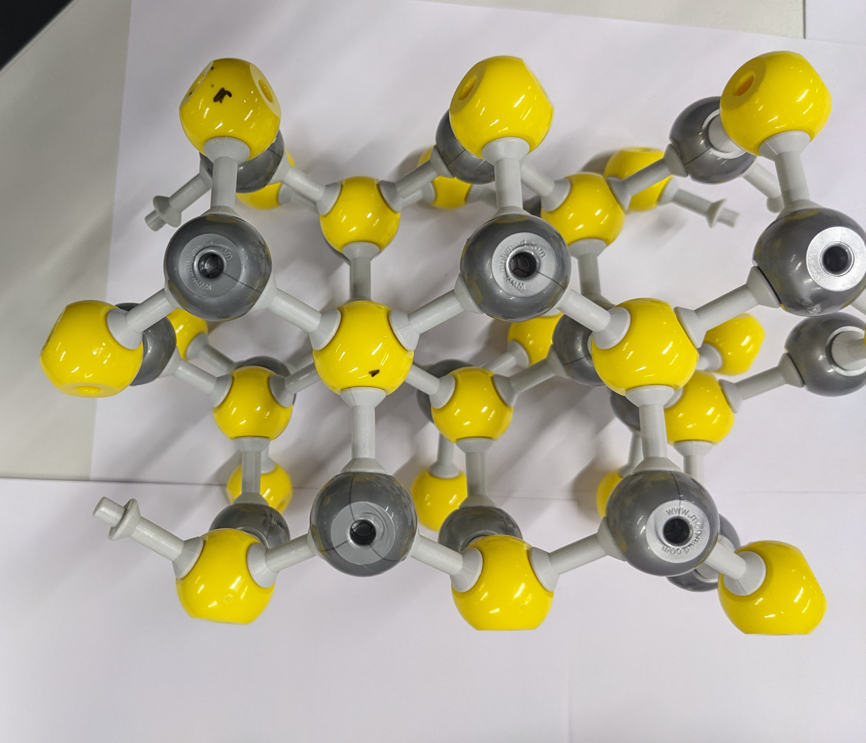
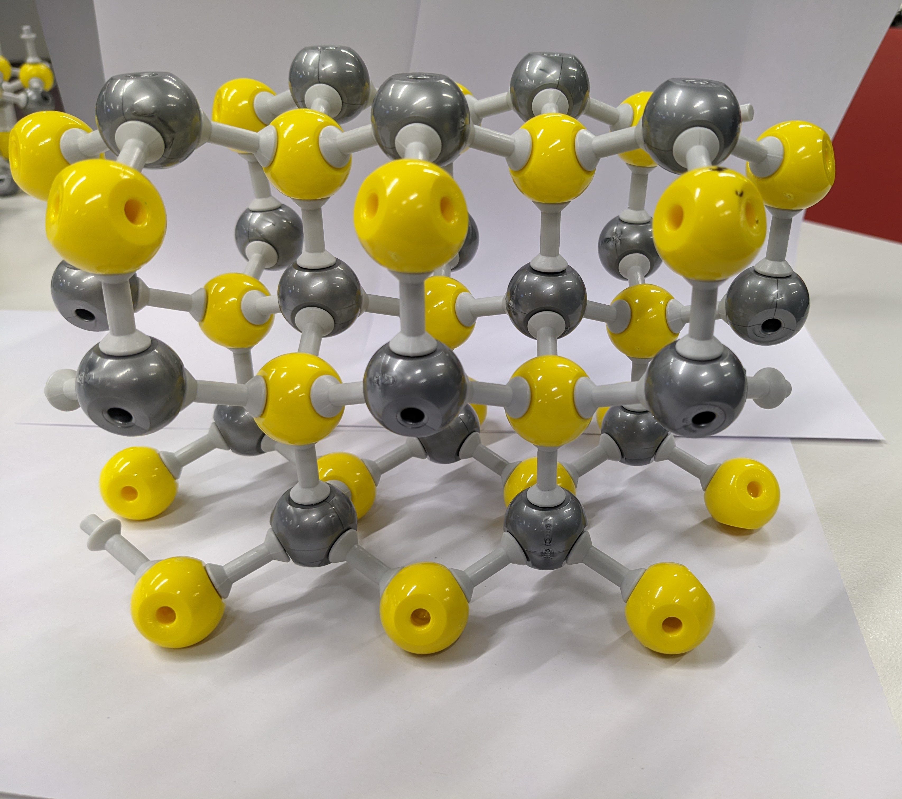
ZnS / Wurtzite
Coordination number of Zn:
Coordination number of S:
Packing of crystal system (only consider the yellow spheres):
Number of S atoms (yellow) per unit cell:
Number of Zn atoms (grey) per unit cell:
Which voids are filled with grey spheres?
4
4
Hexagonal closed packed
2
2
Half of the tetrahedral voids (all T+) are filled. Octahedral voids are empty.
grey = Zn²⁺
yellow = S²⁻

Slide 13
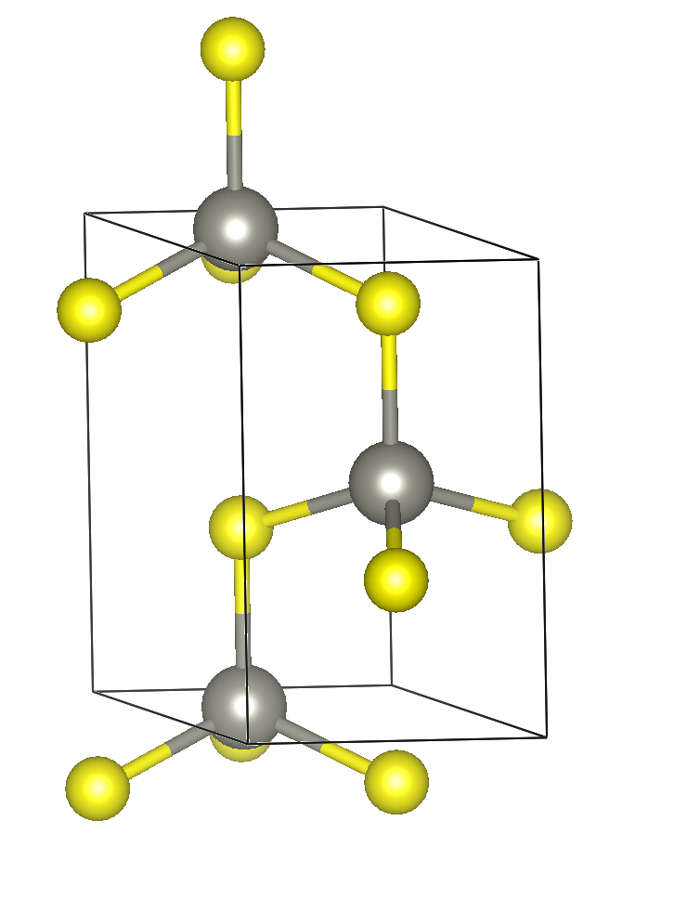
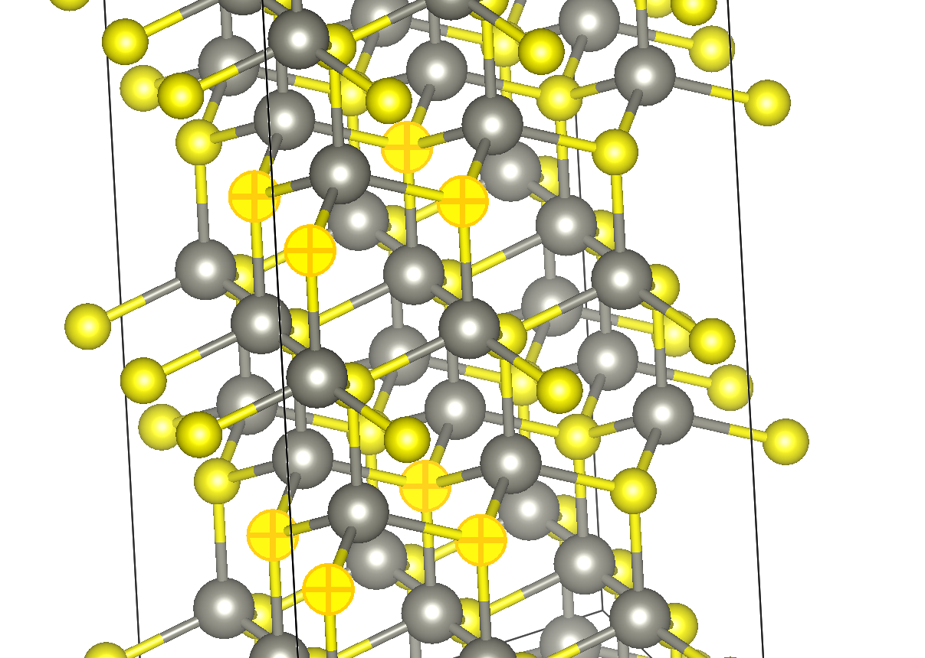
Wurtzite: ABAB both for Zn and S ions
Unit cell with S in corners
Alternative unit cell

Slide 14
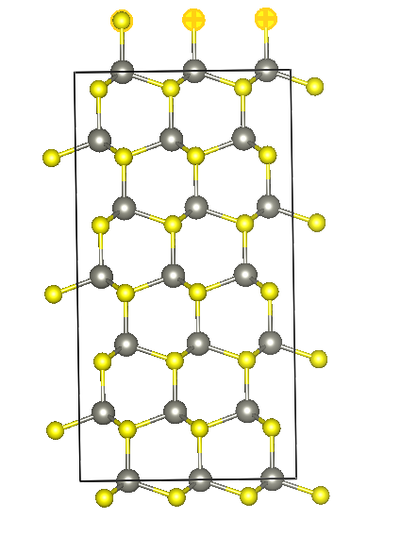
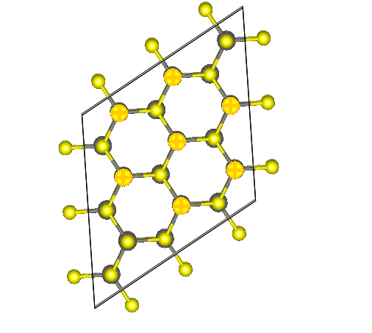
Wurtzite: ABA layers
Hint: extend (transform) the unic cell in vesta, to better visualize the layers.
Both the zinc ions and the sulfide ions are forming hcp layers

Slide 15
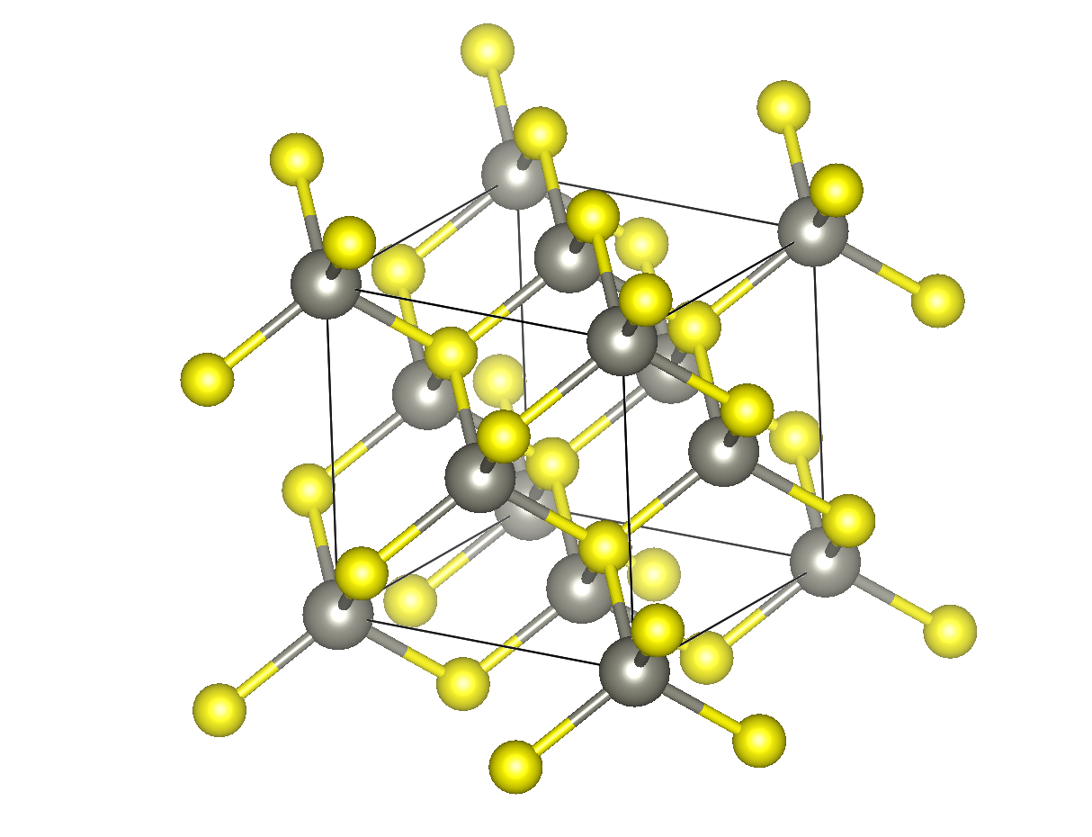
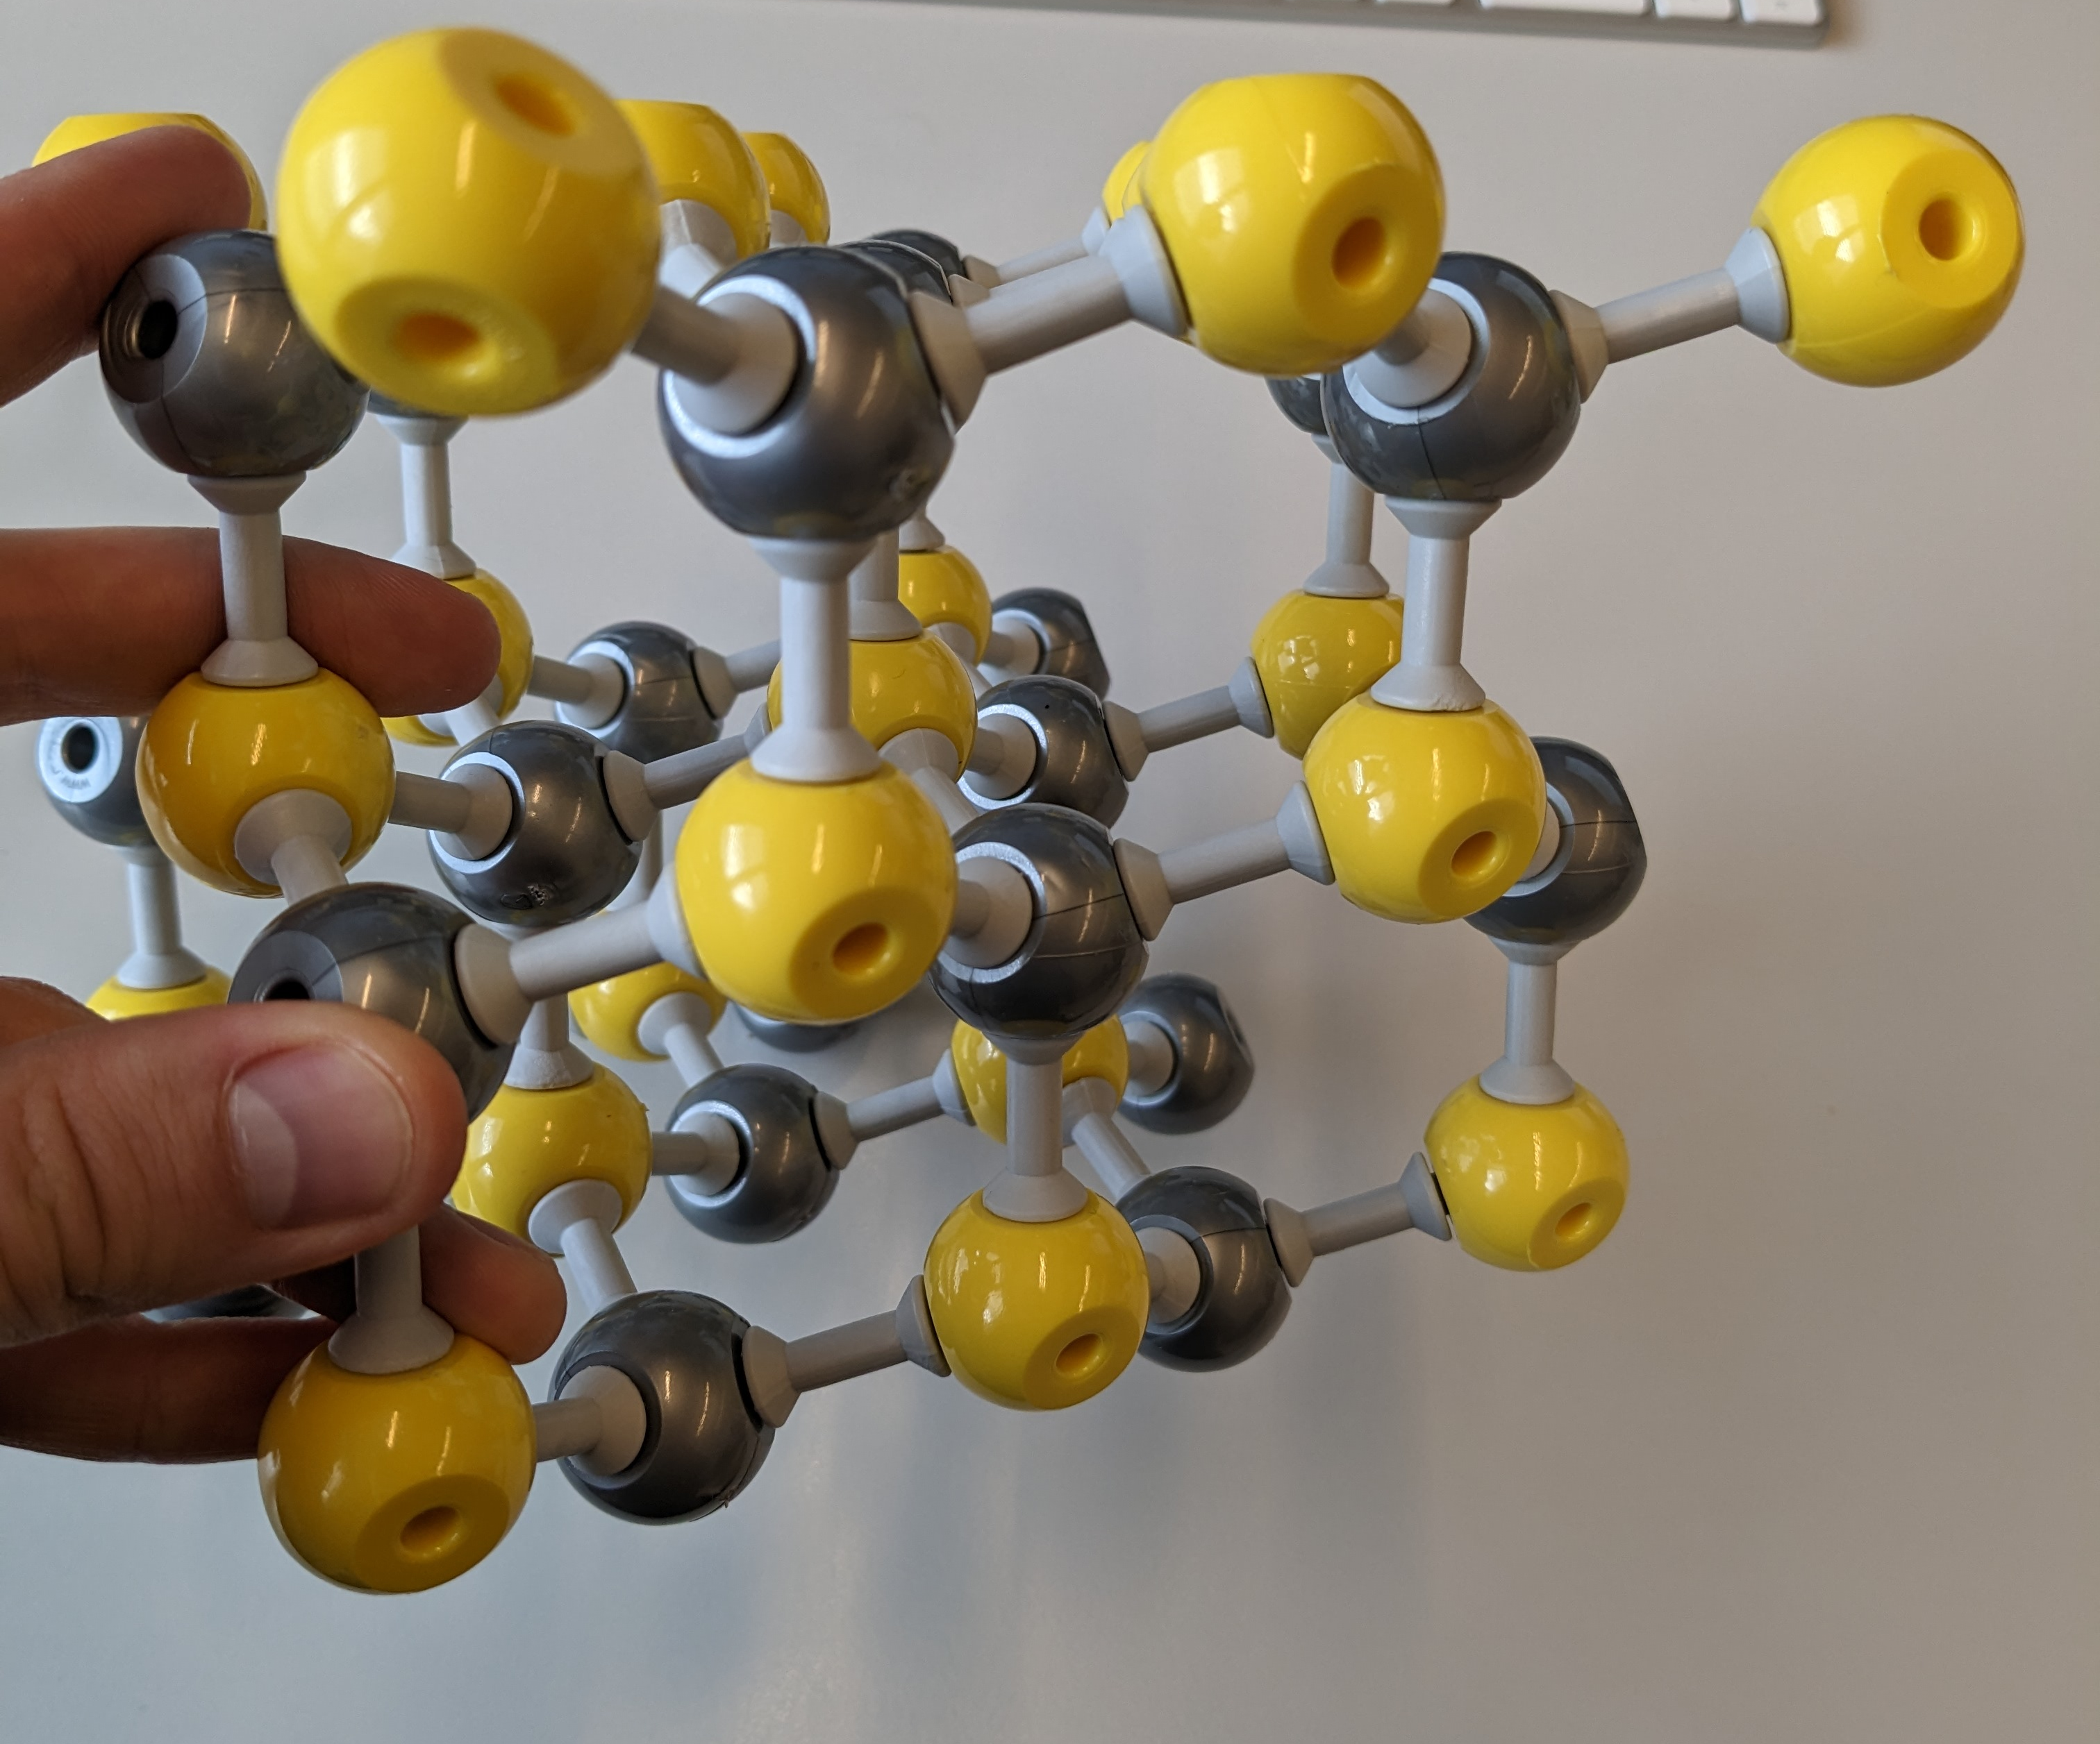
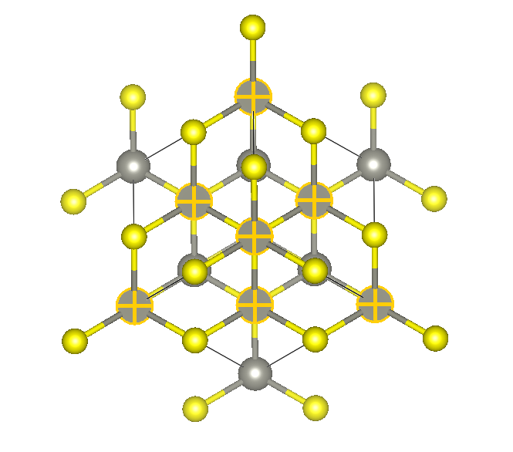
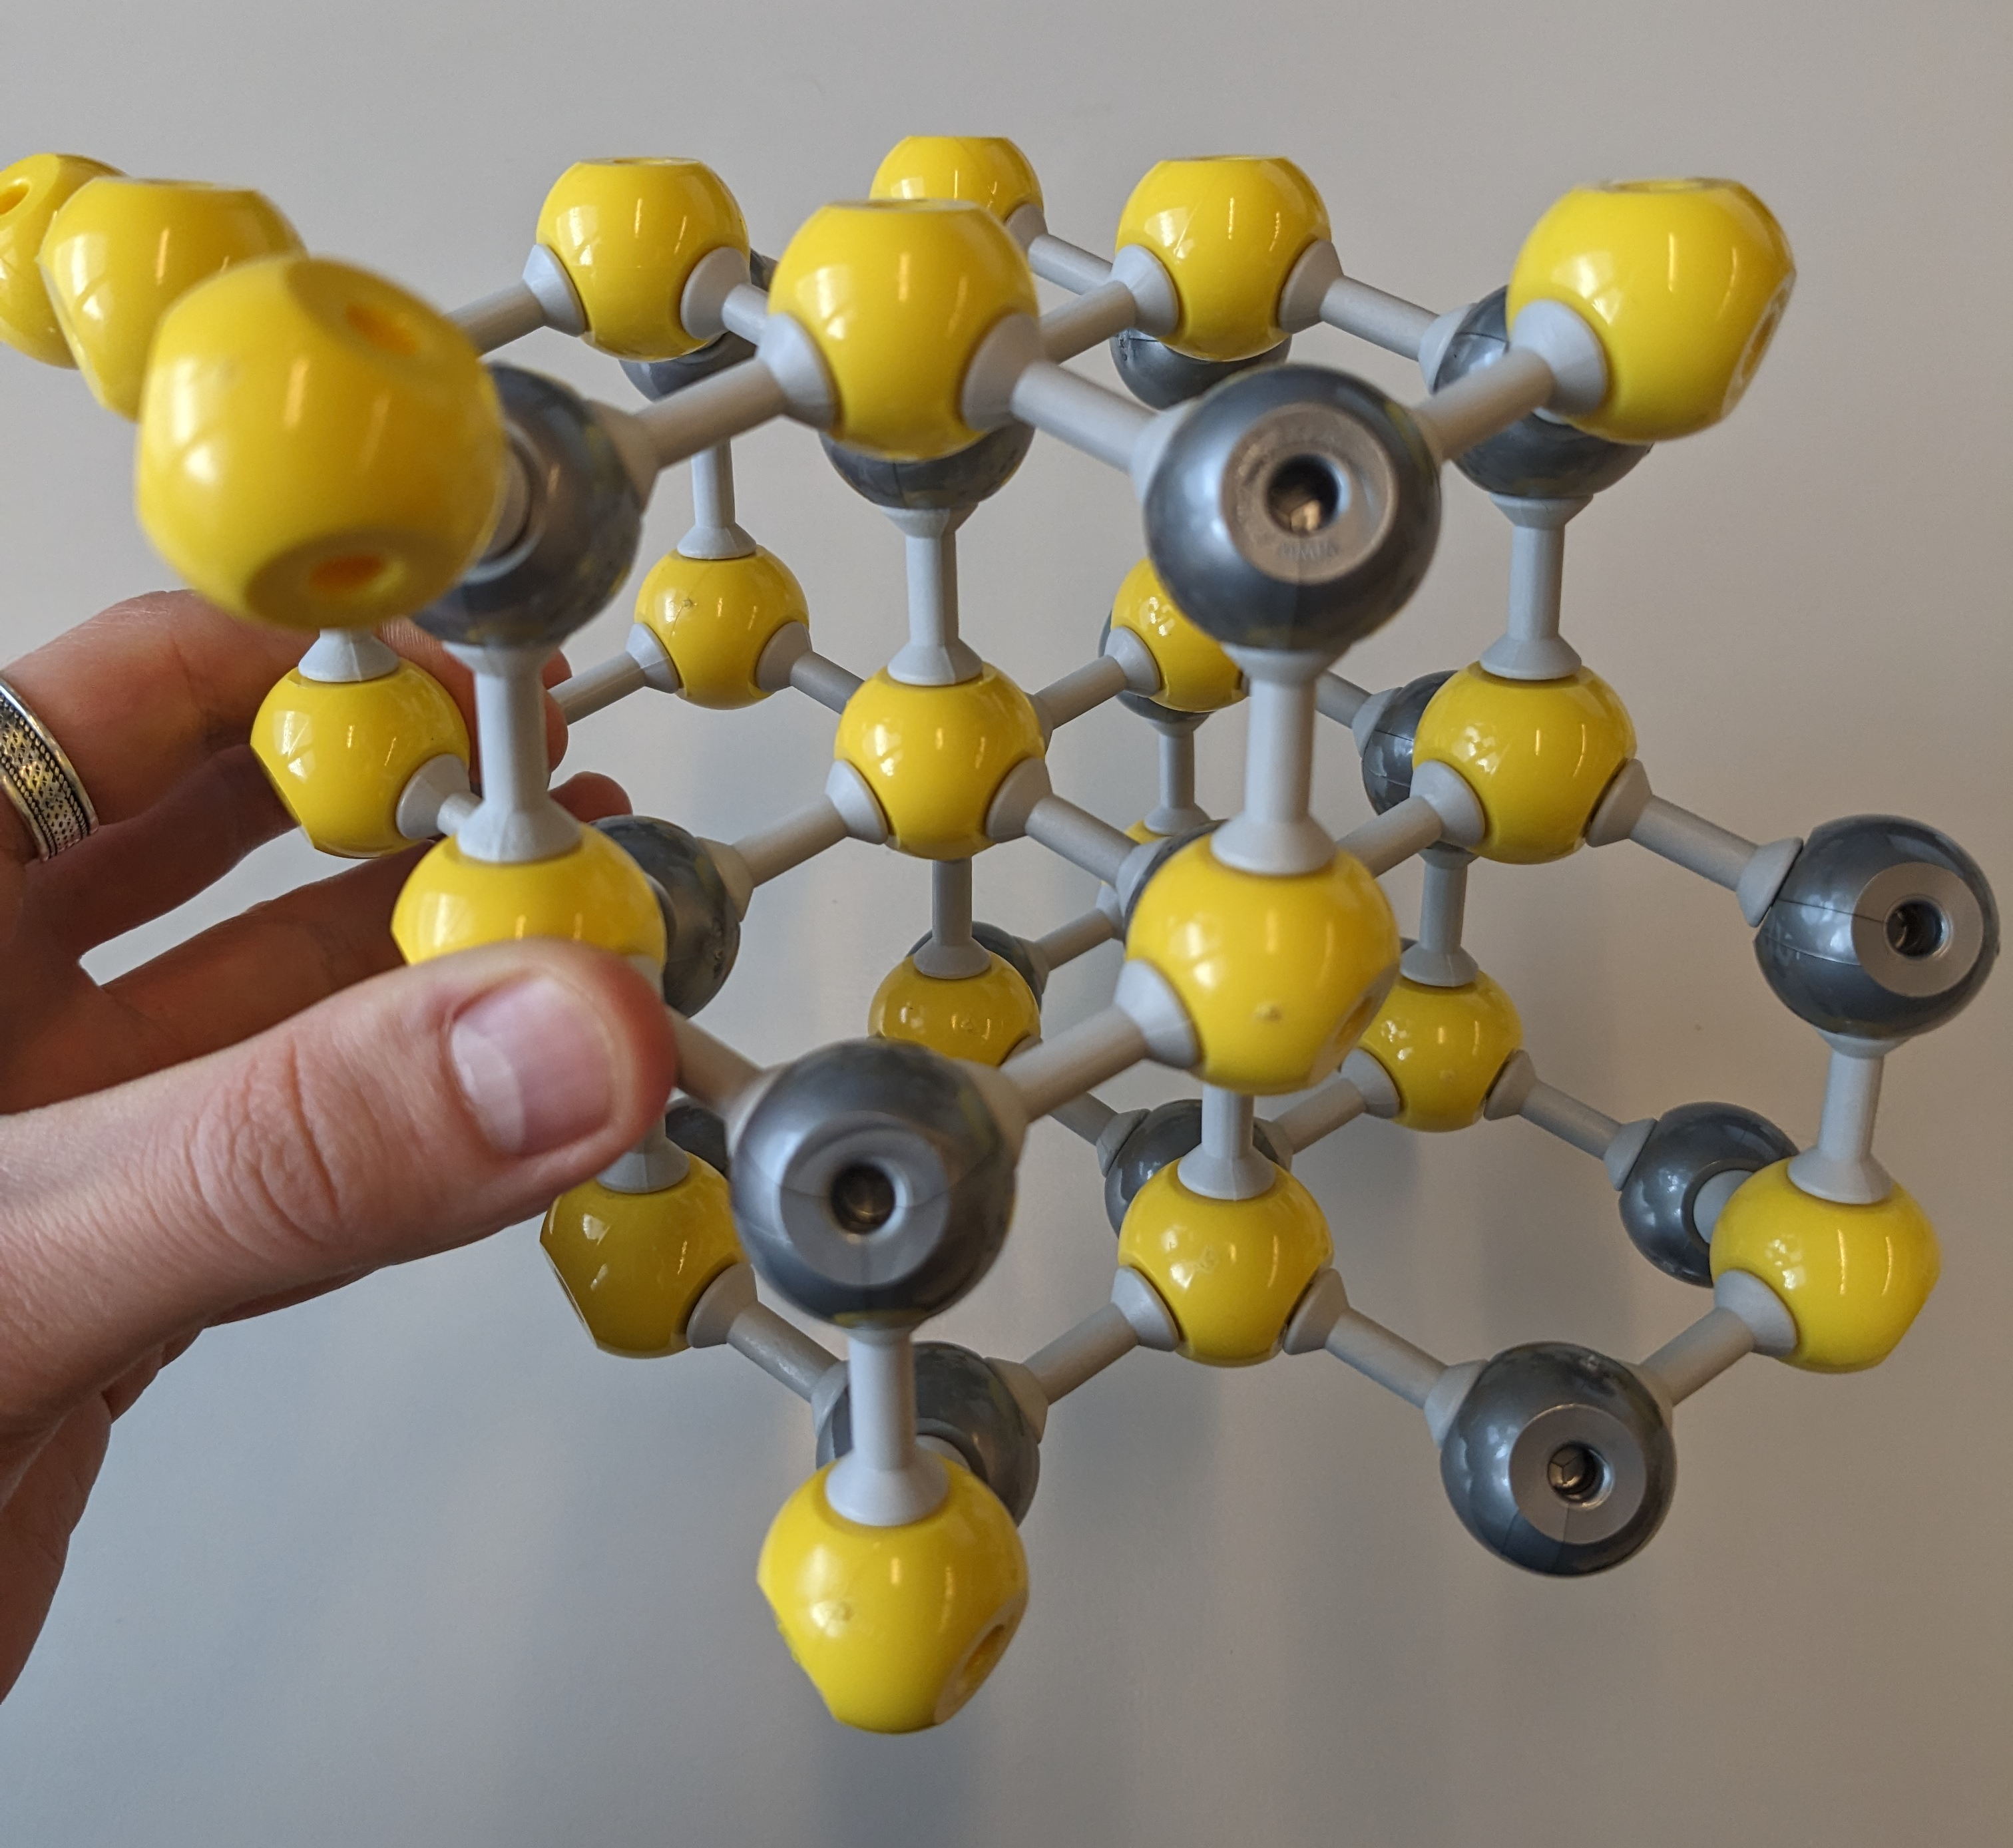
ZnS: Zinc blend Rocksalt structure
Coordination number of Zn:
Coordination number of S:
Packing of crystal system (only consider the yellow spheres):
Number of Zn atoms (grey) per unit cell:
Number of S atoms (yellow) per unit cell:
Which voids are filled with yellow spheres?
4
4
Face-centered cubic / cubic close packed
4
4
Half of the tetrahedral voids (all T+) are filled. Octahedral voids are empty.

Slide 16
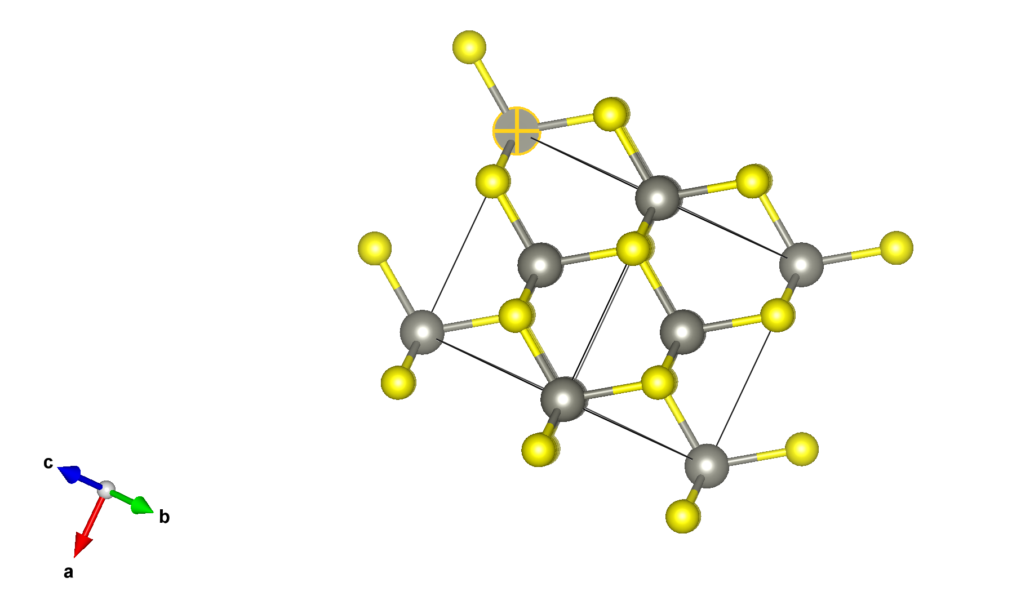
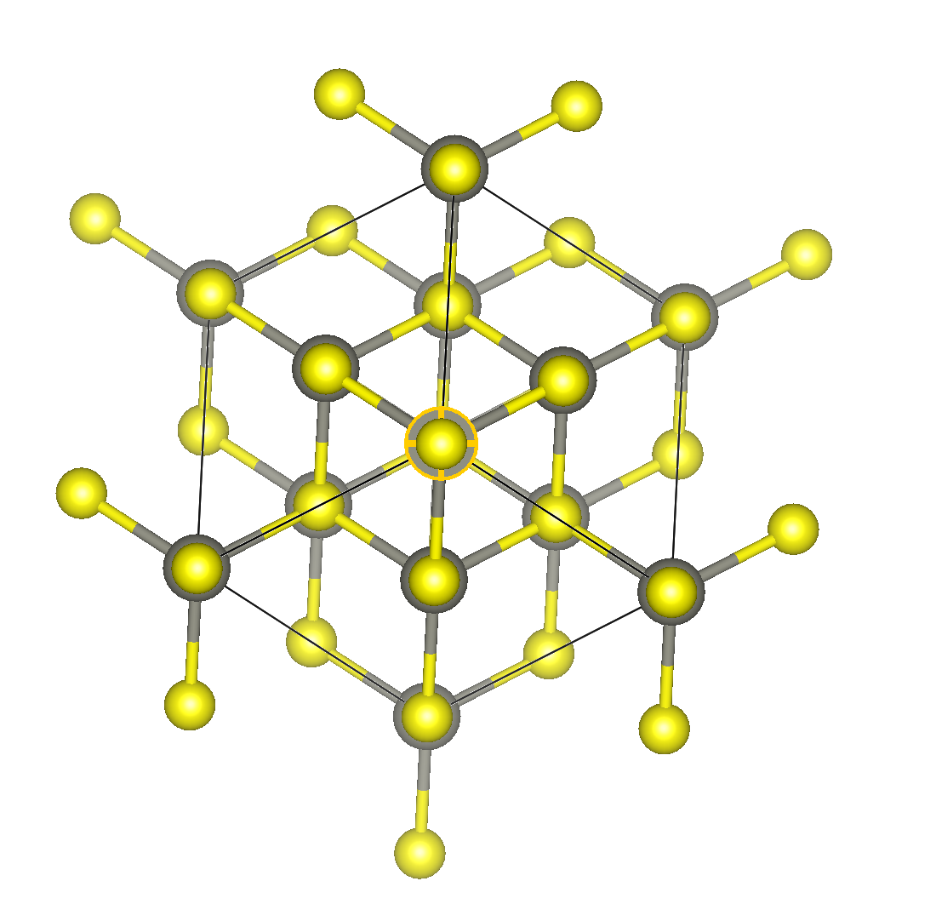
Zinc Blend: ABC layers
ABC layers of S
ABC layers of Zn

Slide 17
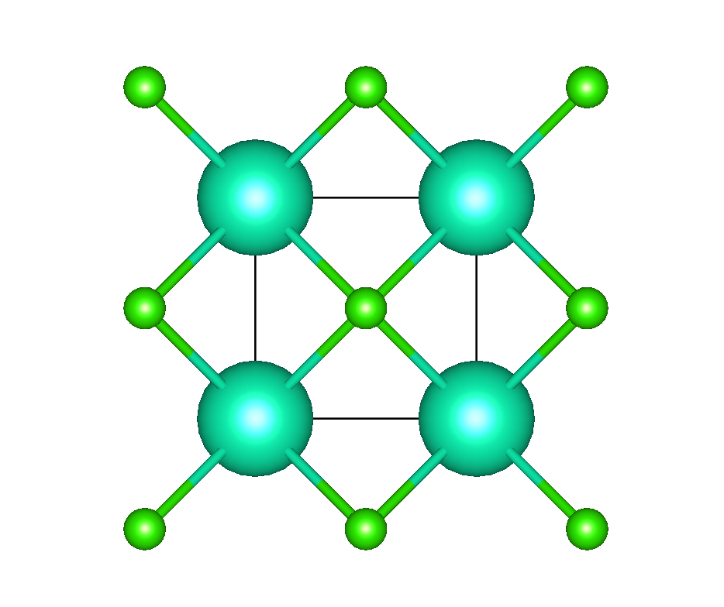
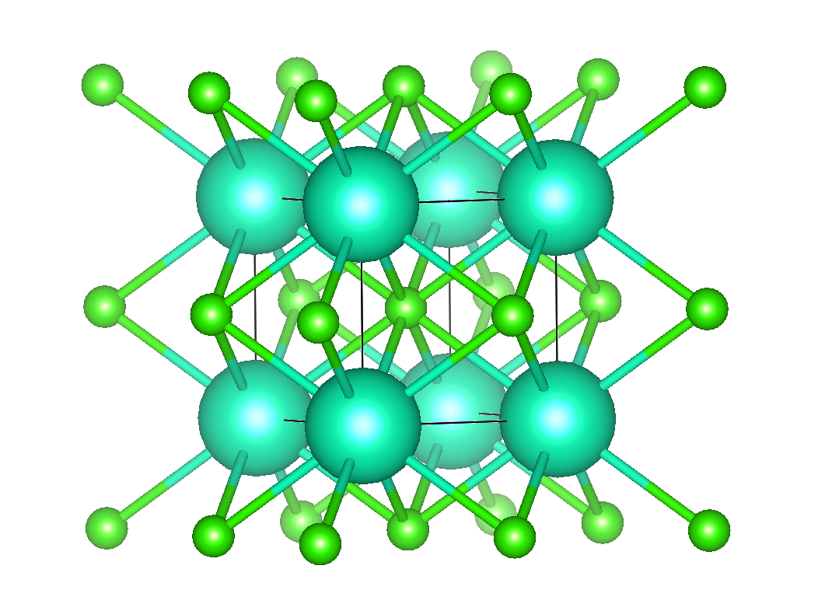
CsCl
8
Coordination number of Cs (corner):
Coordination number of Cl (center):
Packing of crystal system (only consider the grey spheres):
Number of Cs atoms (green) per unit cell:
Number of Cl atoms (white) per unit cell:
Which voids are filled with green spheres?
8
No closed packing! Cubic packing
It’s cubic primitive and not body centered!
1
1
Cubic voids (remember the coordination number!)

Slide 18
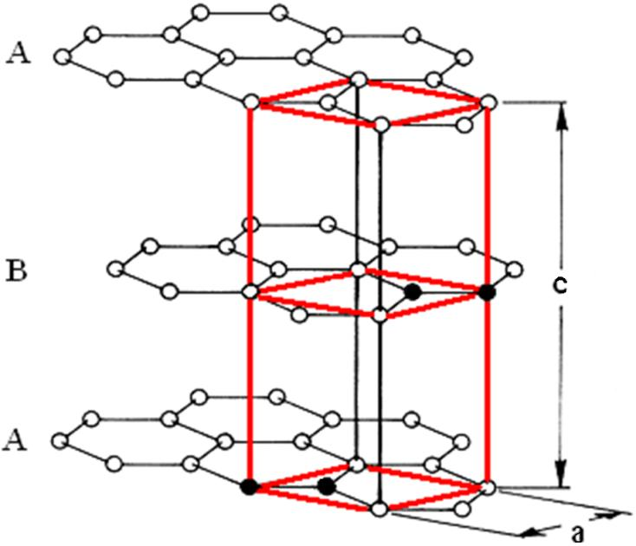
Graphite
Is graphite a closed pack system?
No. It is a layer structure held together by Vander Waal interaction.
What is the hybridization of C?
Formula sp^{n-1} where n = number of groups carbon is bonded to
sp²
What is the geometry of a single carbon atom in single layer and its bond angles?
Trigonal planar with 120° bond angles
What dimensional lattice bonds does graphite contain?
2-dimension
Why is graphite a soft malleable material and used as a lubricant?
The carbon atoms within each layer of graphite contain weaker intermolecular bonds. This allows the layers to slide across each other.

Slide 19
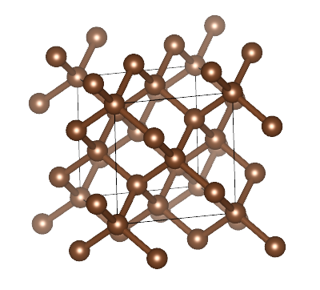
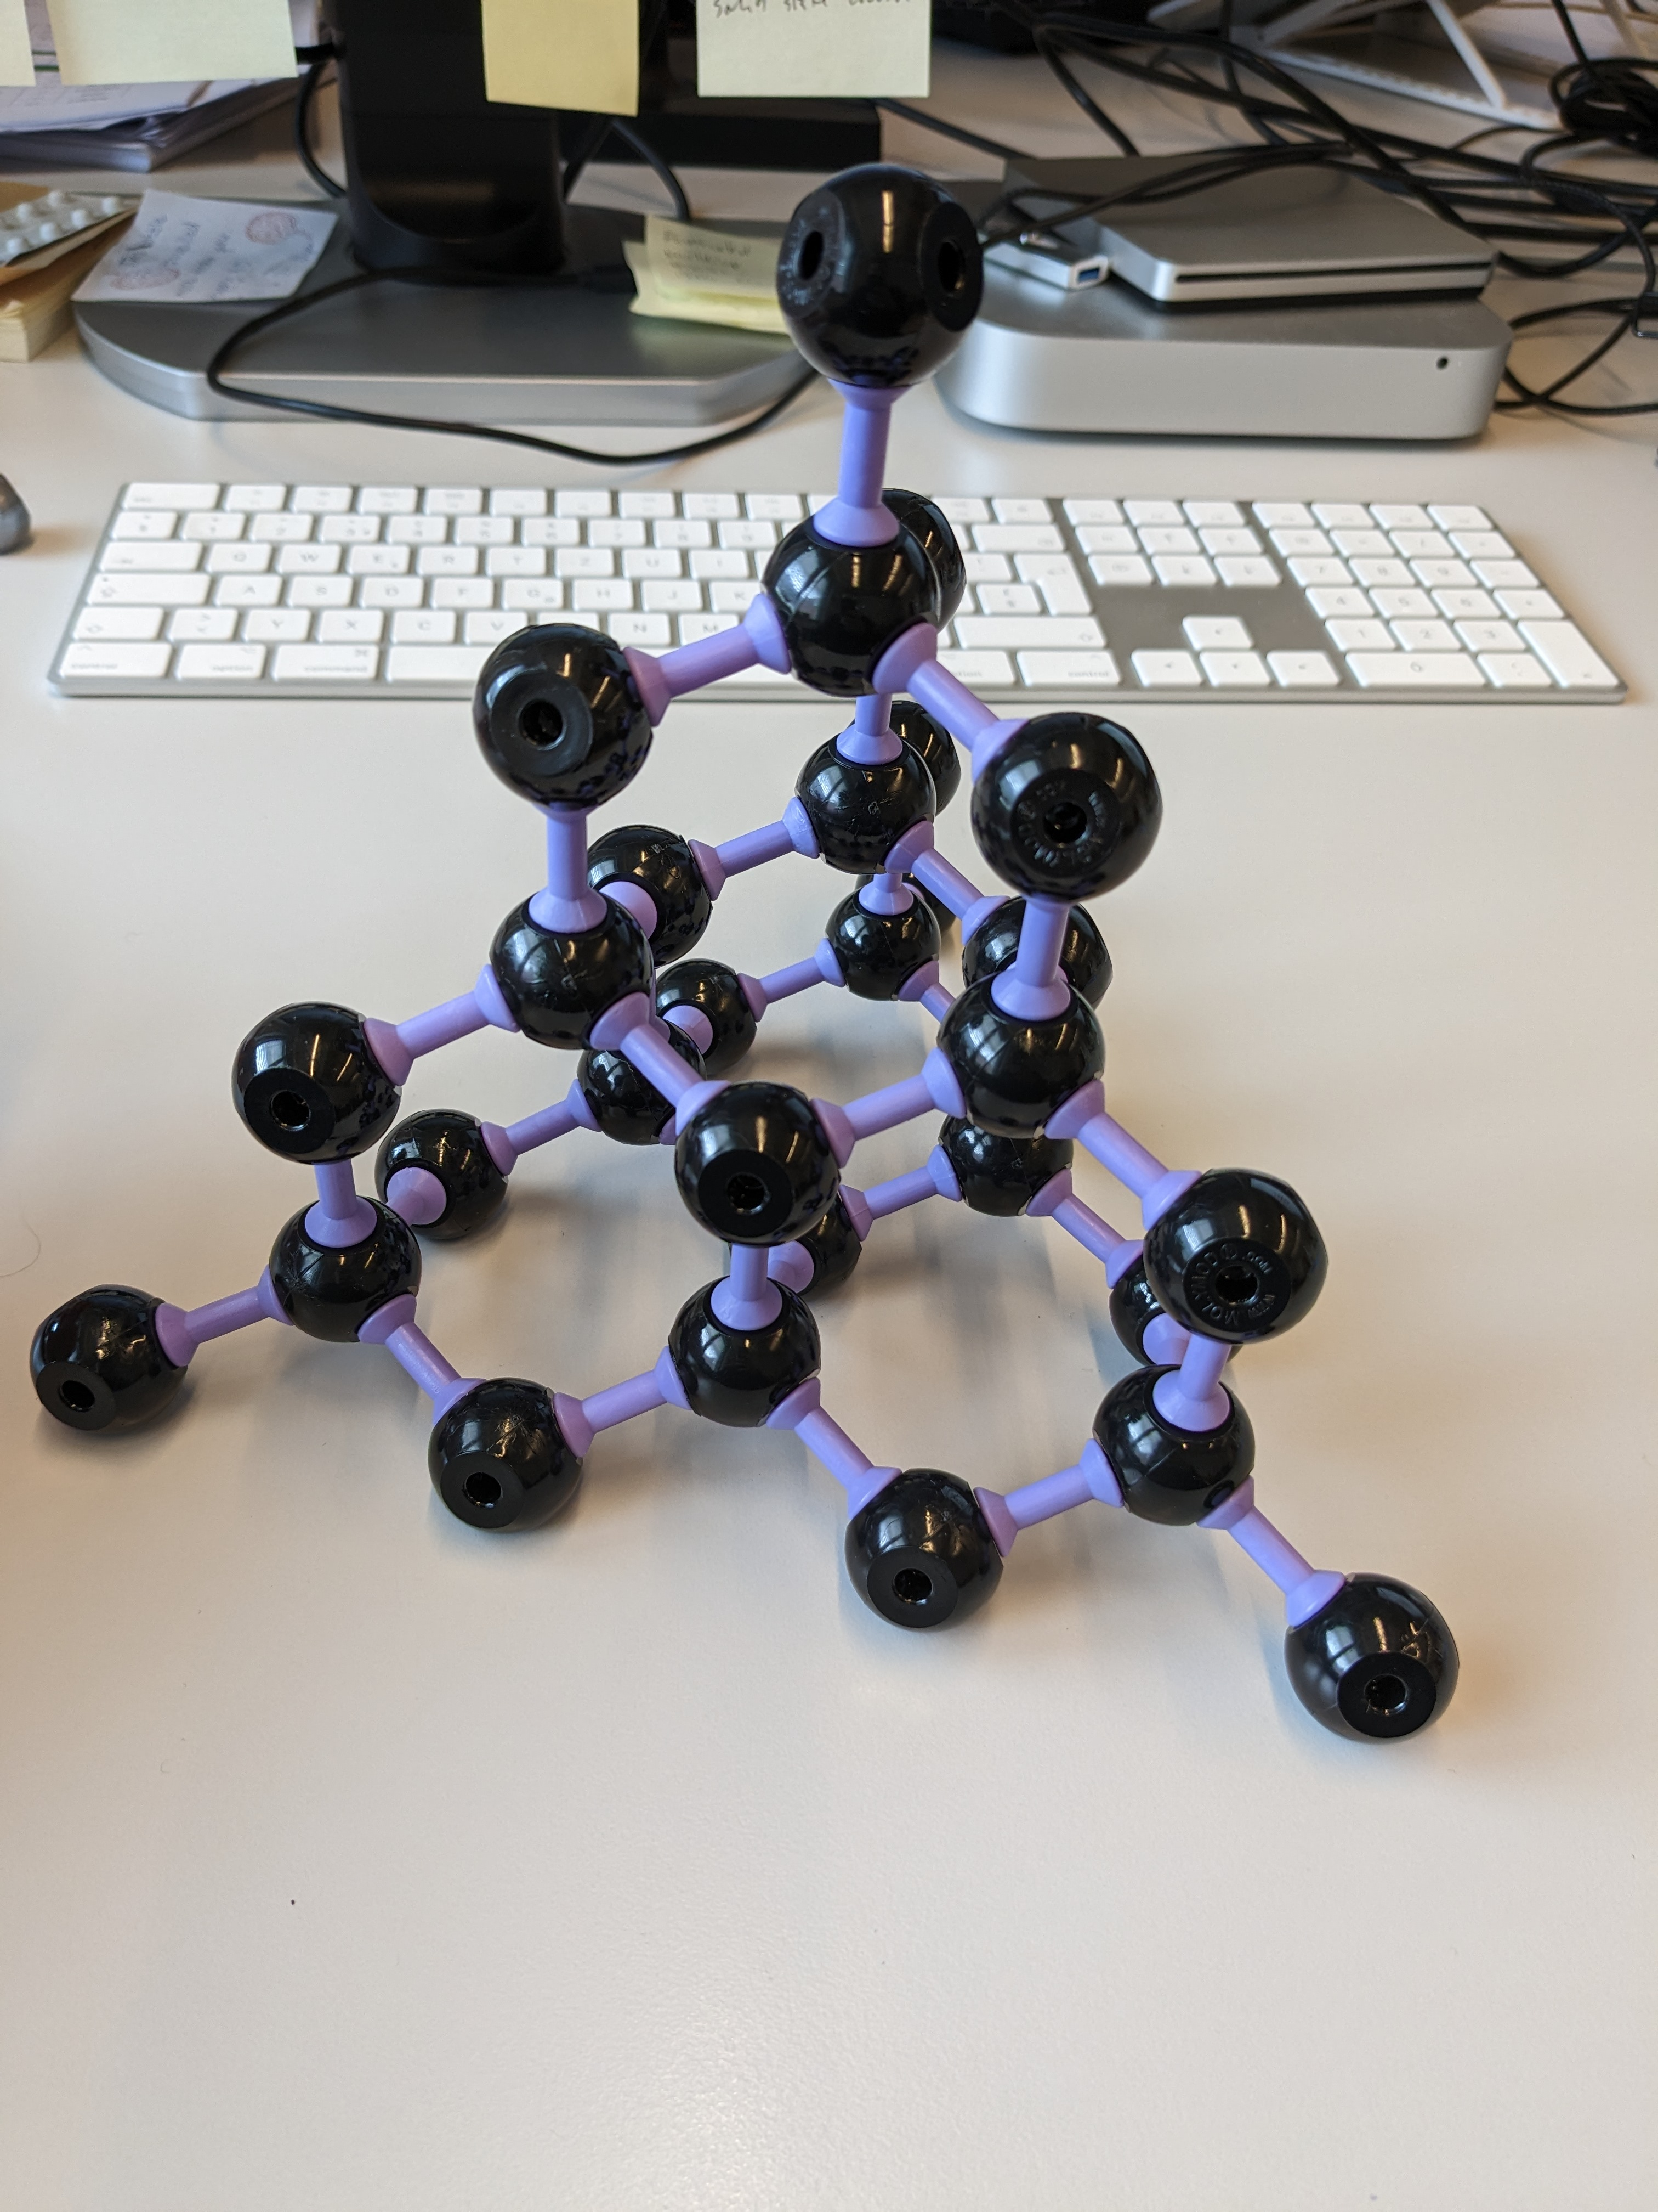
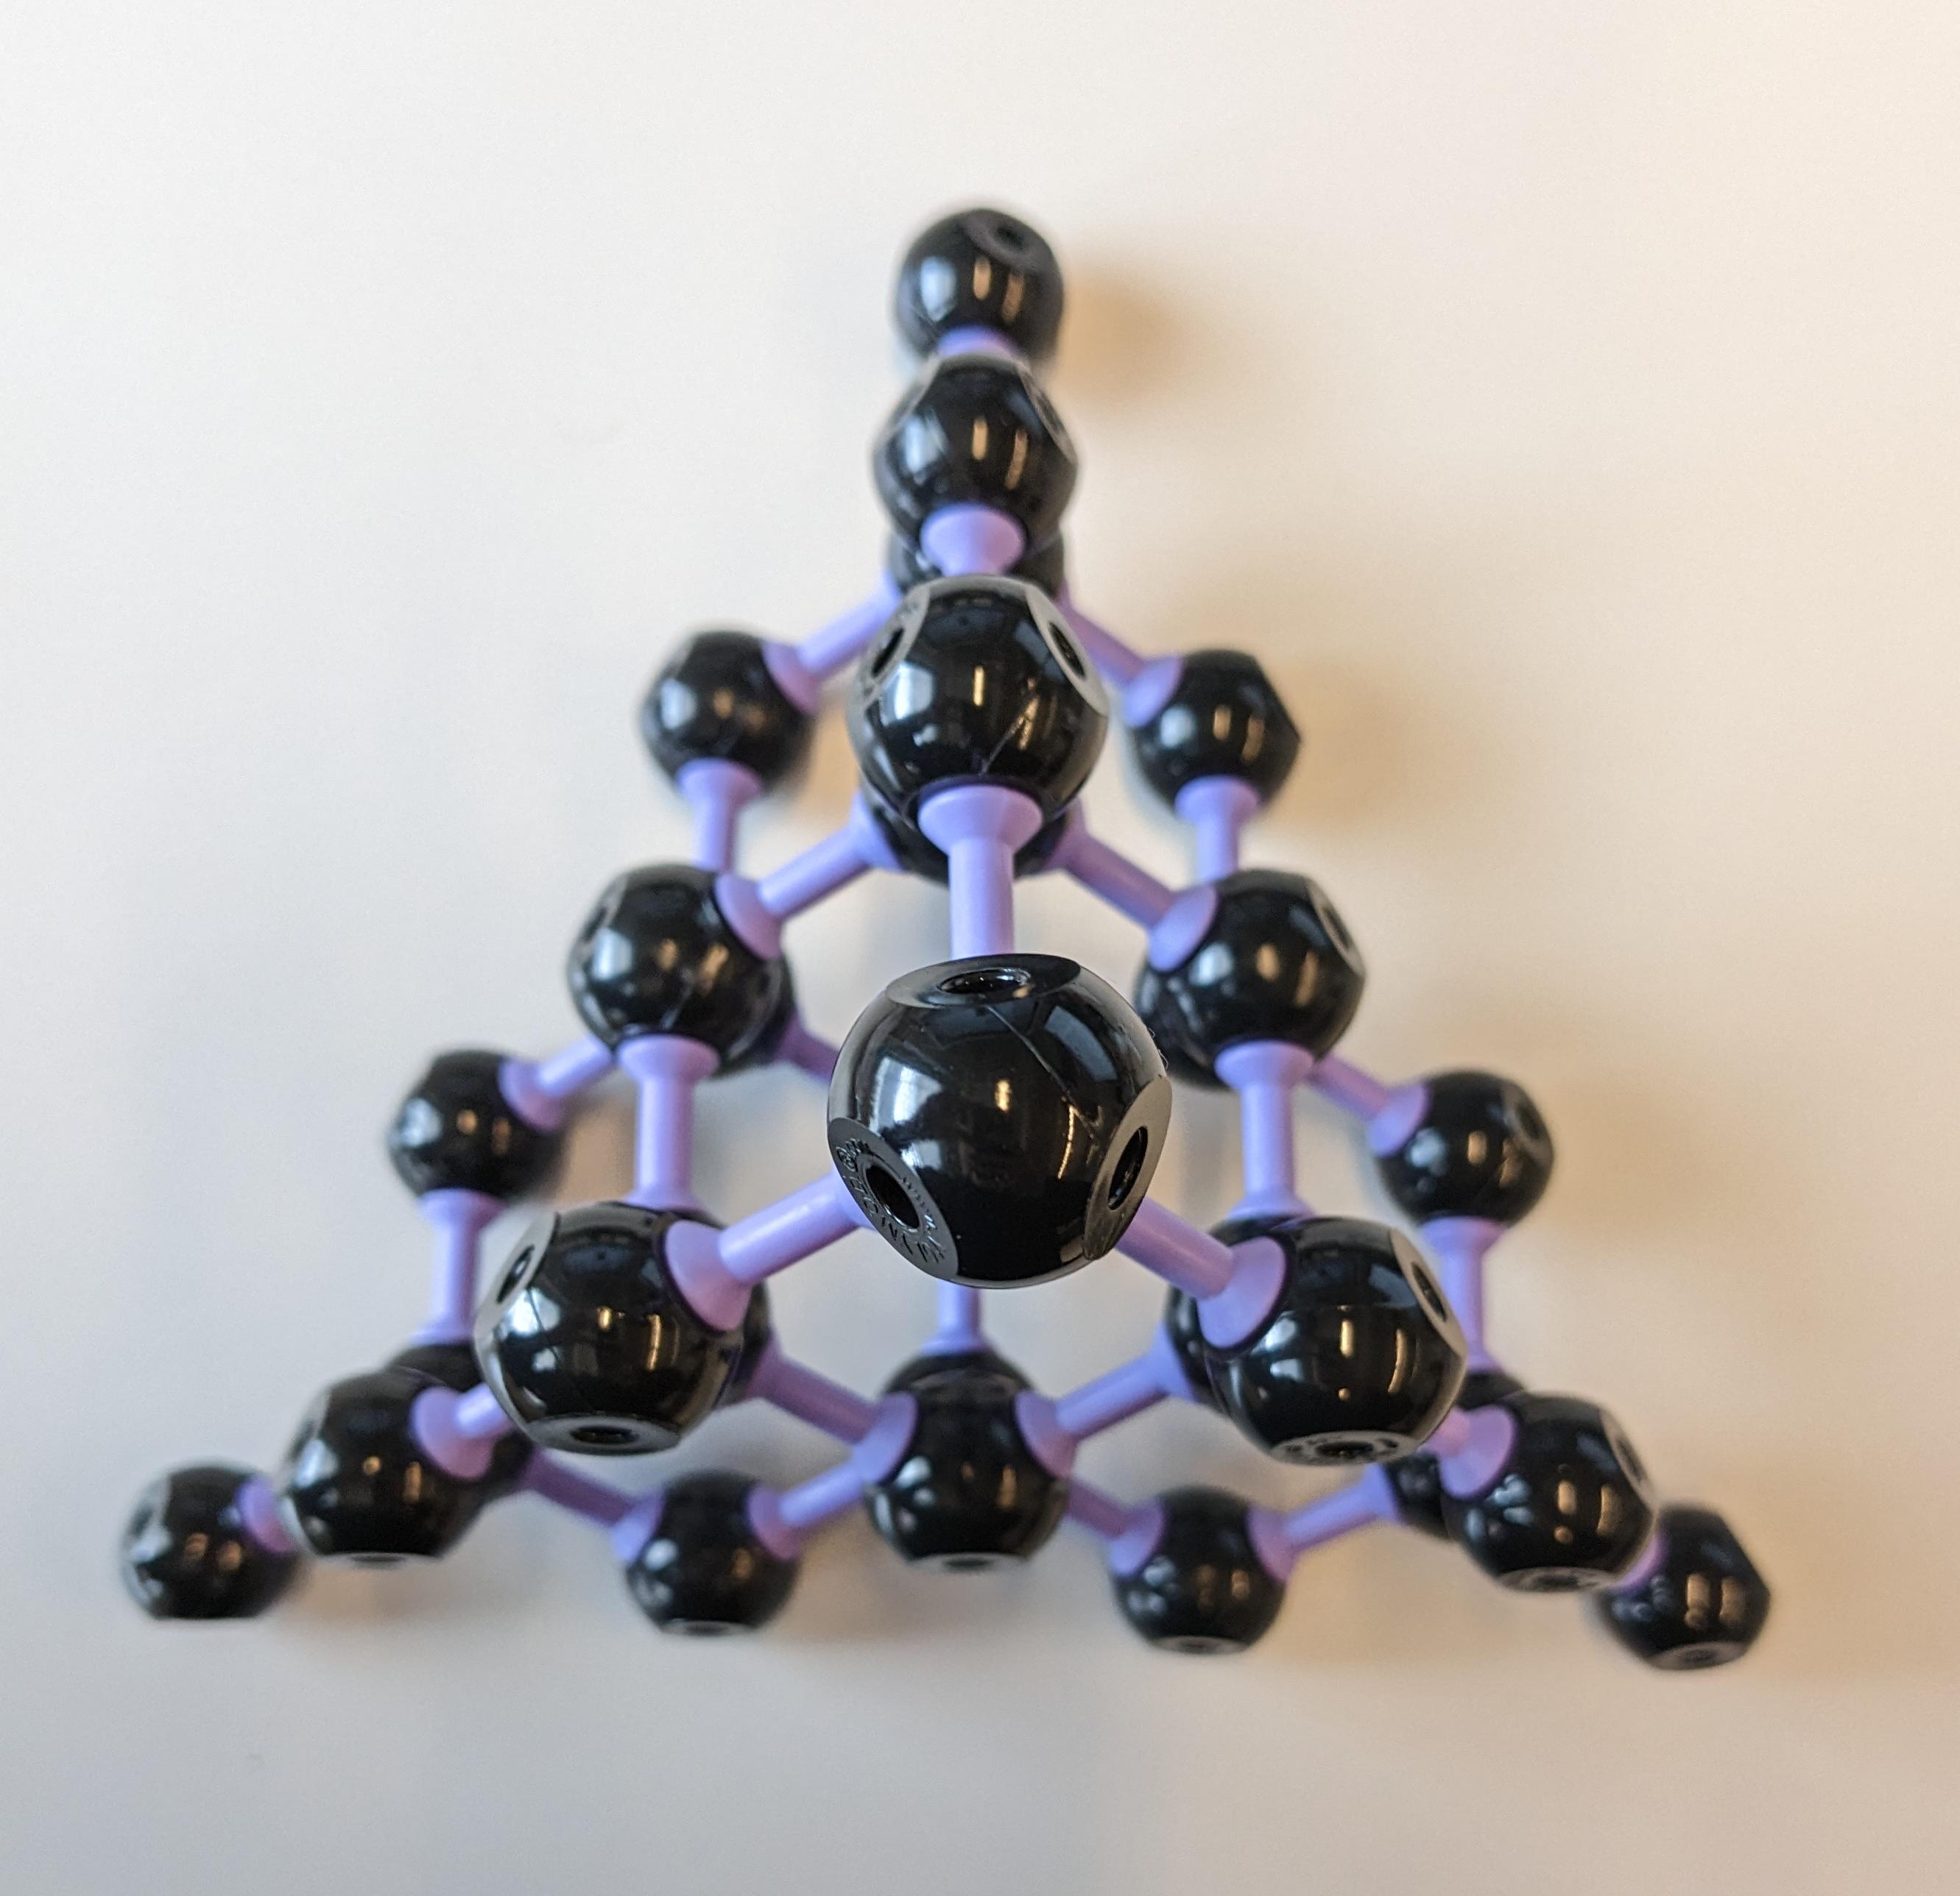
Diamond
Identify the packing of each crystal systems.
face centered cubic
Identify the number of C in the unit cell.
1/8corners *8 + ½*6faces + 4*1(tetrahedral) = 1+3+4 = 8
Find the coordination number of each ions.
Coordination number of C = 4
Identify the voids (Td, Oh sites) occupied by the ions.
four C occupy = Td sites
Total number of ions per unit cell.
8

Slide 20
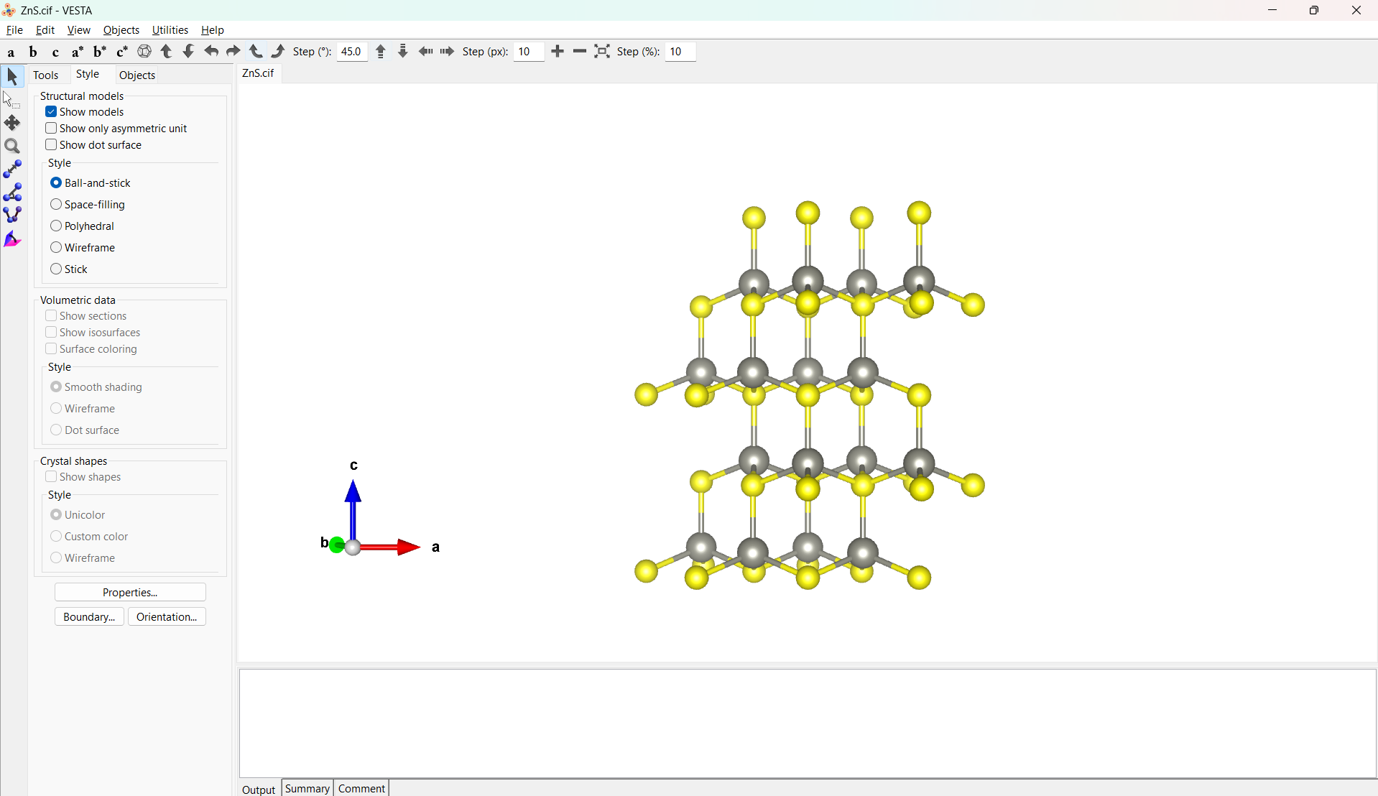
VESTA
https://jp-minerals.org/vesta/en/download.html or searching using “Vesta download” keywords

Slide 21
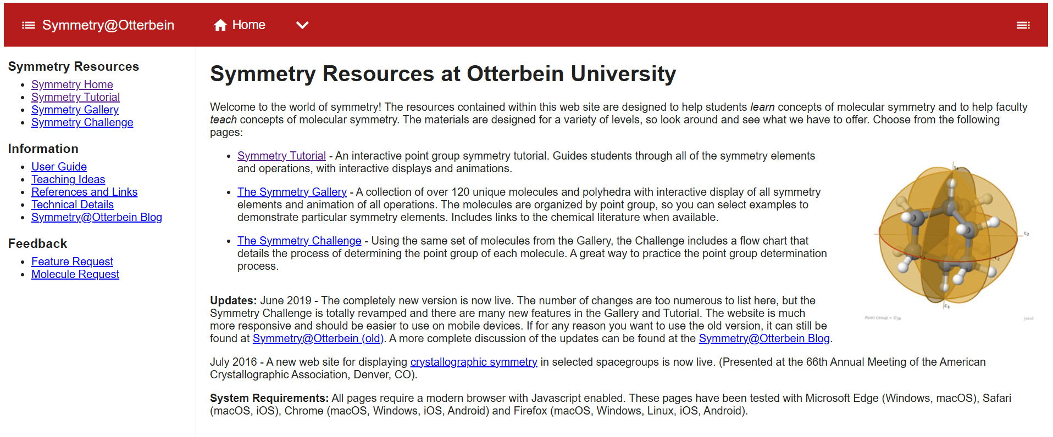
Point group learning assistance
https://djohnston66.gitlab.io/sym-jsmol/ or searching using “Symmetry@Otterbein” keywords

Slide 22
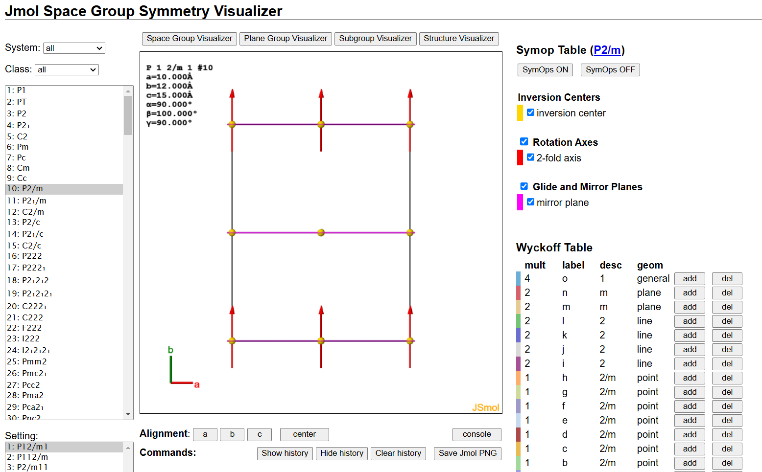
Space group Visualizer
https://spacegroups.symotter.org/index.html or searching using “Symmetry Gallery” keywords

