Slide 1

Asymmetric Catalysis for Fine Chemical Synthesis
Presentation: Angew. Chem. Int. Ed. 2023, 62.
March 17, 2025
Carlo Baldassari & Alec Gagnebin
Low Coordination State Rh^{I}-Complex as High Performance Catalyst for Asymmetric Intramolecular Cyclopropanation: Construction of penta-Substituted Cyclopropanes
Junyou Zhang, Weici Xu, and Ming-Hua Xu*

Slide 2
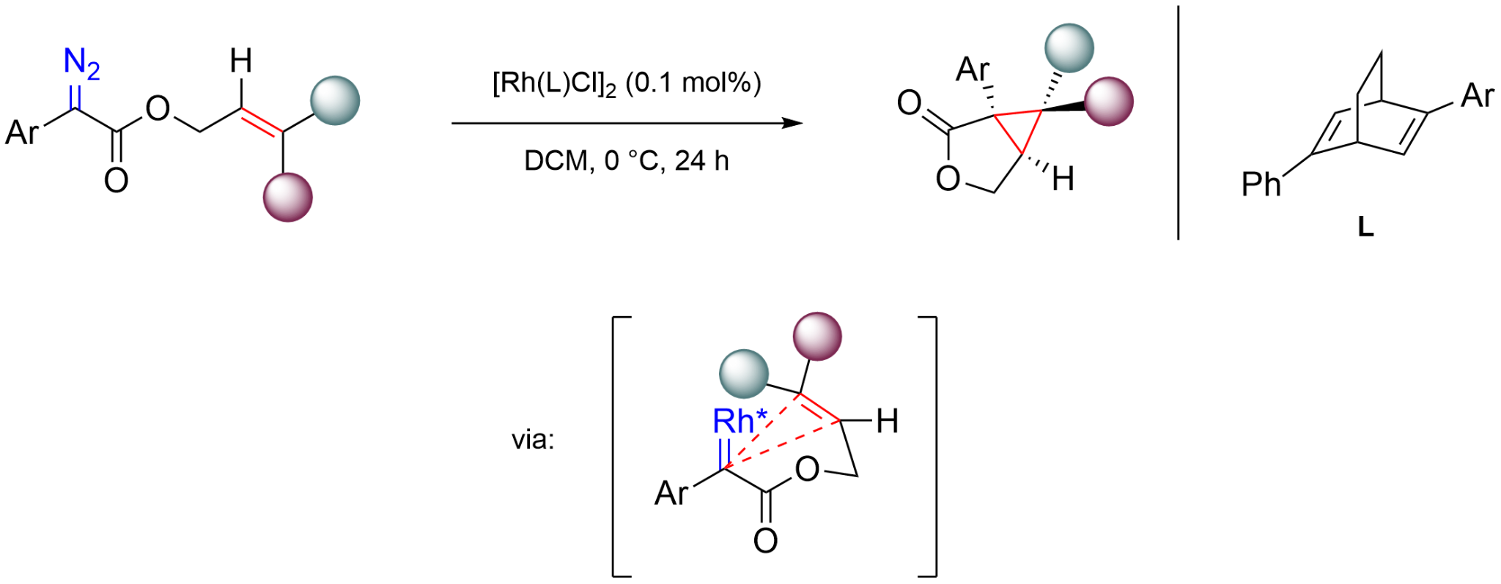
Introduction: Reaction and Reactivity
Intramolecular cyclopropanation
The reaction is an intramolecular cyclopropanation.
Electrophile: donor-acceptor carbenoid
Nucleophile: electron rich olefin
Bond formation: Intramolecular carbene transfer
Catalyst: Rh(I) complexed with a chiral diene (L)

Slide 3
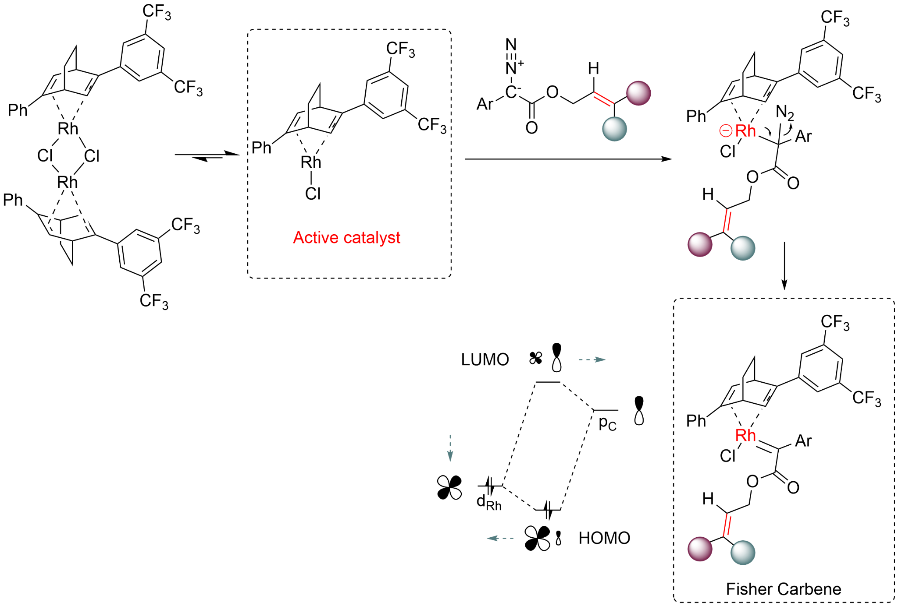
Principle of activation
Catalyst pre-activation by dissociation of the dimeric rhodium to a monomeric Rh (I)
Formation of the Rh(I)-carbene by attack of the carbanion on the metal and release of N₂
LUMO activation promoted by low d-orbital energy (late TM, higher electronegativity), increasing LUMO character on carbon

Slide 4
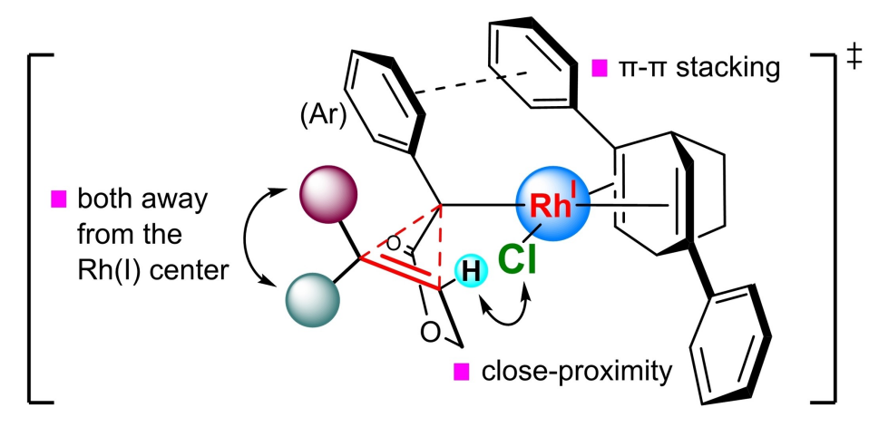
Asymmetric induction
π-π stacking between substrate and ligand
Sterics between alkene substituent and chlorine
Supported by DFT and experimental results

Slide 5
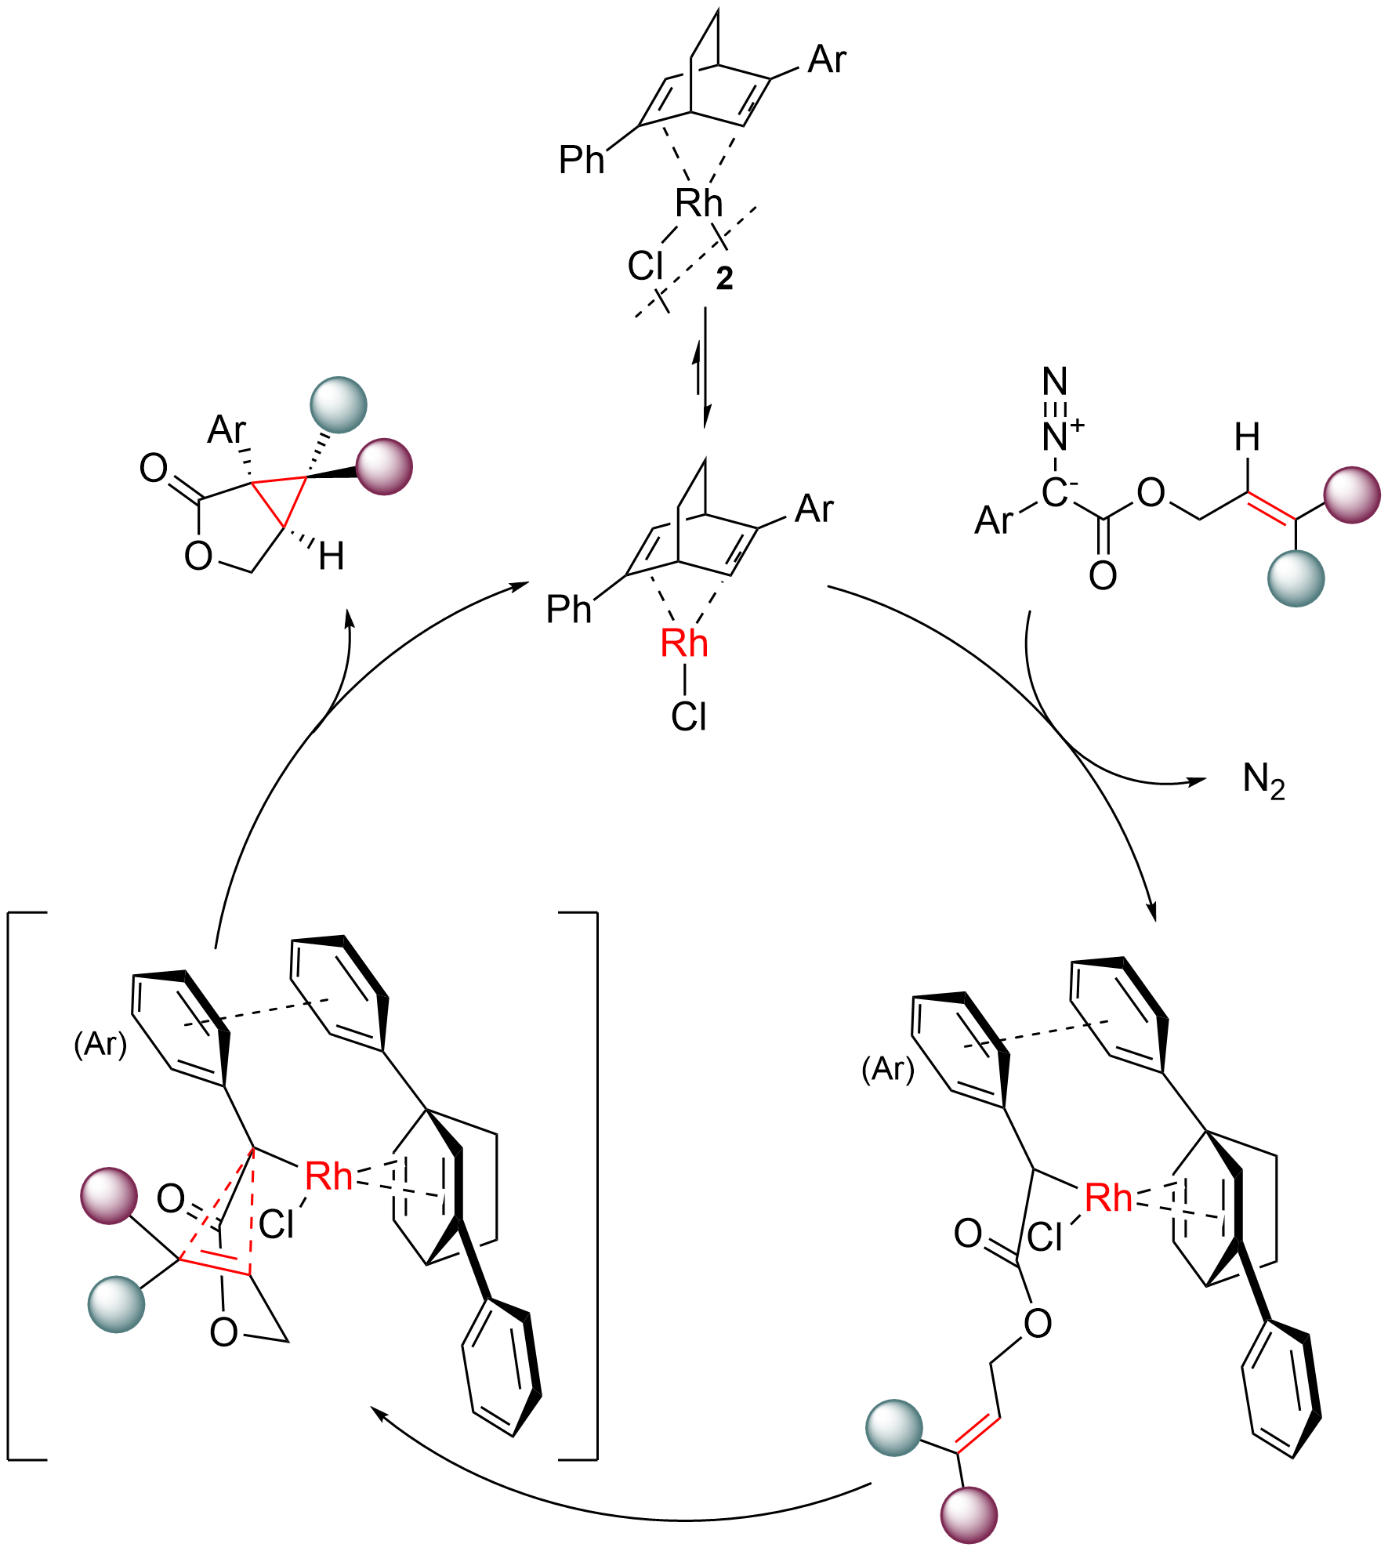
Catalytic Cycle
1
Catalyst pre-activation: dissociation of dimeric rhodium to form monomeric Rh(I)
Rh(I) carbenoid formation by decomposition of N₂
Conformational change leading to the favorized transition state
Carbene transfer leading to the pentasubstituted cyclopropane and catalyst turnover
4
2
3

Slide 6
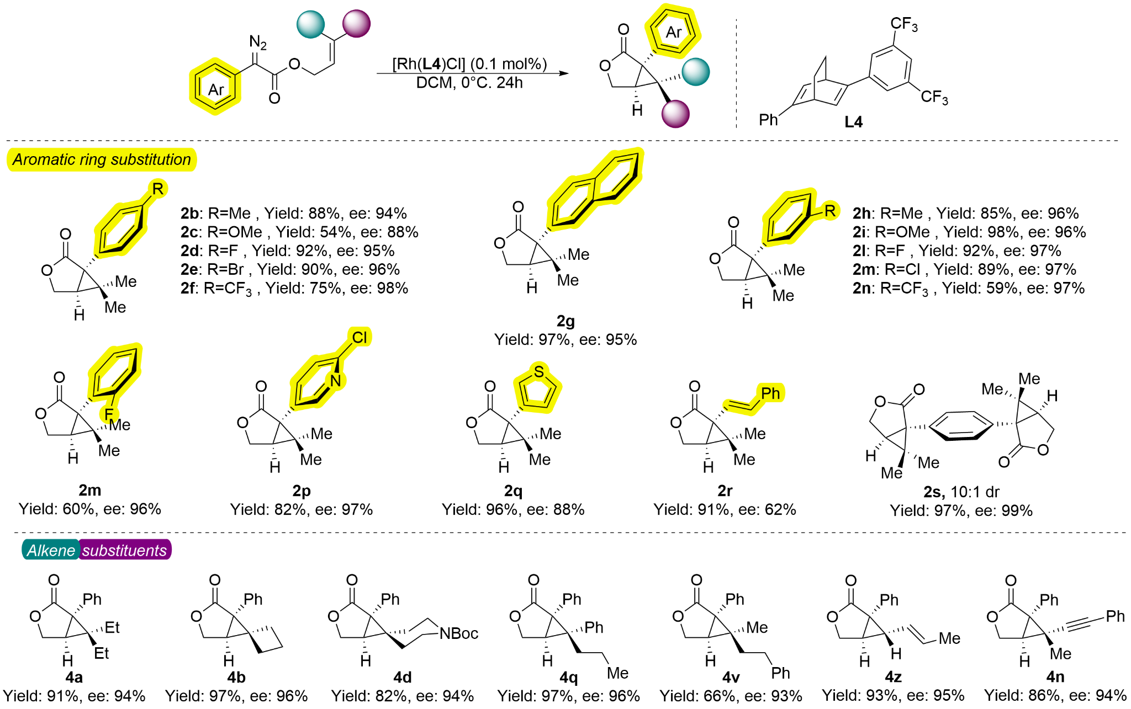
Scope
Scope: Very good ee and diastereoselectivity observed.
Stereoselectivity: reversing the stereochemical pattern of the double bond, the the opposite configuration can be exclusively obtained

Slide 7
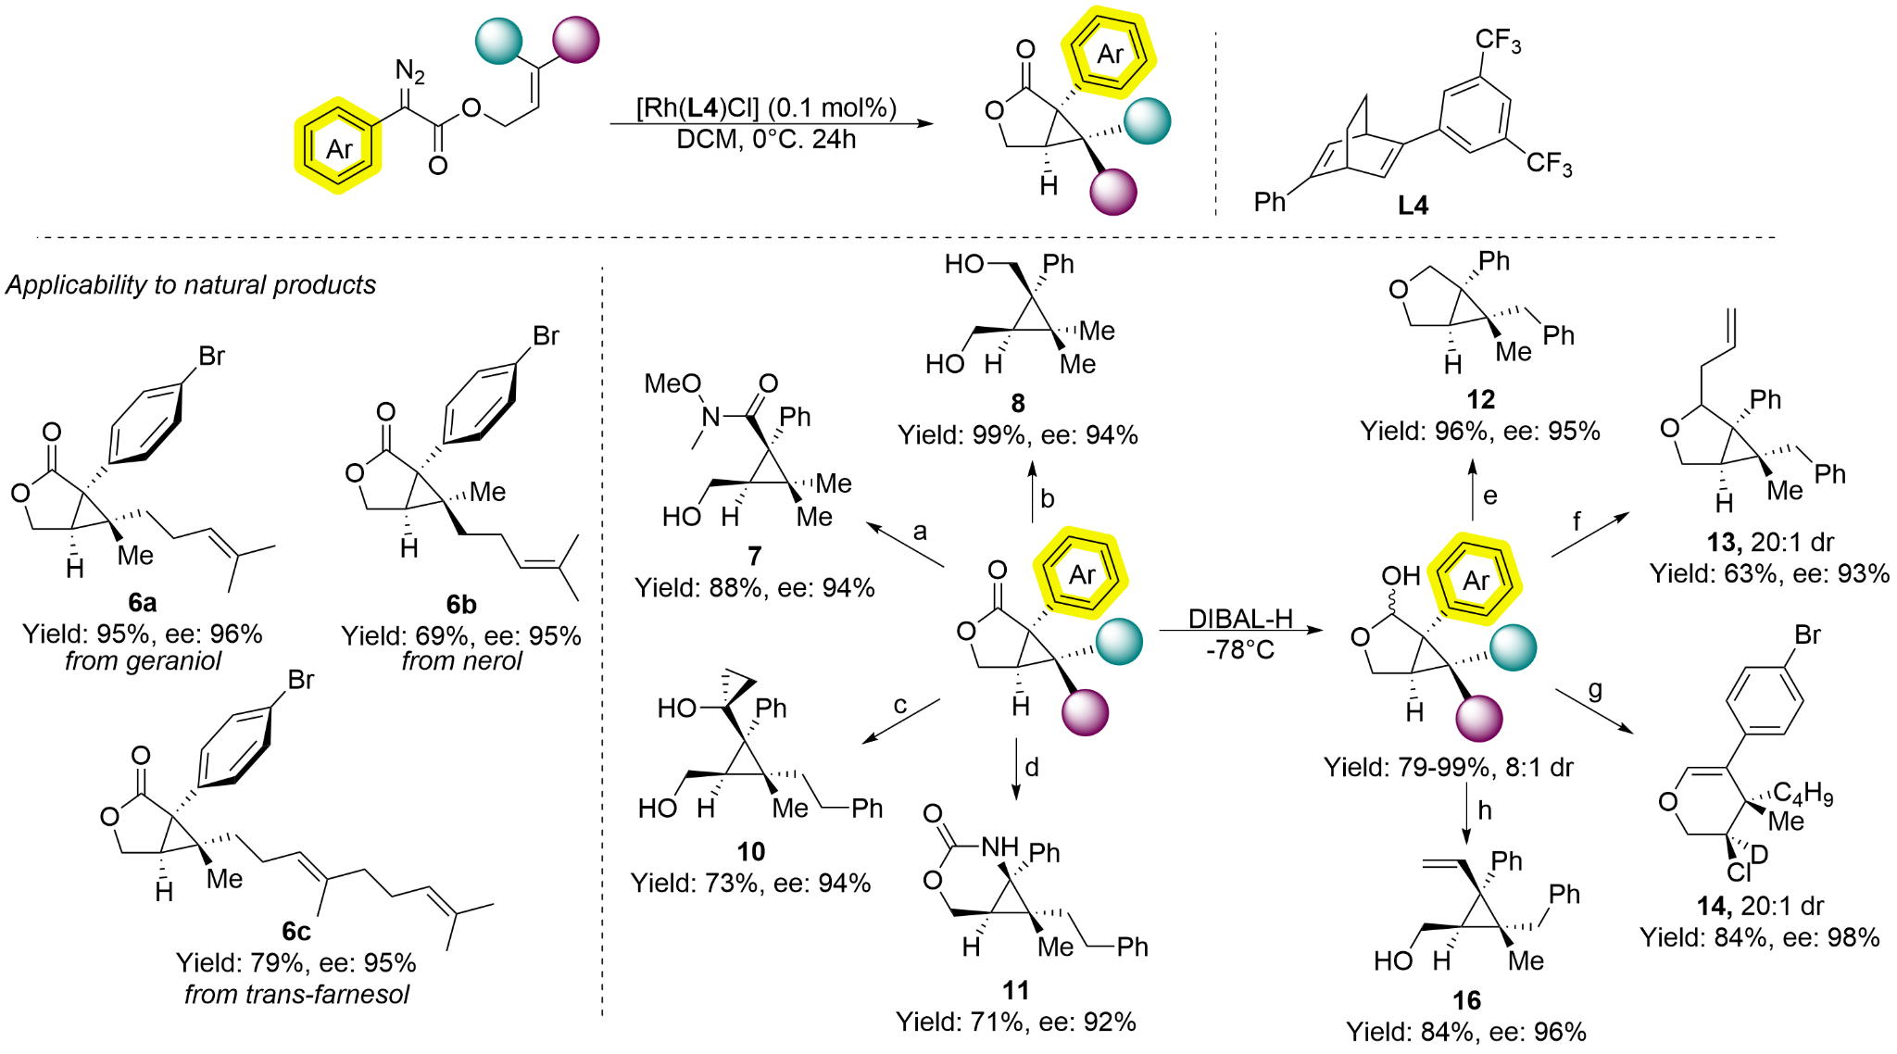
Applicability and Product modifications
a) MeNHOMe·HCl, Me3Al, DCM, 0°C; b) LiAlH4, THF, 0°C; c) Ti(OiPr)4, EtMgBr, THF, 0°C; d) (i) NH3·H2O, MeOH, rt; (ii) PhI(OAc)2, MeCN, 40°C; e) Et3SiH, BF3·Et2O, DCM, 0°C; f) allyltrimethylsilane, BF3·Et2O, DCM, g) Et3N·HCl, BF3·Et2O, DCM, 0°C; h) Ph3P=CH2, THF, -78°C.

Slide 8
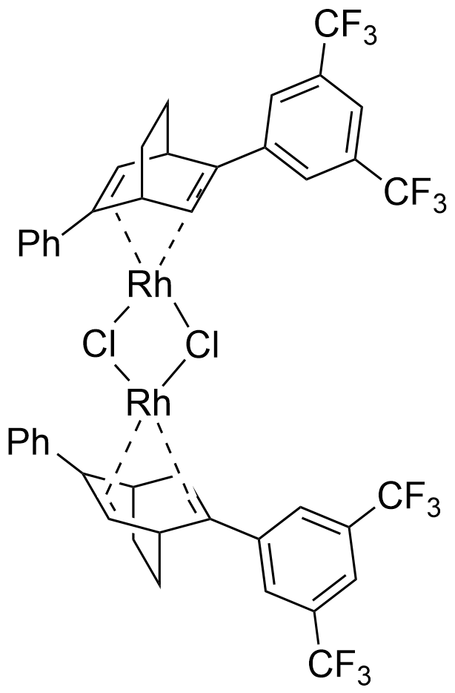
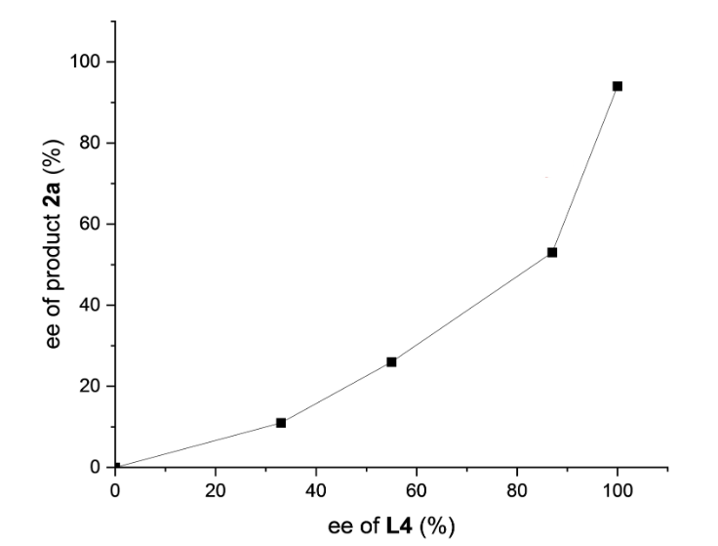
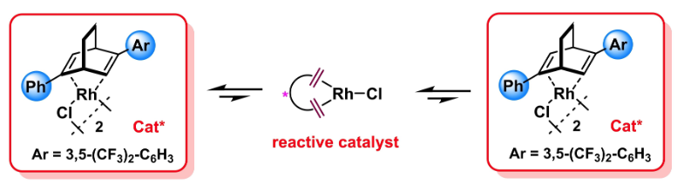
Non Linear Effect
Homochiral dimer more stable
Heterochiral dimer less stable
Negative non-linear effect, when the catalyst is a mixture of R and S ligands
Possible explanation of the results:
Dimers are formed by the catalyst but only the monomer is reactive
The monomeric form is in equilibrium with the dimers
The homodimers are more stable than the heterodimers

Slide 9
Critical analysis: Novelty
Strong points
Highly enantioselective synthesis of penta-substituted cyclopropanes.
Simultaneous control of all three vicinal stereocenters
Low coordination Rh(I) square planar chiral complex
Mild conditions and versatile substrates
Weak points
Well-known reaction under common metal catalysis
2 successful examples of penta-substituted cyclopropanes already reported

Slide 10
Critical analysis: Practicability
Strong points
Mild Conditions
Very high enantioselectivity, diastereoselectivity and yields.
Stereoselectivity: configuration of the double bond determines the configuration of the stereocenter.
Wide applicability and diverse product modifications
Weak points
Low ligand accessibility (11 steps synthesis in low yield)
Low substrate accessibility (Multistep synthesis with min. 2 steps)
Freshly distilled solvents required
Schlenk techniques under argon gas
1
1. Organic Process Research & Development 2012 16 (1), 129-140

Slide 11
Critical analysis: Sustainability
Strong points
Mild Conditions, mild cooling (0ºC)
Low catalytic loading (0.1 mol %)
Good atom economy (catalytic intramolecular reaction)
Weak points
Solvent not sustainable (DCM classified as undesirable «red»)
Rh is a precious, rare and expensive metal.
1
1. Green Chemistry, 2008, 10, 31-36

Slide 12
Questions
Question 1
Compare the Rh(I) system used in this work to the more established Rh(II) catalysts seen in the lecture.
Question 2
A non linear effect was observed in this reaction: compare it with the one of Cu(BOX) complexes seen at the beginning of the lecture.
Question 3
Are pi-pi interactions important in this transformation? What about their role in the enantiodetermining step?

