Slide 1
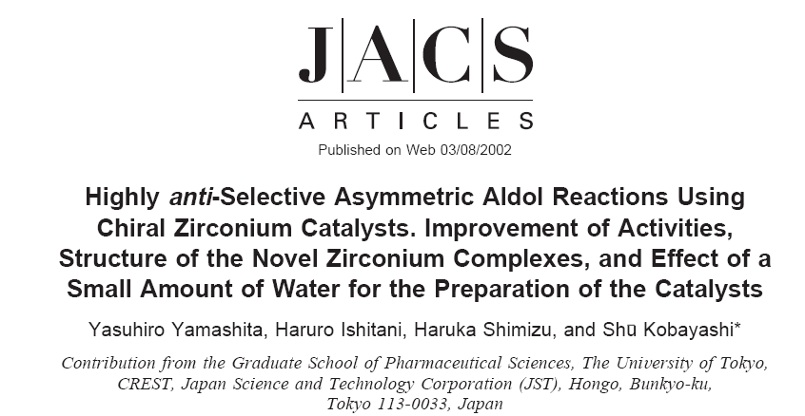
Asymmetric Catalysis for Fine Chemical Synthesis
Presentation: J. Am. Chem. Soc. 2002, 124, 3292.
February 24, 2025
Jérôme Waser

Slide 2
Introduction: Reaction and Reactivity
Aldol Reaction
The reaction is a Mukaiyama Aldol.
Nucleophile: Silyl enol ether, nucleophilic in position beta to oxygen
Electrophile: Aldehyde, electrophilic in position alpha to oxygen
Bond formation: Attack of Enol ether on aldehyde
Catalyst: Zr, a Lewis acidic metal similar to Ti

Slide 3
Principle of activation
Catalyst formation from ligand and metal salt, favored by chelate effect.
LUMO activation by coordination of the aldehyde to the electrophilic carbonyl.
Asymmetric induction coming from the binaphthol ligand.
Exact structure of the active catalyst and transition state still unknown. Dimeric structure proposed based on NMR and NLE effects .

Slide 4
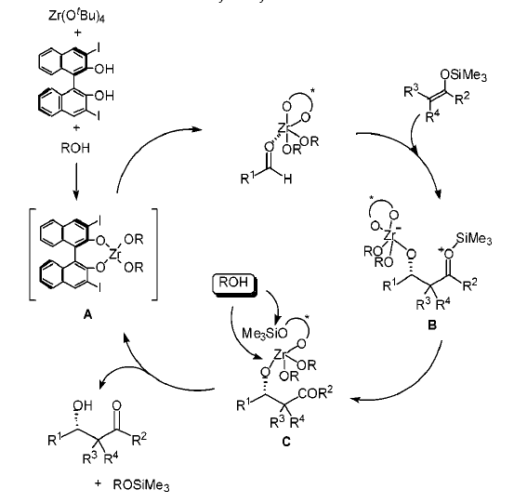
Catalytic Cycle
1
1) LUMO activation by coordination of the aldehyde to the electrophilic carbonyl.
2) Bond formation by attack of the silyl enol ether on the activated carbonyl. Asymmetric induction at this step
3) Catalyst turnover: Transfer of the silicium to the ligand, followed by alcoholysis of the silyl and the Zr-O bond.
2
3

Slide 5
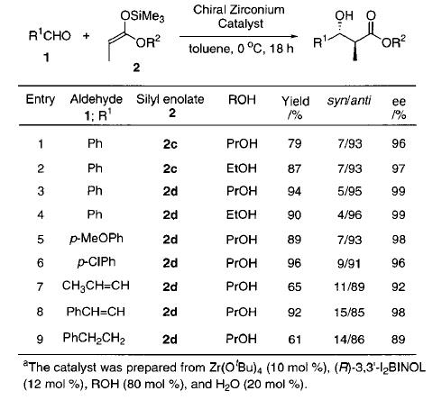
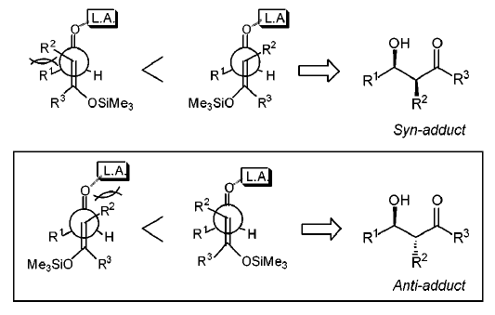
Scope and Diastereoselectivity
Scope: Very good ee and diastereoselectivity observed.
Anti Selectivity:
Rationalized using an open transition state
Olefin and the aldehyde antiperiplanar
Minimization of interactions between Lewis acid and R²

Slide 6
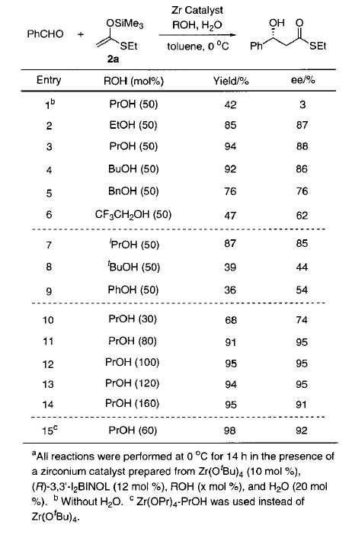
Additive Effect
Without water the reaction is wether efficient nor selective
Propanol was the best additive, 100 mol% was optimal
Water and alcohol promote the formation of a well-defined catalyst, instead of agregates

Slide 7
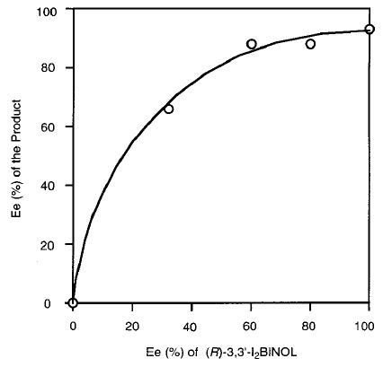
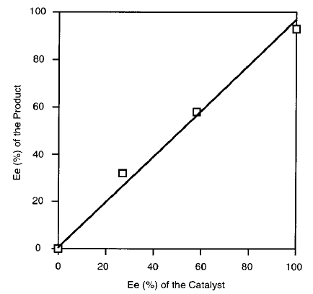
Non Linear Effect
2Zr + L_{R} + L_{S}
Zr₂(L_{R} )₂ + Zr₂ (L_{S} )₂
Positive non-linear effect, when catalyst formed from a mixture of R and S ligands
No non-linear effect when a mixture of preformed catalysts with R and S ligands are mixed
Possible explanation of the results:
Dimers are the active catalysts
Formation of the dimeric complexes is irreversible
Dimer formed with L_{R} and L_{S} is more stable and less reactive than the homodimers

Slide 8
Critical analysis: Novelty
Strong points (in 2002!)
Zr can be a superior Lewis acid
Importance of ortho substituents in BINOL for asymmetric induction
Alcohol and/or water additive essential to prevent the formation of aggregates
Transfer of silicon essential for turnover (to the ligand and then alcohol)
Non Linear effect due to the presence of active dimers
Weaker points
Well established activation mode and well-known reaction
Transfer of silicon essential for turnover already established previously

Slide 9
Critical analysis: Practicability
Strong points
Mild Conditions
Very high enantioselectivity and good diastereoselectivity
Stereoconvergence: Both E/Z silyl enol ethers give same product
Weaker points
Ortho-modification on ligand makes it less accessible
Requirement for precise additive content makes the reaction less reproducible
Narrow scope (few functional groups, only one example of aliphatic aldehyde, only Me on enol)
Silyl ethers need to be prepared for the reaction

Slide 10
Critical analysis: Sustainability
Strong points
Mild Conditions, only mild cooling needed
Solvent is OK (toluene classified as «yellow» solvent)
Cheap non-toxic additives
Weaker points
Atom economy not great (introduction of silyl group in starting material then lost in product)
Synthetic steps required to access modified ligand
Zr less abundant and less availble than Ti

Slide 11
Evaluation Criteria
Reaction description, including fundamental reactivity and electron flow
Principle of activation and stereoinduction
Full catalytic cycle
Highlights of the most interesting specific points of the article
Critical Analysis
Formal quality (oral and written expression, slide quality (avoid overload!))

Slide 12
Questions
Question 1
What is the effect of the introduction of the two I groups in ortho position of the binaphthyl? Try to analyze the impact on the different steps of the catalytic cycle.
Question 2
The authors observed that both the Z-enol ether and the E-enol ether gave the same anti product: How is it possible?
Question 3
The non-linear effect observed in this case is proposed to have a slightly different origin when compared to the one seen in the lectures for Cu-BOX systems. Comment the similitudes and differences between the two systems.

