Slide 1
5. Catalytic Umpolung
5.1 Carbene and Phosphite Catalysts
5.2 SOMO Activation

Slide 2
5. Umpolung: Introduction
Up to Now: catalysis via enhancing of normal reactivity.
Is it possible to inverse reactivity using catalysts?
Carbenes: Aldehydes as Nucleophiles
SOMO (Single Occupied Molecular Orbital) Activation: Enamines as Electrophiles

Slide 3
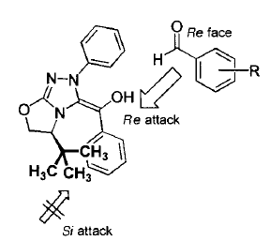
5.1 Umpolung: Carbene Catalysts
Enders: Asymmetric Benzoin Condensation
Mechanism and Model for Selectivity
(1) Enders, D.; Kallfass, U. Angew. Chem., Int. Ed. 2002, 41, 1743-1745.

Slide 4
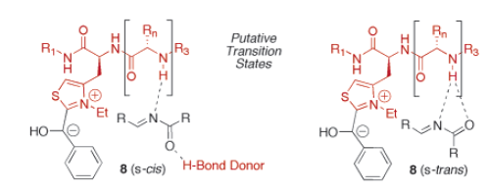
5.1 Umpolung: Carbene Catalysts
Miller: A Peptide-Derived Catalyst for Cross-Benzoin Condensation
Transition State
(1) Mennen, S. M.; Gipson, J. D.; Kim, Y. R.; Miller, S. J. J. Am. Chem. Soc. 2005, 127, 1654-1655.

Slide 5
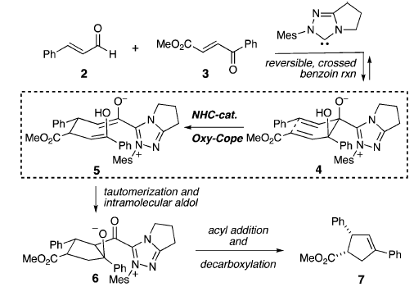
5.1 Umpolung: Carbene Catalysts
Bode: Tandem Benzoin-Cope-Cyclization Reaction
Mechanism
(1) Chiang, P. C.; Kaeobamrung, J.; Bode, J. W. J. Am. Chem. Soc. 2007, 129, 3520.

Slide 6
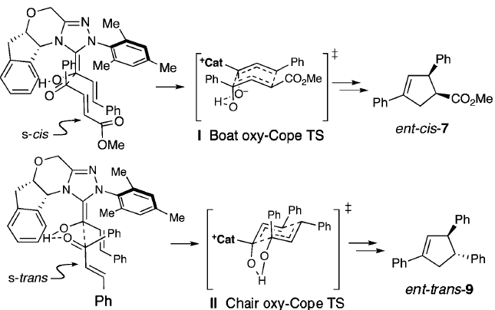
5.1 Umpolung: Carbene Catalysts
Model for Selectivity
(1) Chiang, P. C.; Kaeobamrung, J.; Bode, J. W. J. Am. Chem. Soc. 2007, 129, 3520.

Slide 7
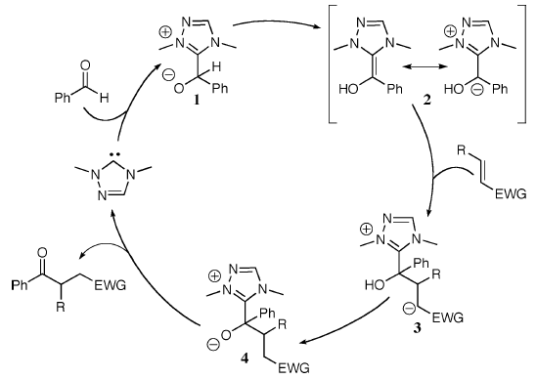
5.1 Umpolung: Carbene Catalysts
Rovis: Catalytic Asymmetric Intramolecular Stetter Reaction
Catalytic Cycle for
the Stetter Reaction
(1) Kerr, M. S.; de Alaniz, J. R.; Rovis, T. J. Am. Chem. Soc. 2002, 124, 10298-10299. (2) Kerr, M. S.; Rovis, T. J. Am. Chem. Soc. 2004, 126, 8876-8877. (3) de Alaniz, J. R.; Rovis, T. J. Am. Chem. Soc. 2005, 127, 6284-6289.

Slide 8
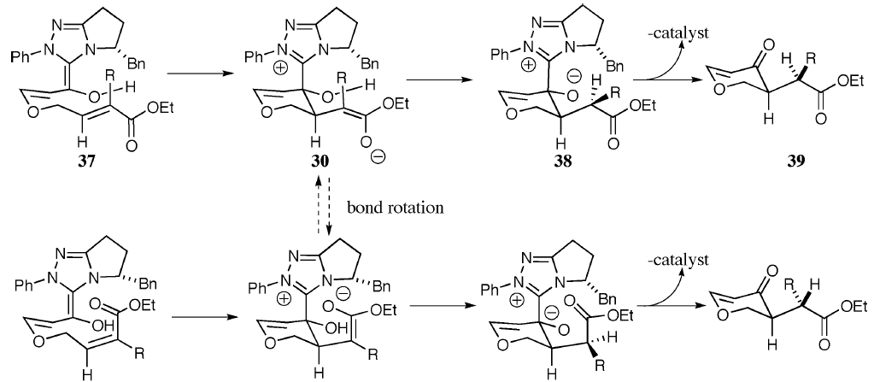
5.1 Umpolung: Carbene Catalysts
Model for Selectivity
(1) Kerr, M. S.; de Alaniz, J. R.; Rovis, T. J. Am. Chem. Soc. 2002, 124, 10298-10299. (2) Kerr, M. S.; Rovis, T. J. Am. Chem. Soc. 2004, 126, 8876-8877. (3) de Alaniz, J. R.; Rovis, T. J. Am. Chem. Soc. 2005, 127, 6284-6289.

Slide 9
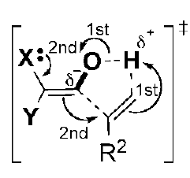
5.1 Umpolung: Carbene Catalysts
Glorius: Intermolecular asymmetric stetter reaction for the synthesis of amino acids¹
Glorius: Intramolecular hydroacylation of olefins²
(1) Jousseaume, T.; Wurz, N. E.; Glorius, F., Angew. Chem., Int. Ed. 2011, 50, 1410. (2) Piel, I.; Steinmetz, M.; Hirano, K.; Frohlich, R.; Grimme, S.; Glorius, F., Angew. Chem., Int. Ed. 2011, 50, 4983.

Slide 10
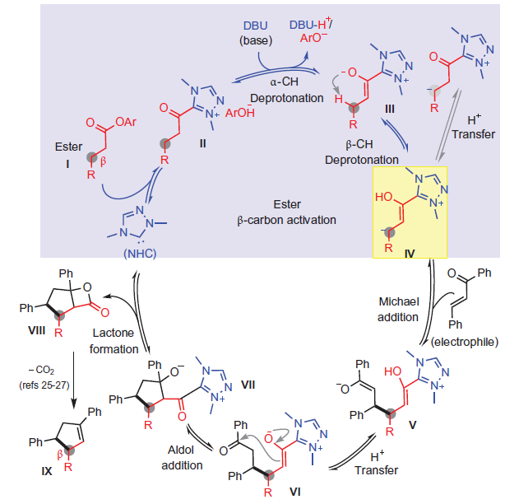
5.1 Umpolung: Carbene Catalysts
Chi: Umpolung of esters
(1) Fu, Z. Q.; Xu, J. F.; Zhu, T. S.; Leong, W. W. Y.; Chi, Y. R. Nature Chem. 2013, 5, 835.

Slide 11
5.2 Umpolung: SOMO Activation
MacMillan: Asymmetric α-Allylation of Aldehydes via SOMO-Activation¹
MacMillan: Asymmetric Synthesis of 1,4- Dicarbonyl Compounds via SOMO-Activation²
(1) Beeson, T. D.; Mastracchio, A.; Hong, J. B.; Ashton, K.; MacMillan, D. W. C. Science 2007, 316, 582-585. (2) Jang, H. Y.; Hong, J. B.; MacMillan, D. W. C. J. Am. Chem. Soc. 2007, 129, 7004-7005.

Slide 12
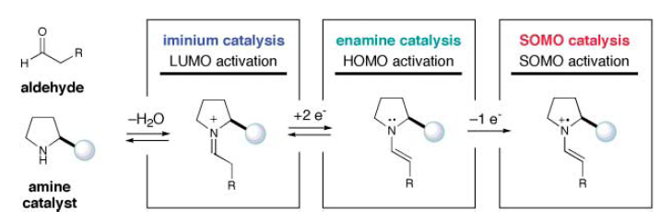
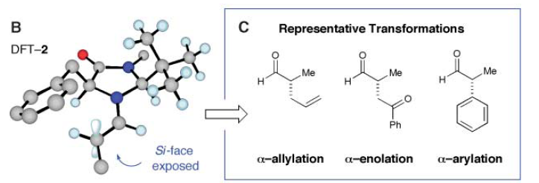
5.2 Umpolung: SOMO Activation
General Concept for Somo Activation
Model for Selectivity
(1) Beeson, T. D.; Mastracchio, A.; Hong, J. B.; Ashton, K.; MacMillan, D. W. C. Science 2007, 316, 582-585. (2) Jang, H. Y.; Hong, J. B.; MacMillan, D. W. C. J. Am. Chem. Soc. 2007, 129, 7004-7005.

Slide 13
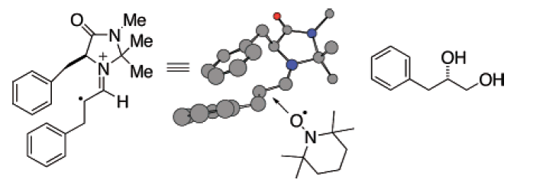
5.2 Umpolung: SOMO Activation
Sibi: α-Oxidation of Aldehydes with Tempo via SOMO Activation
Model for Selectivity
(1) Sibi, M. P.; Hasegawa, M. J. Am. Chem. Soc. 2007, 129, 4124-4125.

Slide 14
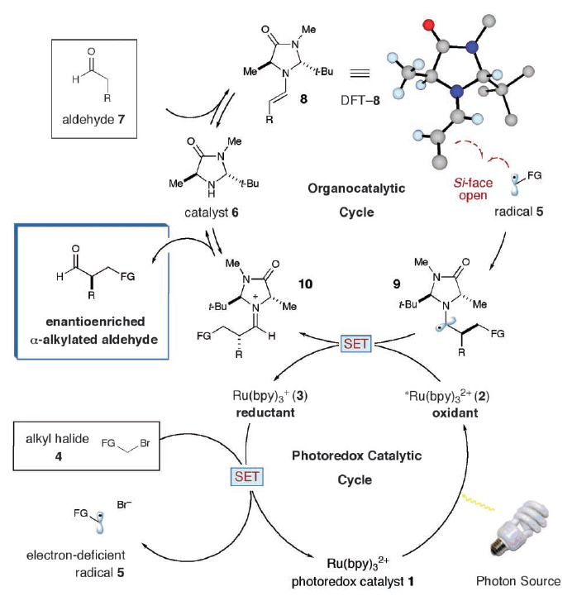
5.2 Umpolung: SOMO Activation
MacMillan: Light Driven Somo Activation¹
(1) Nicewicz, D. A.; MacMillan, D. W. C. Science 2008, 322, 77.

Slide 15
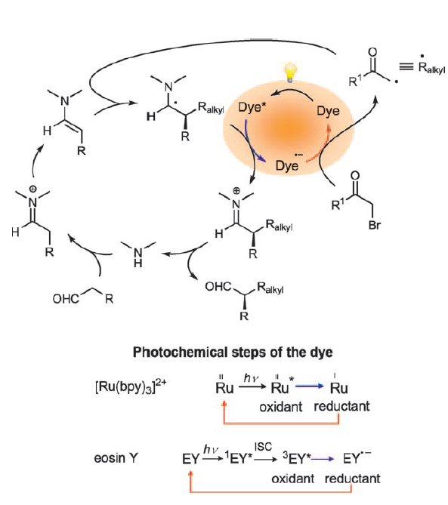
5.2 Umpolung: SOMO Activation
Zeitler: Use of organic dyes¹
(1) Neumann, M.; Fuldner, S.; Konig, B.; Zeitler, K., Angew. Chem., Int. Ed. 2011, 50, 951.

Slide 16
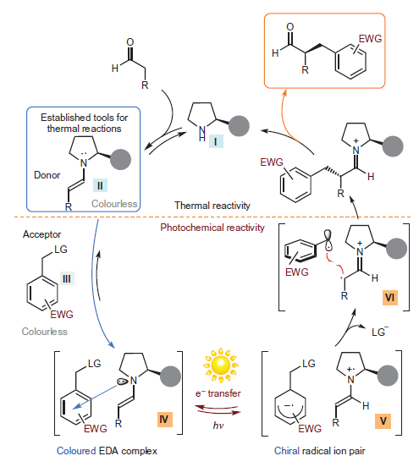
5.2 Umpolung: SOMO Activation
Melchiorre: Activation via Donor-Acceptor Complexes¹
(1) Arceo, E.; Jurberg, I. D.; Alvarez-Fernandez, A.; Melchiorre, P. Nat. Chemistry 2013, 5, 750.

Slide 17
5.2 Umpolung: SOMO Activation
Melchiorre: Conjugate addition of radicals¹
(1) Murphy, J. J.; Bastida, D.; Paria, S.; Fagnoni, M.; Melchiorre, P. Nature 2016, 532, 218-222.

Slide 18
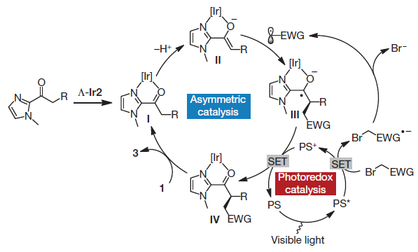
5.2 Umpolung: SOMO Activation
Meggers: Chiral Photoredox Catalysts¹
(1) Huo, H.; Shen, X.; Wang, C.; Zhang, L.; Roese, P.; Chen, L.-A.; Harms, K.; Marsch, M.; Hilt, G.; Meggers, E. Nature 2014, 515, 100.

Slide 19
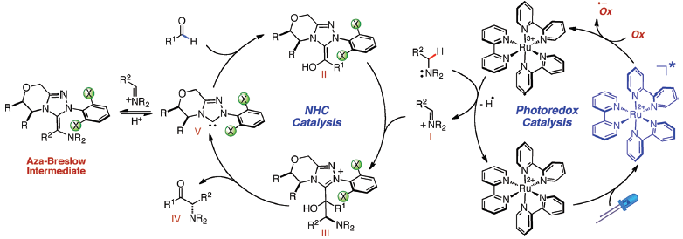
5.2 Umpolung: SOMO Activation
Rovis: Combining Photoredox and carbene catalysis¹
(1) DiRocco, D. A.; Rovis, T. J. Am. Chem. Soc. 2012, 134, 8094.

Slide 20
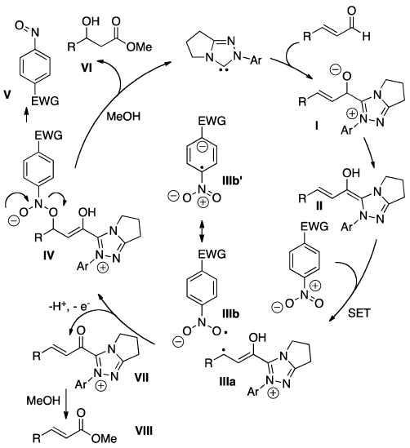
5.2 Umpolung: SOMO Activation
Rovis: From Carbene to Somo¹
(1) White, N. A.; Rovis, T. J. Am. Chem. Soc. 2014, 136, 14674.

Slide 21
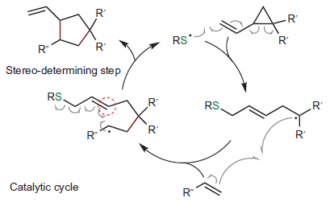
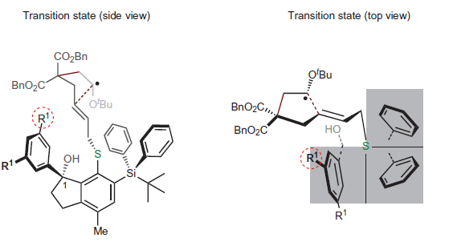
5.2 Umpolung: Chiral Radical Catalyst
Maruoka: First Example of Chiral Thiol Radical Catalyst¹
(1) Hashimoto, T.; Kawamata, Y.; Maruoka, K. Nature Chemistry 2014, 6, 702.

Slide 22
6. Conclusion
Classical Achievement of Asymmetric Catalysis
Chiral Lewis acid activation
Enantioselective hydrogenation
Enantioselective oxidation reactions
Organocatalysis: Bronsted acid and chiral bases
Bifunctional catalysts
Recent Breakthroughs and Hot Topics
CH-functionalization and cyclizations
Base/abundant metal catalysis
Enantioselective photoredox catalysis
Catalytic asymmetric radical reactions

Slide 23
6. Conclusion
The Future of Asymmetric Catalysis
Development of general and efficient methods
Application of the recently developped concepts
Sustainable Chemistry: Away from stoichiometric toxic reagents and precious catalysts
Discovery of new reactions
The Laboratory of Catalysis and Organic Synthesis (LCSO)
- Goal: Discovery of new non conventional reactions
Tools: Organo- and metal- catalysis, Umpolung reactions, hypervalent iodine, small rings chemistry
Applications: Key building blocks and biomolecule functionalization

