Slide 1
4.6 Dual Activation on A Single Metal Center:
Non-Activated Systems
4.6.1 Functionalization of Non-Activated Olefins
4.6.2 Metathesis
4.6.3 Cyclization and Cycloaddition Reactions
4.6.4 Cross-Coupling Reactions
4.6.5 CH Functionalization

Slide 2
4.6.1.Functionalization of Olefins: Epoxidation
Sharpless Epoxidation
Model for Selectivity
(1) Gao, Y.; Hanson, R. M.; Klunder, J. M.; Ko, S. Y.; Masamune, H.; Sharpless, K. B. J. Am. Chem. Soc. 1987, 109, 5765-5780.

Slide 3
4.6.1.Functionalization of Olefins: Hydrogenation
Pfaltz: Asymmetric Hydrogenation of Non-Activated Olefins¹
An Application: Synthesis of Tocopherol (Vitamin E) Derivatives²
(1) Lightfoot, A.; Schnider, P.; Pfaltz, A. Angew. Chem., Int. Ed. 1998, 37, 2897-2899. (2) Bell, S.; Wustenberg, B.; Kaiser, S.; Menges, F.; Netscher, T.; Pfaltz, A. Science 2006, 311, 642-644.

Slide 4
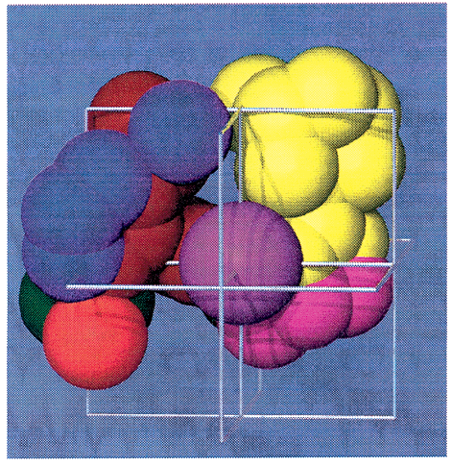
4.6.1.Functionalization of Olefins: Hydrogenation
Burgess:Carbene-Oxazoline Ligands for Asymmetric Hydrogenation
Catalyst Structure
(1) Perry, M. C.; Cui, X. H.; Powell, M. T.; Hou, D. R.; Reibenspies, J. H.; Burgess, K. J. Am. Chem. Soc. 2003, 125, 113-123.

Slide 5
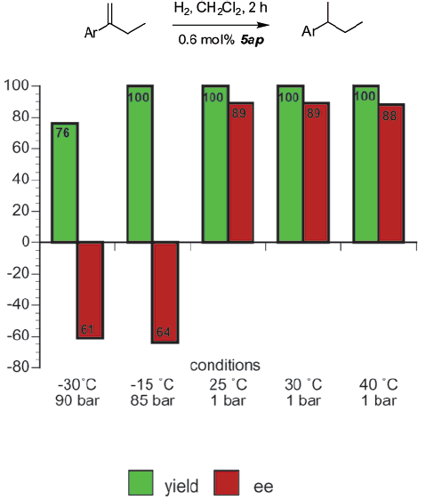
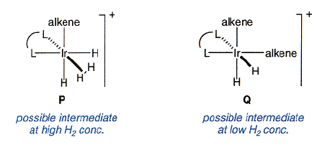
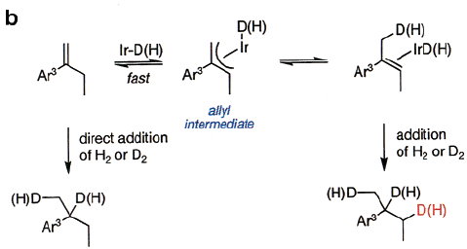
4.6.1.Functionalization of Olefins: Hydrogenation
Influence of Pressure
Mechanistic Insights
(1) Perry, M. C.; Cui, X. H.; Powell, M. T.; Hou, D. R.; Reibenspies, J. H.; Burgess, K. J. Am. Chem. Soc. 2003, 125, 113-123.

Slide 6
4.6.1.Functionalization of Olefins: Isomerization
Isomerization of allylamine: the Takasago process
Synthesis of menthol
Inoue, S.; Takaya, H.; Tani, K.; Otsuka, S.; Sato, T.; Noyori, R. J. Am. Chem. Soc. 1990, 112, 4897-4905.

Slide 7
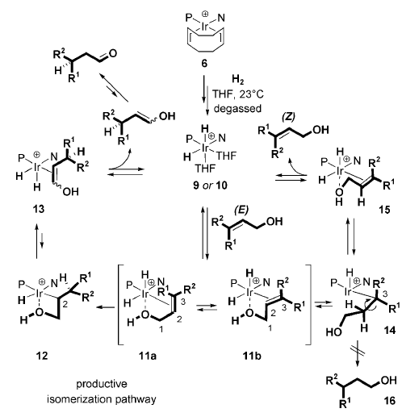
4.6.1.Functionalization of Olefins: Isomerization
Isomerization of allylalcohols: Mazet
Mantilli, L.; Gerard, D.; Torche, S.; Besnard, C.; Mazet, C., Angew. Chem., Int. Ed. 2009, 48, 5143.

Slide 8
4.6.1.Functionalization of Olefins: Hydrosilylation/boration
Hayashi: Palladium-Catalyzed Hydrosilylation of Olefins¹
Micouin: Metal-Dependant Selectivity in Asymmetric Hydroboration²
(1) Hayashi, T.; Hirate, S.; Kitayama, K.; Tsuji, H.; Torii, A.; Uozumi, Y. J. Org. Chem. 2001, 66, 1441-1449. (2) Luna, A. P.; Bonin, M.; Micouin, L.; Husson, H. P. J. Am. Chem. Soc. 2002, 124, 12098-12099.

Slide 9
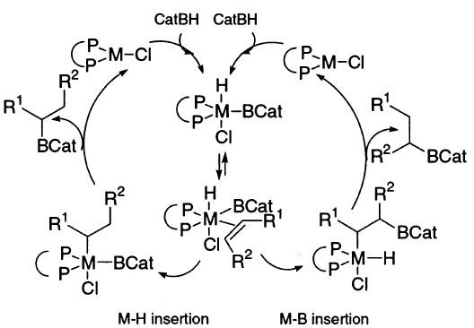
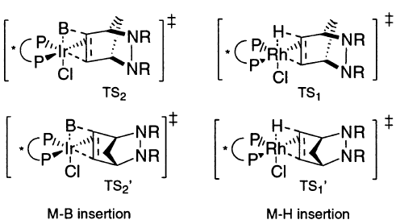
4.6.1.Functionalization of Olefins: Hydroboration
A Mechanistic Proposal for the Reversal of Selectivity¹
(1) Luna, A. P.; Bonin, M.; Micouin, L.; Husson, H. P. J. Am. Chem. Soc. 2002, 124, 12098-12099.

Slide 10
4.6.1.Functionalization of Olefins: Diboration
Morken: Asymmetric Diboration of Alkenes¹
Morken: Asymmetric Diboration of Allenes²
(1) Trudeau, S.; Morgan, J. B.; Shrestha, M.; Morken, J. P. J. Org. Chem. 2005, 70, 9538-9544. (2) Burks, H. E.; Liu, S. B.; Morken, J. P. J. Am. Chem. Soc. 2007, 129, 8766-8773.

Slide 11
4.6.1.Functionalization of Olefins: Hydroformyl/vinylation
Klosin: Asymmetric Hydroformylation¹
Rajanbabu: Asymmetric Hydrovinylation²
(1) Axtell, A. T.; Cobley, C. J.; Klosin, J.; Whiteker, G. T.; Zanotti-Gerosa, A.; Abboud, K. A. Angew. Chem., Int. Ed. 2005, 44, 5834-5838. (2) Zhang, A. B.; RajanBabu, T. V. J. Am. Chem. Soc. 2006, 128, 5620-5621.

Slide 12
4.6.1.Functionalization of Olefins: Hydroarylation
Ackermann: Iron-catalyzed hydroarylation of alkenes with indoles
Loup, J.; Zell, D.; Oliveira, J. C. A.; Keil, H.; Stalke, D.; Ackermann, L., Angew. Chem., Int. Ed. 2017, 56, 14197-14201.

Slide 13
4.6.1.Functionalization of Olefins: Hydroacylation
Dong: Asymmetric hydroacylation based on directing group¹
Dong: Asymmetric hydroacylation based on ring strain²
(1) Coulter, M. M.; Kou, K. G. M.; Galligan, B.; Dong, V. M., J. Am. Chem. Soc. 2010, 132, 16330. (2) Phan, D. H. T.; Kou, K. G. M.; Dong, V. M., J. Am. Chem. Soc. 2010, 132, 16354.

Slide 14
4.6.1.Functionalization of Olefins: Diarylation
Engle: Ni Catalyzed diarylation¹
Cheng: Pd-Catalyzed diarylation²
(1) Apolinar, O.; Kang, T.; Alturaifi, T. M.; Bedekar, P. G.; Rubel, C. Z.; Derosa, J.; Sanchez, B. B.; Wong, Q. N.; Sturgell, E. J.; Chen, J. S.; Wisniewski, S. R.; Liu, P.; Engle, K. M. J. Am. Chem. Soc. 2022, 144, 19337-19343. (2) Xi, Y.; Huang, W.; Wang, C.; Ding, H.; Xia, T.; Wu, L.; Fang, K.; Qu, J.; Chen, Y. J. Am. Chem. Soc. 2022, 144, 8389-8398.

Slide 15
4.6.1.Functionalization of Olefins: Diarylation
Apolinar, O.; Kang, T.; Alturaifi, T. M.; Bedekar, P. G.; Rubel, C. Z.; Derosa, J.; Sanchez, B. B.; Wong, Q. N.; Sturgell, E. J.; Chen, J. S.; Wisniewski, S. R.; Liu, P.; Engle, K. M. J. Am. Chem. Soc. 2022, 144, 19337-19343.

Slide 16
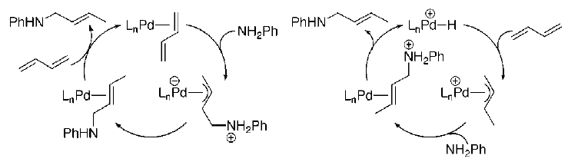
4.6.1.Functionalization of Olefins: Hydroamination
Hartwig: Asymmetric Hydroamination of Dienes¹
Possible Mechanisms
(1) Lober, O.; Kawatsura, M.; Hartwig, J. F. J. Am. Chem. Soc. 2001, 123, 4366-4367.

Slide 17
4.6.1.Functionalization of Olefins: Hydroamination
Hartwig: 20 years later non-activated alkenes¹
(1) Xi, Y.; Ma, S.; Hartwig, J. F. Nature 2020, 588, 254.

Slide 18
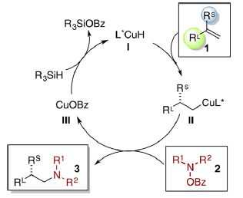
4.6.1.Functionalization of Olefins: Hydroamination
Buchwald: Hydroamination with Hydroxylamines and Silanes¹
(1) Zhu, S.; Buchwald, S. L. J. Am. Chem. Soc. 2014, 136, 15913.

Slide 19
4.6.1.Functionalization of Olefins: Hydroamination/ Ketones
Buchwald: Stereodivergent synthesis of aminoalcohols¹
Buchwald: Addition to ketones²
(1) Shi, S. L.; Wong, Z. L.; Buchwald, S. L. Nature 2016, 532, 353-356. (2) Yang, Y.; Perry, I. B.; Lu, G.; Liu, P.; Buchwald, S. L. Science 2016, 353, 144-150.

Slide 20
4.6.1.Functionalization of Olefins: Diamination
Shi: Asymmetric Diamination of Dienes¹
Shi: Asymmetric C-H Diamination of Terminal Olefins²
(1) Du, H. F.; Yuan, W. C.; Zhao, B. G.; Shi, Y. J. Am. Chem. Soc. 2007, 129, 11688-11689. (2) Du, H. F.; Zhao, B. G.; Shi, Y. J. Am. Chem. Soc. 2008, 130, 8590-8591.

Slide 21
4.6.1.Functionalization of Olefins: Radicals
Guosheng Liu: Trifluoromethylcyanation of alkenes via radicals¹
Wang, F.; Wang, D.; Wan, X.; Wu, L.; Chen, P.; Liu, G., J. Am. Chem. Soc. 2016, 138, 15547-15550.

Slide 22
4.6.1.Functionalization of Olefins: Radicals
Xile Hu: Nickel-catalyzed hydroalkylation of vinyl boronic esters¹ and enamides²
(1) Bera, S.; Mao, R.; Hu, X. Nat. Chem. 2021, 13, 270. (2) Qian, D.; Bera, S.; Hu, X. J. Am. Chem. Soc. 2021, 143, 1959.

Slide 23
4.6.1.Functionalization of Olefins: Radicals
(1) Bera, S.; Mao, R.; Hu, X. Nat. Chem. 2021, 13, 270. (2) Qian, D.; Bera, S.; Hu, X. J. Am. Chem. Soc. 2021, 143, 1959.

Slide 24
4.6.1.Functionalization of Olefins: Radicals
Song Lin: generation of radicals via electrochemistry¹
Fu, N. K.; Song, L.; Liu, J. J.; Shen, Y. F.; Siu, J. C.; Lin, S., J. Am. Chem. Soc. 2019, 141, 14480-14485.

Slide 25
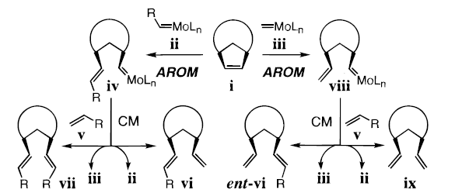
4.6.2 Metathesis: Mo Catalysts
Schrock-Hoveyda: Ring-Opening –Cross Metathesis with Chiral Mo Catalysts (AROM/CM)
Mechanistic Considerations
(1) La, D. S.; Ford, J. G.; Sattely, E. S.; Bonitatebus, P. J.; Schrock, R. R.; Hoveyda, A. H. J. Am. Chem. Soc. 1999, 121, 11603-11604. (1) La, D. S.; Sattely, E. S.; Ford, J. G.; Schrock, R. R.; Hoveyda, A. H. J. Am. Chem. Soc. 2001, 123, 7767-7778.

Slide 26
4.6.2 Metathesis: Mo Catalysts
Schrock-Hoveyda: Asymmetric
Ring-Closing Metathesis (RCM)
Schrock-Hoveyda: Asymmetric Ring-Opening
-Ring Closing Metathesis (AROM-RCM)
(1) Zhu, S. S.; Cefalo, D. R.; La, D. S.; Jamieson, J. Y.; Davis, W. M.; Hoveyda, A. H.; Schrock, R. R. J. Am. Chem. Soc. 1999, 121, 8251-8259. (2) Weatherhead, G. S.; Ford, J. G.; Alexanian, E. J.; Schrock, R. R.; Hoveyda, A. H. J. Am. Chem. Soc. 2000, 122, 1828-1829.

Slide 27
4.6.2 Metathesis: Mo Catalysts
Schrock-Hoveyda: Asymmetric Ring-Closing Metathesis (RCM) with chiral center on Mo
Application: synthesis of quebrachamine
(1) Malcolmson, S. J.; Meek, S. J.; Sattely, E. S.; Schrock, R. R.; Hoveyda, A. H. Nature 2008, 456, 933-937.

Slide 28
4.6.2 Metathesis: Ru Catalysts
Hoveyda: Ru Catalyst for AROM/CM¹
Grubbs: Ru Catalyst for AROM/CM²
Improved chiral at Ru catalyst³
(1) Van Veldhuizen, J. J.; Gillingham, D. G.; Garber, S. B.; Kataoka, O.; Hoveyda, A. H. J. Am. Chem. Soc. 2003, 125, 12502. (2) Berlin, J. M.; Goldberg, S. D.; Grubbs, R. H. Angew. Chem., Int. Ed. 2006, 45, 7591. (3) Hartung, J.; Dornan, P. K.; Grubbs, R. H. J. Am. Chem. Soc. 2014, 136, 13029.

Slide 29
4.6.3 Cyclization Reactions with Alkynes
Mikami: Pd-Catalyzed Alder-Ene Cyclization¹
Zhang: Pd-Catalyzed Alder-Ene Cyclization²
(1) Hatano, M.; Mikami, K. J. Am. Chem. Soc. 2003, 125, 4704-4705. (2) Lei, A. W.; Waldkirch, J. P.; He, M. S.; Zhang, X. M. Angew. Chem., Int. Ed. 2002, 41, 4526-4529.

Slide 30
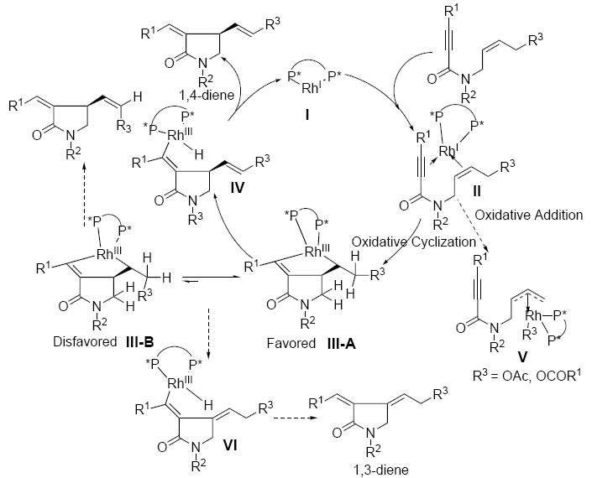
4.6.3 Cyclization Reactions with Alkynes
Mechanism for the Rh-Catalyzed Alder-Ene Reaction¹
(1) Lei, A. W.; Waldkirch, J. P.; He, M. S.; Zhang, X. M. Angew. Chem., Int. Ed. 2002, 41, 4526-4529.

Slide 31
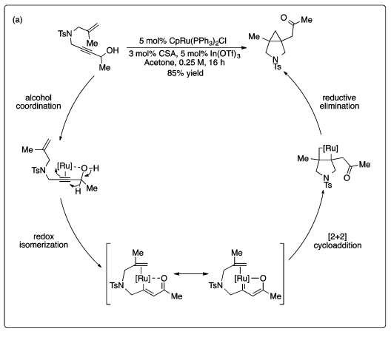
4.6.3 Cyclization Reactions with Alkynes
Trost: Ruthenium-Catalyzed Cycloisomerization Reaction¹
(1) Trost, B. M.; Ryan, M. C.; Rao, M.; Markovic, T. Z. J. Am. Chem. Soc. 2014, 136, 17422.

Slide 32
4.6.3 Cyclization Reactions with Alkenes
Stoltz: Wacker-Type Oxidative Cyclization¹
Tietze: Tandem Wacker-Cyclization Heck Coupling¹
(1) Trend, R. M.; Ramtohul, Y. K.; Stoltz, B. M. J. Am. Chem. Soc. 2005, 127, 17778-17788. (1) Tietze, L. F.; Sommer, K. M.; Zinngrebe, J.; Stecker, F. Angew. Chem., Int. Ed. 2005, 44, 257-259.

Slide 33
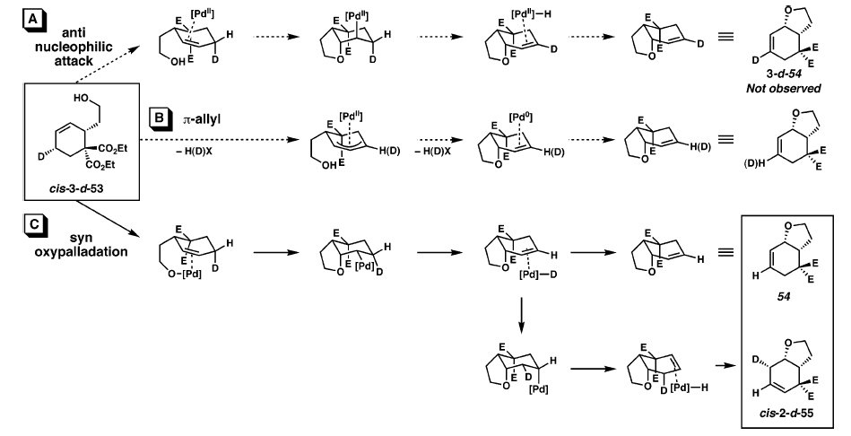
4.6.3 Cyclization Reactions with Alkenes
Stoltz: Deuterium-Labeling Gives Insights into the Reaction Mechanism¹
(1) Trend, R. M.; Ramtohul, Y. K.; Stoltz, B. M. J. Am. Chem. Soc. 2005, 127, 17778-17788.

Slide 34
4.6.3 Cyclization Reactions with Alkenes
Bergman-Ellman: Rh-Catalyzed cyclization initiated by C-H activation¹
Cramer: Ni-Catalyzed cyclization with chiral carbene ligands²
Thalji, R. K.; Ellman, J. A.; Bergman, R. G. J. Am. Chem. Soc. 2004, 126, 7192-7193. (2) Diesel, J.; Grosheva, D.; Kodama, S.; Cramer, N., Angew. Chem., Int. Ed. 2019, 58, 11044-11048.

Slide 35
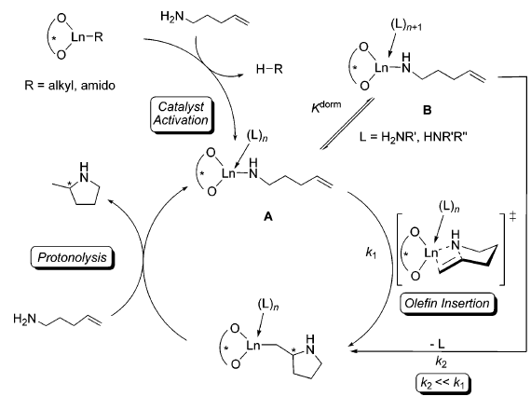
4.6.3 Cyclization Reactions with Alkenes
Hultsch: Intramolecular Hydroamination of Alkenes
(1) Gribkov, D. V.; Hultzsch, K. C.; Hampel, F. 2006, 128, 3748-3759.

Slide 36
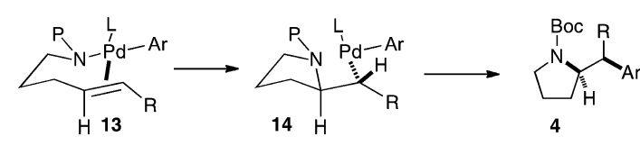
4.6.3 Cyclization Reactions with Alkenes
Wolfe: Asymmetric Carboamination with Pd catalysts¹
Chemler: Asymmetric Carbooxygenation with Cu catalysts²
(1) Mai, D. N.; Wolfe, J. P., J. Am. Chem. Soc. 2010, 132, 12157. (2) Bovino, M. T.; Liwosz, T. W.; Kendel, N. E.; Miller, Y.; Tyminska, N.; Zurek, E.; Chemler, S. R. Angew. Chem., Int. Ed. 2014, 53, 6383.

Slide 37
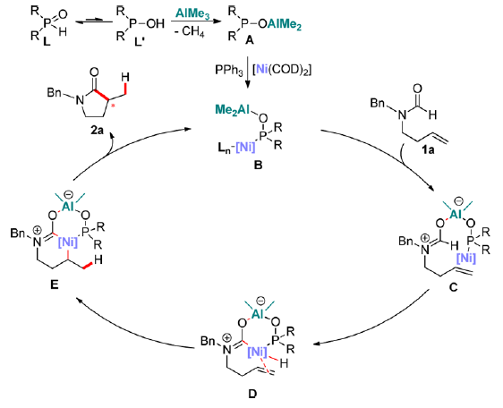
4.6.3 Cyclization Reactions: Hydrocarbamoylation
Cramer: Nickel-catalyzed hydrocarbamoylation of olefins with new phosphine oxide ligand¹
(1) Donets, P. A.; Cramer, N. J. Am. Chem. Soc. 2013, 135, 11772.

Slide 38
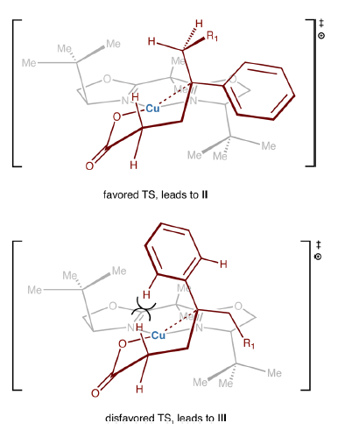
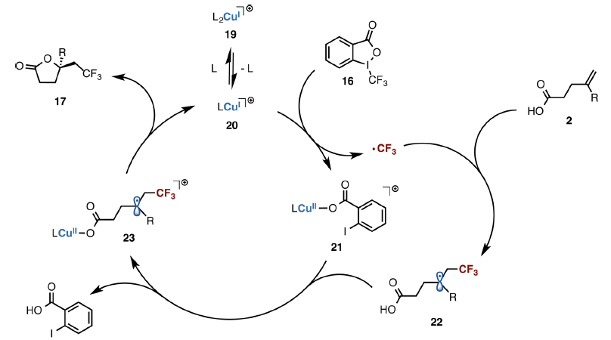
4.6.3. Cyclization Reactions: via radicals
Buchwald: Combining Radical and Metal Pathways¹
(1) Zhu, R.; Buchwald, S. L. J. Am. Chem. Soc. 2015, 137, 8069.

Slide 39
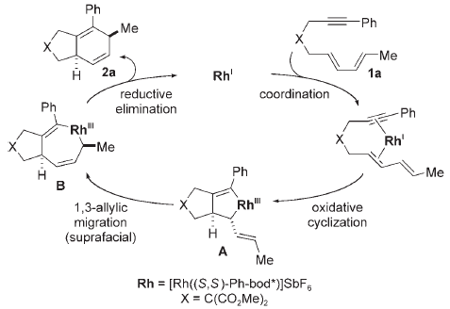
4.6.3 Cycloaddition Reactions
Hayashi: [4+2] Intramolecular Cycloaddition Reaction of Alkynes and Dienes
Mechanism
(1) Shintani, R.; Sannohe, Y.; Tsuji, T.; Hayashi, T. Angew. Chem., Int. Ed. 2007, 46, 7277-7280.

Slide 40
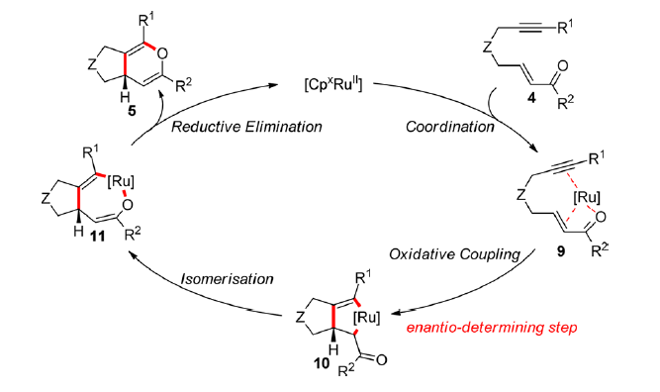
4.6.3 Cycloaddition Reactions
Cramer: Ruthenium-Catalyzed Annulation with Chiral CP ligand¹
(1) Kossler, D.; Cramer, N. J. Am. Chem. Soc. 2015, 137, 12478.

Slide 41
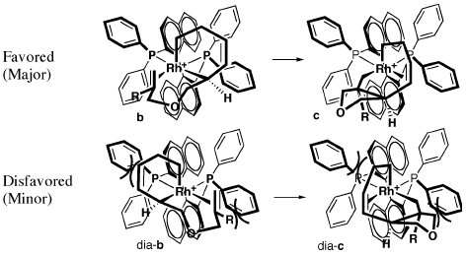
4.6.3 Cycloaddition Reactions
Wender: [5+2] Intramolecular Cycloaddition of Vinylcyclopropanes and Alkenes
Model for Selectivity
(1) Wender, P. A.; Haustedt, L. O.; Lim, J.; Love, J. A.; Williams, T. J.; Yoon, J. Y. J. Am. Chem. Soc. 2006, 128, 6302-6303.

Slide 42
4.6.3 Cycloaddition Reactions
Shibata: Asymmetric [2+2+2] Cycloaddition – Alkyne, Alkyne, Alkene¹
Tanaka: Asymmetric Trimerization of Alkynes for the Synthesis of Axially Chiral Anilides²
(1) Tsuchikama, K.; Kuwata, Y.; Shibata, T. J. Am. Chem. Soc. 2006, 128, 13686-13687. (1) Tanaka, K.; Takeishi, K.; Noguchi, K. J. Am. Chem. Soc. 2006, 128, 4586-4587.

Slide 43
4.6.3 Cycloaddition Reactions
Cramer: [4+4] with iron catalysis¹
(1) Braconi, E.; Götzinger, A. C.; Cramer, N. J. Am. Chem. Soc. 2020, 142, 19819.

Slide 44
4.6.4 Cross-Coupling Reactions: Heck
Shibasaki: The First Asymmetric Heck Cyclization Reaction¹
Overman: Asymmetric Heck Cyclization for the Synthesis of Oxindoles²
(1) Sato, Y.; Nukui, S.; Sodeoka, M.; Shibasaki, M. Tetrahedron 1994, 50, 371-382. (2) Ashimori, A.; Bachand, B.; Calter, M. A.; Govek, S. P.; Overman, L. E.; Poon, D. J. J. Am. Chem. Soc. 1998, 120, 6488-6499. (3) Ashimori, A.; Bachand, B.; Overman, L. E.; Poon, D. J. J. Am. Chem. Soc. 1998, 120, 6477-6487.

Slide 45
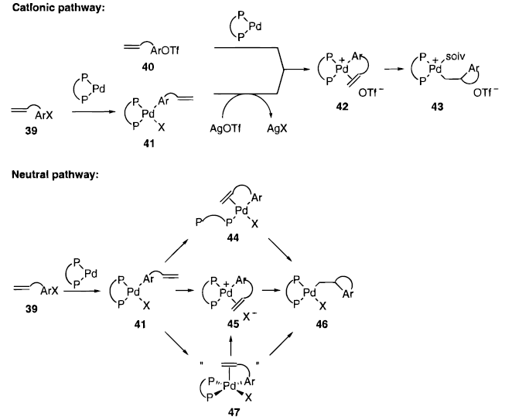
4.6.4 Cross-Coupling Reactions: Heck
The Two Possible Mechanism for the Heck Cyclization¹
(1) Ashimori, A.; Bachand, B.; Calter, M. A.; Govek, S. P.; Overman, L. E.; Poon, D. J. J. Am. Chem. Soc. 1998, 120, 6488-6499.

Slide 46
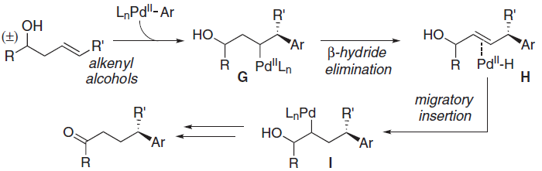
4.6.4 Cross-Coupling Reactions: Heck
Sigman: Enantioselective Heck arylation
(1) Werner, E. W.; Mei, T. S.; Burckle, A. J.; Sigman, M. S. Science 2012, 338, 1455. (2) Mei, T. S.; Patel, H. H.; Sigman, M. S. Nature 2014, 508, 340.

Slide 47
4.6.4 Cross-Coupling Reactions: Dyotropic Rearrangements
Zhu: dyotropic rearrangement of carbon and palladium¹
(1) Cao, J.; Wu, H.; Wang, Q.; Zhu, J. Nat. Chem. 2021, 13, 671-676.

Slide 48
4.6.4 Cross-Coupling Reactions: Negishi and Suzuki
Fu: Asymmetric Negishi Coupling of α-Bromo Amides¹
Fu: Asymmetric Asymmetric Suzuki Coupling of Homobenzylic Bromides²
(1) Fischer, C.; Fu, G. C. J. Am. Chem. Soc. 2005, 127, 4594-4595. (2) Saito, B.; Fu, G. C. J. Am. Chem. Soc. 2008, 130, 6694.

Slide 49
4.6.4 Cross-Coupling Reactions: Reductive and C-N
Reisman: Reductive Cross-Coupling²
Fu/Peters: C-N Coupling Combining Nickel and Photoredox Catalysis²
(1) Cherney, A. H.; Reisman, S. E. J. Am. Chem. Soc. 2014, 136, 14365. (2) Kainz, Q. M.; Matier, C. D.; Bartoszewicz, A.; Zultanski, S. L.; Peters, J. C.; Fu, G. C. Science 2016, 351, 681-684.

Slide 50
4.6.4 Cross-Coupling Reactions: Decarboxylative/Photoredox
MacMillan: Combining Decarboxylative Photoredox and Nickel Catalysis
(1) Zuo, Z.; Ahneman, D. T.; Chu, L.; Terrett, J. A.; Doyle, A. G.; MacMillan, D. W. C. Science 2014, 345, 437-440. (2) Zuo, Z. W.; Gong, H.; Li, W.; Choi, J.; Fu, G. C.; MacMillan, D. W. C. J. Am. Chem. Soc. 2016, 138, 1832-1835.

Slide 51
4.6.4 Cross-Coupling Reactions: Arylation of Ketones
Buchwald: Asymmetric α-Arylation of Ketones¹
Ma: Cu-Catalyzed Arylation of β-Ketoesters²
(1) Hamada, T.; Chieffi, A.; Ahman, J.; Buchwald, S. L. J. Am. Chem. Soc. 2002, 124, 1261-1268. (2) Xie, X. A.; Chen, Y.; Ma, D. W. J. Am. Chem. Soc. 2006, 128, 16050-16051.

Slide 52
4.6.4 Cross-Coupling Reactions: Arylation of Carbonyls
Kundig: Intramolecular Arylation of Ketones using Carbene Ligands¹
Mazet: Intramolecular Arylation of Aldehydes²
(1) Kundig, E. P.; Seidel, T. M.; Jia, Y. X.; Bernardinelli, G. Angew. Chem., Int. Ed. 2007, 46, 8484. (2) Nareddy, P.; Mantilli, L.; Guenee, L.; Mazet, C. Angew. Chem., Int. Ed. 2012, 51, 3826.

Slide 53
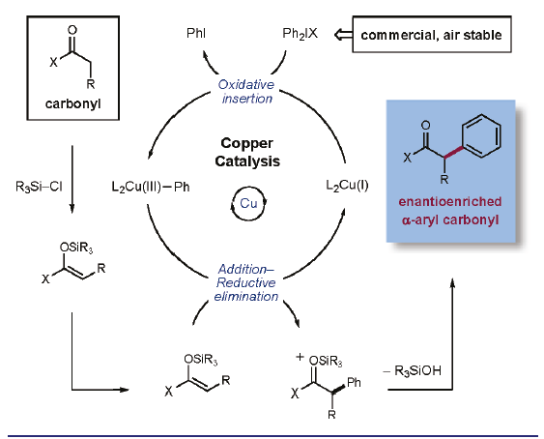
4.6.4 Cross-Coupling Reactions: Arylation of Enols
Gaunt and MacMillan: Cu-Catalyzed arylation of silyl enol ether with aryl iodonium salts^{1,2}
(1) Bigot, A.; Williamson, A. E.; Gaunt, M. J. J. Am. Chem. Soc. 2011, 133, 13778. (2) Harvey, J. S.; Simonovich, S. P.; Jamison, C. R.; MacMillan, D. W. C. J. Am. Chem. Soc. 2011, 133, 13782.

Slide 54
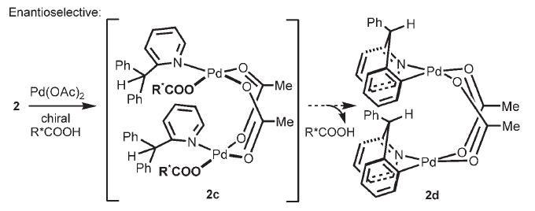
4.6.5 CH Functionalization: SP² C-H activation
Yu: Enantioselective C-H Activation¹
Working Model
(1) Shi, B. F.; Maugel, N.; Zhang, Y. H.; Yu, J. Q. Angew. Chem., Int. Ed. 2008, 47, 4882.

Slide 55
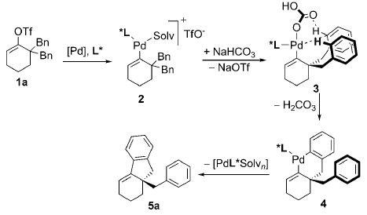
4.6.5 CH Functionalization: SP² C-H activation
Cramer: Enantioselective C-H Activation¹
Working Model
(1) Albicker, M. R.; Cramer, N. Angew. Chem., Int. Ed. 2009, 48, 9139.

Slide 56
4.6.5 CH Functionalization: SP² C-H activation
Cramer: The first truly efficient chiral Cp ligand for C-H activation cyclization¹
Rovis/Ward: An alternative combining transition metals and enzymes²
(1) Ye, B. H.; Cramer, N. Science 2012, 338, 504. (2) Hyster, T. K.; Knorr, L.; Ward, T. R.; Rovis, T. Science 2012, 338, 500.

Slide 57
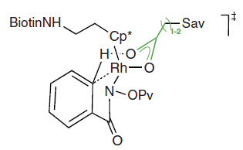
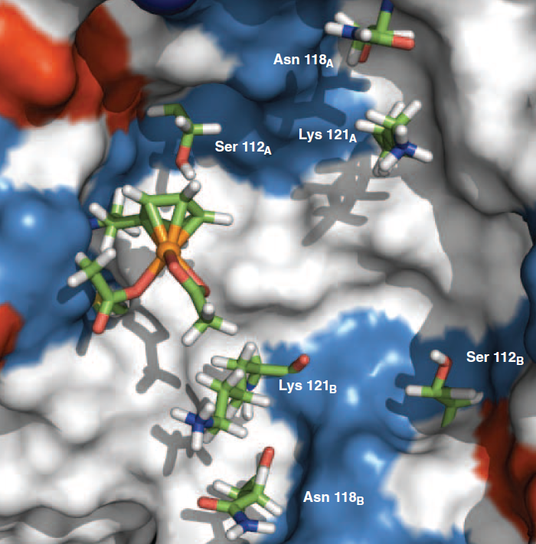
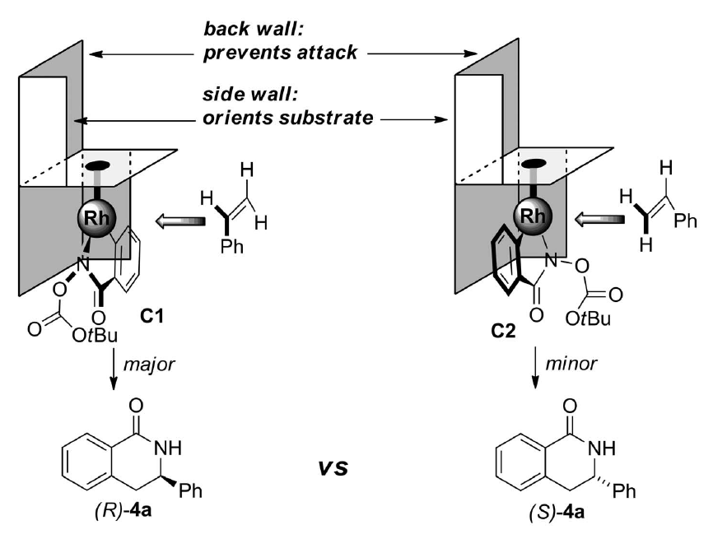
4.6.5 CH Functionalization: SP² C-H activation
Cramer¹
Rovis/Ward²
(1) Ye, B. H.; Cramer, N. Science 2012, 338, 504. (2) Hyster, T. K.; Knorr, L.; Ward, T. R.; Rovis, T. Science 2012, 338, 500.

Slide 58
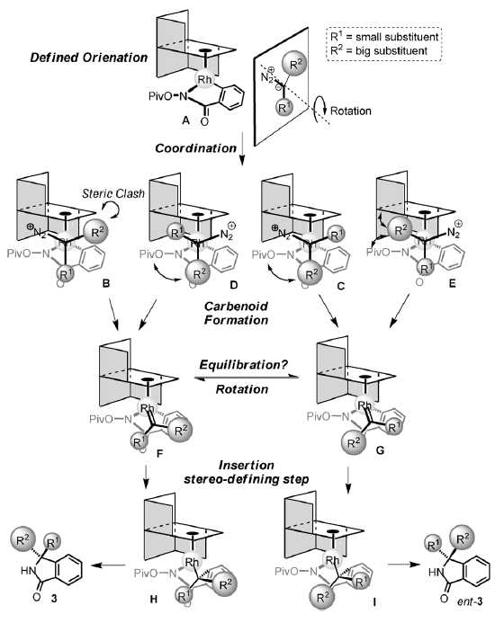
4.6.5 CH Functionalization: SP² C-H activation
Cramer: C-H Functionalization with
Binaphthyl-Based CP ligands¹
(1) Ye, B.; Cramer, N. Angew. Chem., Int. Ed. 2014, 53, 7896.

Slide 59
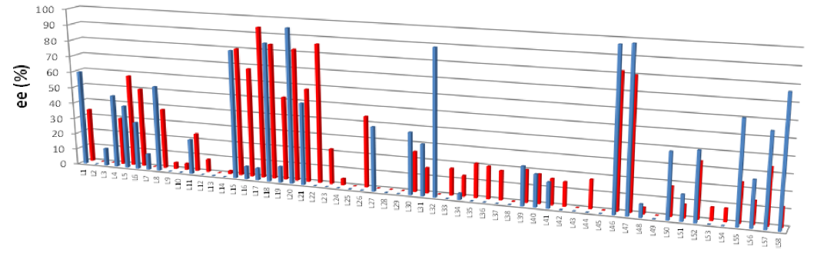
4.6.5 CH Functionalization: SP² C-H activation
Hartwig: Desymmetrization via C-H silylation¹
(1) Lee, T.; Wilson, T. W.; Berg, R.; Ryberg, P.; Hartwig, J. F. J. Am. Chem. Soc. 2015, 137, 6742.

Slide 60
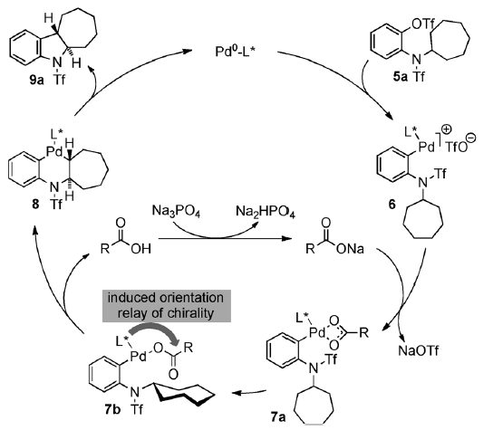
4.6.5 CH Functionalization : SP³ C-H activation
Cramer: Enantioselective C-H Activation of SP³ bonds¹
(1) Saget, T.; Lemouzy, S. J.; Cramer, N. Angew. Chem., Int. Ed. 2012, 51, 2238.

Slide 61
4.6.5 CH Functionalization : SP³ C-H activation
Yu: Enantioselective C-H Activation of SP³ bonds¹
(1) Chen, G.; Gong, W.; Zhuang, Z.; Andra, M. S.; Chen, Y. Q.; Hong, X.; Yang, Y. F.; Liu, T.; Houk, K. N.; Yu, J. Q. Science 2016, 353, 1023-1027.

Slide 62
4.6.5 CH Functionalization : SP³ C-H activation
Gaunt: Enantioselective C-H Activation of SP³ bonds¹
(1) Smalley, A. P.; Cuthbertson, J. D.; Gaunt, M. J. J. Am. Chem. Soc. 2017, 139, 1412-1415.

Slide 63
4.6.5 CH Functionalization : via Radicals
Zhang: HAT for enantioselective radical cyclization
Wang, Y.; Wen, X.; Cui, X.; Zhang, X. P. J. Am. Chem. Soc. 2018, 140, 4792-4796.

Slide 64
4.6.5 CH Functionalization: via Radicals
Guosheng Liu: Controling both regio- and enantio-selectivity for allylic cyanation
Li, J. Y.; Zhang, Z. H.; Wu, L. Q.; Zhang, W.; Chen, P. H.; Lin, Z. Y.; Liu, G. S., Nature 2019, 574, 516.

Slide 65
4.6.5 CH Functionalization: via Radicals
Li, J. Y.; Zhang, Z. H.; Wu, L. Q.; Zhang, W.; Chen, P. H.; Lin, Z. Y.; Liu, G. S., Nature 2019, 574, 516.

Slide 66
4.6.5 CH Functionalization: via Radicals
Xin-Yuan Liu: Enantioselective CH alkynylation¹
Zhaoqing Xu: Enantioselective CH alkylation using visible light²
(1) Liu, L.; Guo, K.-X.; Tian, Y.; Yang, C.-J.; Gu, Q.-S.; Li, Z.-L.; Ye, L.; Liu, X.-Y. Angew. Chem., Int. Ed. 2021, 60, 26710-26717. (2) Qi, R.; Wang, C.; Huo, Y.; Chai, H.; Wang, H.; Ma, Z.; Liu, L.; Wang, R.; Xu, Z. J. Am. Chem. Soc. 2021, 143, 12777-12783.

Slide 67
4.6.5 CH Functionalization: via Radicals
Qi, R.; Wang, C.; Huo, Y.; Chai, H.; Wang, H.; Ma, Z.; Liu, L.; Wang, R.; Xu, Z. J. Am. Chem. Soc. 2021, 143, 12777-12783.

Slide 68
4.6.5 CH Functionalization: Oxidative Biaryl Coupling
Gong: Bis-V Catalysts for Biaryl Coupling¹
Martell: Bis-Cu Catalysts for Biaryl Coupling²
(1) Luo, Z. B.; Liu, Q. Z.; Gong, L. Z.; Cui, X.; Mi, A. Q.; Jiang, Y. Z. Angew. Chem., Int. Ed. 2002, 41, 4532-4535. (2) Gao, J.; Reibenspies, J. H.; Martell, A. E. Angew. Chem., Int. Ed. 2003, 42, 6008-6012.

Slide 69
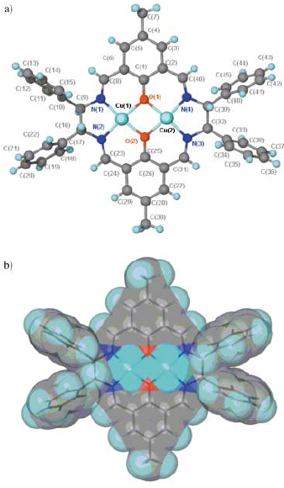
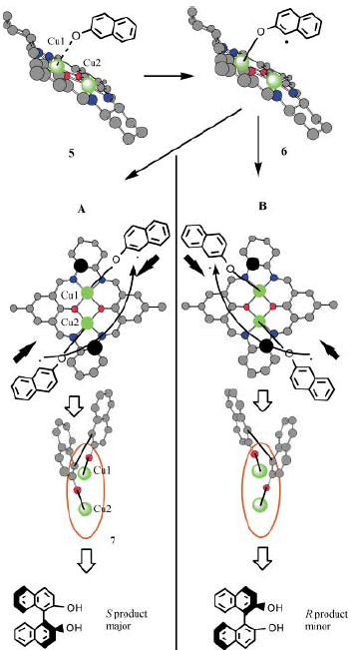
4.6.5 CH Functionalization: Oxidative Biaryl Coupling
Structure of Catalyst
and Mechanism
(1) Gao, J.; Reibenspies, J. H.; Martell, A. E. Angew. Chem., Int. Ed. 2003, 42, 6008-6012.

