Slide 1
4.5 Dual Activation on A Single Metal Center: Activated Systems
4.5.1 Aldol, Mannich and Allylation Reactions
4.5.2 Hydrogenation of Imines and Ketones
4.5.3 Other Addition Reactions to Carbonyls/Imines
4.5.4 Conjugate Reduction/Hydrogenation
4.5.5 Conjugate Addition
4.5.6 Other Reactions

Slide 2
4.5.1 Aldol Reaction: Denmark
Denmark: Aldol Reaction of Methyl Ketone Enolates¹
Denmark: Aldol Reaction of Aldehyde Enolates²
(1) Denmark, S. E.; Bui, T. J. Org. Chem. 2005, 70, 10393-10399. (2) Denmark, S. E.; Stavenger, R. A. Acc. Chem. Res. 2000, 33, 432-440.

Slide 3
4.5.1 Aldol Reaction: Denmark
Small Changes in Catalyst Structure Lead to Reversal of Diastereoselectivity!
(1) Denmark, S. E.; Bui, T. J. Org. Chem. 2005, 70, 10393-10399. (2) Denmark, S. E.; Stavenger, R. A. Acc. Chem. Res. 2000, 33, 432-440.

Slide 4
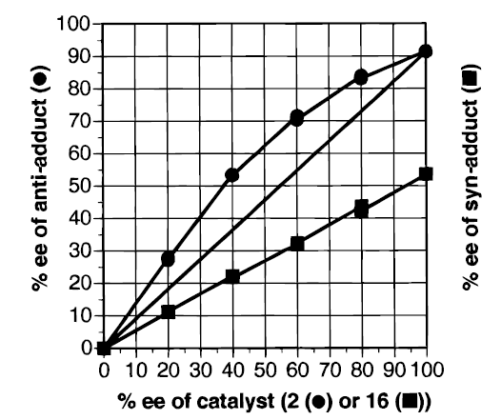
4.5.1 Aldol Reaction: Denmark
Examination of the Non-Linear Effect
(1) Denmark, S. E.; Bui, T. J. Org. Chem. 2005, 70, 10393-10399. (2) Denmark, S. E.; Stavenger, R. A. Acc. Chem. Res. 2000, 33, 432-440.

Slide 5
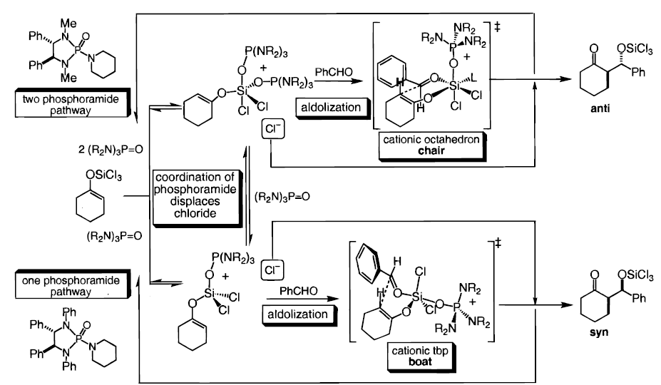
4.5.1 Aldol Reaction: Denmark
Mechanism
(1) Denmark, S. E.; Bui, T. J. Org. Chem. 2005, 70, 10393-10399. (2) Denmark, S. E.; Stavenger, R. A. Acc. Chem. Res. 2000, 33, 432-440.

Slide 6
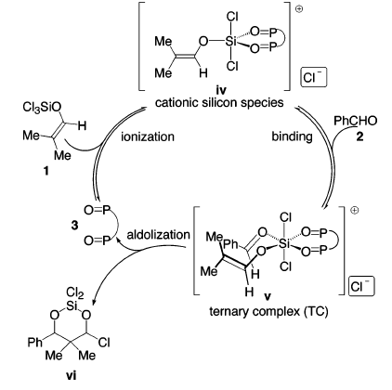
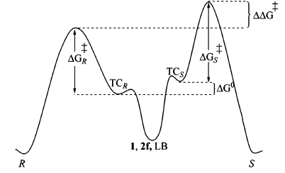
4.5.1 Aldol Reaction: Denmark
With Dimeric Catalyst: A Simpler Situation
A Classical Curtin-Hammet Situation
(1) Denmark, S. E.; Bui, T. J. Org. Chem. 2005, 70, 10393-10399. (2) Denmark, S. E.; Stavenger, R. A. Acc. Chem. Res. 2000, 33, 432-440.

Slide 7
4.5.1 Aldol Reaction: Reductive Aldol
Morken: Syn Selective Asymmetric Reductive Aldol Reaction¹
Nishiyama: Anti Selective Asymmetric Reductive Aldol Reaction²
(1) Russell, A. E.; Fuller, N. O.; Taylor, S. J.; Aurriset, P.; Morken, J. P. Org. Lett. 2004, 6, 2309-2312. (2) Nishiyama, H.; Shiomi, T.; Tsuchiya, Y.; Matsuda, I. J. Am. Chem. Soc. 2005, 127, 6972-6973.

Slide 8
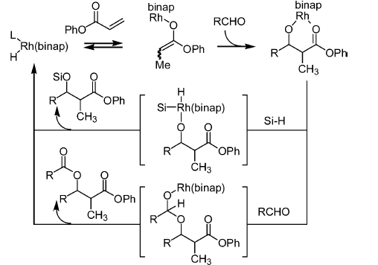
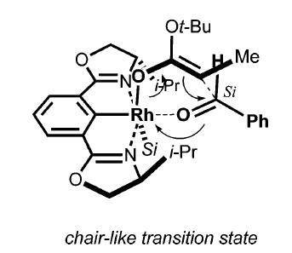
4.5.1 Aldol Reaction: Reductive Aldol
Mechanism Proposed by Morken
Nishiyama’s Model for Selectivity
(1) Russell, A. E.; Fuller, N. O.; Taylor, S. J.; Aurriset, P.; Morken, J. P. Org. Lett. 2004, 6, 2309-2312. (2) Nishiyama, H.; Shiomi, T.; Tsuchiya, Y.; Matsuda, I. J. Am. Chem. Soc. 2005, 127, 6972-6973.

Slide 9
4.5.1 Mannich Reaction: Sodeoka
Sodeoka: Asymmetric Mannich Reaction
A More Stable Dimeric Catalyst
(1) Hagiwara, E.; Fujii, A.; Sodeoka, M. J. Am. Chem. Soc. 1998, 120, 2474-2475. (2) Fujii, A.; Hagiwara, E.; Sodeoka, M. J. Am. Chem. Soc. 1999, 121, 5450-5458.

Slide 10
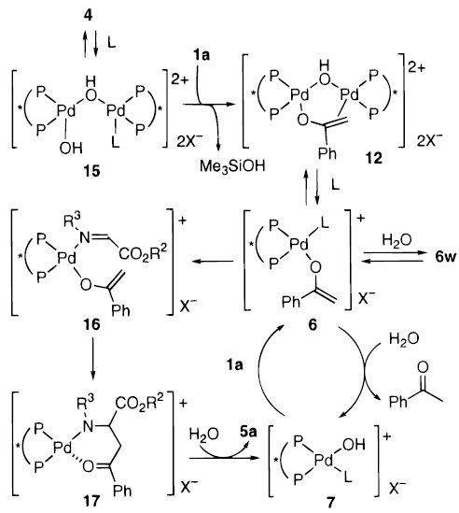
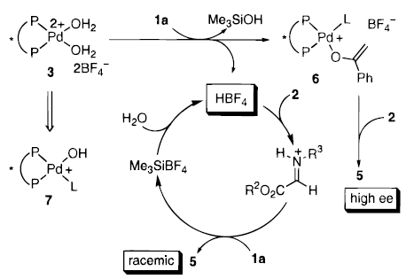
4.5.1 Mannich Reaction: Sodeoka
Mechanism
Background Reaction
(1) Hagiwara, E.; Fujii, A.; Sodeoka, M. J. Am. Chem. Soc. 1998, 120, 2474-2475. (2) Fujii, A.; Hagiwara, E.; Sodeoka, M. J. Am. Chem. Soc. 1999, 121, 5450-5458.

Slide 11
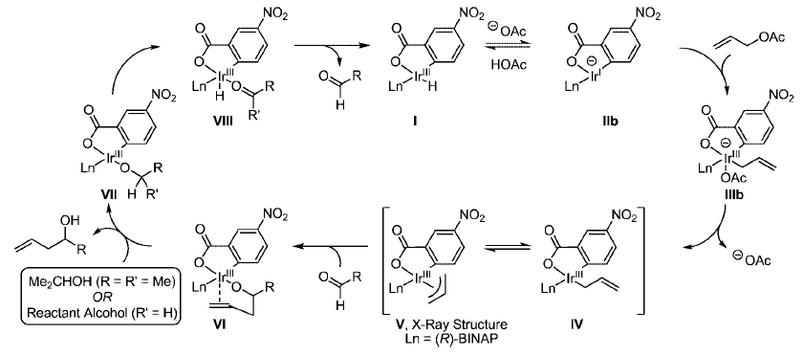
4.5.1 Allylation Reaction: Metal Allyl
Krische: Ir-Catalyzed Allylation Starting from Alcohol and Allyl Acetate¹
Mechanism
(1) Kim, I. S.; Ngai, M. Y.; Krische, M. J. J. Am. Chem. Soc. 2008, 130, 14891.

Slide 12
4.5.1 Allylation Reaction: Ni/photoredox
Cozzi: Alternative Umpolung based on photoredox-mediated reduction¹
(1) Calogero, F.; Potenti, S.; Bassan, E.; Fermi, A.; Gualandi, A.; Monaldi, J.; Dereli, B.; Maity, B.; Cavallo, L.; Ceroni, P.; Cozzi, P. G., Angew. Chem., Int. Ed. 2022, 61, e202114981.

Slide 13
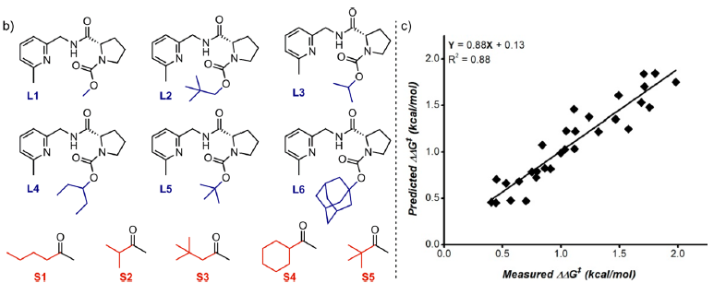
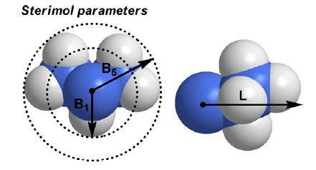

4.5.1 Propargylation: Nosaki-Hiyama-Kishi Conditions
Sigman: ee of the Nosaki-Hiyama-Kishi propargylation predicted from steric parameters¹
(1) Harper, K. C.; Vilardi, S. C.; Sigman, M. S. J. Am. Chem. Soc. 2013, 135, 2482.

Slide 14
4.5.2 Hydrogenation of Carbonyl and Imines
Noyori: Hydrogenation of β-Keto Esters¹
Bergens: a 3-Points-Binding Substrates for Mechanistic Investigations
(1) Noyori, R.; Ohkuma, T.; Kitamura, M.; Takaya, H.; Sayo, N.; Kumobayashi, H.; Akutagawa, S. J. Am. Chem. Soc. 1987, 109, 5856-5858. (2) Daley, C. J. A.; Bergens, S. H. J. Am. Chem. Soc. 2002, 124, 3680-3691.

Slide 15
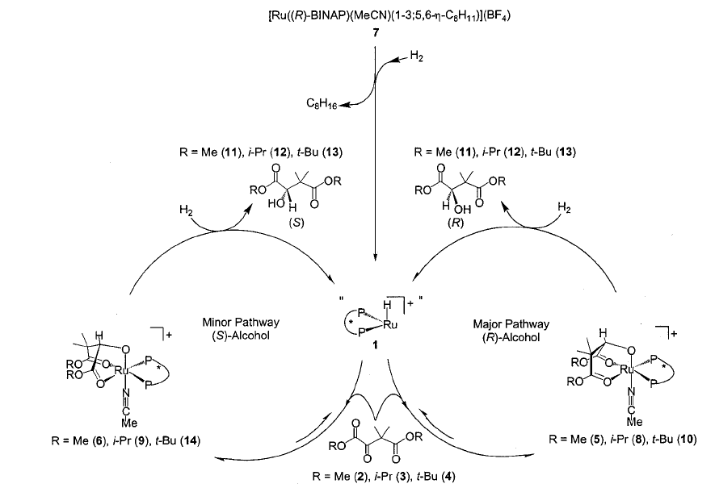
4.5.2 Hydrogenation of Carbonyl and Imines
Proposed Mechanism
(1) Daley, C. J. A.; Bergens, S. H. J. Am. Chem. Soc. 2002, 124, 3680-3691.

Slide 16
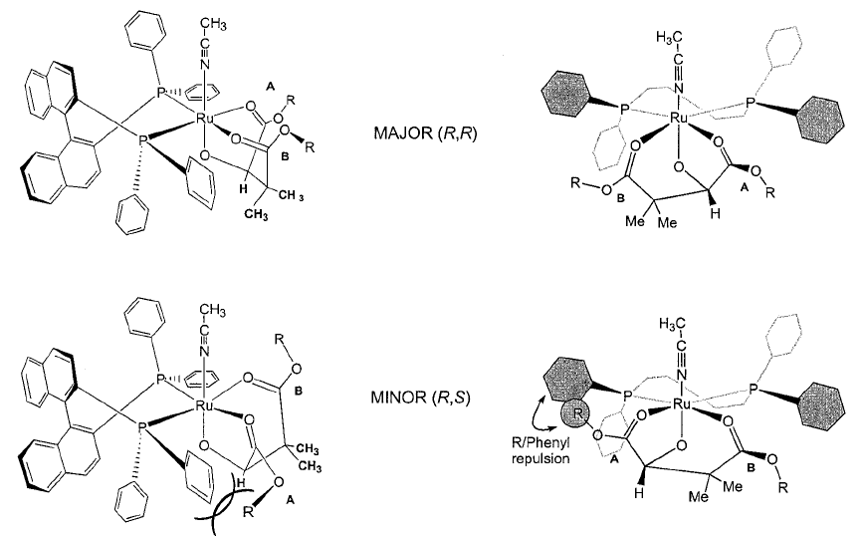
4.5.2 Hydrogenation of Carbonyl and Imines
Model for Selectivity
(1) Daley, C. J. A.; Bergens, S. H. J. Am. Chem. Soc. 2002, 124, 3680-3691.

Slide 17
4.5.2 Hydrogenation of Imines
The Gold Standard for Asymmetric Catalysis in Industry
Ciba-Geigy Synthesis of (S)-Metolachlor

Slide 18
4.5.2 Hydrogenation of Carbonyl and Imines
Burk: Hydrogenation of Hydrazones^{1,2}
Buchwald: Hydrogenation of Imines^{3,4}
(1) Burk, M. J.; Feaster, J. E. J. Am. Chem. Soc. 1992, 114, 6266-6267. (2) Burk, M. J.; Martinez, J. P.; Feaster, J. E.; Cosford, N. Tetrahedron 1994, 50, 4399-4428. (3) Willoughby, C. A.; Buchwald, S. L. J. Am. Chem. Soc. 1994, 116, 8952-8965. (4) Willoughby, C. A.; Buchwald, S. L. J. Am. Chem. Soc. 1994, 116, 11703-11714.

Slide 19
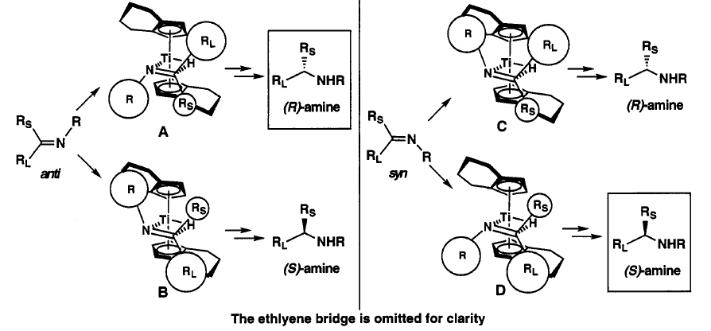
4.5.2 Hydrogenation of Carbonyl and Imines
Model for Selectivity
(1) Willoughby, C. A.; Buchwald, S. L. J. Am. Chem. Soc. 1994, 116, 8952-8965. (2) Willoughby, C. A.; Buchwald, S. L. J. Am. Chem. Soc. 1994, 116, 11703-11714.

Slide 20
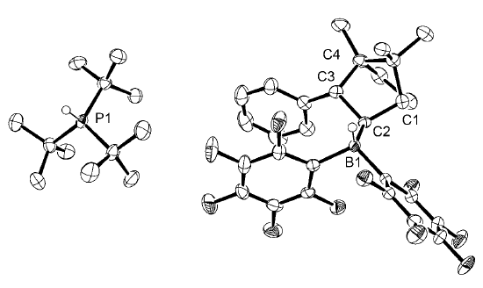
4.5.2 Hydrogenation of Carbonyl and Imines
Klankermayer: Hydrogenation with chiral frustrated Lewis pairs¹
(1) Chen, D. J.; Wang, Y. T.; Klankermayer, J., Angew. Chem., Int. Ed. 2010, 49, 9475.

Slide 21
4.5.2 Hydrogenation of Carbonyl and Imines
Cramer: Hydrogenation of Oximes
Mas-Roselló, J.; Smejkal, T.; Cramer, N. Science 2020, 368, 1098-1102.

Slide 22
4.5.3 Other Additions to Carbonyl/Imines: Cu Catalysts
Shibasaki: Use of Silanes as Nucleophiles¹
Knochel: Addition of Acetylene to Enamines²
(1) Tomita, D.; Wada, R.; Kanai, M.; Shibasaki, M. J. Am. Chem. Soc. 2005, 127, 4138-4139. (2) Koradin, C.; Polborn, K.; Knochel, P. Angew. Chem., Int. Ed. 2002, 41, 2535-2538.

Slide 23
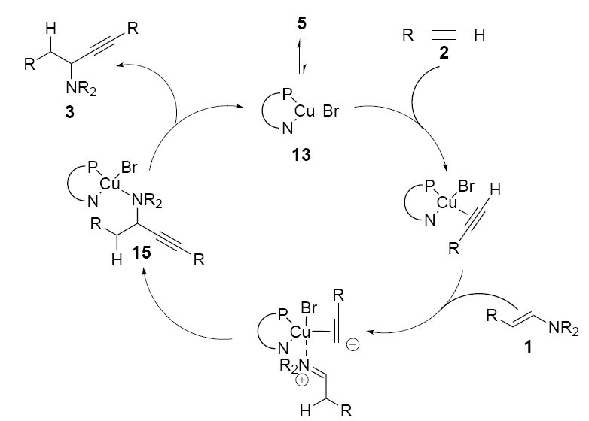
4.5.3 Other Additions to Carbonyl/Imines: Cu Catalysts
Proposed Mechanism
(1) Koradin, C.; Polborn, K.; Knochel, P. Angew. Chem., Int. Ed. 2002, 41, 2535-2538.

Slide 24
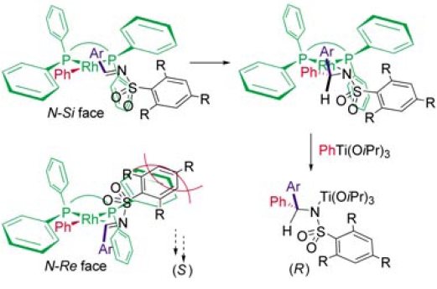
4.5.3 Other Additions to Carbonyl/Imines: Rh Catalysts
Hayashi: Rh-Catalyzed Addition of Organotitanium to Imines
Model for Selectivity
(1) Hayashi, T.; Kawai, M.; Tokunaga, N. Angew. Chem., Int. Ed. 2004, 43, 6125-6128.

Slide 25
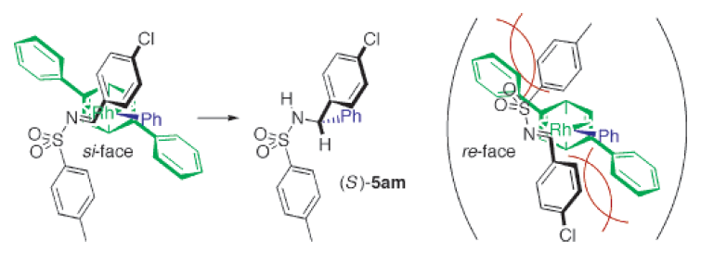
4.5.3 Other Additions to Carbonyl/Imines: Rh Catalysts
Hayashi: Chiral Diene Ligands
Model for Selectivity
(1) Tokunaga, N.; Otomaru, Y.; Okamoto, K.; Ueyama, K.; Shintani, R.; Hayashi, T. J. Am. Chem. Soc. 2004, 126, 13584-13585.

Slide 26
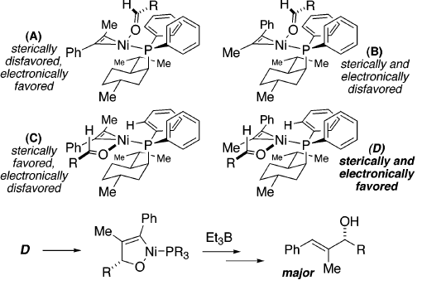
4.5.3 Additions to Carbonyl/Imines: Reductive Coupling
Jamison: Reductive Coupling of Alkynes with Aldehydes¹
(1) Miller, K. M.; Huang, W. S.; Jamison, T. F. J. Am. Chem. Soc. 2003, 125, 3442-3443.

Slide 27
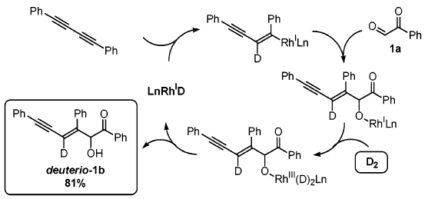
4.5.3 Additions to Carbonyl/Imines: Reductive Coupling
Krische: Rh-Catalyzed Reductive Coupling of diynes using H₂¹
Mechanism
(1) Huddleston, R. R.; Jang, H. Y.; Krische, M. J. J. Am. Chem. Soc. 2003, 125, 11488-11489.

Slide 28
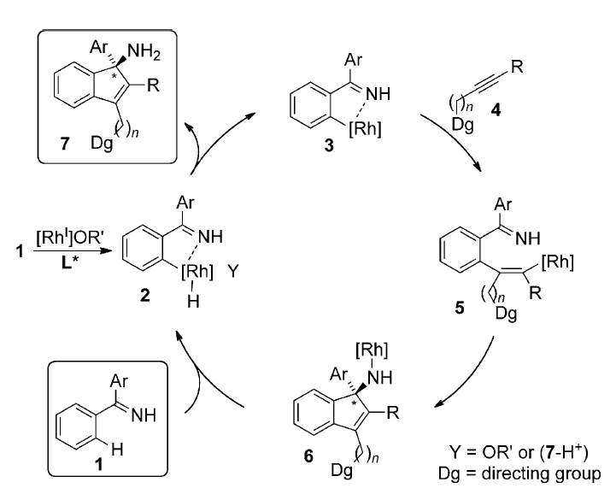
4.5.3 Additions to Carbonyl/Imines: Via C-H Activation
Cramer: Insertion-Addition via C-H Activation
Tran, D. N.; Cramer, N. Angew. Chem., Int. Ed. 2011, 50, 11098.

Slide 29
4.5.4 Conjugate Reduction/Hydrogenation
Knowles (Monsanto): The First Efficient Catalytic Asymmetric Hydrogenation¹
Noyori: The Discovery of BINAP²
(1) Vineyard, B. D.; Knowles, W. S.; Sabacky, M. J.; Bachman, G. L.; Weinkauff, D. J. J. Am. Chem. Soc. 1977, 99, 5946-5952. (2)Miyashita, A.; Yasuda, A.; Takaya, H.; Toriumi, K.; Ito, T.; Souchi, T.; Noyori, R. J. Am. Chem. Soc. 1980, 102, 7932-7934.

Slide 30
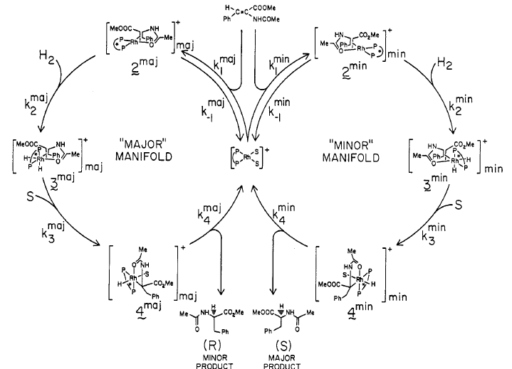
4.5.4 Conjugate Reduction/Hydrogenation
Halpern Studies on Monsanto Hydrogenation
(1) Landis, C. R.; Halpern, J. J. Am. Chem. Soc. 1987, 109, 1746-1754.

Slide 31
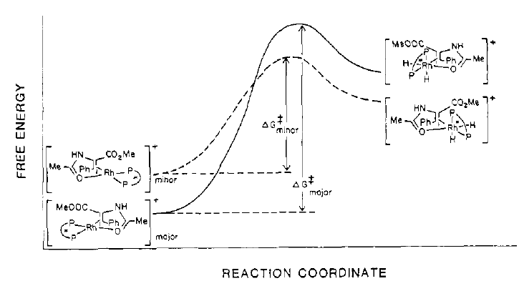
4.5.4 Conjugate Reduction/Hydrogenation
A Classical Curtin-Hammet Case: The Minor Complex Leads to the Observed Product
(1) Landis, C. R.; Halpern, J. J. Am. Chem. Soc. 1987, 109, 1746-1754.

Slide 32
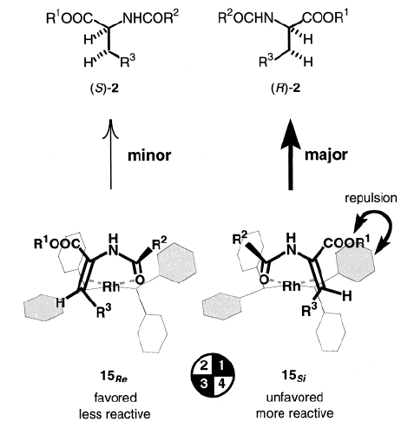
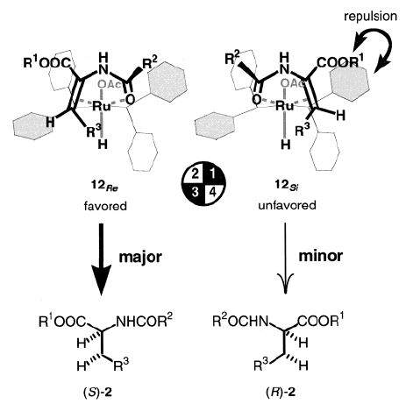
4.5.4 Conjugate Reduction/Hydrogenation
Noyori: Selectivity with BINAP Ligands: Fondamental Differences Between Rh and Ru Catalysts
(1) Kitamura, M.; Tsukamoto, M.; Bessho, Y.; Yoshimura, M.; Kobs, U.; Widhalm, M.; Noyori, R. J. Am. Chem. Soc. 2002, 124, 6649-6667.

Slide 33
4.5.4 Conjugate Reduction/Hydrogenation
Merck/Solvia: Hydrogenation of Unprotected Enamines¹
Buchwald: Conjugate Reduction with Silanes and Cu Catalysts²
(1) Hsiao, Y.; Rivera, N. R.; Rosner, T.; Krska, S. W.; Njolito, E.; Wang, F.; Sun, Y. K.; Armstrong, J. D.; Grabowski, E. J. J.; Tillyer, R. D.; Spindler, F.; Malan, C. J. Am. Chem. Soc. 2004, 126, 9918-9919. (1) Appella, D. H.; Moritani, Y.; Shintani, R.; Ferreira, E. M.; Buchwald, S. L. J. Am. Chem. Soc. 1999, 121, 9473-9474.

Slide 34
4.5.4 Conjugate Reduction: Hydrogen Borrowing Cascade
Donohoe and Duarte: Iridium-catalyzed hydrogen borrowing cascade for cyclohexane synthesis
Armstrong, R. J.; Akhtar, W. M.; Young, T. A.; Duarte, F.; Donohoe, T. J., Angew. Chem, Int. Ed. 2019, 58, 12558-12562.

Slide 35
4.5.5 Conjugate Addition: Cu Catalysts
Feringa: Phosphoramidite Cu-Catalyst for the Conjugate Addition of Organozincs¹
Feringa: Conjugate Addition to Nitroolefins²
DeVries, A. H. M.; Meetsma, A.; Feringa, B. L. Angew. Chem., Int. Ed. Engl. 1996, 35, 2374-2376. (2) Duursma, A.; Minnaard, A. J.; Feringa, B. L. J. Am. Chem. Soc. 2003, 125, 3700-3701.

Slide 36
4.5.5 Conjugate Addition: Cu Catalysts
Feringa: Catalytic Asymmetric Conjugate Addition of Grignard Reagents¹
Feringa: Tandem Conjugate Addition Aldol Reaction²
(1) Lopez, F.; Harutyunyan, S. R.; Minnaard, A. J.; Feringa, B. L. J. Am. Chem. Soc. 2004, 126, 12784-12785. (2) Howell, G. P.; Fletcher, S. P.; Geurts, K.; ter Horst, B.; Feringa, B. L. J. Am. Chem. Soc. 2006, 128, 14977-14985.

Slide 37
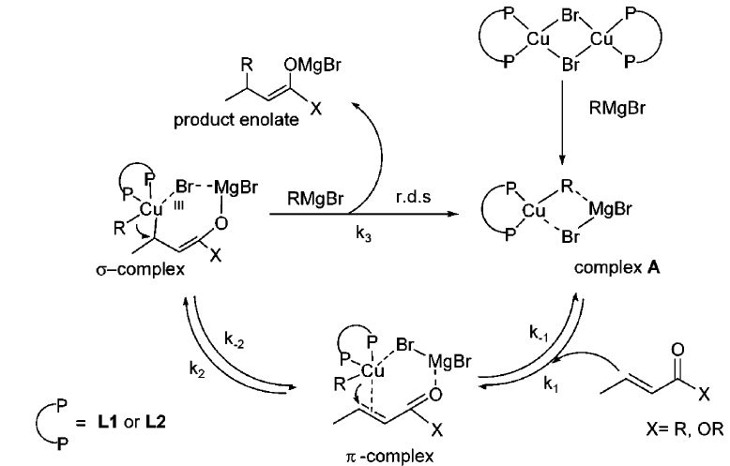
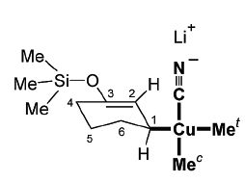
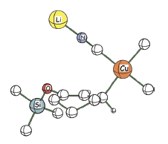
4.5.5 Conjugate Addition: Cu Catalysts
Mechanism
Identified Intermediate
(1) Harutyunyan, S. R.; Lopez, F.; Browne, W. R.; Correa, A.; Pena, D.; Badorrey, R.; Meetsma, A.; Minnaard, A. J.; Feringa, B. L. J. Am. Chem. Soc. 2006, 128, 9103-9118. (2) Bertz, S. H.; Cope, S.; Murphy, M.; Ogle, C. A.; Taylor, B. J. J. Am. Chem. Soc. 2007, 129, 7208-7209. (3) Hu, H. P.; Snyder, J. P. J. Am. Chem. Soc. 2007, 129, 7210-7211.

Slide 38
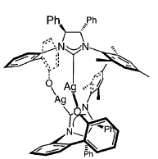
4.5.5 Conjugate Addition: Cu Catalysts
Hoveyda: Carbene ligands for Conjugate Addition¹
Carreira: Conjugate Addition of Phenylacetylene²
(1) Lee, K. S.; Brown, M. K.; Hird, A. W.; Hoveyda, A. H. J. Am. Chem. Soc. 2006, 128, 7182-7184. (2) Knopfel, T. F.; Zarotti, P.; Ichikawa, T.; Carreira, E. M. J. Am. Chem. Soc. 2005, 127, 9682-9683.

Slide 39
4.5.5 Conjugate Addition: Cu Catalysts
Alexakis: Access to Quaternary Stereocentres¹
(1) Hawner, C.; Li, K. Y.; Cirriez, V.; Alexakis, A. Angew. Chem., Int. Ed. 2008, 47, 8211. (2) Henon, H.; Mauduit, M.; Alexakis, A. Angew. Chem., Int. Ed. 2008, 47, 9122.

Slide 40
4.5.5 Conjugate Addition: Rh Catalysts
Hayashi: Rh-Catalyzed Conjugate Addition of Boronic Acids¹
Hayashi: Rh-Catalyzed 1-6 Addition²
(1) Takaya, Y.; Ogasawara, M.; Hayashi, T.; Sakai, M.; Miyaura, N. J. Am. Chem. Soc. 1998, 120, 5579-5580. (2) Hayashi, T.; Yamamoto, S.; Tokunaga, N. Angew. Chem., Int. Ed. 2005, 44, 4224-4227.

Slide 41
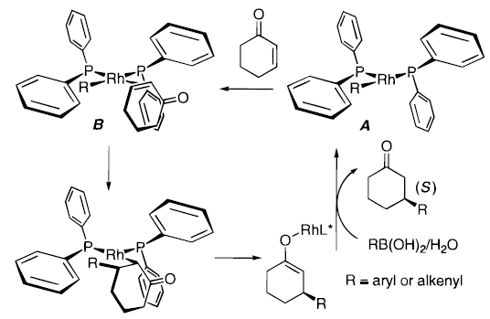
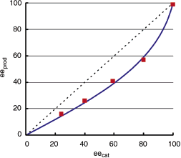
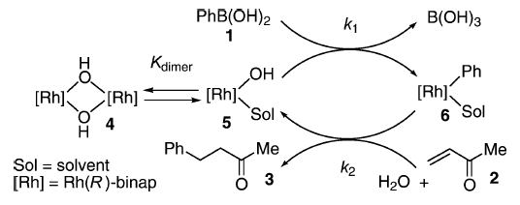
4.5.5 Conjugate Addition: Rh Catalysts
Mechanism and Non-Linear Effect
(1) Takaya, Y.; Ogasawara, M.; Hayashi, T.; Sakai, M.; Miyaura, N. J. Am. Chem. Soc. 1998, 120, 5579-5580. (2) Kina, A.; Iwamura, H.; Hayashi, T. J. Am. Chem. Soc. 2006, 128, 3904-3905.

Slide 42
4.5.5 Conjugate Addition: Rh Catalysts
Hayashi: The First Chiral Diene Ligand¹
Carreira: Diene Ligands Derived From Carvone²
(1) Hayashi, T.; Ueyama, K.; Tokunaga, N.; Yoshida, K. J. Am. Chem. Soc. 2003, 125, 11508-11509. (2) Paquin, J. F.; Defieber, C.; Stephenson, C. R. J.; Carreira, E. M. J. Am. Chem. Soc. 2005, 127, 10850-10851.

Slide 43
4.5.5 Conjugate Addition: Rh Catalysts
Hayashi: Influence of Ligand on Regioselectivity¹
(1) Shintani, R.; Duan, W. L.; Hayashi, T. J. Am. Chem. Soc. 2006, 128, 5628-5629.

Slide 44
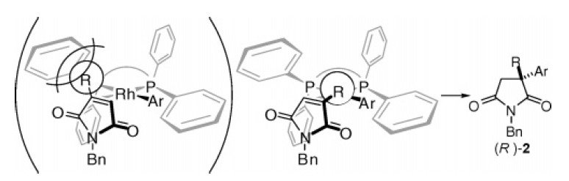
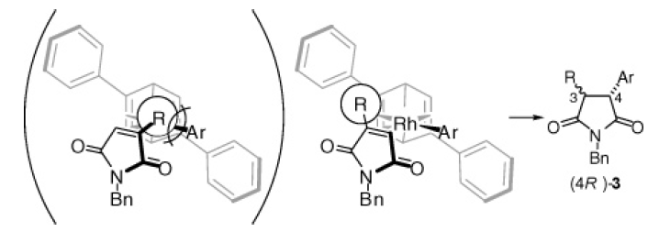
4.5.5 Conjugate Addition: Rh Catalysts
Model for Selectivity
(1) Shintani, R.; Duan, W. L.; Hayashi, T. J. Am. Chem. Soc. 2006, 128, 5628-5629.

Slide 45
4.5.5 Conjugate Addition: Radicals
Guttierez/Chu: Enantioselective Giese Reaction
Guo, L.; Yuan, M.; Zhang, Y.; Wang, F.; Zhu, S.; Gutierrez, O.; Chu, L. J. Am. Chem. Soc. 2020, 142, 20390.

Slide 46
4.5.5 Conjugate Addition: Radicals
Feng: Enantioselective trifluoromethylazidation
Liu, W.; Pu, M.; He, J.; Zhang, T.; Dong, S.; Liu, X.; Wu, Y.-D.; Feng, X. J. Am. Chem. Soc. 2021, 143, 11856-11863.

Slide 47
4.5.6 Other Reactions: Asymmetric Allylation
Alexakis: Asymmetric Allylation of Grignard Reagents with Allyl Chloride¹
Alexakis: Asymmetric Allylation of Grignard Reagents with Bis-Allyl Chloride²
(1) Tissot-Croset, K.; Polet, D.; Alexakis, A. Angew. Chem., Int. Ed. 2004, 43, 2426-2428. (2) Falciola, C. A.; Alexakis, A. Angew. Chem., Int. Ed. 2007, 46, 2619-2622.

Slide 48
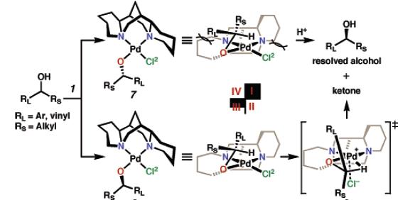
4.5.6 Other Reactions: Asymmetric Oxidation
Sigman and Stoltz: Kinetic Resolution through Asymmetric Oxidation
Model for Selectivity
(1) Jensen, D. R.; Pugsley, J. S.; Sigman, M. S. J. Am. Chem. Soc. 2001, 123, 7475. (2) Ferreira, E. M.; Stoltz, B. M. J. Am. Chem. Soc. 2001, 123, 7725-7726. (3) Trend, R. M.; Stoltz, B. M. J. Am. Chem. Soc. 2004, 126, 4482. (4) Trend, R. M.; Stoltz, B. M. J. Am. Chem. Soc. 2008, 130, 15957.

Slide 49
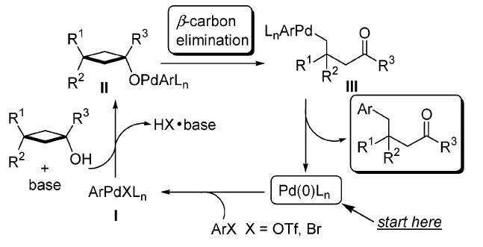
4.5.6 Other Reactions: C-C Activation
Uemura: Asymmetric C-C Coupling via C-C Activation of Cyclobutanol
Mechanism
(1) Matsumura, S.; Maeda, Y.; Nishimura, T.; Uemura, S. J. Am. Chem. Soc. 2003, 125, 8862.

Slide 50
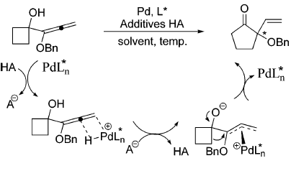
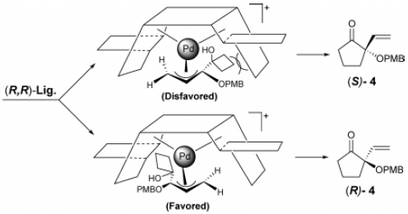
4.5.6 Other Reactions: Asymmetric Ring Expansion
Trost: Asymmetric Ring Expansion via Electrophilic Allylation
Mechanism
(1) Trost, B. M.; Xie, J. J. Am. Chem. Soc. 2006, 128, 6044-6045.

Slide 51
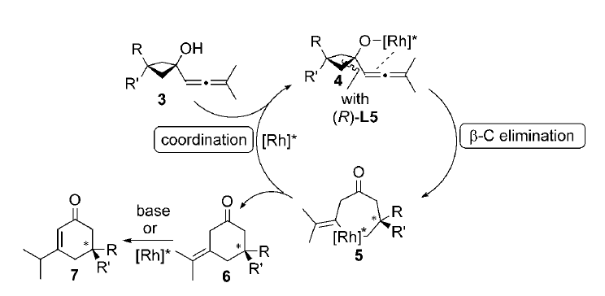
4.5.6 Other Reactions: Ring expansion
Cramer: Asymmetric C-C Coupling via C-C Activation of Cyclobutanol
Mechanism
(1) Seiser, T.; Cramer, N. Angew. Chem., Int. Ed. 2008, 47, 9294.

Slide 52
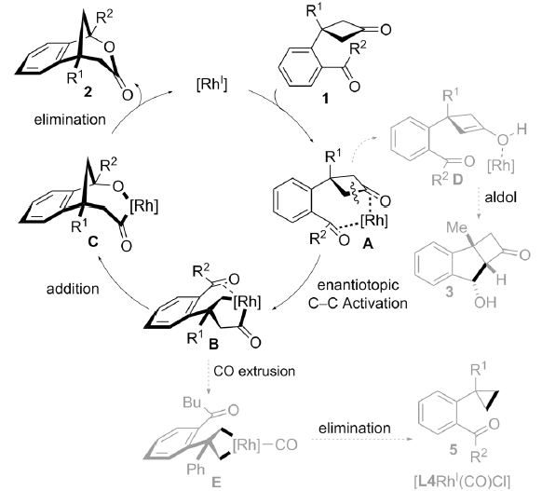
4.5.6 Other Reactions: Ring expansion
Cramer: Asymmetric C-C Coupling via C-C Activation of Cyclobutanone through Oxidative Addition
(1) Souillart, L.; Cramer, N. Angew. Chem., Int. Ed. 2014, 53, 9640.

