Slide 1
4.3 Metal-Ligand Dual Activation

Slide 2
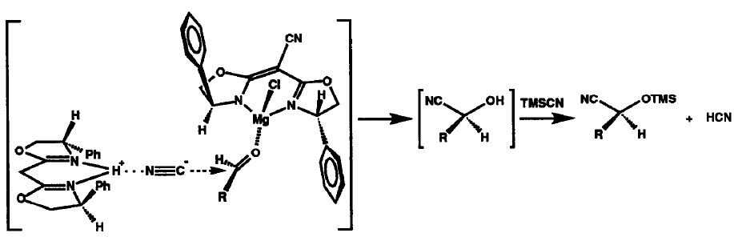
4.3. Metal-Ligand Dual Activation: Cyanide Addition
Corey: Asymmetric Cyanhydrin Synthesis: Dual Activation with Lewis Acid and Basic Ligand
Model for Dual Activation
(1) Corey, E. J.; Wang, Z. Tetrahedron Lett. 1993, 34, 4001-4004.

Slide 3
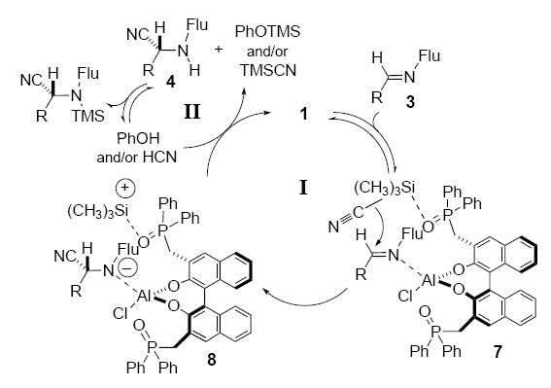
4.3. Metal-Ligand Dual Activation: Cyanide Addition
Shibasaki: Al-Phosphinoxide Bifunctional Catalysts
Mechanism
(1) Takamura, M.; Hamashima, Y.; Usuda, H.; Kanai, M.; Shibasaki, M. Angew. Chem., Int. Ed. 2000, 39, 1650-1652.

Slide 4
4.3. Metal-Ligand Dual Activation: Cyanide Addition
Saa: Bifunctional Al-Amine Catalyst for Cyanophosphorylation of Aldehydes¹
Shibasaki: Cyanohydrin Synthesis with a Li-Binol Catalyst²
(1) Baeza, A.; Casas, J.; Najera, C.; Sansano, J. M.; Saa, J. M. Angew. Chem., Int. Ed. 2003, 42, 3143-3146. (2) Hatano, M.; Ikeno, T.; Miyamoto, T.; Ishihara, K. J. Am. Chem. Soc. 2005, 127, 10776-10777.

Slide 5
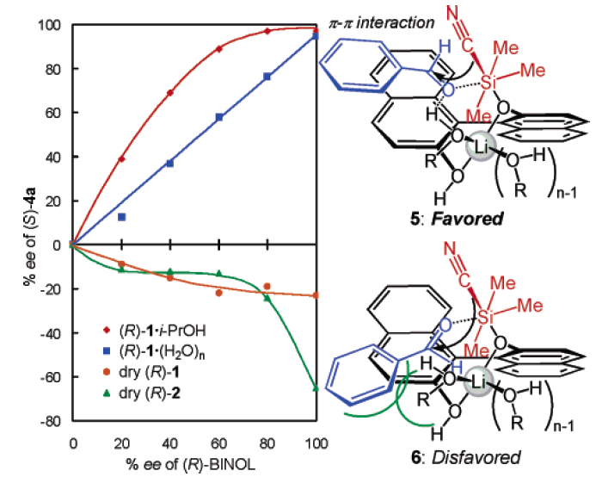
4.3. Metal-Ligand Dual Activation: Cyanide Addition
Model for Selectivity: Influence of Additive
(1) Hatano, M.; Ikeno, T.; Miyamoto, T.; Ishihara, K. J. Am. Chem. Soc. 2005, 127, 10776-10777.

Slide 6
4.3. Metal-Ligand Dual Activation: Noyori Hydrogenation
Noyori: Transfer Hydrogenation of Ketones with Ru-Diamine Complex¹
Noyori: Hydrogenation of Ketones with BINAP-Diamine Ru Complex²
(1) Yamakawa, M.; Ito, H.; Noyori, R. J. Am. Chem. Soc. 2000, 122, 1466-1478. (2) Noyori, R.; Ohkuma, T. Angew. Chem., Int. Ed. 2001, 40, 40-73.

Slide 7
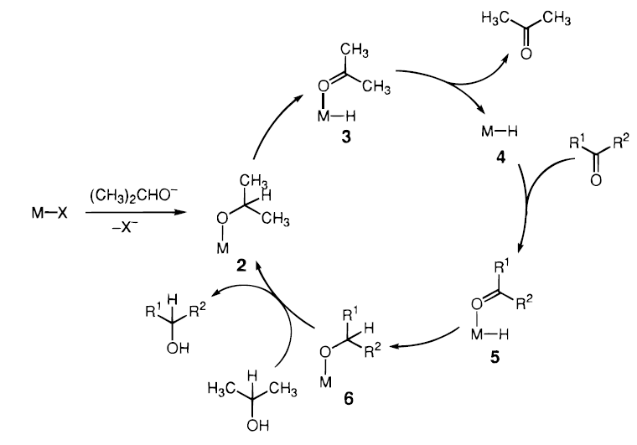
4.3. Metal-Ligand Dual Activation: Noyori Hydrogenation
Classical β-Elimination-Insertion Mechanism for Transfer Hydrogenation¹
(1) Yamakawa, M.; Ito, H.; Noyori, R. J. Am. Chem. Soc. 2000, 122, 1466-1478.

Slide 8
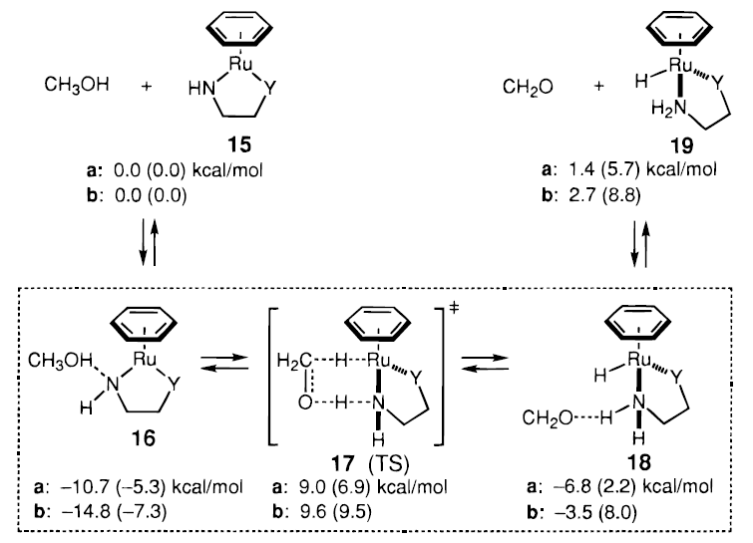
4.3. Metal-Ligand Dual Activation: Noyori Hydrogenation
New Pericyclic Mechanism Proposed by Noyori¹
(1) Yamakawa, M.; Ito, H.; Noyori, R. J. Am. Chem. Soc. 2000, 122, 1466-1478.

Slide 9
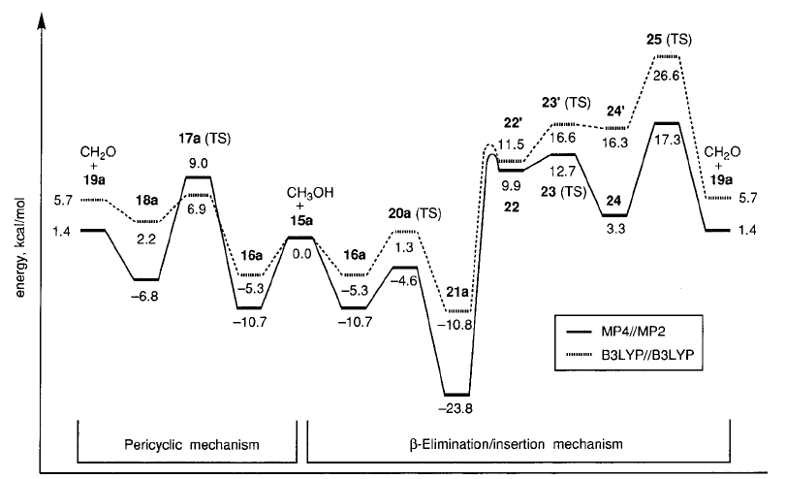
4.3. Metal-Ligand Dual Activation: Noyori Hydrogenation
Calculation of the two Possible Mechanisms for Noyori Hydrogenation¹
(1) Yamakawa, M.; Ito, H.; Noyori, R. J. Am. Chem. Soc. 2000, 122, 1466-1478.

Slide 10
4.3. Metal-Ligand Dual Activation: Noyori Hydrogenation
Wills: A More Stable Catalyst for Transfer Hydrogenation¹
Noyori: A New Catalyst Precursor Allowing a Base-Free Protocole²
(1) Hayes, A. M.; Morris, D. J.; Clarkson, G. J.; Wills, M. J. Am. Chem. Soc. 2005, 127, 7318-7319. (2) Ohkuma, T.; Koizumi, M.; Muniz, K.; Hilt, G.; Kabuto, C.; Noyori, R. J. Am. Chem. Soc. 2002, 124, 6508-6509.

Slide 11
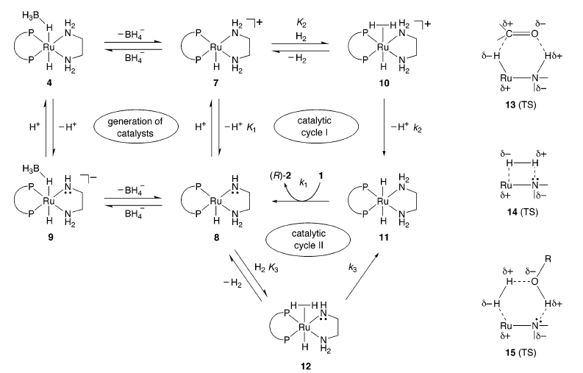
4.3. Metal-Ligand Dual Activation: Noyori Hydrogenation
Mechanism for the Noyori Hydrogenation
(1) Abdur-Rashid, K.; Clapham, S. E.; Hadzovic, A.; Harvey, J. N.; Lough, A. J.; Morris, R. H. J. Am. Chem. Soc. 2002, 124, 15104. (2) Sandoval, C. A.; Ohkuma, T.; Muniz, K.; Noyori, R. J. Am. Chem. Soc. 2003, 125, 13490. (3) Dub, P. A.; Henson, N. J.; Martin, R. L.; Gordon, J. C. J. Am. Chem. Soc. 2014, 136, 3505.

Slide 12
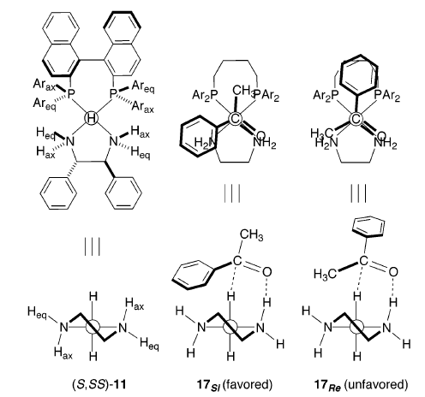
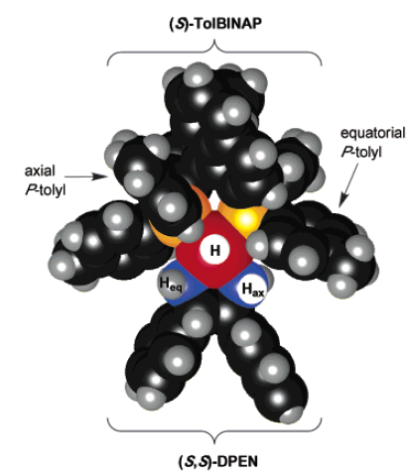
4.3. Metal-Ligand Dual Activation: Noyori Hydrogenation
Model for Enantioselection
(1) Abdur-Rashid, K.; Clapham, S. E.; Hadzovic, A.; Harvey, J. N.; Lough, A. J.; Morris, R. H. J. Am. Chem. Soc. 2002, 124, 15104-15118. (2) Sandoval, C. A.; Ohkuma, T.; Muniz, K.; Noyori, R. J. Am. Chem. Soc. 2003, 125, 13490-13503.

Slide 13
4.3. Metal-Ligand Dual Activation: Noyori Hydrogenation
Revised Mechanism
Dub, P. A.; Henson, N. J.; Martin, R. L.; Gordon, J. C. J. Am. Chem. Soc. 2014, 136, 3505-3521.

Slide 14
4.3. Metal-Ligand Dual Activation: Ketene Activation
Lectka: Cinchona-In-Catalyzed
Synthesis of β-Lactams
A New Bifunctional Catalyst
(1) France, S.; Shah, M. H.; Weatherwax, A.; Wack, H.; Roth, J. P.; Lectka, T. J. Am. Chem. Soc. 2005, 127, 1206-1215.

Slide 15
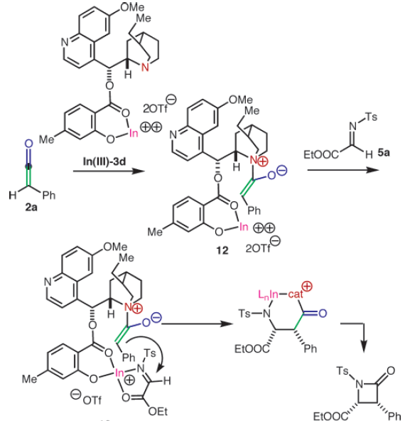
4.3. Metal-Ligand Dual Activation: Ketene Activation
Mechanism
(1) France, S.; Shah, M. H.; Weatherwax, A.; Wack, H.; Roth, J. P.; Lectka, T. J. Am. Chem. Soc. 2005, 127, 1206-1215.

Slide 16
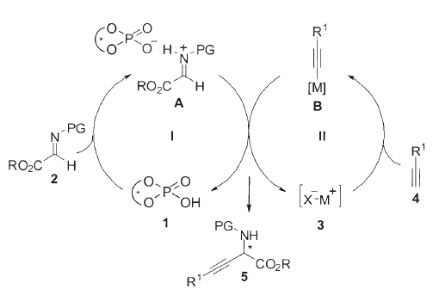
4.3. Metal-Ligand Dual Activation: Chiral Acid/Metal
Rueping: Silver-Chiral Acid Addition of Alkyne
Mechanism
(1) Rueping, M.; Antonchick, A. R.; Brinkmann, C. Angew. Chem., Int. Ed. 2007, 46, 6903-6906.

Slide 17
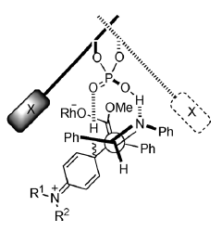
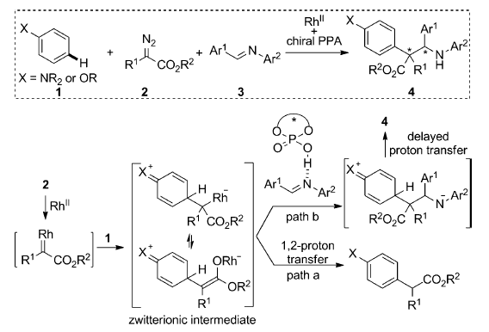
4.3. Metal-Ligand Dual Activation: Chiral Acid/Metal
Hu: Addition of imines on carbenes
(1) Jia, S.; Xing, D.; Zhang, D.; Hu, W. Angew. Chem., Int. Ed. 2014, 53, 13098.

Slide 18
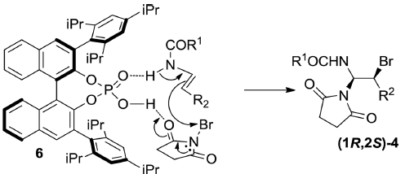
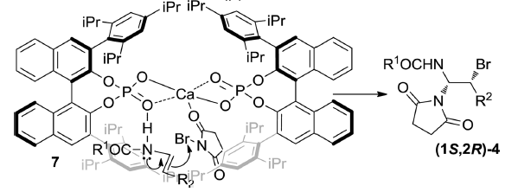
4.3. Metal-Ligand Dual Activation: Acid-Metal
Masson: Switching the selectivity with calcium¹
(1) Alix, A.; Lalli, C.; Retailleau, P.; Masson, G. J. Am. Chem. Soc. 2012, 134, 10389.

Slide 19
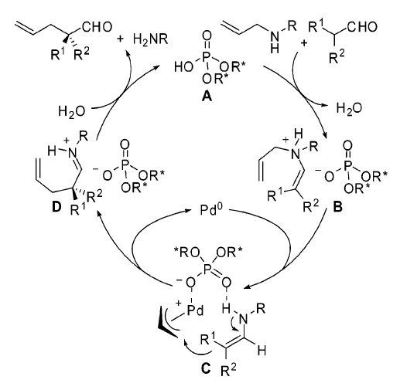
4.3. Metal-Ligand Dual Activation: Enamine/Metal
List: Combining Enamine Chemistry and Electrophilic Allylation
Mechanism
(1) Mukherjee, S.; List, B. J. Am. Chem. Soc. 2007, 129, 11336-11337.

Slide 20
4.3. Metal-Ligand Dual Activation: Enamine/Metal
Bandini: Combining enamine chemistry and gold catalysis¹
Carreira: Complete control over stereochemistry combining amine and iridium catalysts²
(1) Chiarucci, M.; di Lillo, M.; Romaniello, A.; Cozzi, P. G.; Cera, G.; Bandini, M. Chemical Science 2012, 3, 2859. (2) Krautwald, S.; Sarlah, D.; Schafroth, M. A.; Carreira, E. M. Science 2013, 340, 1065.

Slide 21
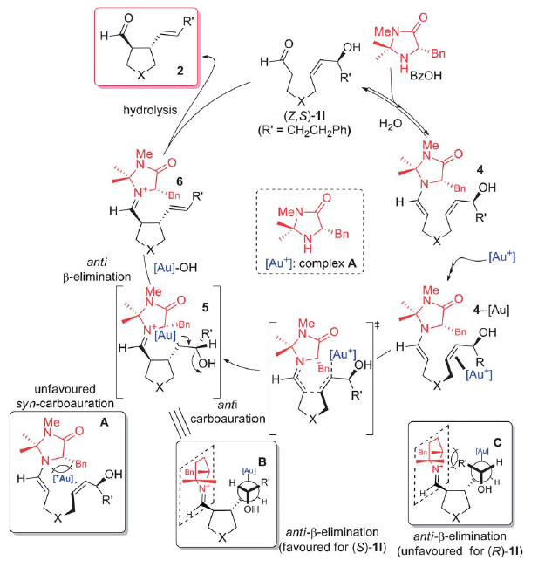
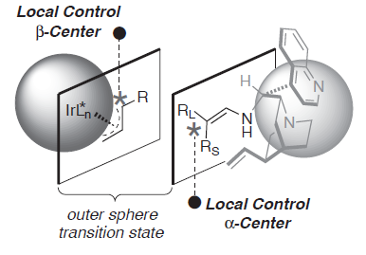
4.3. Metal-Ligand Dual Activation: Enamine/Metal
Bandini: Enamine-Gold Catalysis¹
Carreira: Enamine-Iridium Catalysis²
(1) Chiarucci, M.; di Lillo, M.; Romaniello, A.; Cozzi, P. G.; Cera, G.; Bandini, M. Chemical Science 2012, 3, 2859. (2) Krautwald, S.; Sarlah, D.; Schafroth, M. A.; Carreira, E. M. Science 2013, 340, 1065.

Slide 22
4.3. Metal-Ligand Dual Activation: aldehyde/Pd
Guo: Combining aldehyde catalysis
and π-allyl chemistry.
Chen, L.; Luo, M. J.; Zhu, F.; Wen, W.; Guo, Q. X., J. Am. Chem. Soc. 2019, 141, 5159-5163.

Slide 23
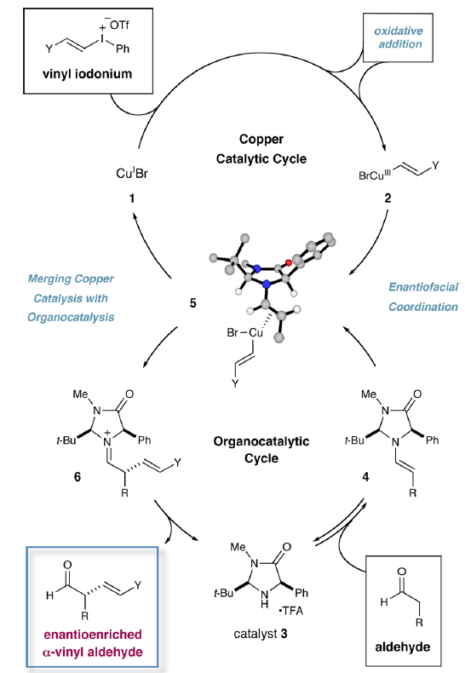
4.3. Metal-Ligand Dual Activation: Enamine/Metal
MacMillan: Vinylation of aldehydes combining enamine and copper catalysis¹
(1) Skucas, E.; MacMillan, D. W. C. J. Am. Chem. Soc. 2012, 134, 9090.

Slide 24
4.3. Metal-Ligand Dual Activation: Carbene/Metal
Glorius: NHC-Palladium catalysis
Guo, C.; Fleige, M.; Janssen-Muller, D.; Daniliuc, C. G.; Glorius, F. J. Am. Chem. Soc. 2016, 138, 7840-7843.

Slide 25
4.3. Metal-Ligand Dual Activation: Palladium/PTC
Toste: Palladium and phase transfer catalysis
Nelson, H. M.; Williams, B. D.; Miro, J.; Toste, F. D. J. Am. Chem. Soc. 2015, 137, 3213-3216.

Slide 26
4.3. Metal-Ligand Dual Activation: Bromonium/PTC
Gong: Chiral cobalt complexes as anion
Jiang, H. J.; Liu, K.; Yu, J.; Zhang, L.; Gong, L. Z. Angew. Chem., Int. Ed. 2017, 56, 11931-11935.

Slide 27
4.3. Metal-Ligand Dual Activation: Nitrene/H bonding
Bach: H-bonding directed nitrene insertion
Annapureddy, R. R.; Jandl, C.; Bach, T. J. Am. Chem. Soc. 2020, 142, 7374-7378.

Slide 28
4.3. Metal-Ligand Dual Activation: Radicals
Liu: Combining radical chemistry, copper catalysis and chiral phosphates
Lin, J. S.; Dong, X. Y.; Li, T. T.; Jiang, N. C.; Tan, B.; Liu, X. Y. J. Am. Chem. Soc. 2016, 138, 9357-9360.

Slide 29
4.4 Dual Activation on Two Metal Centers
4.4.1 Aldol and Mannich Reactions
4.4.2 Addition of Metal Alkyl Reagents
4.4.3 Other Additions to Carbonyl and Imines
4.4.4 Conjugate Addition
4.4.5 Other Reactions

Slide 30
4.4.1 Aldol and Mannich Reactions: Shibasaki
Shibasaki: LLB Catalyst for the Direct Aldol Reaction¹
Shibasaki: Aldol-Tischenko Reaction²
(1) Yamada, Y. M. A.; Yoshikawa, N.; Sasai, H.; Shibasaki, M. Angew. Chem., Int. Ed. Engl. 1997, 36, 1871-1873. (2) Gnanadesikan, V.; Horiuchi, Y.; Ohshima, T.; Shibasaki, M. J. Am. Chem. Soc. 2004, 126, 7782-7783.

Slide 31
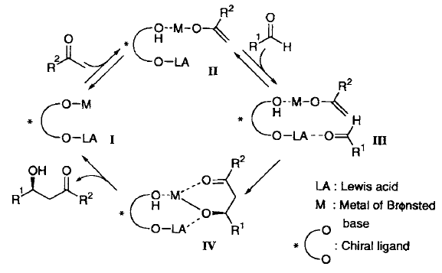
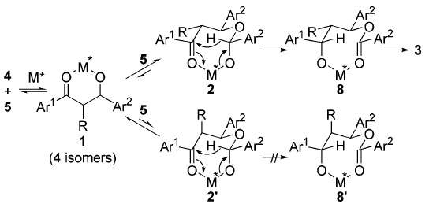
4.4.1 Aldol and Mannich Reactions: Shibasaki
General Mechanism
for the Aldol Reaction¹
Mechanism for the
Tischenko Reaction²
(1) Yamada, Y. M. A.; Yoshikawa, N.; Sasai, H.; Shibasaki, M. Angew. Chem., Int. Ed. Engl. 1997, 36, 1871-1873. (2) Gnanadesikan, V.; Horiuchi, Y.; Ohshima, T.; Shibasaki, M. J. Am. Chem. Soc. 2004, 126, 7782-7783.

Slide 32
4.4.1 Aldol and Mannich Reactions: Trost
Trost: Direct Aldol Reaction with Bis-Zn Catalysts
(1) Trost, B. M.; Ito, H. J. Am. Chem. Soc. 2000, 122, 12003-12004. (2) Trost, B. M.; Ito, H.; Silcoff, E. R. J. Am. Chem. Soc. 2001, 123, 3367-3368.

Slide 33
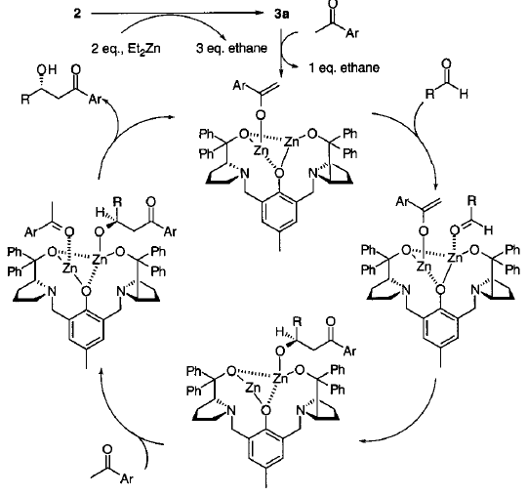
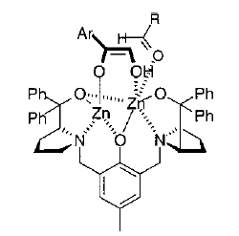
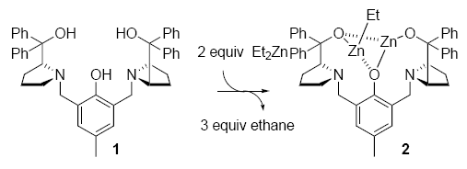
4.4.1 Aldol and Mannich Reactions: Trost
Mechanism
2
3a
(1) Trost, B. M.; Ito, H. J. Am. Chem. Soc. 2000, 122, 12003-12004. (2) Trost, B. M.; Ito, H.; Silcoff, E. R. J. Am. Chem. Soc. 2001, 123, 3367-3368.

Slide 34
4.4.1 Aldol and Mannich Reactions: Trost
Trost: Aldol Using Alkynone as Nucleophiles
Inversion of the ee During the Reaction!
(1) Trost, B. M.; Fettes, A.; Shireman, B. T. J. Am. Chem. Soc. 2004, 126, 2660-2661.

Slide 35
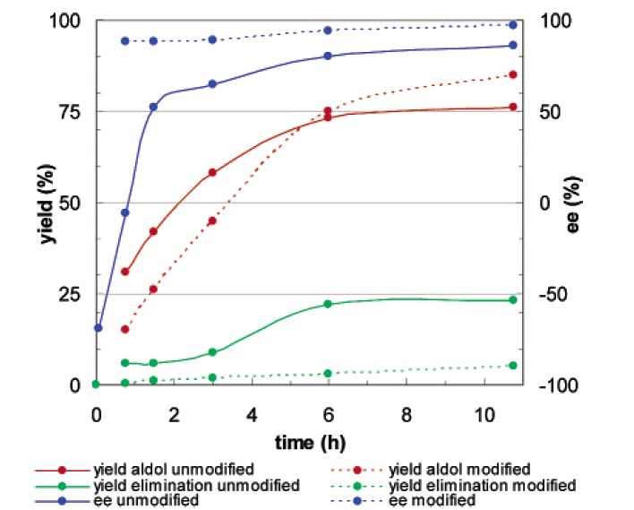
4.4.1 Aldol and Mannich Reactions: Trost
Effect of Adding the Product to the Catalyst Prior to Reaction
(1) Trost, B. M.; Fettes, A.; Shireman, B. T. J. Am. Chem. Soc. 2004, 126, 2660-2661.

Slide 36
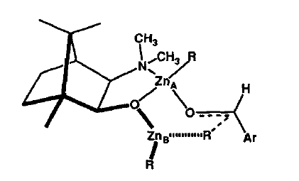
4.4.2 Addition of Metal-Alkyl Reagents: Zn-Zn Activation
Noyori Seminal Discovery: Addition of Alkyl Zinc to Aldehydes Catalyzed by Amino Alcohols
The Principle of Dual Activation with two Zn Centers
Enhance Electrophilicity of Aldehyde
Enhance Nucleophilicity of Zn-R Group
(1) Kitamura, M.; Suga, S.; Kawai, K.; Noyori, R. J. Am. Chem. Soc. 1986, 108, 6071-6072. (2) Noyori, R.; Kitamura, M. Angew. Chem., Int. Ed. Engl. 1991, 30, 49-69.

Slide 37
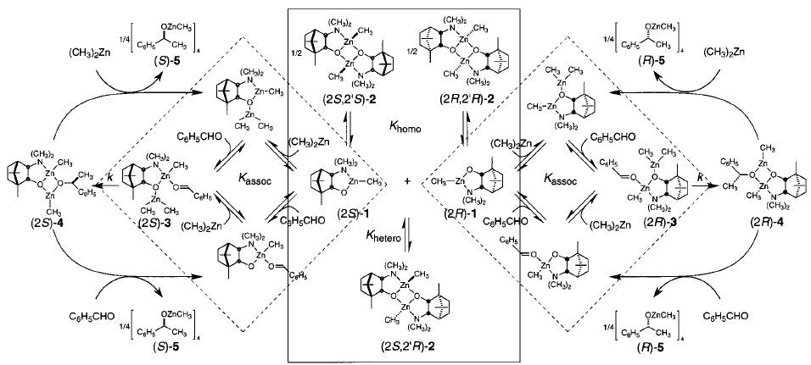
4.4.2 Addition of Metal-Alkyl Reagents: Zn-Zn Activation
Detailed Mechanism
(1) Kitamura, M.; Suga, S.; Oka, H.; Noyori, R. J. Am. Chem. Soc. 1998, 120, 9800-9809.

Slide 38
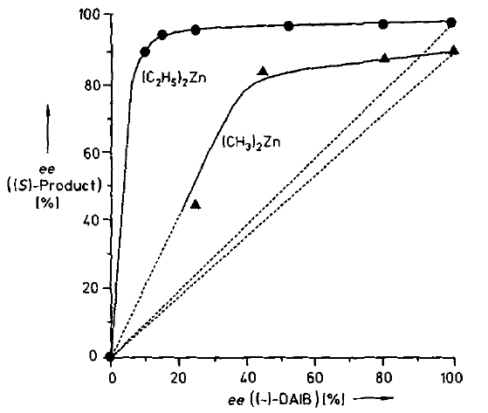
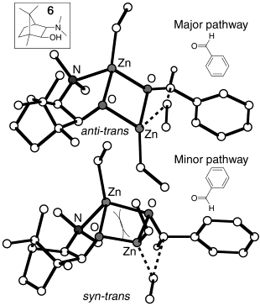
4.4.2 Addition of Metal-Alkyl Reagents: Zn-Zn Activation
Non-Linear Effect and Transitions State
(1) Kitamura, M.; Suga, S.; Oka, H.; Noyori, R. J. Am. Chem. Soc. 1998, 120, 9800-9809. (2) Rasmussen, T.; Norrby, P. O. J. Am. Chem. Soc. 2003, 125, 5130-5138.

Slide 39
4.4.2 Addition of Metal-Alkyl Reagents: Zn-Zn Activation
Bräse: Cyclophane Catalyst for Addition of Diethyl Zinc to Imines¹
Carreira: In-Situ Formation and Asymmetric Addition of Zn Acetylides^{2,3}
(1) Dahmen, S.; Brase, S. J. Am. Chem. Soc. 2002, 124, 5940-5941. (2) Frantz, D. E.; Fassler, R.; Carreira, E. M. J. Am. Chem. Soc. 2000, 122, 1806-1807. (3) Anand, N. K.; Carreira, E. M. J. Am. Chem. Soc. 2001, 123, 9687-9688.

Slide 40
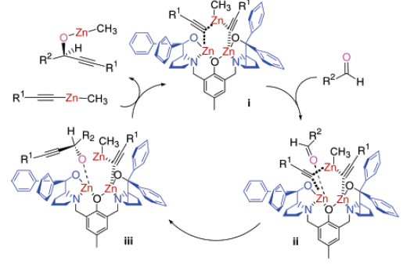
4.4.2 Addition of Metal-Alkyl Reagents: Zn-Zn Activation
Trost: Addition of Zn-Acetylide Catalyzed by Prophenol Ligand
Mechanism
(1) Trost, B. M.; Weiss, A. H.; von Wangelin, A. J. J. Am. Chem. Soc. 2006, 128, 8-9.

Slide 41
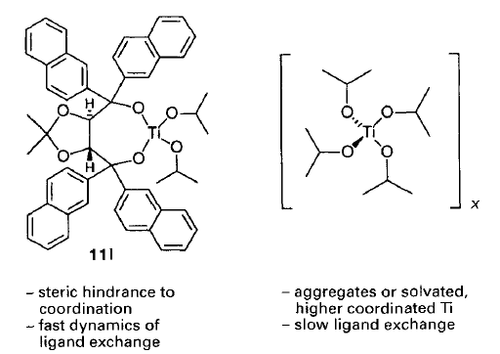
4.4.2 Addition of Metal-Alkyl Reagents: Zn-LA Activation
Seebach: Ti-TADDOL-Catalyzed Addition of Alkyl Zinc Reagents
Ligand Accelerating Effect of TADDOL
(1) Schmidt, B.; Seebach, D. Angew. Chem., Int. Ed. Engl. 1991, 30, 1321-1323. (2) Schmidt, B.; Seebach, D. Angew. Chem., Int. Ed. Engl. 1991, 30, 99-101. (3) Seebach, D.; Beck, A. K.; Heckel, A. Angew. Chem., Int. Ed. 2001, 40, 92-138.

Slide 42
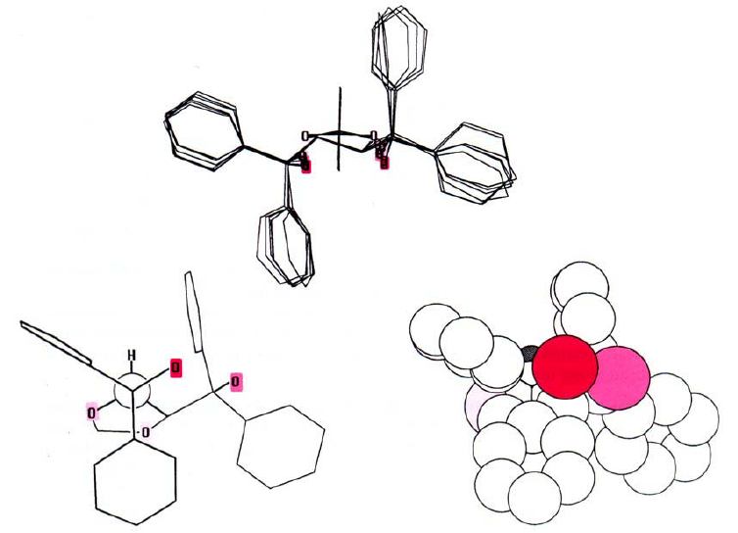
4.4.2 Addition of Metal-Alkyl Reagents: Zn-LA Activation
Structure of TADDOL
(1) Seebach, D.; Plattner, D. A.; Beck, A. K.; Wang, Y. M.; Hunziker, D.; Petter, W. Helv. Chim. Acta 1992, 75, 2171-2209.

Slide 43
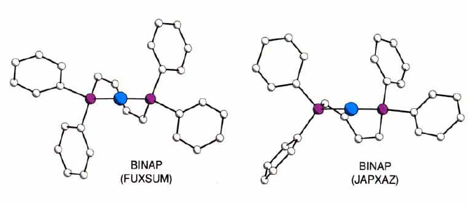
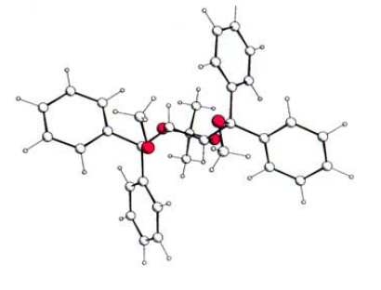
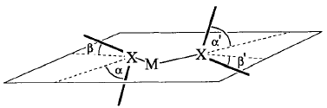
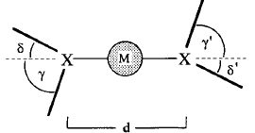
4.4.2 Addition of Metal-Alkyl Reagents: Zn-LA Activation
Structure of TADDOL: Comparison with BINAP
TADDOL
(1) Seebach, D.; Plattner, D. A.; Beck, A. K.; Wang, Y. M.; Hunziker, D.; Petter, W. Helv. Chim. Acta 1992, 75, 2171-2209.

Slide 44
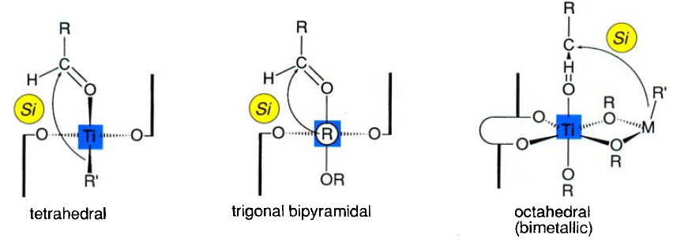
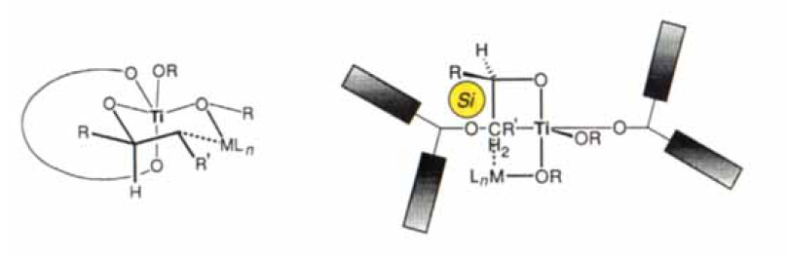
4.4.2 Addition of Metal-Alkyl Reagents: Zn-LA Activation
Different Models for Selectivity
Pentacoordinated Bimetallic
(1) Seebach, D.; Plattner, D. A.; Beck, A. K.; Wang, Y. M.; Hunziker, D.; Petter, W. Helv. Chim. Acta 1992, 75, 2171-2209.

Slide 45
4.4.3 Other Additions to Carbonyl and Imine: Cyanide
Shibasaki: YLB Catalyst for the Cyanation of Aldehydes
(1) Tian, J.; Yamagiwa, N.; Matsunaga, S.; Shibasaki, M. Angew. Chem., Int. Ed. 2002, 41, 3636-3638. (2) Yamagiwa, N.; Tian, J.; Matsunaga, S.; Shibasaki, M. J. Am. Chem. Soc. 2005, 127, 3413-3422.

Slide 46
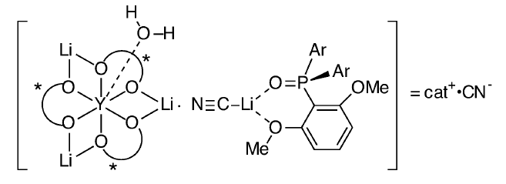
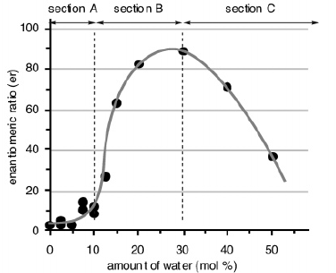
4.4.3 Other Additions to Carbonyl and Imine: Cyanide
Postulated Active Catalyst
Effect of Water
(1) Tian, J.; Yamagiwa, N.; Matsunaga, S.; Shibasaki, M. Angew. Chem., Int. Ed. 2002, 41, 3636-3638. (2) Yamagiwa, N.; Tian, J.; Matsunaga, S.; Shibasaki, M. J. Am. Chem. Soc. 2005, 127, 3413-3422.

Slide 47
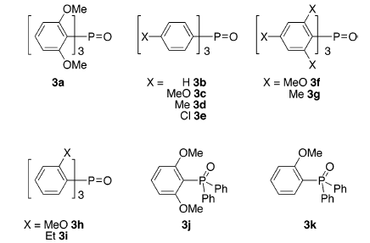
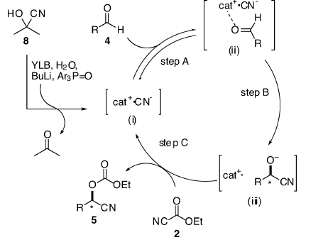
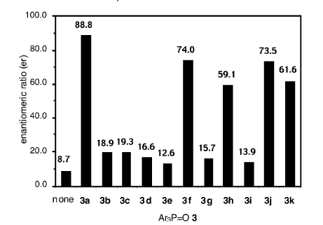
4.4.3 Other Additions to Carbonyl and Imine: Cyanide
Phosphine Oxide Effect
Catalytic Cycle
(1) Tian, J.; Yamagiwa, N.; Matsunaga, S.; Shibasaki, M. Angew. Chem., Int. Ed. 2002, 41, 3636-3638. (2) Yamagiwa, N.; Tian, J.; Matsunaga, S.; Shibasaki, M. J. Am. Chem. Soc. 2005, 127, 3413-3422.

Slide 48
4.4.3 Other Additions to Carbonyl and Imine: Reduction
Corey-Bakshi-Shibata Reduction (CBS Reduction)
Specially Interesting: Highly Selective Reduction of Acrylates
(1) Corey, E. J.; Bakshi, R. K.; Shibata, S.; Chen, C. P.; Singh, V. K. J. Am. Chem. Soc. 1987, 109, 7925-7926. (2) Corey, E. J.; Helal, C. J. Angew. Chem., Int. Ed. 1998, 37, 1987-2012.

Slide 49
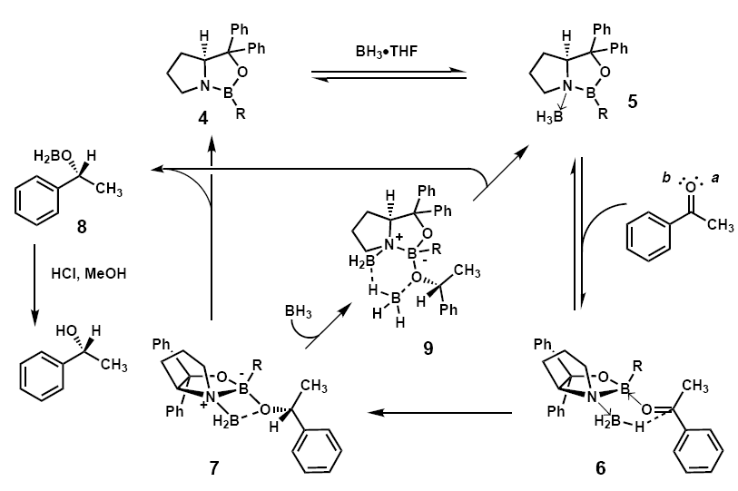
4.4.3 Other Additions to Carbonyl and Imine: Reduction
Mechanism and Model for Selectivity
Eletrophilic Activation
R_{S}
Nucleophilic Activation
R_{L}
(1) Corey, E. J.; Bakshi, R. K.; Shibata, S.; Chen, C. P.; Singh, V. K. J. Am. Chem. Soc. 1987, 109, 7925-7926. (2) Corey, E. J.; Helal, C. J. Angew. Chem., Int. Ed. 1998, 37, 1987-2012.

Slide 50
4.4.5 Other Reactions: Epoxide Opening
Jacobsen: Asymmetric Opening of Meso-Epoxides with Azides
Jacobsen: A Dimeric Catalyst for Probing the Reaction Mechanism
(1) Martinez, L. E.; Leighton, J. L.; Carsten, D. H.; Jacobsen, E. N. J. Am. Chem. Soc. 1995, 117, 5897-5898. (2) Hansen, K. B.; Leighton, J. L.; Jacobsen, E. N. J. Am. Chem. Soc. 1996, 118, 10924-10925. (3) Konsler, R. G.; Karl, J.; Jacobsen, E. N. J. Am. Chem. Soc. 1998, 120, 10780-10781.

Slide 51
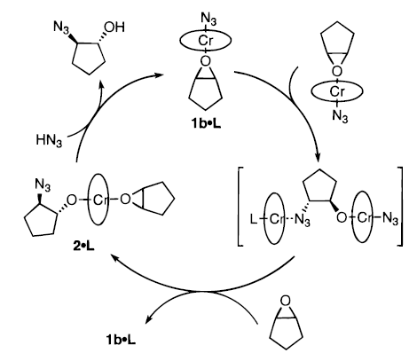
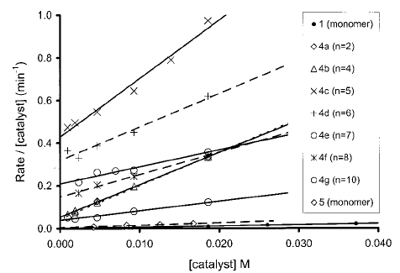
4.4.5 Other Reactions: Epoxide Opening
Mechanism and Results with Dimeric Catalysts
(1) Martinez, L. E.; Leighton, J. L.; Carsten, D. H.; Jacobsen, E. N. J. Am. Chem. Soc. 1995, 117, 5897-5898. (2) Hansen, K. B.; Leighton, J. L.; Jacobsen, E. N. J. Am. Chem. Soc. 1996, 118, 10924-10925. (3) Konsler, R. G.; Karl, J.; Jacobsen, E. N. J. Am. Chem. Soc. 1998, 120, 10780-10781.

Slide 52
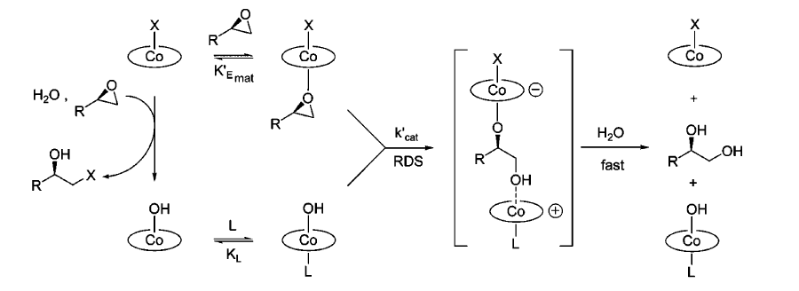
4.4.5 Other Reactions: Epoxide Opening
Jacobsen. Kinetic Resolution
of Epoxides with Water
(1) Tokunaga, M.; Larrow, J. F.; Kakiuchi, F.; Jacobsen, E. N. Science 1997, 277, 936-938. (2) Schaus, S. E.; Brandes, B. D.; Larrow, J. F.; Tokunaga, M.; Hansen, K. B.; Gould, A. E.; Furrow, M. E.; Jacobsen, E. N. J. Am. Chem. Soc. 2002, 124, 1307-1315. (3) Nielsen, L. P. C.; Stevenson, C. P.; Blackmond, D. G.; Jacobsen, E. N. J. Am. Chem. Soc. 2004, 126, 1360-1362. (4) Ford, D. D.; Nielsen, L. P. C.; Zuend, S. J.; Musgrave, C. B.; Jacobsen, E. N. J. Am. Chem. Soc. 2013, 135, 15595.

Slide 53
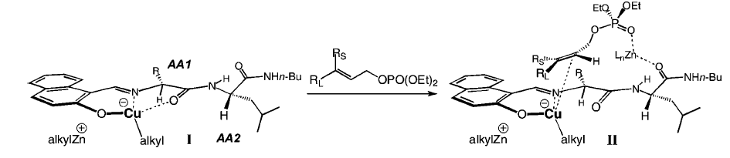
4.4.5 Other Reactions: Asymmetric Allylation
Hoveyda: Cu-Catalyzed Allylation of Organozinc Reagents
Proposed Model
(1) Kacprzynski, M. A.; Hoveyda, A. H. J. Am. Chem. Soc. 2004, 126, 10676-10681.

Slide 54
4.4.5 Other Reactions: Asymmetric Allylation
Shibasaki: Cu/Pd catalyzed asymmetric alkylation
Saito, A.; Kumagai, N.; Shibasaki, M. Angew. Chem., Int. Ed. 2017, 56, 5551-5555.

Slide 55
4.4.5 Other Reactions: Alkene Vinylation
Buchwald: Cu/Pd catalyzed olefin alkenylation
Levi Knippel, J.; Ni, A. Z.; Schuppe, A. W.; Buchwald, S. L. Angew., Chem., Int. Ed. 2022, 61, e202212630.

Slide 56
4.4.5 Other Reactions: Conia-Ene Reaction
Toste: Asymmetric Conia-Ene Reaction
Proposed Mechanism
(1) Corkey, B. K.; Toste, F. D. J. Am. Chem. Soc. 2005, 127, 17168-17169.

Slide 57
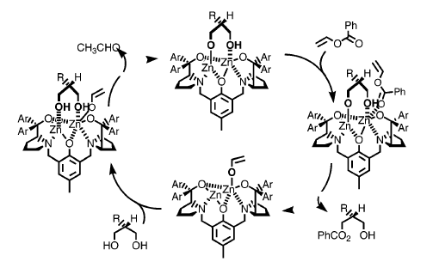
4.4.5 Other Reactions: Desymmetrization
Trost: Desymmetrization of Diols
Proposed Mechanism
(1) Trost, B. M.; Mino, T. J. Am. Chem. Soc. 2003, 125, 2410-2411.
.

Slide 58
4.4.5 Other Reactions: Bis-Ni catalysis
Cramer: Cyclopropanation¹
Uyeda: [4+1] cycloaddition²
(1) Braconi, E.; Cramer, N. Angew. Chem., Int. Ed. 2020, 59, 16425-16429. (2) Behlen, M. J.; Uyeda, C. J. Am. Chem. Soc. 2020, 142, 17294-17300.
.

Slide 59
4.4.5 Other Reactions: Bis-Ni catalysis
Behlen, M. J.; Uyeda, C. J. Am. Chem. Soc. 2020, 142, 17294-17300.

