Slide 1
4.Dual Activation
  4.1 BrØnsted acid / base dual activation
  4.2 Enamine acid dual activation
  4.3 Metal-ligand dual activation
  4.4 Dual activation on two metal centers
  4.5 Dual activation on a single metal center: activated systems
  4.6 Dual activation on a single metal center: non-activated systems

Slide 2
  4.1 Brønsted acid / base dual activation
  4.1.1 Addition to Carbonyl and Imines
  4.1.2 Conjugate Addition
  4.1.3 Other Reactions

Slide 3
4.1.1 Addition to Carbonyl and Imines: Cyanide
Lipton: Guanidine-Dipeptide-Catalyzed Strecker Reaction¹
Corey: Cyclic Guanidine as Catalyst for the Strecker Reaction²
(1) Iyer, M. S.; Gigstad, K. M.; Namdev, N. D.; Lipton, M. J. Am. Chem. Soc. 1996, 118, 4910-4911. (2) Corey, E. J.; Grogan, M. J. Org. Lett. 1999, 1, 157-160.

Slide 4
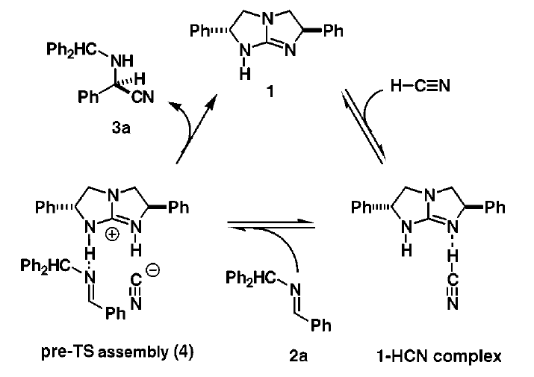
4.1.1 Addition to Carbonyl and Imines: Cyanide
Mechanism
(1) Corey, E. J.; Grogan, M. J. Org. Lett. 1999, 1, 157-160.

Slide 5
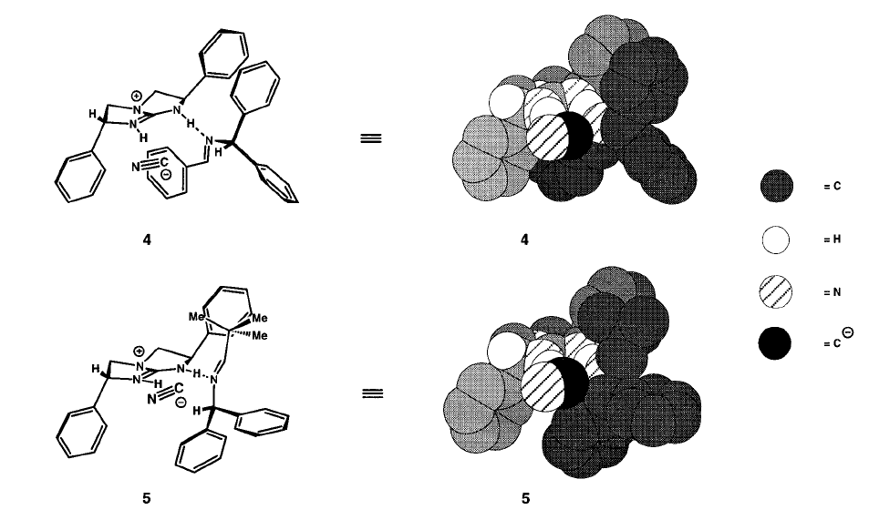
4.1.1 Addition to Carbonyl and Imines: Cyanide
Model for Selectivity: Inversion of Stereochemistry for Aliphatic Imines
(1) Corey, E. J.; Grogan, M. J. Org. Lett. 1999, 1, 157-160.

Slide 6
4.1.1 Addition to Carbonyl and Imines: Cyanide
Jacobsen: Cyanosilylation of Ketones with Thiourea Catalysts
No reaction with:
(1) Fuerst, D. E.; Jacobsen, E. N. J. Am. Chem. Soc. 2005, 127, 8964-8965.

Slide 7
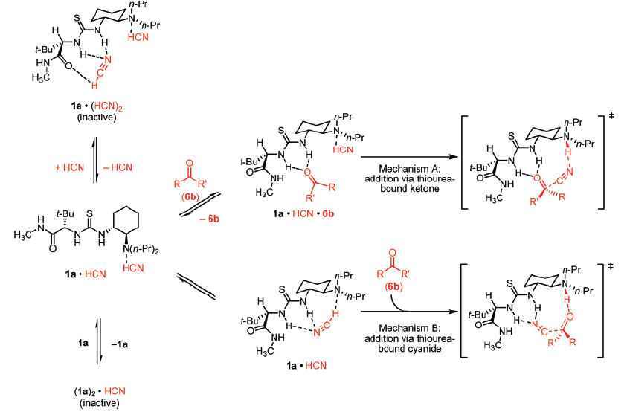
4.1.1 Addition to Carbonyl and Imines: Cyanide
Jacobsen: Mechanistic Studies
Favored
(1) Zuend, S. J.; Jacobsen, E. N. J. Am. Chem. Soc. 2007, 129, 15872-15883.

Slide 8
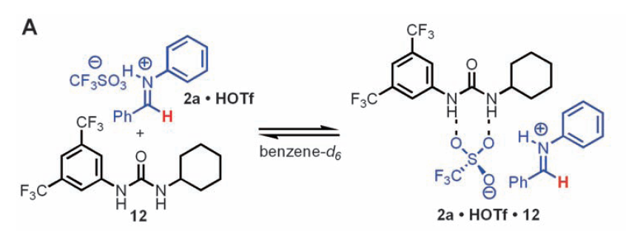
4.1.1 Addition to Carbonyl and Imines: Acid Activation
Jacobsen: Co-Catalysis between strong acid and bifunctional urea (Povarov reaction)
(1) Xu, H.; Zuend, S. J.; Woll, M. G.; Tao, Y.; Jacobsen, E. N. Science 2010, 327, 986.

Slide 9
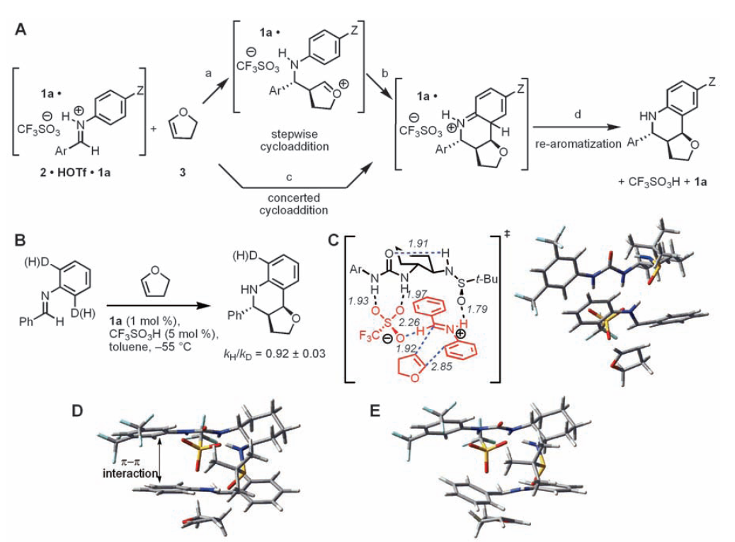
4.1.1 Addition to Carbonyl and Imines: Acid Activation
(1) Xu, H.; Zuend, S. J.; Woll, M. G.; Tao, Y.; Jacobsen, E. N. Science 2010, 327, 986.

Slide 10
4.1.1 Addition to Carbonyl and Imines: Prins Reaction
(1) Kutateladze, D. A.; Jacobsen, E. N., J. Am. Chem. Soc. 2021, 143, 20077. (2) Kutateladze, D. A.; Wagen, C. C.; Jacobsen, E. N. J. Am. Chem. Soc. 2022, 144, 15812.

Slide 11
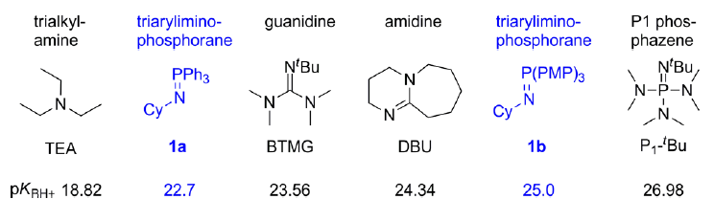
4.1.1 Addition to Carbonyl and Imines: Phosphorane Base
Dixon: Diaryl iminophosphoranes as strong bases
pK_{a} in acetonitrile
(1) Nunez, M. G.; Farley, A. J. M.; Dixon, D. J. J. Am. Chem. Soc. 2013, 135, 16348.

Slide 12
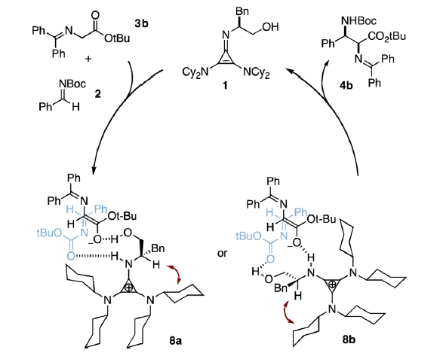
4.1.1 Addition to Carbonyl and Imines: Iminocyclopropene
Lambert: cyclopropylium cation at the origin of the strong basicity of iminocyclopropenes
(1) Bandar, J. S.; Lambert, T. H. J. Am. Chem. Soc. 2013, 135, 11799.

Slide 13
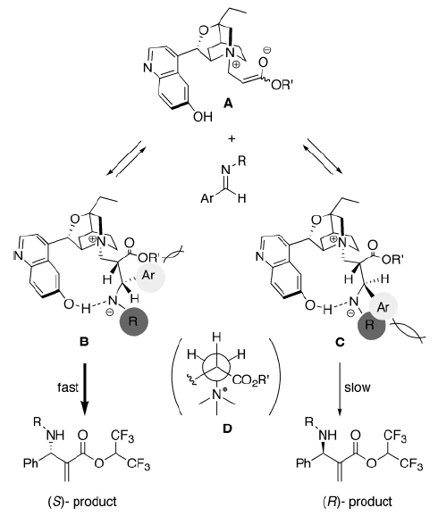
4.1.1 Addition to Carbonyl and Imines: Enolates
Hatakeyama: Aza-Morita-Baylis-Hillman Reaction¹
(1) Kawahara, S.; Nakano, A.; Esumi, T.; Iwabuchi, Y.; Hatakeyama, S. Org. Lett. 2003, 5, 3103-3105.

Slide 14
4.1.1 Addition to Carbonyl and Imines: Alcohols
Miller: Asymmetric Acylation using Peptide Catalysts¹
Alanine Test:
((1) Fierman, M. B.; O'Leary, D. J.; Steinmetz, W. E.; Miller, S. J. J. Am. Chem. Soc. 2004, 126, 6967-6971.

Slide 15
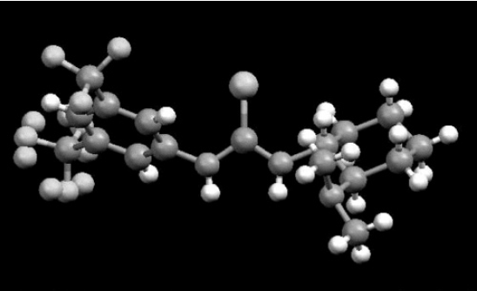
4.1.2 Conjugate Addition: Carbon Nucleophiles
Takemoto: Michael Addition to Nitroolefins
(1) Okino, T.; Hoashi, Y.; Takemoto, Y. J. Am. Chem. Soc. 2003, 125, 12672-12673. (2) Okino, T.; Hoashi, Y.; Furukawa, T.; Xu, X. N.; Takemoto, Y. J. Am. Chem. Soc. 2005, 127, 119-125.

Slide 16
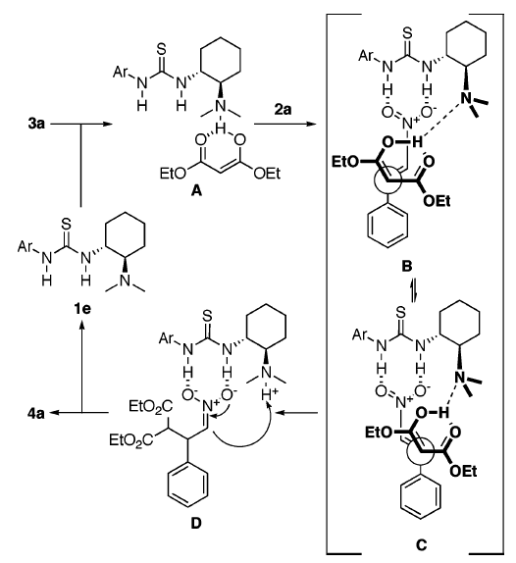
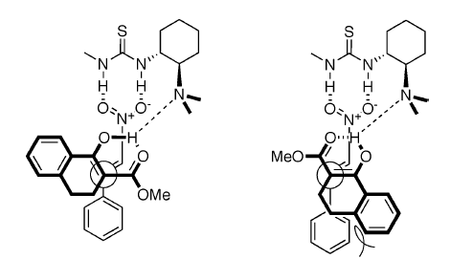
4.1.2 Conjugate Addition: Carbon Nucleophiles
Mechanism and Model for Selectivity
(1) Okino, T.; Hoashi, Y.; Takemoto, Y. J. Am. Chem. Soc. 2003, 125, 12672-12673. (2) Okino, T.; Hoashi, Y.; Furukawa, T.; Xu, X. N.; Takemoto, Y. J. Am. Chem. Soc. 2005, 127, 119-125.

Slide 17
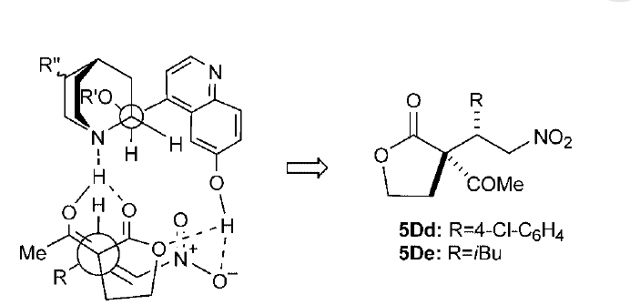
4.1.2 Conjugate Addition: Carbon Nucleophiles
Deng: Use of Bifunctional Cinchona Catalyst
(1) Li, H. M.; Wang, Y.; Tang, L.; Deng, L. J. Am. Chem. Soc. 2004, 126, 9906-9907. (2) Li, H. M.; Wang, Y.; Tang, L.; Wu, F. H.; Liu, X. F.; Guo, C. Y.; Foxman, B. M.; Deng, L. Angew. Chem., Int. Ed. 2005, 44, 105-108.

Slide 18
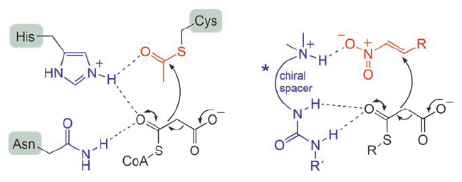
4.1.2 Conjugate Addition: Carbon Nucleophiles
Wennemers: Decarboxylative Conjugate Addition Using Urea-Cinchona Catalysts
A Biomimetic Reaction
(1) Lubkoll, J.; Wennemers, H. Angew. Chem., Int. Ed. 2007, 46, 6841-6844.

Slide 19
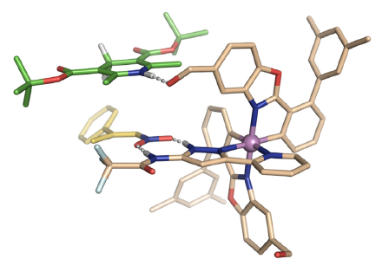
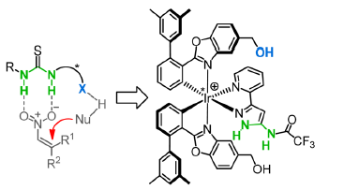
4.1.2 Conjugate Addition: Reduction
Meggers: A «metallic organocatalyst» for conjugate reduction¹
Catalyst
(1) Chen, L. A.; Xu, W. C.; Huang, B.; Ma, J. J.; Wang, L.; Xi, J. W.; Harms, K.; Gong, L.; Meggers, E. J. Am. Chem. Soc. 2013, 135, 10598.
.

Slide 20
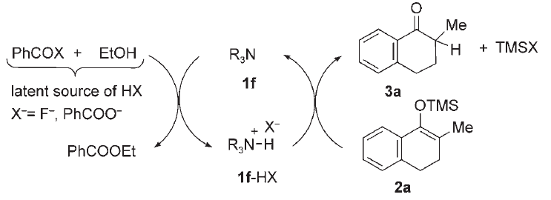
4.1.3 Other Reactions: Protonation
Levacher: Enantioselective Protonation with Cinchona Catalysts
Mechanism
(1) Poisson, T.; Dalla, V.; Marsais, F.; Dupas, G.; Oudeyer, S.; Levacher, V. Angew. Chem., Int. Ed. 2007, 46, 7090-7093.

Slide 21
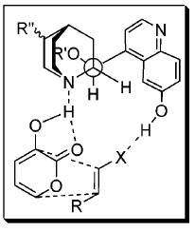
4.1.3 Other Reactions: Diels-Alder Cycloaddition
Deng: Cinchona Catalysts for the Diels-Alder Reactions of Pyrones
General Model
(1) Wang, Y.; Li, H. M.; Wang, Y. Q.; Liu, Y.; Foxman, B. M.; Deng, L. J. Am. Chem. Soc. 2007, 129, 6364-6365.

Slide 22
4.1.3 Other Reactions: Diels-Alder Cycloaddition
Deng: Controlling Diastereoselectivity by Choice of Catalyst
(1) Wang, Y.; Li, H. M.; Wang, Y. Q.; Liu, Y.; Foxman, B. M.; Deng, L. J. Am. Chem. Soc. 2007, 129, 6364-6365.

Slide 23
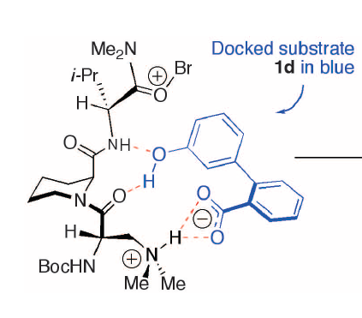
4.1.3 Other Reactions: Bromination
Miller: Atroposelective bromination of diaryls
(1) Gustafson, J. L.; Lim, D.; Miller, S. J. Science 2010, 328, 1251.

Slide 24
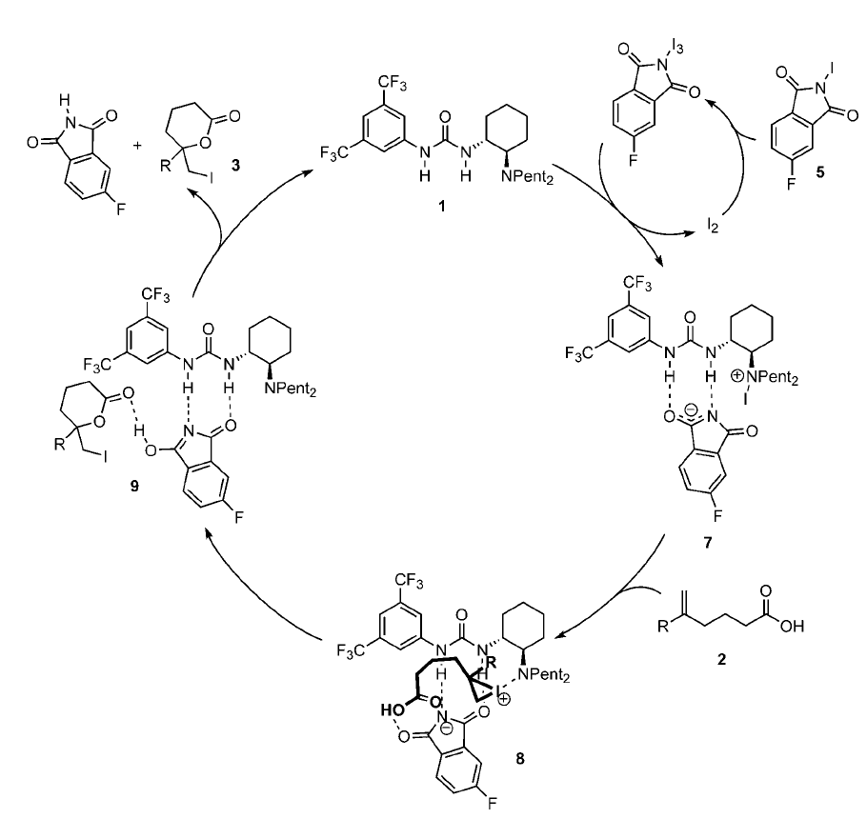
4.1.3 Other Reactions: Iodolactonization
Jacobsen: Enantioselective Iodolactonization
(1) Veitch, G. E.; Jacobsen, E. N., Angew. Chem., Int. Ed. 2010, 49, 7332.

Slide 25
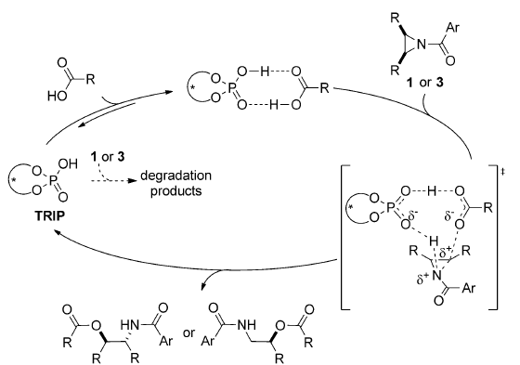
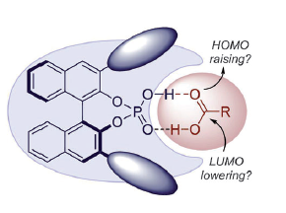
4.1.3 Other Reactions: Epoxides/aziridines opening
List: Opening of aziridines/epoxides via carboxylic acid activation
(1) Monaco, M. R.; Poladura, B.; de Los Bernardos, M. D.; Leutzsch, M.; Goddard, R.; List, B. Angew. Chem., Int. Ed. 2014, 53, 7063. (2) Monaco, M. R.; Prevost, S.; List, B. Angew. Chem., Int. Ed. 2014, 53, 8142. (3) Monaco, M. R.; Fazzi, D.; Tsuji, N.; Leutzsch, M.; Liao, S.; Thiel, W.; List, B., J. Am. Chem. Soc. 2016, 138, 14740-14749.

Slide 26
4.1.3 Other Reactions: Vinylogous Pinacol
Zhu: Vinylogous Pinacol rearrangement catalyzed by phosphoric imides
Wu, H.; Wang, Q.; Zhu, J. P., Angew. Chem., Int. Ed. 2016, 55, 15411-15414.

Slide 27
4.1.3 Other Reactions: Minisci Reaction
Phipps: enantioselective Minisci reaction
(1) Proctor, R. S. J.; Davis, H. J.; Phipps, R. J. Science 2018, 360, 419-422. (2) Reid, J. P.; Proctor, R. S. J.; Sigman, M. S.; Phipps, R. J., J. Am. Chem. Soc. 2019, 141, 19178-19185.

Slide 28
4.1.3 Other Reactions: Minisci Reaction
Phipps: enantioselective Minisci reaction: stereoinduction
Ermanis, K.; Colgan, A. C.; Proctor, R. S. J.; Hadrys, B. W.; Phipps, R. J.; Goodman, J. M. J. Am. Chem. Soc. 2020, 142, 21091.

Slide 29
4.1.3 Other Reactions: Deracemizaton
Knowles: deracemization reaction
Shin, N. Y.; Ryss, J. M.; Zhang, X.; Miller, S. J.; Knowles, R. R., Science 2019, 366, 364.

Slide 30
4.1.3 Other Reactions: Deracemizaton
Shin, N. Y.; Ryss, J. M.; Zhang, X.; Miller, S. J.; Knowles, R. R., Science 2019, 366, 364.

Slide 31
  4.2 Enamide-Acid Dual Activation
  4.2.1 Proline
  4.2.2 Other Amine Catalysts

Slide 32
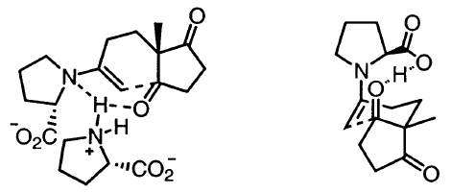
4.2.1 Proline
Proline: The Eder-Sauer-Wiechert-Hajos-Parrish Reaction^{1,2}
Agami-Kagan Mechanism³
List-Houk Mechanism^{4,5}
(1) Eder, U.; Sauer, G.; Weichert, R. Angew. Chem., Int. Ed. 1971, 10, 496-497. (2) Hajos, Z. G.; Parrish, D. R. J. Org. Chem. 1974, 39, 1615-1621. (3) Puchot, C.; Samuel, O.; Dunach, E.; Zhao, S.; Agami, C.; Kagan, H. B. J. Am. Chem. Soc. 1986, 108, 2353-2357. (4) Hoang, L.; Bahmanyar, S.; Houk, K. N.; List, B. J. Am. Chem. Soc. 2003, 125, 16-17. (5) Clemente, F. R.; Houk, K. N. Angew. Chem., Int. Ed. 2004, 43, 5766-5768.

Slide 33
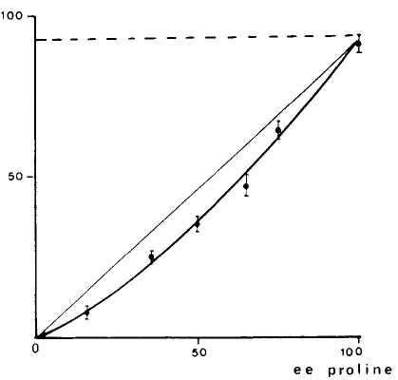
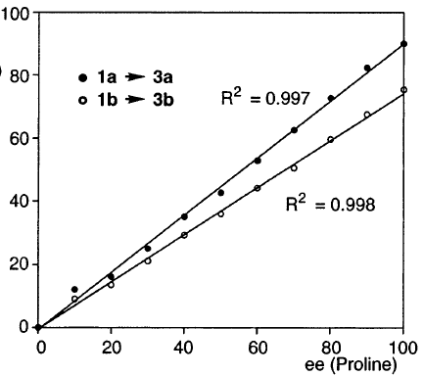
4.2.1 Proline
Non-Linear Effect for the Eder-Sauer-Wiechert-Hajos-Parrish Reaction?
Agami-Kagan
List-Houk
(1) Puchot, C.; Samuel, O.; Dunach, E.; Zhao, S.; Agami, C.; Kagan, H. B. J. Am. Chem. Soc. 1986, 108, 2353-2357. (2) Hoang, L.; Bahmanyar, S.; Houk, K. N.; List, B. J. Am. Chem. Soc. 2003, 125, 16-17.

Slide 34
4.2.1 Proline
List and Barbas: Catalytic Direct Aldol Reaction Catalyzed by Proline^{1,2}
List and Barbas: Catalytic Direct Mannich Reaction Catalyzed by Proline^{3,4}
(1) List, B.; Lerner, R. A.; Barbas, C. F. J. Am. Chem. Soc. 2000, 122, 2395-2396. (2) Sakthivel, K.; Notz, W.; Bui, T.; Barbas, C. F. J. Am. Chem. Soc. 2001, 123, 5260-5267. (1) List, B. J. Am. Chem. Soc. 2000, 122, 9336-9337. (2) Cordova, A.; Notz, W.; Zhong, G. F.; Betancort, J. M.; Barbas, C. F. J. Am. Chem. Soc. 2002, 124, 1842-1843. (3) List, B.; Pojarliev, P.; Biller, W. T.; Martin, H. J. J. Am. Chem. Soc. 2002, 124, 827-833.

Slide 35
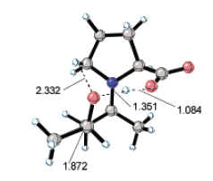
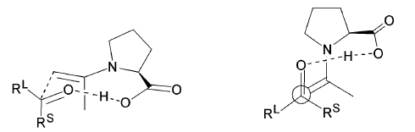
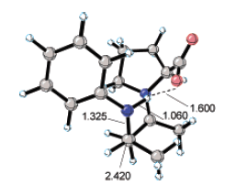
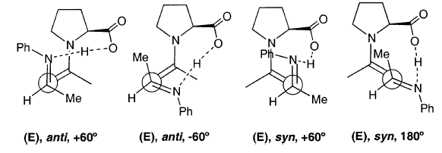
4.2.1 Proline
Mechanism for the Aldol and the Mannich Reaction
Aldol Reaction
Mannich Reaction
Favored TS
(1) Bahmanyar, S.; Houk, K. N. Org. Lett. 2003, 5, 1249-1251.

Slide 36
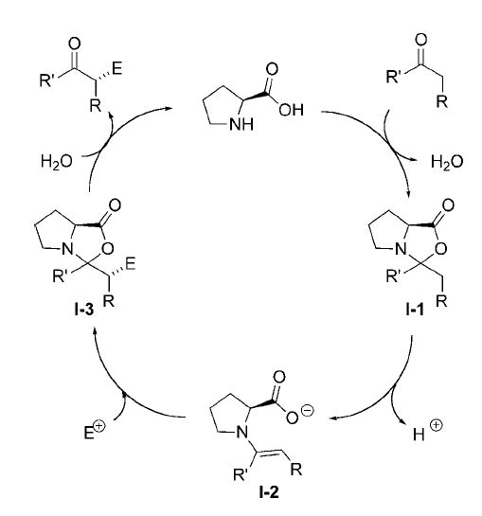
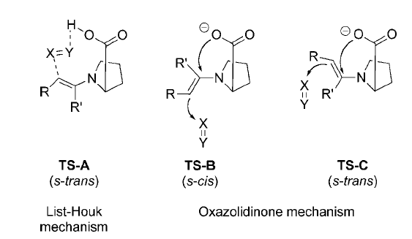
4.2.1 Proline
Alternative Mechanisms
(1) a) Seebach, D.; Beck, A. K.; Badine, D. M.; Limbach, M.; Eschenmoser, A.; Treasurywala, A. M.; Hobi, R.; Prikoszovich, W.; Linder, B., Helvetica Chimica Acta 2007, 90, 425. b) Kanzian, T.; Lakhdar, S.; Mayr, H., Angew. Chem., Int. Ed. 2010, 49, 9526.

Slide 37
4.2.1 Proline
MacMillan: Direct Cross Aldol Reaction of Aldehyde¹
Barbas, Cordova, Hayashi, List: Mannich Reaction with Aldehyde^{2,3}
(1) Northrup, A. B.; MacMillan, D. W. C. J. Am. Chem. Soc. 2002, 124, 6798-6799. (2) Cordova, A.; Watanabe, S.; Tanaka, F.; Notz, W.; Barbas, C. F. J. Am. Chem. Soc. 2002, 124, 1866-1867. (3) Hayashi, Y.; Tsuboi, W.; Ashimine, I.; Urushima, T.; Shoji, M.; Sakai, K. Angew. Chem., Int. Ed. 2003, 42, 3677-3680. (4) Yang, J. W.; Chandler, C.; Stadler, M.; Kampen, D.; List, B. Nature 2008, 452, 453.

Slide 38
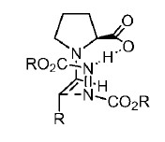
4.2.1 Proline
List and Jorgensen: Amination of Aldehydes and Ketones¹⁻³
Macmillan, Zhong, Cordova and Hayashi: Hydroxylation and Aldehydes and Ketones
(1) Bogevig, A.; Juhl, K.; Kumaragurubaran, N.; Zhuang, W.; Jorgensen, K. A. Angew. Chem.,Int. Ed. 2002, 41, 1790-1792. (2) Kumaragurubaran, N.; Juhl, K.; Zhuang, W.; Bogevig, A.; Jorgensen, K. A. J. Am. Chem. Soc. 2002, 124, 6254-6255. (3) List, B. J. Am. Chem. Soc. 2002, 124, 5656-5657. (4) Brown, S. P.; Brochu, M. P.; Sinz, C. J.; MacMillan, D. W. C. J. Am. Chem. Soc. 2003, 125, 10808-10809. (2) Zhong, G. F. Angew. Chem., Int. Ed. 2003, 42, 4247-4250. (3) Bogevig, A.; Sunden, H.; Cordova, A. Angew. Chem., Int. Ed. 2004, 43, 1109-1112. (4) Cordova, A.; Sunden, H.; Bogevig, A.; Johansson, M.; Himo, F. Chem. Eur. J. 2004, 10, 3673-3684. (5) Hayashi, Y.; Yamaguchi, J.; Sumiya, T.; Shoji, M. Angew. Chem., Int. Ed. 2004, 43, 1112-1115.

Slide 39
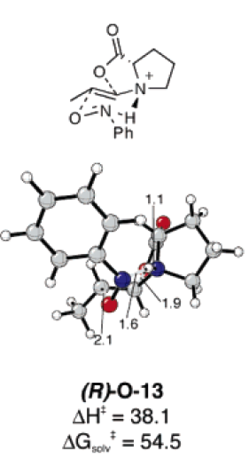
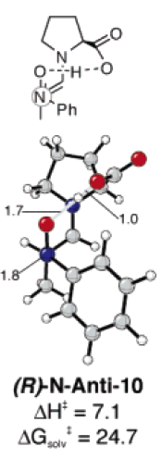
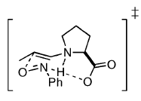
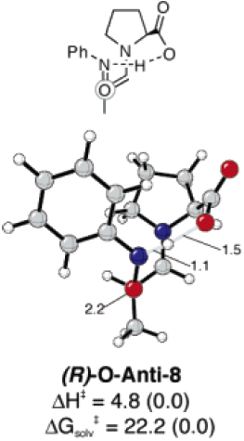
4.2.1 Proline
Mechanism for the hydroxylation of ketones and aldehydes
Not localized
Hayashi-Houk
Zhong
MacMillan
(1) Cheong, P. H. Y.; Houk, K. N. J. Am. Chem. Soc. 2004, 126, 13912-13913.

Slide 40
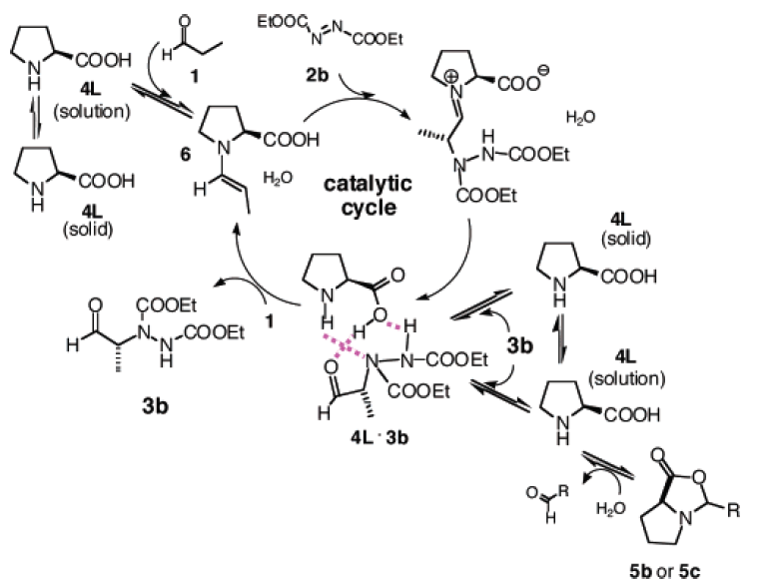
4.2.1 Proline
Blackmond: Product Accelerating effect in Amination Reactions
Mechanism Proposal
(1) Iwamura, H.; Mathew, S. P.; Blackmond, D. G. J. Am. Chem. Soc. 2004, 126, 11770-11771. (2) Iwamura, H.; Wells, D. H.; Mathew, S. P.; Klussmann, M.; Armstrong, A.; Blackmond, D. G. J. Am. Chem. Soc. 2004, 126, 16312-16313.

Slide 41
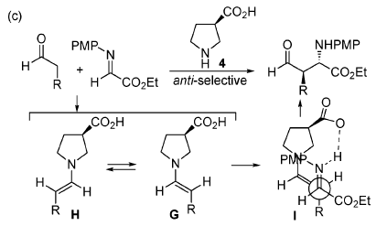
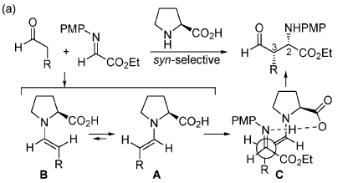
4.2.2 Other Catalysts: Proline derivatives
Barbas: 3-Pyrrolidine Carboxylic Acid for Anti-Mannich Reaction¹
Comparison with Proline
(1) Zhang, H. L.; Mitsumori, S.; Utsumi, N.; Imai, M.; Garcia-Delgado, N.; Mifsud, M.; Albertshofer, K.; Cheong, P. H. Y.; Houk, K. N.; Tanaka, F.; Barbas, C. F. J. Am. Chem. Soc. 2008, 130, 875-886.

Slide 42
4.2.2 Other Catalysts: Proline derivatives
Yamamoto: Formal Nitroso Diels-Alder Reaction¹
Sparr: Aldol Condensation for the Enantioselective Synthesis of Binaphthyl Derivatives²
(1) Yamamoto, Y.; Momiyama, N.; Yamamoto, H. J. Am. Chem. Soc. 2004, 126, 5962. (2) Link, A.; Sparr, C. Angew. Chem., Int. Ed. 2014, 53, 5458.

Slide 43
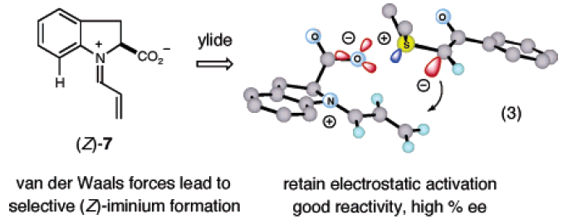
4.2.2 Other Catalysts: Proline Derivatives
MacMillan: The Reversed Approach: Iminium Activation with Carboxylate for Cyclopropanation
(1) Kunz, R. K.; MacMillan, D. W. C. J. Am. Chem. Soc. 2005, 127, 3240-3241.

Slide 44
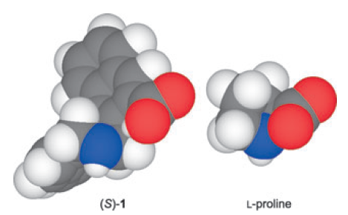
4.2.2 Other Catalysts: Binaphthyl Scaffold
Maruoka: Chiral Amino Acid Derived from Binol for the Aldol Reaction
Comparison with Proline
(1) Kano, T.; Takai, J.; Tokuda, O.; Maruoka, K. Angew. Chem., Int. Ed. 2005, 44, 3055-3057.

Slide 45
4.2.2 Other Catalysts: Binaphthyl Scaffold
Maruoka: Triflamide Derived Catalyst for Better Selectivity in the Mannich Reaction
(1) Kano, T.; Yamaguchi, Y.; Tokuda, O.; Maruoka, K. J. Am. Chem. Soc. 2005, 127, 16408-16409.

Slide 46
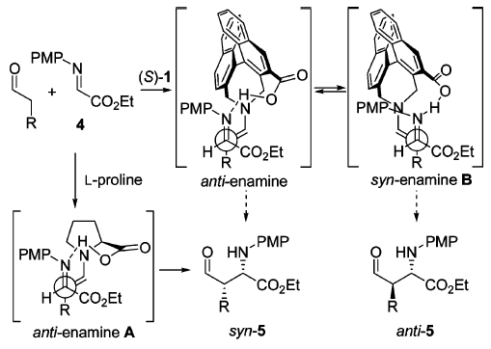
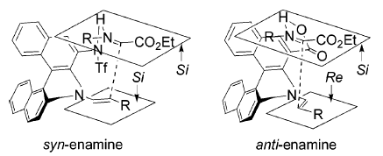
4.2.2 Other Catalysts: Binaphthyl Scaffold
Transition State Analysis
(1) Kano, T.; Yamaguchi, Y.; Tokuda, O.; Maruoka, K. J. Am. Chem. Soc. 2005, 127, 16408-16409.

Slide 47
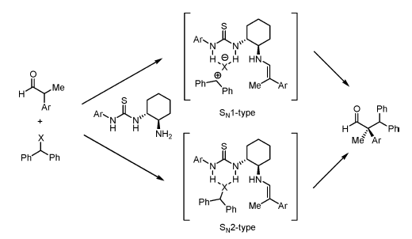
4.2.2 Other Catalysts: Urea-Primary Amine
Jacobsen: combination of enamine and ion pair activation
(1) Brown, A. R.; Kuo, W. H.; Jacobsen, E. N. J. Am. Chem. Soc. 2010, 132, 9286.

Slide 48
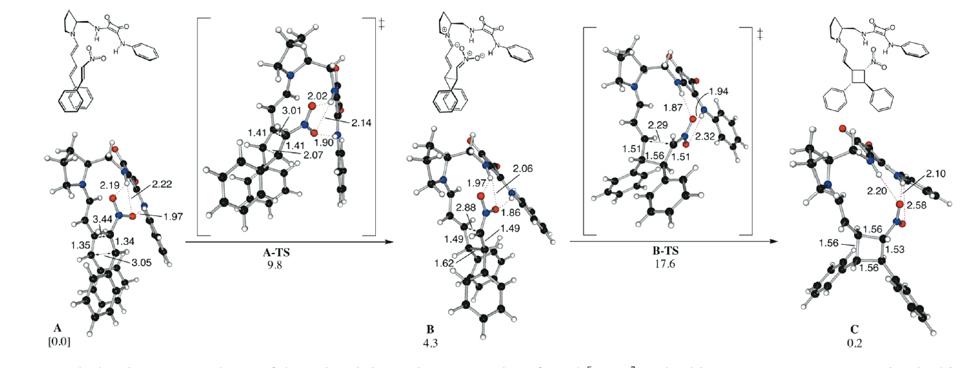
4.2.2 Other Catalysts: Squaramide and dieneamines
Jorgensen: squaramide catalyst for [2+2] cycloaddition via dienamines
Albrecht, L.; Dickmeiss, G.; Acosta, F. C.; Rodriguez-Escrich, C.; Davis, R. L.; Jorgensen, K. A. J. Am. Chem. Soc. 2012, 134, 2543.

Slide 49
4.2.2 Other Catalysts: Deracemization via Enamines
Luo: Deracemization via enamines under light irradiation
Huang, M.; Zhang, L.; Pan, T.; Luo, S. Science 2022, 375, 869-874.

