Slide 1
3.Homo Activation
3.1 Chiral enolate generation
3.2 Enamine catalysis
3.3 Phase-transfer catalysis
3.4 Chiral ylides generation

Slide 2
3.1 Generation of Chiral Enolates
3.1.1 Chiral Enolates via Deprotonation
3.1.2 Chiral Enolates from Enolates and Enol Ethers
3.1.3 Other Ways to Generate Chiral Enolates and other Nucleophiles

Slide 3
3.1.1 Chiral Enolates via Deprotonation: 1,3-Dicarbonyl
General Catalytic Cycle for the Generation of Chiral Enolates from 1,3-Dicarbonyl Compounds
1,3-dicarbonyl compounds allow two-points binding for easier catalyst design

Slide 4
3.1.1 Chiral Enolates via Deprotonation: 1,3-Dicarbonyl
Barnes and Ji: Chiral Mg-Box Catalysts
Application: Synthesis of the Antidepressiv Rolipram
(1) Ji, J. G.; Barnes, D. M.; Zhang, J.; King, S. A.; Wittenberger, S. J.; Morton, H. E. J. Am. Chem. Soc. 1999, 121, 10215-10216. (2) Barnes, D. M.; Ji, J. G.; Fickes, M. G.; Fitzgerald, M. A.; King, S. A.; Morton, H. E.; Plagge, F. A.; Preskill, M.; Wagaw, S. H.; Wittenberger, S. J.; Zhang, J. J. Am. Chem. Soc. 2002, 124, 13097-13105.

Slide 5
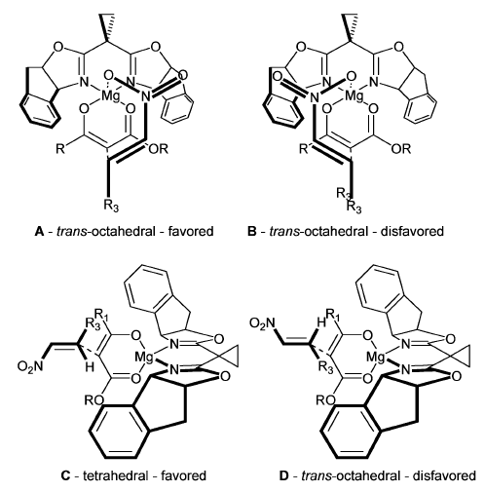
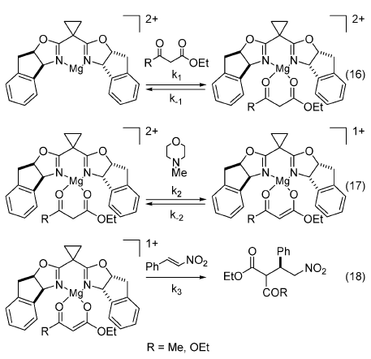
3.1.1 Chiral Enolates via Deprotonation: 1,3-Dicarbonyl
Mechanism and Model for Selectivity
(1) Ji, J. G.; Barnes, D. M.; Zhang, J.; King, S. A.; Wittenberger, S. J.; Morton, H. E. J. Am. Chem. Soc. 1999, 121, 10215-10216. (2) Barnes, D. M.; Ji, J. G.; Fickes, M. G.; Fitzgerald, M. A.; King, S. A.; Morton, H. E.; Plagge, F. A.; Preskill, M.; Wagaw, S. H.; Wittenberger, S. J.; Zhang, J. J. Am. Chem. Soc. 2002, 124, 13097-13105.

Slide 6
3.1.1 Chiral Enolates via Deprotonation: 1,3-Dicarbonyl
Togni: Asymmetric Halogenation with Ti-TADDOL Catalysts
(1) Hintermann, L.; Togni, A. Angew. Chem., Int. Ed. 2000, 39, 4359-4362. (2) Frantz, R.; Hintermann, L.; Perseghini, M.; Broggini, D.; Togni, A. Org. Lett. 2003, 5, 1709-1712.

Slide 7
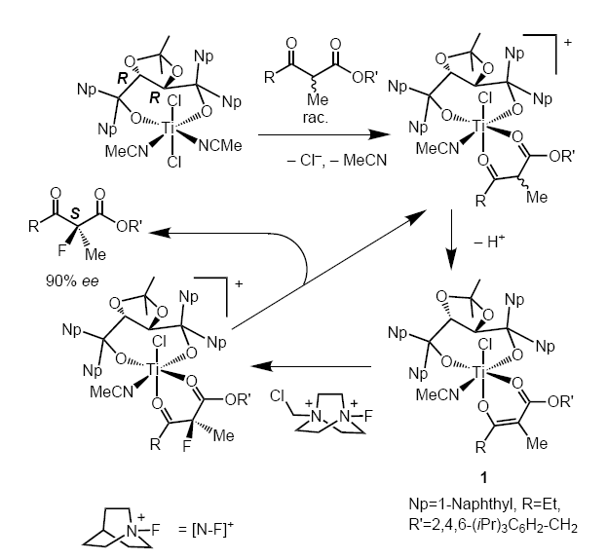
3.1.1 Chiral Enolates via Deprotonation: 1,3-Dicarbonyl
Mechanism
(1) Piana, S.; Devillers, I.; Togni, A.; Rothlisberger, U. Angew. Chem., Int. Ed. 2002, 41, 979-981.

Slide 8
3.1.1 Chiral Enolates via Deprotonation: 1,3-Dicarbonyl
Jorgensen: Chiral Amine Base as Catalyst¹
Shair: Biomimetic Decarboxylative Aldol Reaction²
(1) Saaby, S.; Bella, M.; Jorgensen, K. A. J. Am. Chem. Soc. 2004, 126, 8120-8121. (2) Fortner, K. C.; Shair, M. D. J. Am. Chem. Soc. 2007, 129, 1032-1033.

Slide 9
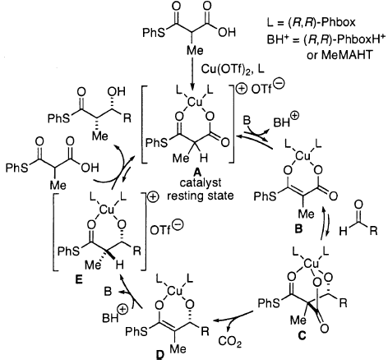
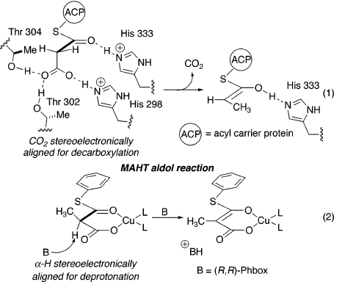
3.1.1 Chiral Enolates via Deprotonation: 1,3-Dicarbonyl
Shair: Comparison with Biocatalysis
(1) Fortner, K. C.; Shair, M. D. J. Am. Chem. Soc. 2007, 129, 1032-1033.

Slide 10
3.1.1 Chiral Enolates via Deprotonation: other
Hayashi: Au-Catalyzed Reaction with Isonitriles
Mechanism
(1) Ito, Y.; Sawamura, M.; Hayashi, T. J. Am. Chem. Soc. 1986, 108, 6405-6406.

Slide 11
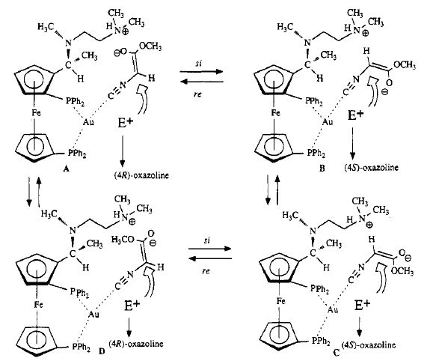
3.1.1 Chiral Enolates via Deprotonation: other
Togni: Mechanistic Investigations
(1) Togni, A.; Pastor, S. D. J. Org. Chem. 1990, 55, 1649-1664.

Slide 12
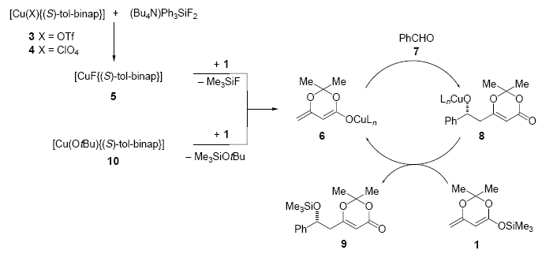
3.1.2 Chiral Enolates from Enolates and Enol Ethers
Carreira: Cu-Fluoride Catalyst for Enolate Generation
Proposed Mechanism
(1) Pagenkopf, B. L.; Kruger, J.; Stojanovic, A.; Carreira, E. M. Angew. Chem., Int. Ed. 1998, 37, 3124-3126. (2) Kruger, J.; Carreira, E. M. J. Am. Chem. Soc. 1998, 120, 837-838.

Slide 13
3.1.2 Chiral Enolates from Enolates and Enol Ethers
Jacobsen: Cr-Catalyzed Alkylation of Sn Enolates
(1) Doyle, A. G.; Jacobsen, E. N. J. Am. Chem. Soc. 2005, 127, 62-63. (2) Doyle, A. G.; Jacobsen, E. N. Angew. Chem., Int. Ed. 2007, 46, 3701-3705.

Slide 14
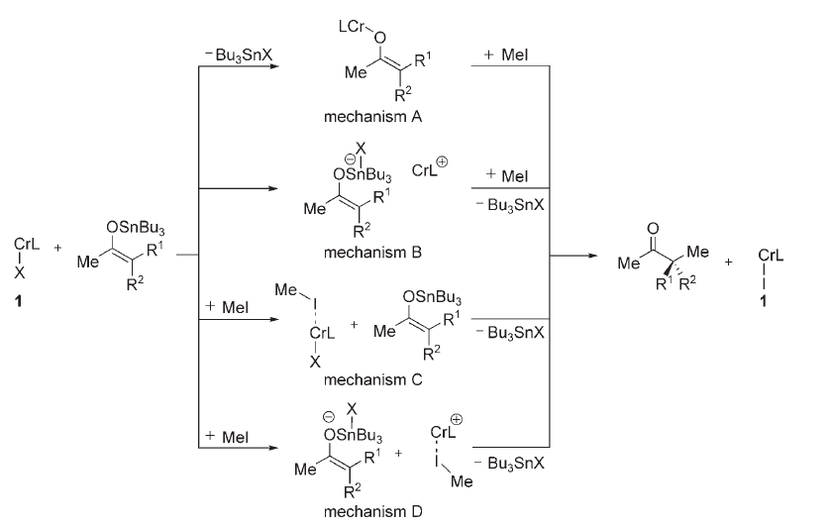
3.1.2 Chiral Enolates from Enolates and Enol Ethers
Role of the Cr Catalyst
(1) Doyle, A. G.; Jacobsen, E. N. J. Am. Chem. Soc. 2005, 127, 62-63. (2)Doyle, A. G.; Jacobsen, E. N. Angew. Chem., Int. Ed. 2007, 46, 3701-3705.

Slide 15
3.1.3 Other Ways to Generate Chiral Enolates: Ketenes
Lectka: Chiral Enolates from Ketenes,
Chlorination Reactions¹
Lectka: Chiral Enolates from Ketenes,
β-Lactams Synthesis²
(1) Wack, H.; Taggi, A. E.; Hafez, A. M.; Drury, W. J.; Lectka, T. J. Am. Chem. Soc. 2001, 123, 1531-1532. (2) Taggi, A. E.; Hafez, A. M.; Wack, H.; Young, B.; Ferraris, D.; Lectka, T. J. Am. Chem. Soc. 2002, 124, 6626-6635.

Slide 16
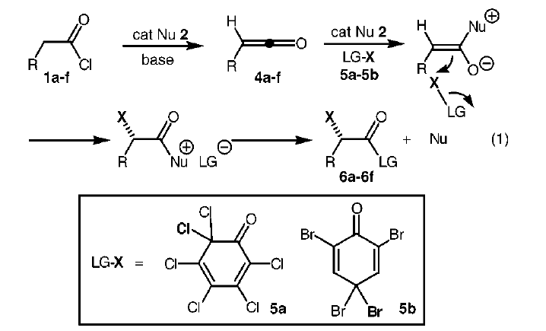
3.1.3 Other Ways to Generate Chiral Enolates: Ketenes
Mechanism for Chlorination
(1) Wack, H.; Taggi, A. E.; Hafez, A. M.; Drury, W. J.; Lectka, T. J. Am. Chem. Soc. 2001, 123, 1531-1532. (2) Taggi, A. E.; Hafez, A. M.; Wack, H.; Young, B.; Ferraris, D.; Lectka, T. J. Am. Chem. Soc. 2002, 124, 6626-6635.

Slide 17
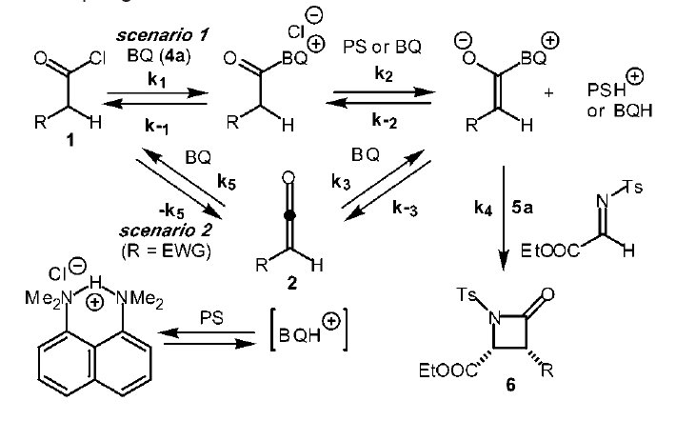
3.1.3 Other Ways to Generate Chiral Enolates: Ketenes
Mechanism for β-Lactams Formation
(1) Wack, H.; Taggi, A. E.; Hafez, A. M.; Drury, W. J.; Lectka, T. J. Am. Chem. Soc. 2001, 123, 1531-1532. (2) Taggi, A. E.; Hafez, A. M.; Wack, H.; Young, B.; Ferraris, D.; Lectka, T. J. Am. Chem. Soc. 2002, 124, 6626-6635.

Slide 18
3.1.3 Other Ways to Generate Chiral Enolates: Ketenes
Fu: β-Lactams Synthesis Using Chiral DMAP Catalysts
(1) Hodous, B. L.; Fu, G. C. J. Am. Chem. Soc. 2002, 124, 1578-1579. (2) Lee, E. C.; Hodous, B. L.; Bergin, E.; Shih, C.; Fu, G. C. J. Am. Chem. Soc. 2005, 127, 11586-11587.

Slide 19
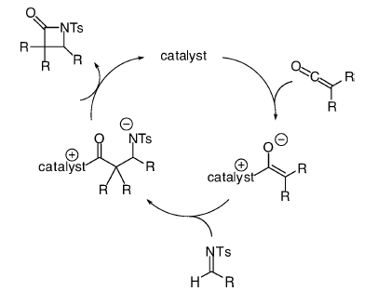
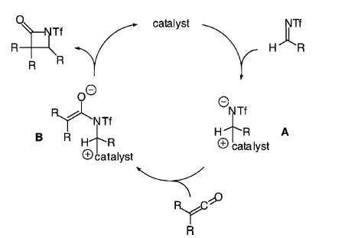
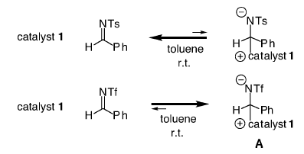
3.1.3 Other Ways to Generate Chiral Enolates: Ketenes
Rationalization for Switch in Diastereoselectivity
(1) Hodous, B. L.; Fu, G. C. J. Am. Chem. Soc. 2002, 124, 1578-1579. (2) Lee, E. C.; Hodous, B. L.; Bergin, E.; Shih, C.; Fu, G. C. J. Am. Chem. Soc. 2005, 127, 11586-11587.

Slide 20
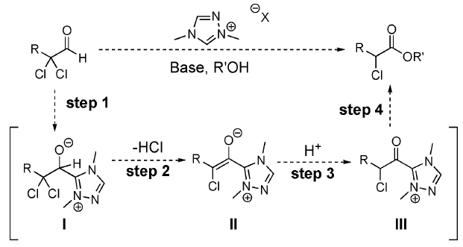
3.1.3 Other Ways to Generate Chiral Enolates: Carbene
Rovis: Chiral Enolates via Carbenes
Mechanism
(1) Reynolds, N. T.; Rovis, T. J. Am. Chem. Soc. 2005, 127, 16406-16407.

Slide 21
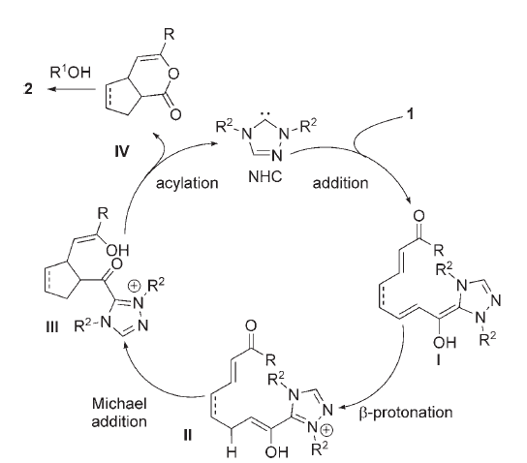
3.1.3 Other Ways to Generate Chiral Enolates: Carbene
Scheidt: Intramolecular Michael Reaction with Carbene Catalysts
Mechanism
(1) Phillips, E. M.; Wadamoto, M.; Chan, A.; Scheidt, K. A. Angew. Chem., Int. Edit. 2007, 46, 3107-3110.

Slide 22
3.1.3 Other Ways to Generate Chiral Enolates: S_{N}2X
Tan: Enantioconvergent S_{N}2X reaction with pentadinium catalysts
Zhang, X.; Ren, J. Y.; Tan, S. M.; Tan, D.; Lee, R.; Tan, C. H., Science 2019, 363, 400.

Slide 23
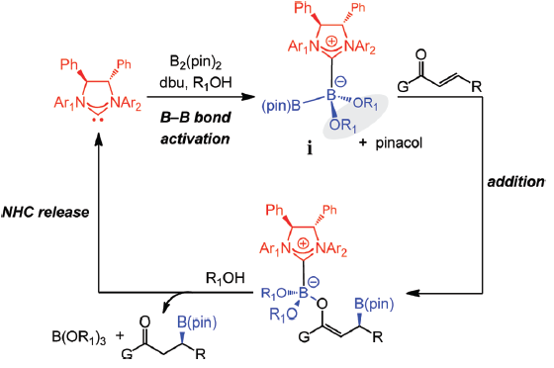
3.1.3 Other nucleophiles: boronates
Hoveyda: Activation of boronic esters with carbenes¹
(1) Wu, H.; Radomkit, S.; O'Brien, J. M.; Hoveyda, A. H. J. Am. Chem. Soc. 2012, 134, 8277.

Slide 24
3.1.3 Other nucleophiles: phospholenes
Cramer: Chiral diazaphospholenes for conjugate reduction
Miaskiewicz, S.; Reed, J. H.; Donets, P. A.; Oliveira, C. C.; Cramer, N. Angew. Chem., Int. Ed. 2018, 57, 4039-4042.

Slide 25
3.2 Enamine Catalysis

Slide 26
3.2 Enamine Catalysis: Introduction
The Principles of Enamine Catalysis

Slide 27
3.2 Enamine Catalysis: Prolinol Catalysts
Jorgensen: Silylated Prolinol as Catalyst
(1) Franzen, J.; Marigo, M.; Fielenbach, D.; Wabnitz, T. C.; Kjaersgaard, A.; Jorgensen, K. A. J. Am. Chem. Soc. 2005, 127, 18296-18304.

Slide 28
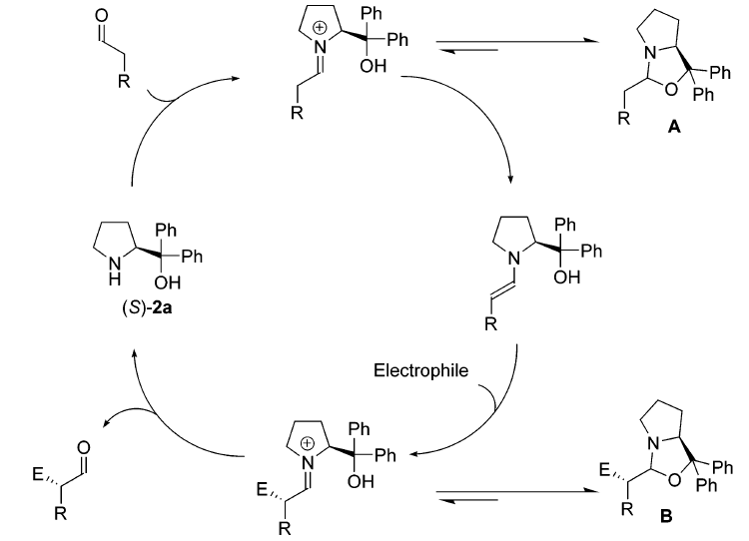
3.2 Enamine Catalysis: Prolinol Catalysts
Jorgensen: Catalytic Cycle and Reason for Superioritiy of Silylated Prolinol
(1) Franzen, J.; Marigo, M.; Fielenbach, D.; Wabnitz, T. C.; Kjaersgaard, A.; Jorgensen, K. A. J. Am. Chem. Soc. 2005, 127, 18296-18304.

Slide 29
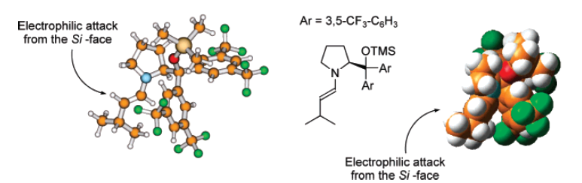
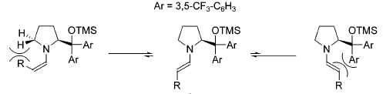
3.2 Enamine Catalysis: Prolinol Catalysts
Jorgensen: Facial Selectivity
Geometry of the Enamine
(1) Franzen, J.; Marigo, M.; Fielenbach, D.; Wabnitz, T. C.; Kjaersgaard, A.; Jorgensen, K. A. J. Am. Chem. Soc. 2005, 127, 18296-18304.

Slide 30
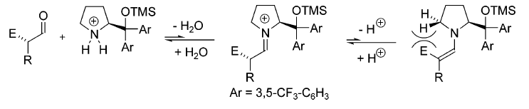
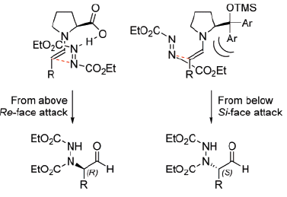
3.2 Enamine Catalysis: Prolinol Catalysts
Why no Racemization?
Comparison with Proline Catalysis
(1) Franzen, J.; Marigo, M.; Fielenbach, D.; Wabnitz, T. C.; Kjaersgaard, A.; Jorgensen, K. A. J. Am. Chem. Soc. 2005, 127, 18296-18304.

Slide 31
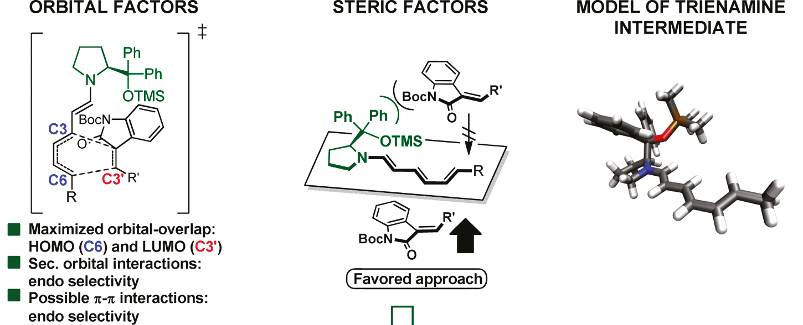
3.2 Enamine Catalysis: Prolinol Catalysts
Jorgensen: Extending enamine catalysis to trienamines¹
(1) Jia, Z. J.; Jiang, H.; Li, J. L.; Gschwend, B.; Li, Q. Z.; Yin, X. A.; Grouleff, J.; Chen, Y. C.; Jorgensen, K. A. J. Am. Chem. Soc. 2011, 133, 5053.

Slide 32
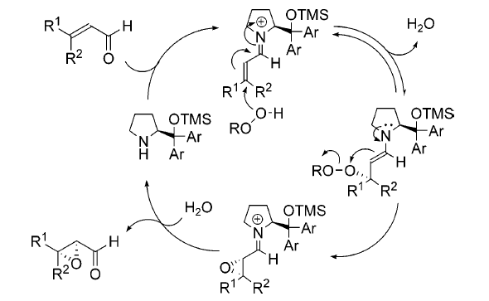
3.2 Enamine Catalysis: Prolinol Catalysts
Jorgensen: Epoxidation: Combining Iminium and Enamine Catalysis
Mechanism
(1) Marigo, M.; Franzen, J.; Poulsen, T. B.; Zhuang, W.; Jorgensen, K. A. J. Am. Chem. Soc. 2005, 127, 6964-6965.

Slide 33
3.2 Enamine Catalysis: Prolinol Catalysts
Jorgensen: Mechanism revision!
Izzo, J. A.; Poulsen, P. H.; Intrator, J. A.; Jorgensen, K. A.; Vetticatt, M. J., J. Am. Chem. Soc. 2018, 140, 8396-8400.

Slide 34
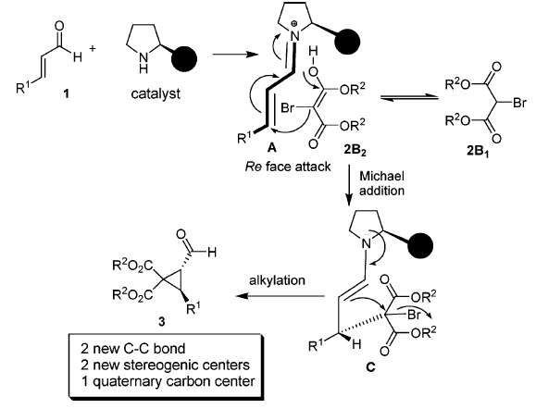
3.2 Enamine Catalysis: Prolinol Catalysts
Wang: Prolinol Catalyzed Cyclopropanation
Mechanism
(1) Xie, H.; Zu, L.; Li, H.; Wang, J.; Wang, W. J. Am. Chem. Soc. 2007, 129, 10886-10894.

Slide 35
3.2 Enamine Catalysis: Prolinol Catalysts
Hayashi: Addition to Nitro Compounds
Hayashi: Addition-Cyclization Sequence
(1) Hayashi, Y.; Gotoh, H.; Hayashi, T.; Shoji, M. Angew. Chem., Int. Ed. 2005, 44, 4212-4215. (2) Hayashi, Y.; Okano, T.; Aratake, S.; Hazelard, D. Angew. Chem., Int. Ed. 2007, 46, 4922-4925.

Slide 36
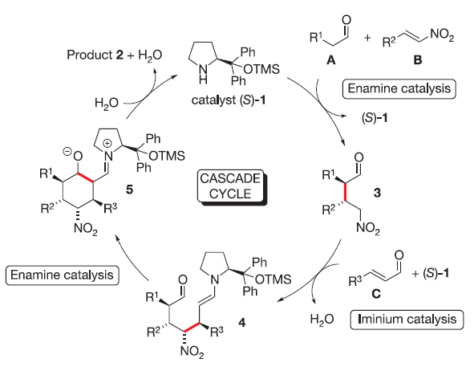
3.2 Enamine Catalysis: Prolinol Catalysts
Enders Cascade Reaction:
(1) Enders, D.; Huttl, M. R. M.; Grondal, C.; Raabe, G. Nature 2006, 441, 861.

Slide 37
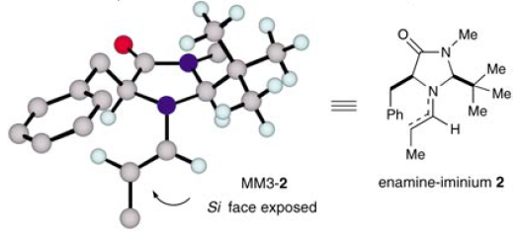
3.2 Enamine Catalysis: Other Catalysts
MacMillan: Aldol Reaction of Aldehydes
Model for Selectivity
(1) Mangion, I. K.; Northrup, A. B.; MacMillan, D. W. C. Angew. Chem., Int. Ed. 2004, 43, 6722-6724.

Slide 38
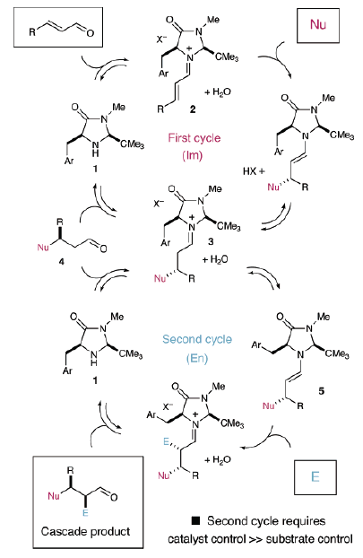
3.2 Enamine Catalysis: Other Catalysts
MacMillan: Iminium-Enamine Cascade
(1) Huang, Y.; Walji, A. M.; Larsen, C. H.; MacMillan, D. W. C. J. Am. Chem. Soc. 2005, 127, 15051-15053.

Slide 39
3.2 Enamine Catalysis: Other Catalysts
MacMillan: trifluormethylation of aldehydes¹
Melchiorre: primary cinchona amines for the aziridination of conjugated ketones²
(1) Allen, A. E.; MacMillan, D. W. C. J. Am. Chem. Soc. 2010, 132, 4986. (1) Pesciaioli, F.; De Vincentiis, F.; Galzerano, P.; Bencivenni, G.; Bartoli, G.; Mazzanti, A.; Melchiorre, P. Angew. Chem., Int. Ed. 2008, 47, 8703.

Slide 40
3.2 Enamine Catalysis: Other Catalysts
List: Epoxidation of conjugated ketones with primary amine catalysts¹
List: asymmetric aldol condensation²
(1) Wang, X.; Reisinger, C. M.; List, B. J. Am. Chem. Soc. 2008, 130, 6070. (2) Zhou, J.; Wakchaure, V.; Kraft, P.; List, B., Angew. Chem., Int. Ed. 2008, 47, 7656.

Slide 41
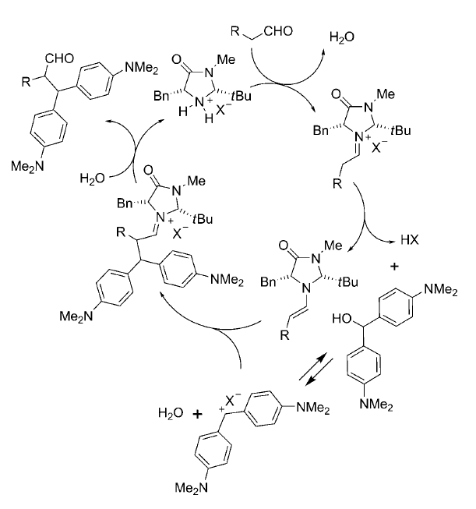
3.2 Enamine Catalysis: Other Catalysts
Cozzi: Alcohols as electrophiles¹
(1) Cozzi, P. G.; Benfatti, F.; Zoli, L. Angew. Chem., Int. Ed. 2009, 48, 1313.

Slide 42
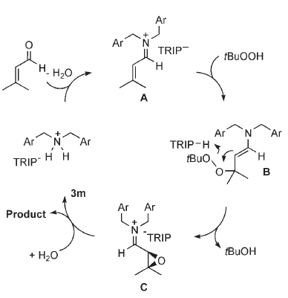
3.2 Enamine Catalysis: Other Catalysts
List: Asymmetric Counteranion-Directed Catalysis for the Epoxidation of Enals (ACDC)
(1) Wang, X.; List, B. Angew. Chem., Int. Ed. 2008, 47, 1119-1122.

Slide 43
3.3 Phase-Transfer Catalysis
3.3.1 Cinchona-Based Catalysts
3.3.2 Other Ammonium Catalysts

Slide 44
3.3 Phase-Transfer Catalysis: Introduction
Phase-Transfer Catalysis: Principles
Use chiral ammonium salts as catalysts!

Slide 45
3.3.1 Phase-Transfer Catalysis: Cinchona Catalysts
O’Donnell: Pioneering Work on Asymmetric Alkylation¹
Corey: Optimization of the Catalyst Structure²
(1) Odonnell, M. J.; Bennett, W. D.; Wu, S. D. J. Am. Chem. Soc. 1989, 111, 2353-2355. (2) Corey, E. J.; Xu, F.; Noe, M. C. J. Am. Chem. Soc. 1997, 119, 12414-12415.

Slide 46
3.3.1 Phase-Transfer Catalysis: Cinchona Catalysts
Jorgensen: Enantioselective Nucleophilic Aromatic Substitution¹
Jorgensen: 1,6 Addition²
(1) Bella, M.; Kobbelgaard, S.; Jorgensen, K. A. J. Am. Chem. Soc. 2005, 127, 3670-3671. (2) Bernardi, L.; Lopez-Cantarero, J.; Niess, B.; Jorgensen, K. A. J. Am. Chem. Soc. 2007, 129, 5772-5778.

Slide 47
3.3.1 Phase-Transfer Catalysis: Cinchona Catalysts
Shibata: Asymmetric Trifluoromethylation of Ketones¹
Corey: Dimerization of Enones²
(1) Mizuta, S.; Shibata, N.; Akiti, S.; Fujimoto, H.; Nakamura, S.; Toru, T. Org. Lett. 2007, 9, 3707-3710. (1) Zhang, F. Y.; Corey, E. J. Org. Lett. 2004, 6, 3397-3399.

Slide 48
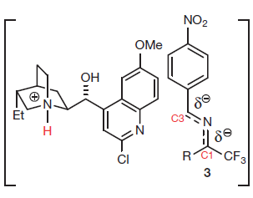
3.3.1 Phase-Transfer Catalysis: Cinchona Catalysts
Deng: Umpolung of imines
Wu, Y. W.; Hu, L.; Li, Z.; Deng, L. Nature 2015, 523, 445-450.

Slide 49
3.3.2 Phase-Transfer Catalysis: Binaphthyl Catalysts
Maruoka: Binaphthyl-Derived Ammonium Salts for Alkylation Reactions^{1,2}
A simpler, more active catalyst³
(1) Ooi, T.; Kameda, M.; Maruoka, K. J. Am. Chem. Soc. 1999, 121, 6519-6520. (2) Ooi, T.; Kameda, M.; Maruoka, K. J. Am. Chem. Soc. 2003, 125, 5139-5151. (3) Kitamura, M.; Shirakawa, S.; Maruoka, K. Angew. Chem., Int. Ed. 2005, 44, 1549-1551.

Slide 50
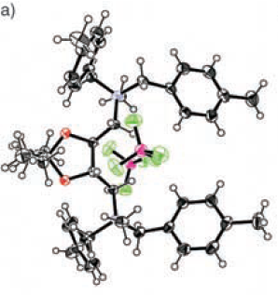
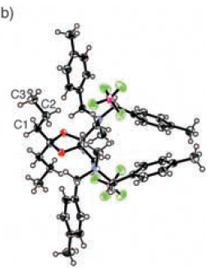
3.3.2 Phase-Transfer Catalysis: TADDOL Catalysts
Shibasaki: Taddol-Derived Ammonium Salts
(1) Okada, A.; Shibuguchi, T.; Ohshima, T.; Masu, H.; Yamaguchi, K.; Shibasaki, M. Angew. Chem., Int. Ed. 2005, 44, 4564-4567.

Slide 51
3.3.2 Phase-Transfer Catalysis: other Catalysts
Song: Binol-derived crown ether¹
Tan: Pentanidium catalyst^{2,3}
(1) Yan, H.; Bin Jang, H.; Lee, J. W.; Kim, H. K.; Lee, S. W.; Yang, J. W.; Song, C. E., Angew. Chem., Int. Ed. 2010, 49, 8915. (2) Ma, T.; Fu, X. A.; Kee, C. W.; Zong, L. L.; Pan, Y. H.; Huang, K. W.; Tan, C. H., J. Am. Chem. Soc. 2011, 133, 2828. (3) Zhang, X.; Ang, E. C. X.; Yang, Z.; Kee, C. W.; Tan, C.-H. Nature 2022, 604, 298-303.

Slide 52
3.3.2 Phase-Transfer Catalysis: other Catalysts
Gouverneur: Phase transfer via H-bonding
(1) Pupo, G.; Ibba, F.; Ascough, D. M. H.; Vicini, A. C.; Ricci, P.; Christensen, K. E.; Pfeifer, L.; Morphy, J. R.; Brown, J. M.; Paton, R. S.; Gouverneur, V., Science 2018, 360, 638. (2) Pupo, G.; Vicini, A. C.; Ascough, D. M. H.; Ibba, F.; Christensen, K. E.; Thompson, A. L.; Brown, J. M.; Paton, R. S.; Gouverneur, V., J. Am. Chem. Soc. 2019, 141, 2878-2883.

Slide 53
3.4 Chiral Ylides Generation

Slide 54
3.4 Chiral Ylides: Introduction

Slide 55
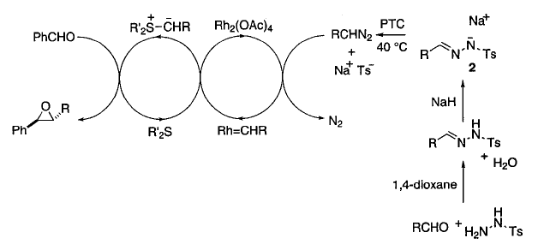
3.4 Chiral Ylides: Sulfur Ylides
Aggarwal: Catalytic Formation of Chiral Sulfonium Ylide
Model for Selectivity
Mechanism
(1) Aggarwal, V. K.; Alonso, E.; Hynd, G.; Lydon, K. M.; Palmer, M. J.; Porcelloni, M.; Studley, J. R. Angew. Chem., Int. Ed. 2001, 40, 1430-1433.

Slide 56
3.4 Chiral Ylides: Ammonium Ylides
Gaunt-Ley: Asymmetric Cyclopropanation via Chiral Ammonium Ylides
(1) Papageorgiou, C. D.; de Dios, M. A. C.; Ley, S. V.; Gaunt, M. J. Angew. Chem., Int. Ed. 2004, 43, 4641-4644. (2) Johansson, C. C. C.; Bremeyer, N.; Ley, S. V.; Owen, D. R.; Smith, S. C.; Gaunt, M. J. Angew. Chem., Int. Edit. 2006, 45, 6024-6028.

Slide 57
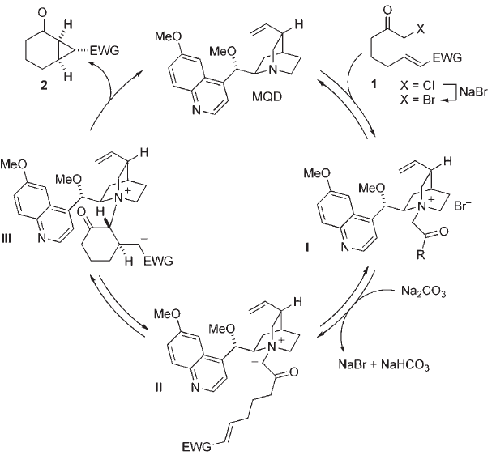
3.4 Chiral Ylides: Ammonium Ylides
Mechanism
(1) Papageorgiou, C. D.; de Dios, M. A. C.; Ley, S. V.; Gaunt, M. J. Angew. Chem., Int. Ed. 2004, 43, 4641-4644. (2) Johansson, C. C. C.; Bremeyer, N.; Ley, S. V.; Owen, D. R.; Smith, S. C.; Gaunt, M. J. Angew. Chem., Int. Edit. 2006, 45, 6024-6028.

Slide 58
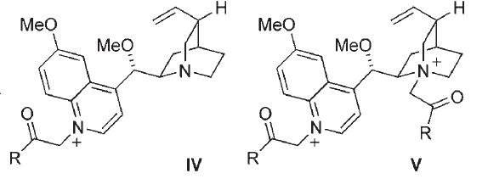
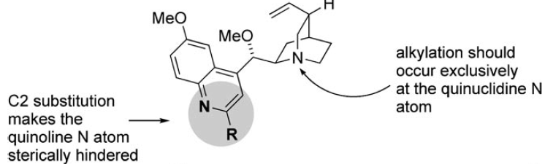
3.4 Chiral Ylides: Ammonium Ylides
Identification of Side Reaction and Catalyst Improvement
(1) Papageorgiou, C. D.; de Dios, M. A. C.; Ley, S. V.; Gaunt, M. J. Angew. Chem., Int. Ed. 2004, 43, 4641-4644. (2) Johansson, C. C. C.; Bremeyer, N.; Ley, S. V.; Owen, D. R.; Smith, S. C.; Gaunt, M. J. Angew. Chem., Int. Edit. 2006, 45, 6024-6028.

Slide 59
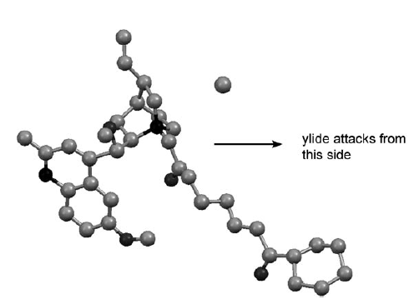
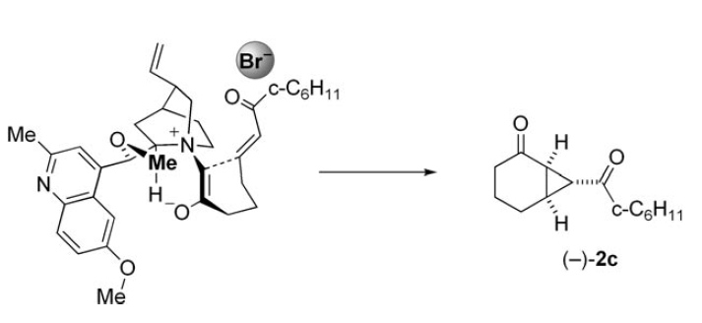
3.4 Chiral Ylides: Ammonium Ylides
Model for Selectivity
(1) Papageorgiou, C. D.; de Dios, M. A. C.; Ley, S. V.; Gaunt, M. J. Angew. Chem., Int. Ed. 2004, 43, 4641-4644. (2) Johansson, C. C. C.; Bremeyer, N.; Ley, S. V.; Owen, D. R.; Smith, S. C.; Gaunt, M. J. Angew. Chem., Int. Edit. 2006, 45, 6024-6028.

Slide 60
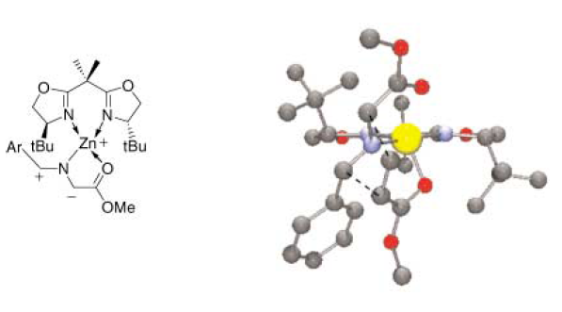
3.4 Chiral Ylides: [3+2] Cycloaddition
Jorgensen: Zn-BOX-Catalyzed Cycloaddition Reaction of Azomethine Ylides
Model for Selectivity
(1) Gothelf, A. S.; Gothelf, K. V.; Hazell, R. G.; Jorgensen, K. A. Angew. Chem., Int. Ed. 2002, 41, 4236-4238.

Slide 61
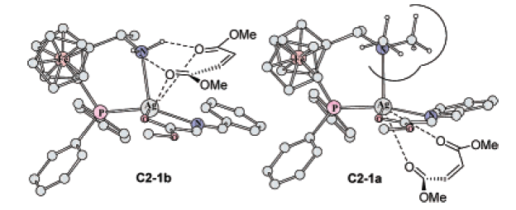
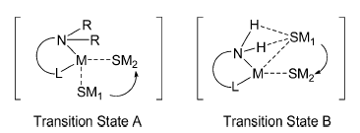
3.4 Chiral Ylides: [3+2] Cycloaddition
Li: Hydrogen Bond Mediated Inversion of Selectivity
(1) Zeng, W.; Chen, G. Y.; Zhou, Y. G.; Li, Y. X. J. Am. Chem. Soc. 2007, 129, 750-751.

Slide 62
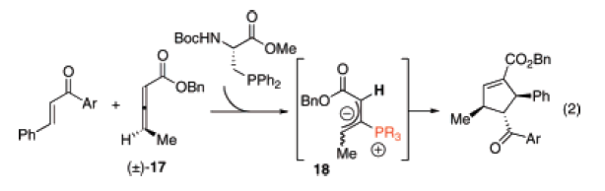
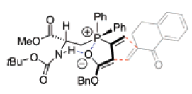
3.4 Chiral Ylides: [3+2] Cycloaddition
Miller: Phosphine-Catalyzed Cycloaddition of Purely Carbocyclic Dipoles
Mechanism and transition state
(1) Cowen, B. J.; Miller, S. J. J. Am. Chem. Soc. 2007, 129, 10988-10989.

Slide 63
3.4 Chiral Ylides: Phosphor Ylides and Redox
Voituriez: Conjugate addition on phosphor yilde combined with Wittig reaction/reduction
Lorton, C.; Castanheiro, T.; Voituriez, A., J. Am. Chem. Soc. 2019, 141, 10142-10147.

Slide 64
3.4 Chiral Ylides: [3+2] Cycloaddition
Trost: Asymmetric Trimethylenemethane (TMM) Cycloaddition Reaction
(1) Trost, B. M.; Stambuli, J. P.; Silverman, S. M.; Schworer, U. J. Am. Chem. Soc. 2006, 128, 13328-13329. (2) Trost, B. M.; Silverman, S. M.; Stambuli, J. P. J. Am. Chem. Soc. 2007, 129, 12398-12399.

Slide 65
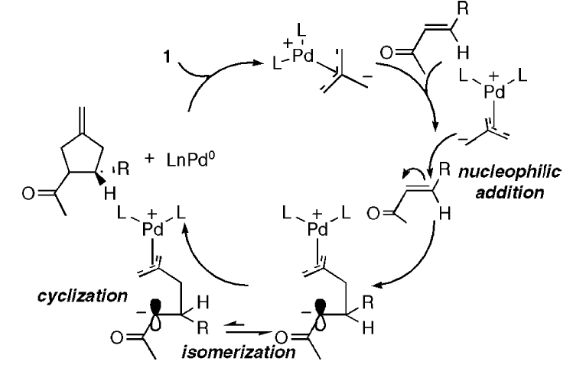

3.4 Chiral Ylides: [3+2] Cycloaddition
Mechanism of the TMM Reaction
(1) Trost, B. M.; Stambuli, J. P.; Silverman, S. M.; Schworer, U. J. Am. Chem. Soc. 2006, 128, 13328-13329. (2) Trost, B. M.; Silverman, S. M.; Stambuli, J. P. J. Am. Chem. Soc. 2007, 129, 12398-12399.

Slide 66
3.4 Chiral Ylides: [3+2] Cycloaddition
TMM Reaction for the Synthesis of Spiro-Oxindoles
(1)Trost, B. M.; Cramer, N.; Silverman, S. M. J. Am. Chem. Soc. 2007, 129, 12396-12397.

Slide 67
3.4 Chiral Ylides: [3+4] and [4+2] Cycloadditions
Trost: TMM for [4+3] Cycloaddition of Tropones¹
Hayashi: Formal [4+2] Cycloaddition via the Decarboxylation of Valerolactones²
(1) Trost, B. M.; McDougall, P. J.; Hartmann, O.; Wathen, P. T. J. Am. Chem. Soc. 2008, 130, 14960. (2) Shintani, R.; Park, S.; Shirozu, F.; Murakami, M.; Hayashi, T. J. Am. Chem. Soc. 2008, 130, 16174.

Slide 68
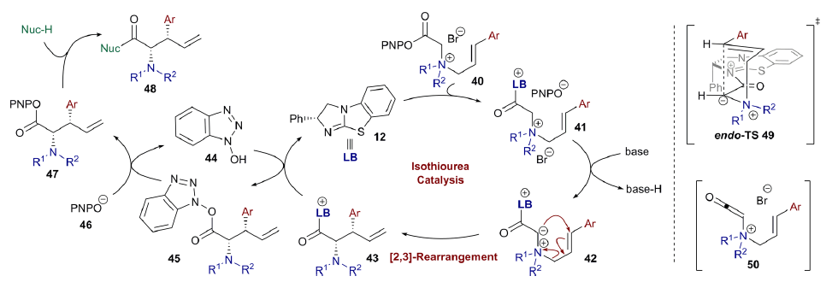
3.4 Chiral Ylides: [2,3] rearrangement
Smith: [2,3] rearrangement of ammonium ylides
(1) West, T. H.; Daniels, D. S. B.; Slawin, A. M. Z.; Smith, A. D. J. Am. Chem. Soc. 2014, 136, 4476.

