Slide 1
2.5. Activation of Allylic Systems
2.5.1 Asymmetric Electrophilic Allylation: Pd
2.5.2 Asymmetric Electrophilic Allylation: other metals
2.5.3 Other Reactions

Slide 2
2.5 Asymmetric Electrophilic Allylation: Introduction
Direct Allylic Substitution
Electrophilic Activation
Nucleophilic Activation

Slide 3
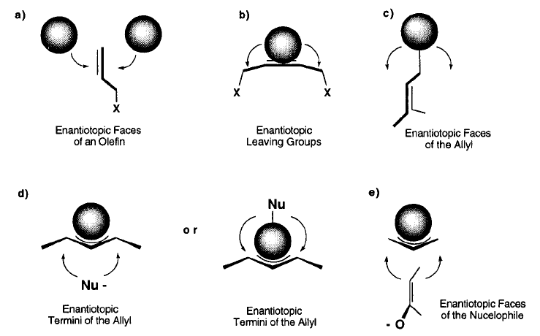
2.5 Asymmetric Electrophilic Allylation: Introduction
Sources of Enantiodiscrimination
(1) Trost, B. M.; VanVranken, D. L. Chem. Rev. 1996, 96, 395-422.

Slide 4
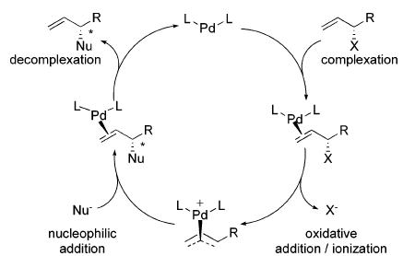
2.5.1 Asymmetric Electrophilic Allylation: Pd-Trost
Trost: Diphenylphosphino Acid (DPPA)- Ligand for AAA (Triple A, Asymmetric Allylic Alkylation)
(1) Trost, B. M.; Machacek, M. R.; Aponick, A. Acc. Chem. Res. 2006, 39, 747-760.

Slide 5
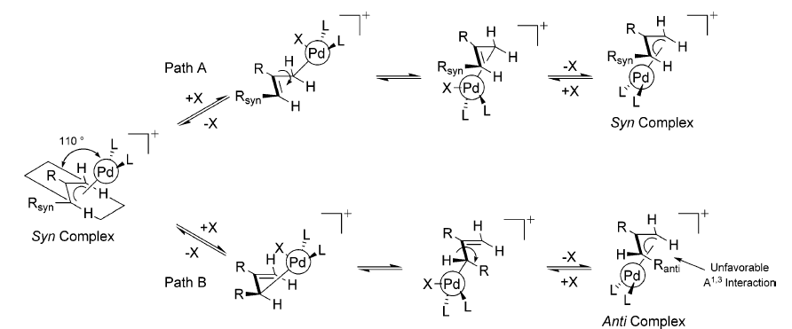
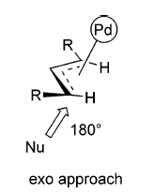
2.5.1 Asymmetric Electrophilic Allylation: Pd-Trost
Equilibration of π-Allyl Complexes via σ-Allyl Complexes: Rate is Substrate Dependent
(1) Trost, B. M.; Machacek, M. R.; Aponick, A. Acc. Chem. Res. 2006, 39, 747-760.

Slide 6
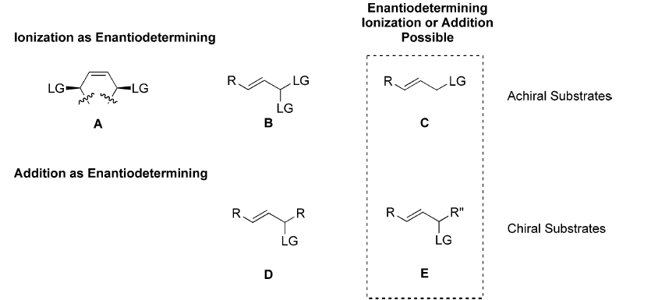
2.5.1 Asymmetric Electrophilic Allylation: Pd-Trost
Equilibration of π-Allyl Complexes via σ-Allyl Complexes: Rate is Substrate Dependent
(1) Trost, B. M.; Machacek, M. R.; Aponick, A. Acc. Chem. Res. 2006, 39, 747-760.

Slide 7
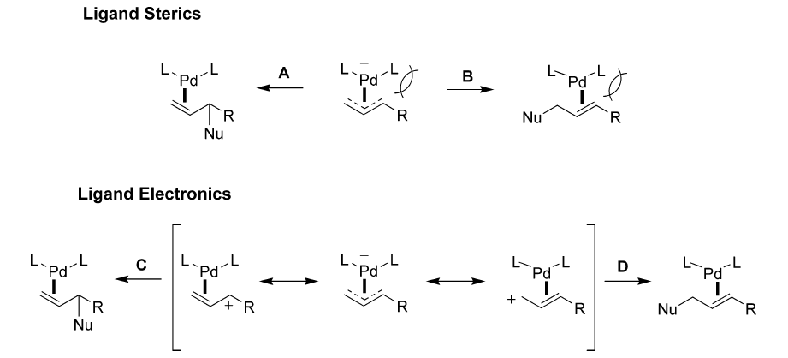
2.5.1 Asymmetric Electrophilic Allylation: Pd-Trost
Factors Determining Regioselectivity
Size of L directs Nu
Size of R directs Nu
L = π-Acceptor
L = not a π-Acceptor
(1) Trost, B. M.; Machacek, M. R.; Aponick, A. Acc. Chem. Res. 2006, 39, 747-760.

Slide 8
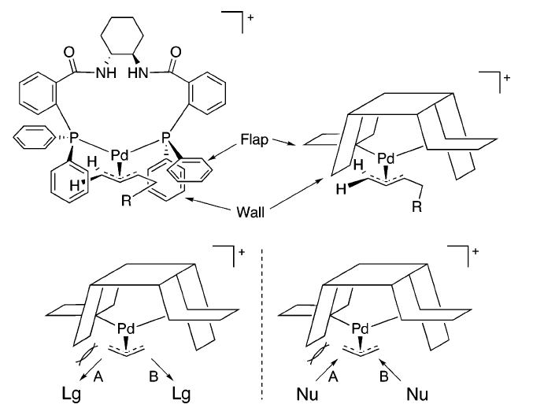
2.5.1 Asymmetric Electrophilic Allylation: Pd-Trost
Model for Ligand Structure
(1) Trost, B. M.; Machacek, M. R.; Aponick, A. Acc. Chem. Res. 2006, 39, 747-760.

Slide 9
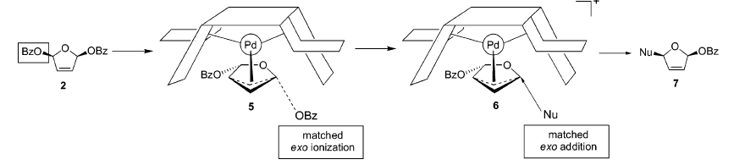
2.5.1 Asymmetric Electrophilic Allylation: Pd-Trost
Desymmetrization of Meso-Substrates
(1) Trost, B. M.; Machacek, M. R.; Aponick, A. Acc. Chem. Res. 2006, 39, 747-760.

Slide 10
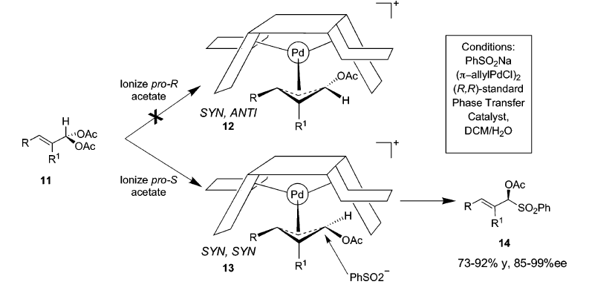
2.5.1 Asymmetric Electrophilic Allylation: Pd-Trost
Reaction of Gem-Diacetate
(1) Trost, B. M.; Machacek, M. R.; Aponick, A. Acc. Chem. Res. 2006, 39, 747-760.

Slide 11
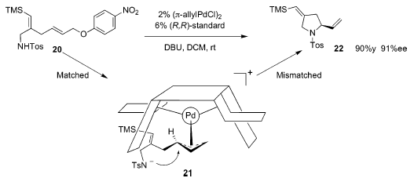
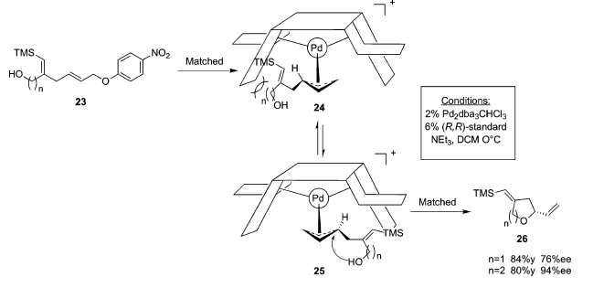
2.5.1 Asymmetric Electrophilic Allylation: Pd-Trost
Cyclization via AAA
(1) Trost, B. M.; Machacek, M. R.; Aponick, A. Acc. Chem. Res. 2006, 39, 747-760.

Slide 12
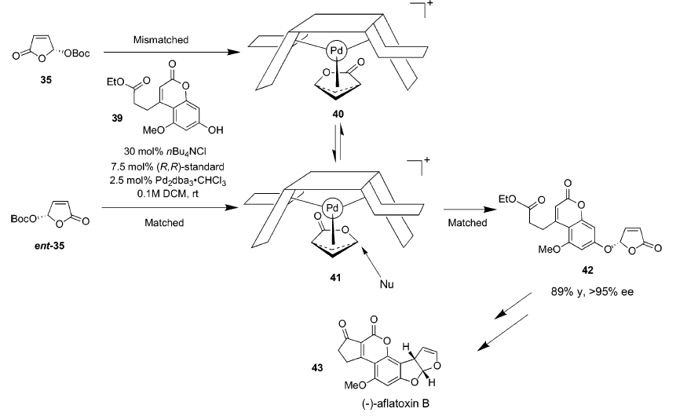
2.5.1 Asymmetric Electrophilic Allylation: Pd-Trost
DYKAT of Butenolide
(1) Trost, B. M.; Machacek, M. R.; Aponick, A. Acc. Chem. Res. 2006, 39, 747-760.

Slide 13
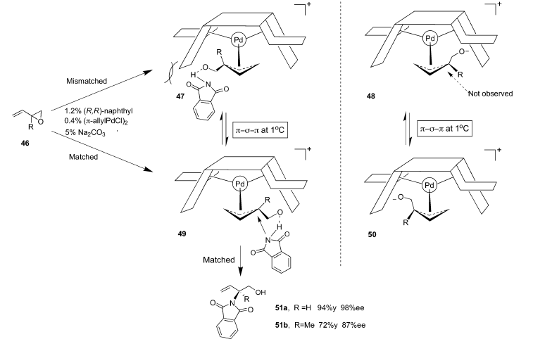
2.5.1 Asymmetric Electrophilic Allylation: Pd-Trost
DYKAT of Epoxides
(1) Trost, B. M.; Machacek, M. R.; Aponick, A. Acc. Chem. Res. 2006, 39, 747-760.

Slide 14
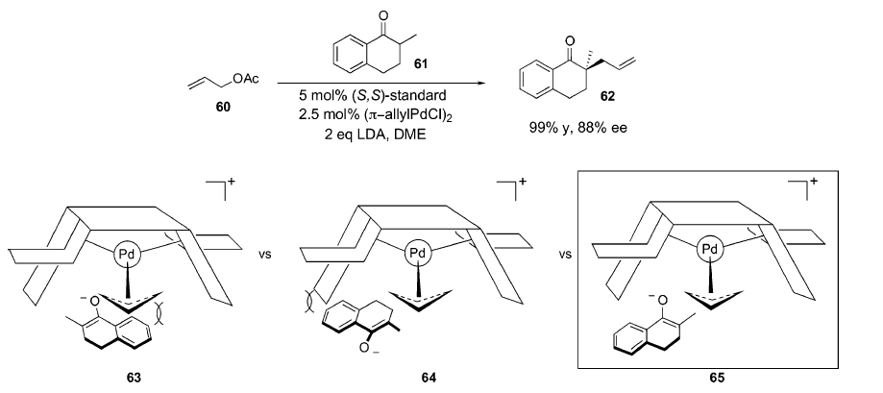
2.5.1 Asymmetric Electrophilic Allylation: Pd-Trost
Allylation of Enolates: Chirality at the Nucleophiles
(1) Trost, B. M.; Machacek, M. R.; Aponick, A. Acc. Chem. Res. 2006, 39, 747-760.

Slide 15
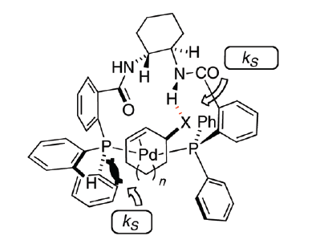
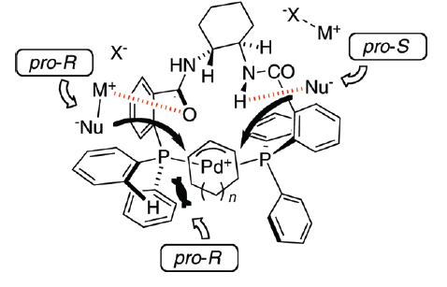
2.5.1 Asymmetric Electrophilic Allylation: New Model
A New Model Based on Positive Interactions with Nucleophiles or Substrate¹
Kinetic Resolution
Asymmetric Induction
Only one enantiomer can make favorable H bonding.
pro-S for weak M-Nu bonds, pro-R for strong M-Nu bonds
(1) Butts, C. P.; Filali, E.; Lloyd-Jones, G. C.; Norrby, P. O.; Sale, D. A.; Schramm, Y. J. Am. Chem. Soc. 2009, 131, 9945.

Slide 16
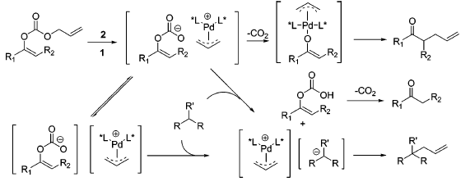
2.5.1 Asymmetric Electrophilic Allylation: Pd-Trost
Asymmetric Alkylation of Acyclic Enolates
Mechanism
(1) Trost, B. M.; Xu, J. Y. J. Am. Chem. Soc. 2005, 127, 17180-17181.

Slide 17
2.5.1 Asymmetric Electrophilic Allylation: Pd
PHOX Ligand for AAA¹
Application in the Tsuji-Trost Alkylation²
(1) Helmchen, G.; Pfaltz, A. Acc. Chem. Res. 2000, 33, 336-345. (2) Behenna, D. C.; Stoltz, B. M. J. Am. Chem. Soc. 2004, 126, 15044-15045.

Slide 18
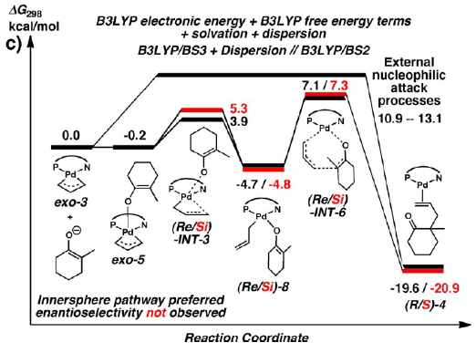
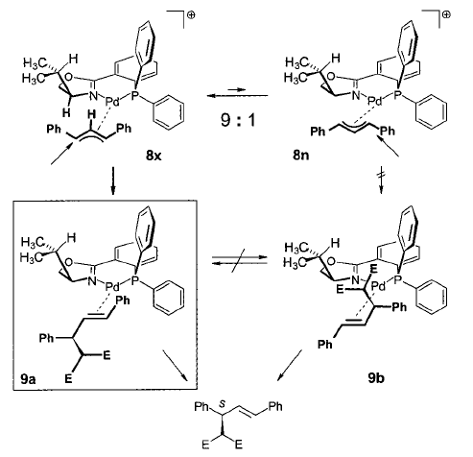
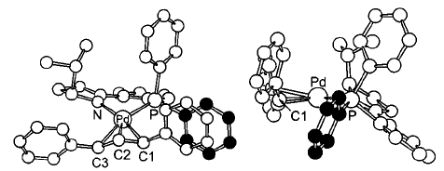
2.5.1 Asymmetric Electrophilic Allylation: Pd
Selectivity and Mechanism with PHOX
(1) Helmchen, G.; Pfaltz, A. Acc. Chem. Res. 2000, 33, 336-345. Keith, J. A.; Behenna, D. C.; Sherden, N.; Mohr, J. T.; Ma, S.; Marinescu, S. C.; Nielsen, R. J.; Oxgaard, J.; Stoltz, B. M.; Goddard, W. A. J. Am. Chem. Soc. 2012, 134, 19050.

Slide 19
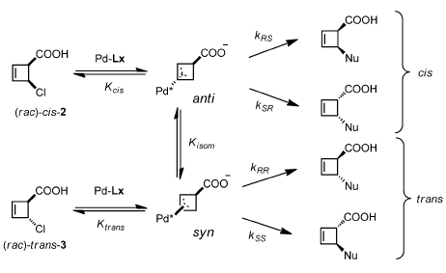
2.5.1 Asymmetric Electrophilic Allylation: Pd
Maulide: Diastereodivergent De-Epimerization¹
(1) Audisio, D.; Luparia, M.; Oliveira, M. T.; Klutt, D.; Maulide, N. Angew. Chem., Int. Ed. 2012, 51, 7314.

Slide 20
2.5.1 Asymmetric Electrophilic Allylation: Pd
Yu: Combining Pd catalysis and photoredox¹
(1) Zhang, H. H.; Zhao, J. J.; Yu, S. Y., J. Am. Chem. Soc. 2018, 140, 16914-16919.

Slide 21
2.5.2 Asymmetric Electrophilic Allylation: Other Metals
Trost: Mo-Catalyst – high Branched Selectivity¹
Trost: Allylation of Oxindoles²
(1) Trost, B. M.; Dogra, K.; Hachiya, I.; Emura, T.; Hughes, D. L.; Krska, S.; Reamer, R. A.; Palucki, M.; Yasuda, N.; Reider, P. J. Angew. Chem., Int. Ed. 2002, 41, 1929-1932. (2)Trost, B. M.; Zhang, Y. J. Am. Chem. Soc. 2006, 128, 4590-4591.

Slide 22
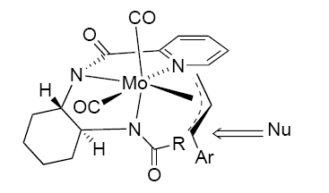
2.5.2 Asymmetric Electrophilic Allylation: Other Metals
Importance of Ligand Structure on Selectivity
Model for Selectivity
(1) Trost, B. M.; Dogra, K.; Hachiya, I.; Emura, T.; Hughes, D. L.; Krska, S.; Reamer, R. A.; Palucki, M.; Yasuda, N.; Reider, P. J. Angew. Chem., Int. Ed. 2002, 41, 1929-1932.

Slide 23
2.5.2 Asymmetric Electrophilic Allylation: Other Metals
Hartwig: Ir-Catalyst with Phosphoramidite¹
Identification of the Active Catalyst^{2,3}
(1) Ohmura, T.; Hartwig, J. F. J. Am. Chem. Soc. 2002, 124, 15164-15165. (2)Shu, C. T.; Leitner, A.; Hartwig, J. F. Angew. Chem., Int. Ed. 2004, 43, 4797-4800. (3) Lipowsky, G.; Miller, N.; Helmchen, G. Angew. Chem., Int. Ed. 2004, 43, 4595-4597.

Slide 24
2.5.2 Asymmetric Electrophilic Allylation: Other Metals
Hartwig: SAR of Ligand: Which Chirality Elements are important?
(1) Leitner, A.; Shekhar, S.; Pouy, M. J.; Hartwig, J. F. J. Am. Chem. Soc. 2005, 127, 15506-15514.

Slide 25
2.5.2 Asymmetric Electrophilic Allylation: Other Metals
Carreira: the First Use of Chiral Diene Ligands for Kinetic Resolution
Synthesis of Ligand
(1) Fischer, C.; Defieber, C.; Suzuki, T.; Carreira, E. M. J. Am. Chem. Soc. 2004, 126, 1628-1629.

Slide 26
2.5.2 Asymmetric Electrophilic Allylation: Other Metals
Carreira: Silanolates as Water Equivalent¹
Carreira: Sulfamic Acid as Ammonia Equivalent²
(1) Lyothier, I.; Defieber, C.; Carreira, E. M. Angew. Chem., Int. Ed. 2006, 45, 6204-6207. (2) Defieber, C.; Ariger, M. A.; Moriel, P.; Carreira, E. M. Angew. Chem., Int. Ed. 2007, 46, 3139-3143.

Slide 27
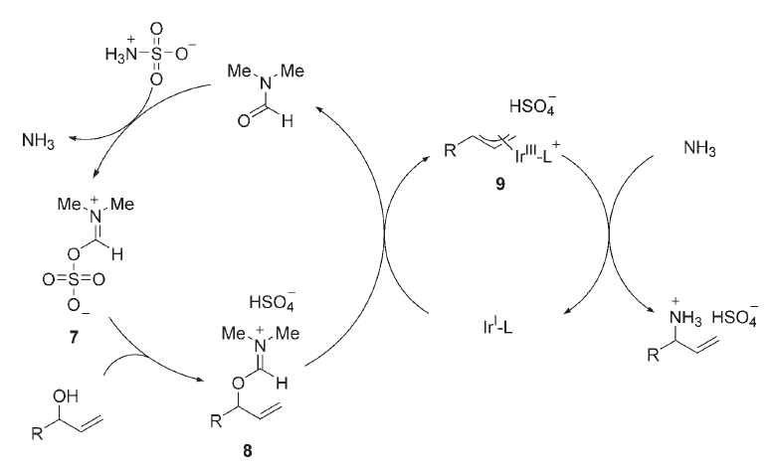
2.5.2 Asymmetric Electrophilic Allylation: Other Metals
Possible Mechanism: the Role of DMF¹
Further interesting new nucleophiles:
Vinyl²
Alkynyl²
(1) Defieber, C.; Ariger, M. A.; Moriel, P.; Carreira, E. M. Angew. Chem., Int. Ed. 2007, 46, 3139. (2) Hamilton, J. Y.; Sarlah, D.; Carreira, E. M. J. Am. Chem. Soc. 2013, 135, 994. (3) Hamilton, J. Y.; Sarlah, D.; Carreira, E. M. Angew. Chem., Int. Ed. 2013, 52, 7532.

Slide 28
2.5.2 Asymmetric Electrophilic Allylation: Other Metals
You: Dearomatization of Indoles¹
You: Dearomatization of Phenols²
(1) Wu, Q. F.; He, H.; Liu, W. B.; You, S. L. J. Am. Chem. Soc. 2010, 132, 11418. (2) Wu, Q. F.; Liu, W. B.; Zhuo, C. X.; Rong, Z. Q.; Ye, K. Y.; You, S. L. Angew. Chem., Int. Ed. 2011, 50, 4455.

Slide 29
2.5.2 Asymmetric Electrophilic Allylation: Other Metals
Lacour: Ru-catalyzed Carroll rearrangement¹
A more Stable and Selective Second Generation Catalyst²
(1) Constant, S.; Tortoioli, S.; Muller, J.; Lacour, J. Angew. Chem., Int. Ed. 2007, 46, 2082-2085. (2) Constant, S.; Tortoioli, S.; Muller, J.; Linder, D.; Buron, F.; Lacour, J. Angew. Chem., Int. Ed. 2007, 46, 8979-8982.

Slide 30
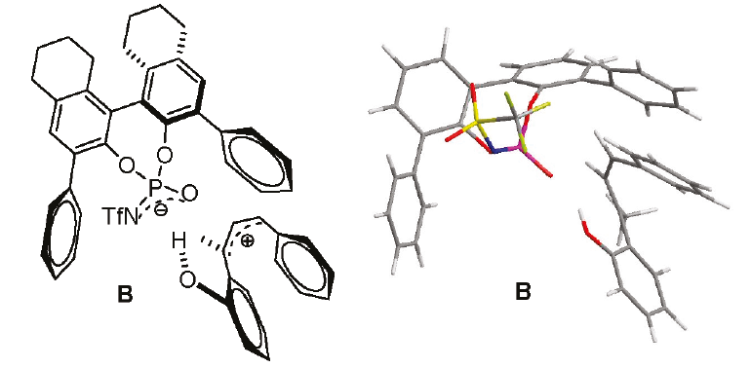
2.5.2 Asymmetric Electrophilic Allylation: Other Metals
Rueping: Asymmetric allylation with chiral counteranion¹
(1) Rueping, M.; Uria, U.; Lin, M. Y.; Atodiresei, I., J. Am. Chem. Soc. 2011, 133, 3732.

Slide 31
2.5.3 Other Reactions: Opening of Cyclic Compounds
Lautens: Rh-Catalyzed Asymmetric Opening of Oxabicyclic Compounds¹
Other Nucleophiles and Substrates
(1) Lautens, M.; Fagnou, K.; Yang, D. Q. J. Am. Chem. Soc. 2003, 125, 14884-14892.

Slide 32
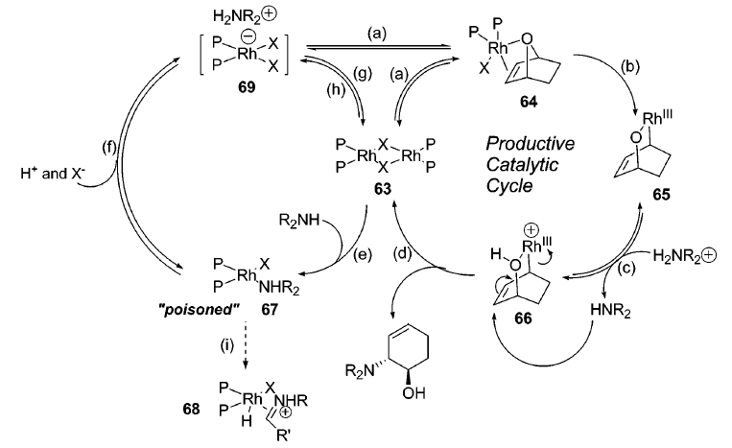
2.5.3 Other Reactions: Opening of Cyclic Compounds
Mechanism
(1) Lautens, M.; Fagnou, K.; Yang, D. Q. J. Am. Chem. Soc. 2003, 125, 14884-14892.

Slide 33
2.5.3 Other Reactions: Opening of Cyclic Compounds
Sarlah: generation of precursors via photodearomatization
Okumura, M.; Shved, A. S.; Sarlah, D. J. Am. Chem. Soc. 2017, 139, 17787-17790.

Slide 34
2.5.3 Other Reactions: Overman Rearrangement
Overman: The first Catalytic Asymmetric Imidate Rearrangement¹
Peters: Ferrocene Imidazoline Catalysts²
(1) Anderson, C. E.; Overman, L. E. J. Am. Chem. Soc. 2003, 125, 12412-12413. (2) Weiss, M. E.; Fischer, D. F.; Xin, Z. Q.; Jautze, S.; Schweizer, W. B.; Peters, R. Angew. Chem., Int. Ed. 2006, 45, 5694-5698.

Slide 35
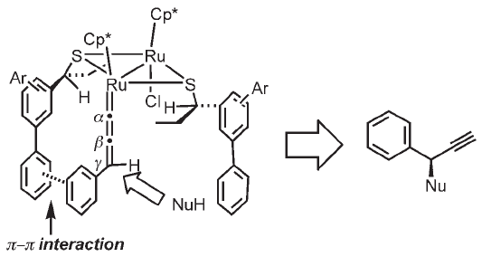
2.5.3 Other Reactions: Propargylic Substitution
Nishibayashi: Ru Catalysts for Propargylic Substitution¹
Model for Selectivity
(1) Inada, Y.; Nishibayashi, Y.; Uemura, S. Angew. Chem., Int. Ed. 2005, 44, 7715-7717.

Slide 36
2.5.3 Other Reactions: Propargylic Substitution
Similar mechanism also possible with Cu catalysts
Kleij¹
Xiao²
(1) Gomez, J. E.; Guo, W. S.; Gaspa, S.; Kleij, A. W. Angew. Chem., Int. Ed. 2017, 56, 15035-15038. (2) Zhang, K.; Lu, L. Q.; Yao, S.; Chen, J. R.; Shi, D. Q.; Xiao, W. J. J. Am. Chem. Soc. 2017, 139, 12847-12854.

Slide 37
2.5.3 Other Reactions: Propargylic Substitution
Jacobsen: Reaction of propargylic cations
Wendlandt, A. E.; Vangal, P.; Jacobsen, E. N. Nature 2018, 556, 447-451.

Slide 38
2.6. Activation C-C Double Bonds
Purely electrophilic activation of double bond is rare and difficult
Most reaction involving not activated double bonds proceed via double activation
Recent progress: use of chiral Au catalysts for the activation of pi systems

Slide 39
2.6 Activation of C-C Double Bonds
Toste: Chiral Au Catalysts
for the Hydroamination of Allenes¹
Toste: Achiral Catalyst with Chiral Counteranion: A Breakthrough²
LaLonde, R. L.; Sherry, B. D.; Kang, E. J.; Toste, F. D. J. Am. Chem. Soc. 2007, 129, 2452-2453. (2) Hamilton, G. L.; Kang, E. J.; Mba, M.; Toste, F. D. Science 2007, 317, 496-499.

Slide 40
2.6 Activation of C-C Double Bonds
Toste: ring expansion of allene-substituted cyclopropanols¹
Toste: Polycyclization cascade through attack on acetylenes²
Kleinbeck, F.; Toste, F. D. J. Am. Chem. Soc. 2009, 131, 9178. (2) Sethofer, S. G.; Mayer, T.; Toste, F. D. J. Am. Chem. Soc. 2010, 132, 8276.

Slide 41
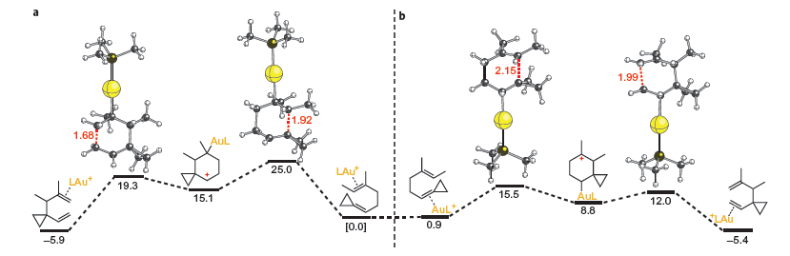
2.6 Activation of C-C Double Bonds
Gagné: Au Catalysts for Asymmetric Cope Rearrangement¹
Mechanism
(1) Felix, R. J.; Weber, D.; Gutierrez, O.; Tantillo, D. J.; Gagne, M. R. Nature Chemistry 2012, 4, 405-409.

Slide 42
2.6 Activation of C-C Double Bonds
Gagne: Platinum-catalyzed domino cyclization-fluorination¹
Czekelius: Desymmetrization of diynes²
(1) Cochrane, N. A.; Nguyen, H.; Gagne, M. R. J. Am. Chem. Soc. 2013, 135, 628. (2) Mourad, A. K.; Leutzow, J.; Czekelius, C. Angew. Chem., Int. Ed. 2012, 51, 11149.

Slide 43
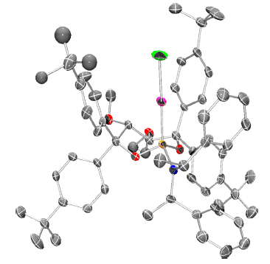
2.6 Activation of C-C Double Bonds
Mascarenas: [4+2] cycloaddition with chiral carbene ligand¹
Fürstner: [2+2] cycloaddition with only one monodentate phosphoramidite ligand²
(1) Francos, J.; Grande-Carmona, F.; Faustino, H.; Iglesias-Siguenza, J.; Diez, E.; Alonso, I.; Fernandez, R.; Lassaletta, J. M.; Lopez, F.; Mascarenas, J. L. J. Am. Chem. Soc. 2012, 134, 14322. (2) Teller, H.; Corbet, M.; Mantilli, L.; Gopakumar, G.; Goddard, R.; Thiel, W.; Furstner, A. J. Am. Chem. Soc. 2012, 134, 15331.

Slide 44
2.6 Activation of C-C Double Bonds
Echavarren: intermolecular [2+2] cycloaddition with non-symmetrical di-gold catalyst
Garcia-Morales, C.; Ranieri, B.; Escofet, I.; Lopez-Suarez, L.; Obradors, C.; Konovalov, A. I.; Echavarren, A. M. J. Am. Chem. Soc. 2017, 139, 13628-13631.

Slide 45
2.7. Chiral Acylation

Slide 46
2.7. Chiral Acylation: Introduction
Activation of Acyl Electrophile with Chiral Nucleophiles

Slide 47
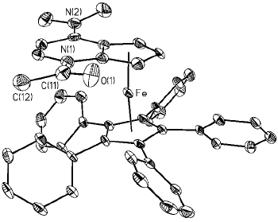
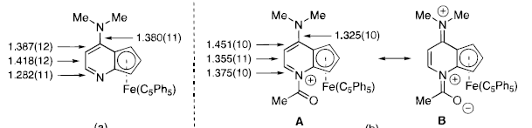
2.7. Chiral Acylation: Kinetic Resolution
Fu: Kinetic Resolution of Propargylic Alcohols. How to make DMAP chiral?
Structure of Acylpyridinium Intermediate
(1) Tao, B. T.; Ruble, J. C.; Hoic, D. A.; Fu, G. C. J. Am. Chem. Soc. 1999, 121, 5091-5092.

Slide 48
2.7. Chiral Acylation: Kinetic Resolution
Vedejs: Chiral Phosphine as Catalysts¹
Maruoka: Chiral Carbenes as Catalysts²
(1) Vedejs, E.; Daugulis, A. J. Am. Chem. Soc. 2003, 125, 4166-4173. (2) Kano, T.; Sasaki, K.; Maruoka, K. Org. Lett. 2005, 7, 1347-1349.

Slide 49
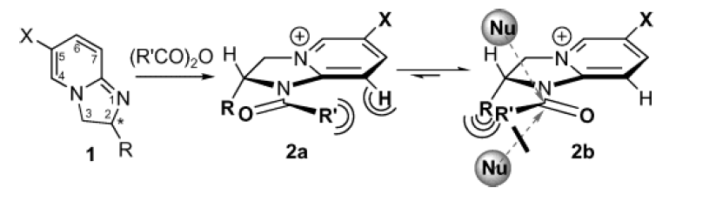
2.7. Chiral Acylation: Kinetic Resolution
Birman: Imidazolin-based Catalysts
Model for Selectivity
(1) Birman, V. B.; Uffman, E. W.; Hui, J.; Li, X. M.; Kilbane, C. J. J. Am. Chem. Soc. 2004, 126, 12226-12227.

Slide 50
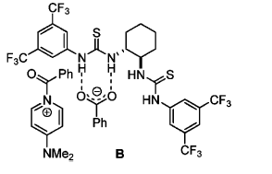
2.7. Chiral Acylation: Kinetic Resolution
Seidel: Achiral DMAP with chiral Urea catalysts¹
Chiral acylation reagent:
(1) De, C. K.; Klauber, E. G.; Seidel, D. J. Am. Chem. Soc. 2009, 131, 17060.

Slide 51
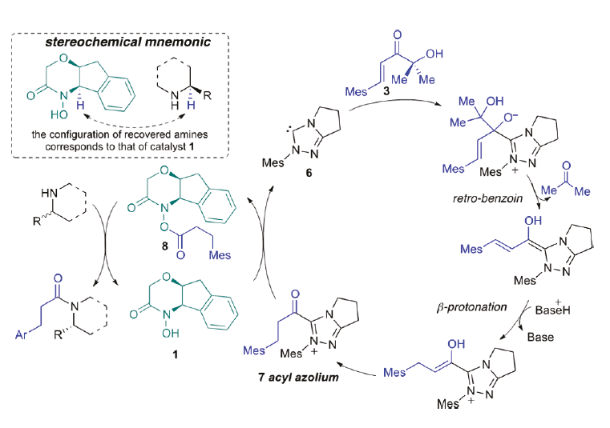
2.7. Chiral Acylation: Kinetic Resolution
Bode: Resolution of cyclic amines via azolium intermediate
Binanzer, M.; Hsieh, S. Y.; Bode, J. W. J. Am. Chem. Soc. 2011, 133, 19698-19701.

Slide 52
2.7. Chiral Acylation: DKR
Chi: Dynamic kinetic resolution of esters
Favored
Chen, X. K.; Fong, J. Z. M.; Xu, J. F.; Mou, C. L.; Lu, Y. P.; Yang, S.; Song, B. A.; Chi, Y. R. J. Am. Chem. Soc. 2016, 138, 7212-7215.

Slide 53
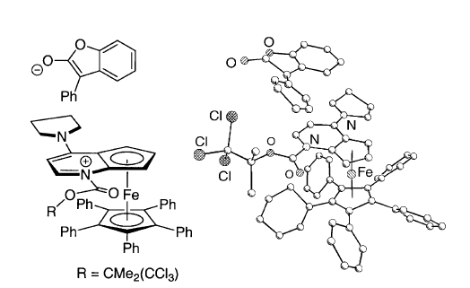
2.7. Chiral Acylation of Enolates
Fu: Asymmetric Intramolecular Acylation
Model for Selectivity
(1) Hills, I. D.; Fu, G. C. Angew. Chem., Int. Ed. 2003, 42, 3921-3924.

Slide 54
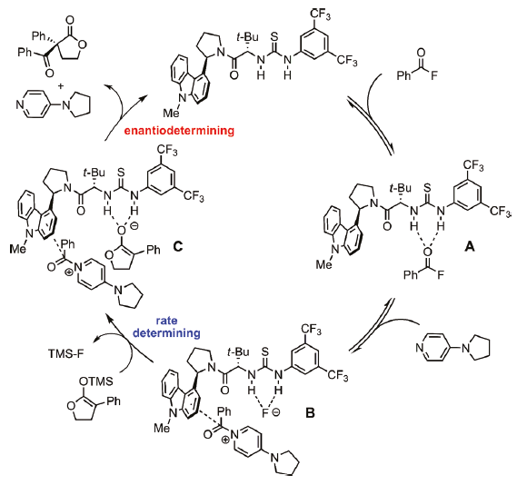
2.7. Chiral Acylation of Enolates
Jacobsen: Asymmetric Acylation Based on Anion Binding
Birrell, J. A.; Desrosiers, J. N.; Jacobsen, E. N. J. Am. Chem. Soc. 2011, 133, 13872-13875.

Slide 55
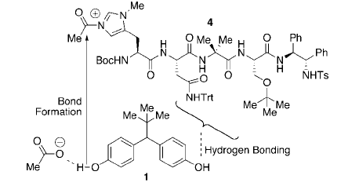
2.7. Chiral Acylation: Desymmetrization
Miller: Peptide catalysts for the remote desymmetrization of diols
Model for Activation
(1) Lewis, C. A.; Gustafson, J. L.; Chiu, A.; Balsells, J.; Pollard, D.; Murry, J.; Reamer, R. A.; Hansen, K. B.; Miller, S. J. J. Am. Chem. Soc. 2008, 130, 16358.

