Slide 1
2.4. Activation of electrophiles other than carbonyl/imines
2.4.1 Epoxidation
2.4.2 Aziridination
2.4.3 Cyclopropanation
2.4.4 Dihydroxylation
2.4.5 C-H/X-H Functionalization
2.4.6 Other Reactions

Slide 2
2.4.1 Epoxidation: Introduction
Often Used (Ep)Oxidation Reagents
Principles for Catalytic Activation via Lowering of the LUMO of the Reagent

Slide 3
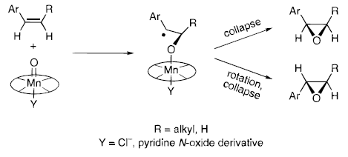
2.4.1 Epoxidation: Jacobsen
The Classical Jacobsen Epoxidation for Cis Olefins
Mechanism
Model for Selectivity
(1) Jacobsen, E. N.; Zhang, W.; Muci, A. R.; Ecker, J. R.; Deng, L. J. Am. Chem. Soc. 1991, 113, 7063-7064. (2) Palucki, M.; Finney, N. S.; Pospisil, P. J.; Guler, M. L.; Ishida, T.; Jacobsen, E. N. J. Am. Chem. Soc. 1998, 120, 948-954.

Slide 4
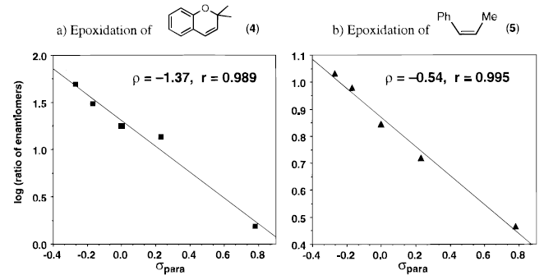
2.4.1 Epoxidation: Jacobsen
Electronic Influence on Selectivity
σ_{para} = Hammet parameter = strenght of electron-withdrawing effect
(1) Palucki, M.; Finney, N. S.; Pospisil, P. J.; Guler, M. L.; Ishida, T.; Jacobsen, E. N. J. Am. Chem. Soc. 1998, 120, 948-954.

Slide 5
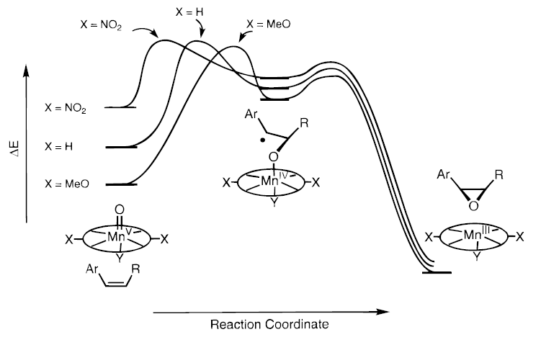
2.4.1 Epoxidation: Jacobsen
Electronic Influence on Selectivity
Hammond Postulate: structure of transition state similar to reactive intermediate
(1) Palucki, M.; Finney, N. S.; Pospisil, P. J.; Guler, M. L.; Ishida, T.; Jacobsen, E. N. J. Am. Chem. Soc. 1998, 120, 948-954.

Slide 6
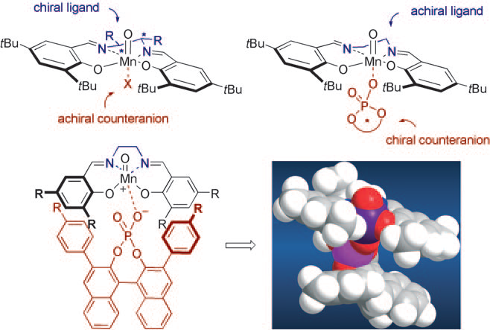
2.4.1 Epoxidation: Counter Anion directed
List: achiral salen complex with chiral countera anion¹
(1) Liao, S. H.; List, B. Angew. Chem., Int. Ed. 2010, 49, 628-631.

Slide 7
2.4.1 Epoxidation: Ketones as Catalysts
Shi: Use of Chiral Ketones as Catalysts
Synthesis of Catalyst
(1) Wang, Z. X.; Tu, Y.; Frohn, M.; Zhang, J. R.; Shi, Y. J. Am. Chem. Soc. 1997, 119, 11224-11235. (2) Shi, Y. Acc. Chem. Res. 2004, 37, 488-496.

Slide 8
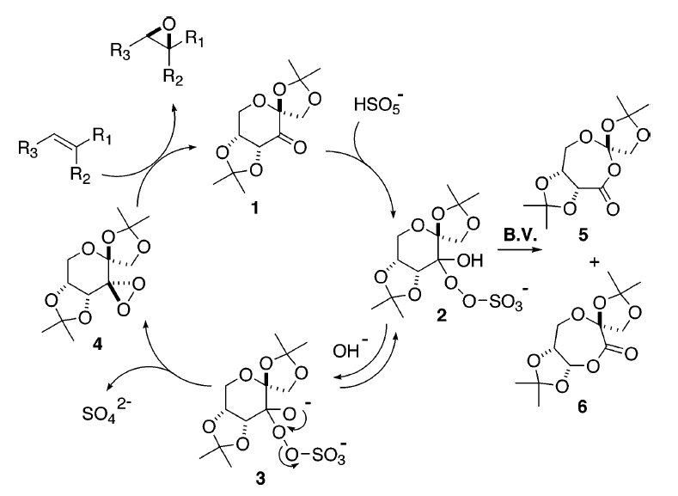
2.4.1 Epoxidation: Ketones as Catalysts
Mechanism
(1) Wang, Z. X.; Tu, Y.; Frohn, M.; Zhang, J. R.; Shi, Y. J. Am. Chem. Soc. 1997, 119, 11224-11235. (2) Shi, Y. Acc. Chem. Res. 2004, 37, 488-496.

Slide 9
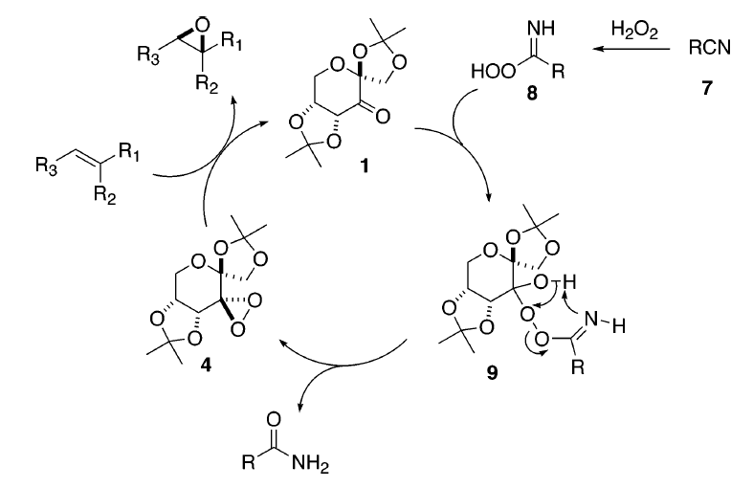
2.4.1 Epoxidation: Ketones as Catalysts
Use of Acetonitrile/Hydrogen Peroxide as Oxidant
(1) Wang, Z. X.; Tu, Y.; Frohn, M.; Zhang, J. R.; Shi, Y. J. Am. Chem. Soc. 1997, 119, 11224-11235. (2) Shi, Y. Acc. Chem. Res. 2004, 37, 488-496.

Slide 10
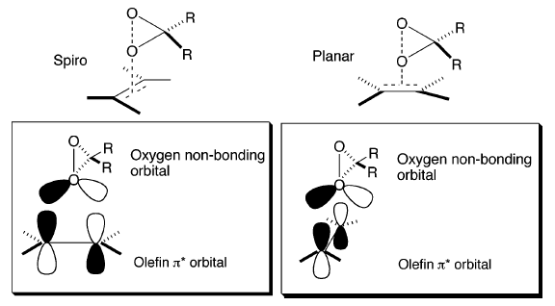
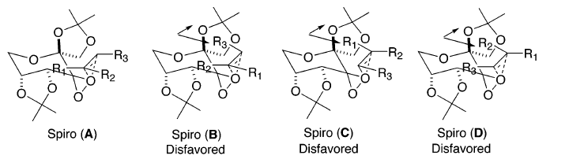
2.4.1 Epoxidation: Ketones as Catalysts
Model for Selectivity
(1) Wang, Z. X.; Tu, Y.; Frohn, M.; Zhang, J. R.; Shi, Y. J. Am. Chem. Soc. 1997, 119, 11224-11235. (2) Shi, Y. Acc. Chem. Res. 2004, 37, 488-496.

Slide 11
2.4.2 Aziridination
Evans Copper Catalyst with BOX Ligands¹
Jacobsen Copper Catalyst with Diimine Ligands²
(1) Evans, D. A.; Faul, M. M.; Bilodeau, M. T.; Anderson, B. A.; Barnes, D. M. J. Am. Chem. Soc. 1993, 115, 5328-5329. (2) Li, Z.; Conser, K. R.; Jacobsen, E. N. J. Am. Chem. Soc. 1993, 115, 5326-5327.

Slide 12
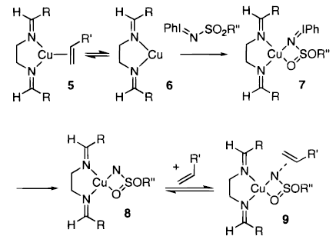
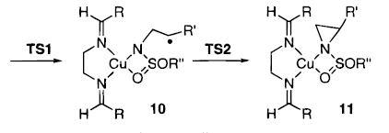
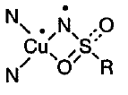
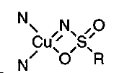
2.4.2 Aziridination
Possible Mechanism
Singlet and Triplet are very close in energy
Triplet Intermediate
Singlet Intermediate
(1) Brandt, P.; Sodergren, M. J.; Andersson, P. G.; Norrby, P. O. J. Am. Chem. Soc. 2000, 122, 8013-8020.

Slide 13
2.4.3 Cyclopropanation: Introduction
Cyclopropanation with Diazo Compounds
Several Pathways for Cyclopropanation

Slide 14
2.4.3 Cyclopropanation: Early Examples
Cyclopropanation of Styrene: One of the First Catalytic Asymmetric Reaction¹
Nakamura: Towards Useful Enantioselectivity^{2,3}
(1) Nozaki, H.; Takaya, H.; Moriuti, S.; Noyori, R. Tetrahedron 1968, 24, 3655. (2) Nakamura, A.; Konishi, A.; Tatsuno, Y.; Otsuka, S. J. Am. Chem. Soc. 1978, 100, 3443-3448. (3) Nakamura, A.; Konishi, A.; Tsujitani, R.; Kudo, M.; Otsuka, S. J. Am. Chem. Soc. 1978, 100, 3449-3461.

Slide 15
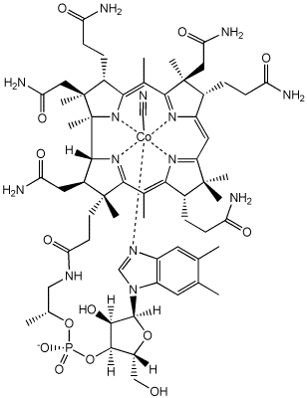
2.4.3 Cyclopropanation: Early Examples
Pfaltz: Vitamin B₁₂ Inspired Semicorrin Ligands¹
Vitamin B₁₂
Evans: BOX Ligands²
(1) Fritschi, H.; Leutenegger, U.; Pfaltz, A. Angew. Chem., Int. Ed. Engl. 1986, 25, 1005-1006. (2) Evans, D. A.; Woerpel, K. A.; Hinman, M. M.; Faul, M. M. J. Am. Chem. Soc. 1991, 113, 726-728.

Slide 16
2.4.3 Cyclopropanation: Early Examples
Nishiyama: Ru-Pybox Catalyst¹
Also ligands with C1 symmetry can be successful²
(1) Nishiyama, H.; Itoh, Y.; Matsumoto, H.; Park, S. B.; Itoh, K. J. Am. Chem. Soc. 1994, 116, 2223-2224. (2) Nishiyama, H.; Soeda, N.; Naito, T.; Motoyama, Y. Tetrahedron: Asymmetry 1998, 9, 2865-2869.

Slide 17
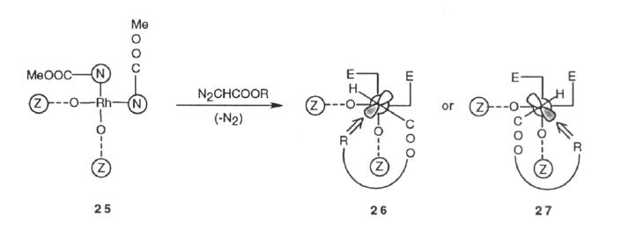
2.4.3 Cyclopropanation: Rh Catalysis
Doyle: Rh-Catalyzed Intramolecular Cyclopropanation
Model for Selectivity
(1) Doyle, M. P.; Austin, R. E.; Bailey, A. S.; Dwyer, M. P.; Dyatkin, A. B.; Kalinin, A. V.; Kwan, M. M. Y.; Liras, S.; Oalmann, C. J.; Pieters, R. J.; Protopopova, M. N.; Raab, C. E.; Roos, G. H. P.; Zhou, Q. L.; Martin, S. F. J. Am. Chem. Soc. 1995, 117, 5763-5775.

Slide 18
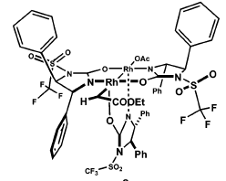
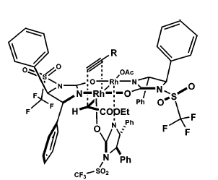
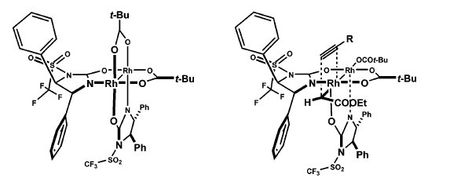
2.4.3 Cyclopropanation: Rh Catalysis
Corey: Rh-Catalyzed Cyclopropanation of Alkynes
Model for Selectivity
(1) Lou, Y.; Horikawa, M.; Kloster, R. A.; Hawryluk, N. A.; Corey, E. J. J. Am. Chem. Soc. 2004, 126, 8916-8918. (2) Lou, Y.; Remarchuk, T. P.; Corey, E. J. J. Am. Chem. Soc. 2005, 127, 14223-14230.

Slide 19
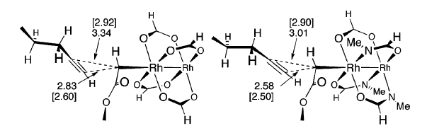
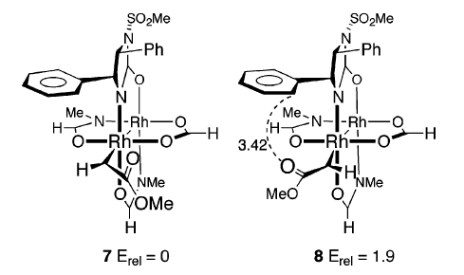
2.4.3 Cyclopropanation: Rh Catalysis
Calculation: Tetrabridged Structures and Direct Cyclopropanation are Favored
Model for Selectivity
(1) Nowlan, D. T.; Singleton, D. A. J. Am. Chem. Soc. 2005, 127, 6190-6191.

Slide 20
2.4.3 Cyclopropanation: Alternative Radical Mechanism
Zhang: Cobalt porphyrin catalysts favoring a radical rebound mechanism
Lee, W.-C. C.; Wang, D.-S.; Zhang, C.; Xie, J.; Li, B.; Zhang, X. P. Chem 2021, 1588-1601.

Slide 21
2.4.3 Cyclopropanation: Alternative to Diazo Compounds
Hypervalent Iodine as Carbene Precursor: Rh Catalyst¹
Hypervalent Iodine as Carbene Precursor: Cu Catalyst²
Muller, P.; Ghanem, A. Org. Lett. 2004, 6, 4347-4350. (2) Moreau, B.; Charette, A. B. J. Am. Chem. Soc. 2005, 127, 18014-18015.

Slide 22
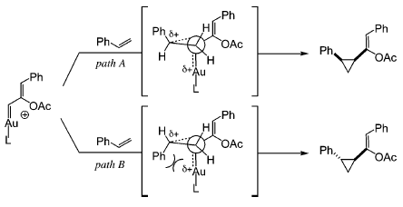
2.4.3 Cyclopropanation: Alternative to Diazo Compounds
Toste: Propargylic Ester as Au-Carbenes Precursors
Mechanism
(1) Johansson, M. J.; Gorin, D. J.; Staben, S. T.; Toste, F. D. J. Am. Chem. Soc. 2005, 127, 18002-18003.

Slide 23
2.4.3 Cyclopropanation: Alternative to Diazo Compounds
Zhuo: From carbonyl groups using a Mo catalyst and phosphine as reductant
(1) Cao, L.-Y.; Wang, J.-L.; Wang, K.; Wu, J.-B.; Wang, D.-K.; Peng, J.-M.; Bai, J.; Zhuo, C.-X. J. Am. Chem. Soc. 2023, 145, 2765-2772.

Slide 24
2.4.4 Dihydroxylation: Sharpless
1. Generation Sharpless Dihydroxylation¹
2. Generation Sharpless Dihydroxylation: Dimeric Ligands and Ad-Mix^{2,3}
(1) Wai, J. S. M.; Marko, I.; Svendsen, J. S.; Finn, M. G.; Jacobsen, E. N.; Sharpless, K. B. J. Am. Chem. Soc. 1989, 111, 1123-1125. (2) Sharpless, K. B.; Amberg, W.; Bennani, Y. L.; Crispino, G. A.; Hartung, J.; Jeong, K. S.; Kwong, H. L.; Morikawa, K.; Wang, Z. M.; Xu, D. Q.; Zhang, X. L. J. Org. Chem. 1992, 57, 2768-2771. (3) Kolb, H. C.; Vannieuwenhze, M. S.; Sharpless, K. B. Chem. Rev. 1994, 94, 2483-2547.

Slide 25
2.4.4 Dihydroxylation: Sharpless
Ligands for Asymmetric Dihydroxylation

Slide 26
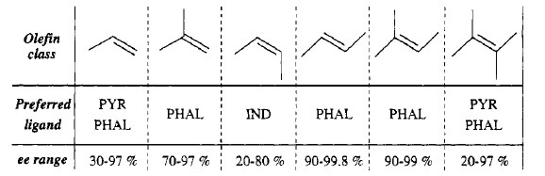
2.4.4 Dihydroxylation: Sharpless

Slide 27
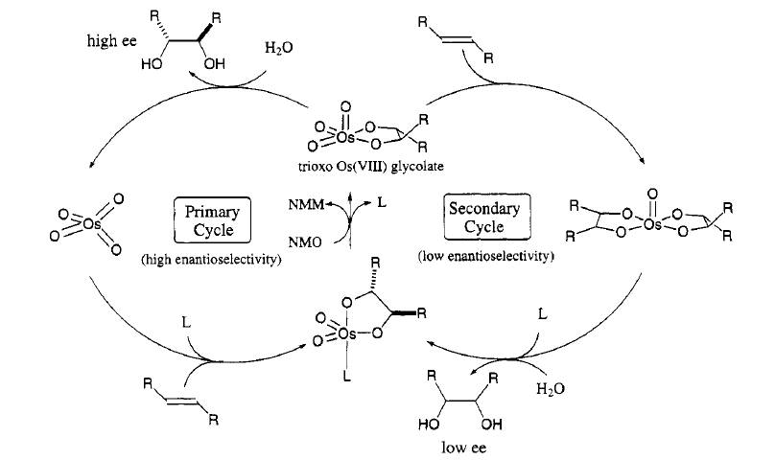
2.4.4 Dihydroxylation: Sharpless
Mechanism for Dihydroxylation Using NMO

Slide 28
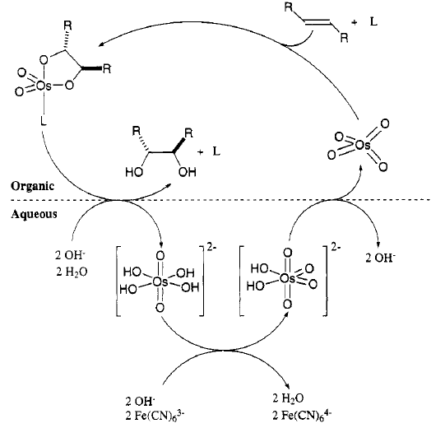
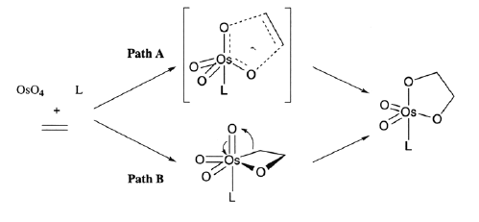
2.4.4 Dihydroxylation: Sharpless
Mechanism for Dihydroxylation Using Add Mix

Slide 29
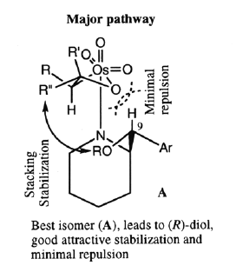
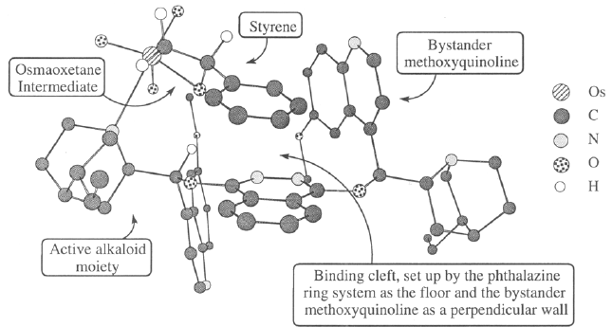
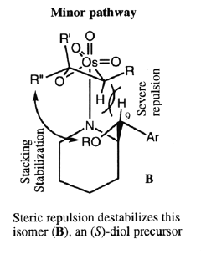
2.4.4 Dihydroxylation: Sharpless
Origin of Enantioselectivity

Slide 30
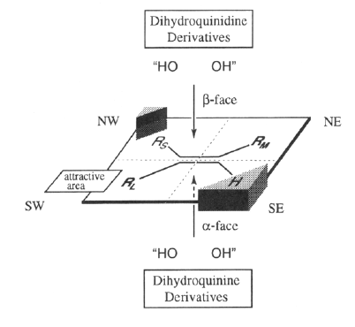
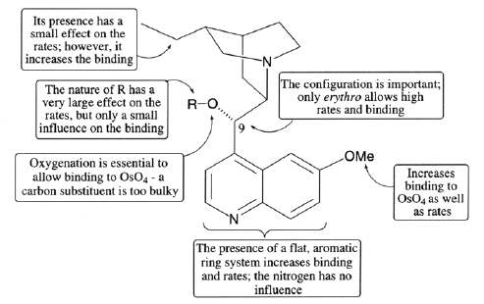
2.4.4 Dihydroxylation: Sharpless
Importance of Structure and Mnemotechnic Model

Slide 31
2.4.4 Dihydroxylation: Sharpless
Corey: The Importance of π−π Interactions for Selectivity
Kinetic Resolution Using Sharpless Dihydroxylation
(1) Corey, E. J.; Guzmanperez, A.; Noe, M. C. J. Am. Chem. Soc. 1995, 117, 10805-10816. (2) Corey, E. J.; Noe, M. C.; Guzmanperez, A. J. Am. Chem. Soc. 1995, 117, 10817-10824.

Slide 32
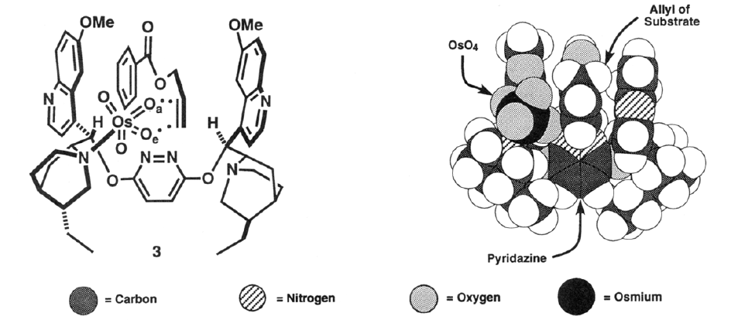
2.4.4 Dihydroxylation: Sharpless
Model for Selectivity
(1) Corey, E. J.; Guzmanperez, A.; Noe, M. C. J. Am. Chem. Soc. 1995, 117, 10805-10816. (2) Corey, E. J.; Noe, M. C.; Guzmanperez, A. J. Am. Chem. Soc. 1995, 117, 10817-10824.

Slide 33
2.4.4 Aminohydroxylation: Sharpless
Sharpless: Asymmetric Aminhydroxylation
Best Nitrogen Sources
(1) Li, G. G.; Chang, H. T.; Sharpless, K. B. Angew. Chem., Int. Ed. Engl. 1996, 35, 451-454. (2) Bodkin, J. A.; McLeod, M. D. J. Chem. Soc. Perkin Trans. 1 2002, 2733-2746.

Slide 34
2.4.5 C-H/X-H Functionalization: Introduction
CH Functionalization
Fast Introduction of Functional Groups
Short and Efficient Synthesis
Outer Sphere
Less Waste
Inner Sphere

Slide 35
2.4.4 C-H Functionalization: Oxygen Transfer
Karasch-Sosnovsky Allylic Oxidation
Pfaltz: Cu BOX Ligands¹
Andrus: Minor Improvements²
(1) Gokhale, A. S.; Minidis, A. B. E.; Pfaltz, A. Tetrahedron Lett. 1995, 36, 1831-1834. (2) Andrus, M. B.; Zhou, Z. N. J. Am. Chem. Soc. 2002, 124, 8806-8807.

Slide 36
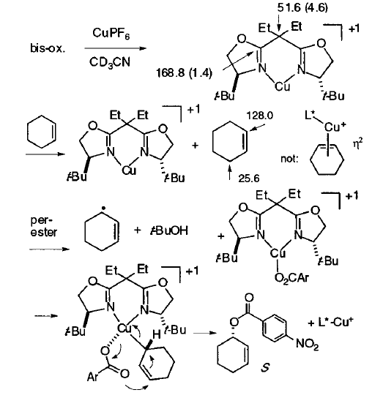
2.4.4 C-H Functionalization: Oxygen Transfer
Proposed Mechanism
(1) Gokhale, A. S.; Minidis, A. B. E.; Pfaltz, A. Tetrahedron Lett. 1995, 36, 1831-1834. (2) Andrus, M. B.; Zhou, Z. N. J. Am. Chem. Soc. 2002, 124, 8806-8807.

Slide 37
2.4.4 C-H Functionalization: Carbenes
Doyle: Intramolecular C-H Insertion¹
Davies: Intermolecular C-H Insertion²
(1) Doyle, M. P.; Vanoeveren, A.; Westrum, L. J.; Protopopova, M. N.; Clayton, T. W. J. Am. Chem. Soc. 1991, 113, 8982-8984. (2) Davies, H. M. L.; Beckwith, R. E. J. Chem. Rev. 2003, 103, 2861-2903. (3) Davies, H. M. L.; Manning, J. R. Nature 2008, 451, 417-424.

Slide 38
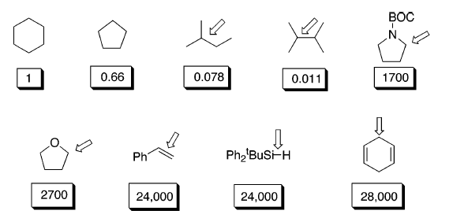
2.4.4 C-H Functionalization: Carbenes
Different Kinds of Carbenoids
Compared Reactivity of Substrates with Rh₂(S-DOSP)₄ and Donor-Acceptor Carbenoids
(1) Davies, H. M. L.; Beckwith, R. E. J. Chem. Rev. 2003, 103, 2861-2903.

Slide 39
2.4.4 C-H Functionalization: Carbenes
Davies: Asymmetric Synthesis of Erogorgiaene
(1) Davies, H. M. L.; Walji, A. M. Angew. Chem., Int. Ed. 2005, 44, 1733-1735.

Slide 40
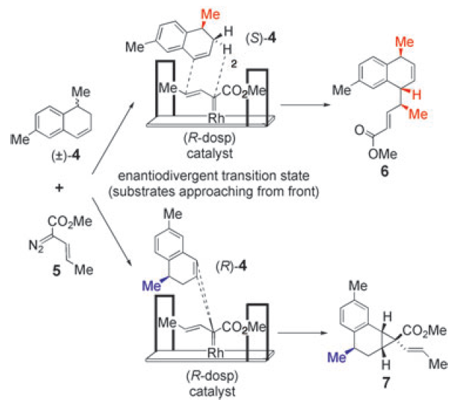
2.4.4 C-H Functionalization: Carbenes
Model for Selectivity
(1) Davies, H. M. L.; Walji, A. M. Angew. Chem., Int. Ed. 2005, 44, 1733-1735.

Slide 41
2.4.4 X-H Functionalization: Carbenes
Fu: Cu-Catalyzed Insertion into OH Bonds¹
Zhou: Cu-Catalyzed Insertion into NH Bonds² or water³
(1) Maier, T. C.; Fu, G. C. J. Am. Chem. Soc. 2006, 128, 4594. (2) Liu, B.; Zhu, S. F.; Zhang, W.; Chen, C.; Zhou, Q. L. J. Am. Chem. Soc. 2007, 129, 5834. (3) Zhu, S. T.; Chen, C.; Cai, Y.; Zhou, Q. L. Angew. Chem., Int. Ed. 2008, 47, 932.

Slide 42
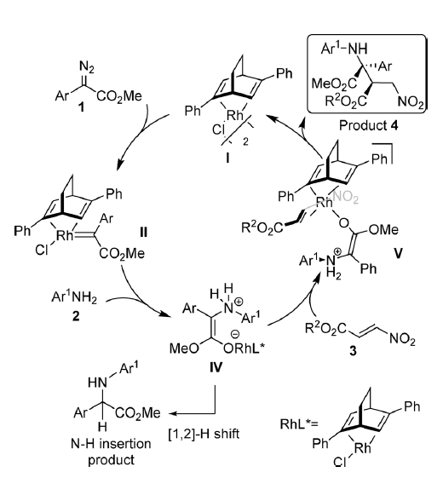
2.4.4 Carbene multi-functionalization
Hu: Rh-Catalyzed multi-functionalization cascade
Ma, X.; Jiang, J.; Lv, S.; Yao, W.; Yang, Y.; Liu, S.; Xia, F.; Hu, W. Angew. Chem. Int. Ed. 2014, 53, 13136.

Slide 43
2.4.4 Carbene multi-functionalization
Waser: Multi-functionalization with EBX (Ethynylbenziodoxolone) hypervalent iodine reagents
Hari, D. P.; Waser, J. J. Am. Chem. Soc. 2017, 139, 8420-8423.

Slide 44
2.4.4 C-H Functionalization: Nitrenes
Du Bois: Rh-catalyzed nitrene insertion with hypervalent iodine¹
Blakey: Ru-catalyzed nitrene insertion with hypervalent iodine²
(1) Zalatan, D. N.; Du Bois, J. J. Am. Chem. Soc. 2008, 130, 9220. (2) Milczek, E.; Boudet, N.; Blakey, S. Angew. Chem., Int. Ed. 2008, 47, 6825.

Slide 45
2.4.4 C-H Functionalization: Nitrenes
Zhang: Co-catalyzed nitrene insertion via radicals¹
(1) Li, C. Q.; Lang, K.; Lu, H. J.; Hu, Y.; Cui, X.; Wojtas, L.; Zhang, X. P., Angew. Chem., Int. Ed. 2018, 57, 16837-16841.

Slide 46
2.4.5 Other Reactions: Azidation of Radicals
Bao: Iron-catalyzed carboazidation¹
Also possible starting from benzylic C-H bonds²
(1) Ge, L.; Zhou, H.; Chiou, M.-F.; Jiang, H.; Jian, W.; Ye, C.; Li, X.; Zhu, X.; Xiong, H.; Li, Y.; Song, L.; Zhang, X.; Bao, H. Nat. Catal. 2021, 4, 28. (2) Cao, M.; Wang, H.; Ma, Y.; Tung, C.-H.; Liu, L. J. Am. Chem. Soc. 2022, 144, 15383-15390.

Slide 47
2.4.5 Other Reactions: Reaction of Oxy-Allyl Cation
Jacobsen: Lewis acidity enhancement
Banik, S. M.; Levina, A.; Hyde, A. M.; Jacobsen, E. N. Science 2017, 358, 761-764.

Slide 48
2.4.5 Other Reactions: Amination of Enolates
Yamamoto: Acid-Catalyzed Nitroso-Aldol Reaction with Enamines:
Amination or Hydroxylation Depending on Catalyst
(1) Momiyama, N.; Yamamoto, H. J. Am. Chem. Soc. 2005, 127, 1080-1081.

Slide 49
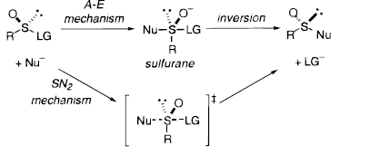
2.4.5 Other Reactions: Sulfide Oxidation
Ellman: Asymmetric Oxidation of Disulfide
Synthesis of Ellman’s Auxiliary
(1) Blum, S. A.; Bergman, R. G.; Ellman, J. A. J. Org. Chem. 2003, 68, 150-155.

Slide 50
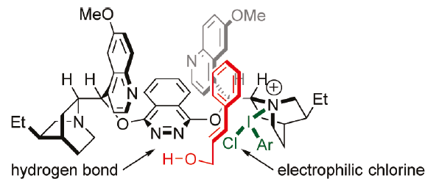
2.4.5 Other Reactions: Asymmetric Chlorination
Bohran: Chlorolactonization¹
Nicolaou: Dichlorination²
(1) Whitehead, D. C.; Yousefi, R.; Jaganathan, A.; Borhan, B., J. Am. Chem. Soc. 2010, 132, 3298. (2) Nicolaou, K. C.; Simmons, N. L.; Ying, Y. C.; Heretsch, P. M.; Chen, J. S., J. Am. Chem. Soc. 2011, 133, 8134.

Slide 51
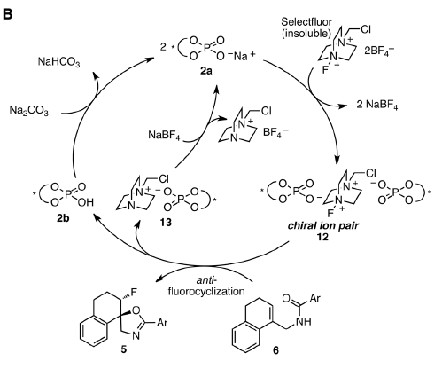
2.4.5 Other Reactions: Asymmetric Fluorination
Toste: Enantioselective oxyfluorination based on phase-transfer of the cation!
Rauniyar, V.; Lackner, A. D.; Hamilton, G. L.; Toste, F. D. Science 2011, 334, 1681-1684.

Slide 52
2.4.5 Other Reactions: Via Sulfonium
Denmark: intermolecular sulfonium formation¹
Jacobsen: intramolecular sulfonium formation²
(1) Denmark, S. E.; Jaunet, A. J. Am. Chem. Soc. 2013, 135, 6419. (2) Lin, S.; Jacobsen, E. N. Nat. Chem. 2012, 4, 817.

Slide 53
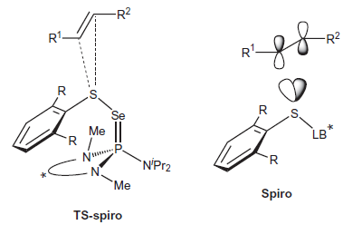
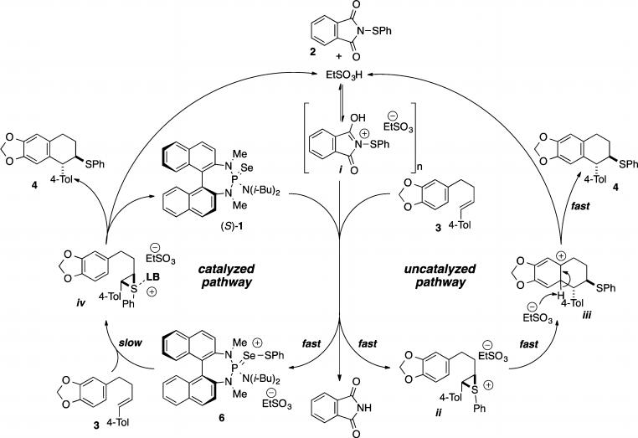
2.4.5 Other Reactions: Via Sulfonium
(1) Denmark, S. E.; Chi, H. M. J. Am. Chem. Soc. 2014, 136, 3655. (2) Denmark, S. E.; Hartmann, E.; Kornfilt, D. J. P.; Wang, H. Nat. Chem. 2014, 6, 1056.

Slide 54
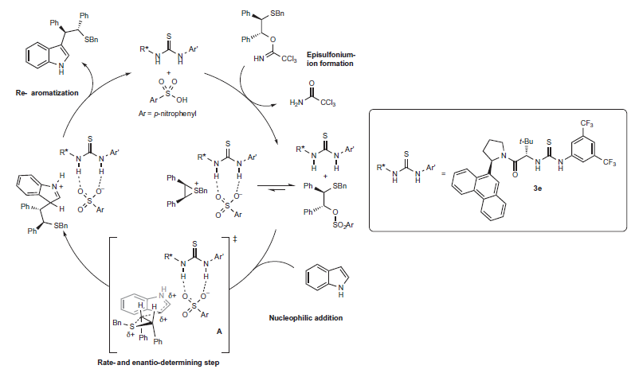
2.4.5 Other Reactions: Via Sulfonium
Lin, S.; Jacobsen, E. N. Nat. Chem. 2012, 4, 817.

Slide 55
2.2.4 Other Reactions: Hypervalent Iodine
Hypervalent with involvement of 5p orbitals
Only partial bond character (4 electrons-3 centres bond)
Exceptional reactivity

Slide 56
2.4.5 Other Reactions: Hypervalent Iodine
Ishihara: Oxidative cyclization with inorganic hypervalent iodine¹⁻²
Ishihara: Oxidative Spirolactonization³
(1) Uyanik, M.; Okamoto, H.; Yasui, T.; Ishihara, K. Science 2010, 328, 1376. (2) Uyanik, M.; Hayashi, H.; Ishihara, K. Science 2014, 345, 291. (3) Uyanik, M.; Yasui, T.; Ishihara, K. Angew. Chem., Int. Ed. 2010, 49, 2175.

Slide 57
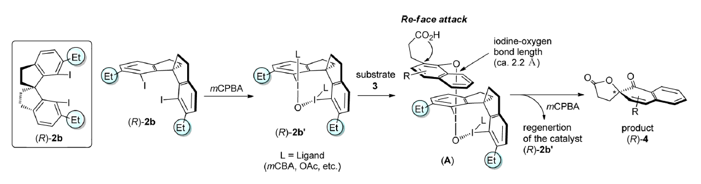
2.4.5 Other Reactions: Hypervalent Iodine
Kita: Oxidative Spirolactonization¹
(1) Dohi, T.; Takenaga, N.; Nakae, T.; Toyoda, Y.; Yamasaki, M.; Shiro, M.; Fujioka, H.; Maruyama, A.; Kita, Y. J. Am. Chem. Soc. 2013, 135, 4558.

Slide 58
2.4.5 Other Reactions: Hypervalent Iodine
Muniz/Ishihara: Diacetoxylation of olefins¹
Muniz: Diamination²
(1) Haubenreisser, S.; Woste, T. H.; Martinez, C.; Ishihara, K.; Muniz, K. Angew. Chem., Int. Ed. 2016, 55, 413-417. (2) Muniz, K.; Barreiro, L.; Romero, R. M.; Martinez, C. J. Am. Chem. Soc. 2017, 139, 4354-4357.

Slide 59
2.4.5 Other Reactions: Hypervalent Iodine
Jacobsen/^{1,2} Gilmour:³ enantioselective difluorination.
Banik, S. M.; Medley, J. W.; Jacobsen, E. N. Science 2016, 353, 51-54. (2) Banik, S. M.; Medley, J. W.; Jacobsen, E. N. J. Am. Chem. Soc. 2016, 138, 5000-5003. (3) Scheidt, F.; Schafer, M.; Sarie, J. C.; Daniliuc, C. G.; Molloy, J. J.; Gilmour, R. Angew. Chem.-Int. Edit. 2018, 57, 16431-16435.

Slide 60
2.4.5 Other Reactions: Hypervalent Iodine
Jacobsen/Houk: Calculated best transition states
Jacobsen, E. N.; Houk, K. N.; Xue, X. S., J. Am. Chem. Soc. 2018, 140, 15206-15218.

