Slide 1
2.2 Lewis and BrØnsted acids activation of extended π- systems of carbonyl and imines
2.2.1 Conjugate (Michael) Addition
2.2.2 Diels-Alder Cycloaddition
2.2.3 [3+2] Cycloaddition
2.2.4 Other Reactions

Slide 2
2.2 Introduction
Selectivity: 1,2 or 1,4?

Slide 3
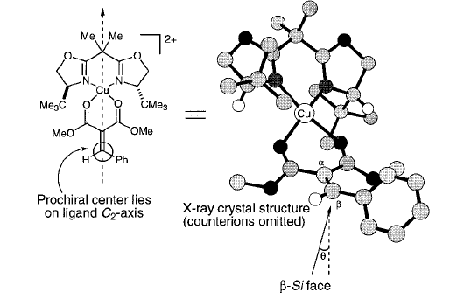
2.2.1 Conjugate (Michael) Addition: Enolates
Evans Michael Addition to Alkylidene Malonates
(1) Evans, D. A.; Rovis, T.; Kozlowski, M. C.; Tedrow, J. S. J. Am. Chem. Soc. 1999, 121, 1994-1995.

Slide 4
2.2.1 Conjugate (Michael) Addition: Enolates
Possible Mechanism and Role of HFIP
(1) Evans, D. A.; Rovis, T.; Kozlowski, M. C.; Tedrow, J. S. J. Am. Chem. Soc. 1999, 121, 1994-1995.

Slide 5
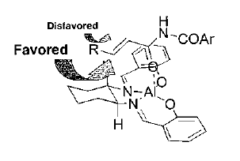
2.2.1 Conjugate (Michael) Addition: Heteroatoms
Jacobsen: Al-Salen Catalyzed Conjugate Addition of Hydrazoic Acid
One Possible Model for Selectivity
Other Successful Nucleophiles
(1) Myers, J. K.; Jacobsen, E. N. J. Am. Chem. Soc. 1999, 121, 8959-8960.

Slide 6
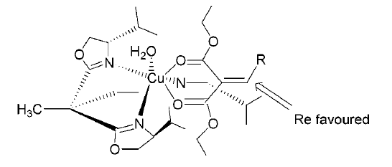
2.2.1 Conjugate (Michael) Addition: Aromatic Compounds
Tang: Use of Trisoxazoline for Indole Conjugate Addition
One Possible Model for Selectivity
(1) Zhou, J.; Tang, Y. J. Am. Chem. Soc. 2002, 124, 9030-9031.

Slide 7
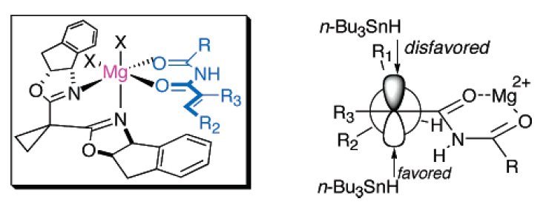
2.2.1 Conjugate (Michael) Addition: Radicals
Sibi: Conjugate Addition of Radicals
One Possible Model for Selectivity
(1) Sibi, M. P.; Petrovic, G.; Zimmerman, J. J. Am. Chem. Soc. 2005, 127, 2390-2391.

Slide 8
2.2.1 Conjugate (Michael) Addition: Radicals
Meggers: Radicals generated under photoredox conditions
(1) Huo, H.; Harms, K.; Meggers, E. J. Am. Chem. Soc. 2016, 138, 6936-6939.

Slide 9
2.2.1 Conjugate (Michael) Addition: Photoredox Concept
Catalytic Cycles
Activation with Light

Slide 10
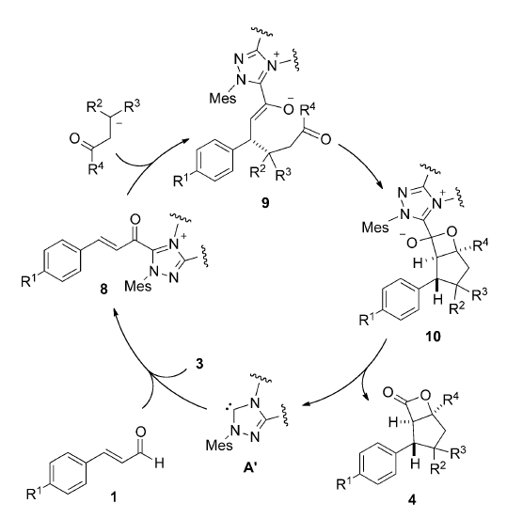
2.2.1 Michael Acceptors Activated with Carbenes
Studer: Activation via carbenes and oxidation
Bera, S.; Samanta, R. C.; Daniliuc, C. G.; Studer, A. Angew. Chem., Int. Ed. 2014, 53, 9622.

Slide 11
2.2.2 Diels Alder Cycloaddition: Introduction
Diels-Alder: Repetition of Key Concepts
Homo-Lumo Interactions
Asynchronous Model

Slide 12
2.2.2 Diels Alder Cycloaddition: Introduction
”Normal Electron-Demand ” Diels Alder
Homo-Lumo Interactions
Major Homo-Lumo Interaction:
Including Perturbation of Substituents

Slide 13
2.2.2 Diels Alder Cycloaddition : Introduction
Normal Electron-Demand ” Diels Alder: Asynchronous Model
Best stabilization
Anion not stabilized
Only destabilization
One destabilization

Slide 14
2.2.2 Diels Alder Cycloaddition : Introduction
” Normal Electron-Demand ” Diels Alder: Lewis Acid Catalysis
Endo vs Exo Selectivity

Slide 15
2.2.2 Diels Alder Cycloaddition : Introduction
” Inverse Electron-Demand ” Diels Alder

Slide 16
2.2.2 Diels Alder Cycloaddition : TADDOL
Seebach and Narasaka: Ti-TADDOL Catalysts
(1) Seebach, D.; Beck, A. K.; Imwinkelried, R.; Roggo, S.; Wonnacott, A. Helv. Chim. Acta 1987, 70, 954-974. (2) Narasaka, K.; Inoue, M.; Okada, N. Chem. Lett. 1986, 1109-1112. (3) Narasaka, K.; Iwasawa, N.; Inoue, M.; Yamada, T.; Nakashima, M.; Sugimori, J. J. Am. Chem. Soc. 1989, 111, 5340-5345.

Slide 17
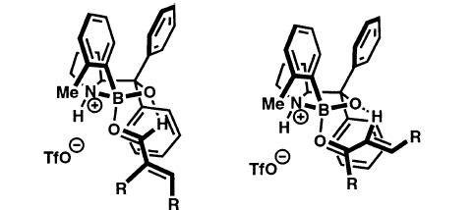
2.2.2 Diels Alder Cycloaddition : Corey‘s Boranes
Corey: Oxazaborolidinium as More General Catalysts
Favored Transition State
(1) Corey, E. J.; Shibata, T.; Lee, T. W. J. Am. Chem. Soc. 2002, 124, 3808-3809. (2) Ryu, D. H.; Lee, T. W.; Corey, E. J. J. Am. Chem. Soc. 2002, 124, 9992-9993.

Slide 18
2.2.2 Diels Alder Cycloaddition : Corey‘s Boranes
Increasing the Reactivity of the Catalyst by the Choice of the Counterion
Furans as Dienes
(1) Ryu, D. H.; Corey, E. J. J. Am. Chem. Soc. 2003, 125, 6388-6390. (2) Liu, D.; Canales, E.; Corey, E. J. J. Am. Chem. Soc. 2007, 129, 1498-1499. (3) Futatsugi, K.; Yamamoto, H. Angew. Chem., Int. Ed. 2005, 44, 1484-1487.(4) Reddy, K. M.; Bhimireddy, E.; Thirupathi, B.; Breitler, S.; Yu, S. M.; Corey, E. J. J. Am. Chem. Soc. 2016, 138, 2443-2453. (5) Thirupathi, B.; Breitler, S.; Reddy, K. M.; Corey, E. J. J. Am. Chem. Soc. 2016, 138, 10842-10845.
.

Slide 19
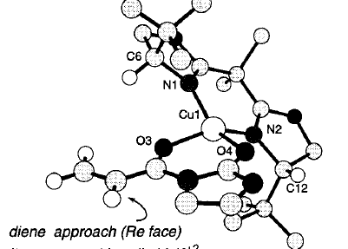
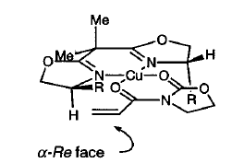
2.2.2 Diels Alder Cycloaddition : Evans‘ BOX
Evans: Two-Points Binding with BOX Ligands
Model for Selectivity
(1) Evans, D. A.; Barnes, D. M.; Johnson, J. S.; Lectka, R.; von Matt, P.; Miller, S. J.; Murry, J. A.; Norcross, R. D.; Shaughnessy, E. A.; Campos, K. R. J. Am. Chem. Soc. 1999, 121, 7582-7594. (2) Evans, D. A.; Miller, S. J.; Lectka, T.; von Matt, P. J. Am. Chem. Soc. 1999, 121, 7559-7573.

Slide 20
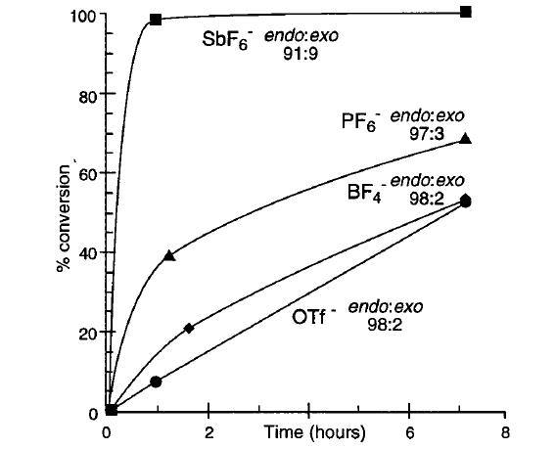
2.2.2 Diels Alder Cycloaddition : Evans‘ BOX
Influence of Counteranion

Slide 21
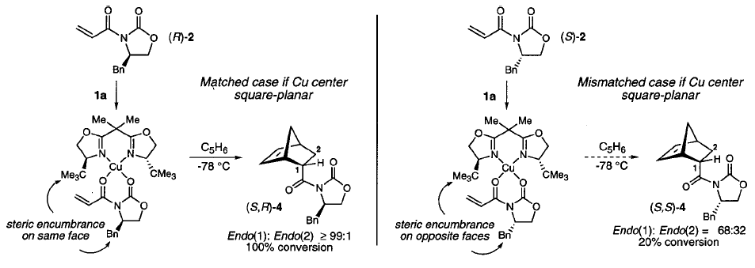
2.2.2 Diels Alder Cycloaddition : Evans‘ BOX
Double Diastereoselection: Matched vs Mismatched

Slide 22
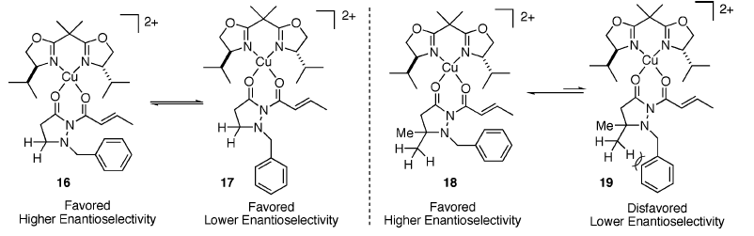
2.2.2 Diels Alder Cycloaddition: Relay Induction
Sibi: Relay Steric Induction
Importance of Auxiliary
(1) Sibi, M. P.; Stanley, L. M.; Nie, X. P.; Venkatraman, L.; Liu, M.; Jasperse, C. P. J. Am. Chem. Soc. 2007, 129, 395-405.

Slide 23
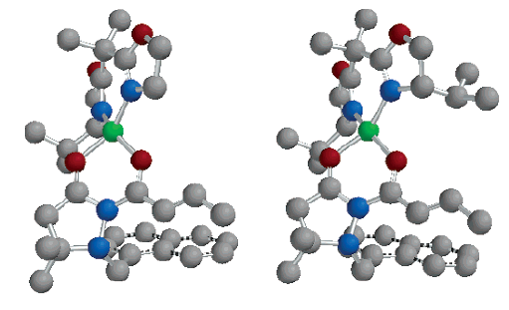
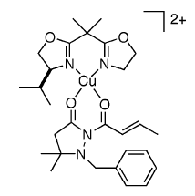
2.2.2 Diels Alder Cycloaddition : Relay Induction
Sibi: Relay Steric Induction
Importance of Auxiliary
(1) Sibi, M. P.; Stanley, L. M.; Nie, X. P.; Venkatraman, L.; Liu, M.; Jasperse, C. P. J. Am. Chem. Soc. 2007, 129, 395-405.

Slide 24
2.2.2 Diels Alder Cycloaddition : Organocatalysis
List: Silylated C-H acids
(1) Gatzenmeier, T.; van Gemmeren, M.; Xie, Y. W.; Hofler, D.; Leutzsch, M.; List, B. Science 2016, 351, 949-952.

Slide 25
2.2.3 [3+2] Cycloaddition Reactions
Kündig: Iron-Catalyzed [3+2] Cycloaddition of Nitrones¹
Topczewski: DKR via alkyne-azide cycloaddition²
(1) Viton, F.; Bernardinelli, G.; Kundig, E. P. J. Am. Chem. Soc. 2002, 124, 4968-4969. (2) Liu, E. C.; Topczewski, J. J., J. Am. Chem. Soc. 2019, 141, 5135-5138.

Slide 26
2.2.3 [2+2] Cycloaddition
Tang: [2+2] Cycloaddition with copper catalyst and BOX ligands¹
Feng: [2+2] Cycloaddition with zinc catalyst and N-oxides ligands²
(1) Hu, J. L.; Feng, L. W.; Wang, L. J.; Xie, Z. W.; Tang, Y.; Li, X. G. J. Am. Chem. Soc. 2016, 138, 13151-13154. (2) Kang, T. F.; Ge, S. L.; Lin, L. L.; Lu, Y.; Liu, X. H.; Feng, X. M. Angew. Chem., Int. Ed. 2016, 55, 5541-5544.

Slide 27
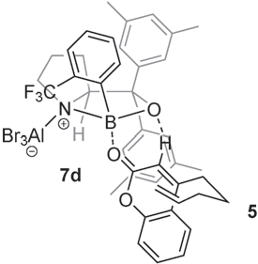
2.2.3 [2+2] Cycloaddition
Bach: [2+2] Cycloaddition using photochemistry
Guo, H.; Herdtweck, E.; Bach, T., Angew. Chem., Int. Ed. 2010, 49, 7782. (2) R. Brimioulle, T. Bach, Science 2013, 342, 840.

Slide 28
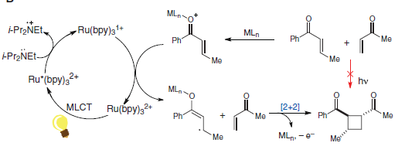
2.2.3 [2+2] Cycloaddition
Yoon : [2+2] Cycloaddition combining photoredox and Lewis acid catalysis
Du, J.; Skubi, K. L.; Schultz, D. M.; Yoon, T. P. Science 2014, 344, 392.

Slide 29
2.2.3 [2+2] Cycloaddition
List : Asymmetric counteranion directed [2+2] cycloaddition
Das, S.; Zhu, C.; Demirbas, D.; Bill, E.; De, C. K.; List, B. Science 2023, 379, 494-499.

Slide 30
2.2.3 Photochemical deracemization
Bach: Photocatalytic deracemization of allenes
Holzl-Hobmeier, A.; Bauer, A.; Silva, A. V.; Huber, S. M.; Bannwarth, C.; Bach, T., Nature 2018, 564, 240.

Slide 31
2.2.3 Formal Cycloadditions with Cyclopropanes
Walsh Orbitals
Homo-Michael
Ring strain:
28 Kcal/mol
Cycloadditions

Slide 32
2.2.3 Formal Cycloadditions with Cyclopropanes
Sibi: Ni-Catalyzed [3+3] Cycloaddition of Nitrones²
Johnson: DYnamic Kinetic Asymmetric Transformation (DYKAT) with donor-acceptor cyclopropanes²
(1) Sibi, M. P.; Ma, Z. H.; Jasperse, C. P. J. Am. Chem. Soc. 2005, 127, 5764. (2) Parsons, A. T.; Johnson, J. S. J. Am. Chem. Soc. 2009, 131, 3122.

Slide 33
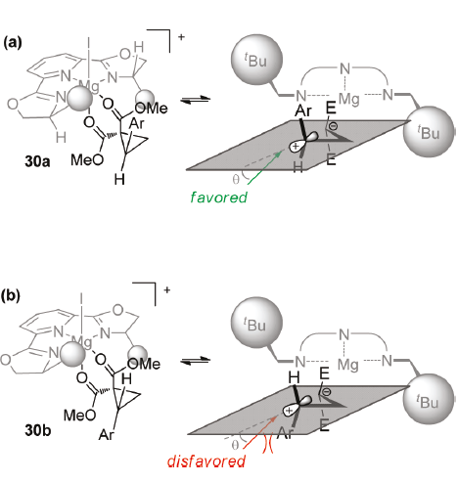
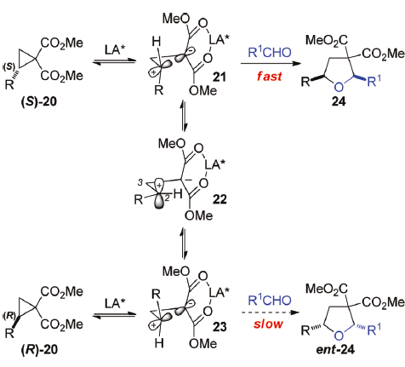
2.2.3 Formal Cycloadditions with Cyclopropanes
(1) Parsons, A. T.; Johnson, J. S. J. Am. Chem. Soc. 2009, 131, 3122. Campbell, M. J.; Johnson, J. S.; Parsons, A. T.; Pohlhaus, P. D.; Sanders, S. D. J. Org. Chem. 2010, 75, 6317.

Slide 34
2.2.3 Formal Cycloadditions with Cyclopropanes
Tang: First example of DYKAT for the synthesis of cyclopentanes¹
Waser: First example of DYKAT with aminocyclopropanes²
(1) Xu, H.; Qu, J. P.; Liao, S. H.; Xiong, H.; Tang, Y. Angew. Chem., Int. Ed. 2013, 52, 4004. (2) De Nanteuil, F.; Serrano, E.; Perrotta, D.; Waser, J. J. Am. Chem. Soc. 2014, 53, 8484.

Slide 35
2.2.3 Formal Cycloadditions with Cyclopropanes
Waser: First Desymmetrization approach
Perrotta, D.; Wang, M.-M.; Waser, J. Angew. Chem., Int. Ed. 2018, 57, 5120-5123.

Slide 36
2.2.3 Formal Cycloadditions with Cyclopropanes
Meggers: a photoredox approach
Huang, X. Q.; Lin, J. H.; Shen, T. Q.; Harms, K.; Marchini, M.; Ceroni, P.; Meggers, E. Angew. Chem., Int. Ed. 2018, 57, 5454-5458.

Slide 37
2.2.3 Nazarov Cyclization
Trauner: Sc Catalyst¹
Rueping: Bronsted Acid Catalyst²
(1) Liang, G. X.; Trauner, D. J. Am. Chem. Soc. 2004, 126, 9544-9545. (2) Rueping, M.; Ieawsuwan, W.; Antonchick, A. P.; Nachtsheim, B. J. Angew. Chem., Int. Ed. 2007, 46, 2097-2100.

Slide 38
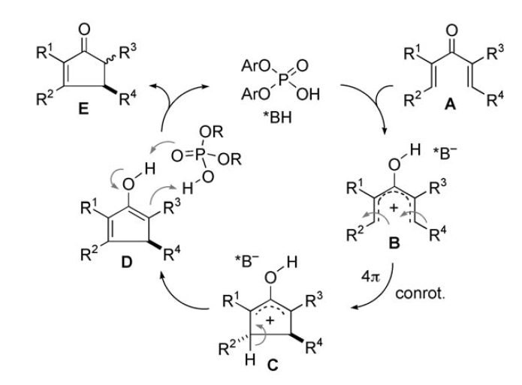
2.2.3 Nazarov Cyclization
Mechanism

Slide 39
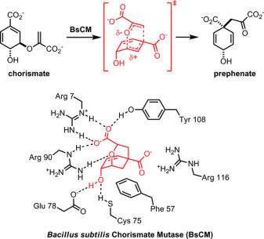
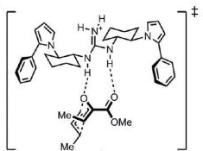
2.2.3 Claisen Rearrangement
Jacobsen: Guanidinium Catalyst for the Claisen Rearrangement¹
(1) (a) Uyeda, C.; Jacobsen, E. N. J. Am. Chem. Soc. 2008, 130, 9228. (b) Uyeda, C.; Jacobsen, E. N., J. Am. Chem. Soc. 2011, 133, 5062.

Slide 40
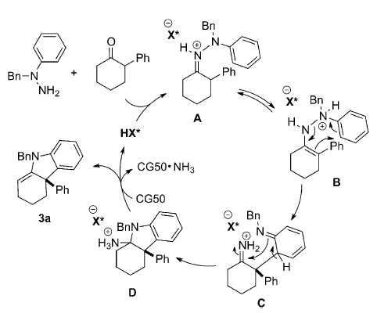
2.2.3 Fischer Indole Synthesis
List: Enantioselective Fischer Indoline Synthesis¹
(1) Martinez, A.; Webber, M. J.; Muller, S.; List, B. Angew. Chem., Int. Ed. 2013, 52, 9486.

Slide 41
2.2.3 Electrocyclic Ring-Closing
Sparr: Enantioselective electrocyclic ring-closing with transfer from central to axial chirality¹
(1) Wu, X.; Sparr, C. Angew. Chem., Int. Ed. 2022, 61, e202201424.

Slide 42
2.3 Iminium Catalysis

Slide 43
2.3 Iminium Catalysis: Introduction
Relative Reactivity of 1,2-Systems
Relative Reactivity of 1,4-Systems
Iminium Catalysis

Slide 44
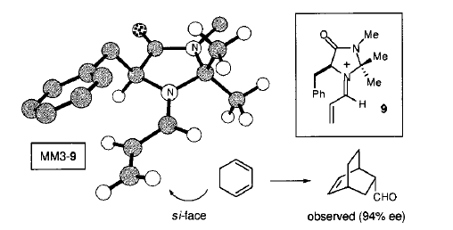
2.3 Iminium Catalysis: Diels-Alder
MacMillan: The First Asymmetric Diels-Alder via Iminium Catalysis
Model for Selectivity
(1) Ahrendt, K. A.; Borths, C. J.; MacMillan, D. W. C. J. Am. Chem. Soc. 2000, 122, 4243-4244.

Slide 45
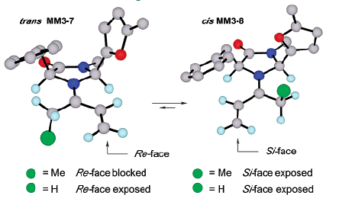
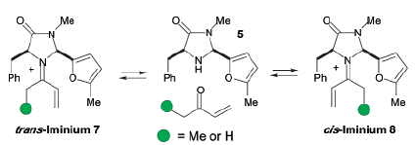
2.3 Iminium Catalysis: Diels-Alder
MacMillan: Asymmetric Diels-Alder of Ketones
Model for Selectivity
(1) Northrup, A. B.; MacMillan, D. W. C. J. Am. Chem. Soc. 2002, 124, 2458-2460.

Slide 46
2.3 Iminium Catalysis: Conjugate Addition
MacMillan: Pyrrole¹ and Indole² Alkylation
(1) Paras, N. A.; MacMillan, D. W. C. J. Am. Chem. Soc. 2001, 123, 4370-4371. (2) Austin, J. F.; MacMillan, D. W. C. J. Am. Chem. Soc. 2002, 124, 1172-1173.

Slide 47
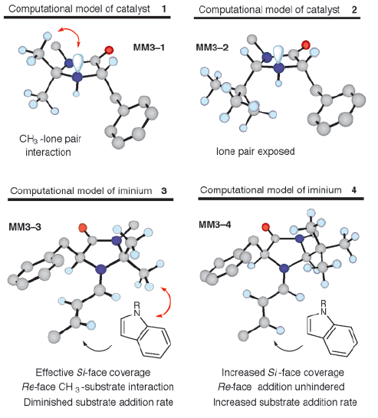
2.3 Iminium Catalysis: Conjugate Addition
Catalyst Design

Slide 48
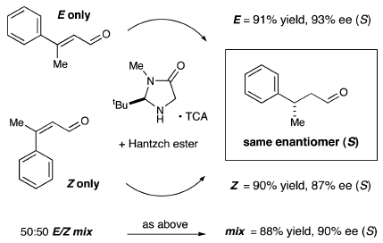
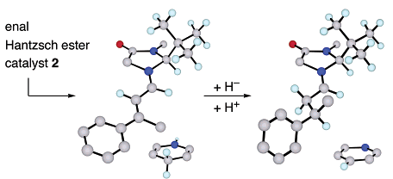
2.3 Iminium Catalysis: Conjugate Reduction
MacMillan: Conjugate Reduction with Hantsch Ester
E/Z Mixtures can be used!
Model for Selectivity
(1) Ouellet, S. G.; Tuttle, J. B.; MacMillan, D. W. C. J. Am. Chem. Soc. 2005, 127, 32-33.

Slide 49
2.3 Iminium Catalysis: Proline Derivatives
Jorgensen: Conjugate Addition of Oximes¹
Melchiorre: Conjugate Addition of Acyl Radicals²
(1) Bertelsen, S.; Diner, P.; Johansen, R. L.; Jorgensen, K. A. J. Am. Chem. Soc. 2007, 129, 1536-1537. (2) Goti, G.; Bieszczad, B.; Vega-Penaloza, A.; Melchiorre, P., Angew. Chem., Int. Ed. 2019, 58, 1213-1217.

