Slide 1
2. LUMO Activation
2.1 Lewis and BrØnsted acids activation of carbonyl and imines
  2.1.1 Aldol Reaction
  2.1.2 Allylation and Ene Reactions
  2.1.3 Other Nucleophiles for Carbonyl Addition
  2.1.4 Mannich Reaction
  2.1.5 Other Nucleophiles for Imine Addition

Slide 2
2.1 Carbonyl and Imine Activation: Introduction

Slide 3
2.1.1 Aldol Reaction: General Scheme
General Catalytic Cycle for Asymmetric Mukaiyama Aldol Reaction
For aldol reactions: difficult to prevent competing racemic cycle!

Slide 4
2.1.1 Aldol Reaction: Early Examples
Corey Asymmetric Aldol Reaction¹
Chiral Boranes: Design of ”Chiral BF₃ ”
Model for Selectivity
  2 interactions to fixe substrate: hydrogen bond and π stacking
  One face blocked by indole of tryptophane
(1) E. J. Corey, C. L. Cywin, T. D. Roper, Tetrahedron Lett. 1992, 33, 6907-6910.

Slide 5
2.1.1 Aldol Reaction: Early Examples
Carreira Asymmetric Aldol Reactions
Acetate Aldol Reaction¹
Acetone Aldol Reaction²
Carreira, E. M.; Singer, R. A.; Lee, W. S. J. Am. Chem. Soc. 1994, 116, 8837-8838.
(2) Carreira, E. M.; Lee, W.; Singer, R. A. J. Am. Chem. Soc. 1995, 117, 3649-3650.

Slide 6
2.1.1 Aldol Reaction: Early Examples
A Modular Catalyst Design
Binaphthyl, a Privileged Scaffold for Asymmetric Catalysis

Slide 7
2.1.1 Aldol Reaction: Two Points Binding
Evans Aldol with (Benzyloxy)acetaldehyde¹
(1) Evans, D. A.; Kozlowski, M. C.; Murry, J. A.; Burgey, C. S.; Campos, K. R.; Connell, B. T.; Staples, R. J. J. Am. Chem. Soc. 1999, 121, 669-685.

Slide 8
2.1.1 Aldol Reaction: Two Points Binding
BOX and PYBOX: Privileged ligands
BOX (BisOXazoline)
PYBOX (PYridineBisOXazoline)
C₂ – Symmetric Ligands
Well-Defined Steric Disposition

Slide 9
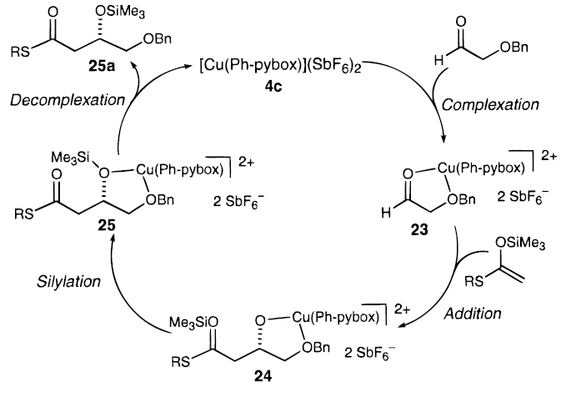
2.1.1 Aldol Reaction: Two Points Binding
Mechanism Proposed by Evans¹
(1) Evans, D. A.; Kozlowski, M. C.; Murry, J. A.; Burgey, C. S.; Campos, K. R.; Connell, B. T.; Staples, R. J. J. Am. Chem. Soc. 1999, 121, 669-685.

Slide 10
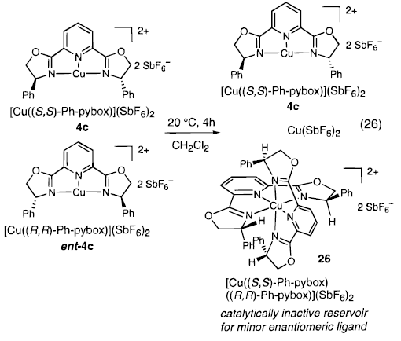
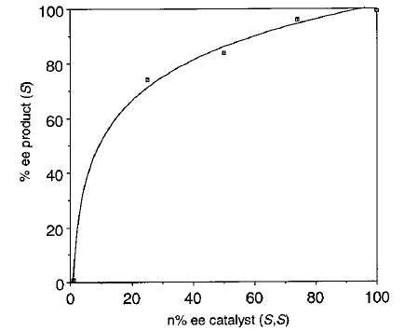
2.1.1 Aldol Reaction: Two Points Binding
Observed Non-Linear Effect: Reservoir Effect

Slide 11
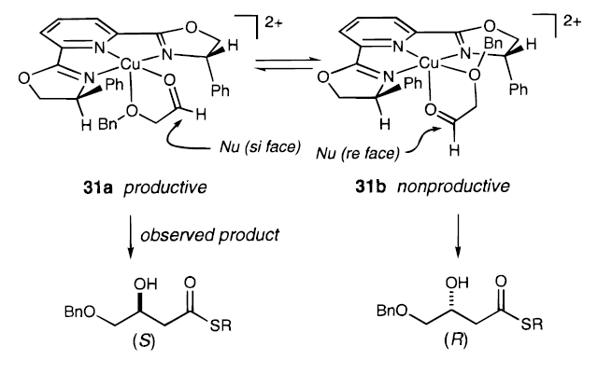
2.1.1 Aldol Reaction: Two Points Binding
Model for Selectivity
  Based on the structure of similar copper complexes, a square planar pyramidal coordination is expected, but how to rationalize the binding mode of the substrate?

Slide 12
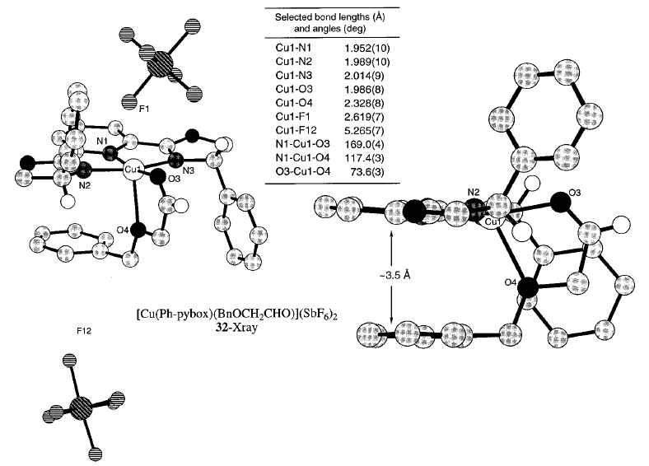
2.1.1 Aldol Reaction: Two Points Binding
Crystal Structure of Substrate-Catalyst Adduct

Slide 13
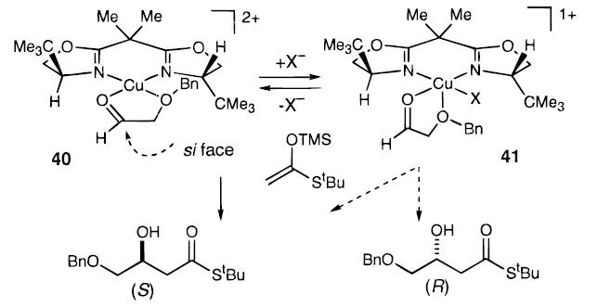
2.1.1 Aldol Reaction: Two Points Binding
BOX ligand: absolute stereochemistry of product is dependent of counter anion!
Observed with X = SbF₆
Observed with X = OTf

Slide 14
2.1.2 Allylation Reactions: Sakurai and Ene Reactions
For the ene, the reaction is usually synchronous via a chair transition state

Slide 15
2.1.2 Allylation Reactions: Keck Allylation
Keck Allylation^{1,2}
The catalyst (unknown structure!) is prepared directly before reaction
(1) Keck, G. E.; Tarbet, K. H.; Geraci, L. S. J. Am. Chem. Soc. 1993, 115, 8467-8468. (2) Keck, G. E.; Krishnamurty, D.; Grier, M. C. J. Org. Chem. 1993, 58, 6543-6544.

Slide 16
2.1.3 Other Nucleophiles: TMSCN
General Considerations for the Silylcyanation of Aldehydes
  Two Mechanisms can be envisaged
    I Direct silylcyanation
    II Activation of the silyl group via a heteroatom of the ligand
Modern reactions are designed on dual activation

Slide 17
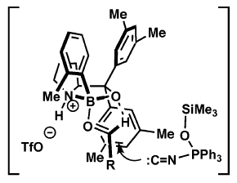
2.1.3 Other Nucleophiles: TMSCN
Corey Boron Catalyst: Purely Lewis Acidic?¹
The Privileged Proline Scaffold and Bronsted Acid Activation of Lewis Acid
A New Cyanation Reagent?
Without Ph₃P=O: Very low selectivity!
(1) Ryu, D. H.; Corey, E. J. J. Am. Chem. Soc. 2004, 126, 8106-8107. (2) Ryu, D. H.; Corey, E. J. J. Am. Chem. Soc. 2005, 127, 5384-5387.

Slide 18
2.1.3 Other Nucleophiles: Isonitriles
Asymmetric Passerini 3 Components Reaction¹
Mechanism
Other important multi-component reaction: Ugi 4 components reaction:
(1) Wang, S. X.; Wang, M. X.; Wang, D. X.; Zhu, J. P. Angew. Chem., Int. Ed. 2008, 47, 388.

Slide 19
2.1.3 Other Nucleophiles: Hetero Diels-Alder
Jacobsen: Cr-Catalyzed Hetero-Diels Alder Reaction with Aldehydes
Other Dienes
(1) Dossetter, A. G.; Jamison, T. F.; Jacobsen, E. N. Angew. Chem., Int. Ed. 1999, 38, 2398-2400.

Slide 20
2.1.4 Mannich: Introduction
Comparison Imine - Carbonyl
Released Amine still very good ligand: Catalyst release is more difficult
E or Z imine formed prior to reaction
Imine more basic: activation is easier
R group offers new possibilities for 2 points binding
Choice of R group is essential to modulate activation and catalyst release!

Slide 21
2.1.4 Mannich: First Examples
Kobayashi: the First Efficient Catalytic System
Deprotection of the Product
(1) Ishitani, H.; Ueno, M.; Kobayashi, S. J. Am. Chem. Soc. 1997, 119, 7153-7154.

Slide 22
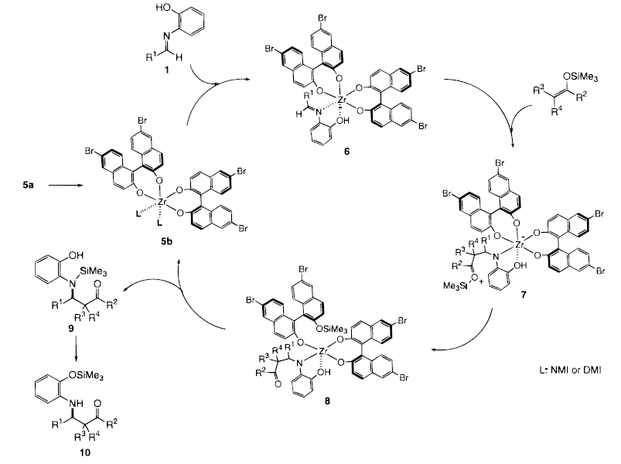
2.1.4 Mannich: First Examples
Proposed Mechanism
(1) Ishitani, H.; Ueno, M.; Kobayashi, S. J. Am. Chem. Soc. 2000, 122, 8180-8186.

Slide 23
2.1.4 Mannich: Phosphoric acids
Akiyama: The First Chiral H⁺!^{1,2}
(1) Akiyama, T.; Itoh, J.; Yokota, K.; Fuchibe, K. Angew. Chem., Int. Ed. 2004, 43, 1566-1568. (2) Yamanaka, M.; Itoh, J.; Fuchibe, K.; Akiyama, T. J. Am. Chem. Soc. 2007, 129, 6756-6764.

Slide 24
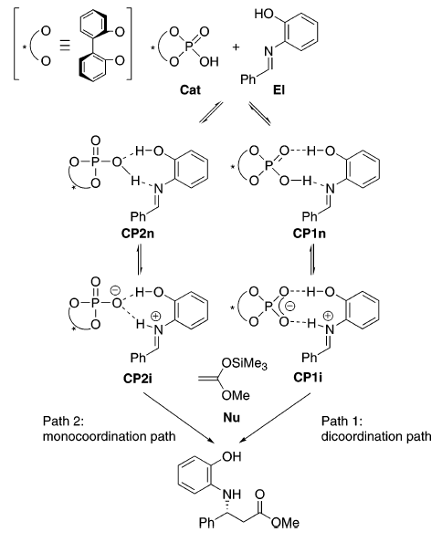
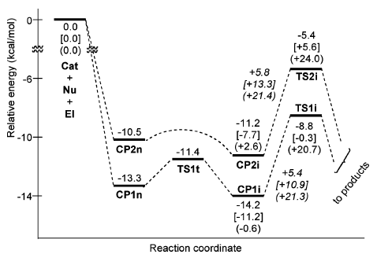
2.1.4 Mannich: Phosphoric acids
2 Pathways for Activation

Slide 25
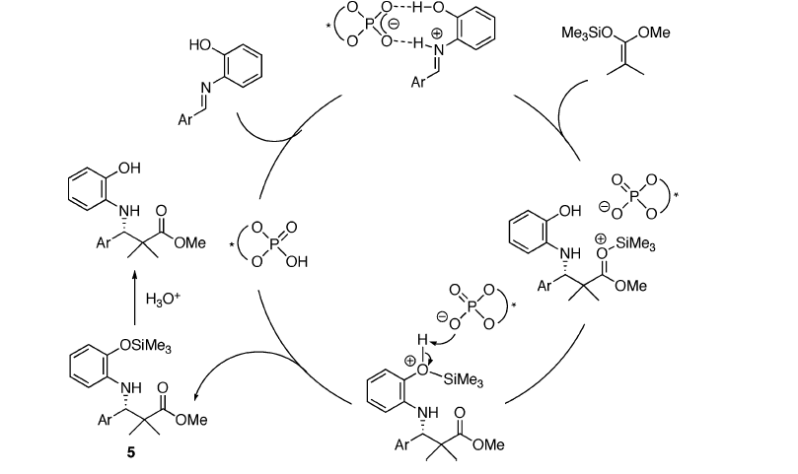
2.1.4 Mannich: Phosphoric acids
Proposed Mechanism

Slide 26
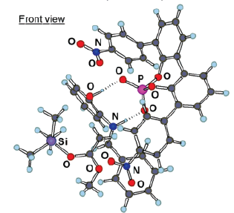
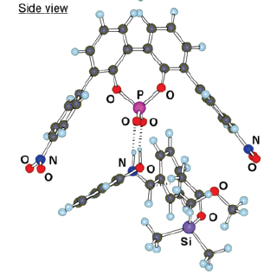
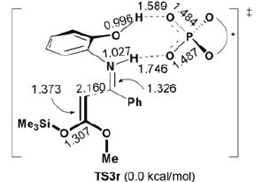
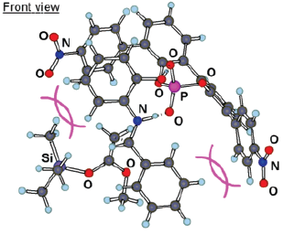
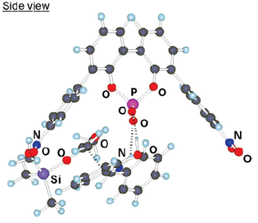
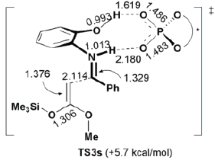
2.1.4 Mannich: Phosphoric acids
Calculation for Transition States

Slide 27
2.1.4 Mannich: Phosphoric acids
Terada Simultaneous Discovery of Chiral H⁺¹
Transformation into Amino Acids
(1) Uraguchi, D.; Terada, M. J. Am. Chem. Soc. 2004, 126, 5356-5357.

Slide 28
2.1.4 Mannich: Phosphoric acids
Is it really chiral Chiral H⁺¹
(1) Hatano, M.; Moriyama, K.; Maki, T.; Ishihara, K. Angew. Chem., Int. Ed. 2010, 49, 3823-3826.

Slide 29
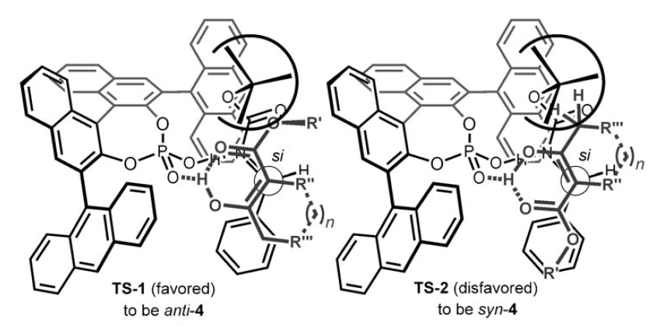
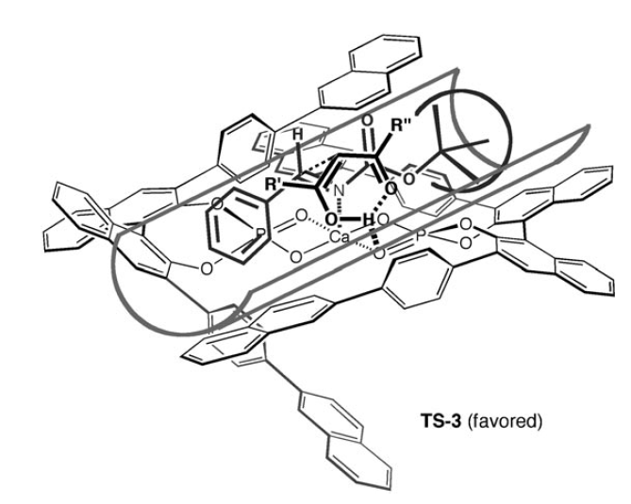
2.1.4 Mannich: Phosphoric acids
With H⁺
A more accurate model using bifunctional activation can explain these results (see chapter 4)!
With Ca
(1) Hatano, M.; Moriyama, K.; Maki, T.; Ishihara, K. Angew. Chem., Int. Ed. 2010, 49, 3823-3826.

Slide 30
2.1.4 Mannich: Other acids
Lambert: New type of chiral Bronsted catalyst
Gheewala, C. D.; Collins, B. E.; Lambert, T. H. Science 2016, 351, 961-965.

Slide 31
2.1.5 Other Reactions with Imines: Strecker
Jacobsen Urea Catalyst: The First Use of Urea in Asymmetric Catalysis^{1,2}
Second Generation Catalyst:
(1) Sigman, M. S.; Jacobsen, E. N. J. Am. Chem. Soc. 1998, 120, 4901-4902. (2) Vachal, P.; Jacobsen, E. N. J. Am. Chem. Soc. 2002, 124, 10012-10014.

Slide 32
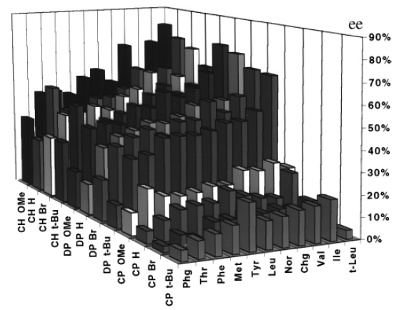
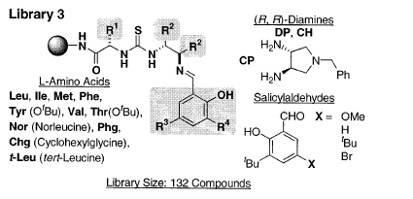
2.1.5 Other Reactions with Imines: Strecker
Discovery of the Urea Catalyst:
A Surprising Control Experiment.
(1) Sigman, M. S.; Jacobsen, E. N. J. Am. Chem. Soc. 1998, 120, 4901-4902. (2) Vachal, P.; Jacobsen, E. N. J. Am. Chem. Soc. 2002, 124, 10012-10014.

Slide 33
2.1.5 Other Reactions with Imines: Aza-Friedel-Craft
Jacobsen: Catalytic Asymmetric Pictet-Spengler Reaction¹
Terada: Aza-Friedel-Craft with Furans²
(1) Taylor, M. S.; Jacobsen, E. N. J. Am. Chem. Soc. 2004, 126, 10558-10559. (2) Uraguchi, D.; Sorimachi, K.; Terada, M. J. Am. Chem. Soc. 2004, 126, 11804-11805.

Slide 34
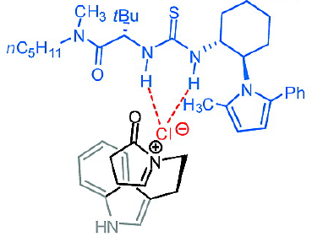
2.1.5 Other Reactions with Imines: Aza-Friedel-Craft
Jacobsen: Catalytic Asymmetric Pictet-Spengler Reaction for tetracyclic systems¹
Mechanism: A Unique Anion-Urea Interaction is Proposed!
(1) Raheem, I. T.; Thiara, P. S.; Peterson, E. A.; Jacobsen, E. N. J. Am. Chem. Soc. 2007, 129, 13404-13405.

Slide 35
2.1.5 Other Reactions with Imines: Reduction
List: Reduction of Imines with Hantsch Ester¹
Hantsch ester: a simpler analog of the bioreductant NADH and NADPH
(1) Hoffmann, S.; Seayad, A. M.; List, B. Angew. Chem., Int. Ed. 2005, 44, 7424-7427.

Slide 36
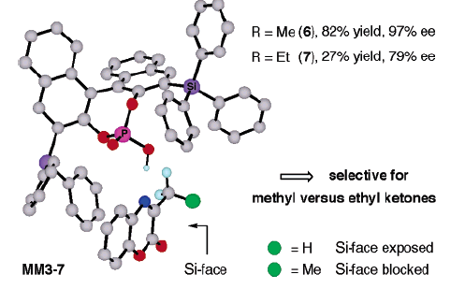
2.1.5 Other Reactions with Imines: Reduction
Mac Millan: Catalytic Asymmetric Reductive Amination
Reduction of Cyclic Imines
(1) Storer, R. I.; Carrera, D. E.; Ni, Y.; MacMillan, D. W. C. J. Am. Chem. Soc. 2006, 128, 84-86.

Slide 37
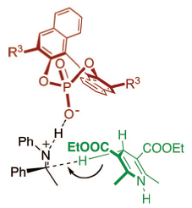
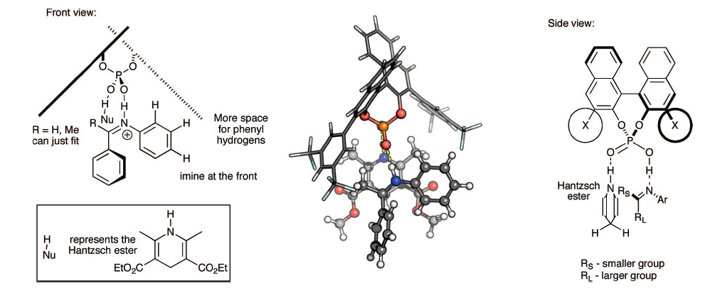
2.1.5 Other Reactions with Imines: Reduction
Reduction of Imines: Old Simple Mechanism
New Calculated Mechanism¹
(1) Simon, L.; Goodman, J. M. J. Am. Chem. Soc. 2008, 130, 8741-8747.

Slide 38
2.1.5 Extension to Carbonyls Activation
Rueping: One of the First Examples of Activation of Carbonyles for Ene Reaction¹
Key Discovery: Enhanced acidity of Trifluoromethansulfonyl Imides
(1) Rueping, M.; Theissmann, T.; Kuenkel, A.; Koenigs, R. M. Angew. Chem., Int. Ed. 2008, 47, 6798-6801.

Slide 39
2.1.5 Extension to Carbonyls Activation
List: Confined Lewis Acid catalysts for the Aldol reaction¹
(1) Schreyer, L.; Kaib, P. S. J.; Wakchaure, V. N.; Obradors, C.; Properzi, R.; Lee, S.; List, B., Science 2018, 362, 216-219.

